Slide 1





Characterization of Backgrounds in Lucas Cells
Elspeth Cudmore – SNO+
CAP Congress 2016
First prize at SNOLAB summer student talk competition – August 2015

Slide 2
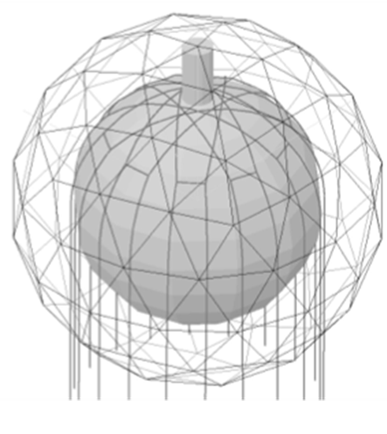
Introduction
SNO+ is a neutrino physics experiment located 2km underground at SNOLAB.​
Detector comprised of a large acrylic vessel filled with LAB liquid scintillator, surrounded by UPW shielding and PSUP, holding ~9500 PMT detectors. ​
Many internal backgrounds affect this experiment and need to be limited.
2016-06-14
CAP Congress 2016

Slide 3
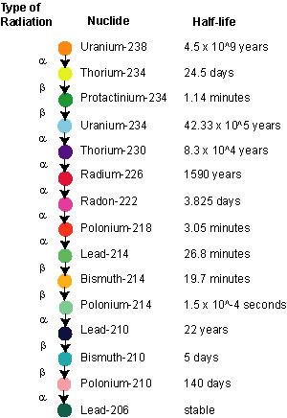
Some Background on Backgrounds
Interfere with signals from the detector and can produce false signals
Two decay chains of interest are U-238 and Th-232.
  U-238 produces Bi-214 and other problematic backgrounds
Can be determined by ‘counting’ Rn-222 emanating from a sample, and creating a counts per day value for said sample
Figure 1: U-238 decay chain & notable alpha decays

Slide 4
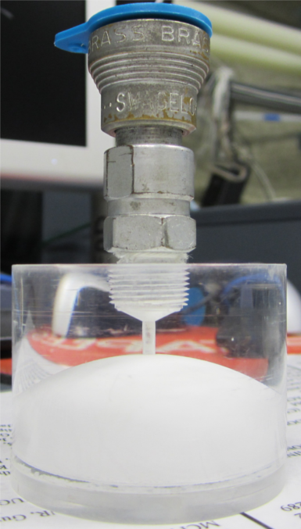
SNO Lucas Cells
Lucas Cells are used to collect Rn-222 emanating or dissolved in a sample in order to count backgrounds
Old SNO Cells are still used but have developed their own background
  Pb-210 and Po-210 buildup from many uses over many years
To properly run radon emanation measurements, the backgrounds of the Lucas Cells must be known for counting
Figure 2: SNO Lucas Cell

Slide 5
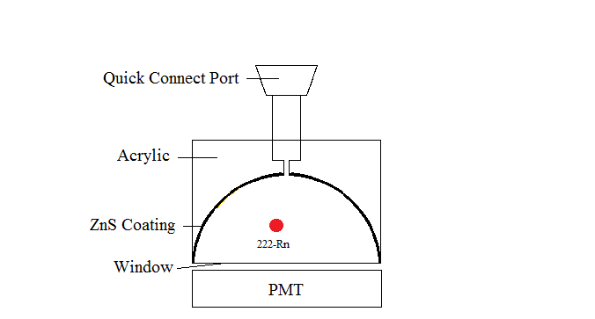
Lucas Cell Geometry
Made up of a small acrylic cylinder with a hemisphere chamber inside, coated with ZnS scintillator
  Scintillator sensitive to α particles produced from decays
Window at bottom of cell to allow PMT to see decay events
Figure 3: Scintillation in Lucas Cells

Slide 6
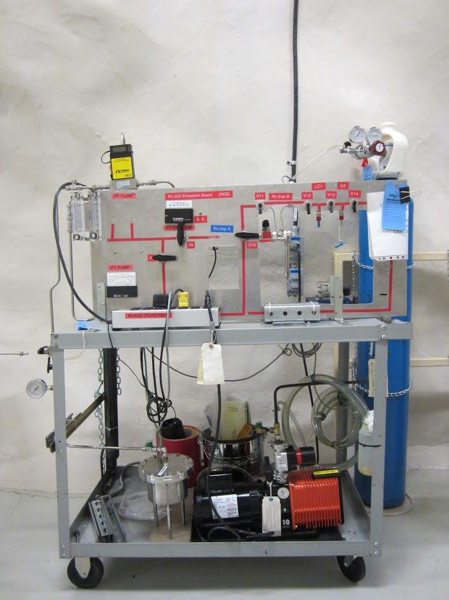
Evacuation of Cells
Cells attached to underground mobile Rn Board, which is used to count radon emanation
Vacuum is pulled on the cells
Flushed with N₂, disconnected, and brought to surface for counting
Figure 4: Underground Rn Emanation Board at SNOLAB

Slide 7
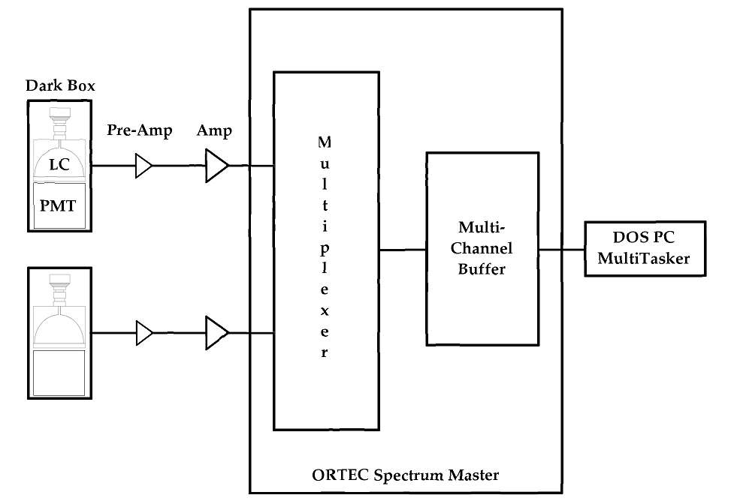
Counter Setup
4 free counters means that 4 cells can be run at once
Lucas Cells placed in counters
  Dark boxes containing a PMT
PMT count impulses sent through system to DOS MultiTasker
Outputs a .log file and a spectrum file
Figure 5: Lucas Cell Counter Setup

Slide 8
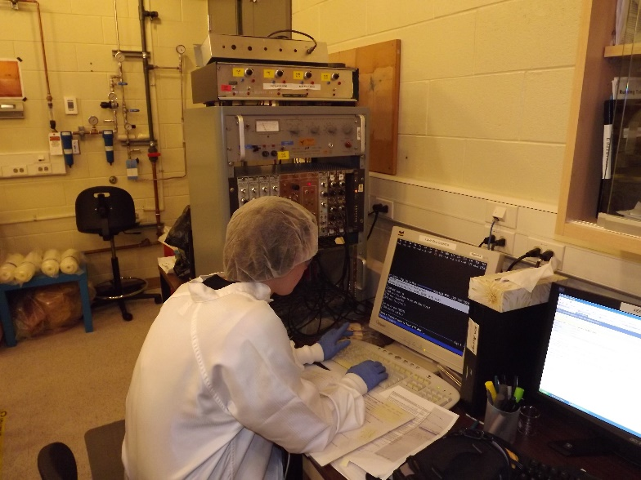
Summary of Runs
Ideally allowed to run for 12 days
20 Cells completed in the summer of 2015
  Found a large range of backgrounds, varying from ~25 CPD to ~2500 CPD
Possibility of organizing cells for use based on their backgrounds
  Specifically, using cells with stable/lower counts for emanation runs and water assays

Slide 9
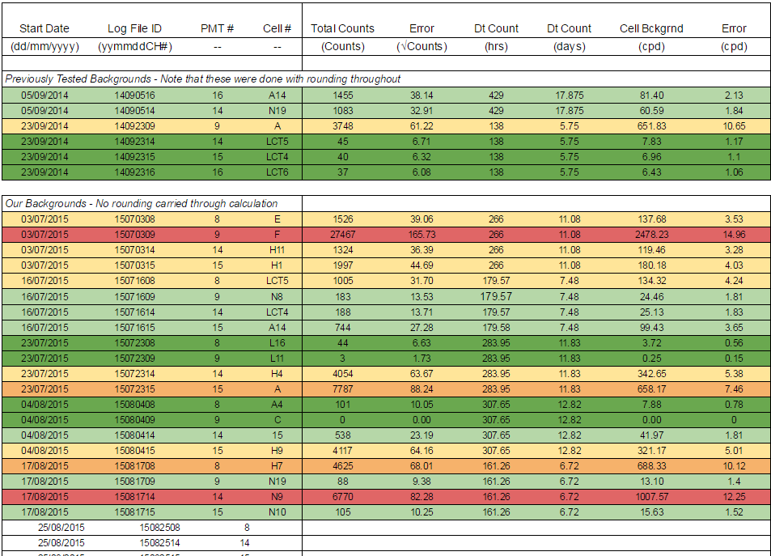
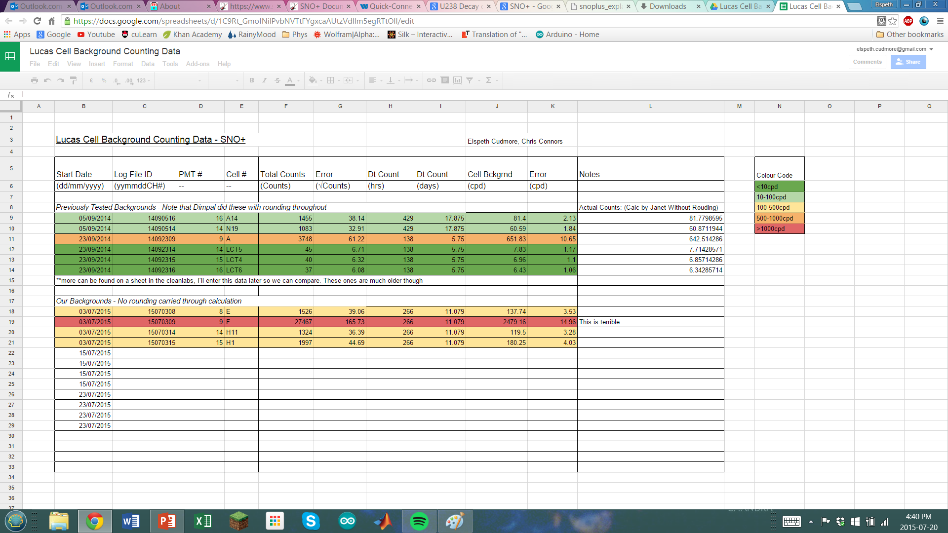

Slide 10
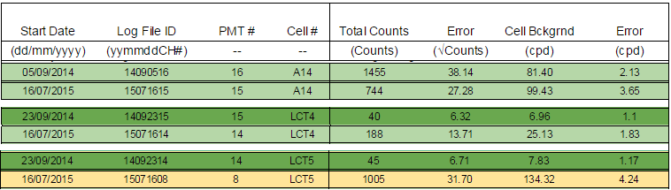
Interesting Findings
The change of backgrounds over time with Cells A14, LCT4 and LCT5

Slide 11
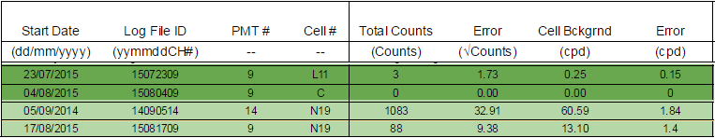
Interesting Findings (cont’d)
The ridiculously high counts for Cell F (~2500 CPD)
Lowest accepted counts from Cell L16 (3.72 CPD)
Possibility of broken counter due to extremely low detection in cells L11, C, and N19

Slide 15
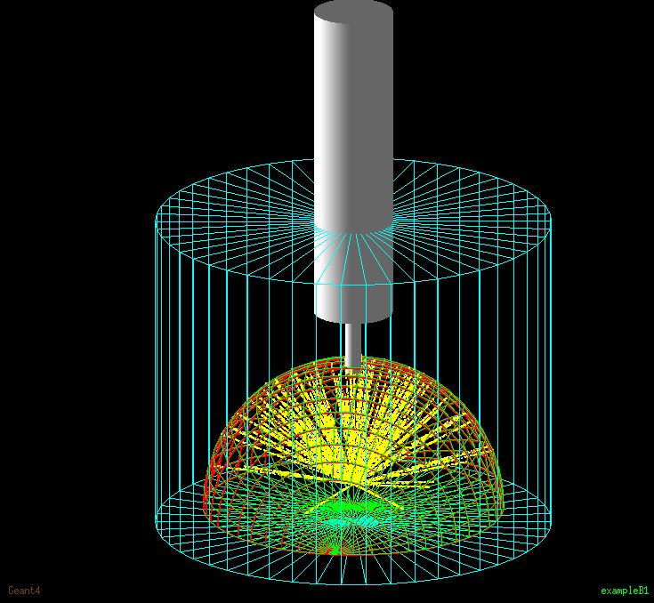
Future Lucas Cell Work
Completion of Lucas Cell Background Counts
Renaming cells and regularly checking backgrounds
New surface emanation board being created on surface at SNOLAB
Thanks!
Figure 6: Geant4 Simulation of Cell, provided by C. Connors

