Slide 1
Astronomy in the undergraduate advanced lab
Studying delta-Scuti variable stars
Etienne Rollin
Penka Matanska
Carleton University, Ottawa
Canadian Association of Physicists Congress 2016 - Ottawa

Slide 2
Outline
Background information
Equipment required
Data collection
Data analysis
Summary

Slide 3
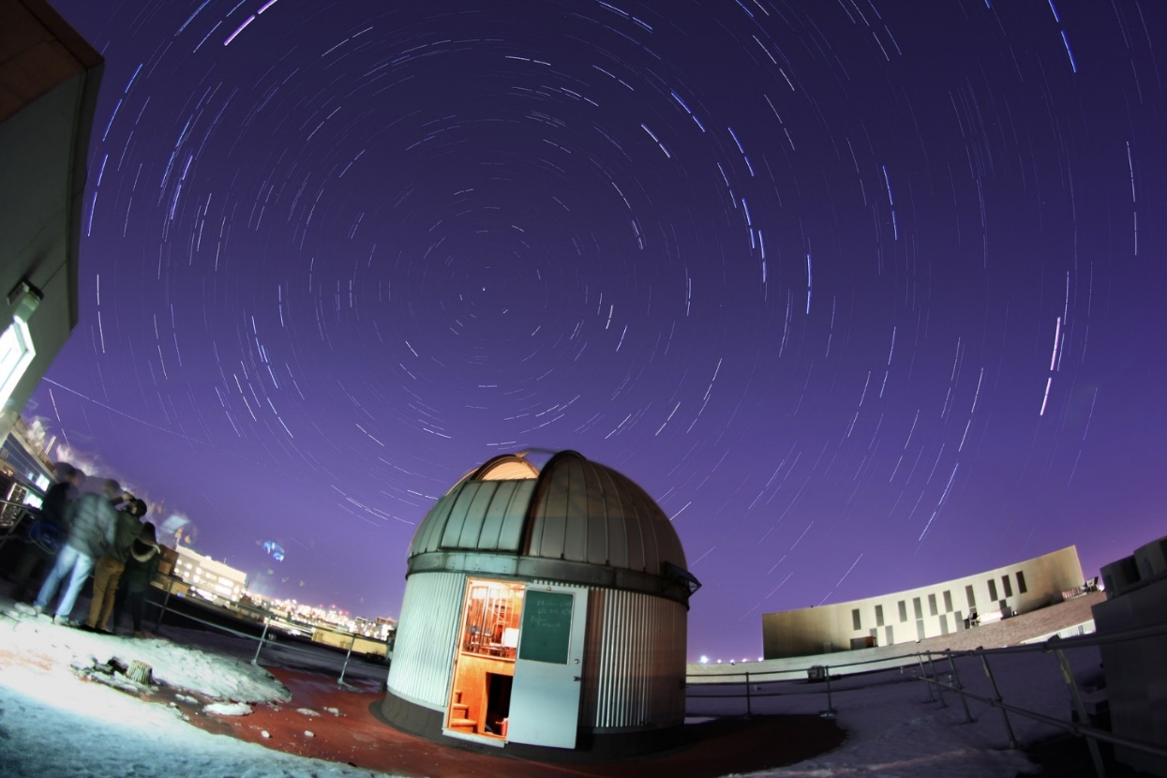
Origin
We wanted an experiment that would allow students to learn about observational astronomy.

Slide 4

Variable Stars Considered
$δ$Sct
HADS
Dwarf Cepheids
SX Phe
Their brightness varies significantly over a few hours.
They can be used as “standard candles”

Slide 5
Equipment required
Item | Recommendation | Price
Telescope | Diameter > 4” | $400 or more
Mount | Good tracking mount Tracks over a period of several hours | $1000 or more
CCD camera | Monochrome Large field of view Filter wheel for temperature measurement | $2000 or more
Acquisition Software | Comes with camera | Free
Analysis Software | AstroImageJ | Free
Alternative 1: Internet connected telescopes
Alternative 2: Computer generated images (Gaussian stars + noise)

Slide 6
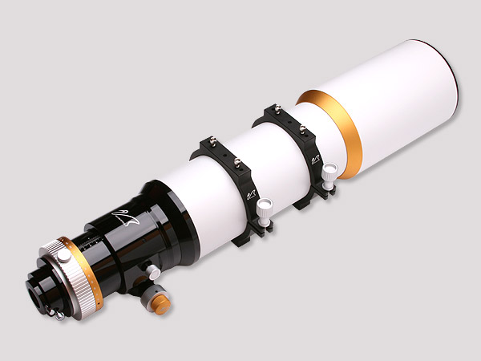
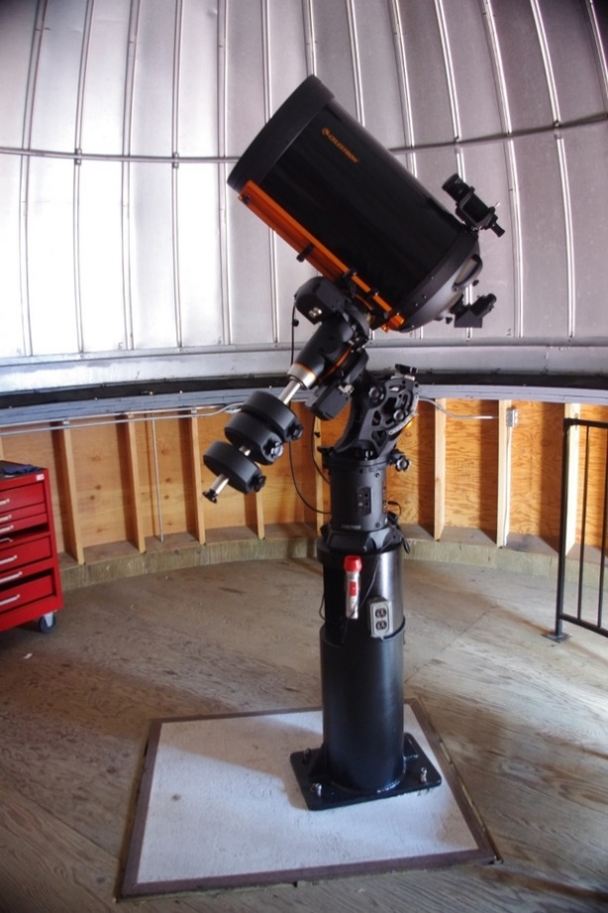
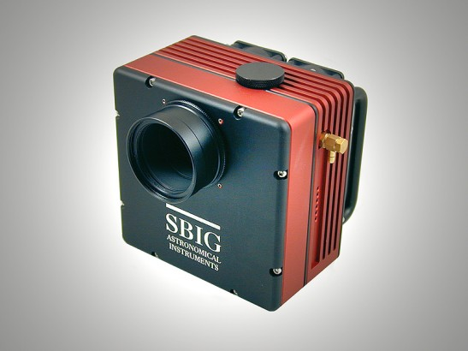
Apparatus at Carleton University

Slide 7
Preparation
Find an adequate variable star
  High altitude, for a few hours
  Bright enough for the instrument
  Large variability
  Short period of variability
Advanced: Ask students to write a pseudo-formal proposal to use the telescope with an observation plan.

Slide 8
Data Collection
Find the star
  Good motorized mount
  Large field of view camera/telescope combination
  Software
Find an adequate exposure time
Record images during several hours
Advanced: Record bias, darks and flats for image reduction.

Slide 9
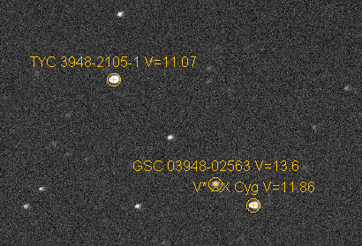
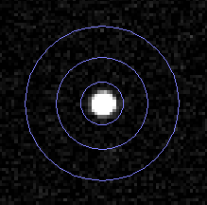
Data Analysis
Differential Photometry
AstroImageJ has intuitive routines
Identification of the stars (target and references)
Integrate the signal and remove the background
Convert the number of counts to a magnitude
Advanced: Submit data to AAVSO

Slide 10
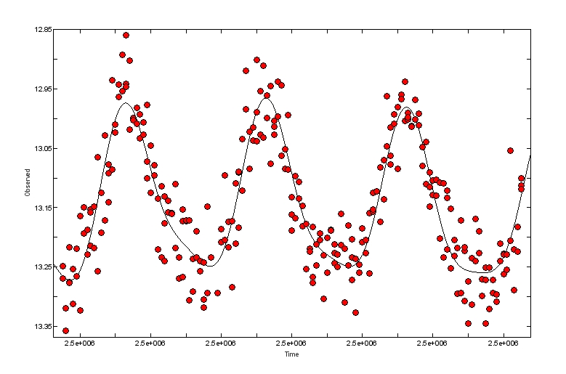
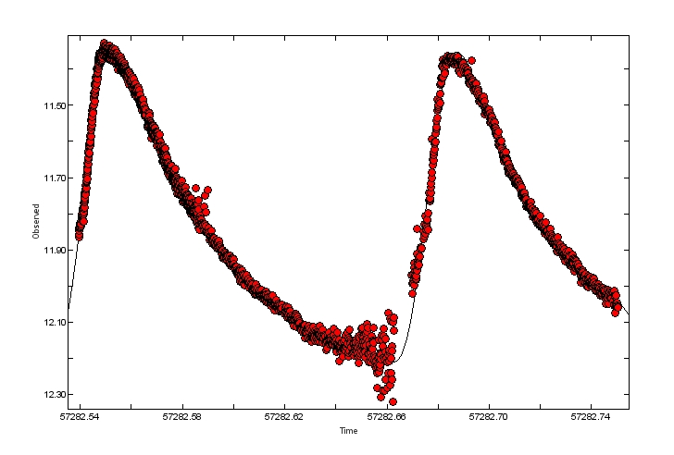
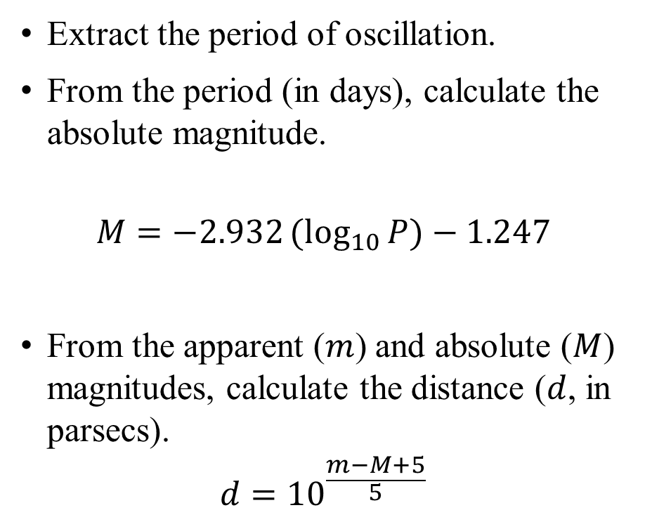
Distance Measurement
Extract the period of oscillation.
From the period (in days), calculate the absolute magnitude.
$$M=−2.932{(log}_{10}{P})−1.247$$
From the apparent ($m$) and absolute ($M$) magnitudes, calculate the distance ($d$, in parsecs).
$$d={10}^{\frac{m−M+5}{5}}$$
Advanced: O-C diagram, phase diagram or periodicity over many days/years

Slide 11
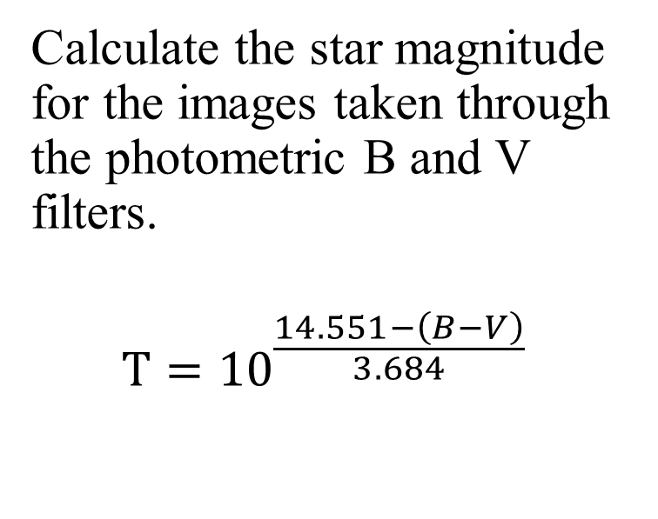

Temperature Measurement
Calculate the star magnitude for the images taken through the photometric B and V filters.
$$T={10}^{\frac{14.551−\left(B−V\right)}{3.684}}$$
Advanced: Extinction – Correction of $\left(B−V\right)$

Slide 12
Summary
The variable stars experiment teaches students:
  Observational astronomy experience
  Quantitative measurements on images; signal integration, noise, etc…
  Error analysis (propagation)
  Fitting routines, Fourier series
  Several astrophysics concepts
    Variable star types/mechanisms
    Inverse square law
    Blackbody spectrum
The variable stars experiment cost about $3000 to $5000 to implement.
Allow students at least 5 hours of data taking and 10 hours of analysis.

Slide 13
Similar projects
Exoplanets
Asteroids
Evidence of Dark matter
Spectroscopy

Slide 14
Useful Links
American Association of Variable Star Observers (AAVSO)
List of interesting variable stars
  Rodriguez, E. et al., 2000, A List of δ Scuti Stars and their Associated Parameters
Period/luminosity relationship
  King, J. R., 1991, On the delta Scuti Period-Luminosity Relation
(B-V)/Temperature relationship
  Reed, C., 1998, The Composite Observational-Theoretical HR Diagram
Stellarium (free planetarium software)

Slide 15
List of high amplitude variable star studied
V2455 Cyg (Summer/Fall)
XX Cyg (Summer/Fall)
BL Cam (Fall/Winter/Spring)
DY Peg (Summer/Fall/Winter)
YZ Boo (Spring/Summer/Fall)

Slide 16

Theory
Increase in
Heat/Pressure
More
Opaque
Star
Contracts
Star
Expands
More
Transparent
He ionization
near the center
of the star
Decrease in
Heat/Pressure

Slide 20
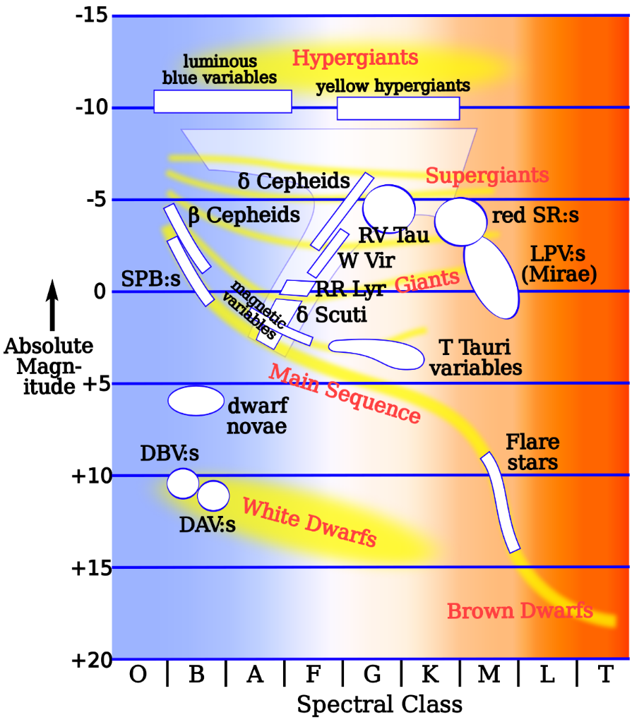
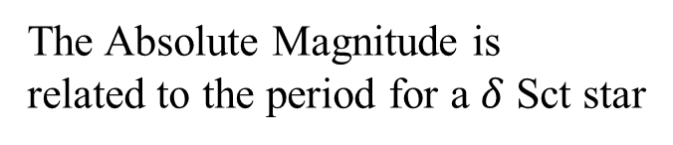
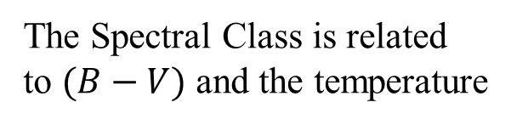
HR Diagram
The Spectral Class is related
to $(B−V)$ and the temperature
The Absolute Magnitude is
related to the period for a $δ$ Sct star
Source: Rursus at Wikimedia

Slide 21
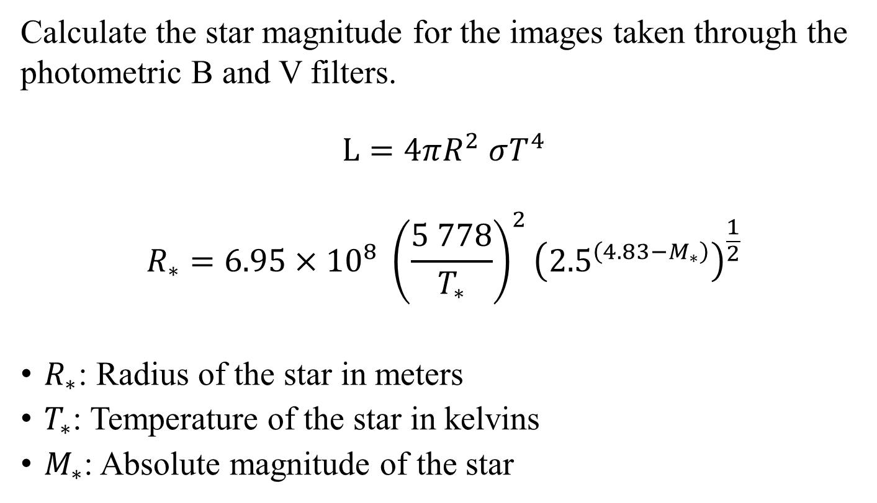
Radius Measurement
Calculate the star magnitude for the images taken through the photometric B and V filters.
$$L=4πR^{2} σT^{4}$$
$$R_{∗}=6.95×{10}^{8} {\left(\frac{5 778}{T_{∗}}\right)}^{2}{\left({2.5}^{\left(4.83−M_{∗}\right)}\right)}^{\frac{1}{2}}$$
$R_{∗}$: Radius of the star in meters
$T_{∗}$: Temperature of the star in kelvins
$M_{∗}$: Absolute magnitude of the star

Slide 22
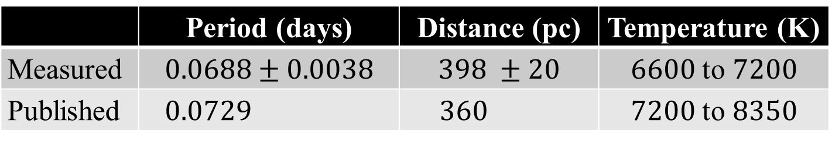
Typical Measurements (DY Peg)
 | Period (days) | Distance (pc) | Temperature (K)
Measured | $$0.0688±0.0038$$ | $$398 ±20$$ | $6600$ to $7200$
Published | $$0.0729$$ | $$360$$ | $7200$ to $8350$

