Slide 1
Neutron Electric Dipole Moment
Measurement at TRIUMF
J. Martin
The University of Winnipeg
S. Ahmed^{3,4}, E. Altiere², T. Andalib^{3,4}, C. Bidinosti^{3,8}, J. Birchall⁴, C. Davis⁵, M. Gericke⁴,
S. Hansen-Romu^{3,4}, K. Hatanaka⁶, T. Hayamizu², B. Jamieson³, D. Jones², K. Katsika⁵, S. Kawasaki¹,
T Kikawa^{5,6,1}, A. Konaka^{5,8}, E. Korkmaz⁷ , M. Lang³, T. Lindner^{5,3}, L. Lee^{4,5}, K. Madison², J. Mammei⁴,
R. Mammei^{3,5}, J. Martin³, R. Matsumiya⁶, E. Miller², T. Momose², S. Page⁴, R. Picker^{5,9}, E. Pierre^{6,5},
W. Ramsay⁵, L. Rebenitsch^{3,4}, J. Sonier⁹, I. Tanihata⁶, W.T.H. van Oers^{4,5}, Y. Watanabe¹,
and J. Weinands²
¹KEK, Tsukuba, Ibaraki, Japan
²The University of British Columbia, Vancouver, BC, Canada
³The University of Winnipeg, Winnipeg, MB, Canada
⁴The University of Manitoba, Winnipeg, MB, Canada
⁵TRIUMF, Vancouver, BC, Canada
⁶RCNP, Osaka, Japan (Osaka University, Osaka, Japan)
⁷The University of Northern BC, Prince George, BC, Canada
⁸Osaka University, Osaka, Japan
⁹Simon Fraser University, Burnaby, BC, Canada

Slide 2
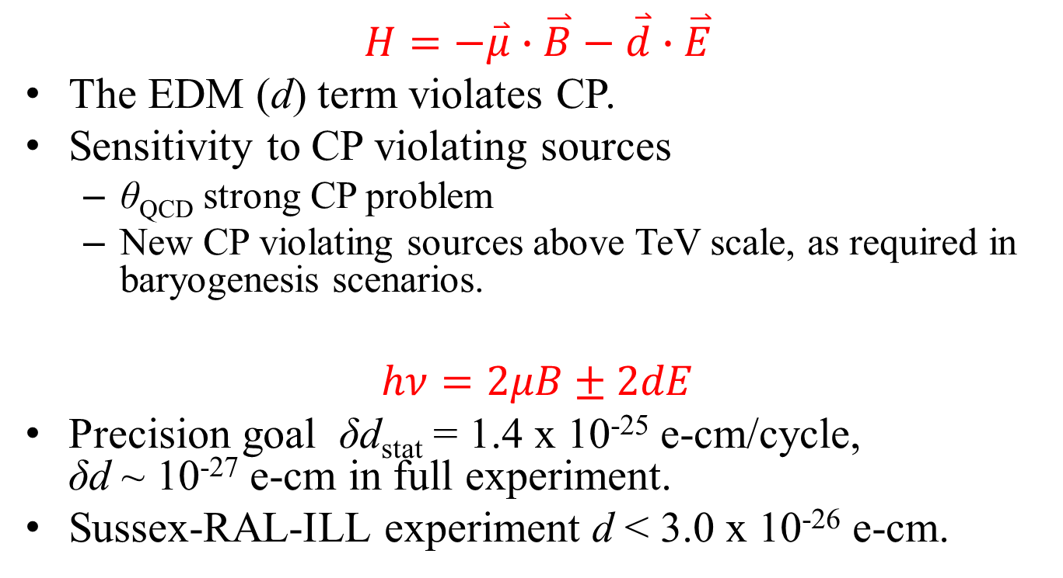
Electric dipole moments and CP violation
$$H=−\overset{⃑}{μ}∙\overset{⃑}{B}−\overset{⃑}{d}∙\overset{⃑}{E}$$
The EDM (d) term violates CP.
Sensitivity to CP violating sources
  θ_{QCD} strong CP problem
  New CP violating sources above TeV scale, as required in baryogenesis scenarios.
$$hν=2μB±2dE$$
Precision goal δd_{stat} = 1.4 x 10⁻²⁵ e-cm/cycle,
δd ~ 10⁻²⁷ e-cm in full experiment.
Sussex-RAL-ILL experiment d < 3.0 x 10⁻²⁶ e-cm.

Slide 3

Ultracold Neutrons (UCN)
Neutrons that are moving so slowly that they bounce off surfaces and can be bottled.
  v < 8 m/s = 30 km/h
  T < 4 mK
  K.E. < 300 neV
Interactions:
  Gravity: V = mgh mg = 100 neV/m
  Magnetic: V = -μ•B μ = 60 neV/T
  Strong: V = V_{eff} V_{eff} < 335 neV
  Weak: τ = 886 s = 15 mins.

Slide 4
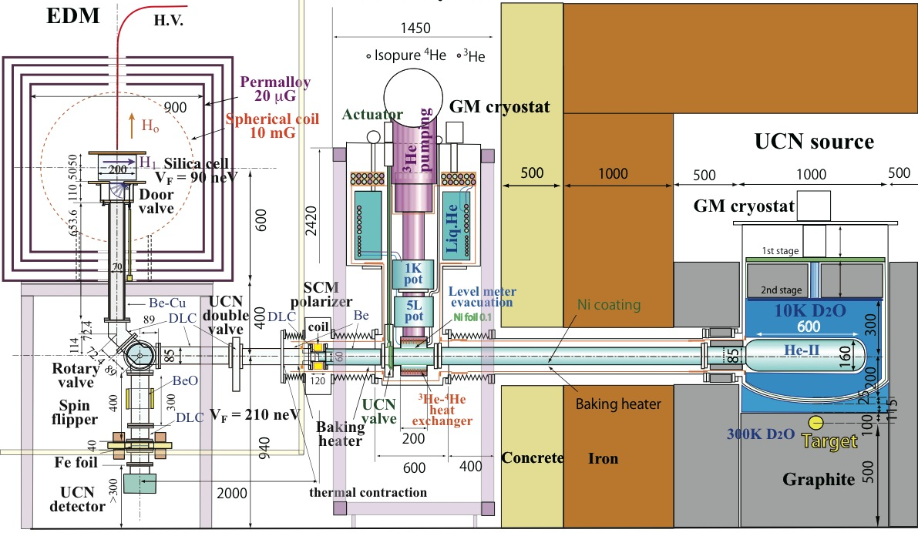
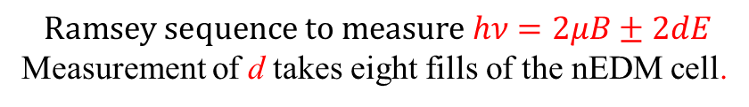
nEDM Experimental Cycle
Experiment
He-II cryostat
D₂O cryostat
⁴He (4K,1K)
³He (0.8K)
Isopure ⁴He
phonon
UCN
valve
opens
n
p
$$Ramsey sequence to measure hν=2μB±2dE$$
Measurement of d takes eight fills of the nEDM cell.

Slide 5
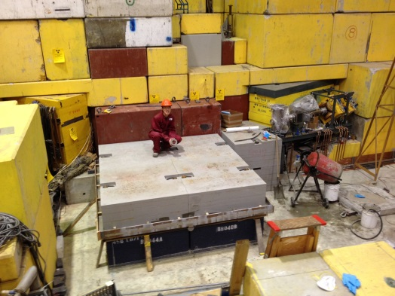
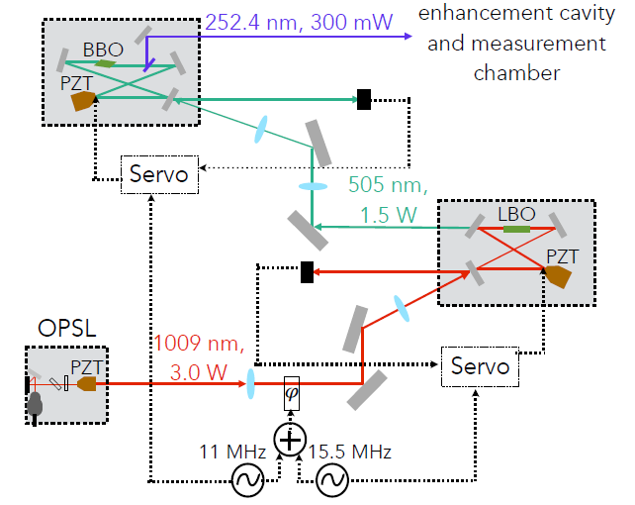
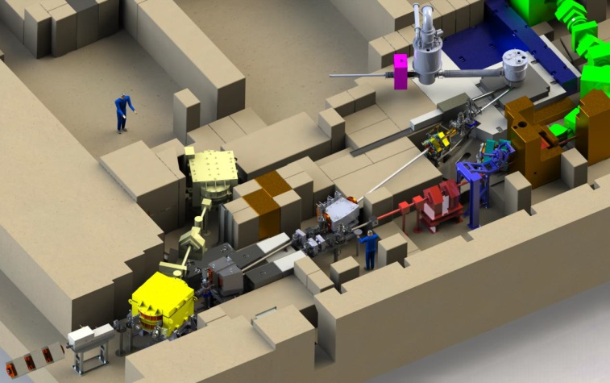
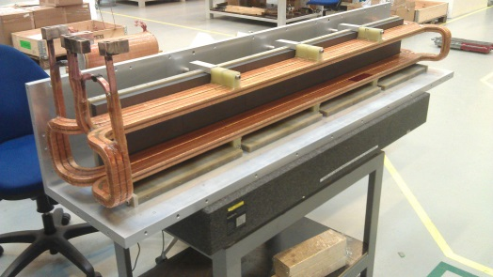
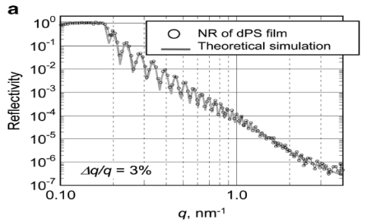
UCN/nEDM at TRIUMF
Overview:
  Spallation-driven superfluid-helium UCN source connected to room-temperature nEDM experiment.
  Goal sensitivity:
  δd_{n} ~ 10⁻²⁷ e-cm (“Phase 2”)
Recent/upcoming progress:
  Ongoing nEDM R&D: magnetic fields, comagnetometry with ¹²⁹Xe- ¹⁹⁹Hg, UCN guides, EDM cell/HV.
  Most components (incl. cold moderator cryostat from Japan) at TRIUMF and prepped.
  Superfluid cryostat by this fall.
  CFI IF proposal for UCN source upgrade and nEDM expt. in prep.
Comagnetometer laser reached
300 mW
Shielding base layer installed
UCN source
UCN guide tests @ J-PARC & PSI this summer
Kicker installed, commissioning
500 MeV
protons
Facility as expected in Sept. 2016

Slide 6
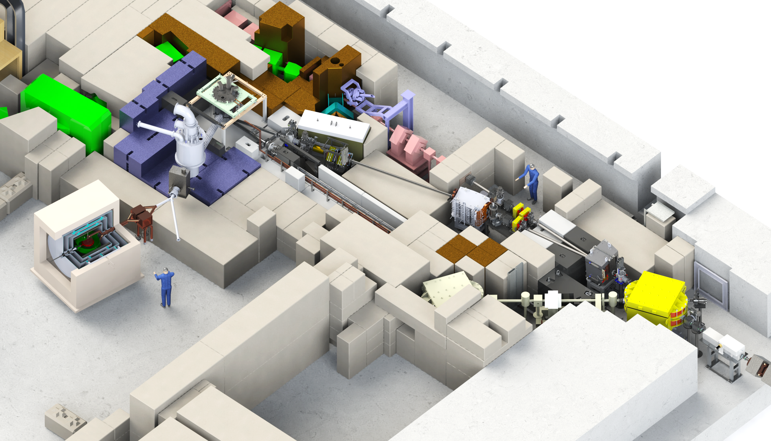

Ultra-Cold Neutrons and the Electric Dipole Moment
2016
Excellent talks by L. Lee and T. Kikawa @ CAP
yesterday morning
Helium cryostat
cools He to < 1 K and neutrons to mK
2015
Quads
Diagnostics
2014
Bending dipole
deflects beam by 7° more
2014
Lambertson septum
deflects upper beam by 9° to the left into BL1U
Phase 2EDM experiment
Passive shielding
coils
EDM cell
Tungsten target + extraction system
HT SC Magnet
100% UCN polarization
2016
2016
2016
Kicker magnet
Deflects every third proton bunch upwards
Status
UCN source
    Beamline finished by May 2016
    Installation of UCN source components by end of 2016
EDM experiment
    Phase 1 coming from Japan in 2017
    Phase 2 developed in Canada (CFI proposal this year) for 2019
Phase 1: 2017
Phase 2: 2019
UCN facility in the Meson hall at TRIUMF

Slide 7
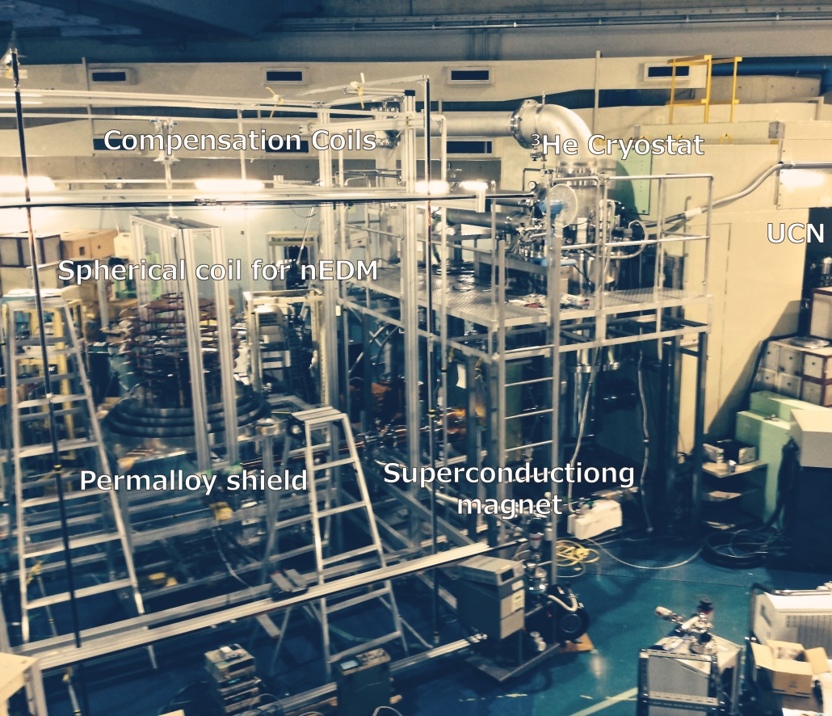
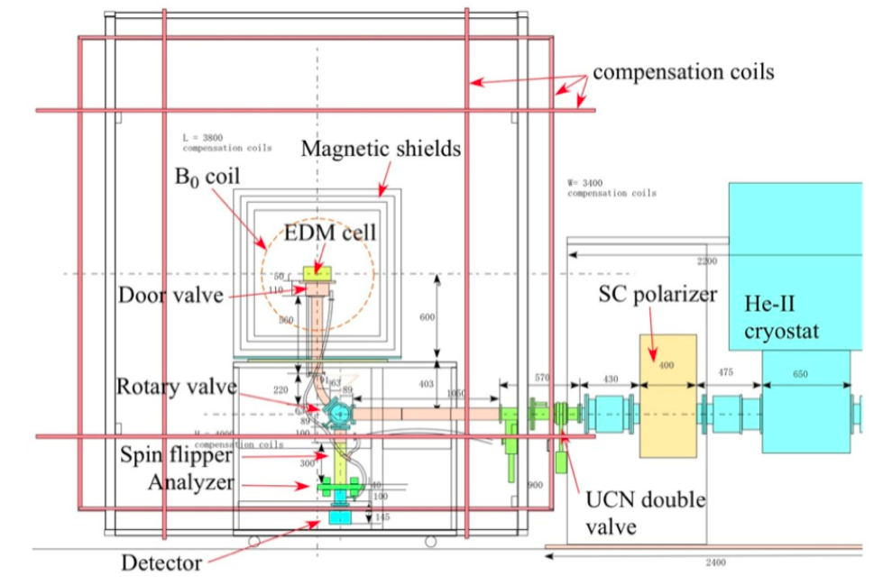
“Phase 1” – what will exist in 2017
use existing EDM Ramsey apparatus from RCNP, Osaka
exploit higher UCN density at TRIUMF (also more beamtime available)
room temperature, 1 small cell, vertical loading, spherical B₀ coil
incremental improvements allowing system tests, until replaced by Phase 2
  Active magnetic compensation system
  high voltage
  comagnetometer
  high-flux detector
ca 1 m
EDM Phase 1 schematic
EDM Phase 1 at RCNP

Slide 8
“Phase 2” – to implement by 2020
LD₂ moderator surrounding superfluid He
LD₂ moderator, to increase cold flux entering the superfluid
New high-quality UCN guides, and coating facility.
World-competitive nEDM experiment apparatus.
  New magnetic shielding, UCN guides/coatings, dual-species comagnetometer, multiple cells/HV, environmental stability, …
Possibly a new superfluid helium UCN source (depending on funding)
CFI Innovation Fund application in progress. Scale $14M.

Slide 9
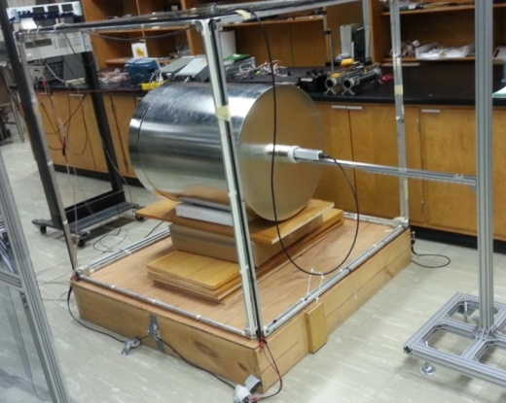
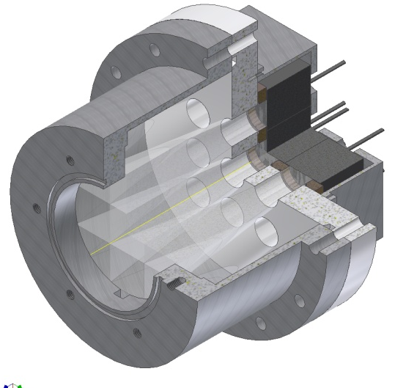



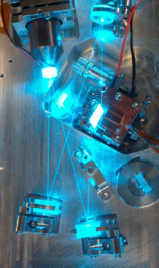
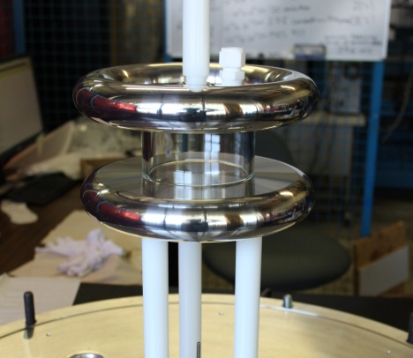


Canadian nEDM R&D
9
Magnetic environment
UCN detection
Lightguides
active shielding
passive shielding
creation of stable, homogeneous B fields
Precision atomic magnetometry and SQUIDs
Need faster detectors
Li glass scintillators + lightguide + PMTs
Test run in August 2015 at PSI
R&D towards dual detectors which count both spin states simultaneously.
Cylindrical shells of the 4 layer FM shield
  n+⁶Li→³H (2.74 MeV) +⁴He (2.05 MeV)
UCNA @ LANL
Li glass
PMTs
Dual Co-magnetometer
UCN detection scheme
Hg, Xe polarisation
laser development
2-photon transition requires development of intense CW UV lasers.
Xe EDM measurement
Electric field, UCN cell
dielectric strength of Xe at 10⁻³ mbar unknown
50x100 mm cylindrical test cell
gas breakdown studies
material studies
HV test cell
0.1 m

Slide 10
Xe/Hg comagnetometer
All nEDM experiments use Hg comagnetometer to measure magnetic field in nEDM cell at same time as neutrons.
Goal: develop new magnetometer technology to remove false EDM of Hg comagnetometer, similar to:
  Cs magnetometers
  Neutrons as magnetometers
  ³He magnetometers
Our plan: dual Xe/Hg comagnetometer cancels false EDM
Key R&D questions to be answered (Xe-129):
  2 photon direct laser probe
  HV breakdown vs. operating pressure
Laser design path parallel to Hg-199 laser.
Pursued by PSI group

Slide 11

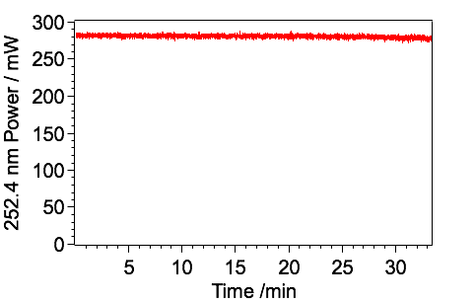
Xe/Hg Comagnetometer
253 nm CW Laser for Xe Excitation
253 nm CW laser system @ UBC
252.4 nm
320 mW
BBO
Beam out
Recent highlight:
We now obtain 320 mW at 252.4 nm (linewidth <200kHz) without any power degradation.
PZT
Feedback beam
Cavity Locking System
505 nm
1.6 W
LBO
252.4 nm Output Power Stability
Feedback beam
PZT
@ 505 nm 1.28 W
OPSL
1009 nm CW
3.3 Watts
Cavity Locking System
PZT
1009 nm 3.3 W
Chip
𝜑
Pump
10 MHz
16.6 MHz

Slide 12

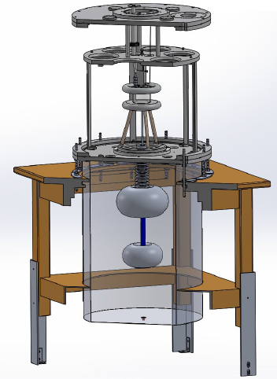
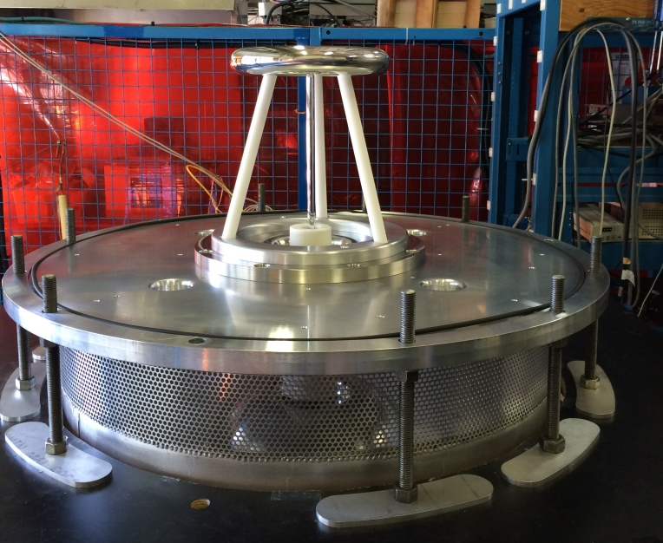
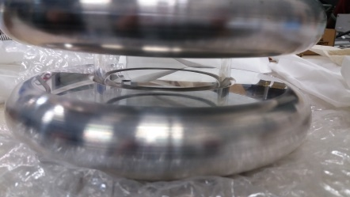
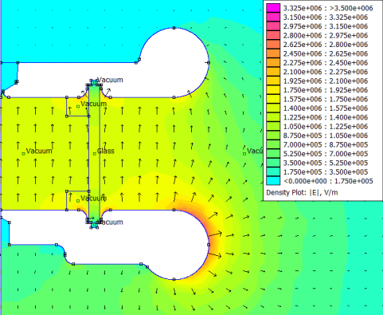
EDM cell and HV development
Goals:
Investigate Xe gas and material compatibility with HV (15 kV/cm), neutrons, spins, lasers
gas filling system
insulator
HV electrode
Macor support
HV feedthrough
Corona rings
Status, plans:
HV test setup complete, electrodes commissioned to 120 kV/cm
2016:
  Xe gas HV measurements
  cold neutron tests of insulating neutron storage coatings (dPE, dPS) at J-PARC
  UV laser transmission tests
1GΩ Resistor
Recent highlight
86 cm

Slide 13
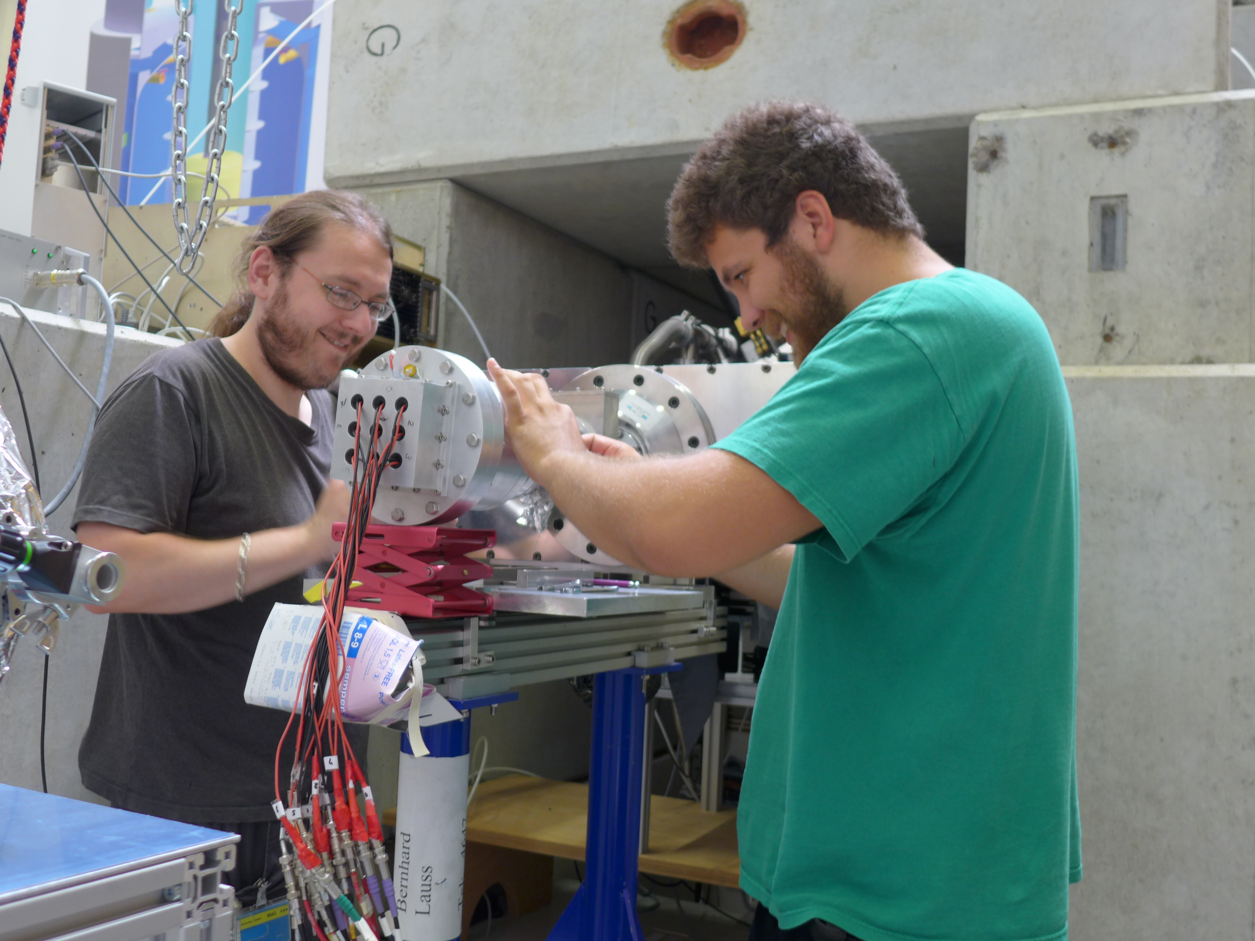
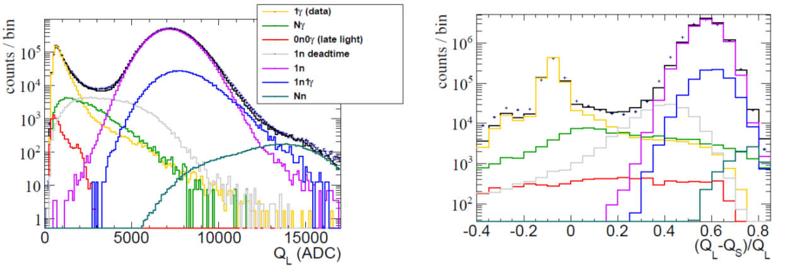
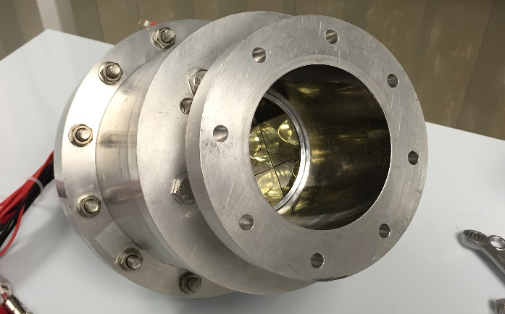
UCN Detector: Tests at PSI
Tested detector based on scintillating 6Li glass
  Benchmarked vs Cascade detector (boron coated gem detector at PSI)
Shown to be more efficient than that technology, particularly for high rates
  No show stoppers up to the rates of UCN tested (~150 kHz/channel)
L. Rebenitsch, B. Jamieson, et al., in prep.
Data taking at PSI,
August 2015.
Recent highlight:
Better understanding of contributions to measured spectra.

Slide 14
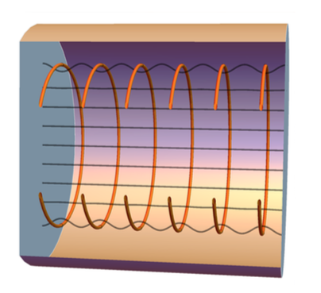
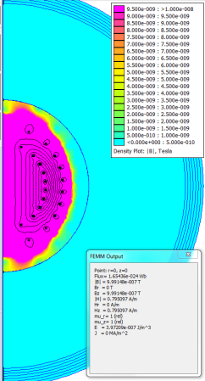
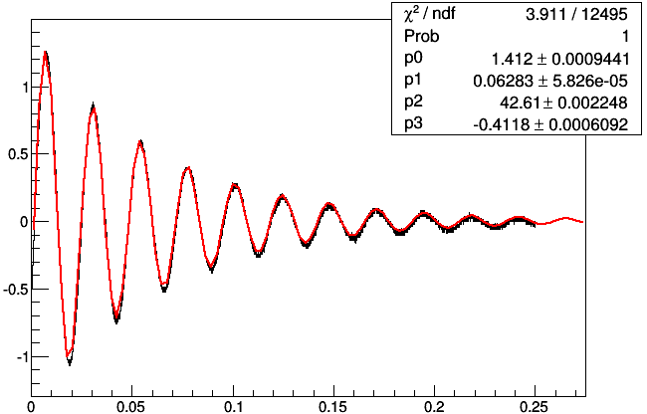
Recent highlights: Magnetic Fields
A few recent highlights:
  Magnetic homogeneity (theoretical/FEA) progress.
  Time/temperature stability of magnetic fields.
  New measurements using NMOR-based Rb magnetometer in free-induction-decay mode, aimed at improving long-term stability.
  Planning for the magnetic environment at TRIUMF.

Slide 15
Magnetic Homogeneity
Need 1 uT field with nT/m homogeneity generated inside multi-layer magnetically shielded room.
Innovative techniques to design very homogeneous coils, and shim coils.
New paradigm could be self-shielded coils,
decoupling the coil design/stability from the
magnetic shielding design/stability.
C. Bidinosti (UWpg) technique
C. Crawford (UKy) technique.

Slide 16
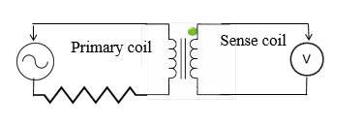
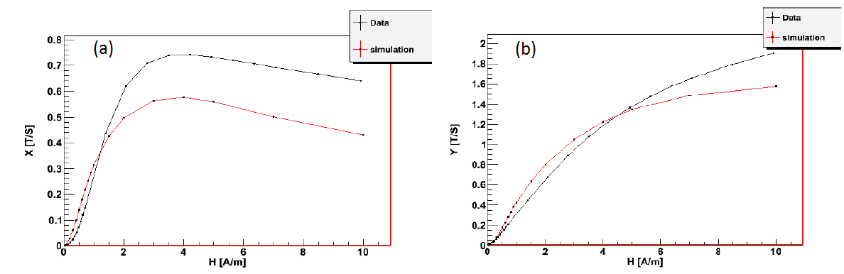
Magnetic Stability
Need long-term ~pT stability
AC measurements of temperature stability of magnetic systems.
  Magnetic shielding
  Transformer core made of same material as shielding
  Studies with application to degaussing
Next: DC stability
e.g. Jiles-Atherton model shows quantitative understanding of hysteresis effects in measurement scheme.
In-phase
Sense coil
Out-of-phase
Sense coil
T. Andalib, et al., in prep.

Slide 17
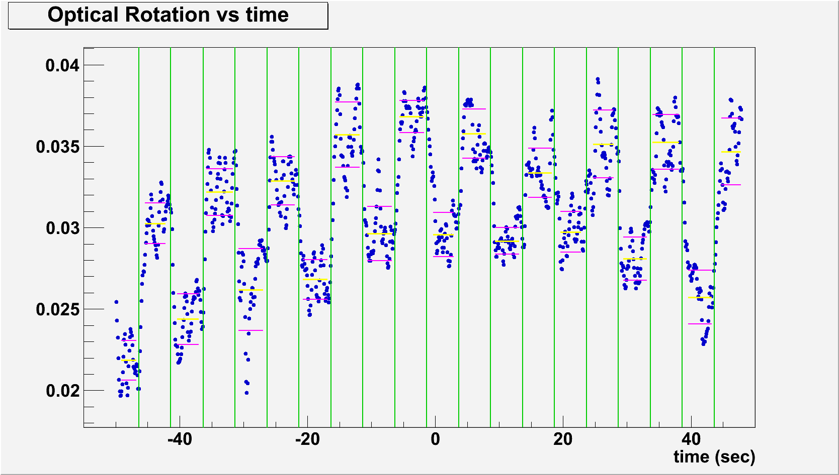
Internal Magnetic Sensors
Developing sensors based on nonlinear magneto-optical rotation (NMOR) of laser light polarization.
Achieved 20 fT precision in
~ 1 Hz bandwidth.
But can these sensors provide good stability in 0.01 Hz bandwidth?
Idea: use free-induction decay mode to remove laser instability. First demonstration completed in Winnipeg December 2015.
100 fT
J.W. Martin et al. NIM A 778, 61 (2015).
time (s)
New: FID of optical rotation signal

Slide 18
Magnetic Environment @ TRIUMF
Magnetic field ~ 300 uT with 100 nT fluctuations at night
Saturation of MSR? Bucking coils?
Active compensation prototype.
Winnipeg prototype…
…modeled after PSI’s design

Slide 19
Summary
UCN source & proton beamline installation to be completed calendar 2016.
R&D progress for the nEDM experiment.
Phase 1 nEDM operating by 2017.
Phase 2 aiming at 10⁻²⁷ e-cm precision, CFI IF application in prep.

Slide 20
Sakharov’s Criteria and
EW Baryogenesis Solutions
Criteria
EW Baryogenesis
Departure from thermal equilibrium
B-violation
CP-violation
EW Baryogenesis Problems:
EW phase transition not strong enough
Not enough CP violation in SM
D.E. Morrissey and M.J. Ramsey-Musolf, New J. Phys. 14, 125003 (2012).
Requires new physics and CP-violation near the EW scale

Slide 21
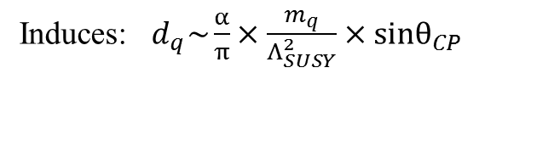
Sensitivity to new sources of CP violation
Induces: $d_{q}\sim \frac{α}{π}×\frac{m_{q}}{Λ_{SUSY}^{2}}×sinθ_{CP}$
e.g. SUSY CP problem and relationship to LHC
M. Pospelov and A. Ritz,
A. Ritz, TRIUMF Summer Institute, 2012.

Slide 22
Sensitivity to SM sources of CP violation
Strong sector may violate CP via θ term.
Naively θ ~ 1.
Experimentally θ < 10⁻¹¹, constrained mainly by nEDM.
Strong CP problem
Solution: Peccei-Quinn symmetry, axions(?)
CKM CP violation is 10⁻³¹ e-cm background

Slide 23









Xe EDM sensitivity
Precession frequency [Hz] with a permanent dipole moment
¹²⁹ Xe gyromagnetic ratio
Xe co-magnetometer
at
Xe
Assuming design parameters for nEDM.
Expected upper limit for Xe atomic EDM measurements
per
with Xe
per day with Xe
The present Xe EDM upper limit
nEDM error due to the present Xe atomic EDM upper limit
For <10⁻²⁷ nEDM measurements
Smaller cell, higher E, higher pressure are other options to boost sensitivity.
64 days of measurement to reach this goal.

