Slide 1


Tune-out Wavelengths and Polarizability for the Helium
1s2s ³S state
Authors: Jacob Manalo, G.W.F Drake
Gordon Drake Research Group

Slide 2
This is a joint theoretical/ experimental project with Dr. Kenneth Baldwin at the Australian National University and Yong-Hui Zhang et al from the Chinese Academy of Sciences

Slide 3
Tune-out Wavelength
Wavelength of photon such that the polarizability of the atom is zero.
New way of testing QED without measuring transition frequencies

Slide 4
Experiment
Michelson Interferometer
Sensitive to QED effects
413.0938(20) nm
[1] B.M. Henderson et al. Phys. Rev. Lett. 115, 043004 (2015)

Slide 5
Polarizability
Defined as the second order perturbation energy due to the external field
It is a measure of how an atom responds to an external field

Slide 6
Instead of summing over the infinite spectrum of physical states, a discrete variational spectrum of pseudostates is used.

Slide 7
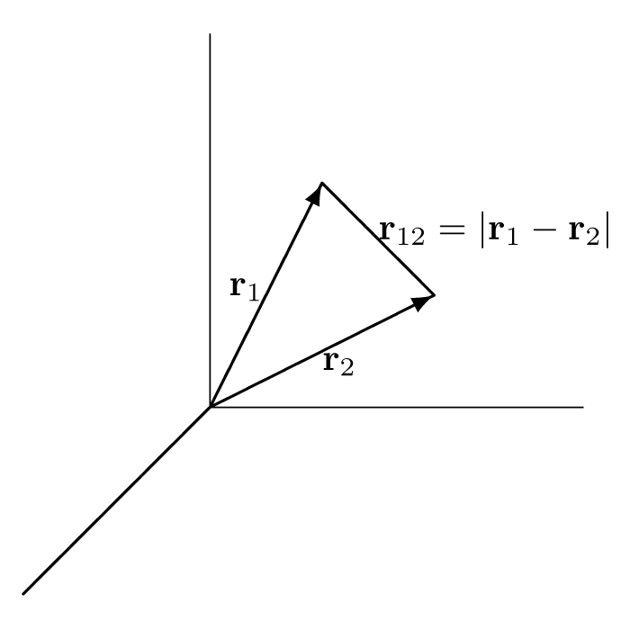
Hylleraas Coordinates
The variational solutions are of the form
e-e interaction

Slide 8
Tune-out Wavelength
To calculate, treat the field as oscillating in time
The wavelength of the incoming photon such that the dynamic polarizability is zero is known as the tune-out wavelength

Slide 9
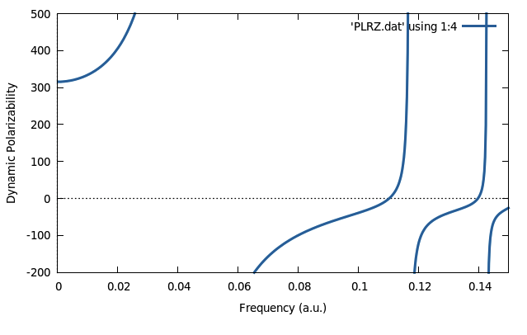
Dynamic Polarizability of the 2 ³S State
Nonrelativistic tune-out wavelength with mass polarization

Slide 10
Convergence Table
Number of Terms | Tune-out Wavelength | Difference
140 | 413.082 328 731 87 | 2.5X10⁻⁴
190 | 413.082 581 514 32 | -2.7X10⁻⁶
246 | 413.082 578 777 26 | -3.0X10⁻⁶
315 | 413.082 575 775 67 | -6.9X10⁻⁷
393 | 413.082 575 088 98 | -2.0X10⁻⁷
485 | 413.082 574 887 63 | -5.1X10⁻⁸
587 | 413.082 574 836 65 | -1.1X10⁻⁸
705 | 413.082 574 825 76 | -2.7X10⁻⁹
843 | 413.082 574 823 05 | -6.7X10⁻¹⁰
981 | 413.082 574 822 39 | -2.3X10⁻¹⁰
1140 | 413.082 574 822 16 | -1.8X10⁻¹⁰
1319 | 413.082 574 821 98 | -7.3X10⁻¹⁰
1906 | 413.082 574 821 91 | -

Slide 11
Relativity
(Breit Interaction)
2nd order perturbation from the field and 1st order
from relativistic effects

Slide 12
Ground State Polarizability
Perturbation | Drake Group (a₀³) | Sapirstein and Pachucki (a₀³)
NR He | 1.3832410089569(7) | 1.383241008958(1)
Breit Interaction | -0.0000803597(3) | -0.000080358(27)
Mass Polarization And motion of nucleus in centre of mass frame | -0.0000803283(2)
Total | 1.3835401453(2) | 1.383160650(27)
[2] K. Pachucki and J. Sapirstein, Phys. Rev. A 63, 012504, (2000).

Slide 13
2³S Polarizability
Perturbation | Drake Group (a₀³) | Zhang et al (a₀³)
NR He | 315.8203499468(2) | 315.8204(2)
Total for M=0 | 315.71609295(1) | 315.7165(4)
Total for M=+-1 | 315.7243852804(92) | 315.7248(4)
Stone Terms | 0.00084629222265(3)
Total for M=0 with Stone terms | 315.716939245(9)
Total for M=+-1 with Stone terms | 315.725231572(10)
Motion of Nucleus in COM frame for M=0 | 315.6736684153(95)
Motion of Nucleus in COM frame for M=+-1 | 315.681959606(10)
[3] Zhang et. al., Phys. Rev. A 93, 052516, (2016).

Slide 14
2³S Polarizability
Dirac-Breit RCI – Slowly convergent, e-e is a perturbation
Schrodinger-Breit with Hylleraas Coordinates – Faster convergence, e-e is built into the wavefunction

Slide 15
Current and Future Work
Relativistic contributions to the tune-out wavelength
QED contributions to polarizability
  tune-out wavelength

Slide 16
Summary
Experiment – Michelson Interferometer
Measurement of tune-out wavelength is sensitive to QED
Polarizability - NR
Tune-out wavelength – NR
Include relativistic effects by perturbation theory

Slide 17
Thank You

