Slide 1
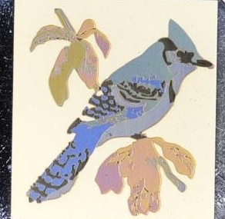
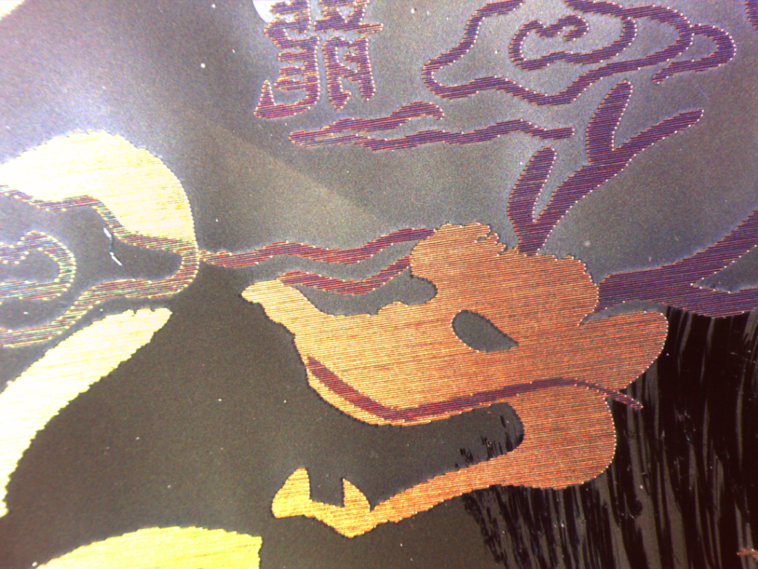
J-M Guay^{1,4}, G. Côté¹, M. Charron¹, A. Cala’ Lesina^{1,3}, J.S. Baxter¹, L. Ramunno^{1,3}, P. Berini^{1,3,4} and A. Weck^{1,2,4}
Plasmonic angle independent/dependent coloring of noble metals using picosecond laser pulses
¹Department of Physics, University of Ottawa, 150 Louis-Pasteur, ON, K1N 6N5, Canada
²Department of Mechanical Engineering, University of Ottawa, 161 Louis Pasteur, ON, K1N 6N5, Canada
³School of Electrical Engineering and Computer Science, University of Ottawa, Ottawa, Canada
⁴Centre for Research in Photonics, University of Ottawa, Ottawa, Canada

Slide 2
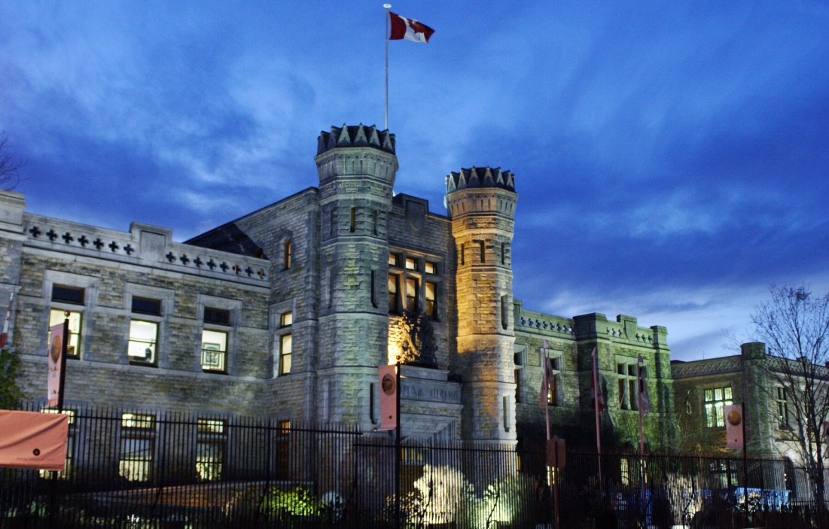


Acknowledgements
Stephen J Bodor, P.Eng
Dr. Iain Brooks, RCM
Dr. Xianyao Li, RCM
18

Slide 3
Outline
Introduction
Coloring of Silver
FDTD simulations
Coloring of Gold
Passivation of Colored surfaces
Laser Induced Periodic Surface Structures (LIPSS)
Stamping
Conclusion
2

Slide 4
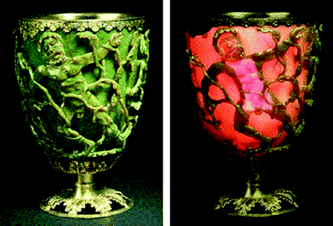
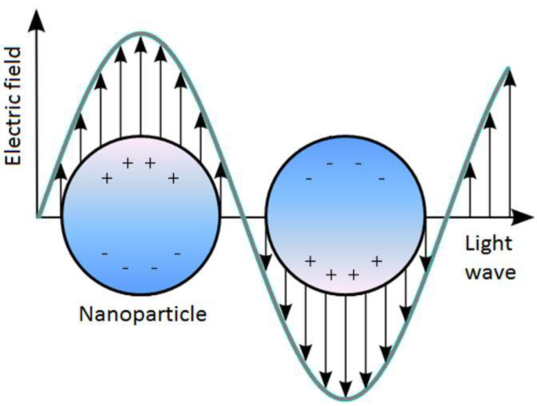
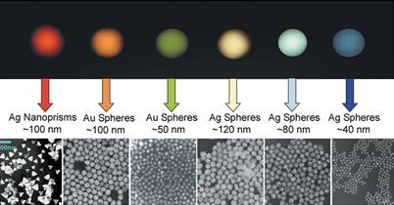
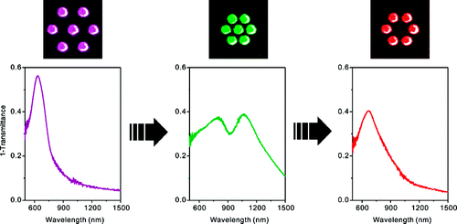
Introduction
2 main ways of controlling perceived colors by the nanoparticles:
1) Size and Shape
2) Volume fraction
Image taken from: ScienceGeist, ‘The Shape of Things’
Hentschel, M. et al. ‘Transition from isolated to Collective Modes in Plasmonic Oligomers’, Nano Letters, 2010
3

Slide 5
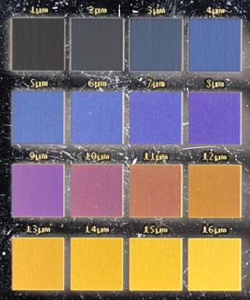
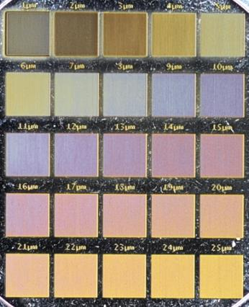
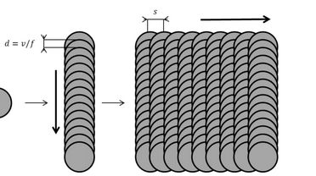
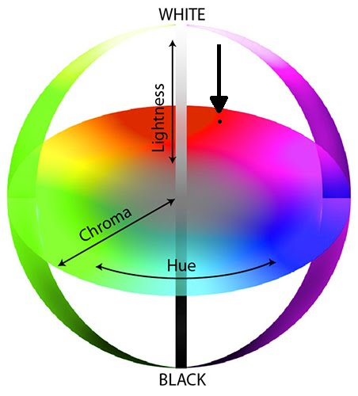
Colouring of Ag
Raster scanning sample surface
Colors obtained at 50 mm/s, 1064 nm, fluence of 1.67 J/cm² (note: lower lightness)
Colors obtained at 1000 mm/s, 1064 nm, fluence of 29.75 J/cm² (note: higher lightness)
Similar colours can be obtained via different sets of laser parameters
Colours are quantified using LCH colour space
Angle independent colours
J-M. Guay et al. Submitted (2016)
4

Slide 6
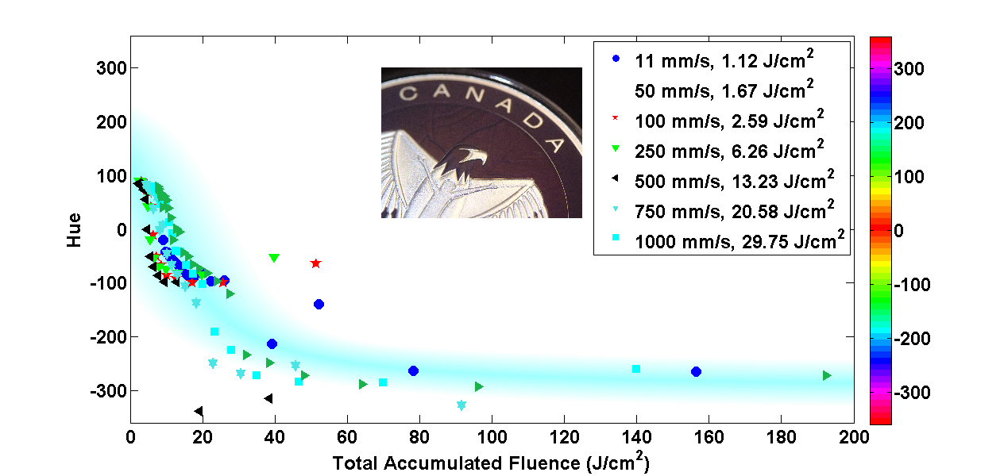
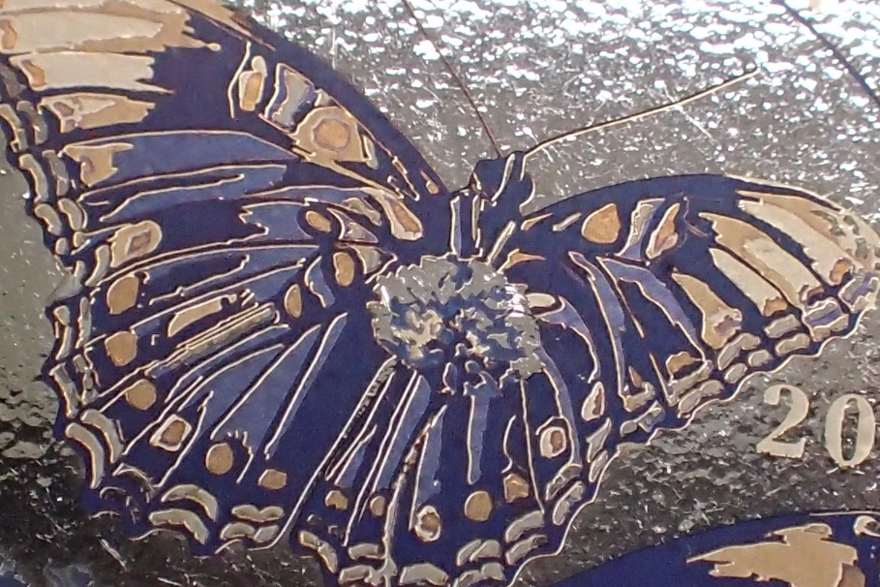
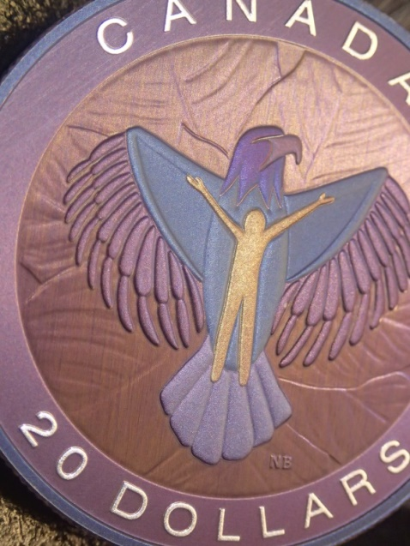
Colouring of Ag
All Hue (colour) linked to a unique ‘total accumulated fluence value’
Colours can be ramped up for industrial applications
Coins that took hours now take minutes…
5

Slide 7
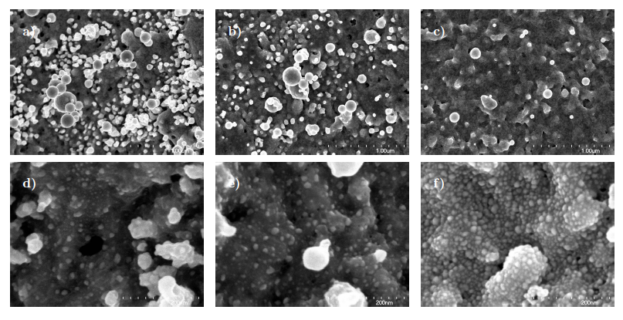
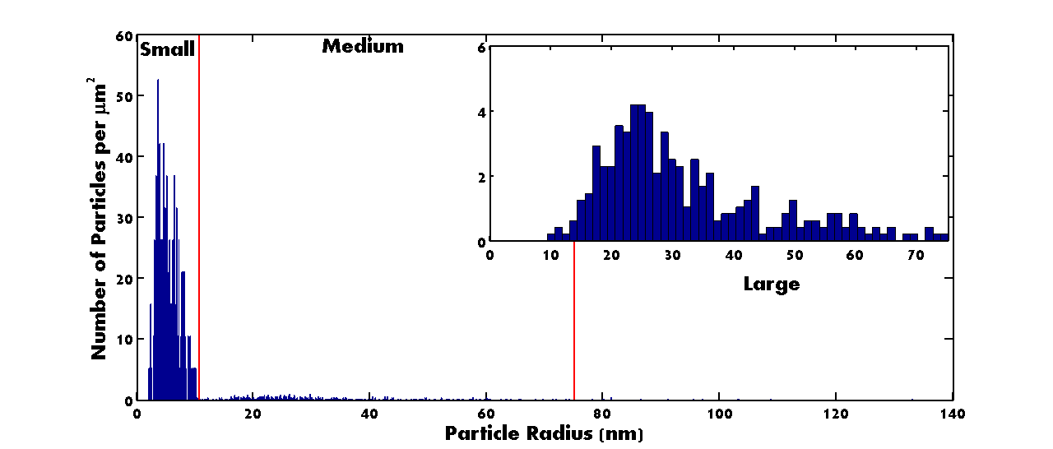
Coloring of Ag
Total accumulated fluence
Medium, Large
Small
Increasing spacing
Controlling particle density with line spacing
3 distinct set of particles are deposited on the surface
2 sets capable of color and each changing oppositely with line spacing
6

Slide 8
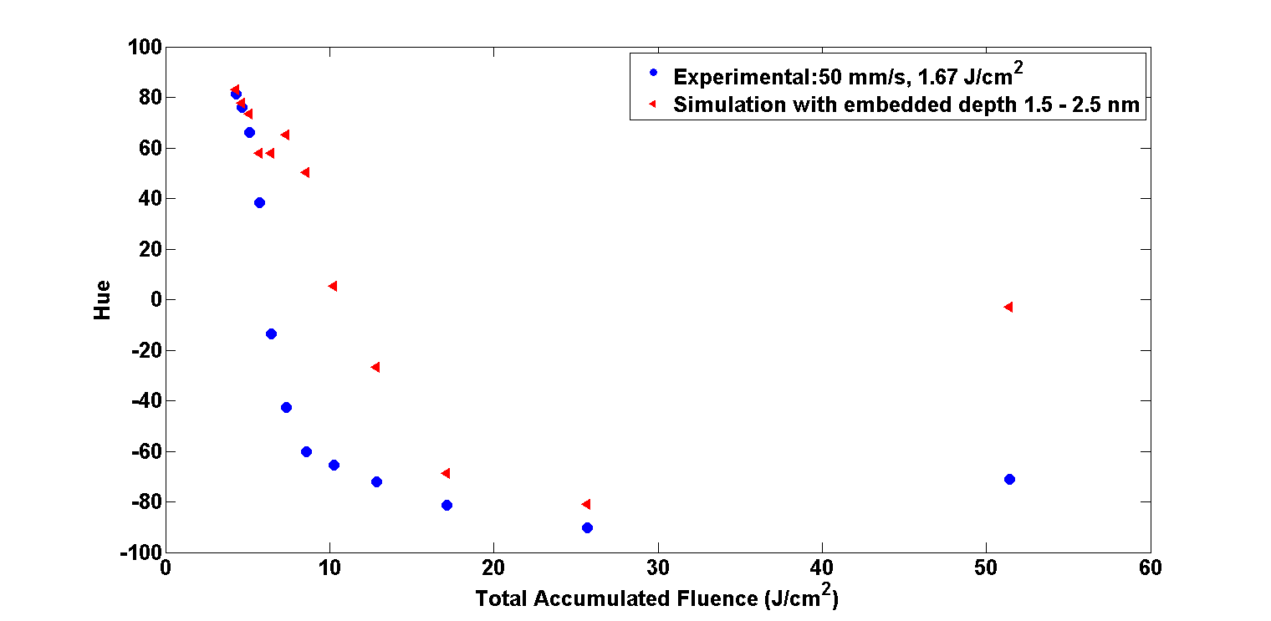
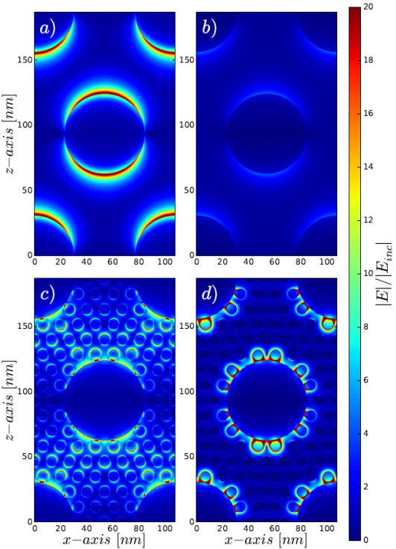
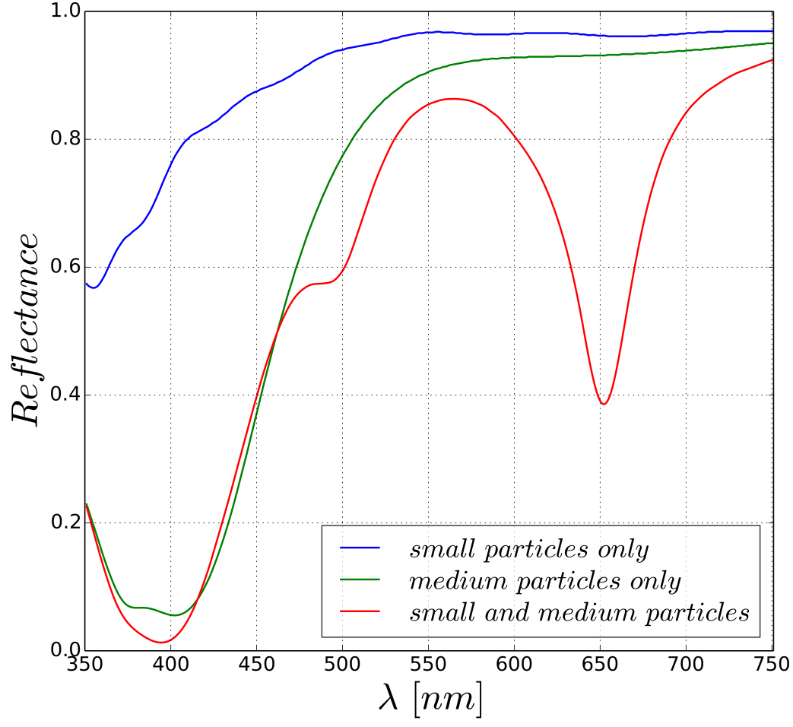
FDTD simulations
Small particles = coupling between the medium size particles
Small particles = plasmon resonances
Embedded small particles are shown to predict the experimental colors
7

Slide 9
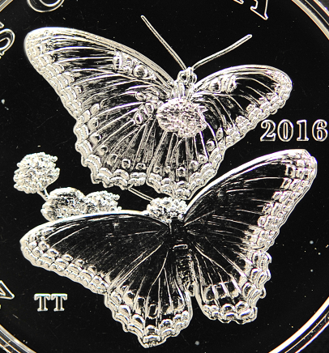
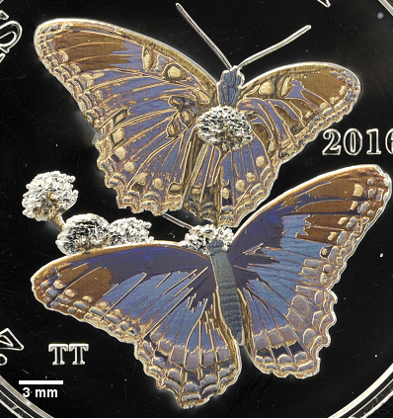
Coloring of Ag
Can color topographical surfaces with ease
For minting it is in fact better than pad printing due to edges
Coloring independent of surface quality
Can color rough (frosted) surfaces
8

Slide 10
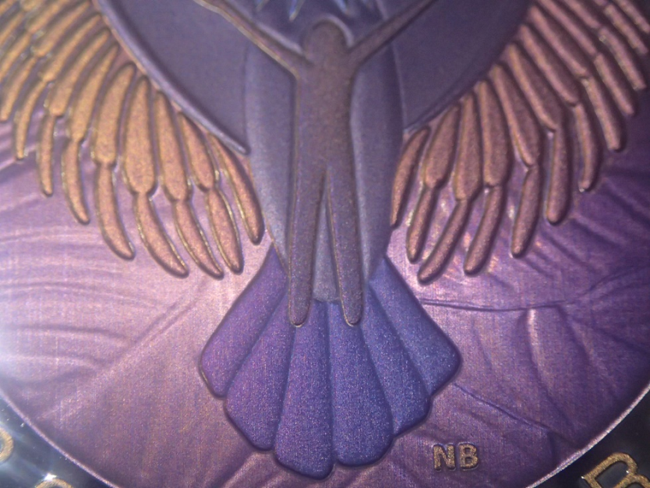
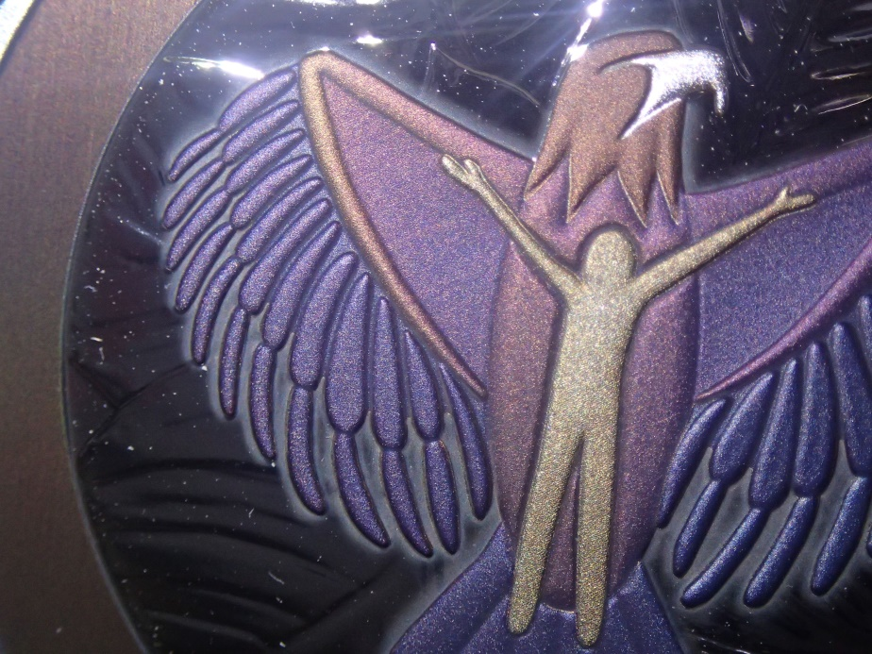
Coloring of Ag
Selective coloring and high resolution coloring of silver
Allows for the creation of color gradients
9

Slide 11
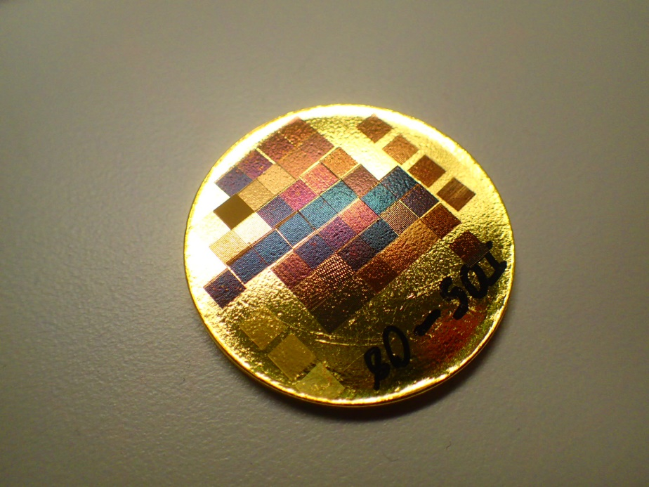
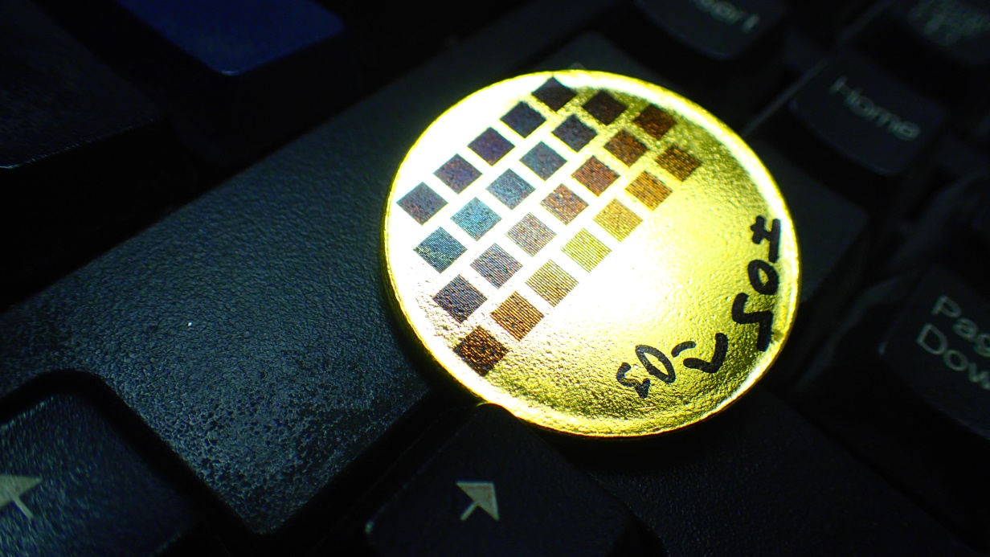
Burst Coloring of Gold
Using burst, gold was also colored
Colors covered the entire visible and intra-spectral region
The nature of the colors are currently under investigation
J-M. Guay et al. Patent Pending (2016)
Purple gold
J-M. Guay et al. In Progress (2016)
16

Slide 12
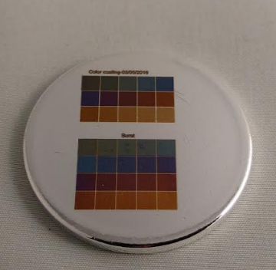
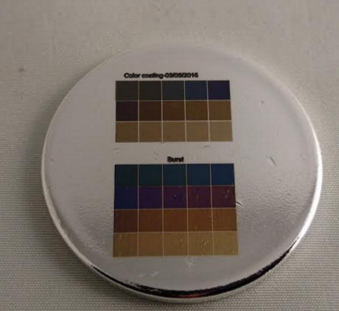
Surface passivation and colour protection
Surface protected while conserving colours using ALD deposition of alumina
Slight red shift in colors
Pre-ALD coated
Post-ALD coated
11

Slide 13
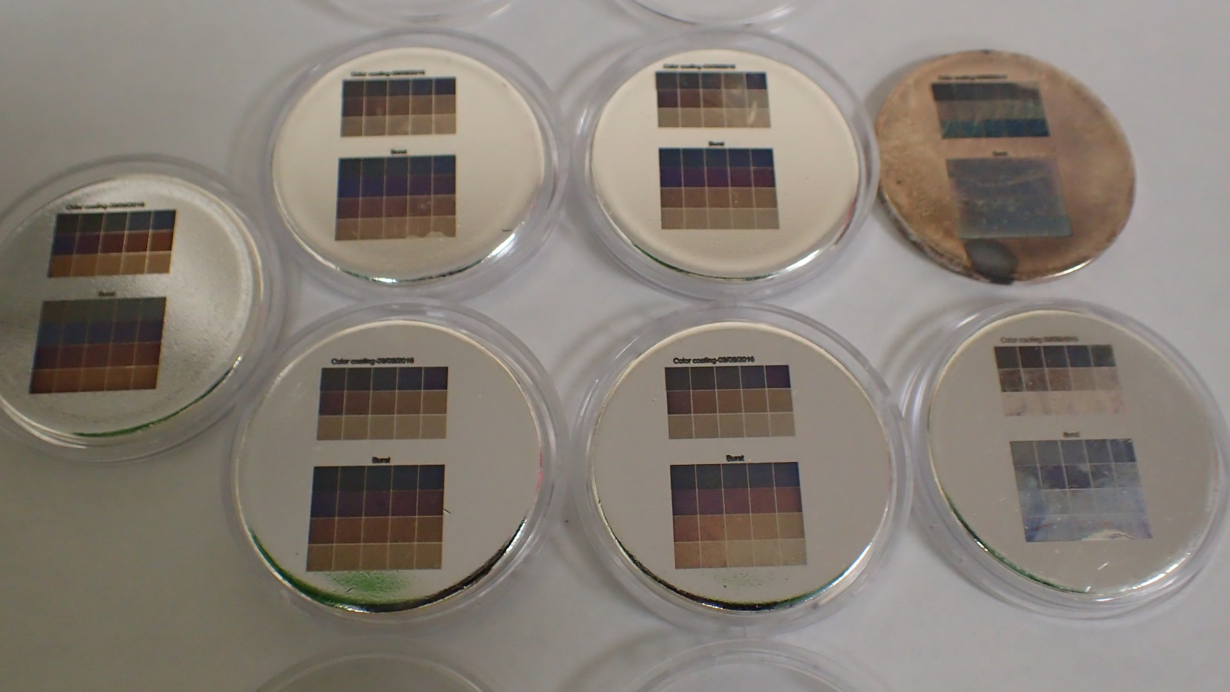
Surface passivation and colour protection
Tarnish test
Colors survived Tarnish and Temperature + Humidity tests
Temperature + Humidity test = 72h in 85% RH at 38°C followed by 6h in 30% RH at 60°C
Tarnish test = 20 hours in chamber with highly concentrated H₂S
Without ALD (control)
Humidity + Temperature Test
J-M. Guay et al. In Progress (2016)
12

Slide 14
Angle dependent colours
13

Slide 15
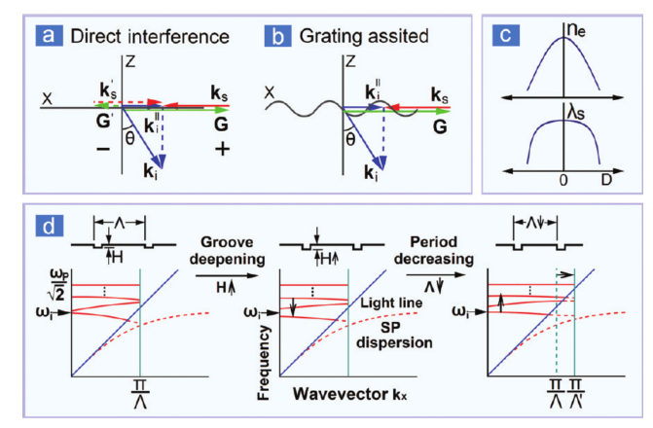
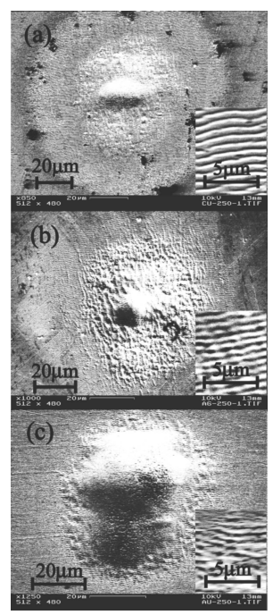
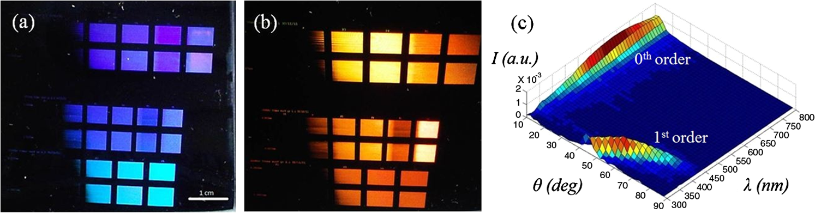
Introduction
Interference between surface EM wave and incoming light
Reduction in periodicity due to grating assisted coupling
Quality of ripples depend on Electron-phonon coupling
Huang et al., ACS Nano, 3(12), 2009,
Wang J. et Guo C., Applied Physics Letters, 87, 2005,
Scorticati, D. et al., Journal of Nanophotonics, 6(1), 2012
14

Slide 16
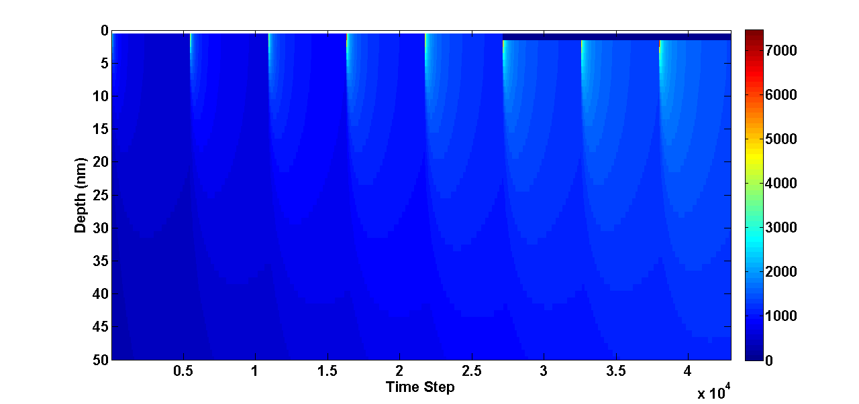
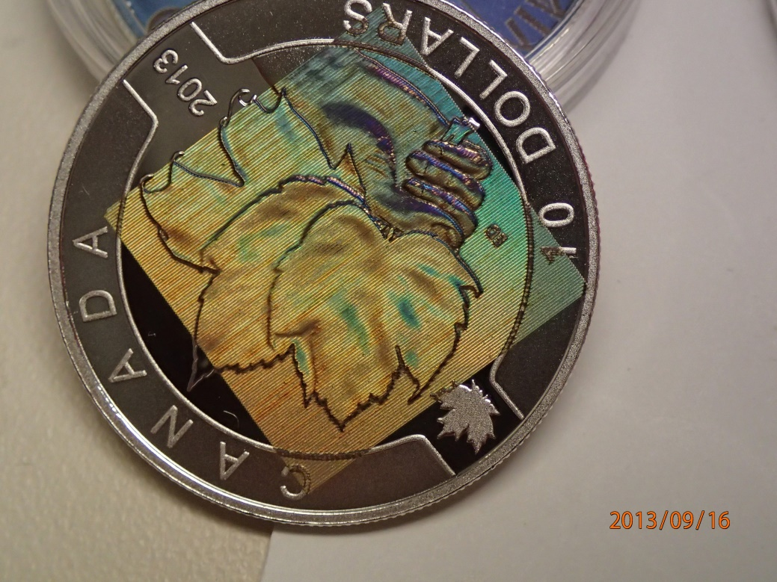
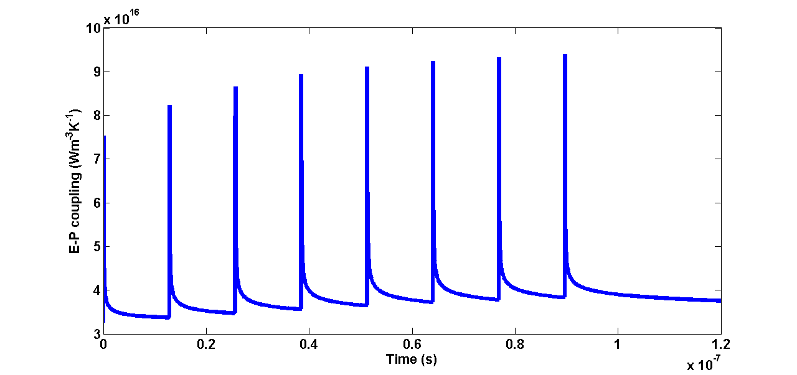
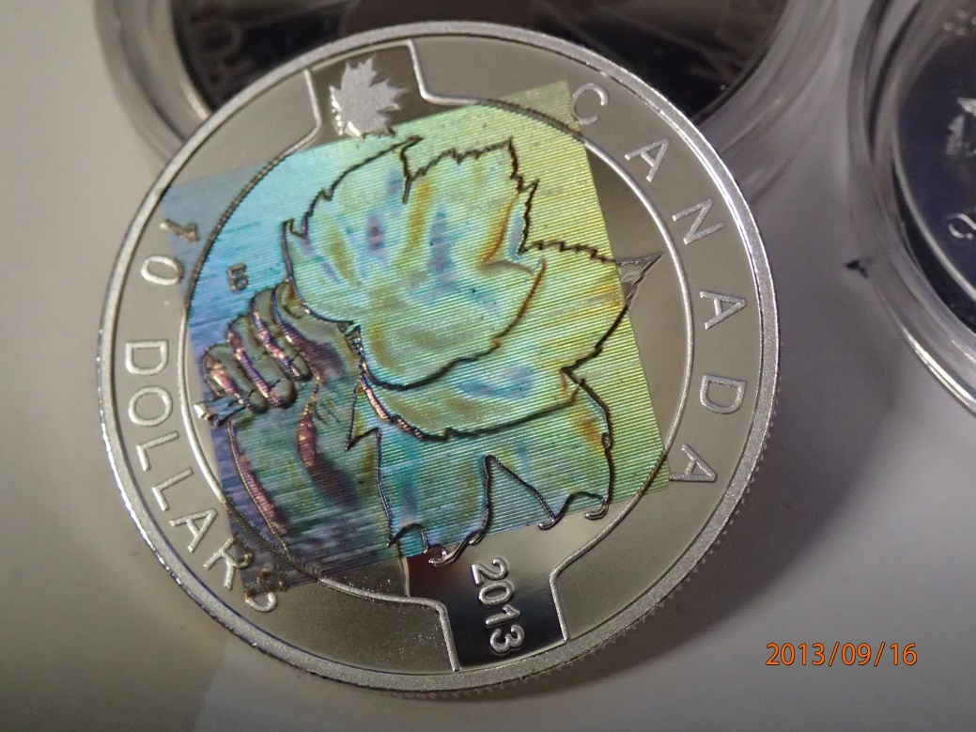
Holograms (direct writing on Ag)
Direct writing of LIPSS unto silver using burst
Burst increases Electron-Phonon coupling causing the LIPSS structures to be more defined
J-M. Guay et al. internal review (2016)
15

Slide 17
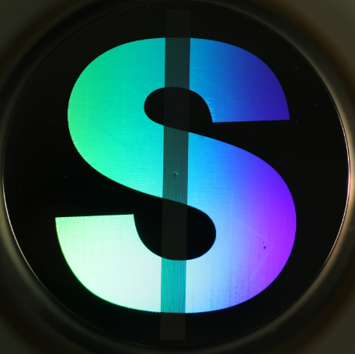
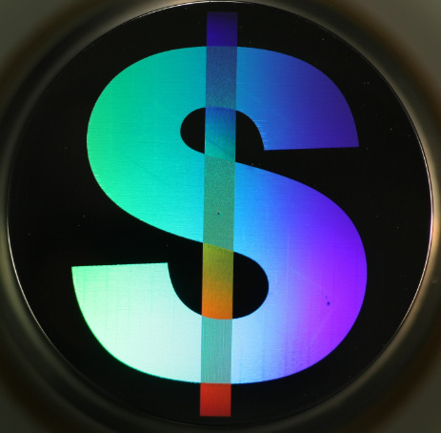
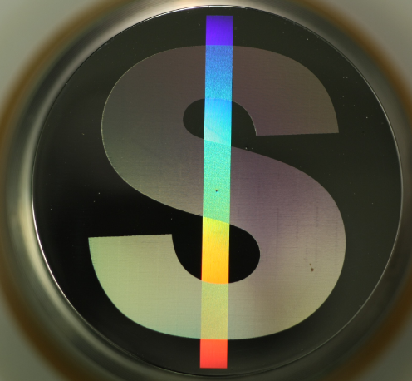
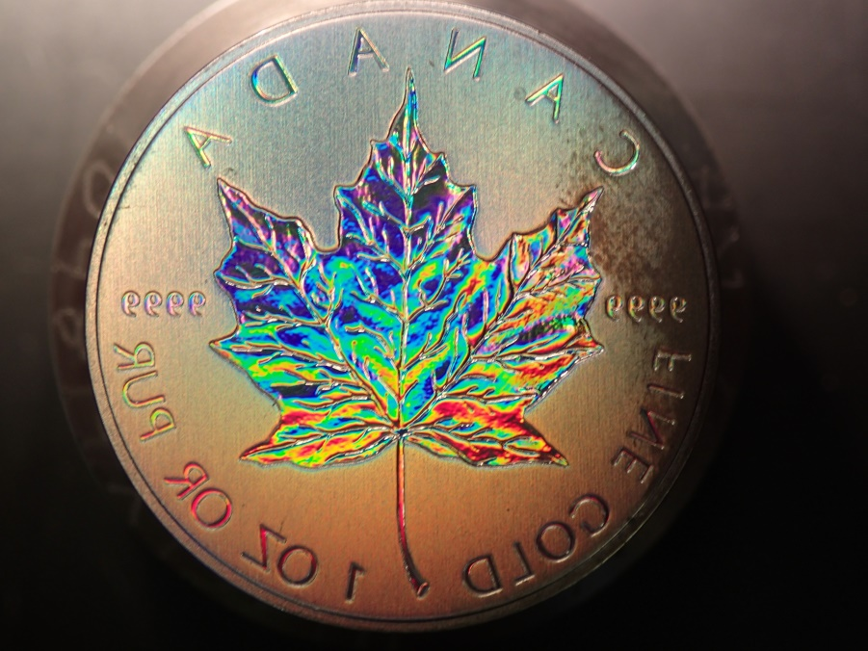
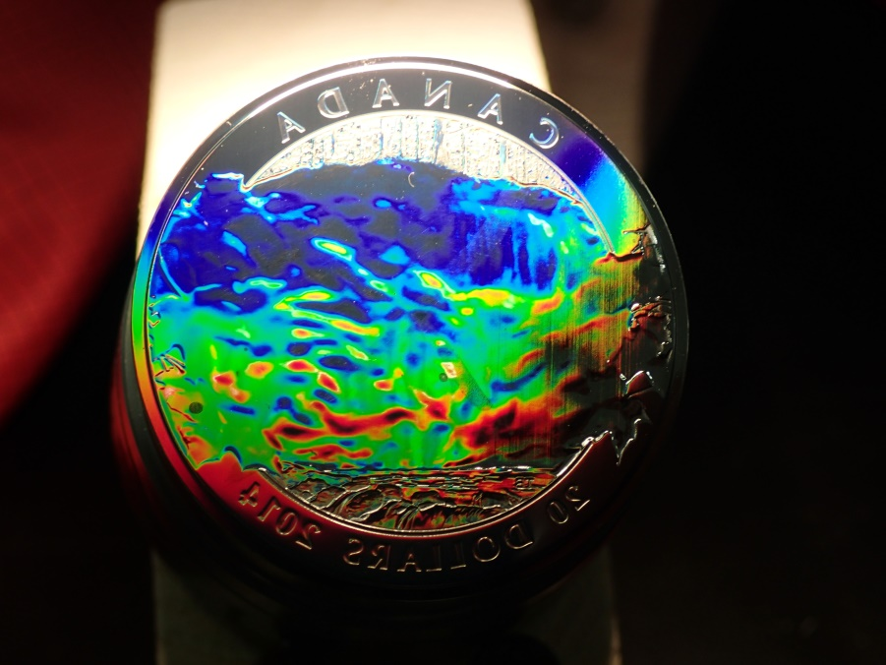
Holograms
Creation of laser induced periodic surface structures on steel
Holograms on topography
16

Slide 18
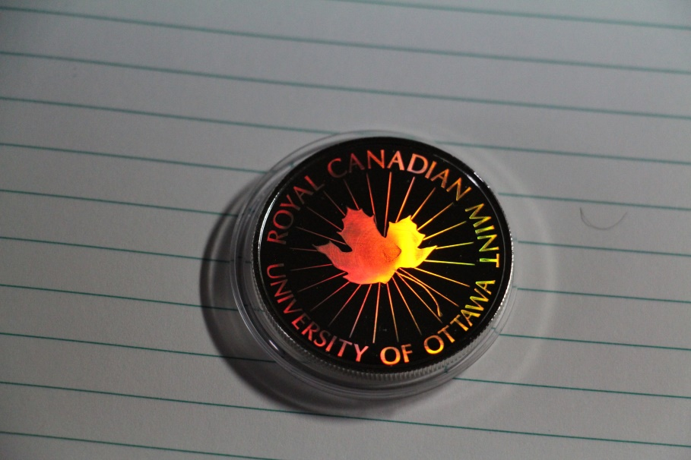
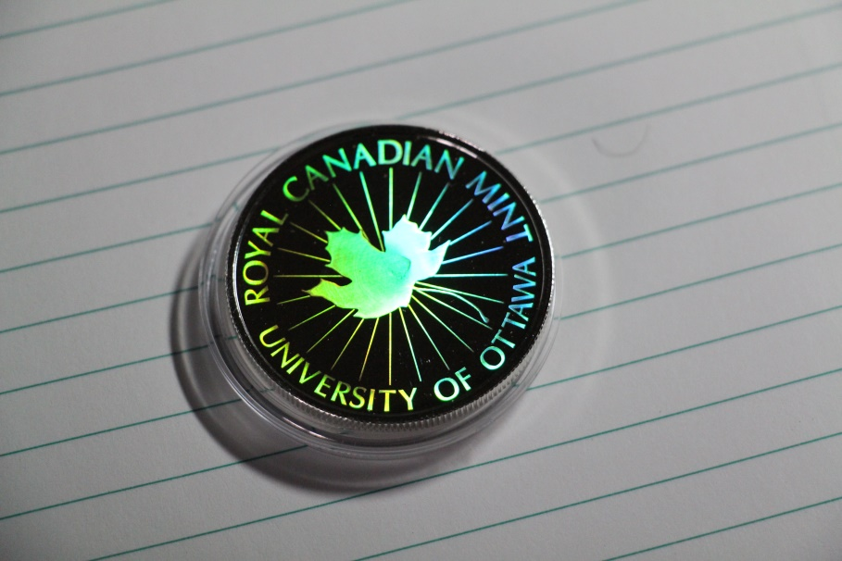
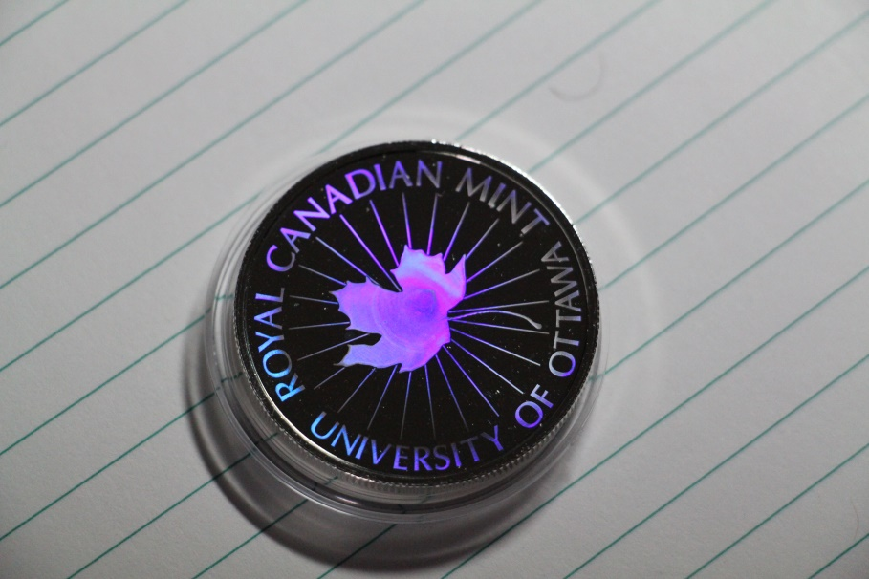
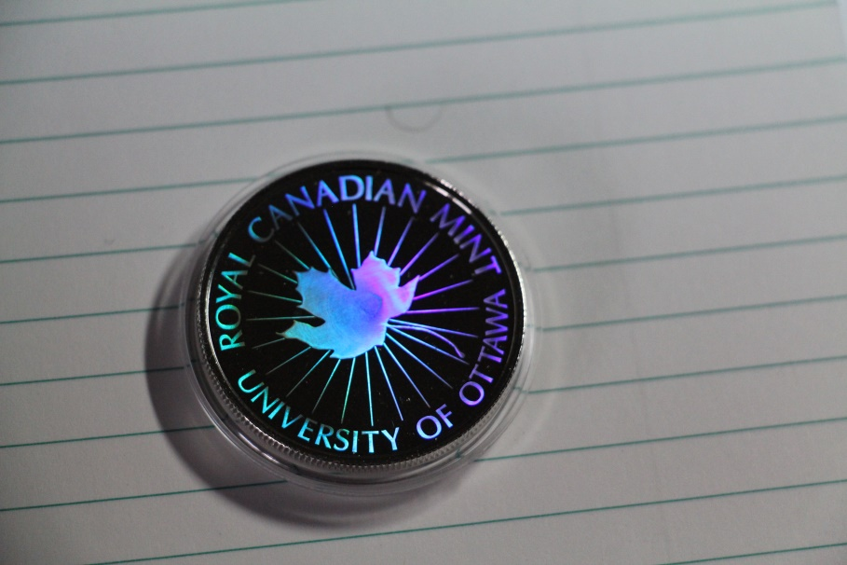
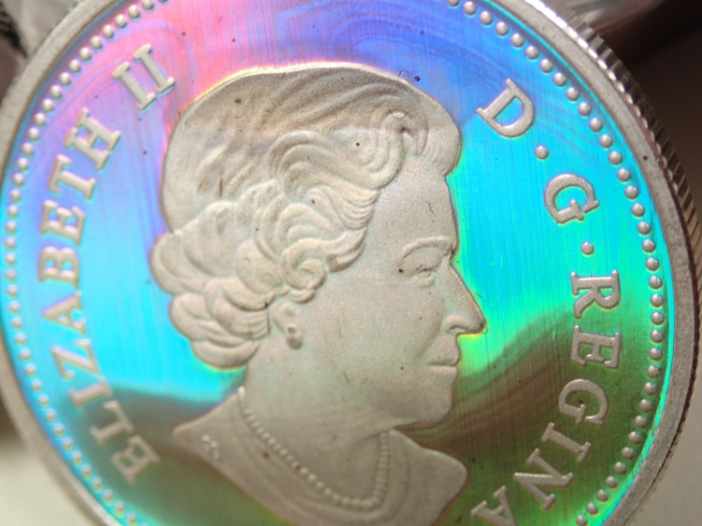
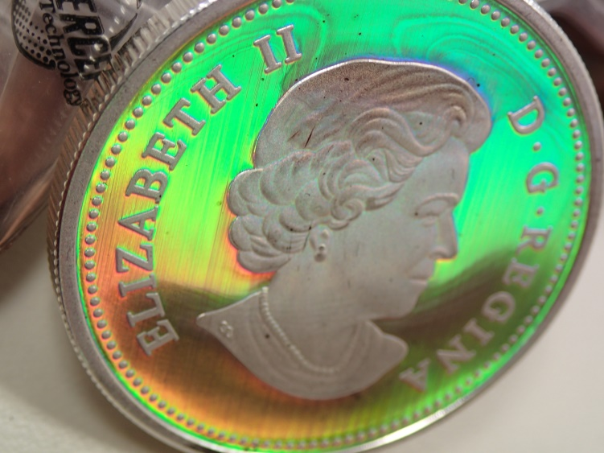
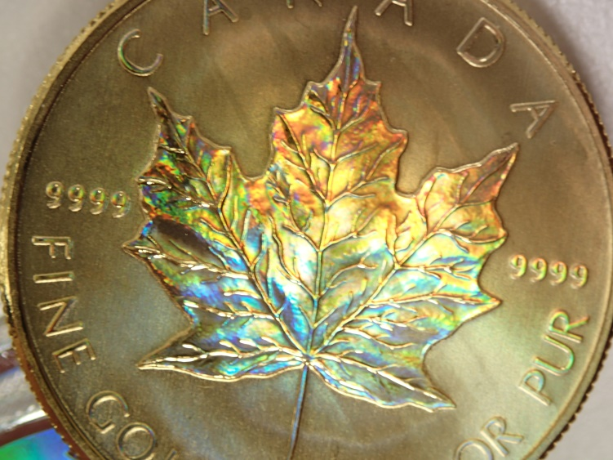
Hologram (Transfer)
Transfer of 2D structures
Transfer of LIPSS via stamping from steel die
Nanometer features can be transferred
Allows for well defined LIPSS on non-plasmonic metals and metals with weak electron-phonon coupling
Transfer of topographical 3D structures
17

Slide 19
Conclusion
Angle-independent colours controlled via the particle density deposited on the silver surface
Colours linked through a similar total accumulated fluence value → scalable
Colouring technique independent of surface quality
The small particles are found to be dominantly responsible for the colours → new plasmonic modes
Colouring of gold → covering the entire visible an extra-spectral range of colours
Burst enhancement of LIPSS
Transferring of LIPSS via a stamping process
18

