Slide 1





Confocal Raman Micro-Spectroscopy
Characterization of Chemo/Radio Resistance in Human Ovarian Cancer Cells
Hamid Moradi
Supervisor: Dr. S. Murugkar
CAP June 15, 2016
Notes:
This project is a collaborative study between our group and …….

Slide 2

Presentation Outline
Motivation
Theory
  Raman spectroscopy
  Raman micro-spectroscopy
Apparatus
Methods
  Data Acquisition
  Preprocessing
  Data Analysis:
    Principle component analysis
    Linear discriminate analysis
Results
Conclusion

Slide 3

Motivation
Ovarian cancer is the 5th most common cancer among women in Canada
Very difficult to detect
Late-stage diagnosis and high (>60%) mortality rate & resists treatment
Canadian Cancer Society's Advisory Committee on Cancer Statistics. (2015).
Canadian Cancer Statistics 2015. Toronto, ON: Canadian Cancer Society.
Notes:
Ovarian Cancer is the 5th leading cause of cancer death among women in Canada and the US.
More than a quarter million women worldwide are diagnosed with ovarian cancer every year.
More than half will die within 5 years of their diagnosis.
This is because ovarian cancer is very difficult to detect, due to the lack of overt Symptoms (not easily seen) .
The majority of the cases are diagnosed in the late stages when the (metastatic) disease is advanced and resists treatment.

Slide 4
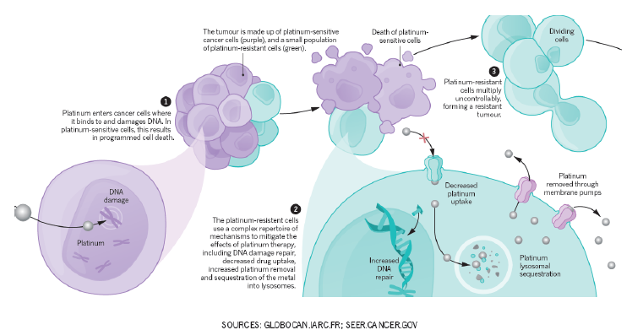
Motivation
Ovarian Cancer: Surgery followed by Chemotherapy
No effective methods for early prediction and monitoring of response to chemotherapy
Resistance to chemotherapy
Notes:
The disease normally presents after wide-spread dissemination and the standard treatment is aggressive surgery followed by chemotherapy
Despite wide initial sensitivity to chemotherapy especially to platinum –based drug, the vast majority of patients with advanced stage of the disease develop recurrences and subsequent resistance to treatments .
This because like many cancers, small population of platinum resistant cancer cells exists in tumor before treatment and flourishes once the treatment killed their platinum sensitive counter parts.
Unfortunately, there are no existing methods by which the patient response to treatment can be predicted or the efficacy of the treatment be assessed at an early point in time.
Our collaborator Dr Vanderhyden is been very keen to find a method to solve this problem.

Slide 5

Objective
Developing high-resolution, sensitive optical techniques to:
  Detect tumor cells that are intrinsically resistant to chemotherapy prior to the treatment
  ?
Apply Raman micro-spectroscopy (RMS) in conjunction with multivariate statistical analysis (PCA-LDA) to discriminate between two subtypes of the human ovarian carcinoma cell line A2780 (S sensitive& CP resistive)
The two cell lines represent a good model of tumor tissues of similar origin but with different intrinsic chemo and radio-sensitivities.
Notes:
Our goal is to develop high-resolution, sensitive optical techniques to detect tumor cells that are intrinsically resistant to chemotherapy prior to the treatment
In this pilot study, we have applied Raman micro-spectroscopy in vitro in conjunction with multivariate analysis to discriminate between two subtypes of the human ovarian carcinoma cell line A2780.
Furthermore, the A2780s/A2780cp cell lines have been previously shown to be sensitive/resistant to radiation and their radiobiological behavior has been extensively studied By our collaborator Dr Gosia
The two cell lines represent a good model of tumor tissues of similar origin but with different intrinsic chemo and radio-sensitivities.
Our collaborator Dr Libni oncologist from ottawa hospital cancer center also showed interest to application of this technique to identify the radiation induced in head and neck cancer tumors.

Slide 6

Objective
Developing high-resolution, sensitive optical techniques to:
  Detect tumor cells that are intrinsically resistant to chemotherapy prior to the treatment
  Identify radiation induced responses in human cancer cells
Apply Raman micro-spectroscopy (RMS) in conjunction with multivariate statistical analysis (PCA-LDA) to discriminate between two subtypes of the human ovarian carcinoma cell line A2780 (S sensitive& CP resistive)
The two cell lines represent a good model of tumor tissues of similar origin but with different intrinsic chemo and radio-sensitivities.
Notes:
And since this cell lines are sensitive and resistive to radiation so we decided to look into the radiation induced as well:

Slide 7
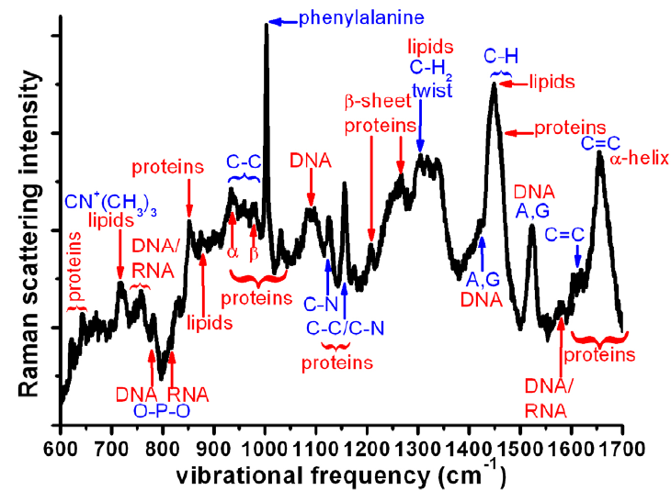
Theory: Raman Spectroscopy
Spectroscopic technique based on inelastic scattering of the light due vibrations of chemical bonds
It provides a molecular finger print of cells and tissues
1/cm
Raman spectrum of live cancer cell
http://www.mdpi.com/1424-8220/10/3/1871/htm
Notes:
Raman spectroscopy is non invasive /nondestructive label free technique that is based on the inelastic scattering of light due to vibrations of molecular bonds.
It provides a molecular finger print of complex biological samples such as cells and tissues
[Raman spectroscopy, a molecular spectroscopy which is observed as inelastically scattered light, allows for the interrogation and identification of vibrational (phonon) states of molecules. As a result, Raman spectroscopy provides an invaluable analytical tool for molecular finger printing as well as monitoring changes in molecular bond structure]

Slide 8
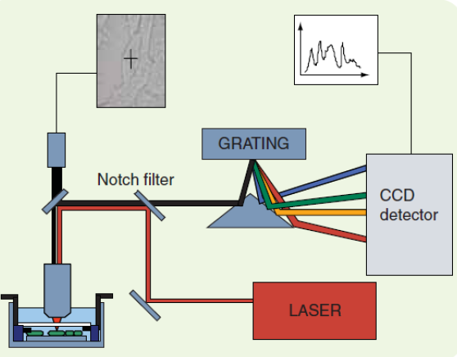
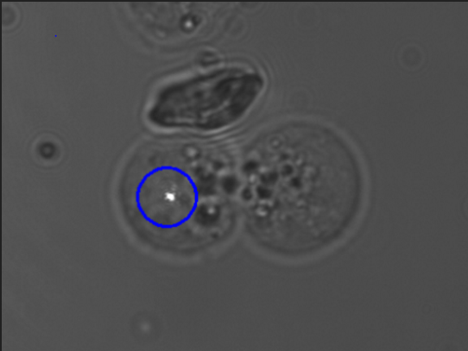
Theory: Raman Micro-Spectroscopy
Couples a Raman spectrometer to a standard optical microscope
Allows investigation of single live cells (high resolution ~1 micron)
Expert. Rev. Med. Devices 3(2), (2006)
Expert. Rev. Med. Devices 3(2), (2006)
Notes:
Raman microspectroscopy is where a Raman microspectrometer is used in place of a standard Raman spectrometer.when we couple microscope with spectrometer enable us to obtain molecular information at the micrometer scale.
This is schematic of typical RMS.
The laser beam falls on the filter and then it passes to the objective and collides with the Sample. The light will be scattered in all directions and will be reflected to the objective again. After the reflected light reaches the objective it falls down on the spectrometer system and finally to the CCD or PMT detectors.
RMS is a well-studied methodology for the past decade. And there have been numerous publications on this subject
[Raman microspectroscopy is where a Raman microspectrometer is used in place of a standard Raman spectrometer. A Raman microspectrometer consists of a specially designed Raman spectrometer integrated with an optical microscope. This allows the experimenter to acquire Raman spectra of microscopic samples or microscopic areas of larger samples. The advantages are that much less samples is require and certain effects may also be enhanced over very localized regions.]

Slide 9
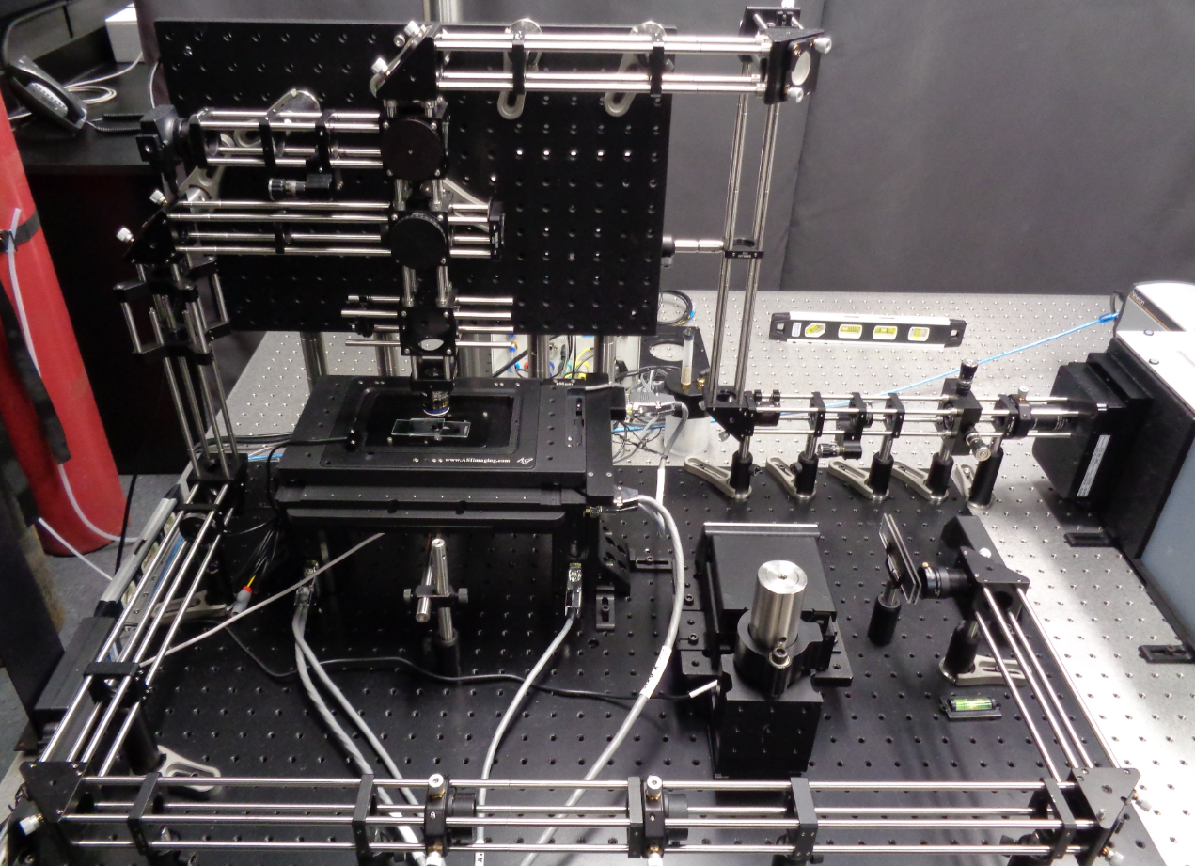
Apparatus - Confocal Raman Microscope
Carleton Confocal Raman Microscope
Notes:
Raman spectra are acquired from individual fixed cells with a home built confocal Raman microscope.

Slide 10
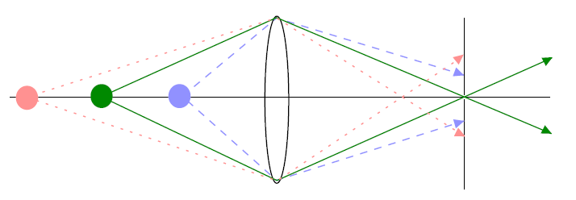
Apparatus - Confocal Raman Microscope
Carleton Confocal Raman Microscope
Notes:
The term confocality comes from the special filter which is added to the set up prior to the spectrometer. What it does it only allows the light which come from focal plane to reach the spectrometer.

Slide 11
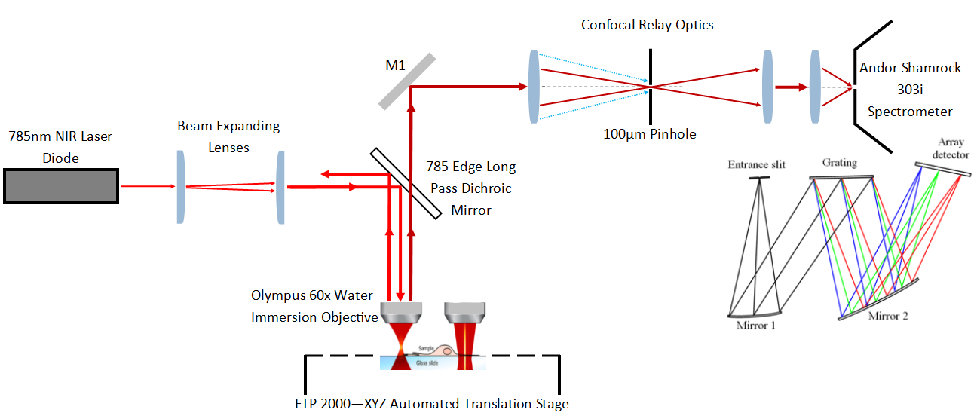
Apparatus - Confocal Raman Microscope
Simplified Confocal Raman Microscope Diagram
Notes:
This is simple schematic of our set up.
For recording spectra from the cells we used 60X water immersion objective providing spot size of about 1mu.
The confocal hole was set at 100 mu
The 785 nm laser was used for this study delivering 35 mW at the sample
Spectrometer contains 3 interchangeable grating for this study we used the grating of 1000 lines/mm for high spectral resolution.

Slide 12
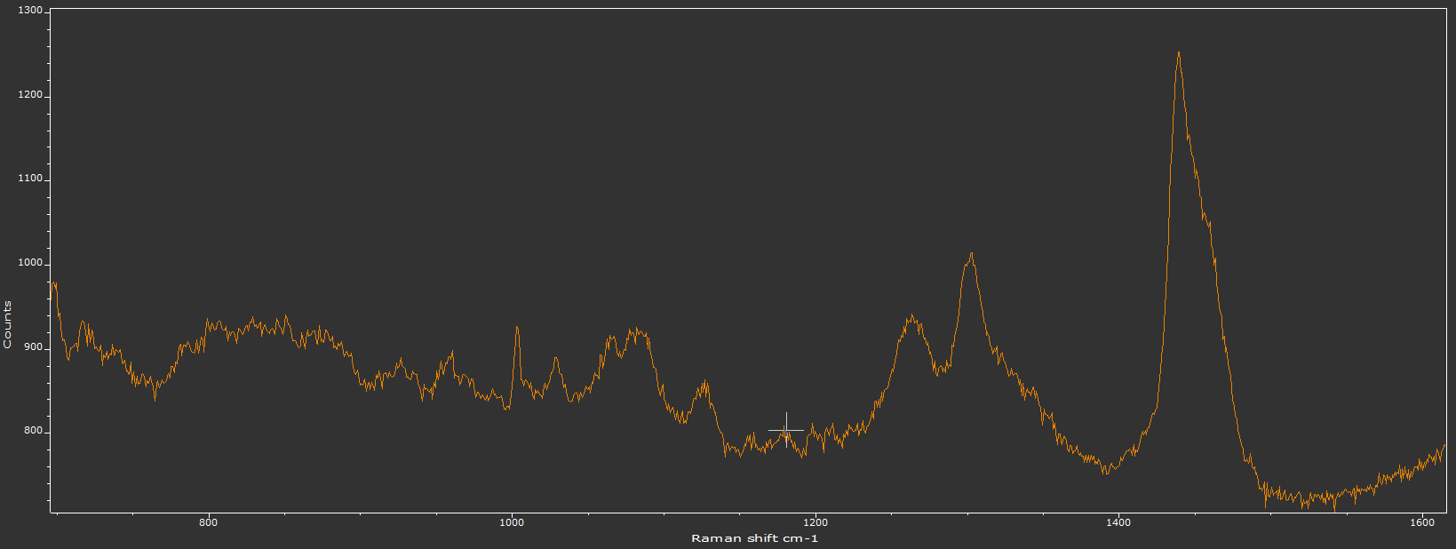
Methods: Data Acquisition
DNA,
Lipids & Proteins
Raw Raman Signal from A2780cp (0Gy)
Lipids
DNA
Proteins
DNA,
Lipids
Proteins
To obtain more interpretable signal we require to apply some techniques called preprocessing.
Raw Spectra
Smoothing
Normalization
Background Removal
Classification
Notes:
The back scattered Raman signal was integrated for 30 seconds over the spectral range 700 to 1680 cm-1 for each cell and repeated for 10 times than we took the average to improve signal to noise ratio.
We collected spectra from about 40 un-irradiated and irradiated cells of each type randomly for each day.
This how the spectrum looks like. It contains unwanted information coming from the substrate and medium
In order to obtain more interpretable signal we require to apply some techniques that called preprocessing.

Slide 13
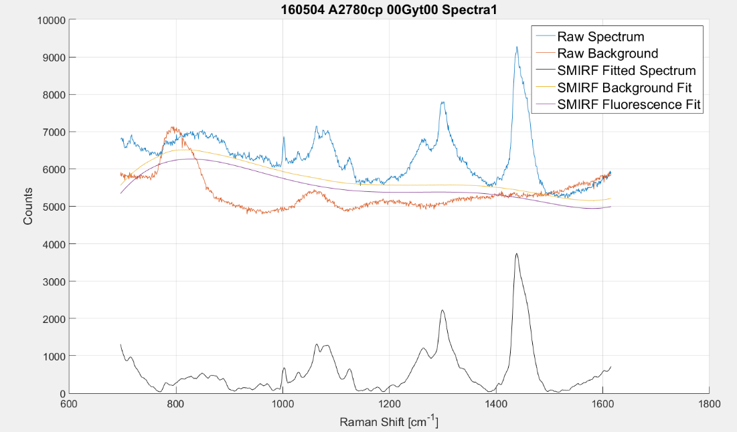

Methods: Preprocessing(SMIRF)
SMIRF Background Estimation, Smoothing and Subtracted Raman Signal
[B.D. Beier, “Confocal Raman Microspectroscopy of Oral Streptococci”, PhD thesis, University of Rochester, 2011]
Raw Spectra
Smoothing
Normalization
Background Removal
Classification
Notes:
For our preprocessing we use an algorithm called SMIRF(Spectrum Based Method for the Iterative Removal of Fluorescence)
it is open source code [from University of Rochester and we modified it for our quartz substrate].
[It compares a reference BG – which is quartz plus medium to the cell spectrum]
Then iteratively estimates the unwanted contribution from the background
Ultimately it subtracts this unwanted information and were left with a pure Raman signal
All spectra are normalized to the total area under the baseline corrected spectrum. Prior to data analysis

Slide 14
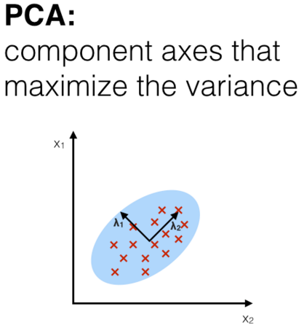
Methods: Data Analysis(PCA)
Principle Component Analysis
Express Data in new Basis
  Reduce Dimensions
  New Basis = Principle Components
Find orthogonal axes with maximum variance
  Unsupervised (non-parametric)
PC2
PC1
Orthogonal Principal Components (λ₁, λ₂) in New Basis
[http://sebastianraschka.com/images/blog/2014/linear-discriminant-analysis/lda_1.png]
Raw Spectra
Smoothing
Normalization
Background Removal
Classification
Notes:
Our data can be displayed as matrix where the columns are wavenumbers (variables) and rows are the spectra
So we have a small Number of spectra with large number of variables for us 1024 wavenumbers
Principal component analysis is a great way to reduce the data
What PCA does It compress high dimensional data by expressing the data in terms of small number of principal components
which are directions that maximize the variance in a data set
It is unsupervised in a sense that it ignores class label and treat data as one

Slide 15
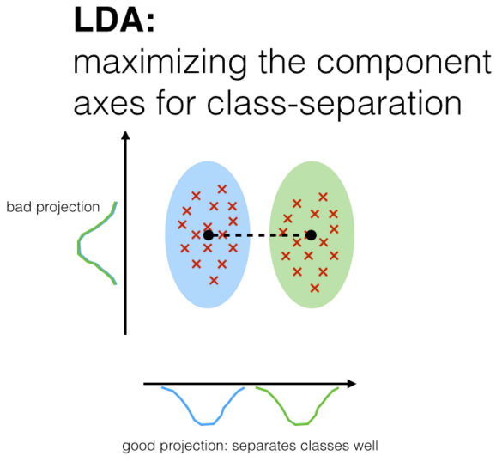
Methods: Data Analysis (LDA)
Linear Discriminate Analysis
Determines class membership
  Sensitive / Resistant
Finds the directions in spectral space (projection)
  Maximize the ratio of between- class variance to within- class variance
Supervised Classification
  Use known data to train model
  Apply model to blind set for prediction
LD2
LD1
LDA Separation Using Meaningful Principal Components
http://sebastianraschka.com/images/blog/2014/linear-discriminant-analysis/lda_1.png
Raw Spectra
Smoothing
Normalization
Background Removal
Classification
Notes:
Now that we’ve reduced our data – we want to label and classify them.
LDA finds the directions in spectral space that maximize the ratio of between- class variance to within- class variance
LDA is supervised classification algorithm for discrimination of sample groups.
There are two important phases :
Training phase: which it uses a training data set( which is labeled) to find pattern in the data
Prediction phase: which it uses the model made from previous phase to identify an unseen data

Slide 16
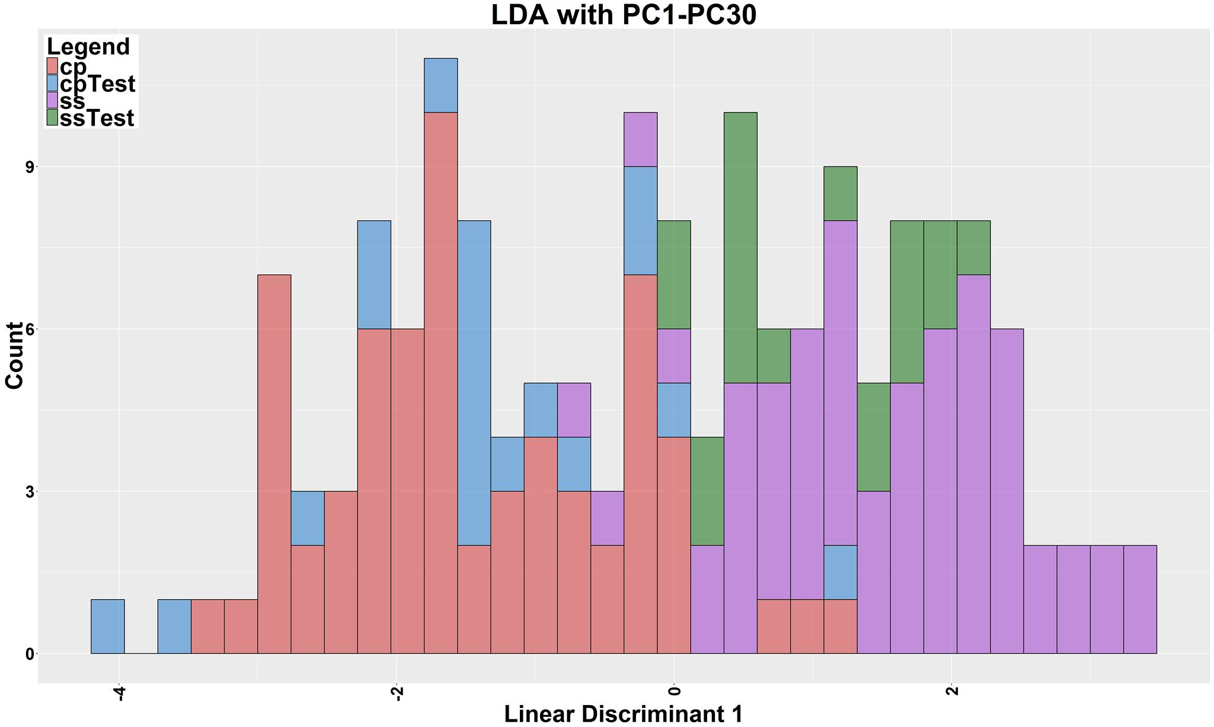
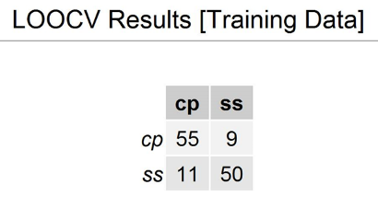

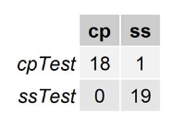
Results
(81% Variance)
A2780 S&CP(0Gy)
CP Cell Resistant cell type
S Cell Sensitive cell type
Test Cells actual S
Test Cells actual CP
LDA stacked histogram showing clear separation between “S” and “CP” types 0 Gy with classification of test set
Notes:
We multiply in our LDA model onto each spectrum you get score
This is a stacked histogram
red – cp – resistant
purple – s – sensitive
Two nice distirbutions
And the training model used to identify unknown or test cells
We in fact classified the unknown sets

Slide 17
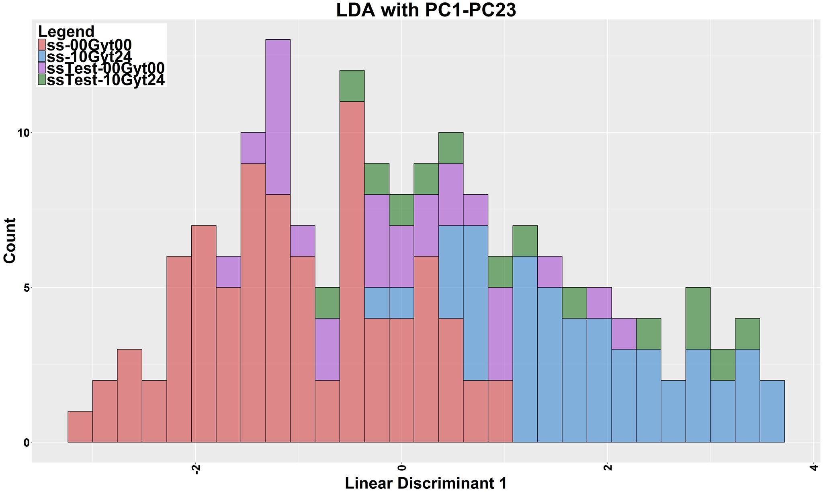
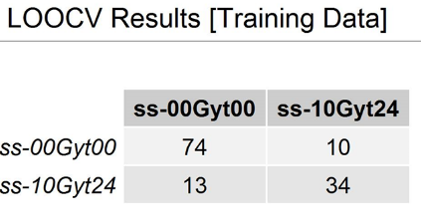
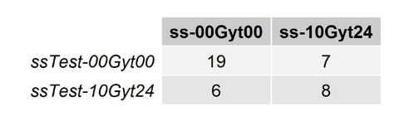
Results
(97% Variance)
A2780 S(0 Vs 10 Gy)
S Cell sensitive cell type, 0Gy
S Cell Sensitive cell type,10Gy
Test Cells actual S 10 Gy
Test Cells actual S 0 Gy
LDA stacked histogram showing clear separation between “0 Gy” and “10 Gy” types for S with classification of test set

Slide 18
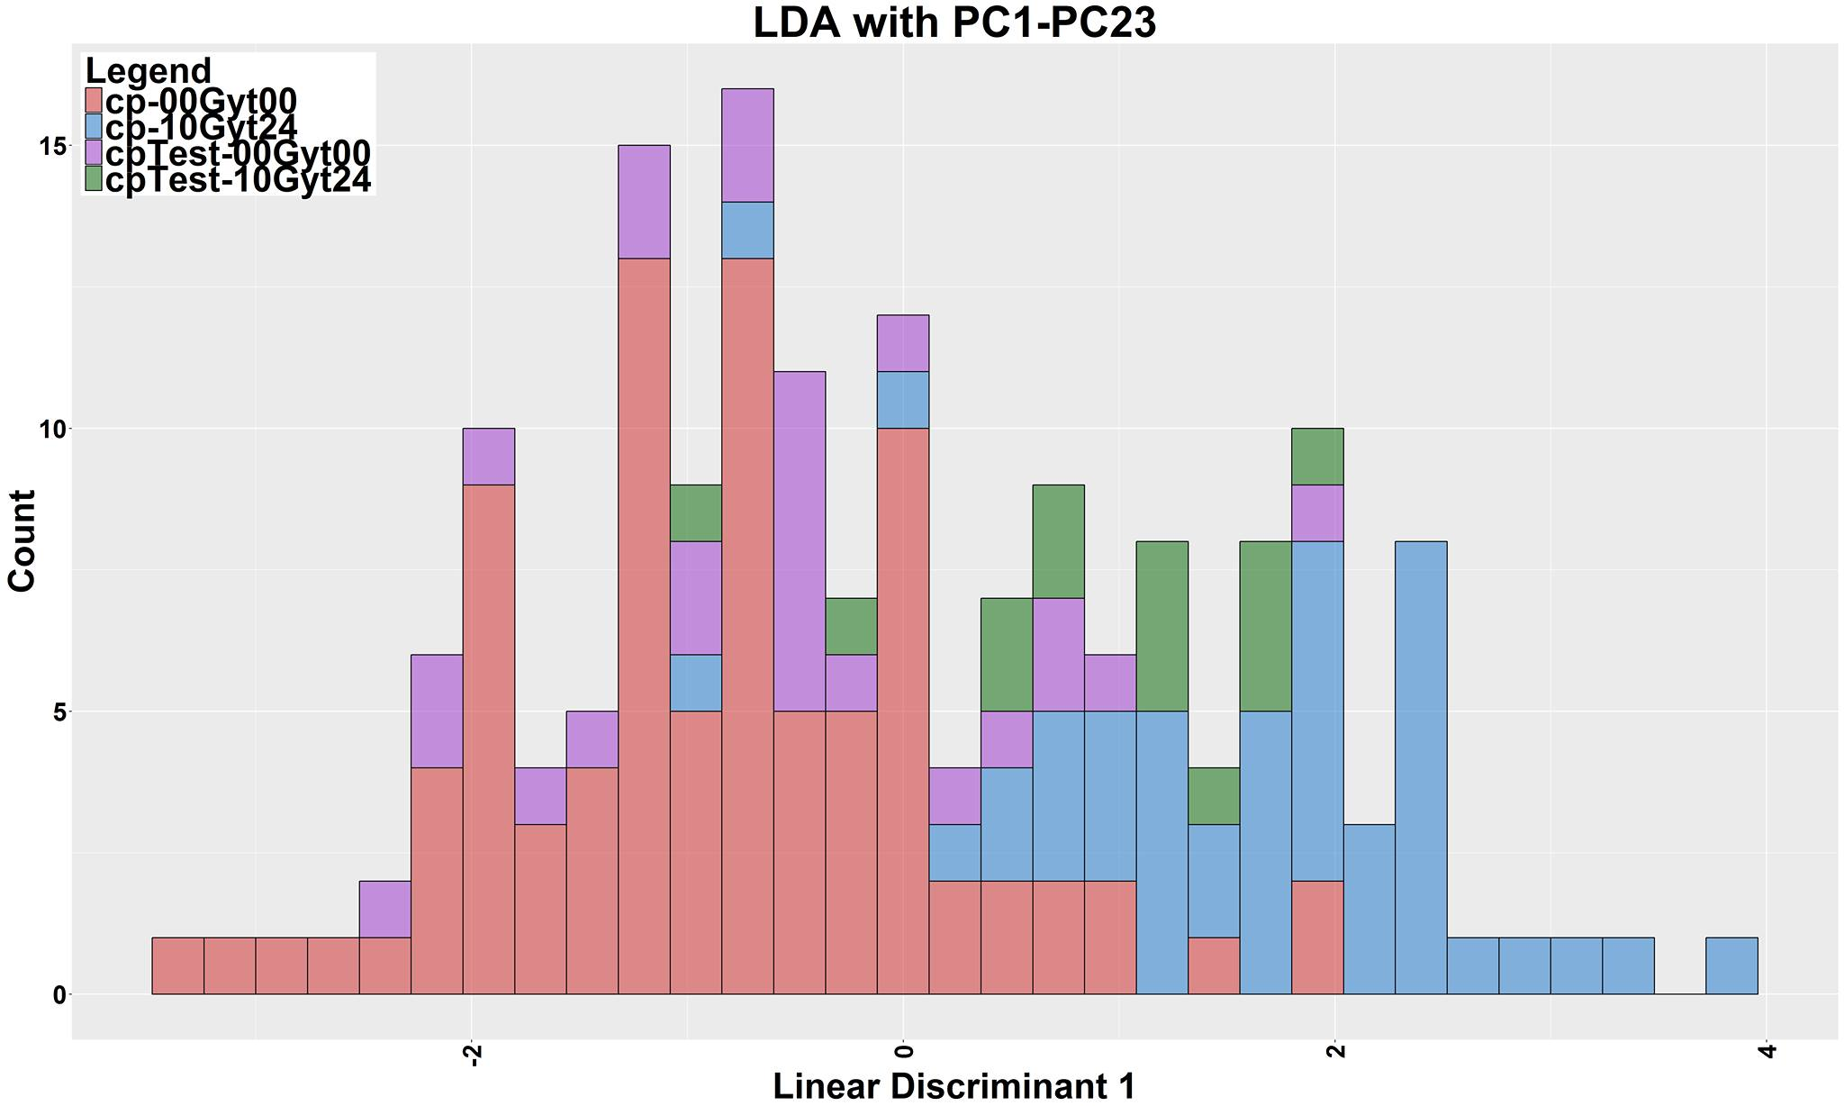
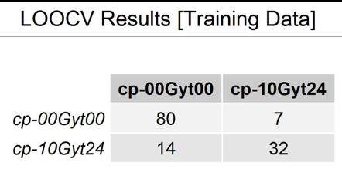
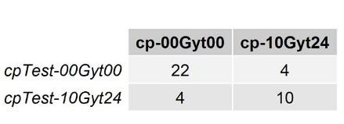
Results
(95% Variance)
A2780 CP(0 Vs10 Gy)
CPCell Resistive cell type, 0Gy
CPCell Resistive cell type,10 Gy
Test Cells actual CP 10Gy
Test Cells actual CP 0Gy
LDA stacked histogram showing clear separation between “0 Gy” and “10 Gy” types for CP with classification of test set

Slide 19
Conclusion
Raman micro-spectroscopy is a highly specific, non-invasive, label free technique that can:
  Discriminate between the sensitive and resistive cells
  Discriminate between un-irradiated from irradiated
  Can potentially be applied for prospective assessment of tumor chemo sensitivity in ovarian cancer patients
Notes:
In conclusion Raman micro-spectroscopy is a highly specific, non-invasive, label free technique when combined with multivariate chemometrics analysis can

Slide 20
Future Work
Optimize Classification Techniques
  Build robust training model
Identifying chemical differences between S & CP
Response to Radiation
  Analyze data for step up dose(2, 4, 6, 8,10) Gy
  Identify biochemical differences & mechanisms of radiation resistance or sensitivity
  Apply RMS to characterize response to RT for other types of cancer
Clinical Translation
  Develop portable probe for real time cancer detection and assessment of treatment response
Notes:
Future will include optimize our classification technique by investigating different methods available for classification
we have collected data for irritated cells too which is work in progress
Improvement of RT treatment outcome

Slide 21



Acknowledgements
Dr. Sangeeta Murugkar (Supervisor)
Abrar Ahmad
Nima Sherafati
Dean Sheperdson
Christopher Dedek
Harry Allen
Dr. Gosia Niedbala
Dr. Balazs Nyiri
Dr. Libni Eapen
Dr. Barbara Vanderhyden
Nhung Vuong
Dr. Vinita Chauhan
Dr. Ruth Wilkins
Dr. Sami Qutob

Slide 22
Extra Slides

Slide 23
Sample preparation
A2780s and A2780cp cells were cultured in Dulbecco’s Modified Eagle Medium with 10% fetal bovine serum and incubated at 37°C and 5% CO₂. Approximately 5x10⁵ cells of each subtype were seeded onto 4 separate quartz coverslips with two of each cell type. They were allowed to attach overnight in the incubator with a resulting confluency of ~60%. The medium was aspirated and a pair of coverslips with S- and CP-cells were washed with PBS and then fixed with 4% formalin for 10 min at room temperature. Raman spectra were collected from these fixed and unirradiated S- and CP-cells (0Gy) on the same day. The second pair of coverslips with S- and CP- cells were irradiated at room temperature with a 250-kVp x-ray unit at a dose rate of 142 cGy/min and allowed to stay in the incubator for 24h post irradiation. The cells were then fixed following the same procedure outlined above and analyzed by Raman micro-spectroscopy

Slide 24
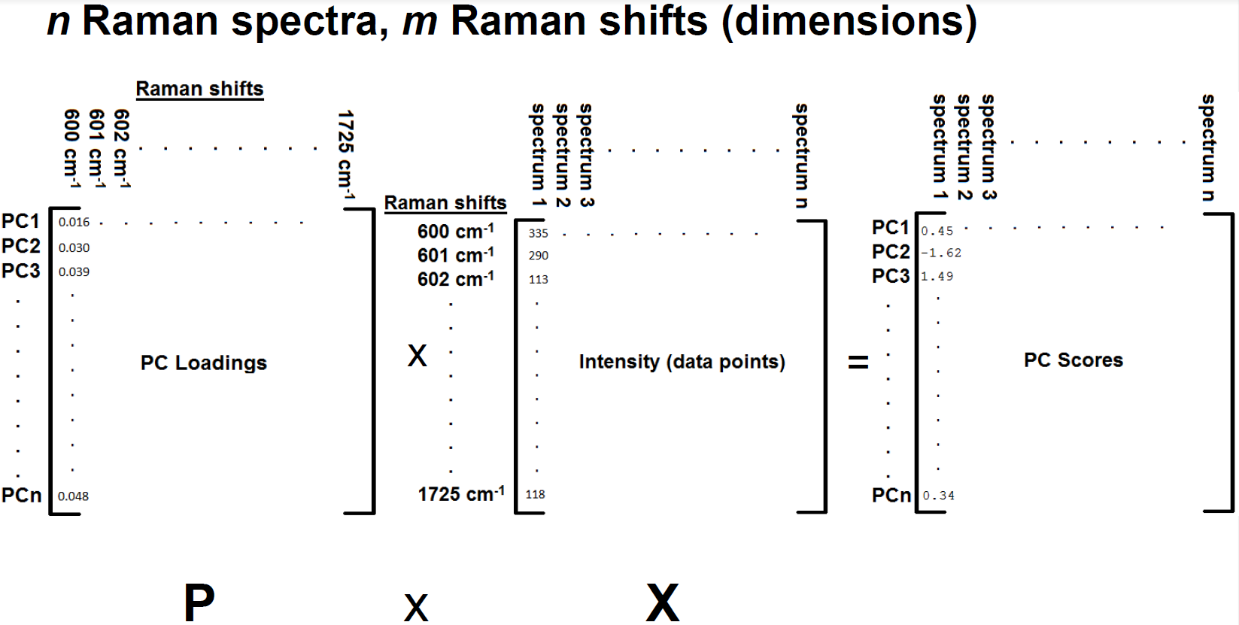
PC Scores

Slide 25
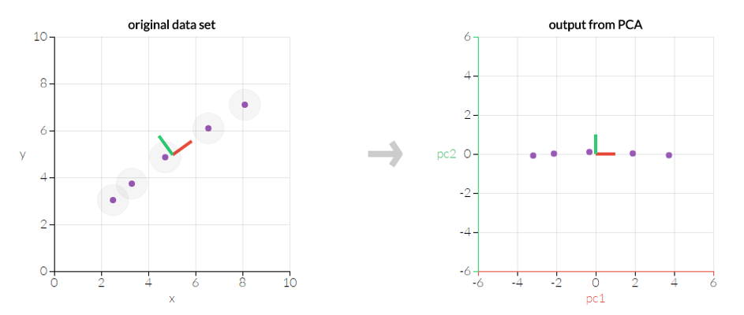
PCA on 2D Data Set
http://setosa.io/ev/principal-component-analysis/

Slide 26
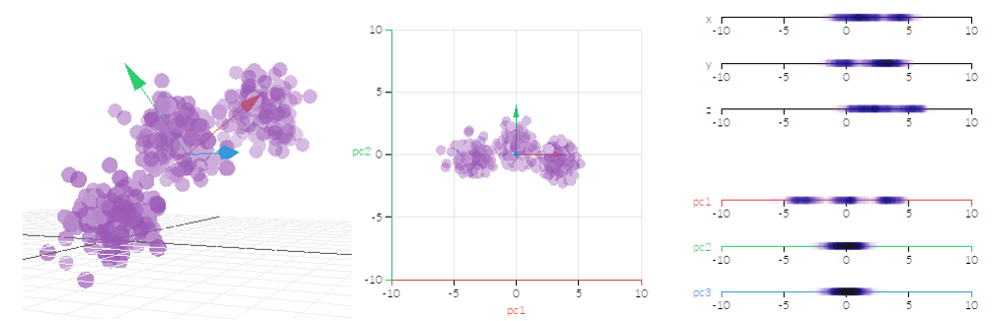
PCA on 3D Data Set

Slide 27
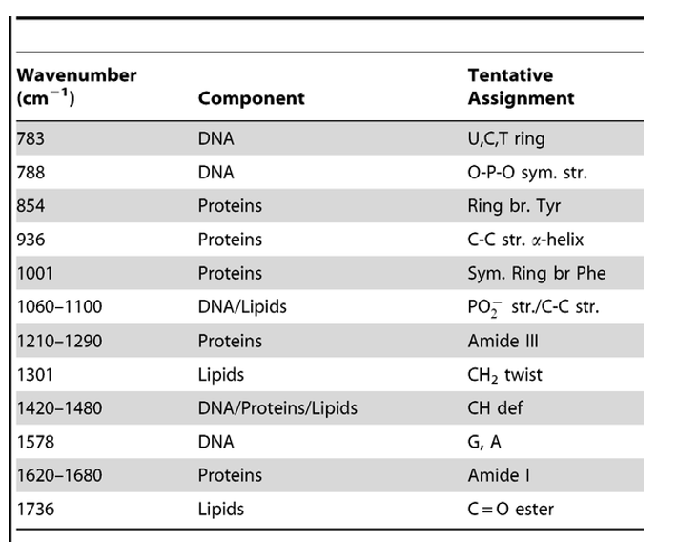
Molecular Assignments
Notes:
Assigning the chemical components to the peaks using available data

Slide 28
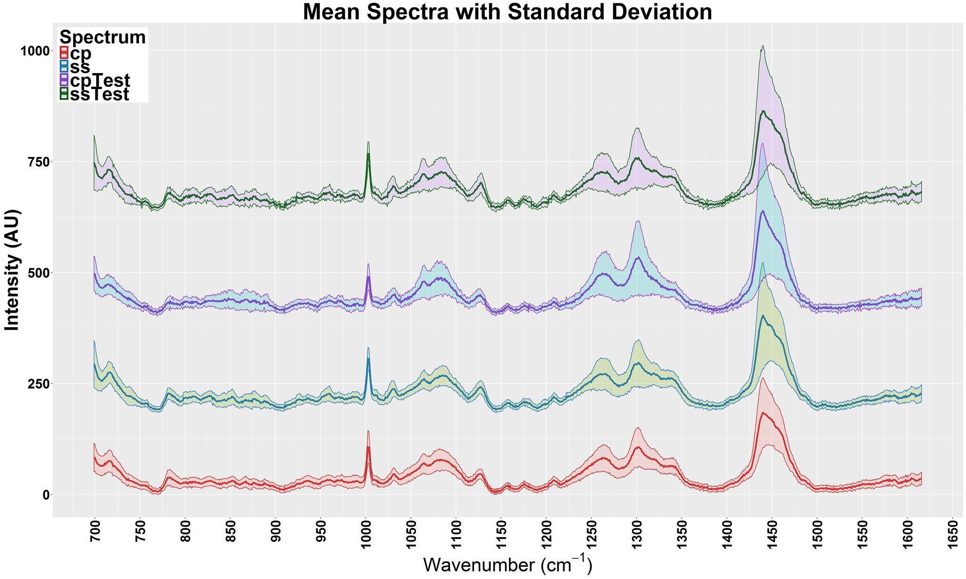
Results
DNA,
Lipids & Proteins
DNA,
Lipids
Proteins
Lipids
Proteins
DNA
S Test
CP Test
S
CP
Notes:
This figure shows the mean spectra of the two type of cells for our data. I have marked some of the prominent peaks and what they represents using available data.
We could see that its hard to visually identify the difference since the spectra are very similar. We have identified the chemical differences for just need to be confirmed by Dr Vanderhyden lab

Slide 29
Results
Molecular composition difference between A2780 S&CP(0Gy)
Wavenumber (cm-1) | Component | Tentative assignment
702
898
902
1072- | Nucleic acids (DNA) | PO2 str
1076 | Lipids | C-C str
1081 | Carbs | C-0
1348
1475

Slide 30
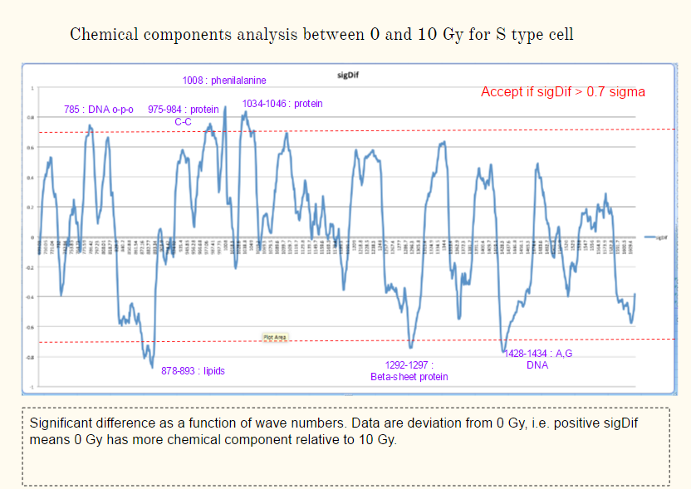
Results

