Slide 1


Terahertz Response of Monolayer
Graphene: Velocity Gauge Vs Length Gauge
P. Navaeipour, M. M. Dignam
Department of Physics, Engineering Physics and Astronomy, Queen’s University, Kingston ON K7L 3N6, Canada

Slide 2
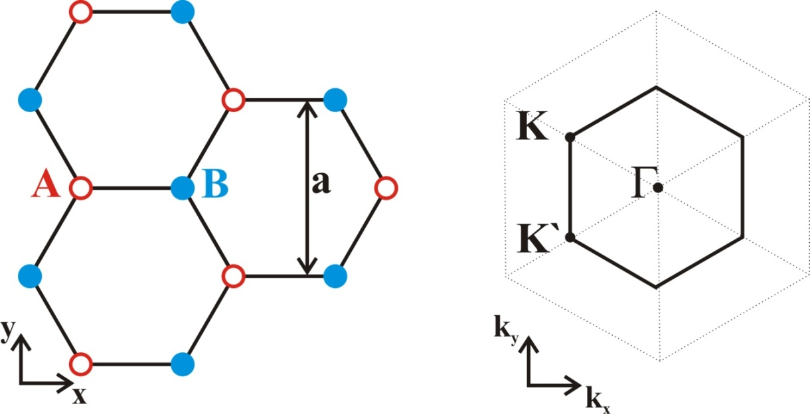
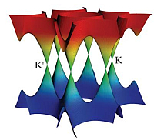
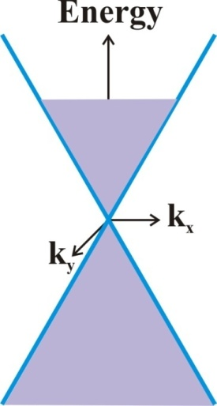
Basics of Graphene
...
ω
ω
3ω
5ω
S. A. Mikhailov, Europhysics Lett. 79, 27002 (2007)

Slide 3
Motivation & Outline
Find the best method to model the nonlinear response of Graphene
Velocity Gauge:
F.H.M. Faisal, arXiv, 1, 0810.07881 (2008)
A.R. Wright, Appl. Phys. 44, 083001 (2011)
Length Gauge:
C. Aversa and J. E. Sipe, Phys. Rev. B 52, 14636 (1995)
K. S. Virk and J. E. Sipe, Phys. Rev. B 76, 035213 (2007)
Response of Graphene to THz field by employing these two gauges

Slide 4
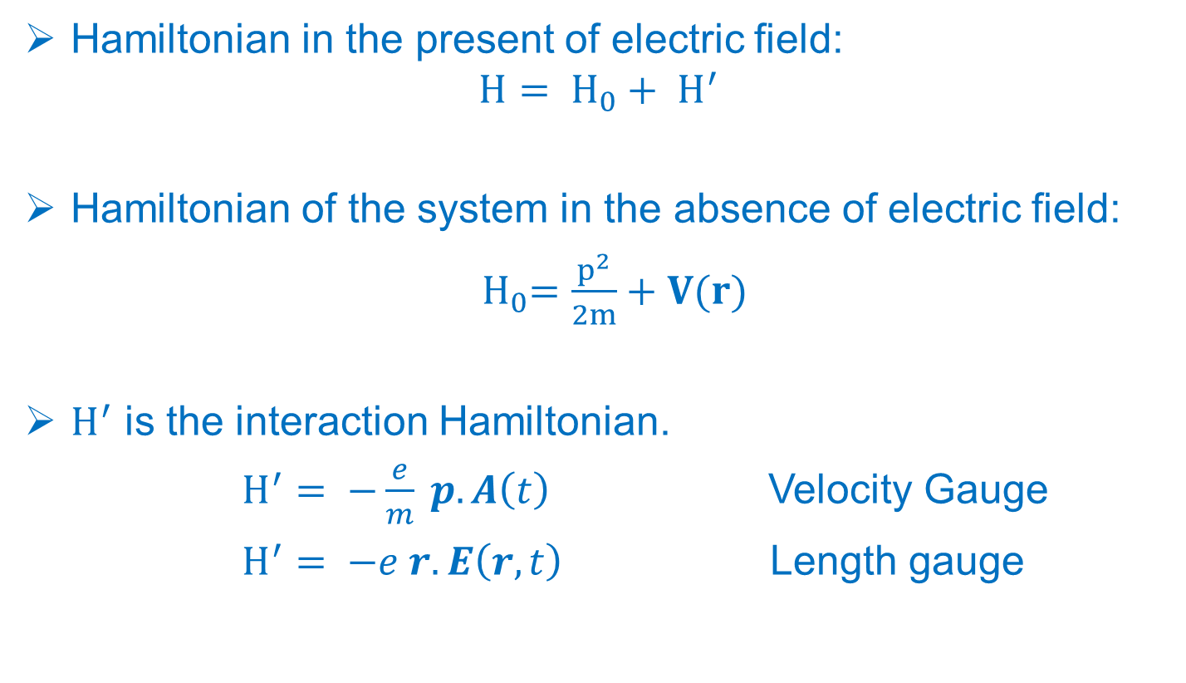
Velocity & Length Gauges
Hamiltonian in the present of electric field:
$$H= H_{0}+ H^{′}$$
Hamiltonian of the system in the absence of electric field:
${ H}_{0}=\frac{p^{2}}{2m}+V(r)$
$H^{′}$ is the interaction Hamiltonian.
$H^{′}= −\frac{e}{m} p. A\left(t\right)$ Velocity Gauge
$H^{′}= −e r. E\left(r,t\right)$ Length gauge
A. Chacona, J Computational Physics.1 ,1508 (2015)

Slide 5
Gauge Choice
Velocity
Length
vs.
Quantum mechanics is gauge invariant and both gauges should give, in principle, identical results
Convergence of dynamic equations using the velocity gauge requires a large number of bands
Divergences at zero frequency arise using the velocity gauge in the nonlinear response
The divergence can be removed by developing sum rules, which become extremely complicated at high-order in the field
C. Aversa and J. E. Sipe, Phys. Rev. B 52, 14636 (1995)
K. S. Virk and J. E. Sipe, Phys. Rev. B 76, 035213 (2007)

Slide 6
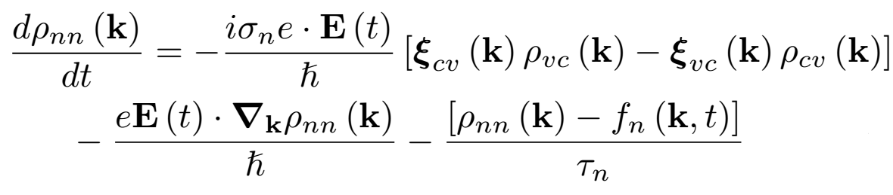
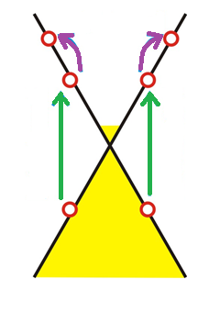
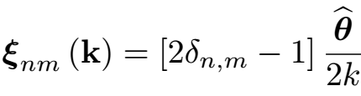
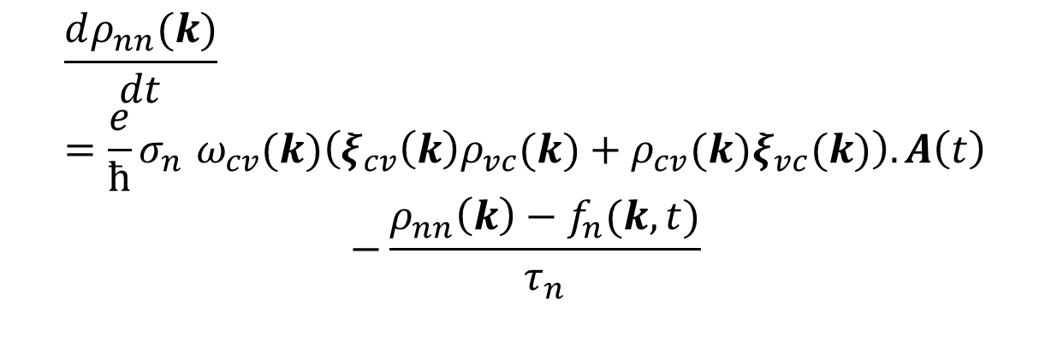

Populations Dynamic Equations
Length Gauge:
Intraband
Velocity Gauge:
$$\frac{dρ_{nn}(k)}{dt} =\frac{e}{ћ}{σ_{n} ω}_{cv}(k)\left(ξ_{cv}{\left(k\right)ρ}_{vc}(k)+ρ_{cv}(k)ξ_{vc}(k)\right).A\left(t\right)$$
$$−\frac{ρ_{nn}\left(k\right)−f_{n}(k,t)}{τ_{n}}$$
Interband
Interband
$$A=−\frac{iE}{ω}$$
I. Al-Naib et al., Phys. Rev. B 90, 245423, 2014

Slide 7
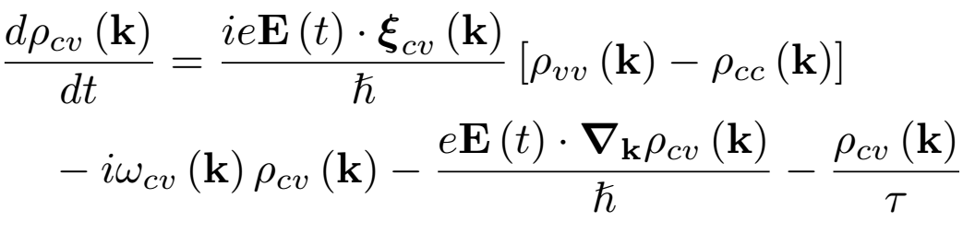
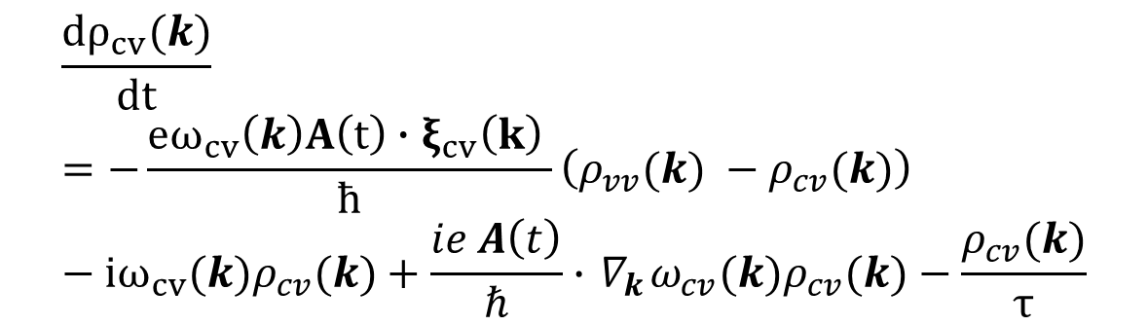
Coherences Dynamic Equations
Length Gauge:
Intraband
Velocity Gauge:
Interband
Interband
$$\frac{dρ_{cv}(k)}{dt}=−\frac{eω_{cv}\left(k\right)A\left(t\right)∙ξ_{cv}\left(k\right) }{ћ}\left(ρ_{vv}(k) −ρ_{cv}(k)\right)−iω_{cv}{(k)ρ}_{cv}(k)+\frac{ie A\left(t\right)}{ℏ}∙{ ∇}_{k}ω_{cv}(k)ρ_{cv}(k)−\frac{ρ_{cv}(k)}{τ}$$
I. Al-Naib et al., Phys. Rev. B 90, 245423, 2014

Slide 8
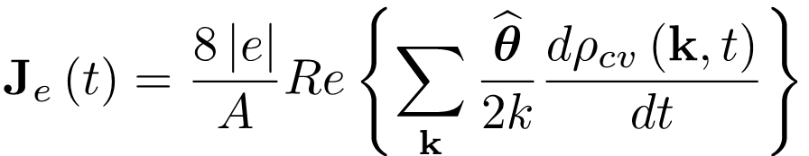
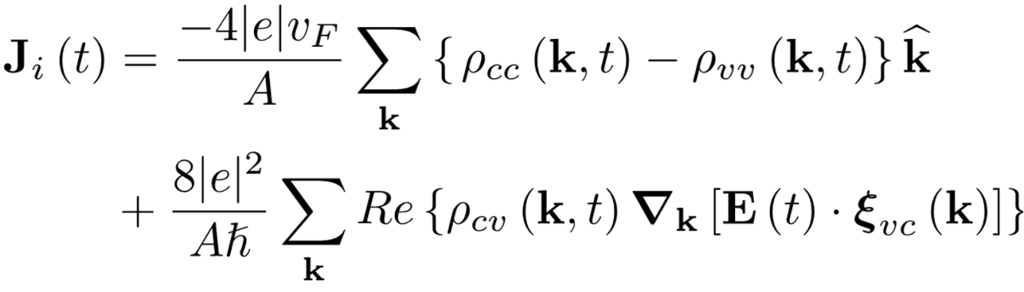
Current Density in Length Gauge
Interband Current:
Intraband
Interband
Interband
Intraband Current:
I. Al-Naib et al., Phys. Rev. B 90, 245423, 2014

Slide 9
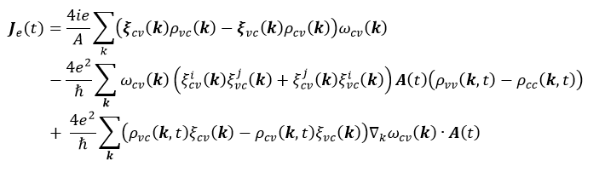
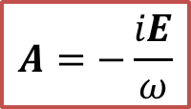
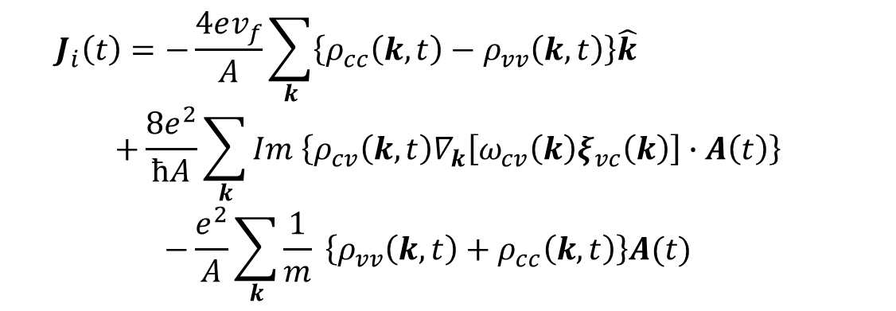
Current Density in Velocity Gauge
Interband Current:
Intraband Current:
$$A=−\frac{iE}{ω}$$
$${ J}_{i}\left(t\right)=−\frac{4ev_{f}}{A}\sum_{k}{\left\{ρ_{cc}\left(k,t\right)−ρ_{vv}\left(k,t\right)\right\}\hat{k}}$$
$$+\frac{8e^{2}}{ћA}\sum_{k}{Im \left\{ρ_{cv}\left(k,t\right)∇_{k}\left[ω_{cv}\left(k\right)ξ_{vc}\left(k\right)\right]∙A\left(t\right)\right\}}$$
$$−\frac{e^{2}}{A}\sum_{k}{\frac{1}{m}} \left\{ρ_{vv}\left(k,t\right)+ρ_{cc}\left(k,t\right)\right\}A(t)$$

Slide 10
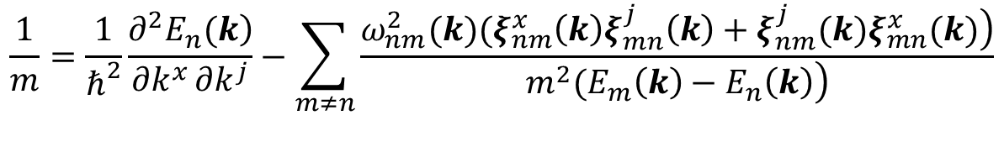
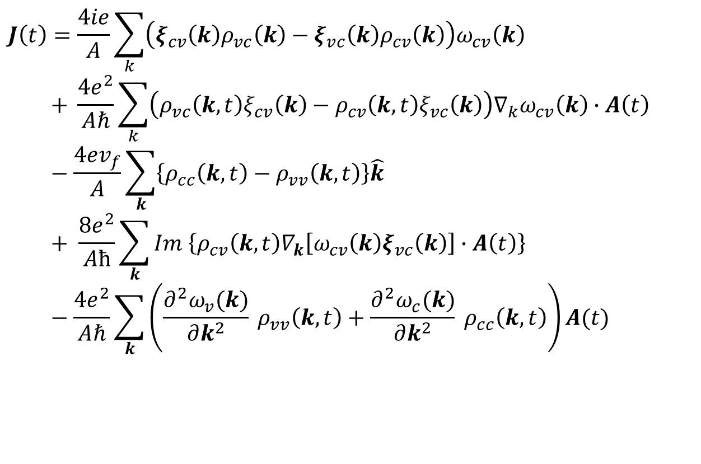
Current Density
Effective Mass Sum Rule:
$$\frac{1}{m}=\frac{1}{ℏ^{2}}\frac{\left.∂^{2}E_{n}(k\right)}{∂k^{x}∂k^{j}}−\sum_{m≠n}{\frac{\left.{ω_{nm}^{2}(k)(ξ}_{nm}^{x}\left(k\right)ξ_{mn}^{j}\left(k\right)+ξ_{nm}^{j}(k)ξ_{mn}^{x}(k)\right)}{\left.m^{2}(E_{m}\left(k\right)−E_{n}\left(k\right)\right)}}$$
Total Current Density:
$$J\left(t\right)=\frac{4ie}{A}\sum_{k}{\left(ξ_{cv}\left(k\right)ρ_{vc}\left(k\right)−ξ_{vc}\left(k\right)ρ_{cv}\left(k\right)\right)ω_{cv}\left(k\right)}$$
$$+ \frac{4e^{2}}{Aℏ}\sum_{k}{\left(ρ_{vc}\left(k,t\right)ξ_{cv}\left(k\right)−ρ_{cv}\left(k,t\right)ξ_{vc}\left(k\right)\right)∇_{k}ω_{cv}\left(k\right)∙A\left(t\right)}−\frac{4ev_{f}}{A}\sum_{k}{\left\{ρ_{cc}\left(k,t\right)−ρ_{vv}\left(k,t\right)\right\}\hat{k}} + \frac{8e^{2}}{Aћ}\sum_{k}{Im \left\{ρ_{cv}\left(k,t\right)∇_{k}\left[ω_{cv}\left(k\right)ξ_{vc}\left(k\right)\right]∙A\left(t\right)\right\}}−\frac{4e^{2}}{Aℏ}\sum_{k}{\left(\frac{∂^{2}ω_{v}(k)}{∂k^{2}} ρ_{vv}\left(k,t\right)+\frac{∂^{2}ω_{c}(k)}{∂k^{2}} ρ_{cc}\left(k,t\right)\right)A(t)}$$
J. Callaway, Academic Press, Second edition, (1974)

Slide 11
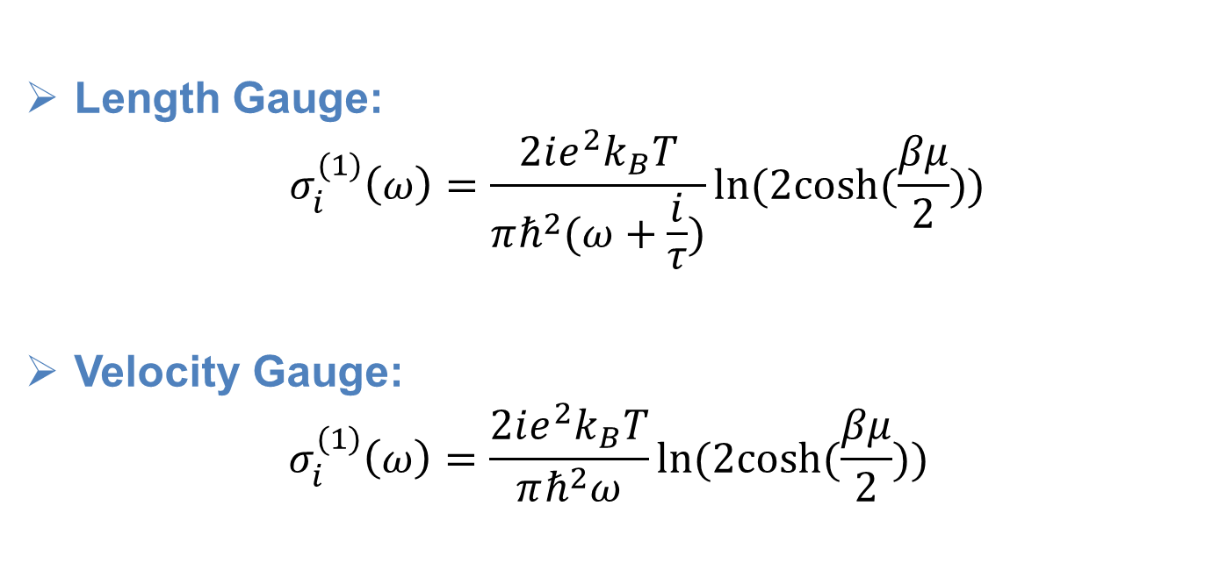
First order Intraband Conductivity
Length Gauge:
$${ σ}_{i}^{(1)}\left(ω\right)=\frac{2ie^{2}k_{B}T}{πℏ^{2}(ω+\frac{i}{τ})}ln⁡(2cosh⁡(\frac{βμ}{2}))$$
Velocity Gauge:
$$σ_{i}^{(1)}\left(ω\right)=\frac{2ie^{2}k_{B}T}{πℏ^{2}ω}ln⁡(2cosh⁡(\frac{βμ}{2}))$$
I. Al-Naib et al., Phys. Rev. B 90, 245423, 2014

Slide 12
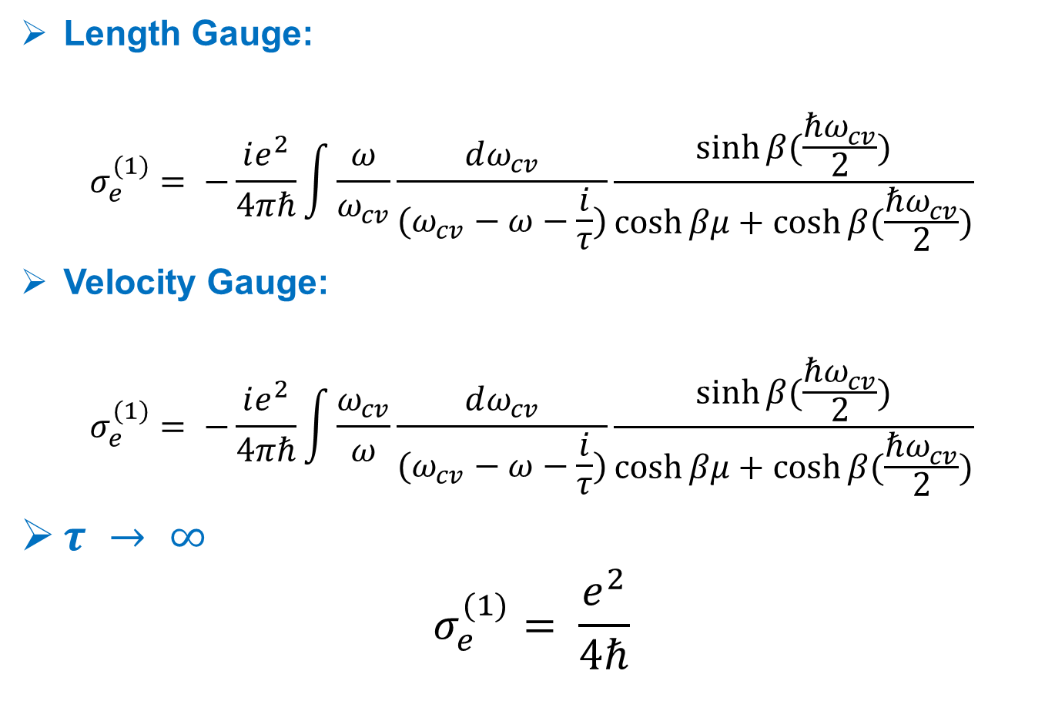
First Order Interband Conductivity
Length Gauge:
$$σ_{e}^{(1)}= −\frac{ie^{2}}{4πℏ}\int{\frac{ω}{ω_{cv}}\frac{dω_{cv}}{(ω_{cv}−ω−\frac{i}{τ})}}\frac{sinh⁡β(\frac{ℏω_{cv}}{2})}{\cosh{βμ+\cosh{β(\frac{ℏω_{cv}}{2})}}}$$
Velocity Gauge:
$$σ_{e}^{(1)}= −\frac{ie^{2}}{4πℏ}\int{\frac{ω_{cv}}{ω}\frac{dω_{cv}}{(ω_{cv}−ω−\frac{i}{τ})}}\frac{sinh⁡β(\frac{ℏω_{cv}}{2})}{\cosh{βμ+\cosh{β(\frac{ℏω_{cv}}{2})}}}$$
$τ → ∞$
$$σ_{e}^{(1)}= \frac{e^{2}}{4ℏ}$$

Slide 13
Summary
If one uses the mass sum rule and neglects scattering, two gauges yield identical linear conductivities.
If we consider scattering term, even the linear interband conductivity is quite different in two gauges.
One should do calculations in the interaction picture when employing velocity gauge.
Nonlinear response can be quite different for the two approaches, due to the diverges arise at zero frequency in the velocity gauge when one uses a basis with a finite number of bands.
One should use the length gauge for graphene when calculating the nonlinear THz response.

Slide 14
Thank You!

Slide 15


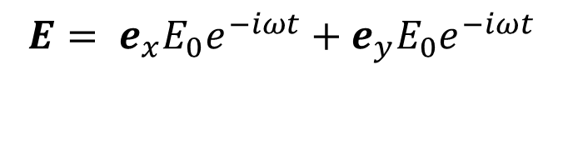
Current
$J\left(t\right)=e\int{\frac{d\vec{k}}{{(2π)}^{2}}V_{nm}(k)ρ_{nm}(k,t)}$
${ V}_{nm}\left(k\right)=v_{nm}\left(k\right)−e\frac{1}{m}δ_{nm}A\left(t\right)$
Last term in the intraband current:
$$\frac{4ie^{2}}{A}\sum_{k}{\frac{1}{mω}}\left\{ρ_{cc}\left(k,t\right)+ρ_{vv}\left(k,t\right)\right\}E(t)$$
$$E= e_{x}E_{0}e^{−iωt}+e_{y}E_{0}e^{−iωt}$$

Slide 16
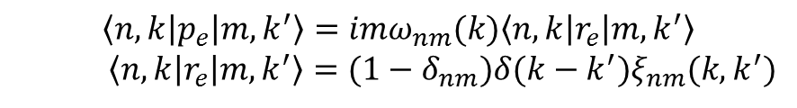

Mass Sum Rule
$\frac{1}{m}=\frac{1}{ℏ}\frac{∂^{2}E_{n}(k)}{∂k^{x}∂k^{j}}+\sum_{m≠n}{\frac{p_{nm}^{x}\left(k\right)p_{mn}^{j}\left(k\right)+p_{nm}^{j}(k)p_{mn}^{x}(k)}{m^{2}(E_{m}\left(k\right)−E_{n}\left(k\right))}}$
$$\left\langle n,k | p_{e} | m, k^{′}\right\rangle =imω_{nm}(k)\left\langle n,k | r_{e} | m,k^{′}\right\rangle$$
$\left\langle n,k | r_{e} | m,k^{′}\right\rangle =(1−δ_{nm})δ(k−k^{′})ξ_{nm}(k,k^{′})$

Slide 17
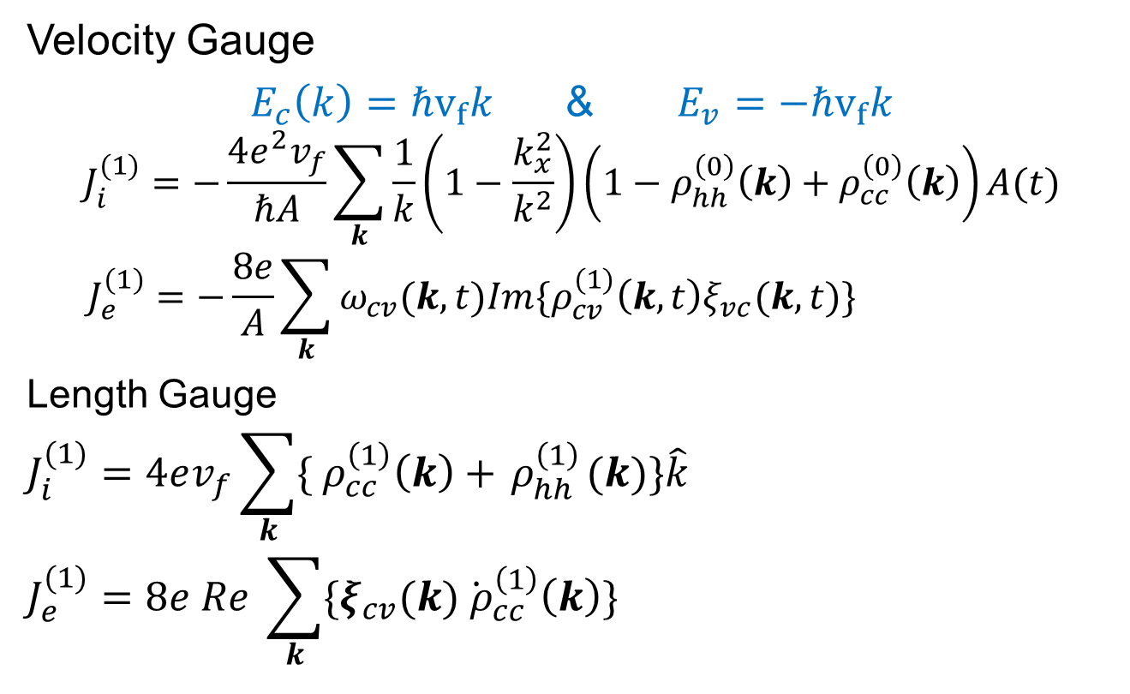
Linear Response
Velocity Gauge
$E_{c}\left(k\right)=ℏv_{f}k$ & $E_{v}=−ℏv_{f}k$
$$J_{i}^{(1)}=−\frac{4e^{2}v_{f}}{ℏA}\sum_{k}{\frac{1}{k}\left(1−\frac{k_{x}^{2}}{k^{2}}\right)\left(1−ρ_{hh}^{\left(0\right)}\left(k\right)+ρ_{cc}^{\left(0\right)}\left(k\right)\right)A(t)}$$
$$J_{e}^{(1)}=−\frac{8e}{A}\sum_{k}{ω_{cv}(k,t)Im\{ρ_{cv}^{(1)}\left(k,t\right)ξ_{vc}(k,t)\}}$$
Length Gauge
$$J_{i}^{(1)}=4ev_{f}\sum_{k}{\{{ ρ}_{cc}^{\left(1\right)}\left(k\right)+{ ρ}_{hh}^{\left(1\right)}(k)\}\hat{k}}$$
$$J_{e}^{(1)}=8e Re \sum_{k}{\{ξ_{cv}(k){\dot{ ρ}}_{cc}^{\left(1\right)}\left(k\right)\}}$$

Slide 18
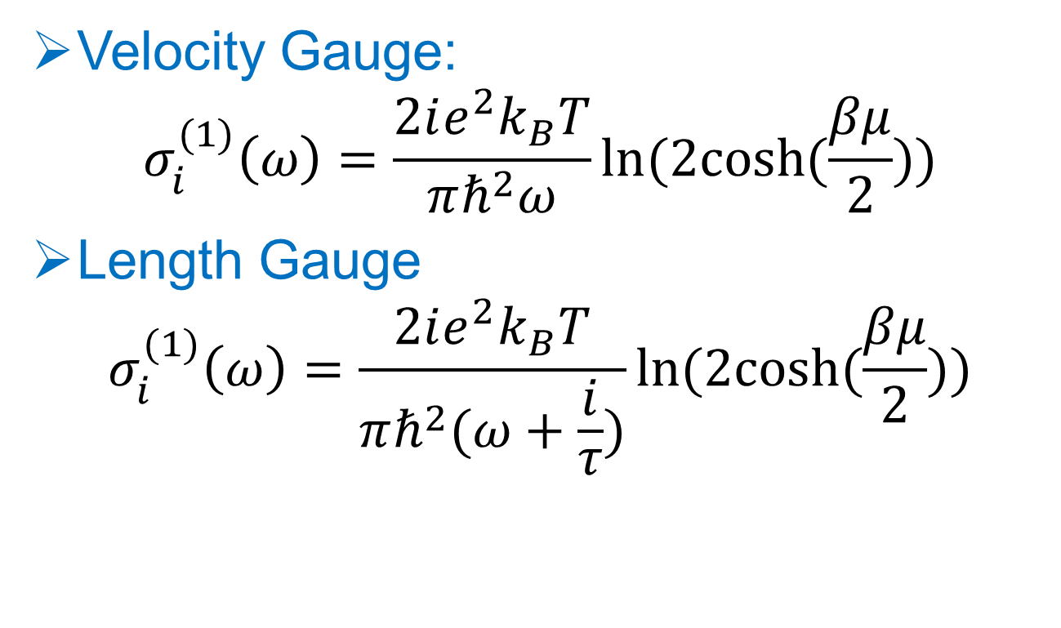

First order Intraband conductivity ($ω$)
Velocity Gauge:
$$σ_{i}^{(1)}\left(ω\right)=\frac{2ie^{2}k_{B}T}{πℏ^{2}ω}ln⁡(2cosh⁡(\frac{βμ}{2}))$$
Length Gauge
$$σ_{i}^{(1)}\left(ω\right)=\frac{2ie^{2}k_{B}T}{πℏ^{2}(ω+\frac{i}{τ})}ln⁡(2cosh⁡(\frac{βμ}{2}))$$

Slide 19
Outline
Motivation
Velocity gauge and Length Gauge
Comparing response of Graphene in Velocity gauge and Length gauge
Conclusion

Slide 20
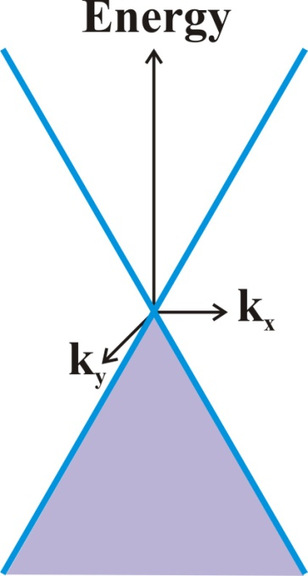
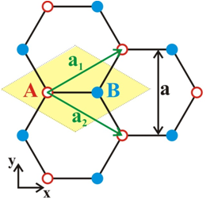
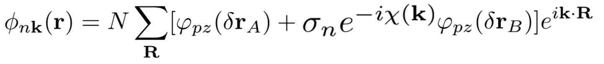




System Under Study
Graphene on a substrate
Fermi level at the Dirac point
Temperature of 30 K
Scattering time of 50 fs
Incident
field
Transmitted
field

Slide 21
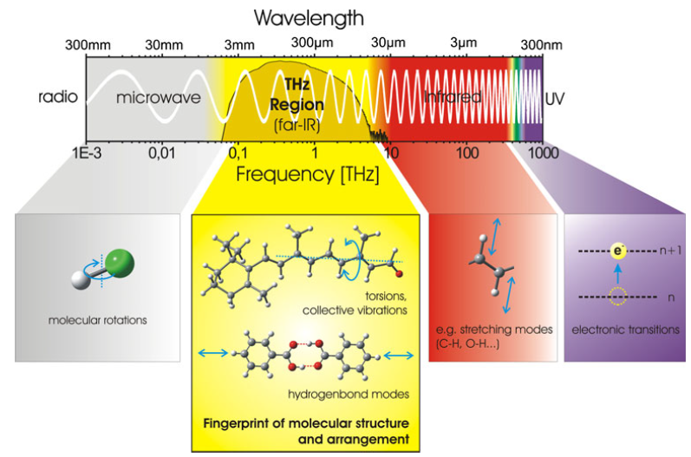
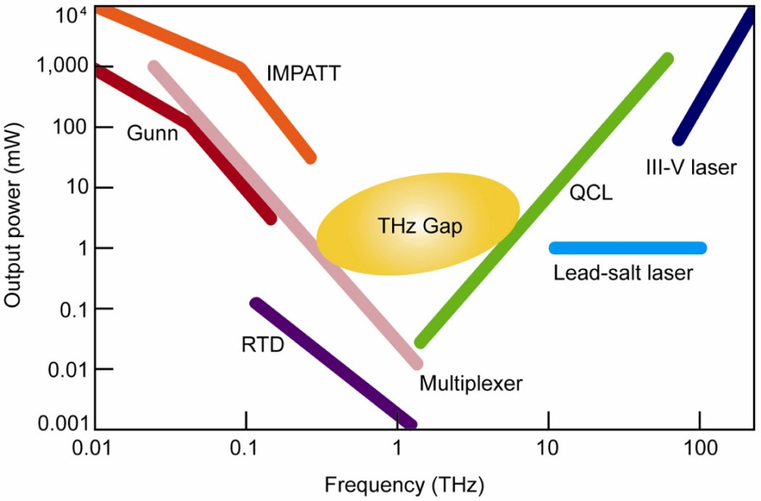
Introduction: THz Band
Moloney et al., DOI: 10.1117/2.1201102.003523
Numerous organic molecules exhibit strong absorption and dispersion due to rotational and vibrational transitions

Slide 22
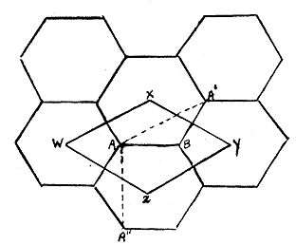
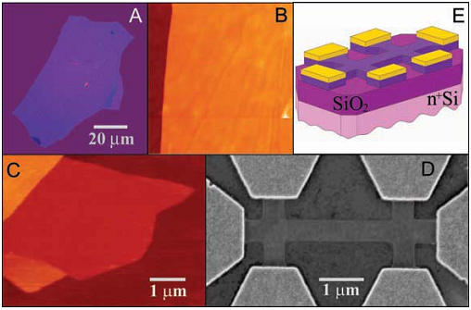
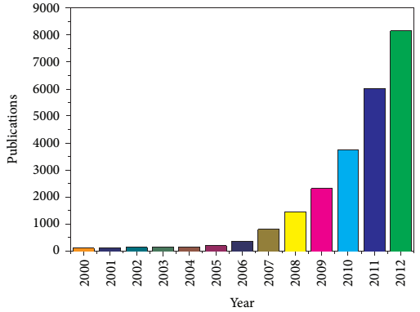
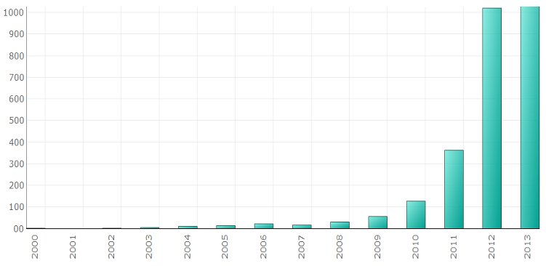
Introduction: Graphene
P. R. Wallace, Physical Review 71, 622 (1947)
K. S. Novoselov et al., Science 306, 666 (2004)
Publication trend
Patents trend
V. Dhand et al., J. of Nanomaterials 763953 (2013)
Technology Insight Report: Graphene (2013)

Slide 23
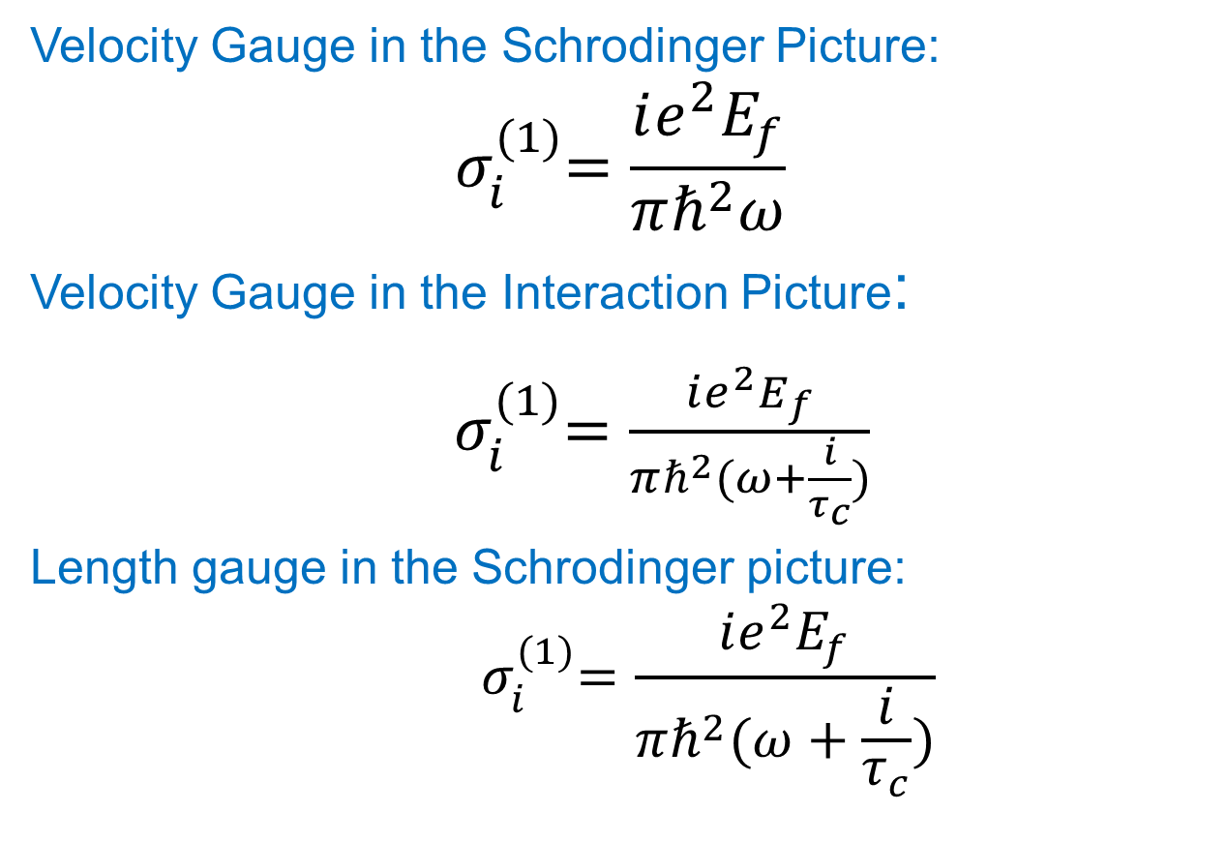
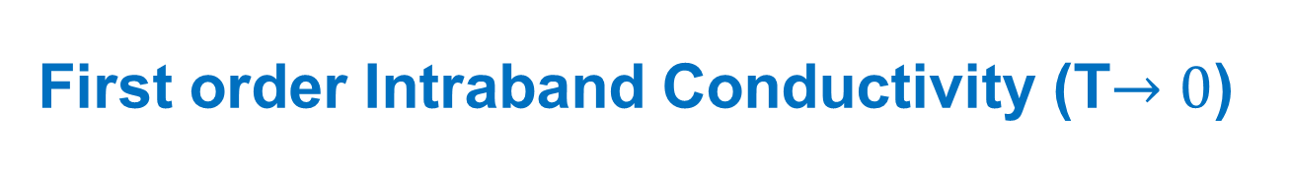
First order Intraband Conductivity (T$→0$)
Velocity Gauge in the Schrodinger Picture:
$${ σ}_{i}^{(1)}=\frac{ie^{2}E_{f}}{πℏ^{2}ω}$$
Velocity Gauge in the Interaction Picture:
${ σ}_{i}^{(1)}=\frac{ie^{2}E_{f}}{πℏ^{2}(ω+\frac{i}{τ_{c}})}$
Length gauge in the Schrodinger picture:
$${ σ}_{i}^{(1)}=\frac{ie^{2}E_{f}}{πℏ^{2}(ω+\frac{i}{τ_{c}})}$$
I. Al-Naib et al., Phys. Rev. B 90, 245423, 2014

