Slide 1


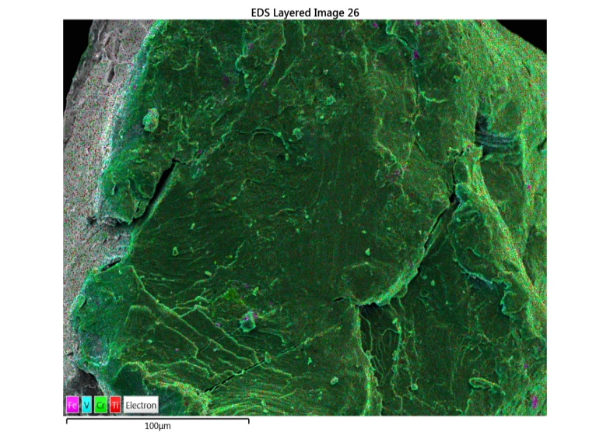
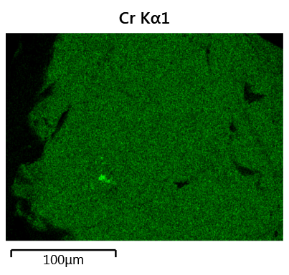
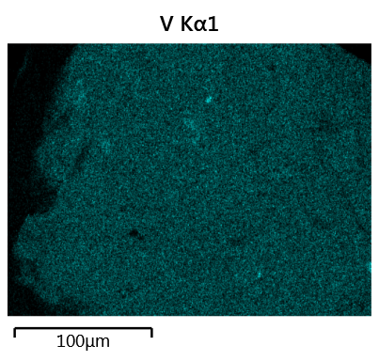
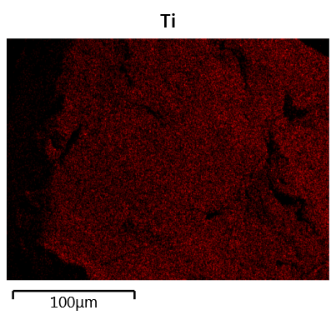
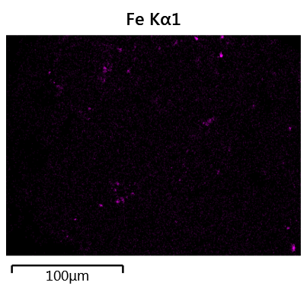
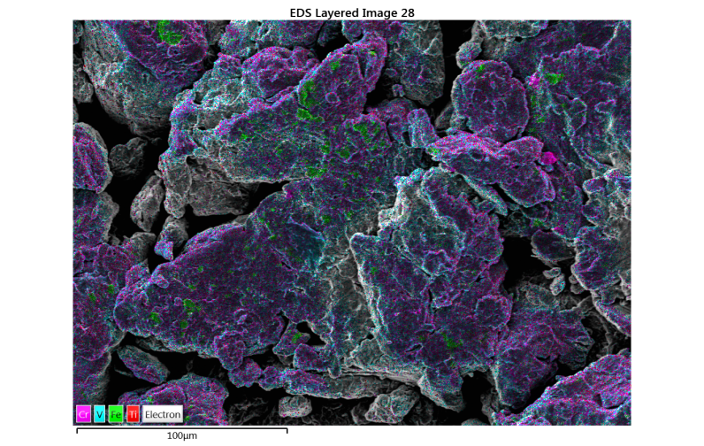
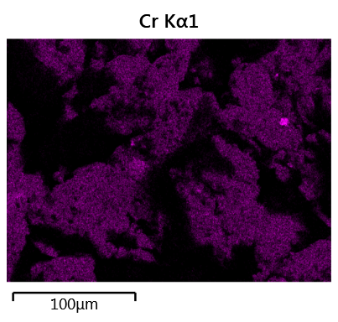
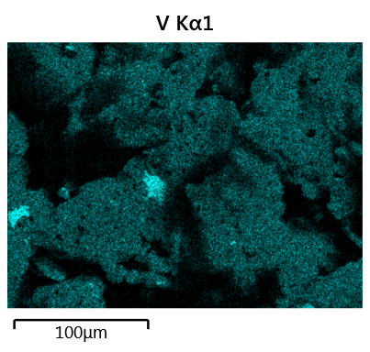
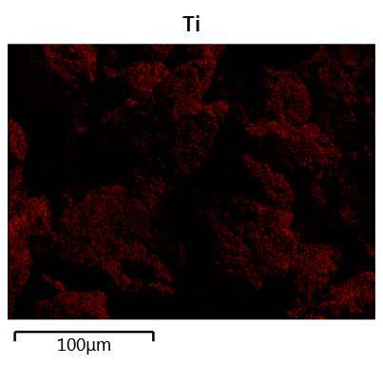
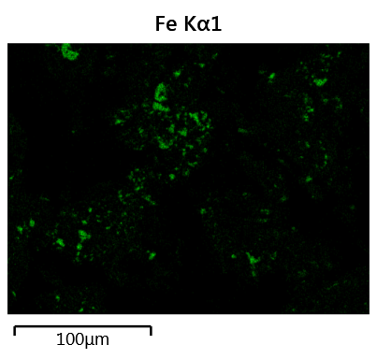
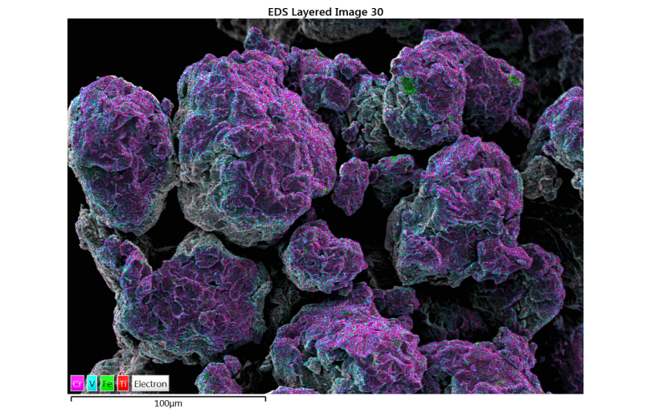
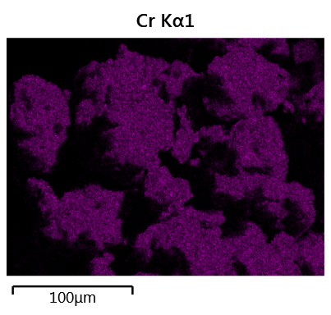
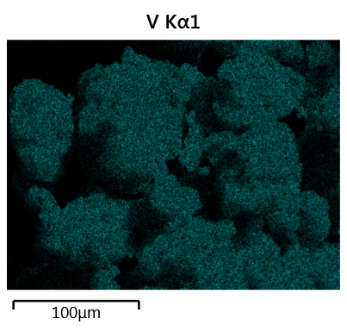
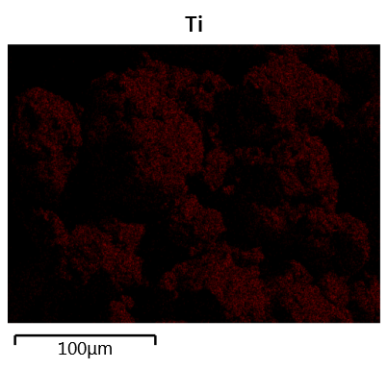
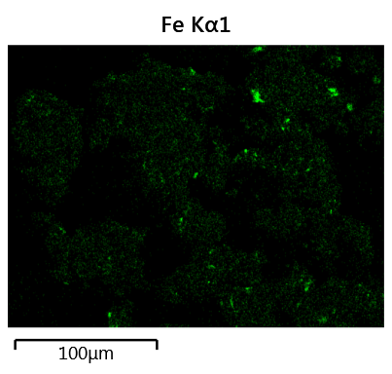
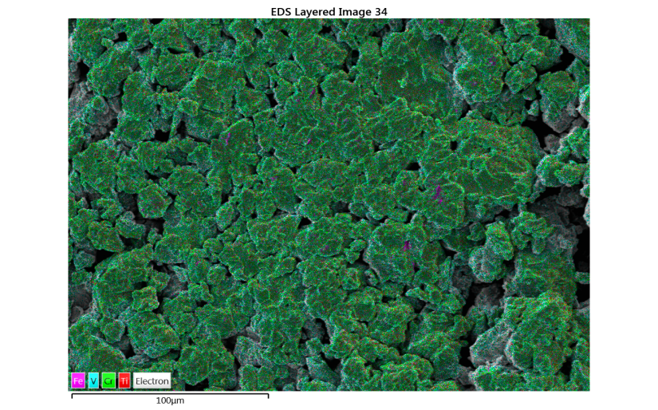
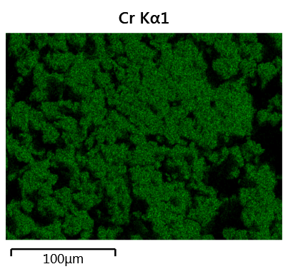
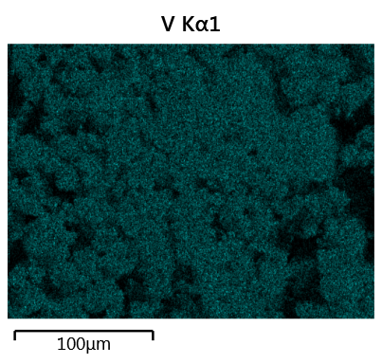
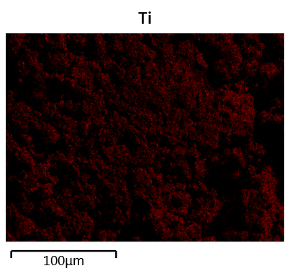
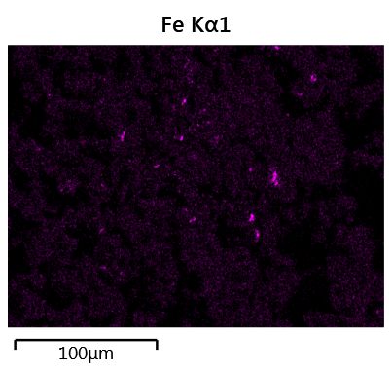
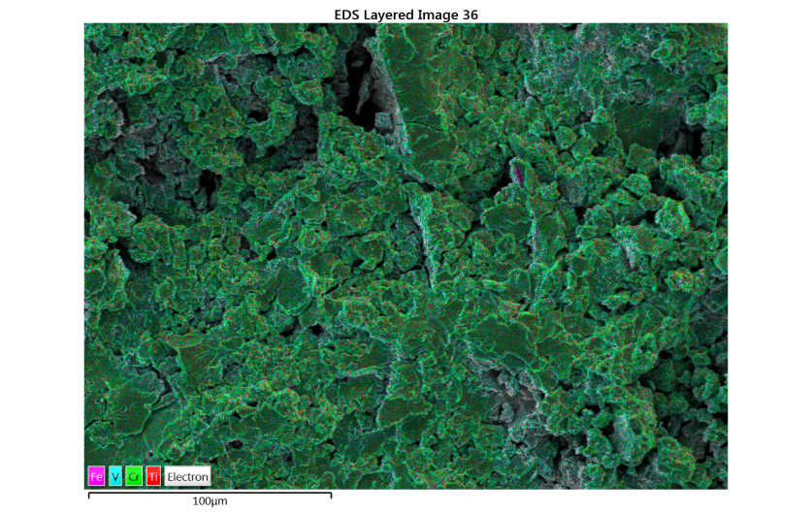
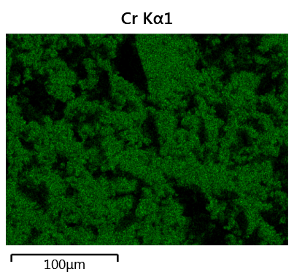
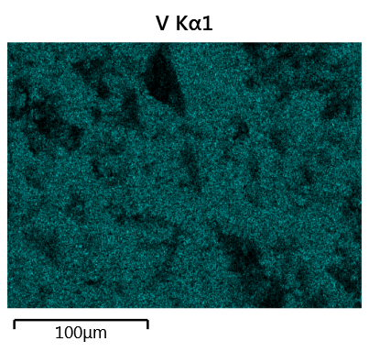
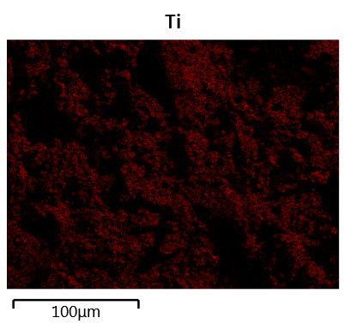
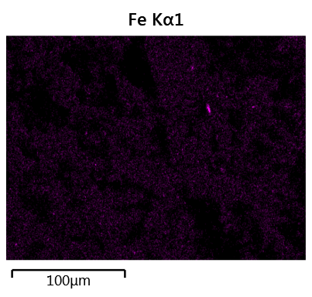



Investigation of effect of ball milling on hydrogen storage properties of 52Ti-12V-36Cr.
Amol KAMBLE ^{1,2,3}, Jacques HUOT ¹, Pratibha SHARMA ²
¹Université du Québec à Trois-Rivières – Institut de Recherche sur l’hydrogène - 3351, boul. des Forges, C.P. 500, Trois-Rivières (Québec) G9A 5H7
²Indian Institute of Technology-Bombay, Department of Energy Science & Engineering, Powai, Mumbai, Maharashtra, India 400076.
ABSTRACT
RESULTS
Structure
A Body-Centered Cubic (BCC) solid solution of composition 52Ti-12V-36Cr was synthesized by arc melting and thereafter ball milled for different milling time. The microstructure of the as-cast and ball milled samples were investigated by Scanning Electron Microscopy and Energy Dispersive Spectroscopy. Hydrogen sorption properties were investigated and we found that ball milling do not improves the first hydrogenation.
Microstructure
Reitveld refinement of ball milled 52Ti-12V-36Cr alloy.
Sample | Lattice parameter (Å) | Crystallite size (nm) | Microstrain (%)
As-cast | 3.1057(5) | 20.7(7) | --
BM 15 | 3.109(1) | 11.5(5) | 1.01(6)
BM 30 | 3.111(1) | 9.1(4) | 0.90(9)
BM 60 | 3.110(2) | 8.6(5) | 1.1(1)
BM120 | 3.110(2) | 6.8(3) | 0.1(4)
BM 300 | 3.091(3) | 4.8(1) | --
BM 600 | 3.098(3) | 4.9(1) | --
BM 1200 | 3.076(2) | 5.0(1) | --
As cast
Cr
V
Ti
Fe
INTRODUCTION
BM-15 min
Ti-V BCC solid solutions are well known metal hydrides. These alloys could absorb hydrogen at room temperature and they have a relatively high reversible hydrogen capacities (>2.5%), which is suitable for utilization in Nickel-Metal Hydride batteries. However, the first hydrogenation is usually a slow process that involves high temperature and elevated hydrogen pressure^{[2]}.
It is well known that ball milling is an effective way to reduce particle and crystallite size as well as creating defects in the material^{[1]}. In metal hydride alloys, these modifications usually result in an enhancement of hydrogen absorption/desorption kinetics..
BM-120 min
X-Ray diffraction patterns of
Ball milled 52Ti-12V-36Cr
All samples present the BCC structure which means that milling do not change the crystal structure.
Peak broadening indicates a reduction of crystallite size with milling time.
BM-600 min
First hydrogenation
OBJECTIVE
BM-1200 min
Even after 20 hours of milling, first hydrogenation was not facilitated.
Theoretical capacity of of 52Ti-12V-36Cr is 3.89 wt.%.
We are now in the process of investigating the effect of heat treatment on first hydrogenation properties.
Characterize the influence of ball milling on the microstructure and hydrogen storage behavior of BCC solid solution alloys.
Microstructure and element distribution in 52Ti-12V-36Cr ball milled at various milling times.
METHODOLOGY
Elements are evenly distributed
Contamination by iron due to ball milling process
First hydrogenation at 25°C under 20 bar of hydrogen of 52Ti-12V-36Cr ball milled 20 Hrs.
Material Synthesis:
  All samples were synthesized by arc melting. Ball milling was performed on a high energy mill (Spex8000).
Element | Ti | V | Cr | Fe
As cast | 53.2 | 12 | 34.3 | 0.5
BM15 | 52.7 | 13.6 | 28.7 | 4.9
BM30 | 50.4 | 12.7 | 30.1 | 6.8
BM60 | 52.9 | 12.6 | 32.9 | 1.6
BM120 | 53.9 | 13.3 | 30.4 | 2.4
BM300 | 55 | 13.9 | 29 | 2
BM600 | 53.1 | 13 | 29.6 | 4.4
BM1200 | 53.8 | 13.1 | 29 | 4.1
CONCLUSION
Ball milling greatly reduces the crystallite size and increases the microstrain
There is no change of crystal structure upon milling
Ball milling do not seems to help the first hydrogenation of BCC solid solution 52Ti-12V-36Cr.
2. Crystal Structure & Micro-Structure:
Crystal structure was studied from X-ray powder diffraction. Lattice parameters, crystallite size and microstrains were determined from Rietveld refinement of X-ray diffraction patterns.
Microstructure and the composition of were determined by scanning electron microscopy (SEM) and energy disperssive spectroscopy (EDS)
REFERENCES
[1] Binod Kumar Singh, Gunchoo Shim,. Int. J. Hydrogen energy, 2007. 32: p. 4961-4965.
[2] T. Bibienne and J. Huot. Alloys & Compounds 2014, 607, 251-257
EDS Map sum specturm of each element present in ball milled 52Ti-12V-36Cr.
ACKNOWLEDGMENT
3. Hydrogenation:
  Hydrogen capacity of the samples was determined using a volumetric method.
A map sum spectrum of each element present in the ball milled 52Ti-12V-36Cr BCC solid solution, obtained by Energy dispersive spectroscopy (EDS). The iron contamination is very less and dispersed homogeneously showing single phase.
This Project is supported by the Queen Elizabeth II Diamond Jubilee Scholarship (Canada).
The authors want to thank Thomas Bibienne for his contribution and Mahatma Education Society’s Pillai HOC college of Engg. & Tech. Rasayani, Mahrashtra, India for their kind support.

