Slide 1
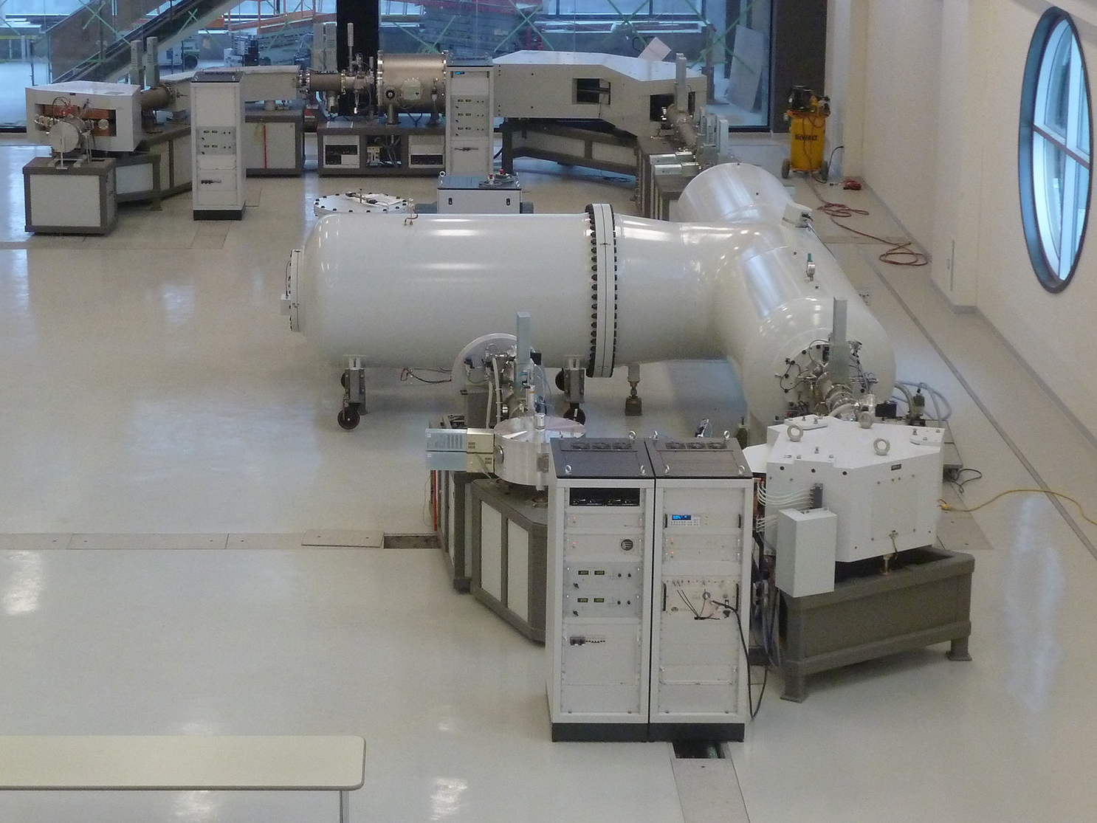
at the A. E. Lalonde Accelerator Mass Spectrometry Lab
The New Reserch Injector Line
Liam Kieser
André E. Lalonde AMS Laboratory and
Dept of Physics
University of Ottawa
W1-6 Instrumentation for the Detection of Low-Level Radioactiivity
CAP 2016 Congress June 15

Slide 2


Overview
Accelerator Mass Spectrometry (AMS) – some basic information
a) Advantages over conventional Mass Spectrometry
b) New applications made possible – (research using AMS)
Physics Research into AMS Itself
a) The generation of ions from the sample – materials, quantity & efficiency
b) Dealing with Isobars – especially atomic, but also molecular
c) Elimination of ME/q² and E/q ambiguities
The New Research Line
a) Principal components
b) Some general ion optics
The Isobar Separator for Anions (ISA)
a) General operating principles
b) Example: the isobars in ⁹⁰Sr analysis
c) The ion optics of deceleration
d) The new pre-commercial system
Summary

Slide 3
Mass Spectrometry – basic functions:
Liberate atoms from the sample and give them an electrical charge
Use electric and magnetic fields to manipulate and sort the ions
Count the ions as an electrical current or by measuring other effects on matter
Heavier Ions
Ion Source
Detector
Ions
Filter or Analyzer
Lighter Ions
Sample
Challenges:
Useful isotopes occur at very low concentrations (10⁻¹² to 10⁻¹⁶) in nature – need large ion currents, highly selective analyzers and very sensitive detectors
Atoms (or molecules) that have the same charge and mass as the analyte isotope – Isobars – are always much more abundant
Solution:
The accelerator provides the energy to destroy molecular isobars, to discriminate against some atomic isobars and for noise-free single atom counting.
Notes:
3

Slide 4
The Accelerator Mass Spectrometer – an overview
Negative ions produced from samples loaded in the Ion Source
Ions selected by mass and energy in the Low Energy Mass Spectrometer
Ions accelerated to high voltage (3 MV) electrode in accelerator
Ion charge changed to positive and molecules destroyed in argon filled canal
Positive ions and molecular fragments accelerated to higher energies
Analyte Ions sorted from fragments in the High Energy Mass Spectrometer
Analyte Ions counted and identified in the Faraday Cups and Gas Ionization Detector

Slide 5
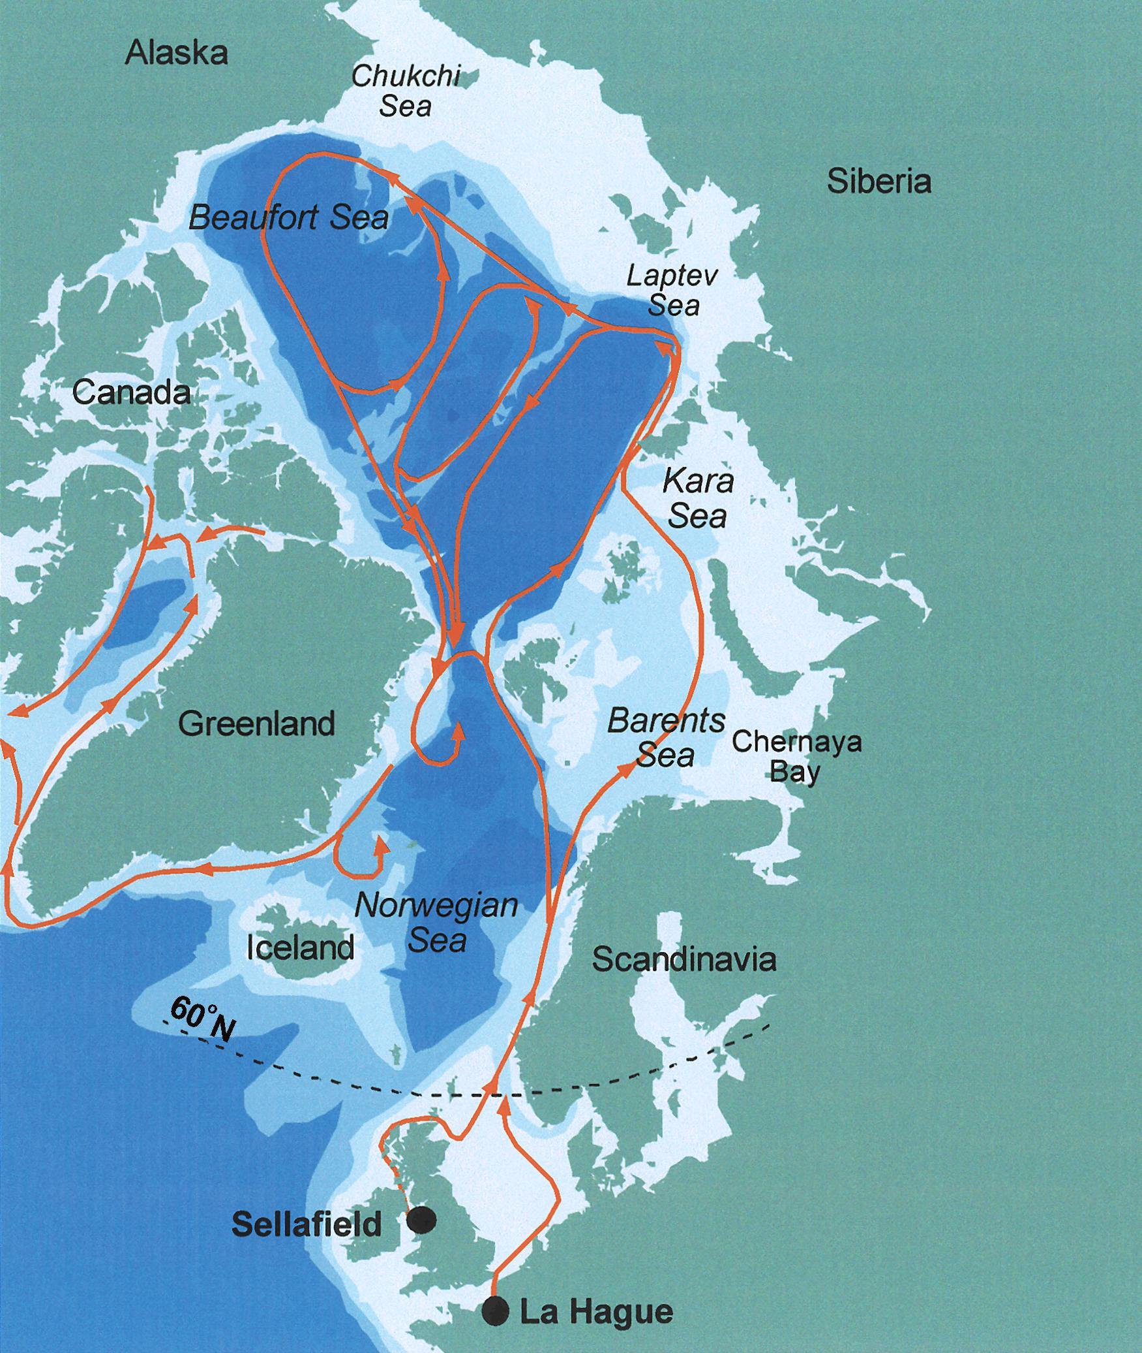
New Applications – Tracing examples:
a) Iodine-129 as a tracer of circulation patterns in the world’s oceans – using only 200 ml of sea water.
b) Tracking new pharmaceuticals through human metabolic processes – label compound with ¹⁴C, administer at extremely low dose levels (Microdosing).
c) Monitoring the flow and recharge rate of groundwater in aquifers with ³⁶Cl
d) Monitoring calcium metabolism in human bone using ⁴¹Ca (t_{1/2}=102 ka, EC decay)
Dating and timing examples:
a) Compound-specific ¹⁴C dating – more precise association with process to be dated
b) Forensic use of weapons test produced ¹⁴C – “bomb-pulse” dating
c) Use of ¹²⁹I (t_{1/2}=15.8 Ma) to time subduction processes on continental margins
Nuclear Industry examples:
a) Monitoring of Pu uptake by nuclear workers
b) Tracking the movement of illicit nuclear material: ^{235,236} U, ²³⁰⁻²⁴³Pu, ⁹⁰Sr, ^{135,137}Cs
c) Monitoring the industrial use of T using organically bound tritium (OBT)
Notes:
5

Slide 6
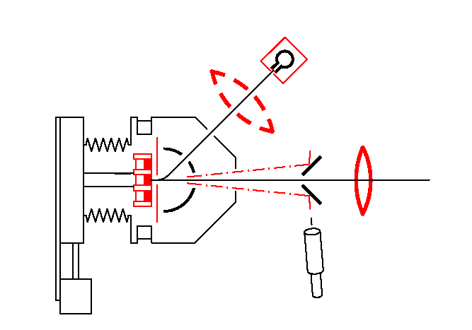
2. Research into AMS Technology:
a) Ion Source Development – need to :
Produce negative ions from a wide range of elements
Generate large ion currents (at least 10s of μA, 100s good if possible)
to obtain sufficient counting statistics for low concentration of rare species with a large ratio to abundant species
Maintain stable operation for a variety of sample matrices
Operate with a relatively low memory of previously analysed samples
Development of the negative ion caesium sputter source for nuclear physics work in the1970s made AMS possible
SIMS Design
High Current Design
Notes:
6

Slide 7
Ion Source Schematic – in cross section
~ -35 kV
Extraction Anode
Analyte
Ions
Cooling Channel
Sample
(Target, Cathode)
Spherical Ionizer ~1200°C
~ -28 kV
Caesium reservoir
0
10
20 mm
Caesium reservoir neater
Notes:
7

Slide 8
AMS Research – b) Isobaric Interferences:
Atomic Isobars:
Several isobars can be eliminated just by using negatitve ions:
¹⁴N for ¹⁴C analysis, ²⁶Mg for ²⁶Al analysis, ¹²⁹Xe for ¹²⁹I analysis
Others can be attenuated using higher energy and interacting with gases or foils:
e.g. ¹⁰B for ¹⁰Be analysis – requires higher energy for heavier masses
Molecular Isobars:
e.g. ¹²CH₂, ¹³CH, ⁷Li₂ for ¹⁴ C analysis – broken up in the accelerator HV terminal
New Approaches for Atomic (and Molecular) Isobars:
1. Retard ions from ion source energy (E > 35 keV) to eV scale energies
2(a) Either use gas-ion collisions to “chemically” remove the isobar (as in ICP-QQQ-MS) or
2(b) Use photon-ion interactions to selectively de-ionize the isobar
Process in 2(a) developed as the Isobar Separator for Anions (ISA)
Notes:
8

Slide 9
3. Second Injection Line – overall layout
Injector 1
(Supplied by HVE)
Injector 2
“Innovation Line”
120° High Resolution Injector Magnet
45° Magnet for off-line analysis
Pre-commercial Isobar Separator
ρ = 35.6 cm Injector Magnet
45° Rotatable Electric Analyser
54° Rotatable Electric Analyser
SO-110 / 200 Ion Source
SO-110 / 200 Ion Source
GIC 834
SIMS type
Ion Source
Notes:
9

Slide 10
Second Injection Line – basic ion optics
Ion Source to Electric Analyzer Image,
Electric Analyzer Image, Magnet Object Slits
Electric Analyzer – spherical plates
Einzel lens
Ion Source Target
Notes:
10

Slide 11
Second Injection Line – basic ion optics
From Electric Analyzer Image to Isobar Separator Entrance
Isobar Separator Image Slits
Isobar Separator Deceleration Region
Magnet Image, Isobar Separator Object Slits
Electric Analyzer Image, Magnet Object Slits
Notes:
11

Slide 12
Second Injection Line – basic ion optics
From Isobar Separator Exit to HVE Magnet Image
HVE 120° Magnet Image Slits
Isobar Separator Image Slits
Einzel lens
Isobar Separator Acceleration Region
Notes:
12

Slide 13
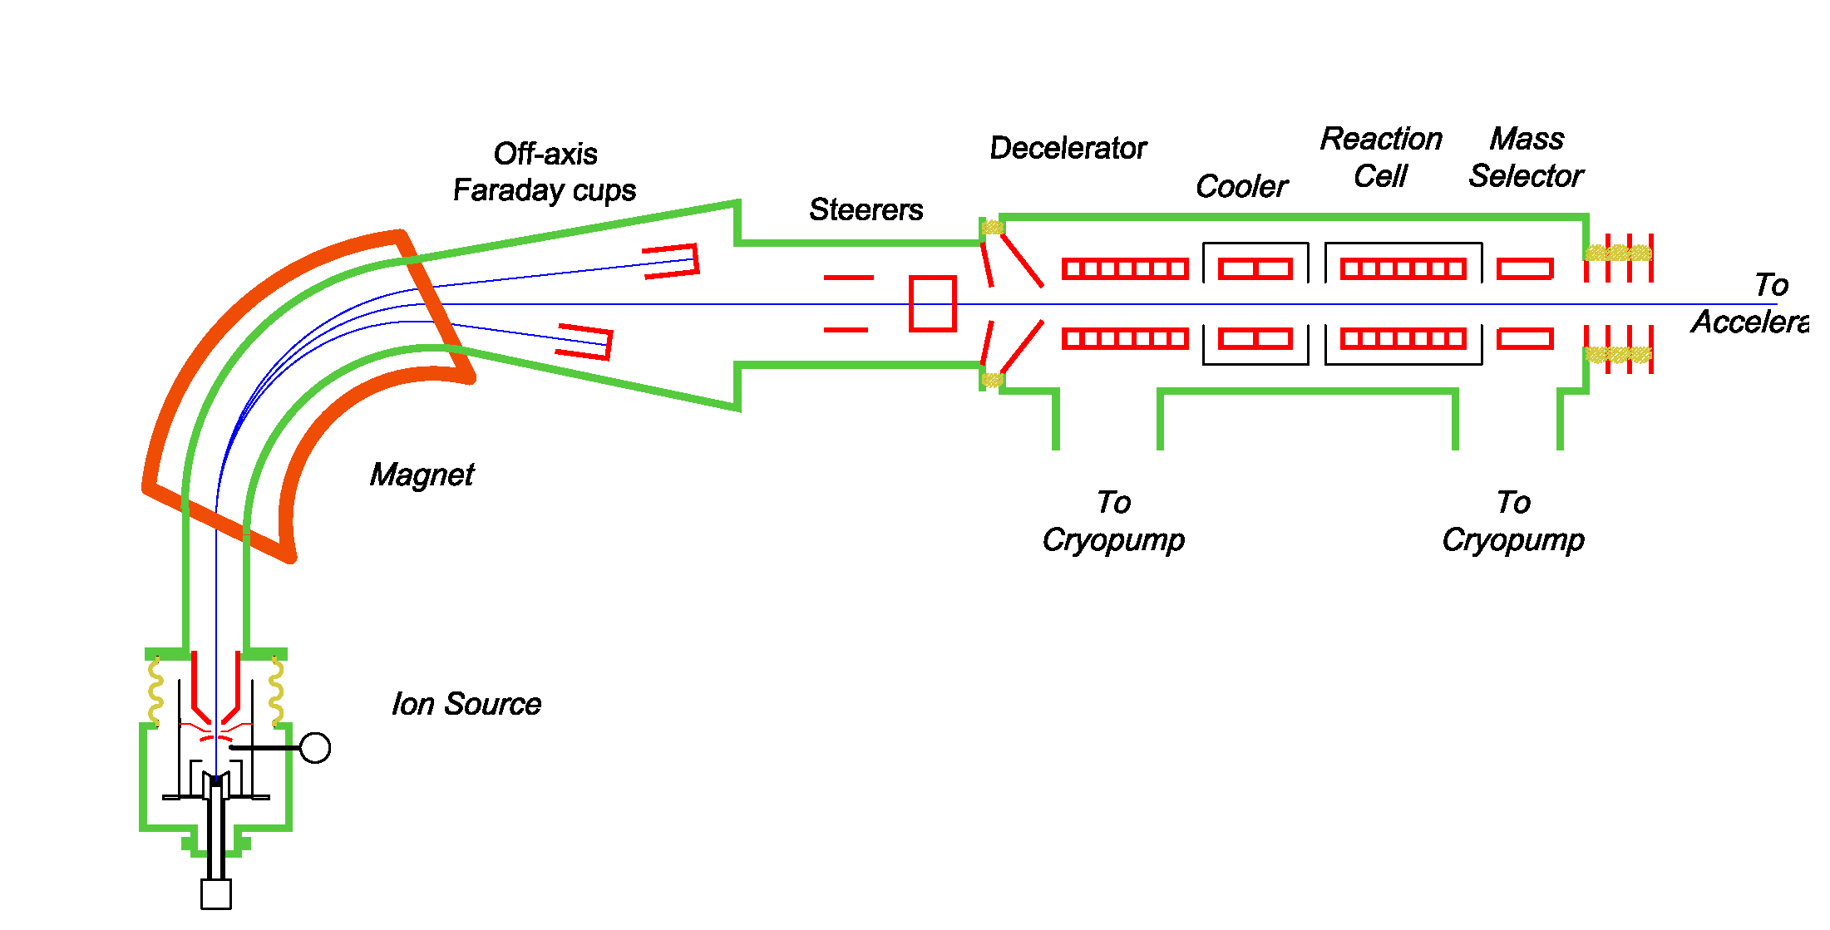
4. The Isobar Separator for Anions (ISA) – basic principles
1. Standard AMS ion source, with mass selection in injection magnet
2. Deceleration of rare mass beam to appropriate energy (≈ the ion source voltage)
3. Radio-frequency Quadrupoles (RFQs) used to contain the slow ions
4. Cooling of the ions using a light gas (He) if required
5. Interaction of the ions with the gas in the reaction cell
6. Re-acceleration to ion source energy for injection into AMS system
7. Standard AMS analysis and detection of interaction products
System schematic
High Voltage Deck

Slide 14
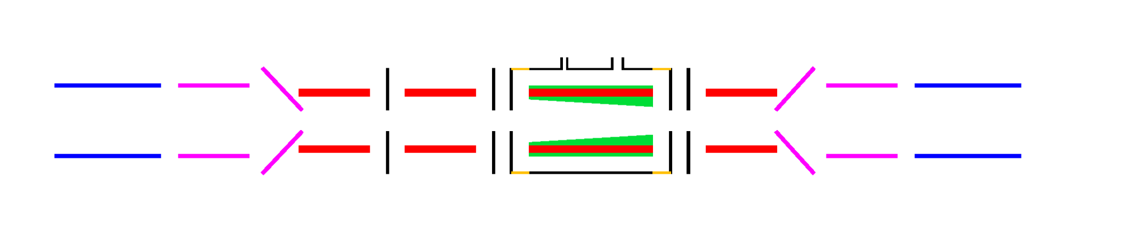
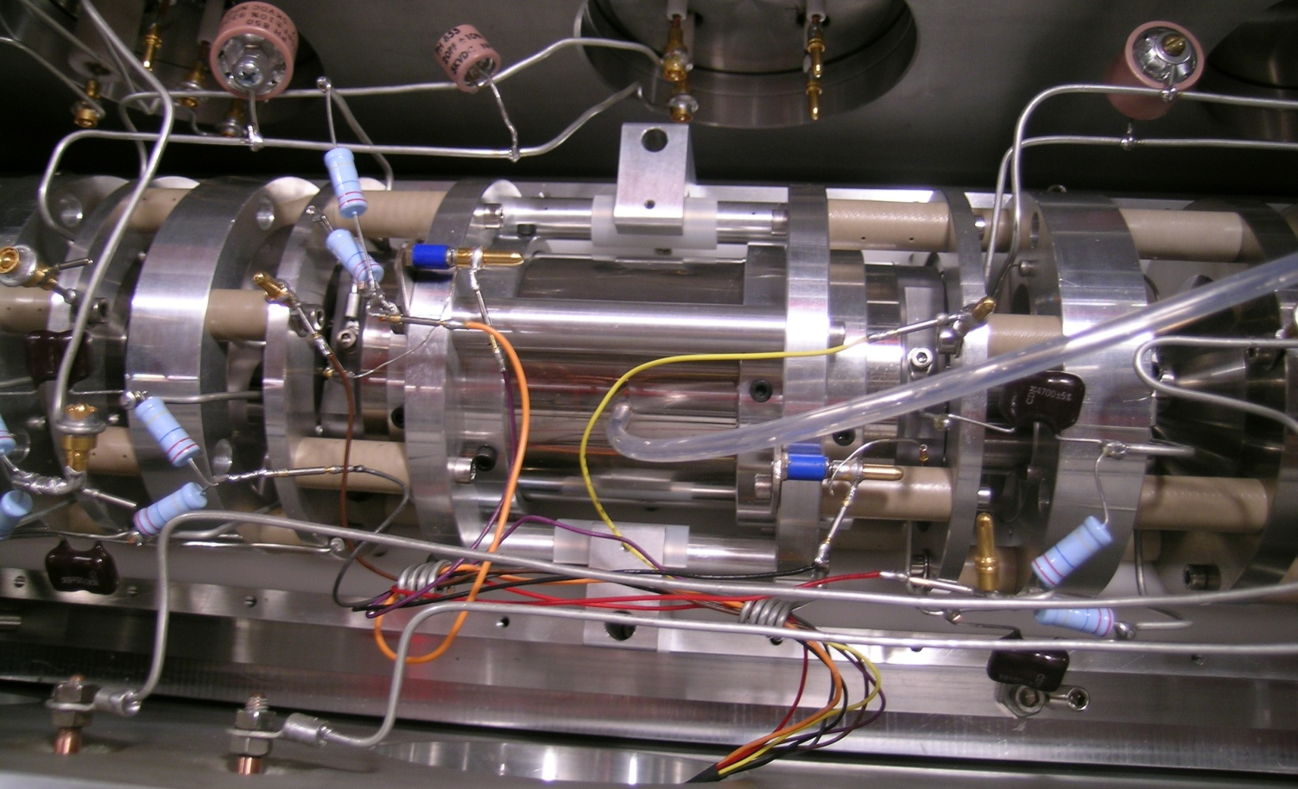
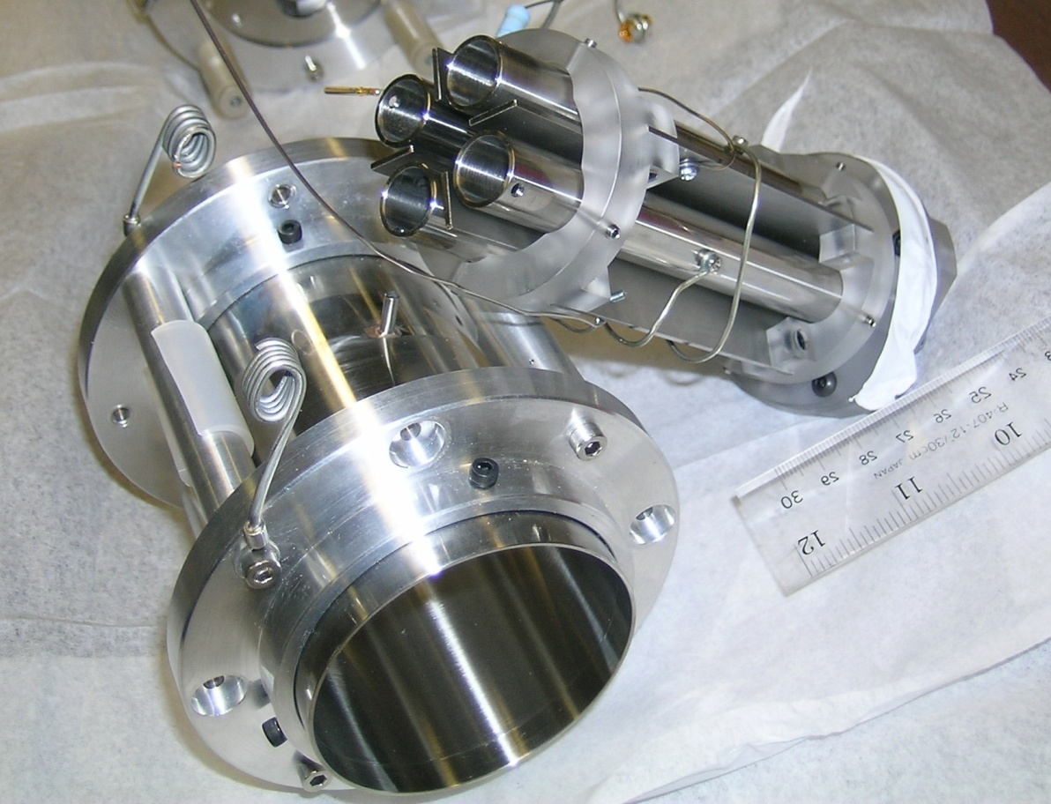
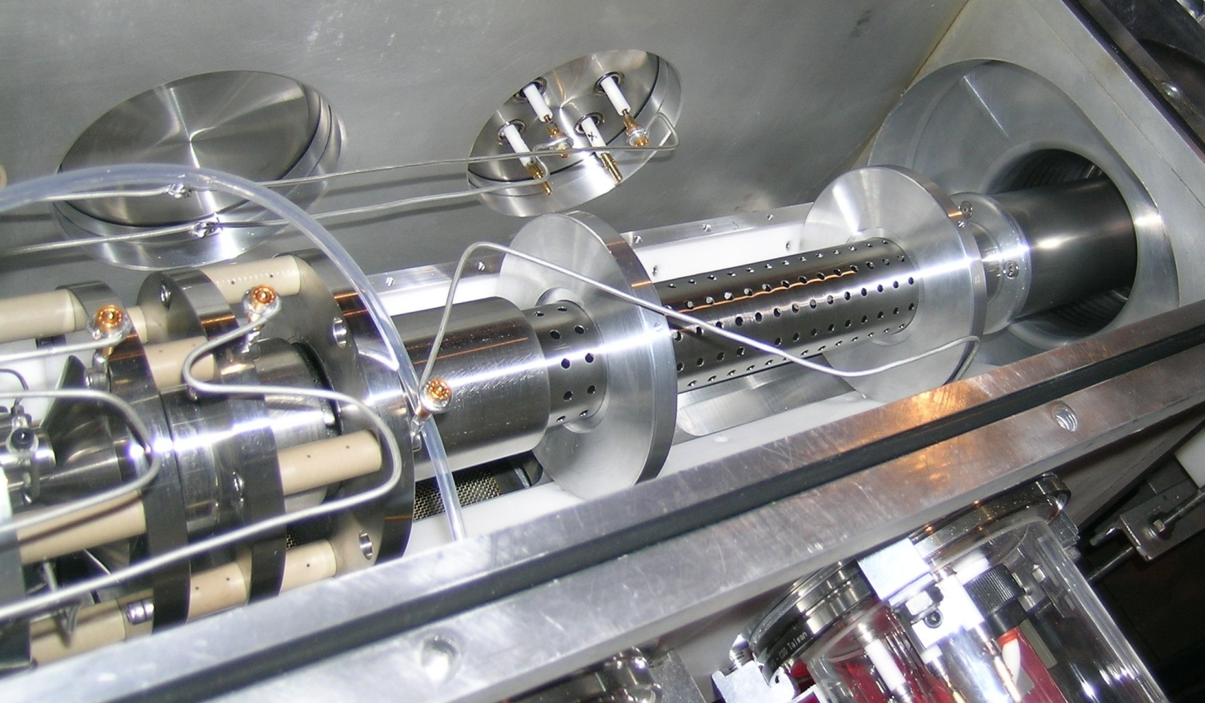
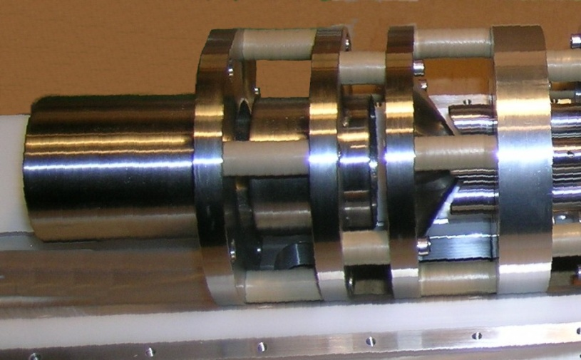
Began testing using a single cell for both cooling and reactions
Lab Ground
Deceleration Lenses
Deceleration Quads
Cooling / Reaction Cell
Acceleration Quad, Lenses
Lab Ground
To Accelerator
Notes:
14

Slide 15
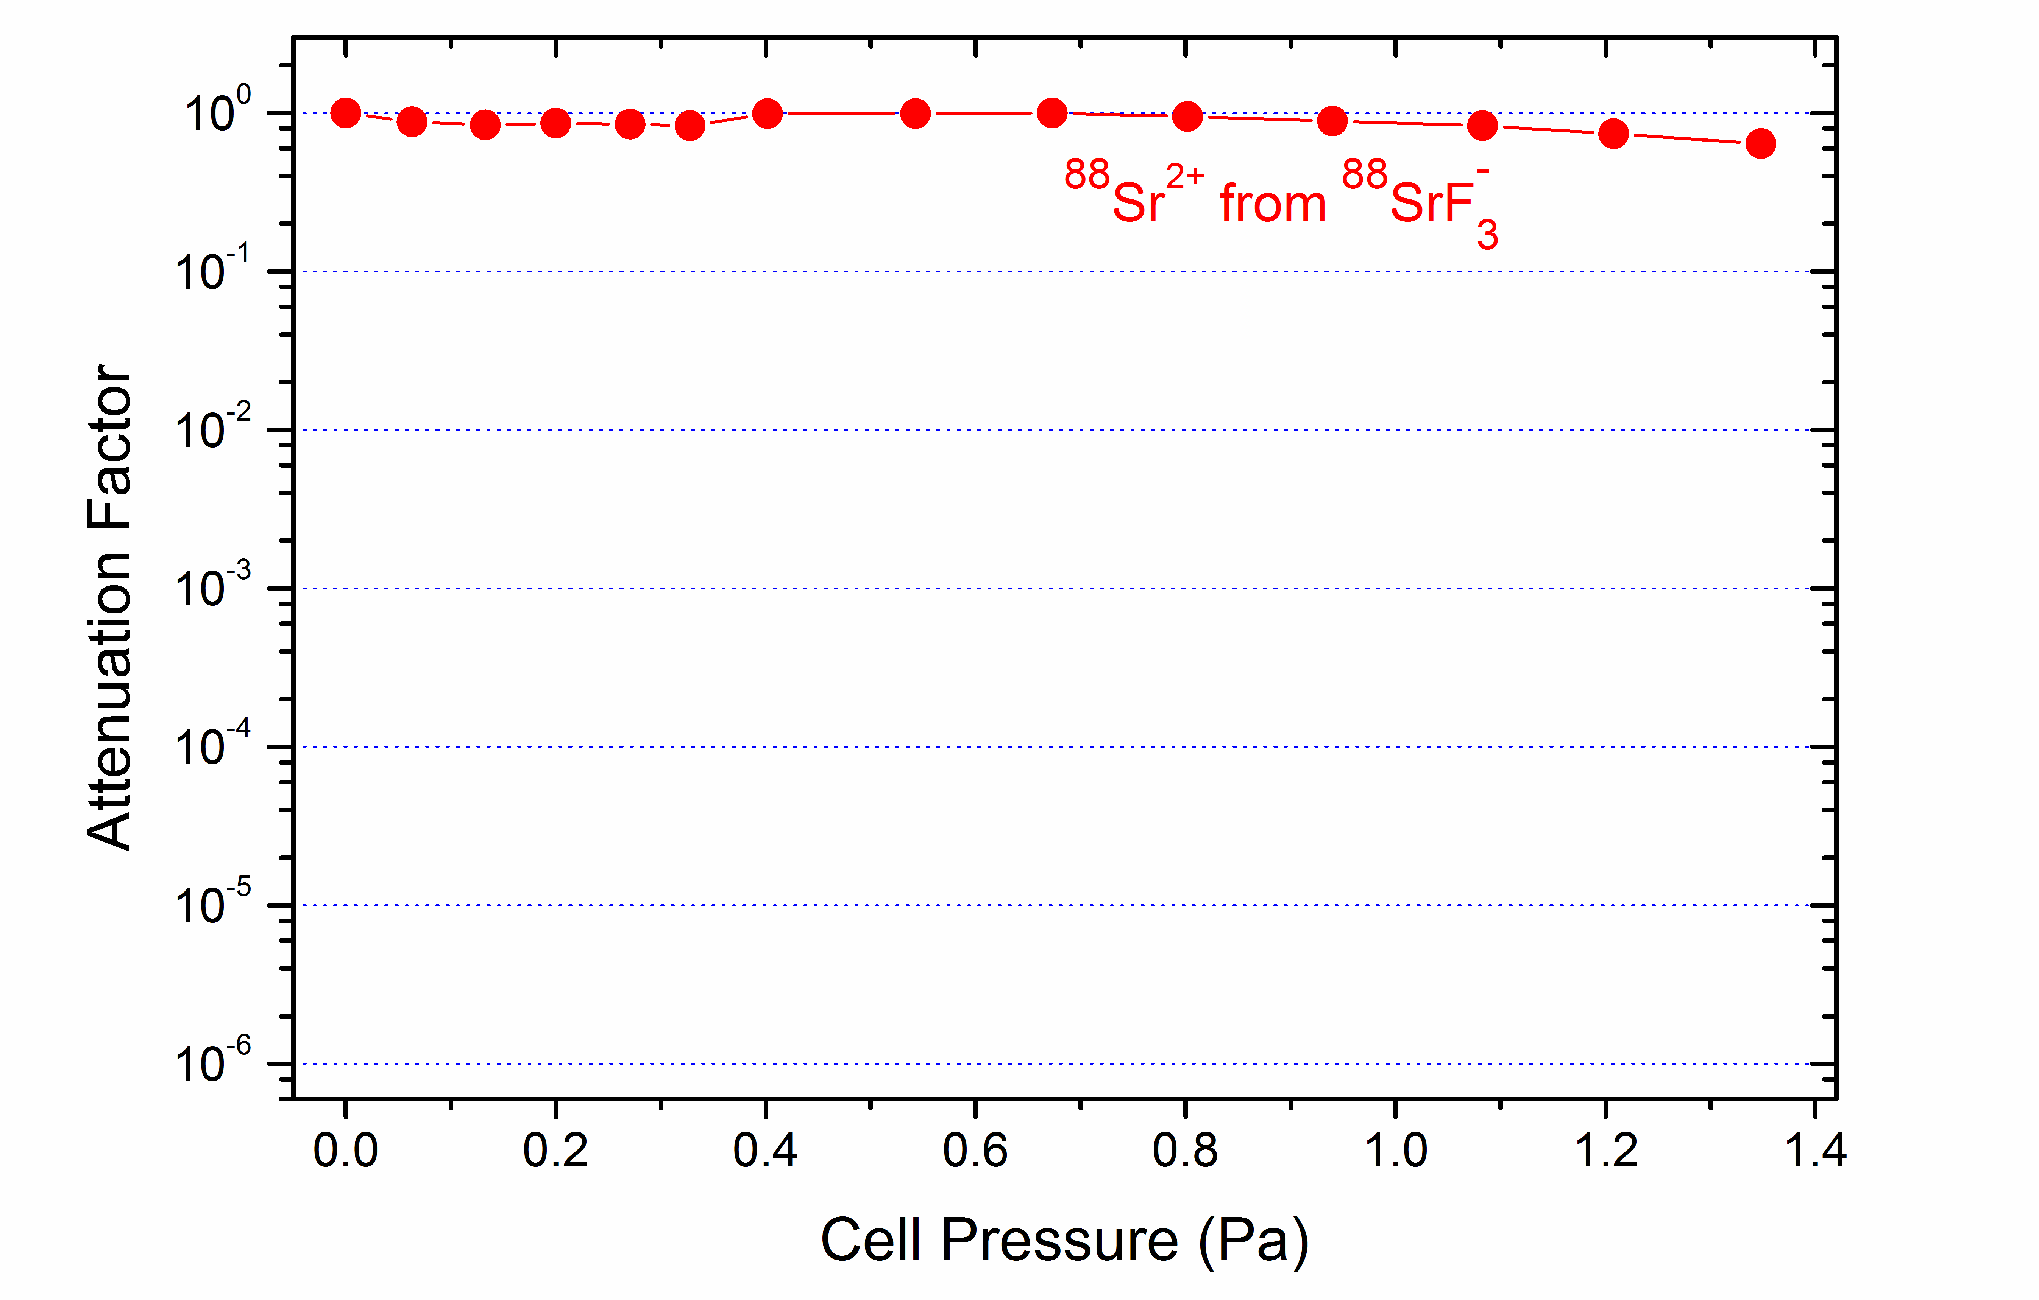
Isobar Suppression Demonstration: Sr – Y – Zr system:
Simulate ⁹⁰Sr with ⁸⁸Sr

Slide 16
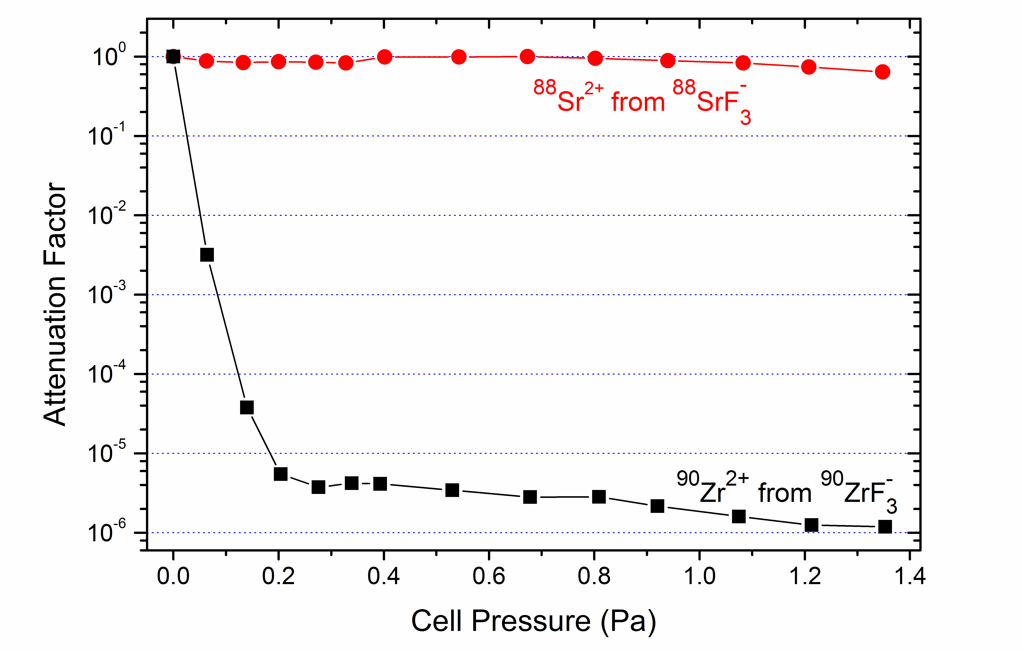
Isobar Suppression Demonstration: Sr – Y – Zr system:
Simulate ⁹⁰Sr with ⁸⁸Sr, ⁹⁰Zr as itself
ZrF₃– / SrF₃– = 4 x 10⁻⁶

Slide 17
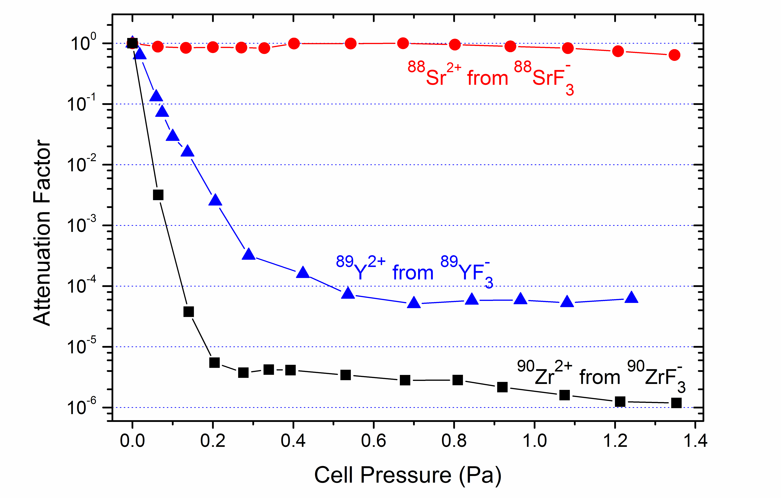
Isobar Suppression Demonstration: Sr – Y – Zr system:
Simulate ⁹⁰Sr with ⁸⁸Sr, ⁹⁰Zr as itself and ⁹⁰Y with ⁸⁹ Y

Slide 18
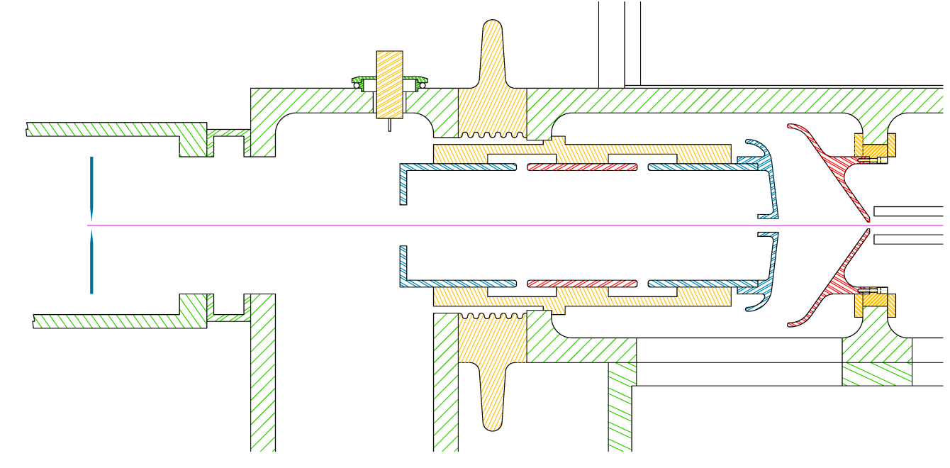
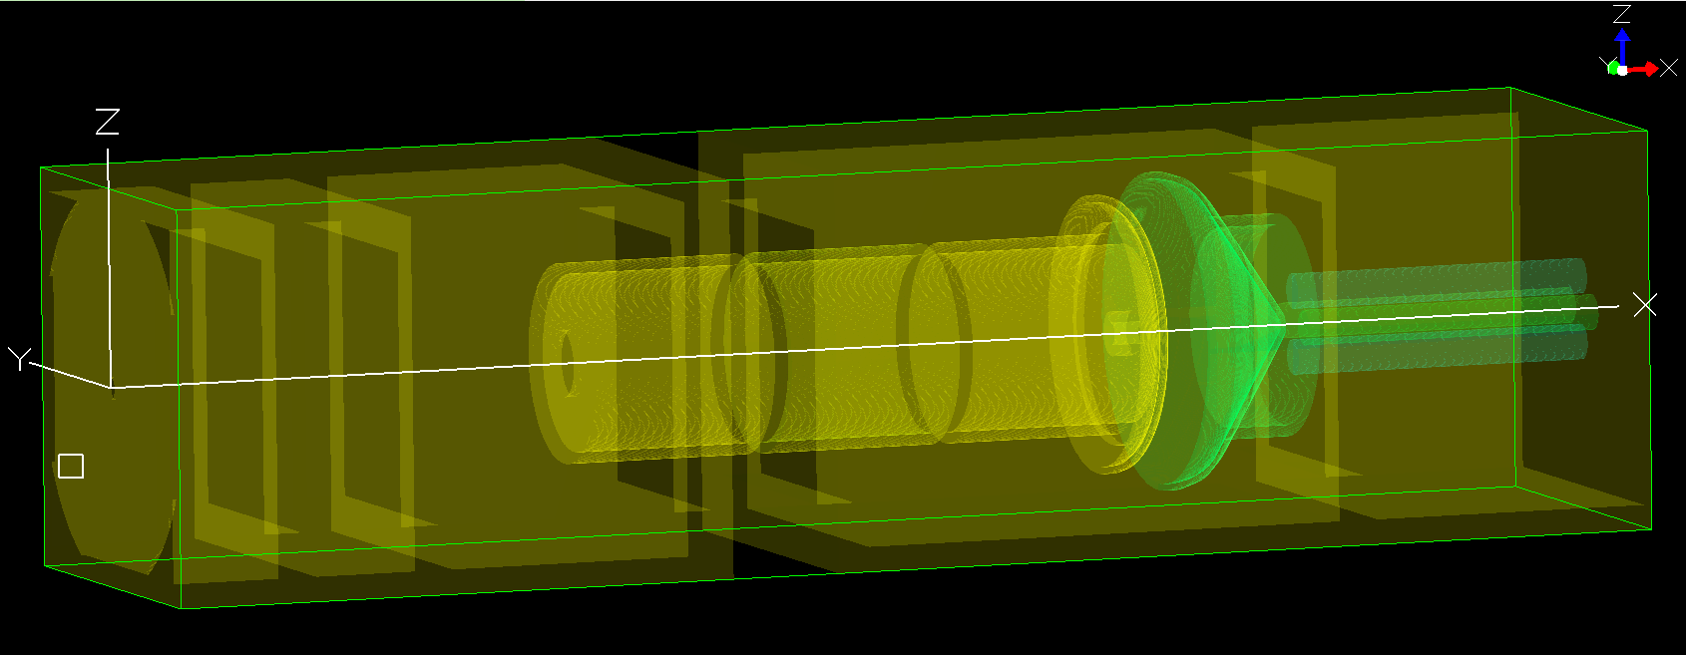
Pre-commercial ISA Deceleration Calculations::
Company formed to develop and market the ISA as a commercial product:
Isobarex
Lab Ground
“”Deck” Voltage
Einzel Lens
Magnet
Image
Slits
Deceleration Gap
3D view of a deceleration geometry as entered into and displayed by Simion 8.1

Slide 19
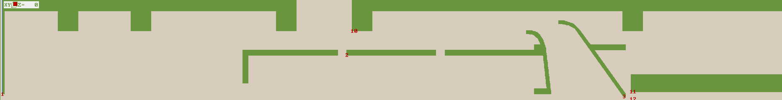
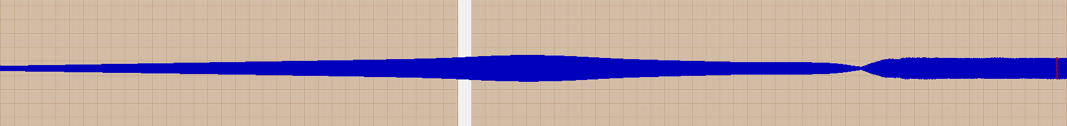
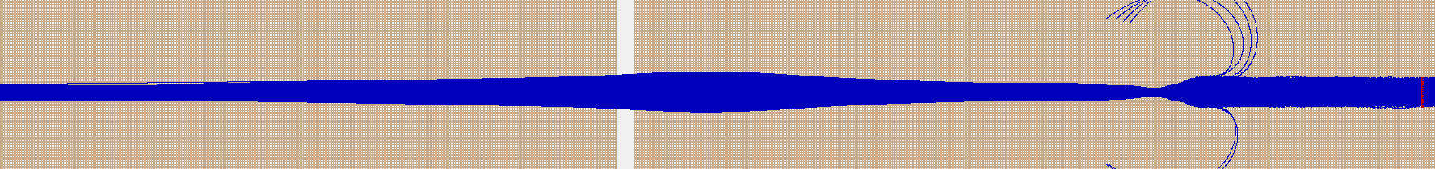
Deceleration Calculations::
Lab Ground
-35 kV(L) = 0 V (D) – Deck Ground
1,500 V(D) =
-33,500 V (L)
0 V(L)
26.5kV(L)
0 V(L)
RO 10 V(D)
Beam at Magnet Image
Calculated Transmission
3 mm Ǿ, ± 17 mr
100%
5 mm Ǿ, ± 17 mr
95%
Calculated by X-L Zhao using SIMION 8.1

Slide 20
Pre-commercial ISA – Mechanical Design
Plan View
Removable Section
Split Flow Turbopump
Split Flow TurbopumpU
Isobarex
To avoid duplication of ion sources an magnets, the system is designed to easily be change from normal AMS operation to Isobar Separation operation

Slide 21
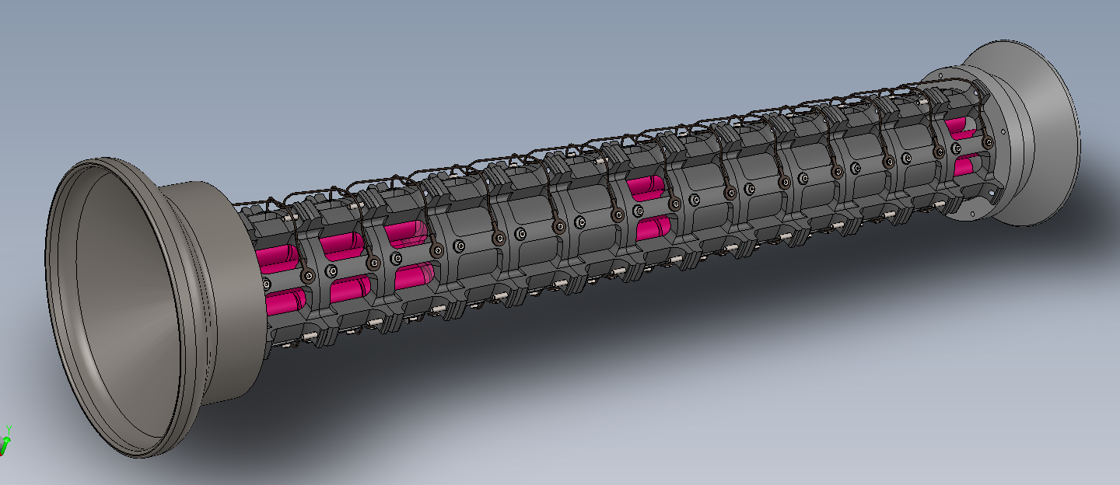
Pre-commercial ISA – Mechanical Design
Replaceable RFQ column – supports and frame removed
Deceleration Electrode
RFQ Modules
Re-aceleration Electrode
Isobarex

Slide 22
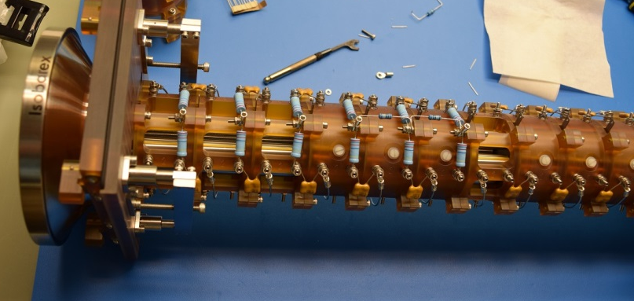
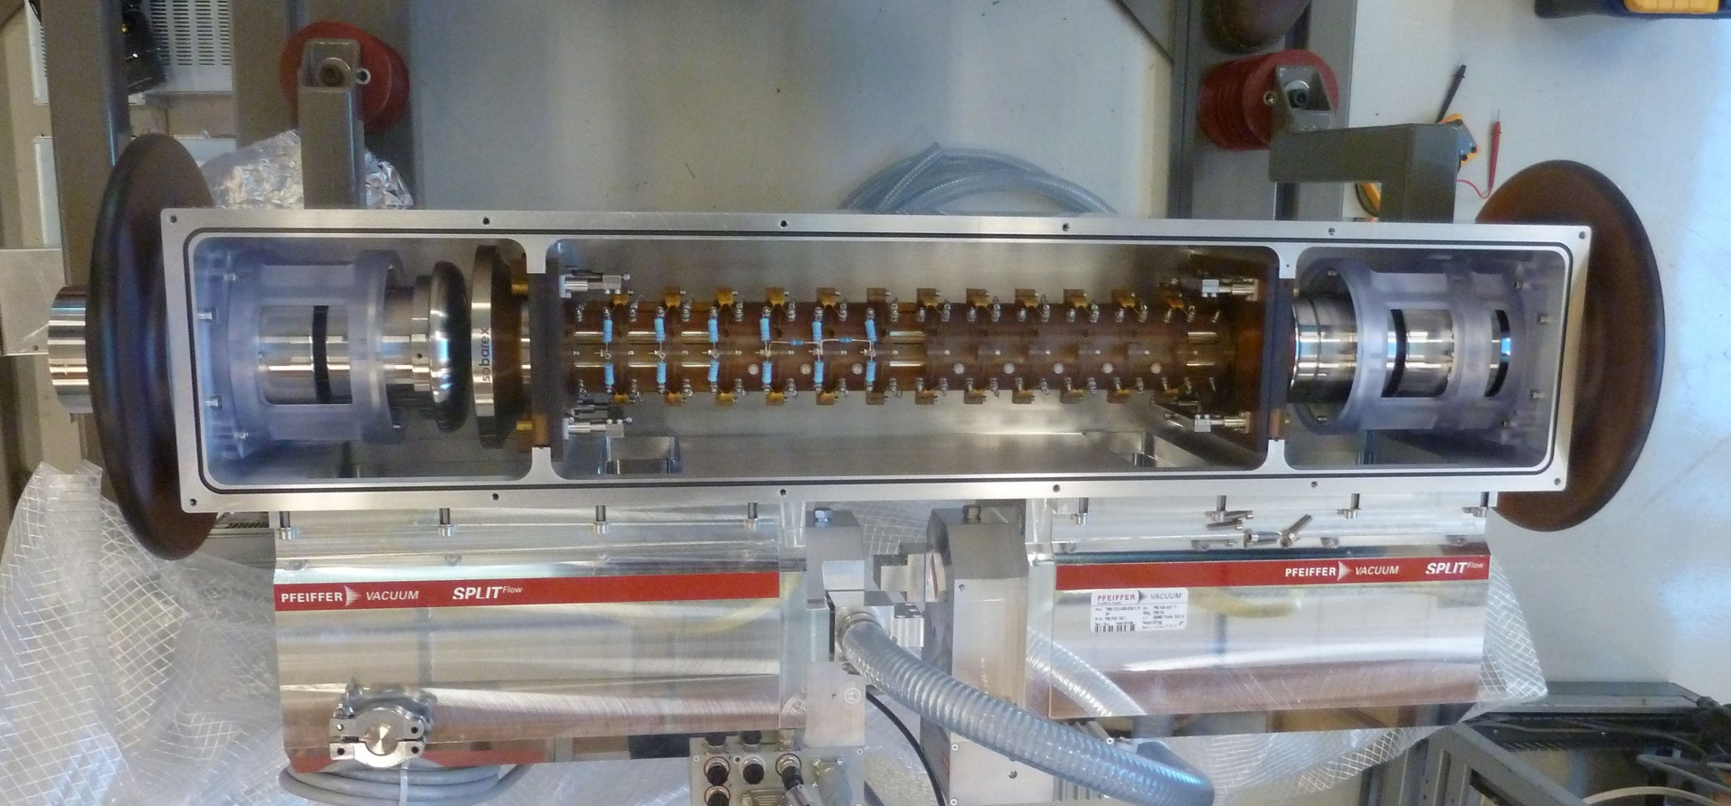
Pre-commercial ISA – Mechanical Design
Deceleration end of column being assembled
Column in vacuum housing with turbopumps, lenses and beamline insulators
Isobarex

Slide 23




Summary
The energy provided by the accelerator enables the destruction of molecular isobars and noise-free, single atom counting capability
Wide-ranging abundance sensitivity and small sample sizes make AMS the method of choice for many isotope applications in Earth, Environmental, Materials, Cultural and Bio-medical Sciences
The new injection line will support research in AMS technologies such as ion source development, the elimination of atomic isobars and applications using new elements and isotopes for tracing and dating.
The collaboration agreement between Isobarex Corp. and uOttawa will lead to new ISA applications and the further development and expansion of ISA technology.
Thank you

Slide 24
Notes:
24

Slide 25
Notes:
25

Slide 26
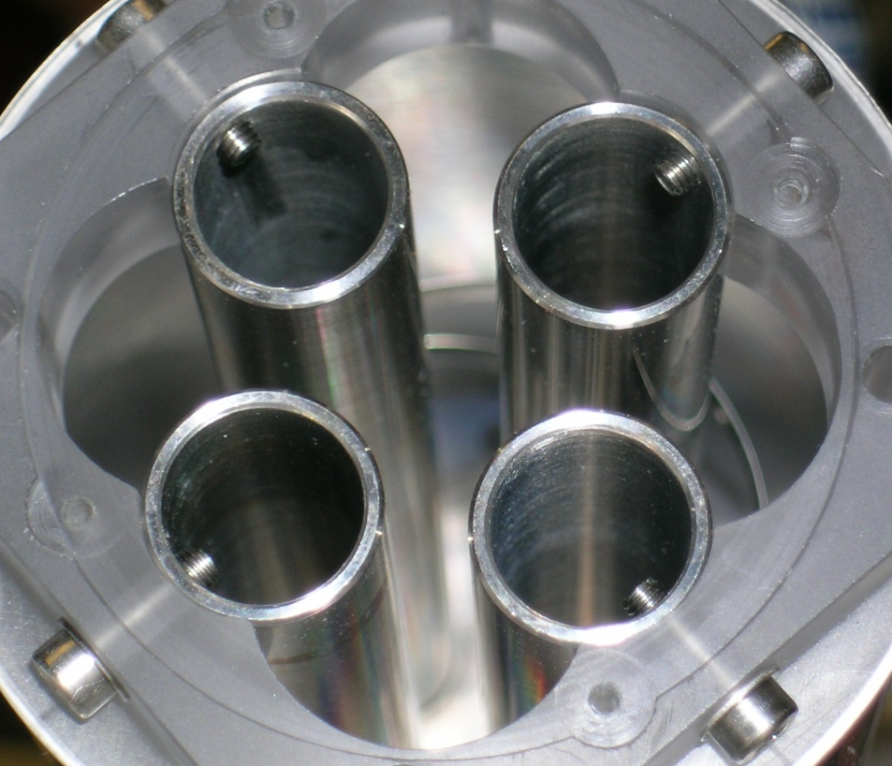
Radio-frequency Quadrupoles:
Stability parameters set limits on the geometrical design and electrical operation of the cell
For quadrupoles:
For confinement only, a = 0
i.e., no mass resolution
q | = | 2 | e V_{rf}
 |  |  | mω²r₀²
For stability (adiabicity), q ≤ 0.3
i.e., more power doesn’t always help
a | = | 4 | e V_{dc}
 |  |  | mω²r₀²
where:
e is the elementary charge
V_{rf} is the peak-to-peak RF voltage
V_{dc} is the DC voltage between the pole pairs
m is the ion mass
ω is the angular RF frequency, and
r₀ is the radius of a circle tangential to the inner surface of the rods.
r₀

Slide 27
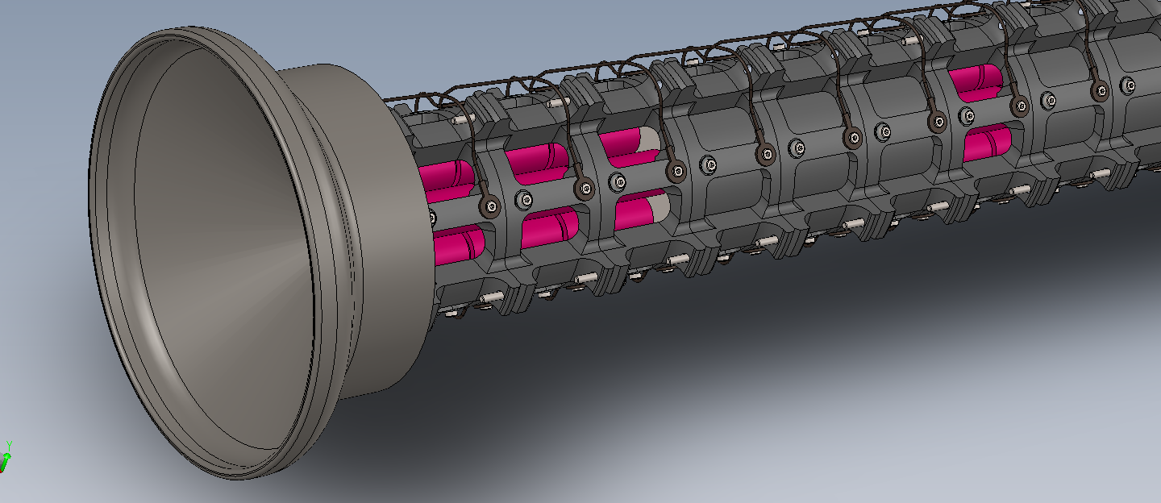
Pre-commercial ISA – Mechanical Design
Close-up of deceleration end
Isobarex

Slide 28
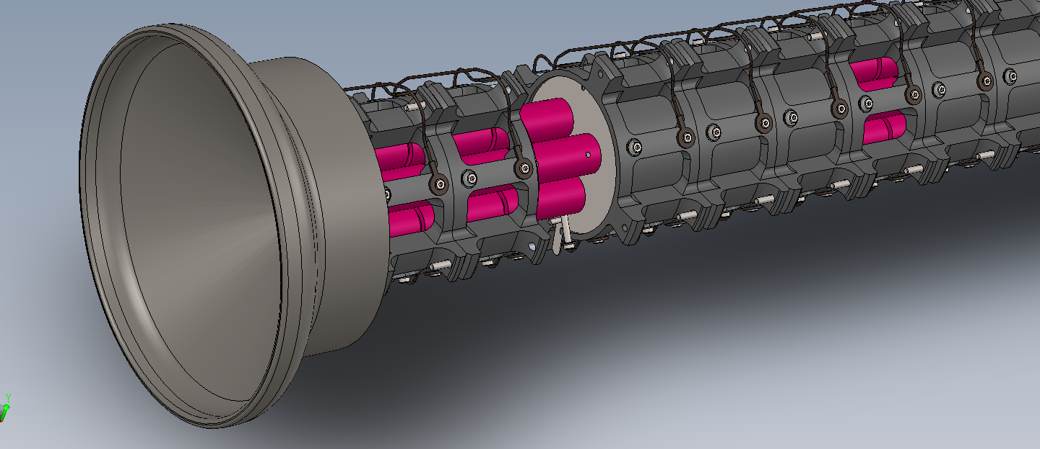
Pre-commercial ISA – Mechanical Design
Close-up of deceleration end – one quad support module removed
Isobarex

Slide 29
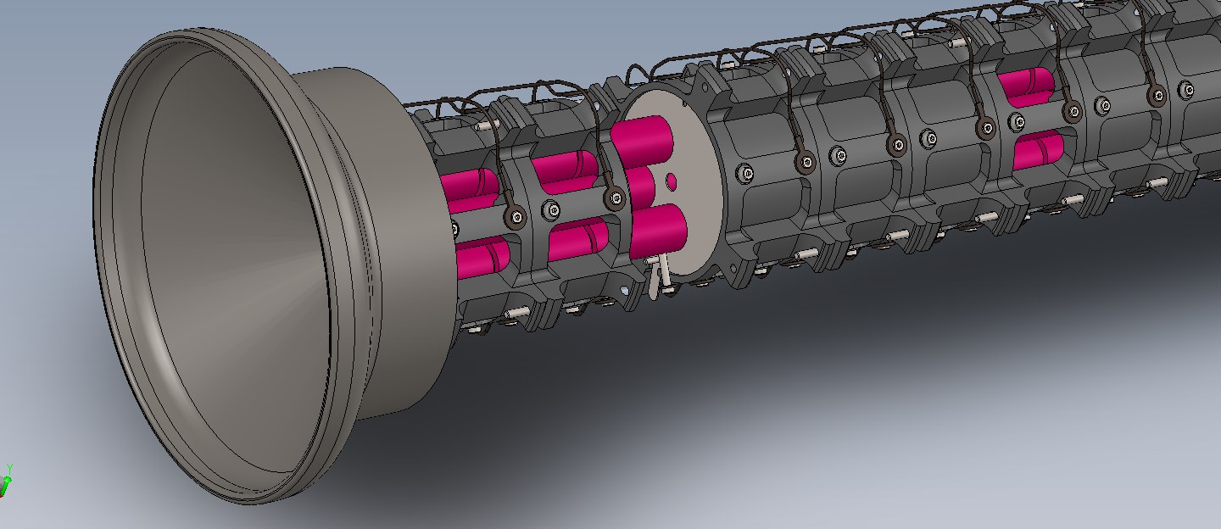
Pre-commercial ISA – Mechanical Design
Close-up of deceleration end – support module and one pole removed
Isobarex

