Slide 1
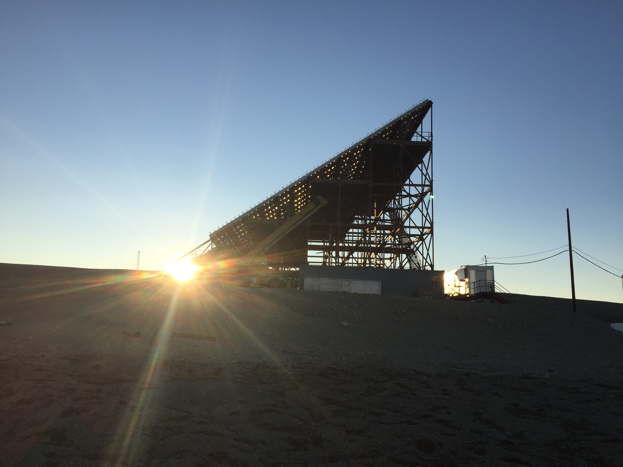
RISR-C incoherent scatter radar operations
June 15, 2016
2016 CAP Congress, University of Ottawa, ON, Canada
R. G. Gillies¹, A. van Eyken², E. Spanswick¹, M. Nicolls², J. Kelly², M. Greffen², D. Knudsen¹, M. Connors³, M. Schutzer², T. Valentic², M. Malone², J.-P. St.-Maurice⁴, E. Donovan¹
1. University of Calgary
3. Athabasca University
2. SRI International
4. University of Saskatchewan

Slide 2
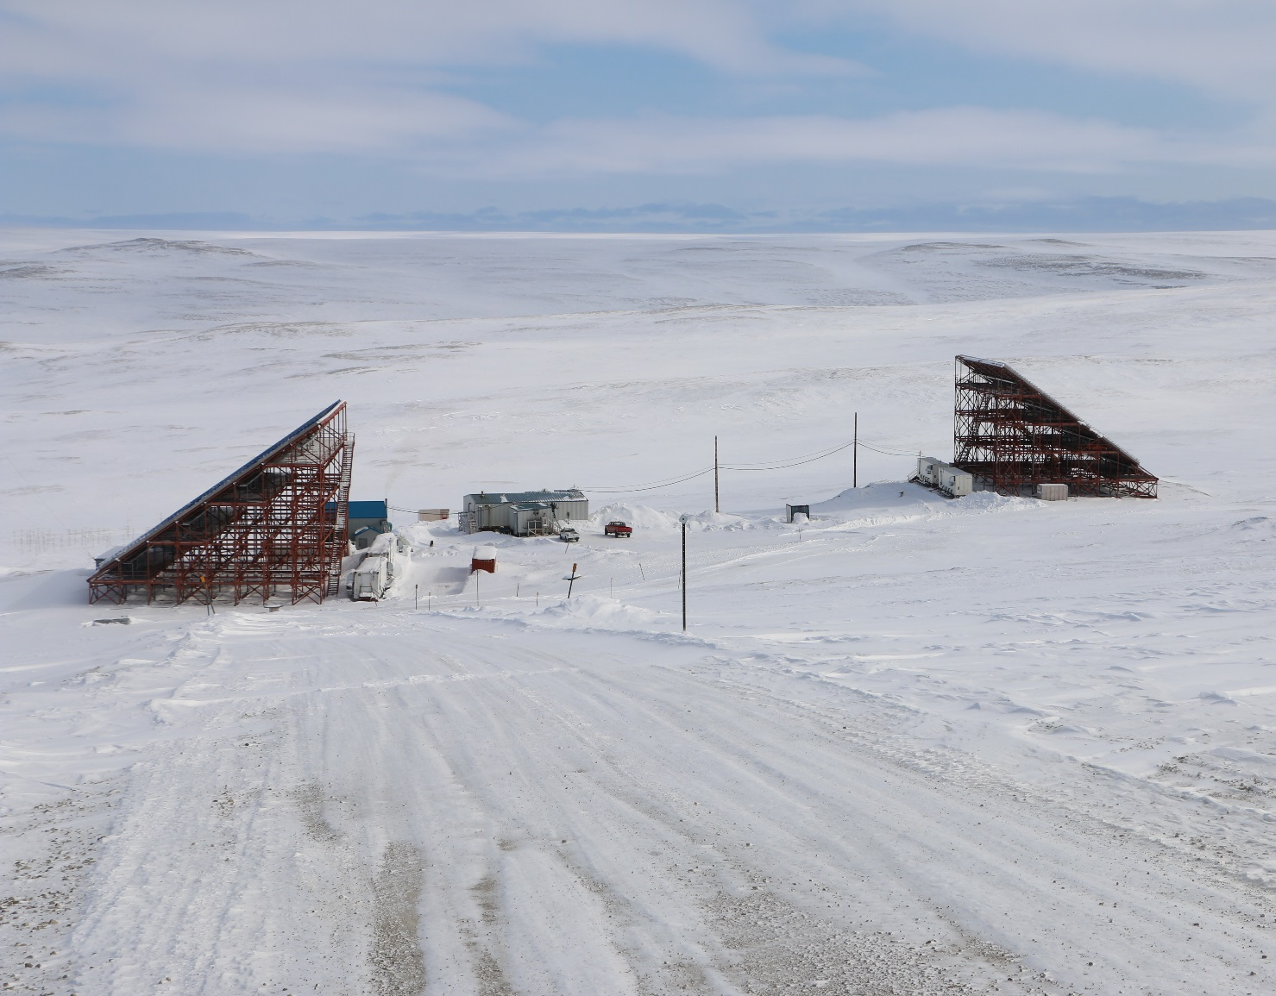
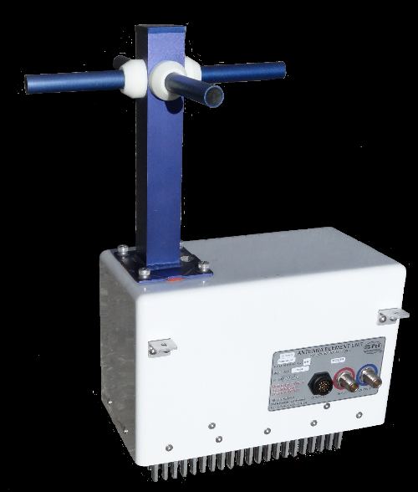
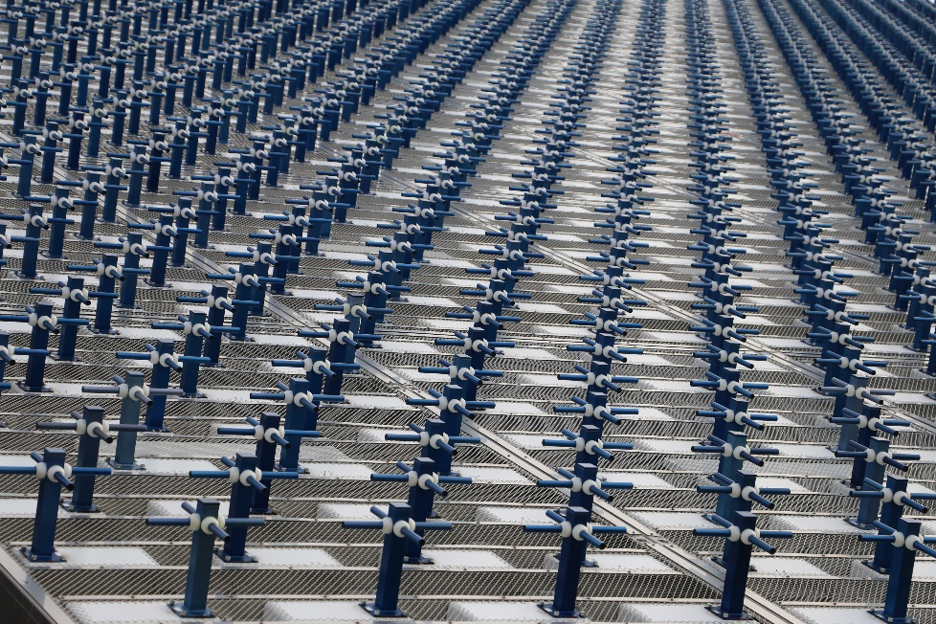
Introduction/background:
Two AMISR radars in Resolute Bay
  RISR-N operated by SRI International since 2009
  RISR-C is recently constructed Canadian counterpart (Aug. 2015)
Electronic beam steering used to effectively sample multiple look directions simultaneously
Both radars run off power from 1-MW diesel generator (~$4000 per day for one radar)
Aside from main generator turn on/off, radars operated completely remotely
RISRs operate at 430-450 MHz
Peak transmitted power -- 2 MW
RISR-C data from the ~42 days of total operations to date is available

Slide 3
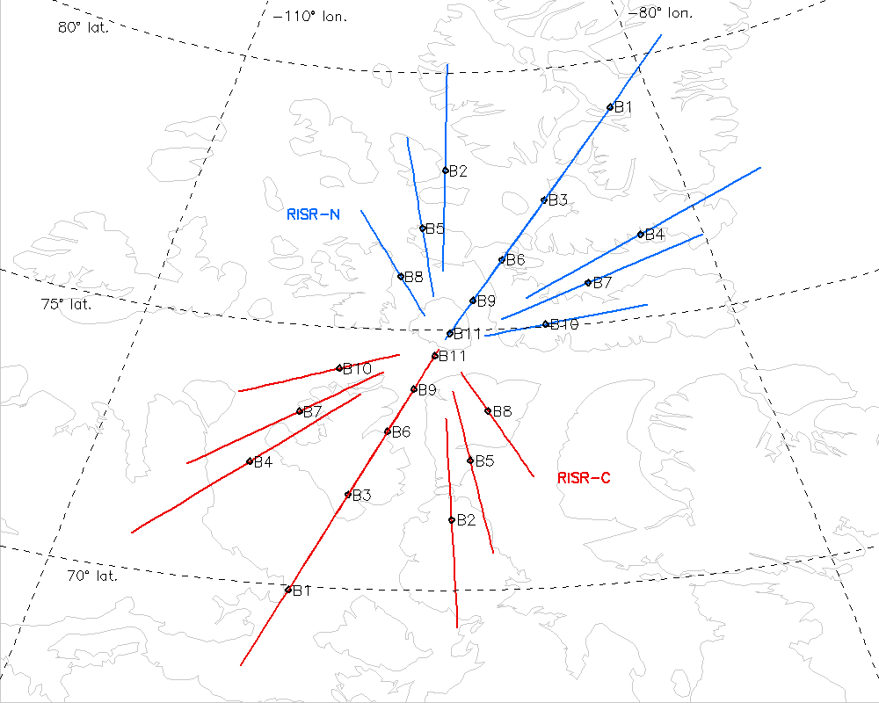
Radar FOV and example beam directions:
-World day mode shown was used in first 25-hour test
-Any combination of ~4000 pre-set beam directions can be used in a given experiment
-diamonds indicate 300 km pierce point

Slide 4

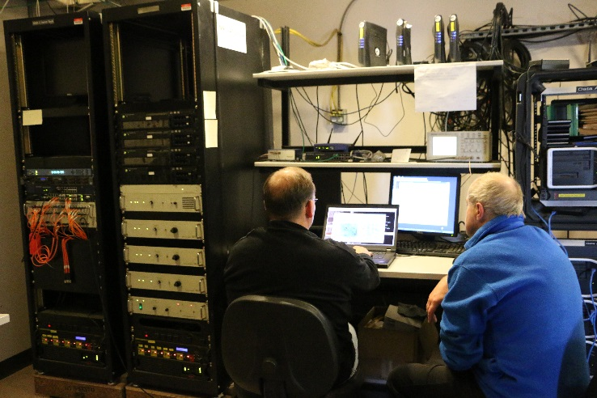
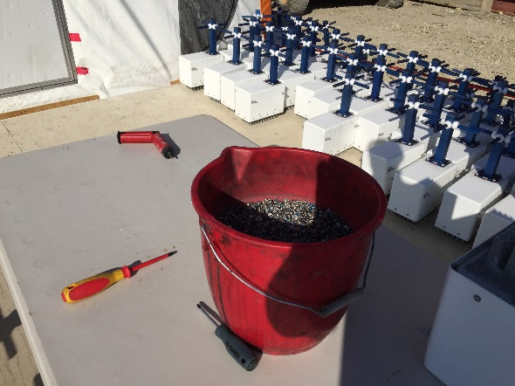
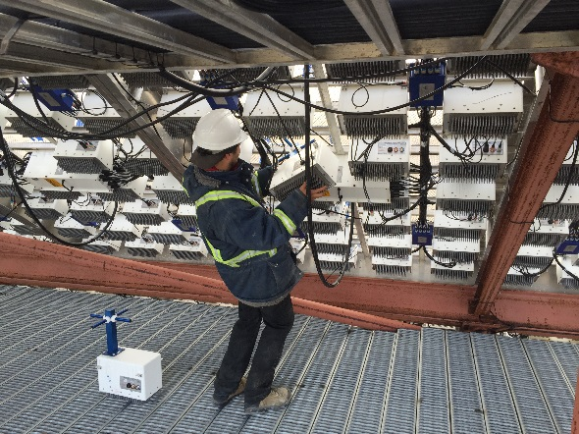
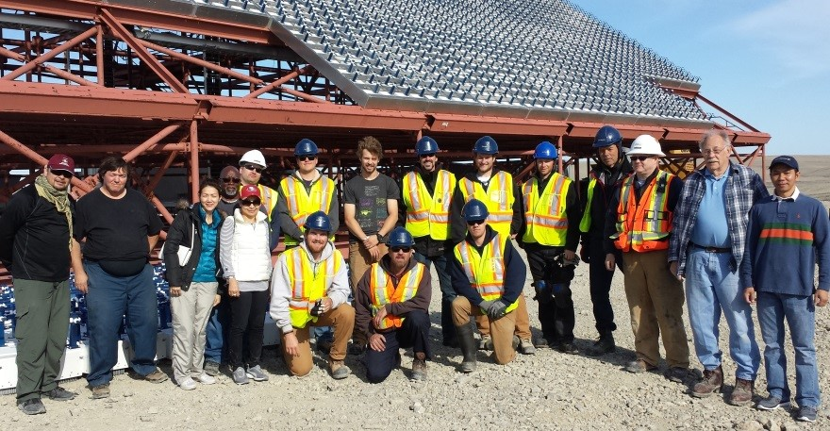
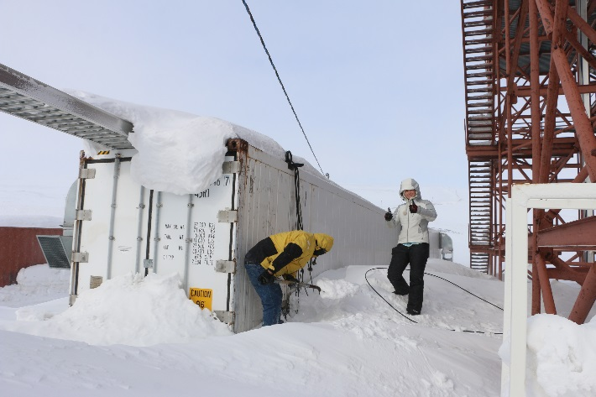
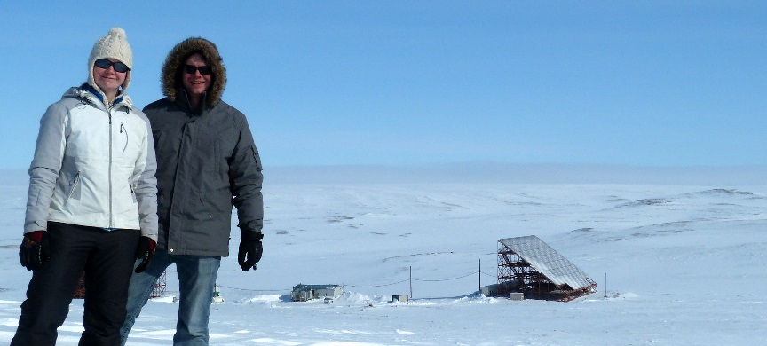
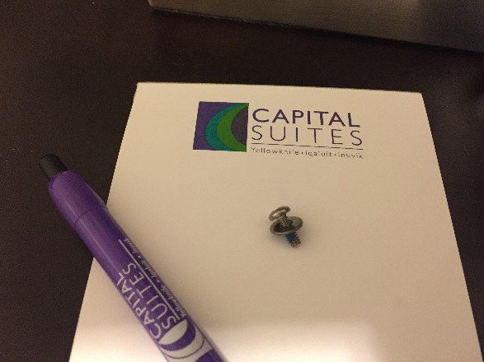
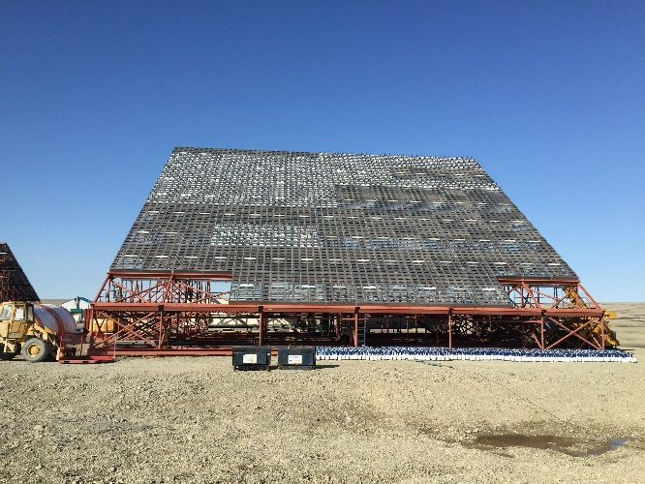
Timeline (2015-present):
April 2015: LNA replacements tested in 32 AEUs (1 panel) at SRI
May 2015: Further tests of 128 AEUs (4 panels) at Resolute
July 2015 Final construction of RISR-C
July/Aug. 2015: First light and initial testing of RISR-C by SRI
Late Aug. 2015: Final testing with UofC personnel at Resolute
Fall 2015: Handover of RISR-C from SRI to UofC
Jan. 2016: Beginning of routine operations of RISR-C

Slide 5
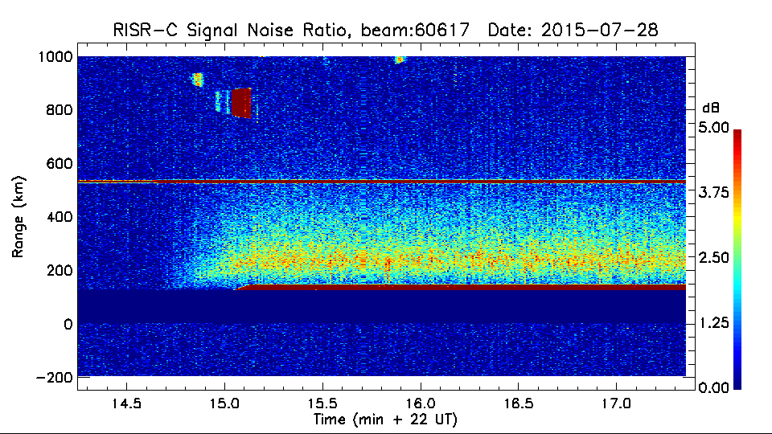
RISR-C first light
July 28, 2015 ~22:15 UT
First turn on of RISR-C with ~121 panels
Further phase calibration was performed after this

Slide 6
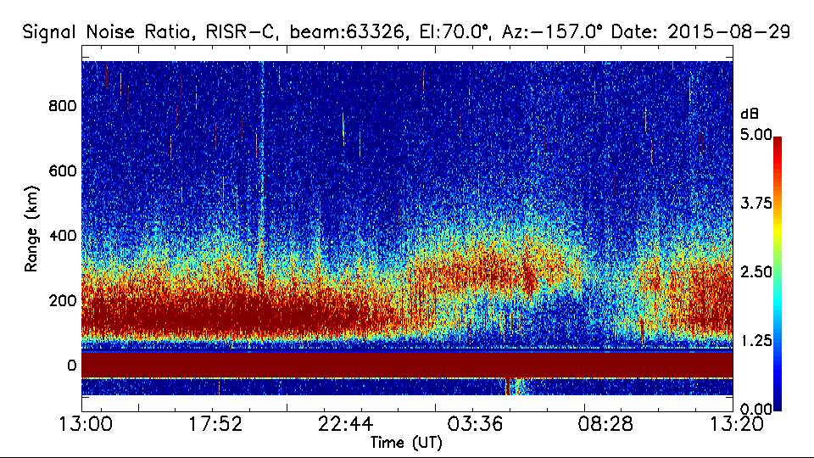
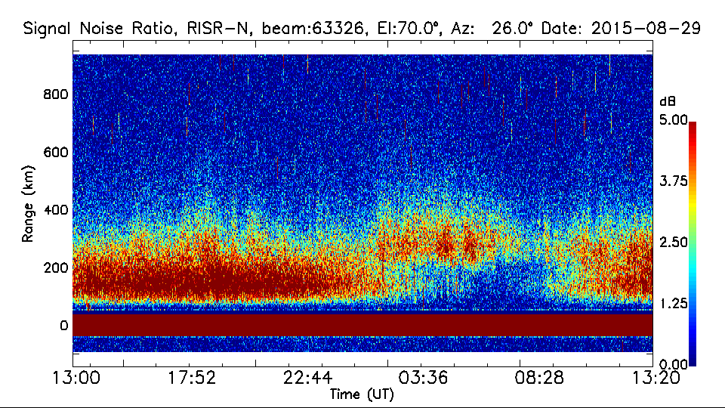
Comparison to RISR-N (SNR):
RISR-C
RISR-N

Slide 7
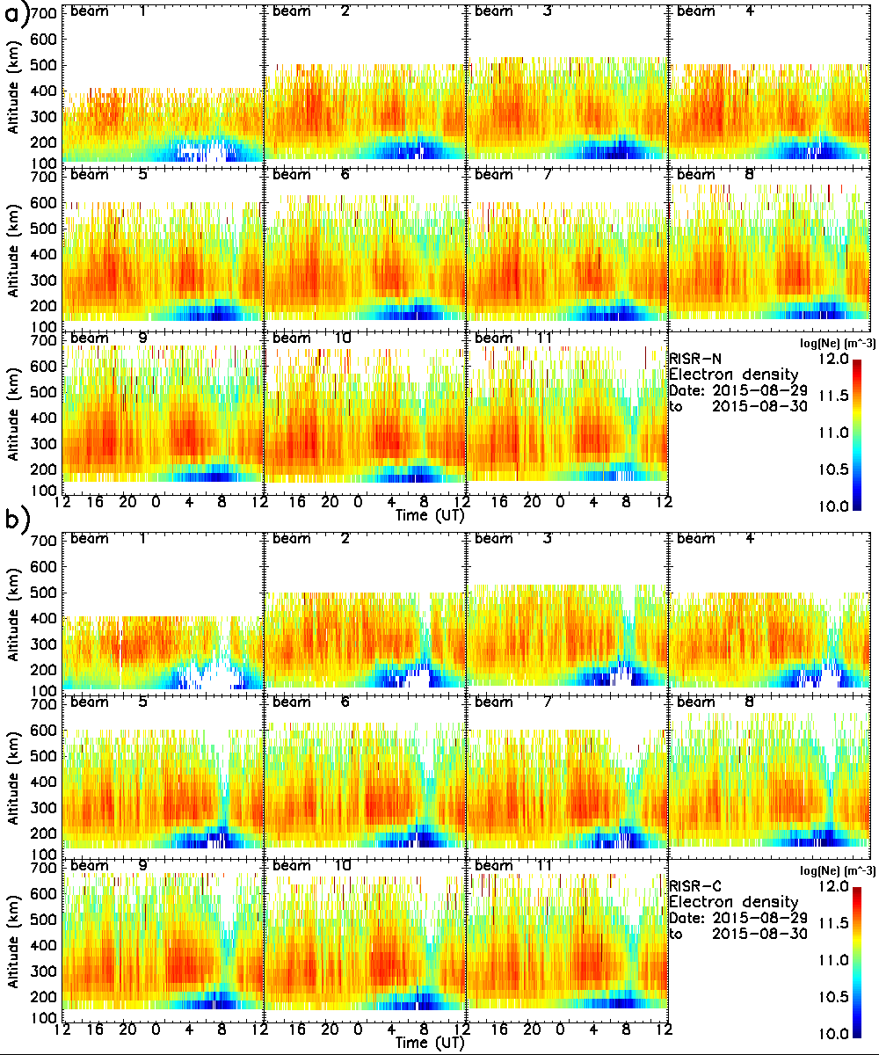
Electron densities:
RISR-N
-Densities for both radars
calibrated using Resolute Bay CADI
RISR-C

Slide 8
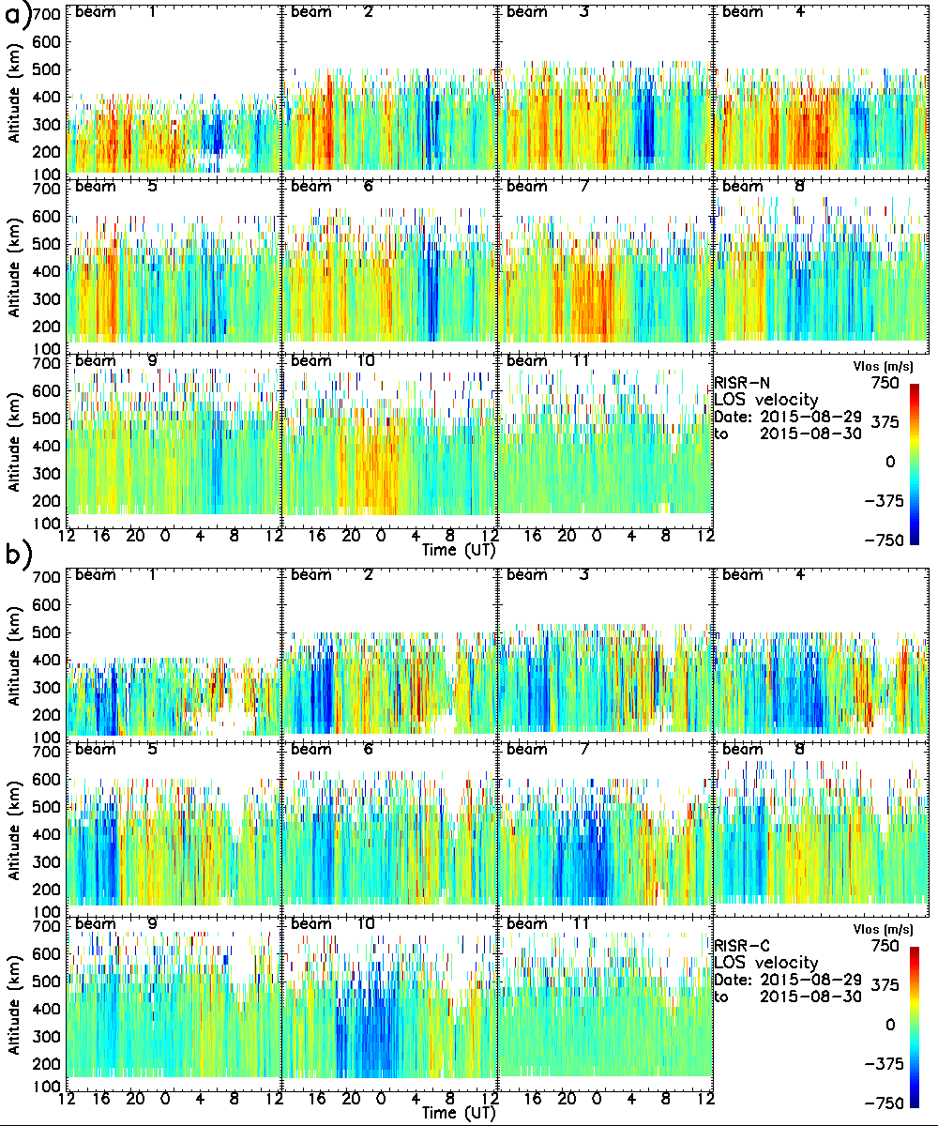
LOS velocities:
RISR-N
RISR-C

Slide 9
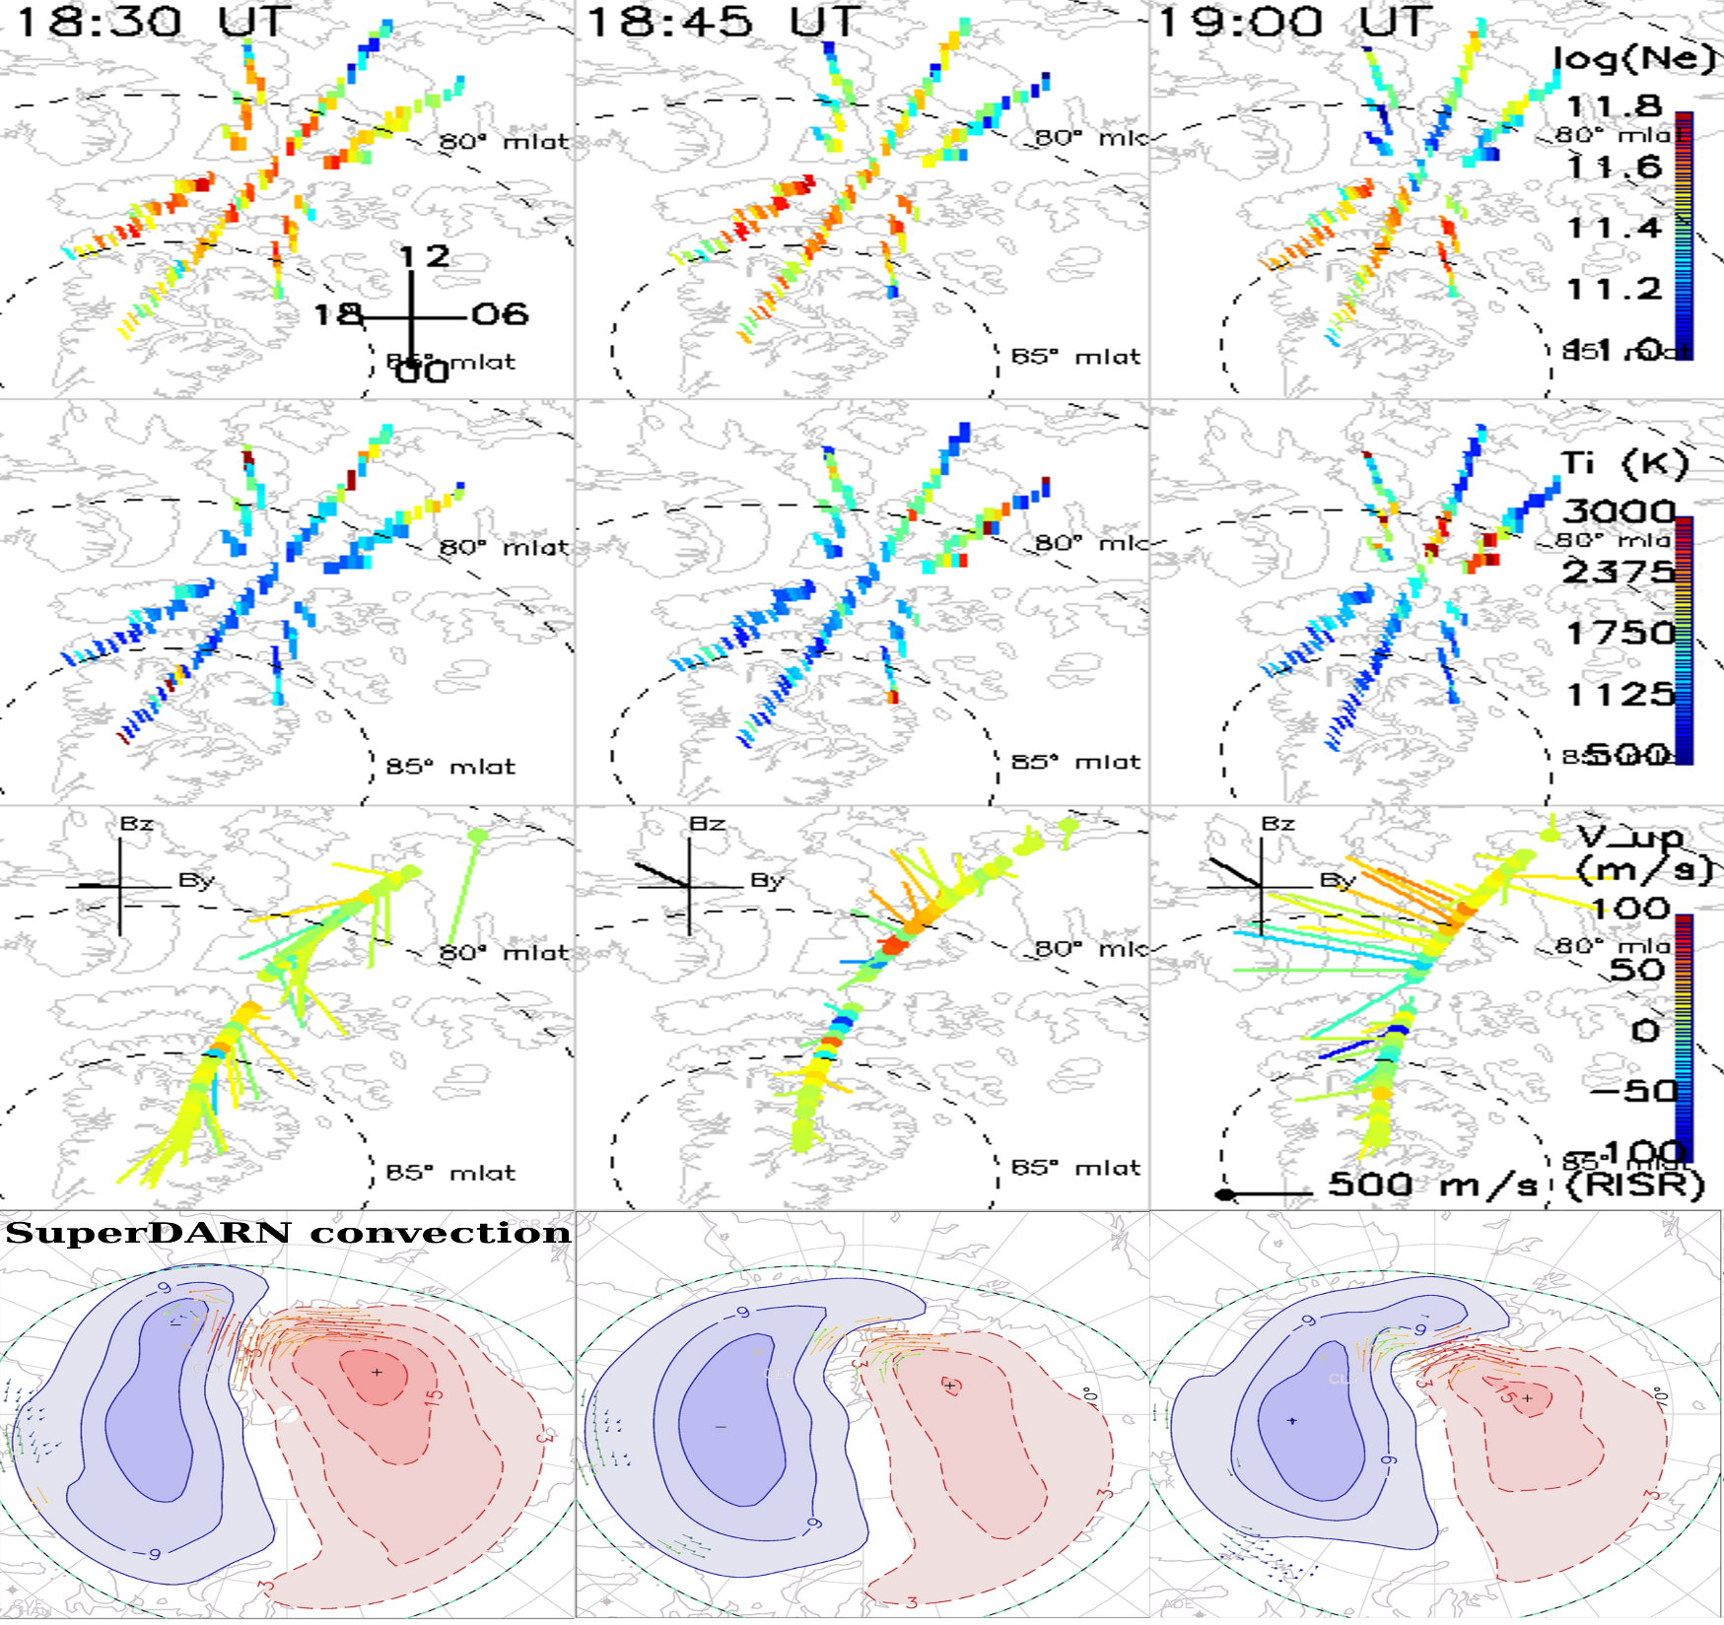
Lat/Lon plots:
Electron density
Ion temperature
Velocity
SuperDARN

Slide 10
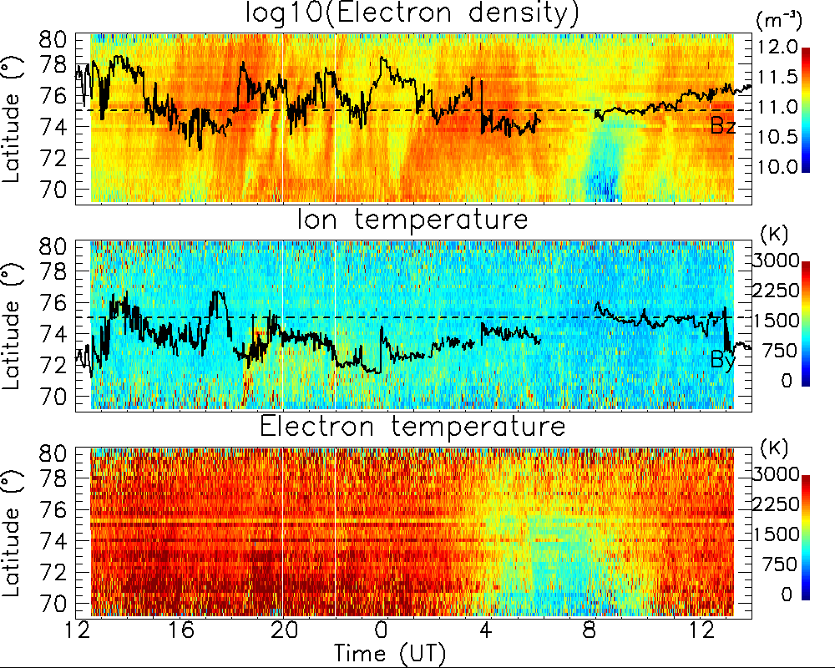
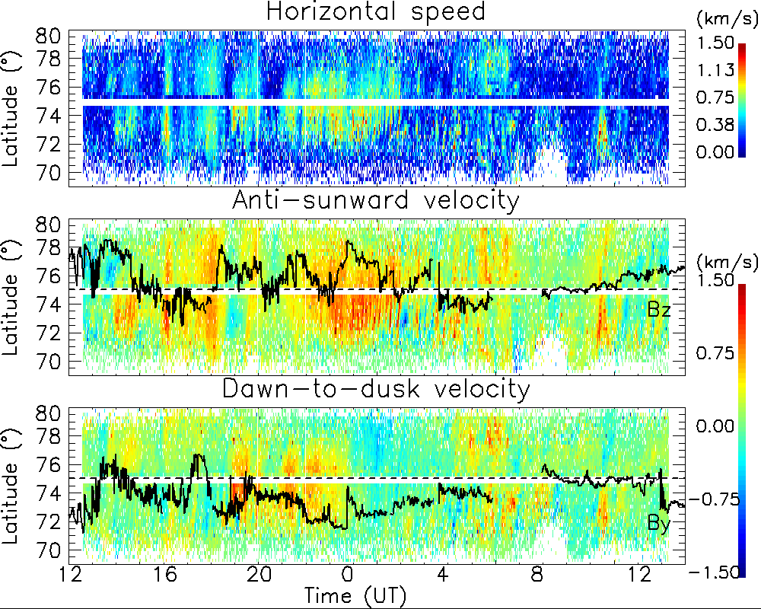
RISR keograms:
-data from 250-450 km and all longitudes averaged
-essentially, RISR-N above 75⁰ and RISR-C below 75⁰

Slide 11
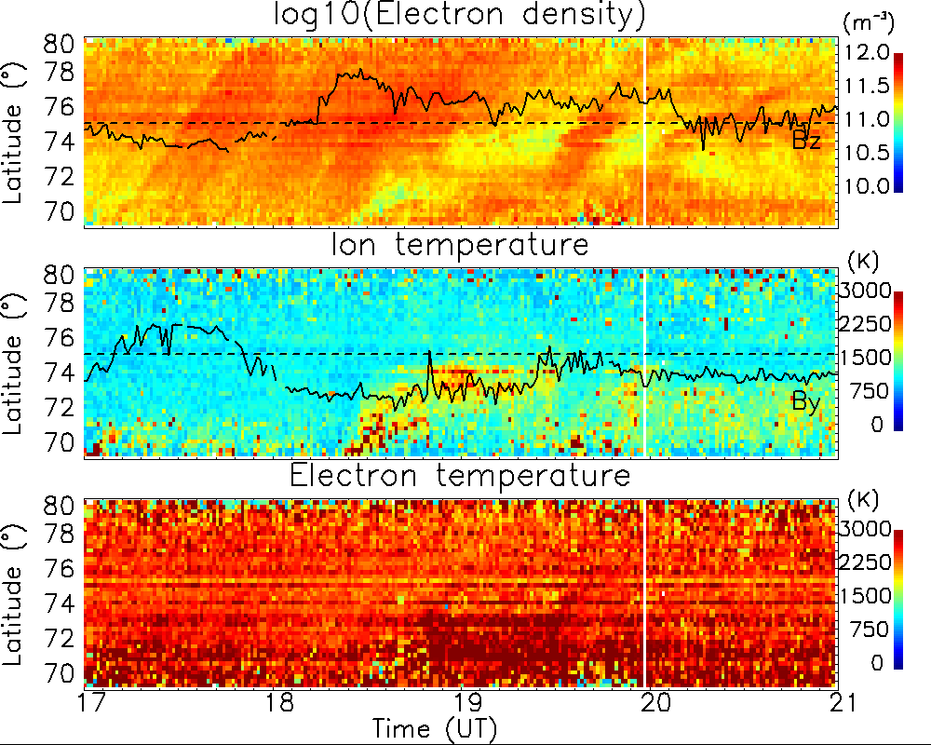
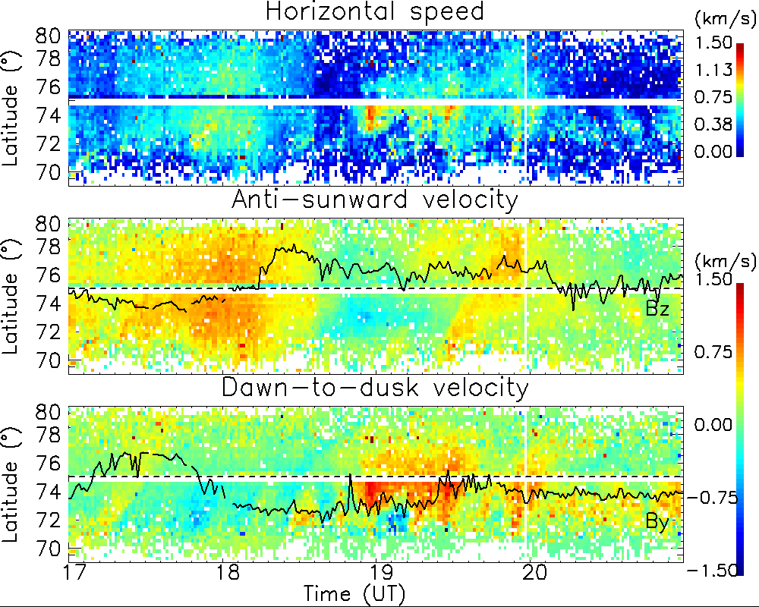
RISR keograms:
-Ion temperature enhancement coincides with electron density depletion and IMF and convection changes

Slide 12
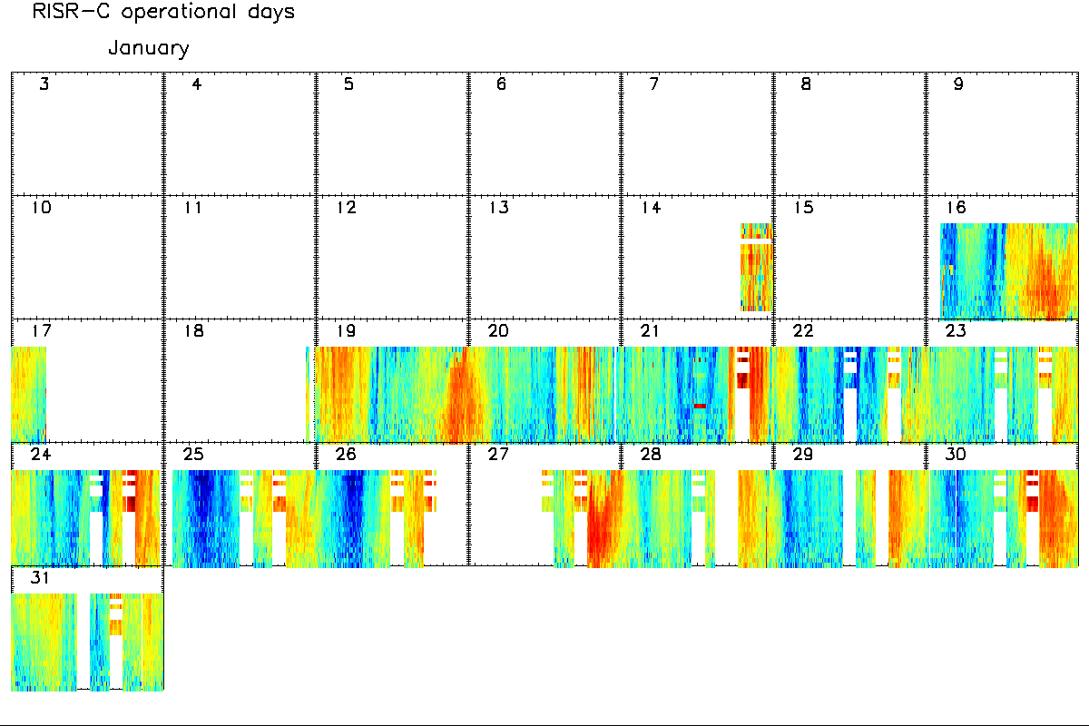
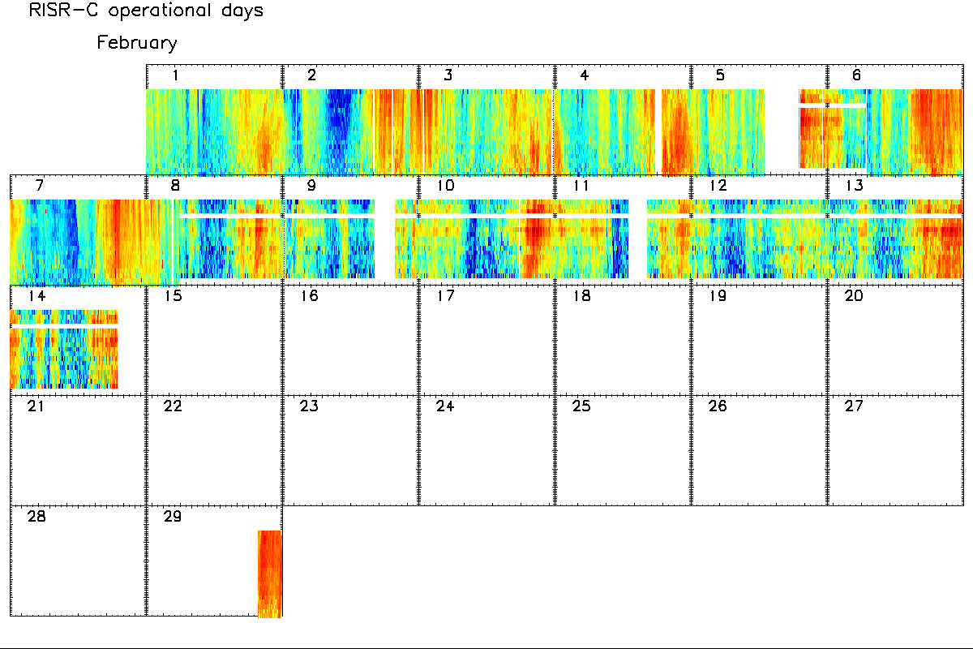
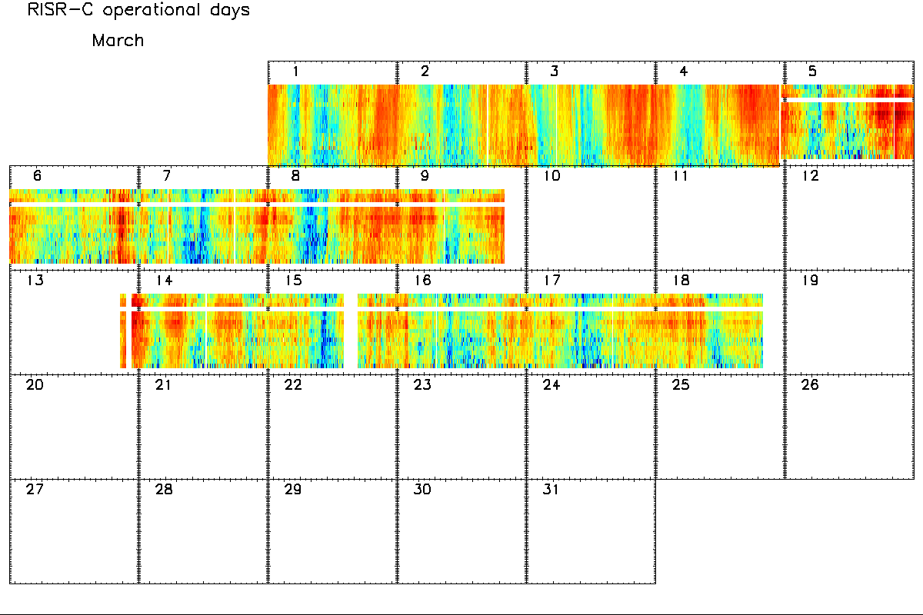
RISR-C 2016 operations and data access:
January:
42 days of RISR-C data from Jan.-Mar.
RISR-N was also operating for these days
Experiment modes used:
  11-beam World day mode (LP and AC data)
  51-beam imaging mode (LP data)
  4-beam topside mode for ePOP conjunctions (LP data)
Processed data available in .H5 file format
  Contact R. Gillies for data (email:rgillies@ucalgary.ca)
February:
March:

Slide 13
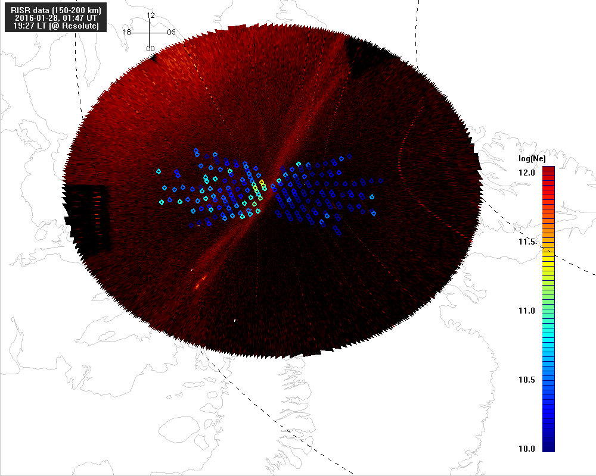
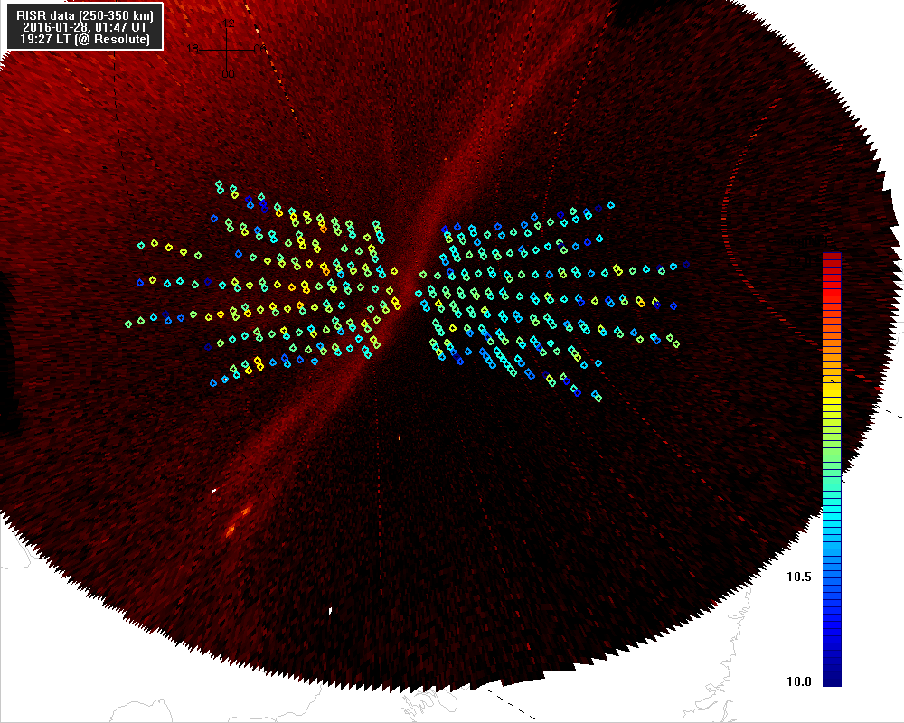
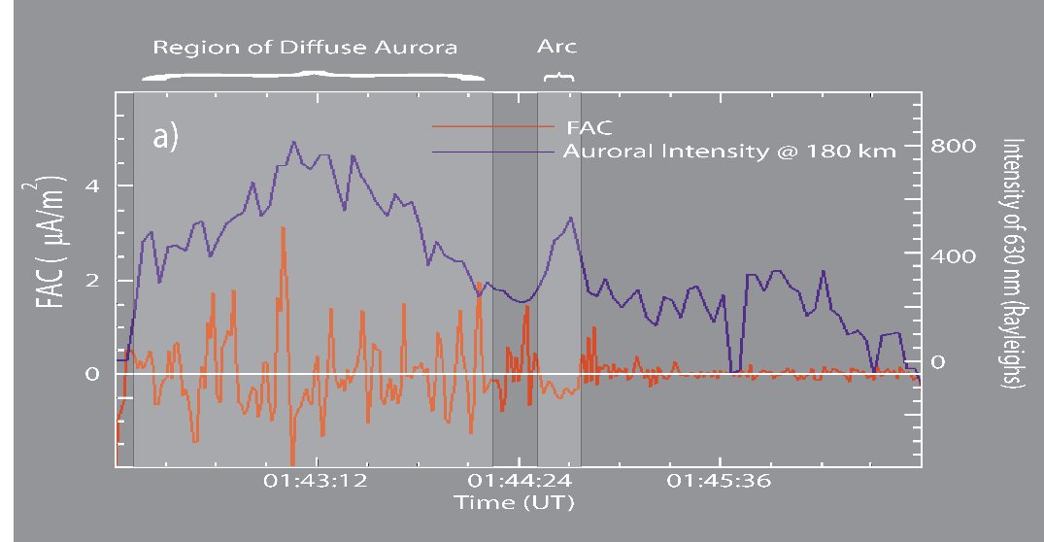
REGO/RISR/SWARM polar arc study
RISR electron density at 150-200 km
REGO redline intensity mapped to 175 km
RISR electron density at 250-350 km
REGO redline intensity mapped to 300 km
SWARM FAC measurements (Figure courtesy D. M. Gillies)

Slide 14
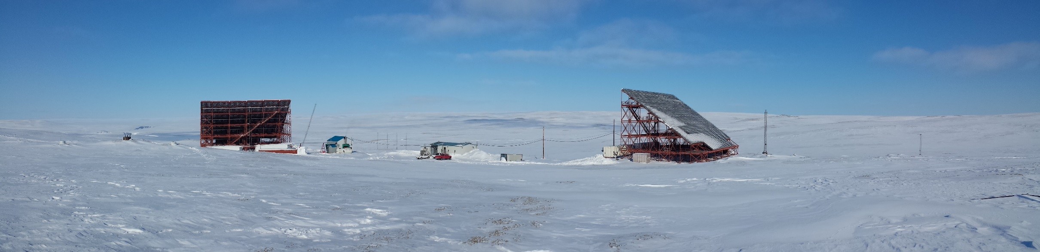
Summary:
RISR-C completed summer 2015
Data from RISR-C compares well to and complements data from RISR-N
Paper submitted to Radio Science on results from first 25-hrs of data
Routine operations since Jan. 2016 (~42 days so far)
RISR-C will be a valuable addition to polar cap science
  Complements other instruments in region: SuperDARN, REGO, SWARM, ePOP, RISR-N, etc.
Contact R. Gillies for data (email:rgillies@ucalgary.ca)

