Slide 1


Investigation of PeerWise Pedagogy to Promote Future Physics Teachers’ Pedagogical Content Knowledge
From Theory to Practice
Proudly supported by TLEF
Proudly supported by TLEF
Marina Milner-Bolotin
Davor Egersdorfer and Murugan Vinayagam
Canadian Association of Physicists’ Congress 2015
Notes:
Do we have a major question or theme to pose to the audience that summarizes our talk to engage them in the process?
2 pronged:
To talk about the resource that we have developed
To talk about how it is being used in classrooms at UBC
Consider it in two capacities at all times (teacher and student)

Slide 2
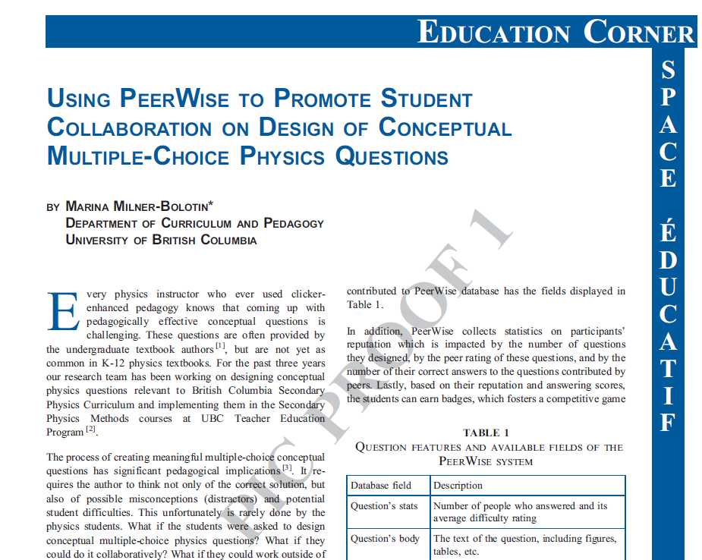
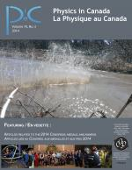
Question Title
Question Title
Milner-Bolotin, M. (2014). Using PeerWise to promote student collaboration on design of conceptual multiple-choice questions. Physics in Canada, 70(3), 149-150.

Slide 3
Question Title
Study Context
Question Title
Secondary Physics Method Course at the UBC Teacher Education Program
8 future teachers
Course Instructor – Dr. Marina Milner-Bolotin
Teaching Assistant – Davor Egersdorfer
Research Assistant – Murugan Vinayagam

Slide 4
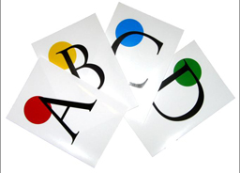
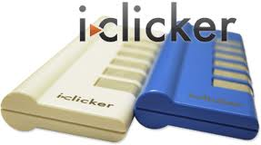
Question Title
Peer Instruction (PI)
Question Title
Engages students in answering conceptual multiple-choice questions that:
  target student difficulties
  use common misconceptions as distractors
Makes use of Classroom Response Systems (clickers) or flashcards
Notes:
In this course the instructor used Peer Instruction to teach the class

Slide 5
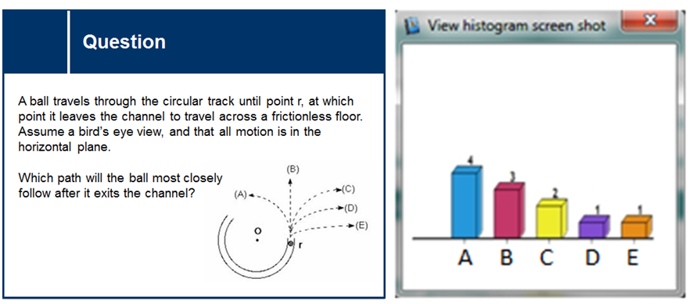
Figure 1: An example of a conceptual multiple-choice question and the distribution of students’ responses. The correct answer B was chosen by 3 out of 11 students.
Notes:
The point of peer instruction is to give students an opportunity to discuss the question amongst themselves and convince/argue/discuss

Slide 6
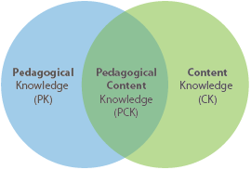
Question Title
Pedagogical Content Knowledge (PCK)
Question Title
PCK is knowledge for teaching specific content (Schulman, 1986)
http://iteacher.pxl.be/tpack
Notes:
PCK – the ability to ask good questions is within PCK
Combination of Content and Pedagogical Knowledge (a content-embedded pedagogy)
PCK includes knowledge of:
content and multiple ways of representing it
potential student difficulties
helpful illustrations, demonstrations, experiments, and examples
how to ask meaningful questions that promote conceptual understanding
how to facilitate independent thinking

Slide 7

Question Title
PeerWise
https://peerwise.cs.auckland.ac.nz/
Question Title
An online collaborative platform for hosting student-authored multiple-choice questions (Denny, 2015)
Allows students to answer, rate, and comment on multiple-choice questions created by their peers.

Slide 8
Question Title
PeerWise Implementation
Question Title
Cycle | Week | Expected Tasks
1 | 1 | Author at least six questions and upload them to PeerWise
 | 2 | Answer at least 10 questions designed by your peers Provide comments on at least five of the questions you answered
2 | 3 | Review all relevant comments on your questions and respond when applicable Modify at least three of your questions to address the comments Author at least three additional questions
 | 4 | Answer at least 10 questions designed by your peers Provide comments on at least five questions you answered
Cycle 2 repeats every two weeks for the duration of the course

Slide 9
Question Title
Analysis of PeerWise Questions
Question Title
Analyzed PCK quality of PeerWise questions (Bloom, 1956)
Weeks 2-3 vs. Weeks 11-13
Preliminary results show a significant increase in the quality of future physics teachers’ PCK
Notes:
A good teacher is someone who can ask good questions
The Instructor, TA and RA analyzed each question independently
Examples of measured PCK variables:
Question’s cognitive level (Bloom’s Taxonomy)
Explanation’s cognitive level (Bloom’s Taxonomy)
Question targets students’ difficulties
Science accuracy
Distractor’s quality
TCs justification of their answer
Clarity of the question
Inter-rater reliability was very high for all variables (greater than 0.8)
All variables showed a significant (p < 0.007) increase between T1 and T2

Slide 10
Question Title
Why should I use PeerWise in my classroom?
Question Title
Students learn content by asking/answering questions
Can be used with regular students
Gaming element (student engagement)
Can be used for any subject
Lots of support
Notes:
PeerWise can be used for other classes, not just physics or science
It doesn’t matter if you work with teachers or regular students
You learn a lot by asking and answering questions (learn content) – FIRST POINT – learn content by asking questions (as a teacher that’s how you learn, when students start asking questions)
We hope that the teachers that we used it with will use it in their classrooms
Make the points shorter, switch point around, questions are anonymous

Slide 11
Question Title
Question Title
Why should I use PeerWise in my classroom?
Does not require computers in the classroom
Once implemented, requires minimal input from the teacher
Promotes collaboration and peer learning
Students learn how to provide positive, constructive feedback
Free
Easy to use
Notes:
This is where I will go to the website and show them how easy it is to use
Conclusions:
Peer Instruction facilitated by PeerWise can help physics TCs develop their PCK
By creating, evaluating and revising their multiple-choice questions, TCs not only improved their ability to author conceptual physics questions, but also acquired skills in providing positive, constructive feedback

Slide 12
Question Title
Resources
Question Title
Bloom, B. S. (1956). Taxonomy of Educational Objectives: Cognitive Domain (1st ed.). New York: Longmans, Green.
Denny, P. (2013). The effect of virtual achievements on student engagement. In Proceedings of the SIGCHI Conference on Human Factors in Computing Systems - CHI ’13 (pp. 763–772). doi:10.1145/2470654.2470763
Denny, P. (2015). PeerWise. Retrieved April 1, 2015, from https://peerwise.cs.auckland.ac.nz/
Hake, R. R. (1998). Interactive-engagement versus traditional methods: A six-thousand-student survey of mechanics test data for introductory physics courses. American Journal of Physics, 66(1), 64–74. doi:10.1119/1.18809
Milner-bolotin, M., Fisher, H., & Macdonald, A. (2013). Modeling Active Engagement Pedagogy through Classroom Response Systems in a Physics Teacher Education Course. LUMAT: Research and Practice in Math, Science, and Technology Education, 1(5), 523–542.
Mishra, P., & Koehler, M. J. (2007). Technological pedagogical content knowledge (TPCK): Confronting the wicked problems of teaching with technology. In Society for Information Technology & Teacher Education International Conference (Vol. 2007, pp. 2214–2226). Retrieved from http://www.editlib.org/p/24919/

Slide 13
Question Title
Why use questions to teach?
Question Title
Challenge misconceptions
Engage students and encourage participation
Stimulate discussion
Determine how students are thinking
In order to ask/answer good conceptual questions you need to know the content

Slide 14
Question Title
Future Directions
Question Title
Analyze the comments that TCs provided, to see how they changed over the time during the course
A follow up study could be implemented to see if the TCs maintain their increased PCK and if they use PI techniques within their classrooms

