Slide 1



Collective modes and interacting Majorana fermions in
topological superfluids
Joseph Maciejko
University of Alberta
CAP Congress @ UofA
June 15, 2015
Notes:
----- Meeting Notes (8/5/14 15:58) -----

Slide 2
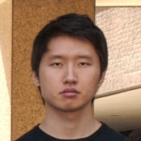
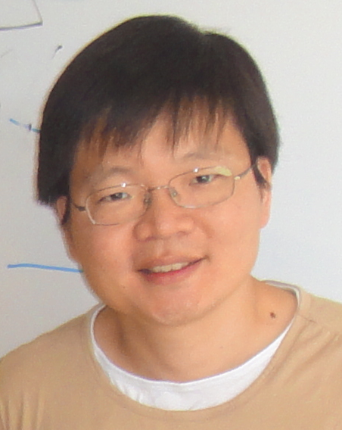
Collaborators
YeJe Park
(KAIST)
Suk Bum Chung
(IBS/SNU)
Y. J. Park, S. B. Chung, and JM, Phys. Rev. B 91, 054507 (2015)

Slide 3
“Free fermion” topological phases
Classification of free fermion topological phases is well understood (Kitaev, Schnyder, Ryu, Furusaki, Ludwig, …)
Bulk: gapped, characterized by topological invariant (Z or Z₂) that corresponds (sometimes) to quantized physical observable
Surface: gapless, protected by symmetry, cannot be realized by symmetry-preserving lattice model in same number of dimensions

Slide 4
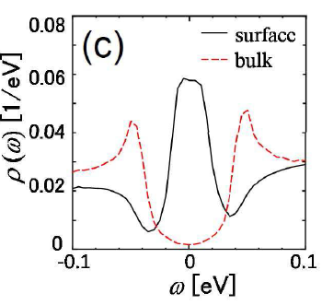
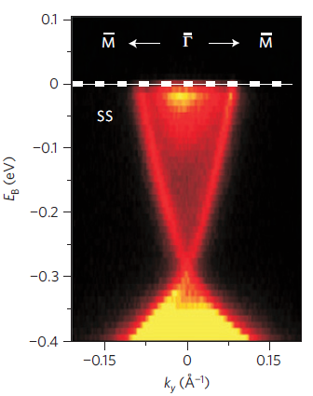
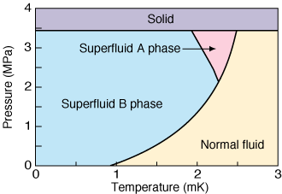
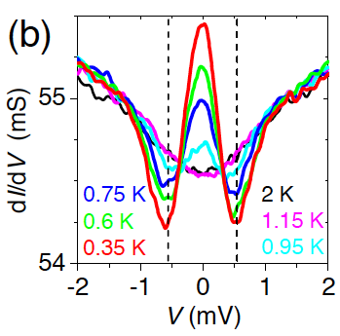
“Free fermion” topological phases
3D topological phases discovered experimentally via detection of 2D surface states
Bi₂Se₃ (Xia et al., Nat. Phys. 2009)
³He-B? (Murakawa et al., JPSJ 2011)
Cu_{x}Bi₂Se₃? (Sasaki et al., PRL 2011)
Notes:
Bi2Se3: ARPES, 3He-B: surface dependence of transverse acoustic impedance (scattering of sound waves by gapless surface Andreev bound states), CuxBi2Se3: point-contact spectroscopy on the surface -> zero-bias peak

Slide 5
“Free fermion” topological phases
3D topological phases discovered experimentally via detection of 2D surface states
Bi₂Se₃ (Xia et al., Nat. Phys. 2009)
³He-B? (Murakawa et al., JPSJ 2011)
Are these surface states truly free fermion systems? If not, how to describe/measure their interactions?
Cu_{x}Bi₂Se₃? (Sasaki et al., PRL 2011)
Notes:
Bi2Se3: ARPES, 3He-B: surface dependence of transverse acoustic impedance (scattering of sound waves by gapless surface Andreev bound states), CuxBi2Se3: point-contact spectroscopy on the surface -> zero-bias peak

Slide 6
“Free fermion” topological phases
3D topological phases discovered experimentally via detection of 2D surface states
³He-B? (Murakawa et al., JPSJ 2011)
Notes:
Bi2Se3: ARPES, 3He-B: surface dependence of transverse acoustic impedance (scattering of sound waves by gapless surface Andreev bound states), CuxBi2Se3: point-contact spectroscopy on the surface -> zero-bias peak

Slide 7
Outline
Motivation
Interacting 3D topological superfluids: Surface Majorana fermions and bulk collective modes in ³He-B
  Y. J. Park, S. B. Chung, and JM, Phys. Rev. B 91, 054507 (2015)
Conclusion

Slide 8
Theory of topological SF/SC
Theory of topological superfluids/superconductors was developed by analogy with topological insulators (Volovik, Read, Green, Roy, Schnyder, Ryu, Furusaki, Ludwig, Kitaev, Qi, Hughes, Raghu, Zhang, …)
Topological Insulator (TI)
Topological Superfluid/Superconductor (TSF/TSC)
electrons
Bogoliubov QPs
Bloch Hamiltonian
BdG Hamiltonian
band gap
pairing gap

Slide 9
Theory of TSF/TSC: beyond BdG?
But TI and TSF/TSC are fundamentally different: pairing comes from interactions!
SF/SC pairing gap comes from a dynamical order parameter, while insulating band gap is static
BdG formalism = mean-field theory, ignores order parameter fluctuations (thermal and quantum)
Bogoliubov QPs are “free fermions” in the BdG description
How do OP fluctuations affect the physics of TSF/TSC?

Slide 10
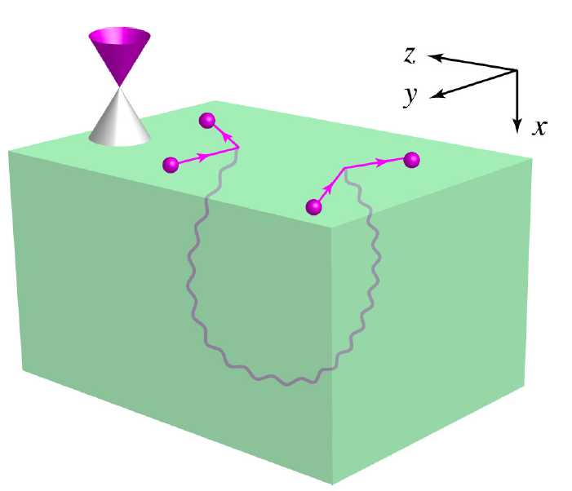
Theory of TSF/TSC: beyond BdG?
Main message: bulk OP fluctuations can induce interactions among boundary Majorana fermions
Focus on quantum (T=0) OP fluctuations in ³He-B (class DIII TSF with ν=1)

Slide 11
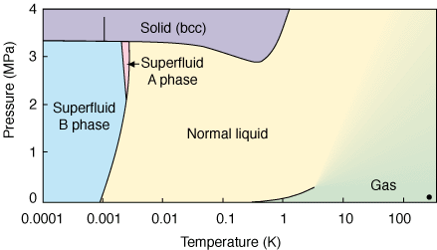
³He phase diagram
(credit: Aalto University)
Notes:
In CMP, we are interested in the way in which systems of many particles organize themselves into states of matter.
DIFFERENCE BETWEEN BEC AND SUPERFLUIDITY?

Slide 12
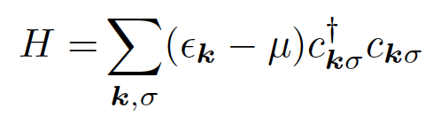
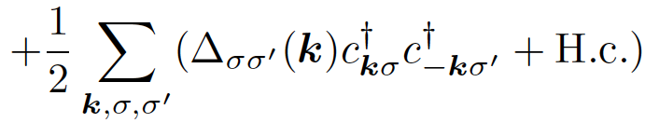

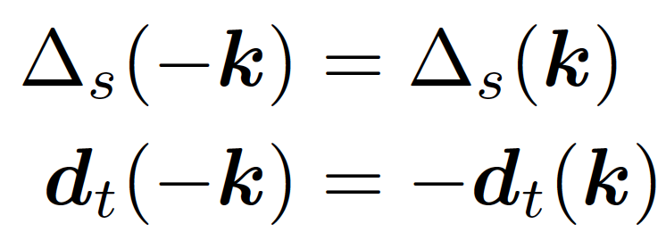
Paired superfluids
³He-B = superfluid of paired fermionic ³He atoms
In general, order parameter can have singlet and triplet components:
Fermi statistics implies:
even-parity (s,d,…)
odd-parity (p,f,…)
Notes:
In CMP, we are interested in the way in which systems of many particles organize themselves into states of matter.
DIFFERENCE BETWEEN BEC AND SUPERFLUIDITY?

Slide 13
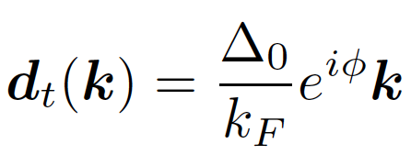
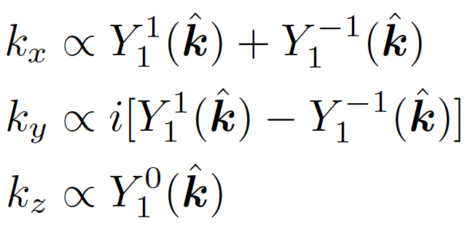
Balian-Werthamer state
Bogoliubov QPs in ³He-B are described by the Balian-Werthamer state = spin-triplet p-wave pairing (Balian & Werthamer 1963; Vdovin 1963)
Notes:
In CMP, we are interested in the way in which systems of many particles organize themselves into states of matter.
DIFFERENCE BETWEEN BEC AND SUPERFLUIDITY?

Slide 14
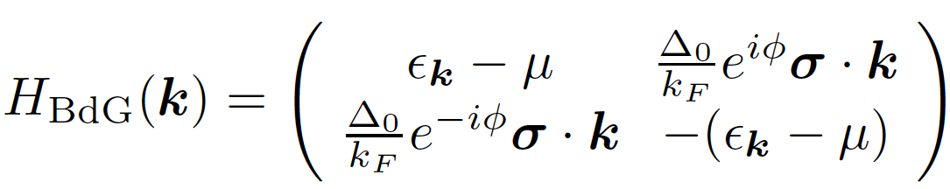
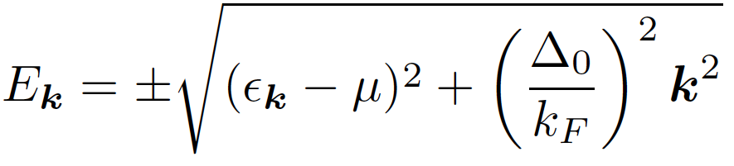
Balian-Werthamer state
Bogoliubov QPs in ³He-B are described by the Balian-Werthamer state = spin-triplet p-wave pairing (Balian & Werthamer 1963; Vdovin 1963)
QP spectrum is fully, isotropically gapped (for μ ≠ 0)
Fermi surface
k
2Δ₀
Notes:
In CMP, we are interested in the way in which systems of many particles organize themselves into states of matter.
DIFFERENCE BETWEEN BEC AND SUPERFLUIDITY?

Slide 15
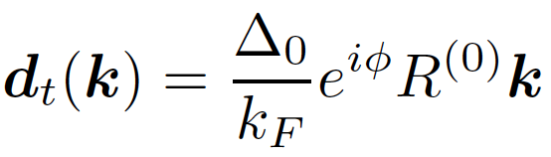
Balian-Werthamer state
Spectrum remains invariant if we rotate k by an arbitrary 3x3 rotation matrix R⁽⁰⁾:
d_{t}
k
Notes:
In CMP, we are interested in the way in which systems of many particles organize themselves into states of matter.
DIFFERENCE BETWEEN BEC AND SUPERFLUIDITY?

Slide 16

Balian-Werthamer state
Spectrum remains invariant if we rotate k by an arbitrary 3x3 rotation matrix R⁽⁰⁾:
d_{t}
k
Notes:
In CMP, we are interested in the way in which systems of many particles organize themselves into states of matter.
DIFFERENCE BETWEEN BEC AND SUPERFLUIDITY?

Slide 17
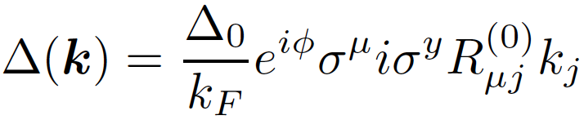
Balian-Werthamer state
Order parameter: amplitude Δ₀ and Josephson phase φ, but also 3x3 matrix R of relative spin-orbit rotations
Notes:
In CMP, we are interested in the way in which systems of many particles organize themselves into states of matter.
DIFFERENCE BETWEEN BEC AND SUPERFLUIDITY?

Slide 18
Strong vs weak pairing
Can show that gapless point μ=0 corresponds to a topological quantum phase transition between a trivial SF and a topological SF
Unlike the BEC-BCS crossover for s-wave SF, in the p-wave case this is a genuine thermodynamic phase transition
³He-B corresponds to μ>0: topological SF
ε_{F}
ε_{F}
strong pairing
“BEC”
weak pairing
“BCS”
μ
trivial SF
μ=0
topological SF
Notes:
In CMP, we are interested in the way in which systems of many particles organize themselves into states of matter.
DIFFERENCE BETWEEN BEC AND SUPERFLUIDITY?

Slide 19
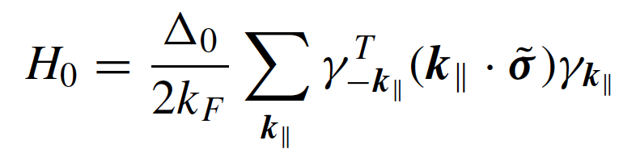
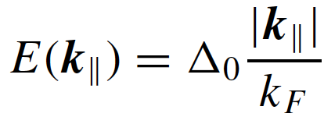
Surface Majorana fermions
Surface Andreev bound states = solution of BdG Hamiltonian in semi-infinite geometry, with uniform, constant background OP Δ₀, φ, R
Gives free Majorana fermions on the surface, linearly dispersing inside bulk gap (Nagato, Higashitani, Nagai 2009; Chung & Zhang, 2009)
³He-B
Notes:
In CMP, we are interested in the way in which systems of many particles organize themselves into states of matter.
DIFFERENCE BETWEEN BEC AND SUPERFLUIDITY?

Slide 20
Collective modes
But OP Δ₀, φ, R = dynamical variables, with quantum and thermal fluctuations
Focus on T=0 limit: only quantum OP fluctuations
Amplitude modes have a gap ~ bulk QP gap, ignore in low-energy limit
Four gapless bosonic Goldstone modes:
  1 phase mode: fluctuations of φ
  3 spin-orbit modes: fluctuations of R (Brinkman & Smith 1974)
Notes:
In CMP, we are interested in the way in which systems of many particles organize themselves into states of matter.
DIFFERENCE BETWEEN BEC AND SUPERFLUIDITY?

Slide 21
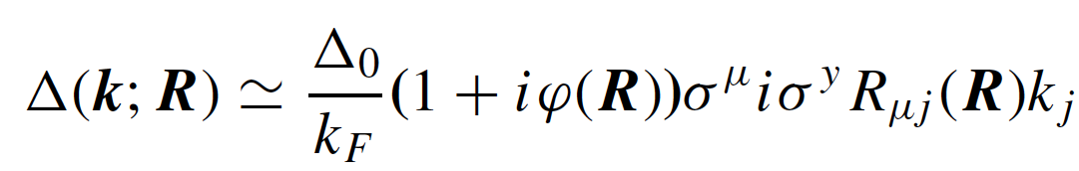
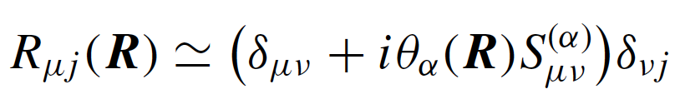
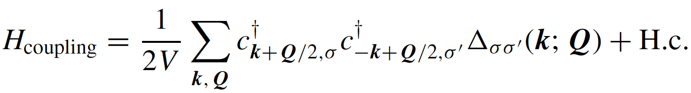
Fermion-boson coupling
Replace static OP in BdG Hamiltonian by position/time-dependent OP (Goldstone) fields
relative momentum
center-of-mass
momentum
Notes:
In CMP, we are interested in the way in which systems of many particles organize themselves into states of matter.
DIFFERENCE BETWEEN BEC AND SUPERFLUIDITY?

Slide 22
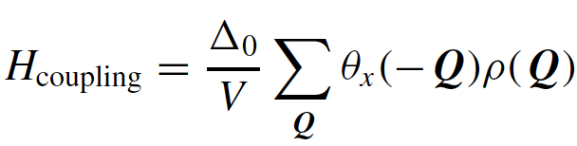
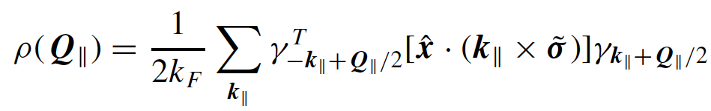
Surface-bulk coupling
In a semi-infinite geometry, this implies a coupling between surface Majorana fermions and bulk Goldstone modes
Of the phase mode φ and the spin-orbit modes θ_{x}, θ_{y}, θ_{z}, only θ_{x} couples to the Majorana fermions
φ does not couple because Majorana fermions are neutral
Only one component of SO modes couples because spin of Majorana fermions is “Ising” (Nagato, Higashitani, Nagai 2009; Chung & Zhang 2009)
Notes:
In CMP, we are interested in the way in which systems of many particles organize themselves into states of matter.
DIFFERENCE BETWEEN BEC AND SUPERFLUIDITY?

Slide 23
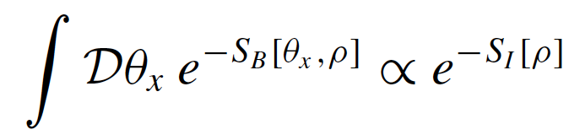

Effective surface theory
Derive an effective surface theory by integrating out bulk SO mode θ_{x}
θ_{x} is not truly gapless because of dipole-dipole interaction: quadratic energy cost for θ_{x} deviating from preferred value θ_{L} = Leggett angle (Leggett 1973; Brinkman & Smith 1974)
Notes:
In CMP, we are interested in the way in which systems of many particles organize themselves into states of matter.
DIFFERENCE BETWEEN BEC AND SUPERFLUIDITY?

Slide 24

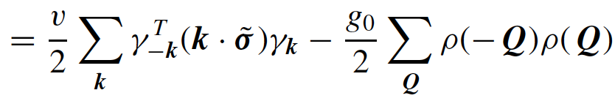
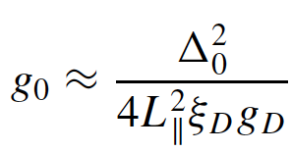
Effective surface interaction
Integrating out θ_{x} yields effective surface interaction = interaction between Majorana fermions mediated by exchange of bulk (quasi-)Goldstone bosons
Notes:
In CMP, we are interested in the way in which systems of many particles organize themselves into states of matter.
DIFFERENCE BETWEEN BEC AND SUPERFLUIDITY?

Slide 25
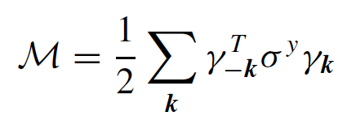
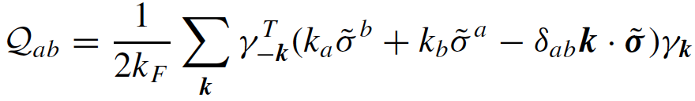
Possible broken symmetries
Interaction is perturbatively irrelevant at the free Majorana fermion fixed point, but here coupling constant is finite
Investigate possible broken symmetry states
To linear order in k, only allowed uniform order parameters are a T-breaking Ising OP (massive Majorana fermions) and a T-invariant nematic OP (gapless but anisotropic Majorana cone)
Investigate those in mean-field theory
Notes:
In CMP, we are interested in the way in which systems of many particles organize themselves into states of matter.
DIFFERENCE BETWEEN BEC AND SUPERFLUIDITY?

Slide 26
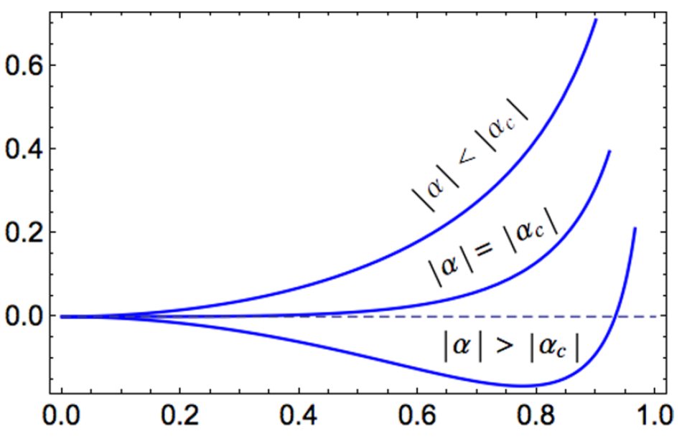
Nematic order
Ground-state
energy (a.u.)
Nematic order parameter (a.u.)
Continuous nematic transition is possible for negative couplings, but here coupling is positive
Notes:
In CMP, we are interested in the way in which systems of many particles organize themselves into states of matter.
DIFFERENCE BETWEEN BEC AND SUPERFLUIDITY?

Slide 27
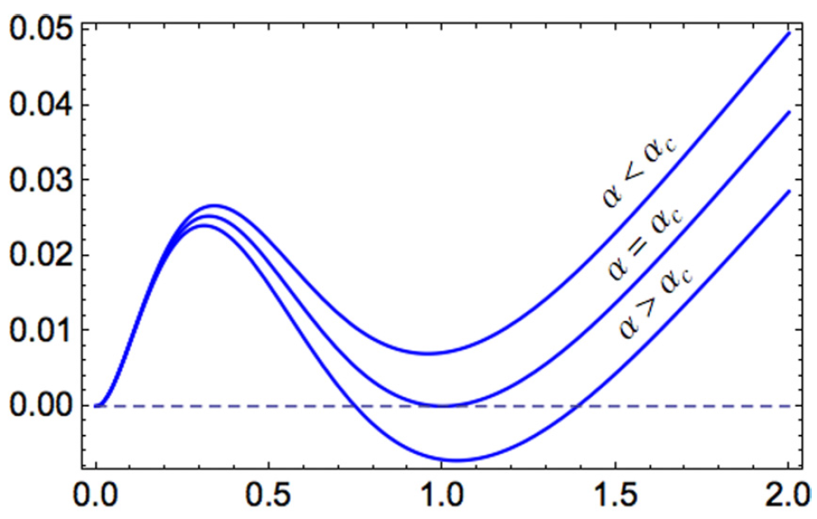
Ising order
Ground-state
energy (a.u.)
Ising order parameter (a.u.)
First-order transition to T-breaking phase with gapped Majorana fermions is possible in principle
Notes:
In CMP, we are interested in the way in which systems of many particles organize themselves into states of matter.
DIFFERENCE BETWEEN BEC AND SUPERFLUIDITY?

Slide 28
Summary
Quantum fluctuations of the superfluid OP in ³He-B can induce effective interactions among surface Majorana fermions
First-order transition to T-breaking phase of gapped Majorana fermions is possible in this model
Since evidence suggests gapless Majorana fermions in ³He-B, may be in a regime with metastable T-breaking surface phase
More exotic possibilities:
  Fluctuations render T-breaking transition continuous → possibility of N=1 SUSY quantum critical point (Grover, Sheng, Vishwanath 2014)
  Symmetric strong-coupling phase with surface topological order (Fidkowski, Chen, Vishwanath 2013; Metlitski, Fidkowski, Chen, Vishwanath 2014)
Notes:
In CMP, we are interested in the way in which systems of many particles organize themselves into states of matter.
DIFFERENCE BETWEEN BEC AND SUPERFLUIDITY?

