Slide 1
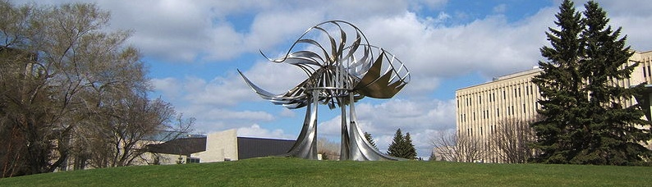




Simulating Anderson localization via a quantum walk on a one-dimensional lattice of superconducting qubits
$
$
Joydip Ghosh

Slide 2
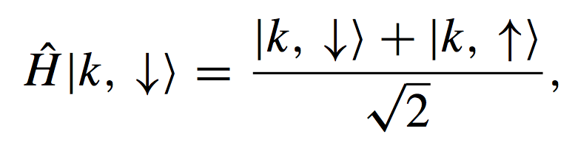
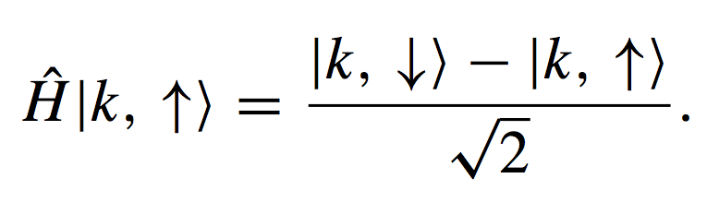
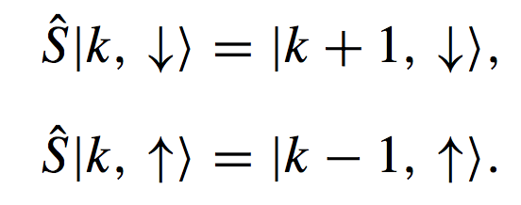
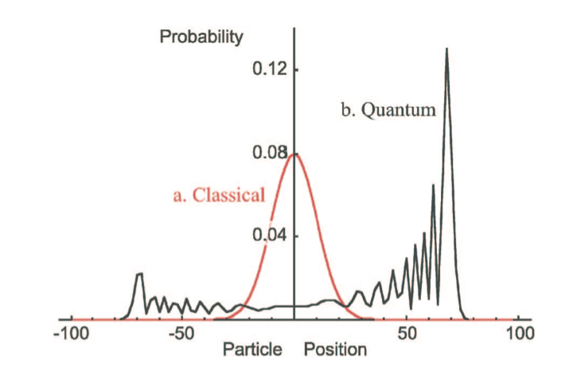
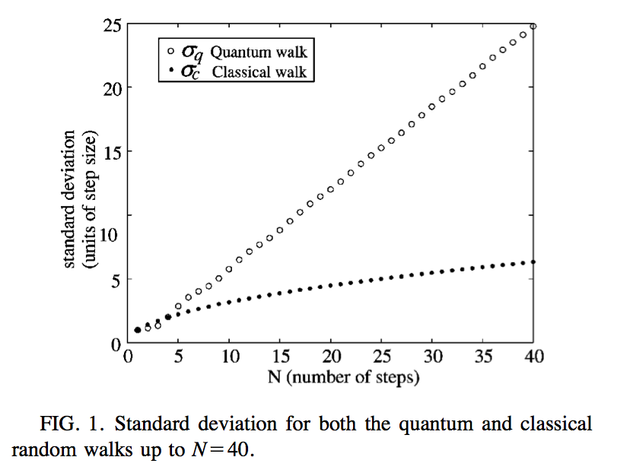
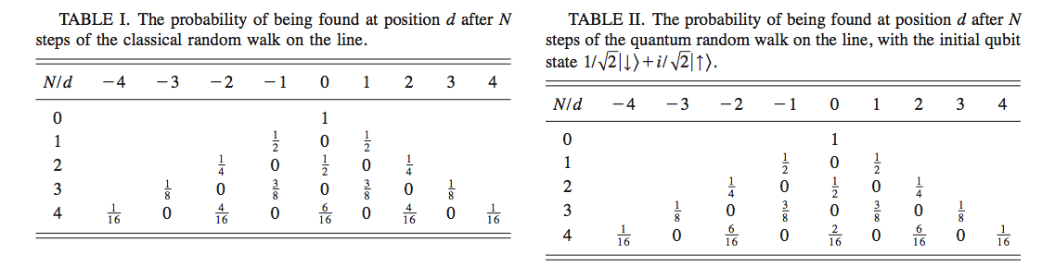

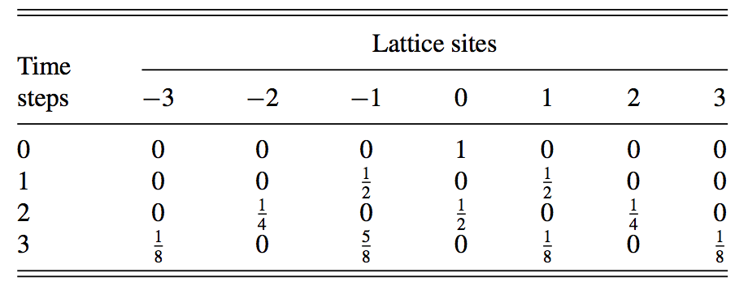
Discrete Time Quantum Walk (DTQW)
-3
-2
-1
0
1
2
3
+
What is the probability that the particle is on location d after N steps ?
  No closed form solution
Omar et al., PRA (2006)
Travaglione et al., PRA (2002)

Slide 3
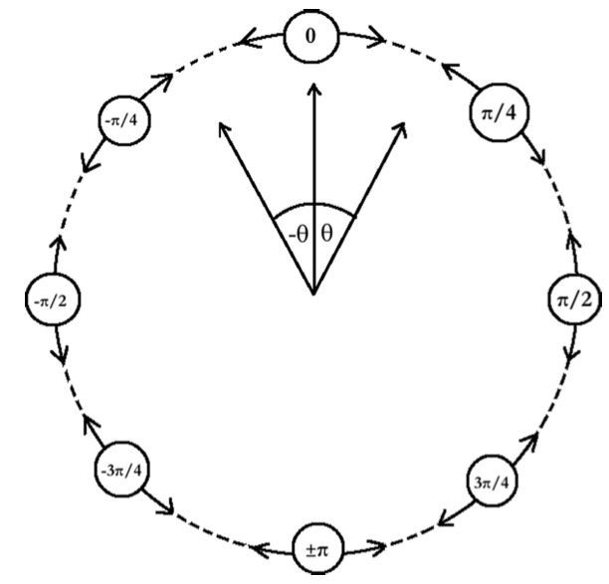

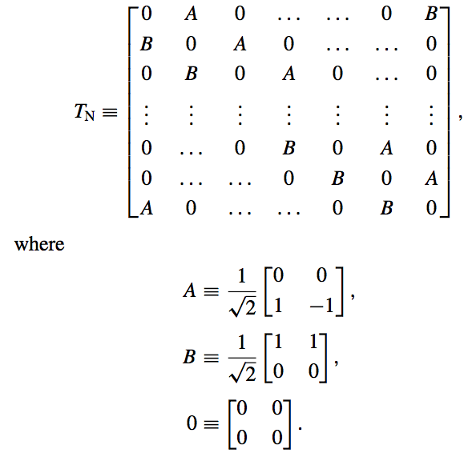
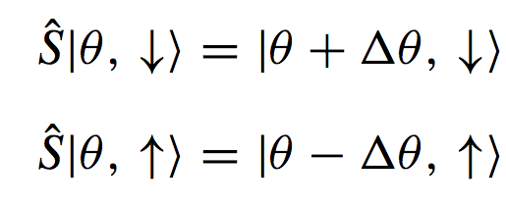

DTQW on a circle
Transfer-matrix representation
Hadamard
The action of transfer-matrix T_{N}
on the j^{th} timestep:
Conditional Shift
Aharonov et al. (2001)
Bednarska et al. (2003)
Notes:
Mention fractional recurrence

Slide 4
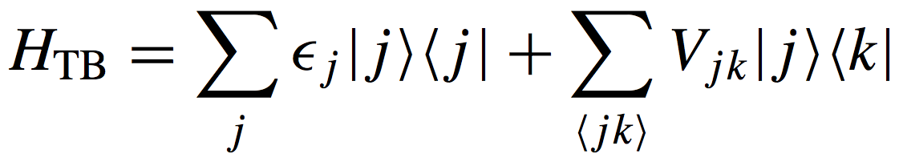
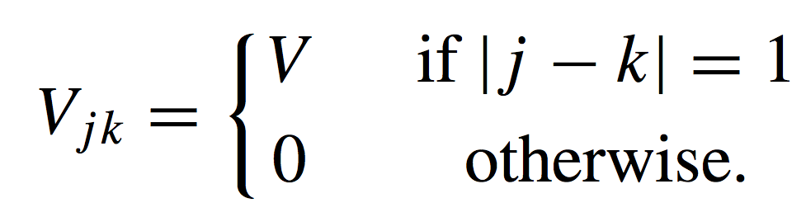
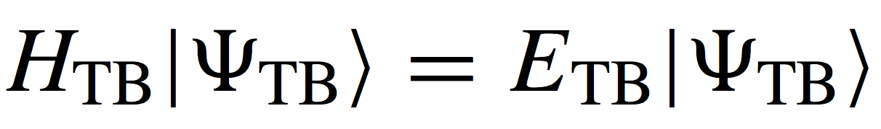
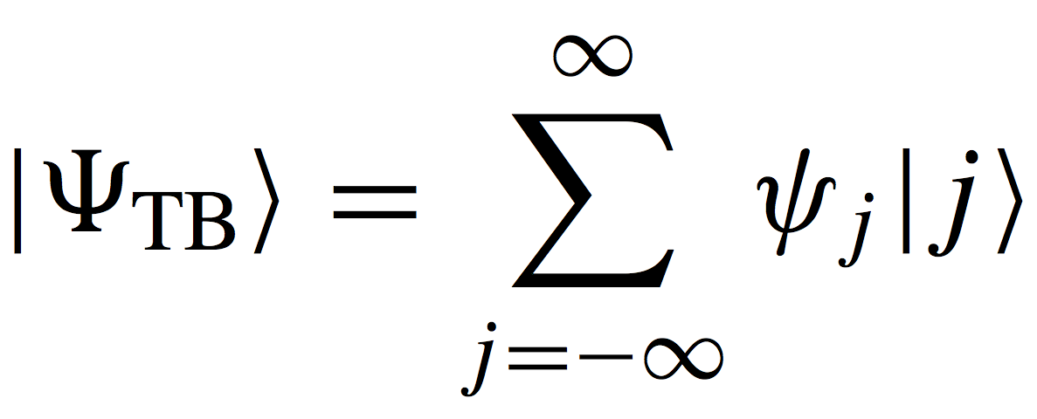
Anderson localization – Tight-binding model
Tight-binding Hamiltonian (on a 1D lattice):
Nearest-neighbor interaction:
Eigenstates:

Slide 5
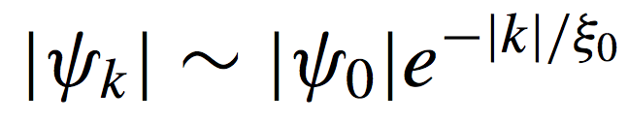
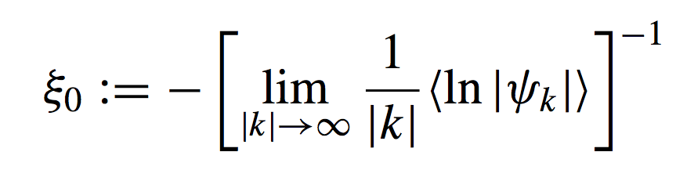
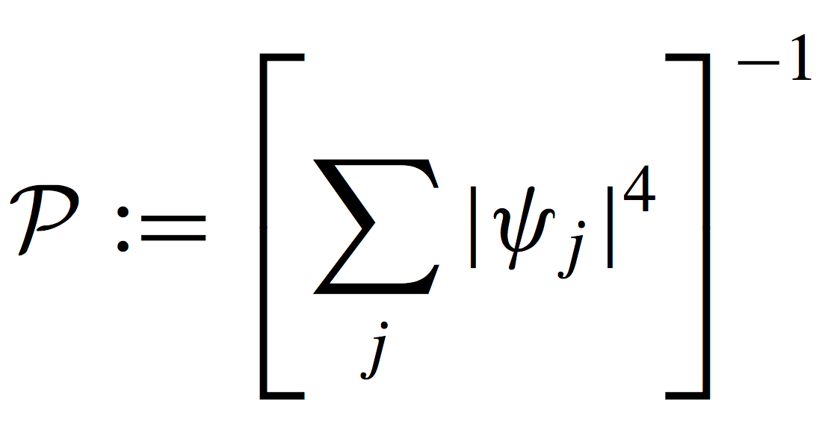

Anderson localization – Measures of localization
Exponential decay:
  Localization length:
Participation ratio:
n^{th} order moment:
(we consider 1st moment, i.e., n=1)

Slide 6
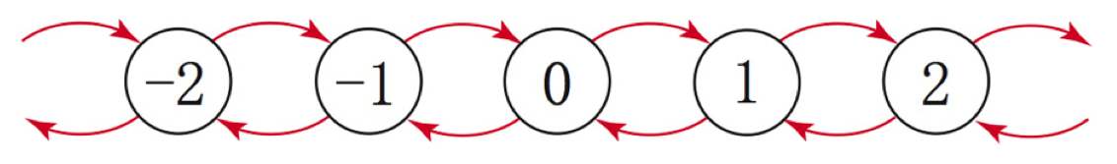
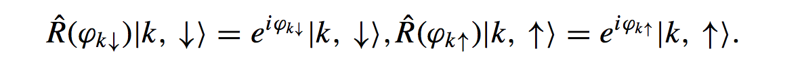
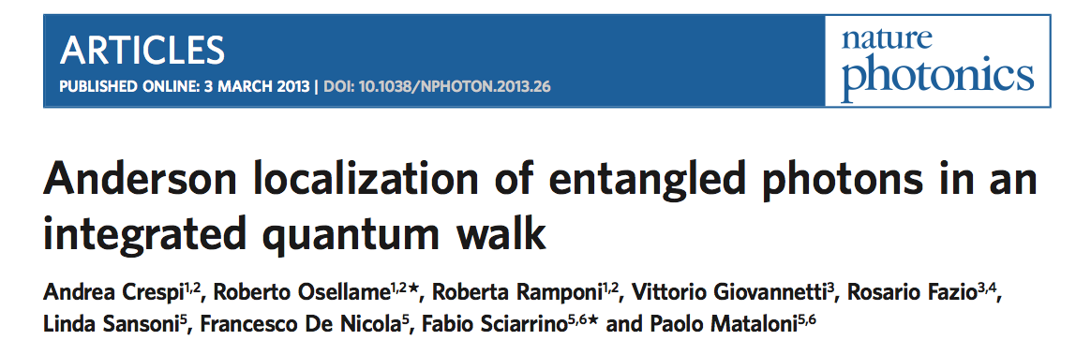
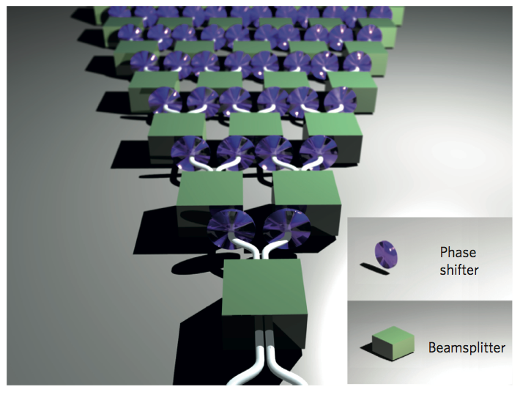
DTQW and Anderson localization
Implementation:

Slide 7
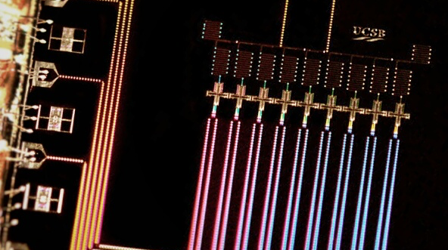
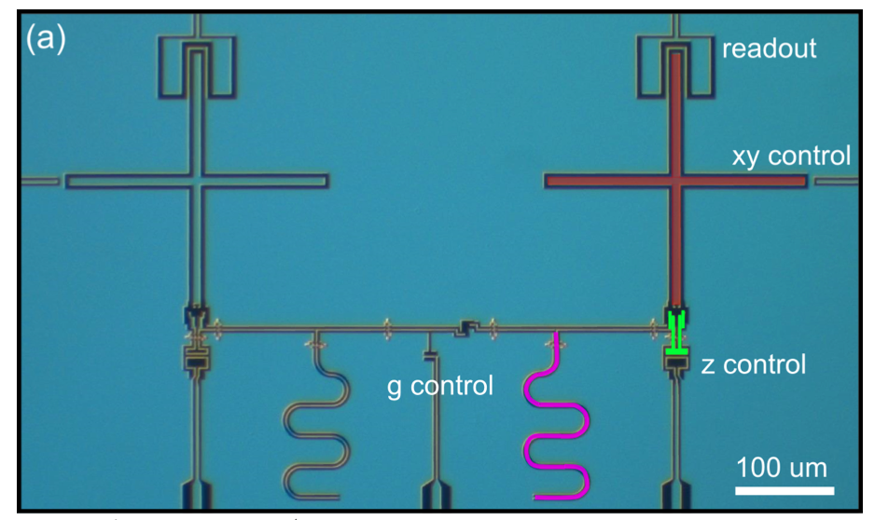
Superconducting qubits: Promises
UCSB
Scalability:
Tunability:
Long Coherence: T₁ ~ 60 μs.
UCSB

Slide 8
Superconducting qubits: Challenges
In-situ qubits: Can’t hop between adjacent lattice sites
Quasiparticles are spinless.

Slide 9
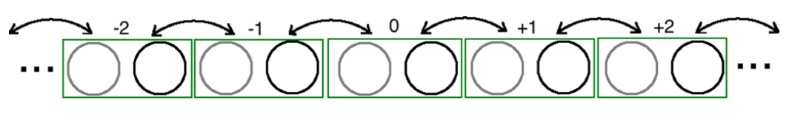
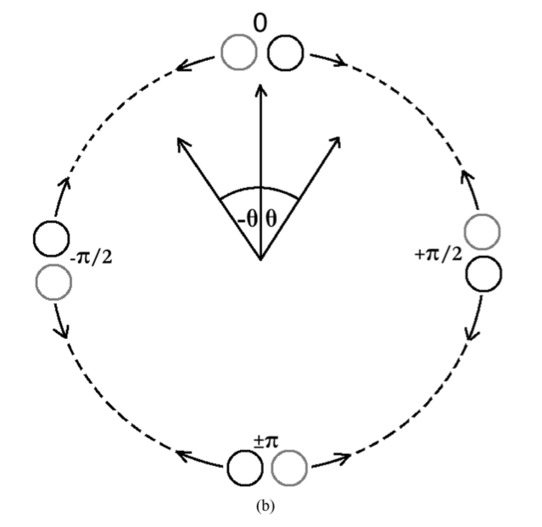
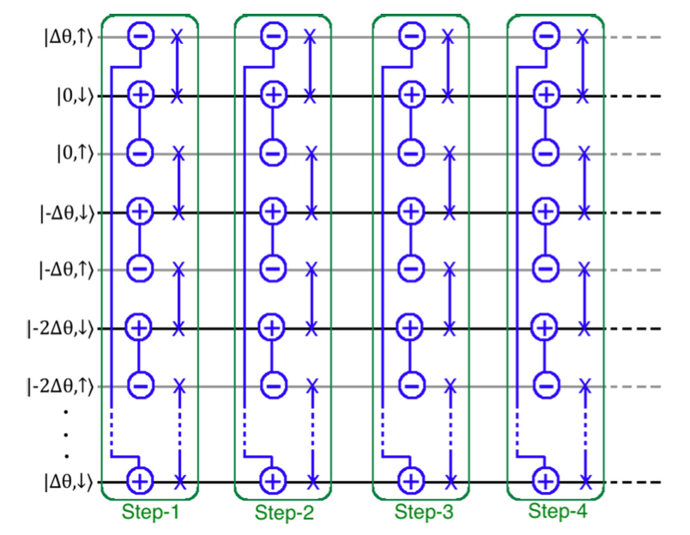
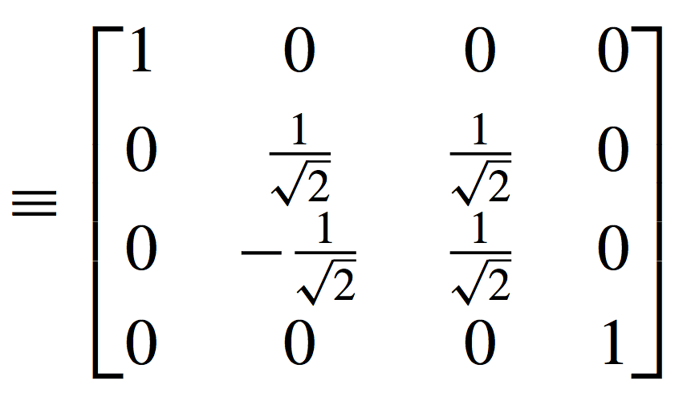
Simulating DTQW with SC qubits
xHadamard

Slide 10
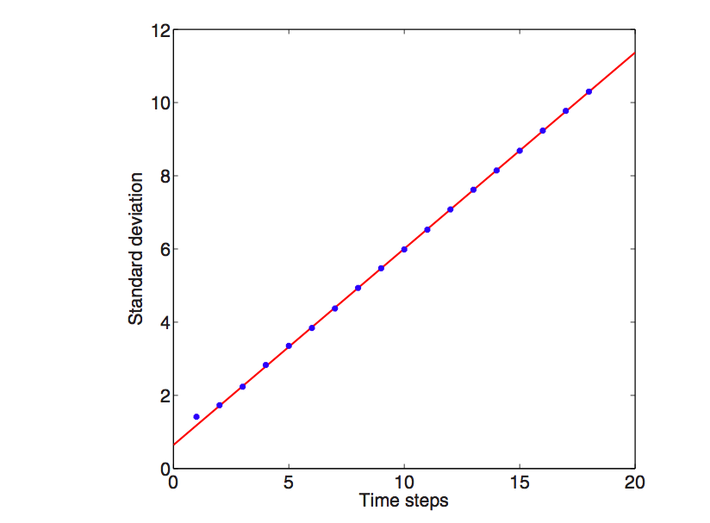
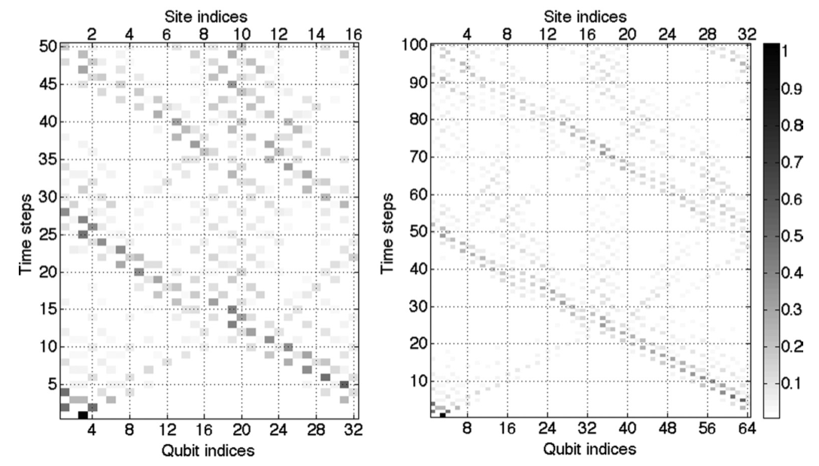
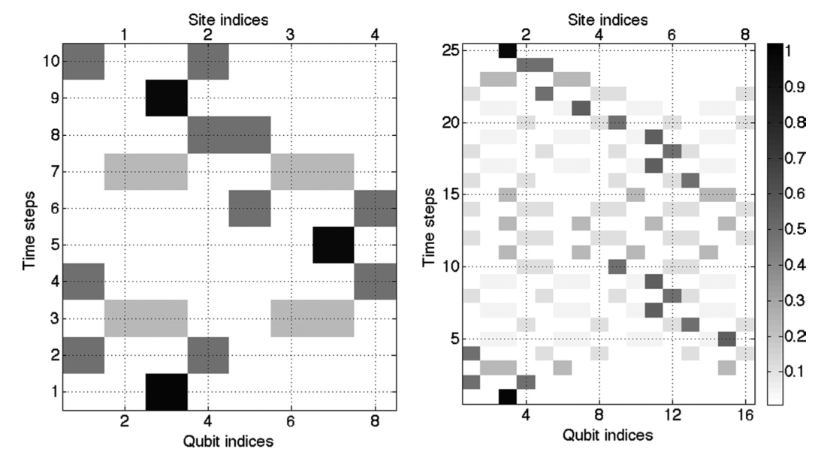

Simulating DTQW: Results

Slide 11
Simulating DTQW with disorder: Results
Z
Z
Z
Z
Z
Z
Z
Z
Z
Z
Z
Z
Z
Z
Z
Z
Z
Z
Z
Z
Z
Z
Z
Z

Slide 12
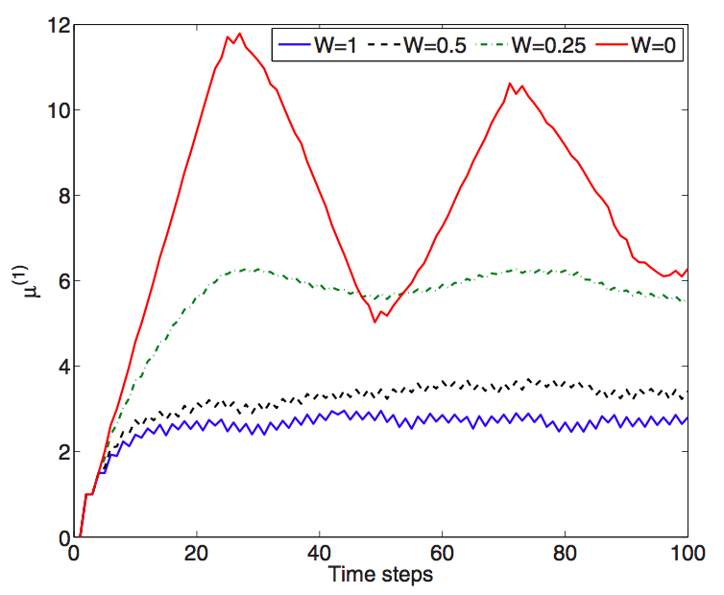
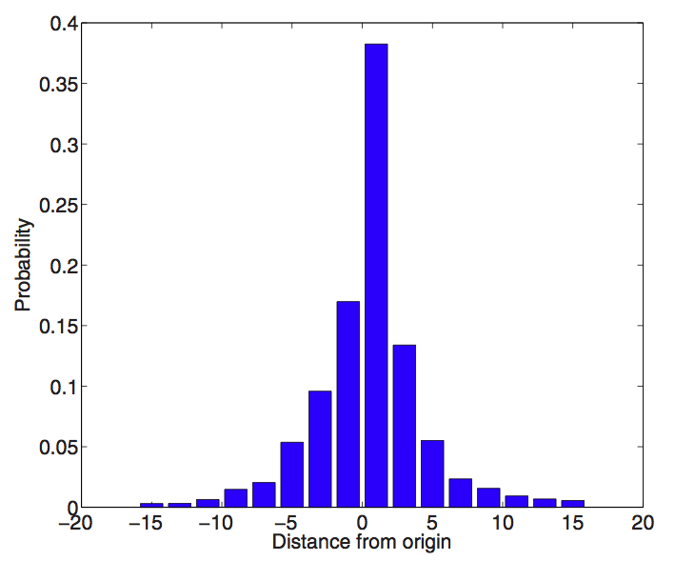
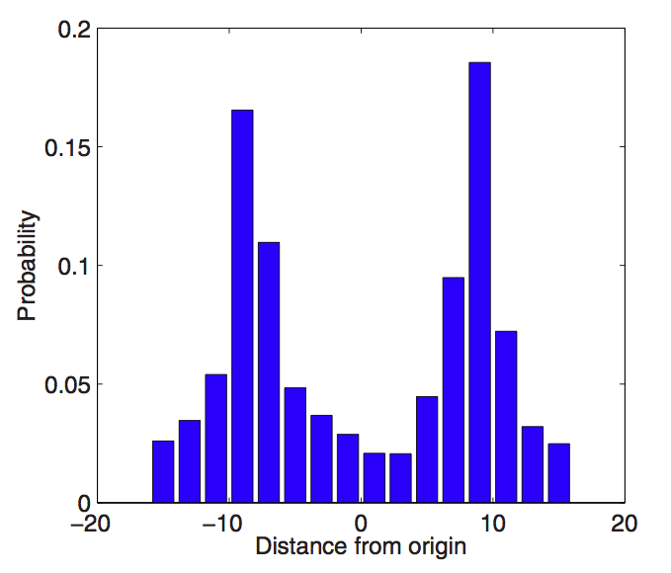
Simulating DTQW with disorder: Results
The Z-rotation angles are chosen randomly from the interval [−Wπ,Wπ], where W denotes the strength of disorder (0 < W < 1).
Bimodal distribution observed if the particle is prepared to be in superposition of two lattice sites.

Slide 13
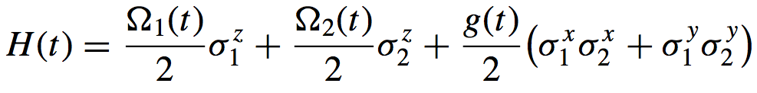
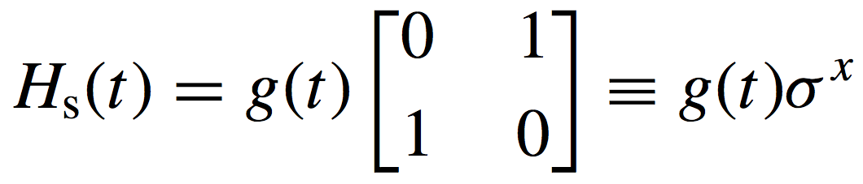
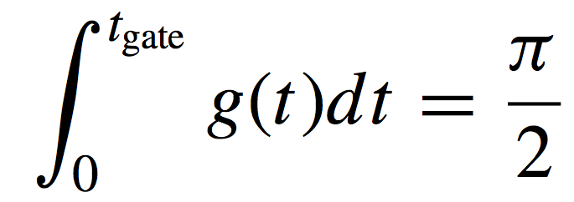
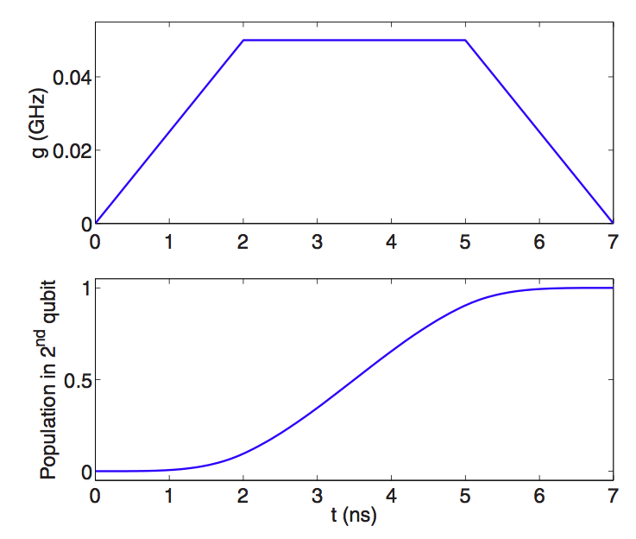
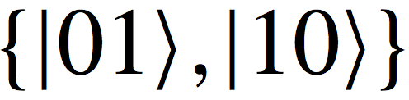
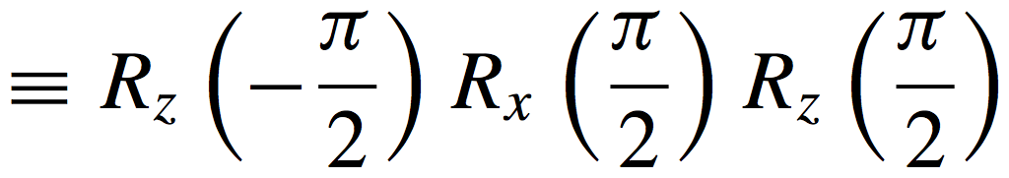
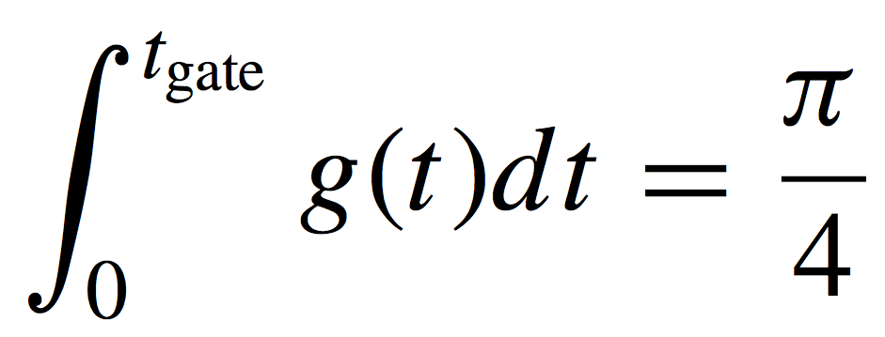
Designing gates
Coupled-qubit Hamiltonian:
Hamiltonian in single-excitation subspace
(with Ω₁ =Ω₂ =0 )
SWAP condition:
xHadamard = R_{y}(-π/2)
Condition:

Slide 14
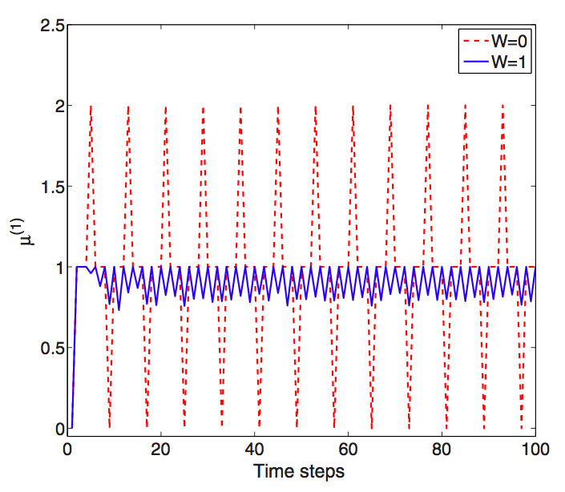
8-qubit case: A near-term (?) experiment
Minimal requirement:

Slide 15
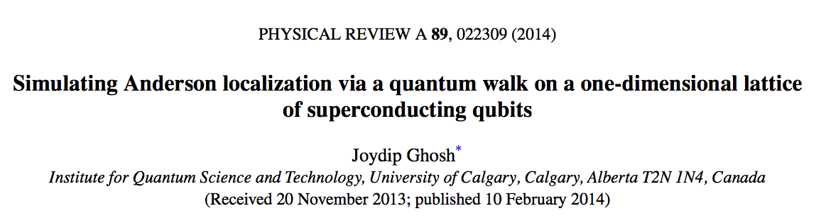
Summary and future directions
A gate-based scheme to simulate DTQW.
Disorders can be introduced and controlled.
Anderson localization observed with SC qubits.
Extension to multi-particle quantum walk.
Study interactions.
Time-dependent disorders.
Thank You !!!

Slide 16
Intrinsic errors and decoherence
Intrinsic errors:
  Suppressed below 10⁻⁴. (Ghosh et al., PRA, 2013)
  For single-particle case, it’s negligible.
Decoherence:
  100 time-steps in ~ 3 μs. (each step 30 ns.)
  T₁ ~ 60 μs.

Slide 17
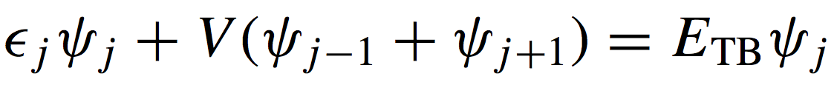
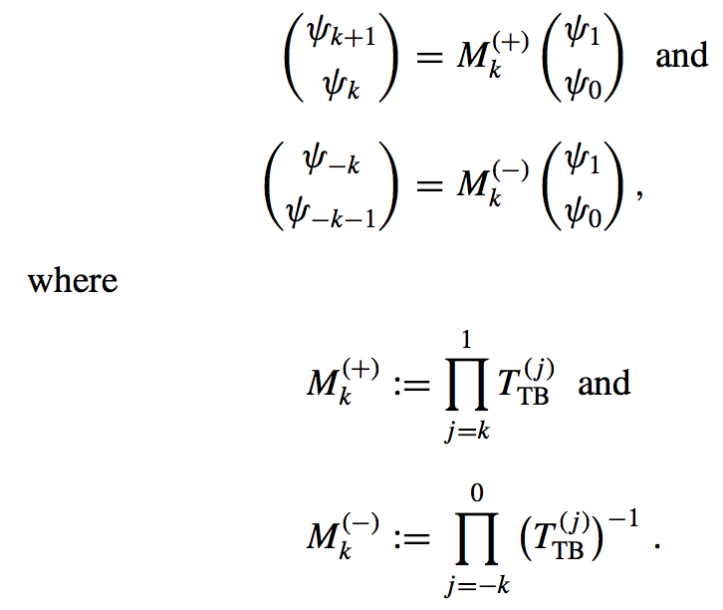
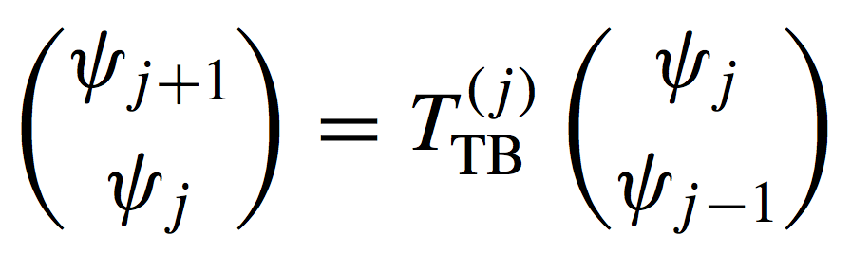
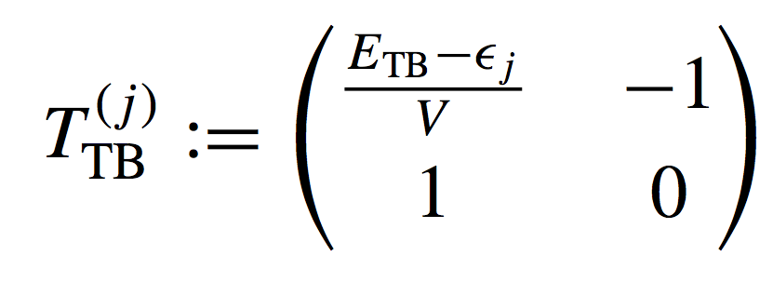
Anderson localization – Random Matrix Theory
Recurrence relation for the probability amplitudes:
In matrix form:
Transfer Matrix:
where

Slide 18
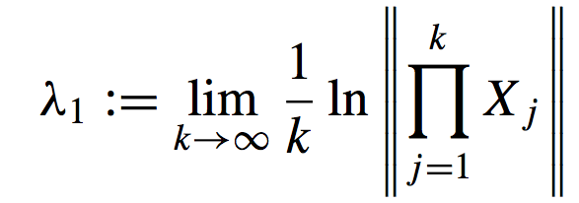
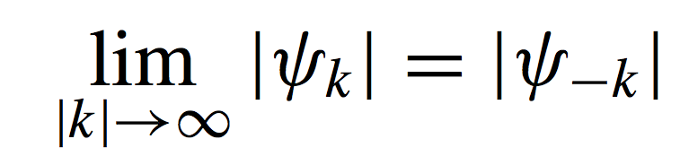
Anderson localization – Lyapunov exponent
Fürstenberg theorem: If {X_{j}} is a set of uniformly distributed random matrices, then the limit,
, exists and λ₁ is usually referred to as
Maximum Lyapunov Characteristic Exponent.
Also,
λ₁ is nonrandom in general and if the random matrices are uniformly distributed and the determinant of each random matrix X_{j} is unity, then λ₁ > 0.
In our case, it implies: .
For circular lattice, ?
Borland conjecture: 1/λ₁ evaluated at any arbitrary energy tends to the localization length as E_{TB} gets closer to the eigenvalue of that eigenstate.

