Slide 1
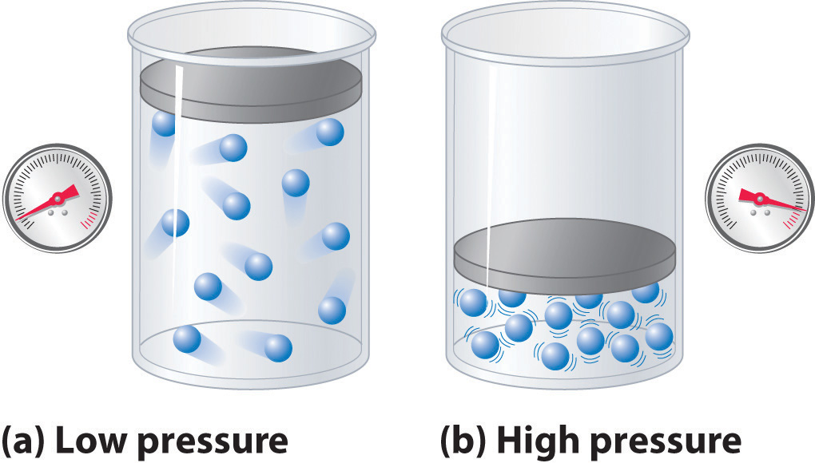
Black hole chemistry: thermodynamics with Lambda
David Kubizňák
(Perimeter Institute)
Λ
2015 CAP Congress
University of Alberta, Edmonton, Canada
June 15-19, 2015

Slide 2
Plan of the talk
Black holes as thermodynamic objects
Pressure-volume term
    Thermodynamic volume
    Isoperimetric inequality
    Smarr relation
Black hole chemistry: AdS thermodynamic analogues
    Van der Waals fluid and charged AdS black holes
    Triple point and solid/liquid/gas analogue
Conclusions
Friends: N.Altamirano, M.Cvetic, B.Dolan, A.Frassino, G.Gibbons, S. Gunasekaran, R.Hennigar, D. Kastor, A. Kostouki, R. Mann, N. Musoke, C. Pope, A. Rajagopal, Z. Sherkatghanad, F. Simovic, M. Teo, J. Traschen

Slide 3
i) Black holes as thermodynamic objects

Slide 4
If someone points out to you that your pet theory of the universe is in disagreement with Maxwell's equations-then so much the worse for Maxwell's equations. If it is found to be contradicted by observation-well these experimentalists do bungle things sometimes. But if your theory is found to be against the second law of thermodynamics I can give you no hope; there is nothing for it but to collapse in deepest humiliation.
Sir Arthur Stanley Eddington
Gifford Lectures (1927), The Nature of the Physical World (1928), 74.

Slide 5
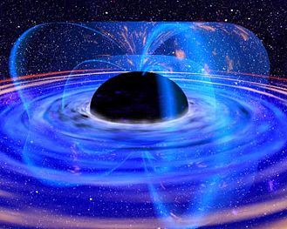
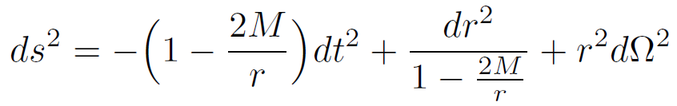
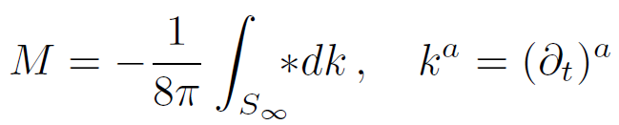

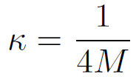



Schwarzschild black hole:
asymptotic mass (total energy)
black hole horizon: (radius rh=2M)
surface gravity
surface area
never decreases
Bekenstein?

Slide 6
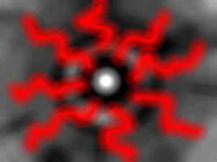
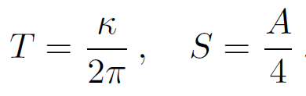
Hawking (1974):
When quantum effects are taken into account, black holes radiate away particles as black body.
When quantum effects are taken into account, black holes radiate away particles as black body.
derivation used QFT in curved spacetime
Other approaches: Euclidean path integral approach, Tunneling approach, LQG, String theory, ….

Slide 7
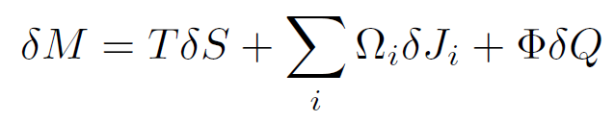
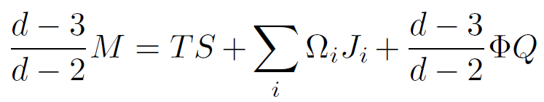
Black hole thermodynamics
First law of black hole thermodynamics:
Smarr-Gibbs-Duhem relation:
Where is the PdV term?

Slide 8
ii) Pressure-volume term
Λ

Slide 9
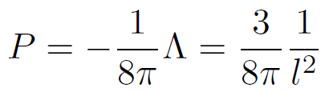
Proposal
Consider an asymptotically AdS black hole spacetime
Identify the cosmological constant with a thermodynamic pressure
Allow this to be a “dynamical” quantity

Slide 10
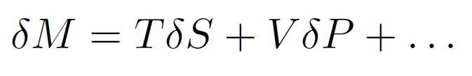


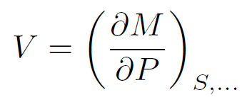
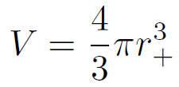
a) Thermodynamic volume
1st Law of black hole thermodynamics:
D.Kastor, S.Ray, and J.Traschen, Enthalpy and the Mechanics of AdS Black Holes, Class. Quant. Grav. 26 (2009) 195011, [arXiv:0904.2765].
Introduces PdV term into black hole thermodynamics
Mass M interpreted as enthalpy rather than energy
Thermodynamic volume of black holes:
Schwarzschild(-AdS):

Slide 11
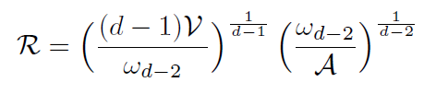
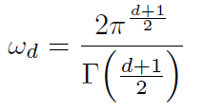

b) Good definition of volume: isoperimetric ineguality
Isoperimetric Inequalities (analogue of Penrose inequalities)
M. Cvetic, G.W Gibbons, DK, C.N. Pope, Black hole enthalpy and an entropy inequality for the thermodynamic volume, Phys. Rev. D84 (2011) 024037, [arXiv:1012.2888].
Conjecture: for any AdS black hole
Entropy inequality for the thermodynamic volume
“For a black hole of given thermodynamic volume V, the entropy is maximised for Schwarzschild-AdS”

Slide 12
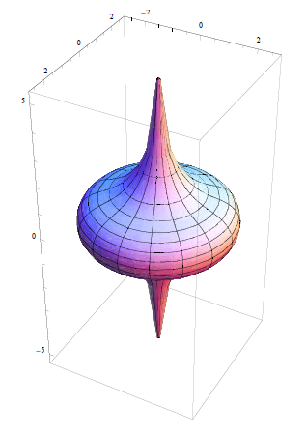
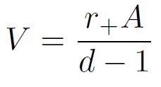
Super-entropic black holes
...recent work with R. Hennigar and R. Mann, N. Musoke
D.Klemm, Four-dimensional black holes with unusual horizons, arXiv:1401.3107.
Can be obtained by ultraspinning the Kerr-AdS black hole
Non-compact horizon with finite horizon area and cylindrical topology
Thermodynamic volume
violates ISO inequality

Slide 13
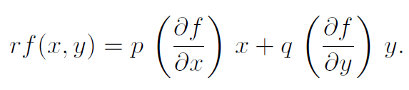



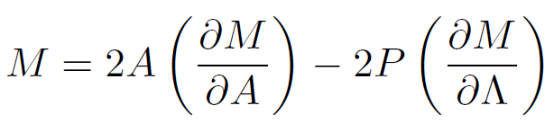


Correct Smarr relation
(scaling argument)
Euler’s theorem:
Mass of black hole:
since
Smarr relation:

Slide 14
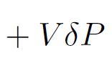
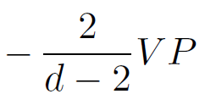
Black hole thermodynamics in AdS
First law of black hole thermodynamics:
Smarr-Gibbs-Duhem relation:

Slide 15
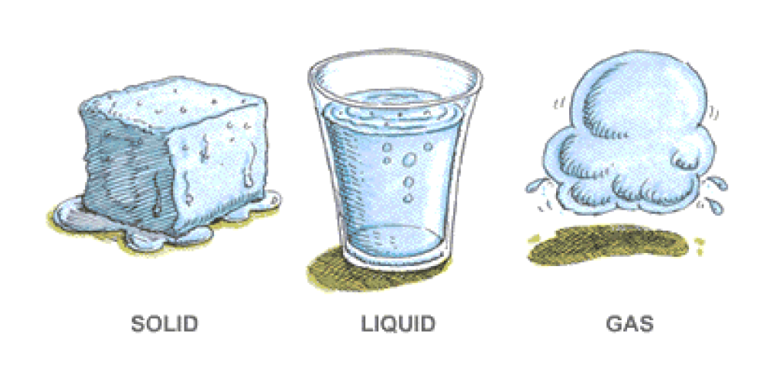
iii) Black hole chemistry: AdS thermodynamic analogues

Slide 16
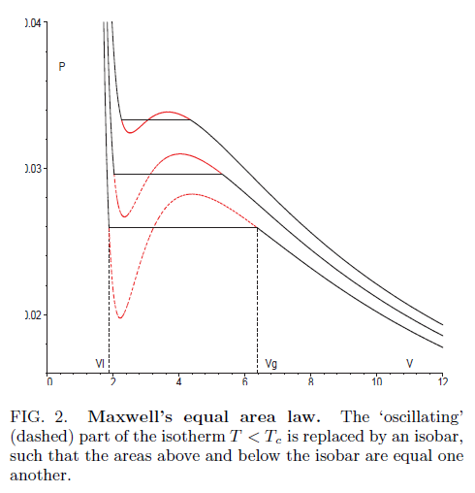

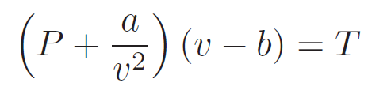

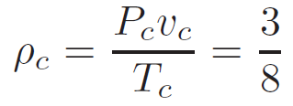
a) Van der Waals fluid and charged AdS BHs
Chamblin, Emparan, Johnson, Myers, Charged AdS black holes and catastrophic
holography, Phys.Rev. D60 (1999) 064018. [See also Cvetic & Gubser-JHEP 9904
(1999) 024.]
DK, R.B. Mann, P-V criticality of charged AdS black holes, JHEP 1207 (2012) 033.
Van der Waals fluid
Parameter a measures the attraction between particles (a>0) and b corresponds to “volume of fluid particles”.
Critical point:

Slide 17
a) Van der Waals fluid and charged AdS BHs
Chamblin, Emparan, Johnson, Myers, Charged AdS black holes and catastrophic
holography, Phys.Rev. D60 (1999) 064018. [See also Cvetic & Gubser-JHEP 9904
(1999) 024.]
DK, R.B. Mann, P-V criticality of charged AdS black holes, JHEP 1207 (2012) 033.
Van der Waals fluid
Critical point:

Slide 18
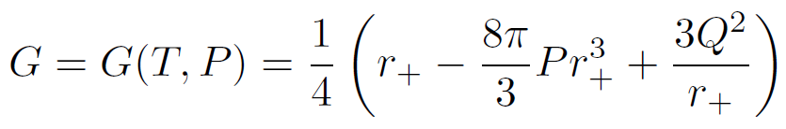
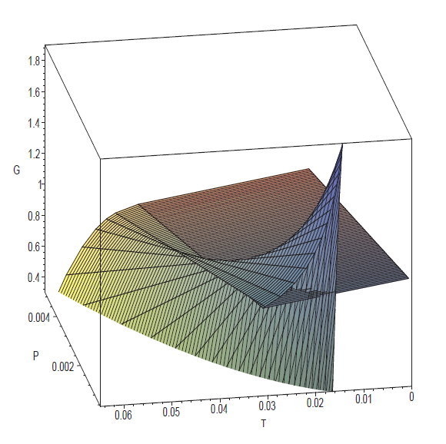
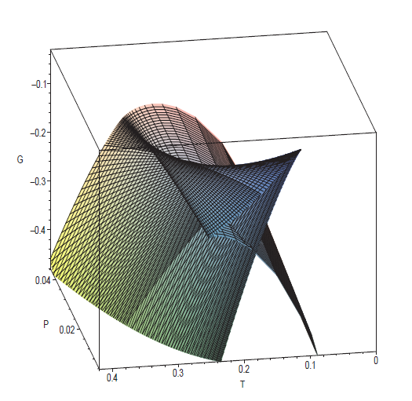
Gibbs free energy: demonstrates standard swallow tail behavior
vs.

Slide 19
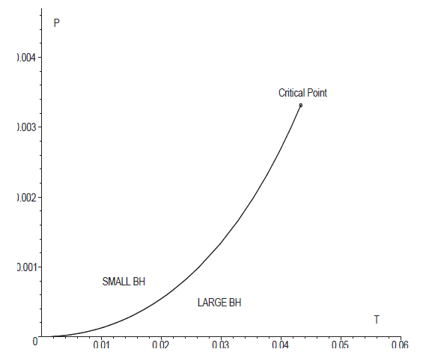
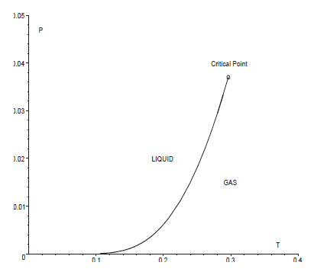
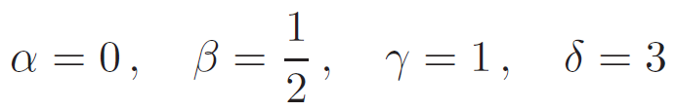
Coexistence line
vs.
Clausius-Clapeyron and Ehrenfest equations are satisfied
MFT critical exponents
govern specific heat, volume, compressibility and pressure at the vicinity of critical point.

Slide 20
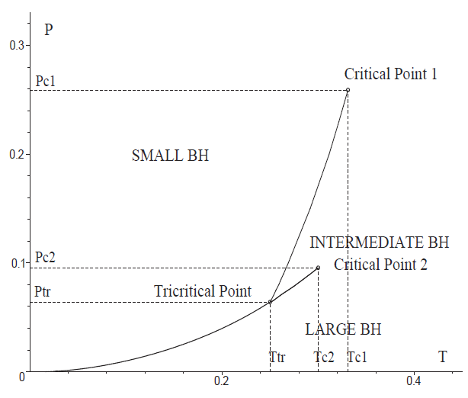
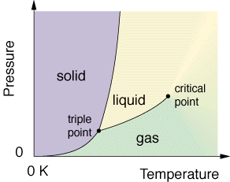
b) Triple point and solid/liquid/gas analogue
large/small/large black hole phase transition and a triple point
in multiply spinning Kerr-AdS BH in 6 dimensions with certain
ratio q of the two angular momenta.
N.Altamirano, DK, R.B. Mann, Z. Sherkatghanad, Kerr-Ads analogue of tricritical point and solid/liquid/gas phase transition, arXiv:1308.2672 (2013).

Slide 21
Conclusions
Black holes behave as thermodynamic objects!
Recently people have been playing with the idea of identifying the cosmological constant with the dynamical pressure. This gives a way of defining the volume of black holes.
Gain some useful properties: Isoperimetric inequality, consistent Smarr relation, compressibility, ...
Black hole chemistry: analogues of everyday thermodynamics:
Is there a reasonable extension of the AdS/CFT duality?
Van der Waals
Triple points & solid/liquid/gas
Reentrant phase transitions
Isolated critical point

Slide 22


Slide 24
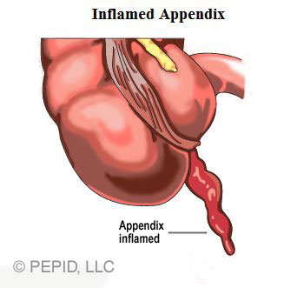
iv) Appendices

Slide 25
a) AdS/CFT interpretation
Interpretation on boundary field theory
Varying Λ corresponds to varying number of dof N
e.g. n=4 SU(N) SYM
Chemical potential
Condensation of branes, Entanglement entropy, …
B. Dolan, Bose condensation and branes, arXiv:1406.7267.
D.Kastor, S.Ray, J.Traschen, Chemical potential in the frst law of holographic entanglement entropy, arXIv:1409.3521.

Slide 26
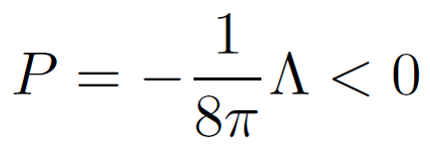
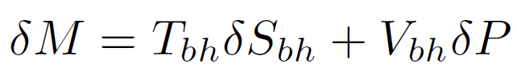



b) Thermodynamics of dS black holes
2 problems:
2 horizons at different temperatures
No timelike KF outside the BH and hence there is no asymptotic mass
B.P. Dolan, D. Kastor, DK, R.B. Mann, J. Traschen, Thermodynamic Volumes and Isoperimetric Inequalities for de Sitter Black Holes, arXiv:13001.5926 (2013).
Identify:
Hamiltonian analysis gives 3 first laws and Smarr relations
TD volume conjectured to obey ISO inequality.

Slide 27
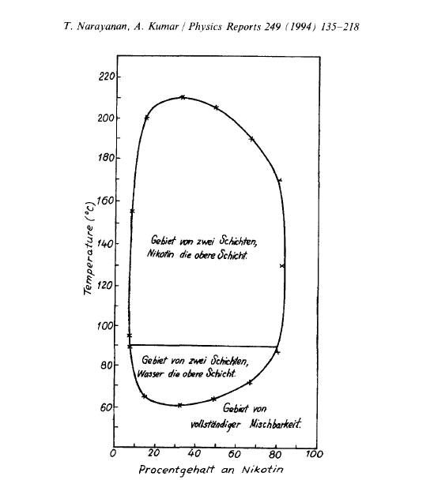
c) Reentrant phase transition
A system undergoes an RPT if a monotonic variation of any thermodynamic quantity results in two (or more) phase transitions such that the final state is macroscopically similar to the initial state.
First observed by Hudson (1904) in a nicotine/water mixture
Z. Phys. Chem. 47 (1904) 113.
Since then:
multicomponent fluid systems, gels, ferroelectrics, liquid crystals, and binary gases
T. Narayanan and A. Kumar, Reentrant phase transitions in multicomponent liquid mixtures, Physics Reports 249 (1994) 135–218.

Slide 28
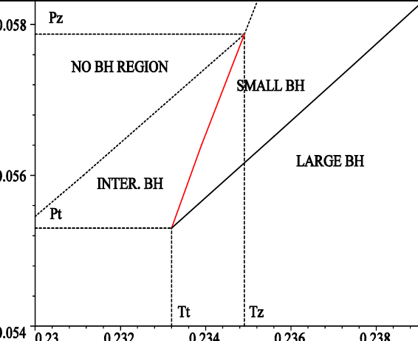
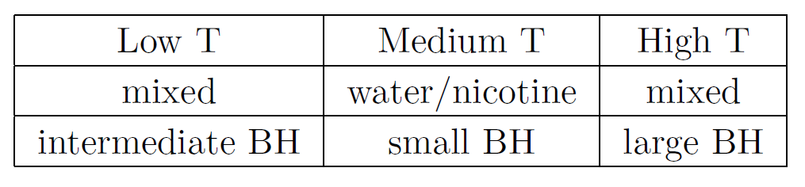
P-T phase diagram
1st order phase transition
0th order phase transition

Slide 29
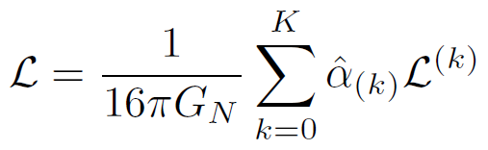
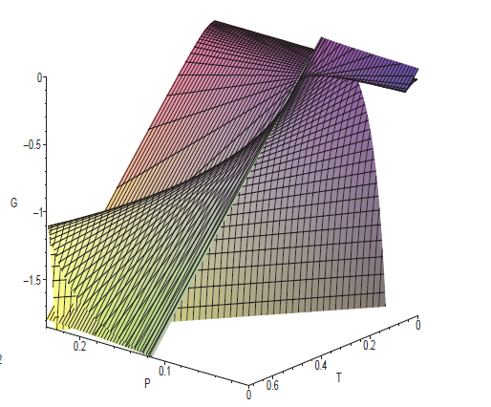
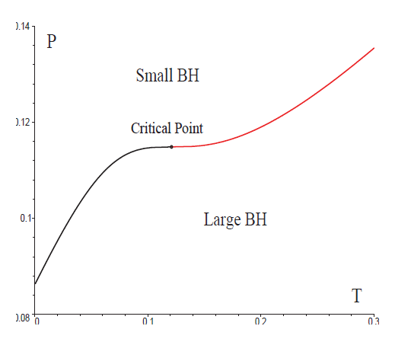
d) Isolated critical point from Lovelock gravity
Lovelock higher curvature gravity
Special tuned Lovelock couplings, odd-order K
B. Dolan, A. Kostouki, DK, R. Mann, arXiv:1407.4783.

Slide 30



Critical exponents:
Comments:
cf. mean field theory critical exponents
satisfies Widom relation and Rushbrooke inequality
Prigogine-Defay ratio
…indicates more than one order parameter?

