Slide 1
Accelerator-Based Isotope Production at TRIUMF
CAP Conference
June 16th, 2015
Paul Schaffer
Head, Nuclear Medicine
TRIUMF

Slide 2
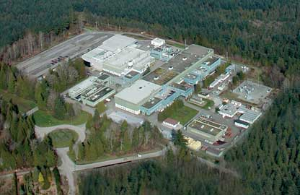
Accelerators at TRIUMF
2 x TR30, CP42, TR13
H⁻ cyclotrons
ISAC (RIB linac)
ARIEL
(50 MeV
electron linac)
500MeV
H⁻ cyclotron
New addition: TR24; to be installed

Slide 3
CP42, TR30, TR13 Operations
TRIUMF Capabilities:
CP42: up to 42 MeV and 200 µA, installed 1980
TR30-1: up to 30 MeV and 900 µA, installed 1990
  first TR30 designed, assembled by TRIUMF, components manufactured by EBCO, commissioned by TRIUMF
TR30-2: up to 30 MeV and 1000 µA, installed 2003
  Manufactured, installed by EBCO, commissioned by TRIUMF
TR13: 13 MeV, 25μA, installed 1986 (UBC Neurology)
  Capable of ¹¹C, ¹⁸F, ¹³N, ⁶⁸Ga, ⁸⁹Zr, ⁶⁴Cu, ⁴⁴Sc, ⁸⁶Y, ⁵⁵Co, ⁵²Mn…solid, liquid, gas targets
TR24: 24 MeV, 500+ μA, to be installed
Overall
  5 solid target, 3 gas stations operating at 30 MeV
    Commercial production: ⁶⁷Ga, ¹¹¹In, ¹²³I, ¹⁰³Pd, ²⁰¹Tl
  Future commercial production: ^{99m}Tc

Slide 4
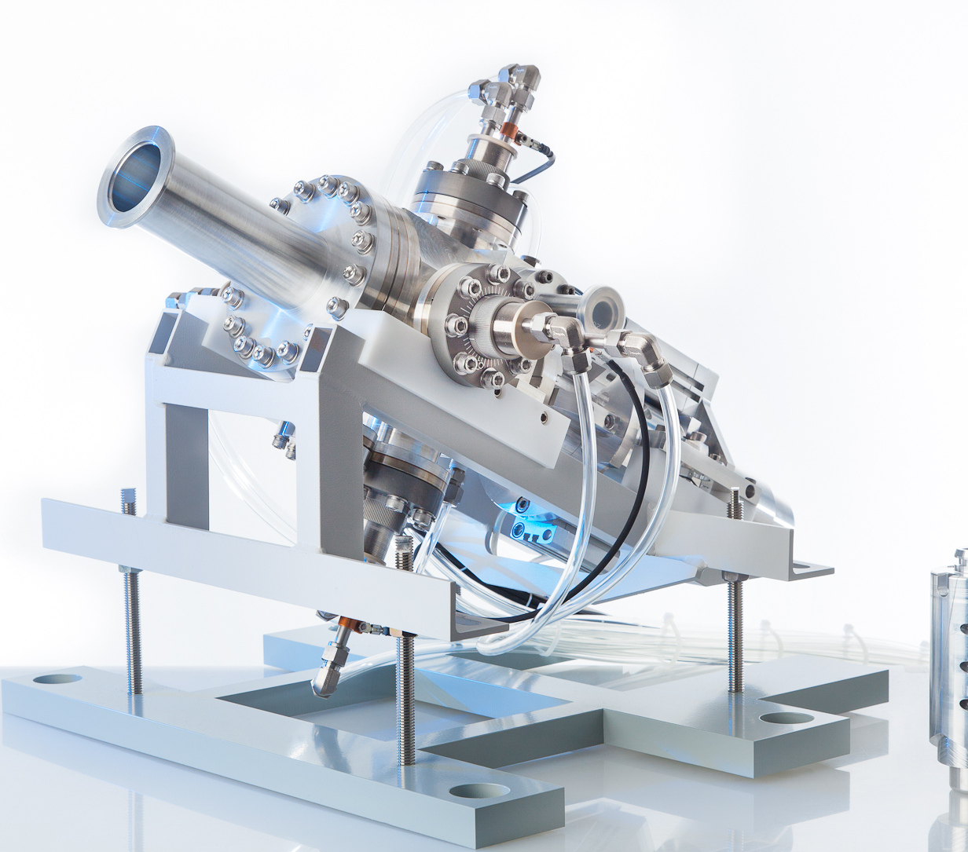
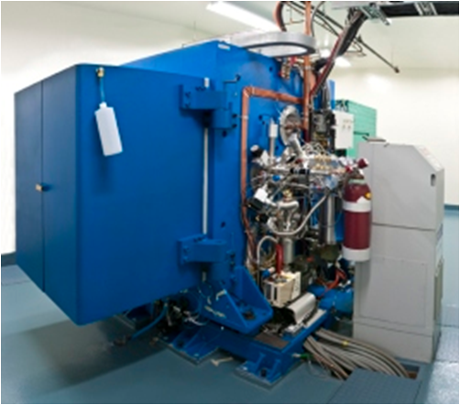
Direct, multi-Curie production of ^{99m}Tc on three different cyclotrons
1) TRIUMF
2) University of British Columbia;
3) BC Cancer Agency;
4) Lawson Health Research Institute;
5) Centre for Probe Development and Commercialization

Slide 5
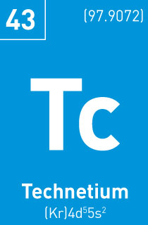
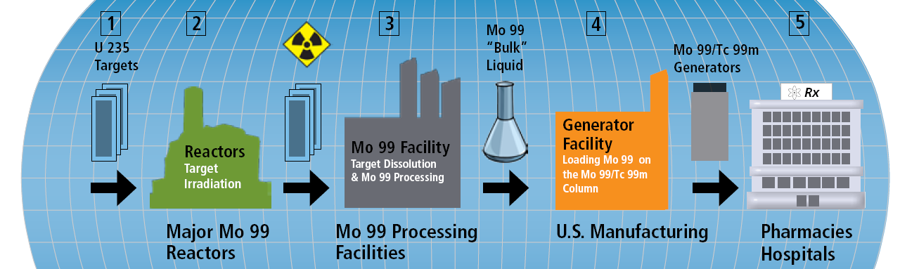
Tc-99m Alternatives: Many options
⁹⁹Mo/^{99m}Tc in high demand (~ 40M doses/yr)
Gov’t owned reactors produce majority of ⁹⁹Mo supply
NRU going offline Oct. 2016 (~40% of global supply)
Capacity emerging (existing reactors, new technology
Projections range from oversupply to shortages¹
Must move to full-cost recovery
Alternatives:
⁹⁸Mo(n,γ)⁹⁹Mo
²³⁸U(γ,F)⁹⁹Mo
LEU ²³⁵U(n,F)
¹⁰⁰Mo(γ,n)⁹⁹Mo
¹⁰⁰Mo(p,2n)^{99m}Tc
1) OECD - NEA/SEN/HLGMR(2014)2
5
graphic from http://www.covidien.com/
Notes:
Direct on-target production of Tc-99m has already been accomplished through proof-of-principle experiments – bypasses need for generator
Similar approach can be used for Tc-94m since only difference is target material

Slide 6
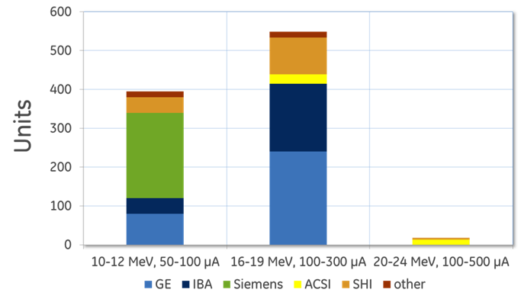
Cyclotrons By the Numbers
Estimated global cyclotron numbers by various manufacturers
(with data from ACSI, GE, IBA and Siemens, Sumitomo data estimated)
6
Schaffer et al. Phys. Proc. in press (2014).

Slide 7
Direct Production of ^{99m}Tc
¹⁰⁰Mo Target
Cyclotron Modification
Optimize Irradiation
Purify ^{99m}TcO₄
Regulatory QA/QC
¹⁰⁰Mo Recovery
Goals:
  Demonstrate routine, reliable, commercial-scale production of ^{99m}Tc via ¹⁰⁰Mo(p,2n) at multiple sites, multiple brands;
  Obtain regulatory approval for clinical use in humans;
  Establish a business plan;
  Disseminate, commercialize the technology
Hypothesis: Future production will be from variety of sources (neutron, proton, electron) and market driven
J. Beaver, H. Hupf, J Nucl Med 1971;12:739-741
7

Slide 8
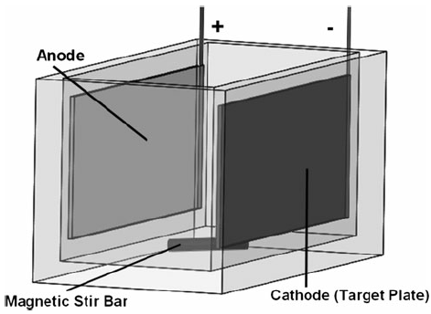
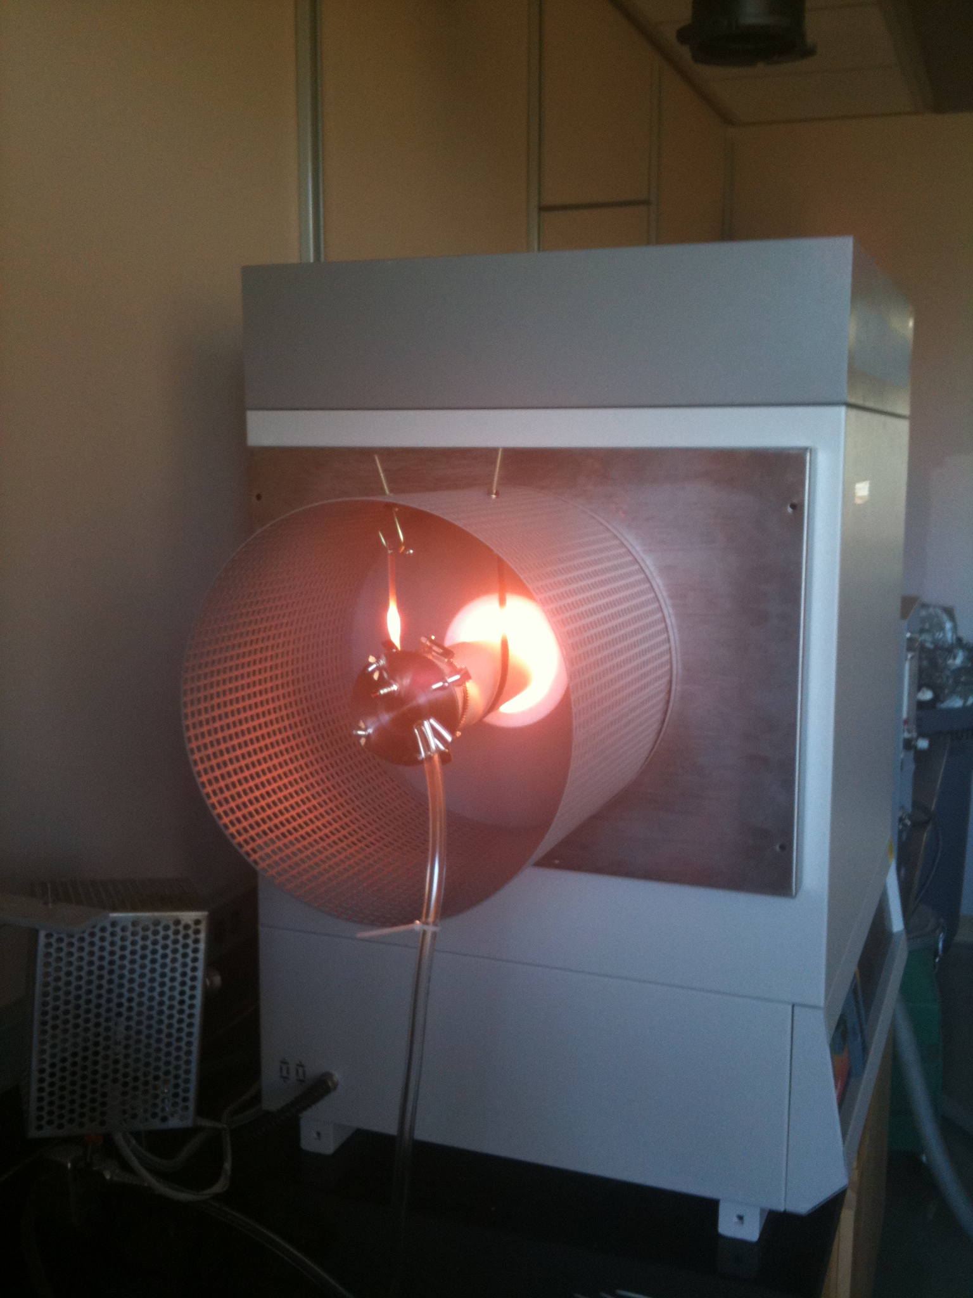
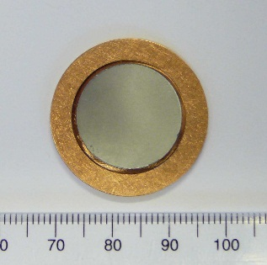
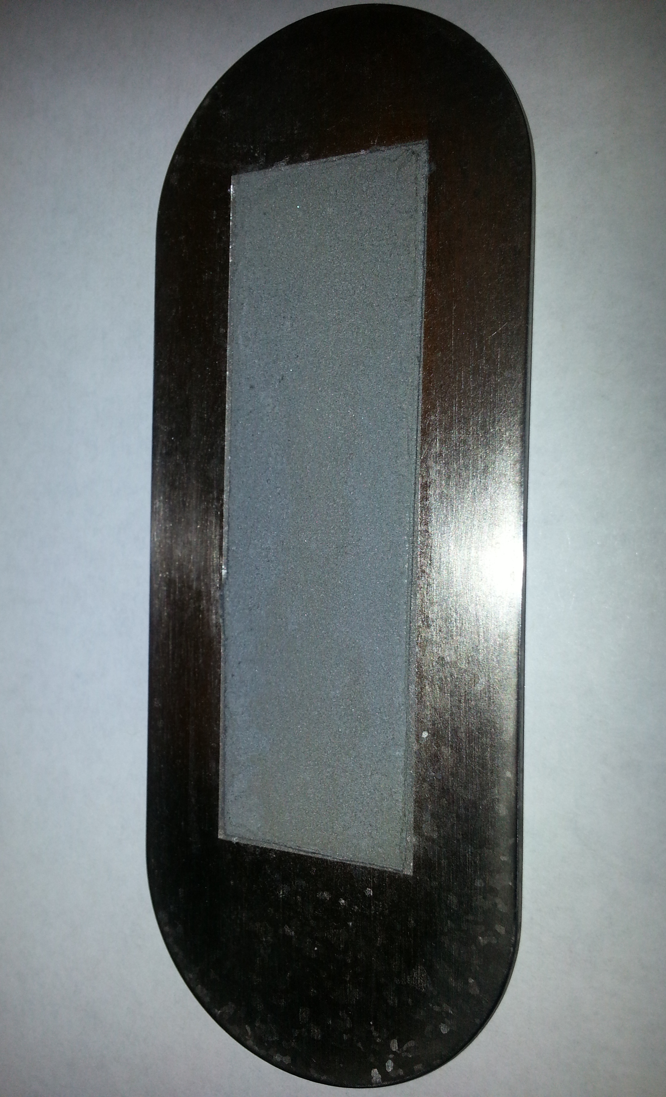
Target Manufacturing
¹⁰⁰Mo Target
Cyclotron Modification
Optimize Irradiation
Purify ^{99m}TcO₄
Regulatory QA/QC
¹⁰⁰Mo Recovery
Electrophoretic deposition
Press-Sinter-Braze
Maximizing ^{99m}Tc production, minimizing impurities:
  <19 MeV proton energy entering ¹⁰⁰Mo
  >8 MeV proton energy exiting ¹⁰⁰Mo
  Stopping power of Mo: Requires <1.2 g of metal
  Reduce density, balance thermal conductivity
Schaffer et al. Phys. Proc. in press (2015).
Zeisler et al. WTTC 2014
8

Slide 9
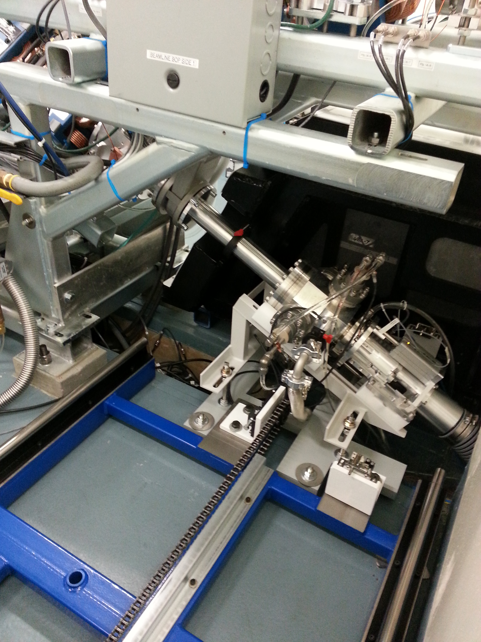
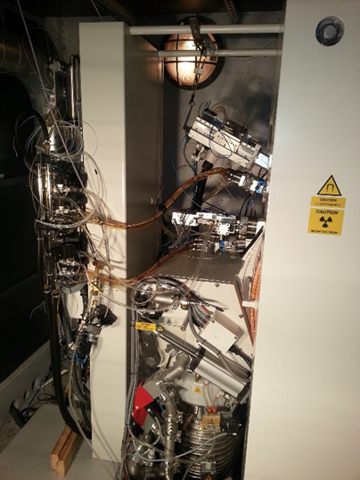
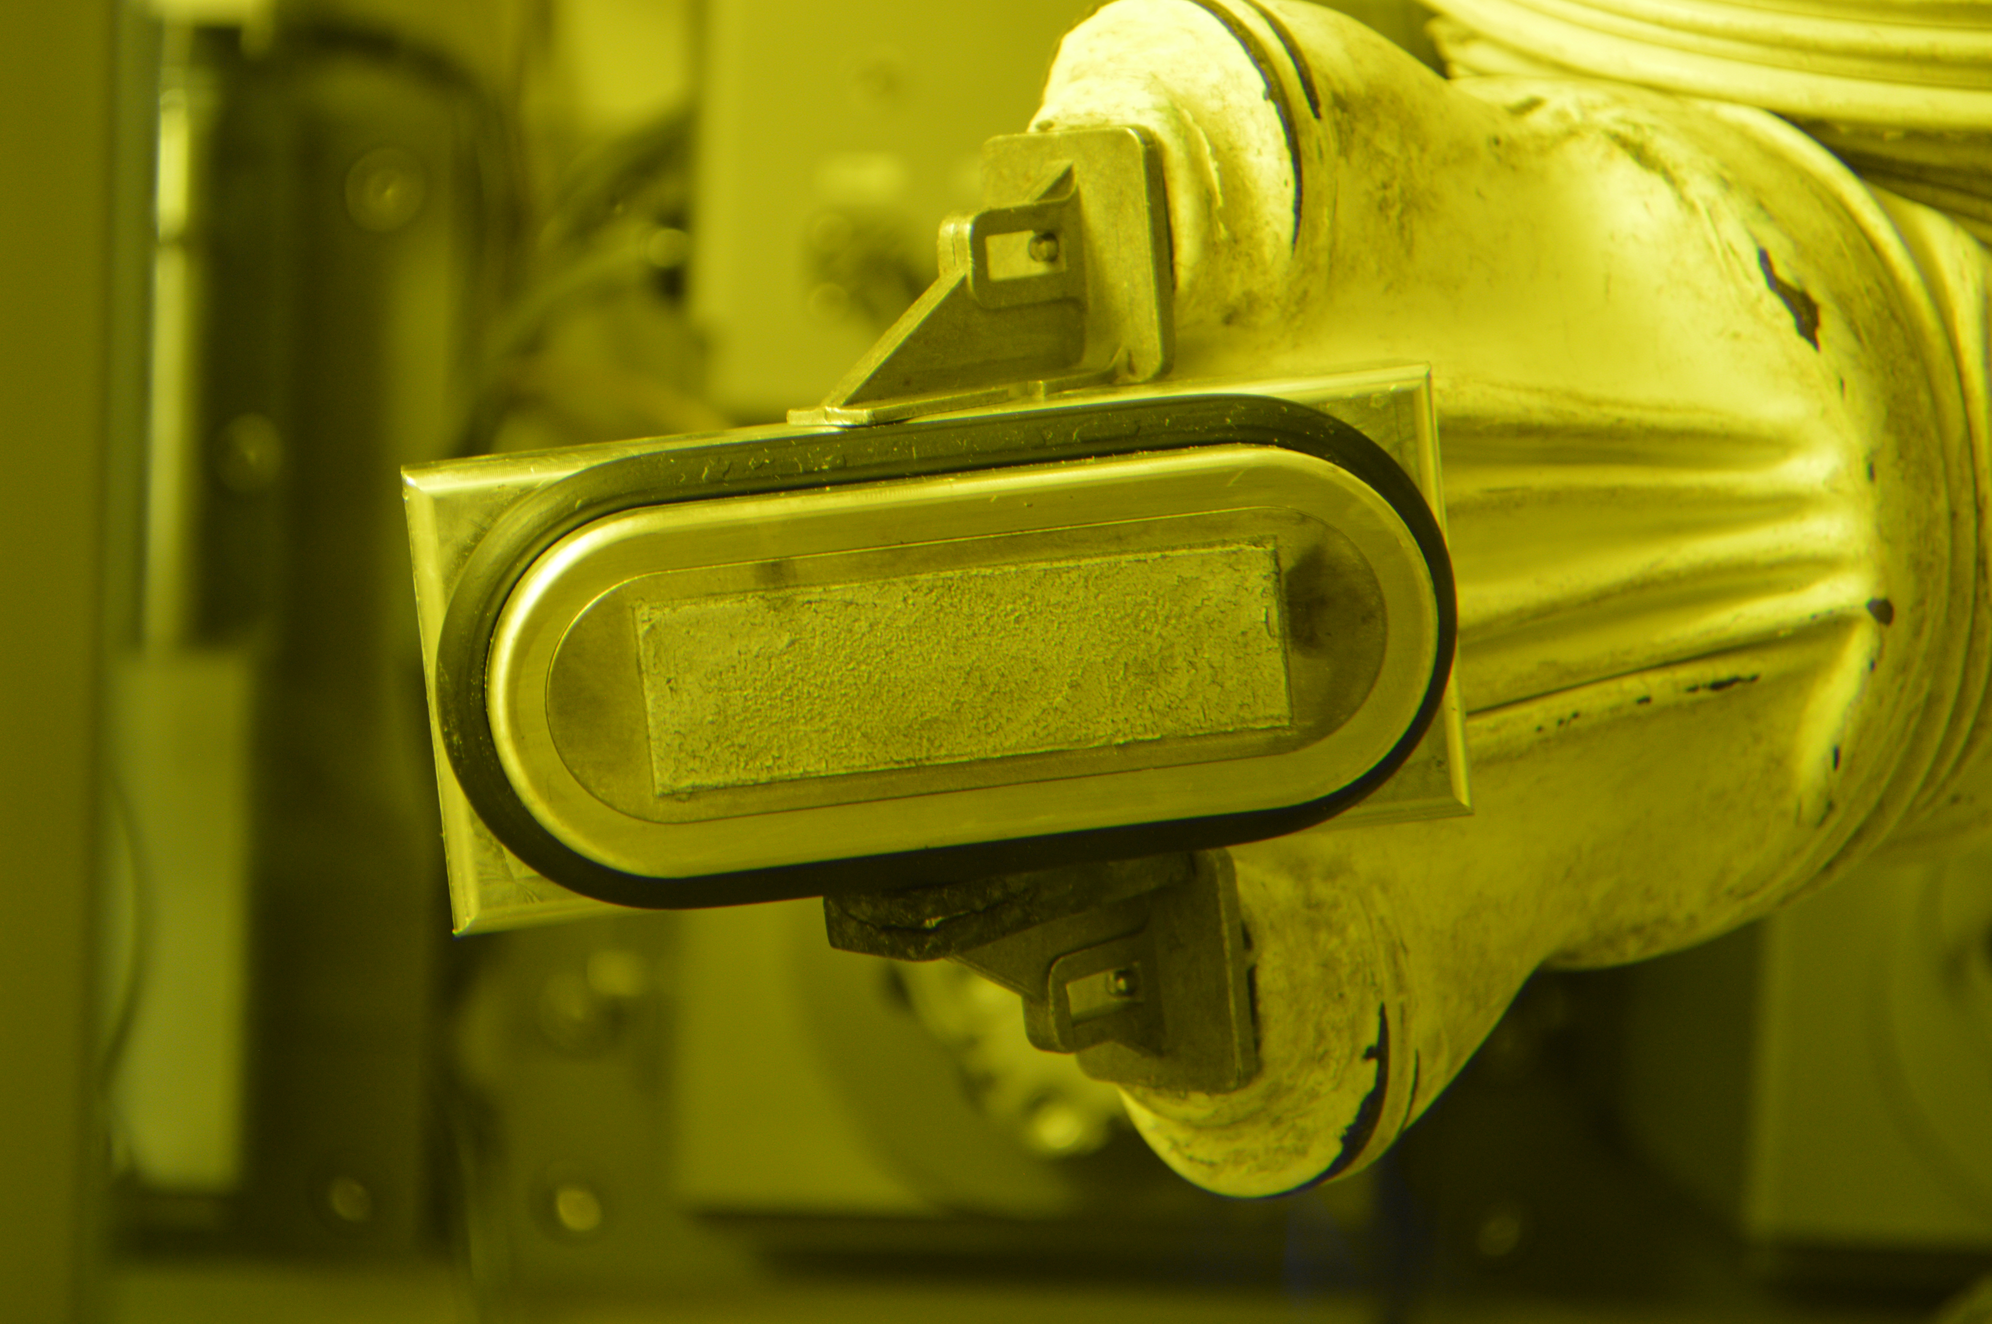
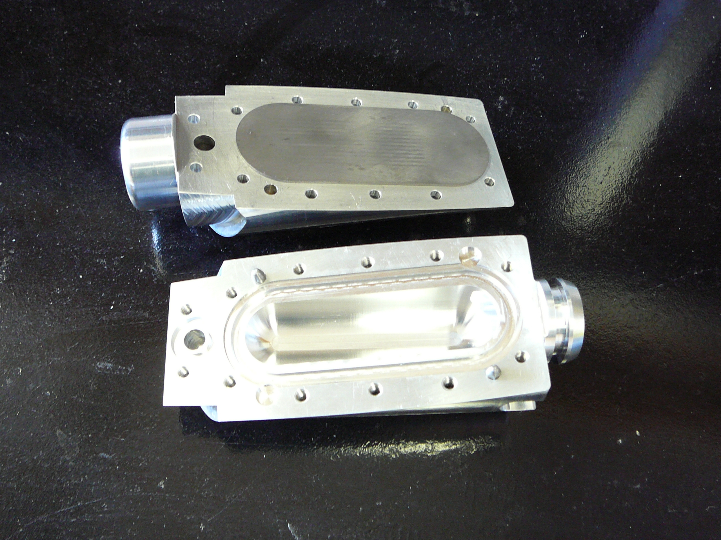
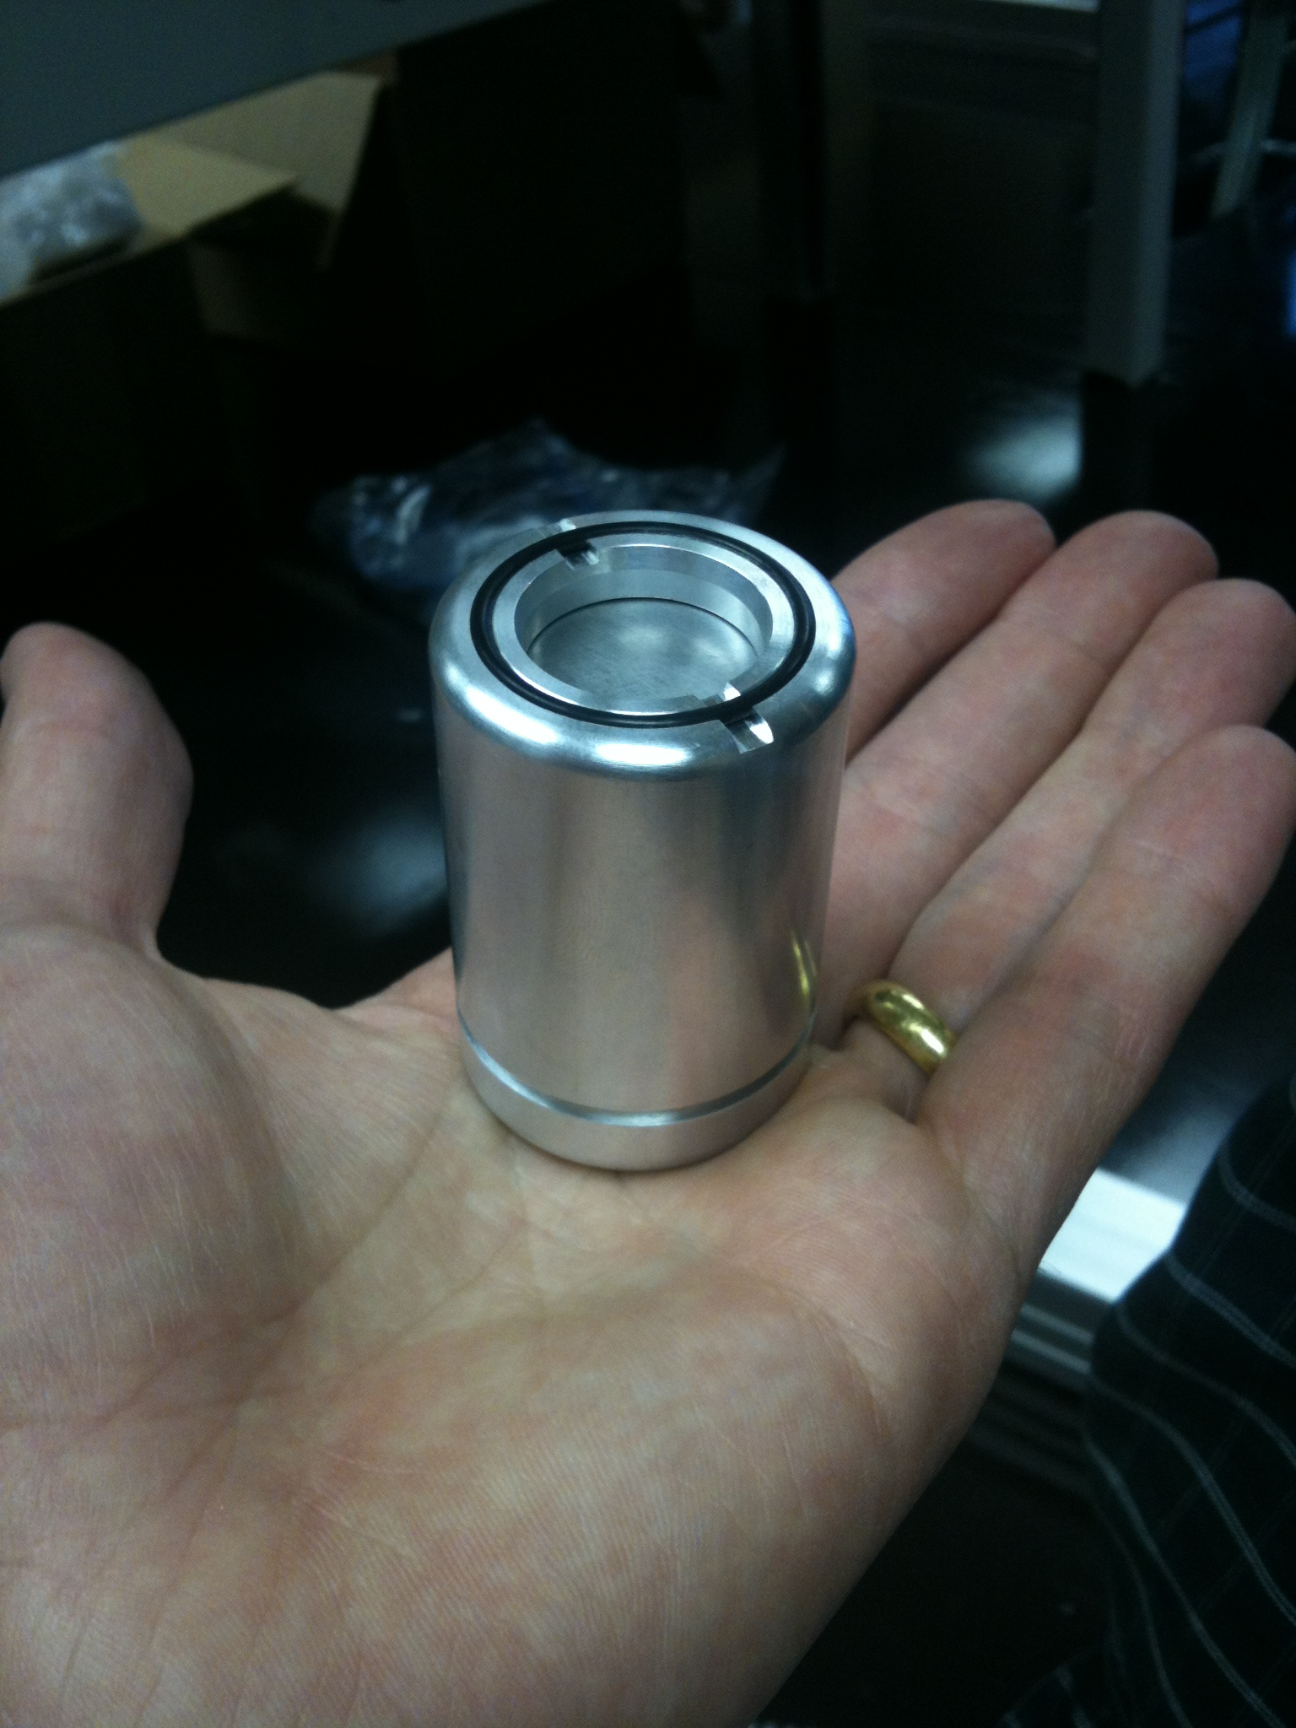
Retrofit Existing Infrastructure
¹⁰⁰Mo Target
Cyclotron Modification
Optimize Irradiation
Purify ^{99m}TcO₄
Regulatory QA/QC
¹⁰⁰Mo Recovery
TR19
TR30
PETtrace
9
Notes:
TR19: Upgrade included new beamline, 300 uA capabilities
PETtrace: 130 uA capabilities (limited by regulator), technically 160 uA, some components

Slide 10
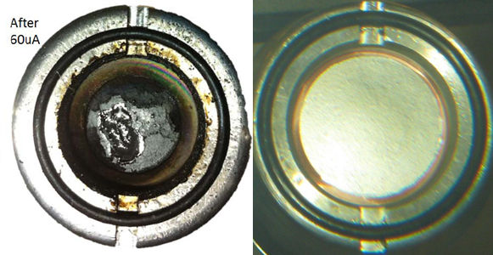
Target Type vs. Cyclotron Power
¹⁰⁰Mo Target
Cyclotron Modification
Optimize Irradiation
Purify ^{99m}TcO₄
Regulatory QA/QC
¹⁰⁰Mo Recovery
TR30 (@24 MeV) target power: 10.8 kW @ 0.6 kW/cm²
TR19 target power: 5.4 kW @ 0.3 kW/cm²
PETtrace target power: 2.1 kW @ ~1.2 kW/cm²
10
Notes:
TR19: Upgrade included new beamline, 300 uA capabilities
PETtrace: 130 uA capabilities (limited by regulator), technically 160 uA, some components

Slide 11
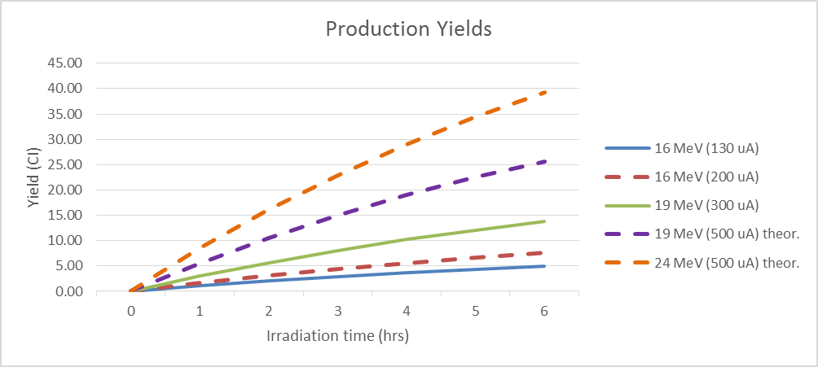
Real and Projected Yields of ^{99m}Tc
¹⁰⁰Mo Target
Cyclotron Modification
Optimize Irradiation
Purify ^{99m}TcO₄
Regulatory QA/QC
¹⁰⁰Mo Recovery
GE PETtrace
16.5 MeV, 130 μA
Theoretical 4.9 Ci (6h)
Achieved 4.7 Ci
Sat^{n}: 75.6 mCi/µA
TR19
18 MeV, 300 μA
Theoretical 15.4 Ci (6h)
Achieved 9.4 Ci (@ 240 µA)
Sat^{n}: 103 mCi/µA
TR30 (@24 MeV)
24 MeV, 500 μA
Theoretical 39 Ci (6h)
Achieved ~32 Ci (@ 450 µA)
Sat^{n}: TBD

Slide 12
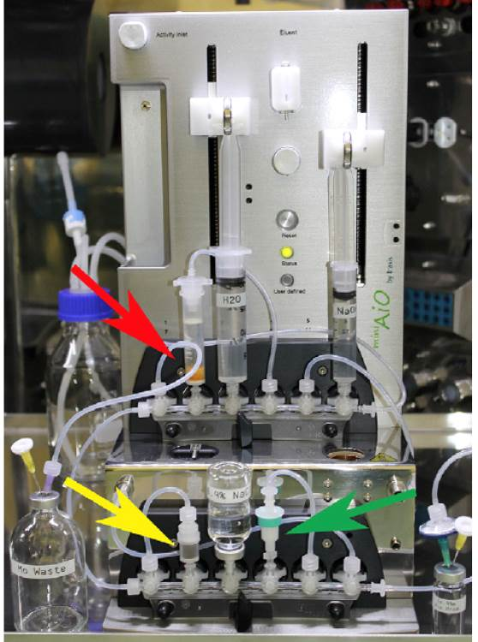
Purification of ^{99m}Tc
¹⁰⁰Mo Target
Cyclotron Modification
Optimize Irradiation
Purify ^{99m}TcO₄
Regulatory QA/QC
¹⁰⁰Mo Recovery
SPE-based method:
  original work: Dowex™ vs ABEC
  new alternative resin: ChemMatrixTM
Process Time: complete in <90 min.
Efficiency Range: 92.7 ± 1.1%
Radiochemical Purity: >99.99% TcO₄
Trace analysis: <10 Bq Mo-99, <5 ppm Al³⁺
non-Tc impurities removed
Disposable fluid path for GMP
Inherent Resin Versatility: Vendor Agnostic
Morley et al. Nuc. Med. Biol. 2012, 551-559
12

Slide 13
Regulatory Process: CTA nearly complete
¹⁰⁰Mo Target
Cyclotron Modification
Optimize Irradiation
Purify ^{99m}TcO₄
Regulatory QA/QC
¹⁰⁰Mo Recovery
Not currently approved by Health Canada, FDA, etc.
CTA preparation underway:
  GLP preclinical rodent data (complete);
  documentation (complete),
  acceptance criteria: RNP, RCP, Al, Mo, H₂O₂ (complete);
  process validation (complete)
Shelf life (18 hrs), irradiation parameters are based on projected patient dose (objective <10% add’l vs. pure ^{99m}Tc)
  Enrichment and irradiation parameters are interrelated and should not be considered independently
CTA submission – June 2015 (60 patient trial)
Fall 2015 - NDS submission
13

Slide 14
¹⁰⁰Mo Raw Material/Irradiation Specifications
Isotope | Proposed max. isotopic impurity to maintain patient dose increase of ~10% compared to pure ^{99m}TcO₄
 | ≤ 20 MeV¹ | 20 – ≤22 MeV² | 22 - ≤24 MeV³
⁹²Mo | 0.03 | 0.03 | 0.02
⁹⁴Mo | 0.03 | 0.03 | 0.02
⁹⁵Mo | 0.03 | 0.03 | 0.02
⁹⁶Mo | 0.03 | 0.03 | 0.02
⁹⁷Mo | 0.03 | 0.03 | 0.02
⁹⁸Mo | 7 | 0.8 | 0.5
¹Maximum increase in patient dose of 9.8 % at 20 MeV, 18 hours after EOB.
²Maximum increase in patient dose of 10.1% at 22 MeV, 18 hours after EOB.
³Maximum increase in patient dose of 10.6% at 24 MeV, 18 hours after EOB.
Based on theoretical yield calculations with ^{99m}Tc pertechnetate
Mitigates the impact of dose due to ⁹⁸Mo(p,3n)⁹⁶Tc reaction at higher E
14

Slide 15
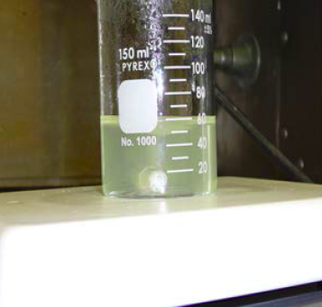
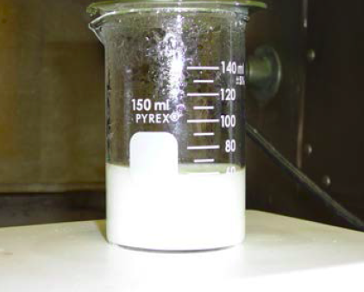
We Recycle
¹⁰⁰Mo Target
Cyclotron Modification
Optimize Irradiation
Purify ^{99m}TcO₄
Regulatory QA/QC
¹⁰⁰Mo Recovery
High efficiency recovery process for multi-gram quantities of
¹⁰⁰MoO₄²⁻ required
Some trace long-lived radionuclidic impurities
Target dissolution waste stream (liquid, 10’s of mL/batch)
Original method: ion exchange
>90% efficiency (non-optimized), large column volumes, slow
Currently using acidic precipitation, thermal decomp. process
Routine recovery yields >99%
Analysis of recovered ¹⁰⁰Mo underway

Slide 16
Remaining Challenges for Cyclotron Production of ^{99m}Tc
Process: Long-term reliability (machine and target)
Quality Control: Decentralized production inherently leads to a greater likelihood of product variability, dose uncertainty
Regulatory: Considerations need to include target isotopic enrichment, but also batch-to-batch target consistency, irradiation energy/duration, shelf-life (patient dose)
Economic: Arguments in one region may not apply in others but FCR must apply
Availability: A viable alternative/backup needs to be used regularly
16

Slide 17

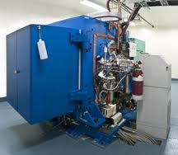
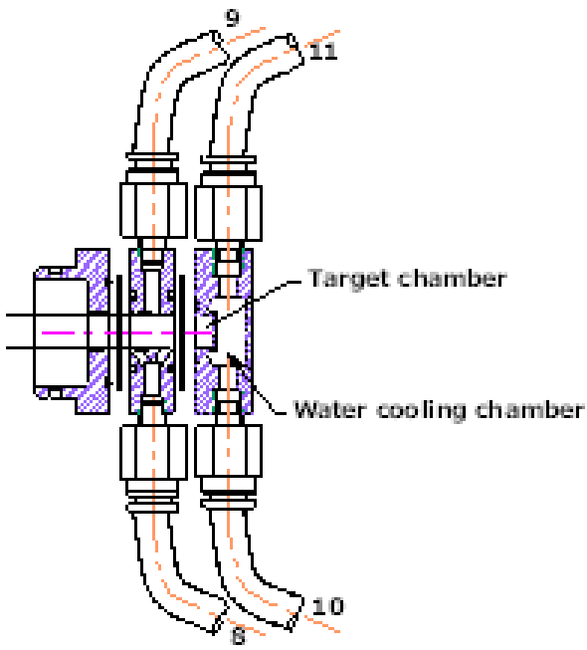


Production, Purification and Radiolabelling of Radiometals Produced in a Liquid Target on a 13 or 19 MeV Medical Cyclotron
Notes:
Change pictures

Slide 18
Proposal
Hypothesis: Established cyclotron centers can obtain research, and possibly clinical quantities of various radiometals by irradiating salt solutions in modified liquid targets
  Leverage existing liquid target infrastructure for the production of other PET isotopes (¹⁸F)
Accepted trade-off:
Lower production yields in exchange for isotope versatility
Vogg ATJ, et al. Proceedings of the Sixth International Conference on Nuclear and Radiochemistry,
2004; Aachen, Germany.
Jensen M, Clark J. Proceedings of the 13th International Workshop on Targetry and Target Chemistry,
Roskilde, Denmark, July 26-28, 2010.
DeGrado TR, et al. J Label Compound Radiopharm 2011. 54, S248
18

Slide 19
Project Goals
Goals:
  Allow broader access to a variety of radiometallic isotopes
  Radiometal production without generators, solid-target installation
  Enable faster optimization of vector-isotope pairing
19

Slide 20
Isotope-Biomolecule Pairing
linker
M
biomolecule
chelate
Proposed application: labeling and in vivo analysis of novel proteins/peptides targeted toward HER2 variants/isoforms
  Larger/slower-clearing constructs → longer-lived isotopes
  Smaller/faster-clearing constructs → shorter-lived isotopes
20
*D Mitra D et al Mol Cancer Ther. 2009;8(8):2152-2162.

Slide 21
Project Overview
Specific Interests:
  ⁹⁴Mo(p,n)^{94m}Tc (half-life: 52.5 min)
  ⁴⁴Ca(p,n)⁴⁴Sc (half-life: 3.9 h)
  ⁸⁶Sr(p,n)⁸⁶Y (half-life: 14.7 h)
  ⁸⁹Y(p,n)⁸⁹Zr (half-life: 78.5 h)
  ⁶⁸Zn(p,n)⁶⁸Ga (half-life: 68 min)
Approach:
  TRIUMF: TR13 (13 MeV, 20 µA), standard water target (testing, feasibility)
  BCCA: TR19 (19 MeV, 300 µA), large volume water target (application: HER2Δ16 binders)
  New target design (i.e. syphon targets)
21

Slide 22
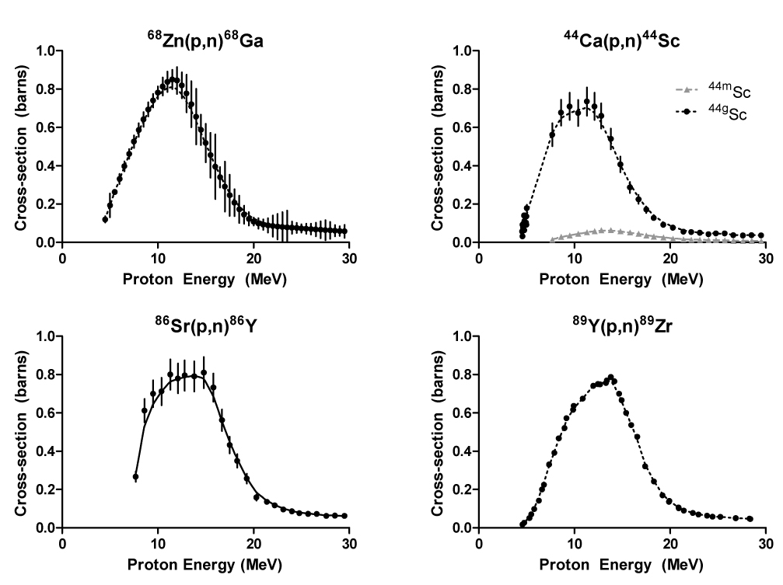
Assessing Feasibility: Cross-sectional Considerations
T_{1/2} = 68 min
T_{1/2} = 3.9 h
T_{1/2} = 14.7 h
T_{1/2} = 78.5 h
22

Slide 23
Production Summary
Prod | Production route | Metal salt | Density (g/mL) | Beam current (μA) | Time (min) | Yield (MBq) | Sat. yield (MBq/ μA)
^{94m}Tc | ⁹⁴Mo(p,n)^{94m}Tc | (NH₄)₆Mo₇O₂₄ | 1.66 | 5 | 60 | 110±20 | 40±6
⁴⁴Sc | ⁴⁴Ca(p,n)⁴⁴Sc | Ca(NO₃)₂ | 1.55 | 7.6 | 60 | 5.55±0.22 | 4.6±0.3
⁶⁸Ga | ⁶⁸Zn(p,n)⁶⁸Ga | Zn(NO₃)₂ | 1.65 | 6.8 | 60 | 275±1 | 68±5
 |  |  | 1.56 | 6.96 | 60 | 480±30 | 141±6
⁸⁹Zr | ⁸⁹Y(p,n)⁸⁹Zr | Y(NO₃)₃ x HNO₃ | 1.49 | 7.3 | 60 | 32±2 | 360±9
⁸⁶Y | ⁸⁶Sr(p,n)⁸⁶Y | Sr(NO₃)₂ | 1.43 | 4.6 | 60 | 7.4±0.5 | 31±1
23
Notes:
Here is the summarize of the irradiation conditions, yields and saturation yields for all the rest of salt solutions. For Y-86, Zr-89 and Tc-94m, the quantities produced using liquid target are enough for in vitro studies or a small animal scan. For Ga-68, we can achieve a yield of 212 MBq with one hour irradiation time, and we can certainly make more with longer beam time. The will produce enough activity for a human scan.

Slide 24
Purification – All metals
Prod. | Irradiated metal salt | Column 1 | Column 2 | Final Eluate
 |  |  |  | Activity received from target (%) | Vol. (mL) | Eluent
⁴⁴Sc | Ca(NO₃)₂ | DGA | - | 88 ± 6 (n = 5) | 2.5 | 0.05M HCl
⁶⁸Ga | Zn(NO₃)₂ | AG 50W-X8 | DGA | 92 ± 8 (n = 3) | 1.0 | H₂O
⁸⁹Zr | Y(NO₃)₃ | Hydroxamate resin | - | 82 ± 5 (n = 4) | 0.75 | 1M Oxalic Acid
⁸⁶Y | Sr(NO₃)₂ | DGA | - | 99 ± 4 (n = 3) | 1.0 | H₂O
^{94m}Tc | (NH₄)₆Mo₇O₂₄ | ABEC-2000 | SCX/ Alumina | 70.9 ± 0.7 (n = 4) | 6.0 | saline
Specific activity: ⁴⁴Sc (1.4 TBq/μmol), ⁶⁸Ga (5.2TBq/μmol), ⁸⁹Zr (0.015 TBq/μmol),
⁸⁶Y (0.41 GBq/μmol, 94mTc ()
24

Slide 25
Radiolabelling chemistry
Radiolabelling conditions
Isotope | Temperature | Time | pH | Buffer
Y-86 | 95 ⁰C | 30 min | pH=6 | 0.33M HEPES
Zr-89 | r.t. | 15 min | pH=7
Ga-68 | 95 ⁰C | 10 min | pH=4 | 0.33M HEPES
25
Notes:
Clearly, the radiolabelling with ⁶⁸Ga did not give optimal results. Since the whole separation procedure for ⁶⁸Ga needs to be optimized (it takes over an hour), no effort has been put into improving the radiolabelling yield for the here reported method.

Slide 26

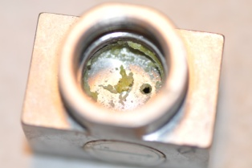
Preparation of Liquid Target Solutions
Gas evolution during irradiation = high target pressures in a closed target body
  Radiolysis of water, O₂, H₂
  1M nitric acid for ^{nat}Zn and ^{nat}Sr salt irradiations*
Compatibility between salt solutions and target components
  Havar foil (Co-based, Cr, Ni, Fe, W, Mo, Mn)
    Failed with Cl⁻ salts (etching evident)
  Al vacuum foil (failed in boil tests)
  Target body (Al) – evidence of corrosion
    Switch to Nb target body
Precipitation
  Need thorough flushing protocol between runs
* Pandey MK, et al., Nucl. Med. Biol. 2014;41:309-16.

Slide 27
Summary
A simple method for the production of research quantities of various radiometals using a modified liquid-target system.
Salt solutions of natural isotopic abundance were irradiated in a standard water target on our 13 MeV cyclotron for 60 min. After irradiation, all solutions were withdrawn from the target and purified using cation exchange or chelating resins.
Several isotopes (⁶⁸Ga, ⁸⁹Zr, ⁴⁴Sc, ⁸⁹Y, ^{94m}Tc) were produced in a standard water target on our 13 MeV cyclotron
Future work: labeling and biodistribution analysis of breast cancer (HER2) binders; novel target designs (higher production)
27
Notes:
production parameters and yields listed in the table

Slide 28
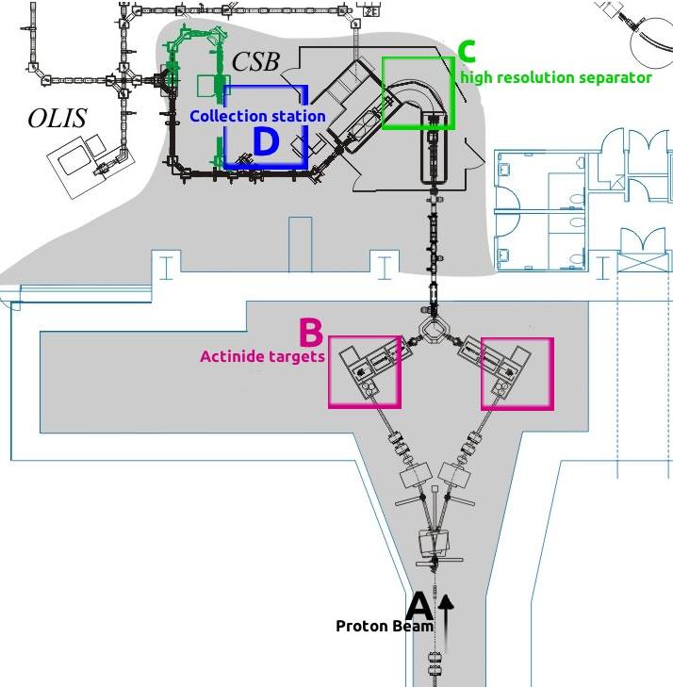
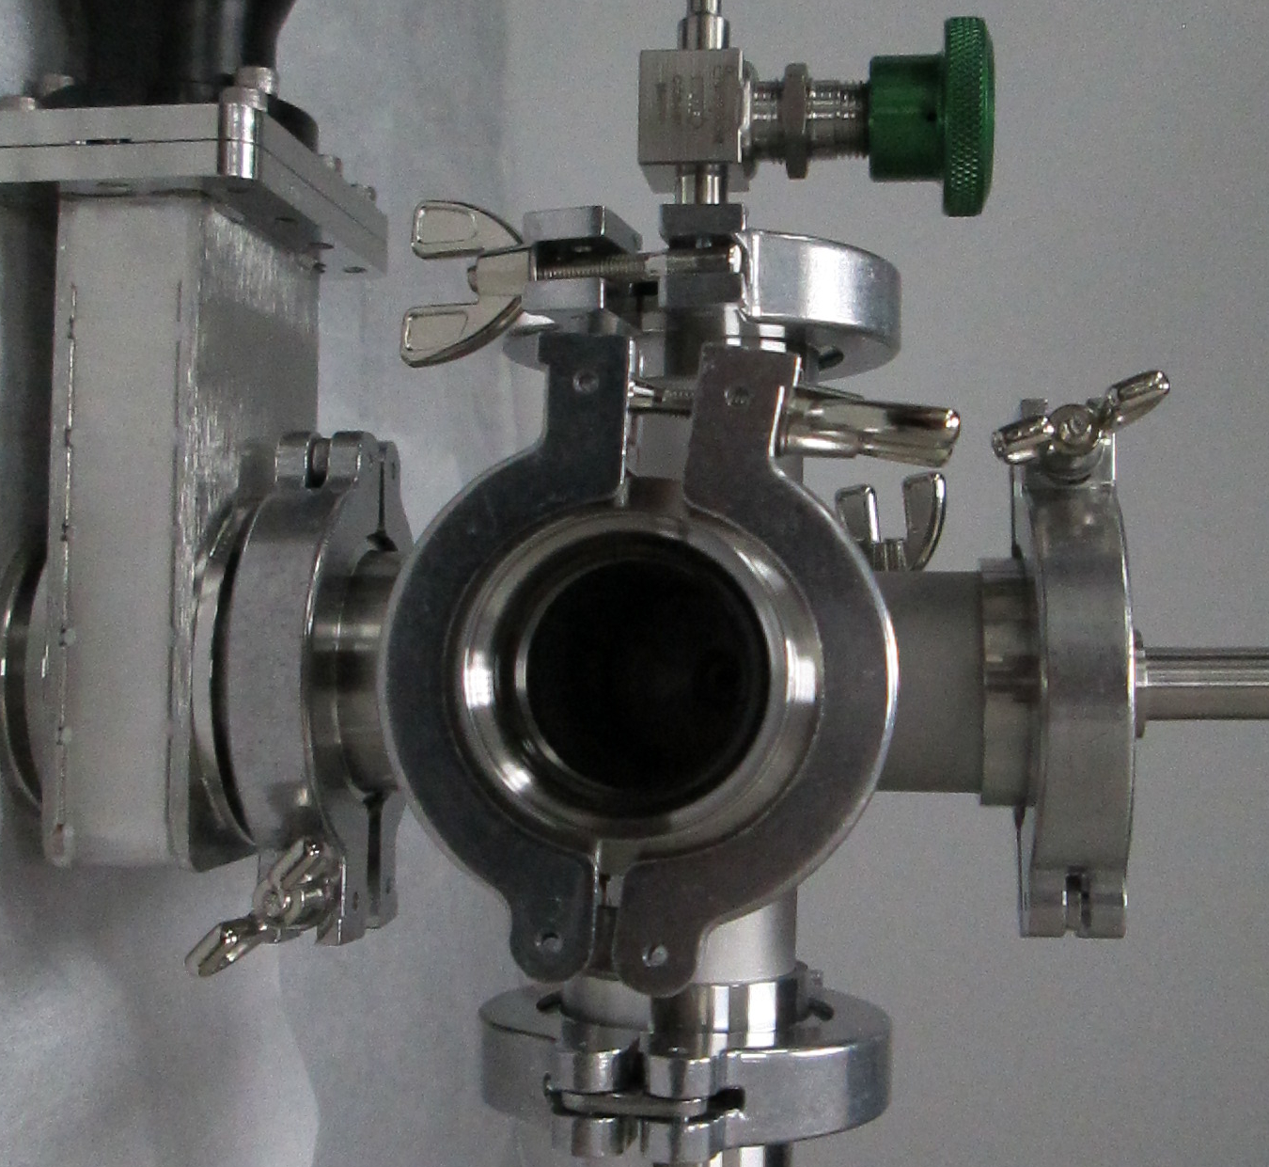
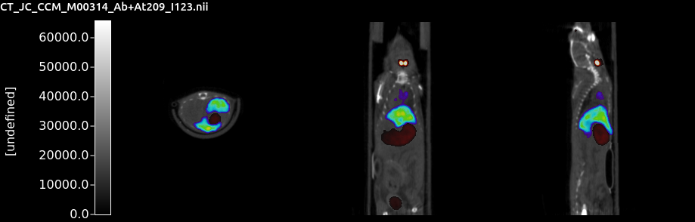
Production and assessment of radiotherapeutic isotopes

Slide 29
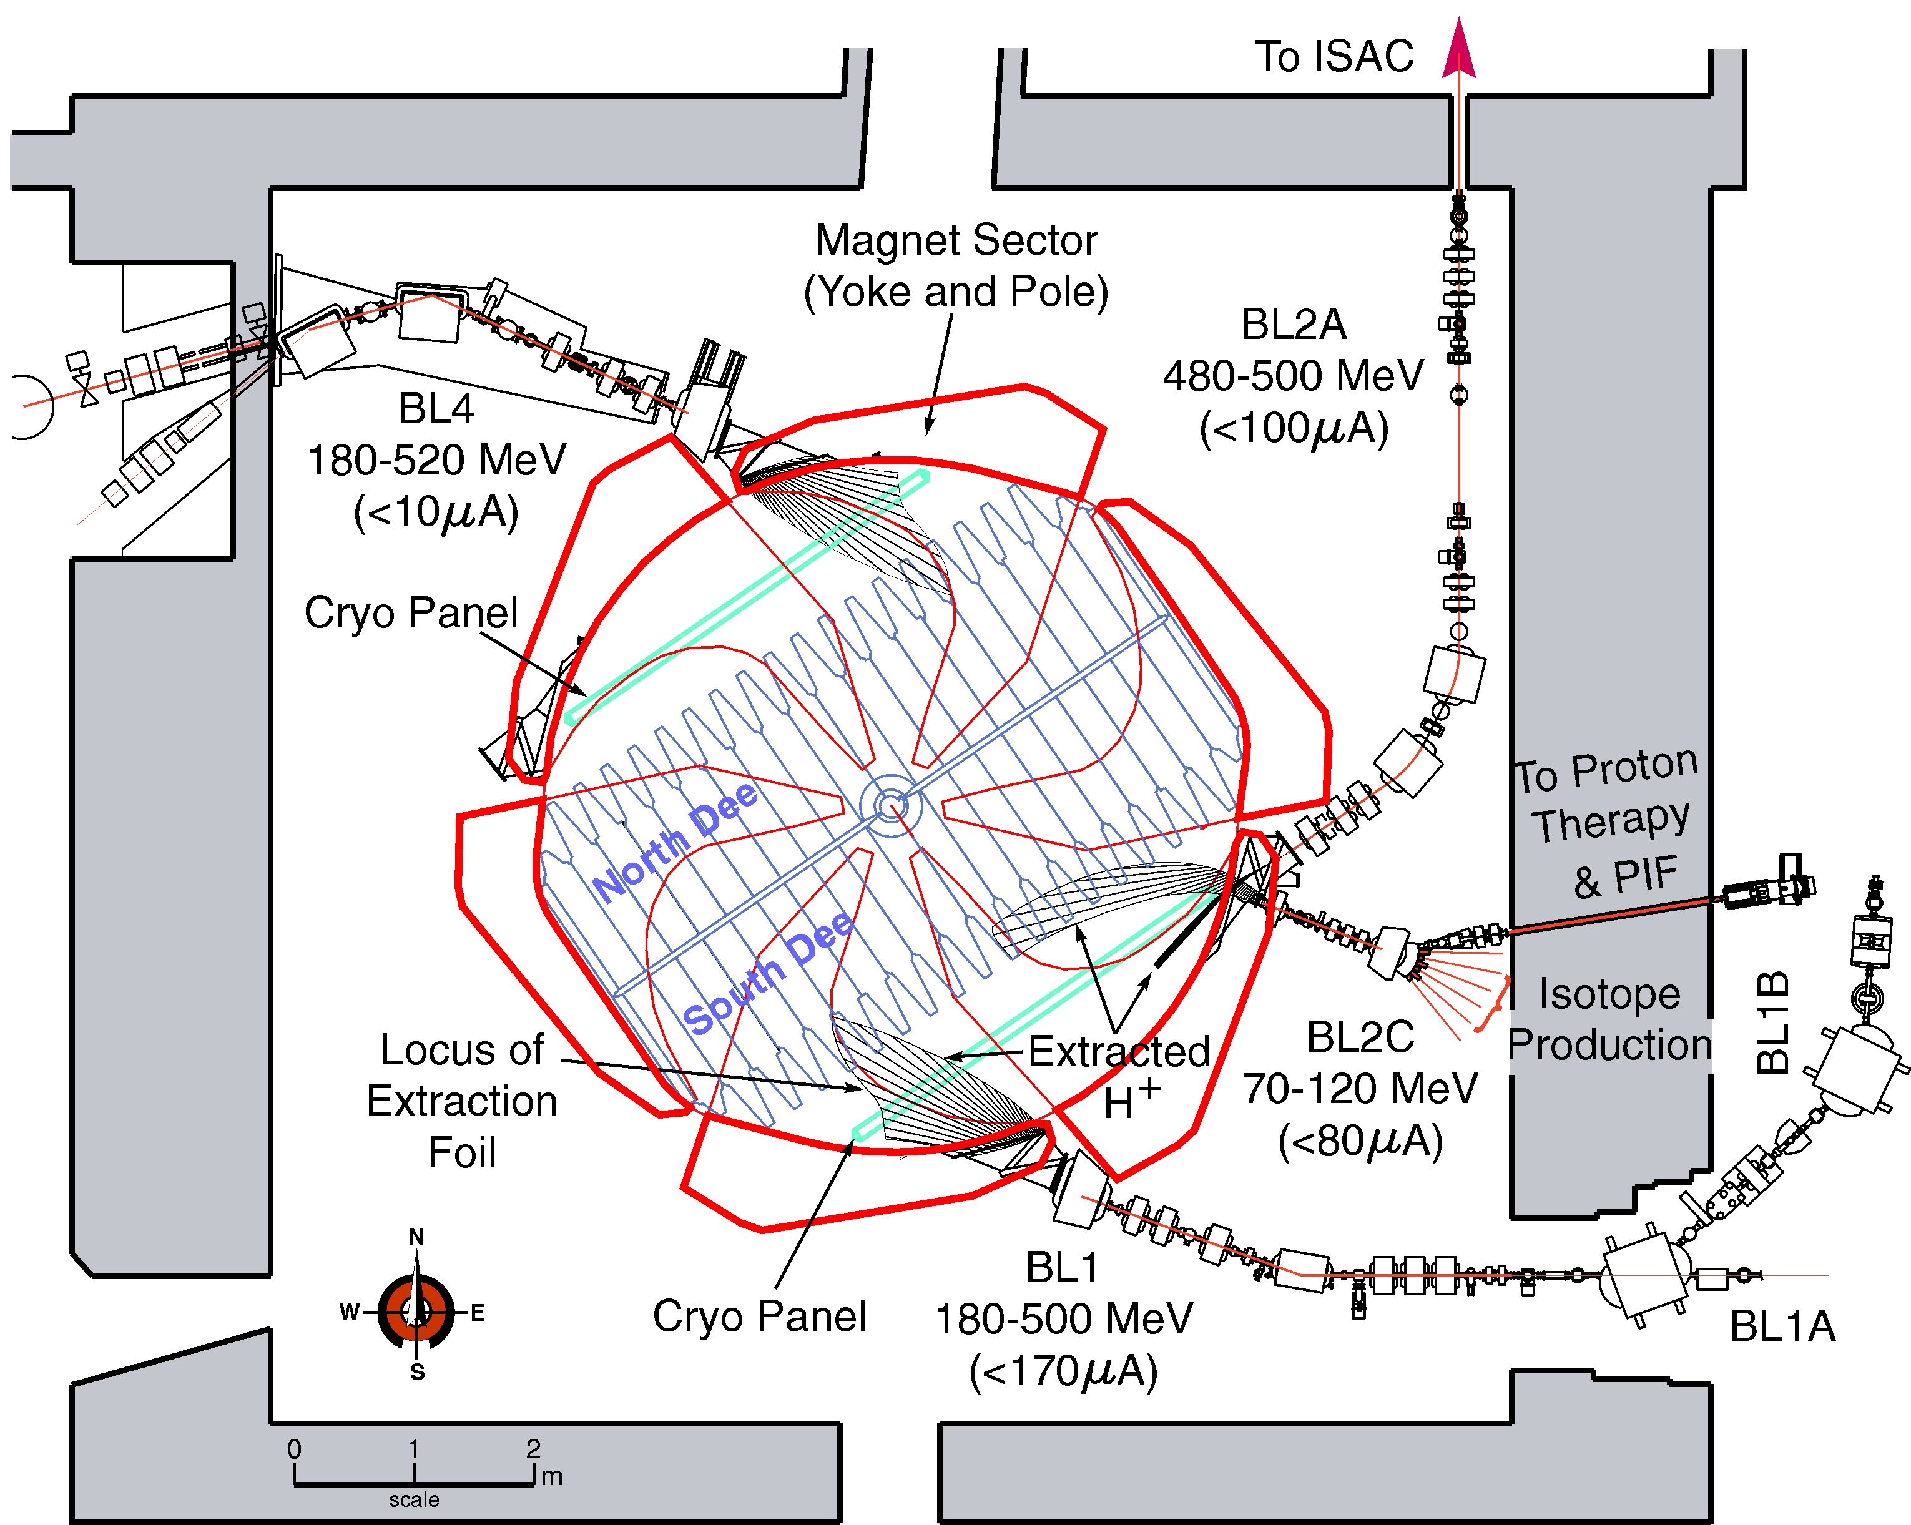
500 MeV Cyclotron Capabilities
Previous decade: routine operation at 220-250μA
Recently achieved:
BL2A
Materials science, 500 MeV isotopes:
  BL1A (100μA)
ISAC program:
  BL2A (100μA)
Sr production:
  BL2C (100μA)
  Total (300μA)
BL4
BL2C
BL1A
29

Slide 30
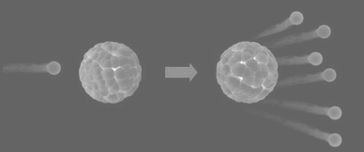
Isotope Accelerator Program (ISAC): 50 kW ISOL Facility
Isotope production
via spallation of uranium:
Implementation of ISOL technique:
  Uranium carbide target
  480 MeV protons, 10 µA
  Various available ion sources
  ~2500:1 mass separation resolution (~10⁶–10⁹ ions/s)
  Ion energy = ~20-60 keV
Uranium carbide, thorium oxide
30

Slide 31
Candidate α-emitters for therapy
Isotope | Half-life | Considerations | Production
¹⁴⁹Tb | 4.2 h | Good chemistry, alt. isotopes | Spallation, heavy-particle accelerator
²¹¹At | 7.2 h | No stable isotope, Thyroid uptake | α-cyclotron
²¹²Bi | 1.0 h | Renal uptake | Generator (²²⁴Ra/²¹²Bi)
²¹³Bi | 0.76 h | Renal uptake | Generator (²²⁵Ac/²¹³Bi)
²²³Ra | 10 d | 4 α-decays, bone targeting | Generator (²²⁷Ac/²²³Ra)
²²⁵Ac | 10 d | 4 α-decays, | Generator (²²⁹Th/²²⁵Ac)
31

Slide 32
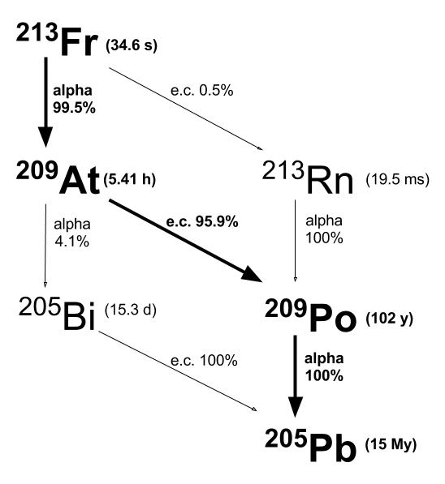
²⁰⁹At-based imaging to establish ²¹¹At α-therapy
²⁰⁹At identified as novel SPECT isotope
Therapy
Imaging
²¹¹At t_{1/2}= 7.2 h
²⁰⁹At t_{1/2}= 5.4 h
(α-emitter)
(γ-emitter)
²⁰⁹At collected from ²¹³Fr ion beams
32

Slide 33
Ion beams of therapeutic α-emitters
Isotope | 1st Ionization energy | Ion Source
TANTALUM TARGET
¹⁴⁹Tb | 5.86 eV | Re surface ionizing
URANIUM TARGET:
²¹¹At | 9.54 eV | Plasma/Resonance ionization laser
^{212/213}Bi | 7.29 eV | Plasma (aka FEBIAD)
^{223/225}Ra | 5.28 eV | Re surface ionizing
²²⁵Ac | 5.28 eV | Re surface ionizing
Note:
^{211/213}Fr | 3.94 eV | Re surface ionizing (Most Intense!)

Slide 34
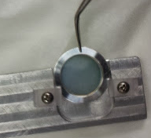
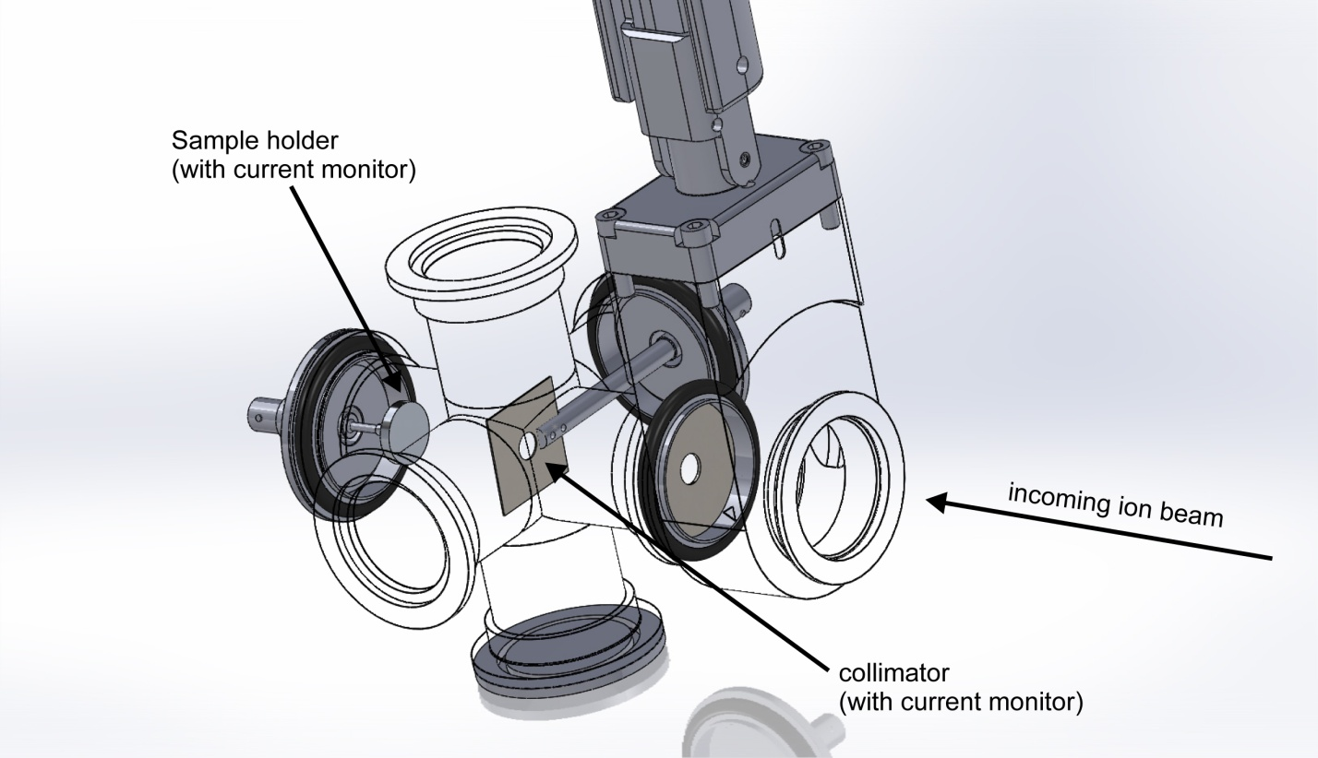
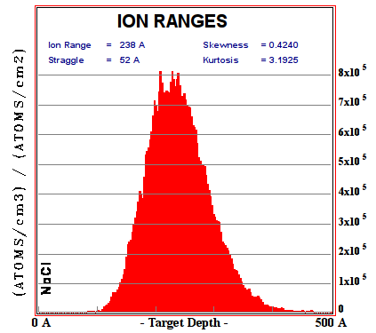
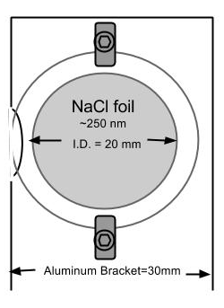
ISOL pilot study: ²⁰⁹At
Implantation chamber
34
Credit to: Peter Kunz, TRIUMF
Notes:
No unexpected inventory. No other astatine isotopes

Slide 35
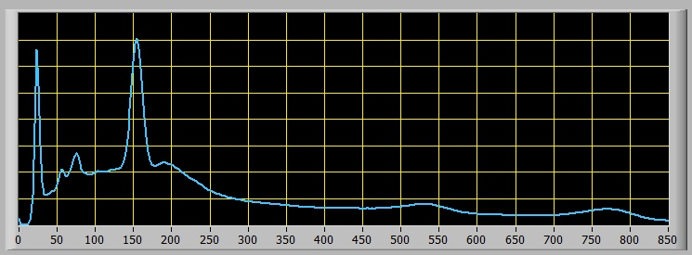
From bench to (pre-clinical) bedside
10⁹ ions/s of ²¹³Fr collected for up to 9.5 h
²⁰⁹At recovered by dissolving NaCl targets in 0.1 N NaOH (< 300 µL)
Up to 8.9 mCi ²⁰⁹At (EOB)
(Measured by γ-ray spectroscopy)
Labeling Chemistry
²⁰⁹At: 80 keV peak
¹²³I: 159 keV peak
²⁰⁹At + ¹²³I

Slide 36
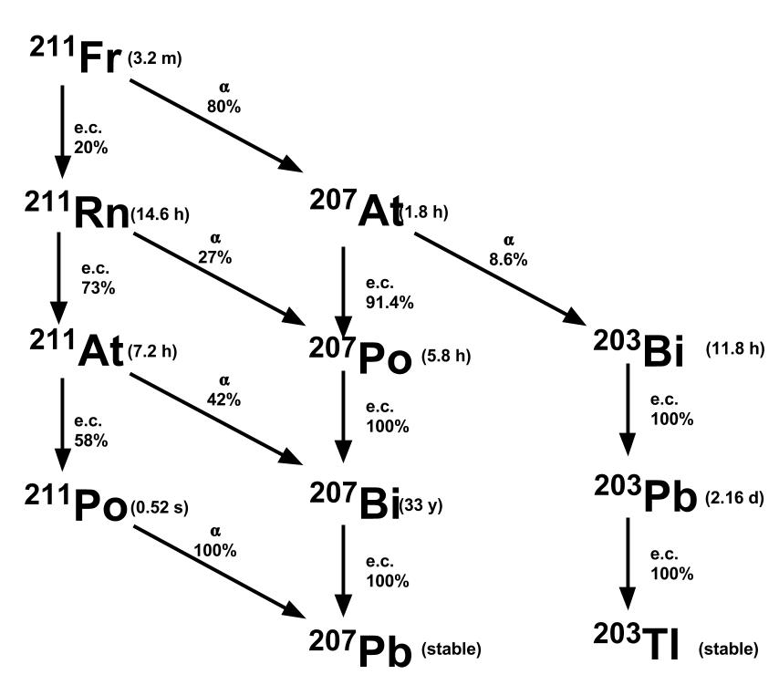
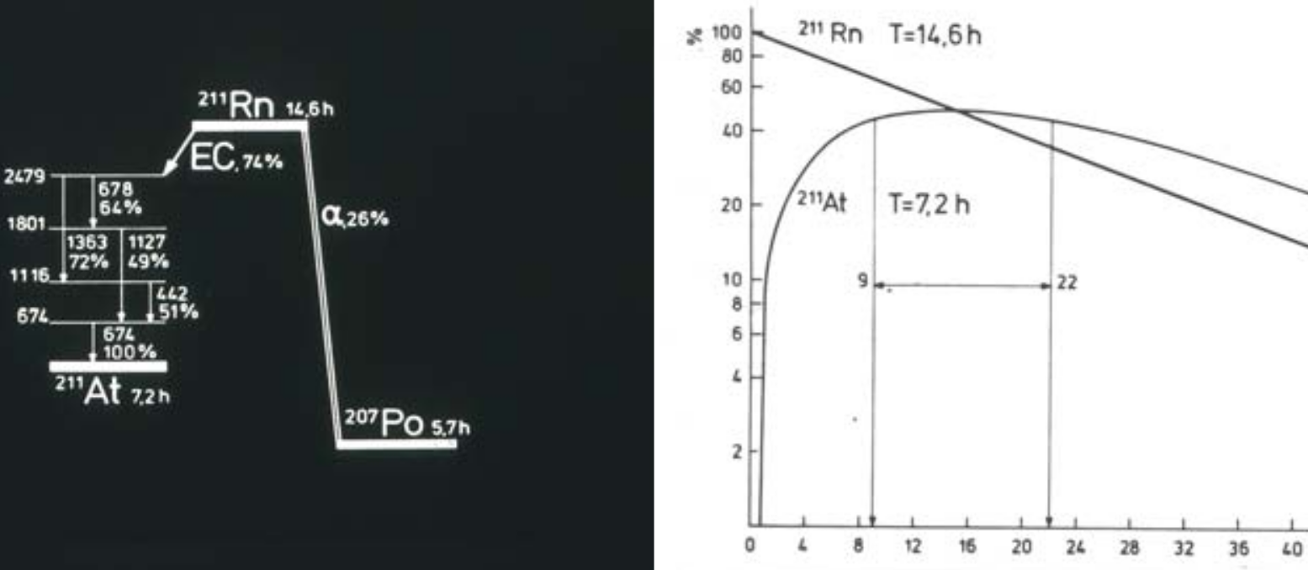
²¹¹Rn/²¹¹At generator system from
²¹¹Fr ion beams (>10⁹ ions/s)
The ²¹¹Fr decay chain provided a novel approach to ²¹¹Rn production
²¹¹Rn/²¹¹At generator could increase ²¹¹At supply and opportunities for distribution
²¹¹Rn was isolated in dodecane,
other radioactive inventory was washed away with aqueous solution
²¹¹At progeny recovered
after several hours of grow-in
36

Slide 37
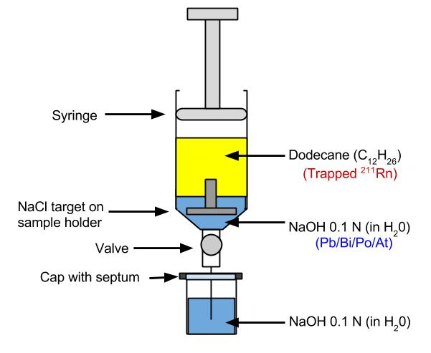
²¹¹Rn isolation design
Implant ²¹¹Fr in NaCl
Submerge target in dodecane
Dissolve NaCl
in dilute NaOH
Mix and remove aqueous solution (Pb/Bi/At/Po)
²¹¹Rn isolated in dodecane →²¹¹A
Adapted from Maeda et al, 2015 Radioanal Nucl Chem, 303:1465-1468 (Kanazawa U.)

Slide 38
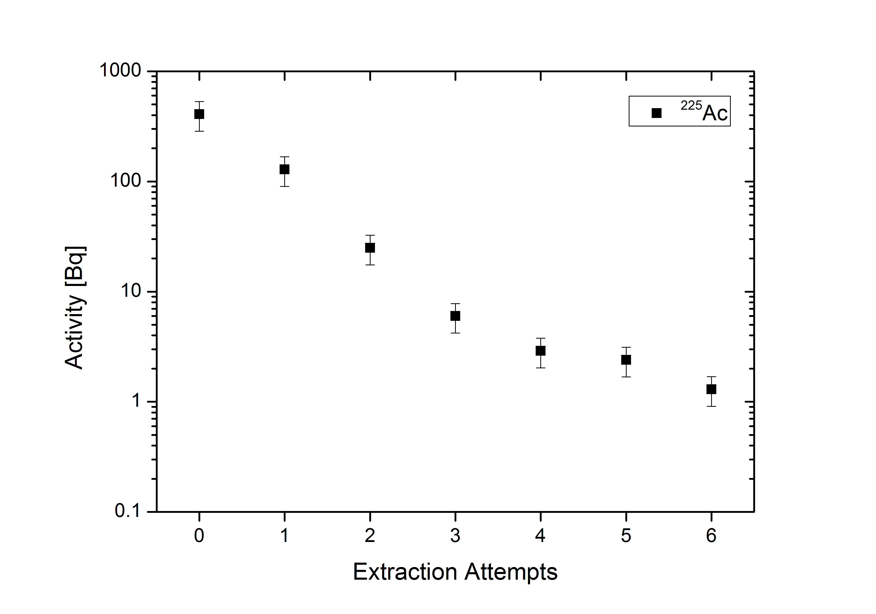
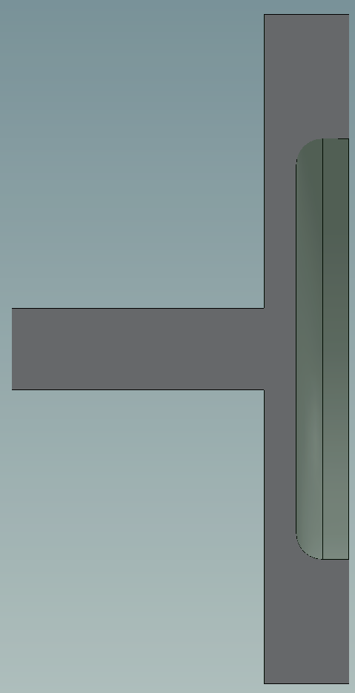
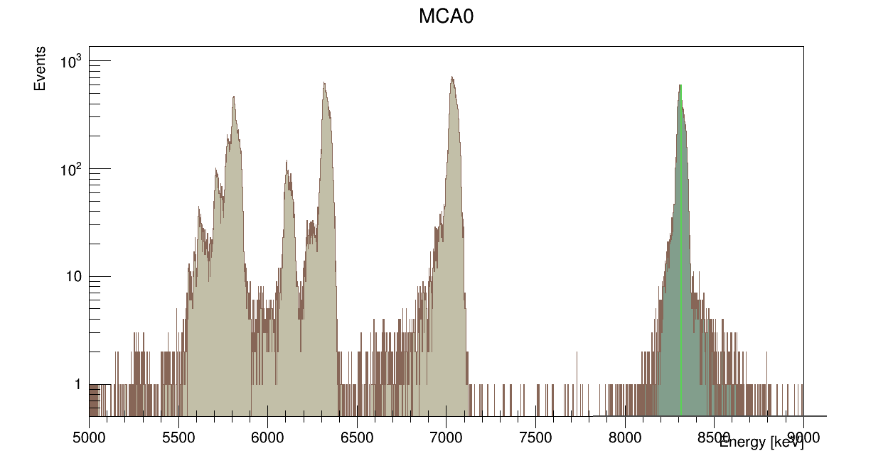
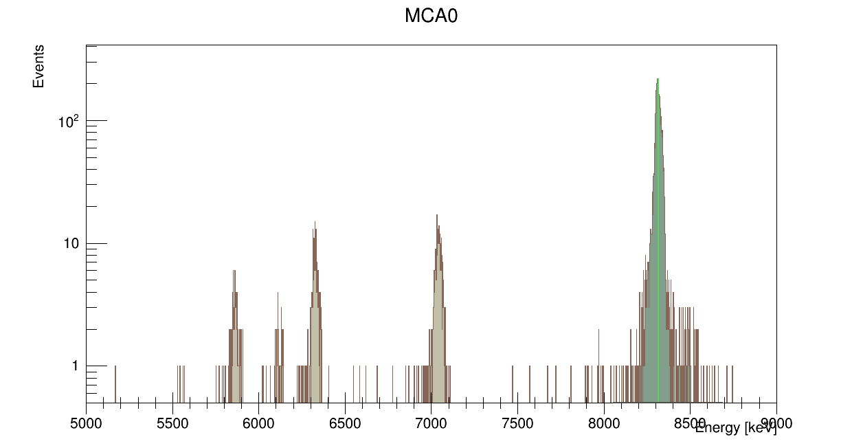
Moving on to feasibility of ²²⁵Ra/²²⁵Ac
Add
0.1 ml 0.1 N HCl
Extraction using 0.1N HCl solution
Residual Activity (Bq)
Evaporate
Add and Retrieve
0.1 ml 0.1N HCl
Evap.-Rinse Cycles
Recoil transfer in vacuum
Catcher
Source
Catcher
²²¹Fr
²¹⁷At
²¹³Po
²¹³Po
²²⁵Ac
²²¹Fr
²¹⁷At
²¹³Bi
Source
Efficiency ~30%
38

Slide 39
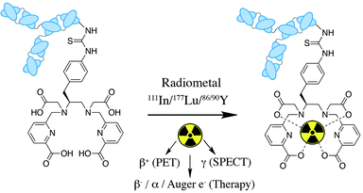
Future Direction: ²²⁵Ac/²¹³Bi
ISOL and Target Dissolution/Extraction
²²⁵Ac, ²¹³Bi,
many other options
Image taken from: E Price, C Orvig, Chem. Soc. Rev., 2014,43, 260-290
  TRIUMF capable of producing large (Ci) quantities of isotopes such as ²²⁵Ac, ^{223,225}Ra, ²¹³Bi, ²¹¹Rn
  Possible to ship targets for off-site processing (short-term)
  Effort in early stages, infrastructure, regulatory capabilities being pursued/implemented (long-term)
39

Slide 40
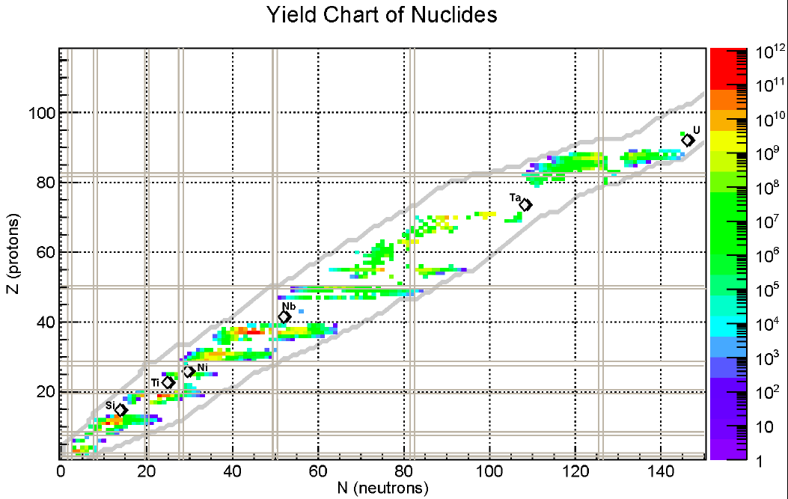
Medical Isotopes from ISAC/ISOL
Generators: ²¹¹Rn/²¹¹At; ²²⁵Ra/²²⁵Ac; ²²⁵Ac/²¹³Bi
Feasibility/Chemistry in lead up to full target harvest:
40

Slide 41





Acknowledgements: Tc-99m
The Team:
  PIs: F. Bénard, T. Ruth, A. Celler, J. Valliant, M. Kovacs,
  Ken Buckley, Vicky Hanemaayer, Brian Hook,
  Stuart McDiarmid, Stefan Zeisler, Frank Prato,
  Anne Goodbody, Joe McCann, Conny Hoehr,
  Tom Morley, Julius Klug, Philip Tsao,
  Milan Vuckovic, Patrick Ruddock, Maurice Dodd,
  Guillaume Langlois, Wade English, Xinchi Hou,
  Jesse Tanguay, Jeff Corsault, Ross Harper,
  Frank Prato, Constantinos Economou
TRIUMF and BCCA machine shops
Finances/Admin
  Henry Chen, Francis Pau, Jenny Song, Steven Foster, Frank Gleeson, James Schlosser, Jim Hanlon, Ann Fong, Neil McLean, Kevin McDuffie, Niki Martin, Karen Young

Slide 42

Acknowledgements: ISAC/ISOL
This work has been funded in part by an Innovation Grant from the Canadian Cancer Society (CCS)
Production
Radiation Safety
Animal Imaging
Jason Crawford
Tom Ruth
Peter Kunz
Jens Lassen
Stefan Zeisler
Friedhelm Ames
Colin Morton
Peter Machule
Stephen Chan
Linda Graham
Joe Mildenberger
Danka Krsmanovic
Roxana Ralea
Maxim Kinakin
David Prevost
Roxana Ralea
Mike Johnson
Lynne Lemessurier
François Bénard (BCCRC)
Kuo-Shyan Lin (BCCRC)
Vesna Sossi (UBC)
Chenoa Mah (UBC)
Tina Jorgensen (CCM)
Stephan Blinder (UBC)
Katherine Dinelle (UBC)
Maryam Shirmohammad (UBC)
Chemistry
D. Scott Wilbur (UW)
Don Hamlin (UW)
Oliver Press (antibody)
Hua Yang (TRIUMF)

Slide 43


Acknowledgements: Salt Target
The Team:
  TRIUMF: E Oehlke, C Hoehr, K Buckley, S Zeisler, M Adam, TJ Ruth,
  V Hanemaayer, M Dodd, B Hook, S McDiarmid, H Yang, Q Miao,
  L Graham, D Prevost
  BCCA: F Bénard, M Vuckovic, G Dias, J Klug, W English, KS Lin
Collaborators, staff and students:
  Mark Martinez (UBC), P Jahangiri,
  C Orvig (UBC), E Price, C Ramogida,
  A Celler (UBC), X Hou
TRIUMF and BCCA machine shops

