Slide 1

The spectrum of ¹⁵NH₃ in the 66-2000 cm⁻¹ region
Adriana Predoi-Crossª, Hoimonti Rozarioª, Michel Herman^{b},
Elisabetta Cané^{c}, Gianfranco Di Lonardo^{c}, and Luciano Fusina^{c}
ªDepartment of Physics and Astronomy, University of Lethbridge, 4401 University Drive, Lethbridge AB, T1K 3M4, Canada; ^{b}Laboratoire de Chimie Quantique et Photophysique, CP 160/09, Faculté des Sciences, Université Libre de Bruxelles, 50 Av. Roosevelt, B-1050 Bruxelles, Belgium; ^{c}Dipartimento di Chimica Industriale “Toso Montanari”, Università di Bologna, Viale Risorgimento 40136 Bologna, Italy

Slide 2

Overview of Presentation
Motivation for this spectroscopic study and the current status of knowledge
Experimental Details
Spectroscopic analysis
Data interpretation and comparisons with other studies
Conclusions and directions for future work
Acknowledgements

Slide 3

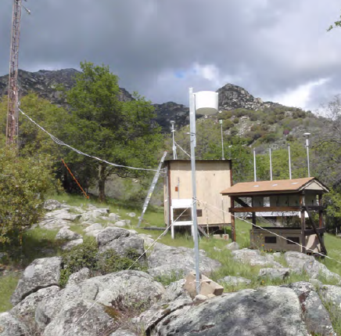
The Importance of Ammonia in the Atmosphere
Ammonia is a gas readily released into the air from a variety of biological sources, as well as from industrial and combustion processes.
While NH₃ has many beneficial uses, it can detrimentally affect the quality of the environment through eutrophication of natural ecosystems, the associated loss of biodiversity, and the formation of secondary particles in the atmosphere, which can reduce visibility.
Possible health effects of ammonia gas in the atmosphere include short-term irritation of the eyes and lungs and the long-term effects on the cardiovascular system through inhalation of fine particulate matter formed from ammonia in the atmosphere.
The dominant source of NH₃ emissions in the Canada is agriculture (~85%), largely from animal waste and commercial fertilizer application.
Source: http://nadp.sws.uiuc.edu/amon/
AMoN (Ammonia Monitoring
Network) field site at Sequoia
National Park, USA

Slide 4
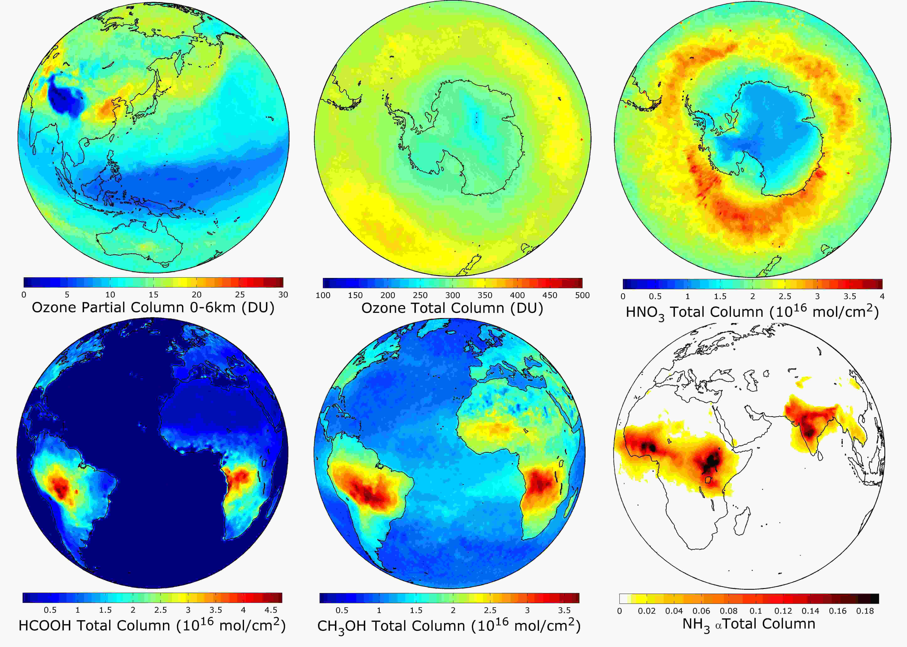
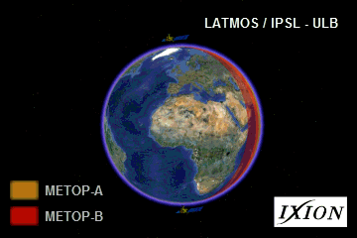
Monitoring Ammonia in the Atmosphere
Animation showing MetOp-A and MetOp-B flying simultaneously. Half an orbit (~50 minutes) is separating the two satellites. Image Credit: Maya George/LATMOS
IASI performs measurements covering the globe twice daily, which makes it an ideal instrument for monitoring the evolution of important compounds in the atmosphere.
Examples of different atmospheric compounds retrieved from the Infrared Atmospheric Sounding Interferometer (IASI) measurements: Ozone (for partial and total columns), nitric acid (HNO₃), formic acid (HCOOH), methanol (CH₃OH) and ammonia (NH₃). Image Credit: Maya George/LATMOS

Slide 5
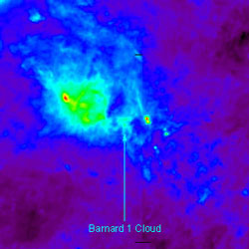
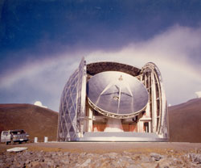
Interstellar Ammonia
The composition of the interstellar medium determines the composition of the objects which form from it such as stars and planets. The information provided by the study of atoms and molecules in interstellar space is crucial to our understanding of star formation and galactic evolution.
Interstellar molecules, such as water and ammonia and atoms such as oxygen and carbon are detected in the infrared in many parts of our galaxy. These molecules are found in the cool clouds of dust and gas within which new stars and planets are formed.
Ammonia (NH₃) was the first polyatomic molecule detected in interstellar space. Since its initial discovery by Cheung et al. (1968), because of its large number of transitions sensitive to a wide range of excitation conditions and the fact that it can be detected in a great variety of regions, NH₃ is perhaps second only to carbon monoxide (CO) in importance. Ammonia is found on Pluto, Jupiter and, in small amounts, on Uranus.
IRAS image of the vicinity of the Barnard~1 cloud in the constellation Perseus, where triply deuterated ammonia was detected at the CSO.
The 10.4-meter Leighton telescope of the Caltech Submillimeter Observatory (CSO) atop Mauna Kea, Hawaii.
Source: http://www.spaceflightnow.com/
news/n0205/31ammonia/

Slide 6
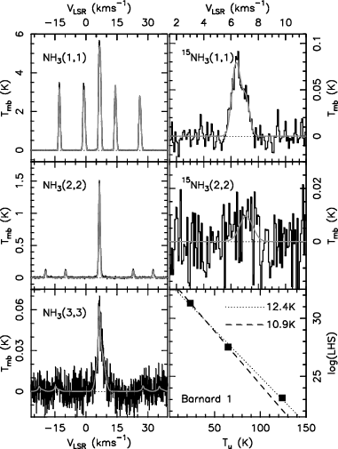
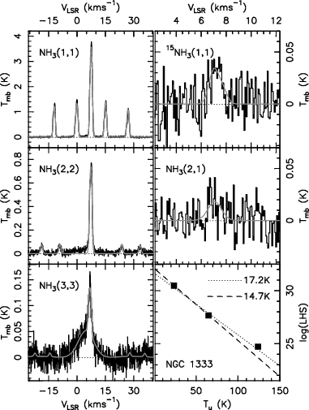
Nitrogen Isotopic Fractionation
in Interstellar Ammonia
Using the Green Bank Telescope (GBT), D.C. Lis et al. Astrophys.J. (2010) have obtained accurate measurements of the ¹⁴N/¹⁵N isotopic ratio in ammonia in two nearby cold, dense molecular clouds, Barnard~1 and NGC 1333. The ¹⁴N/¹⁵N ratio in Barnard~1, 334±50, is particularly well constrained and falls in between the local interstellar medium/proto-solar value of ∼450 and the terrestrial atmospheric value of 272.
Spectra of the ammonia
inversion lines in
Barnard~1 and
NGC 1333

Slide 7
Current status of Spectroscopic Knowledge On Ammonia
Ammonia is a well studied molecule owing to its importance as a model molecule possessing internal inversion motion which can be characterized by infrared spectroscopy.
Until recently, the available data in the far-infrared region were marginal. Indeed previous studies were performed only at low/medium resolution (up to R ~0.1 cm⁻¹).
For this reason the atmospheric retrievals of ammonia performed by infrared techniques use only cross section parameters to analyze the observed atmospheric spectra.
Among the isotopically substituted molecules, ¹⁵NH₃ received little attention in comparison with the parent main isotope ¹⁴NH₃ . ¹⁵NH₃ has an energy pattern very similar to that of ¹⁴NH₃ and represents a suitable test to check the assignment of the transitions and the adequacy of the Hamiltonian for the description of the spectrum, in particular at very high J values.
While recently the ground state transitions of ¹⁴NH₃ [1] has been reinvestigated by means of several high resolution techniques, only two studies were devoted to the analogous spectra in ¹⁵NH₃ [2,3]. Of these, the most recent was performed in 1994 and rotation-inversion transitions were measured only up to J = 6. The bending states of ¹⁵NH₃ were also analysed using spectra recorded at moderate resolution [4].

Slide 8
Spectroscopic Goals for this study
The use of infrared techniques to retrieved tropospheric species is a very powerful technique, provided that accurate spectroscopic parameters are used to analyze the observed spectra.
The goal of the present study is to perform the first detailed infrared study of ¹⁵NH₃ in the far-infrared region. The target task, in the near future, will be to provide a precise and consistent list of ¹⁵NH₃ lines involving accurate line position, intensity and air-broadening parameters.
Since the knowledge of the ground state energy pattern is essential to investigate the vibrationally excited states we recorded the far infrared spectrum of the molecule at very high resolution and path length in order to observe very high J transitions and also the rotation-inversion spectrum in the lowest excited vibrational states.
We aimed to observe perturbation allowed transitions, which are essential to better characterize the rotation and distortion parameters related to the axis of symmetry, C, D_{K}, H_{K}, ... .
The spectral range we aim to investigate extends from 60 to 2000 cm⁻¹ allowing the observation of transitions ν₂ ← GS, ν₄ ← GS, 2ν₂ ← GS and the hot bands 2ν₂ ← ν₂ , ν₄ ← ν₂ and 2ν₂ ← ν₄.

Slide 9
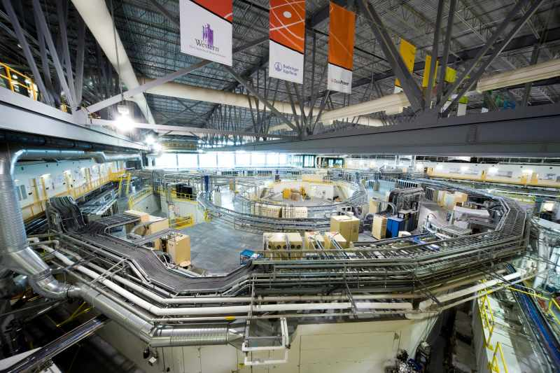
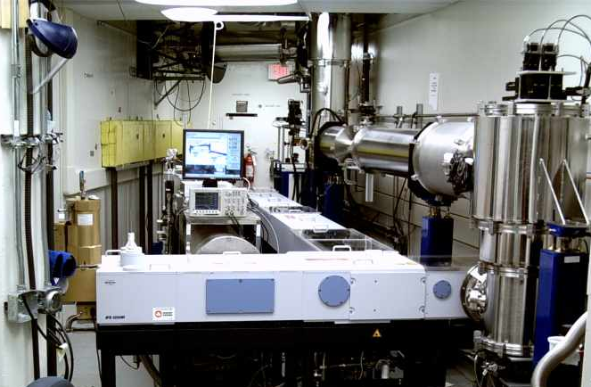
Experimental Conditions
2 m gas cell
absorption paths up to 80 m coolable to ~80 K
- The high resolution of the Bruker Fourier transform spectrometer at the FIR beamline, coupled with the high brightness of the synchrotron in the difficult 60-400 cm⁻¹ region, represented a powerful capability for this study.
- In the FIR region, Doppler broadening of the spectral lines is small, so that the high-resolution of the spectrometer was exploited to the full, while the high brightness gives greatly improved SNR ratio.
- The sample was supplied by Sigma-Aldrich with a purity of 98% and used without any further purification.
Range (cm⁻¹) | Pressure (Torr) | Pathlength (m) | Temperature (K) | Resolution (cm⁻¹) | Source
60-370 | 0.002 | 8 | 298 | 0.00096 | Synchrotron
60-370 | 1 | 72 | 298 | 0.00096 | Synchrotron
60-370 | 0.05 | 72 | 298 | 0.00096 | Synchrotron
896-1149 | 0.05 | 72 | 298 | 0.003 | Globar
1100-1700 | 0.05 | 72 | 298 | 0.003 | Globar
1100-1700 | 0.005 | 72 | 298 | 0.003 | Globar
1600- 2085 | 0.005 | 72 | 298 | 0.003 | Globar

Slide 10
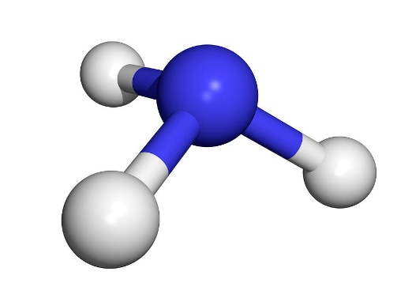
The Physics of Ammonia Molecule
The pyramidal NH₃ molecule is a symmetric top with
inversion, well understood in laboratory microwave
spectroscopy (Townes & Schawlow 1955, Kukolich 1967).
Several important properties make NH₃ particularly interesting
in astrophysical conditions: the existence of metastable and non-metastable states, ortho- and para- species, inversion motion of the molecule, and hyperfine structures.
The rotational energy of NH₃ is a function of the two principal quantum numbers (J, K), corresponding to the total angular momentum and its projection along the molecular axis.
The molecule has an electric dipole moment only along the molecular axis, and the dipole selection rules are ΔK = 0, ΔJ = 0, ± 1. Hence, dipole transitions between K-ladders are normally forbidden.
Interaction between rotational and vibrational motions, induces a small dipole moment perpendicular to the rotation axis, giving rise to very slow Δk = ± 3 (K= |k|) transitions (Oka et al. 1971 ). The K-ladders are essentially independent of each other. Normal intermolecular collisions (not involving weak magnetic effects) also produce only transitions in which Δk is a multiple of 3 (including 0). Within each K -ladder, the upper states (J > K) are called non-metastable because they can decay rapidly via the far-infrared ΔJ = 1 transitions. The lowest states can only decay via the much slower Δk = ± 3 transitions and are called metastable.
Source: PT Ho, C. Townes, Ann. Rev. Astron. Astrophys. 1983. 21: 239-70
¹⁵NH₃

Slide 11
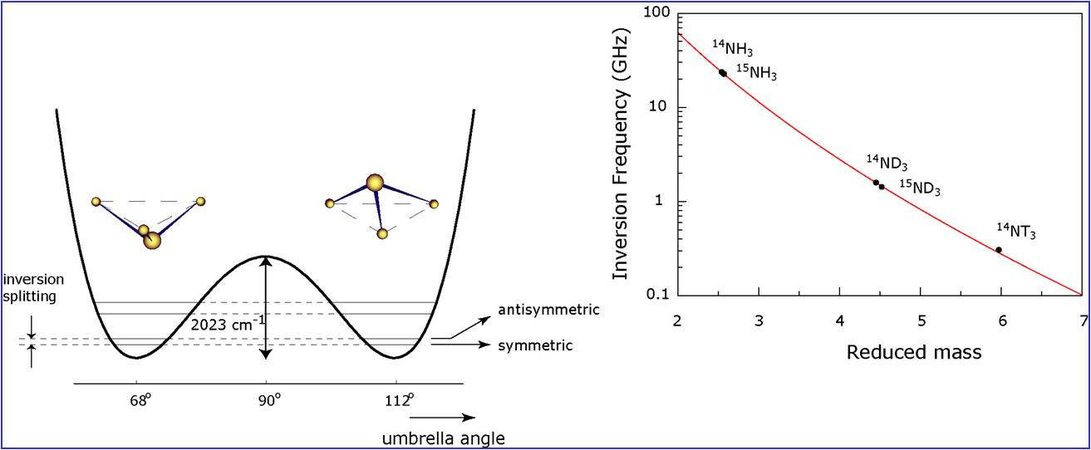
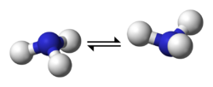
The Inversion Motion of Ammonia
Molecule
¹⁵NH₃
The N atom can tunnel quantum mechanically through the plane of the H atoms. The potential barrier due to the H atoms is low enough that such tunneling occurs rapidly, resulting in the two lowest vibrational states providing a transition frequency that falls in the microwave range.
All (J, K) rotational states are thus split into inversion doublets (except for K = 0, where nuclear spin statistics and symmetry considerations eliminate half of the inversion doublet). The ΔJ = 0, Δ K = 0 inversion transitions across the doublets are allowed from symmetry considerations (Townes & Schawlow 1 955). The inversion doublets are further split by hyperfine interactions.
Source: P.T. Ho, C. Townes, Ann. Rev. Astron. Astrophys. 1983. 21: 239-70

Slide 12
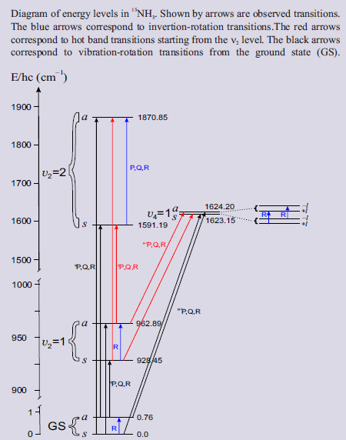
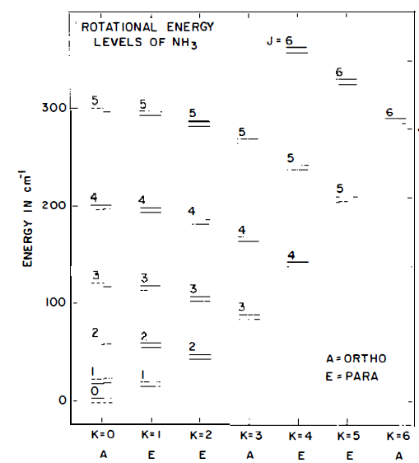

Energy levels in ¹⁵NH₃
Energy diagram of the rotation-inversion energy levels of NH_{3.} J is the total angular-momentum quantum number, and K is the projected angular momentum along the molecular axis.

Slide 13
Spectroscopic Analysis
In the region below 2000 cm⁻¹ three bands involving the states ν₂ = 1, ν₄ = 1 and ν₂ = 2 are observed.
Because of the inversion motion each level is split into two sublevels whose wavefunctions are symmetric (s) or antisymmetric (a) with respect to the plane of inversion. Furthermore each (s) and (a) level of the double degenerate ν₄ = 1 state contains stacks of levels characterized by the l =1 and l = -1 vibrational angular momentum.
Here we report on the observation and the analysis of the inversion rotation spectrum in the ground, v₂ = 1, v₄=1 and v₂ = 2 states. All the allowed and forbidden inversion-rotation transitions belonging to the ground state, together with the pure inversion transitions present in the literature, were fitted simultaneously on the basis of an inversion-rotational Hamiltonian which includes the centrifugal distortion constants up to 12th power and the Δk =±3 and Δk =±6 interaction terms. 651 transitions with J up to 23 were fitted to 54 parameters, with a RMS value for 534 FIR lines of 0.98×10⁻⁴ cm⁻¹ (3.3 MHz).

Slide 14
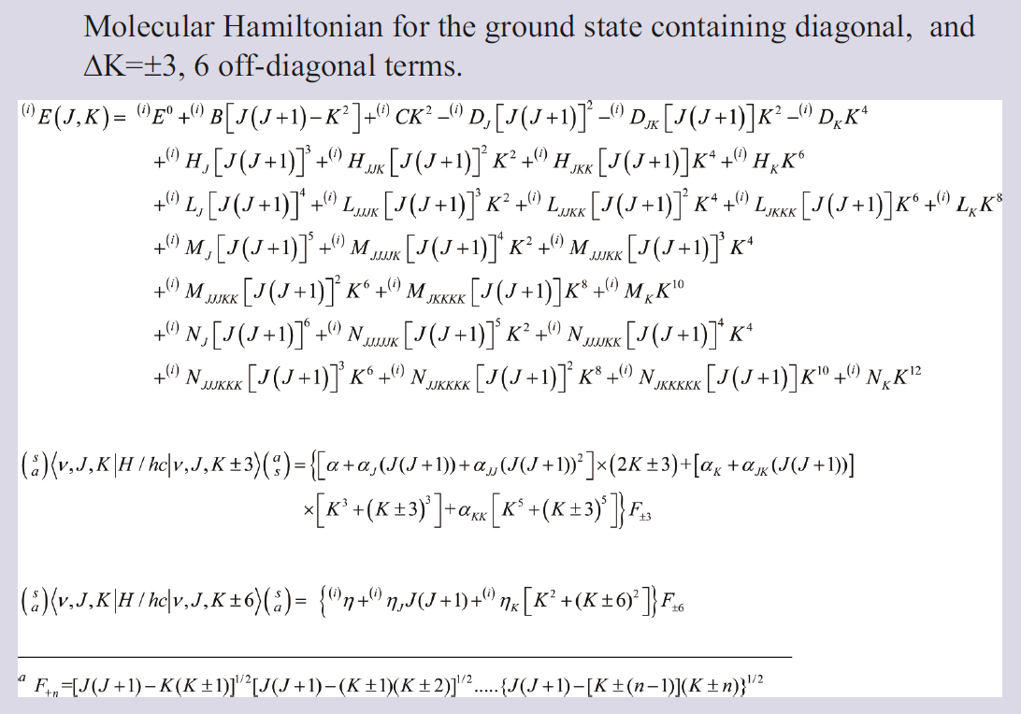
Spectroscopic Analysis

Slide 15
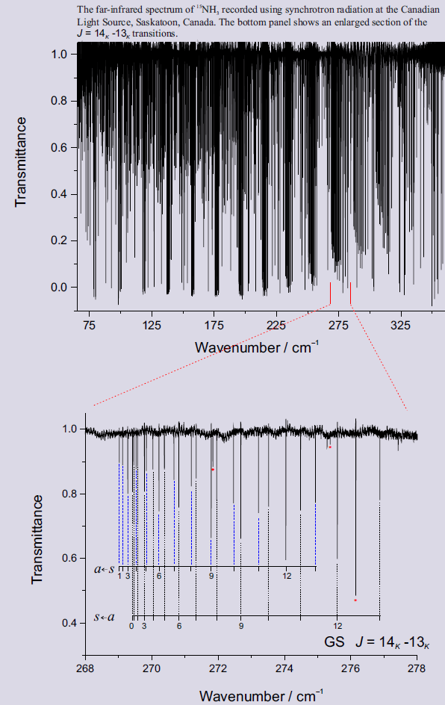
Example of Spectra Analyzed in this Study
¹⁵NH₃

Slide 16
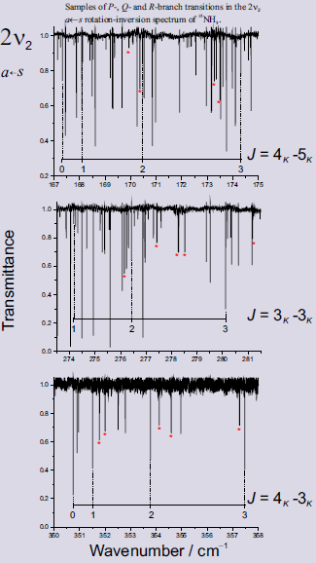
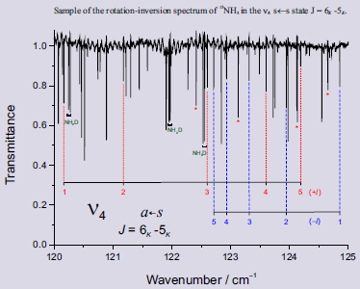
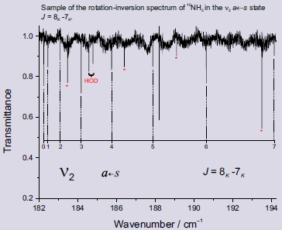
Examples
of
Spectra
Analyzed
in this
Study

Slide 17
Observed Perturbation allowed Δk= ± 3
transitions in the ground state up to J =10
J | K | J | K |  | observed | J | K | J | K |  | observed | J | K | J | K |  | observed
4 | 0 | 3 | 3 | a - a | 112.2217 | 8 | 0 | 7 | -3 | a - a | 189.5146 | 9 | 3 | 9 | -6 | s - s | 97.11553
5 | 0 | 4 | -3 | s - s | 131.8437 | 8 | 1 | 7 | 4 | s - s | 211.4348 | 9 | -3 | 8 | 0 | a - a | 144.0887
5 | 1 | 4 | 2 | a - a | 109.7602 | 8 | 1 | 7 | 4 | a - a | 211.3065 | 9 | 4 | 8 | 1 | s - s | 122.6360
5 | 1 | 4 | 2 | s - s | 109.8208 | 8 | 1 | 7 | 2 | a - a | 167.8585 | 9 | 4 | 8 | 1 | a - a | 122.6451
5 | -3 | 4 | 0 | a - a | 65.9114 | 8 | 2 | 8 | 5 | s - s | 75.80351 | 9 | 5 | 8 | 2 | s - s | 101.0645
6 | 0 | 5 | -3 | a - a | 151.1470 | 8 | 2 | 7 | 1 | s - s | 146.3186 | 9 | 5 | 8 | 2 | a - a | 101.1013
6 | 1 | 5 | 4 | s - s | 173.3057 | 8 | 2 | 7 | 1 | a - a | 146.2798 | 9 | 6 | 8 | 3 | a - a | 79.39756
6 | 1 | 5 | 2 | s - s | 129.3188 | 8 | 2 | 7 | 5 | a - a | 233.2988 | 9 | -3 | 9 | 6 | a - a | 96.98271
6 | 1 | 5 | 2 | a - a | 129.2549 | 8 | 3 | 7 | 6 | a - a | 255.5570 | 9 | 3 | 8 | 6 | s - s | 274.2817
6 | -3 | 5 | 0 | s - s | 85.6074 | 8 | -3 | 7 | -6 | s - s | 255.7657 | 9 | 6 | 8 | -3 | s - s | 79.33243
7 | 0 | 6 | -3 | s - s | 170.5068 | 8 | 4 | 7 | 1 | a - a | 103.1120 | 10 | 0 | 9 | -3 | a - a | 227.2037
7 | 1 | 6 | 2 | s - s | 148.6926 | 8 | 5 | 7 | 2 | s - s | 81.35313 | 10 | 1 | 9 | 4 | s - s | 248.8132
7 | 1 | 6 | 4 | s - s | 192.4580 | 8 | -3 | 7 | 0 | s - s | 124.7274 | 10 | 1 | 9 | 2 | s - s | 205.9055
7 | 1 | 6 | 4 | a - a | 192.3235 | 9 | 0 | 8 | -3 | s - s | 208.5423 | 10 | 1 | 9 | 2 | a - a | 205.8428
7 | 2 | 6 | 1 | s - s | 126.9523 | 9 | 1 | 8 | 2 | s - s | 187.0005 | 10 | 1 | 9 | 4 | a - a | 248.7005
7 | 2 | 6 | 1 | a - a | 126.9166 | 9 | 1 | 8 | 4 | s - s | 230.2241 | 10 | 2 | 9 | 5 | s - s | 270.5480
7 | -3 | 6 | -6 | a - a | 236.8087 | 9 | 1 | 8 | 2 | a - a | 186.9354 | 10 | 2 | 9 | 1 | s - s | 184.6119
7 | -3 | 6 | 0 | a - a | 105.2169 | 9 | 1 | 8 | 4 | a - a | 230.1029 | 10 | 2 | 9 | 1 | a - a | 184.5708
7 | 4 | 6 | 1 | s - s | 83.4423 | 9 | 2 | 8 | 5 | s - s | 252.1149 | 10 | 2 | 9 | 5 | a - a | 270.4050
7 | 4 | 7 | 7 | s - s | 120.9681 | 9 | 2 | 8 | 5 | a - a | 251.9591 | 10 | 3 | 10 | -6 | a - a | 96.22192
7 | 4 | 6 | 1 | a - a | 83.46845 | 9 | 2 | 8 | 1 | s - s | 165.5435 | 10 | 4 | 9 | 1 | s - s | 142.0483

Slide 18
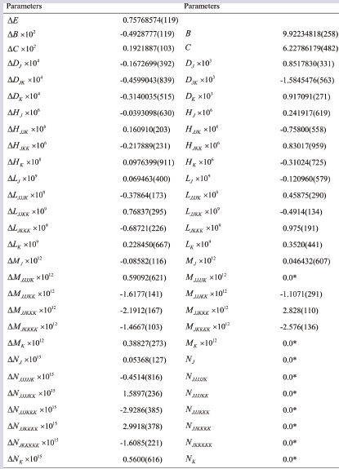
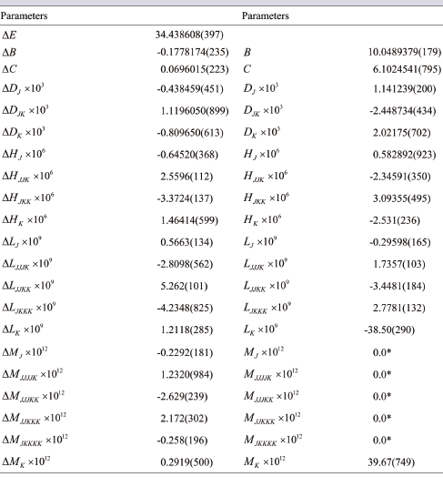
Sample results (¹⁵NH₃ Ground State)
Sample results (¹⁵NH₃ ν₂ state)
Retrieved molecular ground state constants. The reported uncertainties in units of the last significant figure correspond to one standard deviation.
Retrieved molecular constants in the ν₂ state. The reported uncertainties in units of the last significant figure correspond to one standard deviation.

Slide 19
Results of Spectroscopic Analysis
An analogous set of spectroscopic parameters was obtained for the inversion-rotation transitions in the ν₂ = 1 state but the spectroscopic parameters must be considered as effective since the interaction of this state with ν₄ = 1 was not taken into account. For the ν₄ = 1 and ν₂ = 2 states only a list of observed inversion-rotation transitions is reported.
The analysis has been extended to all vibrational transitions falling below 2000 cm⁻¹, namely ν₂ ← GS, ν₄ ← GS and 2ν₂ ← GS and the hot bands 2ν₂ ← ν₂ , ν₄ ← ν₂ and 2ν₂ ← ν₄.
Transitions up to J = 15 have been identified and fitted, together with the rotation-inversion transition in all the excited states, using of a computer program based on an effective Hamiltonian which takes into account all symmetry allowed interactions between and within the excited states.
About 6300 transitions have been observed, 5700 of these have been so far retained in the fit.

Slide 20
Conclusions and Directions
for Future Work
Transmission spectra in spectral range 60 – 2085 cm⁻¹ have been analyzed and the results for molecular constants are presented grouped by bands.
We were also able to determine several molecular constants, among them are the rotational constant C and centrifugal distortion D_{k} and H_{k} parameters.
Currently we are retrieving intensities for the newly assigned transitions. Of special interest are the observed forbidden transitions.

Slide 21
References
[1] S. Yu, J.C. Pearson, B.J. Drouin, K. Sung. O. Pirali, M. Vervloet, M.-A. Martin-Droumel, C.P. Endres, T. Shiraiashi, K. Kobayashi, F. Matsushima, Submillimeter-wave and far-infrared spectroscopy of high-J transitions of the ground and ν₂=1 states of ammonia, J. Chem. Phys. 133 174317 (2010).
[2] M. Carlotti, A. Trombetti, B. Velino, J. Vrbancich, The rotation-invesion spectrum of ¹⁵NH₃, J. Mol. Spectrosc. 83 401 (1980).
[3] S. Urban, S. Klee and K.M.T. Yamada, Ground-state ro-inversional transitions of (NH3)-N-15 in the far-infrared region, J. Mol. Spectrosc. 168 384 (1994).
[4] G. Di. Lonardo, L. Fusina, A. Trombetti, and I.M.Mills, The ν₂, 2ν₂, 3ν₂, ν₄ and ν₁+ ν₄ bands of ¹⁵NH₃ J. Mol. Spectrosc. 92 298 (1982).
Acknowledgements
The spectroscopy group at University of Lethbridge was funded by NSERC, Canada. Research described in this work was also performed at the Dipartimento di Chimica Industriale “Toso Montanari”, Università di Bologna, Bologna, Italy and Laboratoire de Chimie Quantique et Photophysique, Université Libre de Bruxelles, Bruxelles, Belgium under contracts and cooperative agreements.

