Slide 1

Interdisciplinary Applications of Optical Spectroscopy on a Laser-Induced Plasma
Steven J. Rehse
Department of Physics, University of Windsor, Windsor, ON

Slide 2
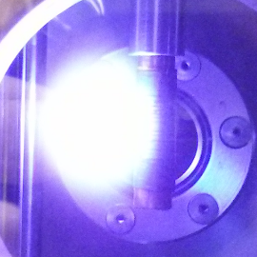
Laser-Induced Plasmas
Laser-induced plasma
What is a “laser-induced plasma?”
Incident Laser Pulse
Rare-earth metal target
Can be done with ns, ps, or fs lasers
Threshold irradiance:

Slide 3
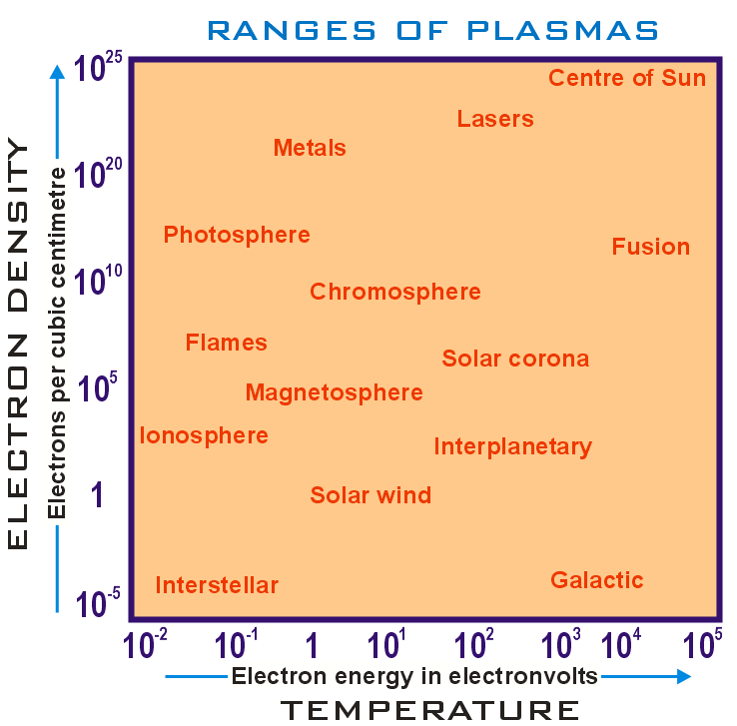
LIP
5,000-50,000 K
10¹⁷ – 10²⁰ cm⁻³
Adapted from Wikipedia

Slide 4
Laser-Induced Plasmas
Laser-induced plasma
What is a “laser-induced plasma?”
Incident Laser Pulse
Rare-earth metal target
Can be done with ns, ps, or fs lasers
Threshold irradiance:
We can do spectroscopy on that!

Slide 5
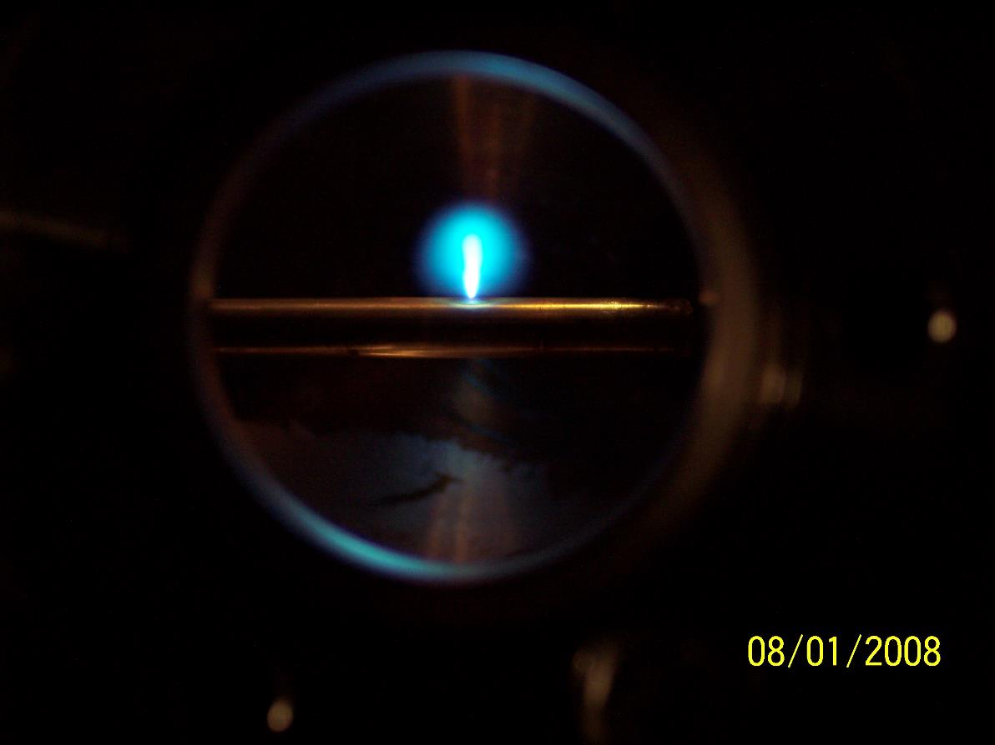
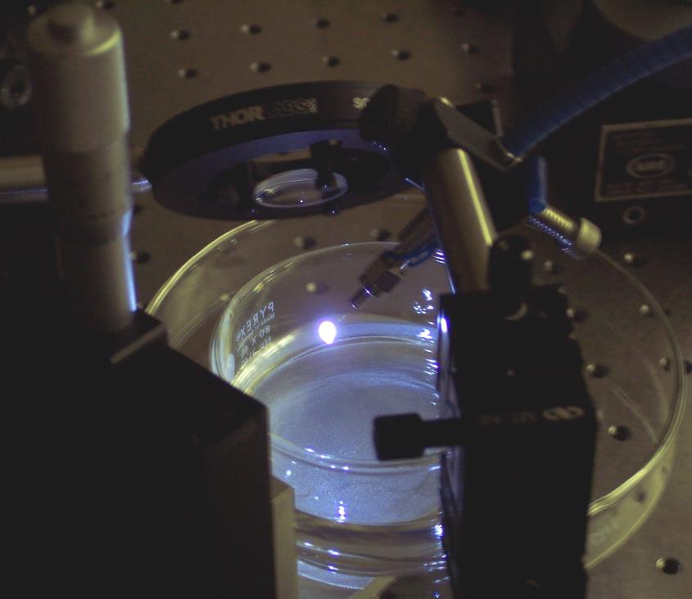
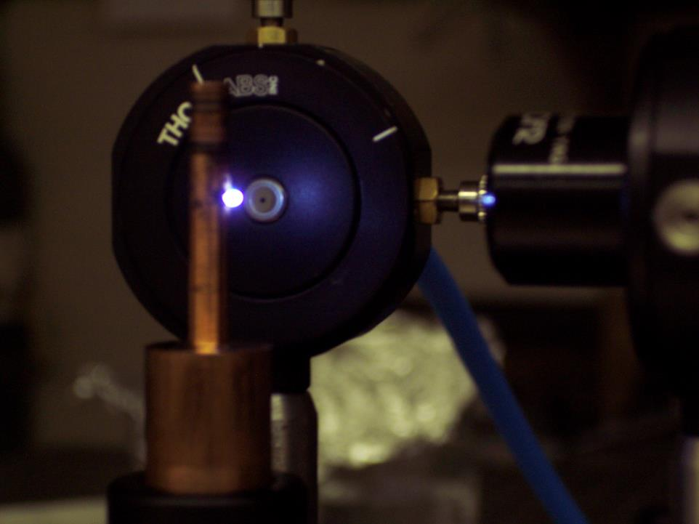
What It looks Like

Slide 6
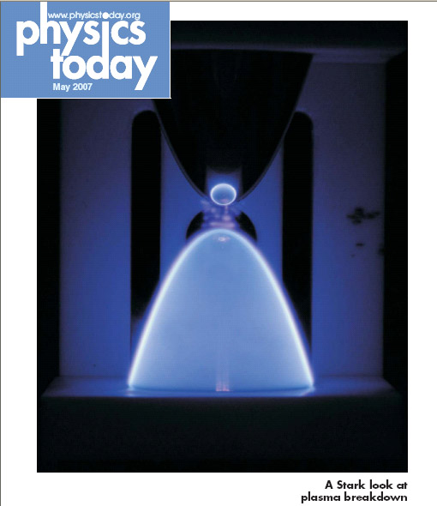
When we do a time-resolved spectroscopy of the plasma, we call it:
“Laser-induced breakdown spectroscopy”
or
LIBS

Slide 7
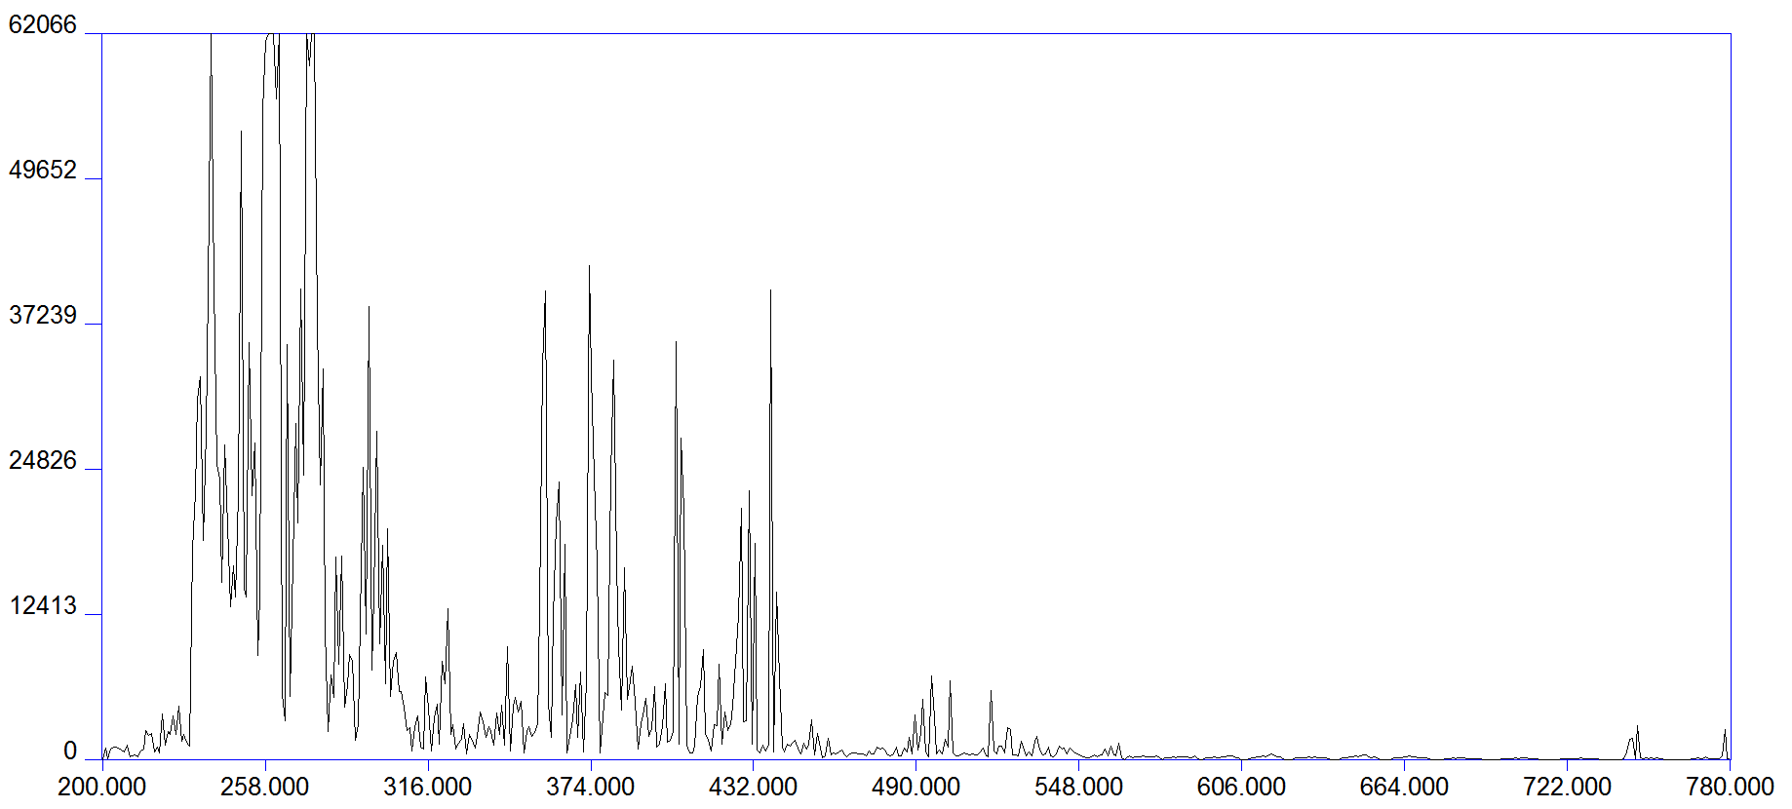
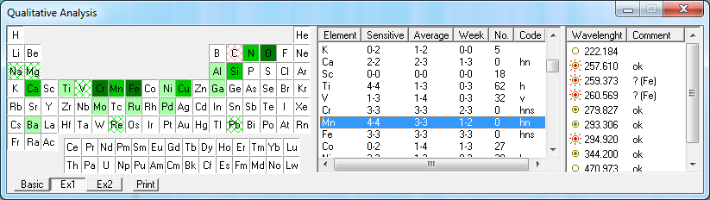
The Goal of LIBS Plasma Creation
to create an optically thin plasma which is in thermodynamic equilibrium (or LTE) and whose elemental composition is the same as that of the target/sample
  if achieved, atomic emission spectral line intensities can be related to relative concentrations of elements (sometimes absolute concentrations)
  typically these conditions are only met approximately.
steel LIBS spectrum

Slide 8
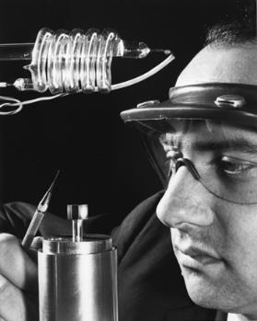
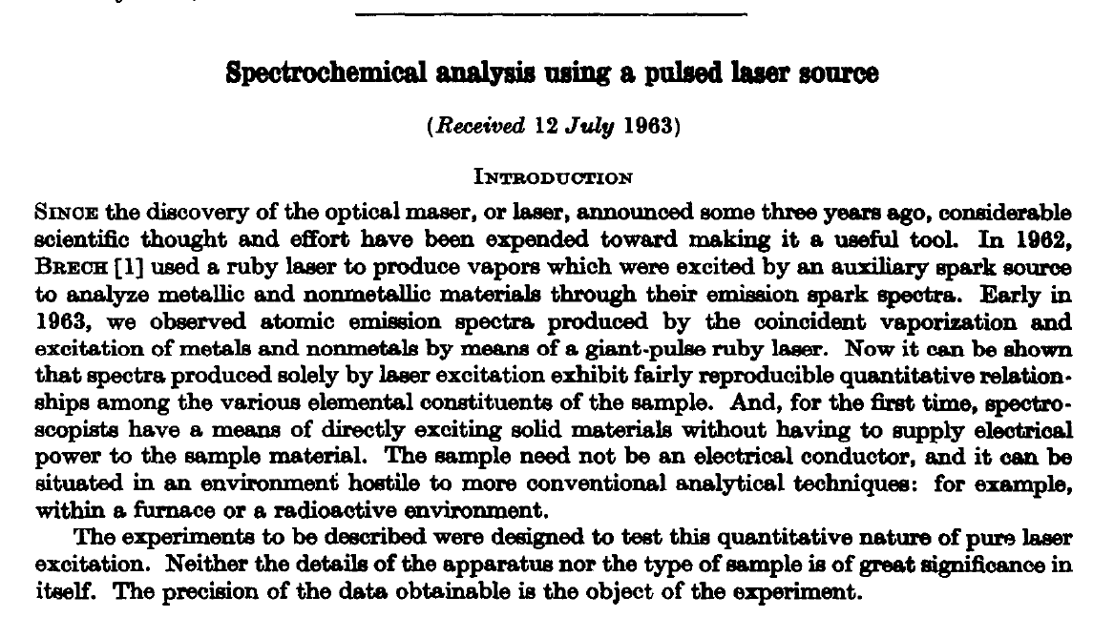
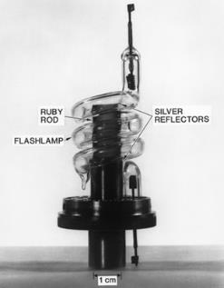
History
1964
Runger et al. First direct spectro-chemical analysis by LIBS
1960
Maiman: first ruby laser
1965
Zel’dovich, Raizer: First theoretical model for laser breakdown of a gas
1962
Brech, Cross: Birth of LIBS: detection of spectrum from ruby laser induced plasma

Slide 9
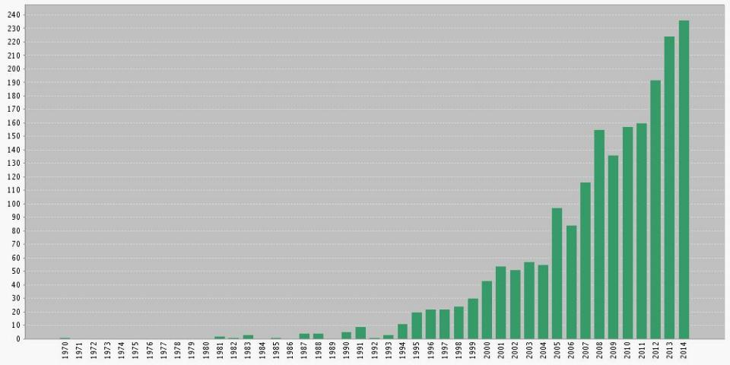
History
“laser-induced breakdown” and/or “laser-induced plasma spectroscopy” @ Web of Science (Thomson Reuters)
>2000 peer-reviewed papers have been published according to the Web of Science
Why the interest?
1962-64: First spectrochemical analysis of laser-induced plasma
LIBS coined at LANL

Slide 10
Applications of LIBS
No matter what your application is, you will be doing one of two things:
Attempting to quantify the amount/concentration of some element by analyzing peak intensities
Attempting to identify a target based on its unique elemental composition by analyzing the presence intensity of all/many lines

Slide 11
Keeping Track of the Elemental Inventory
(underlined elements reported in literature)
(■ Solids ■ Liquids ■ Gases ■ Artificially prepared)
1 H |  |  |  |  |  |  |  |  |  |  |  |  |  |  |  |  | 2 He
3 Li | 4 Be |  |  |  |  |  |  |  |  |  |  | 5 B | 6 C | 7 N | 8 O | 9 F | 10 Ne
11 Na | 12 Mg |  |  |  |  |  |  |  |  |  |  | 13 Al | 14 Si | 15 P | 16 S | 17 Cl | 18 Ar
19 K | 20 Ca | 21 Sc | 22 Ti | 23 V | 24 Cr | 25 Mn | 26 Fe | 27 Co | 28 Ni | 29 Cu | 30 Zn | 31 Ga | 32 Ge | 33 As | 34 Se | 35 Br | 36 Kr
37 Rb | 38 Sr | 39 Y | 40 Zr | 41 Nb | 42 Mo | 43 Tc | 44 Ru | 45 Rh | 46 Pd | 47 Ag | 48 Cd | 49 In | 50 Sn | 51 Sb | 52 Te | 53 I | 54 Xe
55 Cs | 56 Ba | 57 La | 72 Hf | 73 Ta | 74 W | 75 Re | 76 Os | 77 Ir | 78 Pt | 79 Au | 80 Hg | 81 Tl | 82 Pb | 83 Bi | 84 Po | 85 At | 86 Rn
87 Fr | 88 Ra | 89 Ac | 104 Rf | 105 Db | 106 Sg | 107 Bh | 108 Hs | 109 Mt | 110 Uun | 111 Uuu | 112 Uub |  | 114 Uuq |  | 116 Uuh
 |  |  | 58 Ce | 59 Pr | 60 Nd | 61 Pm | 62 Sm | 63 Eu | 64 Gd | 65 Tb | 66 Dy | 67 Ho | 68 Er | 69 Tm | 70 Yb | 71 Lu
 |  |  | 90 Th | 91 Pa | 92 U | 93 Np | 94 Pu | 95 Am | 96 Cm | 97 Bk | 98 Cf | 99 Es | 100 Fm | 101 Md | 102 No | 103 Lr
www.arl.army.mil/wmrd/LIBS

Slide 12
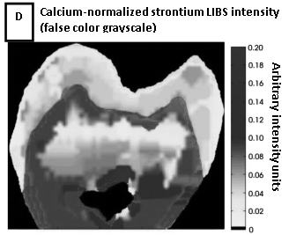
Advantages of LIBS - spatial resolution
Laser allows point sampling (1-100 micron)
Elemental “surface maps” can then be created
Courtesy of F.C. Alvira et al.
Courtesy of Ben Smith, Javier Laserna

Slide 13
Advantages of LIBS - depth profiling
Because laser only removes μg to ng of material, ablation crater only microns deep
Subsequent shots thus sample progressively deeper layers
Courtesy of Ben Smith
Courtesy of Ben Smith

Slide 14
Advantages of LIBS – sensitivity & speed
Concentrations of 1-100 ppm usually detectable in seconds using a standard LIBS apparatus

Slide 15
Advantages of LIBS - portability / standoff
Apparatus is compact, low weight; can be made man-portable
All optical technique, so can be done at a distance “stand-off”

Slide 16
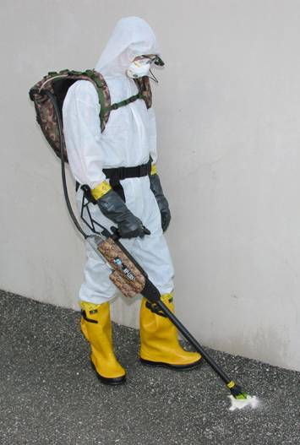
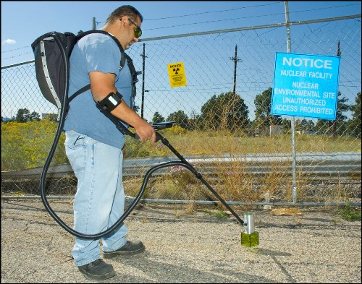
First responder CBRNE prototypes have been built…
Head’s-up display
Backpack contains broadband high-resolution spectrometer, laser power supply, computer, and battery
Hand-held probe contains laser, joystick for control, and focus optics
Microplasma/ LIBS Event
courtesy of Ocean Optics.

Slide 17
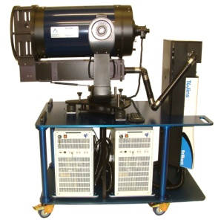
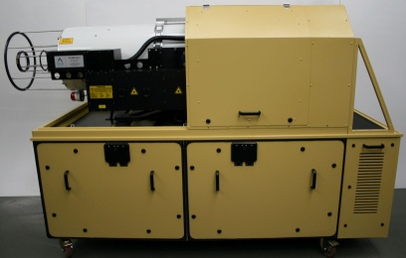
High-energy remote systems have been built…
Courtesy of A.J. Miziolek, A. Whitehouse

Slide 18
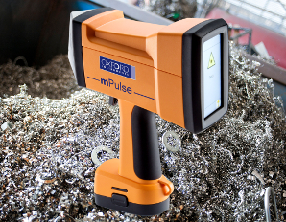
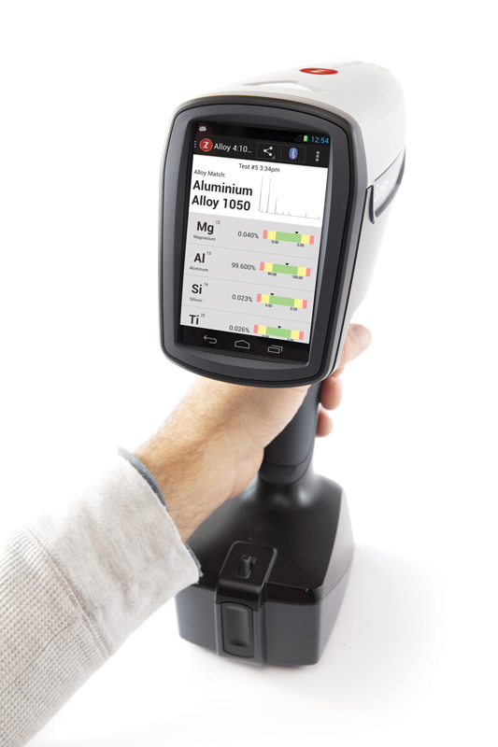
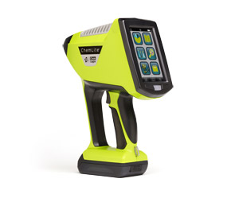
Hand-held systems have been built…
mPulse – Oxford Instruments
LIBZ – SciApps, Inc
ChemLite- TSI, Inc

Slide 19
Interdisciplinary Applications
The utility and ease of operation lend themselves to a variety of interdisciplinary applications.
Four I want to mention:
1. Bacterial identification
2. Biomedical specimens
3. Atomic branching ratios
4. Mars exploration

Slide 20
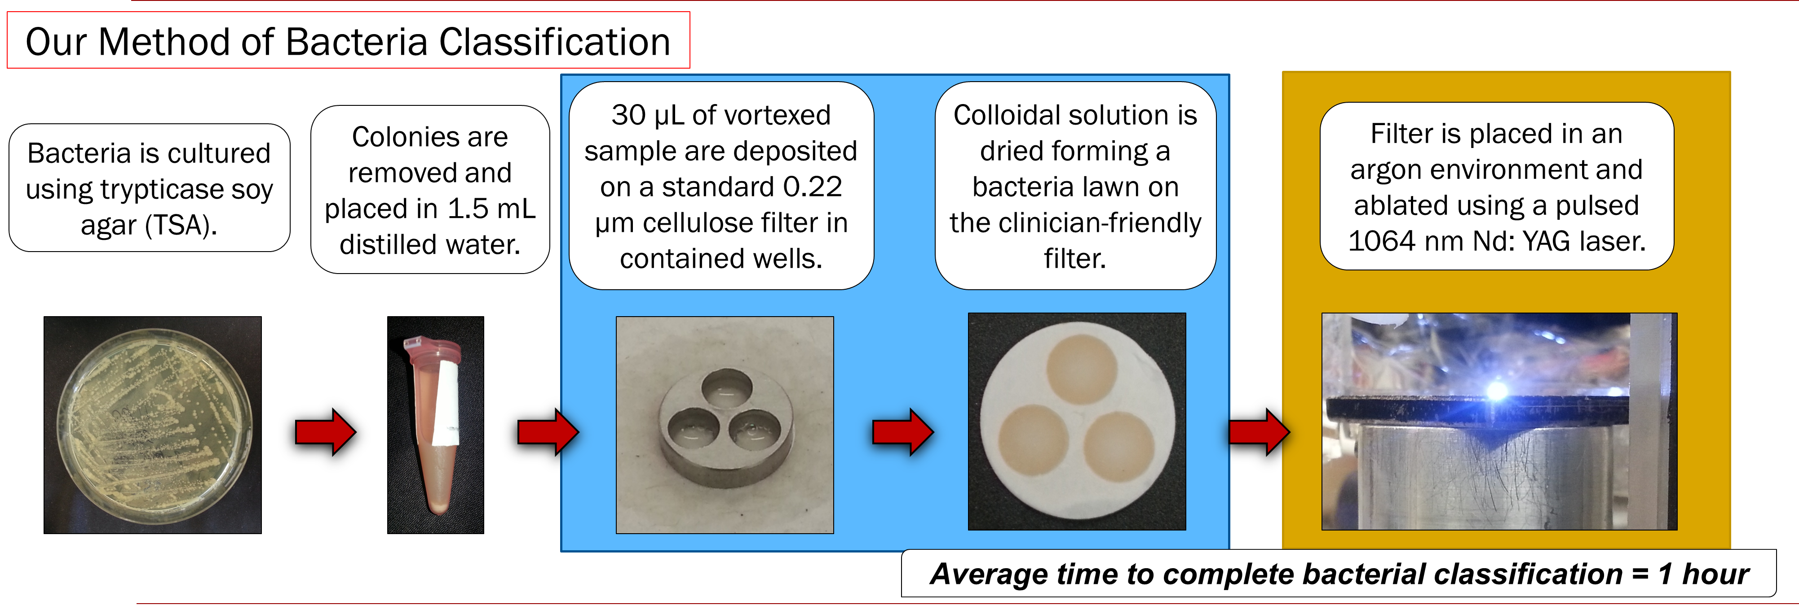
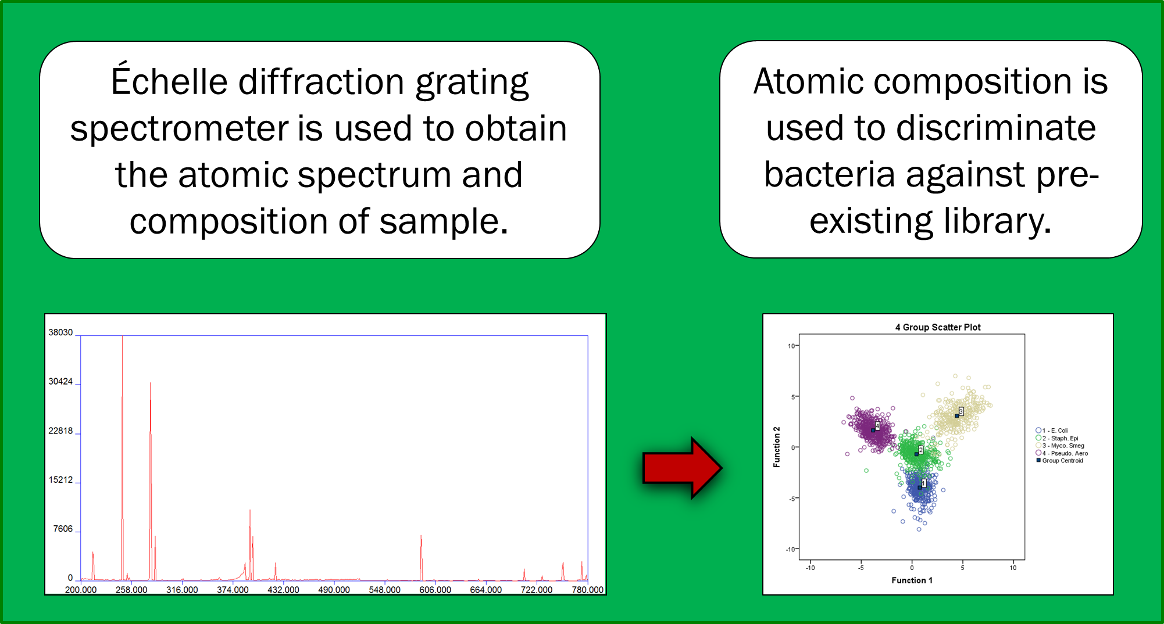
1. Bacterial identification

Slide 21
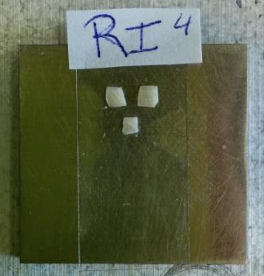
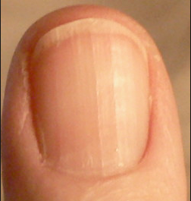
2. Biomedical specimens
Zinc in the fingernails has been shown to represent the overall zinc concentration in the body (needed for enzymatic activity, cellular processes, neuron communication.)
Need a real-time biomedical assay to evaluate zinc content.
We are seeing adequate SNR of zinc at the 150 ppm level in human nails.
Notes:
Shots separated by approximately 0.3 mm

Slide 22
3. Branching Ratios (Fractions)
UPPER ENERGY LEVEL
6p ⁶K_{9/2}
Nd II: 23229.99(cm⁻¹)
Only 8 allowed transitions
636nm
5d ⁶I_{7/2}
7524.74(cm⁻¹)
613nm
6s ⁴I_{11/2}
5d ⁶K_{11/2}
495nm
6931.80(cm⁻¹)
3066.75(cm⁻¹)
6s ⁴I_{9/2}
580nm
1650.19(cm⁻¹)
463nm
5d ⁶K_{9/2}
6005.27(cm⁻¹)
6s ⁶I_{9/2}
513.32(cm⁻¹)
440nm
531nm
5d ⁶L_{11/2}
4437.55(cm⁻¹)
6s ⁶I_{7/2}
0.00 (cm⁻¹)
430nm

Slide 23
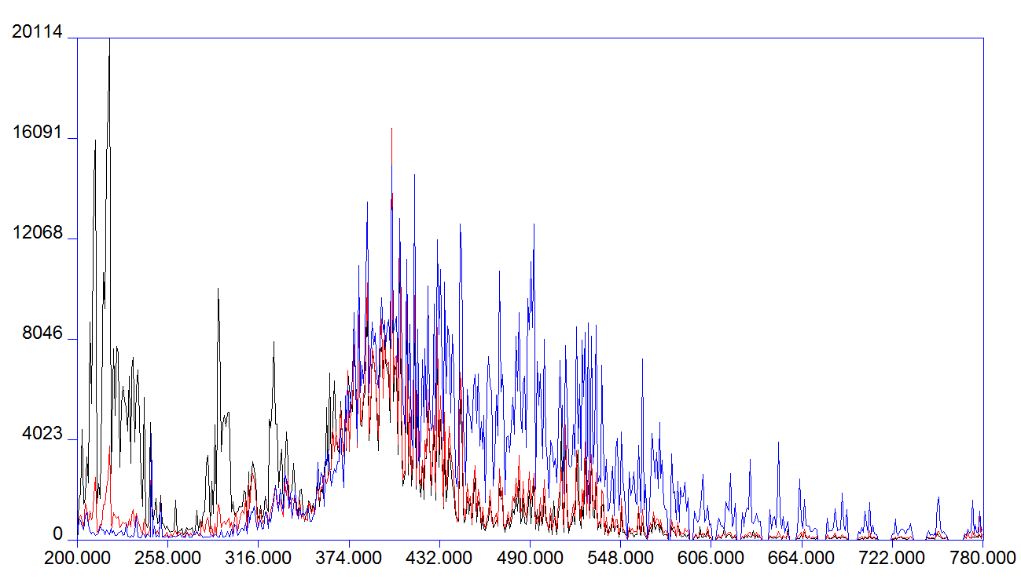
Metallic targets in low pressure Ar atmosphere yield good intensities for BR measurements
3. Branching Ratios (Fractions)
Observation time after plasma formation
Nd III : < 1 μs
Nd II : 1 μs to 3 μs
Nd I : > 3 μs

Slide 24


4. Mars exploration

Slide 25
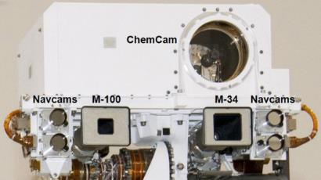
4. Mars exploration

Slide 26
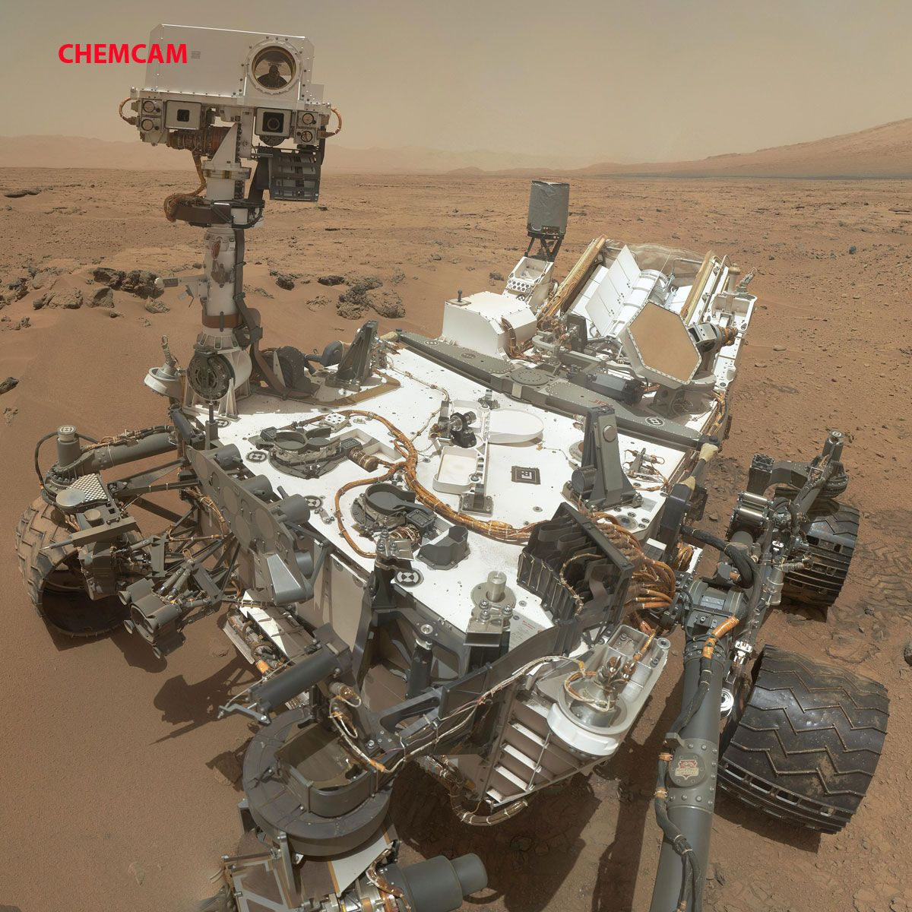
4. Mars exploration
SELFIE ON MARS

Slide 27
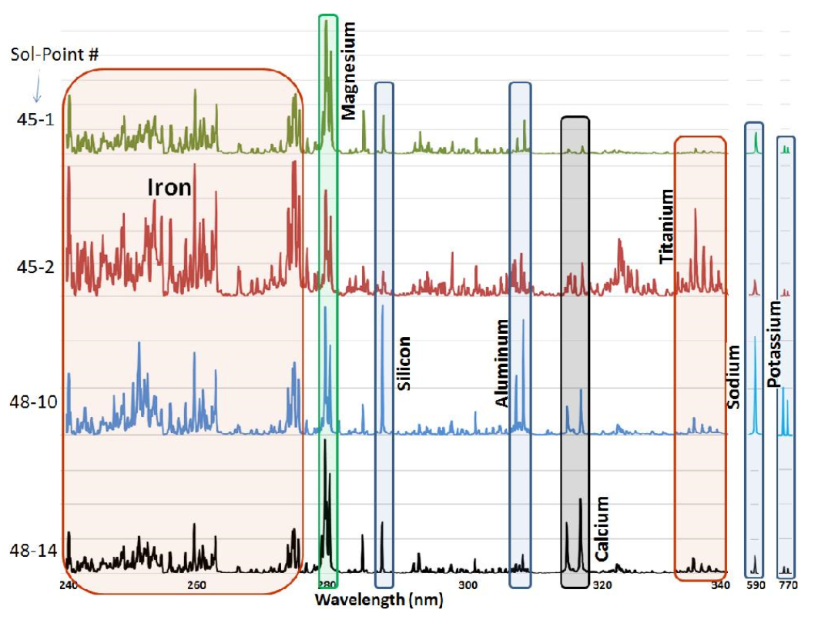
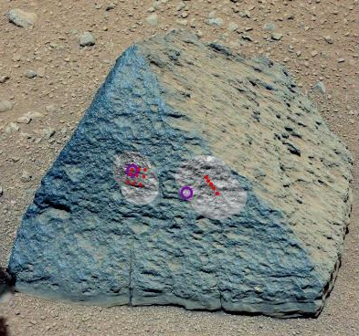
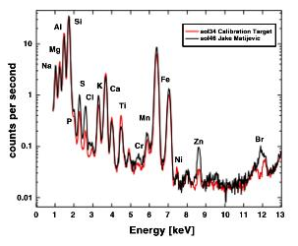
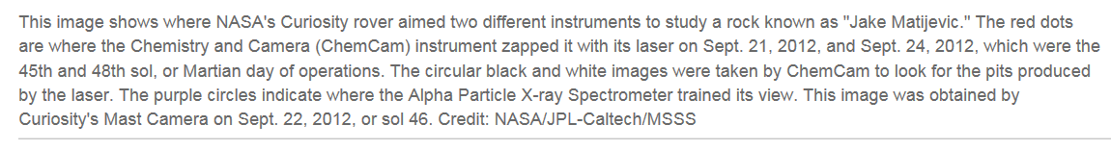
4. Mars exploration
ChemCam (LIBS)
Courtesy of www.phys.org
Alpha Particle X-ray Spectrometer (APXS)

Slide 28
Conclusions
LIBS provides an accurate, fast, spatially resolved, remote spectrochemical analysis of almost any type of target (solid, liquid, gas, powder)
High degree of versatility and robustness suggests its adoption in many different interdisciplinary fields
Experiments utilizing LIBS involve an exciting mixture of physics, laser science, and analytic chemistry (at a minimum)

Slide 29


Funding and Acknowledgements
We gratefully acknowledge funding for this project provided by:
A Natural Sciences and Engineering Research Council of Canada Discovery grant and a Research Tools and Instruments grant
A Canada Foundation for Innovation Leaders Opportunity Fund grant
An Ontario Research Fund Small Infrastructure Funds grant
University of Windsor Outstanding Scholars program
University of Windsor Faculty of Science

Slide 30
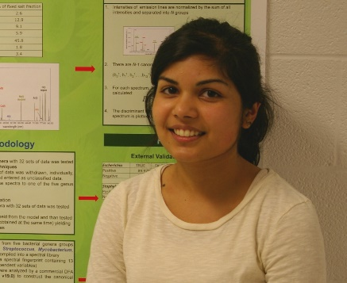
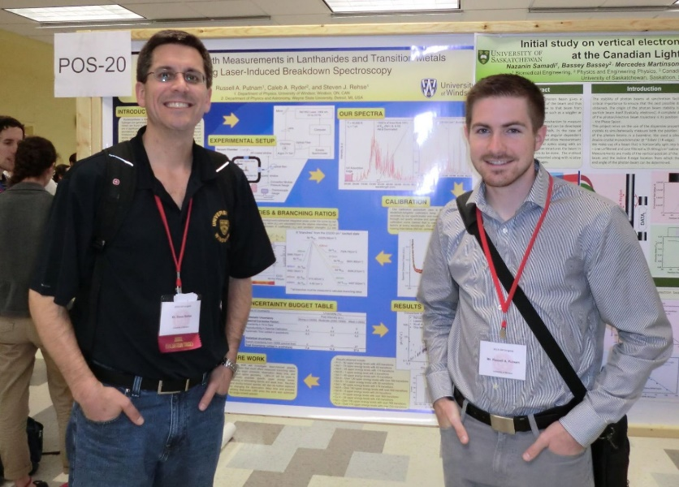
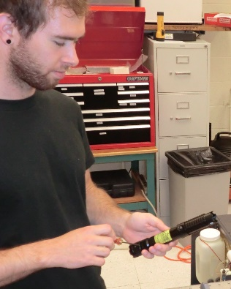
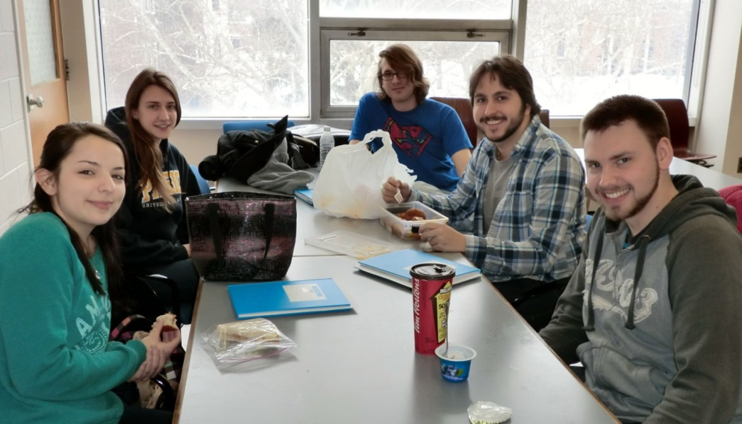
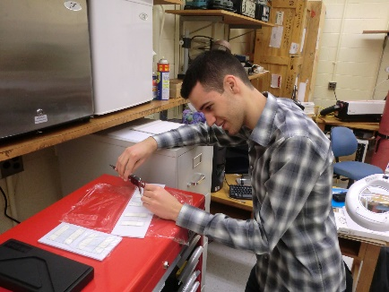
All Credit to the Students!
Dan Trojand
Khadijia Sheikh
Russell Putnam
Anthony Piazza
Dylan Malenfant
Derek Gillies
Allie Paulick
Andrew Daabous
Vlora Riberdy

