Slide 1
Ultracold Neutrons and
Neutron EDM
J. Martin
The University of Winnipeg
T. Adachi¹, E. Altiere², T. Andalib^{3,4}, C. Bidinosti^{3,8}, J. Birchall⁴, M. Chin⁵, C. Davis⁵,
F. Doresty⁴, M. Gericke⁴, S. Hansen-Romu^{3,4}, K. Hatanaka⁶, B. Jamieson³, S. Jeong¹, D. Jones²,
K. Katsika⁵, S. Kawasaki¹, T Kikawa^{5,6,1}, A. Konaka^{5,8}, E. Korkmaz⁷ , M. Lang³, T. Lindner⁵, L. Lee^{4,5},
K. Madison², J. Mammei⁴, R. Mammei³, J.W. Martin³, Y. Masuda¹, R. Matsumiya⁶, K. Matsuta⁸, M. Mihara⁸,
E. Miller², T. Momose², S. Page⁴, R. Picker⁵, E. Pierre^{6,5}, W.D. Ramsay⁵, L. Rebenitsch^{3,4},
J. Sonier⁹, I. Tanihata⁶, W.T.H. van Oers^{4,5}, Y. Watanabe¹, and J. Weinands²
¹KEK, Tsukuba, Ibaraki, Japan
²The University of British Columbia, Vancouver, BC, Canada
³The University of Winnipeg, Winnipeg, MB, Canada
⁴The University of Manitoba, Winnipeg, MB, Canada
⁵TRIUMF, Vancouver, BC, Canada
⁶RCNP, Osaka, Japan (Osaka University, Osaka, Japan)
⁷The University of Northern BC, Prince George, BC, Canada
⁸Osaka University, Osaka, Japan
⁹Simon Fraser University, Burnaby, BC, Canada

Slide 2

Ultracold Neutrons (UCN)
Neutrons that are moving so slowly that they bounce off surfaces and can be bottled.
  v < 8 m/s = 30 km/h
  T < 4 mK
  K.E. < 300 neV
Interactions:
  Gravity: V = mgh mg = 100 neV/m
  Magnetic: V = -μ•B μ = 60 neV/T
  Strong: V = V_{eff} V_{eff} < 335 neV
  Weak: τ = 886 s = 15 mins.

Slide 3
What are the best experiments for UCN?
Those best using their long storage/spin coherence time:
  Neutron EDM (strong CP problem, SUSY CP problem, electroweak baryogenesis)
  Neutron lifetime (BBN, V_{ud}/CKM unitarity)
  Angular correlations, precision spectroscopy in beta decay (V_{ud}/CKM, scalar/tensor currents)
  n-nbar oscillations? Quantum computing/error studies?
Those best using their low energy
  Neutron gravity levels above a mirror (gravity at μm scales, chameleon fields, fifth force, …)
  Surface science of big organic molecules?
Generally accepted that nEDM is top science priority for this field, given present UCN fluxes; it is our flagship experiment.
Breakthrough in UCN production would improve precision of experiments, and open up new possibilities (free n target?)

Slide 4
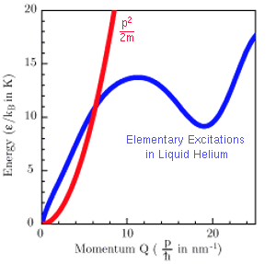
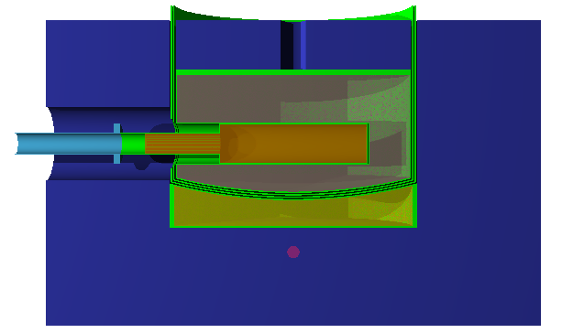
Spallation-driven Superfluid He-II UCN Source
UCN production recipe:
Cold neutron energy transferred to He-II via phonon emission
Spallation – Liberate neutrons from W target
Moderation – Thermalize, cool neutrons in D₂0 ice
Conversion – Convert cold neutrons to UCN in He-II
d
75 cm
10 K D₂O or D₂
44 cm
He-II
30 cm
Thermal, Cold &
Ultra-Cold neutrons
300 K D₂O
Graphite
MeV neutrons
W-Target
Moderators
Thermal: Graphite, 300K D₂O
Cold: 10K D₂O ice
General Layout of UCN Source at RCNP Osaka
400 MeV protons

Slide 5
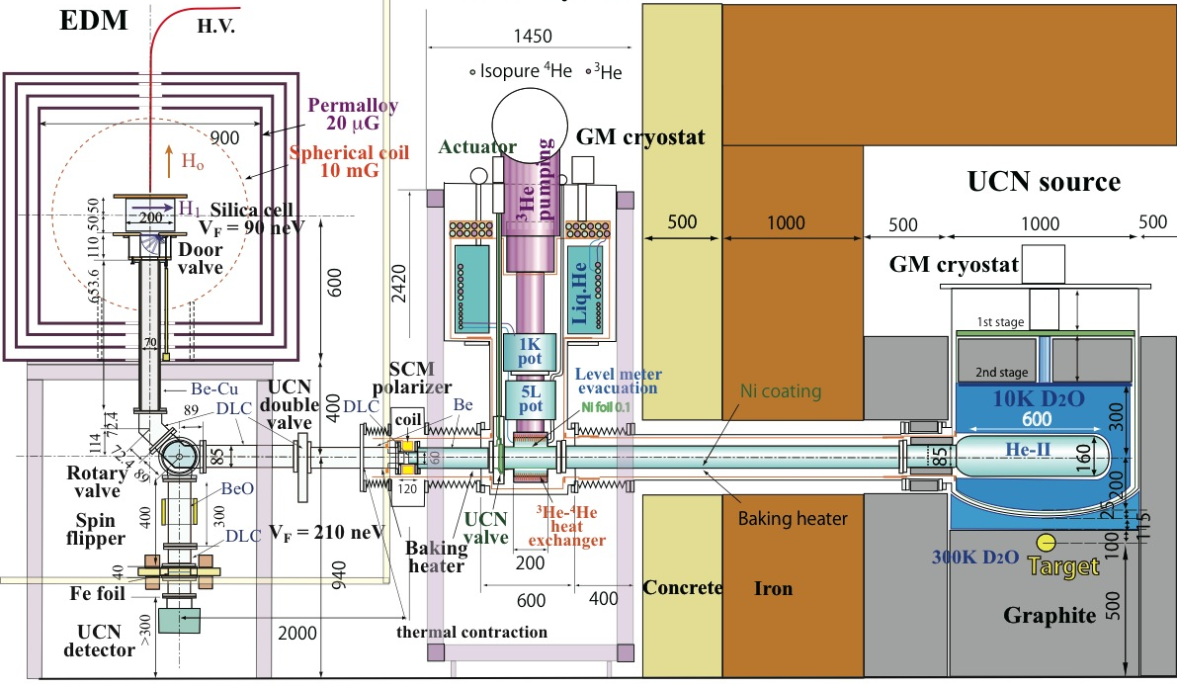
UCN Source (RCNP-TRIUMF)
Horizontal Source/Bottle
Source developed and tested in Japan, shipping to TRIUMF in Oct. 2015
Beamline prepared at TRIUMF, for extended running periods at ~40x higher intensity

Slide 6
Connection to Phase I nEDM experiment
Experiment
He-II cryostat
Horizontal Source/Bottle
D₂O cryostat
⁴He (4K,1K)
³He (0.8K)
Isopure ⁴He
phonon
UCN
valve
opens
n
p
2012-2014: Develop/Test Source (& nEDM) at RCNP [1+ μA]
2015: Source moves to TRIUMF
2016: Commission Source at TRIUMF [ramp to 40μA]

Slide 7
Sakharov’s Criteria and
EW Baryogenesis Solutions
Criteria
EW Baryogenesis
Departure from thermal equilibrium
B-violation
CP-violation
EW Baryogenesis Problems:
EW phase transition not strong enough
Not enough CP violation
D.E. Morrissey and M.J. Ramsey-Musolf, New J. Phys. 14, 125003 (2012).
Requires new physics and CP-violation near the EW scale

Slide 8
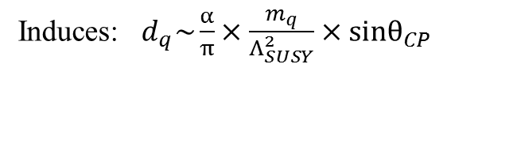
Sensitivity to new sources of CP violation
Induces: $d_{q}\sim \frac{α}{π}×\frac{m_{q}}{Λ_{SUSY}^{2}}×sinθ_{CP}$
e.g. SUSY CP problem and relationship to LHC
M. Pospelov and A. Ritz,
A. Ritz, TRIUMF Summer Institute, 2012.

Slide 9
Sensitivity to SM sources of CP violation
Strong sector may violate CP via θ term.
Naively θ ~ 1.
Experimentally θ < 10⁻¹¹, constrained mainly by nEDM.
Strong CP problem
Solution: Peccei-Quinn symmetry, axions(?)
CKM CP violation is 10⁻³¹ e-cm background

Slide 10
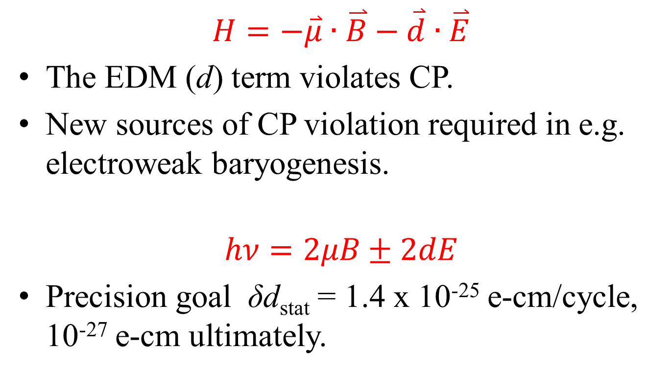
Electric dipole moments and CP violation
$$H=−\overset{⃑}{μ}∙\overset{⃑}{B}−\overset{⃑}{d}∙\overset{⃑}{E}$$
The EDM (d) term violates CP.
New sources of CP violation required in e.g. electroweak baryogenesis.
$$hν=2μB±2dE$$
Precision goal δd_{stat} = 1.4 x 10⁻²⁵ e-cm/cycle, 10⁻²⁷ e-cm ultimately.

Slide 11

TRIUMF Neutron EDM Experiment
Overview/Goals:
  Our approach: Spallation-driven superfluid-helium UCN source connected to room-temperature nEDM experiment.
  Present world’s best limit (Sussex/RAL/ILL)
  d_{n} < 3 x 10⁻²⁶ e-cm
  SM (CKM) lower bound
  d_{n} >~ 10⁻³¹ e-cm
  Our goal sensitivity:
  δd_{n} ~ 10⁻²⁷ e-cm (“phase 2”)
  δd_{n} ~ 10⁻²⁸ e-cm (possible with source upgrades)
Features of nEDM expt.:
  New UCN source with potential world-leading density
  Room temperature with flexibility e.g. to modify cell size in light of systematics vs. stats.
  New dual ¹²⁹Xe 2-photon + ¹⁹⁹Hg comagnetometers
  Improved magnetic field control, diagnostics.
J
J
+
t → -t
+
-
-
±E
B
ν
J
$$hν=2μ_{n}B±{2d}_{n}E$$

Slide 12
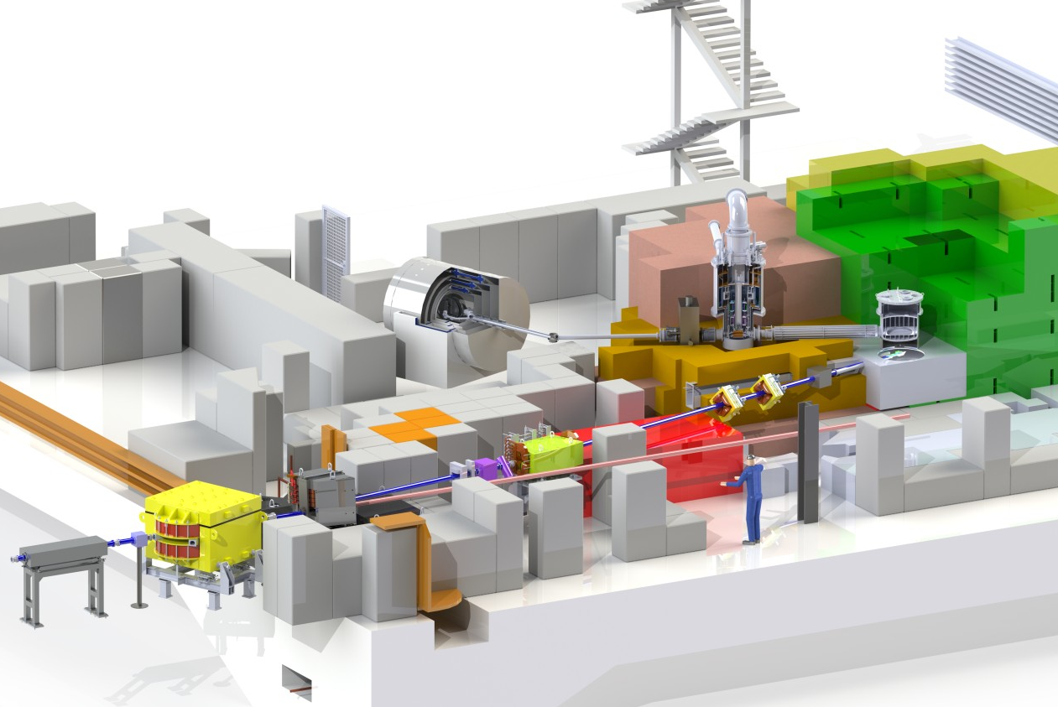


TRIUMF Facility Overview
He-II cryostat
EDM experiment
Cold moderator cryostat
SC polarizer
preliminary
UCNs
nEDM
proton
therapy
protons
Spallation target
Lambertson septum
←
Kicker magnet
bending magnet for proton irradiation facility
Bending dipole
future UCN facility at TRIUMF

Slide 13
Recent UCN highlights
13
2014, TRIUMF (completed):
septum
dipole
replacement of shielding towards cyclotron
2013-14, RCNP, Osaka:
successful cooldown of new cryostat to 0.7 K
first UCN beam time
UCN production and extraction demonstrated
preliminary
nEDM
Source commissioned
(in Japan)
bending magnet for proton irradiation facility
2014 Shutdown
future UCN facility at TRIUMF

Slide 14
Plan for TRIUMF Installation periods: ~Jan-Apr each year
14
2014:
septum
dipole
replacement of shielding towards cyclotron
2015/16:
kicker
target
moderators
He-II cryostat
UCN guides
UCN polarizer
finish shielding
2015 Non-Shutdown
& 2016 Shutdown
preliminary
nEDM
2015 Shutdown
bending magnet for proton irradiation facility
2014 Shutdown
2015:
decommissioning of existing beamline M13
quads
source shielding
2016 Shutdown

Slide 15
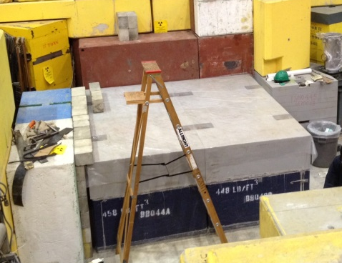
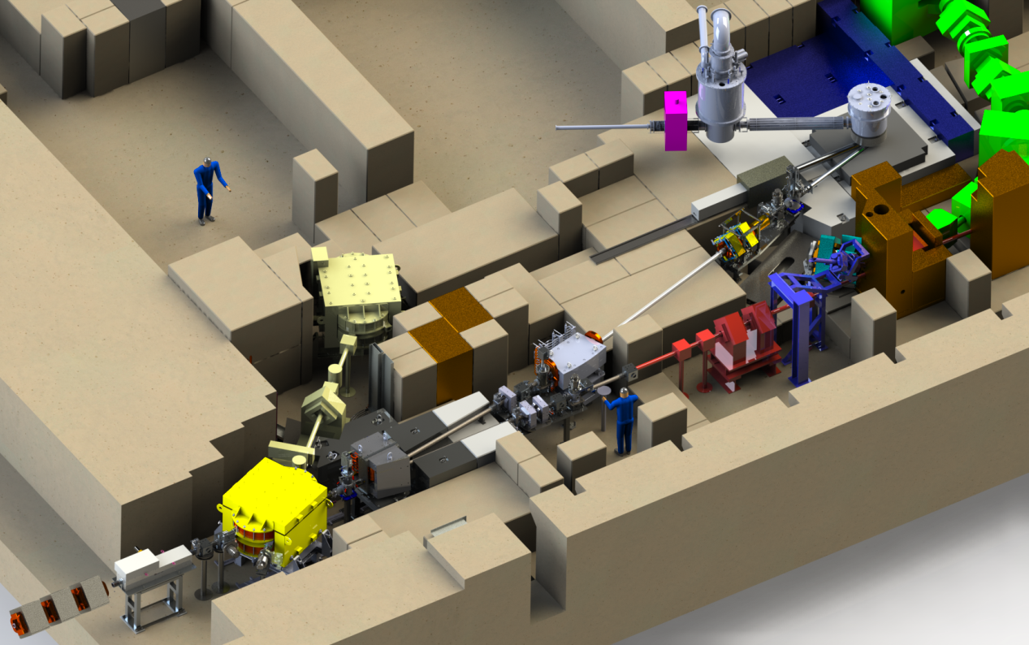
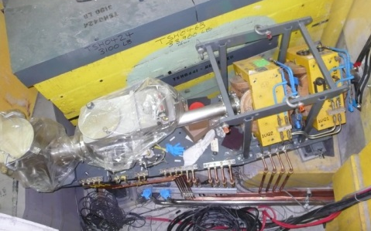
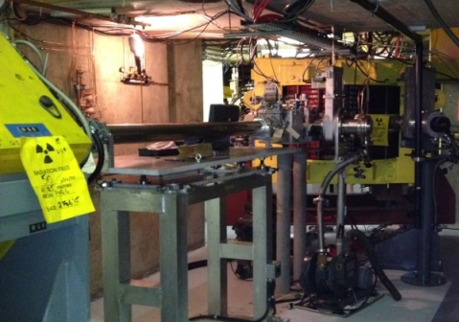
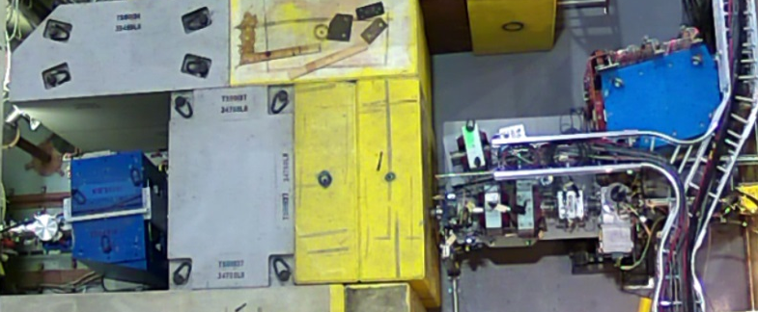
Present Status of UCN Facility
Pyramid base
UCN Source (2013-14, RCNP)
successful cool down of new cryostat to 0.7 K (→ 0.58 K)
ext. heat load from 1 → 0.2 W
first UCN beam time
UCN prod.^{n} in ⁴He (natural) and extraction demonstrated (despite large ³He fraction)
Floorspace
for nEDM
Experiment
UCN
Source
Target
Target in 2016
D/S section
2015
Vault Components
M13 Decommission
Quads & D/S section
Shield Pyramid Base
Quads
BL1U
Dipole
BL1A
Vault section
Septum
U/S section
2014
Septum
Dipole & Girder
Shielding Plug
Kicker in 2016
Kicker

Slide 16
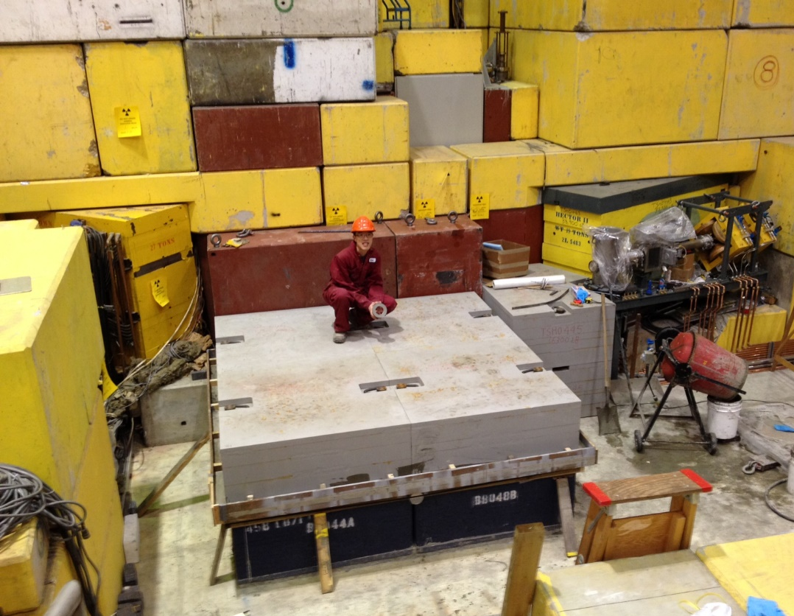
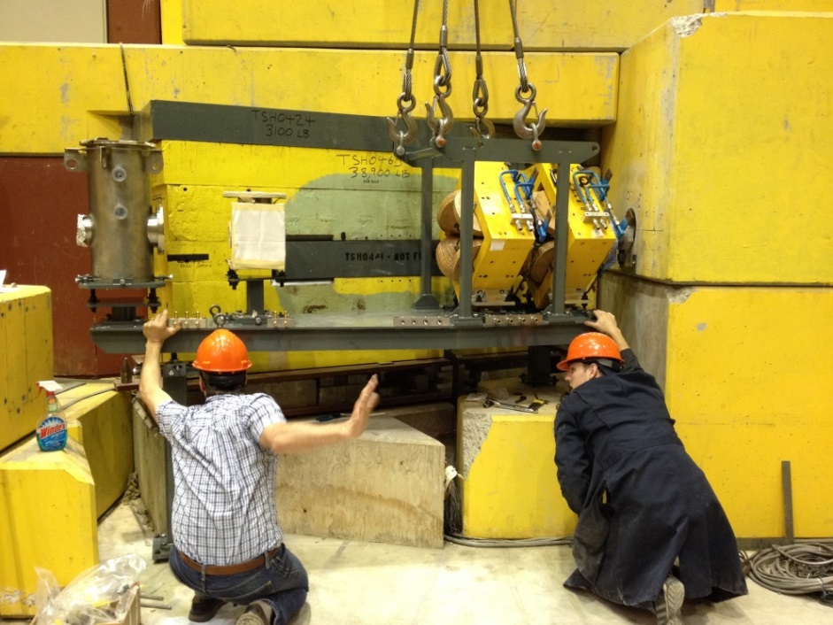
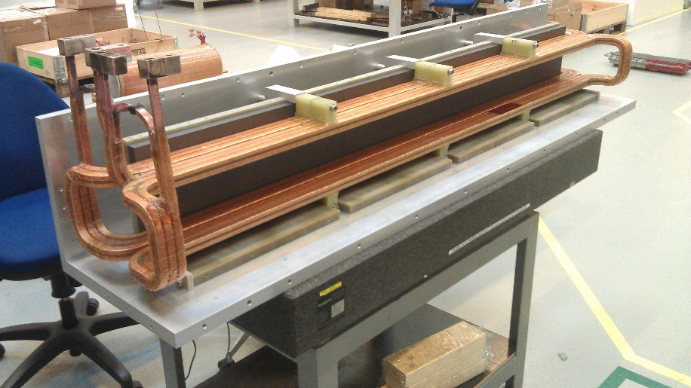
2015 Highlights and 2016 plans
Location of
Spallation Target
Last beamline elements before target
Base shielding underneath UCN source
Design/safety review June 2015
Target design review July 2015
UCN source shipment Oct. 2015
More reviews
Begin installation of final components January 2016.
First UCN fall 2016.
Kicker magnet completed, readying for testing

Slide 17
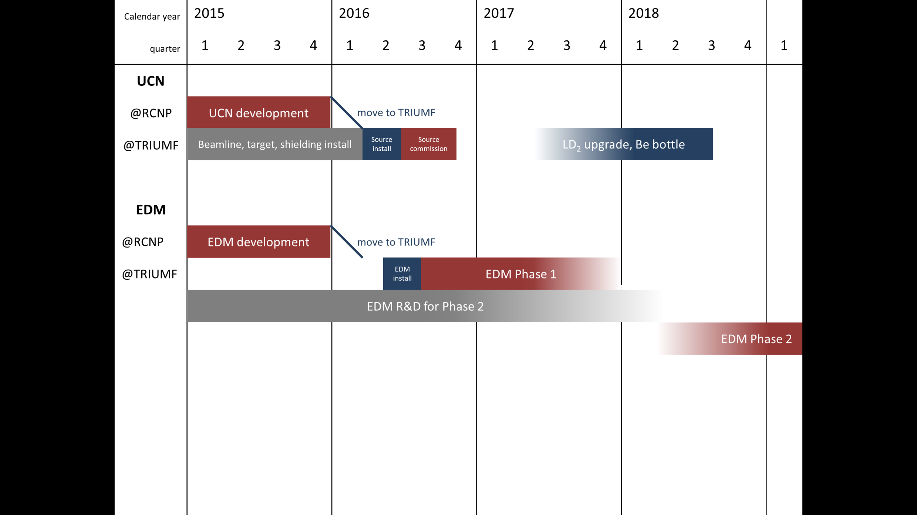
Roadmap Towards nEDM
nEDM experiment first priority (after UCN source commissioning)
move to TRIUMF
Commission B/L & CN Spring ‘16
UCN development
Beamline,target,shielding install
Source
install
Source
commission
LD₂ upgrade, Be bottle
EDM development
move to TRIUMF
EDM
install

Slide 18
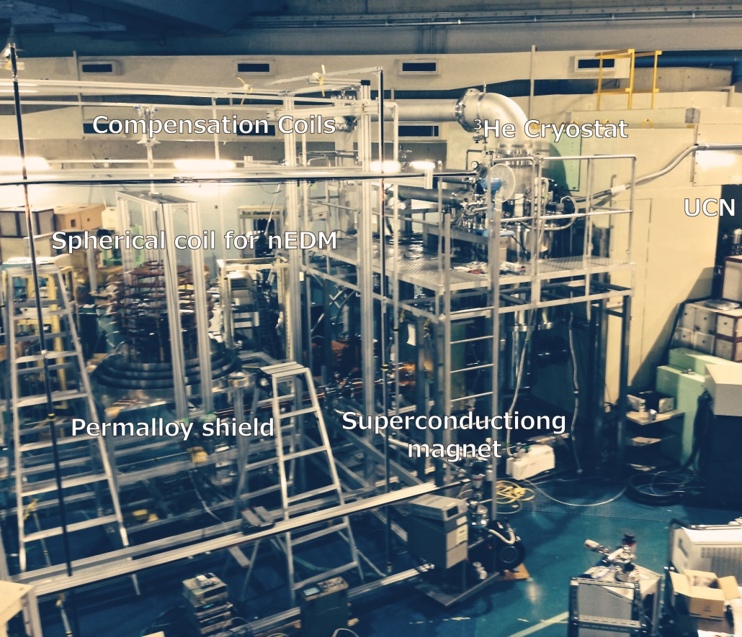
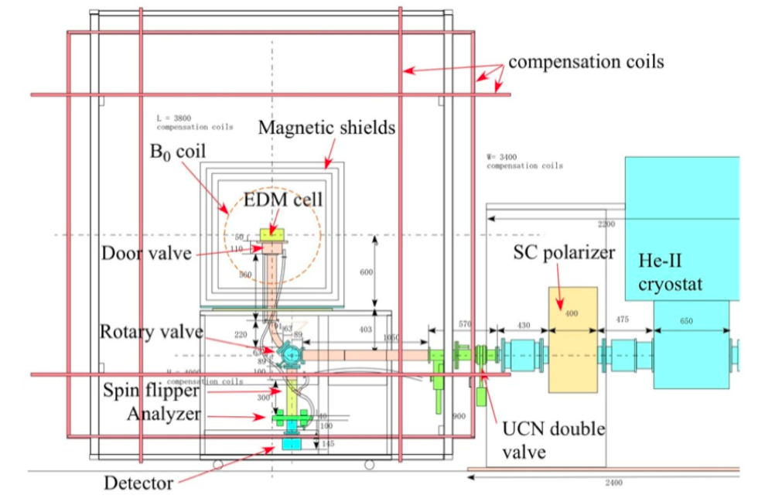
nEDM Phase 1
use existing EDM Ramsey apparatus from RCNP, Osaka
exploit higher UCN density at TRIUMF (also more beamtime available)
room temperature, 1 small cell, vertical loading, spherical B₀ coil
small incremental improvements until replaced by Phase 2
  Active magnetic compensation system
  high voltage
  comagnetometer
  high-flux detector
EDM Phase 1 schematic
EDM Phase 1 at RCNP

Slide 19
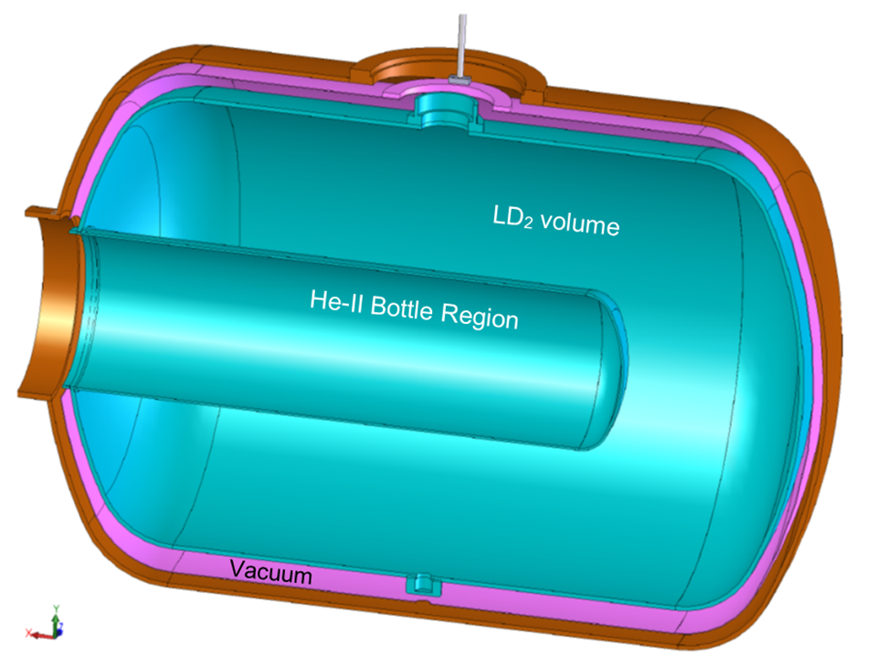
Phase 2: Cold Moderator Upgrade to LD₂
He-II Cryostat
MCNPX Studies:
UCN yield increased by 5-7 when D₂O ice replaced by LD₂ and heat load on He-II cut in half!
LD₂ Cryostat System
Aluminum Cryostat
125 Liquid Litres of D₂
90 W Heat Load
Circulate LD₂ to remote condenser + cryo-cooler
Outer Vacuum
Manifold/Pipe
LD₂ Moderator
Inner UCN Guide
Superfluid Manifold

Slide 20
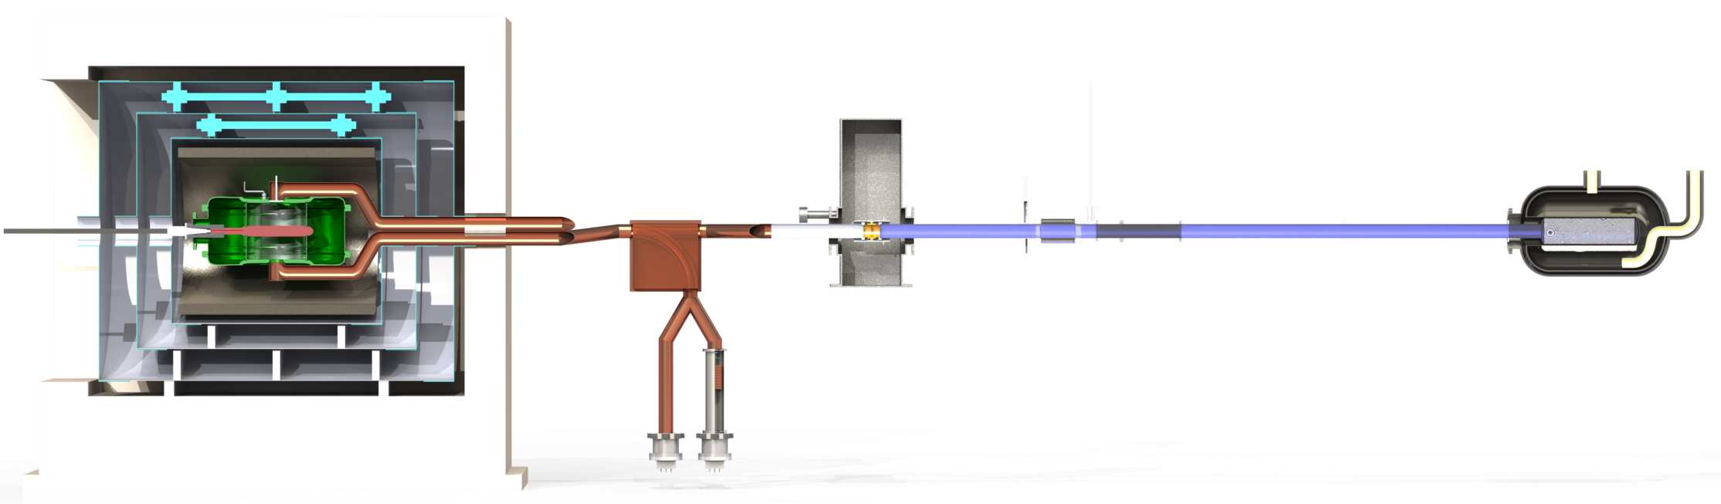
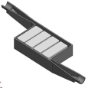

nEDM Phase 2 – circa 2019?
room temperature
improvements
  higher UCN density with LD₂ moderator
  2 cells, probably “horizontal” loading
  dual Xe/Hg comagnetometer
  improved magnetic environment
  simultaneous counting of both polarizations
Sensitivity goal: d_{n} < 10⁻²⁷ e·cm
ongoing extensive R&D program
  Magnetic fields
  UCN detector
  comagnetometer
  HV/EDM cell
  simulations
possible topology
magnetically shielded room
inner passive shielding
SC polarizer
moderator
cryostat
EDM cell(s)
UCN switch
He-II volume
HV feed
spin flipper/
analyzer
spallation target
protons
2.5 m
4 UCN detectors

Slide 21
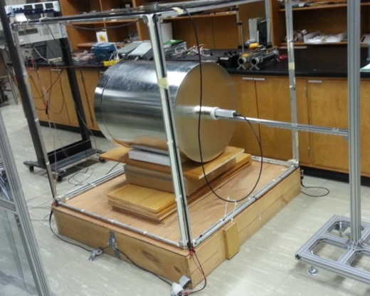
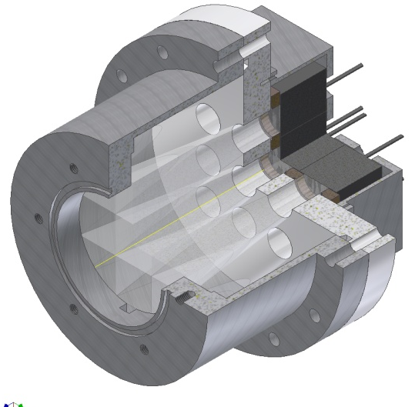



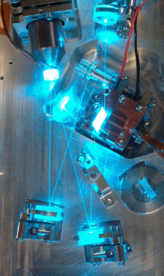
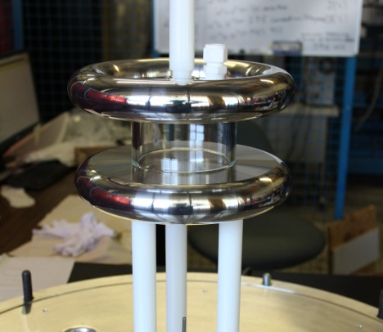


Canadian EDM R&D
21
Magnetic environment
UCN detection
Lightguides
active shielding
passive shielding
creation of stable, homogeneous B fields
Precision atomic magnetometry and SQUIDs
Need faster detectors
Li glass scintillators + lightguide + PMTs
Test run in August 2015 at PSI
R&D towards dual detectors which count both spin states simultaneously.
Cylindrical shells of the 4 layer FM shield
  n+⁶Li→³H (2.74 MeV) +⁴He (2.05 MeV)
UCNA @ LANL
Li glass
PMTs
Dual Co-magnetometer
UCN detection scheme
Hg, Xe polarisation
laser development
2-photon transition requires development of intense CW UV lasers.
Xe EDM measurement
Electric field, UCN cell
dielectric strength of Xe at 10⁻³ mbar unknown
50x100 mm cylindrical test cell
gas breakdown studies
material studies
HV test cell
0.1 m

Slide 22
Long-Range Plan
2017-2021: improvements to UCN source and nEDM experiment
  2017-2018 CFI proposal for major upgrade to UCN source and nEDM experiment ($12M) leveraged by Japan support and TRIUMF 5YP support ($1.6M)
  NSERC support ~$800k/yr (presently ~$500k/yr)
2022-2026: development of facility and other UCN experiments
  Neutron lifetime in a magnetic trap
  Neutron gravity levels
  Cost scale ~$5M/expt. Expect new international users and support for these experiments.

Slide 23
Summary
UCN source testing (RCNP) and installation of beamline components (TRIUMF) proceeding on schedule.
R&D progress for the neutron EDM experiment.
Phase I nEDM operating by 2016-17
Phase II application aiming at sub-10⁻²⁷ e-cm precision planned for 2017-18.

Slide 24
More info and backups

Slide 25
Recent achievements
Recent publications on magnetic field R&D and UCN detector (see our draft brief)
Recent MSc theses (several MSc and PhD in progress) (see draft brief)
Conference proceedings/presentations (most recent one is Larry Lee at SSP2015, Victoria, BC, several others this week at CAP)
Facility, installation at TRIUMF (see this talk and Larry’s talk at SSP)

Slide 26
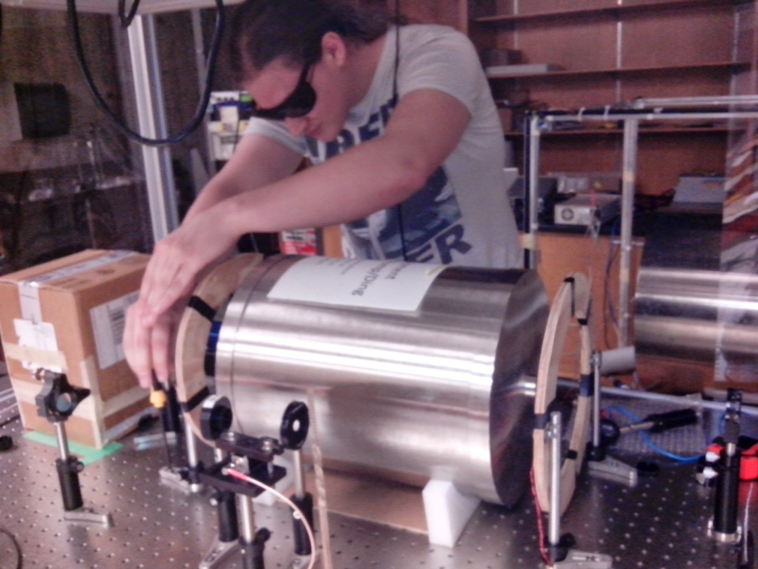
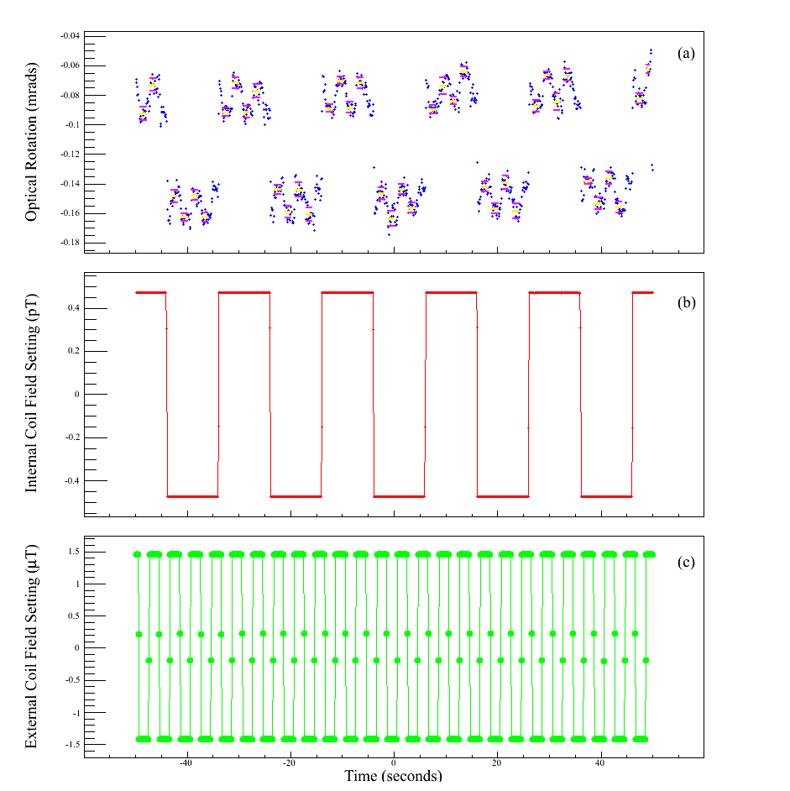
Example nEDM R&D achievement:
Precision atomic magnetometry with Rb
Optical rotation sees shielded field and calibration field
±475 fT applied internally
(calibration)
Wolfgang Klassen (UM/UW) installing external coils.
Magnetometer at 20 fT precision!
(Your brain thinking ~ 1000 fT)
Shielding factor = 1.3 x 10⁷ couldn’t have been measured with any other magnetometer.
±1.45 uT applied externally
“Large magnetic shielding factor measured by nonlinear magneto-optical rotation,” J.W. Martin, R.R. Mammei, W. Klassen, C. Cerasani, T. Andalib, C.P. Bidinosti, M. Lang, and D. Ostapchuk, Nucl. Instr. Meth. A 778, 61-66 (2015).

Slide 27
NSERC Faculty Research FTE’s
Name Institution FTE
C. Bidinosti U. Winnipeg 0.4
J. Birchall U. Manitoba 0.3
M. Gericke U. Manitoba 0.1
B. Jamieson U. Winnipeg 0.5
D. Jones UBC 0.3
A. Konaka TRIUMF 0.2
E. Korkmaz UNBC 0.3
T. Lindner TRIUMF/U. Winnipeg 0.1
K. Madison UBC 0.3
J. Mammei U. Manitoba 0.1
R. Mammei U. Winnipeg 0.9
J. Martin U. Winnipeg 0.8
T. Momose UBC 0.3
W. van Oers U. Manitoba/TRIUMF 0.3
S. Page U. Manitoba 0.1
R. Picker TRIUMF 1.0
J. Sonier SFU 0.1
Joint Position TRIUMF/U. Winnipeg 0.9
Total 7.0
This is list expected for our next renewal April 2015
Also ~4 Japan faculty FTE’s
Expect 1-2 more Canadians to join over next 5YP period, and some Japanese
More international users once facility is operational and time can be dedicated to other experiments (2022-)

Slide 28
Full Collaboration List (06/2015)
T. Adachi¹, E. Altiere², T. Andalib^{3,4}, C. Bidinosti^{3,8}, J. Birchall⁴, M. Chin⁵, C. Davis⁵,
F. Doresty⁴, M. Gericke⁴, S. Hansen-Romu^{3,4}, K. Hatanaka⁶, B. Jamieson³, S. Jeong¹, D. Jones²,
K. Katsika⁵, S. Kawasaki¹, T Kikawa^{5,6,1}, A. Konaka^{5,8}, E. Korkmaz⁷ , M. Lang³, T. Lindner⁵, L. Lee^{4,5},
K. Madison², J. Mammei⁴, R. Mammei³, J.W. Martin³, Y. Masuda¹, R. Matsumiya⁶, K. Matsuta⁸, M. Mihara⁸,
E. Miller², T. Momose², S. Page⁴, R. Picker⁵, E. Pierre^{6,5}, W.D. Ramsay⁵, L. Rebenitsch^{3,4},
J. Sonier⁹, I. Tanihata⁶, W.T.H. van Oers^{4,5}, Y. Watanabe¹, and J. Weinands²
¹KEK, Tsukuba, Ibaraki, Japan
²The University of British Columbia, Vancouver, BC, Canada
³The University of Winnipeg, Winnipeg, MB, Canada
⁴The University of Manitoba, Winnipeg, MB, Canada
⁵TRIUMF, Vancouver, BC, Canada
⁶RCNP, Osaka, Japan (Osaka University, Osaka, Japan)
⁷The University of Northern BC, Prince George, BC, Canada
⁸Osaka University, Osaka, Japan
⁹Simon Fraser University, Burnaby, BC, Canada
Grad students highlighted in red
Typically 8-10 undergraduates per year (not listed)
More collaborators always welcome:
- nEDM R&D, future UCN source R&D, future experiments R&D

