Slide 1


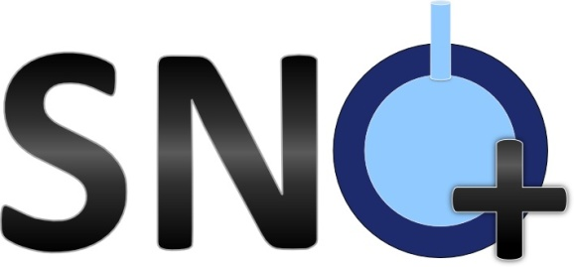

Extraction of optical parameters in SNO+ with an in-situ optical calibration system
Dr. Kalpana Singh
On behalf of the SNO+ Collaboration
CAP Congress 2015

Slide 2
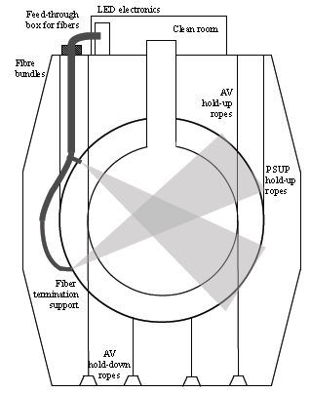
Light Injection System
Timing Calibration
  96 PMMA fibres
  504 nm LEDs
Scattering Measurement
  12 collimated sources (gr. of 3)
  4 injection points, 3 directions
  Multiple wavelengths
Absorption length Monitoring
  4 injection points (group of 2)
  385 nm and 500 nm
  2 injection directions

Slide 3

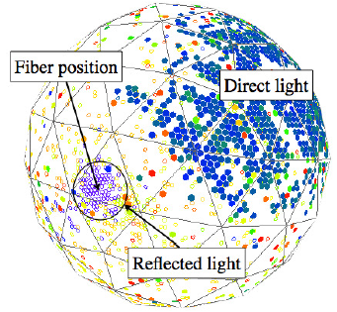
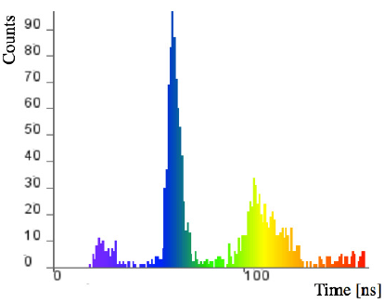
Spatial and temporal distribution of
Light Components
Direct Light
Fibre Position

Slide 4

Spatial and temporal distribution of
Light Components
Near AV Reflected Light
Fibre Position

Slide 5

Spatial and temporal distribution of
Light Components
Late Light
Far AV Reflection
Fibre Position

Slide 6

Spatial and temporal distribution of
Light Components
Late Light
Fibre Position
PSUP Reflection

Slide 7
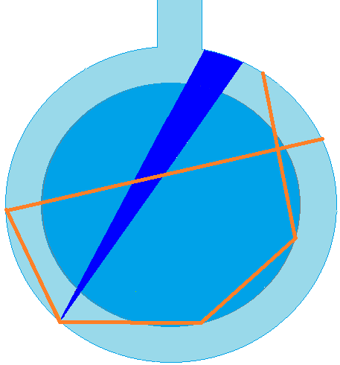
Spatial and temporal distribution of
Light Components
PSUP and AV
Scattering
Fibre Position

Slide 8
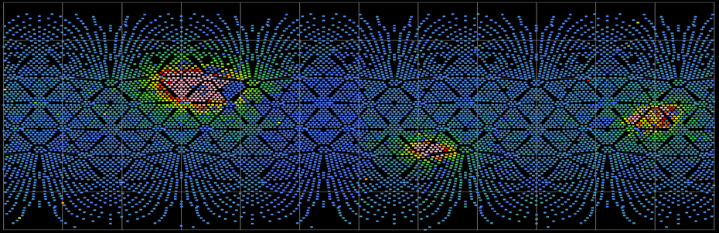
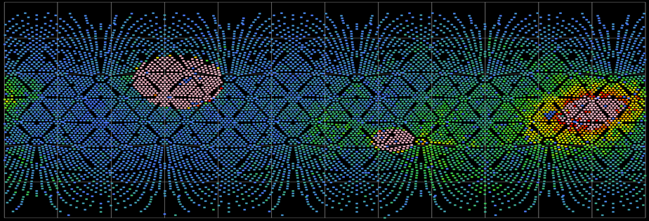
Monte Carlo tuning of fibre positions and pointing directions
Data Fibre237
Direct Light
Far AV Reflection
Near AV Reflection
MC Fibre237

Slide 9
Sorting pmts based on angle
PMT
D
Direct Light
on the other side of detector :
cosθ ~= 1
θ
AV or PSUP reflections
on fibre side:
cosθ ~= 0
Fibre

Slide 10
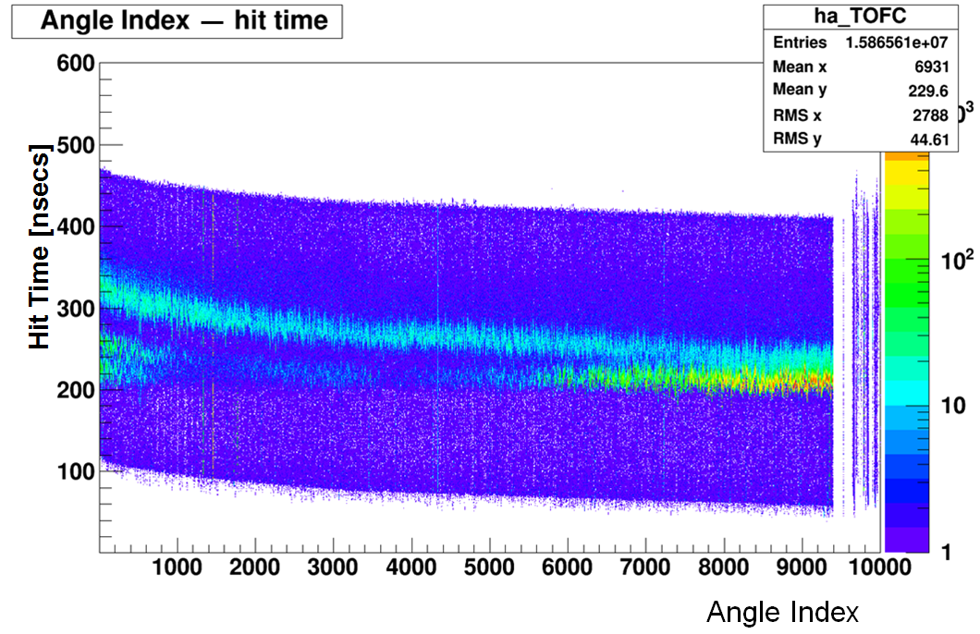
Sorting pmts based on angle

Slide 11
Direct Light

Slide 12

Near AV Reflection

Slide 13
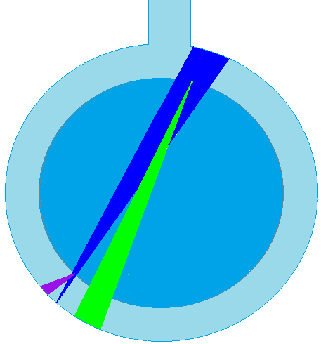
Far AV Reflection

Slide 14

Far PSUP Reflection

Slide 15
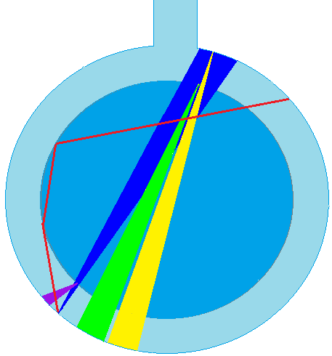
AV and PSUP Scattering

Slide 16

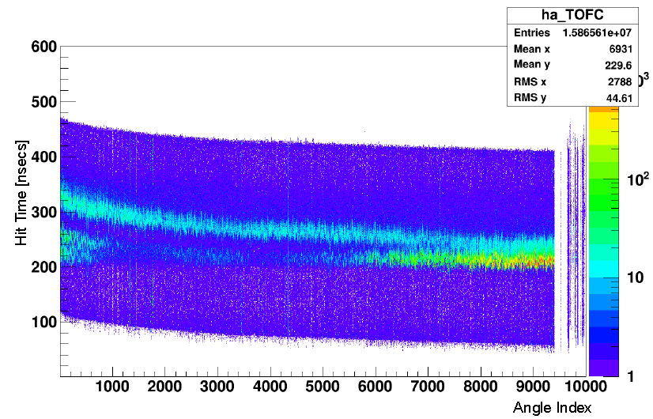
Far AV and PSUP Reflection
Near AV Reflection
Direct Light

Slide 17
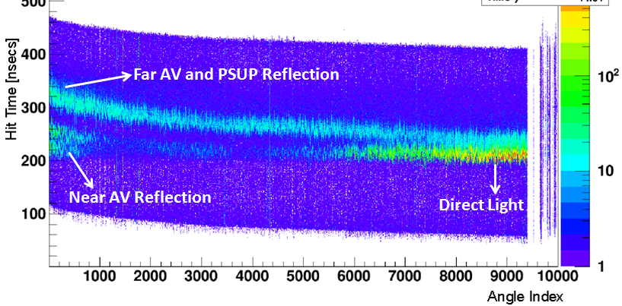
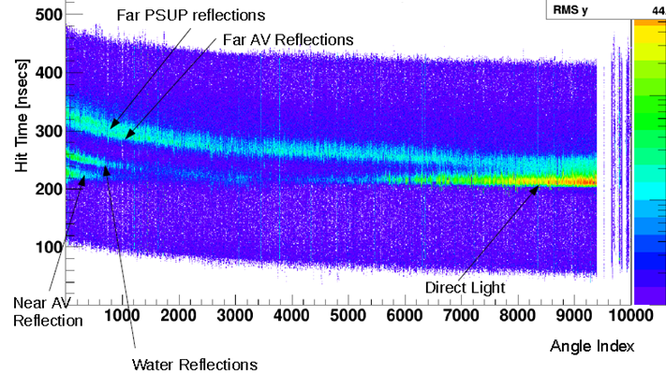
Before Time Calibration
After Time Calibration

Slide 18
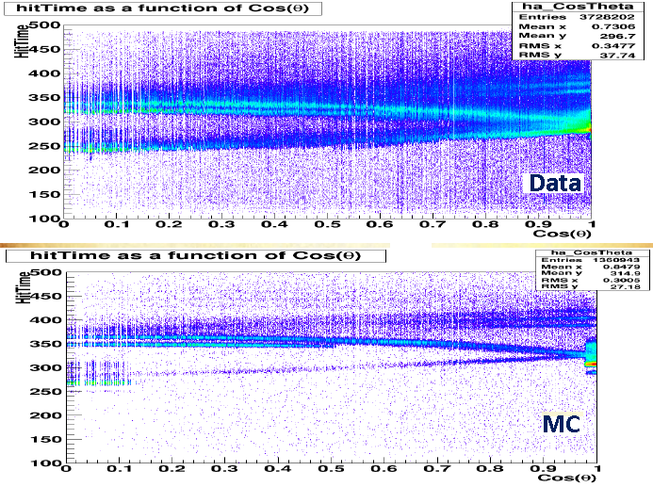

Slide 19
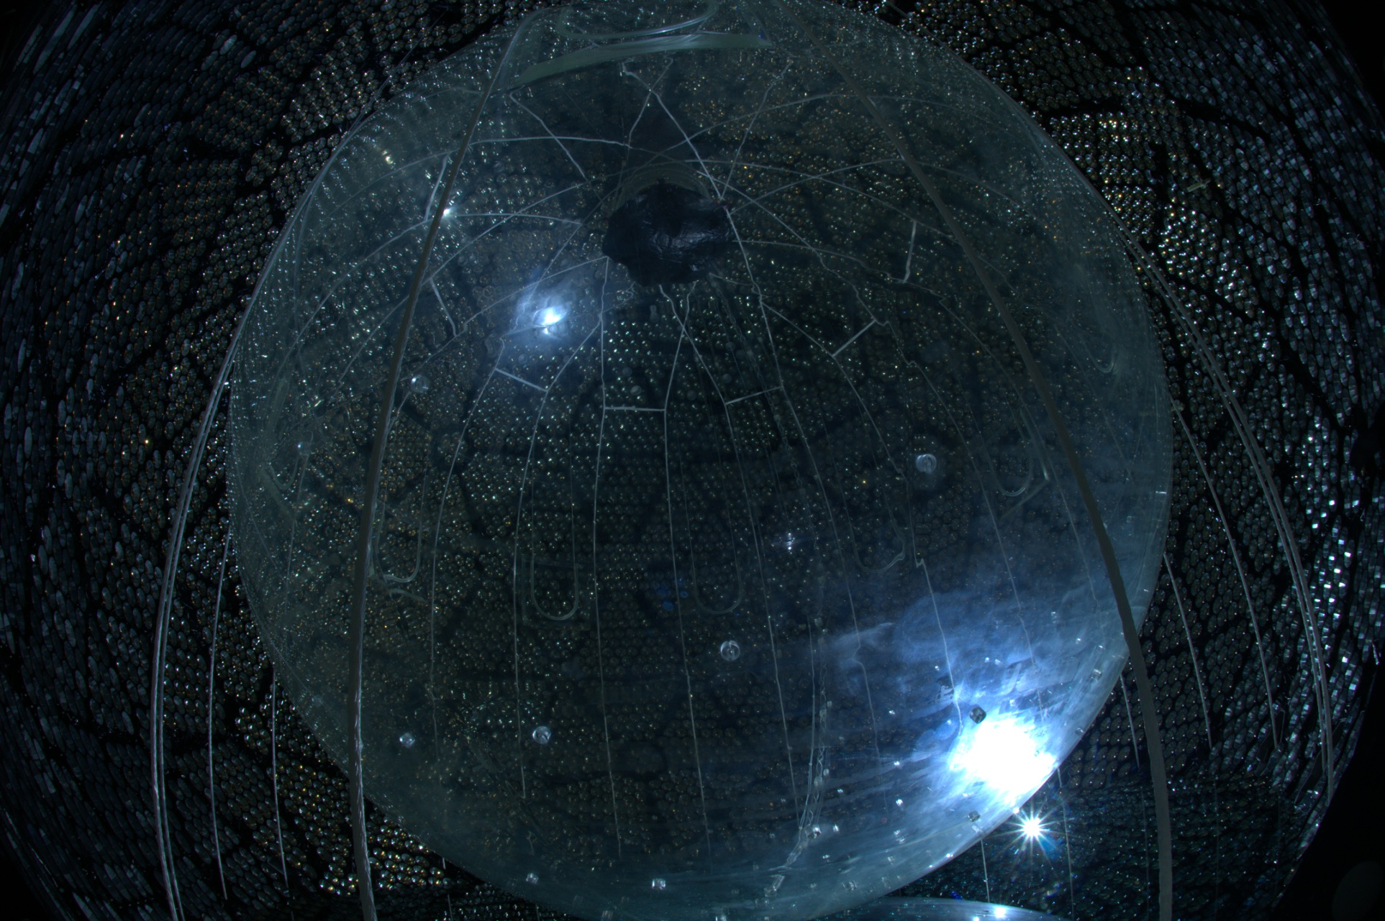
Fibre data and Rope position

Slide 20
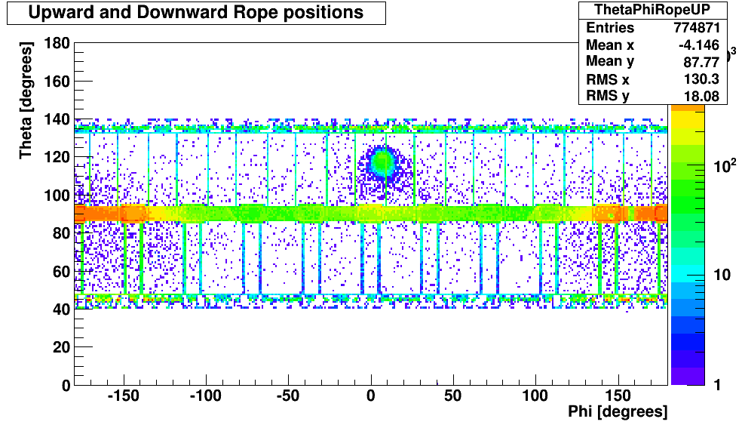
Monte Carlo Tracks of photons – Fibre is in front of Hold down rope

Slide 21
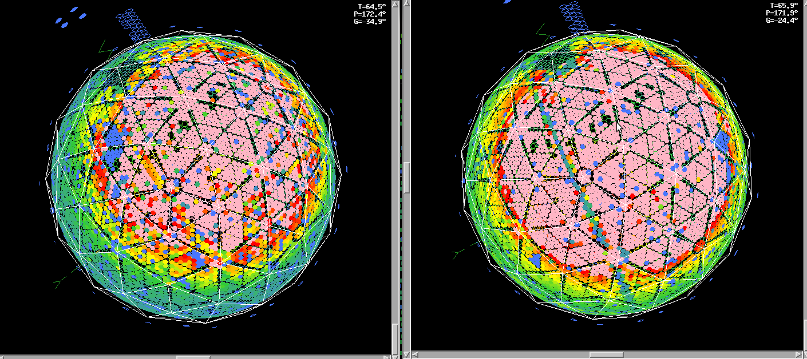
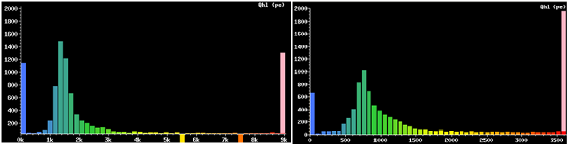
Rope Shadows and MC tuning
Data
MC

Slide 22
Tuning of rope coordinates and radius
where vertical has coordinates (0,0,1) and
R has coordinates at equator (z=0) of nearest rope to the fibre

Slide 23
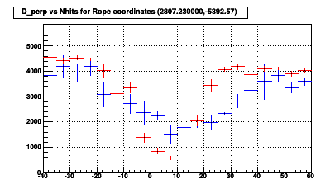
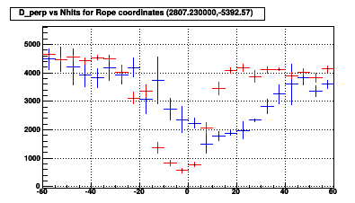
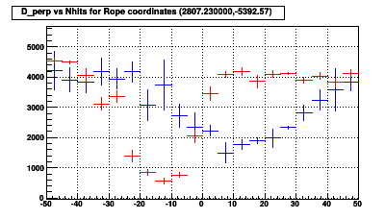
MC tuning for rope radius and coordinates
Blue – Data, Red – MC
Nhit

Slide 24
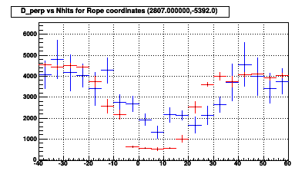
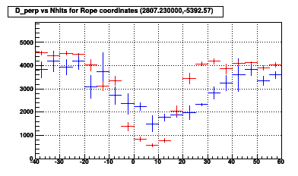
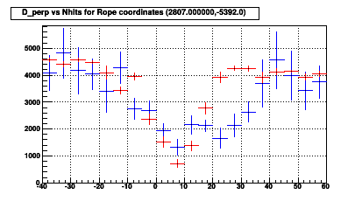
MC tuning for rope radius and coordinates
Nhit
Radius = 19 mm
Radius = 15 mm
Nhit
Nhit
Radius = 12 mm

Slide 25
Outlook
Commissioning data of fibres have been very useful in MC tuning
  position and radius of ropes at different tensions.
Fibres are meant to be used for time calibration and scattering measurement, data from empty detector is useful to extract optical parameters
An algorithm is under development to quantify the scattered fraction of light
  Angular distribution of PSUP surface scattering and reflections and its normalization
  Angular distribution of AV surface scattering and reflection and its normalization

