Slide 1



A Multiorbital DMFT Analysis of Electron-Hole Asymmetry in the Dynamic Hubbard Model
Christopher Polachic
Frank Marsiglio

Slide 2

The Hubbard Model
restrict i and j to nearest neighbour lattice sites
Pauli exclusion allows only two electrons per site
U – double occupancy Coulomb repulsion
t_{ij} – nearest-neighbour hopping
single band model
electron-hole symmetric

Slide 3
Double Occupancy and Orbital Relaxation
The Hubbard model assumes a single orbital on each lattice site and an electron’s state is static regardless of occupancy.
J. E. Hirsch, Phys. Rev. B 65, 184502 (2002):
The real electronic ground state includes higher-orbital contributions with weaker Coulomb repulsion which become especially important for strongly-correlated systems (large local Coulomb repulsion) at high filling
Need to adjust the Hubbard model to capture the flexibility for electrons to change their state in response to changes in occupancy: dynamic Hubbard model

Slide 4
Dynamic Hubbard Model (DHM)
J. E. Hirsch, Phys. Rev. B 65, 184502 (2002)
Two non-degenerate orbitals: energies ϵ₀ < ϵ₁
Three local Coulomb repulsions U₀, U₁, U₀₁
Two intraband hopping parameters t₀, t₁
Nonlocal hybridization (interband hopping) t₀₁
Local interband hybridization t′

Slide 5
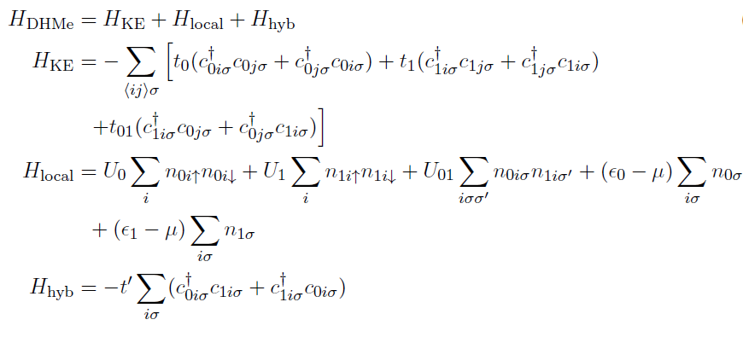
DHM Hamiltonian

Slide 6
Orbital Relaxation in the DHM
Double occupancy energy-ordering conditions

Slide 7
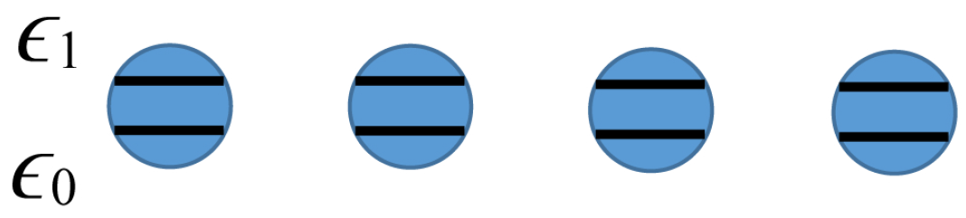
Comparison: Four-Site Exact Diagonalization
J. E. Hirsch, Phys. Rev. B 67, 035103 (2003)
Main result: electron-hole asymmetry in the Dynamic Hubbard Model
  fixed values of t' = 0.2, t₀₁ = 1.0 = t₀ = t₁

Slide 8
Multiorbital Dynamical Mean Field Theory (MODMFT)
A. Georges, G. Kotliar, W. Krauth, and M. J. Rozenberg, Rev. Mod. Phys. 68, 13 (1996)
Maps an infinite-dimensional lattice model onto a local impurity model
Solve the impurity model self-consistently for a set of effective mean field parameters which approximate the influence of the full lattice environment on a single site
Retains the local dynamics of electronic occupancy of the impurity, yielding the Green’s function and self energy of the system
LATTICE

Slide 9
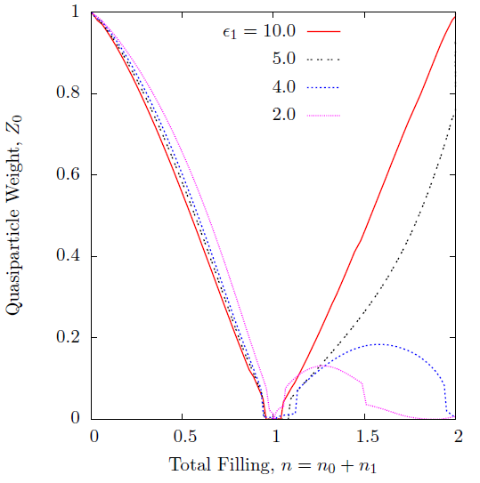
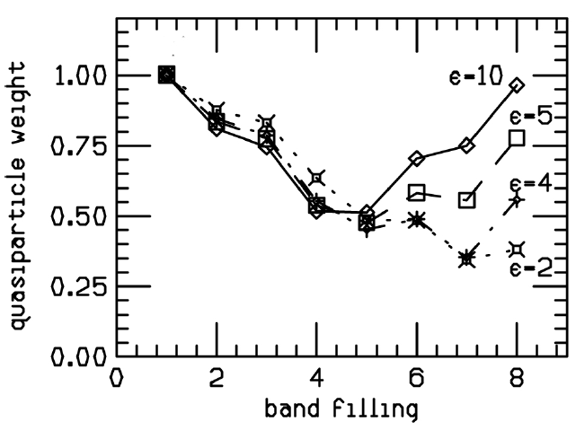
Result: Observed Asymmetry in Z
U₀ = 10.0, U₀₁ = 6.0, U₁ = 5.0, t₀ = t₁ = t₀₁ = 1.0, t′ = 0.2
Quasiparticles become increasingly dressed with orbital relaxation.
Four Site ED
Bethe Lattice MODMFT

Slide 10
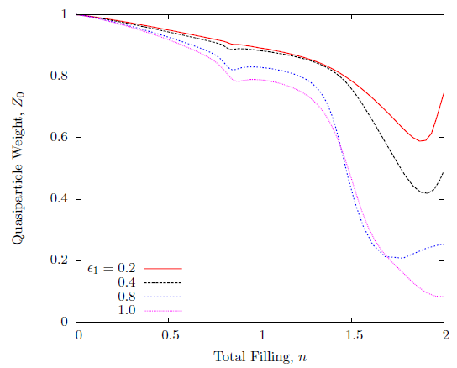
Or the Opposite Effect...
U₀ = 3.0, U₀₁ = 2.0, U₁ = 1.0, t₀ = t₁ = t₀₁ = 1.0, t′ = 0.2
Quasiparticles can also undress with orbital relaxation.

Slide 11
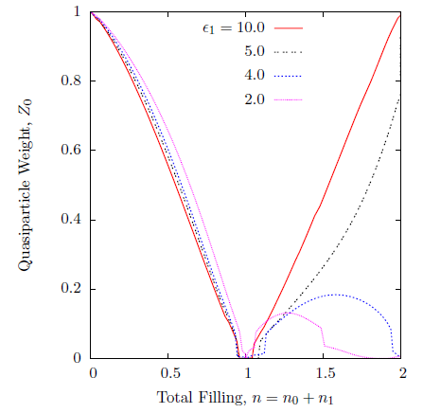
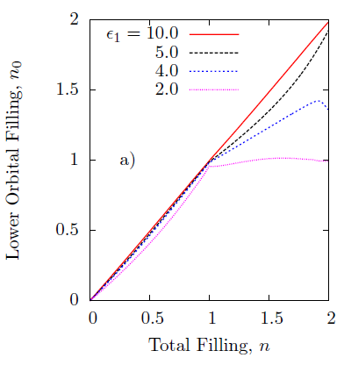
The Influence of Mott Physics on Dressing
(Not Evaluated in Hirsch’s ED Study)
U₀ = 10.0, U₀₁ = 6.0, U₁ = 5.0, t₀ = t₁ = t₀₁ = 1.0, t′ = 0.2

Slide 12
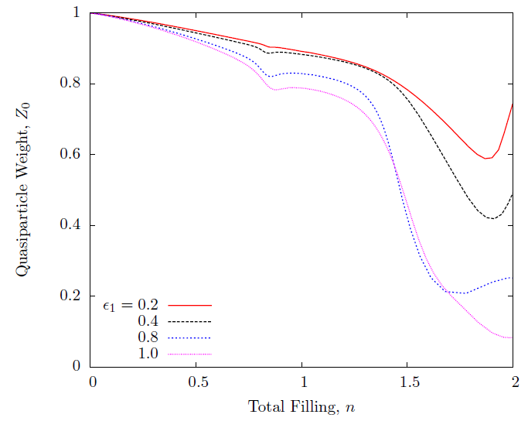
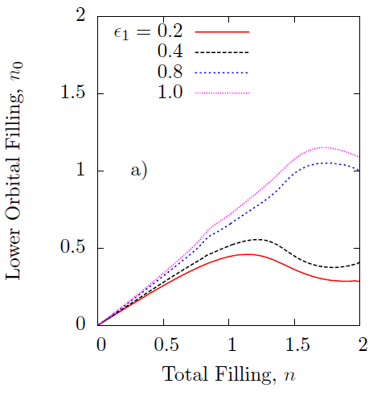
The Influence of Mott Physics on Undressing
U₀ = 3.0, U₀₁ = 2.0, U₁ = 1.0, t₀ = t₁ = t₀₁ = 1.0, t′ = 0.2

Slide 13
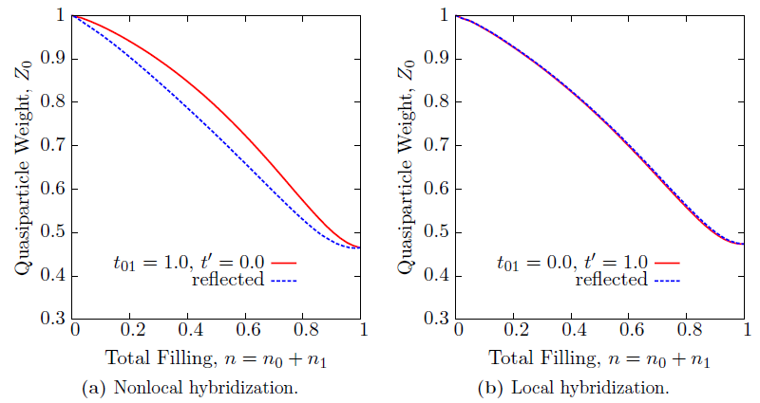
The Influence of Hybridization
t₀₁ is qualitatively more relevant to the physics of orbital relaxation than the (local) t′ hybridization parameter. For example:
U₀ = 3.0, U₀₁ = 2.0, U₁ = 1.0, t₀ = t₁ = t₀₁ = 1.0, t′ = 0.2, ϵ₁ = 10.0

Slide 14
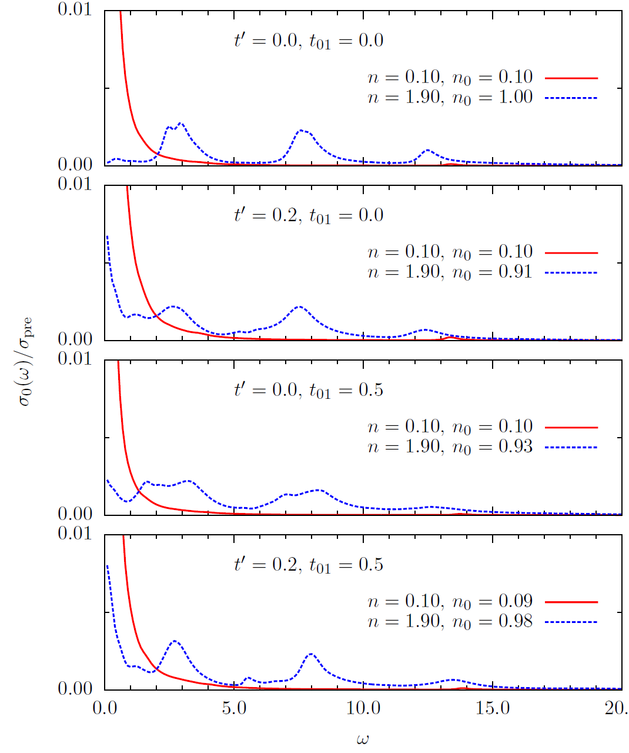
Asymmetry Evidenced in Optical Conductivity Weight Transfer
U₀ = 10.0, U₀₁ = 5.0, U₁ = 0.5,
t₀ = t₁ = 1.0, ϵ₁ = 4.0, η = 0.1
Hole regime shows transfer of low energy to higher energy features: electron-hole asymmetry
Significant effect of hybridization on the low energy Drude region

Slide 15
Conclusions
Confirmed Hirsch’s four-site ED observation of electron-hole asymmetry in the dynamic Hubbard model
    in the quasiparticle weight
    in optical conductivity weight transfer
Nonlocal hybridization is qualitatively more important than local hybridization
Complicated dependence of orbital relaxation on the energy gap, hybridization values and Mott physics in the DHM

Slide 17
MODMFT Background
MODMFT has been in use since the earliest years of DMFT studies
Q. Si and G. Kotliar, Phys. Rev. Lett. 70, 3143 (1993)
Q. Si and G. Kotliar, Phys, Rev. B 48, 13881 (1993)
Benchmark: A. Liebsch and H. Ishida, J. Phys.-Condens. Mat. 24, 053201 (2012)
Several studies of two-orbital systems with local hybridization t'
Few with nonlocal hybridization t₀₁
Focus has been on orbital selective Mott transitions with Hund’s coupling; none appear to address the dynamic Hubbard model

