Slide 1
Rapid Elemental Analysis of Human Fingernails Using Laser-Induced Breakdown Spectroscopy
Vlora A. Riberdy
Department of Physics
University of Windsor
Windsor, Ontario

Slide 2
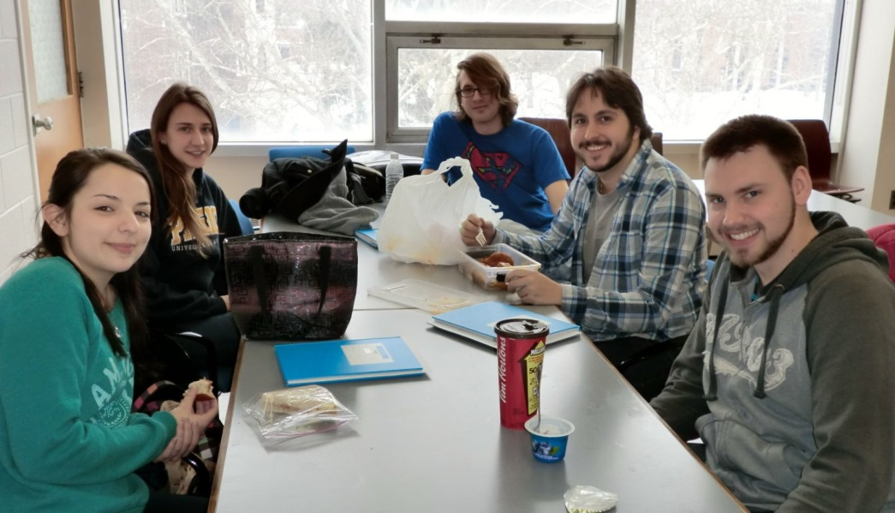
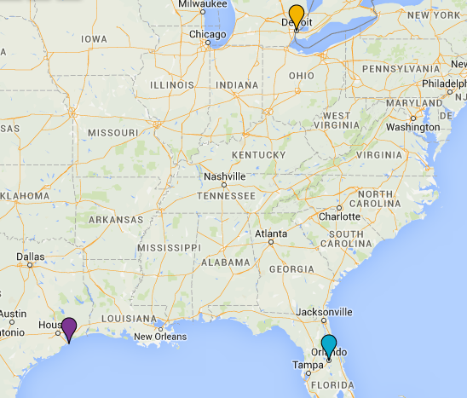
Acknowledgements
Lab Group: Alexandra Paulick, Dylan Malenfant, Anthony Piazza, Derek Gilles
Collaborators:
Dr. Chris Frederickson- Neurobiotex, Galveston, TX,
Dr. Matthieu Baudelet- University of Central Florida-CREOL, Orlando, FL

Slide 3

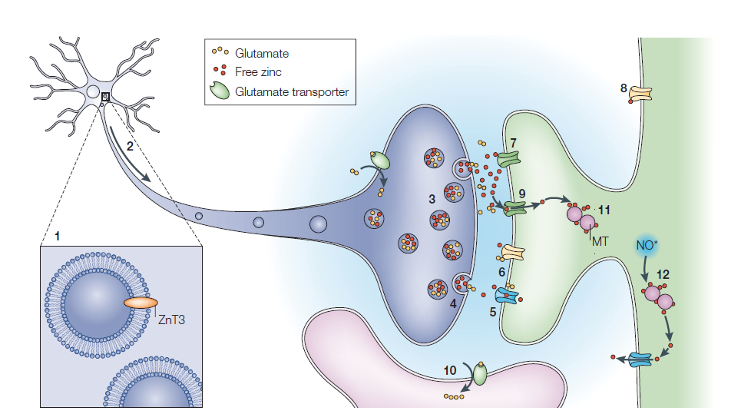
Motivation for this Project
~25 receptors
Zn2+
Zinc deficiency is the leading cause of death among toddlers worldwide.
It is also a leading cause of weakened immunity in the elderly.
Copenhagen Consensus (8 Nobel Laureates) says: Zinc supplementation is the number ONE most cost-effective move to improve world health. (2-3 billion people deficient worldwide).
Frederickson et al., Nature Neuroscience, 2003

Slide 4
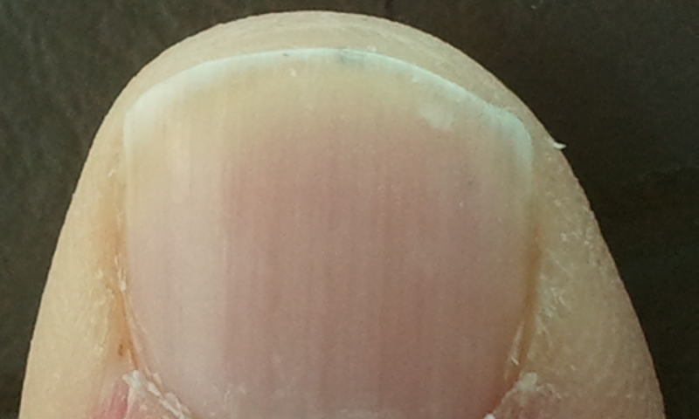

How do we diagnose and monitor zinc deficiency & remediation in
2-3 billion people?
Can LIBS do this?
Why not fingernail zinc?
Zinc in the fingernails has been shown to represent the overall zinc concentration in the body.
Need a real-time biomedical assay

Slide 5
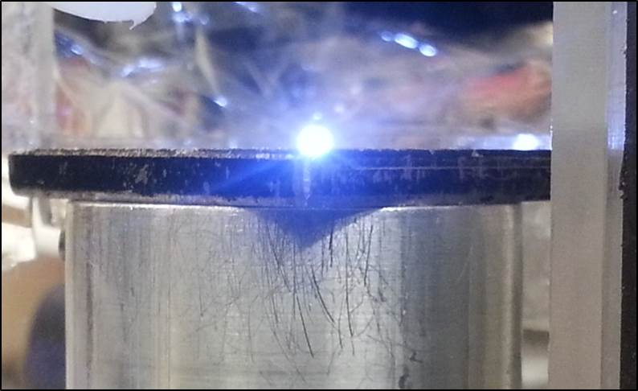
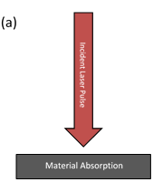
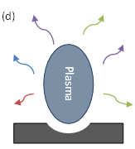
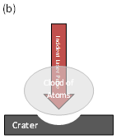
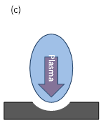
What is LIBS?
Intense laser pulse interacts with the target material and energy is absorbed.
Energy absorbed results in heating and vaporization of the material. Matter from the surface is removed and a vapor is formed.
Laser pulse is still incident on the vapor. Energy is absorbed, inducing heating and plasma formation (with temperature of 10,000 - 20,000 K).
As the plasma cools, atoms/ions/molecules decay by spontaneous emission. Light is collected and dispersed by the spectrometer. Resulting spectrum is analyzed to identify elements present in the target material.

Slide 6
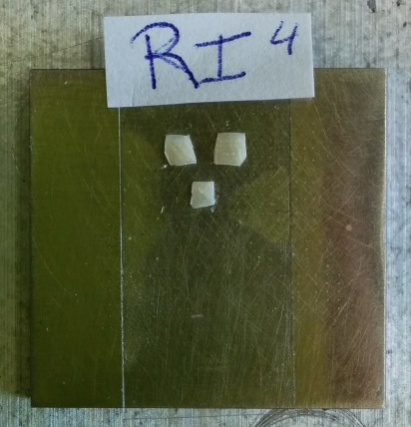
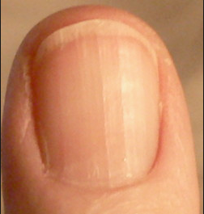
Preparation of Nails
Nail clippings of the index, middle and ring fingers (both right and left hands) of 5 subjects were taken→ a total of 6 nail clippings per subject.
Clippings were cleaned with acetone in an ultrasound bath for 10 minutes and allowed to dry for 20-30 minutes.
Clippings are cut into approximately 2 mm by 1 mm fragments to provide a flat target.

Slide 7
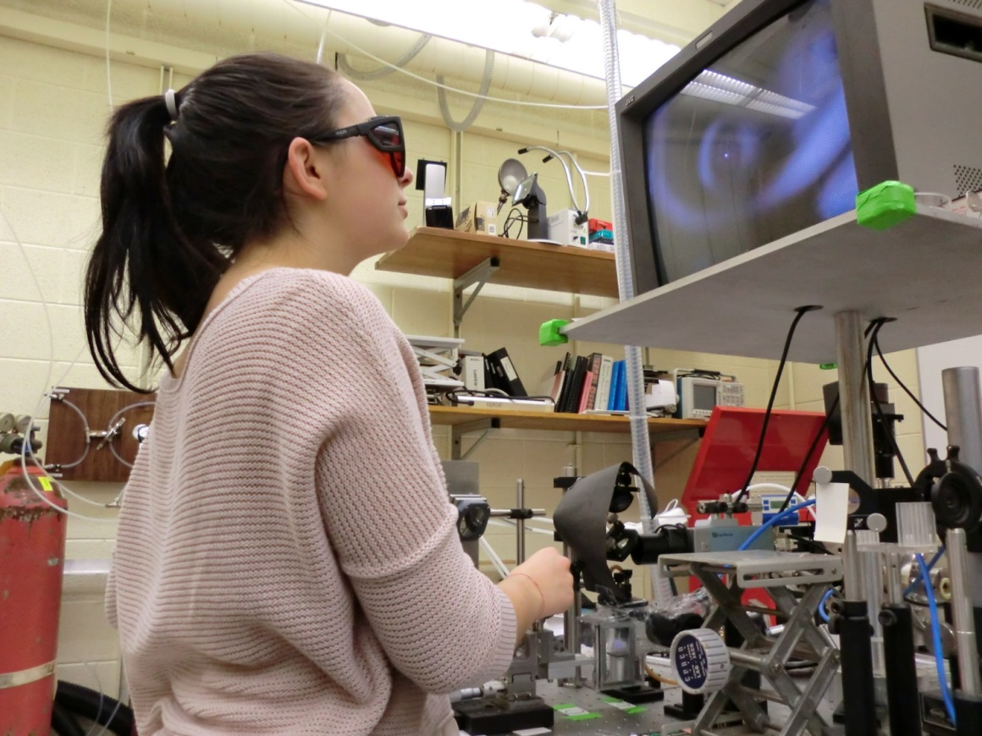
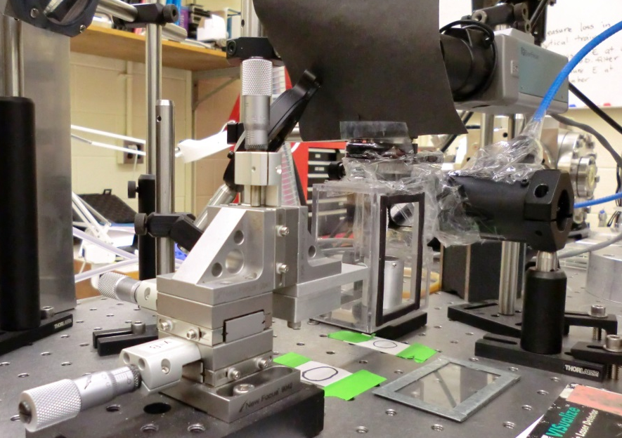
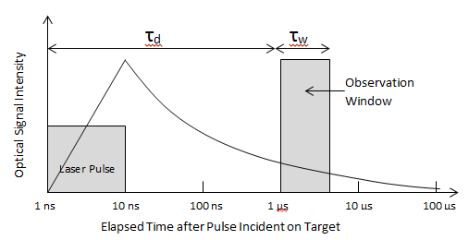
Data Acquisition
1064 nm Nd:YAG laser operating at 10 Hz with pulse energy = 5 mJ.
Shot in an argon environment
Data was taken using 10 laser pulses per location and 5 locations were averaged to make one spectrum. (50 laser shots per spectrum).
Studies were performed to optimize zinc SNR:
  Camera delay time = 1 μs
  Camera gate width = 5 μs
  Amplification = 2000

Slide 8
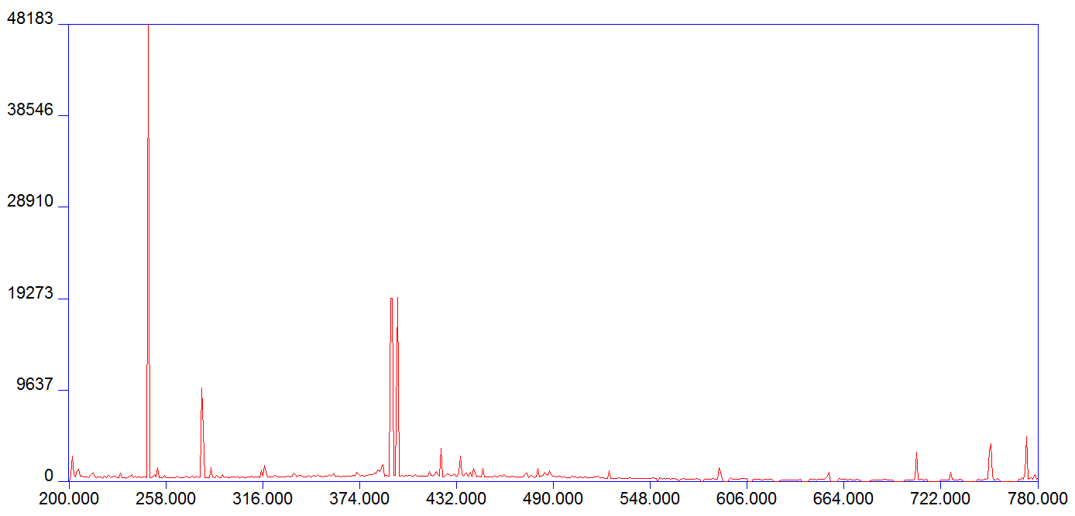
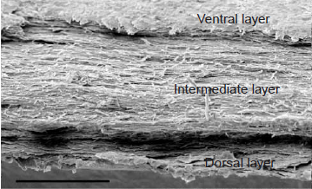
Typical Nail Components
Element | Mean (ppm) | ±Std.Dev.
Mg | 570.8 | ±511.5
Al | 837.4 | ±427.2
Si | 974.3 | ±594.1
P | 1035.2 | ±597.8
S | 24810 | ±8776
Cl | 1770.2 | ±1121.9
K | 831.9 | ±666.1
Ca | 2311.6 | ±1448.3
Fe | 128.6 | ±69.6
Ni | 5.1 | ±2.1
Cu | 20.8 | ±20.8
Zn | 151.7 | ±74.8
C247.9
Ca393.4
Ca396.8
Olabanji et al. Nuc. Instrum. Methods Section B: Beam Interactions with Materials and Atoms, 2005
Mg279.6
Mg280.3
Mg285.2
Zn202.5
Zn206.2
Zn213.8
Ca422.7
Ar
Ca315.7
Ca317.9
CN
Na589.0
Na589.6
Ar
Farren, Shayler, Ennos, The Journal of Experimental Biology, 2004
Wavelength (nm)

Slide 9
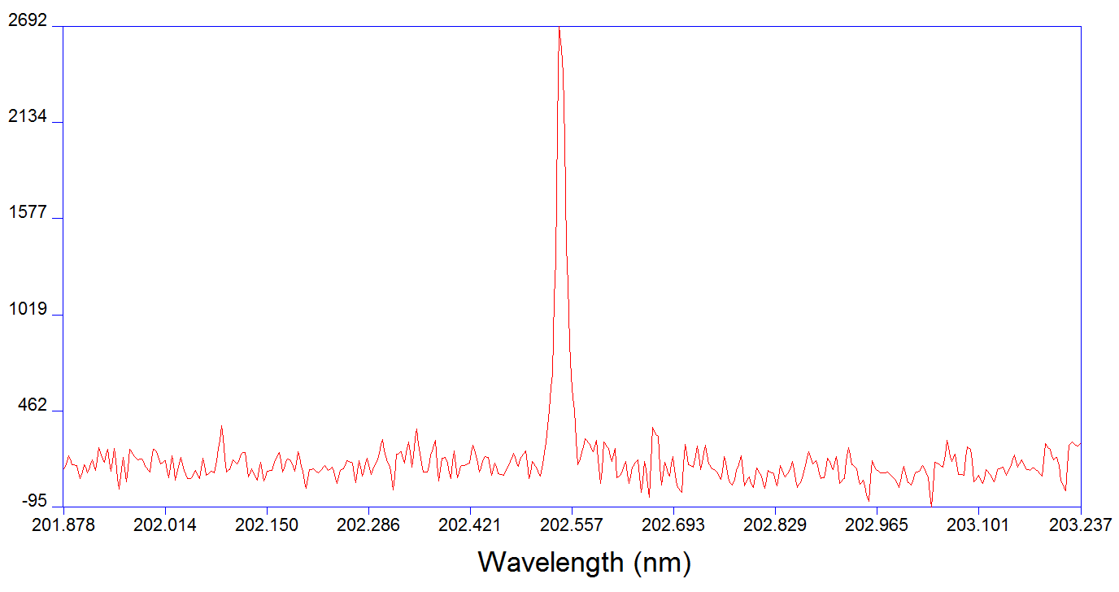
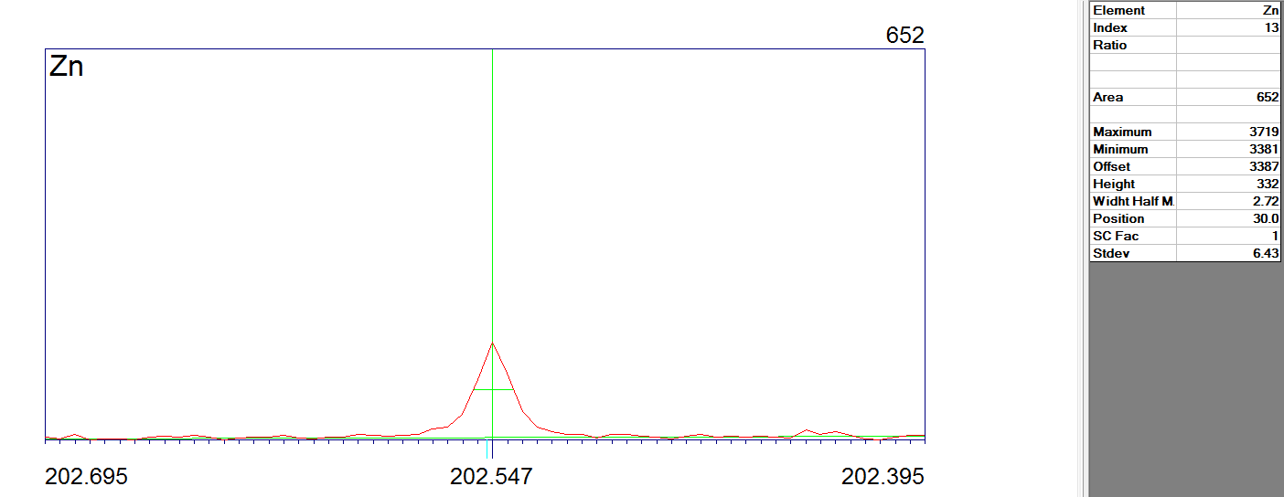
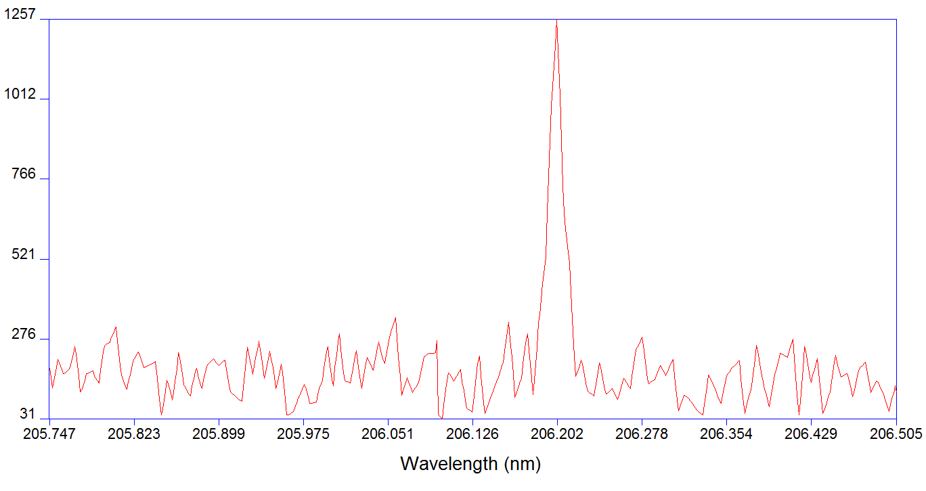
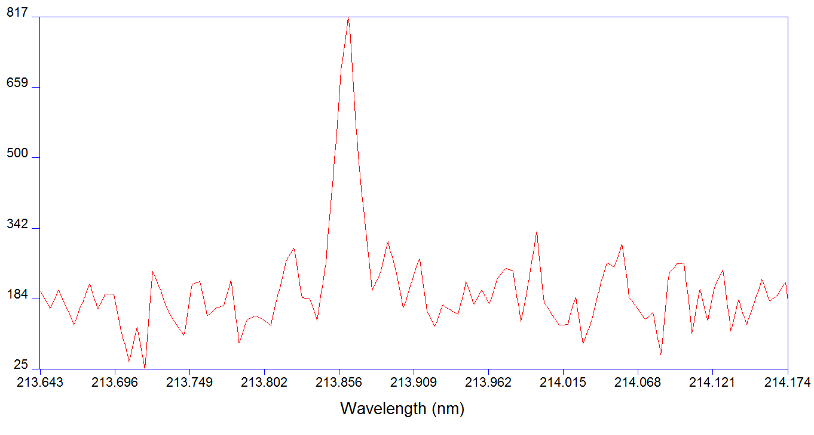
Observed Zinc Lines
ZnII 202.547
ZnII 206.2
ZnI 213.855

Slide 10
Results
Subject
Each bar is an average of 10 spectra. Error bars are the standard deviations of those measurements. There is no statistical difference between the 3 fingers for each sample.

Slide 11
Each value is an average of 30 spectra→1500 laser shots
Measurements from left and right hands agree with each other for each sample→ group left and right hands together for one measurement per patient
Subject
Each value is an average of 60 spectra→3000 laser shots in total.
Goal: We want one measurement per patient. Are they zinc deficient or not?
Subject

Slide 12
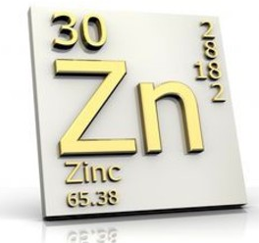
LIBS vs. SIDMS
Speciated isotope dilute mass spectrometry
Nail clippings from each subject sent to Texas
Is the zinc intensity value proportional to the actual concentration of zinc?
LIBS Intensity Value
Actual Zinc Concentration

Slide 13
Effects of Normalization to Carbon
Normalization can reduce the shot-to-shot variation
Ratio of the lines should be stable
Subject Comparison using LIBS Intensity
Normalized Subject Comparison
Subject
Subject

Slide 14
Future Work
Influence of nail preparation→ buffing the nail to smooth out the surface before ablation
Tests to determine the change in zinc concentrations over time→ shooting along the direction of nail growth
Larger subject sizes are being acquired
PLS regression→ multivariate analysis to discriminate between normal and zinc deficient nails
Goal: To have one measurement per patient that determines whether they are zinc deficient or not.

Slide 15

Thank You to…
My advisor Dr. Steven J. Rehse
University of Windsor Outstanding Scholars Program
NSERC USRA
Canada Foundation for Innovation- Leaders Opportunity Fund
GLIER- University of Windsor

