Slide 1

Effect of lipid composition on peptide-induced coalescence in bicellar mixtures
Chris Miranda¹, Michael R. Morrow¹, Valerie Booth^{2,1}
Memorial University of Newfoundland and Labrador
¹Department of Physics and Physical Oceanography
²Department of Biochemistry

Slide 2
Protein-Lipid Interactions
Perturbation of bilayers by peptides can be important in many biological contexts. For example:
  Lung surfactant
  Antimicrobial activity
This Study:
  Compare effects of a lung surfactant peptide fragment and an antimicrobial peptide on a membrane model system (bicellar dispersions) whose organization is very sensitive to perturbing interactions
Ask:
  Do two peptides (both cationic and amphipathic but apparently different functionally) perturb the model system differently?
  Is the observed perturbation sensitive to bilayer composition (i.e. anionic lipid content)?
Notes:
Protein perturbation of lipid bilayers is important in many contexts; two such contexts are in Lung Surfactant systems and in antimicrobial activity
This study examines the peptide induced perturbation of a lung surfactant protein fragment and an antimicrobial peptide on a model membrane system that is sensitive to perturbations
In particular two questions are investigated:
Do these two peptides of similar structure, but different function perturb our model system differently?
And are these perturbations sensitive to the composition of the membrane system? (For example the presence of anionic lipids)

Slide 3
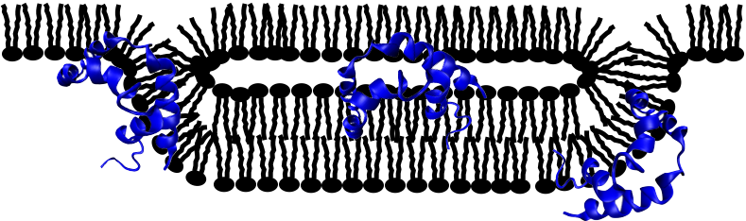
Surfactant Protein B
Alveolar Function
Surfactant Protein B
SP-B:
  79 residue monomer
  Cationic (+7), amphipathic, mainly hydrophobic
SP-B_{C-TERM}
  Amphipathic α-helix
  Cationic (+3), mainly hydrophobic
  Retains some functionality of full length SP-B
air
fluid
tubular
myelin
multilayers
lamellar bodies
type II alveoli
H₃N⁺-GR⁺MLPQLVCR⁺LVLR⁺CS-COO⁻
Notes:
Respiration depends on recruitment of surfactant material from lamellar reservoirs into a spread surface active layer.
The essential surfactant protein B (amphipathic, cationic and hydrophobic protein) is thought to facilitate and help maintain necessary contacts between the lamellar reservoir and surfactant layer.
One of the peptides in this work, the C-Terminal SP-B alpha helix (SP-B_{C-TERM}) retains some SP-B functionality and similar properties.
It is important to note that anionic lipids are important components of surfactant material.

Slide 4
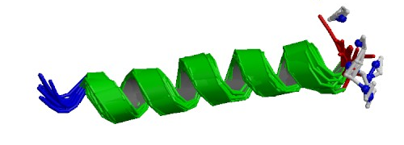
Magainin 2
Amphipathic α-helix
  Cationic (+4) and hydrophobic
Suggested to disrupt membrane via pore formation
PDBID: 2MAG
Gesell, J. . Z. M. . O. S. J. (1997). Two-dimensional 1H NMR experiments show that the 23-residue magainin antibiotic peptide is an alpha-helix in dodecylphosphocholine micelles, sodium dodecylsulfate micelles, and trifluoroethanol/water solution. J.Biomol.NMR, 9, 127–135.
Notes:
The other class of proteins used are antimicrobial peptides
AMPs are thought to target bacterial membranes which are particularly rich in anionic lipids.
Magainin 2 is a cationic and amphipathic helix (similar to SP-B_{C-TERM}) thought to disrupt the bacterial membrane through the promotion of pores

Slide 5
Bicellar Mixtures
Mixtures of long chain and short chain lipids
Coalesce to larger structures upon warming
1
2
Magnetically Oriented Phase
Extended Lamellar Phase
Isotropic Phase
Low Temperature
High Temperature
Notes:
Bicellar mixtures (long (red)/short (blue) lipids) tend to form long chain bilayer regions bounded by short chain lipids.
Useful here because of their propensity to reorganize into larger structures upon warming
Low temperature - small isotropically-reorienting discs
Intermediate temperature - Magnetically orientable, wormlike Micelles
High Temperature - Extended lamellae or multilamellar vesicles (likely with short chain lipids lining pores)

Slide 6
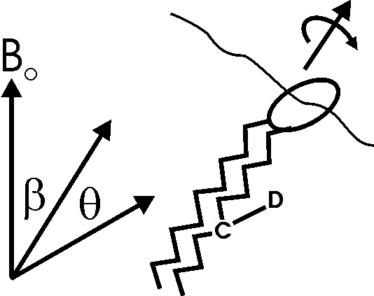
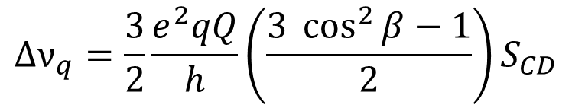
²H NMR of Bicelles
²H NMR
²H NMR distinguishes bicelle phases
Deuteron splittings reflect motional averaging of orientational dependent quadrupole interaction
2
1
$$∆ν_{q}=\frac{3}{2}\frac{e^{2}qQ}{h}\left(\frac{3 \cos^{2}{β}−1}{2}\right)S_{CD}$$
Notes:
Deuterium NMR spectral splittings reflect modulation of the orientation-dependent interaction between deuteron quadrupoles and the CD bond electric field gradient.
The spectra of the three bicellar mixture phases are easily distinguished by the distribution of intensity.

Slide 7
Zwitterionic Bicellar Mixtures with/without SP-B_{C-TERM}
DMPC-d₅₄/DMPC/DHPC (3:1:1)
With 10% SP-B_{C-TERM} (w/w)
DMPC-d₅₄/DMPC/DHPC (3:1:1)
2
2
DMPC-d₅₄ /DHPC
SP-B_{C-TERM} has little effect on transitions in mixtures of DMPC/DHPC (both zwitterionic)
1
1
Notes:
We first examined bicelles with and without SP-B C-Term using mixtures of DMPC (long) and DHPC (short). These lipids are both zwitterionic which means they have a net neutral charge but charge separation.
These series of spectra show bicellar phase behaviour as temperature increases. The associated arrows indicate the transition from isotropic to ribbon-like structures and green show the ribbon-like to extended lamellar transition
SP-B C-term has little effect on the reorganization temperatures (yellow and green arrows).

Slide 8
SP-B_{C-TERM} and Bicellar Mixtures with Anionic Lipids
DMPC-d₅₄/DMPG/DHPC (3:1:1)
With 10% SP-B_{C-TERM} (w/w)
DMPC-d₅₄/DMPG/DHPC (3:1:1)
DMPC-d₅₄ /DMPG/DHPC
In lipid-only bicellar mixtures, anionic lipid lowers and sharpens the ribbon-to-extended lamellar transition.
SP-B_{C-TERM} further lowers the ribbon-to-extended lamellar transition
Implies that SP-B_{C-TERM} depends on the presence of anionic lipids to promote ribbon-micelle coalescence
2
2
1
1
Notes:
In lipid-only bicellar mixtures, anionic lipid (DMPG) lowers and has a more distinct ribbon-to-extended lamellar transition.
SP-B_{C-TERM} further lowers the ribbon-to-extended lamellar transition, in contrast to the effect on zwitterionic lipid mixtures
Implies that SP-B_{C-TERM} depends on the presence of anionic lipids to promote ribbon-micelle coalescence

Slide 9
Does SP-B_{C-TERM} segregate DMPG?
DMPC/DMPG-d₅₄/DHPC (3:1:1)
With 10% SP-B_{C-TERM} (w/w)
DMPC/DMPG-d₅₄/DHPC (3:1:1)
DMPC /DMPG-d₅₄/DHPC
DMPG-d₅₄ and DMPC-d₅₄ report similar behaviours
2
DMPC-d₅₄/DMPG/DHPC (3:1:1)
DMPC-d₅₄/DMPG/DHPC (3:1:1)
With 10% SP-B_{C-TERM} (w/w)
2
1
1
Notes:
By keeping the lipid mixtures in the same molar concentration, but changing the probing lipid we are able to determine whether there are distinct lipid environments of DMPC and DMPG
DMPG-d₅₄ and DMPC-d₅₄ report similar behaviours where SP-B_{C-TERM} lowers the temperature of ribbon-to extended lamellar transitions in both species
Reflects that there is likely no separation of DMPG from DMPC

Slide 10
How does Magainin 2 affect bicellar phase behaviour?
DMPC-d₅₄ /DMPG/DHPC
Addition of Magainin 2 appeared to reverse the effect of DMPG on bicellar mixture phase behaviour
  Spectra similar to DMPC-d₅₄/DHPC (4:1) bicelles
Peptide-induced segregation of DMPG?
DMPC-d₅₄/DMPG/DHPC (3:1:1)
With 10% Magainin 2 (w/w)
DMPC-d₅₄/DMPG/DHPC (3:1:1)
2
2
DMPC-d₅₄/DMPG/DHPC (3:1:1)
With 10% SP-B_{C-TERM} (w/w)
DMPC-d₅₄/DMPG/DHPC (3:1:1)
1
1
Notes:
Like SP-B_{C-TERM}, Magainin 2 did not change the behaviour of DMPC/DHPC mixtures.
Unlike SP-B_{C-TERM,} Magainin 2 appears to have the reverse effect when DMPG is added → Spectra are more closely related to DMPC/DHPC bicelles
Separation of DMPG from DMPC?
We note that the bicellar mixtures containing only lipids are two different samples with very similar phase behaviour indicating good reproducibility in sample preparation

Slide 11
DMPC and DMPG appear to be in different environments in bicellar mixtures with Magainin 2
DMPC/DMPG-d₅₄/DHPC (3:1:1)
With 10% Magainin 2 (w/w)
DMPC/DMPG-d₅₄/DHPC (3:1:1)
DMPC /DMPG-d₅₄/DHPC
Spectra suggest that Magainin 2 interaction promotes a distinct environment for DMPG (anionic lipid)
Peptide-induced clustering anionic lipids?
2
2
1
1
Notes:
We note that when using DMPG-d₅₄ as a probe, a distinct series of spectra are shown which suggest that Magainin 2 is promoting a distinct environment of DMPG
It’s possible that this lipid environment may involve the clustering of anionic lipids by the peptide

Slide 12
Conclusions
Peptide-induced reorganization of bicellar mixtures appears to be facilitated by the presence of anionic lipid
SP-B_{C-TERM}
  Promotes ribbon-to-extended lamellar coalescence at a lower temperature when anionic lipids are present
  Does not appear to involve separation of DMPG and DMPC
Magainin 2
  Appears to preferentially interact with anionic lipids
  Spectra suggest separation of anionic lipids, possibly clustering

Slide 13
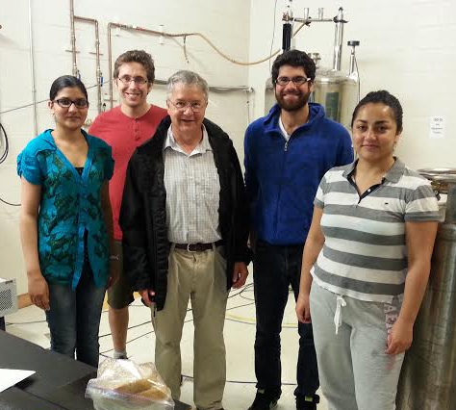
Acknowledgements
Supervisor: Michael R. Morrow
Group Members:
Gagandeep Sandhu
Suhad Sbeih
Collin Knight
Collaborators:
Valerie Booth
Donna Jackman
Funding Provided by:

