Slide 1
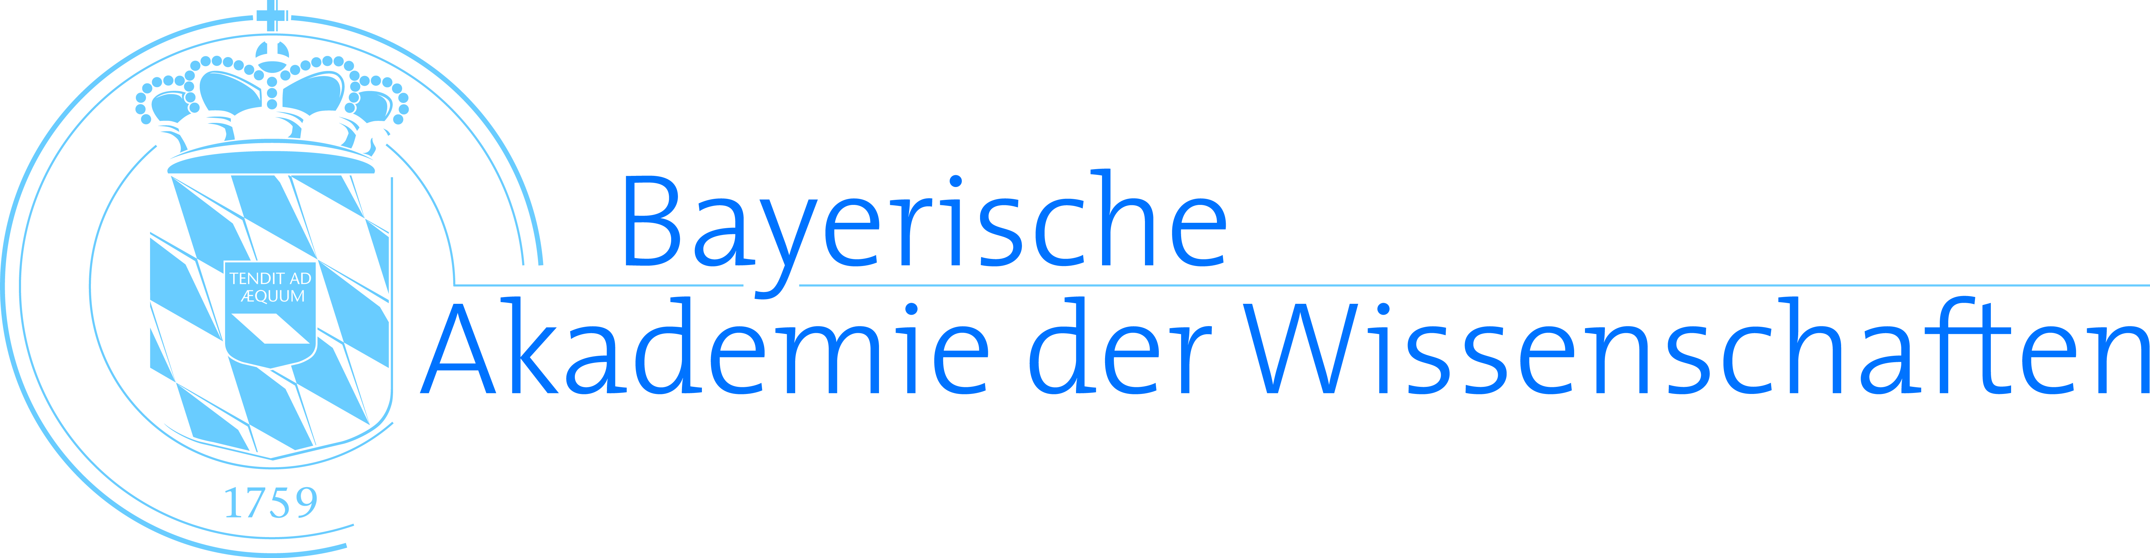
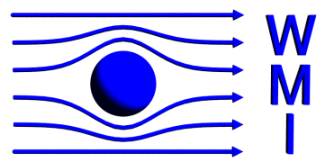
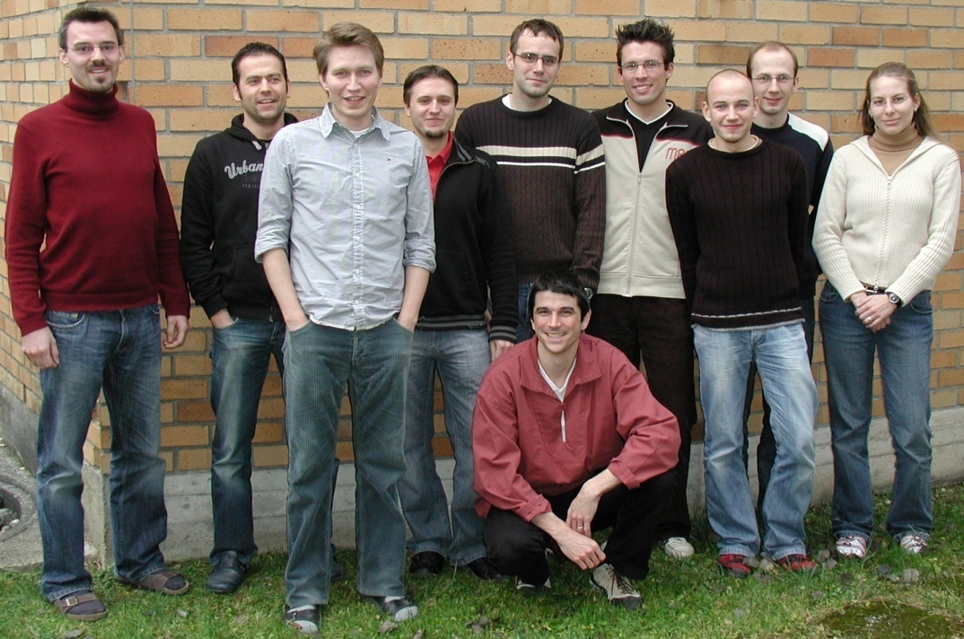
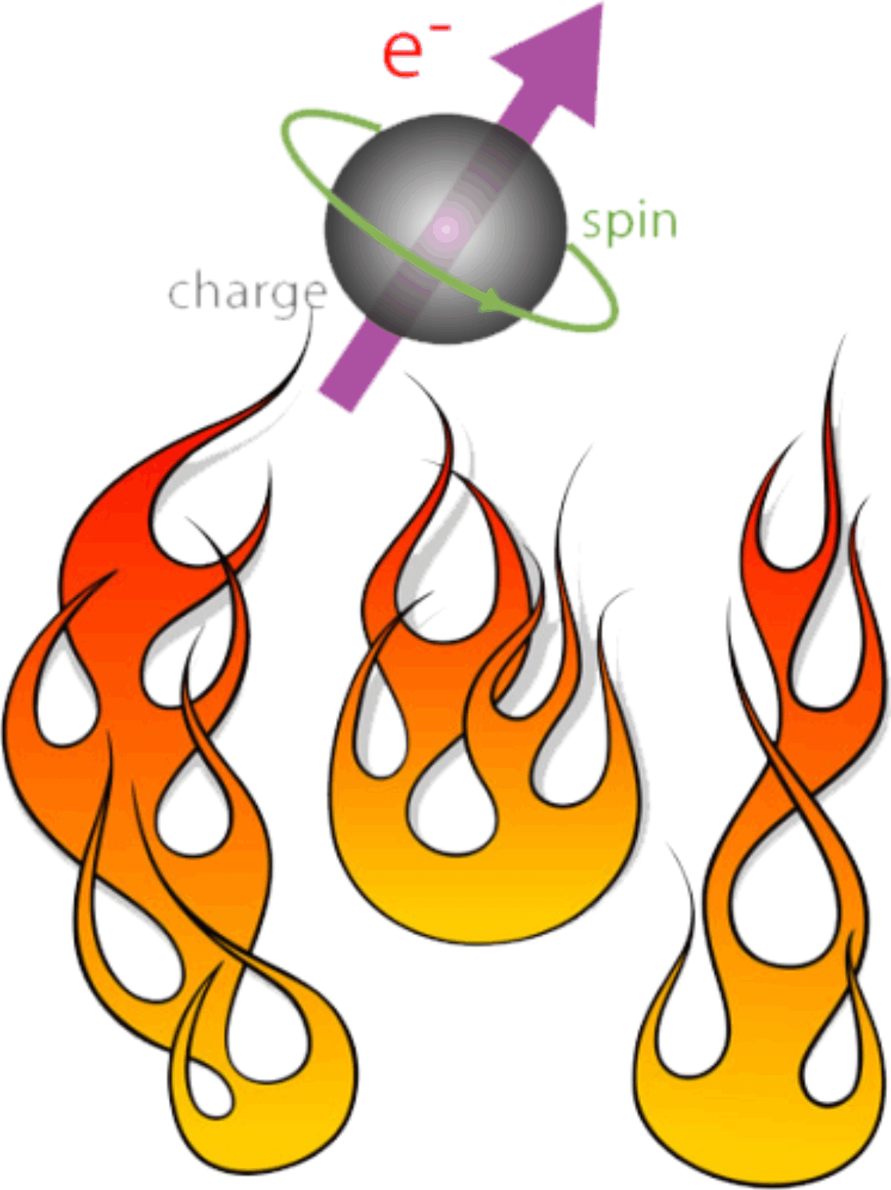

Spin Currents
in Magnetic Insulator / Normal Metal Heterostructures
Sebastian T. B. Goennenwein
Walther-Meißner-Institut, Bayerische Akademie der Wissenschaften
M. Althammer, F. D. Czeschka, J. Lotze,
S. Meyer, M. Schreier, M. Weiler,
S. Geprägs, M. Opel, H. Huebl, R. Gross,
Walther-Meißner-Institut
E. Saitoh and G.E.W. Bauer & groups
Institute for Materials Research, Tohoku U, Japan, Kavli Institute of NanoScience, TU Delft, NL
J. Xiao & group, Fudan U, Shanghai
Y. Tserkovnyak & group, UCLA, USA
M. Kläui & group, Uni Mainz
Financial support: Deutsche Forschungsgemeinschaft via
SPP 1538 “SpinCAT” (GO 944/4) and
Excellence Cluster NanoSystems Initiative Munich

Slide 2
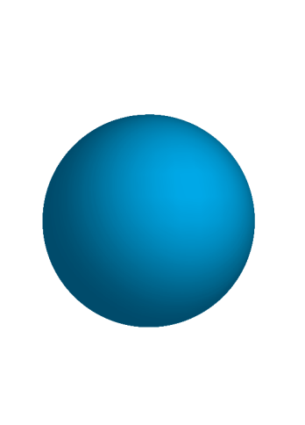
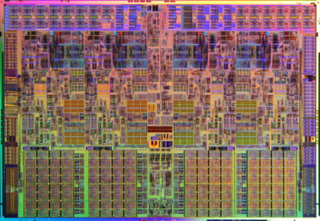
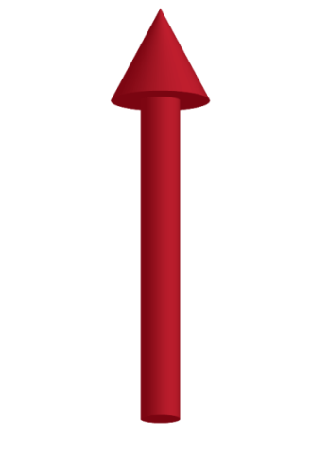
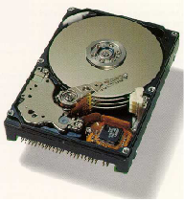
Spin electronics = putting a spin to electronics ?
electronics (charge-tronics):
… ONLY charge
… charge currents
in electrical conductors
charge current sources
charge current detectors
charge amplification
electron =
Intel Core i7
charge
magneto-electronics:
… charge AND spin
… spin-polarized currents
in electrical conductors
spin
IBM
spin-tronics:
… ONLY spin
… spin currents
in “angular momentum conductors”
spin currents ?
spin current sources ?
spin current detectors ?
spin current gain ?

Slide 3
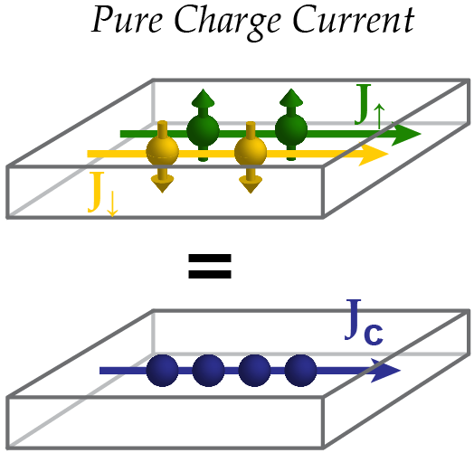
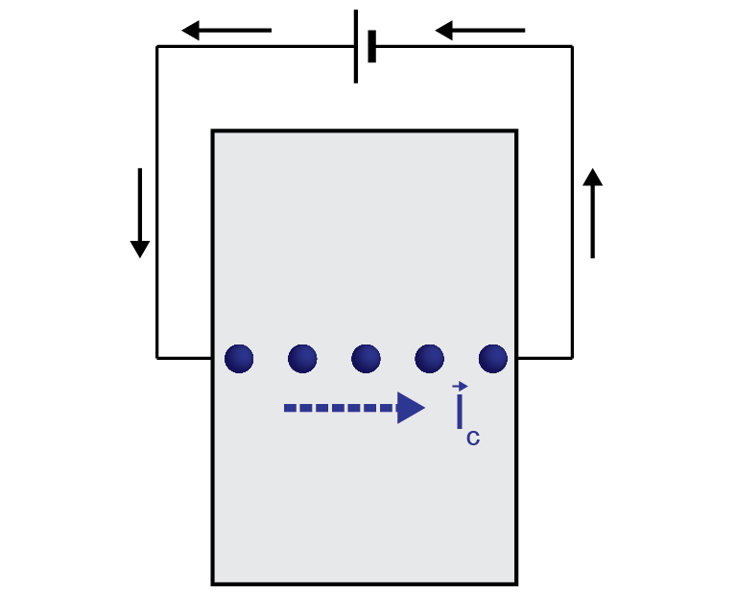
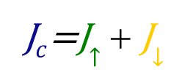
From charge currents to spin currents
J$c$=J$↑$ + J$↓$

Slide 4
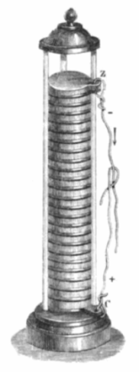
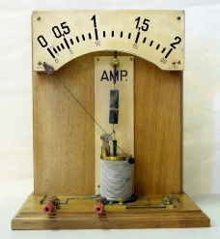
From charge currents to spin currents
Schulhistorische
Sammlung,
Bremerhaven
wikipedia
J$c$=J$↑$ + J$↓$
Ørsted
Volta

Slide 5

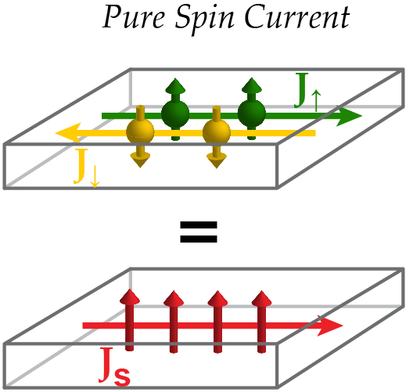
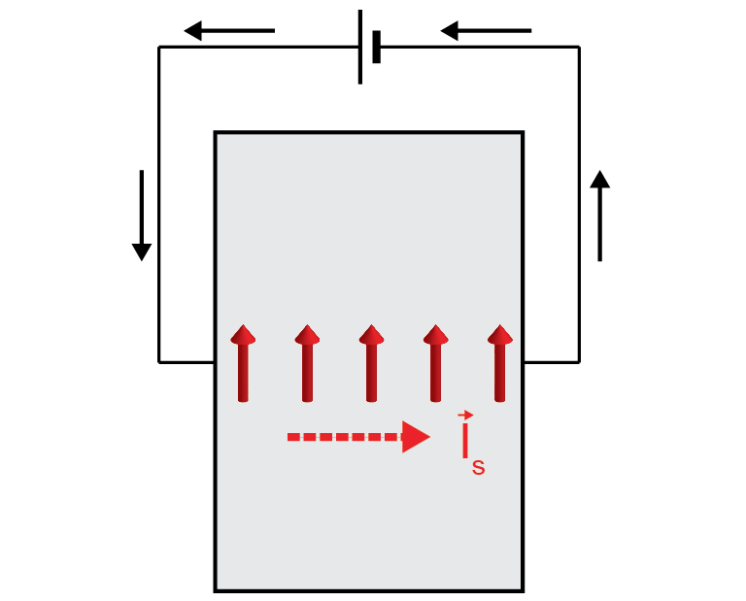
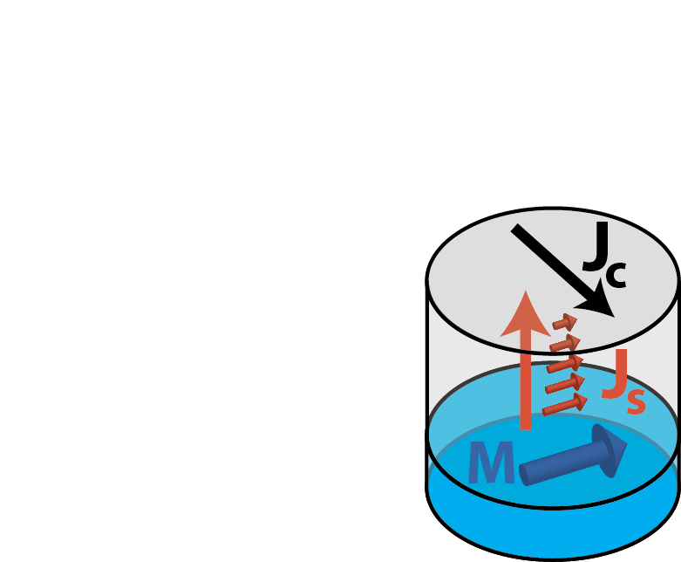
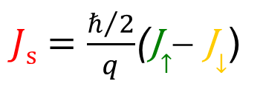
From charge currents to spin currents
J$c$=J$↑$ + J$↓$
Intel Core i7
?
spin current source ?
spin current meter ?
?
…this talk:
F/N hybrids !
$Js=\frac{ℏ/2}{q}$(J$↑$− J$↓$)

Slide 6
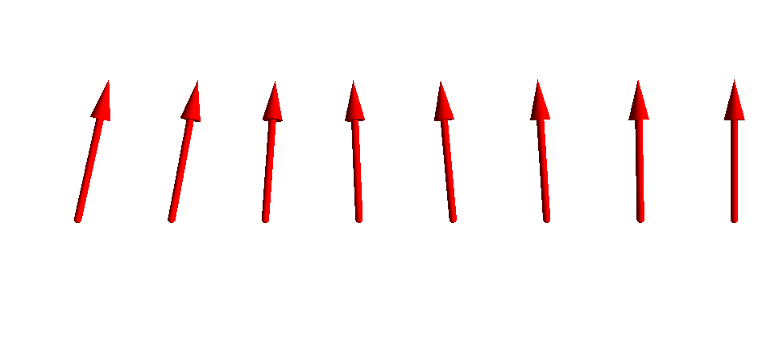
From charge currents to spin currents
J$c$=J$↑$ + J$↓$
Intel Core i7
?
spin current source ?
spin current meter ?
?
J_{S} can also flow in
electrical insulators, as a
magnon (spin) current !
$Js=\frac{ℏ/2}{q}$(J$↑$− J$↓$)

Slide 7
spin current detection
(in metals with s-o coupling)

Slide 8
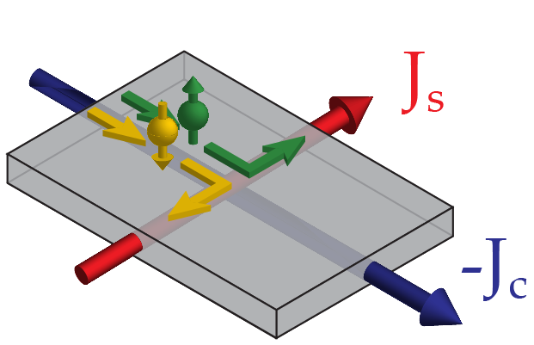
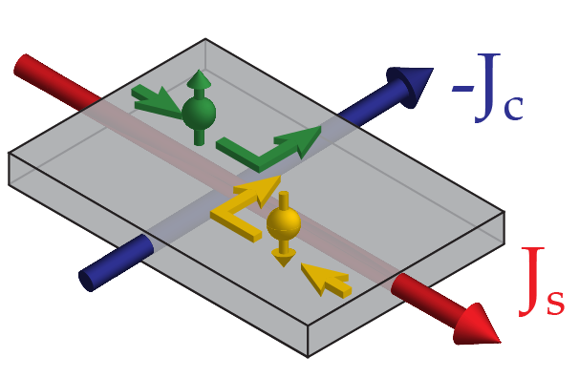
The spin Hall effect (SHE) : spin – charge current conversion
Spin Hall effect
  spin-orbit coupling: interaction between spin and charge motion
  spin Hall angle α_{SHE} parameterizes charge current ↔ spin current
  conversion efficiency
direct spin Hall effect (SHE)
inverse spin Hall effect (ISHE)
charge current spin current
spin current charge current

Slide 9
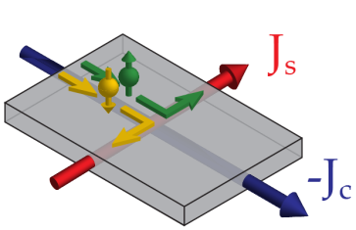
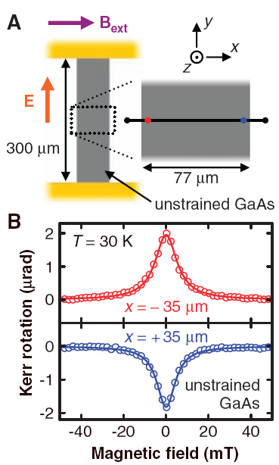
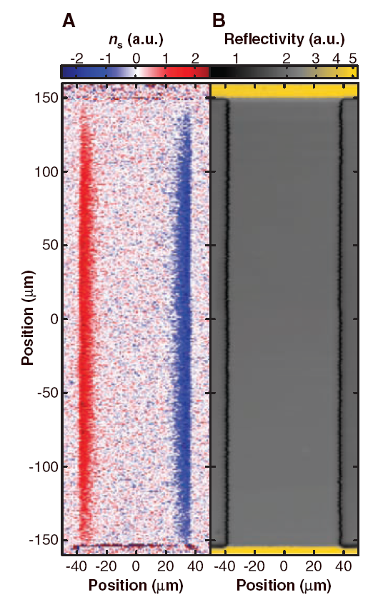
Direct spin Hall effect in GaAs
Kato et al., Science 306, 1910 (2004).
Kerr microscopy
(„spin imaging“)
-J_{c}
J_{s}
⊗
Notes:
one of the first experiments getting …

Slide 10
The spin Hall effect (SHE) : spin – charge current conversion
Spin Hall effect
  spin-orbit coupling: interaction between spin and charge motion
  spin Hall angle α_{SHE} parameterizes charge current ↔ spin current
  conversion efficiency
direct spin Hall effect (SHE)
inverse spin Hall effect (ISHE)
charge current spin current
spin current charge current

Slide 11
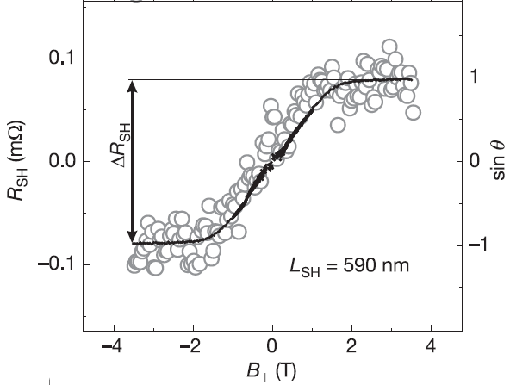
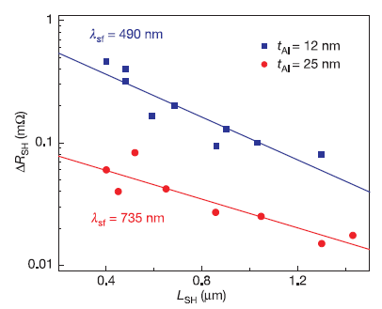
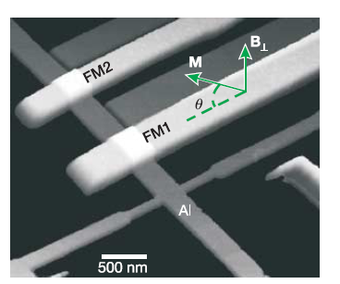
iSHE in Metallic F/N Nanostructures
Valenzuela & Tinkham, Nature 442, 176 (2006).
L_{SH}
-J_{c}
FM1
Al
J_{s}
J_{s}
Aluminium:
detection of diffusive spin current
via inverse spin Hall effect
Valenzuela & Tinkham, Nature 442, 176 (2006).
Mosendz et al., Phys. Rev. Lett. 104, 046601 (2010).
Liu et al., Science 336, 555 (2012).
Niimi et al., Phys. Rev. Lett. 109, 156602 (2012).
…and many more …
Gold : α_{SHE}=0.0016
Platinum : α_{SHE}=0.013 … 0.11 (0.16)
Bi, Bi/Ag, Ta : α_{SHE}=0.1 … 0.3
Notes:
non-local due to :
spin polarisation is not a conserved quantity → diffusion in both direction
no magnetic contacts: stray fields, interface problems
Non-local
magnetic probes
Aluminium

Slide 12
iSHE in Metallic F/N Nanostructures
Valenzuela & Tinkham, Nature 442, 176 (2006).
L_{SH}
-J_{c}
FM1
Al
J_{s}
take away:
SHE enables “simple” experimental
spin current detection
(… given the spin Hall angle α_{SHE} and
the spin diffusion length λ_{SF} are known ! )
J_{s}
Aluminium:
detection of diffusive spin current
via inverse spin Hall effect
Valenzuela & Tinkham, Nature 442, 176 (2006).
Mosendz et al., Phys. Rev. Lett. 104, 046601 (2010).
Liu et al., Science 336, 555 (2012).
Niimi et al., Phys. Rev. Lett. 109, 156602 (2012).
…and many more …
Gold : α_{SHE}=0.0016
Platinum : α_{SHE}=0.013 … 0.11 (0.16)
Bi, Bi/Ag, Ta : α_{SHE}=0.1 … 0.3
Notes:
non-local due to :
spin polarisation is not a conserved quantity → diffusion in both direction
no magnetic contacts: stray fields, interface problems
Non-local
magnetic probes
Aluminium

Slide 13
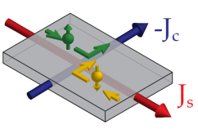
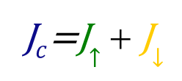
From charge currents to spin currents
Schulhistorische
Sammlung,
Bremerhaven
J$c$=J$↑$ + J$↓$
Ørsted
Volta
?
ISHE
$Js=\frac{ℏ/2}{q}$(J$↑$− J$↓$)
Hirsch
(1999)

Slide 14
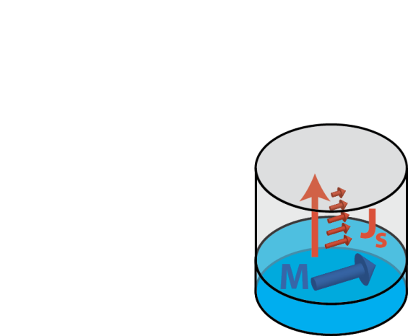
From charge currents to spin currents
Schulhistorische
Sammlung,
Bremerhaven
J$c$=J$↑$ + J$↓$
Ørsted
Volta
?
ISHE
Hirsch
(1999)
magnetic excitations
@F/N interface
$Js=\frac{ℏ/2}{q}$(J$↑$− J$↓$)

Slide 15
spin current generation
(in ferromagnet / metal hybrid structures)

Slide 16
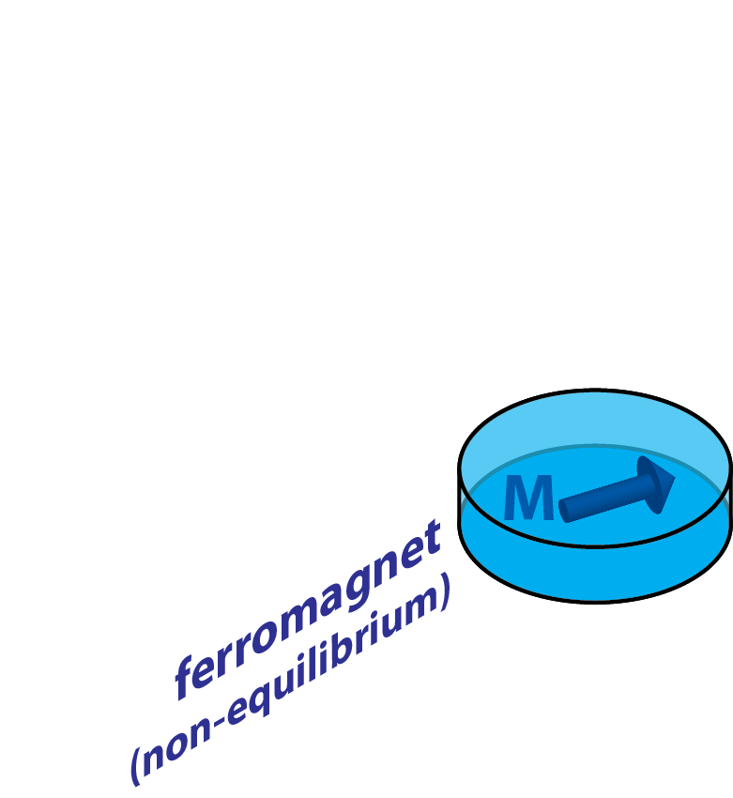
Spin currents in hybrid structures
ferromagnet

Slide 17
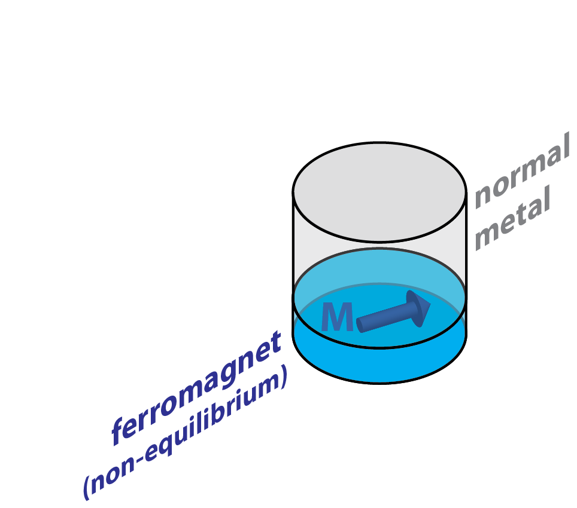
Spin currents in hybrid structures
„normal“ metal
ferromagnet

Slide 18


Spin currents in hybrid structures
$$J_{S}=\frac{g_{↑↓}}{2π}∆E$$
„normal“ metal
Weiler et al., PRL 111, 176601 (2013).
ferromagnet
(out of equilibrium)

Slide 19
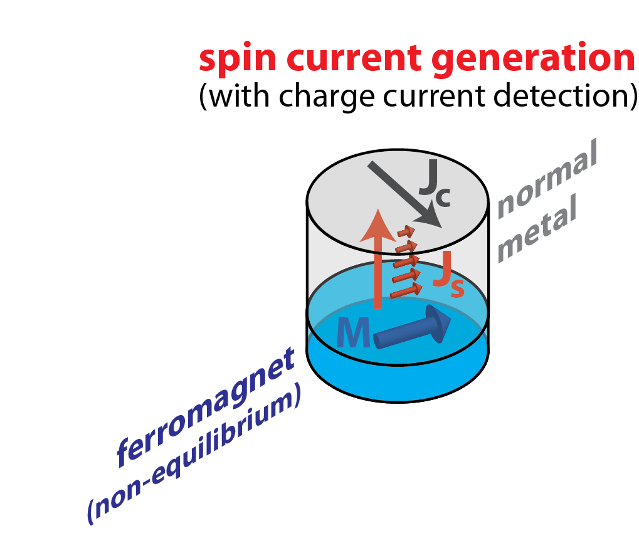
Spin currents in hybrid structures
$$J_{S}=\frac{g_{↑↓}}{2π}∆E$$
„normal“ metal
Weiler et al., PRL 111, 176601 (2013).
ferromagnet
(out of equilibrium)

Slide 20
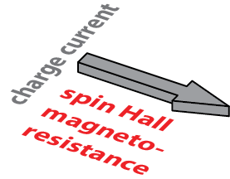
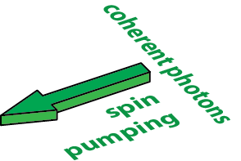
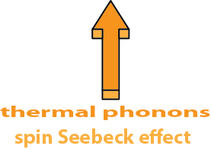

Spin currents in hybrid structures
Weiler et al., PRL 108, 106602 (2012) .
Huang et al., PRL109, 107204 (2012).
Nakayama et al., PRL 110, 206601 (2013).
Chen et al., PRB 87, 144411 (2013).
Althammer et al., PRB 87, 224401 (2013).
Vlietstra et al., PRB 87, 184421 (2013).
Hahn et al., PRB 87,174417 (2013).
Lotze et al., PRB 90,
174419 (2014).
Tserkovnyak et al., PRL 88, 117601 (2002). Saitoh et al., APL 88, 182509 (2006).
Mosendz et al., PRL 104, 046601 (2010).
Czeschka et al., PRL 107, 046601 (2011).
Bai et al., PRL 114, 227201 (2015).
$$J_{S}=\frac{g_{↑↓}}{2π}∆E$$
Weiler et al., PRL 111, 176601 (2013).
Uchida et al., Nature 455, 778 (2008).
Jaworski et al., Nature Mater. 9, 898 (2010).
Uchida et al., Nature Mater. 9, 894 (2010).
Weiler et al., PRL 108, 106602 (2012) .
Gepraegs et al., APL 101, 262407 (2012).
Schreier et al., PRB 88, 094410 (2013).
Schreier et al., APL 103, 242404 (2013).
Roschewsky et al., APL 104, 202410 (2014).
Geprägs et al.,arXiv:1405.4971
coherent phonons:
Bömmel & Dransfeld,
PR 117, 1245 (1960).
Weiler et al.,
PRL 106, 117601 (2011).
PRL 108, 176601 (2012).

Slide 21

Spin currents in hybrid structures
Weiler et al., PRL 108, 106602 (2012) .
Huang et al., PRL109, 107204 (2012).
Nakayama et al., PRL 110, 206601 (2013).
Chen et al., PRB 87, 144411 (2013).
Althammer et al., PRB 87, 224401 (2013).
Vlietstra et al., PRB 87, 184421 (2013).
Hahn et al., PRB 87,174417 (2013).
Lotze et al., PRB 90,
174419 (2014).
Tserkovnyak et al., PRL 88, 117601 (2002). Saitoh et al., APL 88, 182509 (2006).
Mosendz et al., PRL 104, 046601 (2010).
Czeschka et al., PRL 107, 046601 (2011).
Bai et al., PRL 114, 227201 (2015).
$$J_{S}=\frac{g_{↑↓}}{2π}E$$
Weiler et al., PRL 111, 176601 (2013).
Uchida et al., Nature 455, 778 (2008).
Jaworski et al., Nature Mater. 9, 898 (2010).
Uchida et al., Nature Mater. 9, 894 (2010).
Weiler et al., PRL 108, 106602 (2012) .
Gepraegs et al., APL 101, 262407 (2012).
Schreier et al., PRB 88, 094410 (2013).
Schreier et al., APL 103, 242404 (2013).
Roschewsky et al., APL 104, 202410 (2014).
Geprägs et al.,arXiv:1405.4971
coherent phonons:
Bömmel & Dransfeld,
PR 117, 1245 (1960).
Weiler et al.,
PRL 106, 117601 (2011).
PRL 108, 176601 (2012).

Slide 22
Spin Seebeck Effect
in magnetic insulator / metal hybrid structures

Slide 23
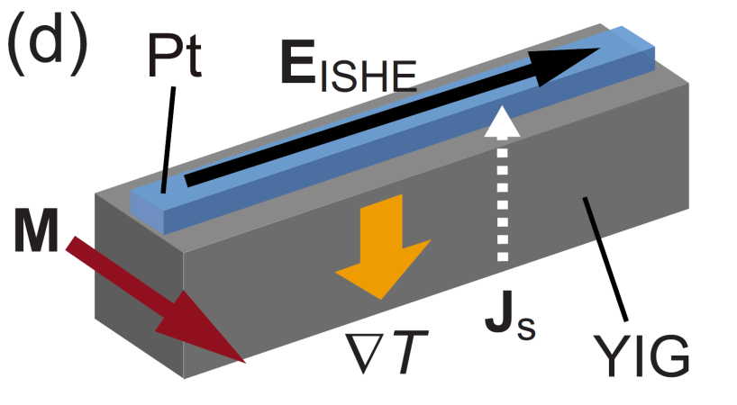
Spin Seebeck effect (SSE)
longitudinal SSE
magnetic insulator / N
( YIG / Pt )
Uchida, Saitoh et al.,
Nature 455, 778 (2008).
Nature Mater. 9, 894 (2010).
APL 97,172505 (2010). ….

Slide 24
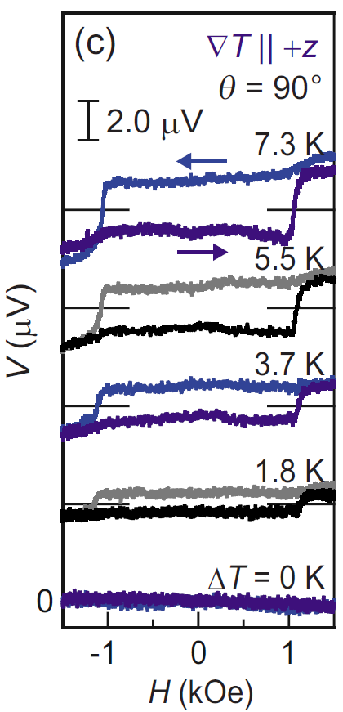
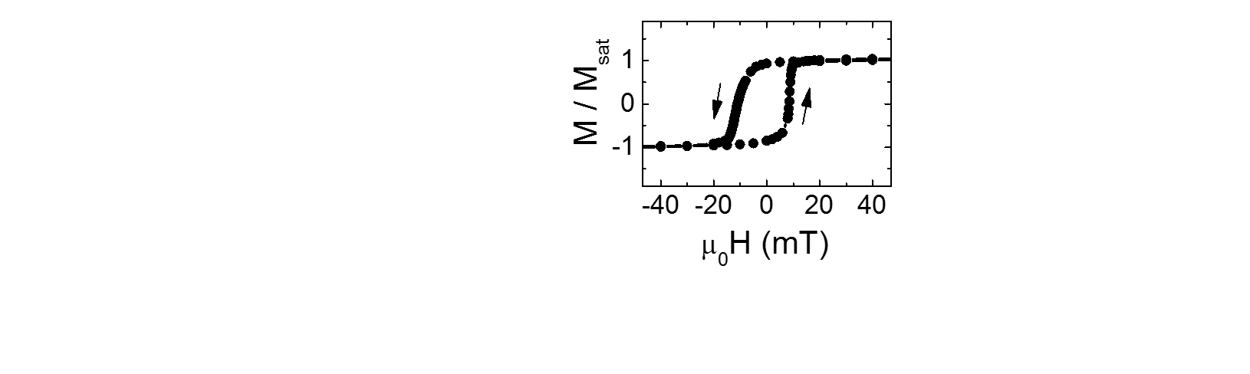
Spin Seebeck effect (SSE)
M
longitudinal SSE
magnetic insulator / N
( YIG / Pt )
Uchida, Saitoh et al.,
Nature 455, 778 (2008).
Nature Mater. 9, 894 (2010).
APL 97,172505 (2010). ….

Slide 25
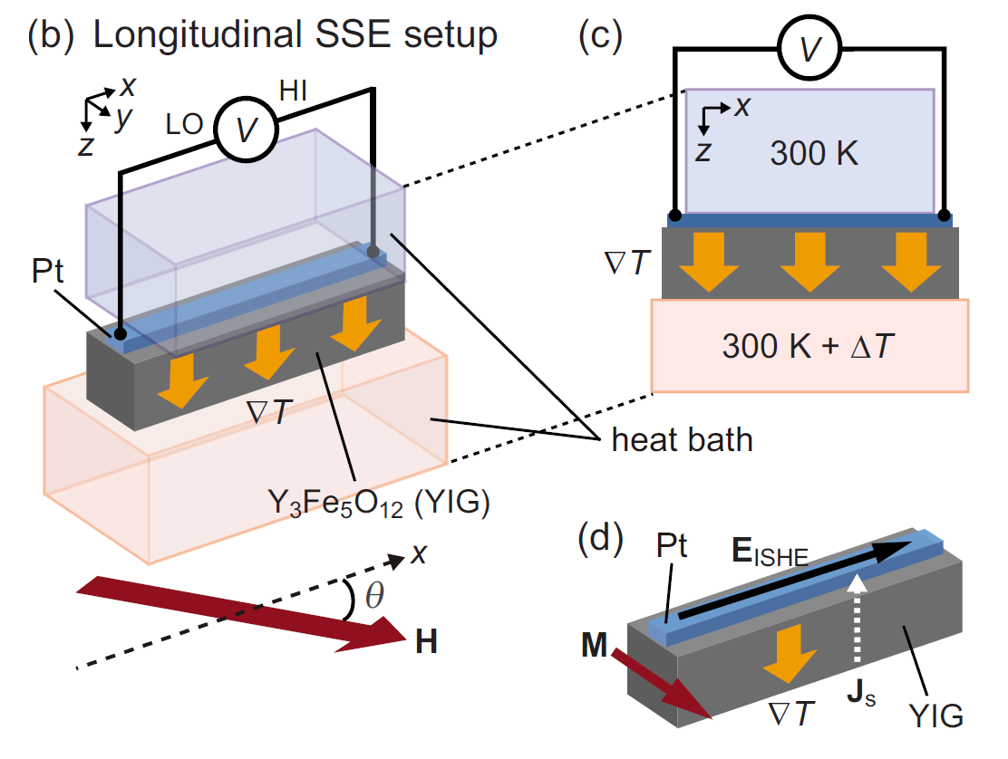
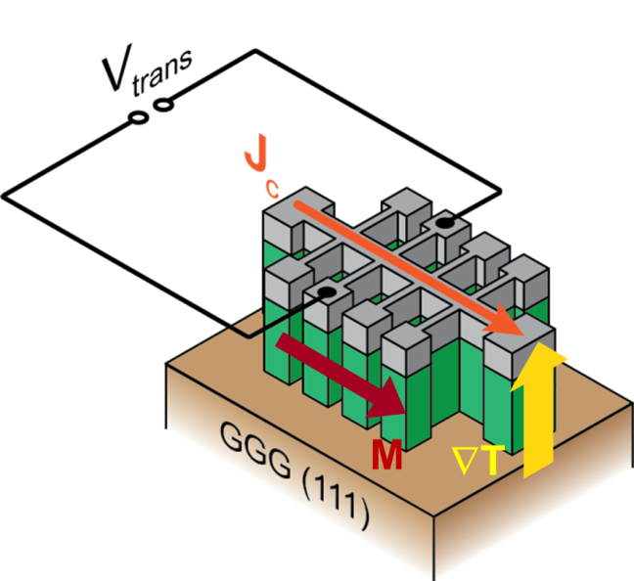
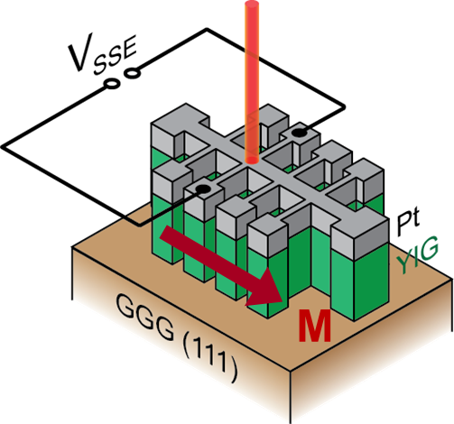
Spin Seebeck effect (SSE)
heat baths
(local) laser heating
Joule current heating
many groups
around the world
use this
„thermoelectric
approach“
Weiler et al., PRL 108, 106602 (2012). Schreier et al., APL 103, 242404 (2013).
Roschewsky et al., APL 104, 202410 (2014).

Slide 26
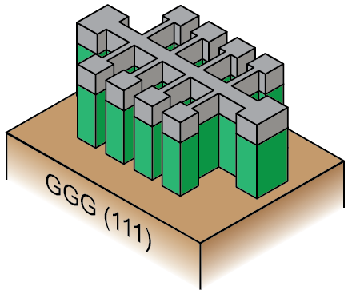
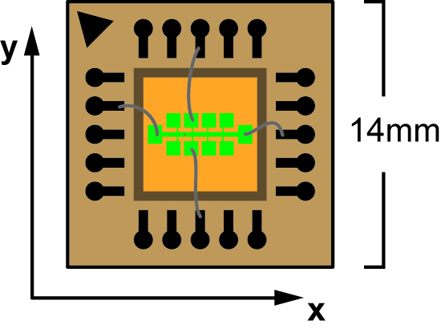
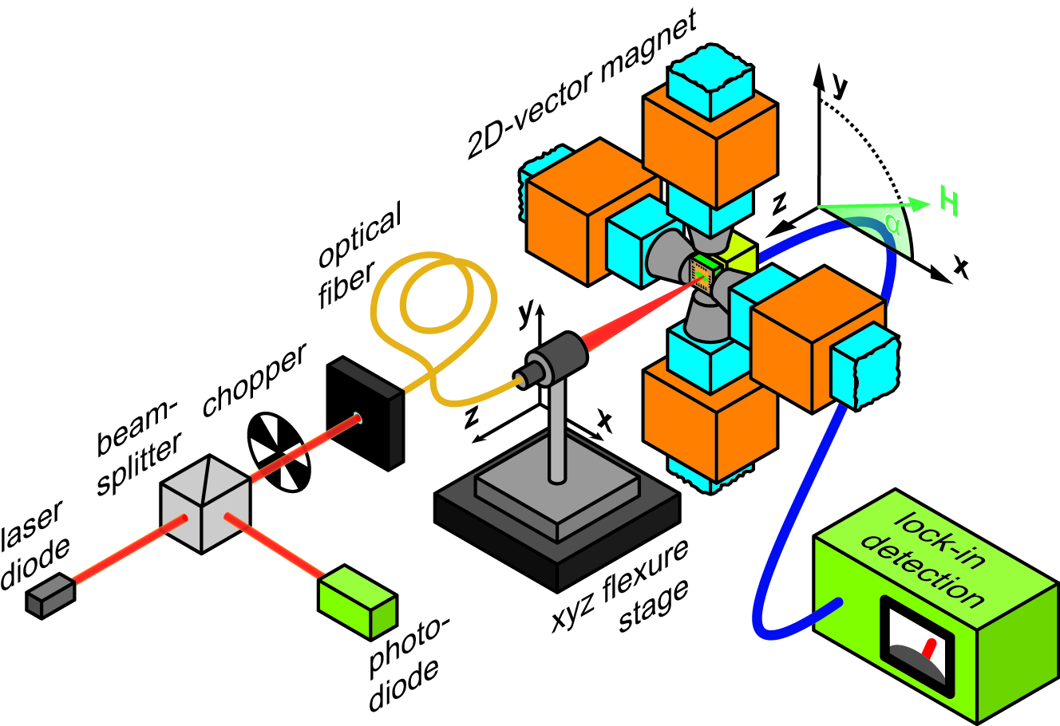
Spatially resolved spin Seebeck experiments
… inspired by EPFL, e.g.: Gravier, Ansermet et al., EPL 77, 17002 (2007).
Pt
YIG

Slide 27
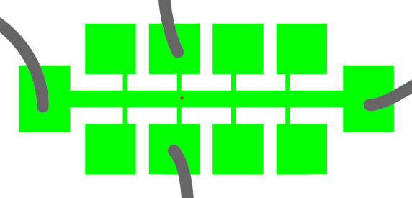
Spatially resolved spin Seebeck experiments
… inspired by EPFL, e.g.: Gravier, Ansermet et al., EPL 77, 17002 (2007).

Slide 28
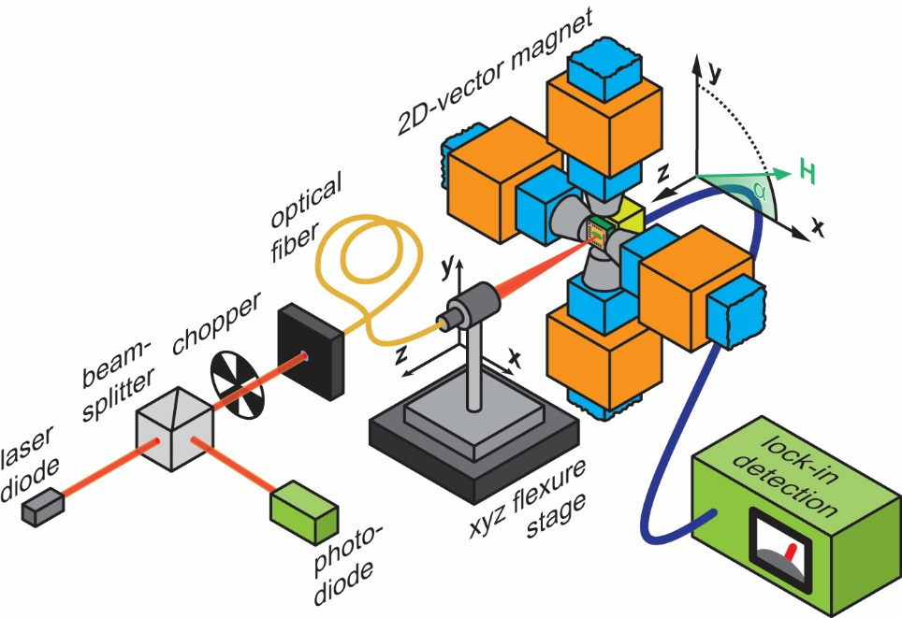
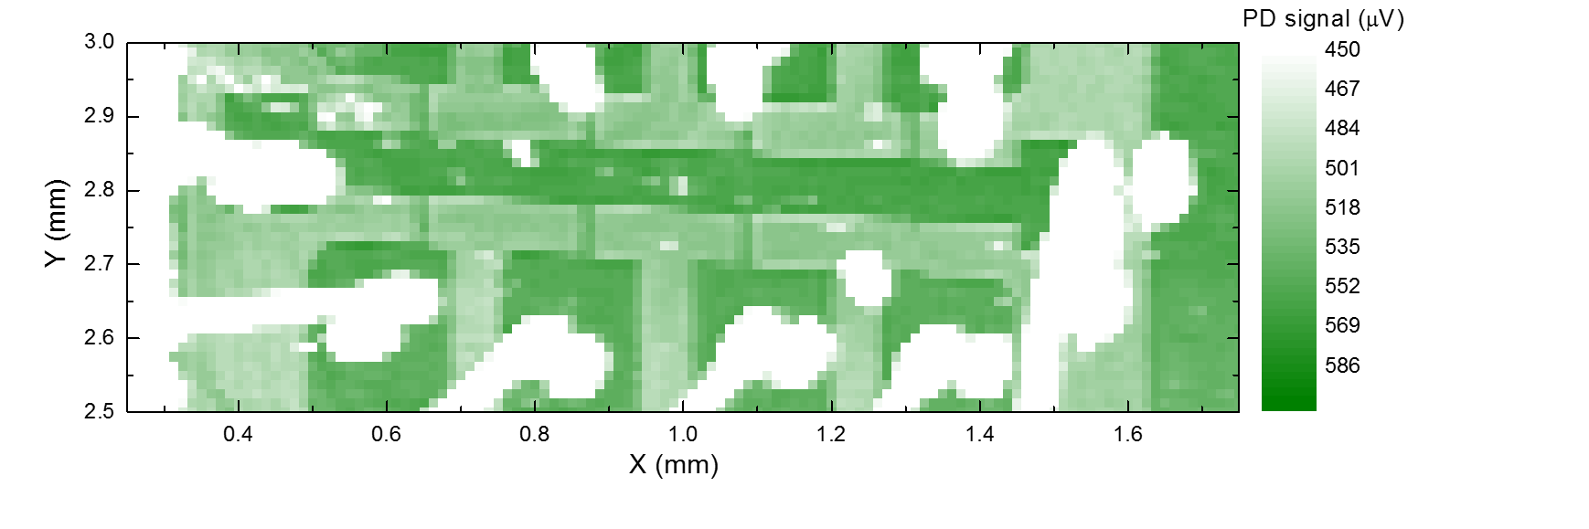
Optical imaging ( = reflected intensity )
1 pixel =
2 μm × 2 μm
Pt
YIG
1 pixel = 12.5 μm × 12.5 μm

Slide 29
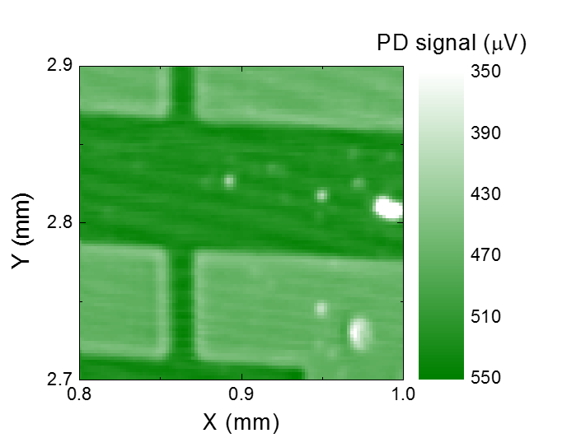
Optical imaging ( = reflected intensity )
1 pixel =
2 μm × 2 μm
1 pixel = 12.5 μm × 12.5 μm

Slide 30
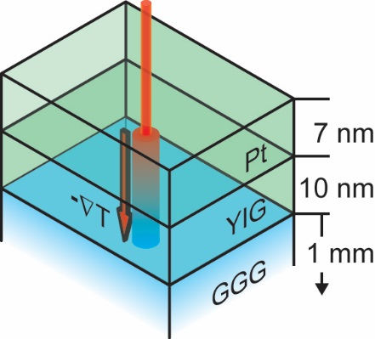



Spatially resolved spin Seebeck effect in YIG/Pt bilayers
H
optical

Slide 31

Spatially resolved spin Seebeck effect in YIG/Pt bilayers
H
optical
V_{ISHE} ⇔ spin Seebeck effect

Slide 32


SSE in YIG(20nm)/Pt(7nm) bilayer
H
μ₀H = − 70 mT
room temperature
⇒ local emf

Slide 33

SSE in YIG(20nm)/Pt(7nm) bilayer
H
μ₀H = + 70 mT
room temperature
local,
bipolar,
magnetically
controllable emf

Slide 34



SSE in YIG(20nm)/Pt(7nm) bilayer
H
Weiler et al., PRL 108, 106602 (2012).

Slide 35

SSE in YIG(20nm)/Pt(7nm) bilayer
Weiler et al., PRL 108, 106602 (2012).

Slide 36
SSE in YIG(20nm)/Pt(7nm) bilayer
Spin Seebeck effect:
thermally driven spin currents give rise to local, bipolar, M-controllable emf
electrically detected magnetometry of magnetic insulators
? SSE mechanism
Weiler et al., PRL 108, 106602 (2012).

Slide 37


Time-resolved SSE
… how quickly can we modulate
the laser power and still
observe a “DC” SSE signal ?

Slide 38

Time-resolved SSE
Kaiserslautern:
YIG(6700nm)/Pt(10nm) sample
SSE signal exhibits time dep.
⇒ SSE time constant of 570 ns
Agrawal et al., PRB 89, 224414 (2014).
Garching:
YIG(55nm)/Pt(<20nm) samples
SSE signal unaltered
up to at least 30MHz
⇒ SSE time constant < 5 ns
Roschewsky et al., APL 104, 202410 (2014).

Slide 39
Spin currents: towards (more complex) spin textures
spin current (e.g., SSE)
ferri-
magnet
=
… do spin currents
„simply“ mirror the net
magnetization ?

Slide 40





Spin Seebeck Effect in GdIG/Pt
Geprägs et al., arXiv: 1405.4971

Slide 41



Conclusions
pure spin currents
spin Hall effect
inverse spin Hall effect
spin Seebeck effect (SSE):
spin-current induced
thermopower voltage
in a nonmagnetic metal (Pt),
governed by M in insulating FM (YIG)
… what is the SSE time constant ?
… spin currents DO NOT „simply“ mirror
the net magnetization

