Slide 1
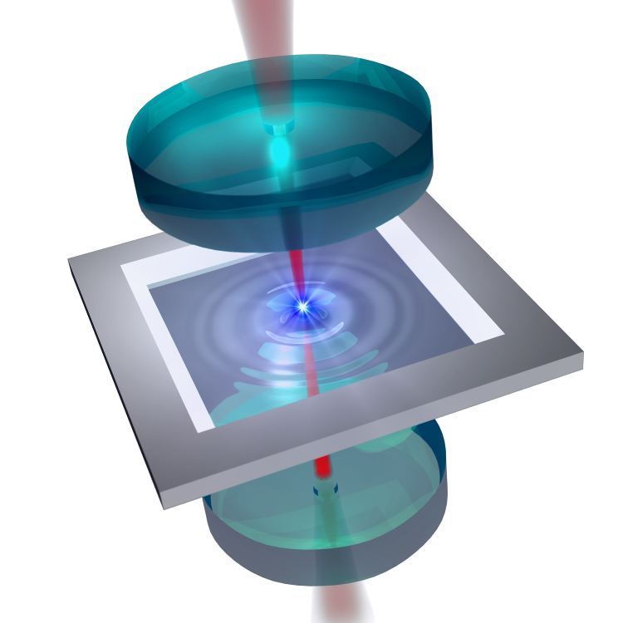









Mechanical photons at McGill
Current goals
Partial levitation and ultrahigh Q MEMS
Wavelength-scale optical cavities
Photonic crystal reflectors
MEMS materials research

Slide 2
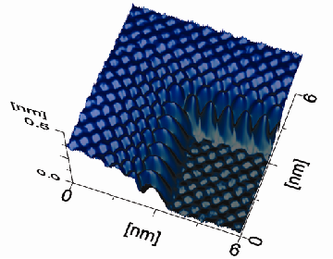
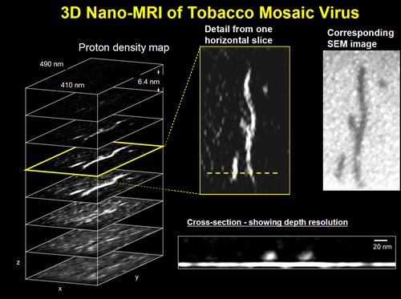
Mechanical systems = force sensors
Typical force measurement:
Electronic forces (Grütter Lab, McGill)
cantilever
deflection measurement
sample exerts forces
on cantilever
Nuclear forces (Rugar Lab, IBM)
See also
gravity wave detectors
accelerometers in phones & cars
electronic filters (also in phones)

Slide 3
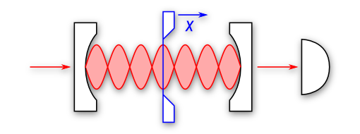
Optomechanics, and you
New functionality through radiation forces, e.g.:
Laser cooling & observation of quantum motion
Detecting the “hiss” from incident photons
Mechanically squeezing light
Wavelength conversion & qubit transduction
Our focus
Laser-enhanced micromechanical sensors (MEMS)
New geometries and new types of coupling
Example system (ours, coincidentally)
laser input
mirror
mirror
100-nm-thick “trampoline”

Slide 4
Quantum sensing and information transfer
information transfer
photon
“superposition”
optical fiber
CHINGGGGGGGGGG!
(entangled)
information transfer
“superposition”

Slide 5
Optomechanics, and you
New functionality through radiation forces, e.g.:
Laser cooling & observation of quantum motion
Detecting the “hiss” from incident photons
Mechanically squeezing light
Wavelength conversion & qubit transduction
Our focus
Laser-enhanced micromechanical sensors (MEMS)
New geometries and new types of coupling
Example system (ours, coincidentally)
laser input
mirror
mirror
100-nm-thick “trampoline”

Slide 6
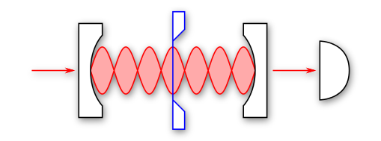
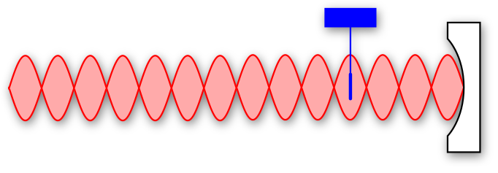
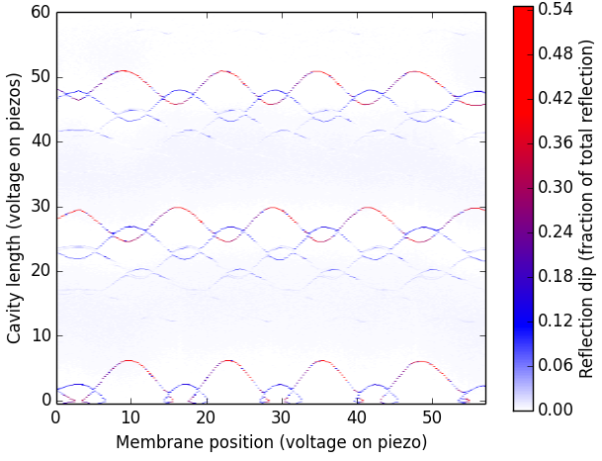

Example: “quadratic” optical spring
laser input
mirror
mirror
membrane
Resonant input light
Enhanced radiation forces in cavity
Dielectrics drawn to antinodes
Resonant frequency coupled to position
Same per-watt efficiency as dipole trap
Optical levitation? (“trapping”)
Empty Cavity Resonances
λ/2
λ/2
stable spring
energy
cavity photons
curvature
Notes:
U(x) = \frac{1}{2} {\color{Red} n_\gamma} \hbar \left(\color{Magenta}\frac{\partial\omega_\gamma}{\partial x^2} \color{black}\right ) {\color{Blue} x^2 }

Slide 7
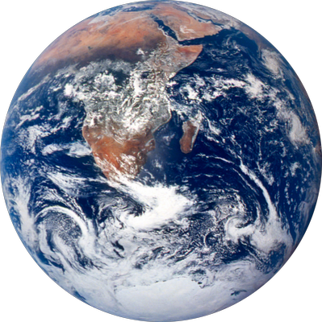
Reduced damping & noise via levitation
!!!
damping
force noise
Flexible materials
fixed frequency
fixed damping / force noise
rings for 10’s - 100’s of seconds
Optical levitation
laser-tuned mechanical frequency
laser-tuned mechanical damping
predicted to ring for weeks
(lasers have very low noise)
VERY sensitive! (in theory)

Slide 8
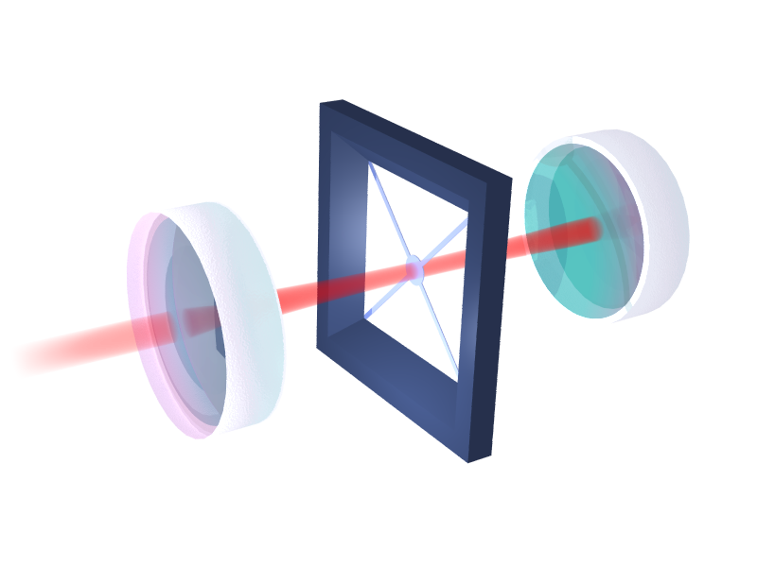
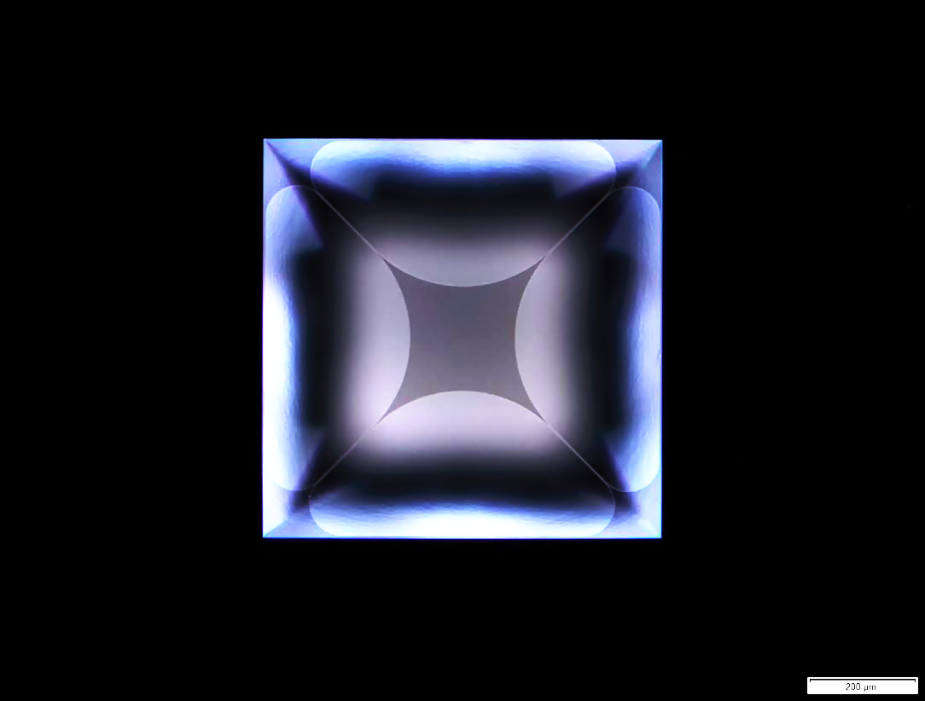
A “practical” goal: mostly levitated systems
weak mechanical spring from materials
Fabrication at McGill
100-nm-thick nitride on silicon
strong optical spring from cavity light
enhanced mechanical properties
could approach levitated limits
easier to integrate with other systems
nitride
200 μm
1 μm

Slide 9

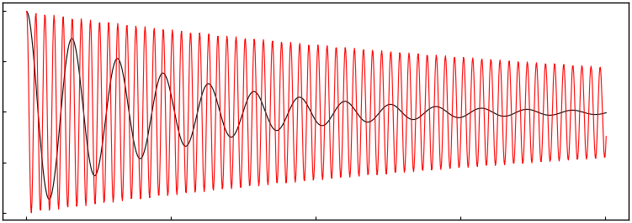
Partial levitation improves performance
Modified High-Quality MEMS:
# oscillations before energy is gone
material parameters
laser
Oscillator Position
Trapped MEMS
faster response
less dissipation
Time
Notes:
\color{blue}m\color{black}} \ddot{x} + \color{blue}\gamma_m\color{black} \dot{x} + (\color{blue}k_m\color{black} + \color{red} k_L \color{black}) x = 0
\color{blue}m\color{black} \ddot{x} + (\color{blue}k_m + i \gamma_m \color{black} + \color{red} k_L \color{black}) x = 0

Slide 10
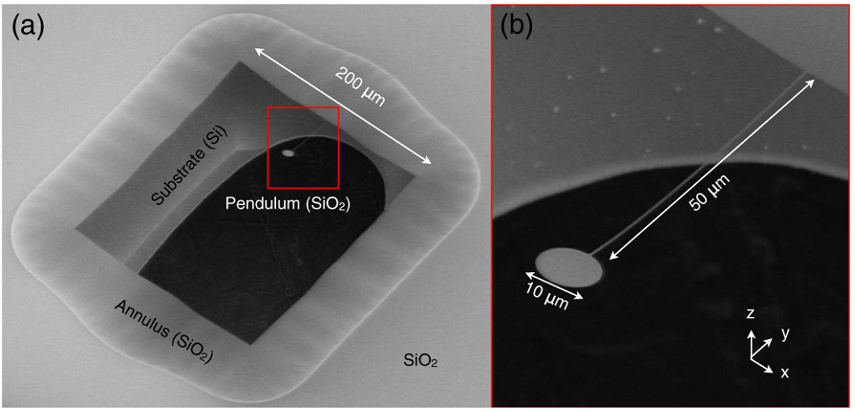
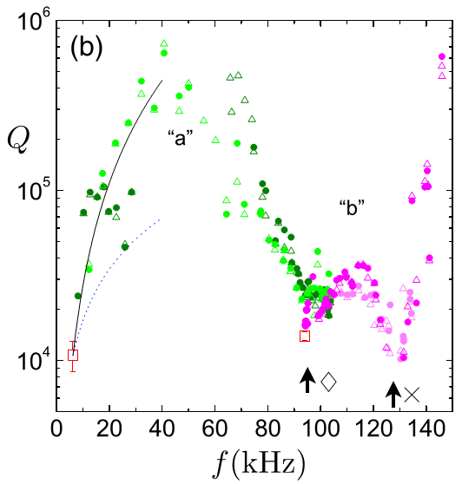
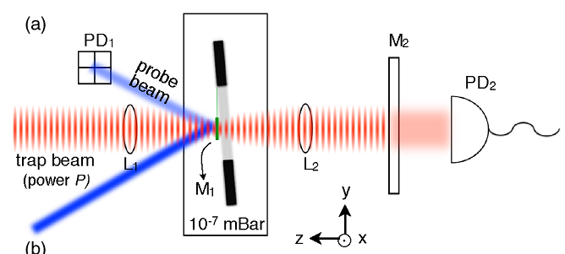

Encouraging results (Caltech, 2012)
Free-space standing wave trap ~ 10W
50x increase in mechanical Q!
pop-up
(no cavity)
tether modes
low bare Q
K. K. Ni et. al. PRL 108, 214302 (2012)

Slide 11
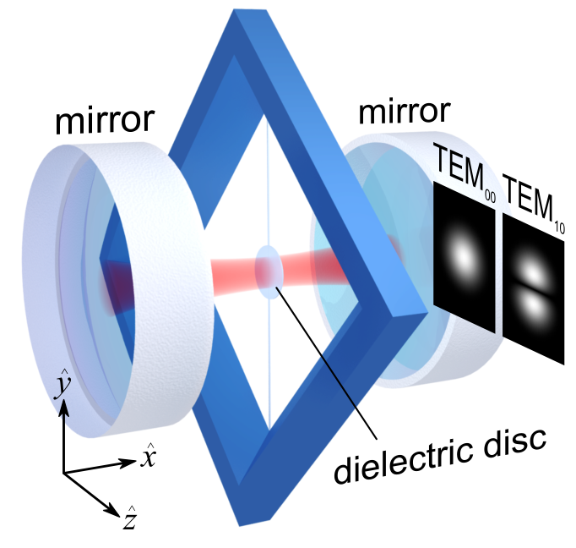
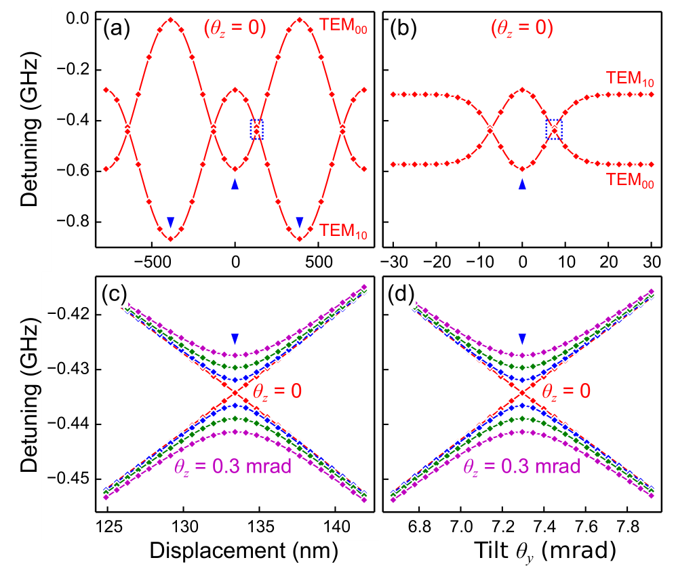
Increasing the per-photon trap strength
Optical perturbation theory
Limitations on partial levitation
High laser power & melting
Low untrapped Q
Hybridization with untrapped modes
Center of mass and torsional trapping
Tilt (aboot the z-axis) tunes scattering rate between transverse modes
Tunable quadratic coupling for both center-of-mass and torsional motion
~10 MHz trap = no problem
T. Müller, C. Reinhardt, J. C. Sankey, PRA (2015)

Slide 12
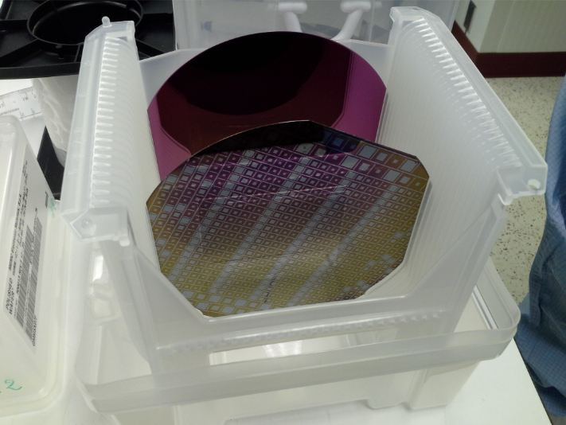
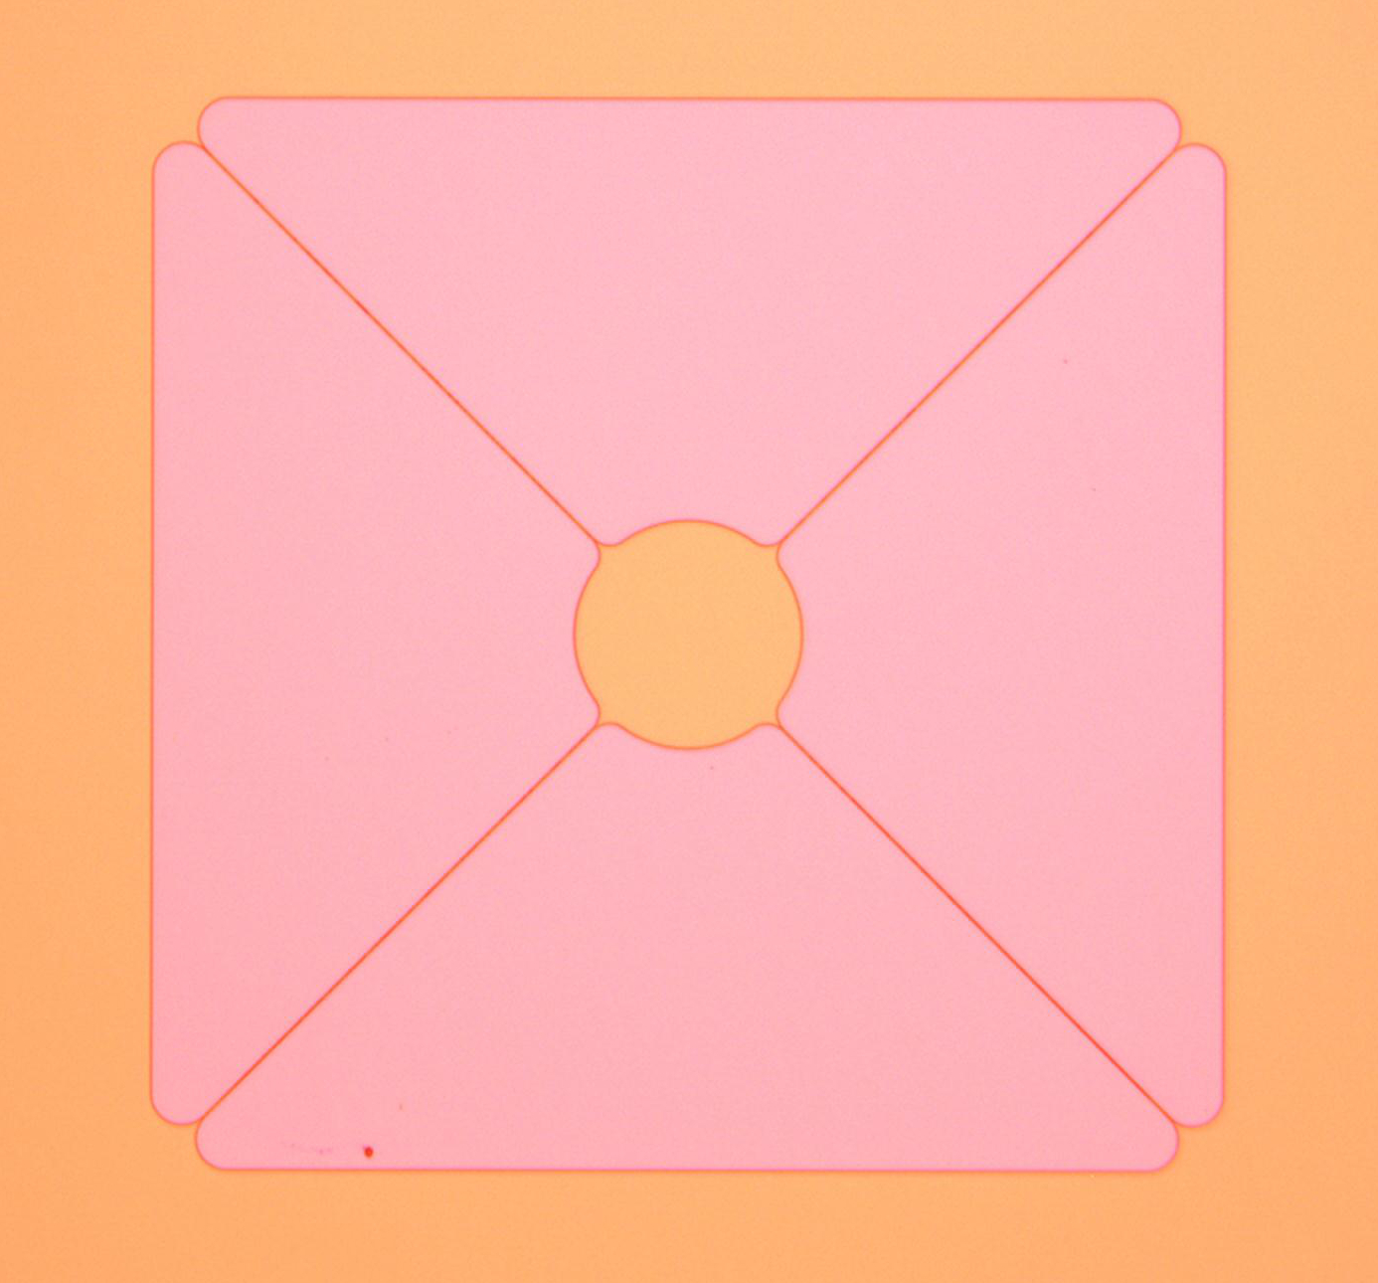
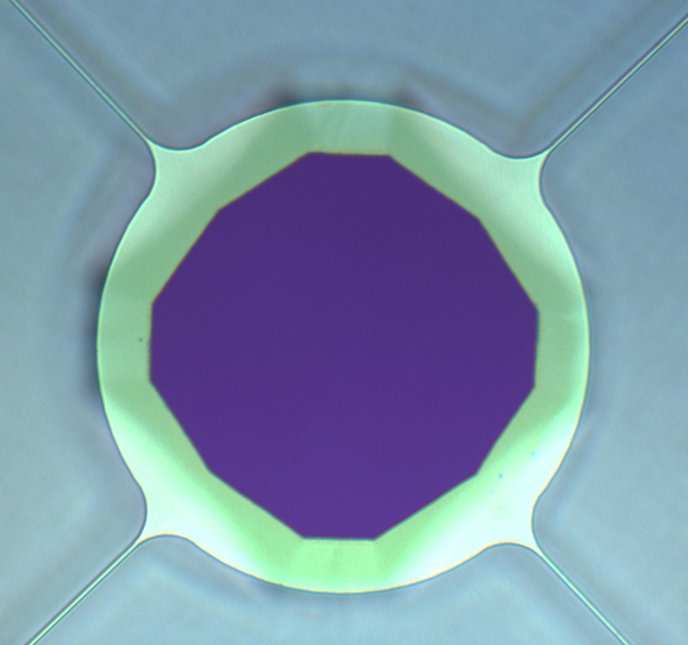
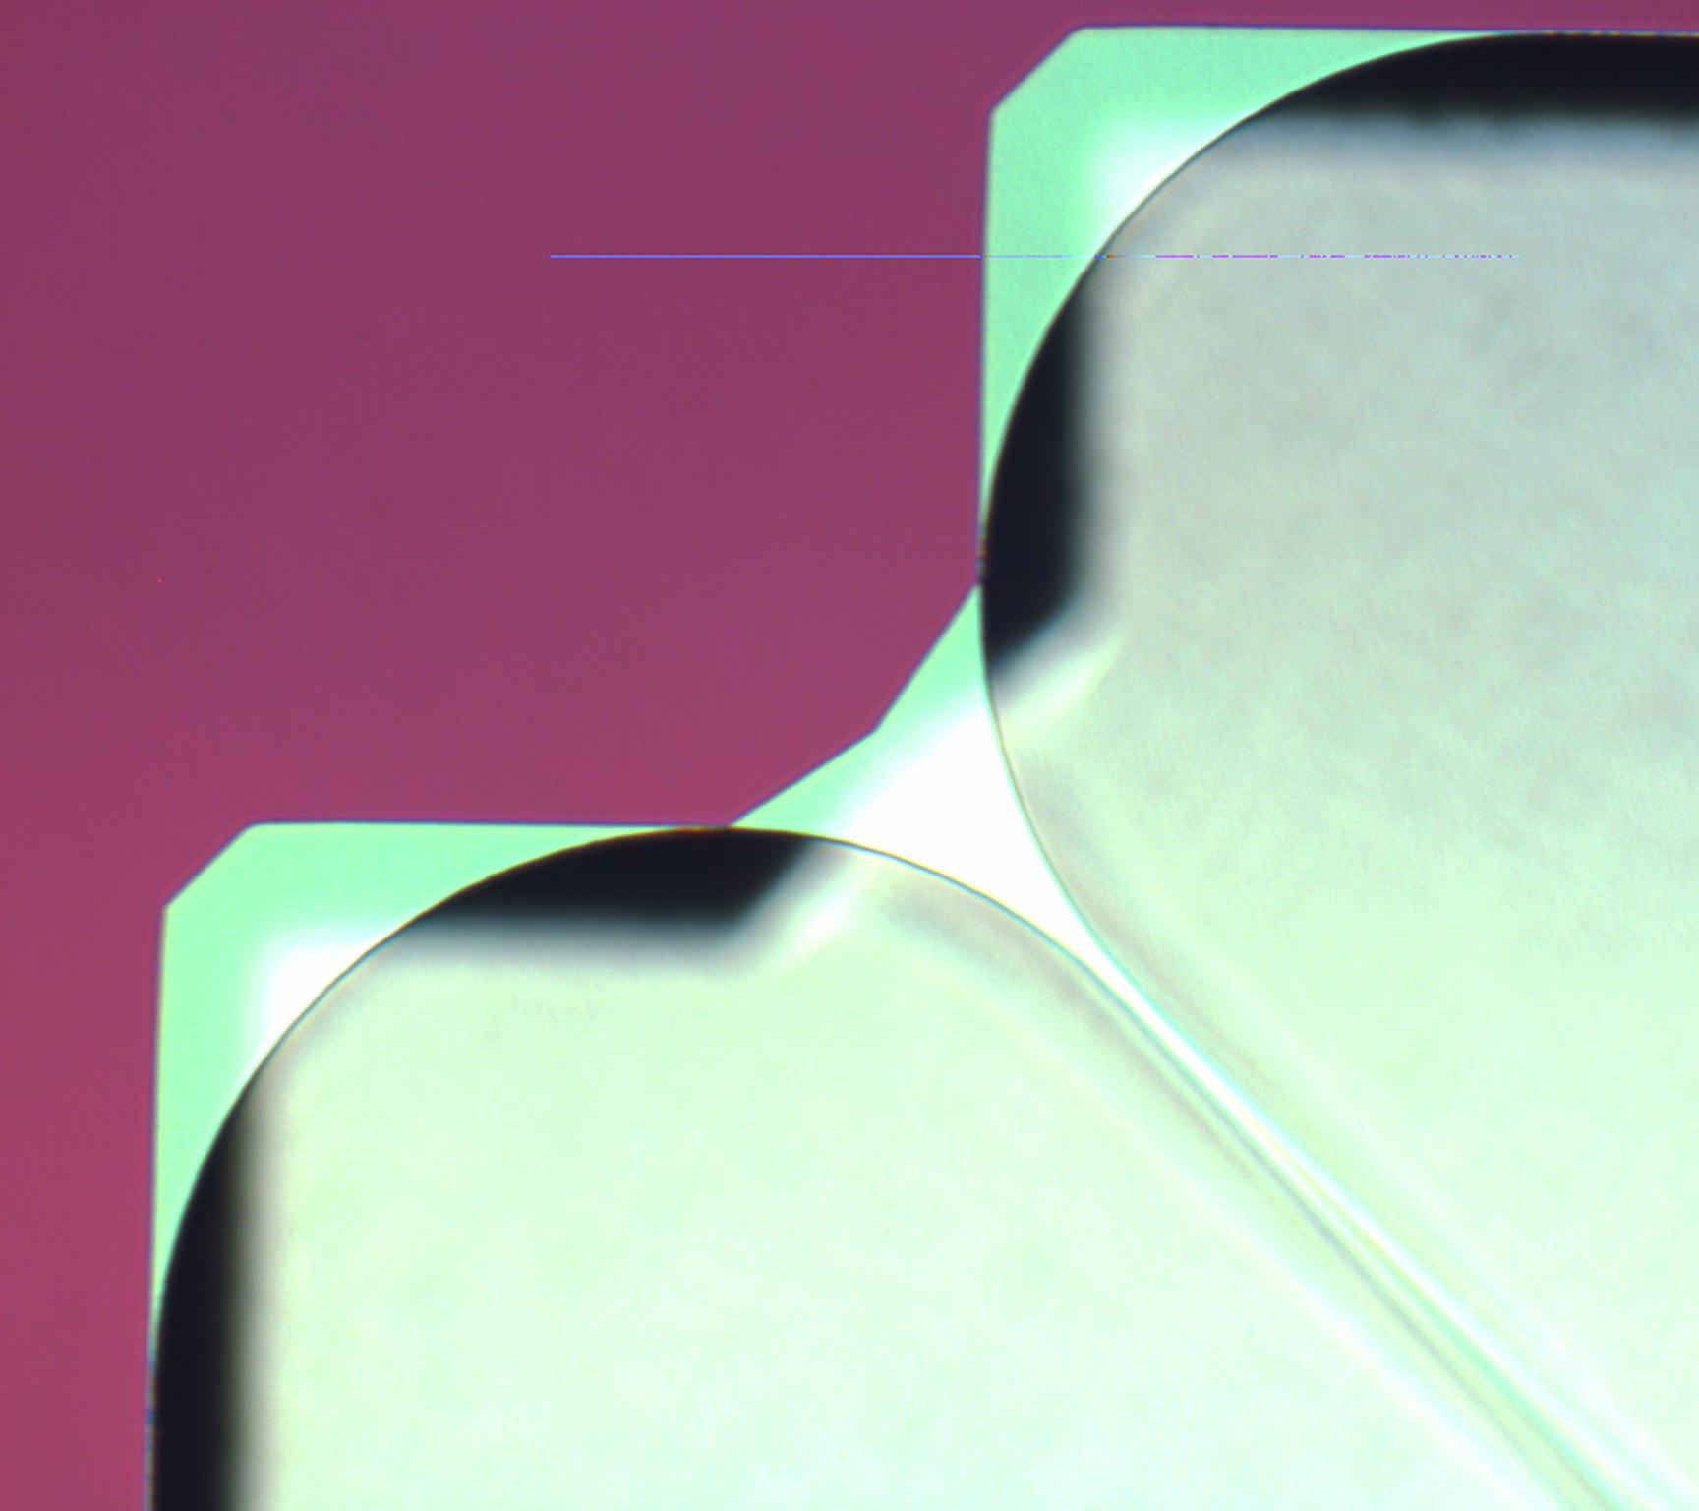
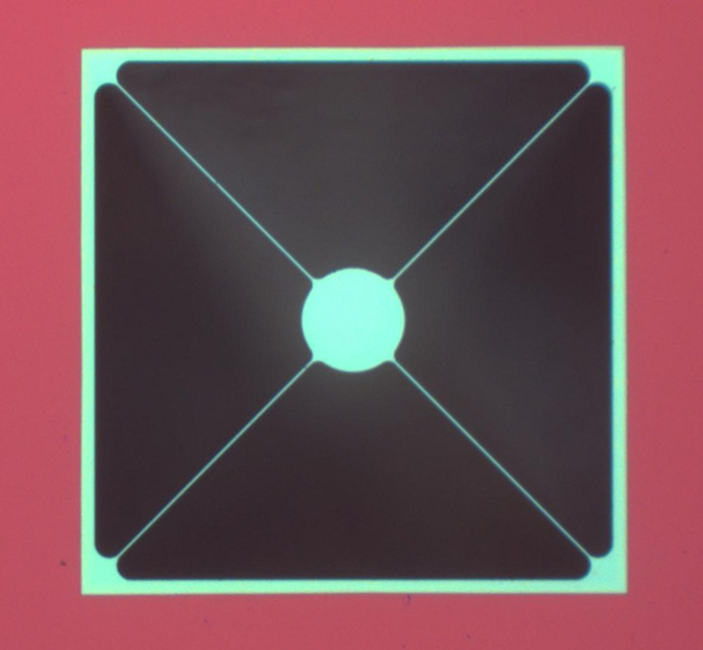
Nanofabrication at McGill
Process flow
Start with nitride on silicon
Photolithography to define structures
Reactive ion etch to remove SiN
KOH dip to etch silicon wafer
SiN
Si
SiN
Photolithography and reactive ion etch
photoresist on SiN
SiN
Si
SiN
KOH or TMAH wet etch
released
nitride
SiN
SiN on Si
Si
SiN on Si
SiN

Slide 13
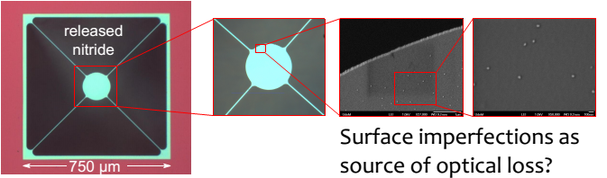
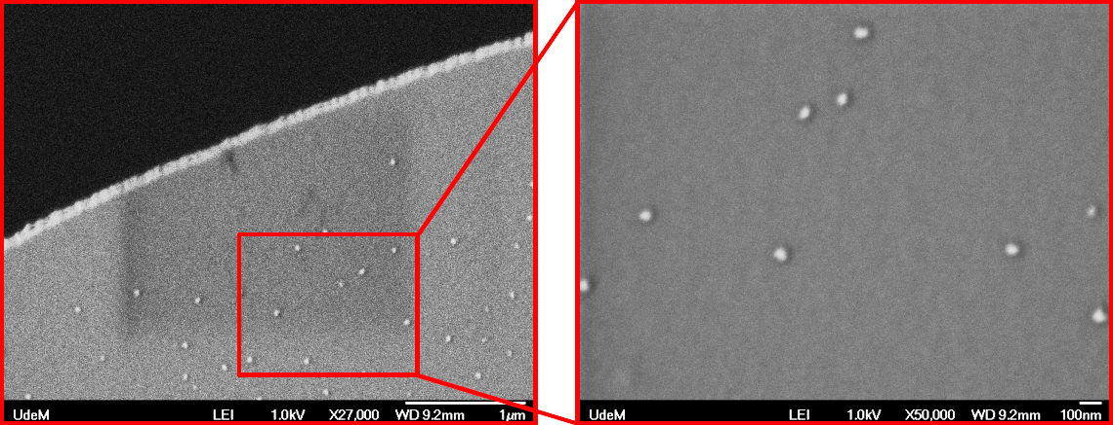
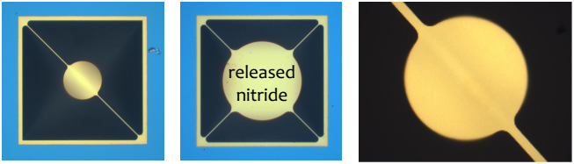
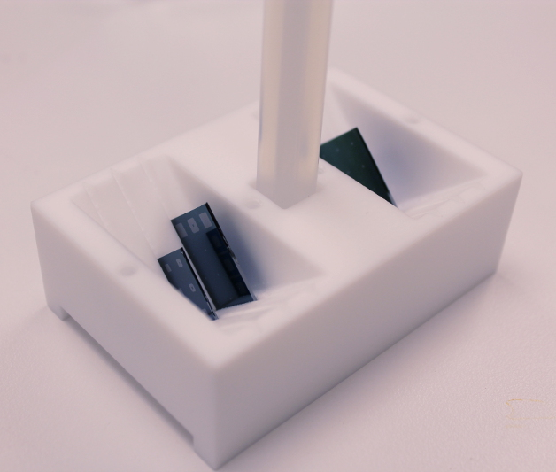
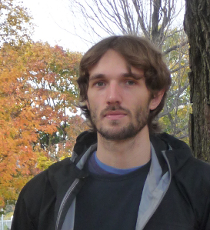
Fabrication attempts & initial success
Low-stress nitride test
Price = $0
Floppy
Optically lossy (boo!)
High-stress nitride
Low optical loss
Potato-chipping (boo!)
Stiffer (boo?)
curling
custom chip carrier (important)
Latest iteration
High yield
No potatoes
High starting Q
(not actually glowing)
Christoph Reinhardt

Slide 14
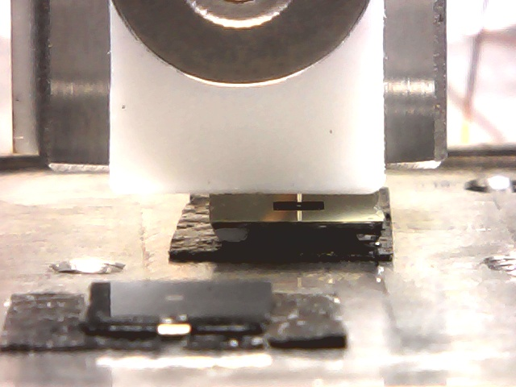
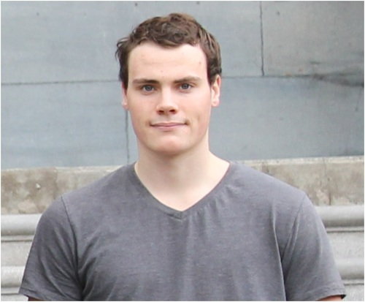
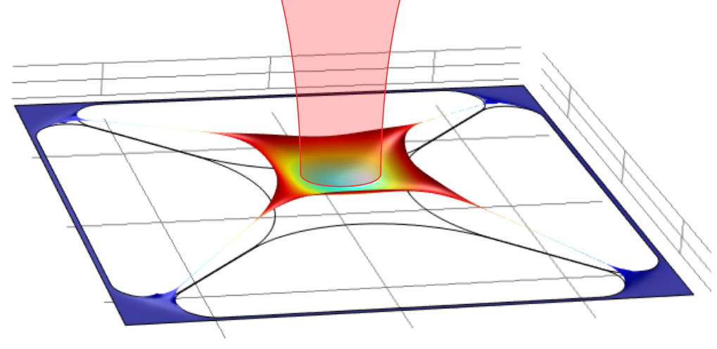
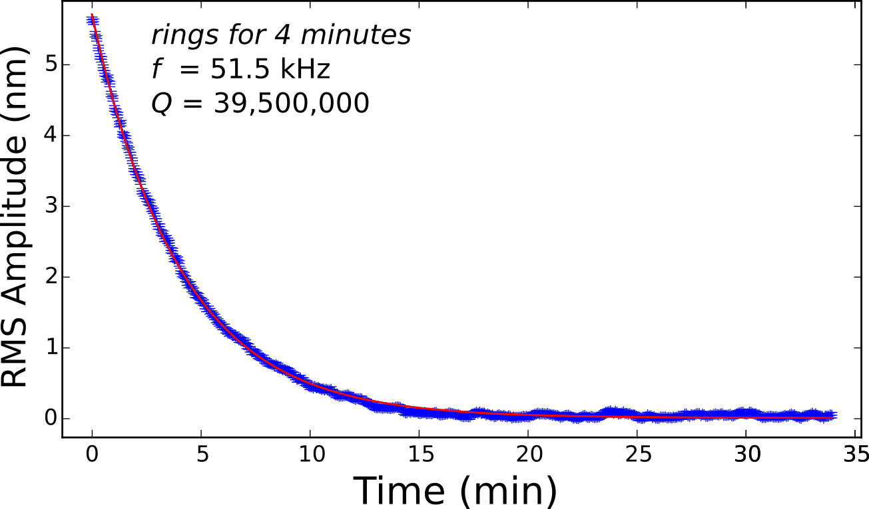
Mechanical characterization in UHV
cleaved optical fiber
Limitations on trapping
High laser power & melting
We have a stupid high untrapped Q
Will these work in our cavities?
Hybridization with untrapped modes
interference
sample
Performance
Typical frequency ~ 50 kHz
“Typical” Q ~ 10-35 million
Initial Goal
Trap to Q ~ 200 million?

Slide 15
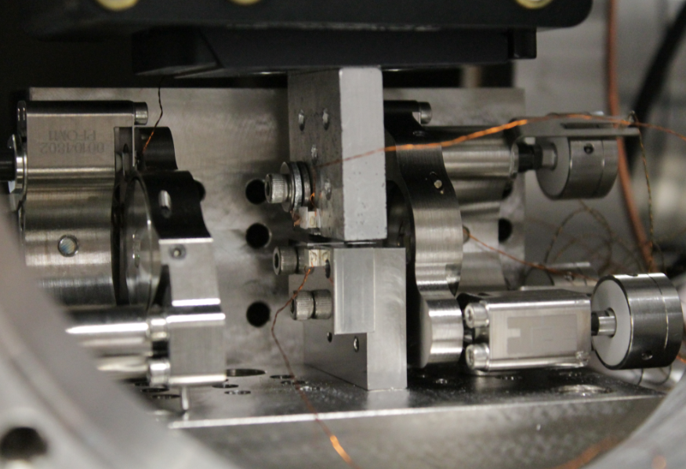
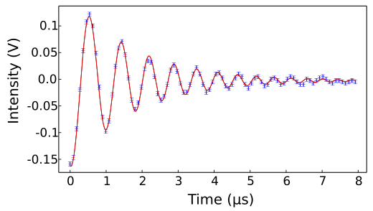
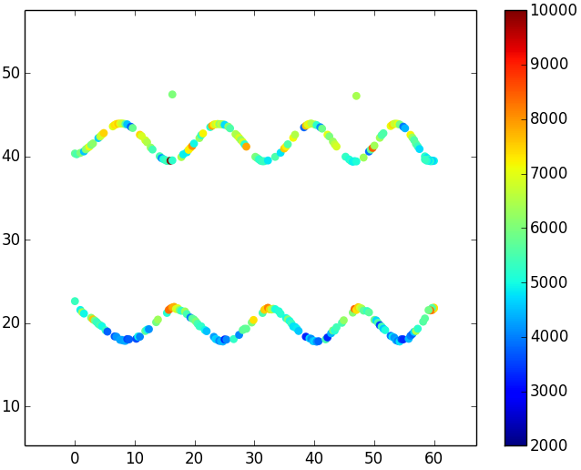
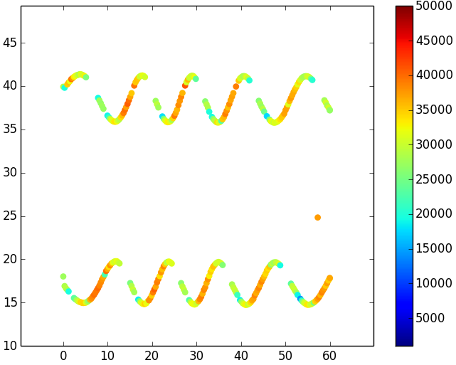
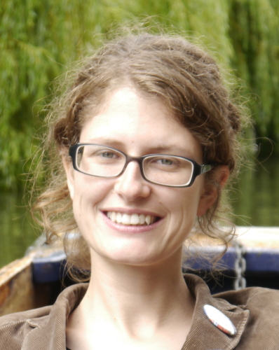
Homemade trampolines in a cavity
UHV chamber
Limitations on trapping
High laser power & melting
Low untrapped Q
Will these work in our cavities?
Hybridization with untrapped modes
Mirror
Mirror
Cavity hold time ~ “Finesse”
Membrane / trampoline goes here
Small trampoline we don’t care about: diffraction losses (expected)
Processed membrane: ~ zero absorption
Tina Müller
λ/2
Finesse
Cavity Length (Piezo Volts)
λ/2
Christoph Reinhardt
Membrane Position (Piezo Volts)

Slide 16
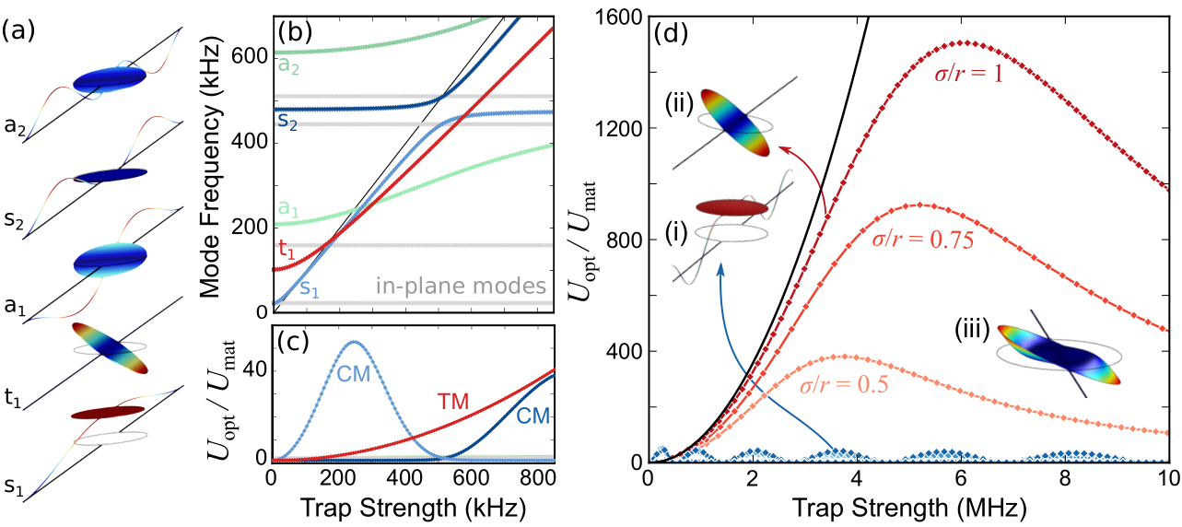
Torsional mode = no tether mixing
COMSOL simulations of optically trapped mechanical modes
Limitations on trapping
High laser power & melting
Low untrapped Q
Will these work in our cavities
Hybridization with untrapped modes
No potato chips allowed
previously inaccessible
Q-Enhancement
increased laser spot size
Q-Enhancement Frequency (kHz)
Trap Strength (kHz)
Trap Strength (MHz)
Tina Müller
Torsional mode (TM) levitation
No hybridization with low-frequency modes (by symmetry)
First hybridization with “flappy” disc mode
1500 x Q enhancement possible (Q ~ billion??)
T. Müller, C. Reinhardt, J. C. Sankey, PRA (2015)

Slide 17
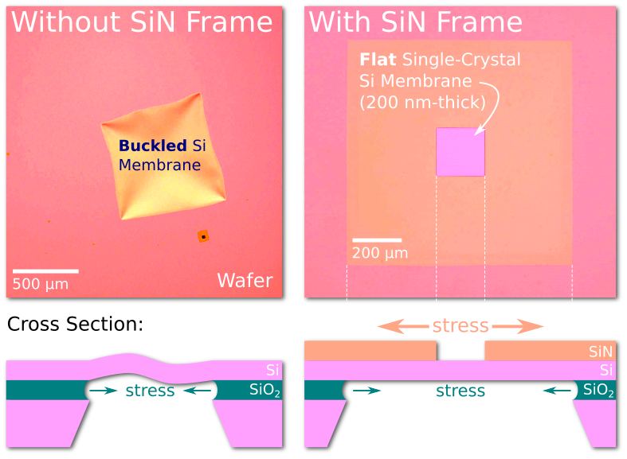
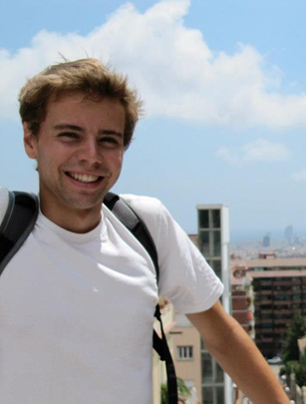
Single-crystal silicon fab
Tina Müller
Simon Bernard
Next step: delicate mechanical (and photonic) structures!

Slide 18
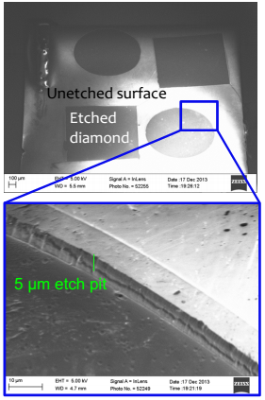
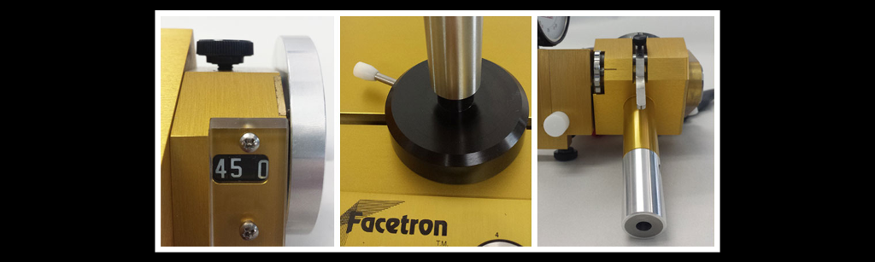
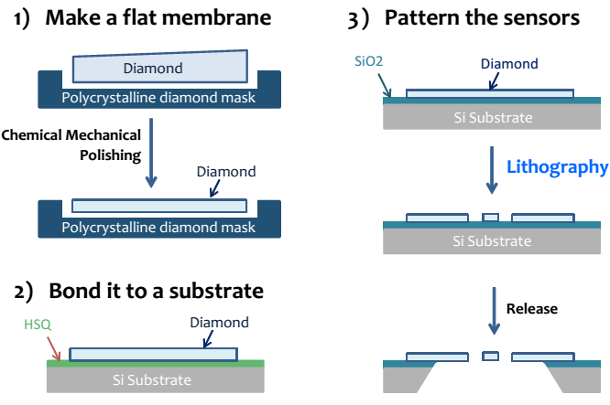
New material: single-crystal diamond
Single-crystal diamond (DOI)
Higher unstressed Q than Si (new)
High power handling
Contains embedded quantum systems (NV, SiV centers)
Initial ArCl etch of e6 diamond
Alumina hard mask
Optical grade diamond
Collaboration with Ye Tao & Christian Degen @ ETH

Slide 19
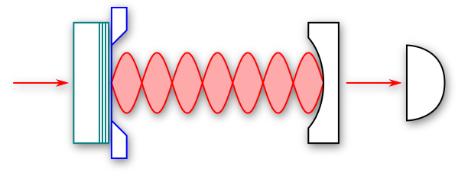
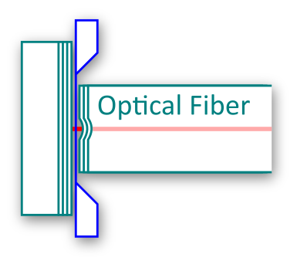
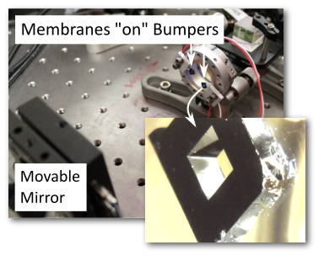
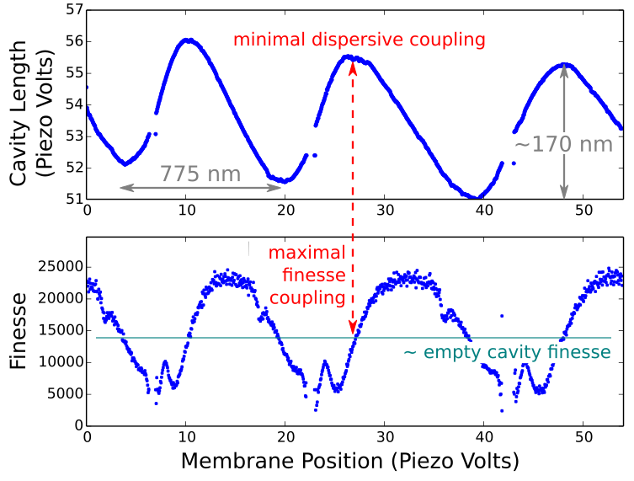
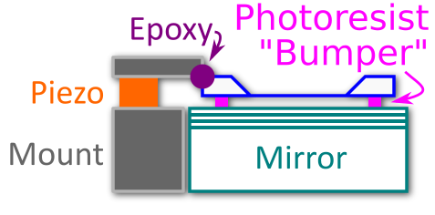
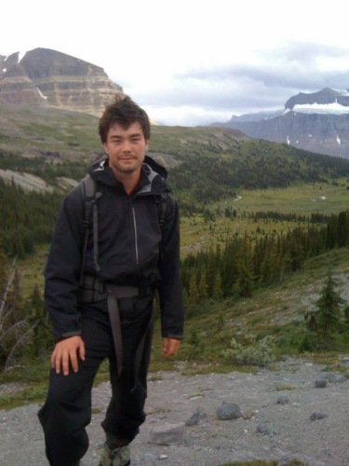
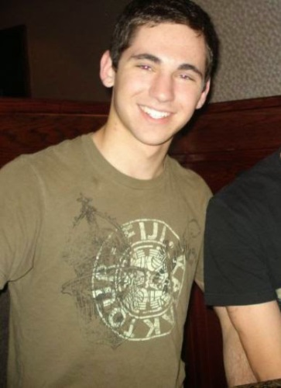
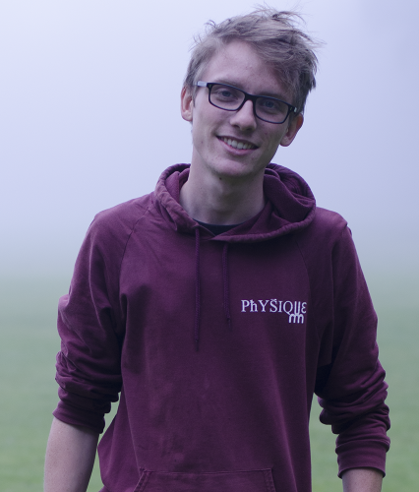
Related goals II: really short cavities
“Compound input mirror”
Membrane as “movable Bragg layer”
Input transmission coupled to membrane motion
Kyle Johnson
Vincent Dumont
Alex Kato

Slide 20
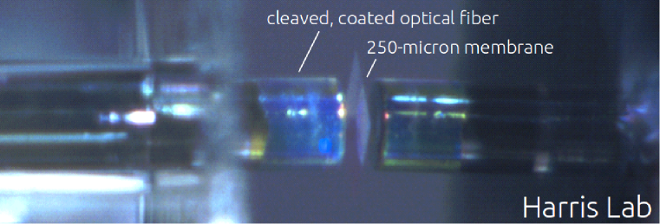
Stronger coupling to smaller devices
Fiber-based microcavities
Shorter cavity = more bounces per second = stronger coupling
Confined optical mode = naturally addresses smaller, lighter MEMS
Compact, fiber-coupled package
Ablated fibers courtesy of Jakob Reichel Group
Fiber Mirror Fabrication with 40W CO₂ laser
freshly-cleaved fiber
laser ablation, glass melts, reflow
high-reflectivity mirror coating

Slide 21










new dot

Slide 22








Really short full cavities
Laser-ablated, coated fiber mirrors
Goal: cavity length ~ wavelength
Stronger per-photon force (shorter round-trip time)
Suited for smaller MEMS
Fiber-coupled input and output
Mirrors
Interferometer Image
Mirror Fabrication
ablation dip
< 0.2 nm roughness!
cavity lengths
~ 10’s of μm
Max
Ruf
~25,000
Erika
Janitz
Alex
Bourassa

Slide 23


Related goals I: Wifflebranes®
increased reflectivity by removing material
(Solgaard group, Stanford)
Resonance tuning with HF
simulated input pulse
Predictions (MEEP)
Resonant reflection of one wavelength
Subsequent HF (acid) dips thin membrane, widen holes
  Controlled tuning of resonance
resonances in photonic crystal
Simon Bernard
Collaboration with Yves-Alain Peter (Polytechnique)

Slide 24



Preliminary results
Fabrication in silicon nitride
Electron beam instead of photolith
No surprise: new surprises
Resonance tuned with HF
Next step: measure actual reflectivity with a cavity.
Why? Why?!
Simon Bernard
Tuning the resonance post fabrication

Slide 25


Less force noise & higher Q’s: cryostat
At Low Temperature
Reduced force noise, higher bare Q
Quantum experiments more accessible
Fiber input, same hardware
Vary temperature & trap to study dissipation
3K - 300K
(hang from springs)
Incoming upgrade: 10 mK (!)

Slide 26




Unrelated advertisement: spin transfer
Fabricated
Contacts
Simulated Dynamics
Zackary Flansberry
N-V magnetometry of magnetic nanocircuits
All-electrical FMR on protected magnetic nanocircuit
Imaging of dynamics with N-V defects in diamond
Nanoscale magnetic elements, sub-wavelength techniques
Coherent coupling between N-V spins and magnons?
collaboration with Wife (McGill) & Michel Pioro-Ladrière (Sherbrooke)

Slide 27
Summary
Flip the slide, Sankey.
Current & future goals
Partial levitation and ultrahigh Q MEMS
Wavelength-scale optical cavities
Photonic crystal reflectors
MEMS materials research
Nanoscale magnetic circuits

Slide 28

McGill Optomechanics Lab
Andre Diamant- Boustead
Chris McNally
Simon Bernard
Max Ruf
Tina Müller
Me
Christoph Reinhardt
Chandra Curry
Laurent René de Cotret
Bogdan Piciu
André Provost
Alexandre Bourassa
Abeer Barasheed
Echo

