Slide 1
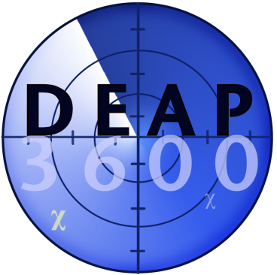

Alpha particle backgrounds from the neck of the DEAP-3600 dark matter detector
James Bueno, University of Alberta
for the DEAP-3600 collaboration
CAP Congress, 16 June 2015

Slide 2
Overview
Neck region of the DEAP-3600 detector
Radioactive contamination in DEAP-3600
Mitigating neck alpha particle backgrounds:
  Material selection and construction process
  Choosing shape of components
  Analysis of backgrounds

Slide 3
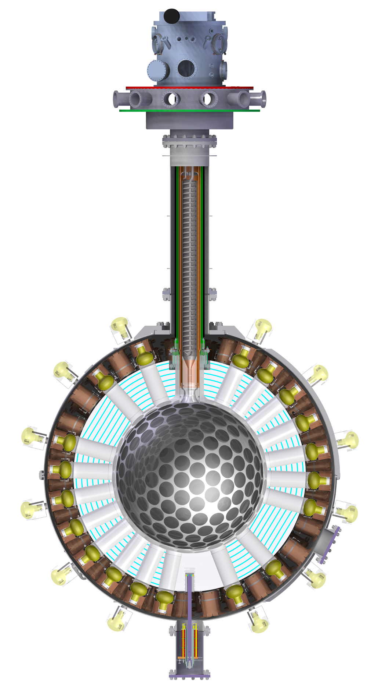
The DEAP-3600 detector
Cooling coil
Neck region
50 cm long acrylic light guides
TPB wavelength shifter
PMTs
Located at SNOLAB, 2 km
below ground.
Searching for WIMP nuclear recoils from 1 T liquid argon scintillator.
Single phase operation with 255 PMTs (Hamamatsu R5912),
32% QE, 71% coverage
Cooled through a neck region.
Acrylic vessel

Slide 4
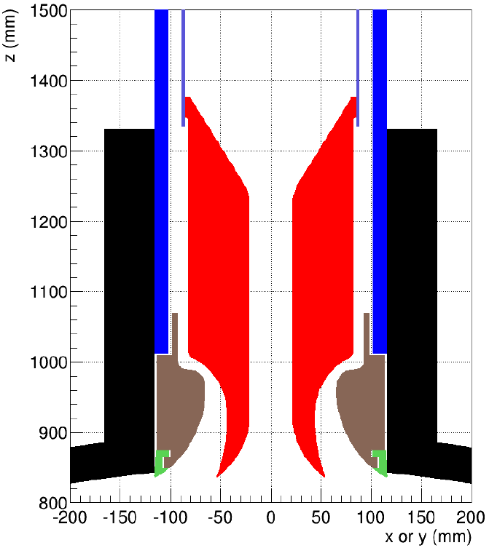
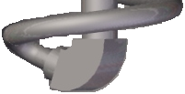
The DEAP-3600 detector: neck region
Cooling coil
Steel
Very carefully designed geometry.
Acrylic flow guides to direct warm liquid argon up and cool liquid argon down.
Same acrylic as main vessel.
  No line of sight from steel to spherical acrylic vessel, except for the cooling coil.
    Steel has ~10³ more radioactivity than DEAP acrylic.
  Roughly 15 m of welds in contact with argon.
    5 m in cooling coil,
    10 m in neck steel.
Inner flow guide
Neck of acrylic vessel
Outer flow guide
Split ring

Slide 5
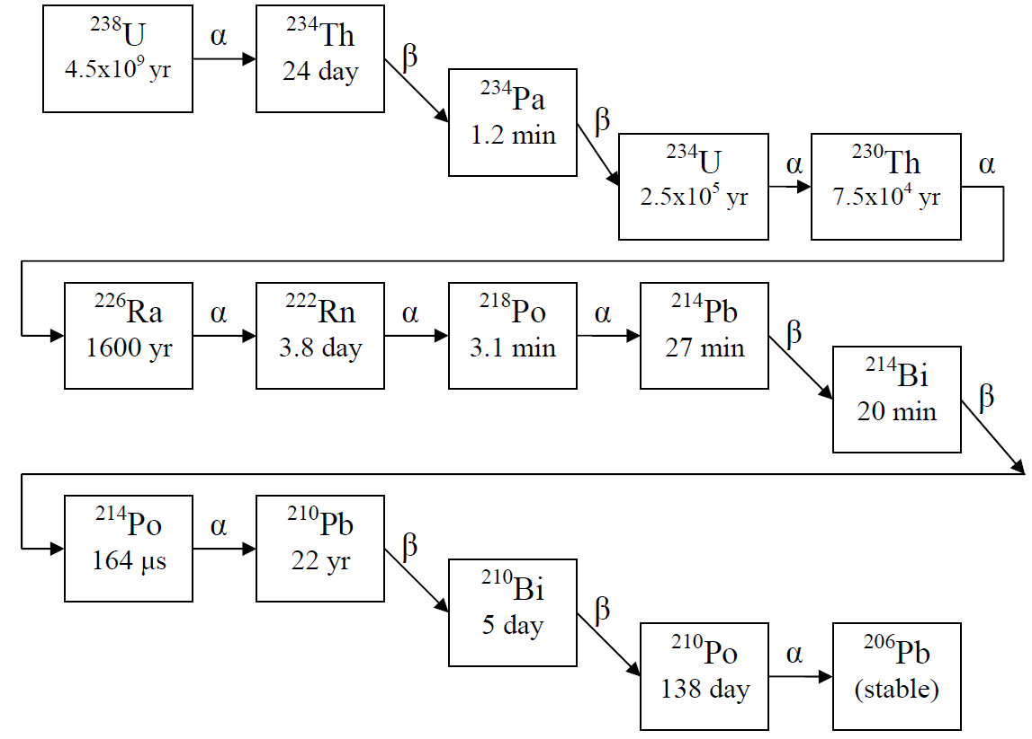
Where do the alpha particle backgrounds come from?
Bulk contamination from ²³⁸U and ²³²Th chains in equilibrium.
Clean acrylic monitored for years before construction.
Figure from J. Lidgard, 2008, Masters Thesis

Slide 6
Where do the alpha particle backgrounds come from?
Bulk contamination from ²³⁸U and ²³²Th chains in equilibrium.
Clean acrylic monitored for years before construction
Surface contamination
  Exposure to air during construction.
  From liquid argon: none thanks to carbon trap.
  Weld emanation.
Gas
Charged
Figure from J. Lidgard, 2008, Masters Thesis

Slide 7
Why do alpha particles cause a background?
Radioactive decays in detector materials release alpha particles.
  Energies are 4-9 MeV.
  5 MeV alpha’s have a range of ~35 µm in acrylic.
Alpha particle in liquid argon produces 1000’s of photons.
  Shadowed events with obstructed line of sight can look like WIMPs.

Slide 8
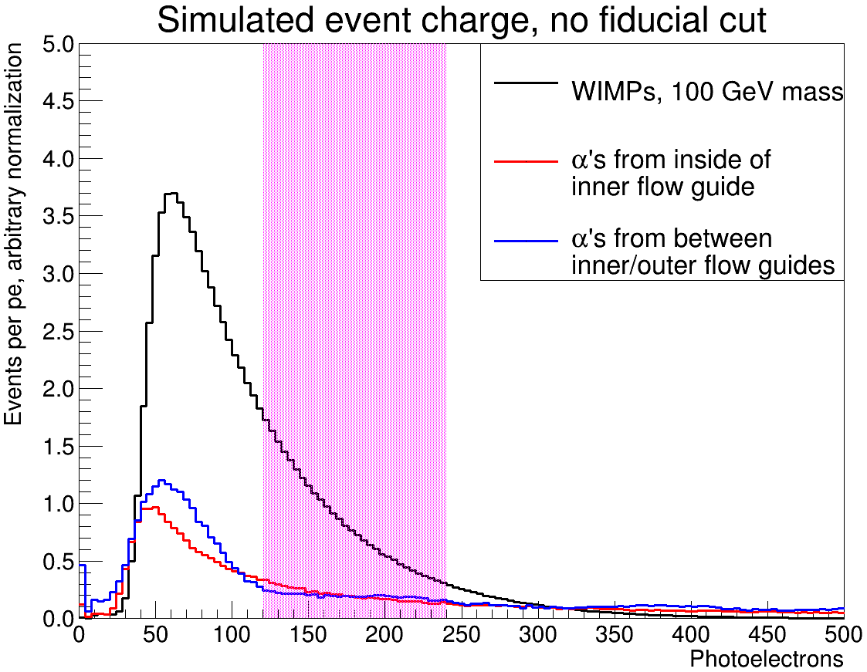
Why do alpha particles cause a background?
Radioactive decays in detector materials release alpha particles.
  Energies are 4-9 MeV.
  5 MeV alpha’s have a range of ~35 µm in acrylic.
Alpha particle in liquid argon produces 1000’s of photons.
  Shadowed events with obstructed line of sight can look like WIMPs.
DEAP-3600 goal: < 0.2 alpha particle background events in
3 yrs.
WIMP region of interest
Preliminary

Slide 9
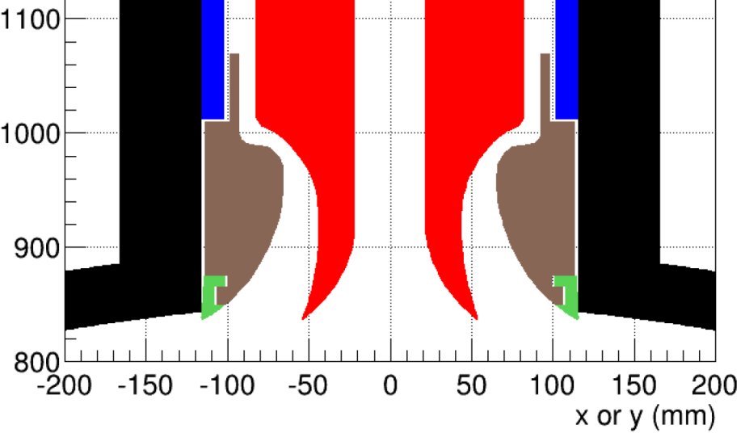
Mitigation by GEANT4 tuning and analysis
Shape tuned by GEANT4
Fixed to maintain cooling
Flow guide geometry tuned by GEANT4 background simulations.
Alpha particle decays in the neck have non-uniform position reconstruction.

Slide 10
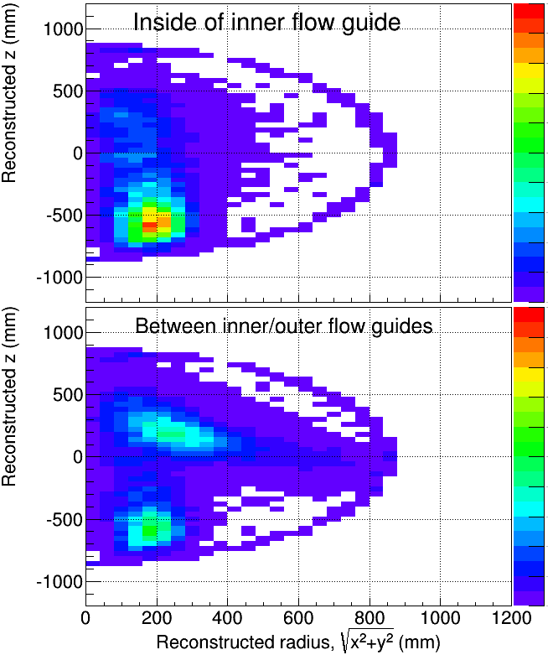
Mitigation by GEANT4 tuning and analysis
Shape tuned by GEANT4
Simulation
Fixed to maintain cooling
Preliminary
Flow guide geometry tuned by GEANT4 background simulations.
Alpha particle decays in the neck have non-uniform position reconstruction.
Radial cut removes most neck backgrounds, while maintaining a one-tonne fiducial.
Pattern recognition using PMT light distribution and timing is under development.
  See poster by Courtney Mielnichuk.
Preliminary

Slide 11
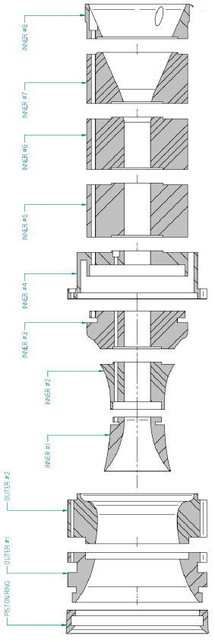
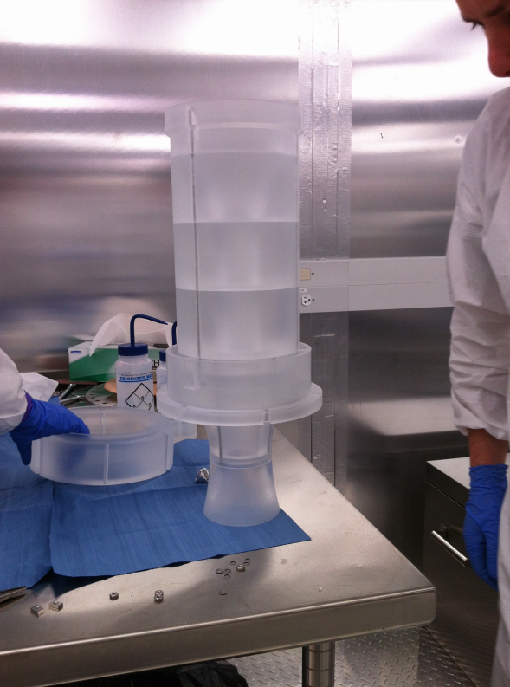
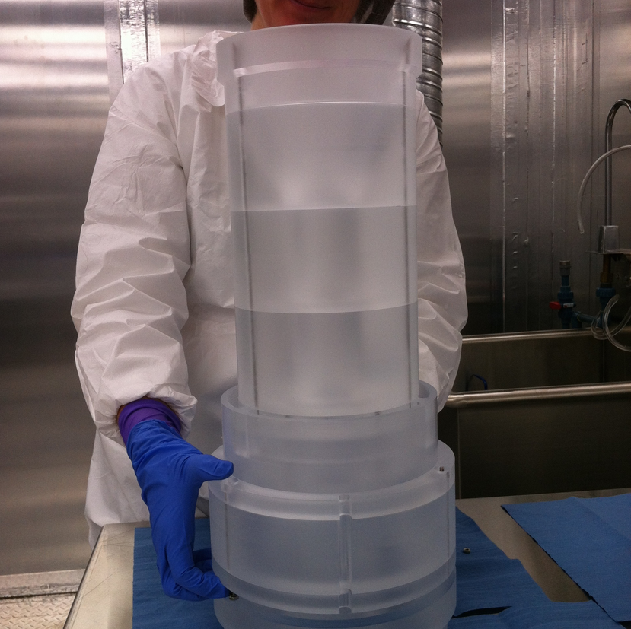
Machining neck flow guides
Nov/Dec 2014: acrylic pieces machined in low radon environment at the University of Alberta and annealed in same air.
  Radon level ~0.3 Bq/m³ compared to ~15 Bq/m³ outside.
Inner flow guide
Inner & outer flow guides

Slide 12

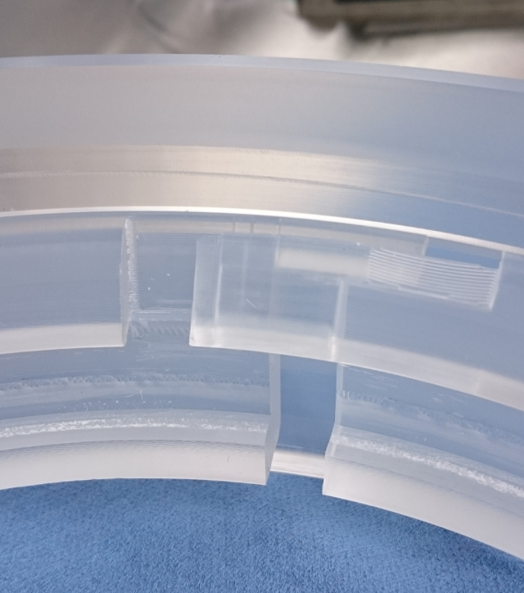
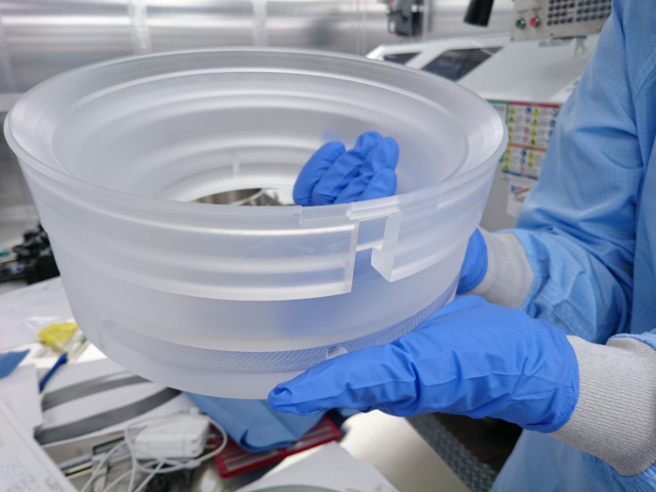
Covering up the acrylic vessel neck
Spherical part of acrylic vessel was sanded with resurfacer.
  Neck of acrylic vessel was sanded with separate device.
  Gap between neck and outer flow guide was covered up.
Split ring, eliminates ~12 events in 3 years

Slide 13
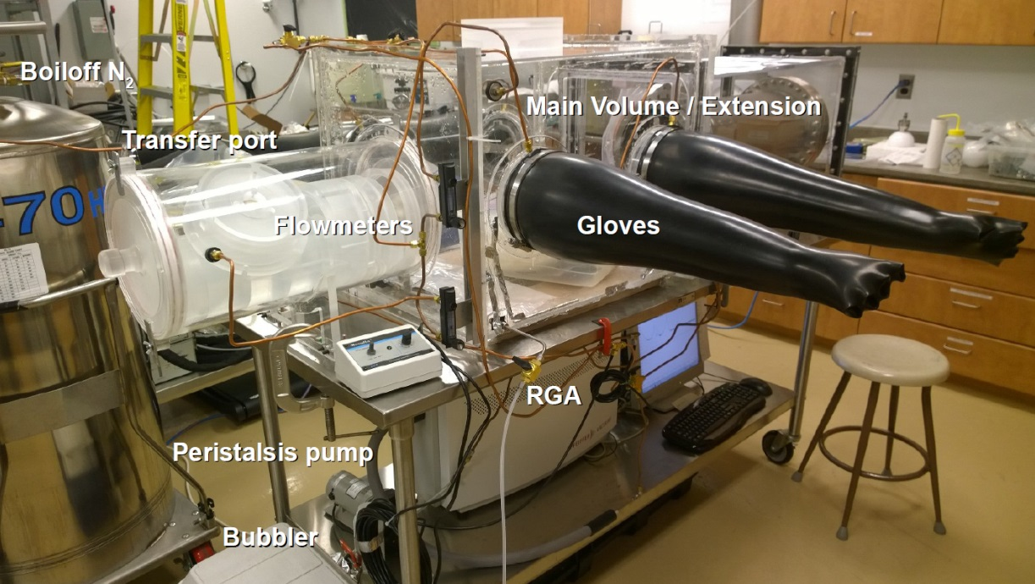
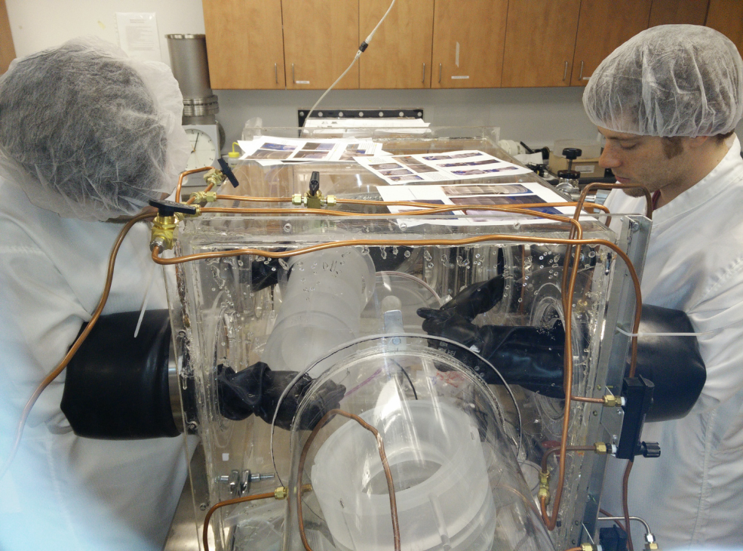
Sanding flow guides
Mar-Jun 2015: Hand sanded flow guide pieces in a nitrogen purged glovebox to remove embedded radon daughters.
Glovebox at Queen’s University
Flow guide pieces in glove box

Slide 14
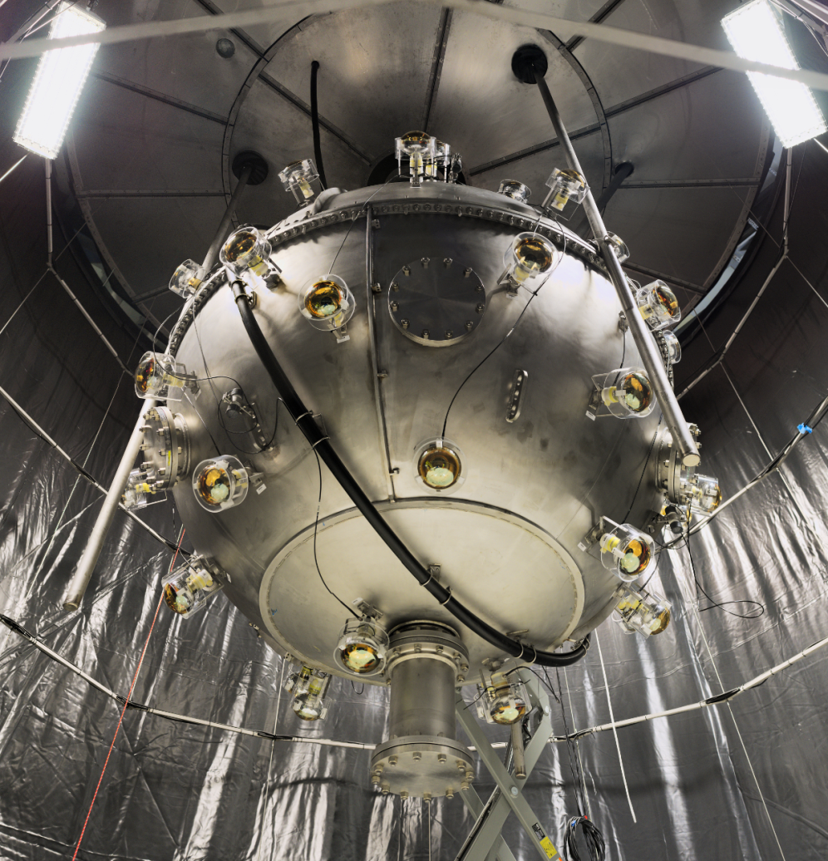
Summary
Gone to great lengths to minimize alpha particle backgrounds.
    Selected clean materials.
    Machined and sanded in clean environments.
    Designed geometry carefully.
Looking forward to argon data to verify the background rates.

Slide 15
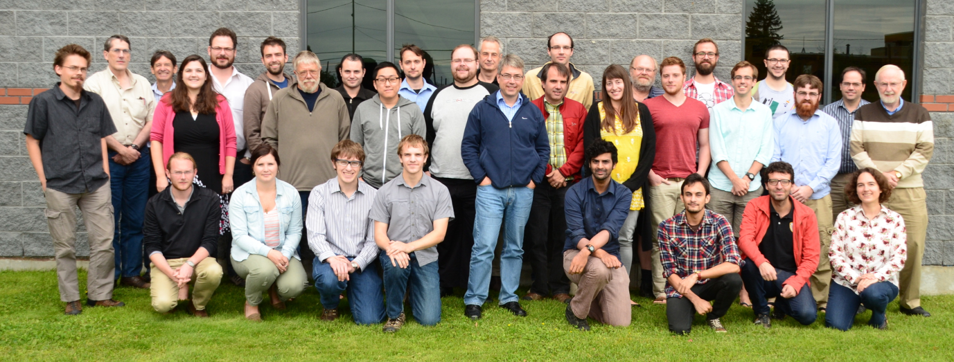




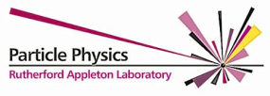




The DEAP collaboration
~60 collaborators in Canada, the UK, and Mexico
Thanks to CFI, NSERC, the provinces of Alberta and Ontario, and SNOLAB for funding and support.

Slide 16
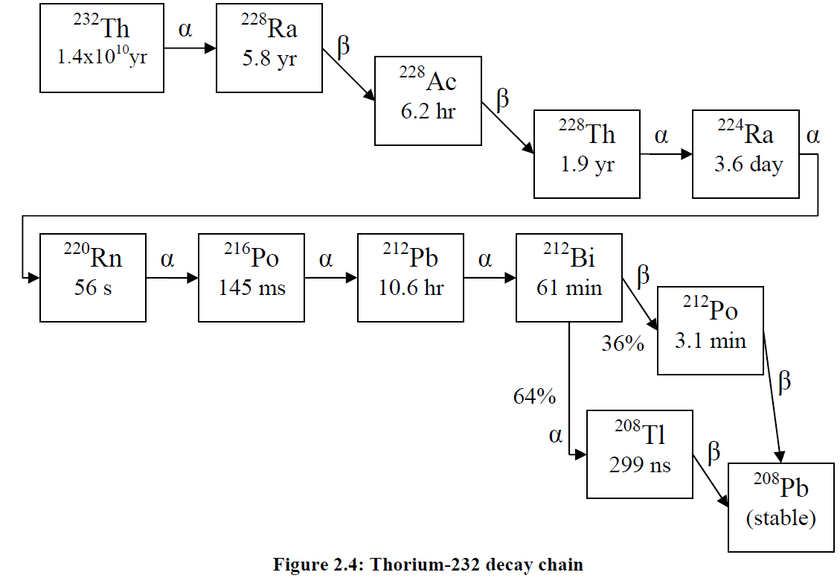
Backup: 232 Th chain
Figure from J. Lidgard, 2008, Masters Thesis

