Slide 1
Wind and Gravity Wave Observations with ERWIN-II
Samuel Kristoffersen (UNB) and William Ward (UNB)

Slide 2
ERWIN
ERWIN is a Michelson interferometer which detects airglow
  Greenline, O₂, and OH emissions
Determines winds, via Doppler shift, in the mesopause (~90 km).
Has an observational cadence of ~3 minutes for all three emissions

Slide 3
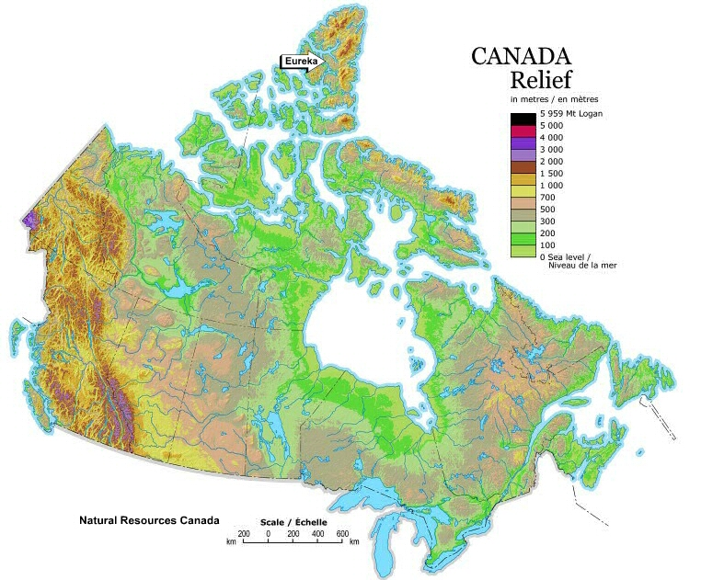
PEARL
Polar Environment Atmospheric Research Laboratory
Located in Eureka, Nunavut (80 N, 86 W)
Operated by CANDAC (Canadian Network for the Detection of Atmospheric Change).
Collaboration between researchers from all over Canada to measure atmospheric dynamics, chemistry and radiative effects in the arctic

Slide 4
Wind Calculation
The phase difference between the viewing direction, say N, and zenith, Z, is used to calculate wind.
sin(α) accounts for the different line of sight angles between north view, and zenith view.

Slide 5
Wind Precision: ~1 m/s

Slide 6
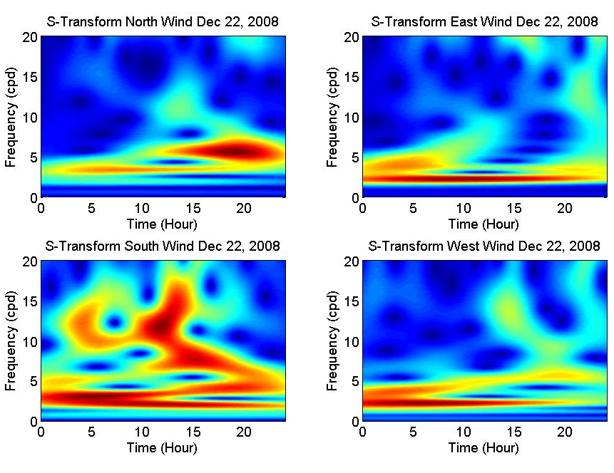
Gravity Wave Signatures

Slide 7
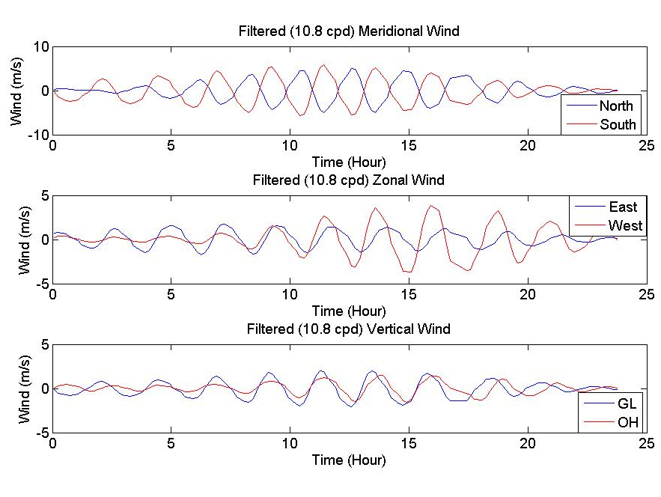
Gravity Wave (10.8 cpd)
Meridional wavelength
Zonal wavelength
Horizontal wavelength
Vertical wavelength
Wave vector is

Slide 8
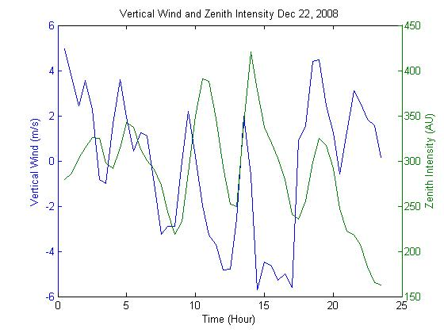
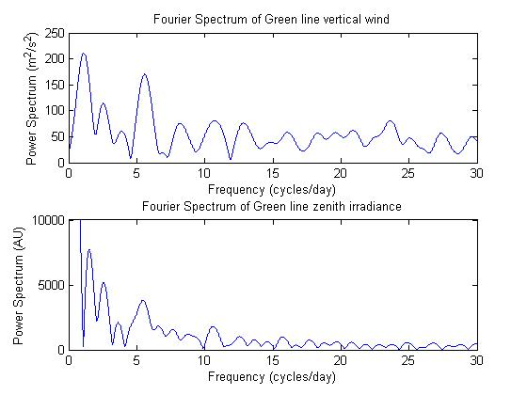
Vertical Wind and Zenith Intensity

Slide 9
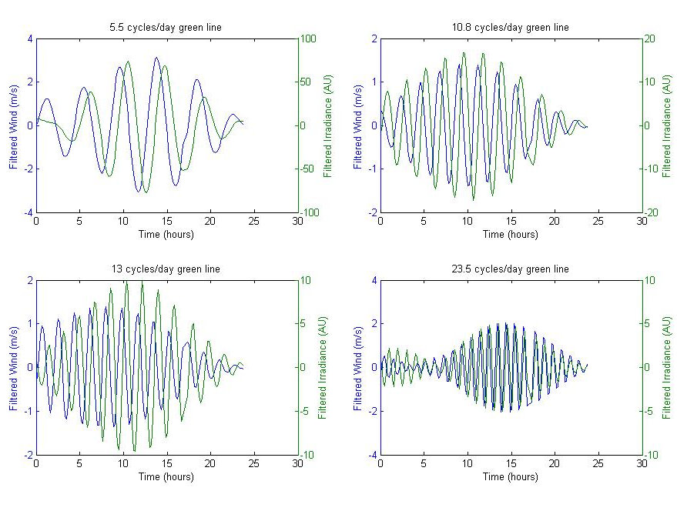

Slide 10
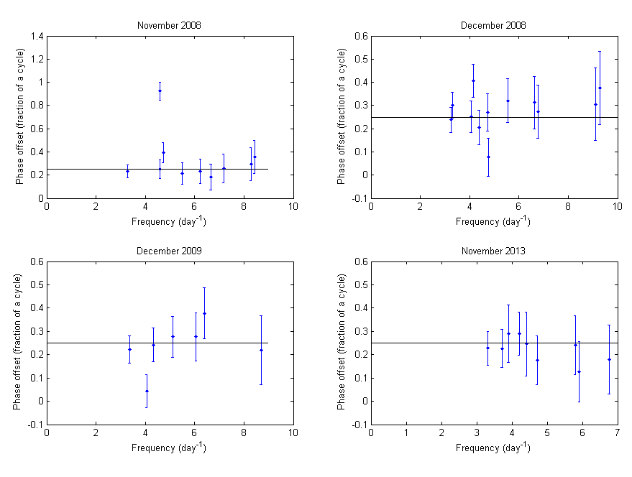

Slide 11
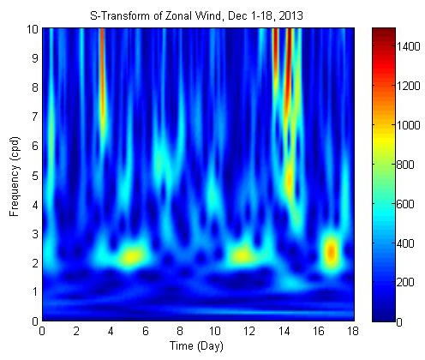

Slide 12
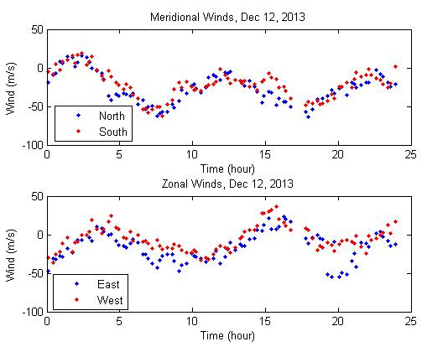
Observed Tide
Zonal Wavelength – 6800 km
Meridional Wavelength 6200 km
Observed Frequency – 2 cpd
Observed wavenumber 1.02 ≈ 1
Eastward propagating non-migrating semidiurnal tide

Slide 13
Conclusion
ERWIN is providing reliable wind measurements in the polar region, with a precision of better than 2 m/s.
Vertical winds have been measured, and comparisons with intensity show correlations consistent with vertical motion of the airglow layers.
Tides and gravity waves have been observed, though there are some inconsistencies which need to be further investigated.

Slide 14
Acknowledgements
Funding support from CANDAC/CFCAS and CREATE gratefully acknowledged.
Thanks to my supervisor William Ward.
Thanks to the operations personnel at Eureka for their support.
Thanks to Stephen Brown for his work on developing ERWIN-2 and installing it at PEARL.

