Slide 1
Fast damping of ultra low frequency waves excited by interplanetary shocks in the magnetosphere
2015 CAP Congress
Chengrui Wang^{*1}, Robert Rankin¹, Qiugang Zong², and Dmytro Sydorenko¹
1.Department of Physics, University of Alberta
2. Institute of Space Physics and Applied Technology, Peking University
June 15, 2015

Slide 2
Outline
Motivation and Introduction
Satellite Observations:
  Interplanetary shock caused large amplitude ULF wave: event on Nov. 7, 2004
  ULF wave observed near plasmasphere boundary layer: event on Aug. 30, 2001
Discussion: Mechanisms of Fast Damping ULF waves
  Joule heating;
  Drift-bounce resonance with ions;
  Energy propagation through inner magnetosphere waveguides;
Conclusion and Future Works

Slide 3
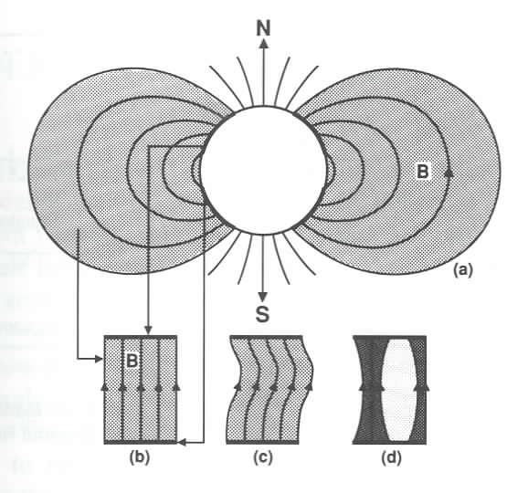
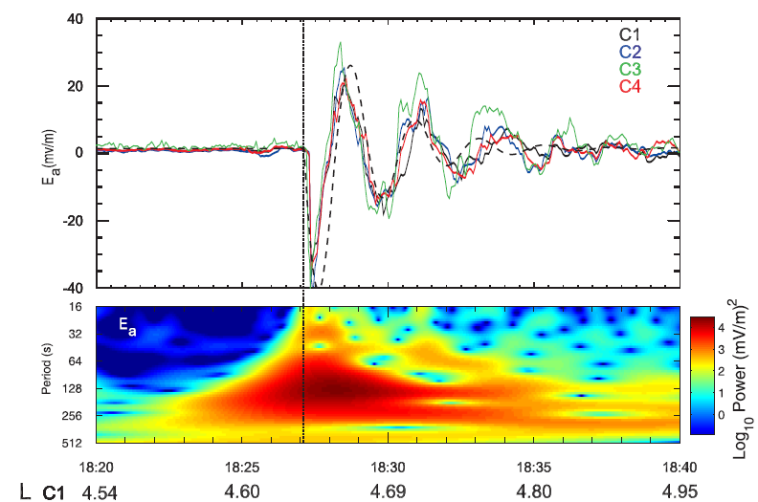
Motivation and Introduction
Field Line Resonance(FLR) in magnetosphere: Standing wave oscillations of magnetic field lines in the ultra low frequency (ULF) range (periods from 1 to 1000 seconds).
Sources of ULF waves:
  Outside the magnetosphere: Dynamic pressure pulse, magnetic reconnection, K-H instability, etc;
  Inside the magnetosphere: Substorm, plasma instabilities such as drift-mirror instability.
[Kivelson and Russell ,1995]
[Wang et al., 2015]

Slide 4
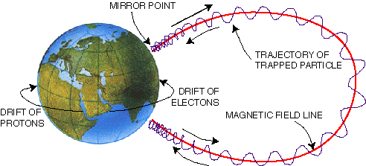
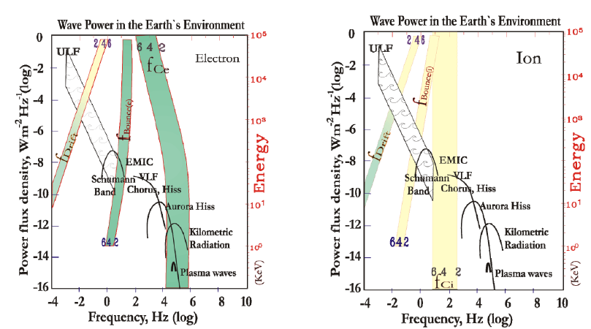
Motivation and Introduction
Wave-particle interaction in
magentosphere:
[Zong et al.,2008]

Slide 5
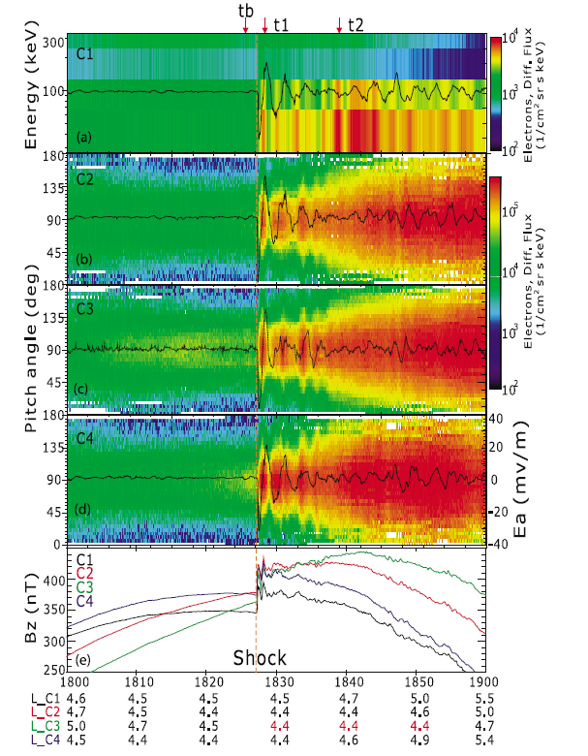
Motivation and Introduction
ULF waves can alter the behavior of electrons and ions remarkably through wave-particle interactions in the inner magnetosphere.
1 MeV electron at L=6.6
  Gyro: ~ millisecond
  Bounce: ~ 0.1-1.0 s
  Drift: ~ 1-10 minutes
Sunday, June 14, 2015
5
[Zong et al., 2009]

Slide 6
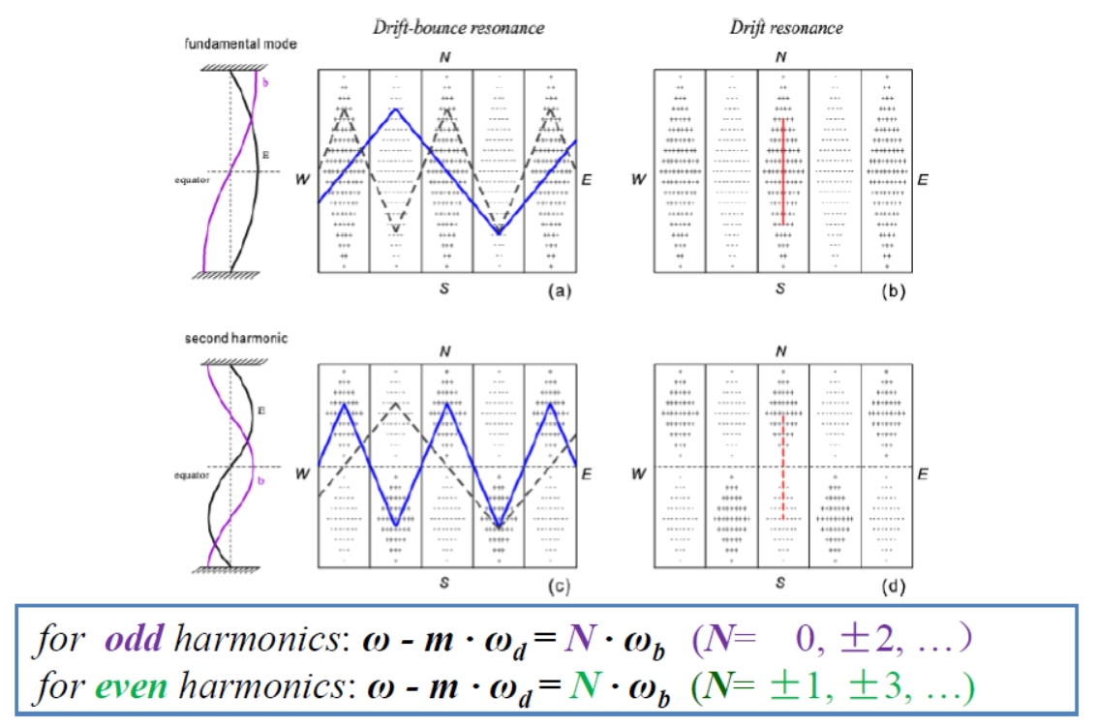
Motivation and Introduction
Drift or drift-bounce resonance condition[Southwood et al. 1969]:

Slide 7
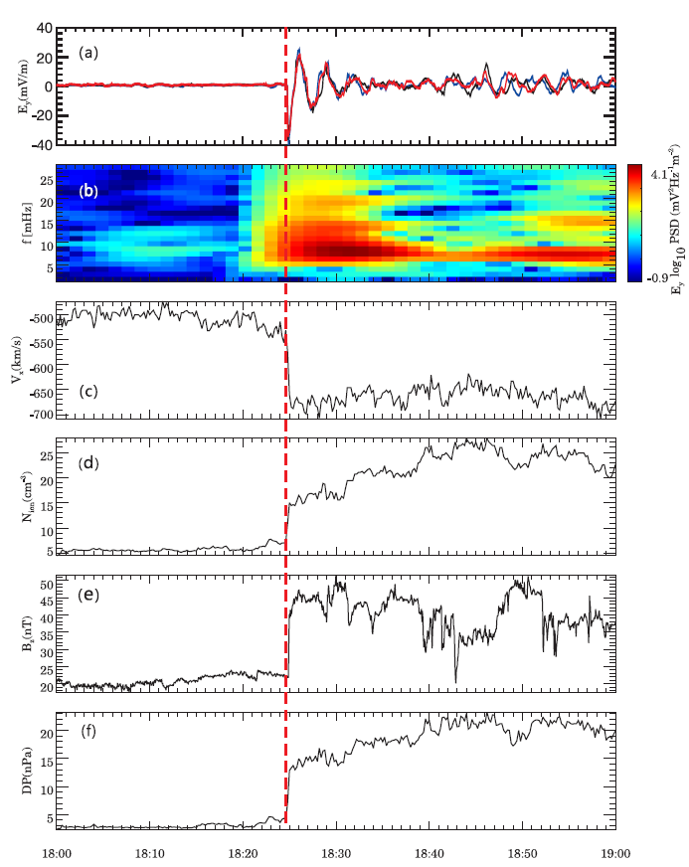
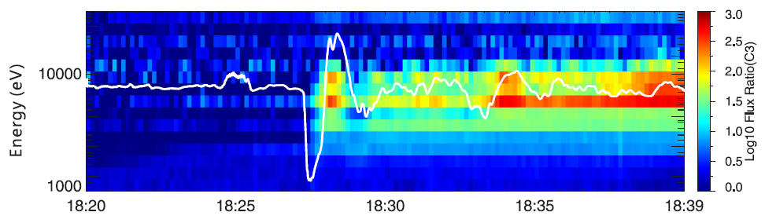
Satellite Observations - Event1: Nov. 7, 2004
The Cluster satellites observed large amplitude Pc-5 ULF waves generated after a shock

Slide 8
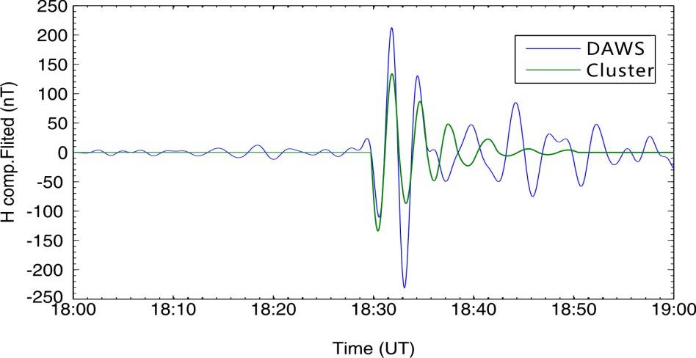
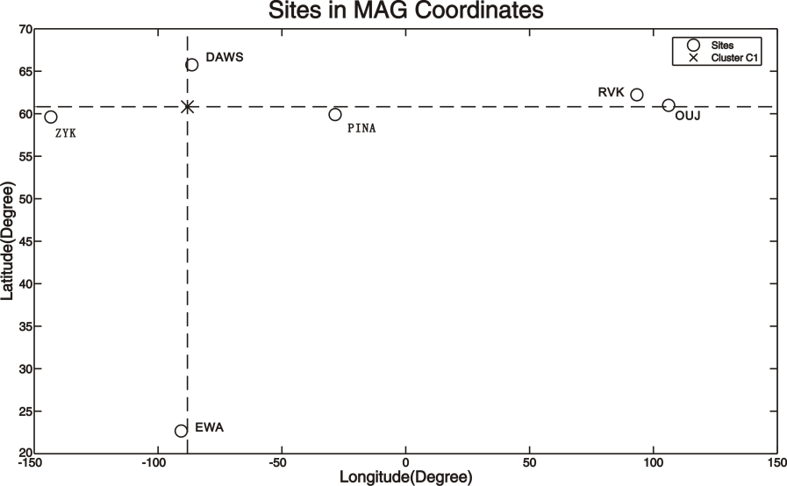
Satellite Observations
The observed quasi-sinusoidal electric field with a period of about 3 minutes had a peak amplitude of ~40 mV/m and was fast attenuated over time.
8
[Wang et al., 2010]

Slide 9
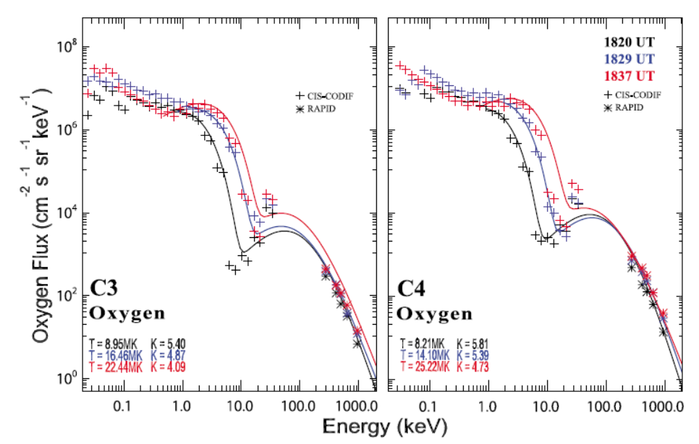
Satellite Observations
After the interplanetary shock impact, the temperatures for both hydrogen and oxygen ions were significantly enhanced

Slide 10
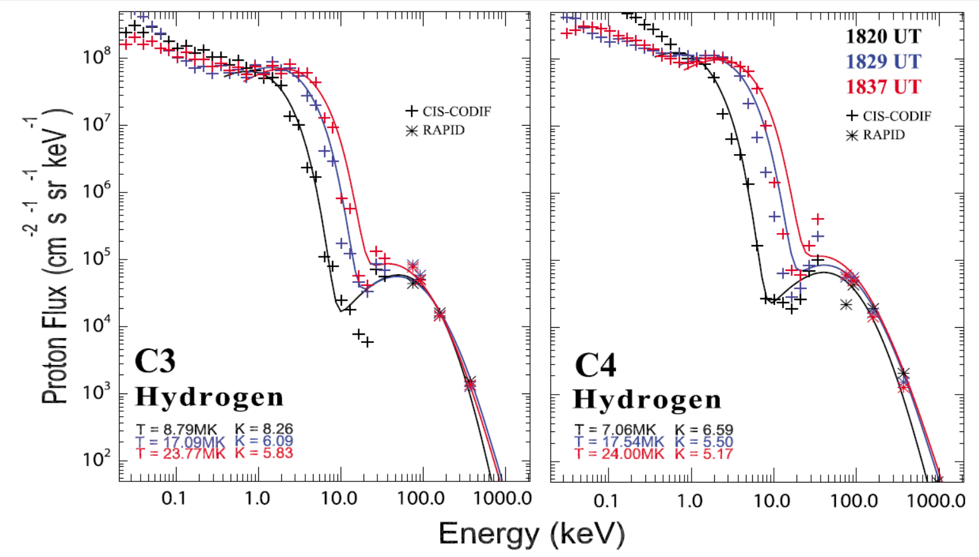
Satellite Observations

Slide 11
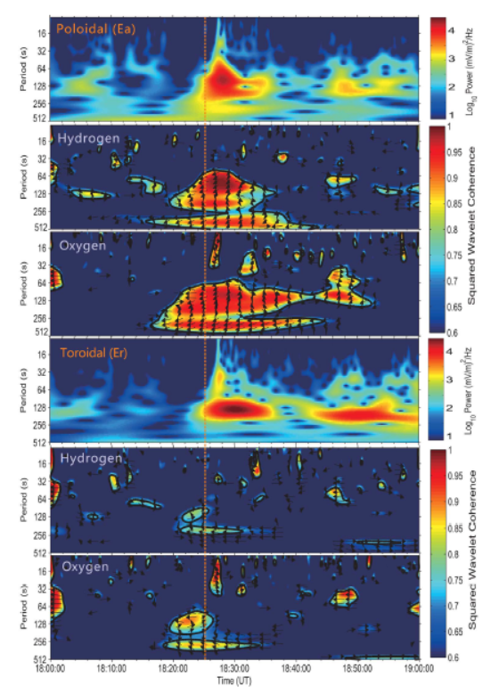
Satellite Observations
The plasma hydrogen and oxygen ions in the inner magnetosphere can be accelerated by the ULF waves induced by interplanetary shocks.
The hydrogen and oxygen ions satisfy the drift-bounce resonance condition with poloidal mode waves.
[Zong et al., 2012]

Slide 12
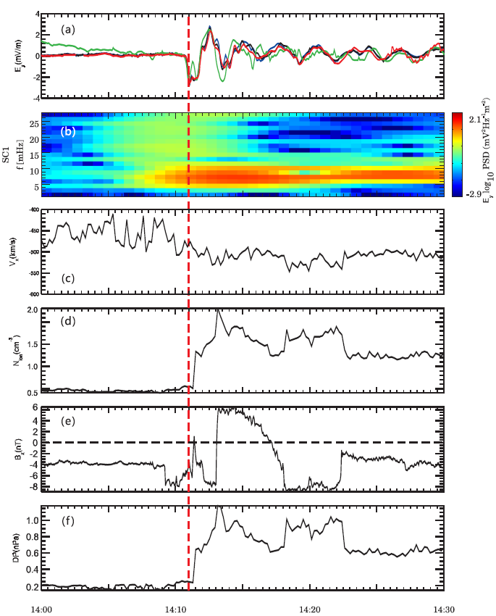
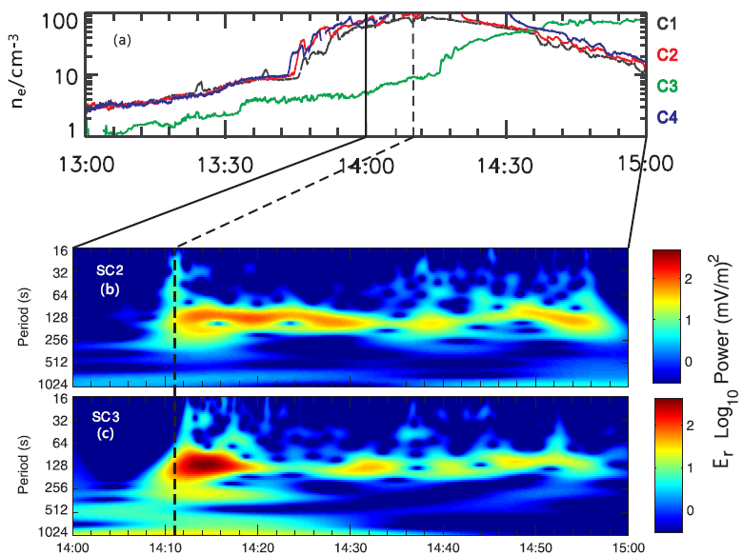
Satellite Observations - Event 2: Aug. 30, 2001
C3 is in plasma boundary layer with small density gradient.
Other three satellites are inside plasmapause.
12

Slide 13
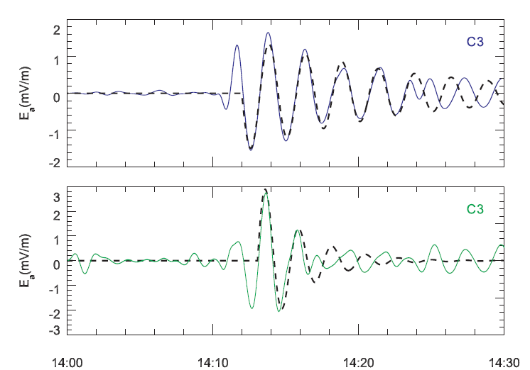
Satellite Observations
Damping rate of ULF waves are different for C2 and C3 (4mHz-9mHz):
C2
C3

Slide 14
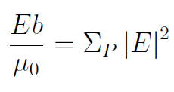

Discussion: Mechanisms of Fast Damping ULF waves
Joule Heating:
  Ionospheric damping of Alfven waves is one of the main sinks of energy. Joule heating is balanced by net Poynting flux into the ionosphere. In the events of interest, damping rates are calculated according to [Southwood and Hughes, 1983]：
  The Pedersen conductivity is large in the dayside ionosphere [Newton et al., 1978]:
14

Slide 15
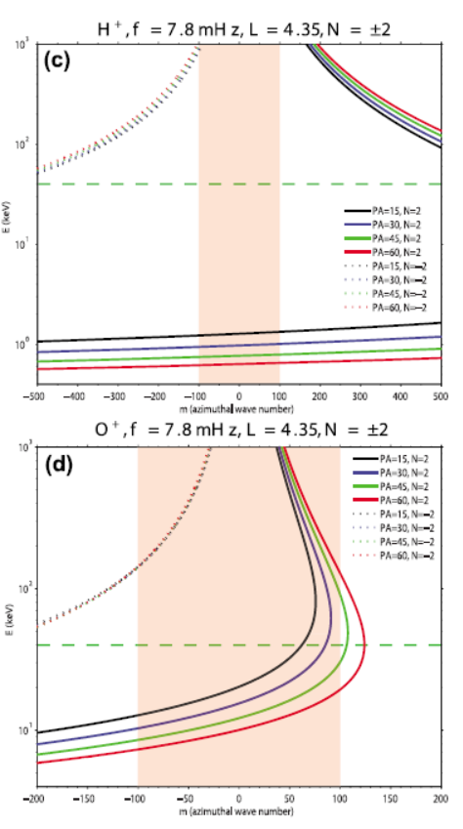
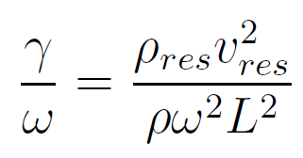
Discussion
Landau damping caused by drift-bounce resonance with ions represents an additional damping on waves over joule heating.
The approximate damping rate can be calculated following Southwood [1976]:
15

Slide 16
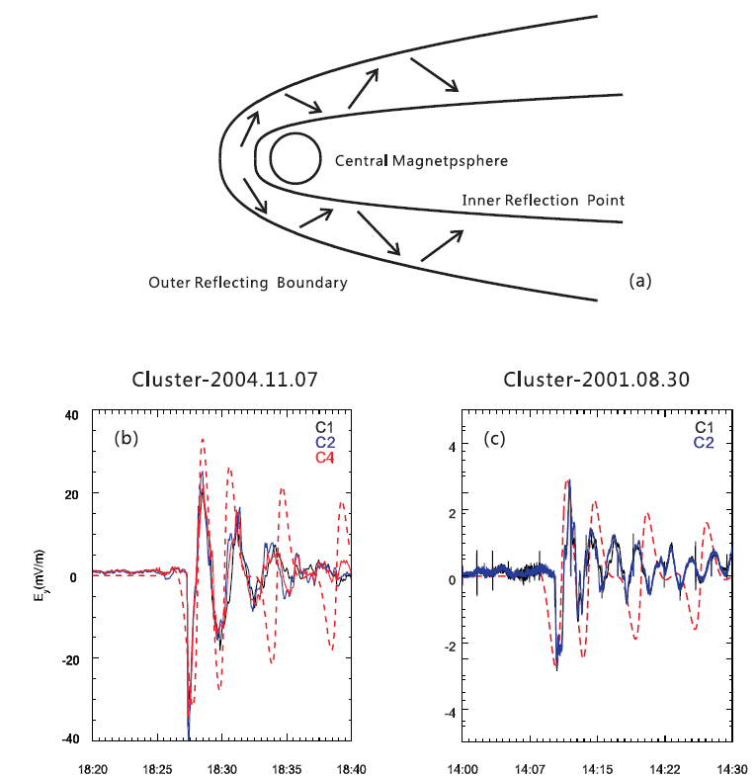
Discussion: Mechanisms of Fast Damping ULF waves
Waveguide propagation:
  The other potential sources of ULF waves observed by Cluster is compressional waves.
  Wave lose amplitude as a result of propagation in the magnetotail waveguide.
[Wright, 1994]
学位答辩
16

Slide 17
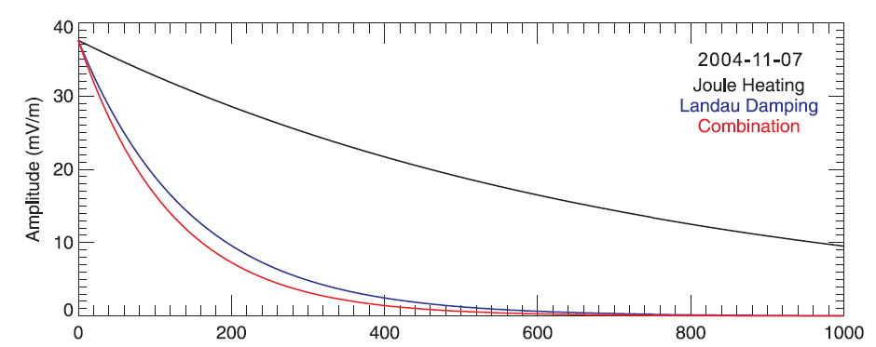
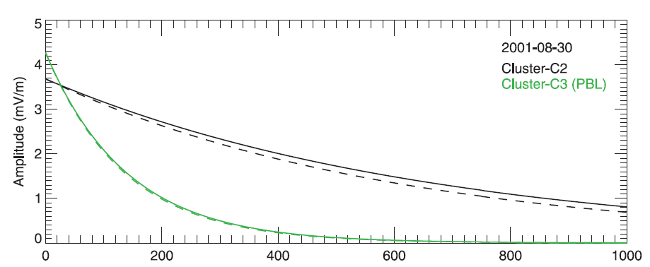
Discussion: Mechanisms of Fast Damping ULF waves
Joule heating is found to be significant in the two events studied but cannot account for the fast damping of ULF waves that is observed. Interactions between Alfven waves and different ions provide an effective ULF wave energy exchange process.
It is found that Alfven waves are damped faster in the plasmasphere boundary layer than within the plasmasphere in the 2001 event.

Slide 18
Discussion: Mechanisms of Fast Damping ULF waves
Damping rate estimation:
2004 event:
2001 event:

Slide 19
Conclusion
In the event on 7 November 2004, the four Cluster spacecraft observed intense ULF waves after arrival of the interplanetary shock. The resulting Alfven waves with strong poloidal components can accelerate particles effectively [Zong et al., 2009] and were damped very fast within several hundred seconds.
In the event on 30 October 2001, C1, C2 and C4 observed relatively weak shock-induced ULF waves in the plasmasphere. By comparing the power of observed waves, it is found that Alfven waves are damped faster in the plasmasphere boundary layer than within the plasmasphere in this event.
Joule heating is found to be significant in the two events studied but cannot account for the fast damping of ULF waves that is observed. Interactions between Alfven waves and different ions provide an effective ULF wave energy exchange process.

Slide 20
Future Works
Test particle simulations will be used to simulate the energy dispersions of particles caused by ULF waves.
Liouville’s theorem will be used to reconstruct the distribution function at the location of Cluster in a model magnetosphere.

Slide 21
Thank you!
Sunday, June 14, 2015
21

