Slide 1


Under the supervision of Dr. Robert thompson
Evaporative Cooling of Ions in
Linear Paul Traps
LOHRASP SEIFY

Slide 2
Overview
What we are trying to achieve
Theory
Results
Discussion
Where to go from here

Slide 3
Goals & Motivation
Evaporative cooling in Linear Paul traps
Cooling method independent of species
Non-invasive, universal method of cooling
  Titan trap mass measurement
Optimize temperature drop per particle lost

Slide 4

Evaporative Cooling
#particles
Energy
#particles
Energy

Slide 5
Evaporative Cooling

Slide 6
Evaporative Cooling
Particles must interact, and allow system to equilibrate
Highest energy particles are allowed to escape

Slide 7
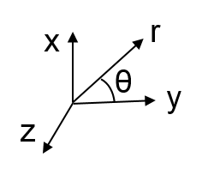
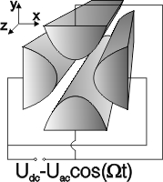
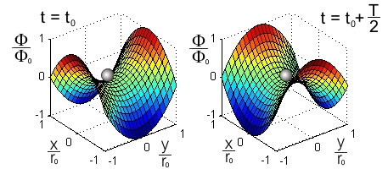
Electrode Configuration
Shape of the potential at some t_{o} and half a period later
Ω : Oscillation Frequency
r_{o} : Radius of the trap
z_{o} : Length of the trap
U_{DC} : Amplitude of DC component
U_{AC} : Amplitude of AC component
Images from:
Humboldt-Universität zu Berlin - http://www.physik.hu-berlin.de/nano/forschung-en/np

Slide 8
Ions in Linear Paul Traps
Simple harmonic motion in z-direction
Number of particles and energy not conserved
  Particle-trap heating
  Particle-particle coulomb heating
Any cooling method must compete with above

Slide 9
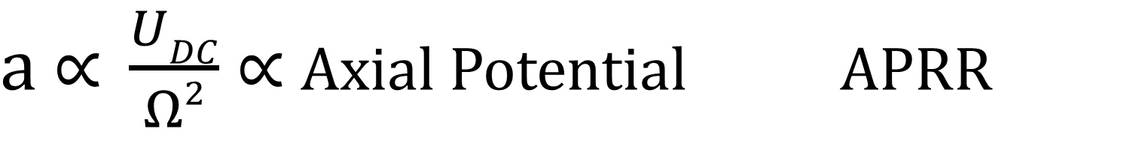
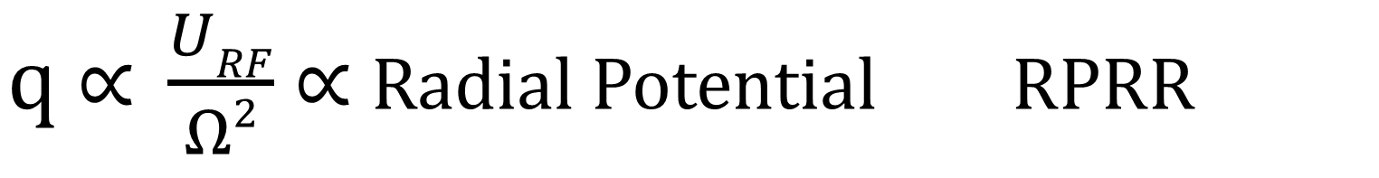
$q \text{∝} \frac{URF}{Ω2}$∝ Radial Potential RPRR
Radial Potential Reduction Rate
$a \text{∝} \frac{UDC}{Ω2}$∝ Axial Potential APRR
Axial Potential Reduction Rate

Slide 10
Method of Investigation
a and q are systematically picked
RPRR and APRR are picked by monte-carlo method
Simulations model the ensemble
Cooling measured

Slide 11
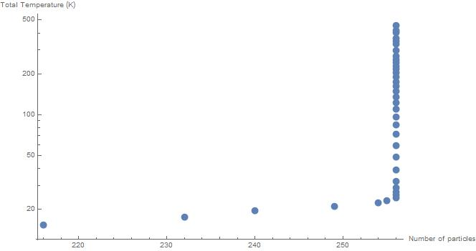
Results

Slide 12
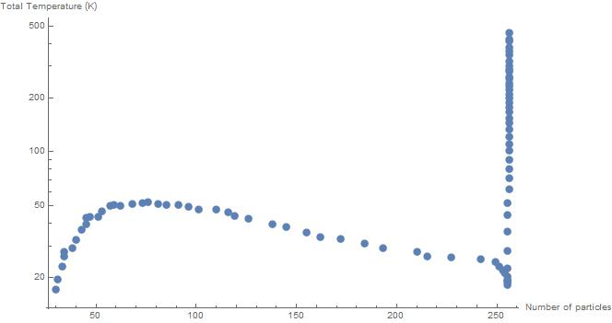
Results

Slide 13
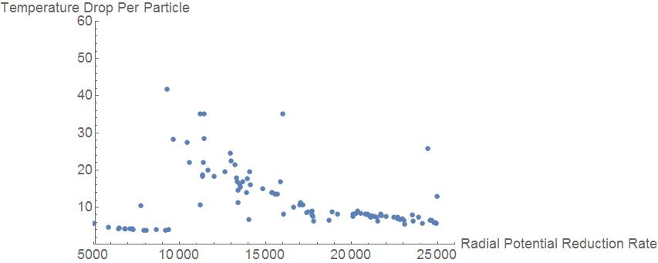
Results

Slide 14
Conclusion
Evaporative cooling overcomes intrinsic heating of LPT
Evaporative cooling can be optimized
Temperature drop of ~95% , by losing less than 10% of initial particles

Slide 15
Future work
Run MC sets for lower q values to verify interaction rate
Apply evaporative cooling to experiments in TITAN located in TRIUMF

Slide 16
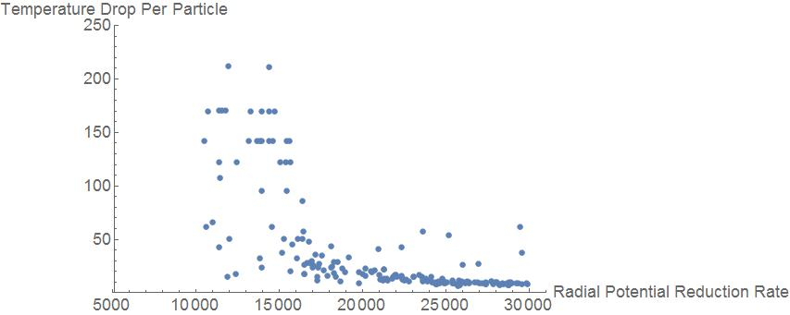
Results
Temperature drops of
  min ~ -1 K/Particle
  max ~ 120 K/Particle
Unsuccessful runs:
  A lot of heating before good evaporations
  A lot of heating, and only bad evaporations

Slide 17
Constants
Initial particles = 256
Initial temperature = 450K
Simulation time of 5x10⁻⁴ sec
Computational time of ~4 hours

Slide 18
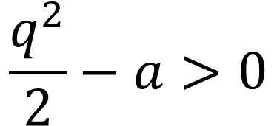
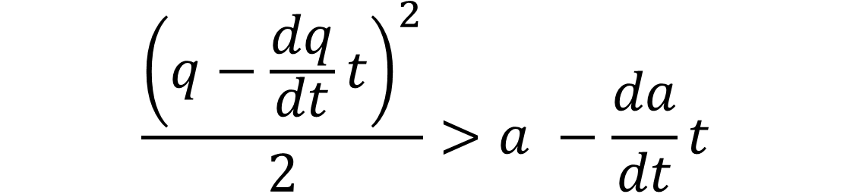
Not all data is useful

Slide 19



