Slide 1
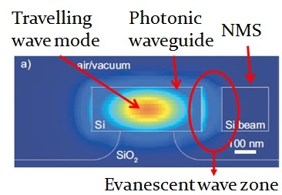
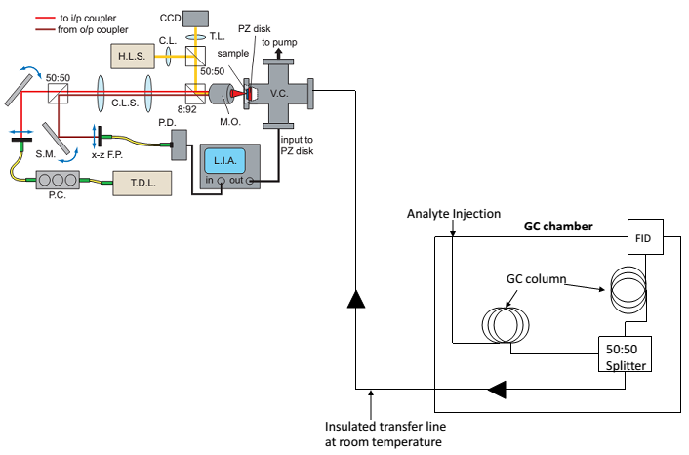
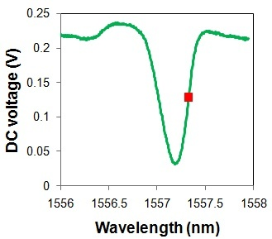
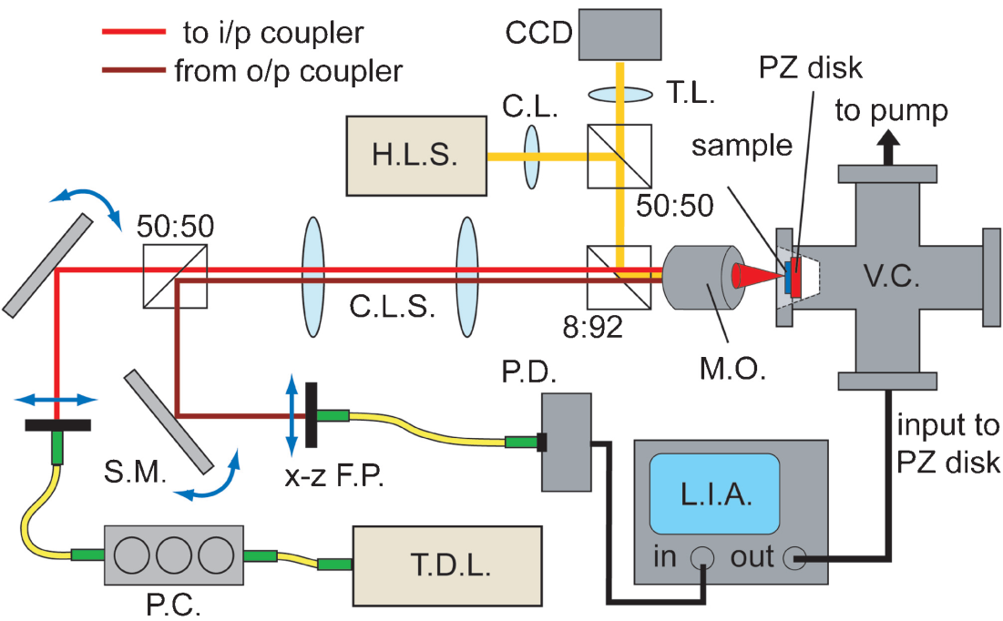
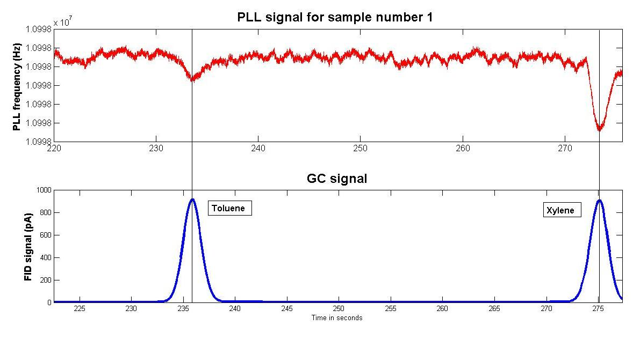
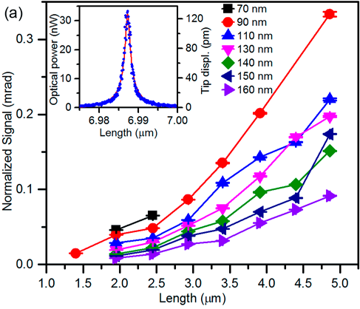
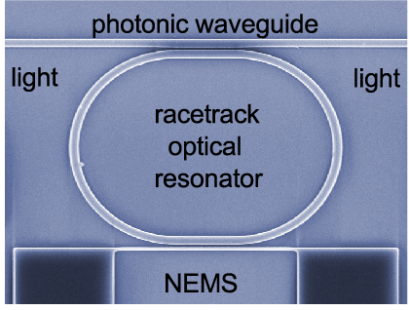

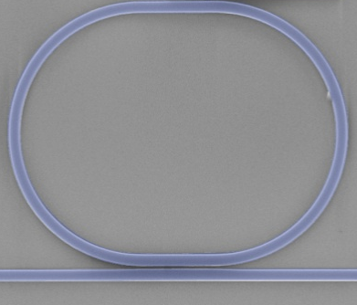

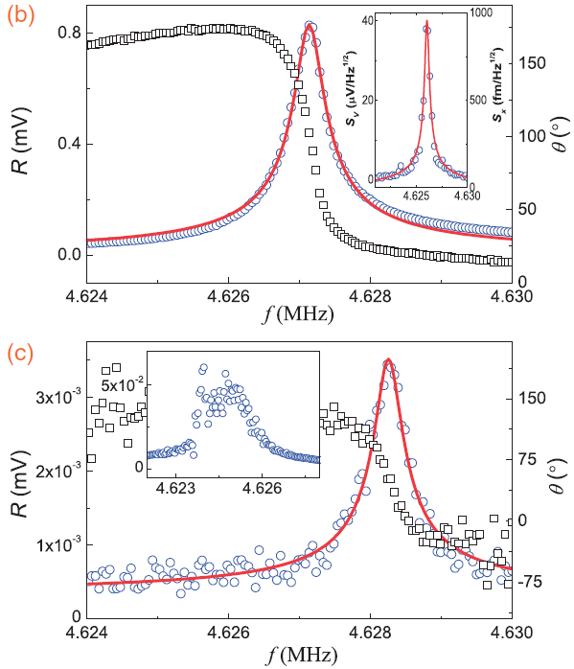
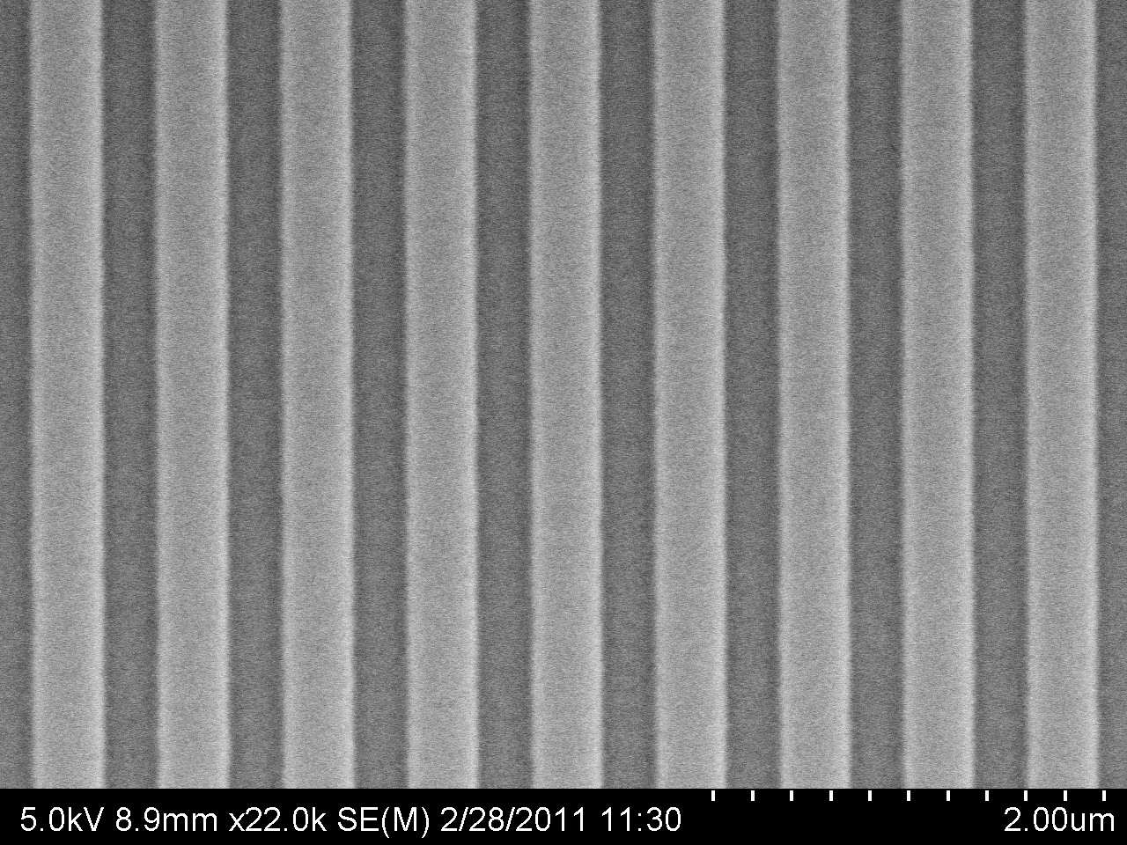
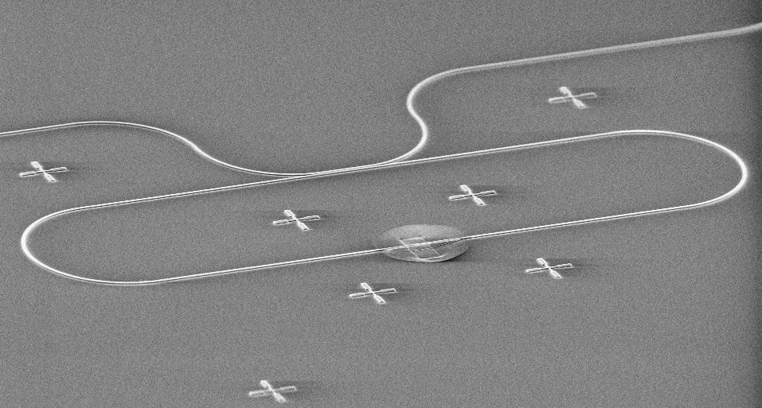




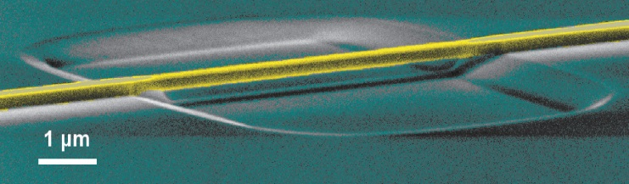
GC-MS to GC-NOMS: A step towards portable analysis
Optical Racetrack NOMS Devices
First NOMS Sensing of GC Peaks
A.Venkatasubramanian, S.K.Roy, V.T.K.Sauer, W.K.Hiebert
National Institute of Nanotechnology, 11421 Saskatchewan Drive, Edmonton, AB, Canada
Motivation
Free space confocal optical setup
The objective of this research is to develop portable metabolomic devices for companion diagnostics and personalized medicine.
The motivation was to identify new sensing mechanism that can potentially replace the Mass spectrometer (MS) from the Gas chromatography (GC) – Mass spectrometer (MS) system to improve its portability
NOMS Responsivity:
optical transmission equation
Response to toluene and xylene
Optical cavity
Properties (T_{o}, Ƒ)
Optomechanical
coupling (g_{om}, L_{mech})
  Some target applications:
  biosensing
  gas sensing
  breath analysis
  gas chromatography
SNR ~ 3
SNR > 5
Thermomechanical Noise Signal Normalized By
dT/dφ: Gap and Length dependence
NOMS super-sensitivity
Comparing photonic to free-space transduction
New method for getting light onto chip
633 nm
NA~0.6
Spot~ 1μm
λ_{probe}
modulation
ΔT
Conclusions
To the best knowledge of the authors, this is the first demonstration of Nano-optomechanical system (NOMS) integrated with Gas chromatography.
Initial results of analyte adsorption is encouraging with accurate synchronization of analyte peaks. Clear indication of analyte adsorption is when SNR ratio above 2.5.
2 μm
Δλ
vibration
1550 nm
NA~0.1
Spot~16μm
Ƒ~1
vibration
NOMS device fabrication
Photonic is roughly finesse (Ƒ) times better
Ƒ~100
SOI platform; Foundry photonic fabrication; NOMS finishing in-house
800
400
ACKNOWLEDGEMENTS
1 μm
10 μm
0
Substrate coupling geometry with
lithographically defined release step
Lateral coupling geometry with
maskless release step (V Sauer)
Free-space signal (μV) Photonic signal (μV)
grating coupler
released waveguide
3
LETI or IMEC
via CMC
2
Sauer, Diao, Freeman, Hiebert,
Applied Physics Letters 100, 261102 (2012)
1
0

