Slide 1
Status of the SNO+ Experiment
Aksel Hallin for the SNO+ Collaboration
CAP Congress
Edmonton
June, 2015

Slide 2

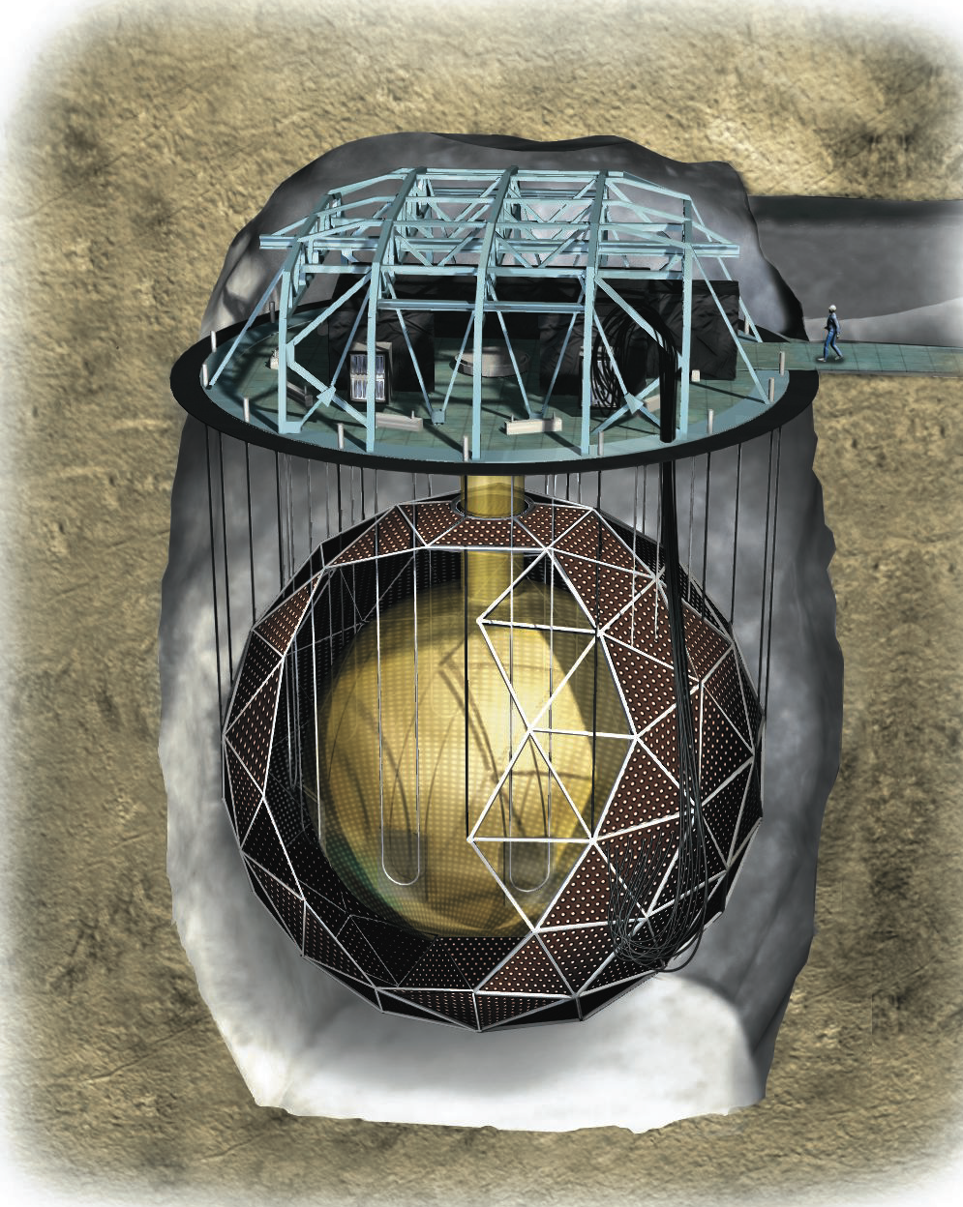
780 tonnes of liquid scintillator as active volume
  Can be loaded with double beta decay isotope
~9500 PMTs
1500 + 5300 tons ultra-pure water shielding
6800’ underground in SNOLAB
Image courtesy National Geographic
Notes:
~70 muons/day in SNO+

Slide 3
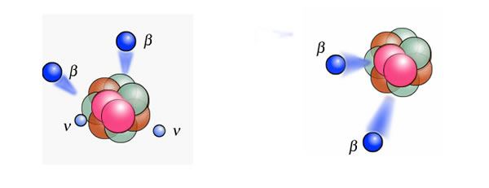
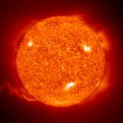
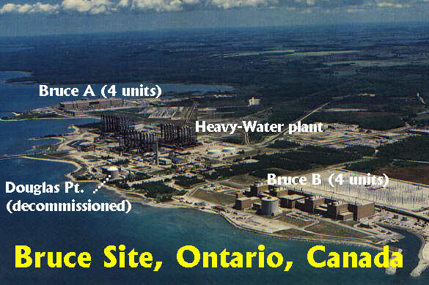
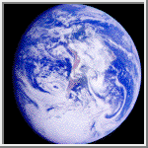
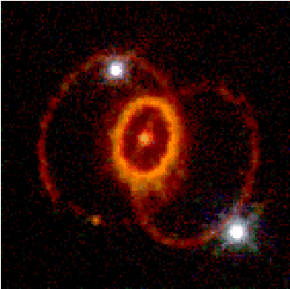
SNO+ Physics
Neutrinoless Double Beta Decay
Low Energy Solar Neutrinos
Reactor Antineutrinos
Geo-Neutrinos
Supernova Neutrinos

Slide 4
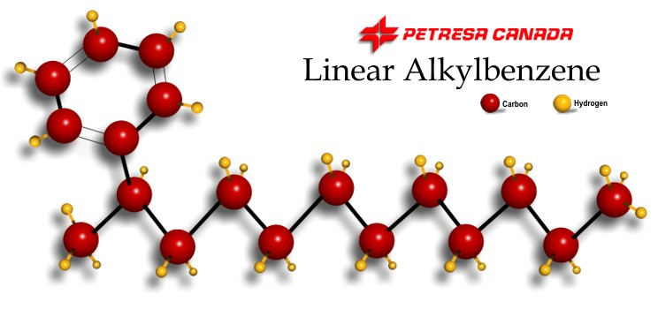

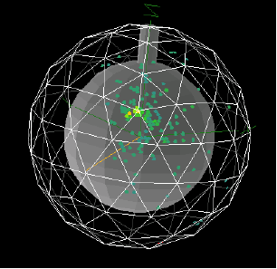
Detection Principle
Organic scintillator (LAB + PPO) produces light when excited by charged particles
~10,000 photons/MeV, of which a few hundred photons/MeV are detected by the PMTs
  Can detect events depositing < 50 keV
Calorimetric measurement + pulse shape
  Event energy from number of photons
  Event position from photon time-of-flight

Slide 5
Particle Detection
For double beta decay, the signal is two electrons. SNO+ works as a large conventional scintillator with three important advantages:
  Backgrounds can be reduced by chemical processing and can even be changed/tuned if necessary
  Backgrounds can be measured with a variety of radiochemical/counting techniques and the assumption of homogeneity is physically motivated.
  The type of isotope, amount of loading, and techniques for loading can accommodate different measurements.

Slide 6
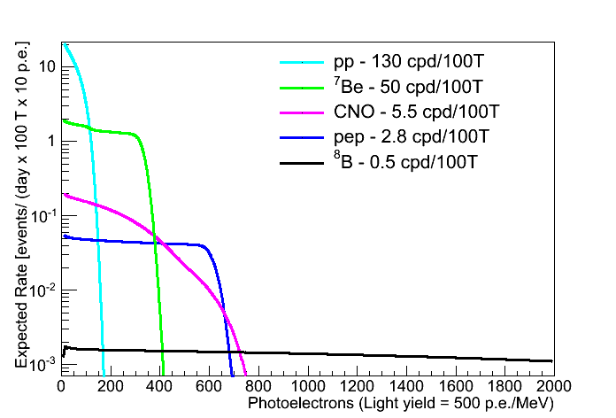
Neutrino Detection
Neutrinos interact via elastic scattering with electrons
    Sensitive to all neutrino species, but cross section is 4-7 times larger for v_{e} than v_{μ,τ}
    Detect scintillation from the recoiling electron (poor energy correlation between electron and neutrino. There is good directional correlation between electron and neutrino, but that information is not transferred into scintillation light.
e⁻
v_{e}
v_{e}
W±
e⁻
W±
v_{x}
e⁻
v_{x}
Z⁰
e⁻

Slide 7
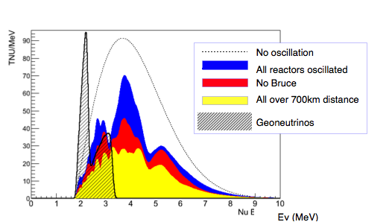
Electron Antineutrino Detection
ν_{e} + p ➔ e⁺ + n
Large cross section, clean anti-coincidence tag, but low flux from reactors and earth.

Slide 8
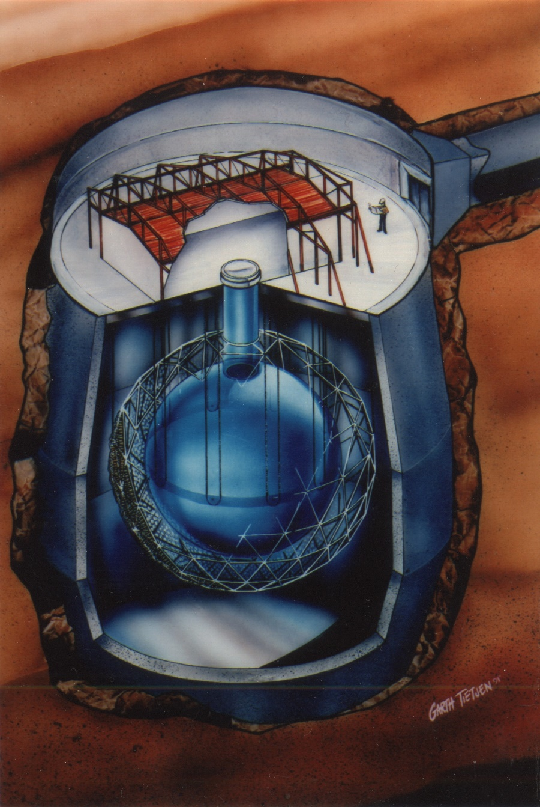
Central Challenge: Backgrounds
Internal Radioactivity
traces of radioisotopes (U/Th chain, ⁴⁰K, etc) in the scintillator.
External Gammas
from decays in the acrylic, water, PMTs, etc.
Cosmic Ray Muons
Cosmogenics
Neutrons and radionuclides from spallation and hadronic showers
Fast Neutrons
from external muons
μ
n, p, ¹¹C…
n
α,β
γ

Slide 9
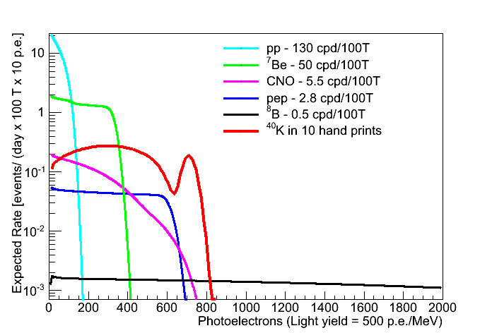
Central Challenge: Backgrounds
Internal Radioactivity
traces of radioisotopes (U/Th chain, ⁴⁰K, etc) in the scintillator.
External Gammas
from decays in the acrylic, water, PMTs, etc.
Cosmic Ray Muons
Cosmogenics
Neutrons and radionuclides from spallation and hadronic showers
Fast Neutrons
from external muons
μ
n, p, ¹¹C…
n
α,β
γ

Slide 10
ββ Decay
e⁻
Z
ν_{e}
Z+1
ν_{e}
e⁻
Z+2
Requires Massive Majorana Neutrino
ΔL=2
Two Neutrino Spectrum
Zero Neutrino Spectrum
1% resolution
Γ
(2
ν
) = 100 *
Γ
(0
ν
)
e⁻
Z
ν_{e}
Z+1
e⁻
Z+2
0.0
0.5
1.0
1.5
2.0
Endpoint
Energy
Sum Energy for the Two Electrons (MeV)

Slide 11
SNO+ with Te-Loaded Liquid Scintillator
large natural isotopic abundance 34% for ¹³⁰Te
  tonne scale for ¹³⁰Te isotope, cost is only $1.5 million (because using natural tellurium without enrichment)
    …compare to O($100 million) for tonne scale of enriched isotope
  0.3% Te (by weight) in SNO+ is 2.34 tonnes of Te or 800 kg of ¹³⁰Te isotope
recently, SNO+ received additional funding – should allow us to go to 0.5% Te loading or 1,300 kg of isotope

Slide 12
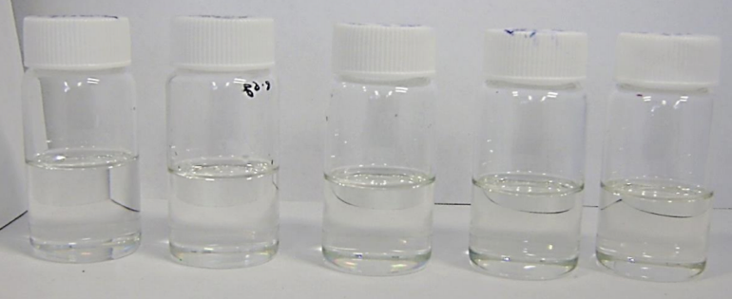
Percent Loading of Tellurium
0.3%, 0.5%, 1%, 3%, 5% (from left to right)

Slide 13
SNO+ Simulated Spectrum

Slide 14
SNO+ Phase 2 with 3% TeLS

Slide 15
Excluded by EXO-200, GERDA, KamLAND-Zen
SNO+ 0.5%
m_{ββ} [eV]
SNO+ 3%

Slide 16
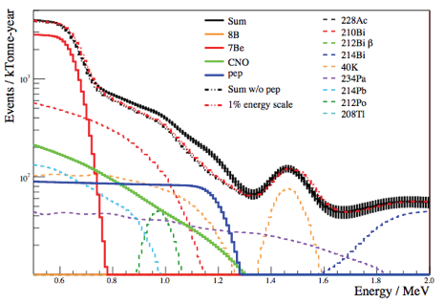
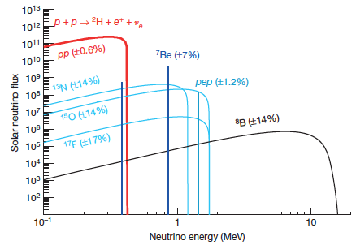
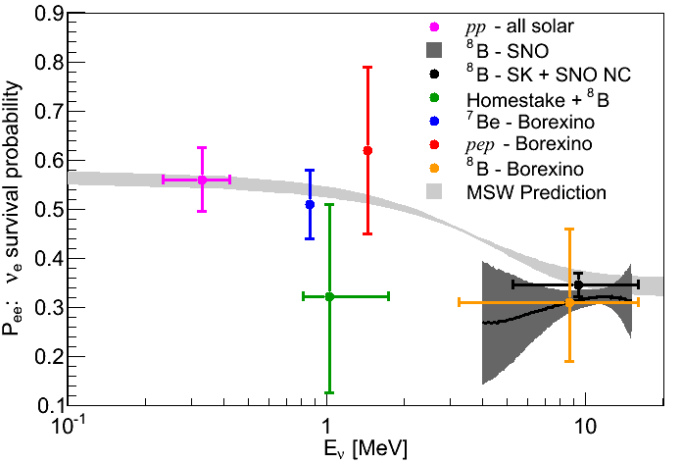
Solar Neutrinos
Precise measurements of the low energy solar neutrinos can confirm that we understand the neutrino oscillation mechanism, how neutrinos interact with matter, and what’s going on inside the sun.
SNO
SNO: LETA
SNO+

Slide 17
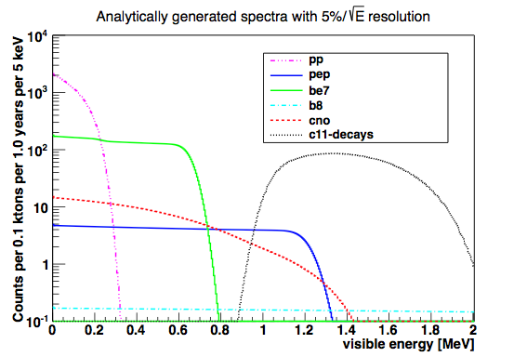
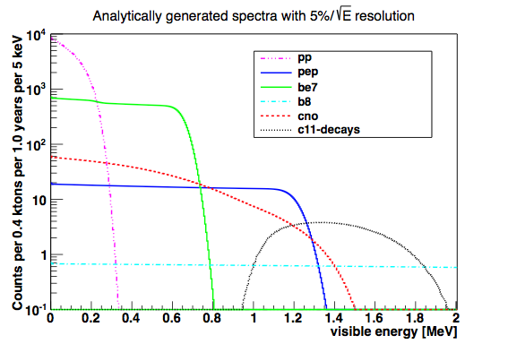
Solar Neutrinos
Precise measurements of the low energy solar neutrinos can confirm that we understand the neutrino oscillation mechanism, how neutrinos interact with matter, and what’s going on inside the sun.
At LNGS depth
SNOLAB
The depth of SNOLAB gives SNO+ a unique opportunity to make a precise measurement.

Slide 18
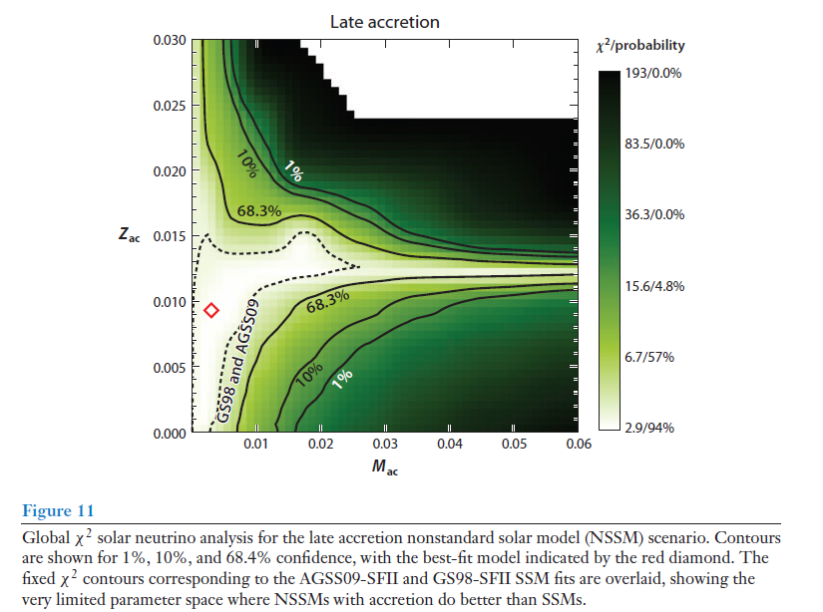
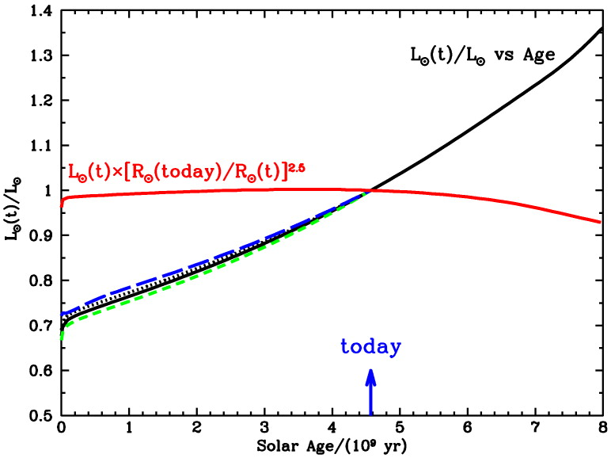
Solar Physics: Neutrinos and Helioseismology are Probes of the Solar Interior
Accreted Metallicity and Mass:
Annual Review of Astronomy and Astrophysics 51:21-61 (Haxton, Robertson and Serenelli) 2013

Slide 19
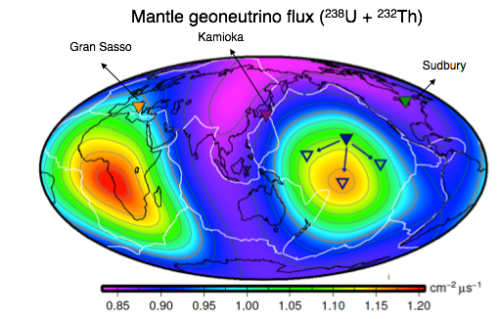
Geo- and Reactor Antineutrinos
Detect antineutrinos via:
ν_{e} + p ➔ e⁺ + n
Delayed coincidence means very low backgrounds!
Measuring the geo-neutrino flux tells us about the earth’s internal chemical composition, and thermal history
Well known fluxes and baselines for reactor neutrinos provides precision probe of neutrino oscillations

Slide 20
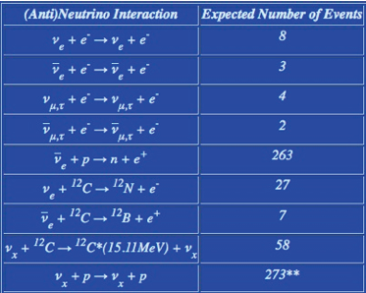
Supernova Neutrinos
Type II supernovae release ~99% of their gravitational binding energy as neutrinos
  More neutrinos in a few seconds than in the rest of the star’s life combined
  Burst detectable at galactic distances
Galactic supernovae estimated to happen ~once in 30 years
Neutrinos provide “early warning” of supernova for optical observations
Neutrinos provide information on neutrino oscillations, the supernova itself, cosmological parameters, etc.
Expected signal for a 10kPc Supernova

Slide 21
The SNO+ Story
Past
  Identify acrylic compatible scintillator
  Install acrylic vessel hold-down net
  Upgrade electronics
  Clean acrylic vessel
Present
  Design purification systems for tellurium and surfactant
  Install scintillator purification plant
  Fill detector with water
  Upgrade calibrations and covergas systems
Future
  Operate water filled detector to study backgrounds and nucleon decay - 2015
  Commission scintillator plant and fill detector with scintillator – 2015-2016
  Install isotope and surfactant purification equipment – 2016
  Purify and load DBD isotope – 2016-2017

Slide 22
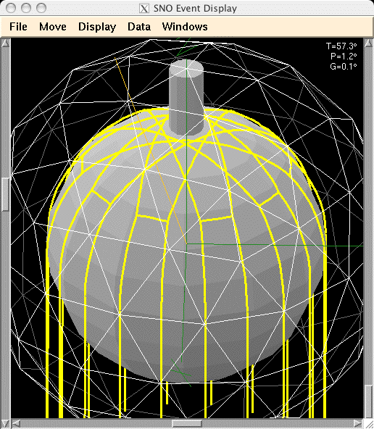
Install AV Hold-Down Net
Hold-down anchors and new floor liner installed
Notes:
130T buoyancy

Slide 23
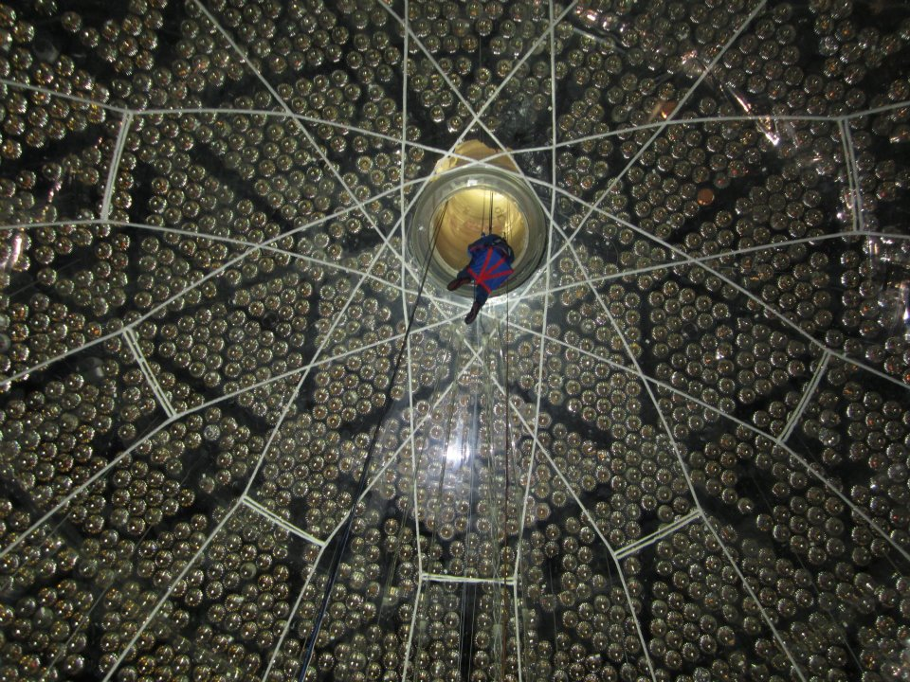
Install AV Hold-Down Net
Hold-down rope net installed, pre-tensioned, and tested by “float the boat” testing.

Slide 24
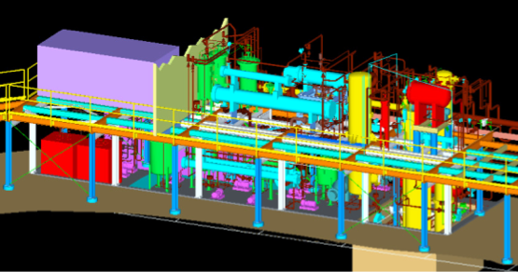
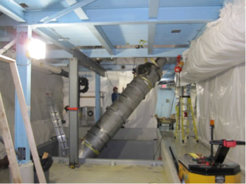
Scintillator Process System
Essentially had to install an industrial petrochemical processing facility underground. Major piping/vessel installation done, working on leak checking, then cleaning & passivation
Notes:
Water extraction column

Slide 25
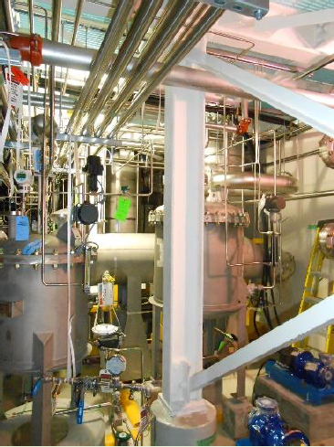
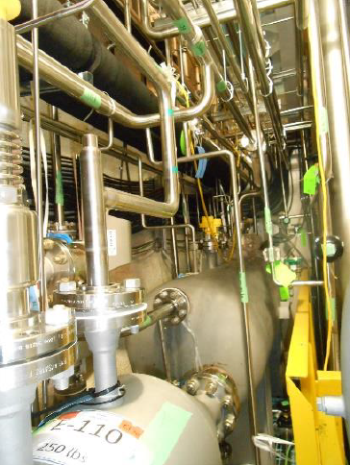
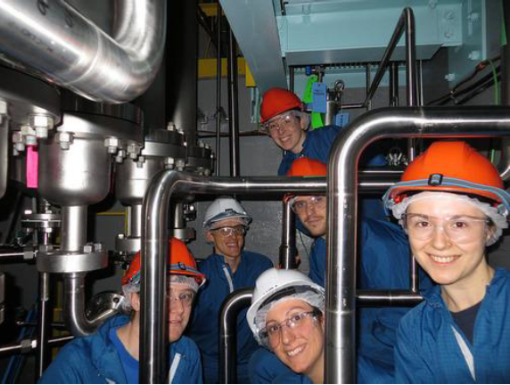
Scintillator Process System
Essentially had to install an industrial petrochemical processing facility underground. Major piping/vessel installation done, working on leak checking, then cleaning & passivation
Notes:
Water extraction column

Slide 26
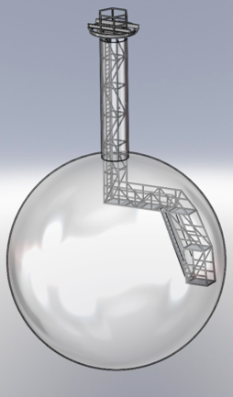
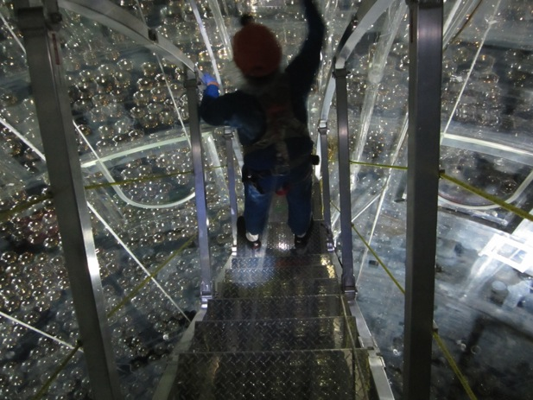
Acrylic Vessel Cleaning
Upper hemisphere – suspended platform

Slide 27
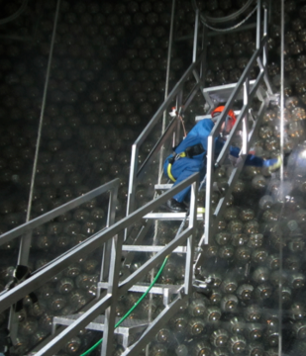
Acrylic Vessel Cleaning
Lower hemisphere - rotating ladder

Slide 28
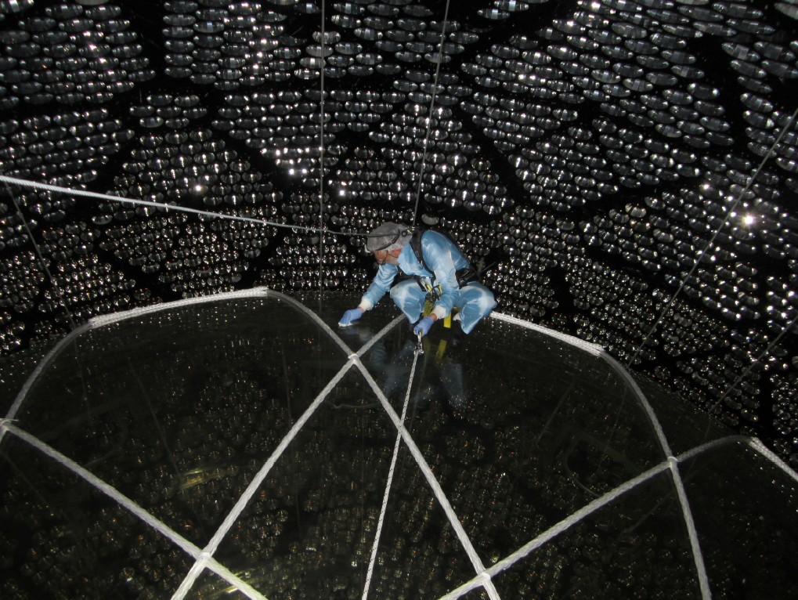
Acrylic Vessel Cleaning
Even the outside!

Slide 29
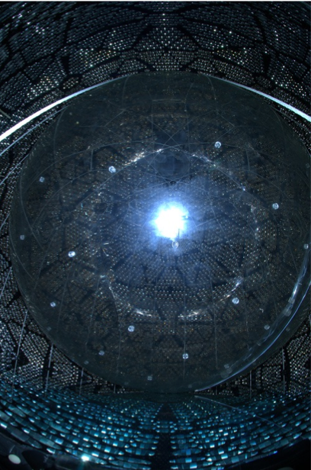
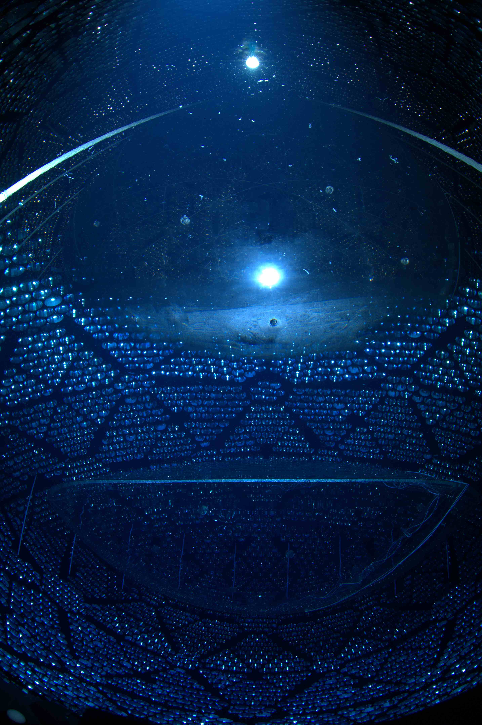
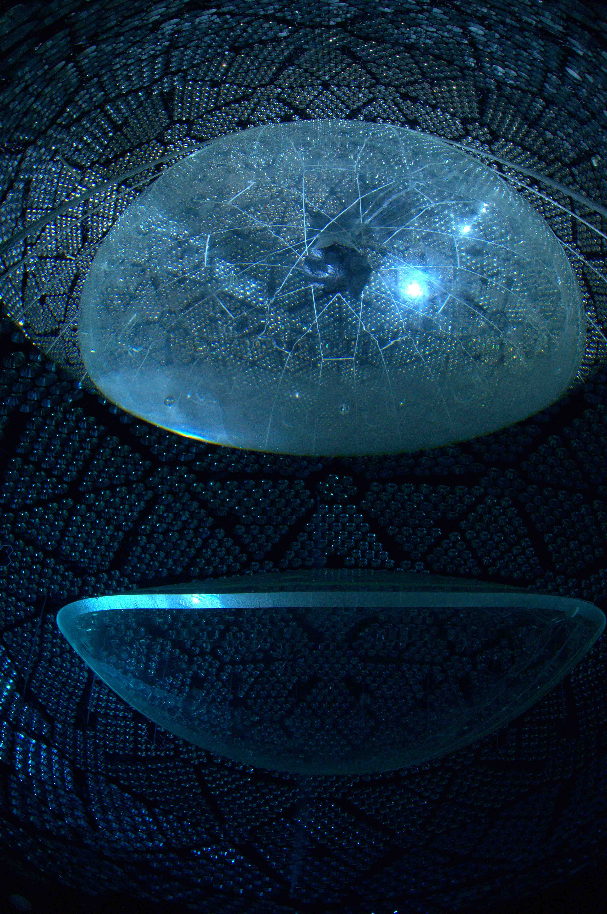
Water Filling
Camera and light underwater
Camera underwater, light above water
Camera above water
The detector and cavity are currently about half filled with water. This leads to interesting optics!
Notes:
Camera submerged. Lights either under water or not.

Slide 30
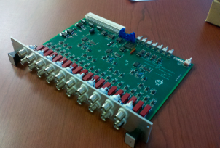
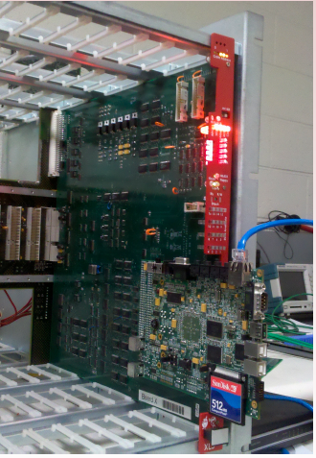
Electronics Upgrades
New crate readout interfaces (20)
Local intelligence for independent control and data
Rate up to 40 Mbyte/s
New central trigger boards (7)
Handles much higher currents for scintillator events
Allows auto “re-triggering” to capture coincidences from BiPo and other backgrounds

Slide 31
In addition
New DAQ
Moved MC/Analysis framework to RAT/Geant4; code was essentially rewritten
Repaired many of the failed PMT bases

Slide 32
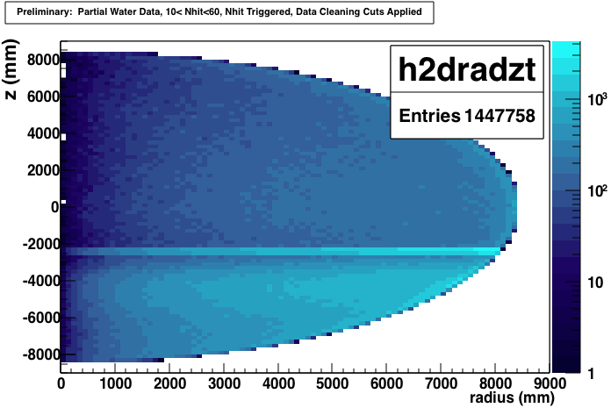
Partial Fill Data
See Kalpana Singh’s talk on LED flasher system and extracting optics
Have acquired data, tested data cleaning cuts, run it through reconstruction code.
Still need to calibrate channel timings, fit resolutions and efficiencies and finalize many algorithms and fully automate processing
In general things are functioning well…

Slide 33
Status
now filling the SNO+ detector with water
water-filled data taking starts end of 2015
  to study external backgrounds and detector optics
scintillator purification plant installation completion in Summer 2015
begin commissioning scintillator purification plant in Fall 2015
liquid scintillator filling starting in 2016
installation of tellurium purification skid and Te purification in 2016
addition of Te to SNO+ liquid scintillator and DBD run in late 2016 to early 2017

