Slide 1
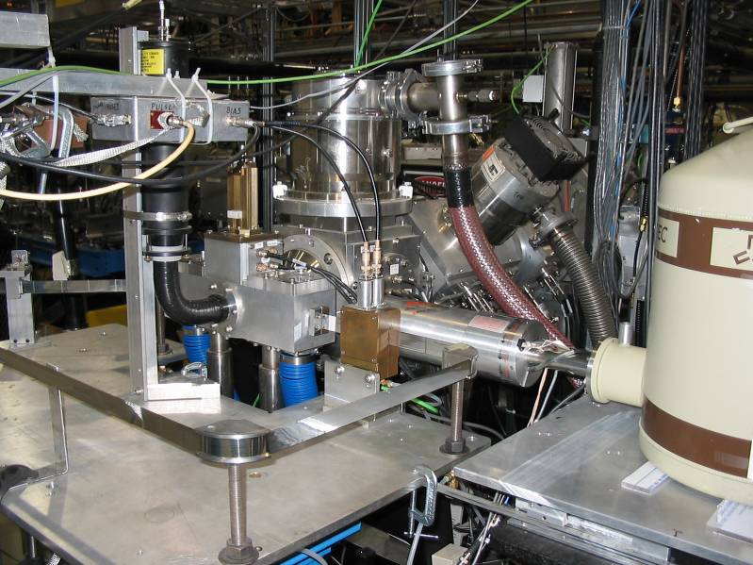
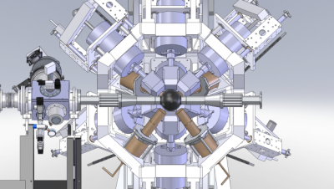
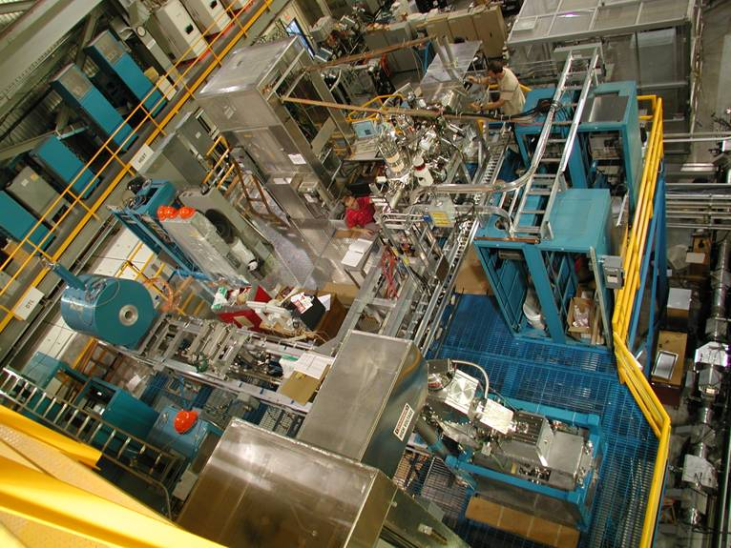
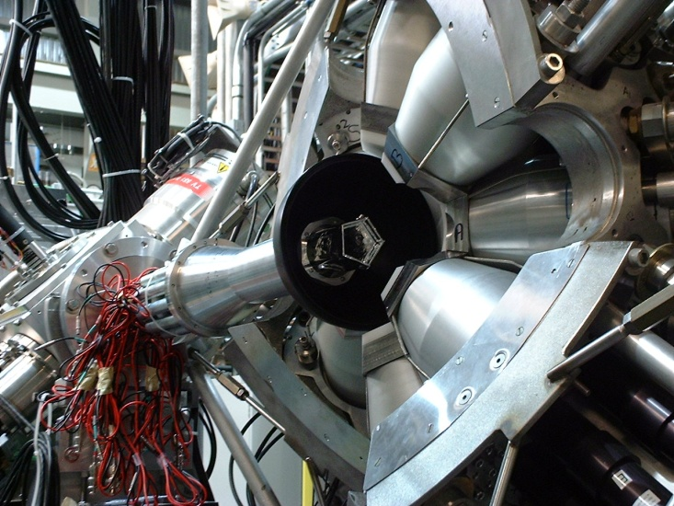
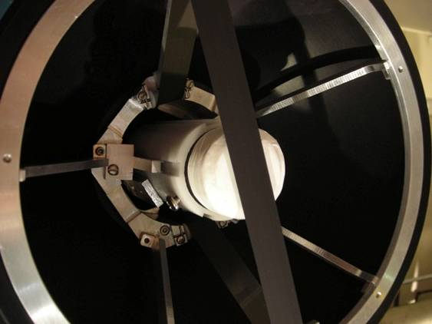
Superallowed Fermi Beta Decay Studies at TRIUMF-ISAC
C.E. Svensson, University of Guelph
CAP Congress,
Sudbury, Ontario
June 16 – 20, 2014

Slide 2
The Cabibbo-Kobayashi-Maskawa (CKM) matrix
The CKM matrix plays a central role in the Standard Model
  and underpins all quark flavour-changing interactions:
  weak interaction eigenstates ≠ quark mass eigenstates
In the Standard Model the CKM describes a unitary transformation.
W⁻
e⁻
g
d′
g
ν_{e}
u
The first row of the CKM matrix provides, by far, the most demanding experimental test of this unitarity condition.

Slide 3
CKM Unitarity
V_{ud}
V_{us}
V_{ub}
J.C. Hardy and I.S. Towner, Ann. Phys. (Berlin) 525, 443 (2013).

Slide 4
CKM Unitarity
…
|V_{ud}|² + |V_{us}|² + |V_{ub}|² = 1.00008(43)_{Vud}(36)_{Vus}
J.C. Hardy and I.S. Towner, Ann. Phys. (Berlin) 525, 443 (2013).

Slide 5
New Lattice QCD Form Factor Calculations for V_{us}
  R.J. Dowdall et al., Phys. Rev. D 88, 074504 (2013)
  K⁺ → lν / π⁺ → lν (HPQCD Collaboration)
  |V_{us}| = 0.22564(53)
In the Standard Model the CKM describes
a unitary transformation.
|V_{ud}|² + |V_{us}|² + |V_{ub}|² = 1.00009(43)_{Vud}(24)_{Vus}
  A. Bazavov et al., Phys. Rev. Lett. 112, 112001 (2014)
  K⁺ → π⁺lν (Fermilab Lattice and MILC Collaborations)
  |V_{us}| = 0.22290(90)
In the Standard Model the CKM describes
a unitary transformation.
|V_{ud}|² + |V_{us}|² + |V_{ub}|² = 0.99885(43)_{Vud}(40)_{Vus}

Slide 6
V_{ud} from Superallowed Fermi β Decay
To first order, β decay ft values can be expressed as:
constants
phase space (Q-value)
K
f t =
Weak coupling
strength
half-life, branching ratio
|M_{fi}|² g²
matrix element
For the special case of 0⁺ 0⁺ (pure Fermi) β decays between
isobaric analogue states (superallowed) the matrix element is
that of an isospin ladder operator:
|M_{fi}|² = (T – T_{Z})(T + T_{Z} + 1) = 2 (for T=1)
Strategy: Measure superallowed ft-values, deduce G_{V} and V_{ud}:
Vector coupling
constant
K
G_{V}² =
|V_{ud}| = G_{V} / G_{F}
Fermi coupling
constant
2 ft

Slide 7
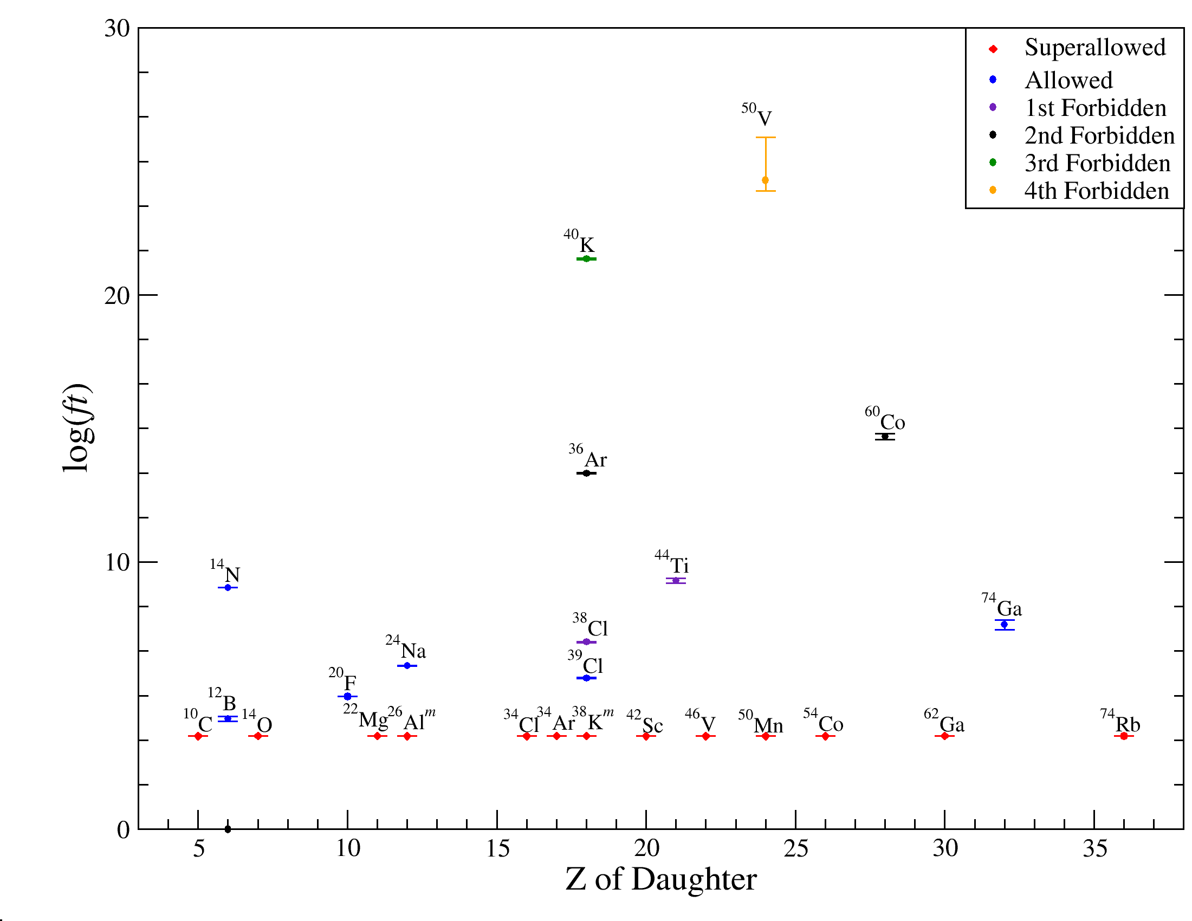
β decay ft-values

Slide 8
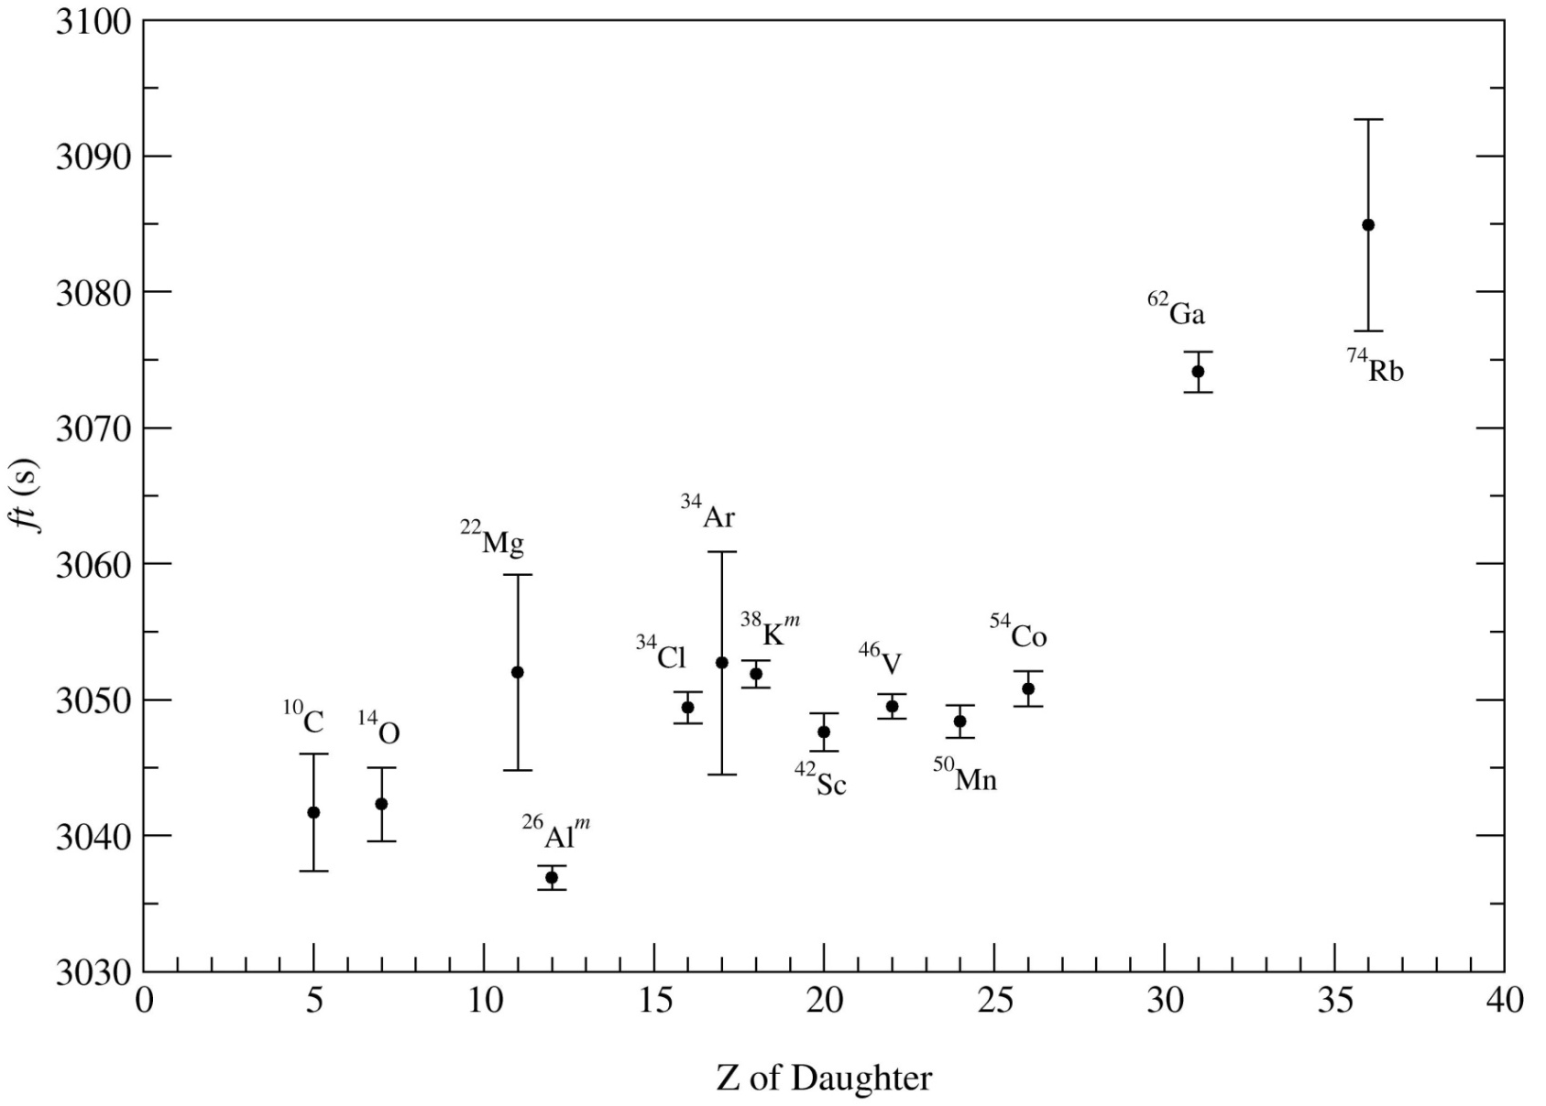
Superallowed ft-values
K
ft ≈
= constant (CVC)
2 G_{v}²
2%

Slide 9
Superallowed Fermi β Decay: Corrections
Ft
“Corrected” ft value
CVC Hypothesis
Calculated corrections (~1%) (nucleus dependent)
Inner radiative correction (~2.4%) (nucleus independent)
Experiment
Δ_{R} = nucleus independent inner radiative correction: 2.361(38)%
δ_{R} = nucleus dependent radiative correction to order Z²α³: ~1.4%
- depends on electron’s energy and Z of nucleus
δ_{NS} = nuclear structure dependent radiative correction: -0.3% – 0.03%
δ_{C} = nucleus dependent isospin-symmetry-breaking correction: 0.2% – 1.5%
- strong nuclear structure dependence
V

Slide 10
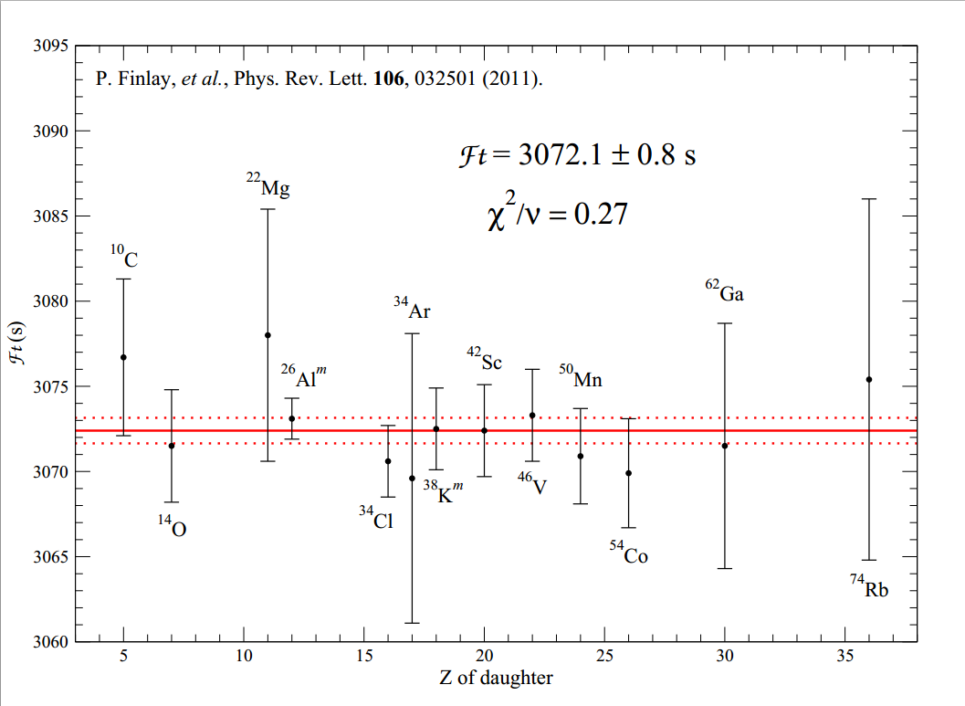
Corrected Superallowed Ft Values
Ft_{WS} = 3072.38(75)
χ²/ν = 0.32
P. Finlay, et al., Phys. Rev. Lett. 106, 032501 (2011)
R. Dunlop, et al., Phys. Rev. C 88, 045501 (2013)

Slide 11
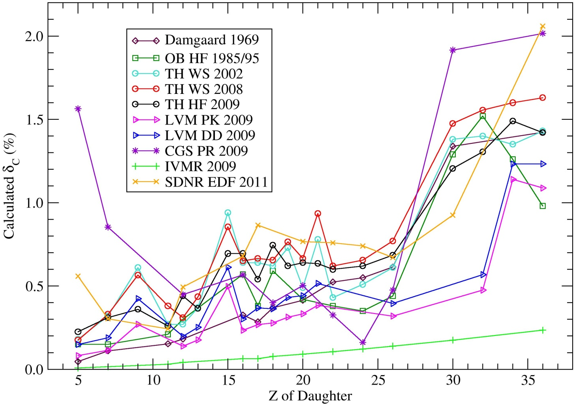
Theoretical Treatment of δ_{C}
Many recent approaches to ISB corrections
→ Nuclear Shell
Model
→ Relativistic
Hartree-Fock
→ Random Phase
Approximation
→ Energy Density
Functional

Slide 12
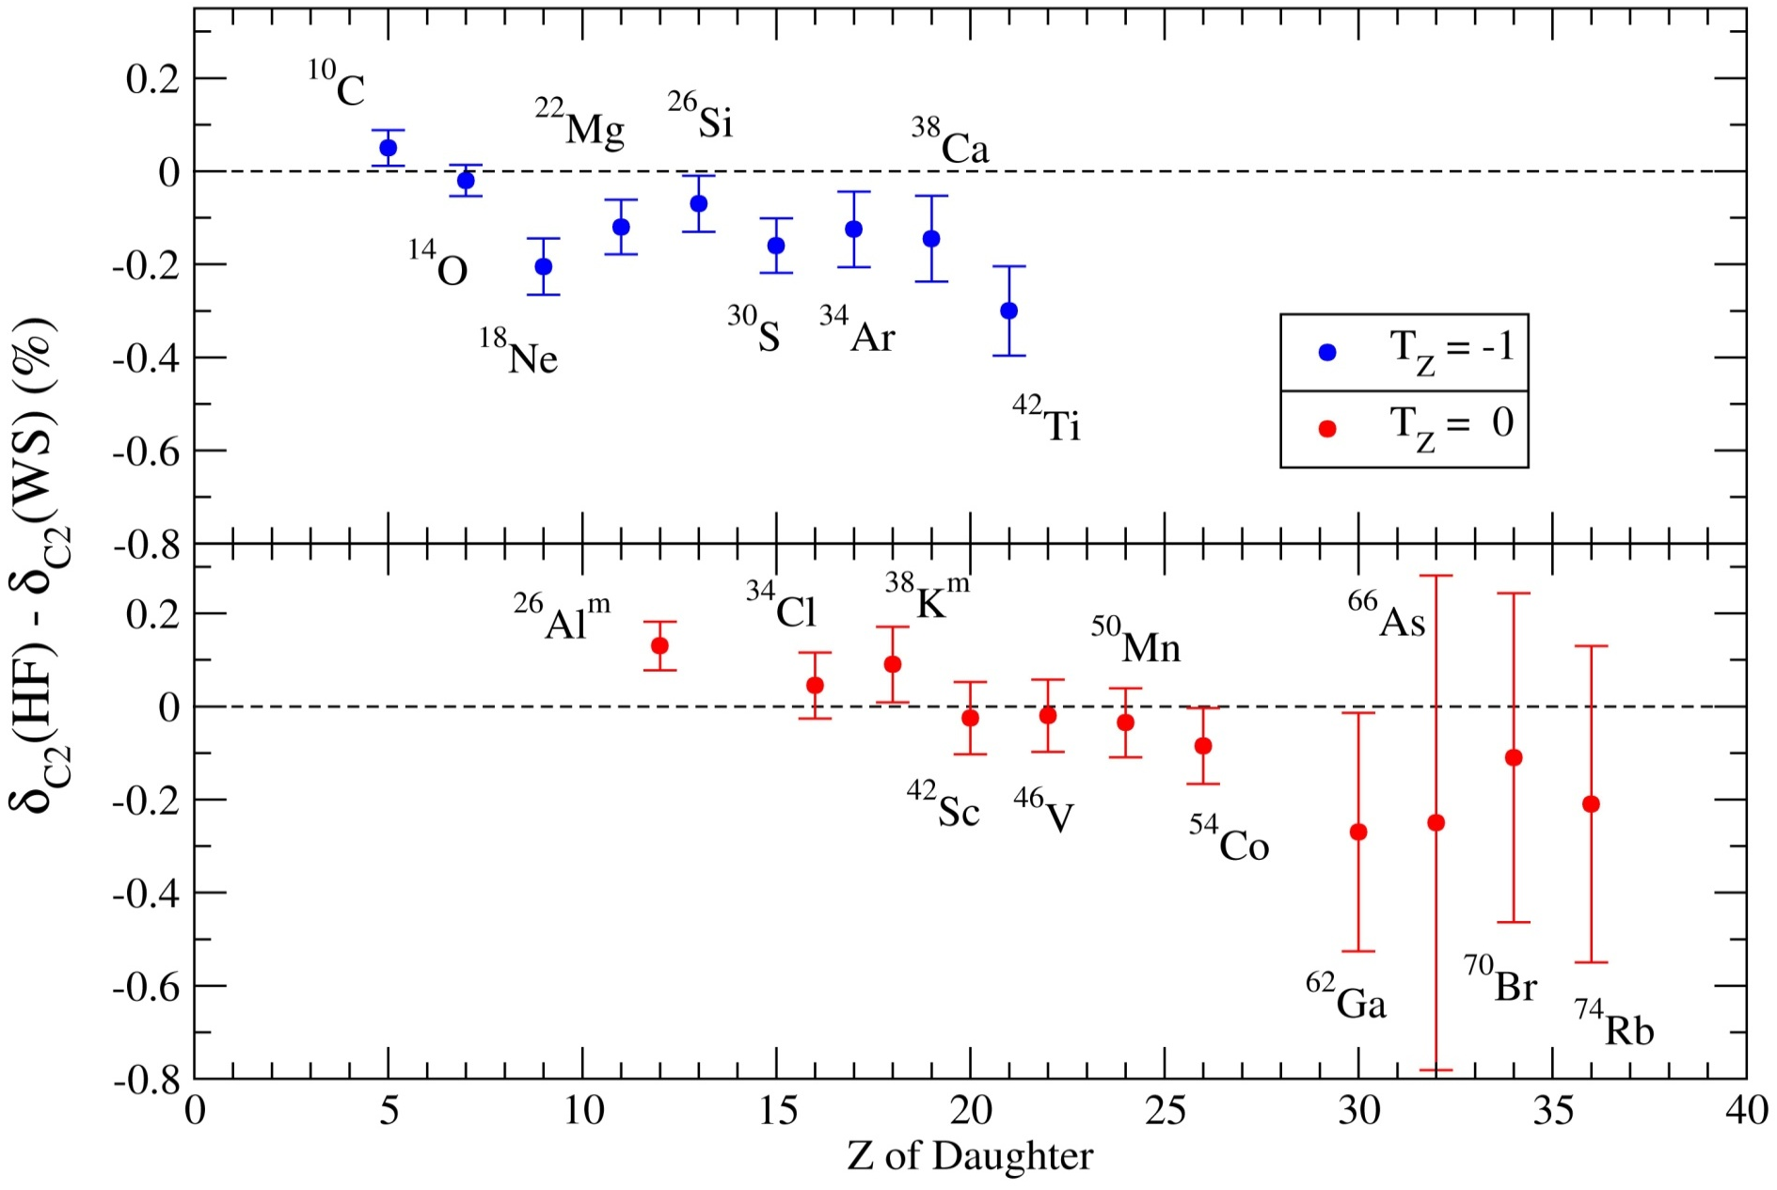
Difference between Woods-Saxon and
Hartree-Fock Radial Overlap Corrections

Slide 13

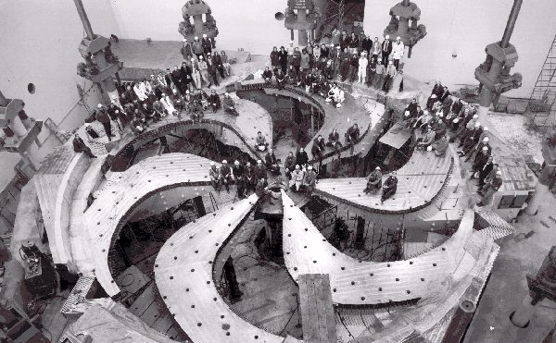
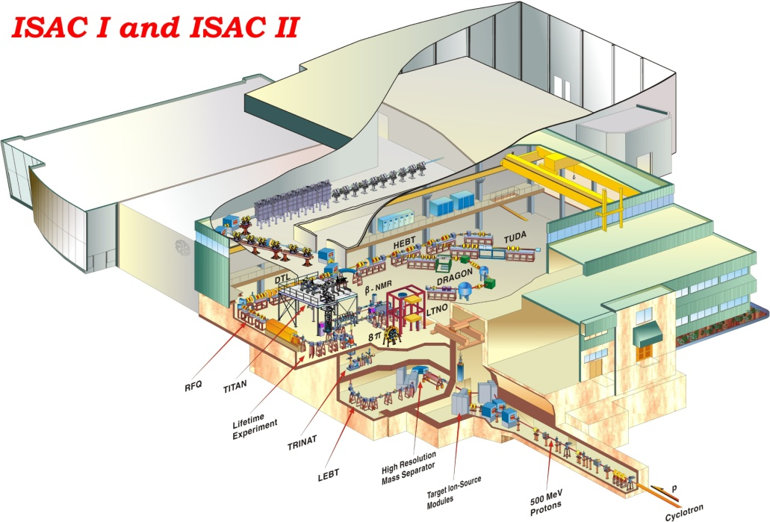
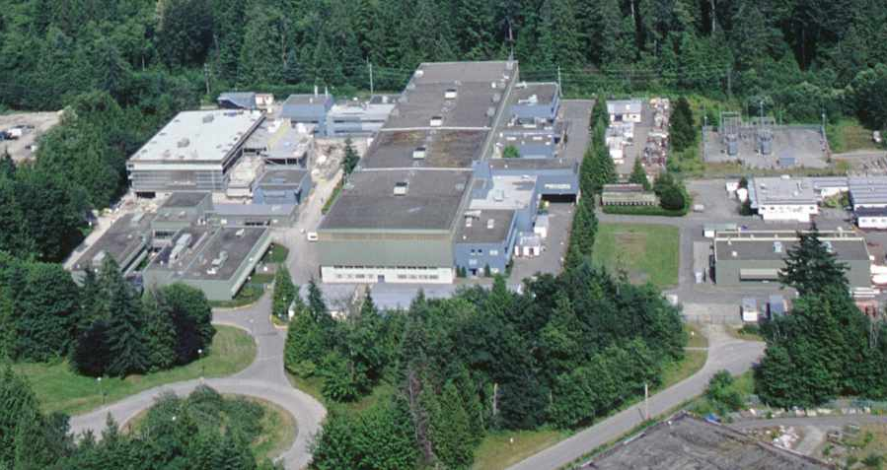
TRIUMF-ISAC
Up to 100 μA, 500 MeV proton beams from the TRIUMF main cyclotron produce high-intensity secondary beams of many of the superallowed emitters by the ISOL technique.

Slide 14


Superallowed Fermi β Decay Studies at ISAC
Halflives (GPS)
Branching ratios (8π)
Masses (TITAN)
Charge Radii (laser spectroscopy)
Near Future (GRIFFIN)
Halflives (ZDS)

Slide 15
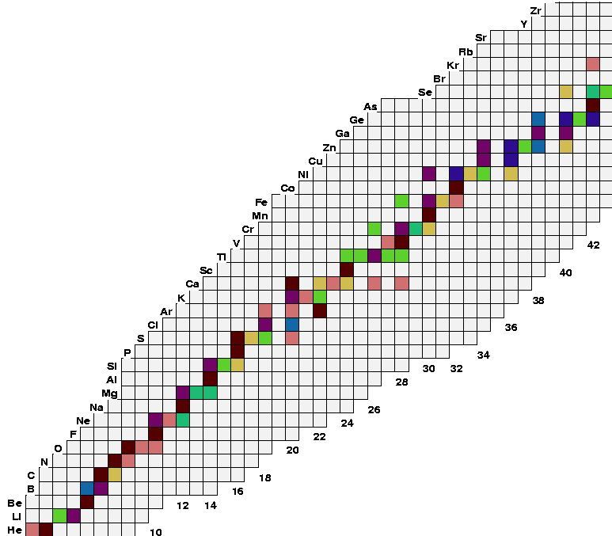
Superallowed β Decay
Studies at ISAC
T_{1/2} , G.C. Ball et al, PRL 86 1454 (2001)
BR, A. Piechaczek et al, PRC 67, 051305 (2003)
BR, R. Dunlop et al, PRC 88, 045501 (2013)
Q: S. Ettenauer et al., PRL 107, 272501 (2011)
CR: E. Mané et al, PRL 107, 212502 (2011)
⁷⁴Rb
⁷⁰Br
T_{½}, G.F. Grinyer, PRC 77, 201501 (2008)
BR, B.H. Hyland, PRL 97, 102501 (2006)
BR, P. Finlay PRC 78, 044321 (2008)
⁶²Ga
⁶⁶As
{
⁵⁴Co
T_{½} and BR
⁵⁰Mn
BR, K.G. Leach et al., PRL 100, 192504 (2008) T_{1/2} , G.C. Ball et al, PRC 82, 045501 (2010)
⁴⁶V
N=Z line
^{38m}K
T_{½} and BR
³⁴Ar
T_{½} P. Finlay et al, PRL 106, 032501 (2011)
BR, P. Finlay et al, PRC 85, 055501 (2012)
^{26m}Al
T_{½}, G.F. Grinyer et al, PRC 76, 025503 (2007) PRC 87, 045502 (2013)
¹⁸Ne
¹⁴O
T_{½}, A.T. Laffoley et al, PRC 88, 015501 (2013)
¹⁰C
T_{½} by β and γ counting M. Dunlop et al.

Slide 16
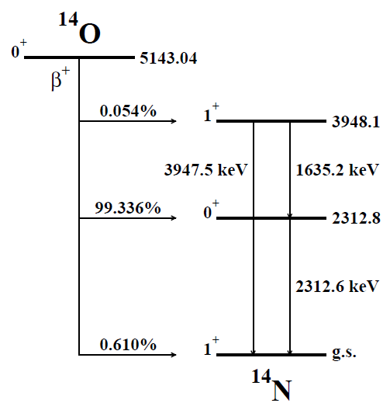
¹⁴O Half-Life Measurement
Simultaneous independent direct β and γ-ray counting experiments using the 8π spectrometer and the Zero-Degree Scintillator.
γ Counting:
-Decay Selective
-Slow & Inefficient
Previous measurements reveal a systematic discrepancy between detection method
β Counting:
-Fast & Efficient
-Not Decay Selective

Slide 17
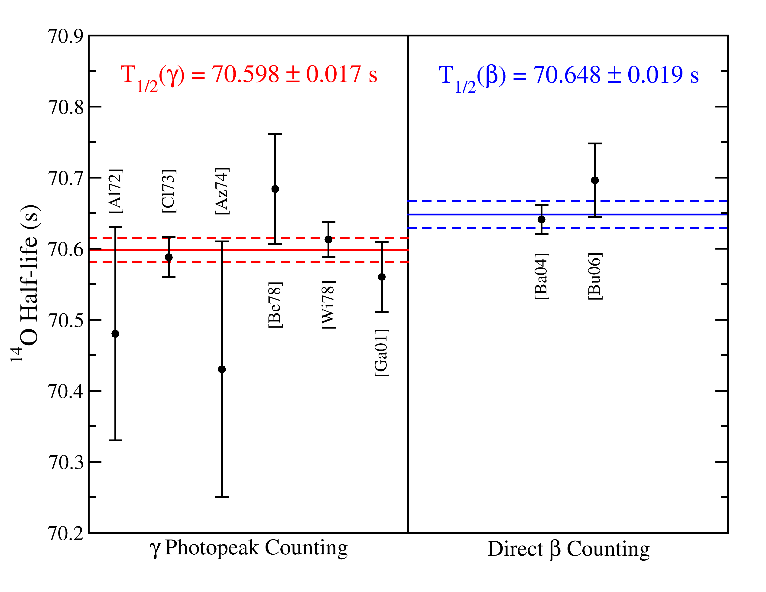
¹⁴O Half-Life vs Detection Method
Notes:
Ft value could be shifted by 0.5 sigma!

Slide 18
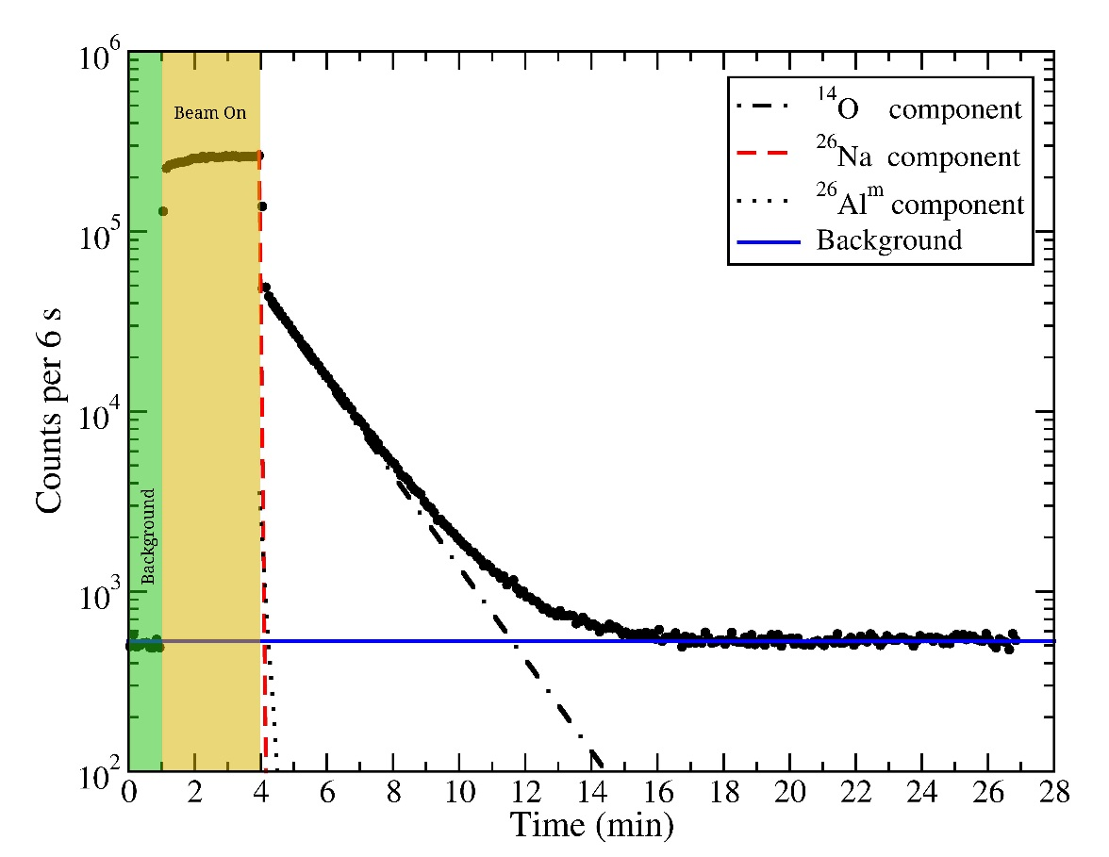
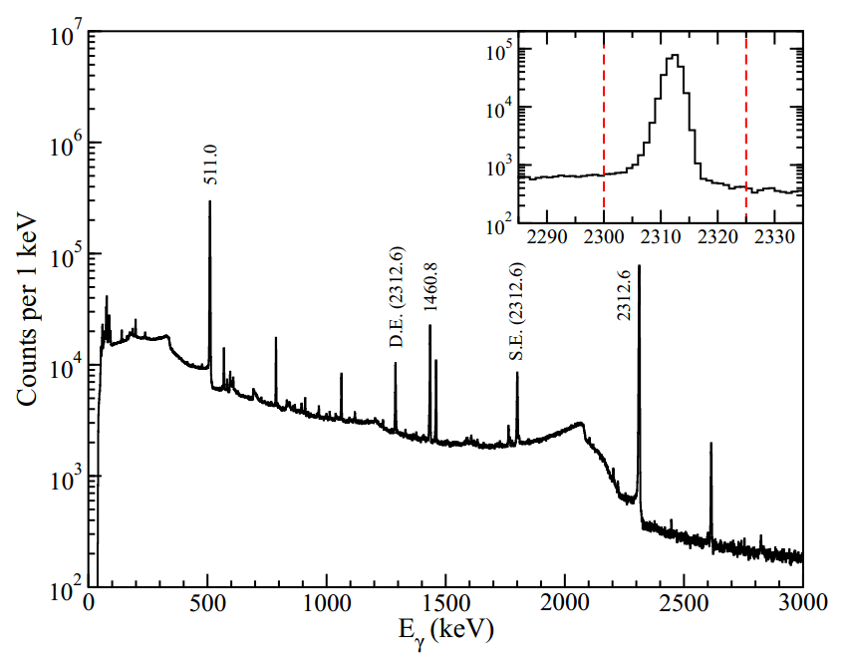
¹⁴O Half-Life Measurement at ISAC
¹²C-¹⁴O: T_{1/2} = 70.620 s
²⁶Al^{m}: T_{1/2} = 6.3465 s
²⁶Na: T_{1/2} = 1.072 s
Beam
γ Counting
β Counting

Slide 19
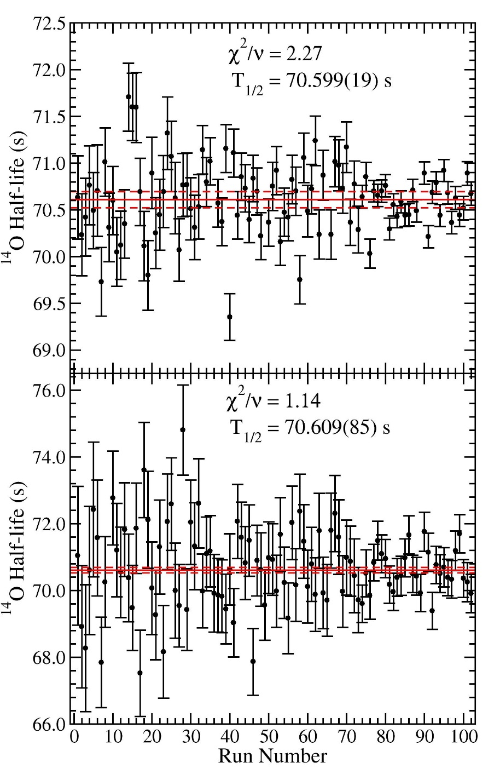
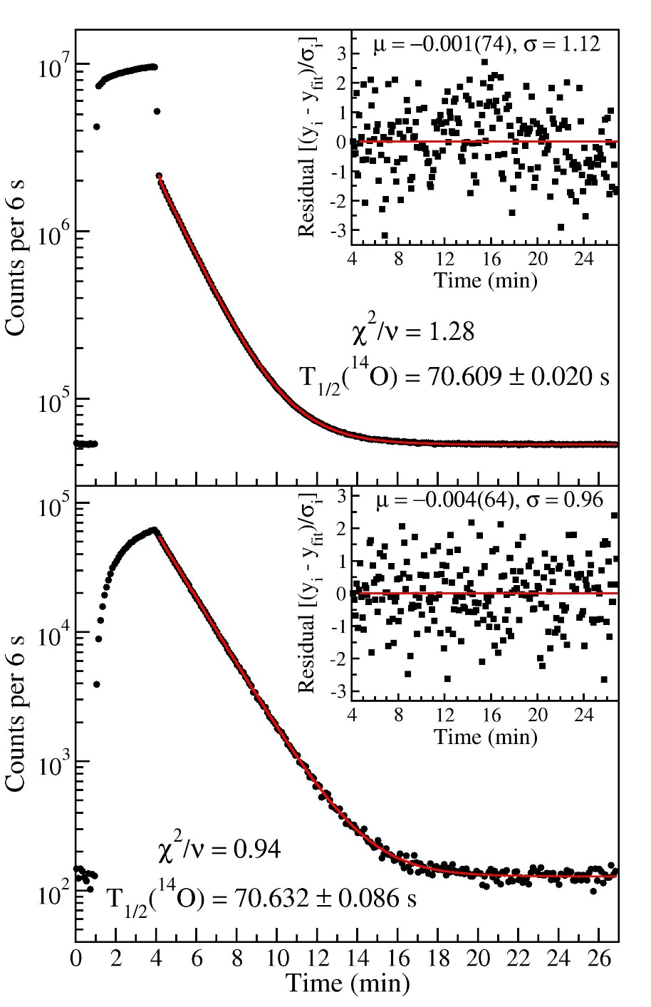
β
γ

Slide 20
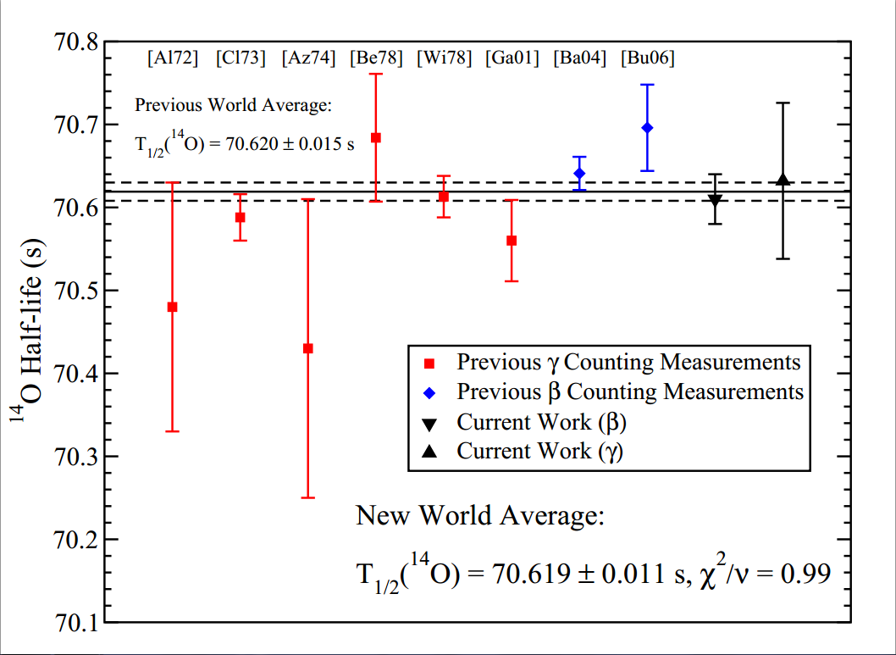
¹⁴O Half-Life
Initial experiment shows consistency between β and γ half-life measurements for ¹⁴O.
A follow-up experiment is scheduled for July, 2014 to push to 0.01% precision.
ft measurements for light superallowed Fermi β emitters are required to constrain scalar currents in the weak interaction.
A.T. Laffoley et al., Phys. Rev. C 88, 015501 (2013)

Slide 21
¹⁸Ne
¹⁸Ne Superallowed Decay
T = 1
0⁺
T_{½} = 1.6654(11) s
β⁺
Q = 4443.6 keV
1⁺ 1701 0.19%
β⁺
0⁻ 1081 0.0002%
T = 1
0⁺ 1042 7.70%
T = 1
β⁺
T = 0
¹⁸F
1⁺ 0 92.11%
T_{½} = 109.73(2) min
β⁺
Q = 1655.5 keV
¹⁸O
T = 1
0⁺
stable

Slide 22
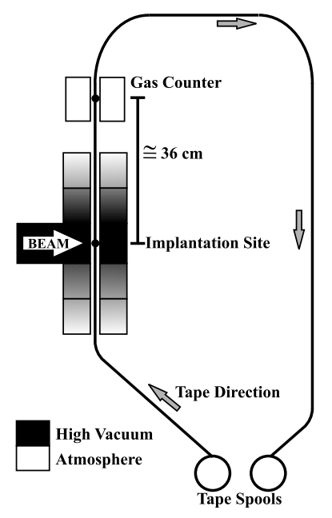
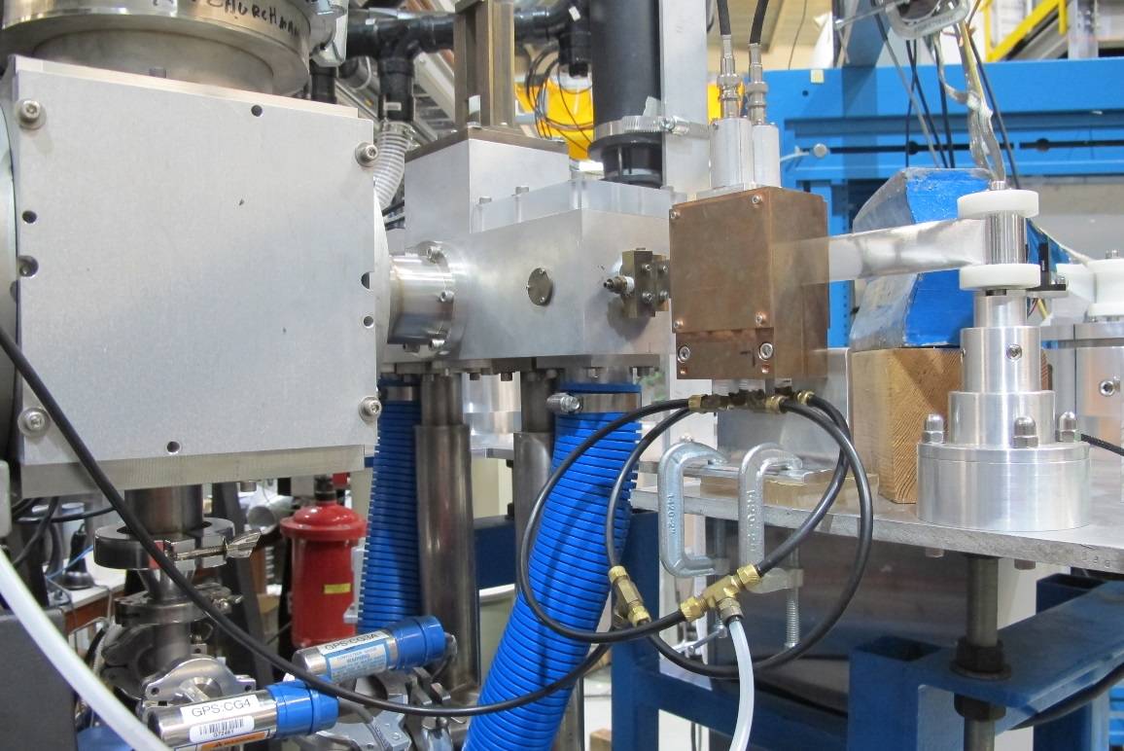

4π Gas Counter and Thick Tape Transport
28 cm
4π continuous-flow gas-proportional counter and tape transport system
Methane (CH₄) gas
~ 100% efficient β counter
Very low background rates
E. F. Zganjar
Notes:
Modify the 28cm figure (black text on white)

Slide 23
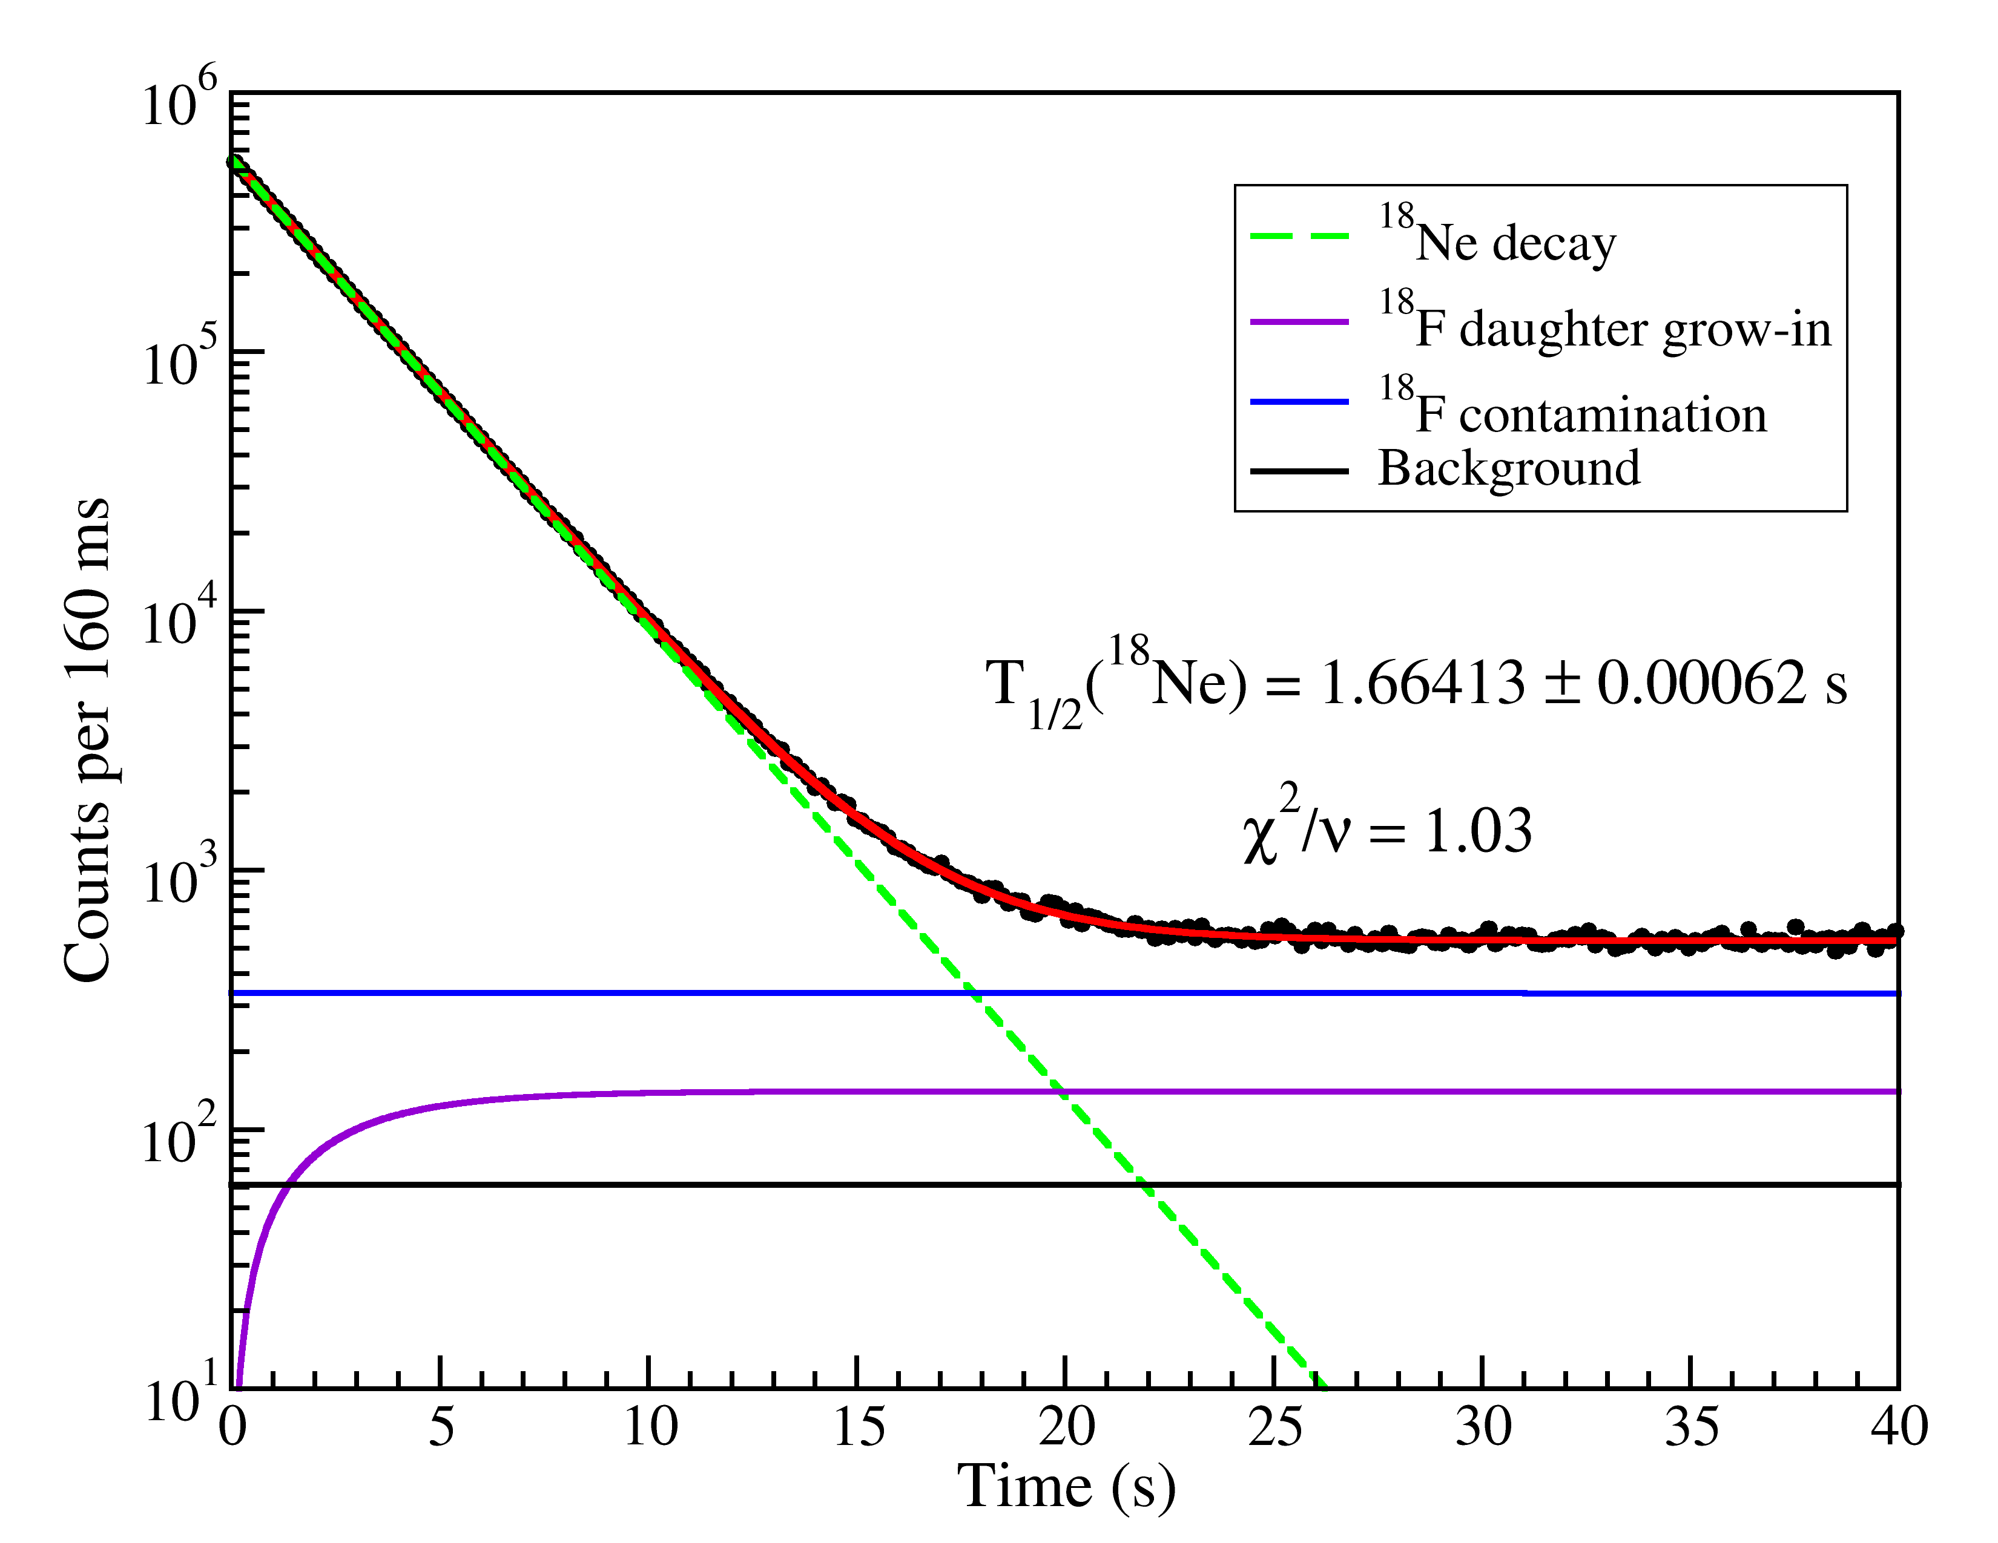
¹⁸Ne Sample Data – Gas Counter
Notes:
We made 3 measurements, one with the gas counter, and a simultaneous one with the ZDS and 8pi

Slide 24
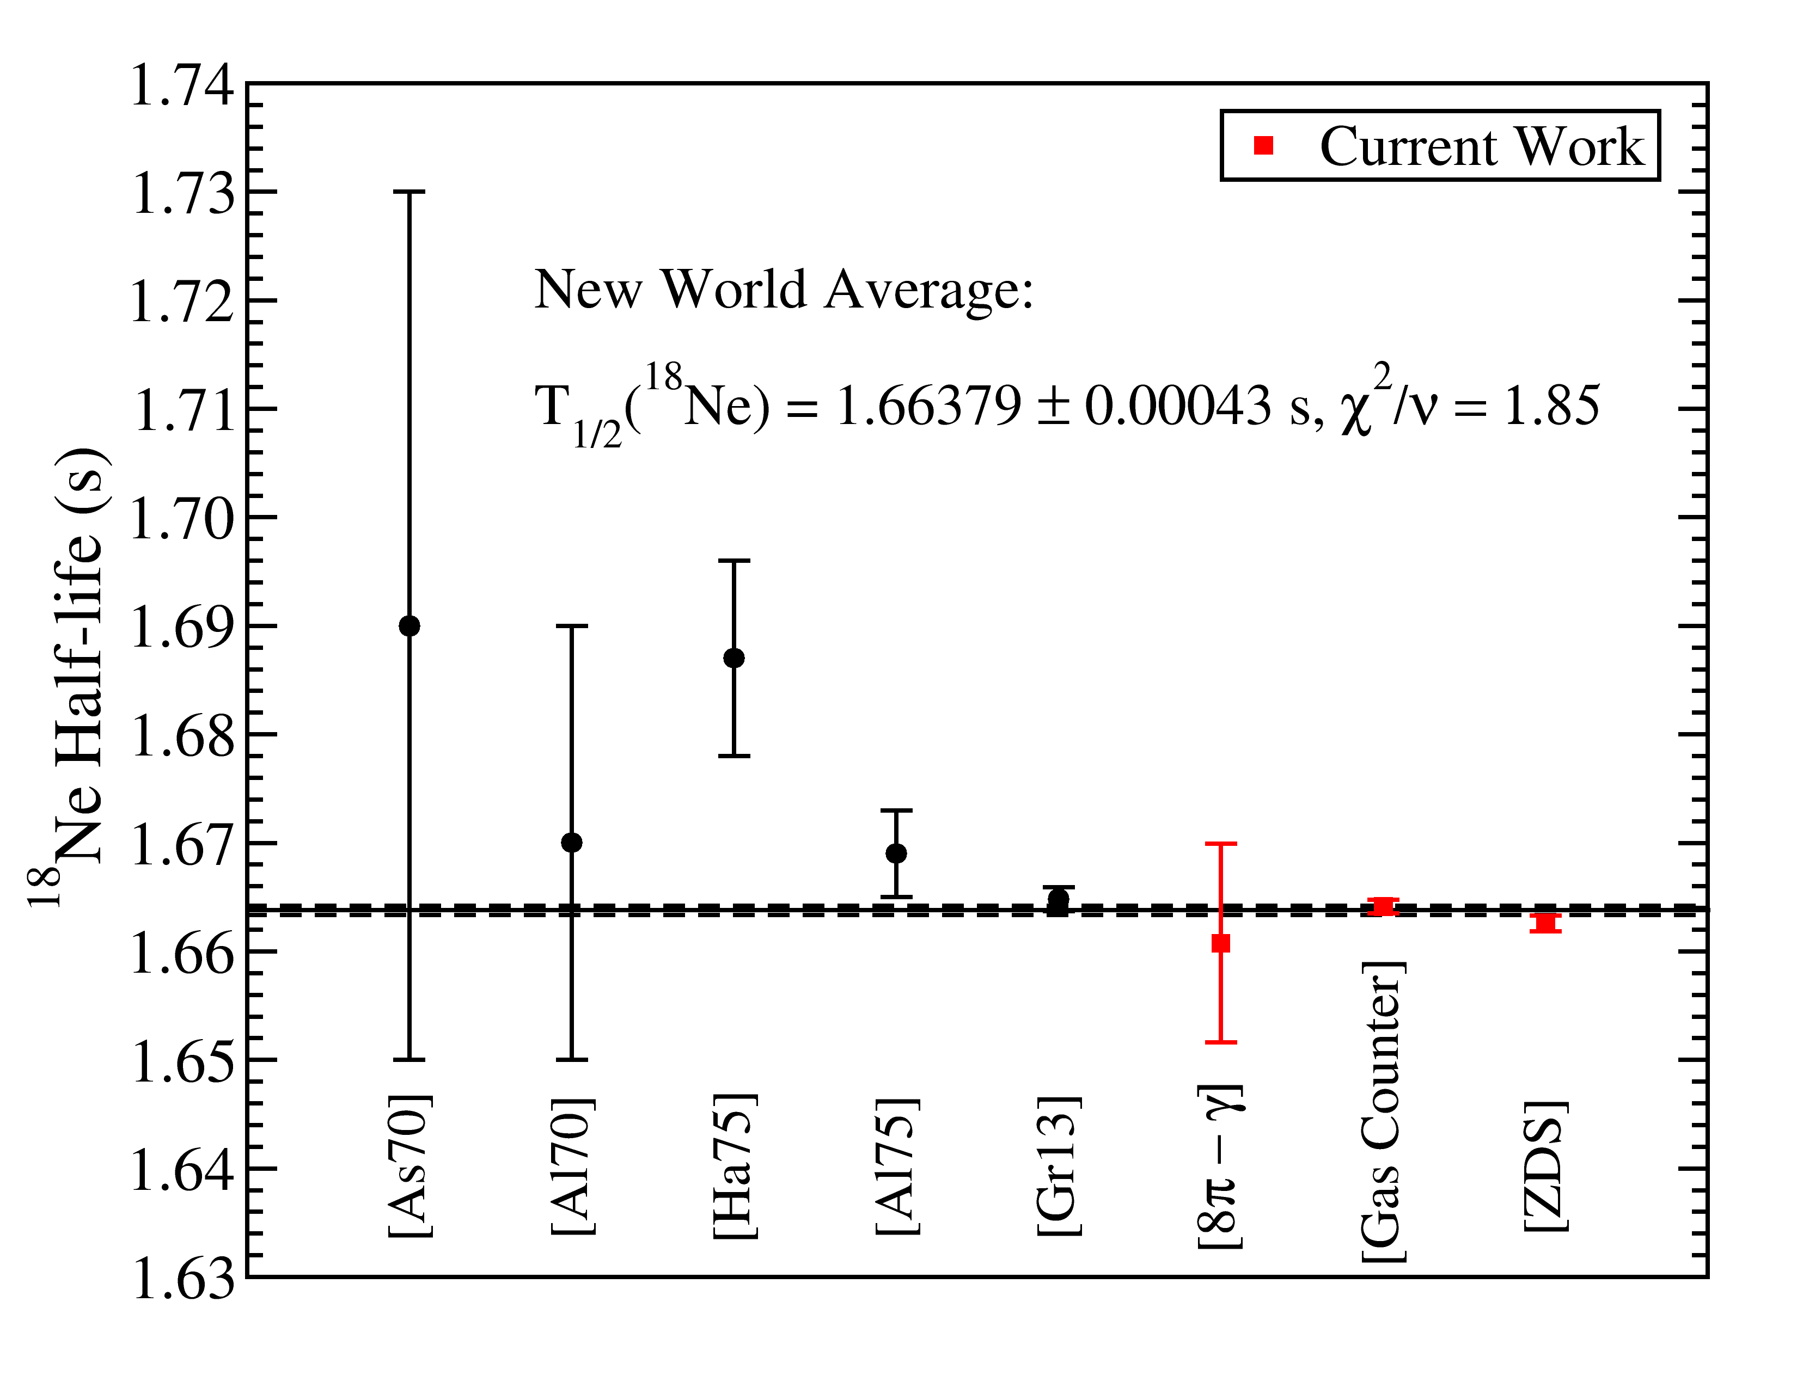
Status of ¹⁸Ne Half-life
Half-life precision improved
by a factor of 3, to 0.025%
Preliminary
Notes:
Put precision of half-life of 18Ne (0.025%?)

Slide 25
⁷⁴Rb Superallowed Decay (T_{1/2} ~ 65 ms)
Halflife: Measured with the GPS 4π gas proportional counter at ISAC.
T_{1/2} = 64.761(31) ms
G.C. Ball et al., Phys. Rev. Lett. 86, 1454 (2001).
Mass: First demonstration of a high charge state mass measurement for a short-lived isotope with the TITAN Penning trap.
S. Ettenauer et al., Phys. Rev. Lett. 107, 272501 (2011).
Charge Radius: Measured via collinear laser spectroscopy:
<r²_{ch}>^{1/2} = 4.19(1) fm
Reduces uncertainty in theoretical δ_{C2} by ~ 20%
E. Mané et al., Phys. Rev. Lett. 107, 212502 (2011).
Branching Ratio: Measured with the 8π Spectrometer to ± 0.03%
BR = 99.545 (31) %
R. Dunlop et al., Phys. Rev. C 88, 045501 (2013).

Slide 26
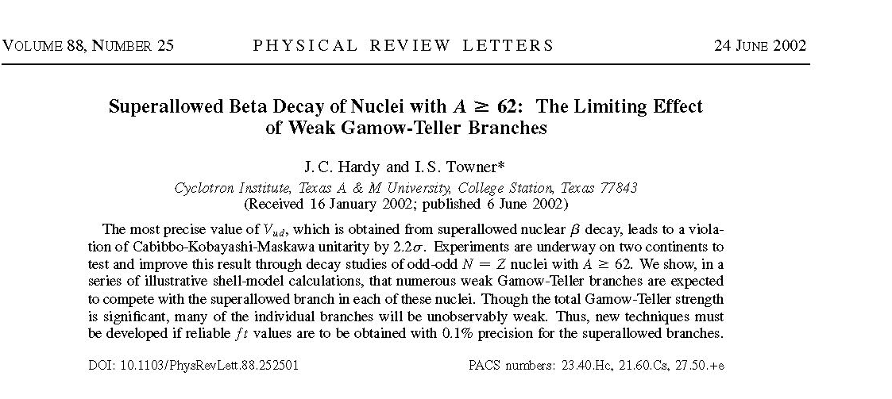
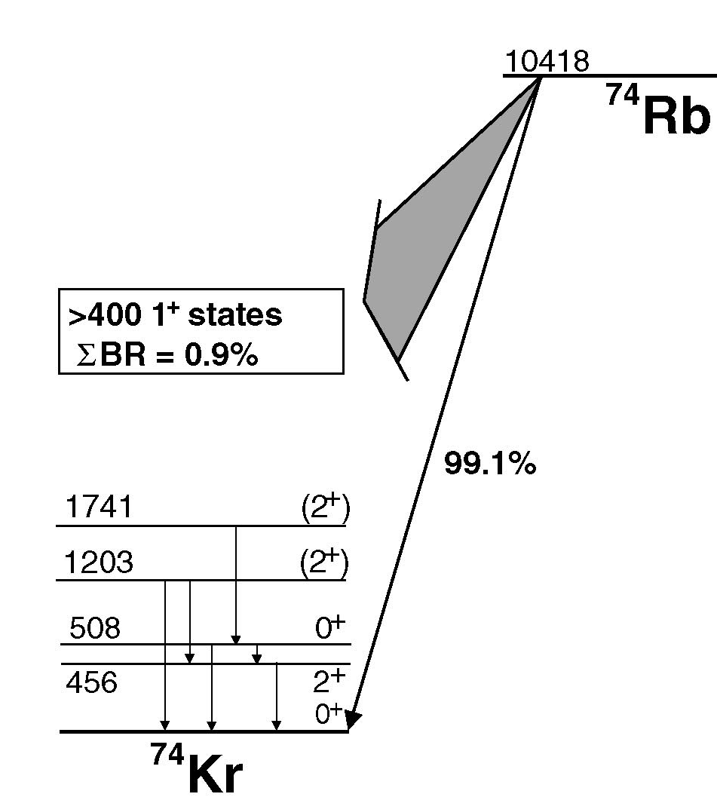
Superallowed β Branching Ratios for A ≥ 62 and the Pandemonium Effect
For large Q-value β decays, there are generally many weak β branches to the large number of daughter states within the Q-value window.
In the subsequent γ decay, many individual γ-rays may be too weak to identify.
The sum of these unobserved γ intensities will, however, generally be sufficient to prevent precision determination of β decay branching ratios through γ-ray spectroscopy.

Slide 27
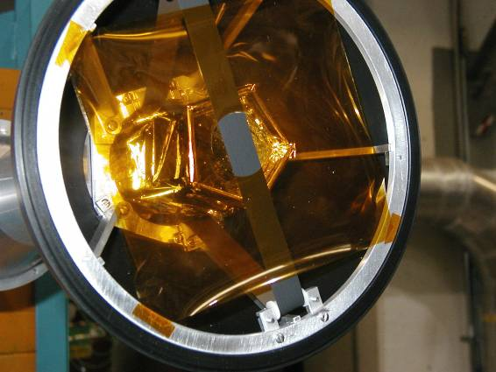

8π Spectrometer – Decay Spectroscopy at ISAC-I
Simultaneous collection of γ-singles, γγ coincidences, β tagging, conversion electrons, and lifetime measurements

Slide 28
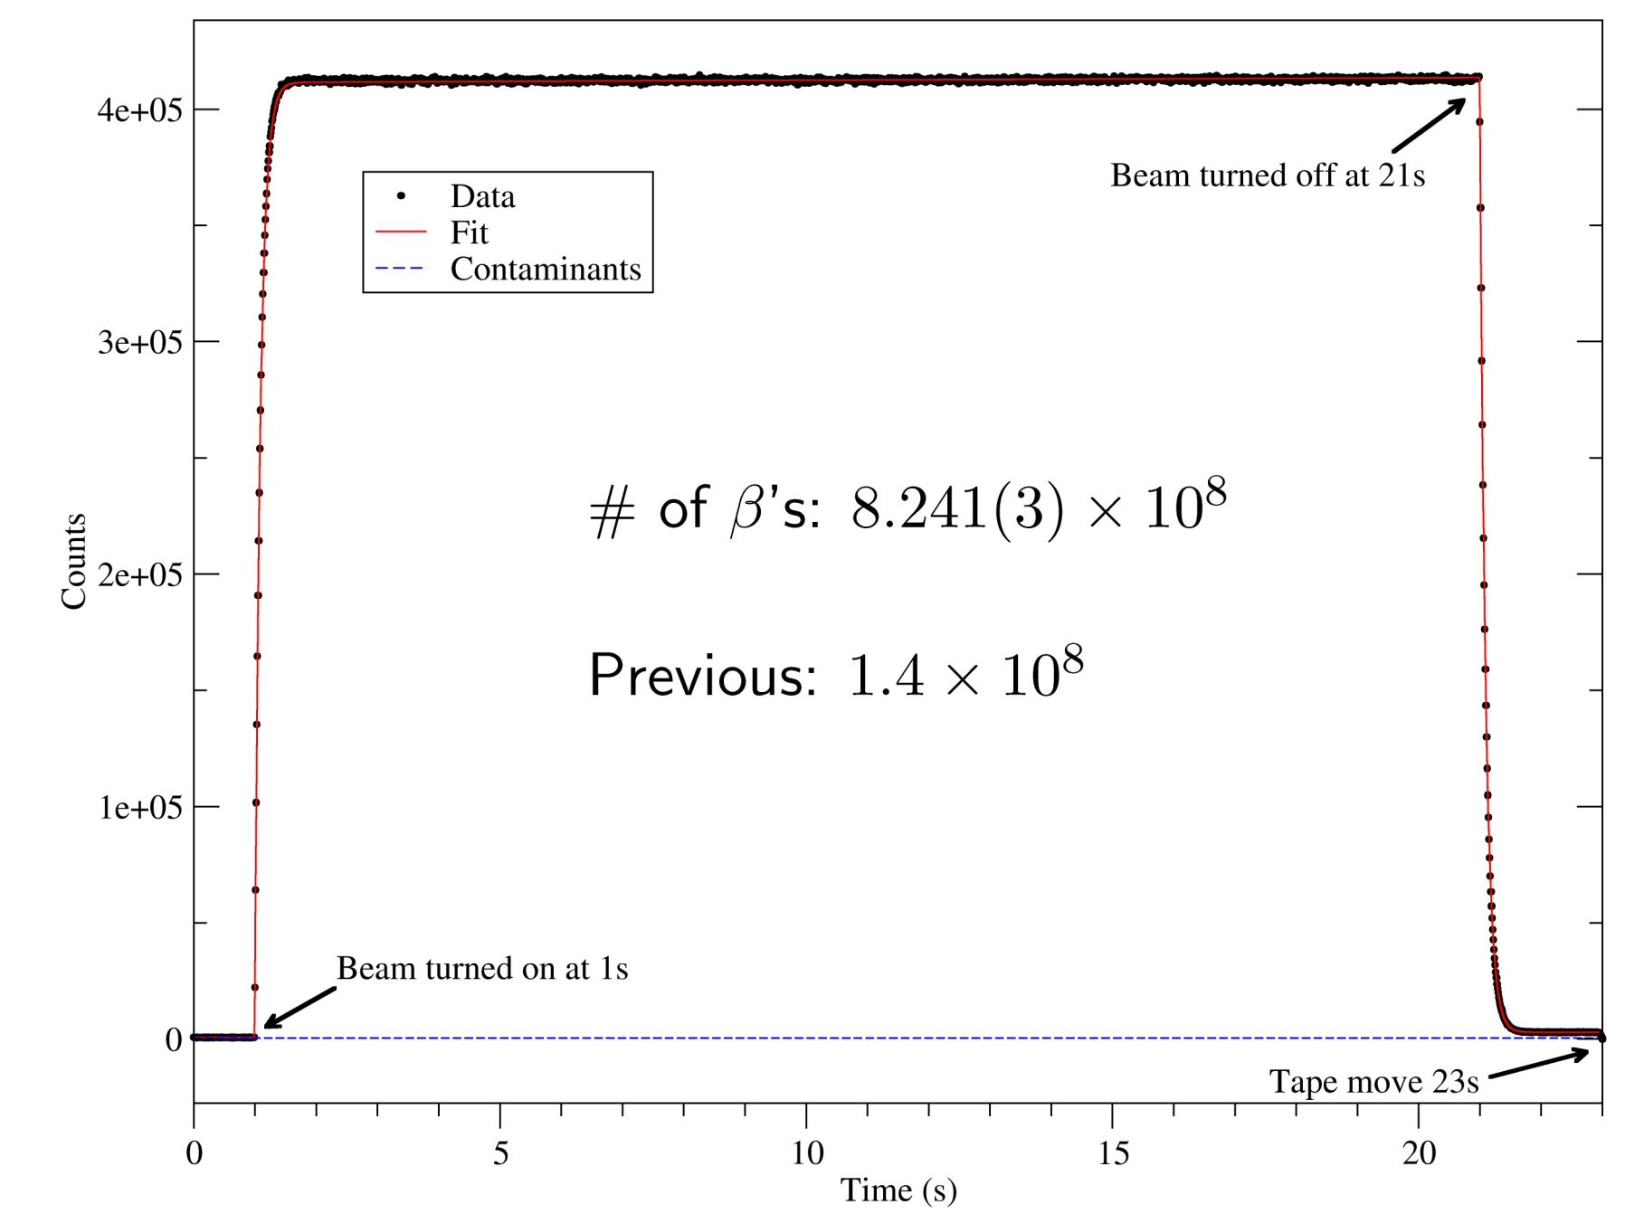
Counting ⁷⁴Rb β Decays with SCEPTAR

Slide 29
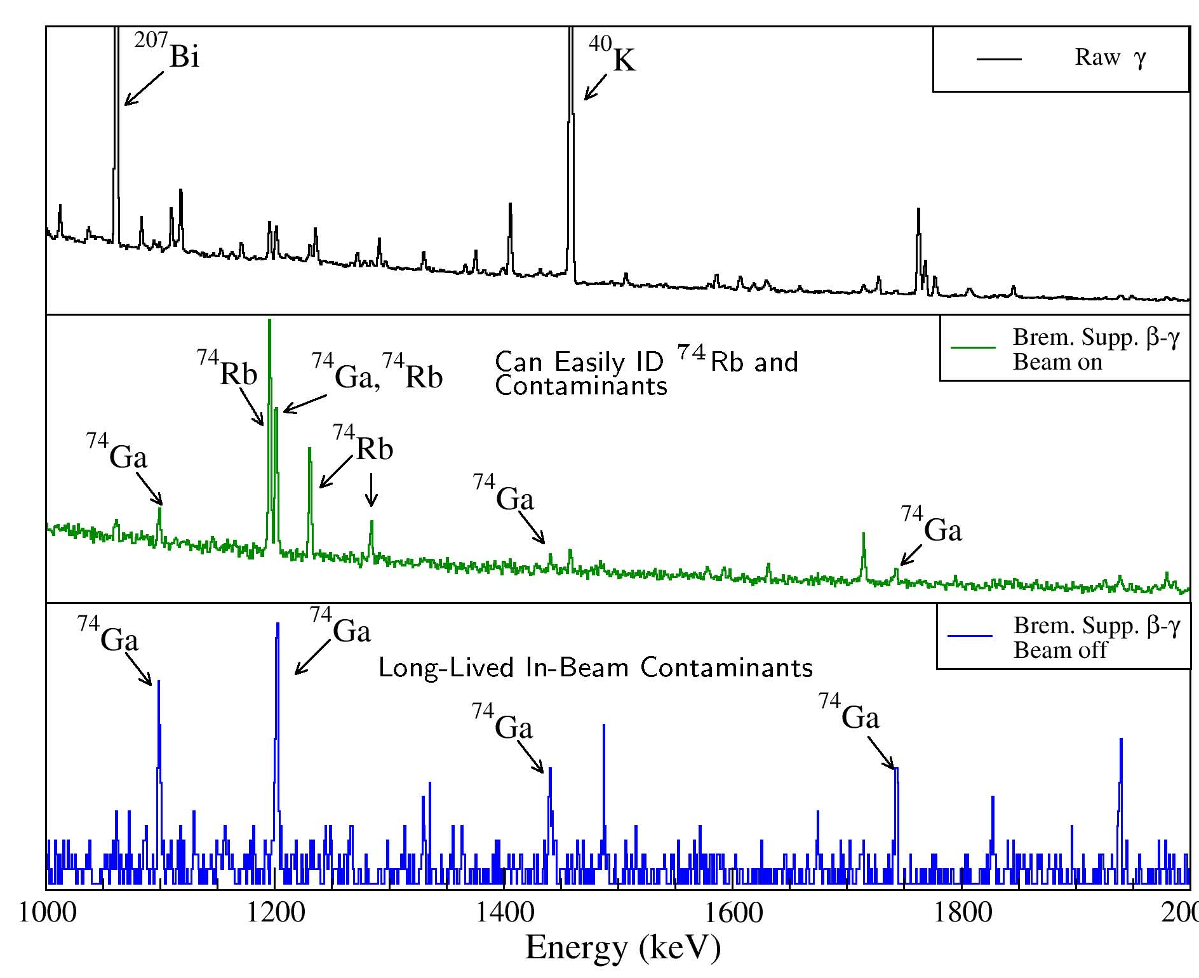
Identifying γ-rays from ⁷⁴Rb Decay
Raw γ-spectrum contains lines from room background and in-beam contaminants
β-γ coincidence, Bremsstralung suppression reduce background
Spectrum during beam-off allows one to identify long-lived contaminants

Slide 30
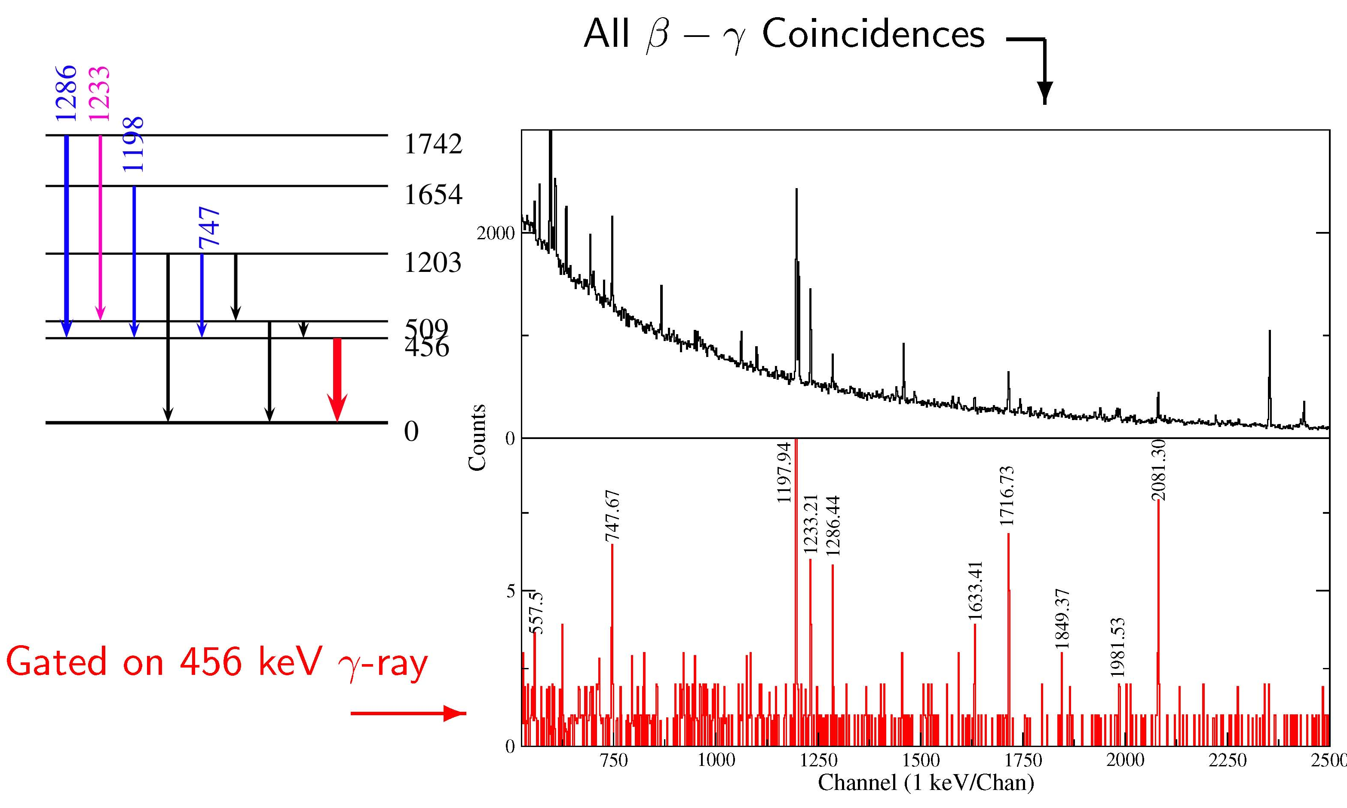
γ−γ Coincidences following ppm β-decay branches of ⁷⁴Rb

Slide 31
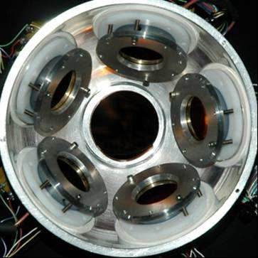
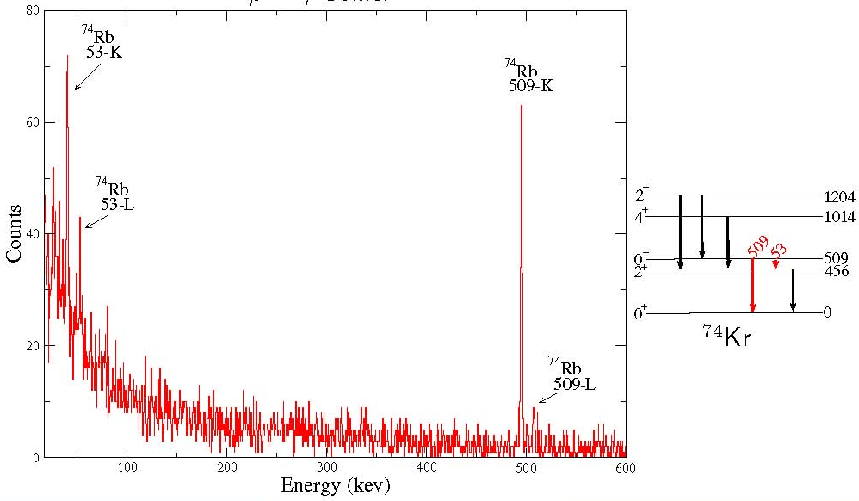
Internal Conversion Decay of the 0⁺₂ State of ⁷⁴Kr
β − γ − electron Coincidence Spectrum

Slide 32
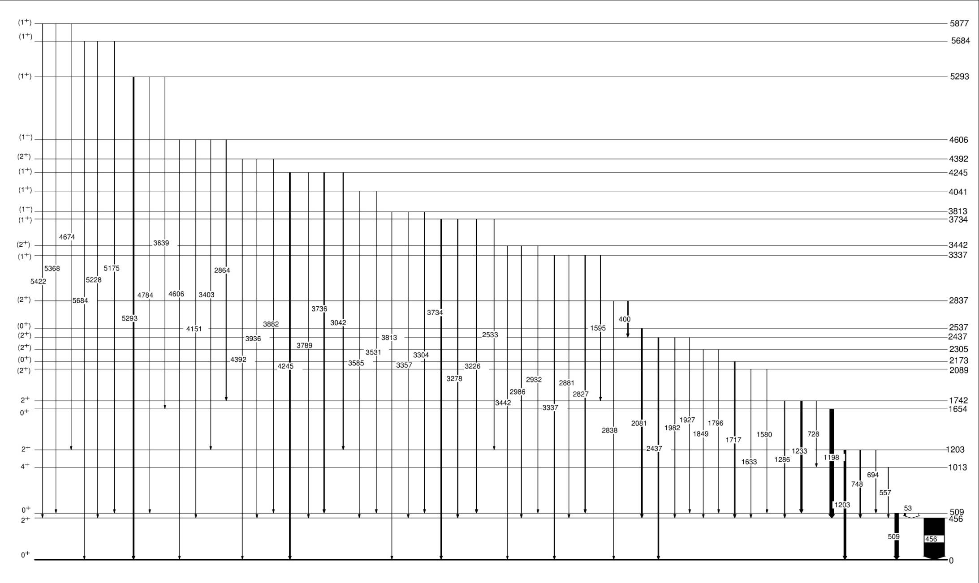
57 γ-ray transitions identified following ⁷⁴Rb decay
Ground-state γ-feeding of I_{gs} = 3950(70) ppm identified.

Slide 33
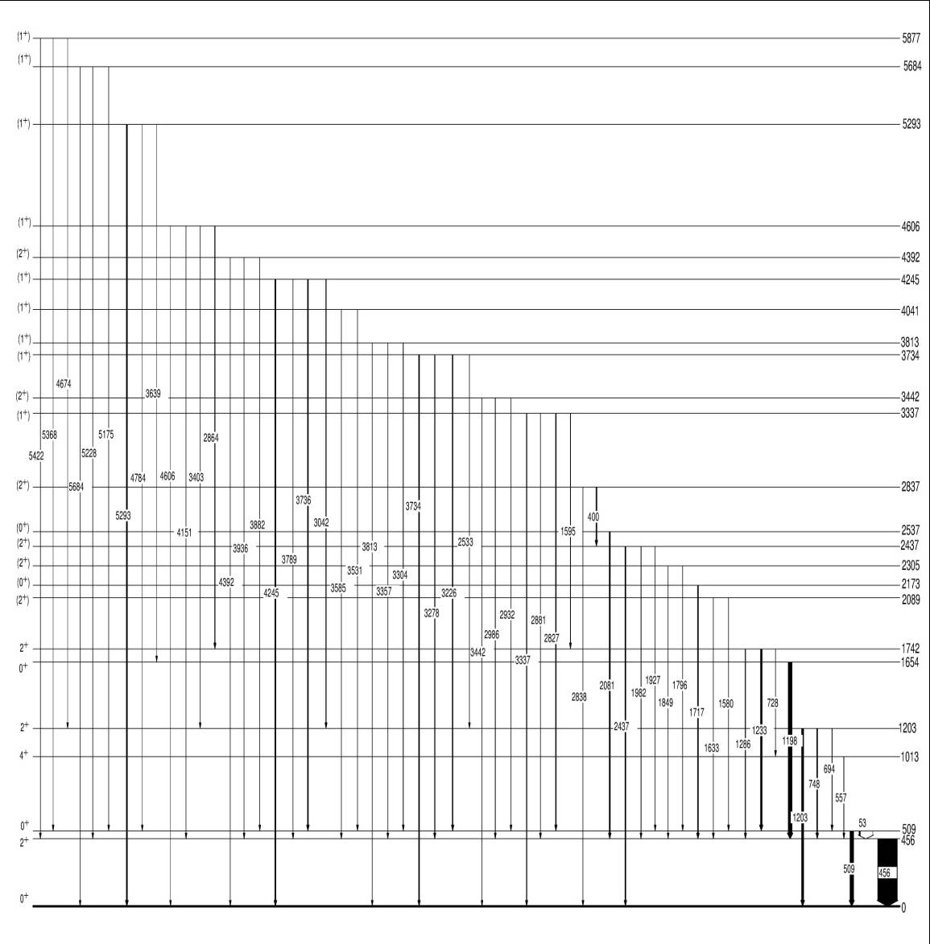
Controlling Pandemonium via 2⁺ “Collector” States
I_{gs} = 3950(70) ppm
I'_{gs}
I'₂₊
Direct β feeding of 2⁺
states is negligible
~ 400 1⁺ Levels
I'₂₊ = 1225(57) ppm
B_{gs} = I'_{gs} /(I'_{gs} + I'₂₊)
Expt + Shell Model:
B_{gs} = 0.33(11)
I'_{gs} = 600(300) ppm
Superallowed Branching Ratio:
99.545 ± 0.031 %
R. Dunlop PRC 88, 045501 (2013)

Slide 34
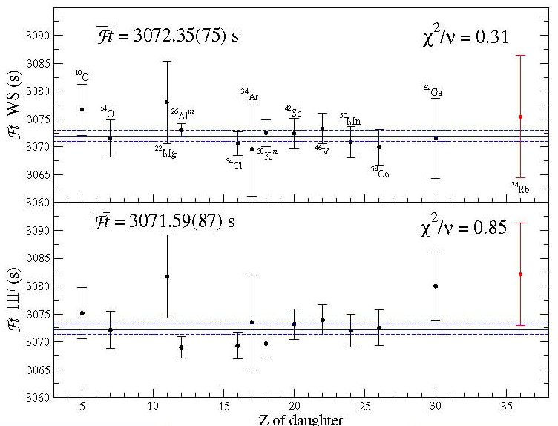
⁷⁴Rb Superallowed Decay

Slide 35
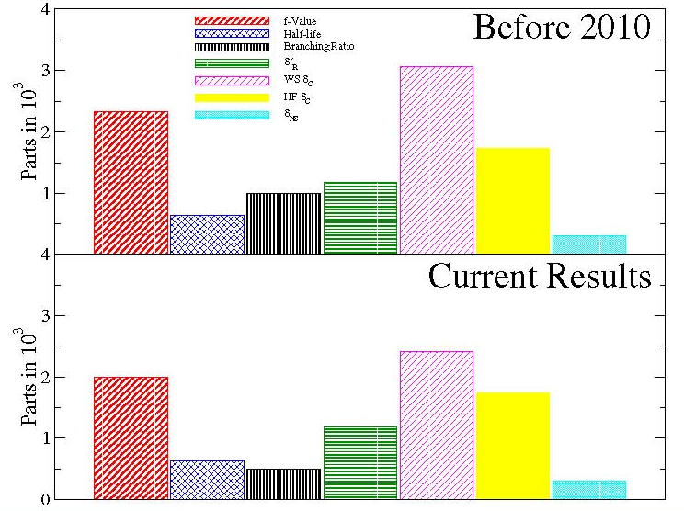
⁷⁴Rb Superallowed Error Budget

Slide 36

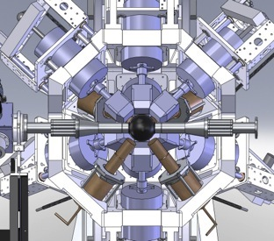
The Future …
Gamma
Ray
Infrastructure
For
Fundamental
Investigations
of
Nuclei
A new high-efficiency decay spectroscopy facility for ISAC-I

Slide 37
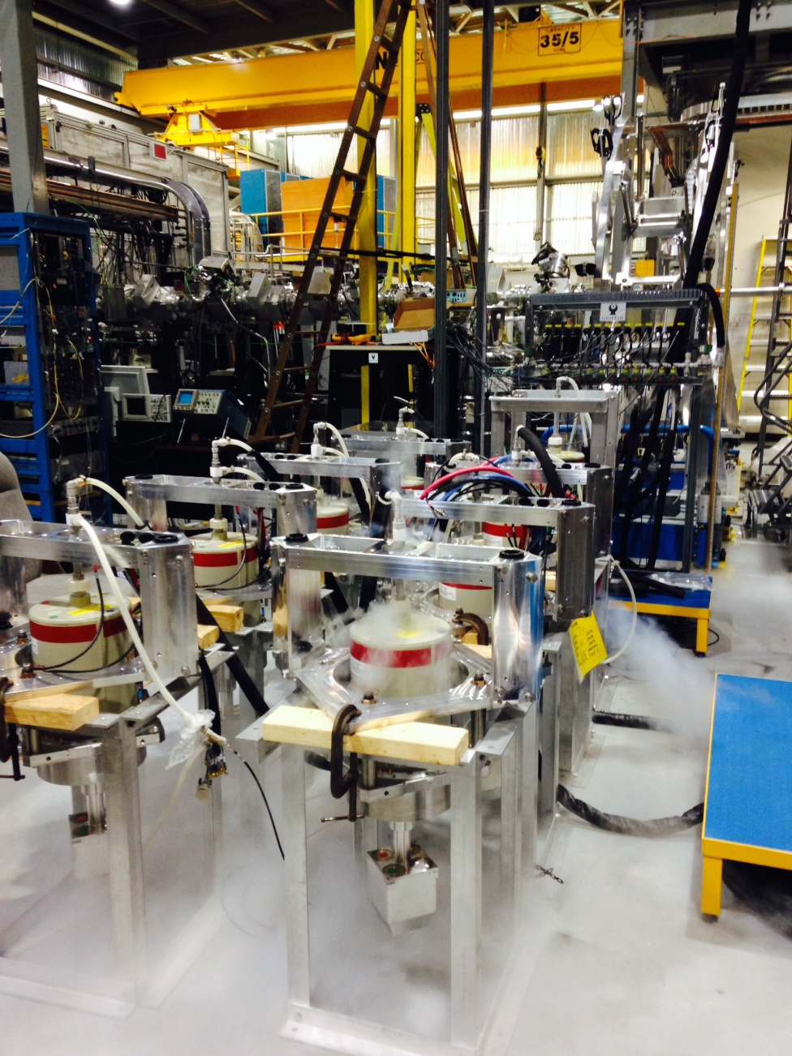
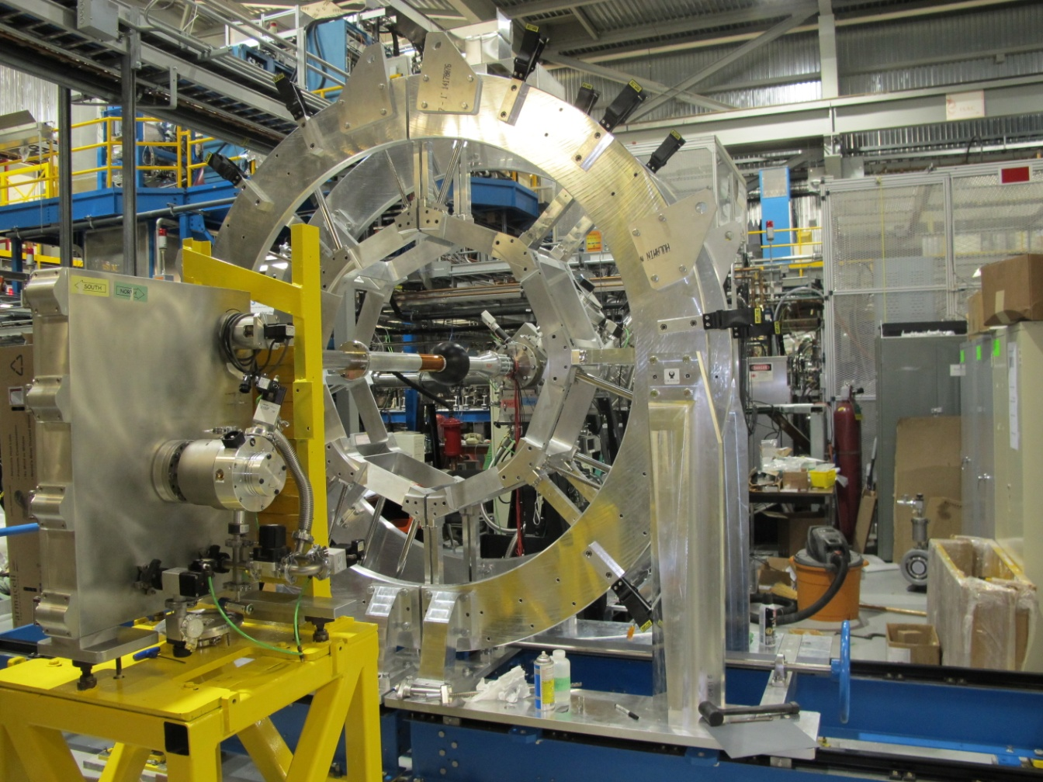
GRIFFIN @ ISAC-I
June 14, 2014

Slide 38
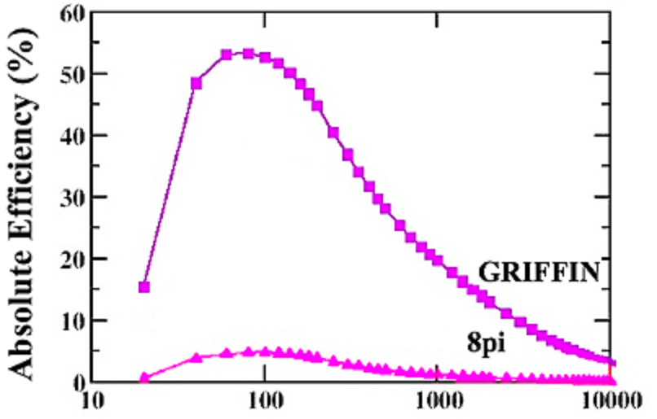
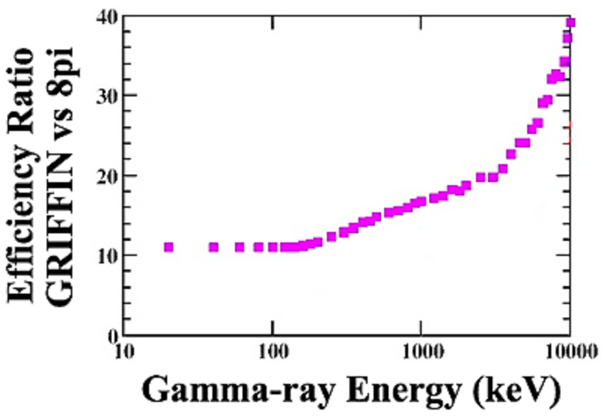
GRIFFIN
16 large-volume clover-type
HPGe γ-ray detector
17 times the efficiency of the
8π at E_{γ} = 1 MeV
Efficiency improvement
increases with γ-ray energy
~300x the γ-γ efficiency
of the 8π
Geant4

Slide 39
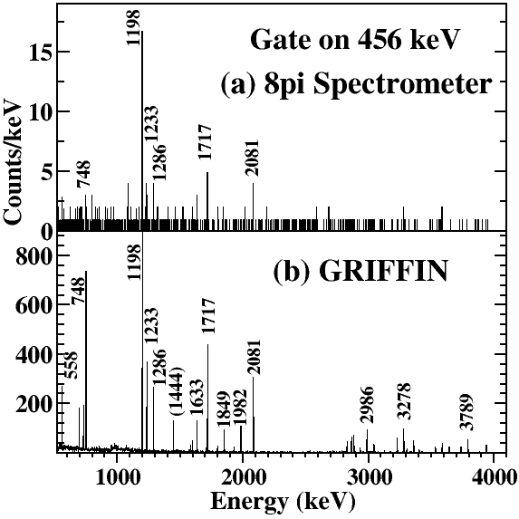
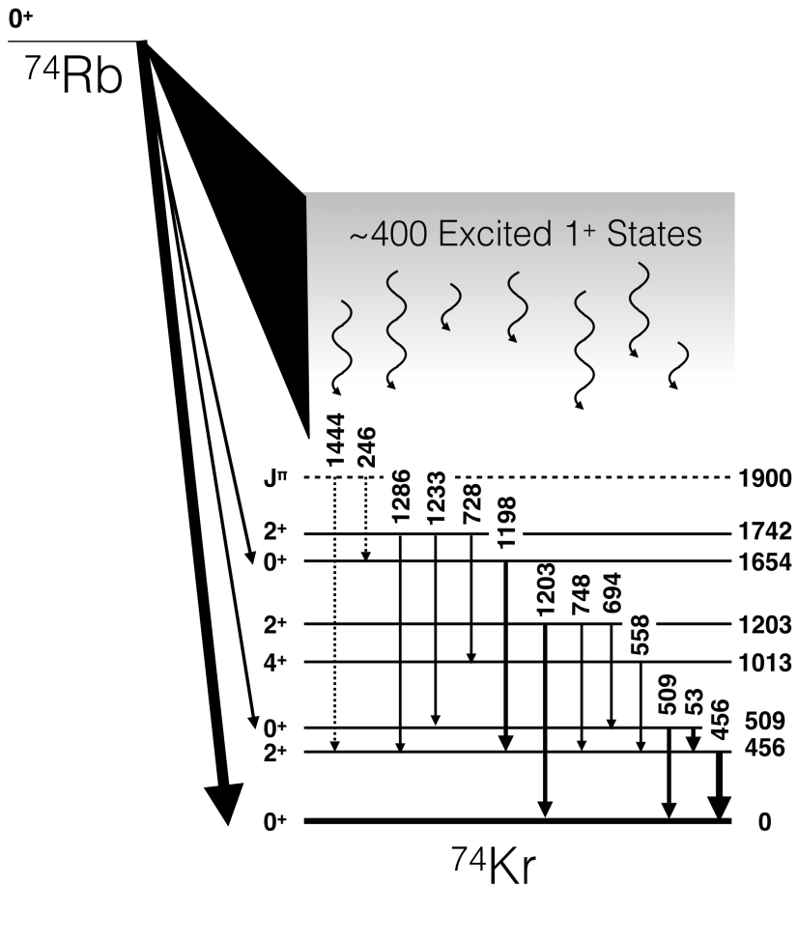
⁷⁴Rb Superallowed Decay with GRIFFIN

Slide 40
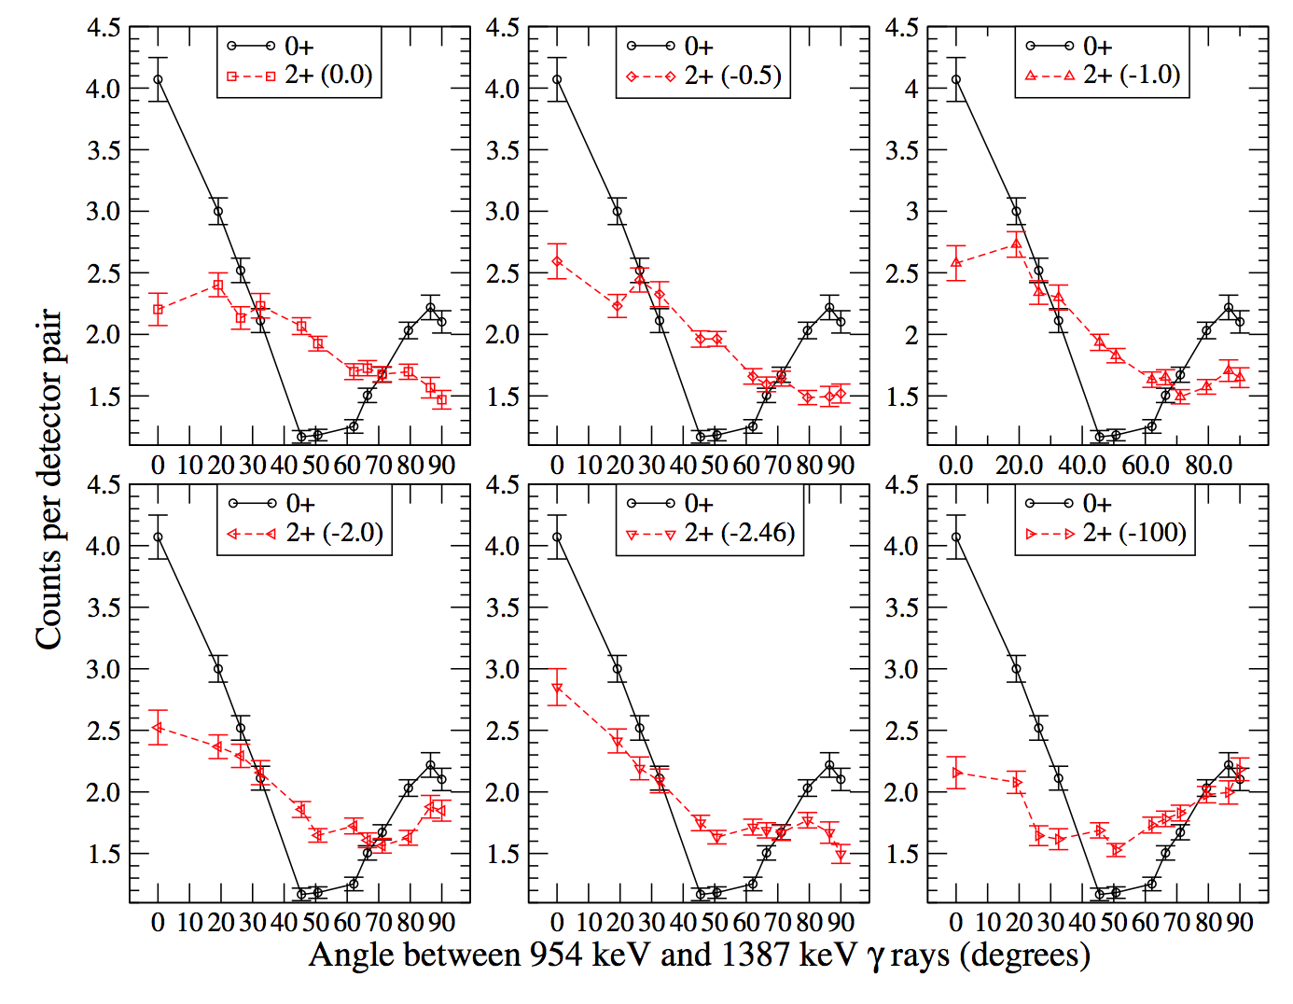
Angular Correlation Measurements with GRIFIFN
(S1518: ⁶²Ga superallowed decay)
2⁺
2342
0⁺
E2
M1+E2
2⁺
954
E2
0⁺
0.0
Using GRIFFIN we can determine the spin-parity of the 2342 keV state
Geant4

Slide 41
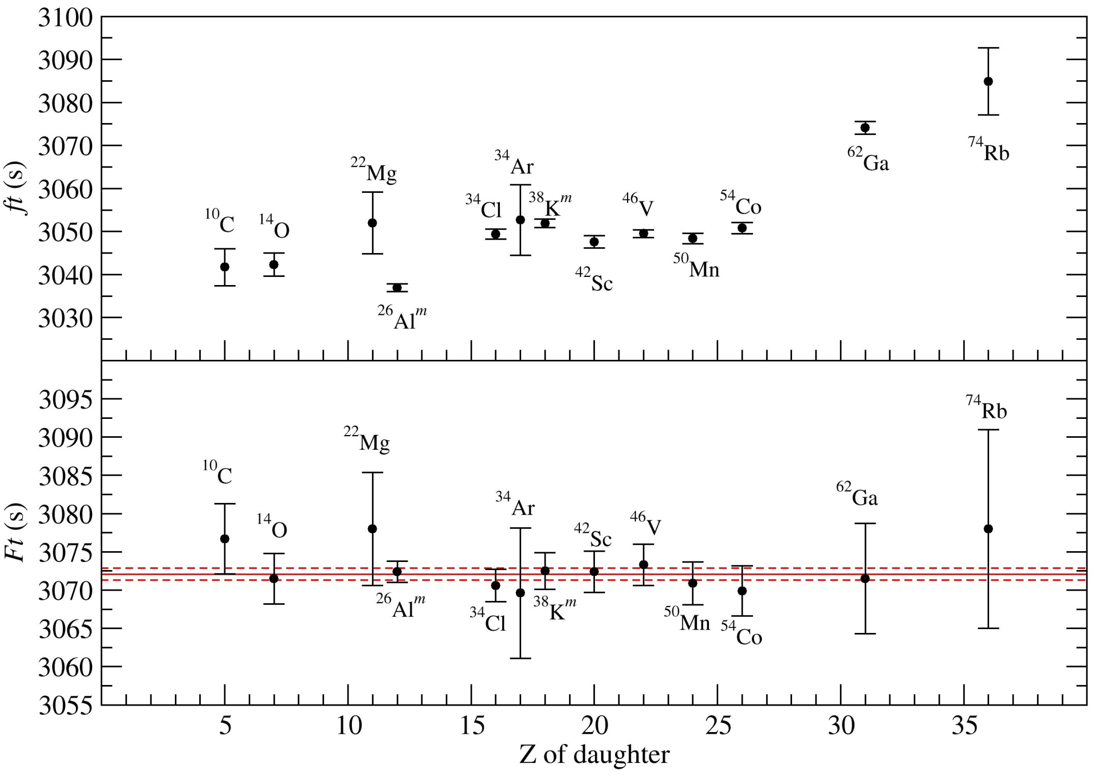
World Superallowed Fermi β Decay Data
Ft = 3072.35(75)s
χ²/ν = 0.31

Slide 42
World Superallowed Fermi β Decay Data
CVC hypothesis confirmed to ± 0.013%
Set limits on maximally parity violating weak scalar currents:
C_{S}/C_{V} = 0.0011 ± 0.0013
V_{ud} determined from the superallowed data is, by far, the most precisely
determined element of the CKM quark-mixing matrix:
|V_{ud}| = 0.97425 ± 0.00022
and together with V_{us} (and V_{ub}) provides the most demanding
experimental test of the unitarity of the CKM matrix:
|V_{ud}|² + |V_{us}|² + |V_{ub}|² = 1.00008 ± 0.00056
Model-dependence of the strongly nuclear structure dependent isospin
symmetry breaking corrections in superallowed Fermi β decays remains
a key focus of research for both the theoretical and experimental
communities.

Slide 43









V. Bildstein
G. Deng
A. Diaz Varela
M. Dunlop
R. Dunlop
Z. Fairchild
P. E. Garrett
B. Hadinia
D. S. Jamieson
B. Jigmeddorj
A.T. Laffoley
A. Radich
E. T. Rand
C. E. Svensson
E. F. Zganjar
G. C. Ball
P. C. Bender
T. Bruhn
A. B. Garnsworthy
G. Hackman
S. Ketelhut
K. G. Leach
B. Mills
M. Moukaddam
M. M. Rajabali
E. Tardiff
C. Unsworth
J. R. Leslie
C. Andreoiu
D. S. Cross
P. Voss K. Starosta
I.S. Towner
R. A. E. Austin
H. Bouzomita
G. F. Grinyer
J. C. Thomas
B. Blank
J. Giovinazzo
P. Finlay

Slide 44
Superallowed β Decay
Studies at ISAC
T_{1/2} , G.C. Ball et al, PRL 86 1454 (2001)
BR, A. Piechaczek et al, PRC 67, 051305 (2003)
BR, R. Dunlop et al, PRC 88, 045501 (2013)
Q: S. Ettenauer et al., PRL 107, 272501 (2011)
CR: E. Mané et al, PRL 107, 212502 (2011)
⁷⁴Rb
⁷⁰Br
T_{½}, G.F. Grinyer, PRC 77, 201501 (2008)
BR, B.H. Hyland, PRL 97, 102501 (2006)
BR, P. Finlay PRC 78, 044321 (2008)
⁶²Ga
⁶⁶As
{
⁵⁴Co
T_{½} and BR
⁵⁰Mn
BR, K.G. Leach et al., PRL 100, 192504 (2008) T_{1/2} , G.C. Ball et al, PRC 82, 045501 (2010)
⁴⁶V
N=Z line
^{38m}K
T_{½} and BR
³⁴Ar
T_{½} P. Finlay et al, PRL 106, 032501 (2011)
BR, P. Finlay et al, PRC 85, 055501 (2012)
^{26m}Al
T_{½}, G.F. Grinyer et al, PRC 76, 025503 (2007) PRC 87, 045502 (2013)
¹⁸Ne
¹⁴O
T_{½}, A.T. Laffoley et al, PRC 88, 015501 (2013)
¹⁰C
T_{½} by β and γ counting M. Dunlop et al.

