Slide 1




Topological insulators:
interaction effects
and new states of matter
Joseph Maciejko
PCTS/University of Alberta
CAP Congress, Sudbury
June 16, 2014

Slide 2



Collaborators
Andreas Rüegg (ETH Zürich)
Victor Chua (UIUC)
Greg Fiete
(UT Austin)
Notes:
Nu=filling fraction = number of electrons/number of flux quanta through the system.

Slide 3
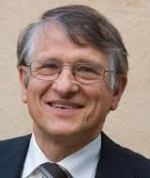
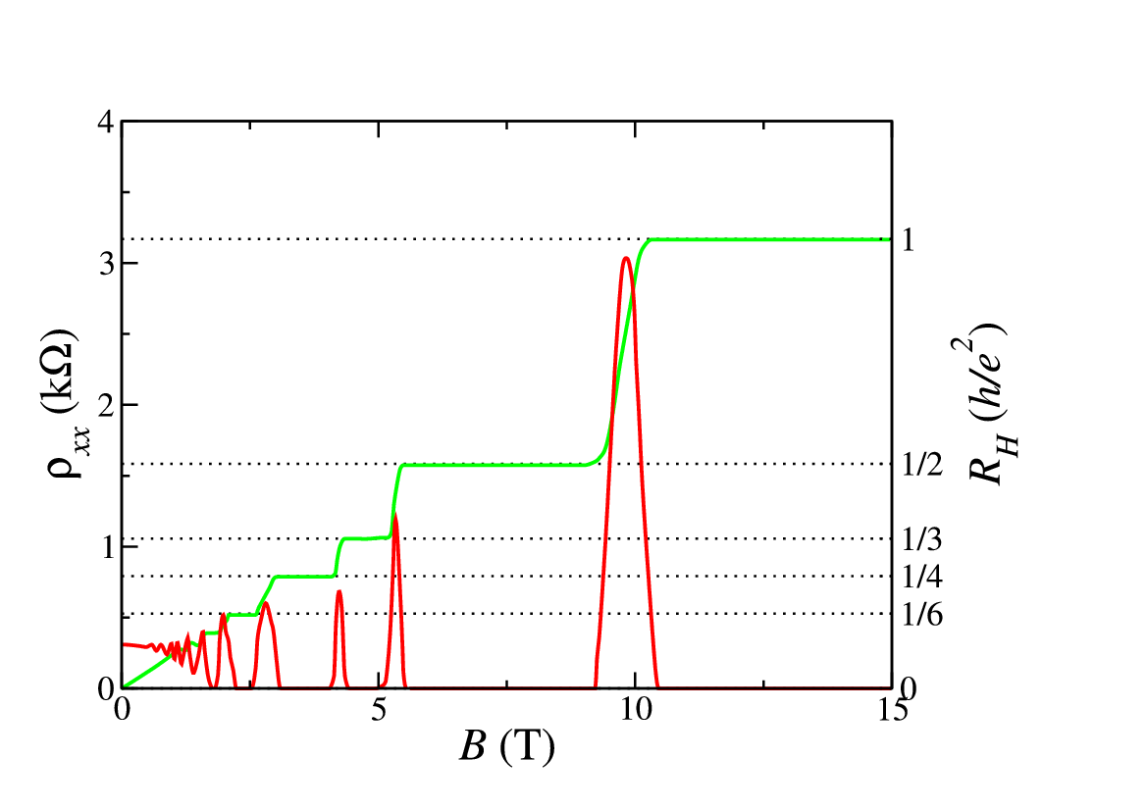
Integer quantum Hall insulator
von Klitzing et al., PRL 1980
Notes:
Nu=filling fraction = number of electrons/number of flux quanta through the system.

Slide 4
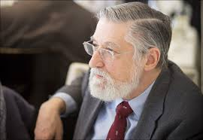
Chiral edge states
…
ν = 1 IQHE
n=3
n=2
E_{F}
n=1
Halperin, PRB 1982
Notes:
Nu=filling fraction = number of electrons/number of flux quanta through the system.

Slide 5
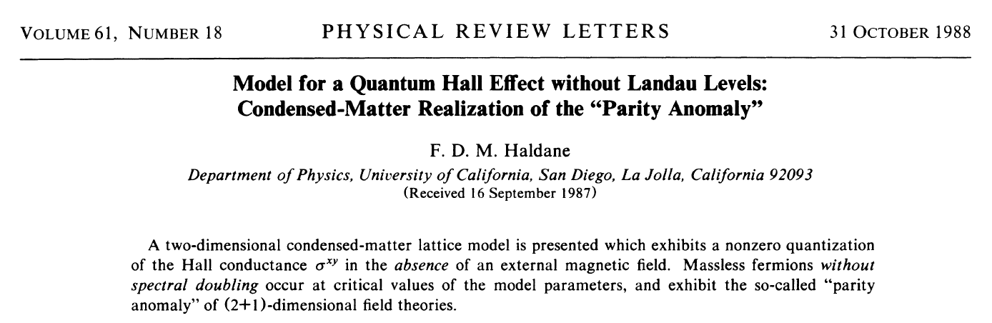
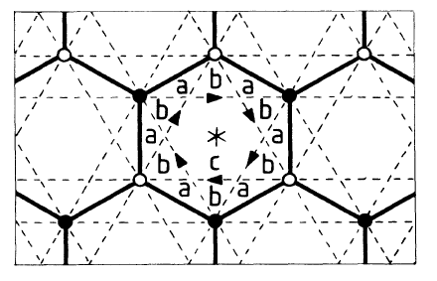
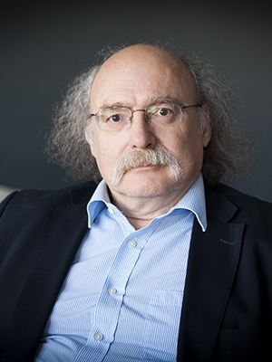
QHE at B=0: Chern insulator
Notes:
But to the difference of the FQHE, here the fractional charge is on the edge, not in the bulk
We hope that this can be measured soon

Slide 6
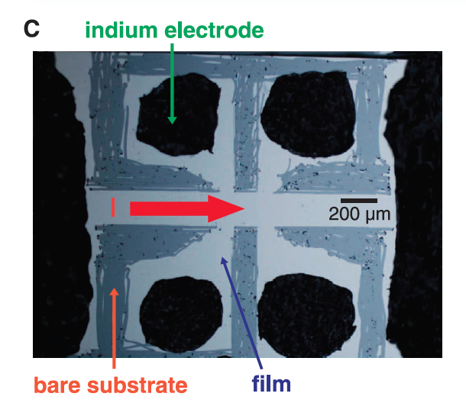
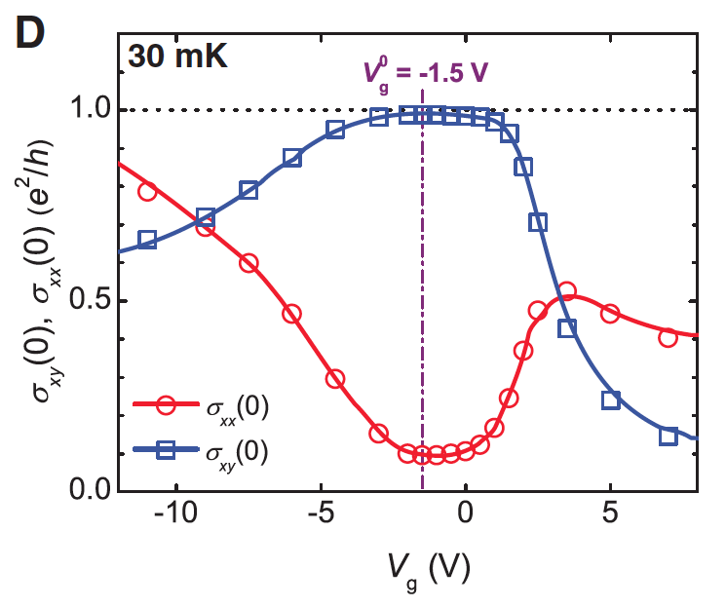
QHE at B=0: Chern insulator
Cr-doped Bi_{x}Sb_{1-x}Te₃
ν = 1 QHE at B=0!
Chang et al., Science 2013 (theory: Yu et al., Science 2010)

Slide 7
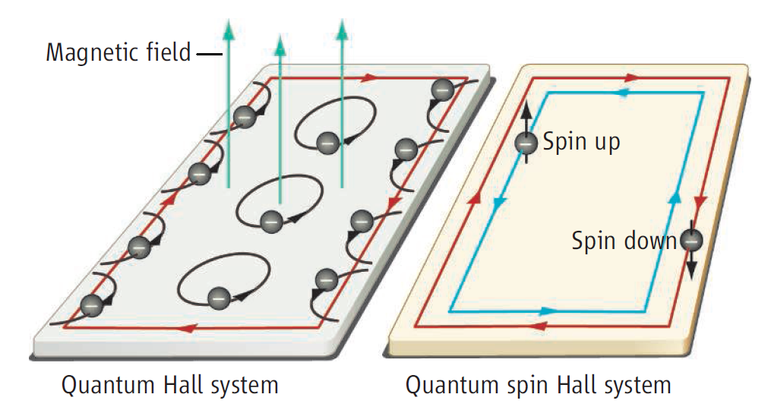
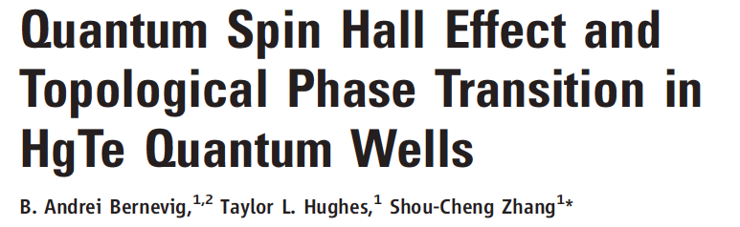
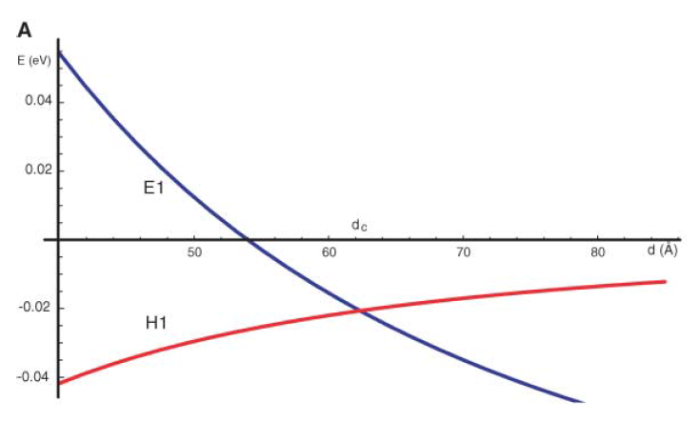
2D TR-invariant topological insulator
B↑
Kane, Mele, PRL 2005;
Bernevig, Zhang, PRL 2006
B↓
d_{c}
d

Slide 8
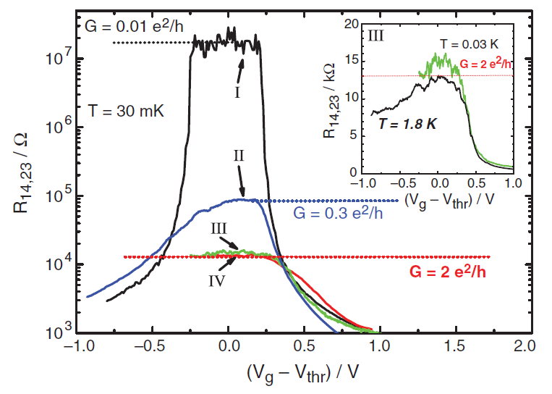
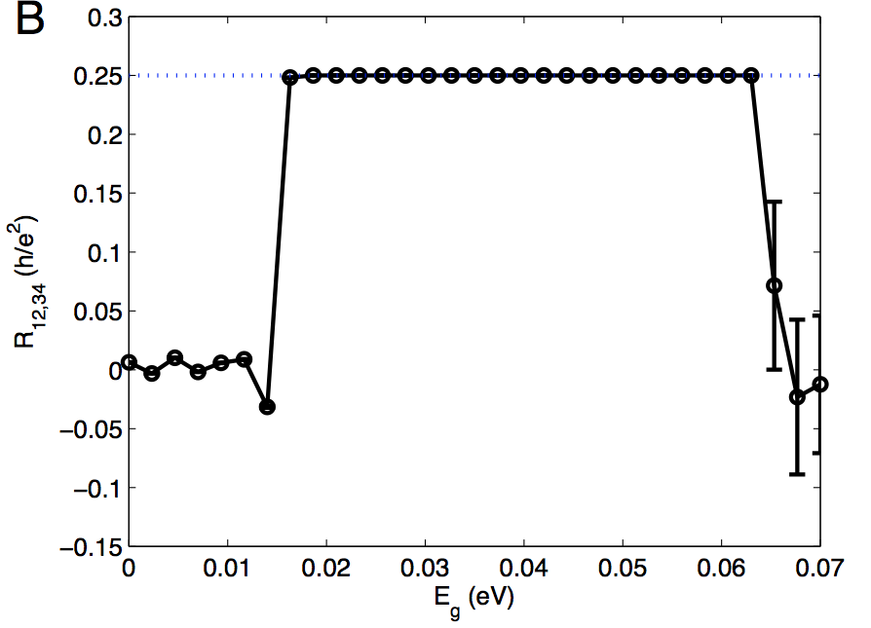
2D topological insulator in HgTe QWs
QSHE
König et al., Science 2007
1/4 h/e²
R_{14,23} (h/e²)
Roth, Brüne, Buhmann, Molenkamp, JM, Qi, Zhang, Science 2009

Slide 9
Beyond free fermions
Bulk is gapped, perturbatively stable against e-e interactions
Stability of gapless edge?
L
ν = 1 CI
2D TI
stable against weak interactions: chiral LL
stable against weak T-invariant interactions: helical LL
(Wen, PRB 1990, …)
(Xu, Moore, PRB 2006; Wu, Bernevig, Zhang, PRL 2006)

Slide 10
Beyond weak interactions
correlated topological insulator
= adiabatically
connected to TBI
topological band insulator
(U=0)
?
U
U_{c}

Slide 11
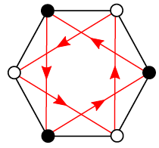
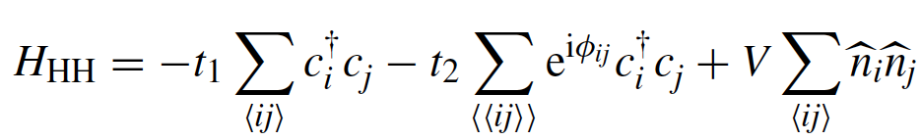
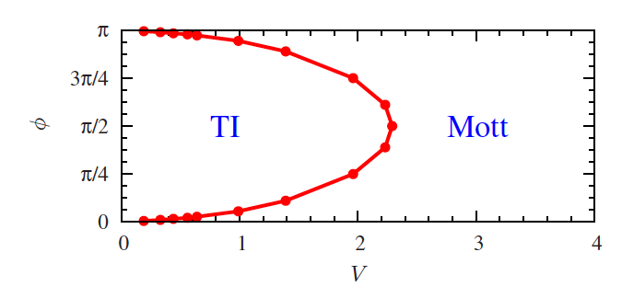
Interacting Chern insulator
spinless Haldane-Hubbard model:
t₁
t₂e^{iφ}
(ν=1 CI)
(CDW)
ED on 24-site cluster
Varney, Sun, Rigol, Galitski, PRB 2010; PRB 2011
Notes:
No on-site U for spinless fermions

Slide 12
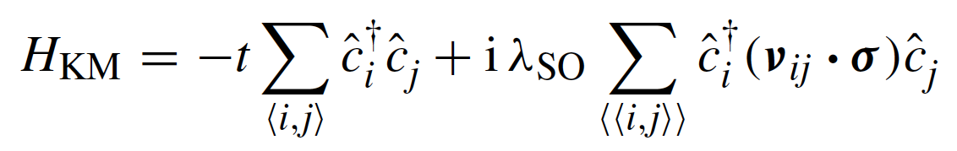
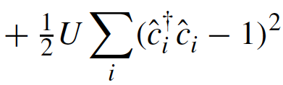
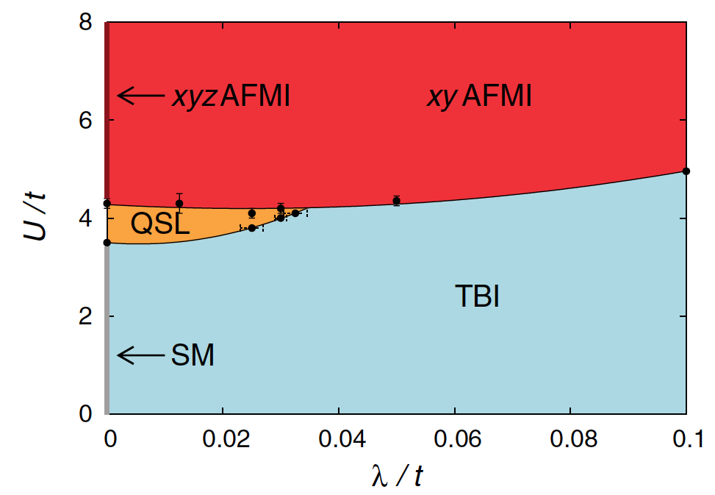
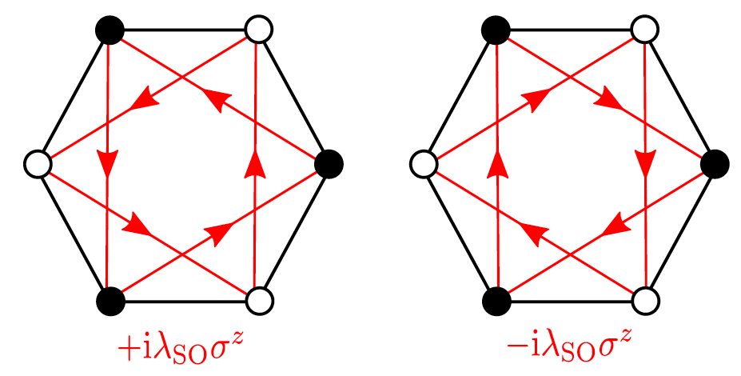
Interacting QSH insulator
Kane-Mele-Hubbard model:
QMC
?
see Sorella, Otsuka, Yunoki, Sci. Rep. 2012
Hohenadler, Lang, Assaad, PRL 2011;
Hohenadler et al., PRB 2012

Slide 13
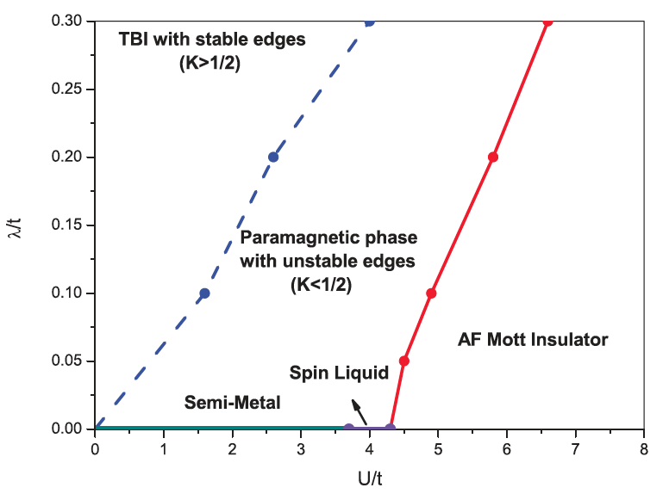
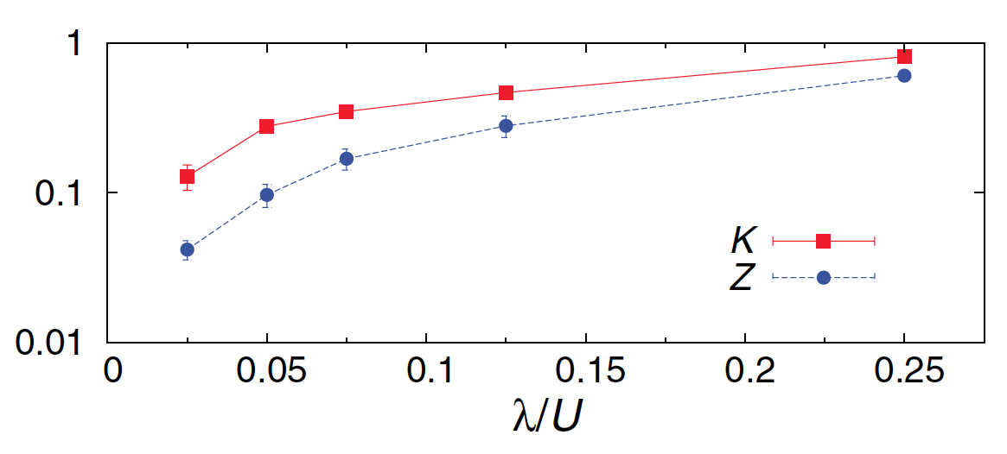
Interacting QSH insulator
correlated QSHI with gapless edge
correlated QSHI with AF insulating edge
bulk AF insulator
noninteracting QSHI
(U=0)
U
U_{c}^{edge}
U_{c}^{bulk}
Hohenadler, Assaad, PRB 2012
Edge instabilities can be studied via bosonization (Xu, Moore, PRB 2006; Wu, Bernevig, Zhang, PRL 2006; JM et al., PRL 2009; JM, PRB 2012)
Zheng, Zhang, Wu, PRB 2011

Slide 14
Beyond broken symmetry?
corr. CI
CDW
spinless CI
U
U_{c}
corr. QSH
with edge AF
corr. QSH
bulk AF
QSH
U
U_{c}^{edge}
U_{c}^{bulk}
Can correlation effects in TIs produce novel phases beyond broken symmetry?

Slide 15
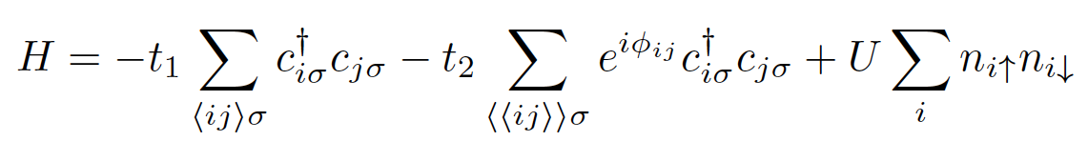

Spinful Chern insulator
U=0:
SU(2) symmetric
ν = ν↑ + ν↓ = 2 CI

Slide 16
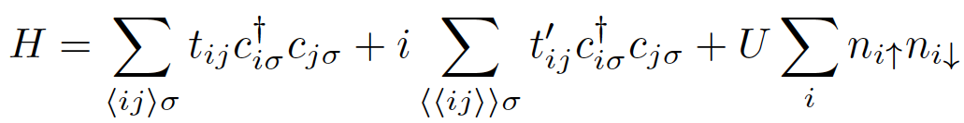
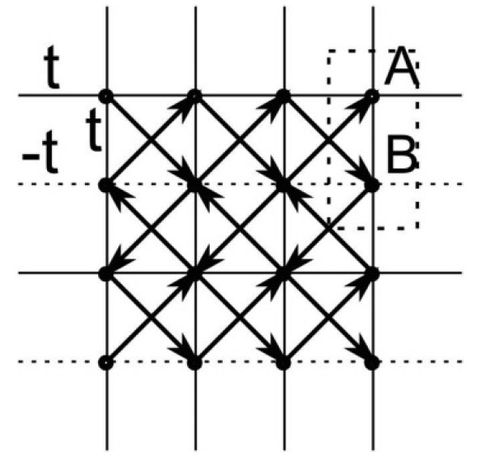

U→∞ Gutzwiller projection
t’
SU(2) symmetric spin wave function
ν=2 CI
Zhang, Grover, Vishwanath, PRB 2011

Slide 17
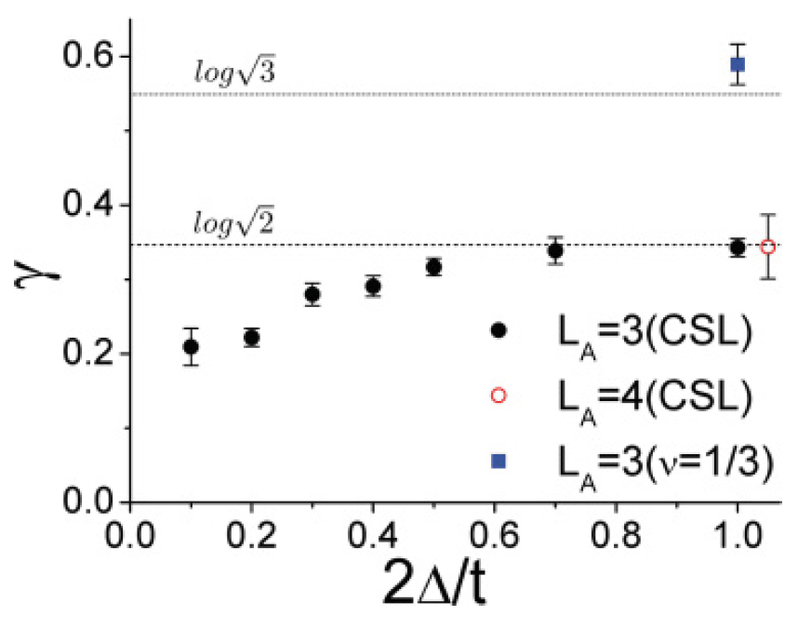

Chiral spin liquid?
topological entanglement entropy
γ = ln D
Kitaev, Preskill, PRL 2006;
Levin, Wen, PRL 2006
for ν = 1/m FQH state
ν = 1/2 FQH ⇔ CSL
2t’/t
Kalmeyer, Laughlin, PRL 1987;
Wen, Wilczek, Zee, PRB 1989
Zhang, Grover, Vishwanath, PRB 2011

Slide 18
Correlated spinful Chern insulator
correlated CI
CSL(?)
spinful CI
U
∞
U_{c}
What about finite U?

Slide 19

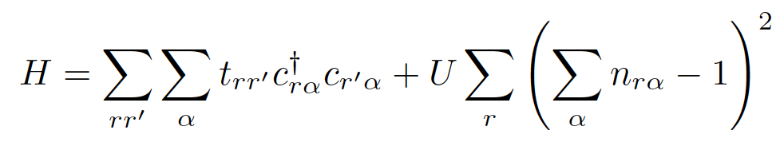
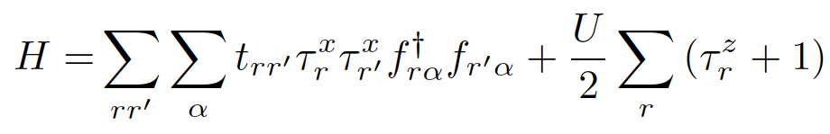
Slave-Ising representation
+1
-1
-1
+1
Huber and Rüegg, PRL 2009; Rüegg, Huber, Sigrist, PRB 2010; Nandkishore, Metlitski, Senthil, PRB 2012; JM, Rüegg, PRB 2013; JM, Chua, Fiete, PRL 2014
Notes:
But to the difference of the FQHE, here the fractional charge is on the edge, not in the bulk
We hope that this can be measured soon

Slide 20
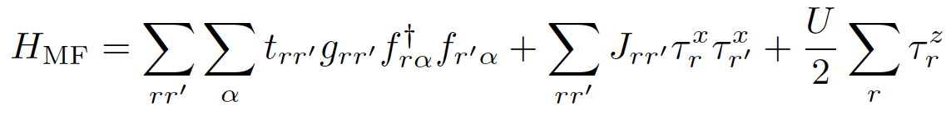
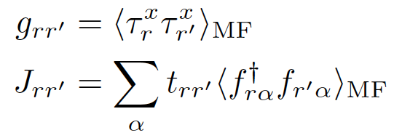
Mean-field theory
free fermions in (renormalized) CI bandstructure
quantum Ising model
<τ^{x}>≠0
<τ^{x}>=0
U
U_{c}
Notes:
But to the difference of the FQHE, here the fractional charge is on the edge, not in the bulk
We hope that this can be measured soon

Slide 21
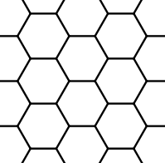
Mean-field theory
it’
t
20
CI*
VBS
15
U/t
10
5
CI
0
0
0.2
0.4
0.6
0.8
1
t’/t
JM, Rüegg, PRB 88, 241101 (2013)
Notes:
But to the difference of the FQHE, here the fractional charge is on the edge, not in the bulk
We hope that this can be measured soon

Slide 22
Mean-field theory
it’
t
20
CI*
<τ^{x}>=0
VBS
15
U_{c}/t
U/t
10
<τ^{x}>≠0
5
CI
0
0
0.2
0.4
0.6
0.8
1
t’/t
JM, Rüegg, PRB 88, 241101 (2013)
Notes:
But to the difference of the FQHE, here the fractional charge is on the edge, not in the bulk
We hope that this can be measured soon

Slide 23

Slave-Ising transition
<τ^{x}>
1
correlated CI
CI*
CSL(?)
CI
U
<τ^{x}>=0
∞
<τ^{x}>≠0
U_{c}
A(q,ω) is gapped (even on the edge)
Physical properties?
JM, Rüegg, PRB 88, 241101 (2013)
Notes:
But to the difference of the FQHE, here the fractional charge is on the edge, not in the bulk
We hope that this can be measured soon

Slide 24
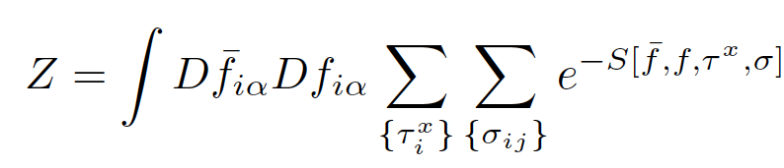
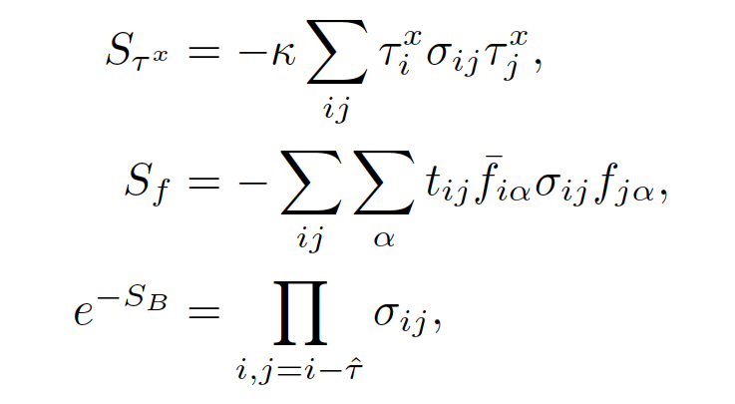
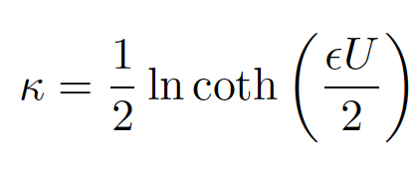
Beyond mean-field theory
Projection to physical Hilbert space introduces a Z₂ gauge field σ_{ij}=±1 (Senthil and Fisher, PRB 2000)
U
JM, Rüegg, PRB 88, 241101 (2013)
Notes:
But to the difference of the FQHE, here the fractional charge is on the edge, not in the bulk
We hope that this can be measured soon

Slide 25
Beyond mean-field theory
κ ~ slave-Ising spin bandwidth
Z₂ deconfined phase
κ_{c}
Higgs/
confined phase
CI
U
U_{c}
<τ^{x}>=0
CI*
∞
<τ^{x}>≠0
corr. CI
κ=0:
Gutzwiller-projected
f fermions (CSL?)
JM, Rüegg, PRB 88, 241101 (2013)
[also Fradkin, Shenker, PRD 1979; Senthil, Fisher, PRB 2000]
Notes:
But to the difference of the FQHE, here the fractional charge is on the edge, not in the bulk
We hope that this can be measured soon

Slide 26
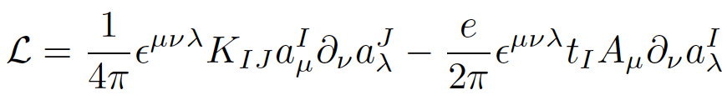
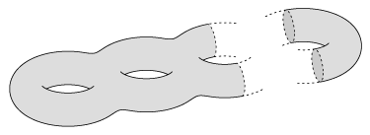
CI* phase
Deconfined phase of Z₂ gauge theory has Z₂ topological order (Wegner, JMP 1971; Wen, PRB 1991)
Abelian topological order: TQFT is multi-component Chern-Simons theory (Wen, Zee, PRB 1992) → ground-state degeneracy, quasiparticle charge & statistics
Derive TQFT from mean-field + (gauge) fluctuations
…
g
2
1
GSD(Σ_{g}) = |det K|^{g}
JM, Rüegg, PRB 88, 241101 (2013)
Notes:
But to the difference of the FQHE, here the fractional charge is on the edge, not in the bulk
We hope that this can be measured soon

Slide 27


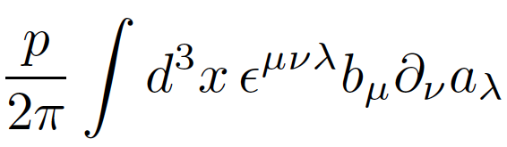

From lattice to continuum
Z₂ gauge theory can be written as U(1) gauge theory coupled to conserved charge-2 “Higgs” link variable (Ukawa, Windey, Guth, PRD 1980)
Deconfined phase: U(1) gauge field is weakly coupled and we can take the continuum limit
p=2
Δ_{μ}n_{i,i+μ} = 0
level-p (2+1)D BF term
Notes:
But to the difference of the FQHE, here the fractional charge is on the edge, not in the bulk
We hope that this can be measured soon

Slide 28

Mean-field + fluctuations
all matter fields massive:
τ^{x}
a_{μ}
a_{ν}
<τ^{x}(p) τ^{x}(-p)> ~ (p²+m²)⁻¹
CI ~ massive (2+1)D Dirac fermions
f↑ , f↓
“parity anomaly” (Niemi, Semenoff, PRL 1983; Redlich, PRL 1984)
a_{μ}
a_{ν}
Notes:
But to the difference of the FQHE, here the fractional charge is on the edge, not in the bulk
We hope that this can be measured soon

Slide 29
Mean-field + fluctuations
all matter fields massive:
τ^{x}
a_{μ}
a_{ν}
<τ^{x}(p) τ^{x}(-p)> ~ (p²+m²)⁻¹
CI ~ massive (2+1)D Dirac fermions
irrelevant
f↑ , f↓
“parity anomaly” (Niemi, Semenoff, PRL 1983; Redlich, PRL 1984)
a_{μ}
a_{ν}
Notes:
But to the difference of the FQHE, here the fractional charge is on the edge, not in the bulk
We hope that this can be measured soon

Slide 30
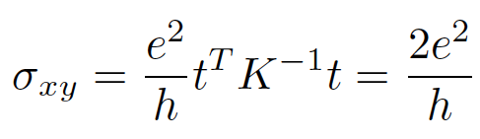
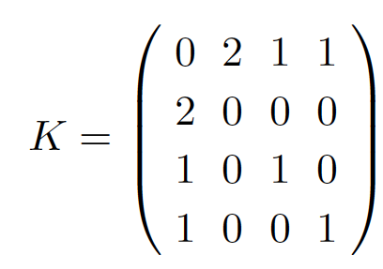
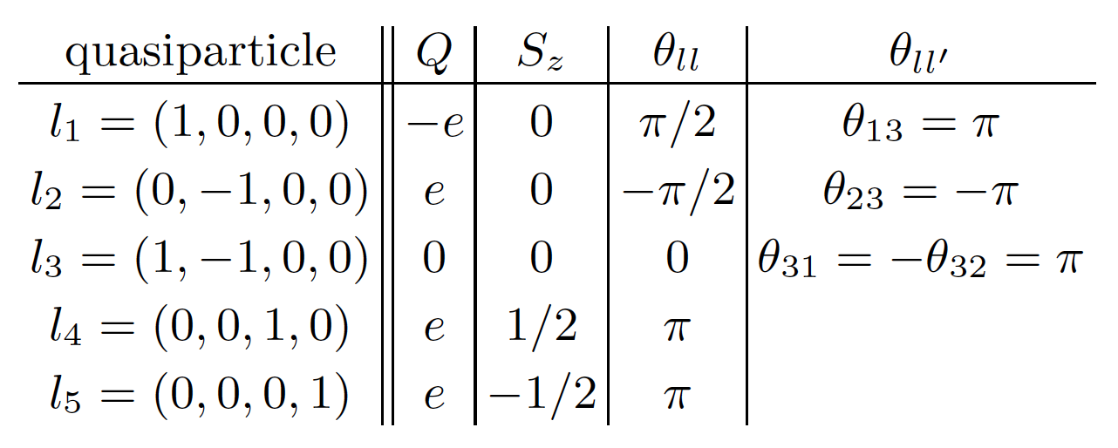
Properties of CI* phase
Integer Hall conductance and quasiparticle charge
Fractional (semionic) statistics and 4-fold GS degeneracy on T²
GSD = 4
i
l₁
l₁
− i
l₂
l₂
Notes:
But to the difference of the FQHE, here the fractional charge is on the edge, not in the bulk
We hope that this can be measured soon

Slide 31
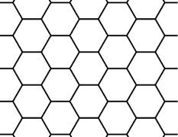
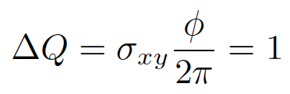
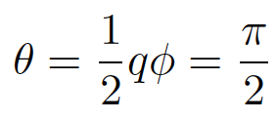
Integer charge, fractional statistics?
π
π
Goldhaber, Mackenzie, Wilczek, MPLA 1989
Notes:
But to the difference of the FQHE, here the fractional charge is on the edge, not in the bulk
We hope that this can be measured soon

Slide 32
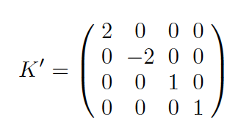

A Z₂ chiral spin liquid
CI* ~ “Z₂ chiral spin liquid” (see also Barkeshli, 1307.8194)
Nonzero Chern number “twists” Z₂ topological order from toric-code type to double-semion type (Levin and Wen, PRB 2005)
Equivalent to Dijkgraaf-Witten topological gauge theory/twisted quantum double D^{ω}(Z₂) (Dijkgraaf and Witten, CMP 1990; Bais, van Driel, de Wild Propitius, NPB 1993)
W ∈ GL(4,Z)
H³(Z₂,U(1)) = Z₂ = {toric code, double semion}
Notes:
But to the difference of the FQHE, here the fractional charge is on the edge, not in the bulk
We hope that this can be measured soon

Slide 33
Phase diagram
correlated CI
CI*?
CSL(?)
spinful CI
U
∞
U_{c}
Notes:
But to the difference of the FQHE, here the fractional charge is on the edge, not in the bulk
We hope that this can be measured soon

Slide 34
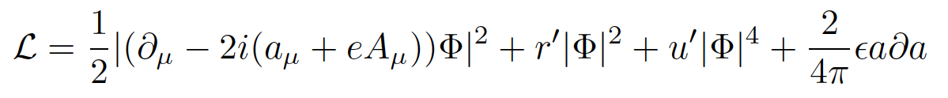
Phase diagram
CSL also predicted by U(1) slave-boson mean-field theory (He et al., PRB 2011)
CI* = condensed slave-boson pairs
correlated CI
CI*?
CSL(?)
spinful CI
U
<b>≠0
U_{c1}
<bb>≠0
U_{c2}
<b>=0
transition in the universality class of the FQH-Mott insulator transition
(Wen, Wu, PRL 1993)
Notes:
But to the difference of the FQHE, here the fractional charge is on the edge, not in the bulk
We hope that this can be measured soon

Slide 35
Summary
TI: stable against weak interactions
In addition to broken-symmetry phases, strong correlations may lead to novel fractionalized phases: CSL, CI*
Future work:
Numerical ED studies of spinful Haldane-Hubbard model
Away from half-filling, large U (t-J): anyon SC? (Laughlin, PRL 1988)
Spinful CI with higher Chern number N>1: SU(2)_{N} non-Abelian topological order? (Zhang, Vishwanath, PRB 2013)
Generalization to Z_{p} slave-spins (Rüegg, JM, in preparation)
Fractionalized phases in correlated 3D TIs (Pesin, Balents, Nat. Phys. 2010; JM, Chua, Fiete, PRL 2014): Dijkgraaf-Witten TQFT in higher dimensions? (Wang, Levin, arXiv 2014)
maciejko@ualberta.ca
Notes:
But to the difference of the FQHE, here the fractional charge is on the edge, not in the bulk
We hope that this can be measured soon

Slide 36
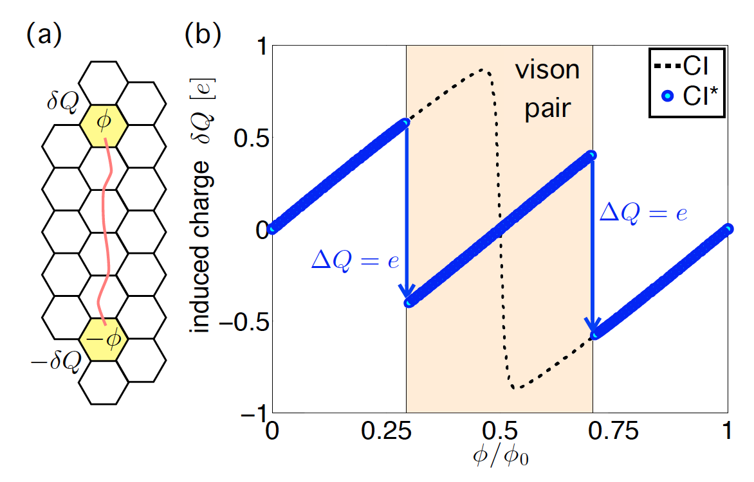
Linear vs nonlinear response
Spontaneously created Z₂ vortices can screen external fluxes
Notes:
But to the difference of the FQHE, here the fractional charge is on the edge, not in the bulk
We hope that this can be measured soon

Slide 37
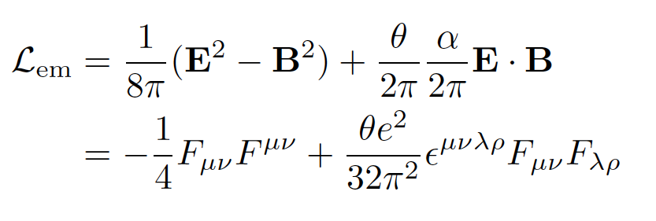

Axion electrodynamics
Electromagnetic response of 3D TI described by axion electrodynamics (Qi, Hughes, Zhang, PRB 2008; Essin, Moore, Vanderbilt, PRL 2009; Wilczek, PRL 1987)
θ=0: trivial insulator, θ=π: topological insulator
Notes:
Everything I’ve been telling you about so far was in 2D
what really led to an explosion of TI research in the last 5 years is the experimental discovery of TI in 3D
in materials which are relatively easy to fabricate (compared to 2D)
Physics Today plot represents the surface state of bismuth selenide (or telluride?) explain surface state cone

Slide 38
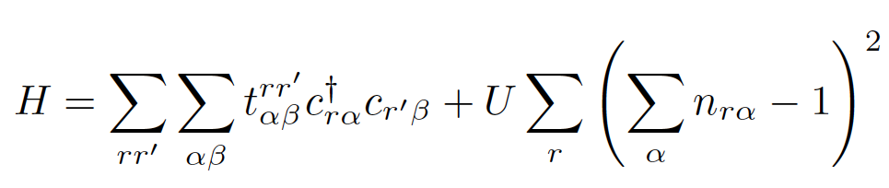
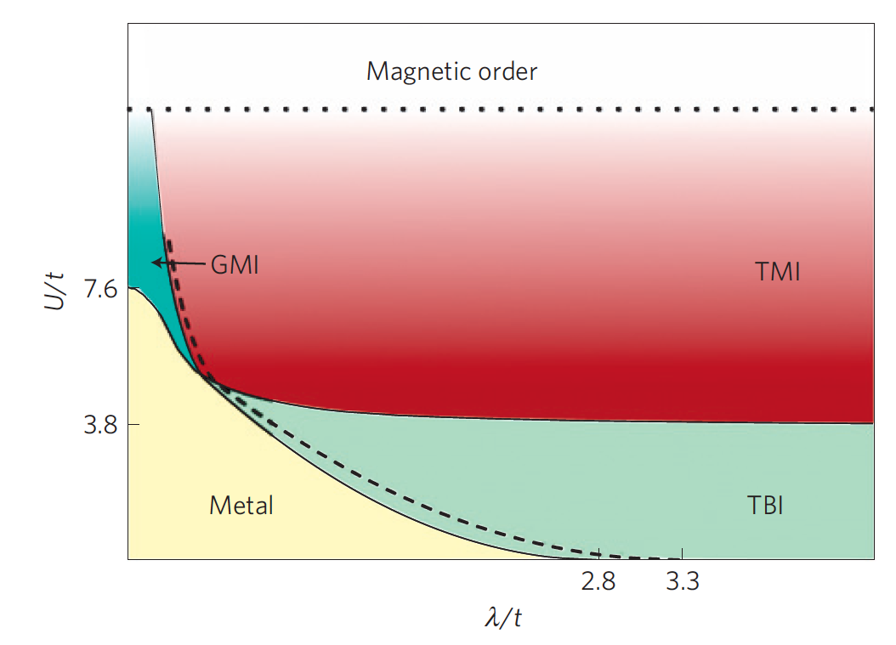
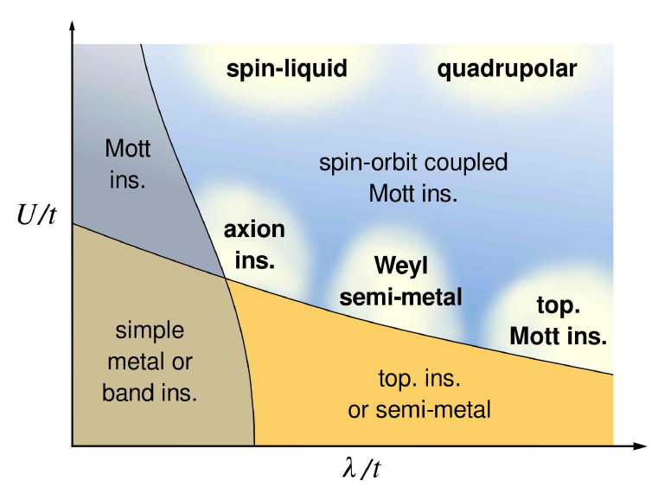
Interaction effects in the 3D TI
U(1) slave-rotor theory predicts a topological Mott insulator (TMI) with bulk gapless photon and gapless spinon surface states (Pesin and Balents, Nature Phys. 2010; Kargarian, Wen, Fiete, PRB 2011)
Notes:
Everything I’ve been telling you about so far was in 2D
what really led to an explosion of TI research in the last 5 years is the experimental discovery of TI in 3D
in materials which are relatively easy to fabricate (compared to 2D)
Physics Today plot represents the surface state of bismuth selenide (or telluride?) explain surface state cone

Slide 39
Interaction effects in the 3D TI
The TMI is essentially a 3D algebraic spin liquid with no charge response, e.g., possible ground state of frustrated spin model on pyrochlore lattice (Bhattacharjee et al., PRB 2012)
Can there be novel phases with charge response at intermediate U?
Use Z₂ slave-spin representation → (3+1)D Z₂ gauge theory
(3+1)D Z₂ gauge theory has a deconfined phase: TI* phase
Notes:
Everything I’ve been telling you about so far was in 2D
what really led to an explosion of TI research in the last 5 years is the experimental discovery of TI in 3D
in materials which are relatively easy to fabricate (compared to 2D)
Physics Today plot represents the surface state of bismuth selenide (or telluride?) explain surface state cone

Slide 40

Mean-field study on pyrochlore lattice
JM, Chua, Fiete, PRL 112, 016404 (2014)
Notes:
Everything I’ve been telling you about so far was in 2D
what really led to an explosion of TI research in the last 5 years is the experimental discovery of TI in 3D
in materials which are relatively easy to fabricate (compared to 2D)
Physics Today plot represents the surface state of bismuth selenide (or telluride?) explain surface state cone

Slide 41


From Z₂ to U(1)
Deconfined phase: U(1) gauge field is weakly coupled and we can take the continuum limit
b_{μν}: 2-form gauge field
i
level-p (3+1)D BF term
JM, Chua, Fiete, PRL 112, 016404 (2014)
Notes:
But to the difference of the FQHE, here the fractional charge is on the edge, not in the bulk
We hope that this can be measured soon

Slide 42


TQFT of TI* phase
TQFT of the BF + θ-term type
p=1: effective theory of a noninteracting TI (Chan, Hughes, Ryu, Fradkin, PRB 2013)
p=2: fractionalized TI* phase, GSD = 2³ = 8 on T³
E&M response: integrate out b_{μν} and a_{μ}:
Excitations: gapped Z₂ vortex loops and slave-fermions, with mutual statistics 2π/p = π
JM, Chua, Fiete, PRL 112, 016404 (2014)
Notes:
But to the difference of the FQHE, here the fractional charge is on the edge, not in the bulk
We hope that this can be measured soon

Slide 43
Oblique confinement in a CM system
What about the confined phase of Z₂ gauge theory?
Condensate of composite dyons = oblique confinement (‘t Hooft, NPB 1981; Cardy and Rabinovici, NPB 1982; Cardy, NPB 1982)
Oblique confined may be a symmetry-protected topological (SPT) phase (von Keyserlingk and Burnell, arXiv 2014)
deconfined phase | confined phase = condensate of…
U(1) MI | monopoles
U(1) TMI | Witten dyons (Cho, Xu, Moore, Kim, NJP 2012)
Z₂ TI* | composite dyons
Notes:
But to the difference of the FQHE, here the fractional charge is on the edge, not in the bulk
We hope that this can be measured soon

