Slide 1


Predicting the rare decay in light-front QCD
Ruben Sandapen
CAP 2014 congress
Laurentian University

Slide 2
Work done in collaboration with
Mohammad Ahmady (Mount Allison U.)
Robyn Campbell (Mount Allison U.)
Sébastien Lord (Université de Moncton)
Published in PRD 89 (2014) 074021

Slide 3
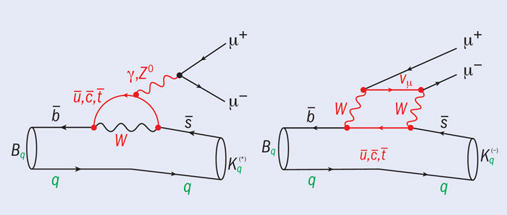
Figure from LHCb
website
Electroweak penguin and box diagram
Loop suppressed in Standard Model
Sensitive to New Physics

Slide 4
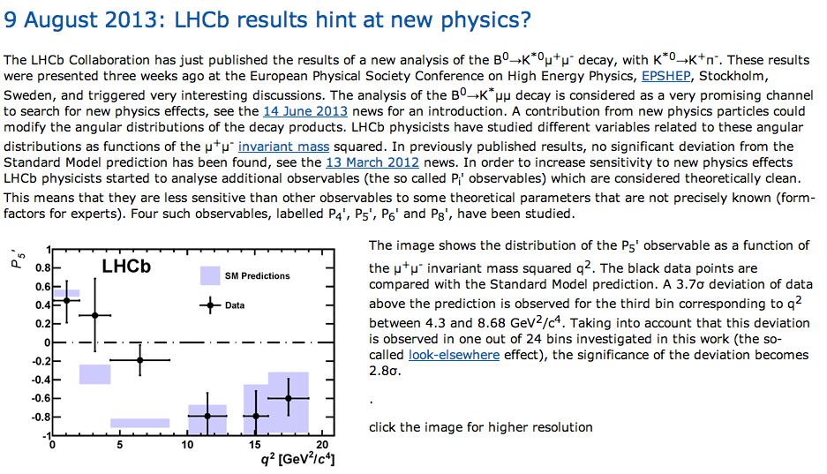
From LHCb website
Observables largely free from form factor uncertainties

Slide 5
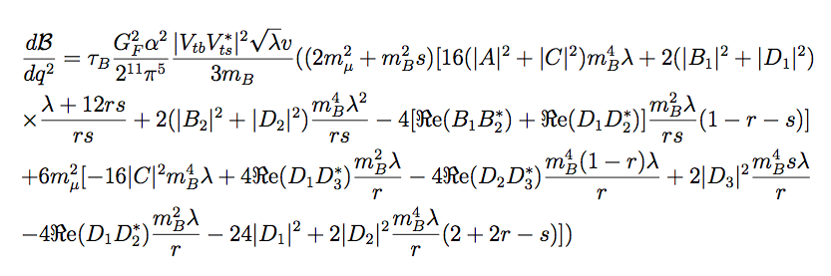

The differential branching ratio for
T. Aliev, A. Ozpineci, M. Savci
(1997)
Given in terms of form factors and Wilson coefficients

Slide 6
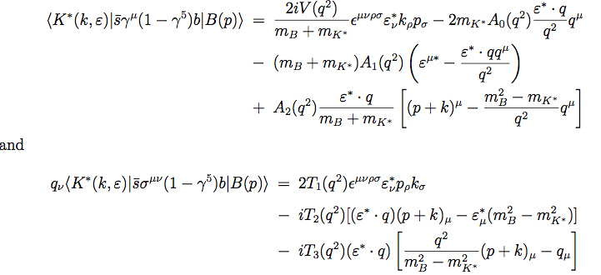
7 form factors
7 form factors required to compute Branching Ratio

Slide 7
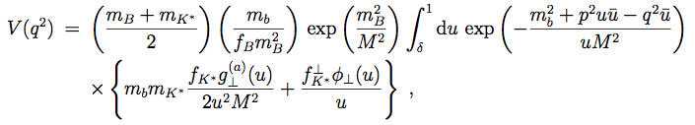
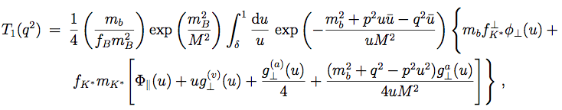
Light-cone sum rules for form factors
T. Aliev, A. Ozpineci, M. Savci
(1997)
Valid for low to intermediate momentum transfer
We compute the form factors using new AdS/QCD Distribution Amplitudes
Traditionally, these DAs are computed using additional Sum Rules

Slide 8
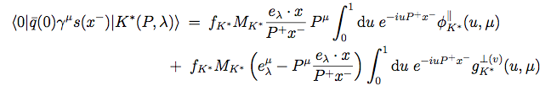

Distribution Amplitudes
Ball and Braun (1997)
DAs parametrize the OPE of vacuum-to-meson transition matrix elements of quark-antiquark
non-local gauge invariant operators at light-like separations. At equal light-front time and in the light-front gauge:

Slide 9
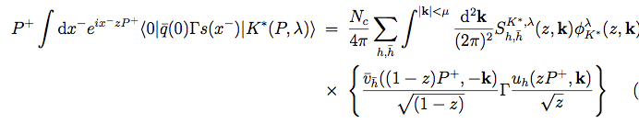
A useful relation
Light-front wavefunction
Light-front spinors
Renormalization scale as ultraviolet cut-off on transverse momentum

Slide 10


Distribution Amplitudes are related to light-front wavefunctions
We can then deduce that
M. Ahmady & RS
PRD, 2013
4 DAs: Twist-2 (long & trans), Twist-3(vector & axial vector)

Slide 11
Brodsky and de Teramond
PRL, 2009
Light-front Schroedinger equation

Slide 12
A holographic light-front Schroedinger equation
Brodsky and de Teramond
PRL, 2009
A relativistic QM equation for mesons in physical 4D spacetime which maps onto the classical wave equation for strings propagating in a modified 5D anti-de Sitter (AdS) space
Transverse distance in 4D maps onto fifth dimension in 5D AdS
Angular momentum in 4D maps onto 5D mass times curvature radius of anti-de Sitter space
Interacting potential in 4D driven by the geometry in fifth dimension of AdS

Slide 13
Unique potential
Phenomenological & theoretical arguments constrain the dilation profile to be quadratic
S. Brodsky, G. de Teramond & H. G. Dosch (2013)
Only possibility consistent with
chiral symmetry in the massless quark limit.
Linear Regge trajectories
Harmonic oscillator potential in QCD

Slide 14

Final form of the holographic AdS/QCD wavefunction
Prefactor fixed by matching expression for pion EM form factor in AdS and physical spacetime
Quarks masses introduced using Brodsky-de Teramond prescription
We shall use constituent quark masses

Slide 15
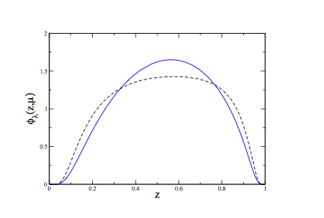
Twist-2 DAs for K*
Solid blue: longitudinal twist-2 DA
Dashed black: transverse twist-2 DA

Slide 16

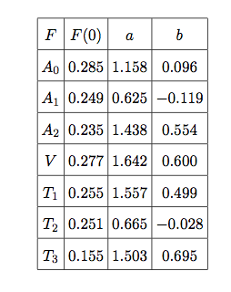
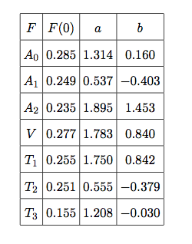
Fits for the form factors
AdS/QCD LCSR fit
AdS/QCD LCSR + lattice fit

Slide 17
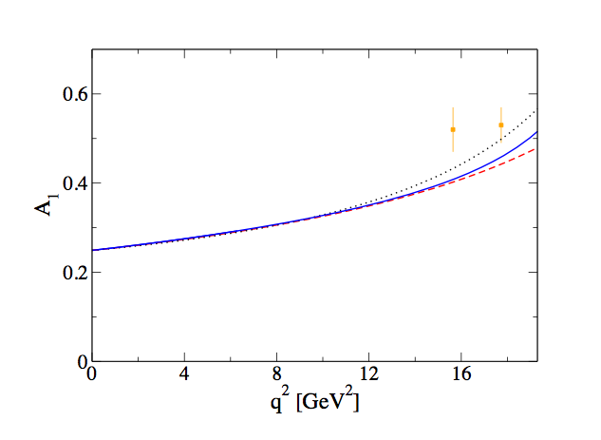
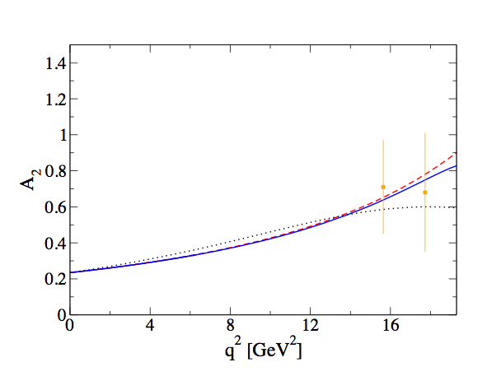
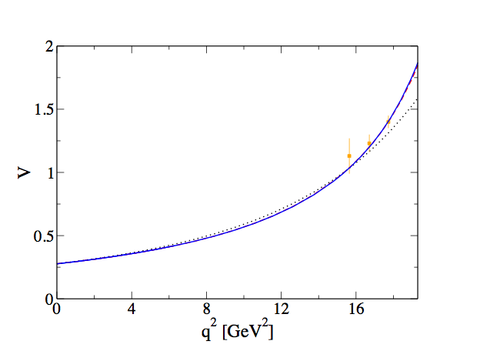
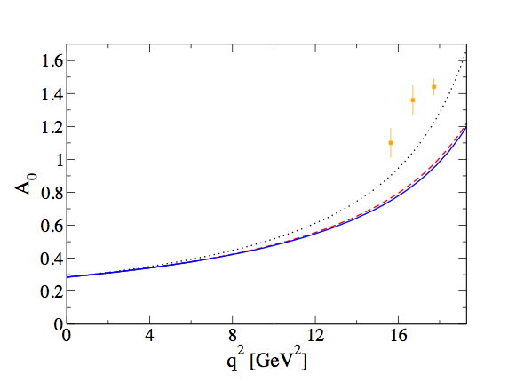
Form factors and lattice data
Lattice data from
R. R. Horgan et al. (2013)
Blue: AdS/QCD
Red: AdS/QCD fit
Black: AdS/QCD + Lattice fit

Slide 18
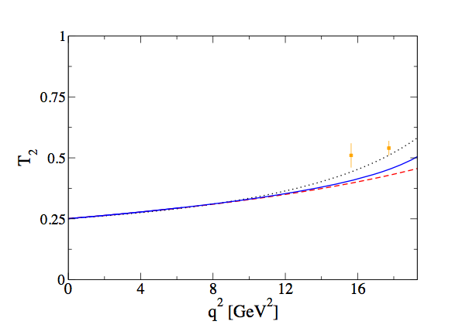
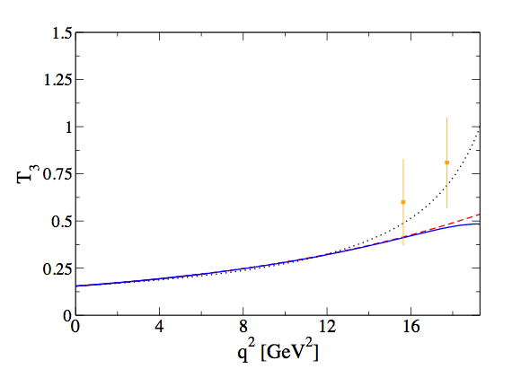
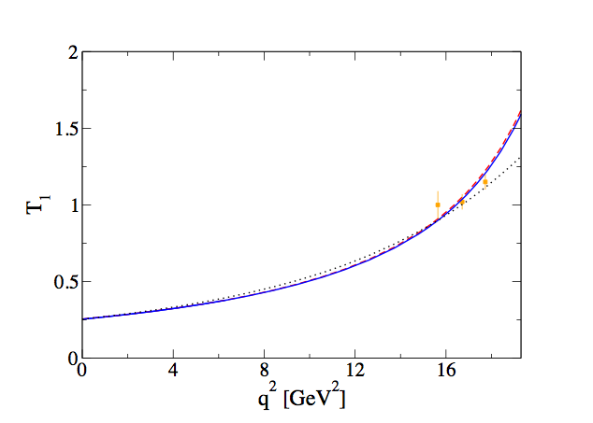
Form factors and lattice data
Blue: AdS/QCD
Red: AdS/QCD fit
Black: AdS/QCD + Lattice fit

Slide 19
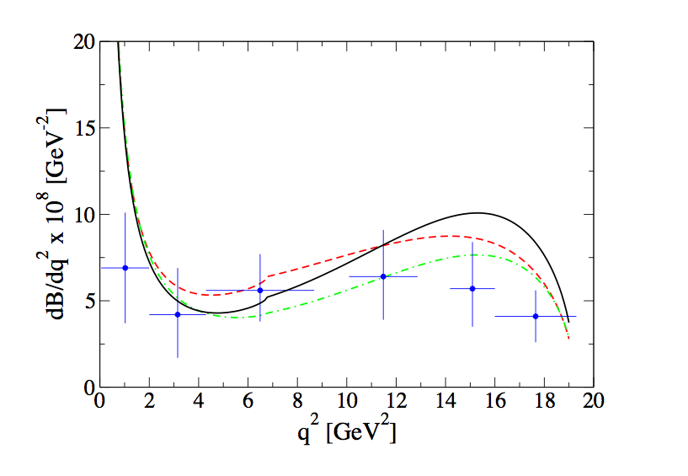
Differential branching ratio
Red: AdS/QCD
Black: AdS/QCD + Lattice
Green: AdS/QCD + Lattice + New Physics (reduced C₉)
Data from LHCb

Slide 20
Conclusions and outlook
We have computed the transition form factors as well as the differential branching ratio for using new holographic DAs for the vector meson
Agreement with LHCb data except at large momentum transfer. Possible NP in C9 ?
Now looking at other observables: isospin asymmetry, forward-backward asymmetry,…

Slide 21


Acknowledgements
This research is supported by the Canadian National Science and Engineering Research Council of Canada (NSERC)

