Slide 1

Interactions + Spin-orbit = ?
Tami Pereg-Barnea
McGill University
CAP Congress, June 16, 2014

Slide 2
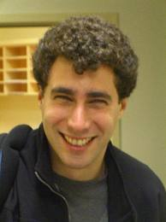
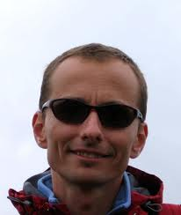



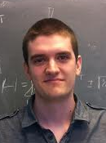



Collaborators
Gil Refael
(Caltech)
Marcel Franz (UBC)
Jan Borchmann
Rosa Rodriguez
Aaron Farrell
Ying-Jer Kao (NTU)
KunWu Kim
(Caltech)
Maxime Beaudry
Shunji Matsuura

Slide 3
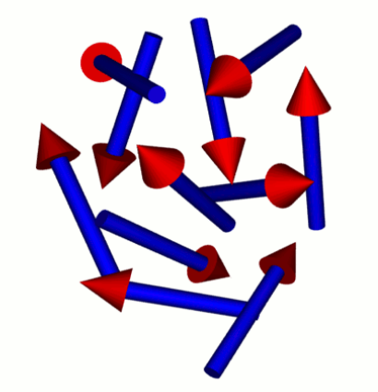
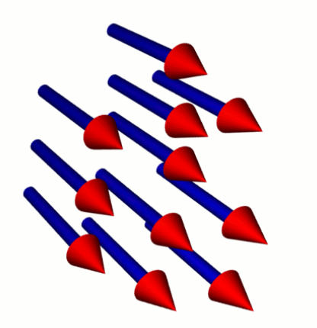
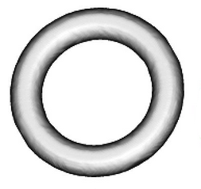
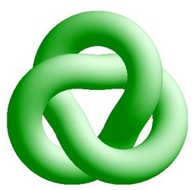
Paradigm shift in CM physics
Symmetry
Topology

Slide 4
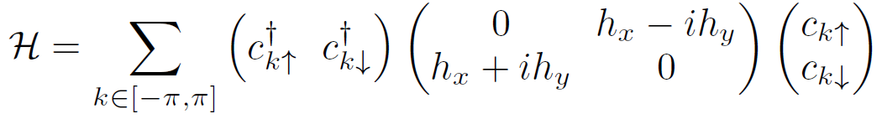
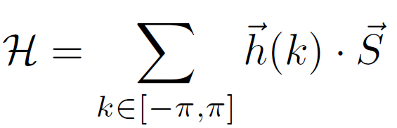


2 level system
1d
π/2
$\vec{h}(k)/|\vec{h}(k)$|
$$E= ±|\vec{h}\left(k\right)|$$
0
Chern # = how many times the spin winds around the unit circle
±π
-π/2
Winding is important

Slide 5



2 level system
2d
$$E= ±|\vec{h}\left(k\right)|$$
$\vec{h}(k)/|\vec{h}(k)$|
Chern # = how many times the spin covers the unit sphere

Slide 6
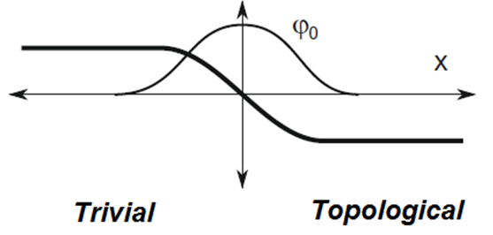
Bulk → Edge
Topological invariant /Chern number – non-local operator, integer.
Cannot change smoothly → gap closes
Δ(x)

Slide 7





Majorana Fermions
Wanted since 1937!
Majorana Fermion
Fermion
Majorana

Slide 8


Majorana statistics
Non-Abelian statistics: $ψ⟶ψ′$
Bosons : $ψ⟶ψ$ ,
Fermions $ψ⟶−ψ,$
Anyons $ψ⟶e^{iφ}ψ$
Non-abelian Anyons $ψ⟶ψ^{′}$
A fermion: $c=\frac{1}{2}(γ_{1}+iγ_{2})$;${ c}^{+}=\frac{1}{2}(γ_{1}−iγ_{2})$
Is it useful?

Slide 9

Topological superconductors
Pairing order parameter $∆_{k}\sim <c_{k }c_{−k}>$
The topology is a k-space vortex in the order parameter.
$Δ_{k}\sim ∆_{0}e^{iφ_{k}}$
$tg\left(φ_{k}\right)=k_{y}/k_{x}$
$\frac{Im(∆_{k})}{Re(∆_{k})}= \frac{k_{y}}{k_{x}}$

Slide 10
Topo Insulator → Topo Superconductor
s-wave
Topological super-conductor
2D Dirac cone
3D TI
Fu and Kane, PRL 2008

Slide 11
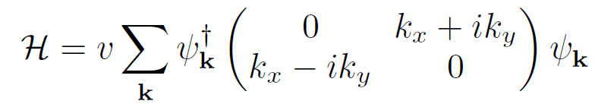
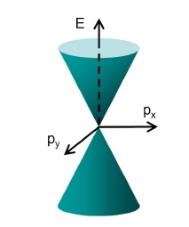
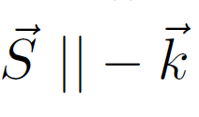
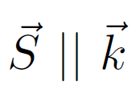


Dirac point in 2d
ky
kx

Slide 12

Superconductivity + Dirac
} 2Δ

Slide 13
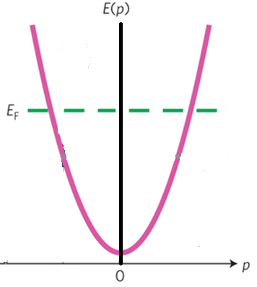
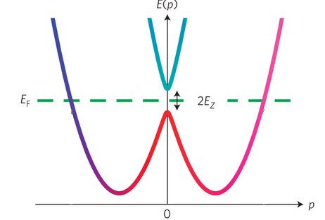
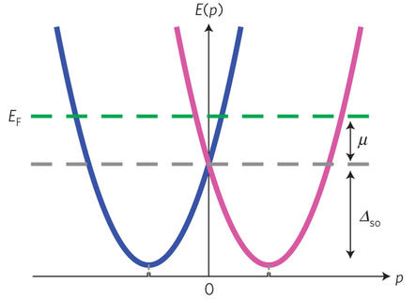



Spin-orbit semiconductors

Slide 14
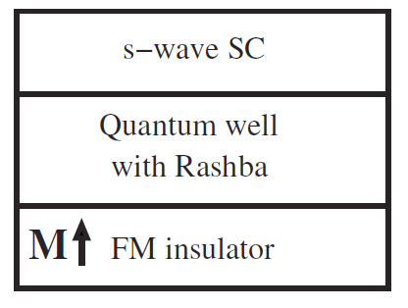
Proximity effect driven superconductivity
Proximity effect → topological superconductor
Sau, Lutchyn, Tewari, and Das Sarma,
PRL 2010.
Alicea PRB 2010

Slide 15
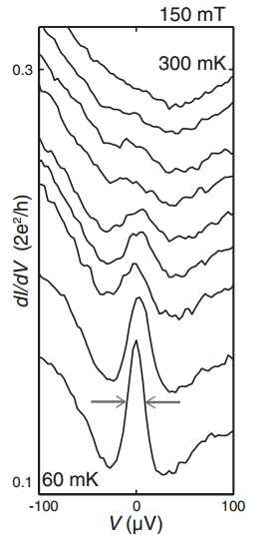
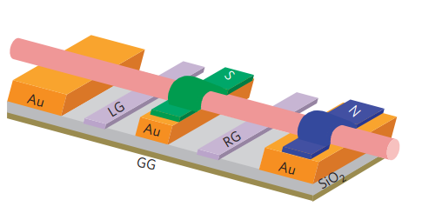
1D topo-superconductivity
Theory: Oreg, Refael, vonOppen, PRL 105, 177002 (2010)
Cook, Vazifeh and Franz, PRB 86, 155431 (2012)
Experiments: Mourik et al. , Science 336, 1003 (2012)
Das et al., Nature Physics 8, 887(2012)

Slide 16
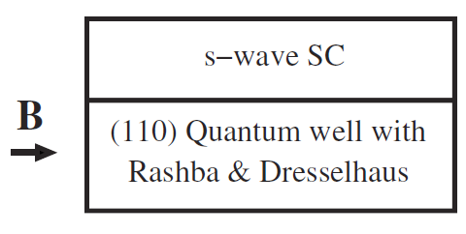
Interaction driven superconductivity?
Interaction induced superconductivity?
  Can e-e interactions replace the proximity effect?
Aaron Ferrell and TPB
PRB 87 214517 (2013)

Slide 17

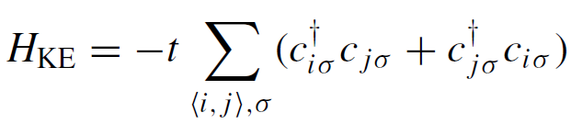
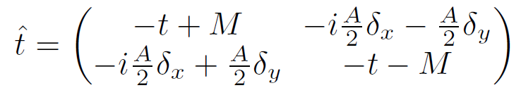
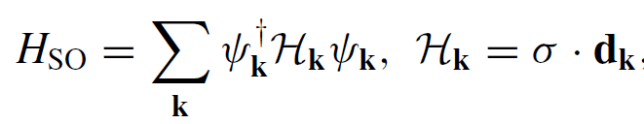

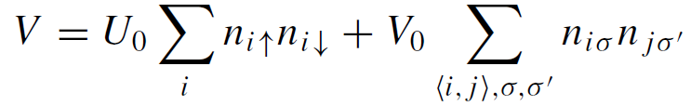
Interaction driven topological superconductivity

Slide 18
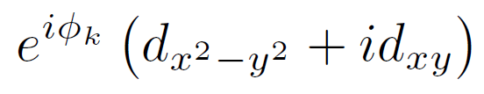
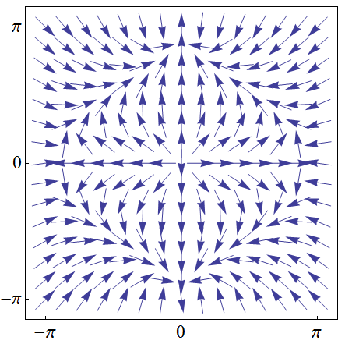
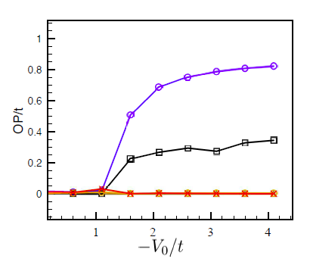



Interaction driven topological superconductivity
Aaron Ferrell and TPB
PRB 87 214517 (2013)

Slide 19
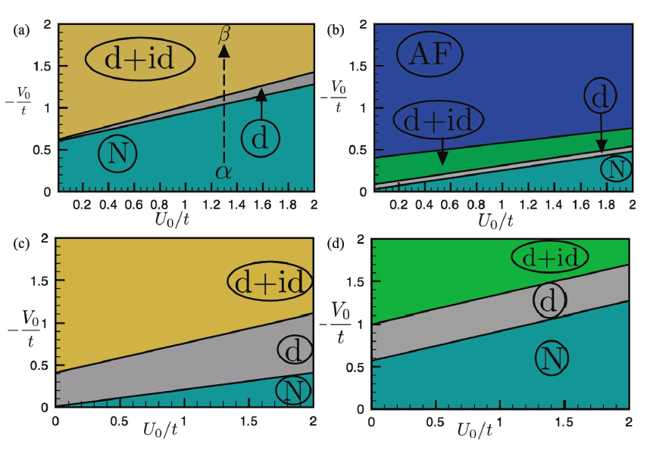
Phase diagram

Slide 20

Strong coupling treatment
The interaction isn’t weak - expand in a t/U fashion.
Up to second order – t-J model generalization
Spin-spin
Zeeman
hopping

Slide 21
At half filling
No hopping
Unconventional spin Hamiltonian
J_{δ} is anisotropic, non diagonal.
Dzjaloshinskii-Moriya and Compass anisotropy

Slide 22
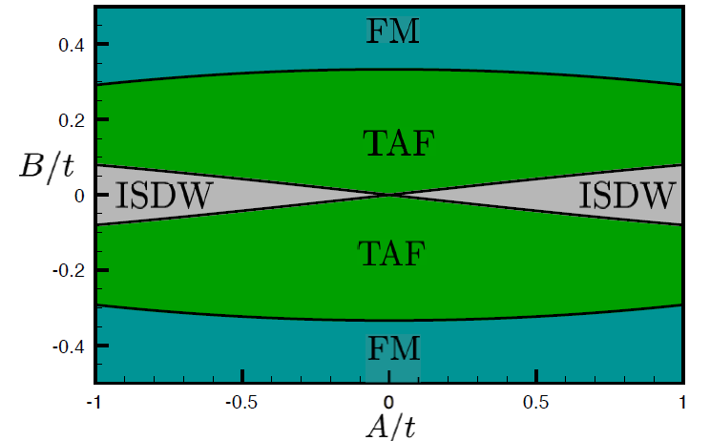
½ filling phase diagram

Slide 23
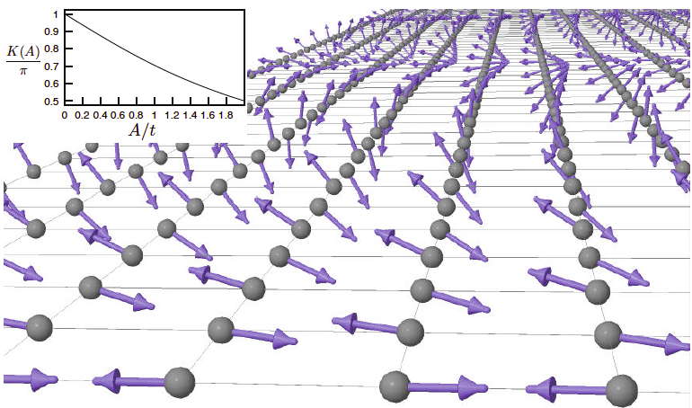
At half filling
Incommensurate spin density wave
Aaron Ferrell, P.-K. Wu, Y-J Kao and TPB
arXiv:1402.4093

Slide 24
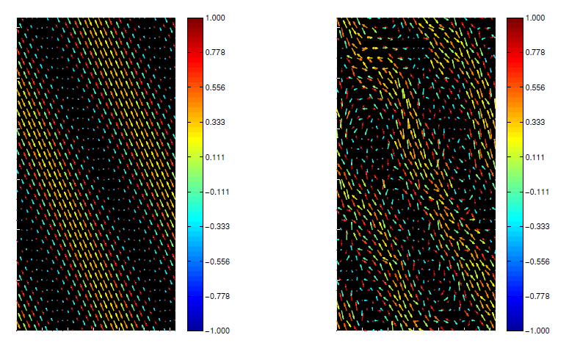
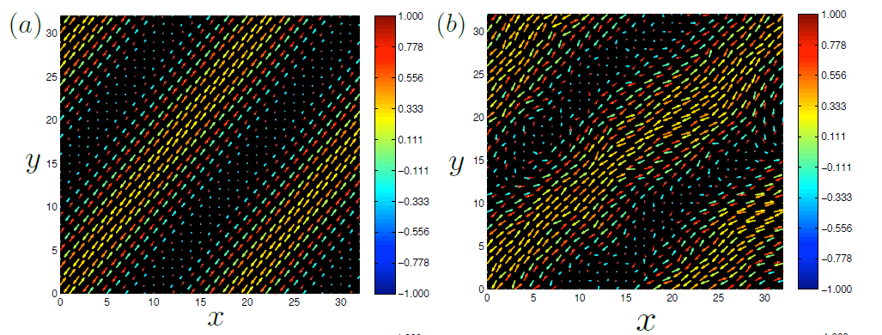
Ansatz vs. Monte-Carlo

Slide 25


Away from ½ filling:
Gutzwiller projected variational wavefunction
Variational study
Gutzwiller projected mean field wave function
Estimate the energy and minimize:
Evaluated by Monte-Carlo

Slide 26

Gutzwiller Approximation
Parameters get renormalized
Evaluate the man field energy

Slide 27
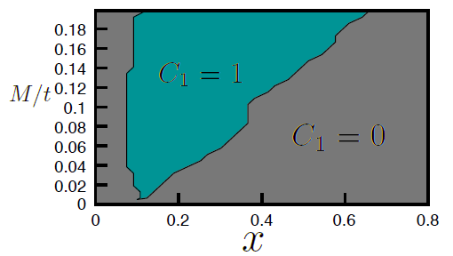
Strong coupling treatment
Aaron Ferrell and TPB
Phys. Rev. B 89, 035112 (2014)

Slide 28

Interacting topological systems
Chern # = momentum integral on Berry curvature. $|\left.n,k\right\rangle$ states involved.
Well defined in non-interacting systems.
Alternative definition includes Green’s function (require the full spectrum)
Entanglement entropy,
entanglement spectrum.

Slide 29

Entanglement entropy
Density Matrix $ρ_{ij}=<{c_{i}^{+}c}_{j}>$
Von-Neumann entropy $S=−tr[ρ ln⁡(ρ)]$
Reduced density matrix
$ρ_{A}={tr}_{B}ρ$
$S_{A}=−tr[ρ_{A} ln⁡(ρ_{A})]$
A measure of entanglement
Sensitive to topology
A
B

Slide 30
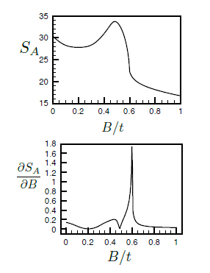
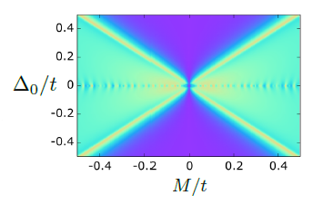
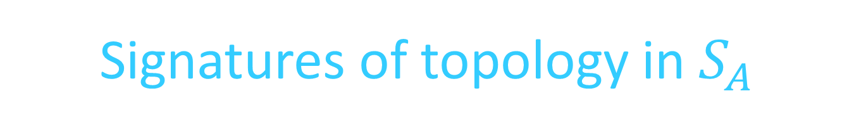
Signatures of topology in $S_{A}$

Slide 31
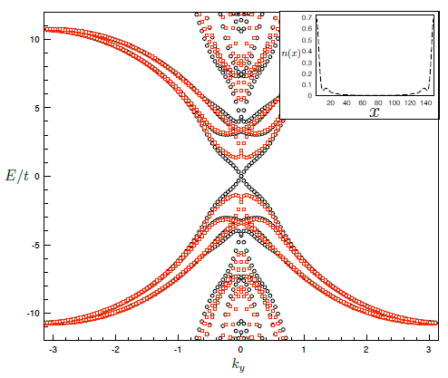


Entanglement spectrum
Defined as the spectrum of $H_{A}$
Different from the physical spectrum
Contains edge modes predominantly

Slide 32
Summary and Outlook
Closer to a topological superconductor
Majorana fermions are closer than ever!
  Still need - characterization, control
Developing new tools to study strongly interacting topological systems
New types of topological systems in the strongly correlated regime?

