Slide 1
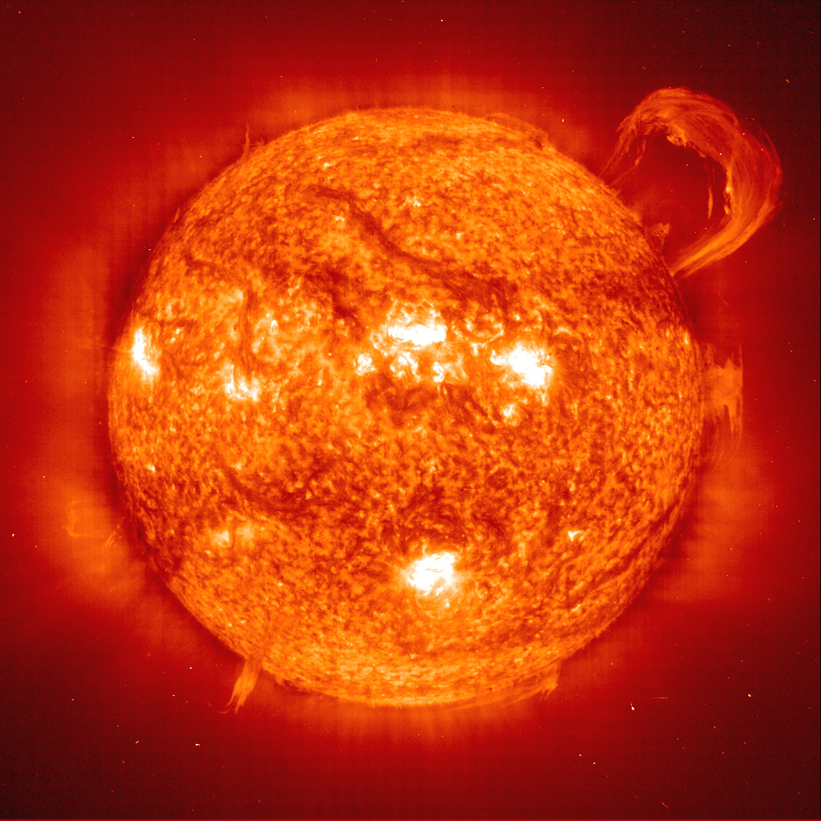
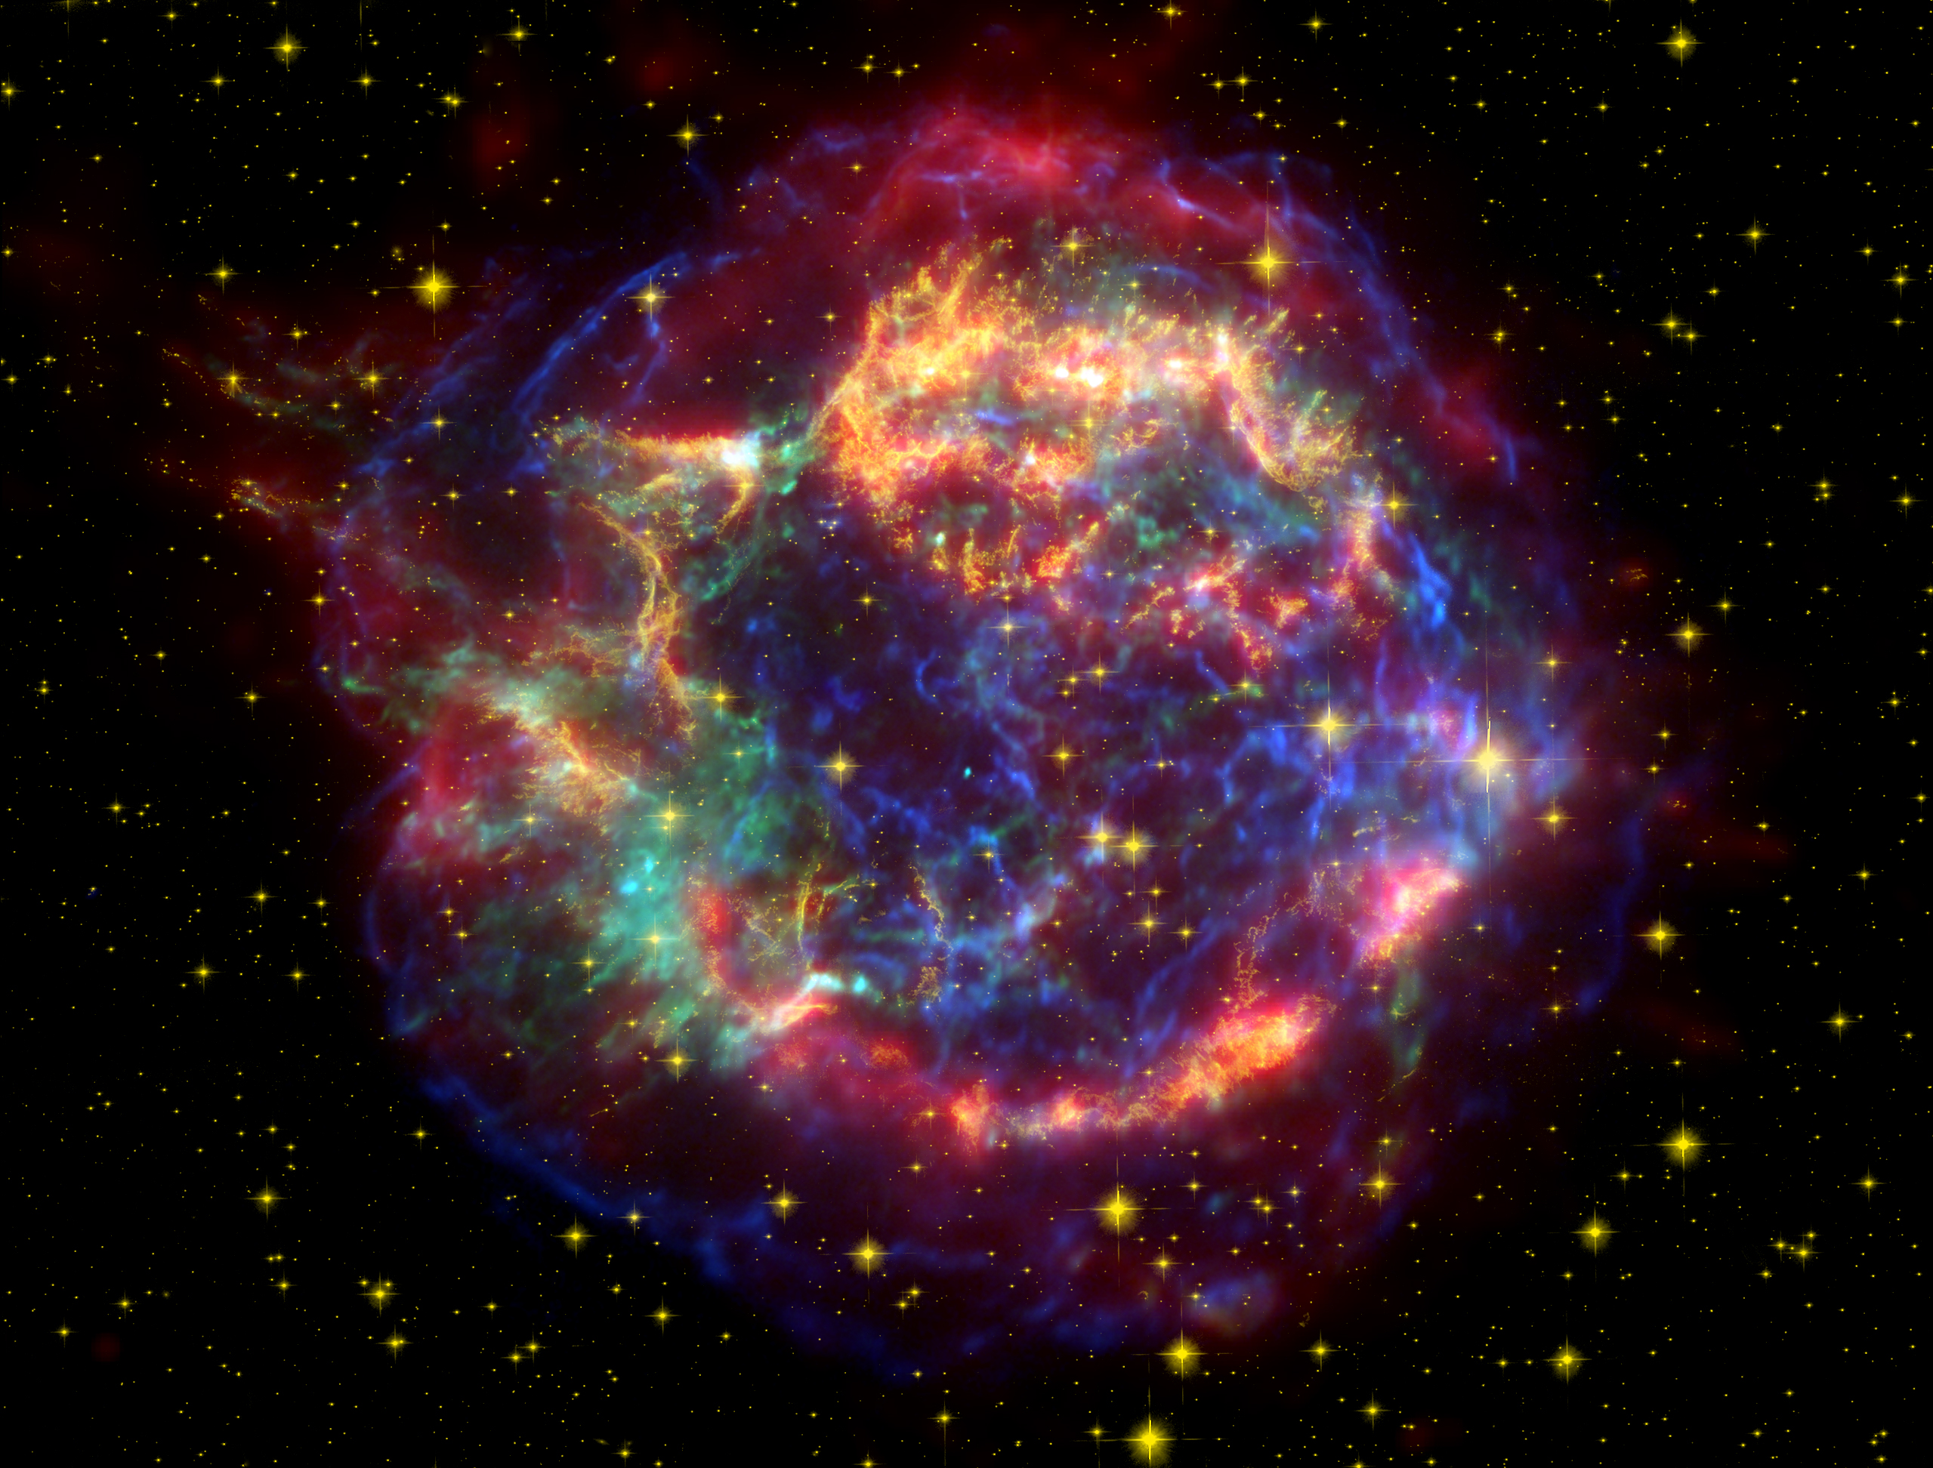
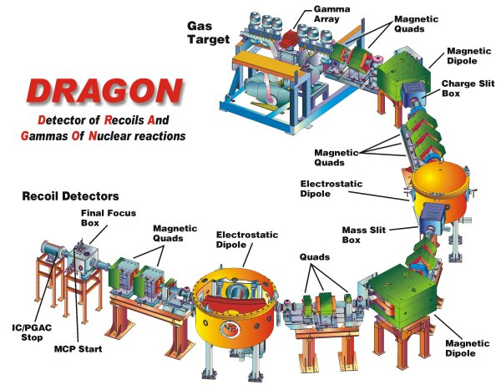
Measurement of the p-process branching point reaction ⁷⁶Se(α,γ)⁸⁰Kr at DRAGON
Jennifer Fallis | Postdoc- DRAGON group | TRIUMF

Slide 2
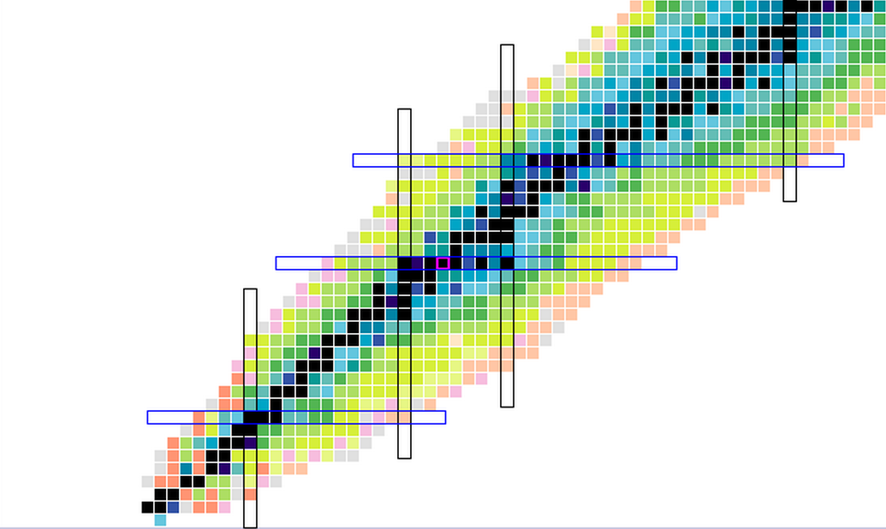
DRAGON was designed to study nuclear reactions in novae:
(p,γ) and (α,γ) reactions
using original ISAC-I beams
(A < 30 at 150 – 1500 keV/u)
Nova nucleosynthesis thought to terminate at ⁴⁰Ca
²¹Na(p,γ)²²Mg – S. Bishop et al. PRL (2003)
– J. D’Auria et al. PRC (2004)
²⁶Al(p,γ)²⁷Si – C. Ruiz et al. PRL (2006)
²³Mg(p,γ)²⁴Al – L. Erikson et al. PRC (2010)
¹⁷O(p,γ)¹⁸F – U. Hager et al. PRC (2012)
¹⁸F(p,γ)¹⁹Ne – C. Akers et al. PRL (2013)

Slide 3
First experiment moving beyond A=30 was ⁴⁰Ca(α,γ)⁴⁴Ti
- Affects the production of ⁴⁴Ti in ccSN α-rich freeze out
- Opened the door for nova endpoint studies
- Required a solid foil to be placed downstream of the gas target to boost the charge state of the beam and recoils as the charge state from the gas was not sufficient
⁴⁰Ca(α,γ)⁴⁴Ti – C. Vockenhuber et al. PRC (2007)
³³S(p,γ)³⁴Cl – J. Fallis et al. PRC (2013)
³⁸K(p,γ)³⁹Ca - G. Christian et al.

Slide 4
A high mass program was initiated to explore the limits of DRAGON

Slide 5
A high mass program was initiated to explore the limits of DRAGON

Slide 6
rp-process
νp-process
α-rich freeze out
p-process
Novae

Slide 7
Outline:
⬥ Discussion of high mass program
at DRAGON (goals, testing)
⬥ Introduction to the p-process
⬥ First science results:
measurement of ⁷⁶Se(α,γ)⁸⁰Kr

Slide 8
DRAGON high mass program
Main Aims:
Explore the mass limits of the separator transmission for the available charge states using the available MD1 and ED1 fields.
Test the charge state distribution calculations.
Compare simulated and measured separator transmissions for reduced mass and charge slit widths.
Determine the rate of ‘leaky’ beam in these conditions.
Demonstrate clear particle ID.
Confirm a known resonance energy.

Slide 9
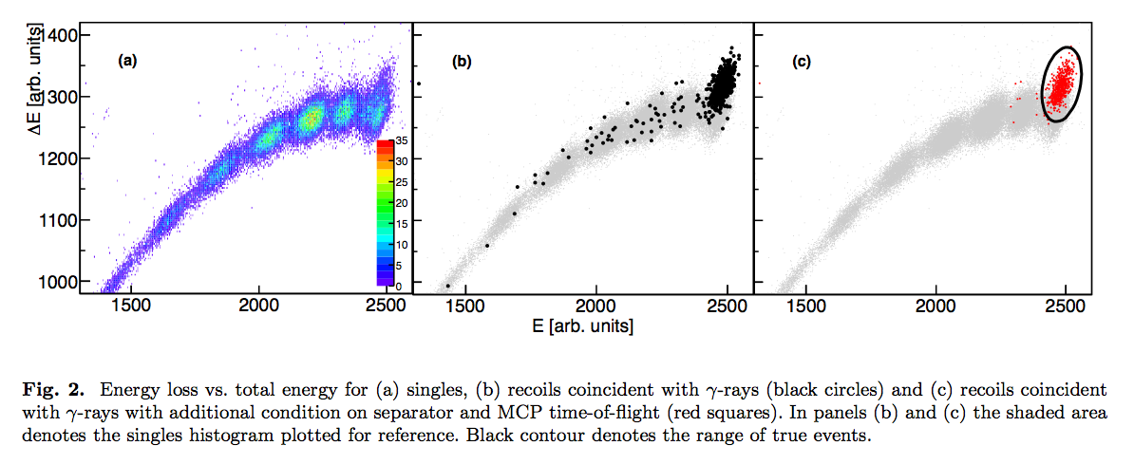
DRAGON high mass program
⁵⁸Ni(p,γ)⁵⁹Cu measurement (Δm/m <⁷⁶Se(α,γ)⁸⁰Kr)
For the 1.424 MeV resonance we confirmed a resonance strength of 0.687(96) eV
A. Simon, J. Fallis et al., Eur. Phys. J. A (2013) 49: 60

Slide 10
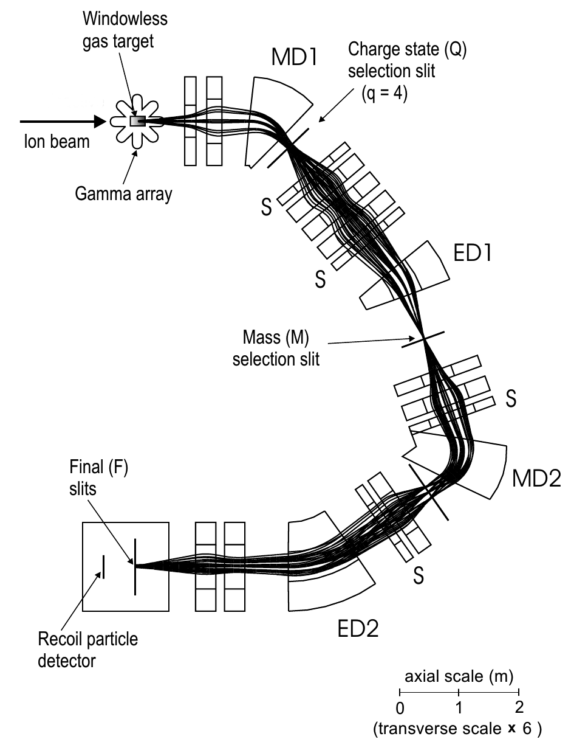
DRAGON high mass program

Slide 11
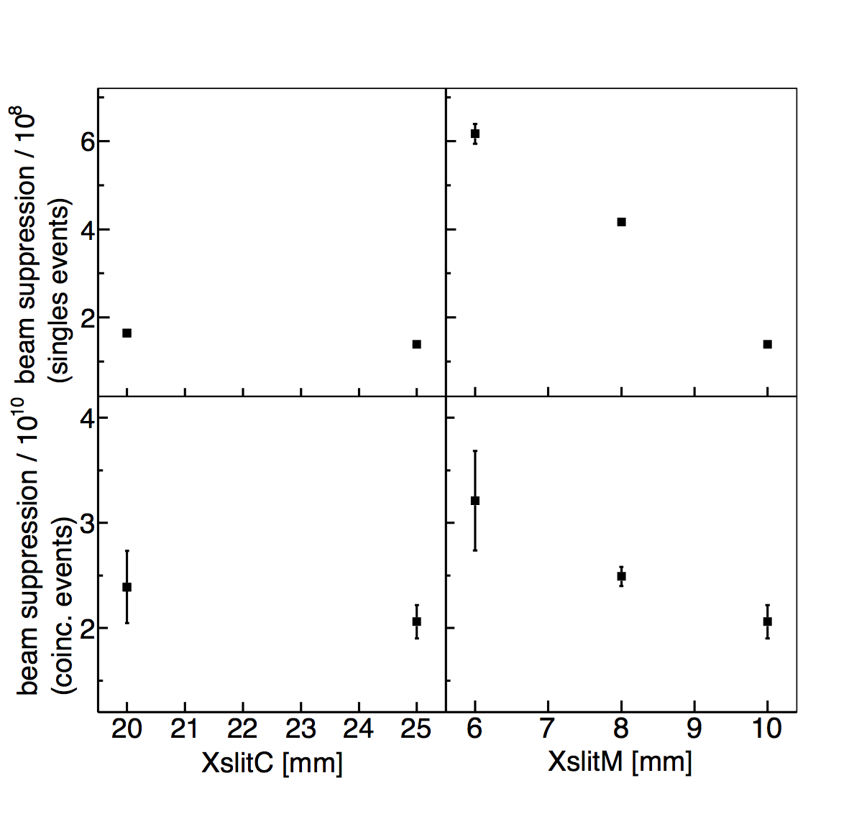
DRAGON high mass program

Slide 12
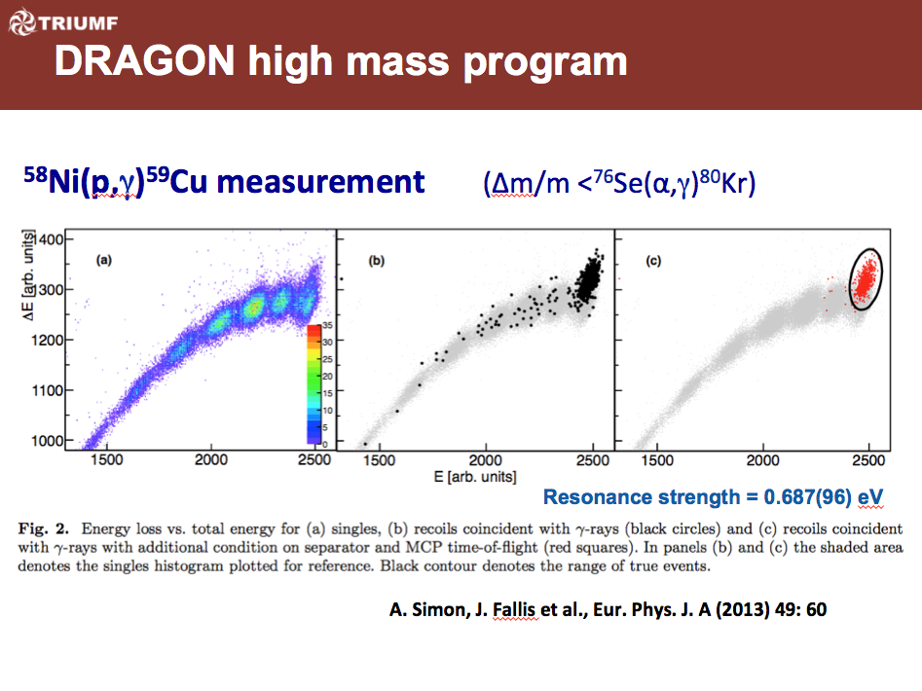
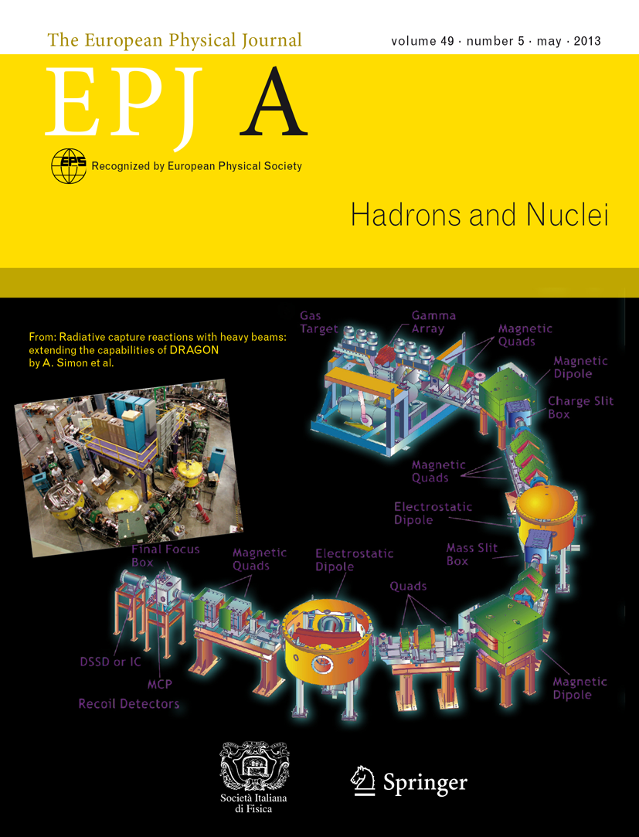
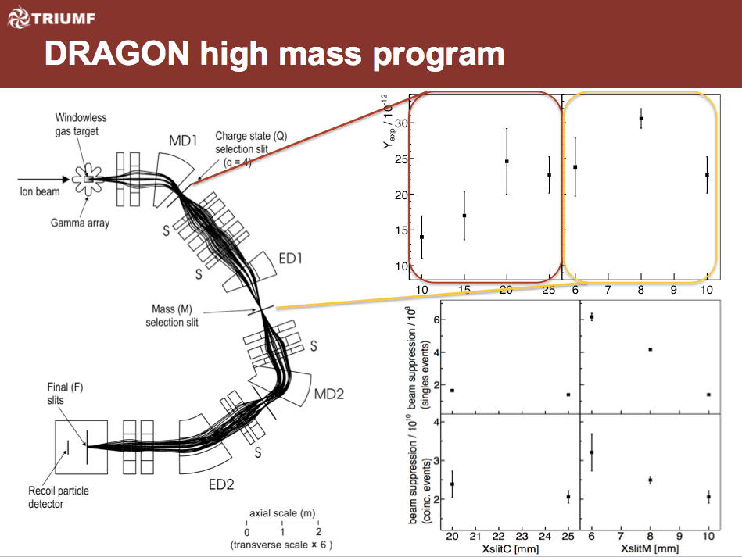
A. Simon, J. Fallis et al., Eur. Phys. J. A (2013) 49: 60

Slide 13
p-process nucleosynthesis
p-process

Slide 14
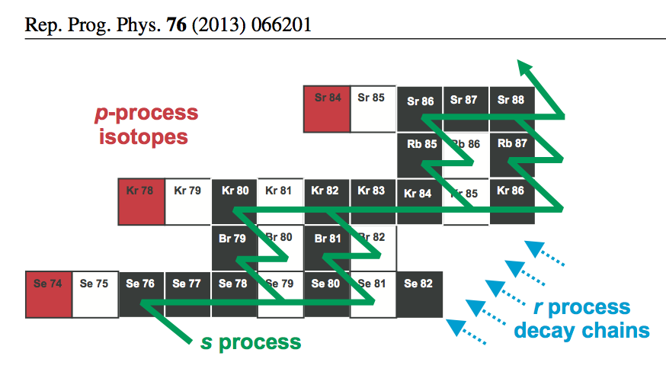
p-process nucleosynthesis

Slide 15
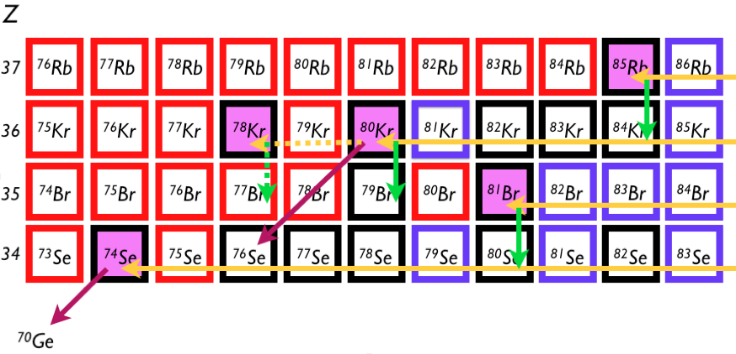
⁷⁶Se(α,γ)⁸⁰Kr and p-process nucleosynthesis
⁸⁰Kr is critical branching point for ⁷⁸Kr
If (γ,α)/(γ,p) dominate, flow of material is deflected away from ⁷⁸Kr
If (γ,n) dominates, flow moves towards ⁷⁸Kr

Slide 16
⁷⁶Se(α,γ)⁸⁰Kr and p-process nucleosynthesis
“Problems persist with α-captures at energies and in the mass region relevant for the γ-process. Comparisons of theoretical data with the few available data at low energies revealed a mixed pattern of good reproductions and maximally 2 – 3 times overprediction of the (α,γ) cross sections when using a standard [optical] potential”
“Data for the (α,γ) reactions are… scarce, leaving the theoretical reaction rate calculations largely untested”
- T. Rauscher et al., Rep. Prog. Phys. 76, 066201 (2013)

Slide 17
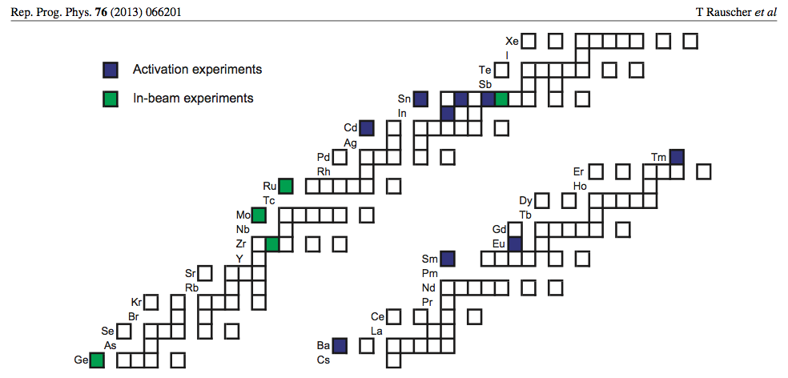
⁷⁶Se(α,γ)⁸⁰Kr and p-process nucleosynthesis
“Problems persist with a-captures at energies and in the mass region relevant for the g-process. Comparisons of theoretical data with the few available data at low energies revealed a mixed pattern of good reproductions and maximally 2 – 3 times overprediction of the (a,g) cross sections when using a standard [optical] potential”
“Data for the (a,g) reactions are… scarce, leaving the theoretical reaction rate calculations largely untested”
- T. Rauscher et al., Rep. Prog. Phys. 76, 066201 (2013)

Slide 18
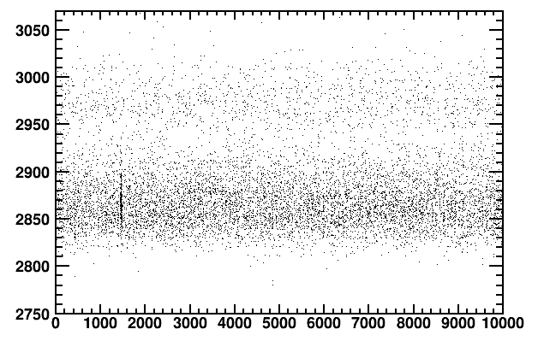
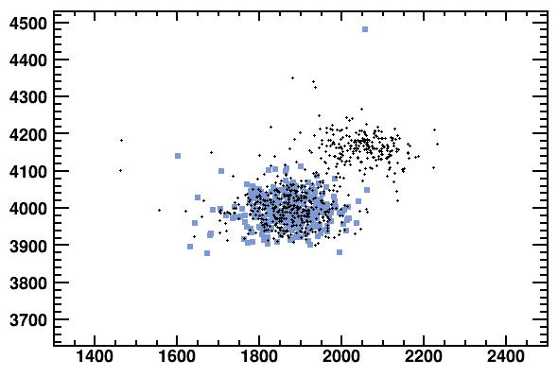
⁷⁶Se(α,γ)⁸⁰Kr results
Beam intensity 2x10¹⁰ pps
Measurement at E_{lab} = 1.5 MeV/u
Gamow Window for 1.8 – 3 GK
=> 1.0 – 2.3 MeV/u
MCP TOF [channels]
Separator TOF [channels]
ΔE (IC anodes 2 and 3) [channels]
ΔE (IC anodes 0 and 1) [channels]

Slide 19
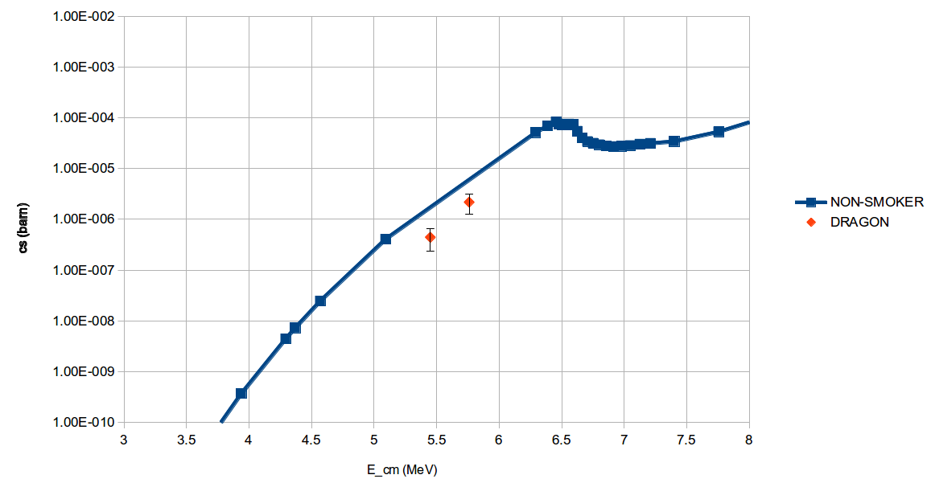
⁷⁶Se(α,γ)⁸⁰Kr results
Very Preliminary!
Courtesy of Charlie Akers
Charge state distributions still to be measured - Scheduled for late June
γ-decay scheme (which affects BGO array efficiency) unknown – Likelihood analysis of GEANT3 simulations is underway

Slide 20

TRIUMF
C. Ruiz, D. Hutcheon, G. Christian,
L. Buchmann, B. Davids, I. Dillmann,
A. Rojas
Colorado School of Mines
U. Greife, U. Hager, P. O’Malley, D. Connolly
University of York
B. Fulton, A. Laird, C. Akers, J. Riley
Michigan State University
A. Spyrou, A. Simon, S. Quinn

Slide 22
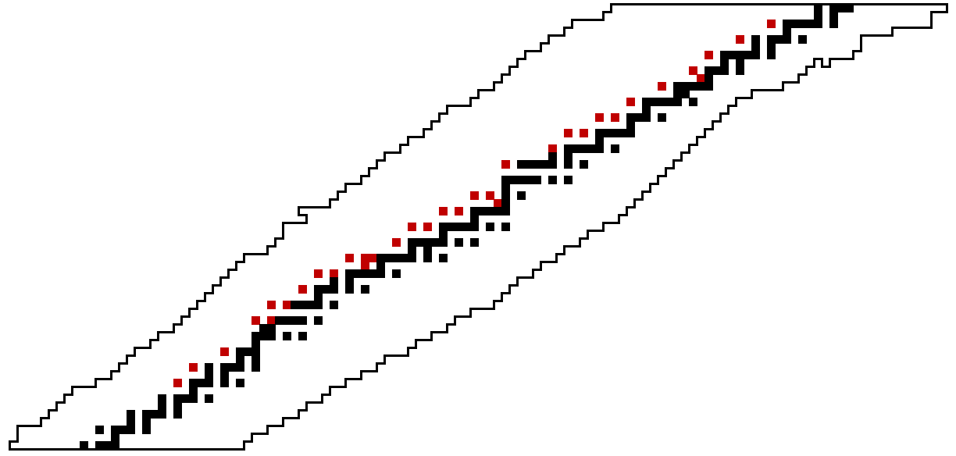
p-process nucleosynthesis
Pb
Proposed scenarios
O/Ne layer of Type II SN
Type Ia SN
ν-driven winds of Type II SN
Accreting neutron stars
Proton Number (Z)
Fe
Neutron Number (N)

Slide 23

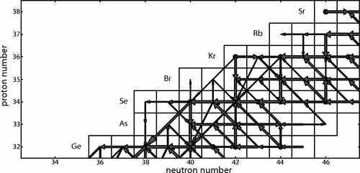
W. Rapp et al, The Astrophysical Journal, 653 (2006) 474-489.

Slide 24
