Slide 1

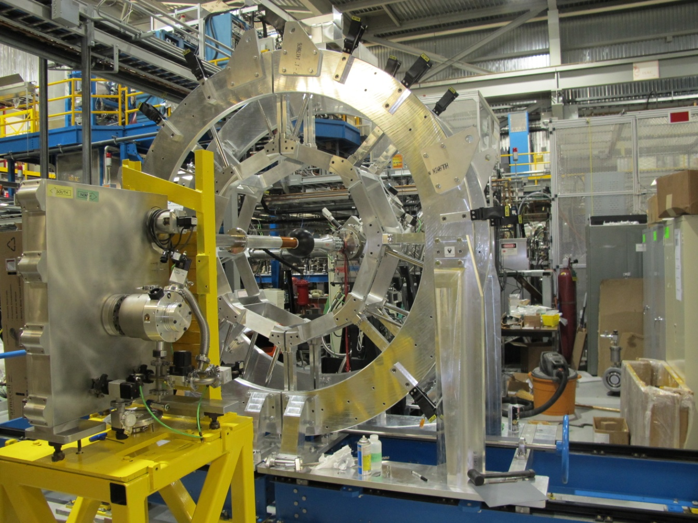
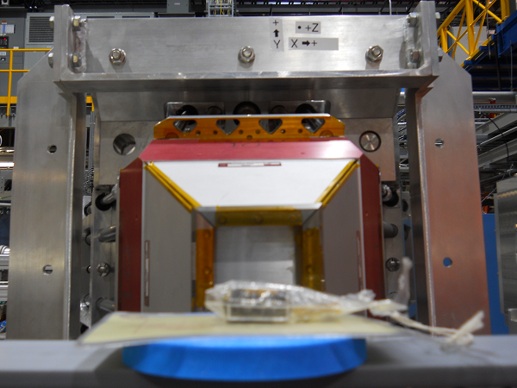
Investigations of Background and Compton Suppression Shields for GRIFFIN
Nikita Bernier, UBC and TRIUMF
for the GRIFFIN collaboration
2014 Canadian Association of Physicists Congress
June 17th, 2014.

Slide 2

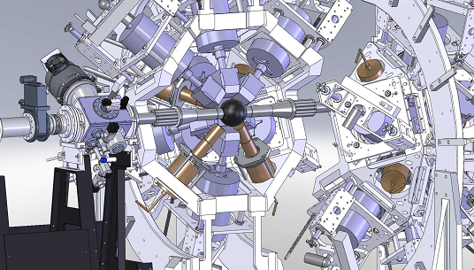
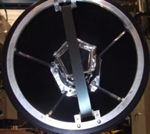
GRIFFIN Spectrometer
2
N. Bernier
GRIFFIN : Gamma-Ray Infrastructure For Fundamental Investigations of Nuclei
  16 large-volume clover-type High Purity Ge [HPGe] detectors dedicated to decay spectroscopy research with the low-energy radioactive ion beams in ISAC-I at TRIUMF
  Five sub-systems are combined to create a high-efficiency decay spectrometer for sensitive measurements.
In-vacuum moving tape collector system
See A.B. Garnsworthy (M2-2)

Slide 3
GRIFFIN Spectrometer
2
N. Bernier
GRIFFIN : Gamma-Ray Infrastructure For Fundamental Investigations of Nuclei
  16 large-volume clover-type High Purity Ge [HPGe] detectors dedicated to decay spectroscopy research with the low-energy radioactive ion beams in ISAC-I at TRIUMF
  Five sub-systems are combined to create a high-efficiency decay spectrometer for sensitive measurements.
In-vacuum moving tape collector system
See A.B. Garnsworthy (M2-2)

Slide 4
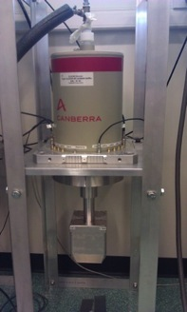
Suppression Shields
3
N. Bernier
The performance of a γ- ray spectrometer is determined primarily by
  γ- ray energy resolution
  total γ- ray photopeak detection efficiency
  photopeak-to-total ratio, and
  suppression of environmental background signals.
Solutions for improved performance :
  Significantly reduce Compton scattering and escape peaks [high rate] by placing HPGe detectors in close proximity and add energy loss in each crystal
  Shield against the radioactive background [low rate] present in the experimental hall by surrounding HPGe with a high density scintillator.

Slide 5
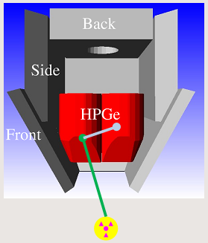
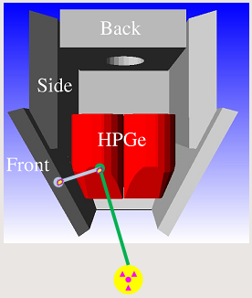
Addback and Escape Suppression
4
N. Bernier
High probability that an incoming γ- ray Compton scatters, or an annihilation photon, will escape the detector
  Results in a continuous spectrum of lost energy and escape peaks.
✗
If energy deposited in two crystals, treat as a single incident γ-ray :
add energies.
If energy measured in a scintillator, veto any HPGe event in coincidence.
G. Hackman

Slide 6
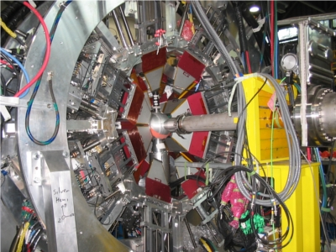
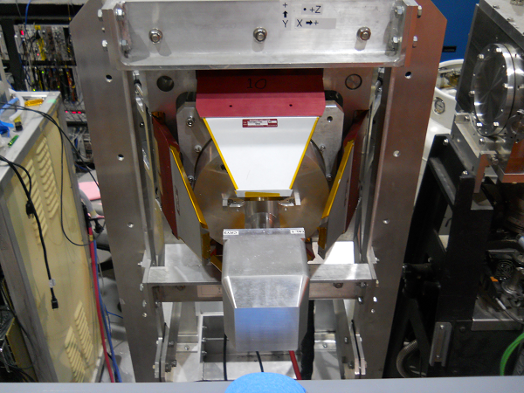
5
N. Bernier
Experimental Setup
GRIFFIN clover set up with TIGRESS shields
20 optically-isolated scintillators per shield
for crystal specific Compton suppression
  Retractable BGO front shields, BGO
  side shields and CsI back shields.
TIGRESS array in ISAC-II experimental hall

Slide 7
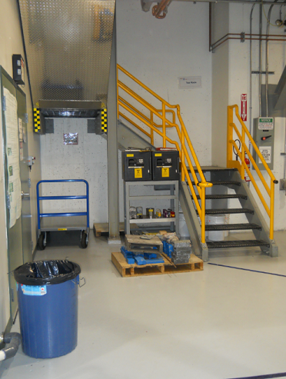
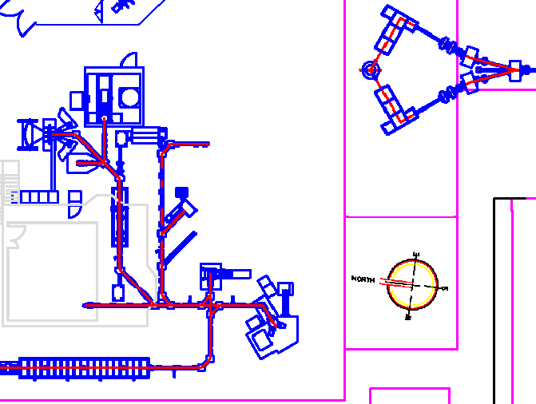


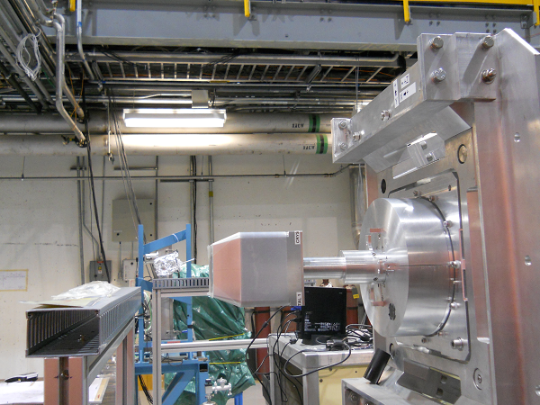
Background Characterization
6
N. Bernier
Measurements taken with GRIFFIN clover in 2 locations in ISAC-I hall
  East : closer to sources safe
  West : closer to yield station.
Target Stations
Yield Station

Slide 8
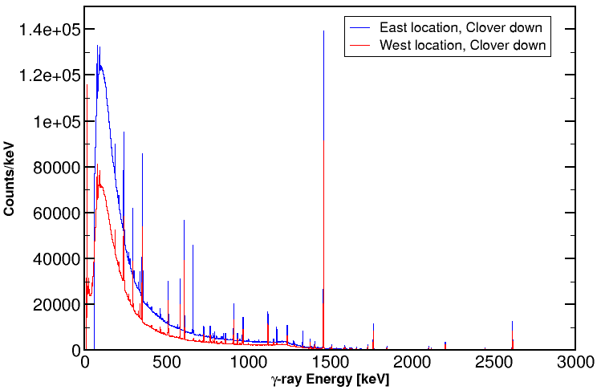
Different Locations
7
N. Bernier
Proton beam off, 48h
East : >124 Hz/crystal, West : 102 Hz/crystal
>18% difference between both locations.
! Different energy thresholds
Blue=59 keV Red=30 keV
Calibration sources
⁴⁰K in concrete
²³⁸U and ²³²Th decay chains

Slide 9
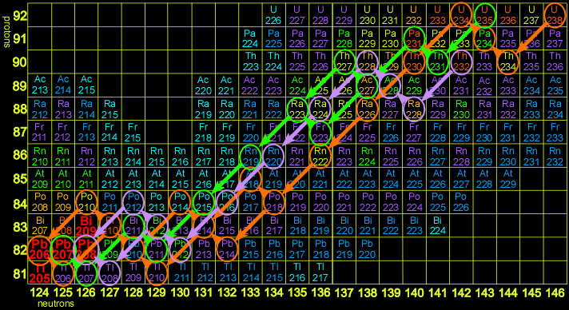
Environmental Background
8
N. Bernier
⁴⁰K and U/Th series decays and cosmic rays
Activity generated by high-energy neutrons produced when the 500 MeV proton beam impinges on the high-power ISAC production targets located 2 stories below the ISAC-I experimental hall.
M. Brown

Slide 10
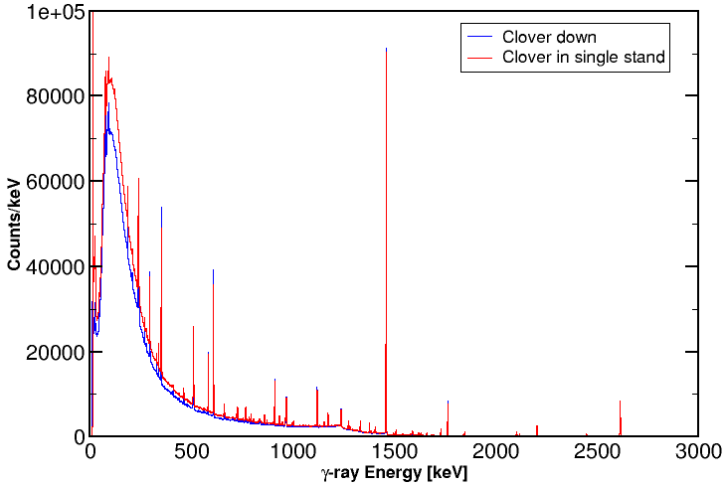
Different Orientations
9
N. Bernier
Proton beam off, 48h
Down : 102 Hz/crystal, Horizontal : 87 Hz/crystal
14% decrease with orientation.
²¹⁴Pb
²³⁸U series
⁴⁰K
Concrete
351.9
1460.8
²²⁸Ac
²³²Th series
²¹⁴Bi
²³⁸U series
²⁰⁸Tl
²³²Th series
911.2
1764.5
2614.5

Slide 11
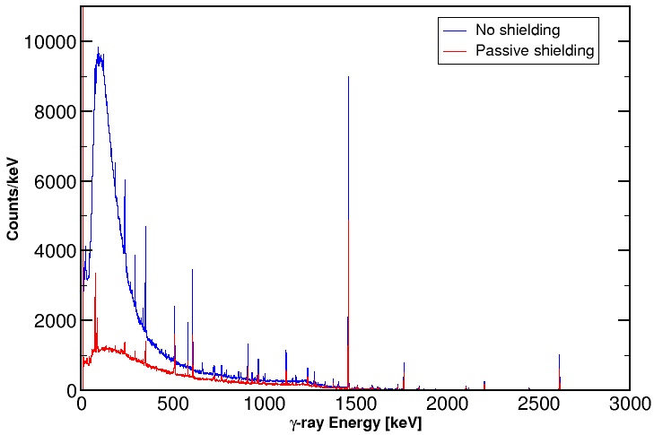
Shielded Clover
10
N. Bernier
Proton beam off, 2h
Passive Shielding : 101 Hz/clover, No Shielding : 321 Hz/clover
69% decrease with passive shielding only.
! 4 HPGe crystals summed without addback.
²¹⁴Pb
²³⁸U series
⁴⁰K
Concrete
351.9
1460.8
²²⁸Ac
²³²Th series
²¹⁴Bi
²³⁸U series
²⁰⁸Tl
²³²Th series
911.2
1764.5
2614.5

Slide 12
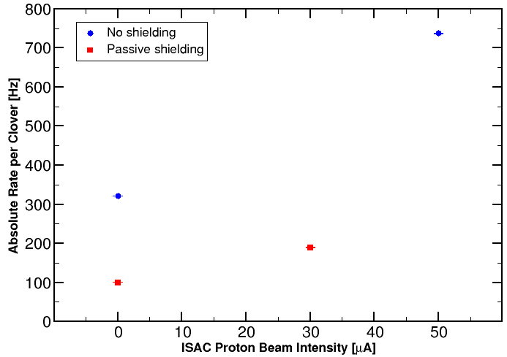
ISAC Proton Beam ON
11
N. Bernier
737 Hz/clover, ~12 kHz in the full GRIFFIN array without shielding
Expecting 0.1 mHz for ~0.01 ions/s radioactive beams
Background exceeding signal of interest by factor 10⁸.

Slide 13
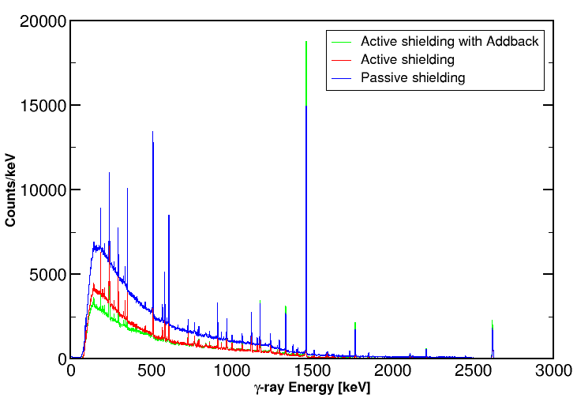
Active Suppression
12
N. Bernier
TIGRESS clover in closed array, 24h
Passive : 50 Hz/clover, local active : 23 Hz/clover
Reduction of GRIFFIN background by a factor 20.
²¹⁴Pb
²³⁸U series
⁴⁰K
Concrete
! Background rates will be moderately higher due the closer proximity of GRIFFIN to the ISAC production targets.
351.9
1460.8
²²⁸Ac
²³²Th series
²¹⁴Bi
²³⁸U series
²⁰⁸Tl
²³²Th series
911.2
1764.5
2614.5

Slide 14
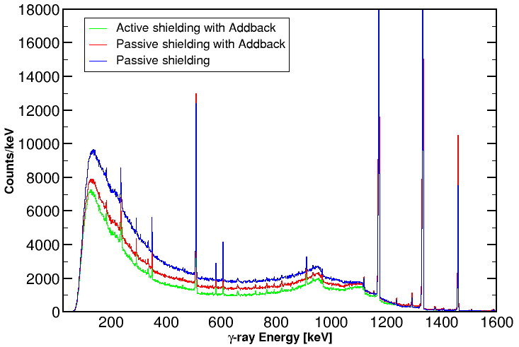
Peak-to-Total Ratios
13
N. Bernier
TIGRESS clover in closed array, 4h
Improved ratios from 9.8% to 11% for a ⁶⁰Co source.
1173.2
1332.5

Slide 15
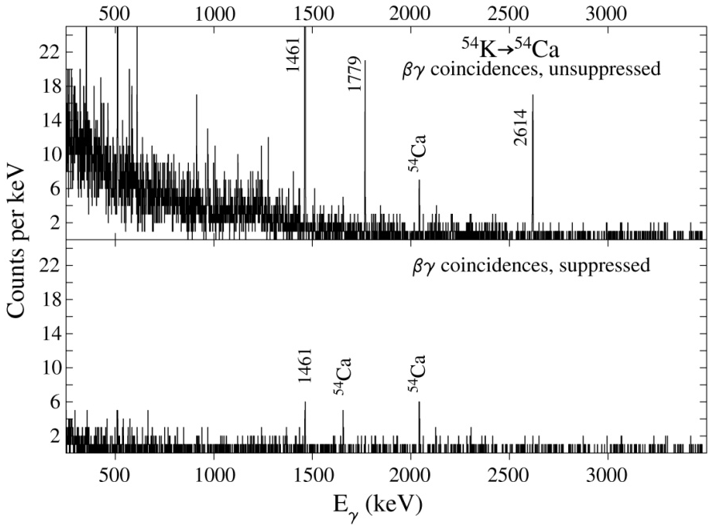
Example : Decay of ⁵⁴K to ⁵⁴Ca
14
N. Bernier
Simulation for a one week experiment using GRIFFIN at a beam rate of 0.01 ions/s using TIGRESS background measurements
β-γ coincidence condition already suppresses by a factor 10⁶
Impossible without the suppression shields !
Photopeaks from
⁴⁰K, Th series and
neutron capture on ²⁷Al
1656
2043
C.E. Svensson

Slide 16
Overview
15
N. Bernier
GRIFFIN array (16 clovers) will count ~12 kHz of background triggers without suppression shields, limiting experiments to isotopes with beam intensities ≥ 0.1 ions/s.
Suppression shields will represent a factor of 20 reduction in environmental background enabling an entire class of sensitive experiments down to beam intensities ~0.01 ions/s, approximately
200 additional exotic isotopes.

Slide 17

P.C. Bender, R. Churchman, S. Ciccone, I. Dillmann,
A.B. Garnsworthy, S. Georges, G. Hackman, R. Krücken, D. Miller, W.J. Mills, M.M. Rajabali, C. Unsworth
TRIUMF
E.T. Rand, C.E. Svensson
University of Guelph
Merci!
Thank you!

