Slide 1
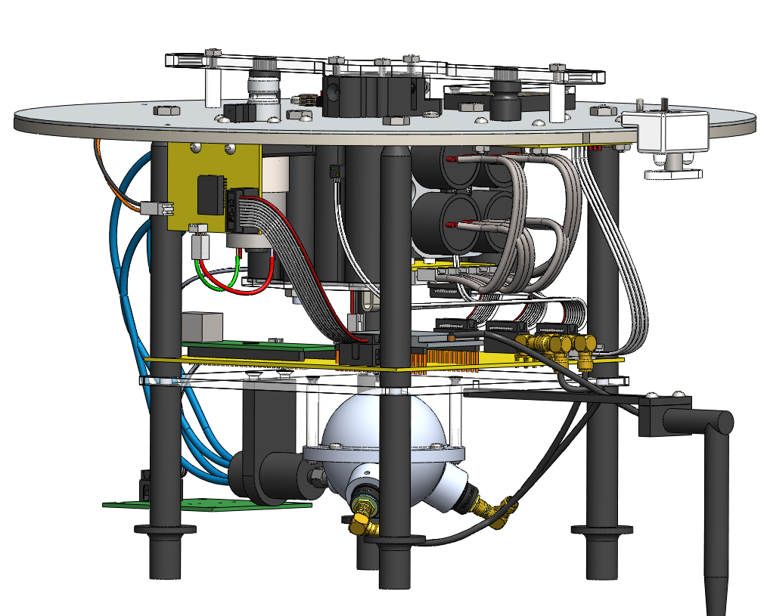
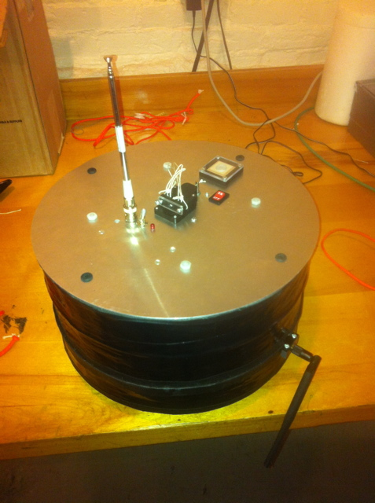
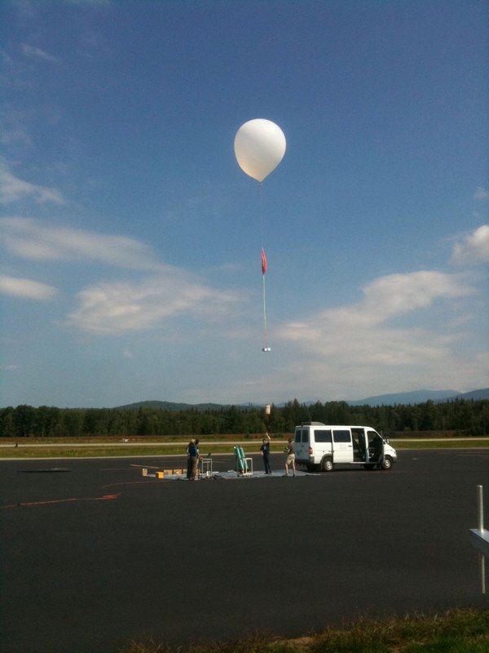
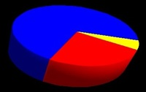
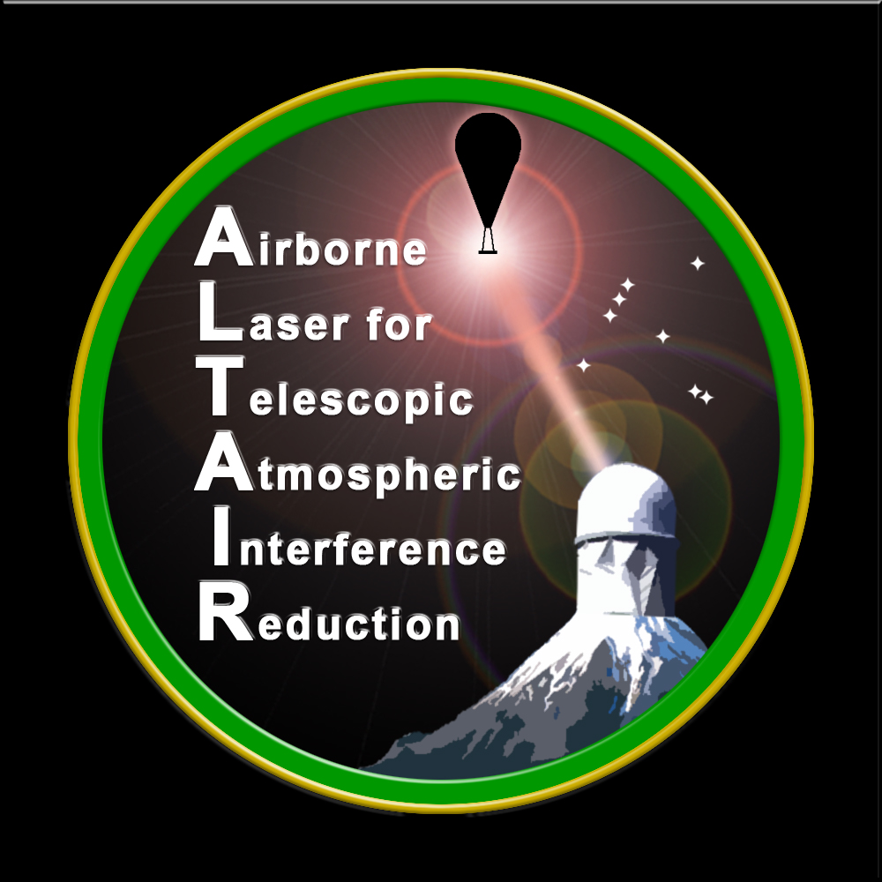

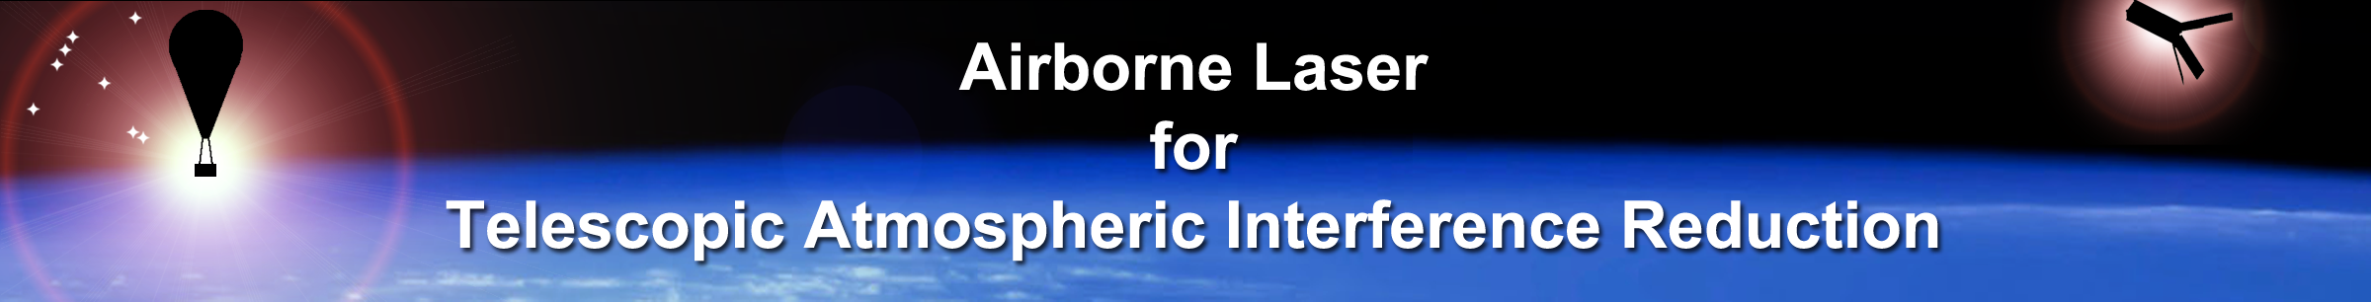
ALTAIR: Precision Photometric Calibration via Low-Cost Artificial Light Sources Above the Atmosphere
Divya Bhatnagar
Univ. of Victoria

Slide 2
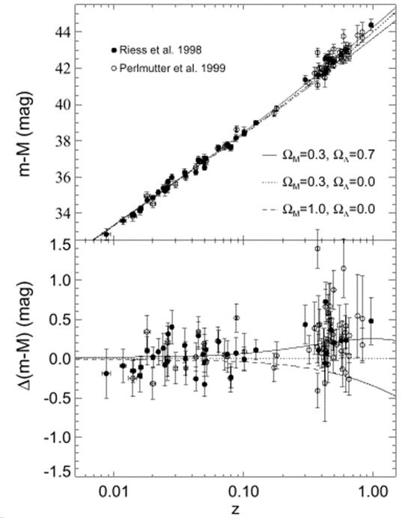
Our Story so far …….
Supernova surveys in the 1990s revealed that the Hubble expansion is accelerating.
The acceleration is caused by mysterious “dark energy.”
The challenge of the 1990s was supernova statistics; the challenge of today is to measure Supernova flux at better than 1% precision.
Calibration is the critical item for further progress in supernova surveys.

Slide 3
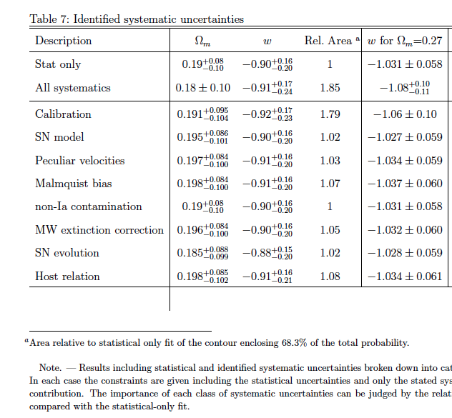
Uncertainty on supernova photometry COMPLETELY DOMINATES both present & future SNIa dark energy measurements
SNLS: Conley et al (2011), ApJS 192, 1:

Slide 4
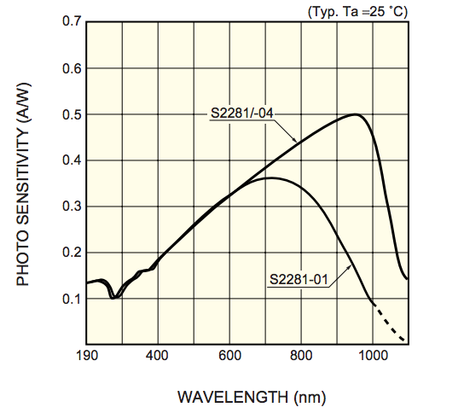
Technique: A 0.1% Calibrated, Mobile Source Above the Atmosphere
Balloon Payload
Integrating
Sphere
100 mW lasers
NIST
Photodiode
440 nm
532 nm
639 nm
808 nm
Well-characterized
Lambertian spatial profile
Known
view angle
Telescope
NIST-calibrated (< 0.1% absolute)
photodiode spectral response

Slide 5
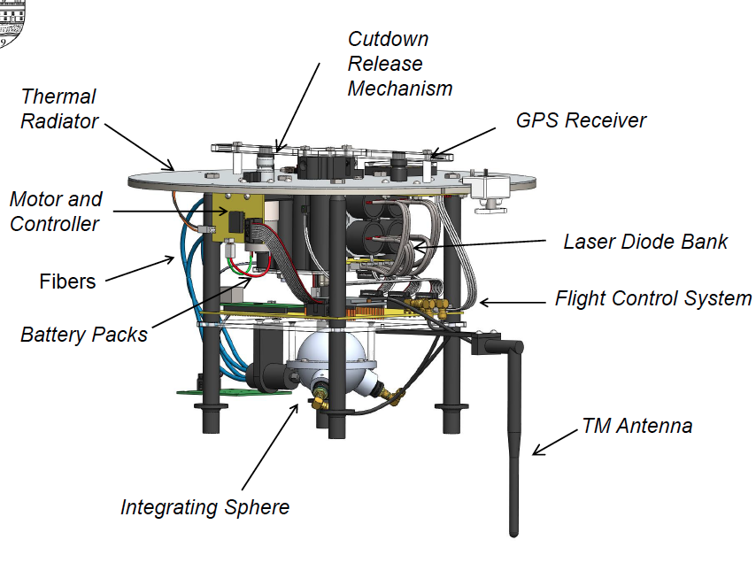
Payload Design

Slide 6
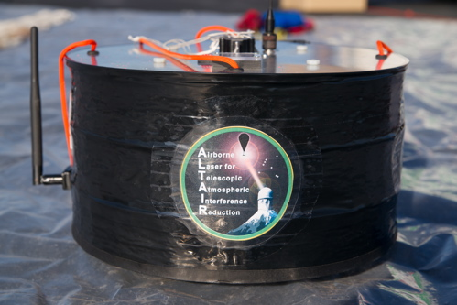
Payload

Slide 7
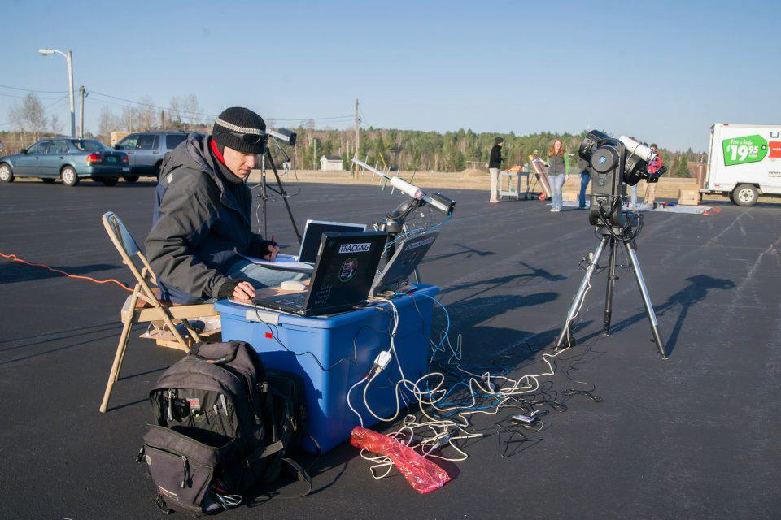
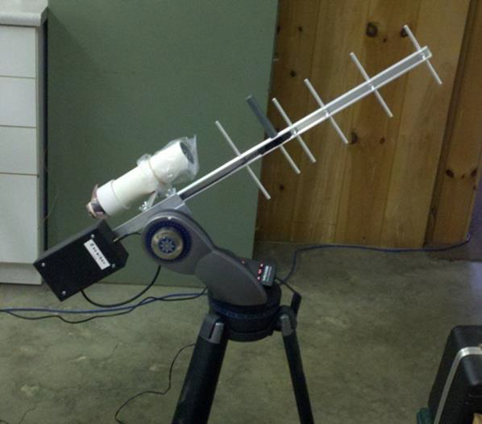
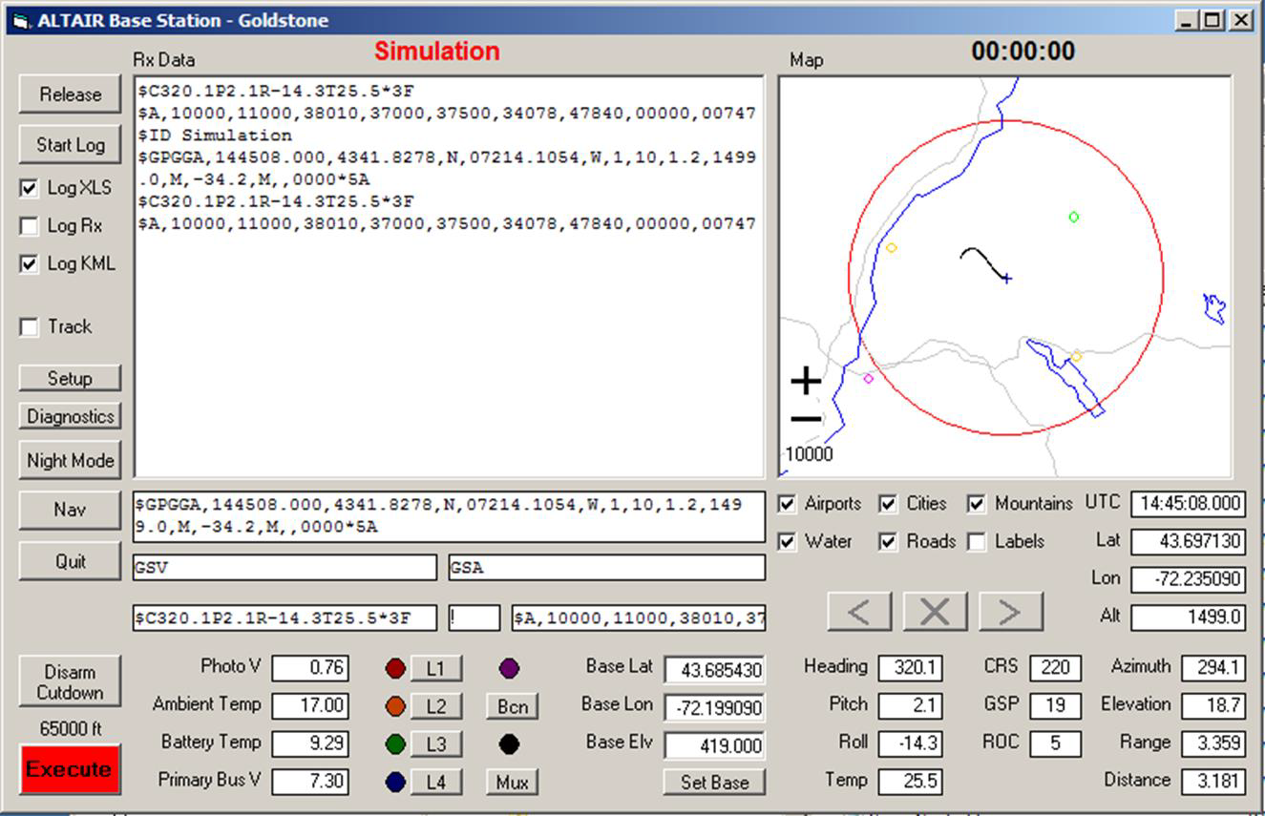
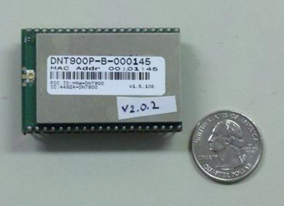
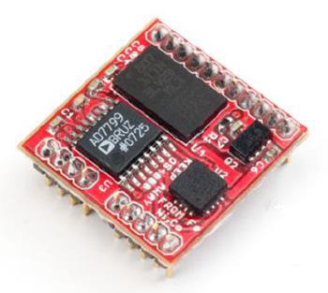
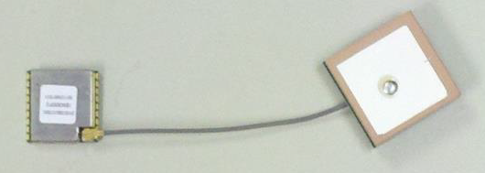
Flight Control
910 MHz directional antennas, range approx. 60 km.
Always ≥ 2 ground stations in contact.
Onboard primary radio (RFM DNT900P, 1W omni, 200 kbps)
Onboard payload attitude accelerometer/magnetometer
(Ocean Server OS4000T)
Onboard high-altitude-capable GPS (Inventek ISM300F2)

Slide 8
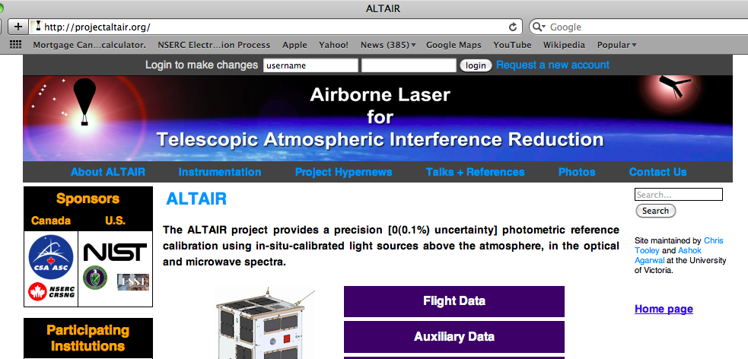
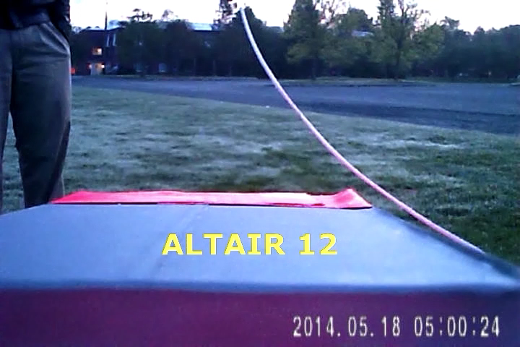
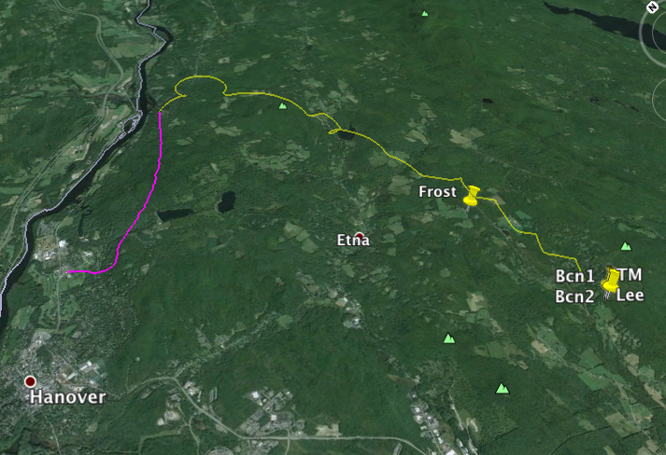
Flights and Data (so far)
Twelve flights to date (most recent 1 month ago), all test flights over New Hampshire so far.
All available online:
Telemetry, .kml files, photodiode monitoring data, ground imagery, photometry …

Slide 9
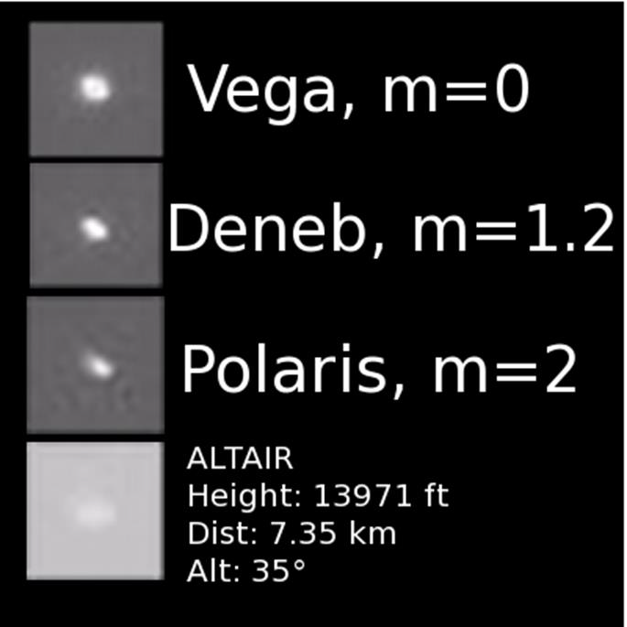
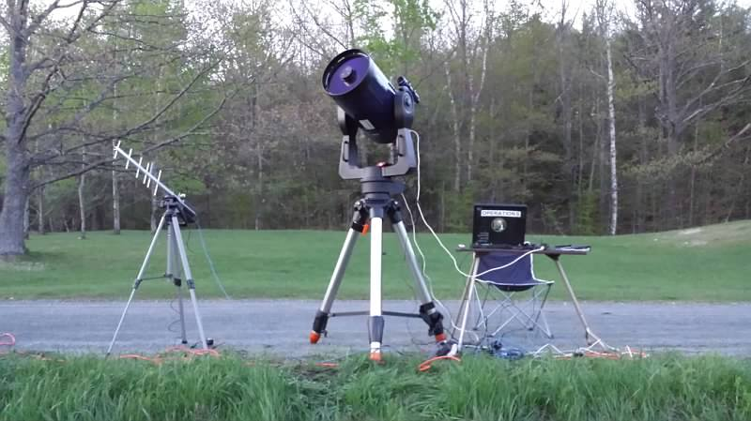
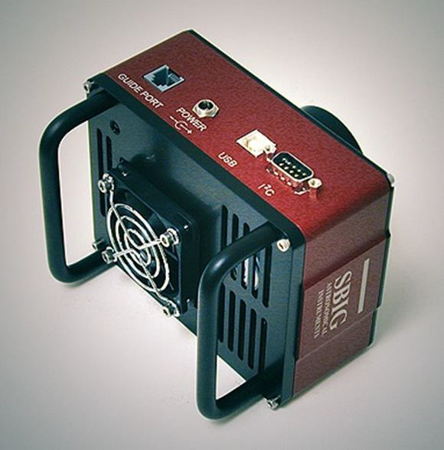
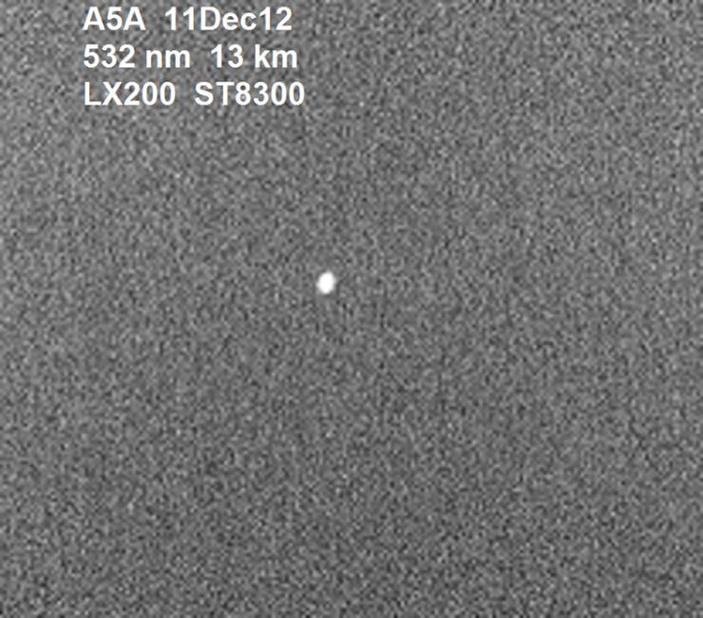
Imagery, and Upcoming Plans
Portable observation station:
We will be performing full end-to-end flight tests of ALTAIR photometric precision this summer …
Meade LX200GPS 12” telescope
with SBIG ST-8300 camera:
… then on to flight tests over Mt. Hopkins (AZ) and Pan-STARRS (Maui).
Following that, we intend to begin flight testing in Chile in 2016.

Slide 10
Conclusion
Artificial sources are, in principle, able to reach up to two orders of magnitude better photometric calibration precision than any natural light sources.
  1) Can study them into the lab before and after use, unlike stars.
  2) Can monitor them in-situ, in real time.
  3) Can be used to calibrate white dwarfs (and the Moon) very precisely, and on a detector-based standards scale.
  4) Small balloons are inexpensive.
  5) Your choice of spectrum & color on demand (including microwave! etc.), …and brightness, … location in the sky, and time of night (or day), …
This is a core program for LSST: will be a primary photometry calibration method for LSST SNIa observations.
MORE NEWS AND DATA FROM US SOON !!!

Slide 11
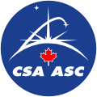

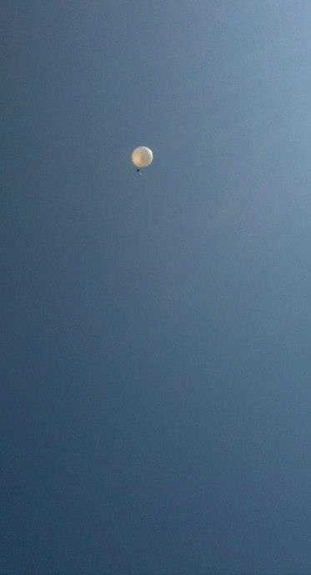

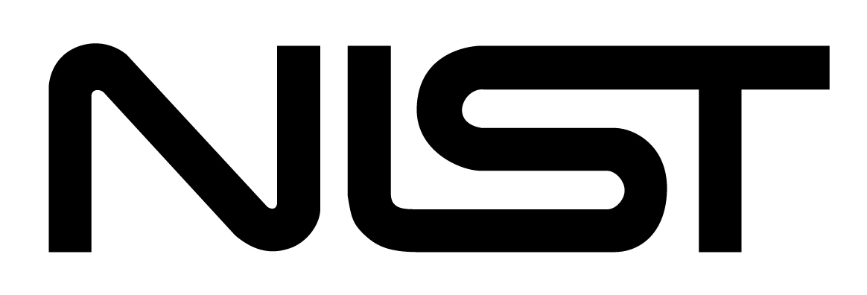
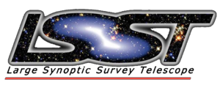
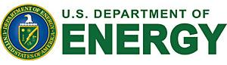




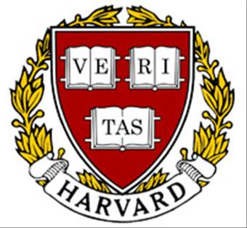
Yorke Brown, Max Fagin, Cynthia Tan, Waad Kahouli
Dartmouth
Arnold Gaertner, Jeff Lundeen
NRC-INMS
Matt Dobbs, Khoi Nam, Nate Long
McGill
Keith Vanderlinde, Ray Carlberg
Toronto
Christopher Stubbs, Peter Doherty, William High, Isaac Shivvers
Harvard
Keith Lykke, Steven Brown, Claire Cramer, John Woodward
NIST
Justin Albert, Karun Thanjavur, Paul Kovacs, Divya Bhatnagar, Ryan Thomas
Univ. of Victoria
Funding graciously provided by:
NRC Institute for National Measurement Standards

