Slide 1

New Software for PET/MR Image Registration
Esmat Elhami, PhD
CAP Congress 2014
Sudbury, ON

Slide 2
Contents
Biomedical Application
  Stem Cell Therapy
  Rat Infarct Heart Model
Imaging Techniques
  Positron Emission Tomography (PET)
  Magnetic Resonance Imaging (MRI)
Image Registration
  Affine Image Registration
Work in progress

Slide 3
Biomedical Application:
Statistics
30% of Canadian deaths are due to cardiovascular disease
  50% of deaths in the United States
Costs Canadian economy ~20 billion every year
  Due to hospital costs, physician services, lost wages, and decreased productivity
How can we reduce the number of deaths due to cardiovascular disease?

Slide 4

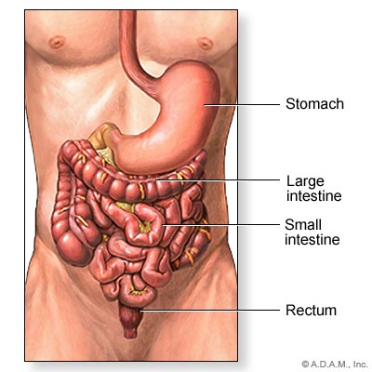
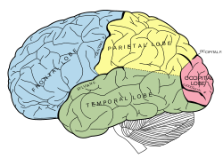
Biomedical Application:
Stem Cell Therapy
Stem cell therapy may be able to treat several diseases and disorders such as:
  Cardiovascular Diseases
    Ischemic Heart Disease
    Acute Myocardial Infarction
  Digestive Disease
    Crohn’s Disease
  Neurological Disorders
    Temporal Lobe Epilepsy
http://www.nlm.nih.gov/medlineplus/heartdiseases.html
http://en.wikipedia.org/wiki/Human_brain
http://www.healthcentral.com

Slide 5
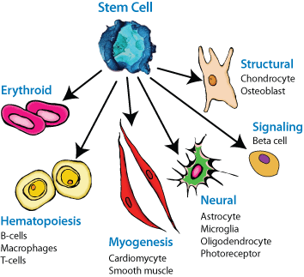
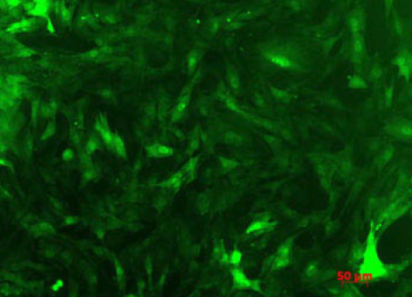
Biomedical Application:
Stem Cell Therapy
Adipose derived stem cells are multipotent, meaning they have the ability to differentiate into several different cells
Stem cells have the ability to differentiate into cardiomyocytes
Two main categories of stem cells:
Somatic (Adult) Stem Cells
Embryonic Stem Cells

Slide 6
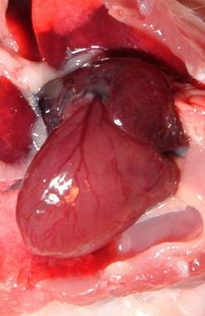
Biomedical Application:
Rat Model of Heart Infarction
Rat model heart failure
  Heart attack induced by occluding the artery supplying oxygenated blood to the heart muscle
Inject stem cells directly
into myocardial tissue
Repair damaged heart
muscle with stem cells
http://www.ratfanclub.org/hearts.html

Slide 7
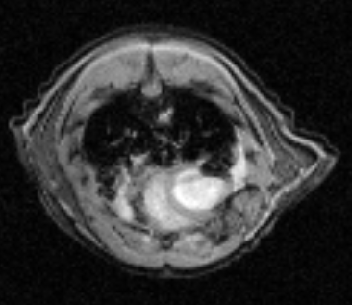
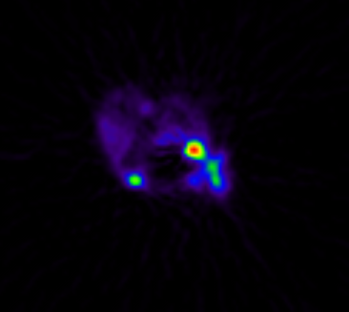
Stem cells are combined with:
  ¹⁸F-FDG (Fluoro-2-deoxy-D-glucose)
    Shows up in PET images
  SuperParamagnetic Iron Oxide (SPIO) particles
    Shows up as dark regions in MR image

Slide 8
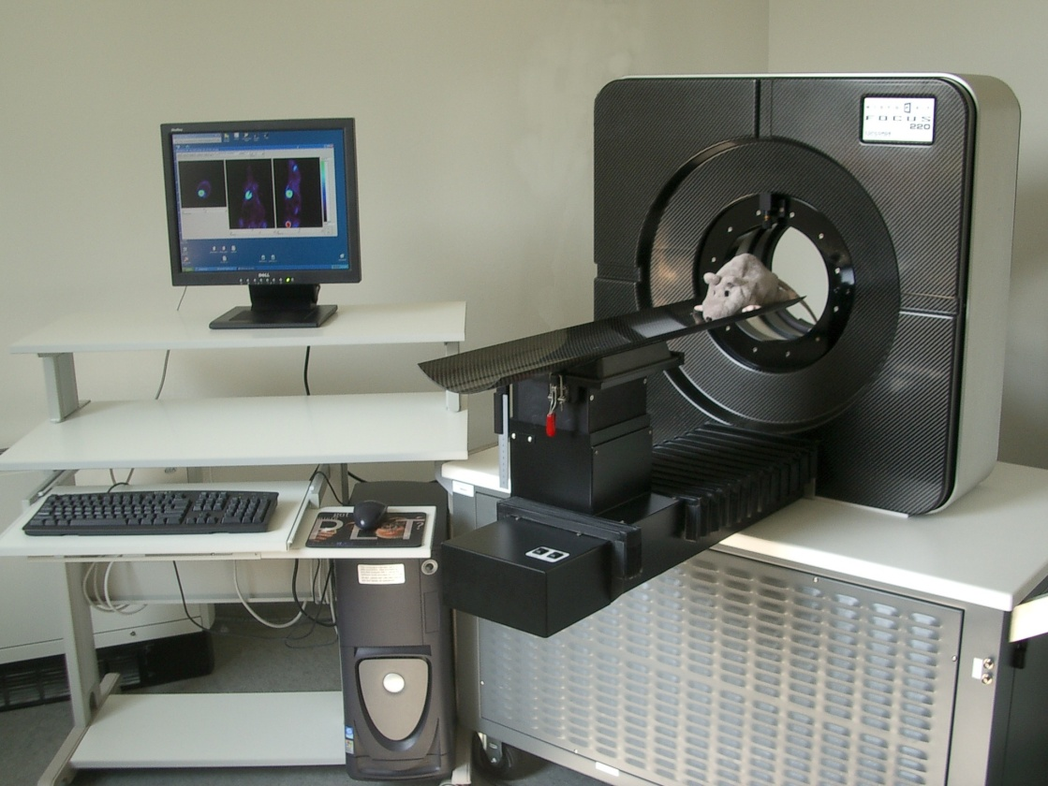
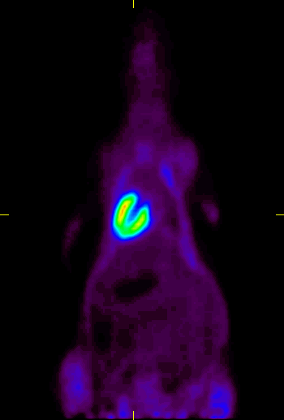
Imaging Techniques
Positron Emission Tomography

Slide 9
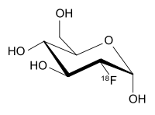
Imaging Techniques
Positron Emission Tomography
PET is a functional imaging modality
  Images are of physiological processes
  Most common example is glucose uptake
Radiopharmaceuticals
  Radionuclide attached to a chemical tracer
  ¹⁸F-FDG (Fluoro-2-deoxy-D-glucose)
  Administered intravenously
http://en.wikipedia.org/wiki/Fludeoxyglucose_(18F)

Slide 10
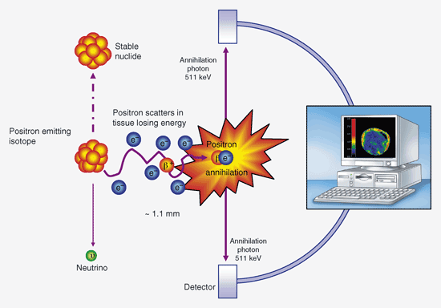
http://vefir.mh.is/emjul/efni/nemverk/nemverkv09/SPG/eldsneyti.htm

Slide 11
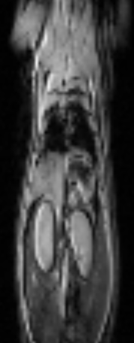
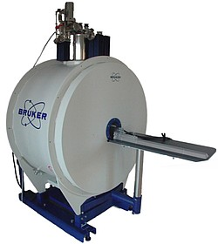
Imaging Techniques
Magnetic Resonance Imaging
Transverse and Coronal cross sections of a rat injected with stem cells

Slide 12
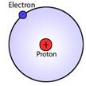
MRI is an anatomical imaging modality
  Creates detailed image of object
MRI creates images by utilizing the nuclear properties of matter (Hydrogen)
  Hydrogen contains 1 proton & 1 electron
Humans made up of 75% H₂O
  H₂O contains 2 H atoms (2 protons)

Slide 13
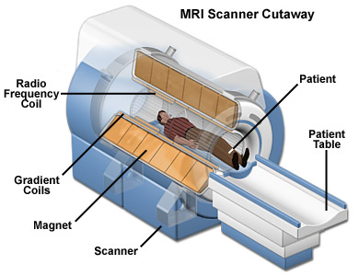
MRI scanner has a submillimeter resolution
Rat
Large magnet aligns protons
RF coil sends energy to protons
As protons relax they release energy, which is detected by RF coil
http://www.magnet.fsu.edu/education/tutorials/magnetacademy/mri/
Gradient coils allow for localization of the signal, by creating a gradual change in the x, y, and z axis fields.

Slide 14
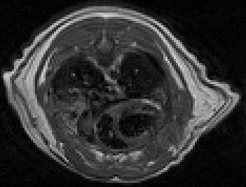
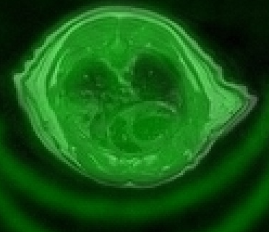
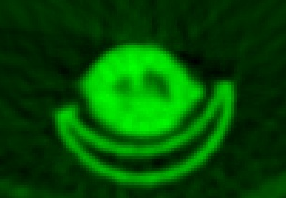
Image Registration

Slide 15
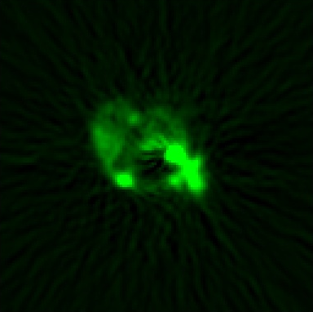
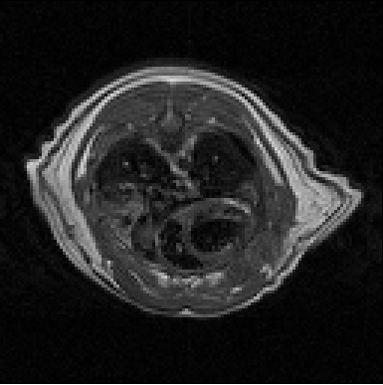
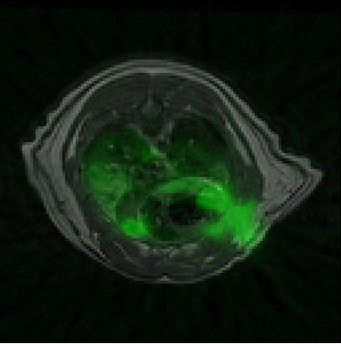
PET
PET images contain functional information, which is used to determine the stem cell location and proliferation
Anatomical MRI images show detailed information of the structure, but not stem cell location (except injection site)
Combining these two imaging modalities, is essential for quantification
MR
PET/MR

Slide 16
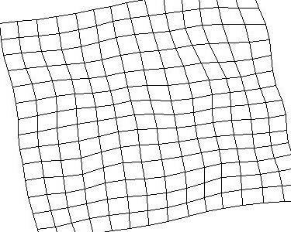
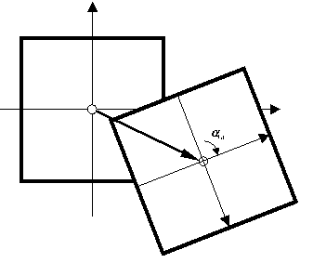
Image Registration Algorithm
Several image transformations exist
  Rigid Body (3 DOF – 6 DOF)
  Affine (6 DOF – 9 DOF)
  Deformation Field (non-linear: ∞ DOF)
Rigid body too simple and non-linear too complicated
Rigid Body
Deformation
Field
http://biocomp.cnb.uam.es/~iarganda/bUnwarpJ/

Slide 17
Automated image registration programs
  Automatic Image Registration (AIR),
  FMRIB’s Linear Image Registration Tool (FLIRT),
  Medical Image Processing, Analysis, and visualization (MIPAV),
Various Cost Functions for image registration (minimization of the cost ft.)
  correlation ratio (CR)
  normalized cross correlation (NCC)
  mutual information (MI)
  normalized mutual information (NMI)
  Woods algorithm (Woods)

Slide 18
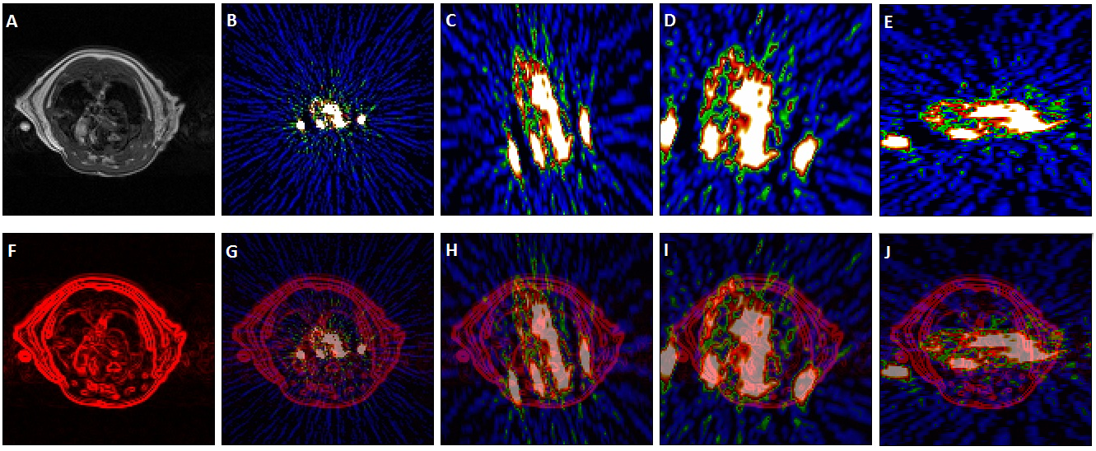
Application to Animal Images
  Due to the fact that the cardiac region of the PET and MRI images are not similar, automated image registration software did not produce accurate registration
AIR
FLIRT
Woods

Slide 19
Affine Image Registration
An affine transformation is any transformation in which parallel lines remain parallel (preservation of collinearity)
  Transformations include:
    Translation
    Rotation
    Skew
    Scale
    Any combination of the above

Slide 20

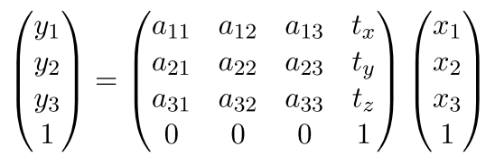
Some math:
The 3x3 a_{ij} matrix includes:
  Rotation, Skew, & Scale
t_{x}, t_{y}, & t_{z} are translation variables
i, j = 1,2,3

Slide 21
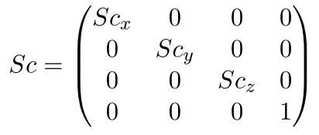
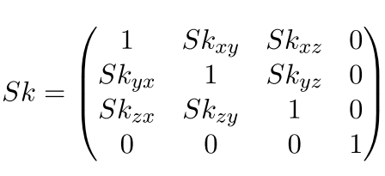
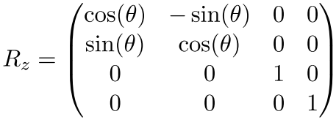
Scale Matrix
Skew Matrix
Rotation Matrix
about z-axis

Slide 22
A simple affine transformation may be the solution
Transformation is calculated using fixed points between the two images
  Requires fiducial markers for accurate registration
    Fiducial markers spheres filled with contrast agents visible in both imaging modalities
  Can use anatomical landmarks, but not rigid enough for accurate registration

Slide 23
Using Matlab software, a program was developed to perform affine image registration
  The user loads in a floating image, and a reference image
    Floating image is mapped to reference image
  The user selects a number of fiducial markers, or landmarks
    Must be # of Dimensions + 1 at minimum

Slide 24
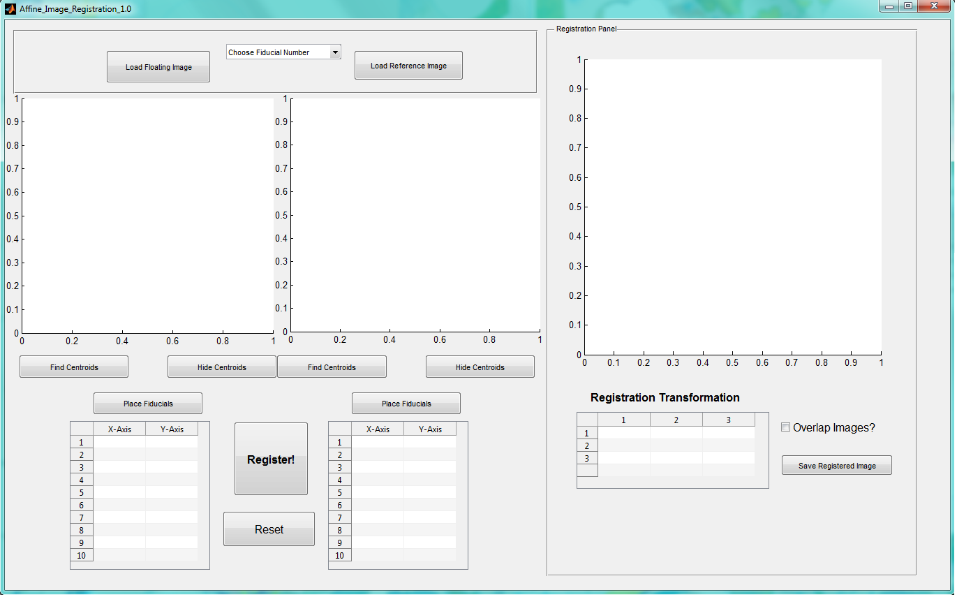

Slide 25
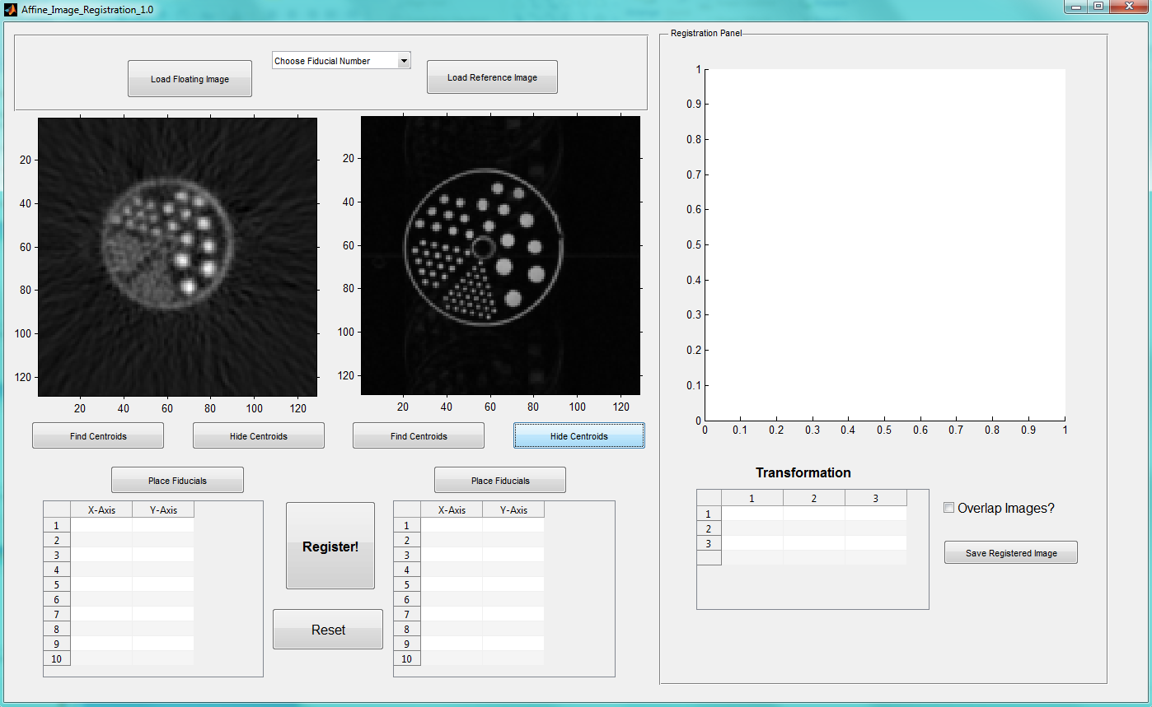

Slide 26
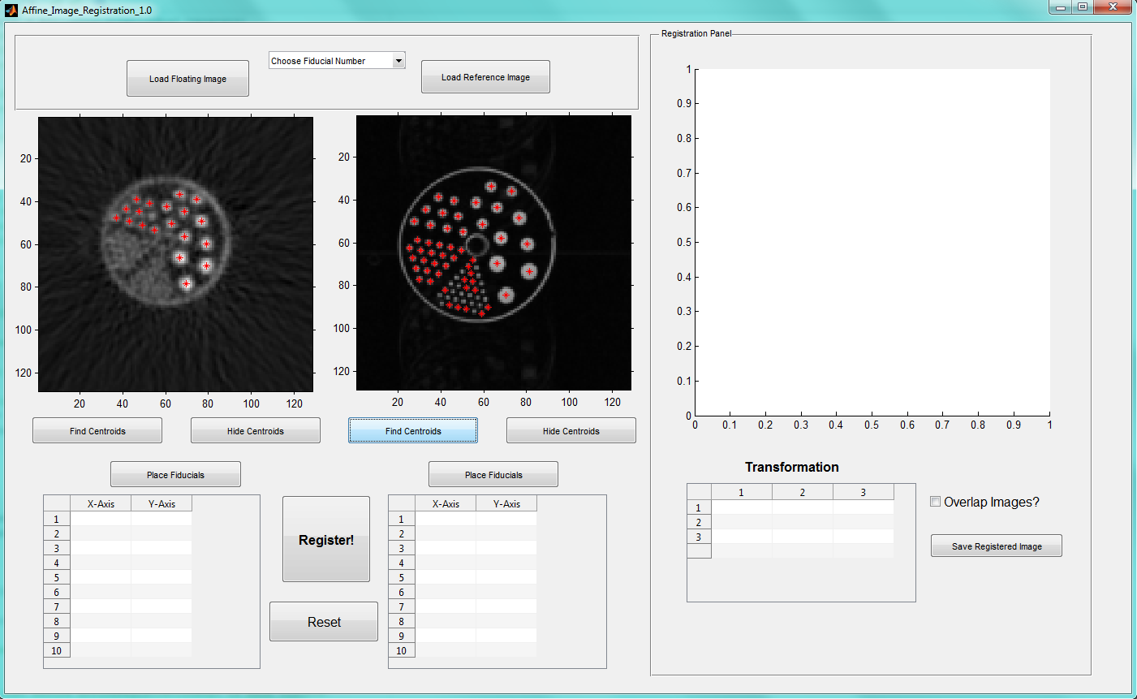

Slide 27
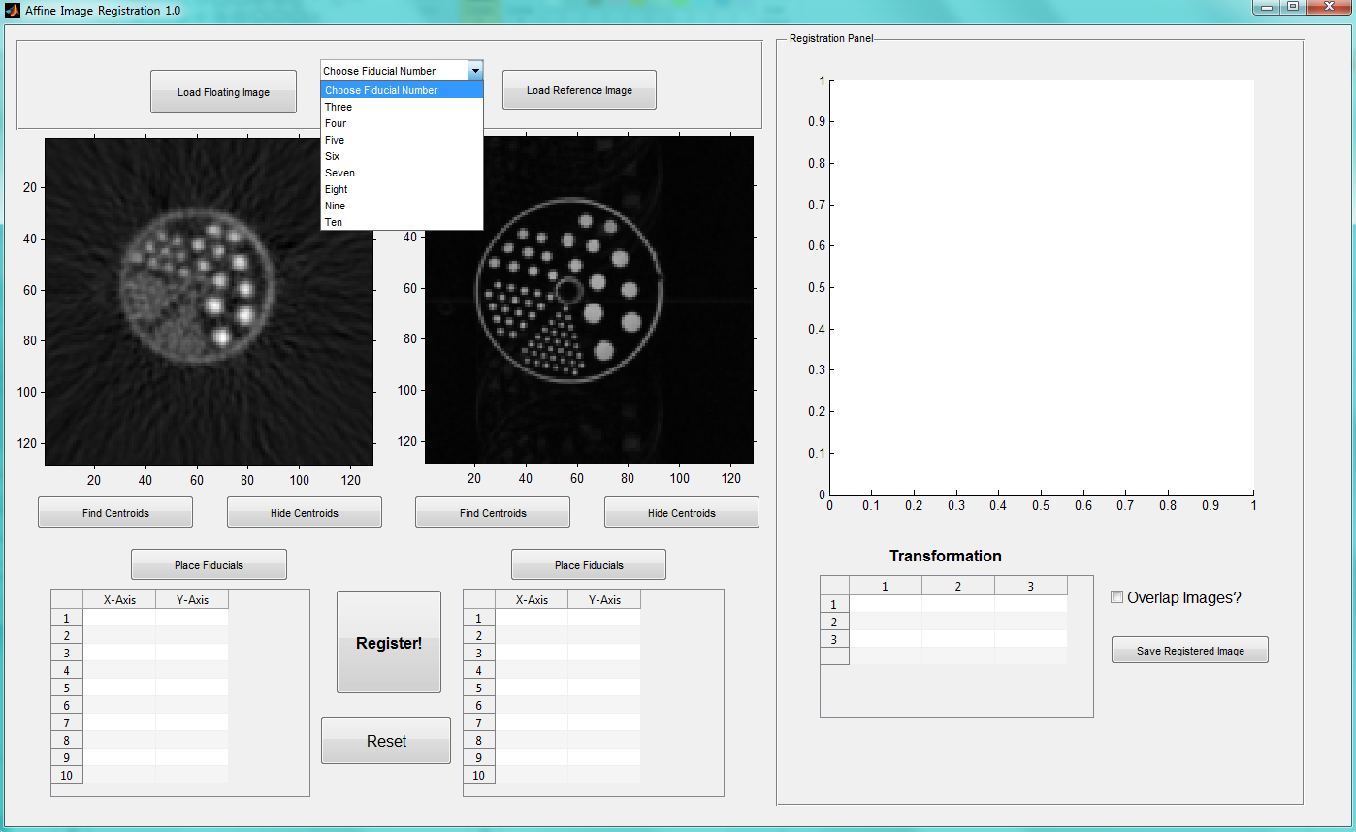

Slide 28
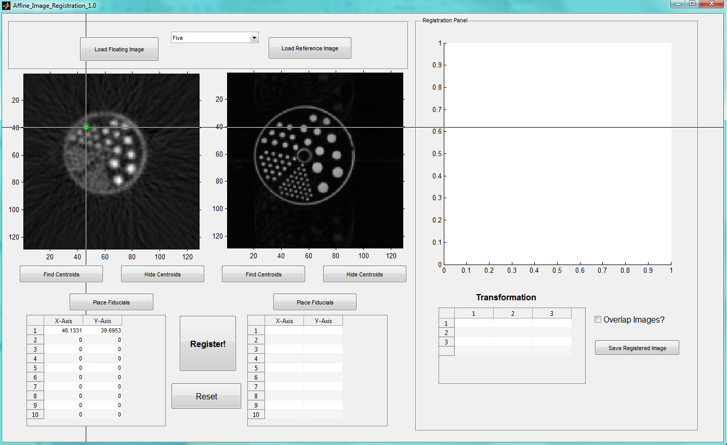

Slide 29
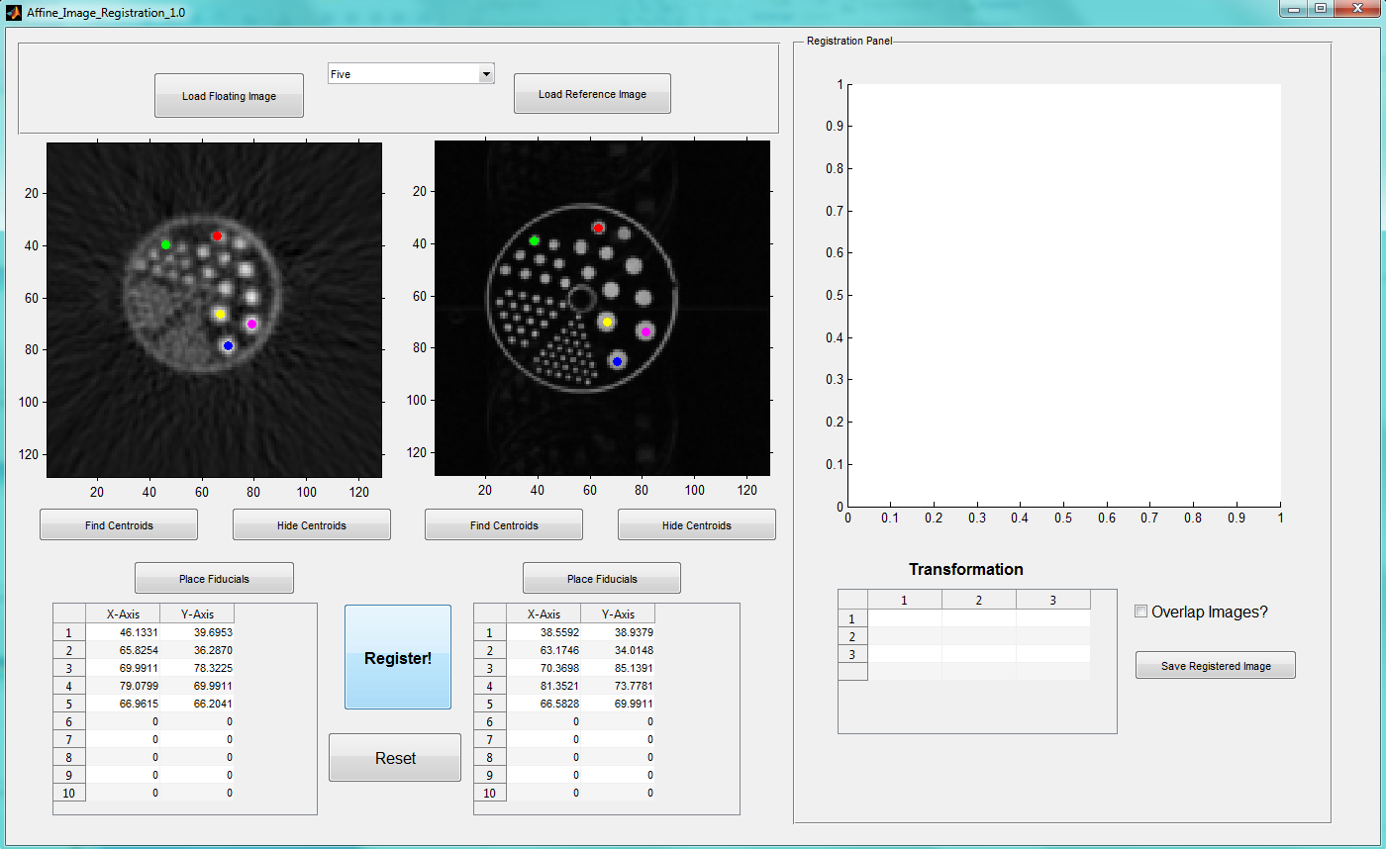

Slide 30
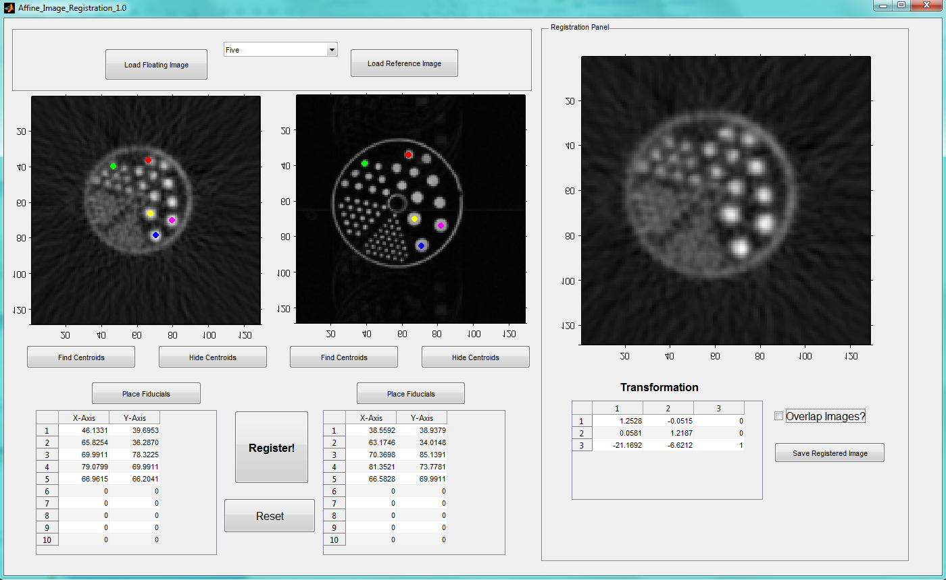

Slide 31
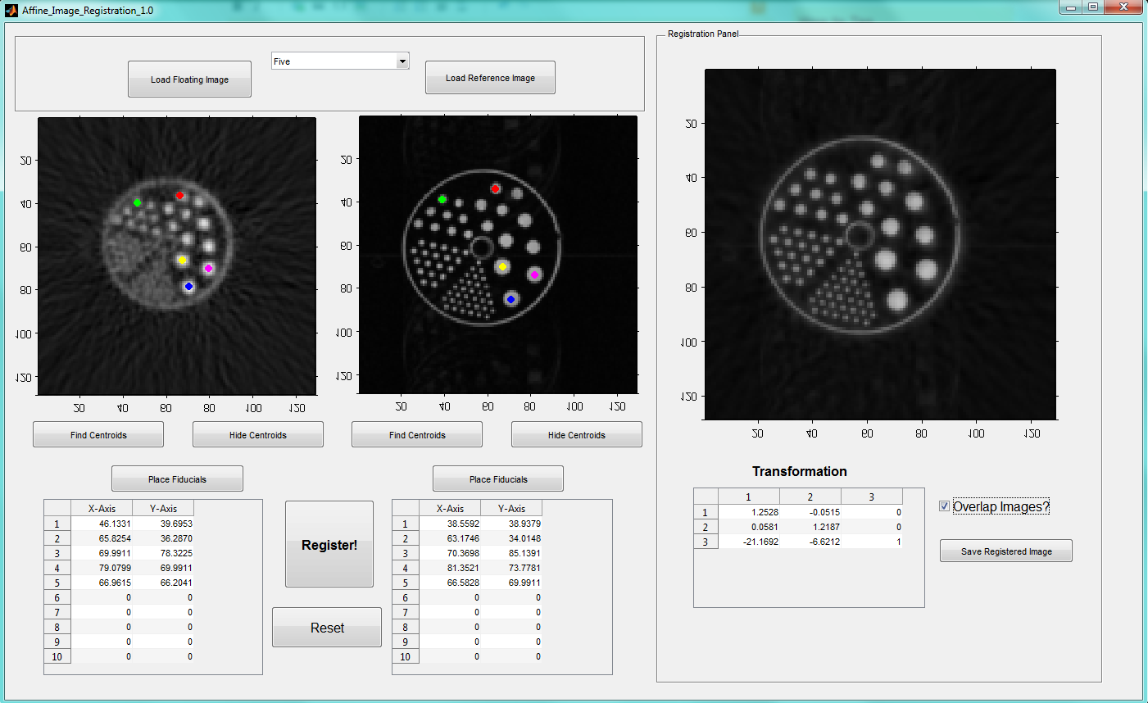

Slide 32
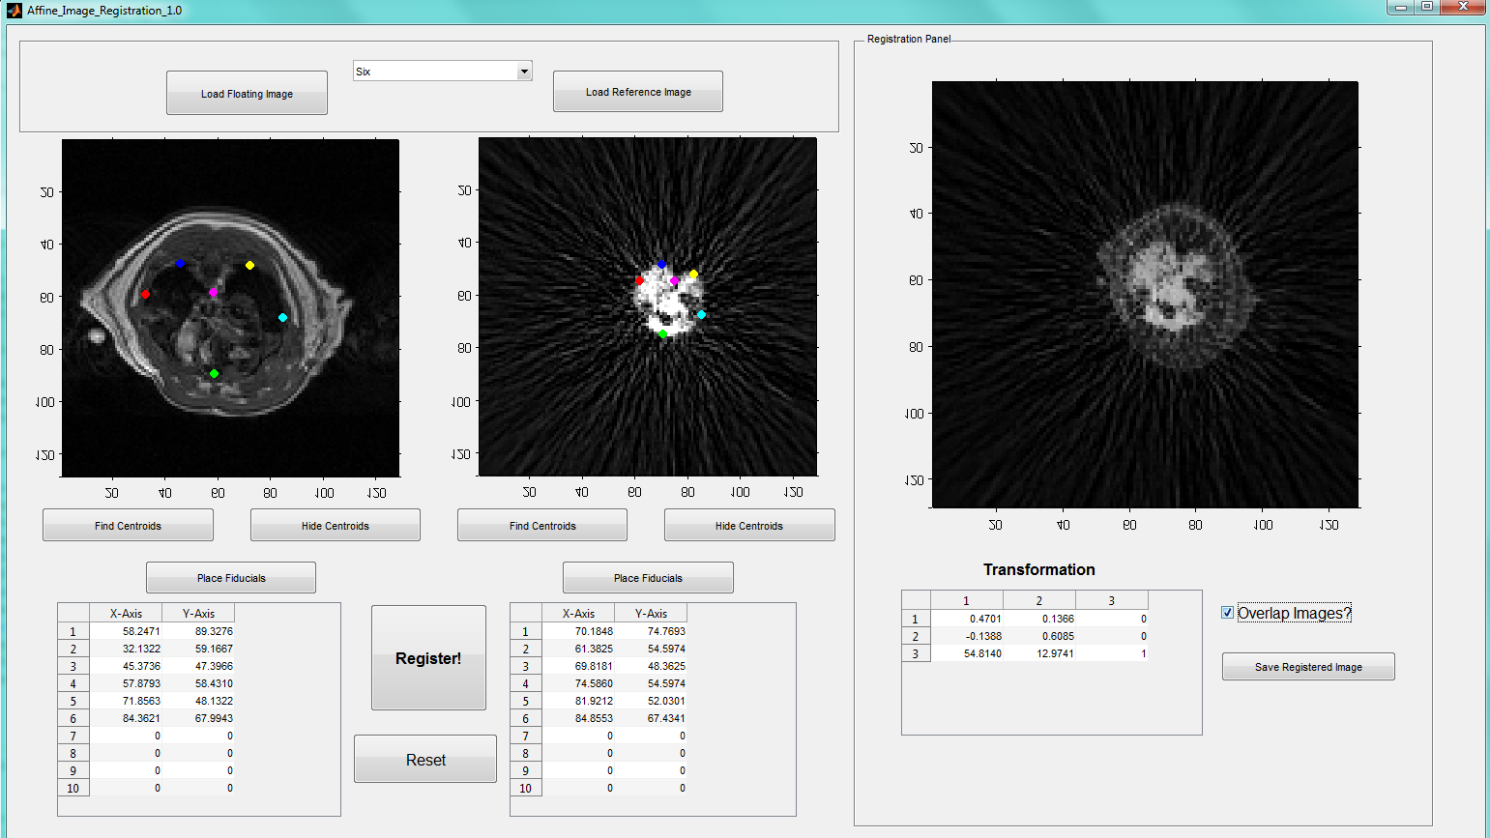

Slide 33
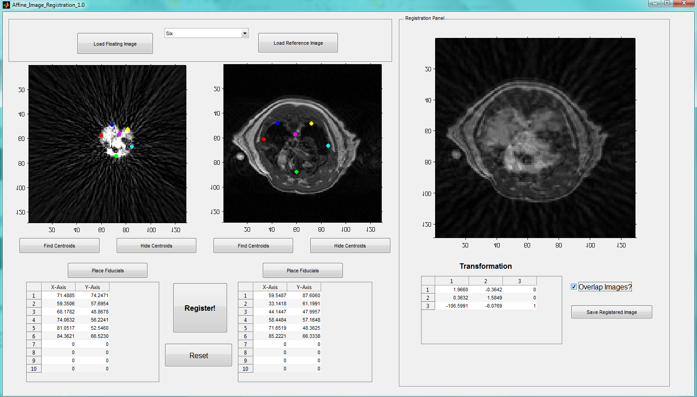

Slide 34
Testing Automated Software
We used small hollow spheres (31 μl) as fiducial markers
Filled with FDG and CuSO₄ solution as PET and FDG contrasts and attached to phantoms or animal bed
Imaged with PET and MR
Image registration using above mentioned automated software
Calculate fiducial registration error as a metric for image registration

Slide 35
Fiducial Registration Error
Program | Method | Average X FRE | Average Y FRE | FRE Norm
MIPAV | CR | 1.58 | 1.10 | 1.93
MIPAV | NCC | 1.43 | 1.05 | 1.77
MIPAV | NMI | 2.19 | 0.61 | 2.27
FLIRT | CR | 1.70 | 0.94 | 1.94
FLIRT | NCC | 1.11 | 0.93 | 1.45
FLIRT | MI | 1.69 | 1.09 | 2.01
FLIRT | NMI | 2.02 | 1.30 | 2.40
AIR | Woods | 10.75 | 1.10 | 10.81
MAR | GUI | 1.13 | 0.76 | 1.36
Fiducial registration error (FRE) results in units of mm. The methods of registration are as follows: correlation ratio (CR), normalized cross correlation (NCC), mutual information (MI), normalized mutual information (NMI), and the Woods algorithm (Woods). The FRE is calculated for each ducial and averaged for each axis. The nal column is the Euclidean norm of the average x and y FRE.

Slide 36
Summary
Landmark registration is a simple and effective way to register images, that more sophisticated methods cannot
Further work required
  Add optimization routine
  Read 3D formats (DICOM, NifTi, Analyze...)
More image editing features, relevant to stem cell quantification

Slide 37







