Slide 1



The High Cost of Science Disengagement of Canadian
Youth: Reimagining Physics Teacher Education for 21st Century
Dr. Marina Milner-Bolotin
Proudly supported by TLEF
Proudly supported by TLEF
Department of Curriculum and Pedagogy
University of British Columbia
Canadian Association of Physicists Sudbury, Ontario
June 15-21, 2014
Notes:
Title: The high cost of science disengagement of Canadian
Youth: Reimagining Physics Teacher Education for 21st Century
Authors: Marina Milner-Bolotin
Abstract:
Last year, Let’s Talk Science released a report on the cost of high school students’ dropping science, technology, engineering and mathematics (STEM) subjects. The disengagement of Canadian students with STEM has dire economic and political consequences for the country:
less than 50% of our secondary students take advanced STEM courses and even fewer decide to pursue science-heavy degrees. Thus, it is not surprising that for the past decade, Canada has been also falling behind on the innovation index. This talk will attempt to reimagine physics teacher education for the 21st century that will help engage Canadian youth in meaningful physics learning. In order to succeed in this process, teacher education should be grounded in physics education research. Moreover, it will require a long-term collaboration between physics faculty members, teacher educators, university administrators, and school districts. An example of the beginning of such collaboration will be discussed in this talk.
Paper source:
Milner-Bolotin, M., Fisher, H., & MacDonald, A. (2013). Modeling active engagement pedagogy through classroom response systems in a physics teacher education course. LUMAT: Research and Practice in Math, Science and Technology Education, 1(5), 525-544. http://www.luma.fi/lumat-en/2636

Slide 2
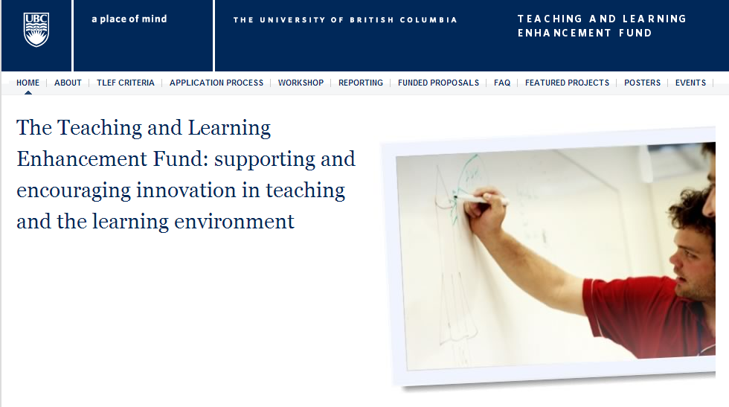

Supported by UBC Teaching & Learning Enhancement Fund
  Generously supported by UBC TLEF 2012-2015: $151, 000

Slide 3
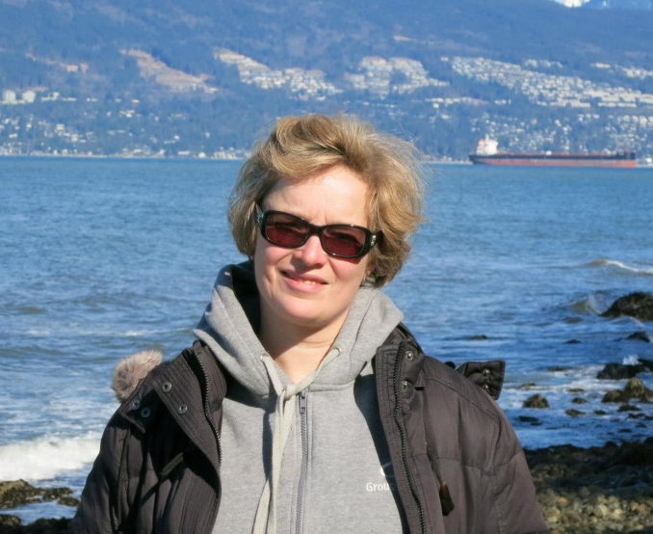
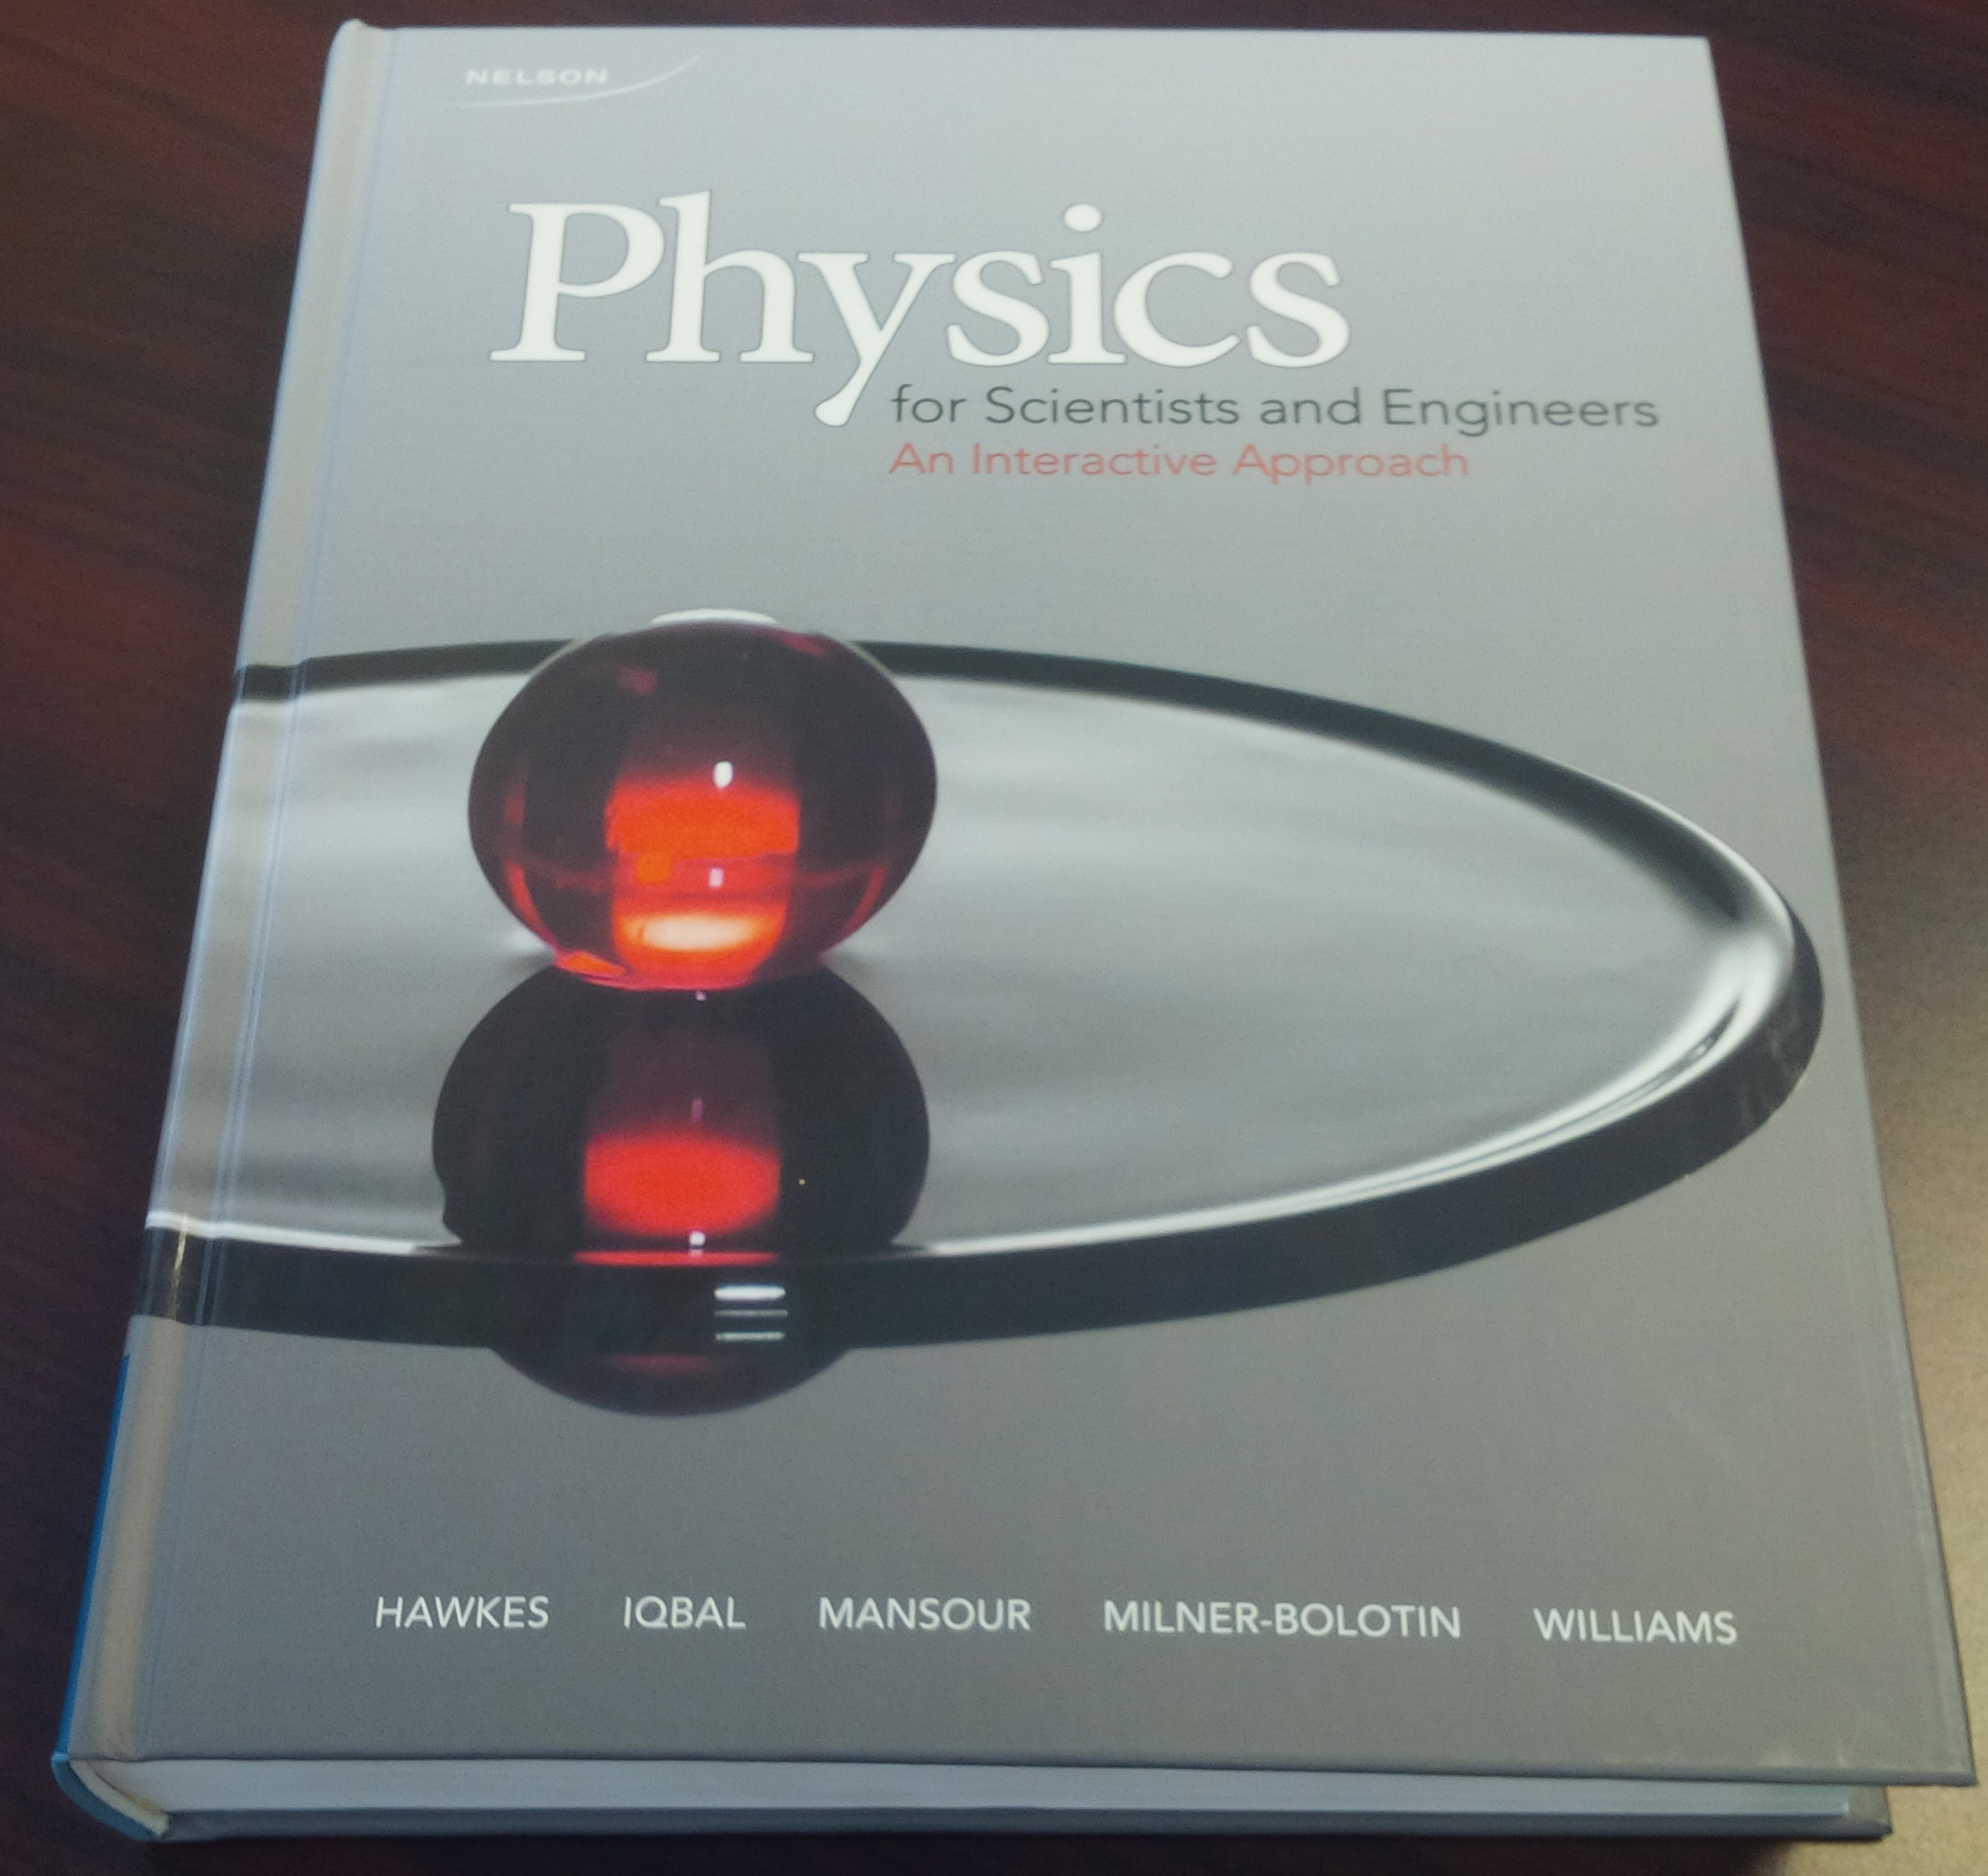
Dr. Marina Milner-Bolotin
Position: Assistant Professor in Science Education, Faculty of Education, @ UBC
Field: Math & Physics educator: K-college since 1991: Ukraine, Israel, USA, Canada (Vancouver & Toronto)
Passion: Math & Science Teacher Education
Teaching Awards: NSTA, UBC, Ryerson, CAP
Co-Author of an undergrad. physics textbook
e-mail: marina.milner-bolotin@ubc.ca
Web site: http://blogs.ubc.ca/mmilner/
Notes:
Contact information

Slide 4
Outline
Introduction: Why should we care?
How do we engage our students?
  The value of meaningful STEM engagement
  What happens if we fail to engage them meaningfully
  c. Why teacher education matters
Reimagining physics teacher education
Summary: What is next

Slide 5


1.
Why Should We Care?
Let's Talk Science. (2013). Spotlight on science learning: The high cost of dropping science and math.
Notes:
Recent Report from Let’s Talk Science – relevant to Canada

Slide 6
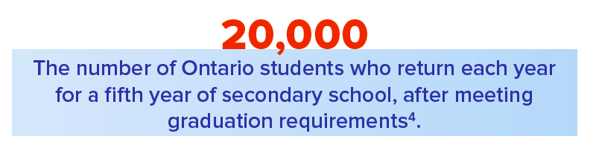
Numbers Speak
Less than 50% of secondary graduates, complete grade 11 and 12 level math & science
Science disengagement costs money to students, parents, and Canada
Notes:
Recent Report from Let’s Talk Science – relevant to Canada

Slide 7
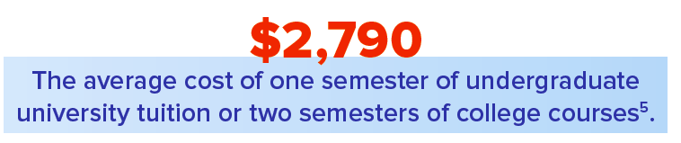

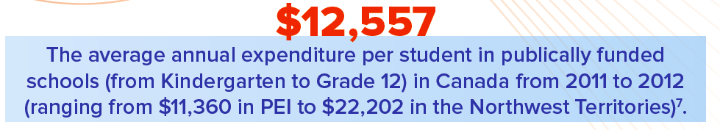
$$$ - Numbers Speak
Notes:
Recent Report from Let’s Talk Science – relevant to Canada

Slide 8
Other Report Findings
More job opportunities with STEM: 70% of the top jobs require STEM, including skilled trades
Their earning power is higher by about 26% regardless of whether they work in STEM or not
STEM is a key to modern innovation
Women are still underemployed in STEM fields
Many skilled trades in Canada require K-12 STEM

Slide 9
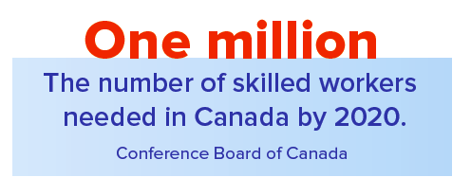

SKILLED WORKERS by 2020
In 2014, Canada – 35 million people, ~18,000,000 workforce

Slide 10
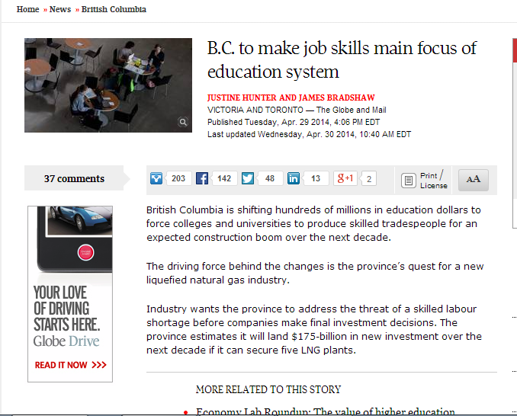
Western Canada – Lack of Skilled Workers in Trades
Controversy over Foreign Skilled Workers Program
Globe and Mail, April 30, 2014

Slide 11
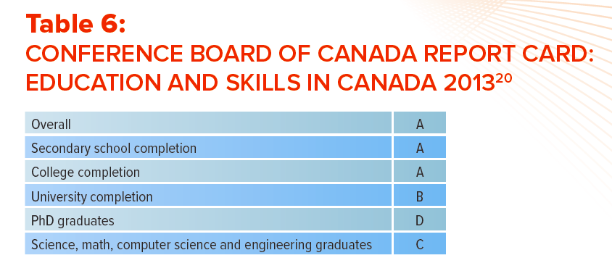
Canadian Report Card

Slide 12
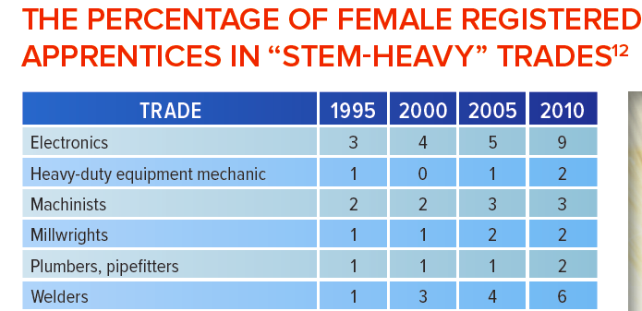
Gender Gaps in STEM Education & Employment

Slide 13
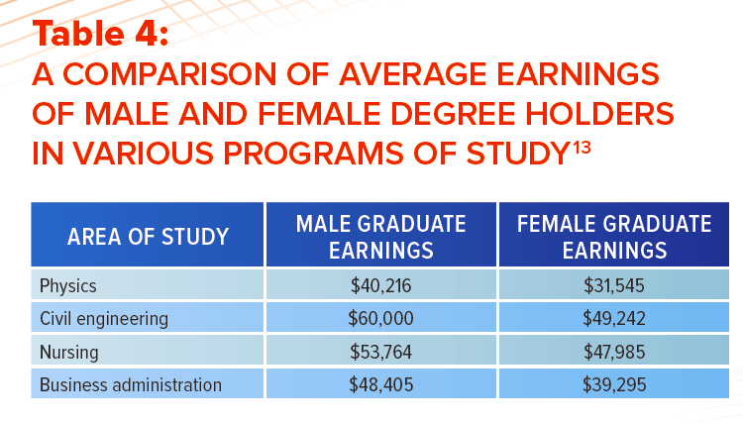
Gender Gaps in STEM Education & Employment

Slide 14
2.
How do we engage our students?
Introduction: Why should we care?
Introduction: How do we engage our students?
  The value of meaningful STEM engagement
  What happens if we fail to engage them meaningfully
  c. Why teacher education matters
Reimagining physics teacher education
Summary: What is next

Slide 15





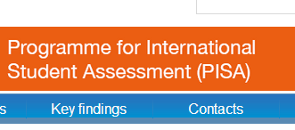
Intro: Why are our students disengaged from STEM?
http://www.oecd.org/

Slide 16
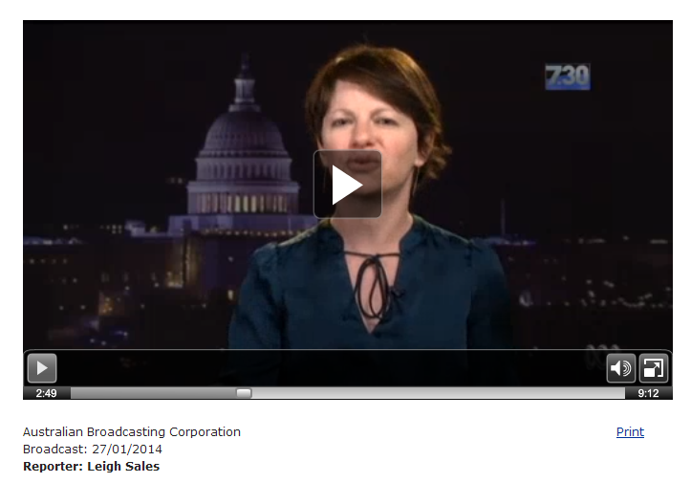
Amanda Ripley: The Smartest Kids in the World…
Notes:
http://www.abc.net.au/7.30/content/2013/s3932853.htm

Slide 17
Some Ideas from the Book
Rigour for students and for teachers: doing work worth doing
Getting used to productive failure
Giving meaningful praise that is earned
Teachers’ quality is vital into prestige
Teachers’ life long learning and support
Notes:
Focus on HOW we engage them – not just to be engaged, but to be meaningfully engaged

Slide 18
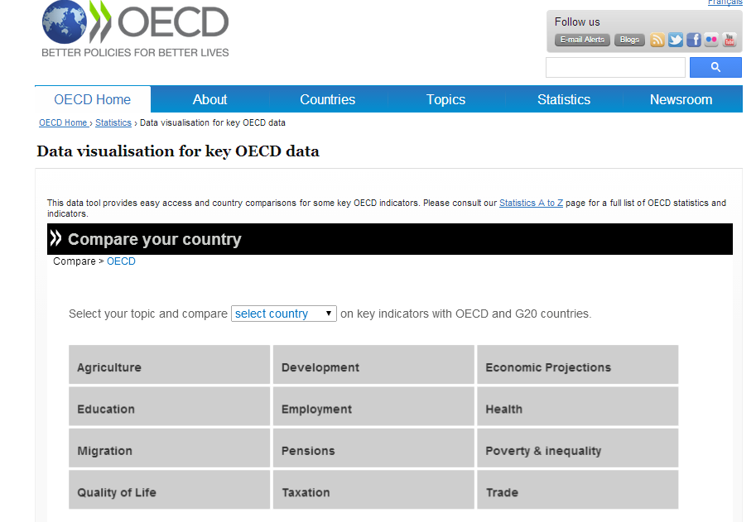
STEM Engagement across the World

Slide 19
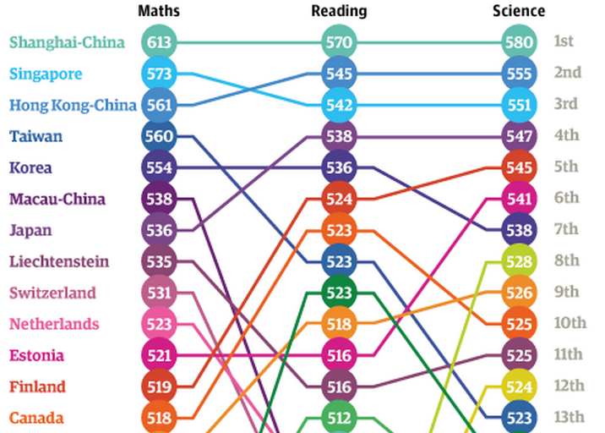
PISA 2012 Results
[OECD, PISA 2012 Results]

Slide 20
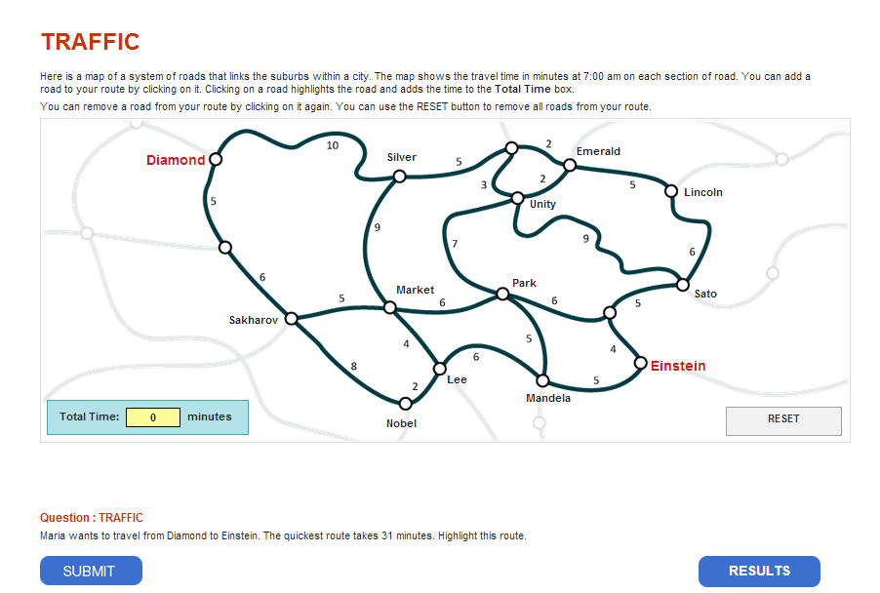
Example of a PISA Question
Notes:
http://www.oecd.org/pisa/test/form/
Here is a map of a system of roads that links the suburbs within a city. The map shows the travel time in minutes at 7:00 am on each section of road. You can add a road to your route by clicking on it. Clicking on a road highlights the road and adds the time to the Total Time box.
You can remove a road from your route by clicking on it again. You can use the RESET button to remove all roads from your route.

Slide 21
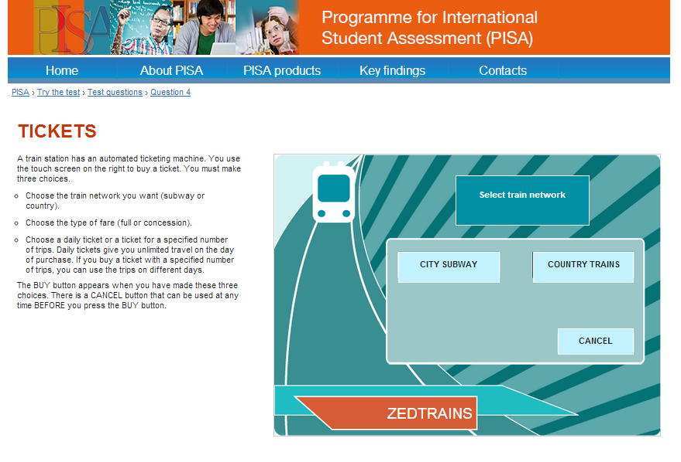
Example of a PISA Question
Notes:
http://www.oecd.org/pisa/test/form/
Here is a map of a system of roads that links the suburbs within a city. The map shows the travel time in minutes at 7:00 am on each section of road. You can add a road to your route by clicking on it. Clicking on a road highlights the road and adds the time to the Total Time box.
You can remove a road from your route by clicking on it again. You can use the RESET button to remove all roads from your route.

Slide 22
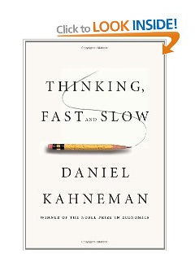
The Value of Meaningful STEM Engagement
Central thesis: a dichotomy between two modes of thought:
"System 1" is fast, instinctive and emotional; "System 2" is slower, more deliberative, and more logical.
It delineates cognitive biases associated with each type of thinking by highlighting several decades of academic research to suggest that people place too much confidence in human judgment.
Notes:
It also exists as an audio book. It is a great book for teachers – it discusses how our brains work and how we think sometimes slow but most of the time – fast…

Slide 23
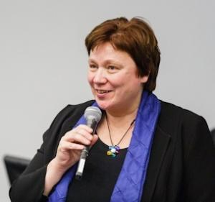
Why Teacher Education Matters
Prof. Maija Aksela, Helsinki, Finland
If we want to change how our students learn science we have to change how we prepare teachers, who goes into K-12 teaching, and how teachers’ professional development is organized

Slide 24
3.
Reimagining Physics Teacher Education
Introduction: Why should we care?
Introduction: How do we engage our students?
  The value of meaningful STEM engagement
  What happens if we fail to engage them meaningfully
  c. Why teacher education matters
Reimagining physics teacher education
Summary: What is next

Slide 25
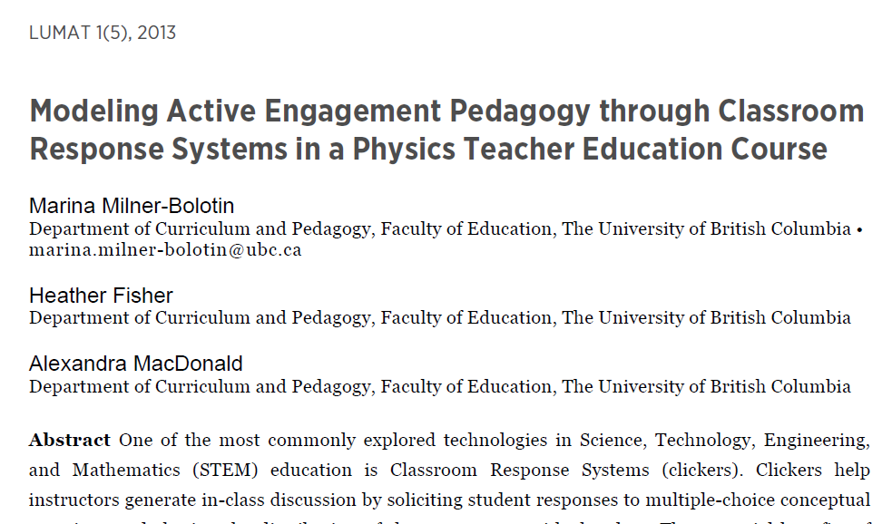
Physics Teacher Education
[LUMAT: Research and Practice in Math, Science & Technology Education, 2013. 1(5): p. 525-544.]
Notes:
We attempted to answer these questions in our recent paper titled Modeling Active Engagement Pedagogy though Classroom Response System in Physics Teacher Education Course, where Classroom Response Systems is an alternative name for clickers.

Slide 26
Teacher Education Should Model Good Teaching Practices
Rigour for students and for teachers: doing work worth doing
Getting used to productive failure
Giving meaningful praise that is earned
Teachers’ quality is vital – it takes time to prepare good STEM teachers
Teacher-candidates should be mentored - life long learning and support

Slide 27
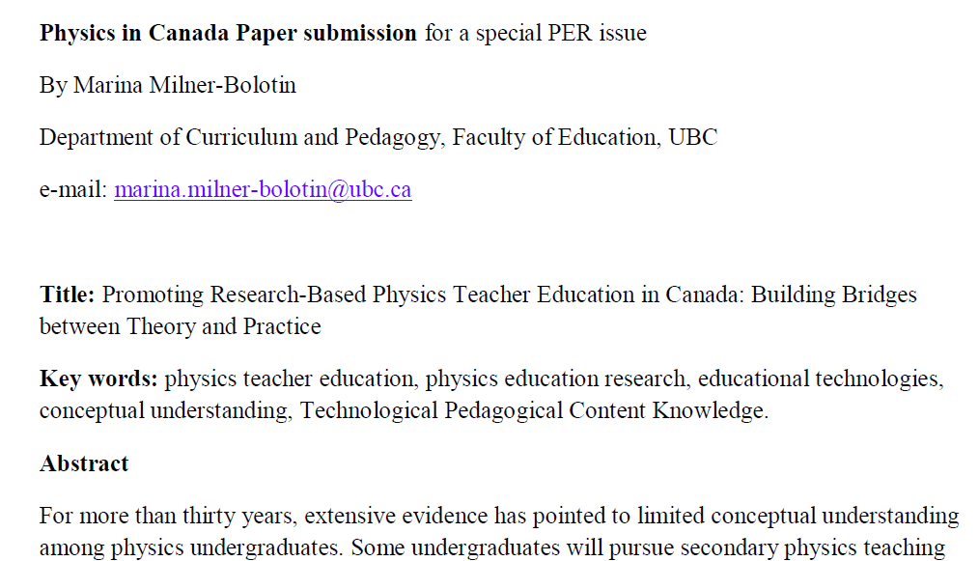
PER Upcoming issue of PiC (Vol. 69, Summer Issue)
PiC volume is devoted to Physics Education Issues, Editors (C. Kalman, T. Antimirova and N. Lasry)
Notes:
Recent paper on Physics Teacher Education in Canada

Slide 28
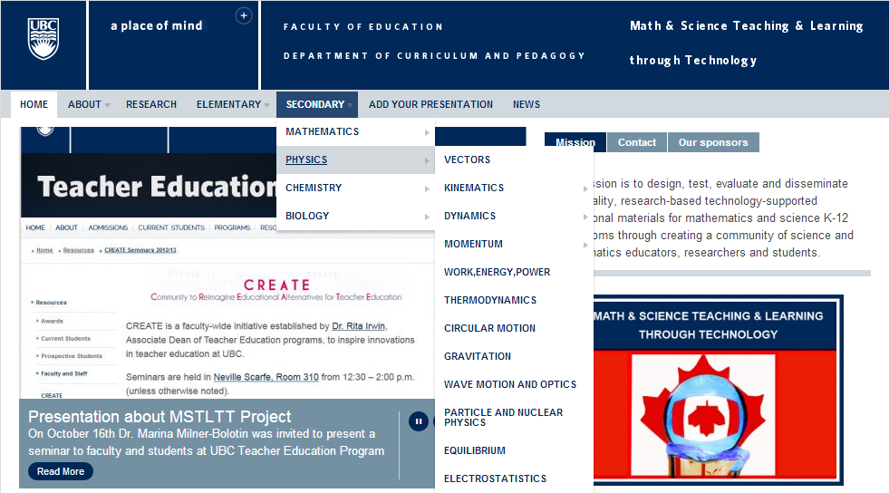
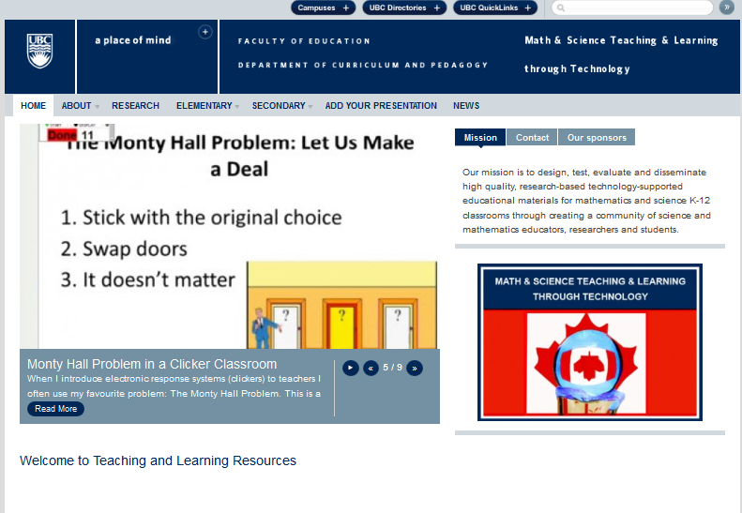
Teacher Education Resources should be Based on Research
Notes:
This slide shows how our resource looks like. It is divided into primary and secondary, by subject area, and then by specific topics within each subject. These topics are determined largely by the British Columbia Ministry of Education and question sets in the database are developed to meet the Prescribed Learning Outcomes outlined in the Ministry documents.

Slide 29

Question Title
Blocks and a Pulley
Question Title
m₁
m₂
Notes:
Tags: physics, dynamics, mechanics, weight, gravity, acceleration, constant, velocity, weight, tension, friction
Subject: Physics
Topic: Dynamics – Newton’s second law
Grade Level: Senior High School
Difficulty Level: Medium - Hard
Required Mathematics: Conceptual and algebra
Other comments: Students must understand net forces, how pulleys work

Slide 30

Question Title
Blocks and a Pulley II
Question Title
Two blocks are connected via a pulley. The blocks are initially at rest as block m₁ is attached to a wall. If string A breaks, what will the accelerations of the blocks be? (Assume friction is very small and strings don’t stretch)
A
B
m₁
m₂
Why are the assumptions above important?

Slide 31
Comments
Solution
Comments
Answer: E
Justification: None of the above answers is correct. Consider two blocks as one system: one can see that the system has a mass of (m₁+m₂), while the net force pulling the system down is m₁g. Therefore, applying Newton’s second law, one can see that the acceleration of the system must be less than g:
Some people think that the acceleration will be g. They forget that the system consists of two blocks (not just m₁) and the only pulling force is m₁g. Thus the system is NOT in a free fall. Compare this questions to the previous one to see the difference.
Notes:
What makes our resource different from many others is this component of the question set – having a justification for the correct and incorrect answers, to help students or teachers to understand the concept as well as the misconceptions surrounding a given question.

Slide 32
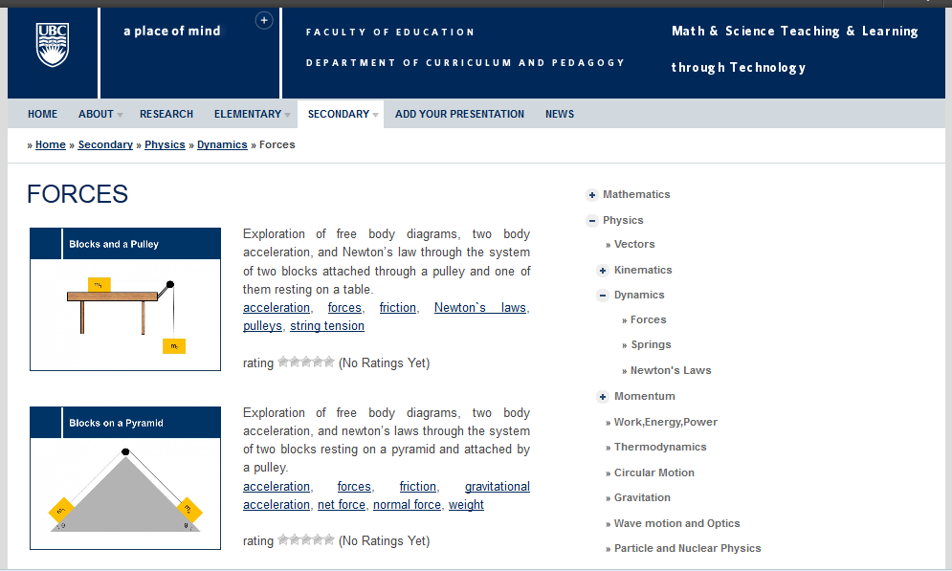
Navigating the Resource
Notes:
As you can see here, under a given category (here, Physics > Dynamics > Forces) there are a variety of questions (all the questions are included into a question set – a sequence of 5-15 questions), each with a brief summary and a list of tags describing the topics covered in that set. The image provides a glimpse into the situation/topic that question set will be covering. On the right, a user of the resource can navigate to the various areas of the resource quickly and conveniently. The resource is free and is open to anybody, teachers, students, teacher-candidates. Moreover, the users can rate the quality of the questions and leave their comments. Every question set is a PowerPoint slide, so teachers can download and edit them as they wish.

Slide 33
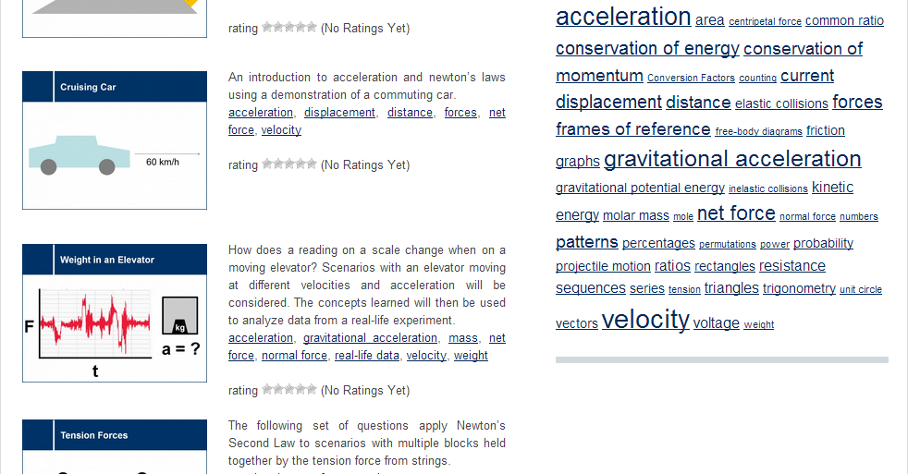
Navigating the Resource
http://scienceres-edcp-educ.sites.olt.ubc.ca/
Notes:
It is also possible to search the resource for a particular topic using the tags, listed on the right hand side of the page. For example, choosing acceleration will bring up a list of all question sets, from all areas, that touch on acceleration. This allows teachers and students to approach topics from different angles.

Slide 34
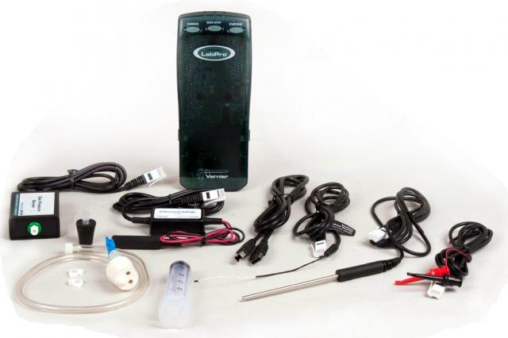
Are Good Recourses Enough?
Teachers need to want to use these resources and to be supported by Science Educators.
Resources are only as good as the teachers can make pedagogically effective use of them

Slide 35
4.
What is Next?
Introduction: Why should we care?
How do we engage our students?
  The value of meaningful STEM engagement
  What happens if we fail to engage them meaningfully
  c. Why teacher education matters
Reimagining physics teacher education
Summary: What is next

Slide 36
STEM in Canada: Can We afford to keep our educational system?
I hope that Canadian Educational System will undergo a major transformation in this century (like Finland did):
Teaching should become a profession, not a job
Teachers should be paid adequately and supported
Teacher Education Programs should accept highly-qualified candidates (the best ones)
Teachers should be held accountable for the quality of their work
Teaching should become one of the most desirable, respected and valued professions in Canada.

Slide 37

Teachers Matter

Slide 38
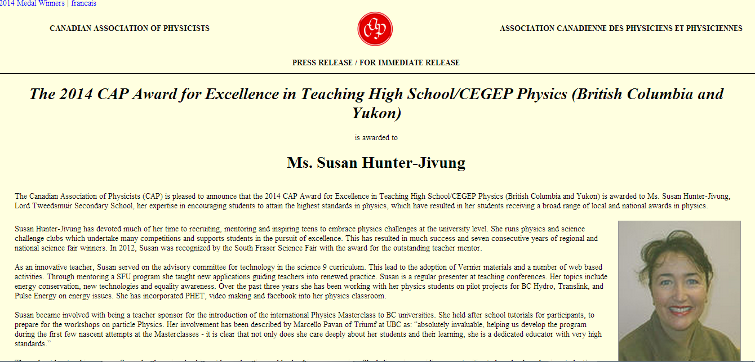
The 2014 CAP HS Teaching Award
Notes:
The Canadian Association of Physicists (CAP) is pleased to announce that the 2014 CAP Award for Excellence in Teaching High School/CEGEP Physics (British Columbia and Yukon) is awarded to Ms. Susan Hunter-Jivung, Lord Tweedsmuir Secondary School, her expertise in encouraging students to attain the highest standards in physics, which have resulted in her students receiving a broad range of local and national awards in physics.
Susan Hunter-Jivung has devoted much of her time to recruiting, mentoring and inspiring teens to embrace physics challenges at the university level. She runs physics and science challenge clubs which undertake many competitions and supports students in the pursuit of excellence. This has resulted in much success and seven consecutive years of regional and national science fair winners. In 2012, Susan was recognized by the South Fraser Science Fair with the award for the outstanding teacher mentor.
As an innovative teacher, Susan served on the advisory committee for technology in the science 9 curriculum. This lead to the adoption of Vernier materials and a number of web based activities. Through mentoring a SFU program she taught new applications guiding teachers into renewed practice. Susan is a regular presenter at teaching conferences. Her topics include energy conservation, new technologies and equality awareness. Over the past three years she has been working with her physics students on pilot projects for BC Hydro, Translink, and Pulse Energy on energy issues. She has incorporated PHET, video making and facebook into her physics classroom.
Susan became involved with being a teacher sponsor for the introduction of the international Physics Masterclass to BC universities. She held after school tutorials for participants, to prepare for the workshops on particle Physics. Her involvement has been described by Marcello Pavan of Triumf at UBC as: “absolutely invaluable, helping us develop the program during the first few nascent attempts at the Masterclasses - it is clear that not only does she care deeply about her students and their learning, she is a dedicated educator with very high standards.”
Throughout her teaching career, Susan has been involved in outdoor education and leadership programming. She believes in providing opportunities to broaden her physics student’s experiences and involvement in the real world.
The CAP Award for Excellence in Teaching High School/CEGEP Physics, which was introduced in 2010, is intended to recognize excellence in teaching physics in Canadian high schools or CEGEPs and to encourage and promote physics at the high school/CEGEP level in Canada. The award is sponsored by the CAP, TRIUMF, Perimeter Institute for Theoretical Physics, Nelson Education, and the Association of Professional Engineers and Geoscientists of BC.
Ms. Susan Hunter-Jivung will receive the 2014 CAP Award for Excellence in Teaching High School/CEGEP Physics (British Columbia and Yukon) in their high school or CEGEP before the end of the 2013-14 school year.
The Canadian Association of Physicists, founded in 1945, is a professional association representing over 1600 individual physicists and physics students in Canada, the U.S. and overseas, as well as a number of Corporate, Institutional, and Departmental Members. In addition to its learned activities, the CAP also undertakes a number of activities intended to encourage students to pursue a career in physics.
For more information, please contact:
Canadian Association of Physicists
Tel: (613) 562-5614
Fax: (613) 562-5615
E-mail: cap@uottawa.ca

