Slide 1

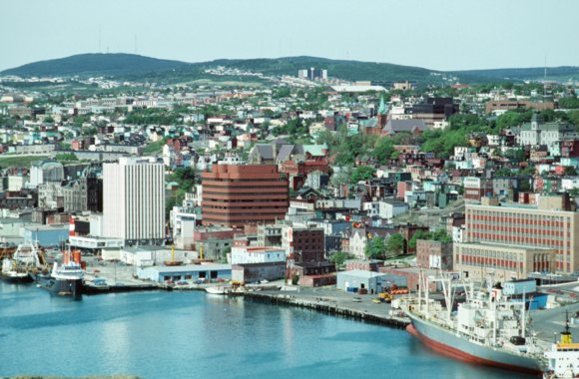
Inverse melting and phase behaviour of core-softened attractive disks
Ahmad M. Almudallal
Ivan Saika-Voivod
Department of Physics and Physical Oceanography
Memorial University of Newfoundland, St. John’s, NL
Sergey V. Buldyrev
Yeshiva University, New York
CAP Congress
June 18, 2014
Notes:
Thank for this opportunity to present my work.
My name is Ahmad Almudallal from Memorial University of Newfoundland.
I will talk about Inverse melting and phase behaviour of core-softened attractive disks

Slide 2
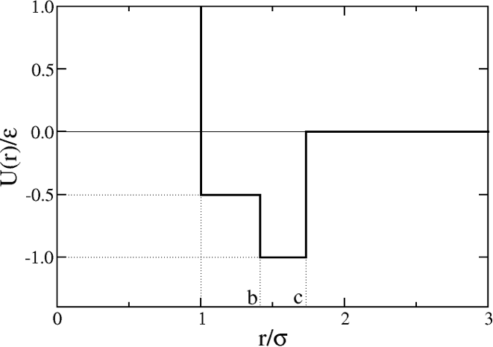
Outline
Why this potential?
Increase inverse melting
Phase diagram
More interesting stuff
Notes:
This is my outline
I will start taking about the motivation of using this square-shoulder square well potential, and then I will talk about the phase diagram that I calculated.
Next I will explain how I modified the potential to increase the range of inverse melting, and how this modification lead to more interesting stuff.

Slide 3
Square shoulder-square well pair potential
A. Scala, M. R. Sadr-Lahijany, N. Giovambattista, S. V. Buldyrev, H. E. Stanley, Phys. Rev. E 63, 041202 (2001).
Notes:
1) I calculated the phase diagram for this square shoulder-square well pair potential in 2D system.
2) This potential has a feature of having different bond energies at different distances.
3) This potential is motivated by water molecules.

Slide 4
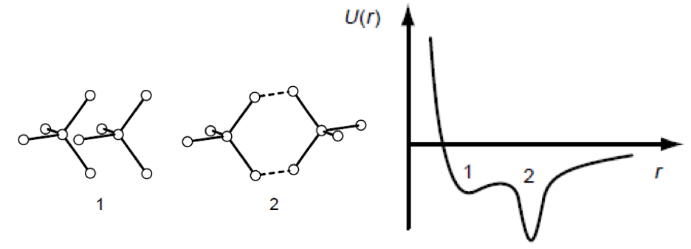
Motivation for the potential: water
Average over relative orientations of two water molecules to obtain a radial potential. There are two characteristic distances in the result.
O. Mashima and H.E. Stanley, Nature 396, 329 (1998)
Notes:
For a pair of water molecules, an effective radial potential can be obtained by averaging over the relative orientations of the two water molecules.
This obtained potential can form hydrogen bonding at long distance and an energetically favorable alignment at a shorter distance.
These two length scales are responsible for liquid anomalies and a possible LL phase transition in the supercooled liquid.

Slide 5
Square shoulder-square well
Square and low density triangular crystals have the same potential energy.
Bond with energy
Bond with energy
Notes:
The potential that I used in my research is a simpler version of the previous one.
It was constructed to have two local environments of quite different densities with the same energy. This will drive the system to have a phase separation between two liquids.

Slide 6
P-T Phase Diagram (2D system)
Monte Carlo simulations:
-NPT
-Frenkel-Ladd Integration
-Gibbs-Duhem Integration
-Gibbs Ensemble (for L-G)
All transitions in the phase diagram appear to be first-order phase transitions.
A. M. Almudallal, S. V. Buldyrev and I. Saika-Voivod, J. Chem. Phys. 137, 034507 (2012).
Notes:
This is the phase diagram that I obtained using different Monte Carlo Simulations techniques.
All transitions in the phase diagram seem to be first-order phase transitions.

Slide 7
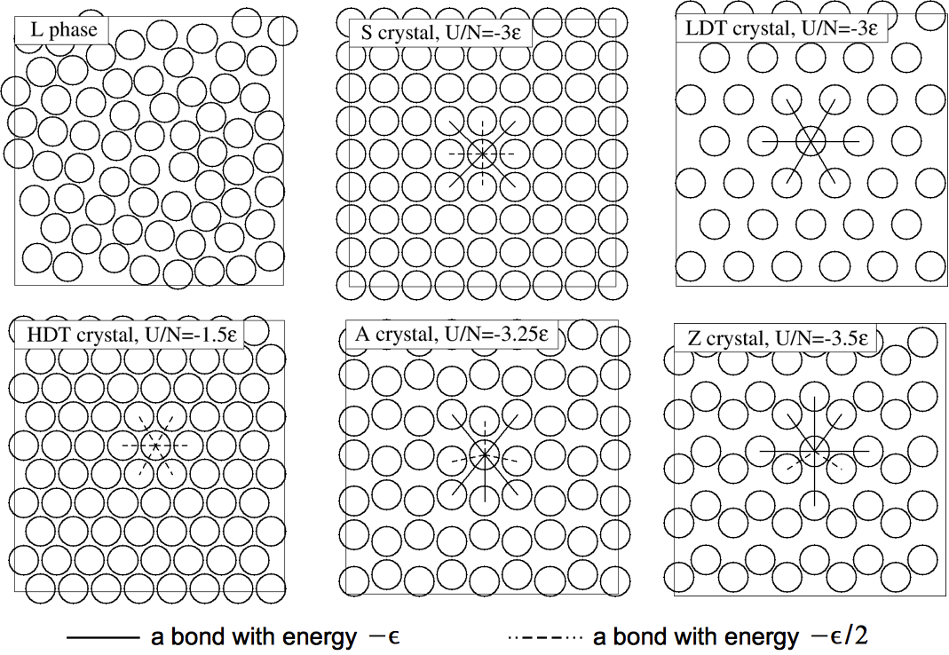
P-T Phase Diagram
HDT
A. M. Almudallal, S. V. Buldyrev and I. Saika-Voivod, J. Chem. Phys. 137, 034507 (2012).
Notes:
This phase at high pressure is the high density triangular crystal.

Slide 8
P-T Phase Diagram
(not previously reported)
A
A. M. Almudallal, S. V. Buldyrev and I. Saika-Voivod, J. Chem. Phys. 137, 034507 (2012).
Notes:
At low pressure and low temperature we have the A phase which is not previously reported.

Slide 9
P-T Phase Diagram
(not previously reported)
Z
A. M. Almudallal, S. V. Buldyrev and I. Saika-Voivod, J. Chem. Phys. 137, 034507 (2012).
Notes:
We also have the z phase at low temperature low pressure. It is also not previously reported.

Slide 10
P-T Phase Diagram
LDT
A. M. Almudallal, S. V. Buldyrev and I. Saika-Voivod, J. Chem. Phys. 137, 034507 (2012).
Notes:
The low density triangular crystal occupies a very small portion of the phase diagram.

Slide 11
P-T Phase Diagram
L
A. M. Almudallal, S. V. Buldyrev and I. Saika-Voivod, J. Chem. Phys. 137, 034507 (2012).
Notes:
Here we have liquid, which shows different local environments, square and triangular.

Slide 12
P-T Phase Diagram
S
A. M. Almudallal, S. V. Buldyrev and I. Saika-Voivod, J. Chem. Phys. 137, 034507 (2012).
Notes:
Finally this is the square crystal

Slide 13
Maximum melting temperature
The L-S melting curve exhibits a maximum temperature, indicating that at higher pressure, the liquid is more
dense than the solid.
A. M. Almudallal, S. V. Buldyrev and I. Saika-Voivod, J. Chem. Phys. 137, 034507 (2012).
Notes:
The L-S melting curve exhibits a maximum temperature, indicating that at higher pressure, the liquid is more dense than the solid

Slide 14
Maximum melting pressure
Also it exhibits a maximum pressure, indicating that the inverse melting occurs in a small range of pressure
A. M. Almudallal, S. V. Buldyrev and I. Saika-Voivod, J. Chem. Phys. 137, 034507 (2012).
Notes:
And here the L-S melting curve exhibits a maximum pressure, indicating that the inverse melting occurs over a small range of pressure.

Slide 15
Inverse melting
Inverse melting is a rare phenomenon and confirming it for a simple model will allow for deeper exploration into the basic physics surrounding it.
A. M. Almudallal, S. V. Buldyrev and I. Saika-Voivod, J. Chem. Phys. 137, 034507 (2012).
Notes:
To explain what I mean by inverse melting, here I Just show a close up to this part of the phase diagram.
Inverse melting happens here; where liquid transforms to square crystal by heating.
We are interested to study the inverse melting because it is a rare phenomenon and confirming it for a simple model will allow for deeper exploration into the basic physics surrounding it

Slide 16
Increasing range of inverse melting
What changes can we make to the potential in order to increase the pressure range for which inverse melting can be obtained?
b
c
Notes:
Because inverse melting occurs over a small range of pressure, the question that arises here is what changes can we make to the potential in order to increase the range of pressure for which inverse melting can be obtained
The changes to the potential will be due changing epsilon, b and c independently.

Slide 17
Hamiltonian Gibbs-Duhem Integration
This technique allows one to obtain a phase diagram of a new model u₂ starting from the known phase diagram (for u₁).
At λ=0 we recover the original potential and at λ=1 we transform the potential to the new one.
Technique tells you e.g. how the coexistence pressure will shift if you change the potential and keep temperature constant (or vice versa).
b
c
Parameters to be changed
are b and c.
Notes:
The technique that I used to calculate the change in the melting line when changing the potential parameters is called the HGDI.
This technique tells you how the coexistence pressure will shift if you change the potential and keep temperature constant (or vice versa).
With this techniques we sample the system according to this potential. Lambda is coupling constant. When lambda equal zero, we recover the original potential and at lambda equal 1 we transform the potential to the new one.
Our investigations show that b is the only important parameter. Increasing b increases the range of inverse melting. The other two parameters don’t contribute in inverse melting.

Slide 18
Inverse melting becomes more obvious
A. M. Almudallal, S. V. Buldyrev and I. Saika-Voivod, J. Chem. Phys. 140, 144505 (2014).
Notes:
I calculated the whole square-crystal melting line for different values of b.
It becomes so obvious that as we increase b, the range of inverse melting increases as well.
These curves were calculated by two different ways, HGDI (the open points) and GDI (solid lines) and the results show a perfect agreement.

Slide 19
Pick b=1.46 and confirm transition
Carry out umbrella sampling Monte Carlo to calculate the free energy as a function of density at constant T and P, which are taken to be on the coexistence line.
A. M. Almudallal, S. V. Buldyrev and I. Saika-Voivod, J. Chem. Phys. 140, 144505 (2014).
Notes:
We pick b=1.46 to confirm the transition.
This transition up to this maximum is first order, but what is about the rest of the curve where we have inverse melting? It should be also a first order, otherwise, the inverse melting does not exist.
To answer this concern, we carry out umbrella sampling Monte Carlo to calculate the free energy as a function of density at constant T and P for about 2000 particles.
The free energy shows two basins separated by a barrier. This picture of the free energy is consistent with the first order transition.

Slide 20
Confirming transition
Carry out umbrella sampling Monte Carlo to determine the free energy as a function of density at constant T and P, which are taken to be on the coexistence line.
A. M. Almudallal, S. V. Buldyrev and I. Saika-Voivod, J. Chem. Phys. 140, 144505 (2014).
Notes:
This snapshot is taken from umbrella simulations at density about 0.89. Black circles are crystal-like particles and red circles are liquid-like.
The interface between the liquid and crystal is consistent with the flatness of the free energy barrier.
Another possibility is that the liquid phase we see is indeed a hexatic phase not a liquid. So we have to check for the hexatic phase. Because if it is not liquid then inverse melting does not exist.

Slide 21
Hexatic Phase: Colloidal Experiment
KTNHY Theory
Kosterlitz, Thouless, Halperin, Nelson and Young
η₆ < 1/4
Notes:
We check for the hexatic phase by calculating the Orientational correlation function.
This graph here is for a previous experimental study for colloidal system in 2D. According to KTNHY, the first three curves are for the crystal phase because they tend to a constant. These two for a hexatic because they decay as a power law. And the last two for a liquid because the decay exponentially.

Slide 22
Checking for hexatic phase, N=65536, P=5.6
A. M. Almudallal, S. V. Buldyrev and I. Saika-Voivod, J. Chem. Phys. 140, 144505 (2014).
Notes:
Here I calculated the Orientational correlation function along this isobar where we have the inverse melting.
The graph does not show any power-law decay indicating that hexatic phase doesn’t exist in the system. All I have here is a constant behaviour for the crystal and exponential decay for the liquid. These results support our findings for the inverse melting.

Slide 23
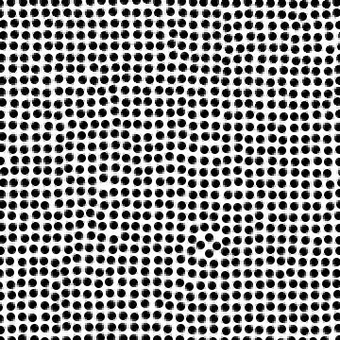
Direct Confirming with MD
Start with S crystal at P=5.6, T=0.30 and see what happens.
Notes:
As a direct confirmation of inverse melting, we perform a molecular dynamic simulation in the stable liquid starting from a crystal configuration. If we really have inverse melting, then this crystal should eventually melt, and that is what we see in the video.
The density over time shows a jump indicating that the transition when the square crystal melted is a first-order transition.

Slide 24
What about the rest of the phase diagram?
HDT melting line would need to curve a lot.
Notes:
What about the rest of the phase diagram? Changing the potential parameter b from … to 1.46 makes this melting line to bend a lot, so we expect the HDT melting curve to bend as well to make the triple point.

Slide 25
Add HDT-L Coexistence Curve
HDT-S-L triple point disappears
HDT-L line inflects (?!)
Notes:
This is what I got, the HDT melting line inflects the other way, and the triple point disappears.

Slide 26
Add HDT-L Coexistence Curve
Is this a channel of liquid super stability with no crystals in the way?
Notes:
Leaving behind a liquid corridor. The question now, does this liquid go to zero temperature or we have a crystal on the way?

Slide 27
Add HDT-L Coexistence Curve
Let’s take a look at the liquid here.
Notes:
To answer this question, let us have a look at the liquid here.

Slide 28
Liquid at
Notes:
This is the liquid

Slide 29
It has various local environments
Notes:
Here we just connect the first neighbors by segments.

Slide 30
Close-packed
Notes:
We can see some triangular crystal local environment.

Slide 31
Squares
Notes:
And some square crystal local environment.

Slide 32
And pentagons
(surrounded by triangles and little squares or rhombuses)
Notes:
With the pentagons, we have nice tile.

Slide 33
And pentagons
(surrounded by triangles and little squares or rhombuses)
O-phase
(Outphase?
… still looking for a name)
Notes:
This is a crystal. We call O-crystal, and we still looking for a name.

Slide 34
And pentagons
(surrounded by triangles and little squares or rhombuses)
I-phase
(Inline phase?
… still looking for a name)
Notes:
This is another crystal. We call it I crystal, and we also still looking for a name.

Slide 35
New Phases
Notes:
We constructed these two new crystals, I and O to show them clearly.

Slide 36
A look at metastability
I-phase not stable above T=0.4
Notes:
Here I calculated the range of stability and metastability for the two phases.
We can see that the I phase has bigger stability field, and the O phase is metastable with respect to the I phase.
We can conclude that the I phase will prevent the liquid in the liquid corridor for going to zero temperature.

Slide 37
HDT-L Coexistence Curve
HDT-S-L triple point disappears
HDT-L line inflects (?!)
This is a very strange point, as we shall later see.
Notes:
Another interesting feature in the phase diagram is this strange point, we call it the funny point. I will explain later why I call it the funny point.

Slide 38
HDT-L Coexistence Curve
Notes:
The free energy calculated along the HDT melting line shows a barrier separating two basins, one basin for HDT and another for liquid. This picture is of course consistent with the first-order transition.
From this label we see that as the temperature decreases, the free energy barrier decreases as well.

Slide 39
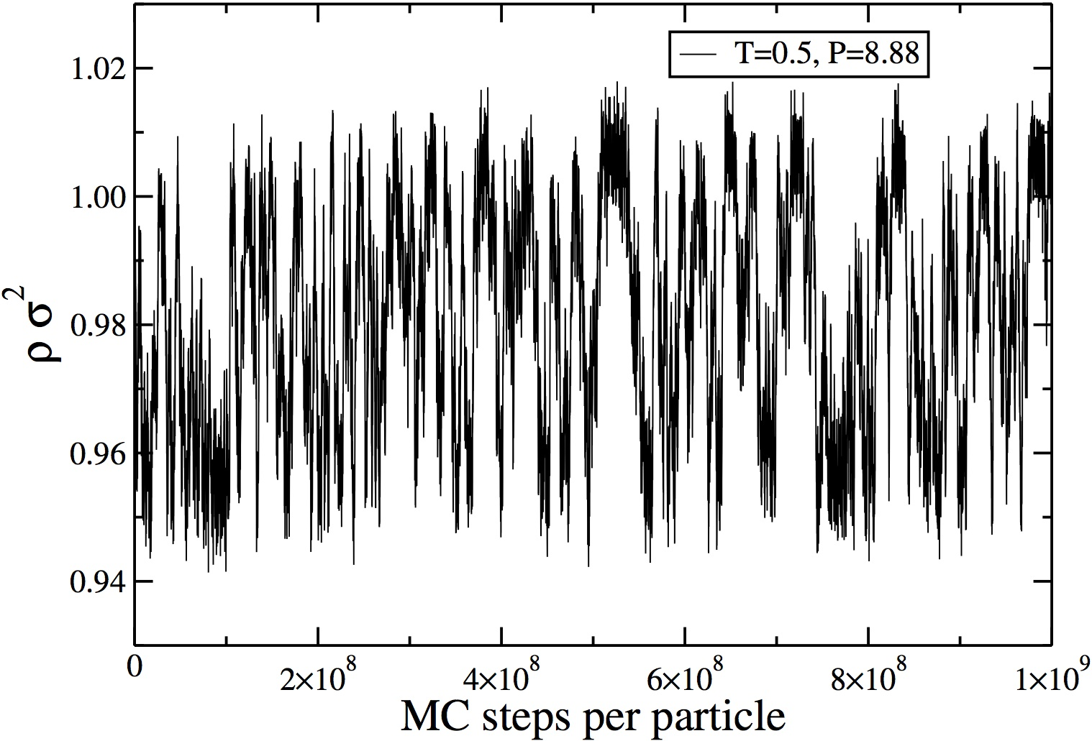
HDT-L Coexistence Curve
T=0.5
Notes:
When decreasing the temperature down to T=0.5, the free energy barrier vanishes. That is why we call it the funny point.
In this case the system can easily sample the two states as you see here in the density graph. It shows a quick switching between the two phases. The phase down here is for liquid and this one here is for the HDT.

Slide 40
HDT-L Coexistence Curve
T=0.46
(umbrella sampling)
Below this temperature, we can use Gibbs-Duhem integration.
Notes:
Interestingly, at T=0.46, the barrier grows again to a big value and below this point we can easily use Gibbs-Duhem integration to trace the rest of the melting curve.
The work is not done yet. I am still working on it and hopefully I will come up with explanation for this funny point soon..

Slide 41
Conclusions
Calculated phase diagram for a tricky potential developed to produce liquid anomalies.
Found inverse melting – weak effect.
Tweaked potential (made shoulder wider) to amplify inverse Melting.
Really does look like first-order melting.
New crystal phases thwart liquid’s stability down to T=0.
A funny point, where free energy barrier between HDT and L vanishes, appears at T=0.5.

Slide 42
Thank you for your attention

