Slide 1
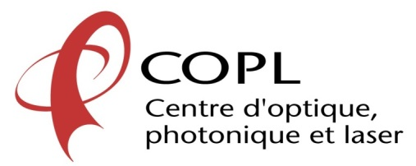
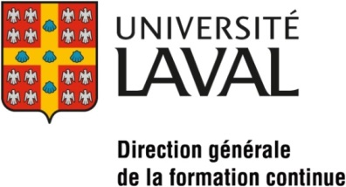
Study of chiral molecular diffusion in anisotropic liquids
Karen Allahverdyan and Tigran Galstian
Presented by: K. Allahverdyan
karen.allahverdyan.1@ulaval.ca
Center for Optics, Photonics and Laser (COPL),
Department of Physics, Engineering Physics and Optics, Laval University,
Pav. d’Optique-Photonique, 2375 Rue de la Terrasse, Québec, Canada G1V 0A6

Slide 2
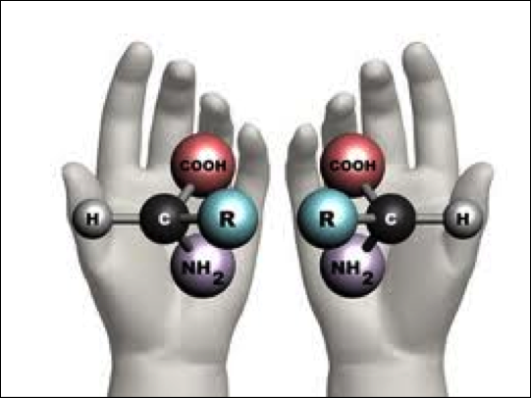
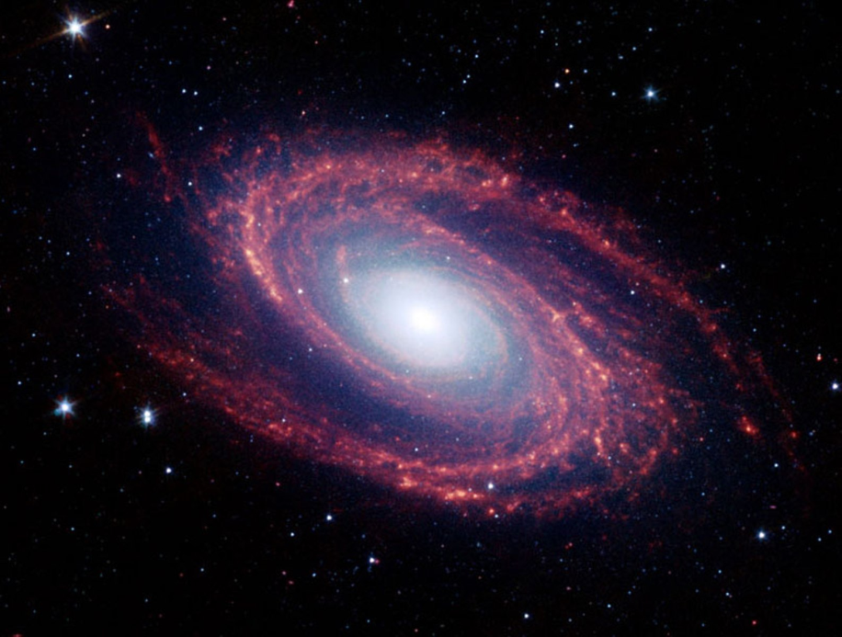
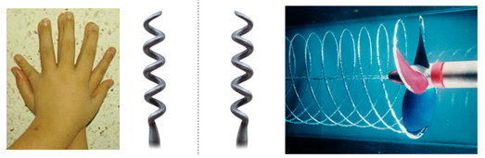
Chirality

Slide 3
The presence of chiral compound in liquids
Optical activity
In isotropic liquids
Manipulation of light polarization & path
Precise measurement of concentration
Various biomedical applications, drugs …
etc.
Periodic structure
1D photonic crystal
Tunable Bragg gratings
Selective reflection
Etc.
In anisotropic liquids
Photonic band gap structures
Reflective LC displays, thermometers (temperature distribution maps), circular polarizers, dichroic filters& mirrors… Smart windows…

Slide 4
Chiral compound in anisotropic liquids
NLC
CLC
Chiral dopant

Slide 5
Boundary conditions
Strong
Weak
rubbing
Chiral dopant
Chiral dopant

Slide 6
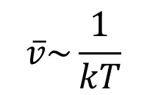
Chiral droplet in NLC
For given materials, the temperature is the major factor acting on the diffusion dynamics.
$$\overline{v}\sim \frac{1}{kT}$$
Strong boundary conditions vs Weak boundary conditions

Slide 7
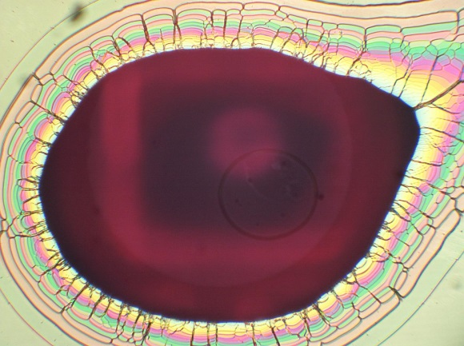
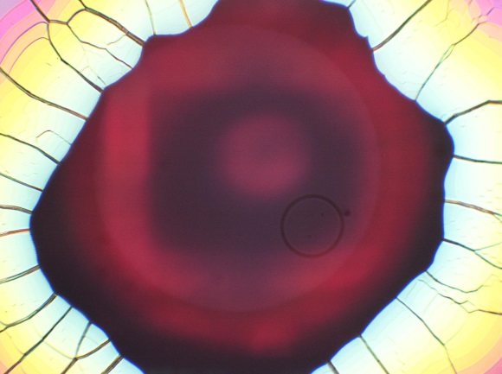
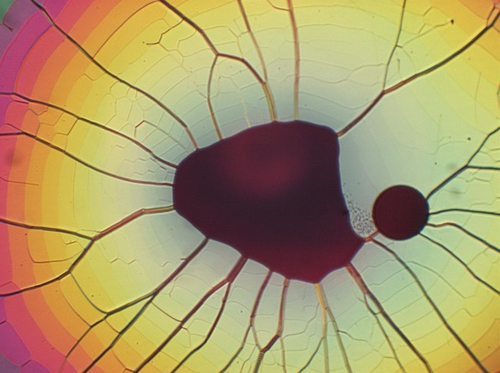
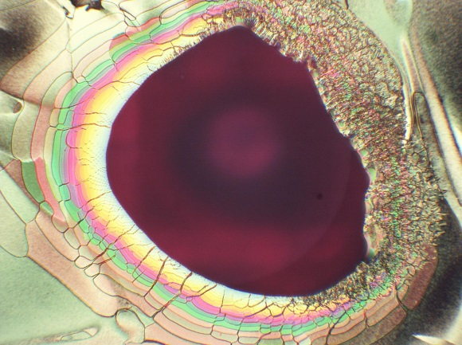
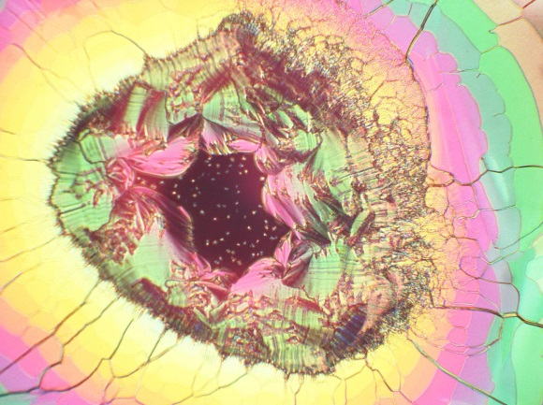
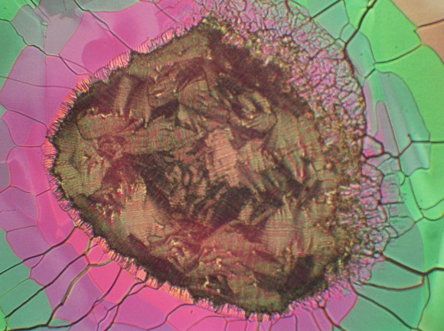
Chiral droplet in NLC
15min
10h
18h
Rubbed
(strong)
0.5mm
Non-rubbed
(weak)

Slide 8
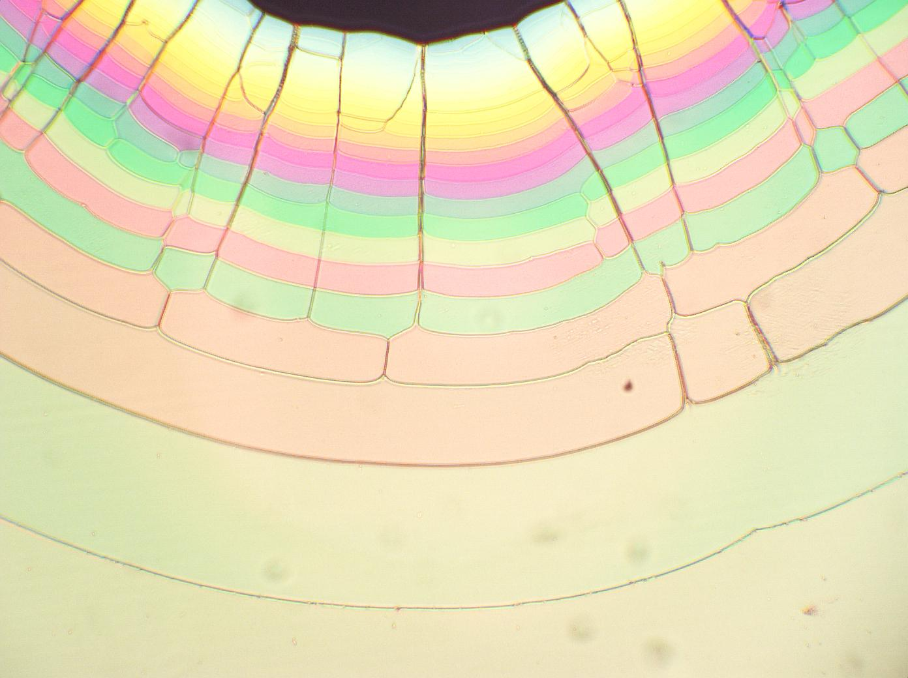
r
d

Slide 9
The evolution of fringes

Slide 10
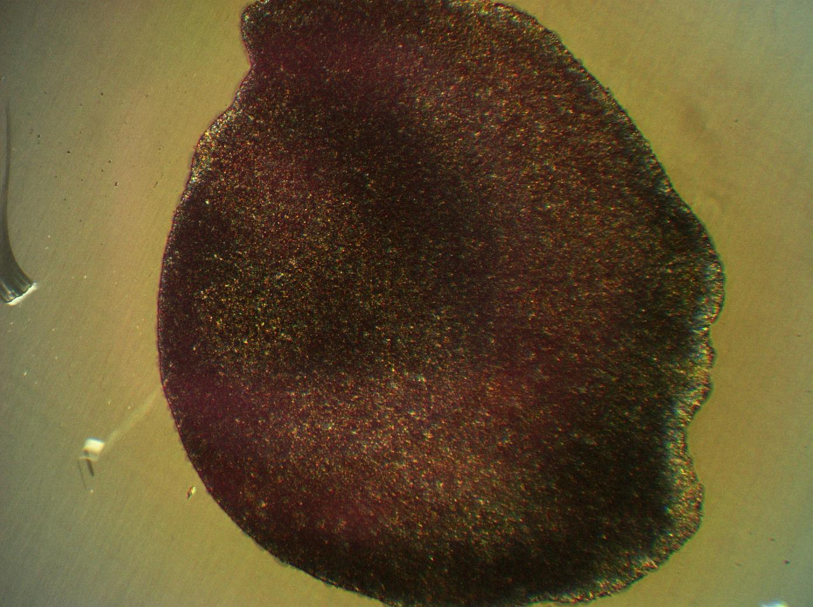
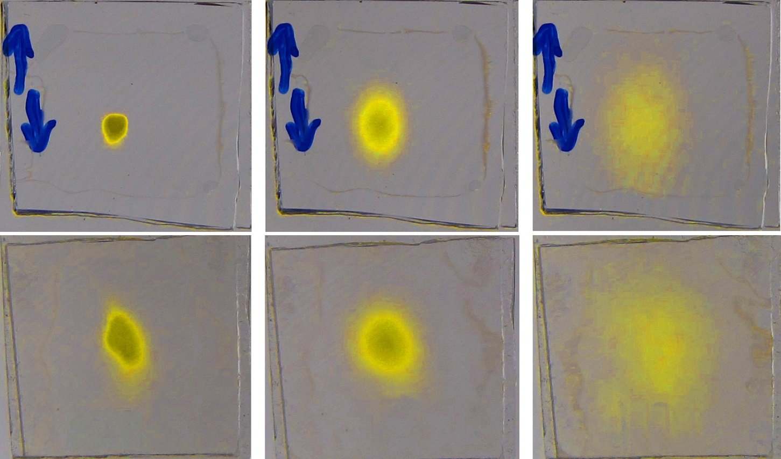
Azobenzene droplet in NLC
Rubbed
(strong)
0.5mm
Non-rubbed
(weak)

Slide 11
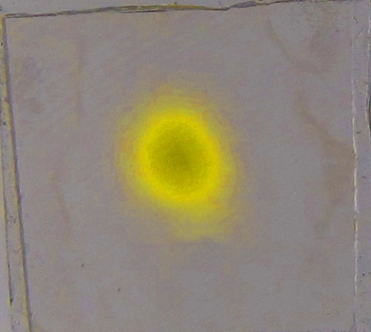
The diffusion dynamics
Distribution of azo. concentration
The diffusion processes are similar in both cases (strong or weak boundaries)
The diffusion is faster in the rubbing direction.

Slide 12
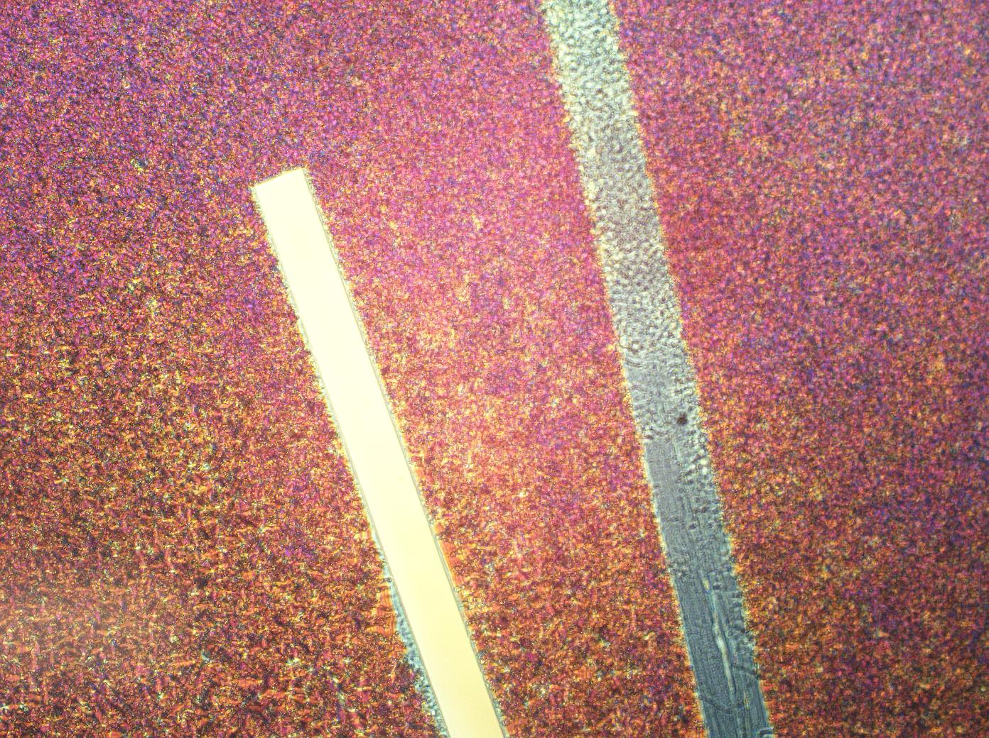
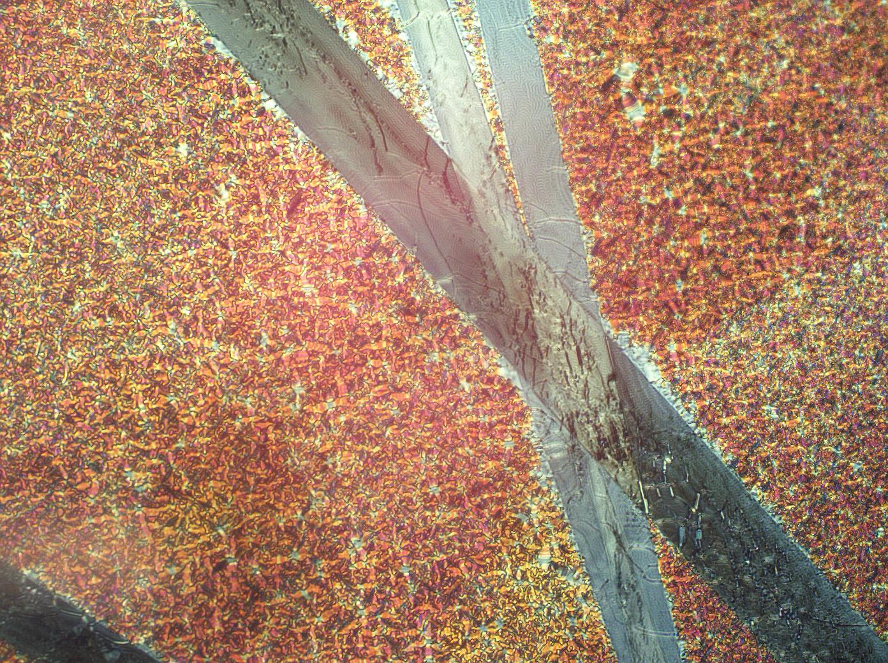
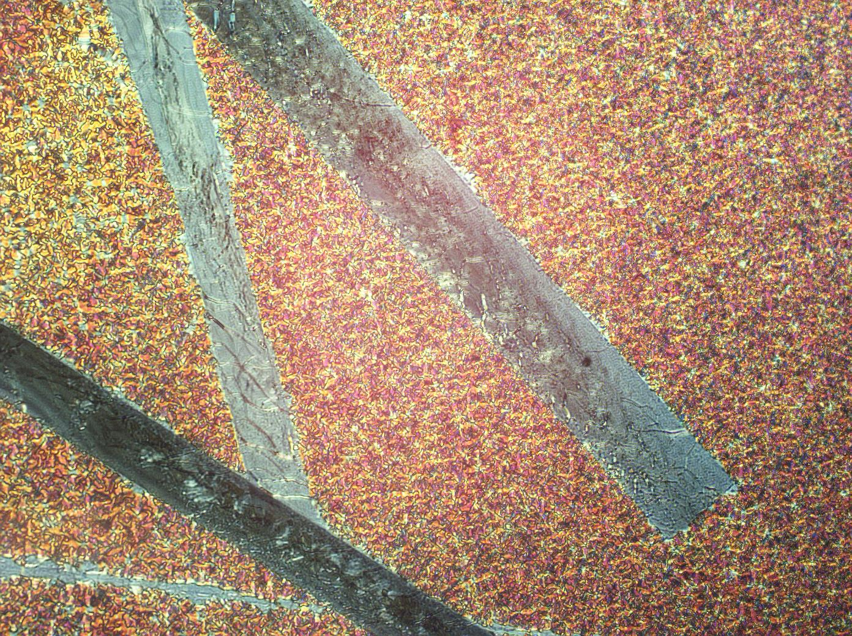
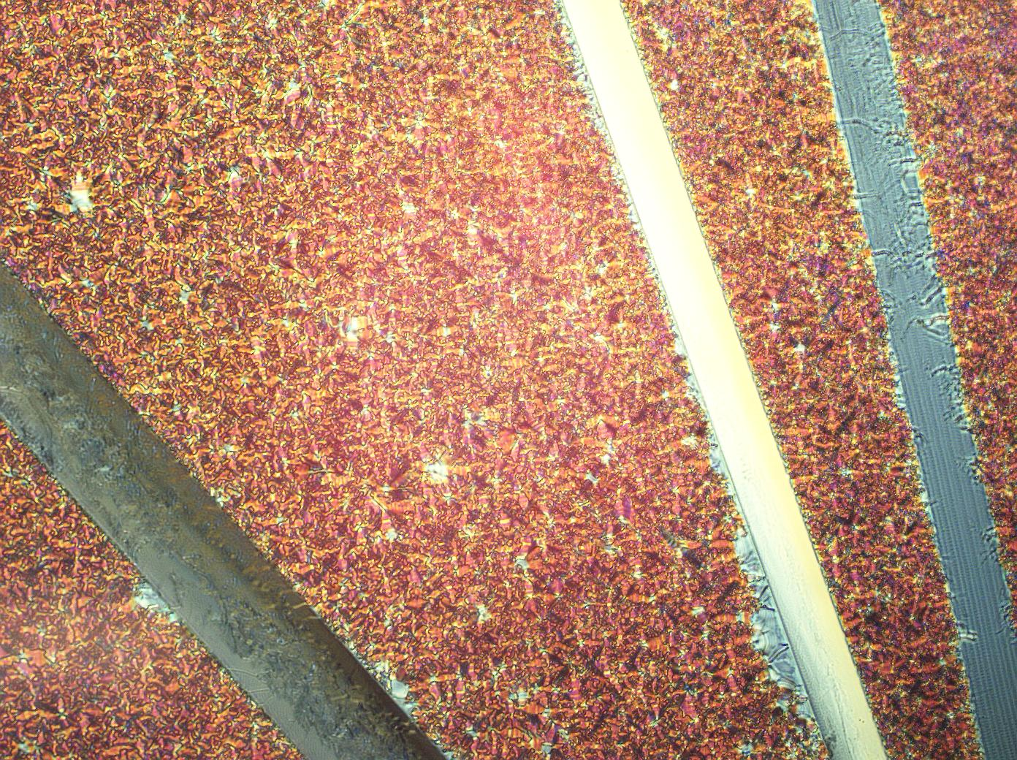
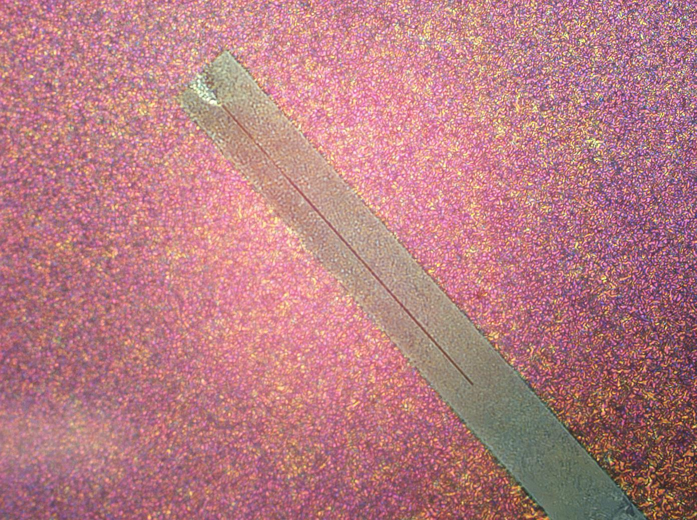
Agglomeration of chiral molecules

Slide 13
Conclusion
The diffusion of chiral molecules in anisotropic liquids is different then in isotropic liquids.
The boundary conditions can be used to control the diffusion dynamics in anisotropic liquids.
The differences and the possibility of control is due to collective organizing tendency of liquid crystals.

Slide 14
