Slide 1

XPS measurements of sodium in Bridgman-grown CuInSe_{2+x}
by
Sunyoung Park, C. H. Champness and I. Shih
Electrical and Computer Eng., Dept.
McGill University
Sunyoung Park
Ph.D. student

Slide 2
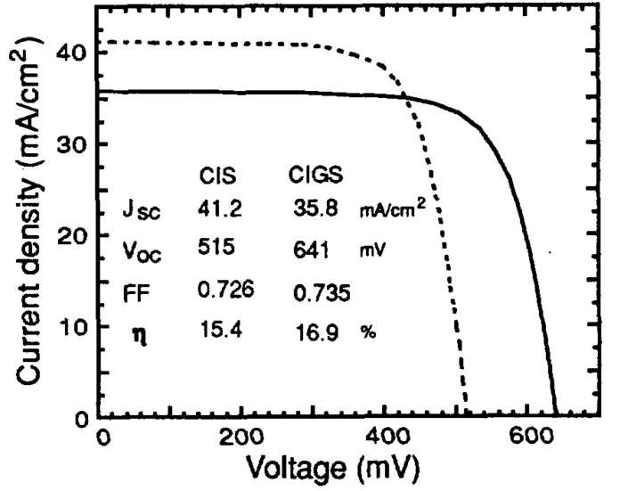
J-V characteristics under simulated AM 1.5
conditions of a Cu(In,Ga)Se and a CuInSe₂ cell.
The cells are AR-coated.
Cell temperature is 25 °C
(Hedstrom and Ohlsen, 1993)
hν
Metal grid evap.
hν
ZnO cond
ZnO cond
Sputtered
ZnO i
ZnO i
n CdS
Solution grown
(50 nm)
n CdS
p CuInSe₂
p Cu(In,Ga)Se₂
2 µm
Mo
Mo
Sputtered
Glass substrate
Glass substrate
Earlier cell
Later cell

Slide 3
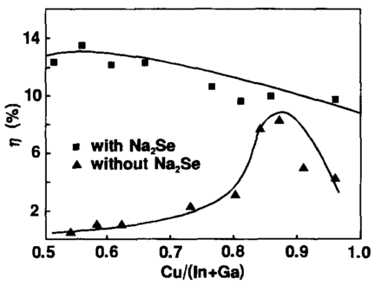
Solar cell efficiency with added Na₂Se
(Nakada and Ohbo, 1997)

Slide 4
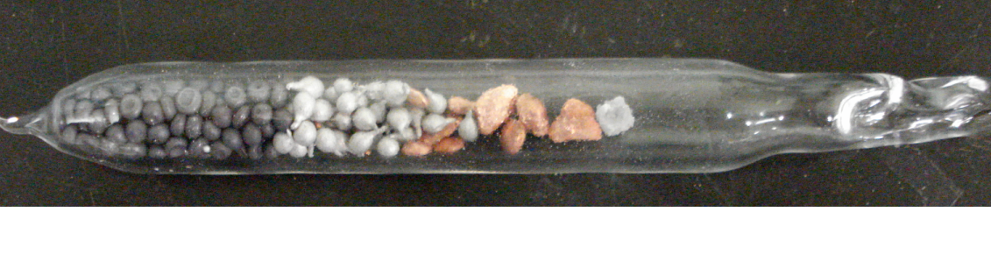
A quartz ampoule with Cu, In, Se, and Na
Se
In
Cu
Na

Slide 5
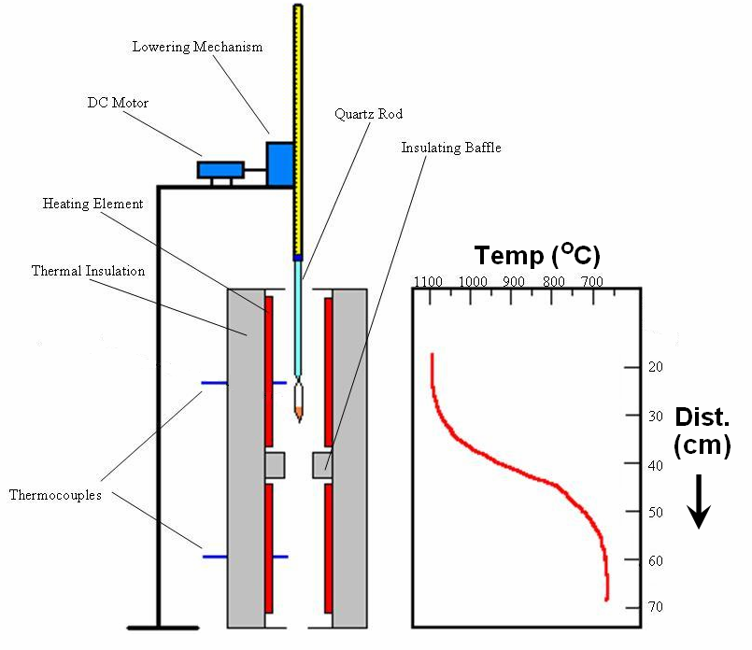
Bridgman Growth Apparatus

Slide 6
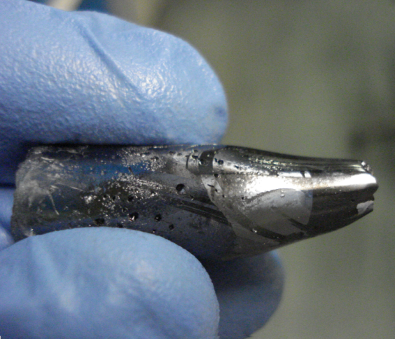
Bridgman-grown ingot

Slide 7
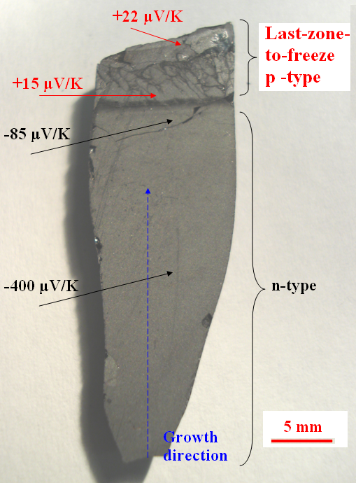
Bridgman-grown ingot
CuInSe_{2+x}
n-type
If
[Na]>[Na]_{crit} =2x+δ

Slide 8
Before abrasion

Slide 9
After abrasion

Slide 10
XPS survey scans for different locations of an ingot

Slide 11
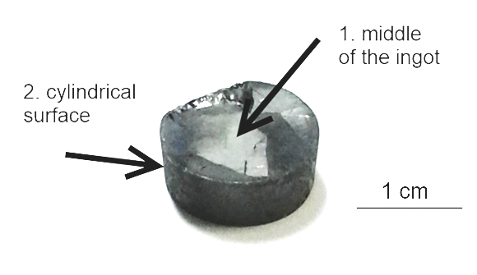
Na1s scan

Slide 12
Na1s scan

Slide 13
[Cu]_{surf} vs. [Na]_{surf}

Slide 14
[Cu]_{surf} vs. [Na]_{melt}

Slide 15
[Se]_{surf} vs. [Na]_{sulf}

Slide 16
Conclusions
The present results in Bridgman-grown CuInSe_{2+x} demonstrate that:
(1) The main variations in ternary composition occur in the first 100 nm from the ingot surface, even without Na addition.
(2) With increase of up to about 1 at. % of added elemental Na to the melt, the relative surface concentration of Cu is decreased and that of Se, in p-type (bulk) material, is increased.
(3) The Na is mostly present in a 0.2 micron surface layer and none is detected by XPS in the bulk.
(4) The reduction of Cu proportion at the surface occurs with and without added Na but is accentuated with up to 1 at. % of added Na in the melt.
(5) Some of the XPS results may have been affected by the abundant carbon present.
(6) For samples exposed to air, the addition of Na gives rise to the extra compounds CuSe₂, Na₂SeO₄, and Na₂SeO₃, at least at the surface.

Slide 17
Speculation
CdS
interface
Lower recombination
interface
hν
CdS
Low Cu
Ternary
n
CuInSe₂
or
Cu(InGa)Se₂
p
Low Cu ternary/CuInSe₂
n/p interface
The End

Slide 18
The End

