Slide 1
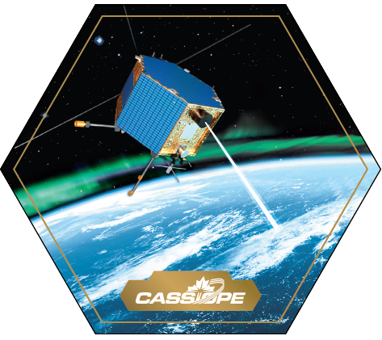










Probing the Ionosphere with Radioscience Instruments on
CASSIOPE-e-POP
H.G. James and A.W. Yau
University of Calgary
P.A. Bernhardt
Naval Research Laboratory
R.B. Langley, University of New Brunswick
Thanks to T. Cameron, G. Enno,
R. Gillies, D. Knudsen
Athabasca University - University of Alberta - University of Calgary - University of Saskatchewan - University of Western Ontario - York University - University of New Brunswick

Slide 2
Outline
E-POP scientific goals and instruments
CASSIOPE and e-POP status
Radio-science experiments
Radio Receiver Instrument (RRI) results
Summary
Athabasca University - University of Alberta - University of Calgary - University of Saskatchewan - University of Western Ontario - York University - University of New Brunswick

Slide 3
The CASSIOPE/e-POP Mission
Overview Paper immediately follows: Yau

Slide 4
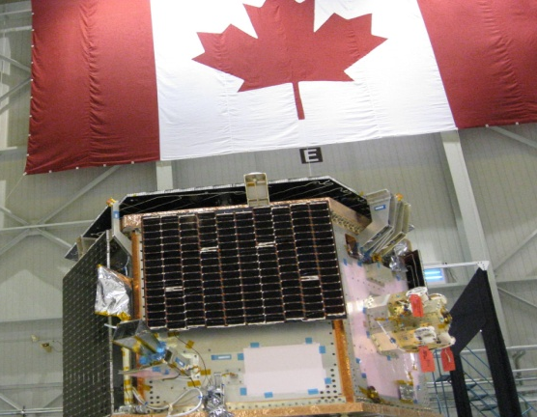
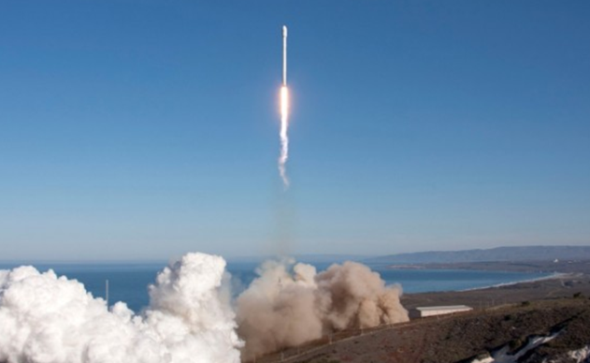
CASSIOPE Mission at a Glance…
Multi-purpose small satellite funded by Canadian Space Agency and Industrial Technology Office
Carries e-POP and Cascade payloads
e-POP: science payload; hi-res plasma and field, 3D radio propagation, meso-scale auroral imaging
Cascade: comm. payload; high-speed U/L and D/L
Launched 2013/09/29, 16:00 UT
Polar orbiter: 325×1500 km, 81°, 3-axis stabilized

Slide 5
Enhanced Polar Outflow Probe (e-POP) Objectives
The scientific objectives of e-POP are to
quantify the micro-scale characteristics of plasma outflow and related micro- and meso-scale plasma processes in the polar ionosphere,
explore the occurrence morphology of neutral escape in the upper atmosphere, and
study the effects of auroral currents on plasma outflow and those of plasma microstructures on radio propagation.

Slide 6
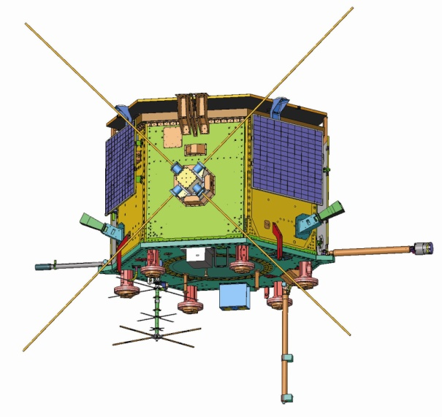
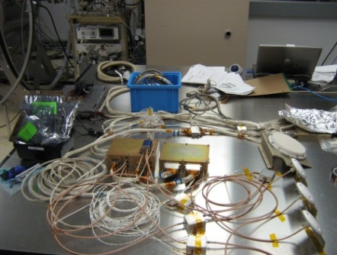
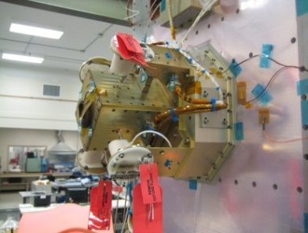
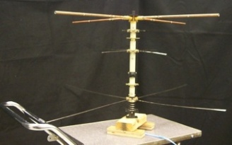
e-POP Radio Measurements
RRI
GAP
CER
Instrument | Measurements |  | Resolution
RRI Radio receiver instrument | E, k(ω) | ULF/HF (0–18MHz) | 16 μs
GAP GPS attitude and profiling | L1, L2 | Radio occultation | 0.05 s | <1 km TEC
CER Coherent EM radio tomography | TEC | Ionospheric irregularity |  | ~1 km/TEC pixel

Slide 7
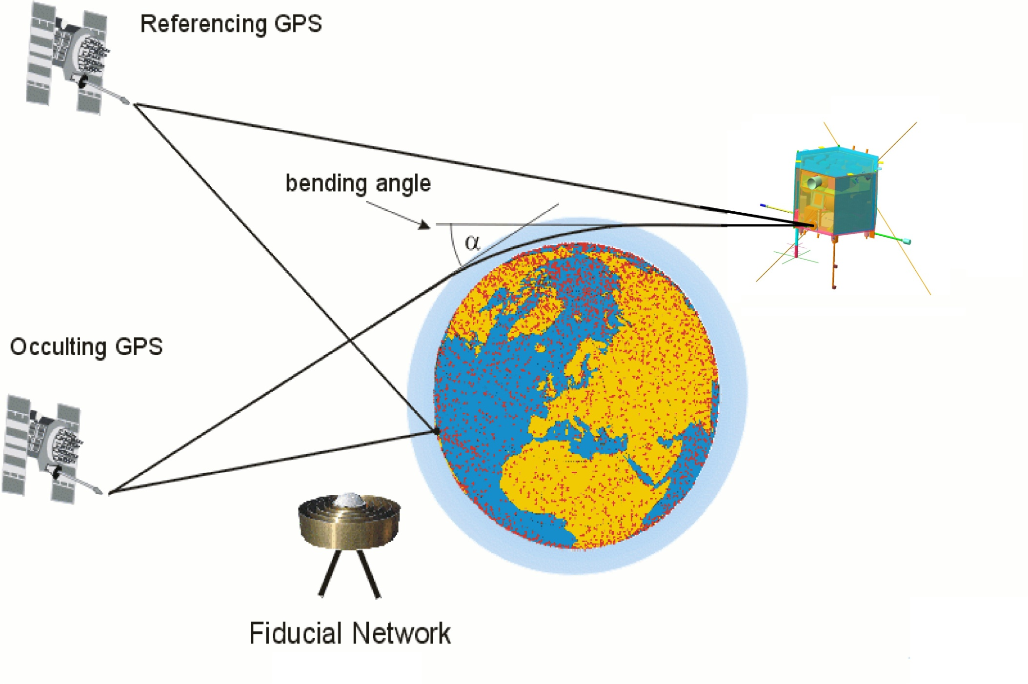
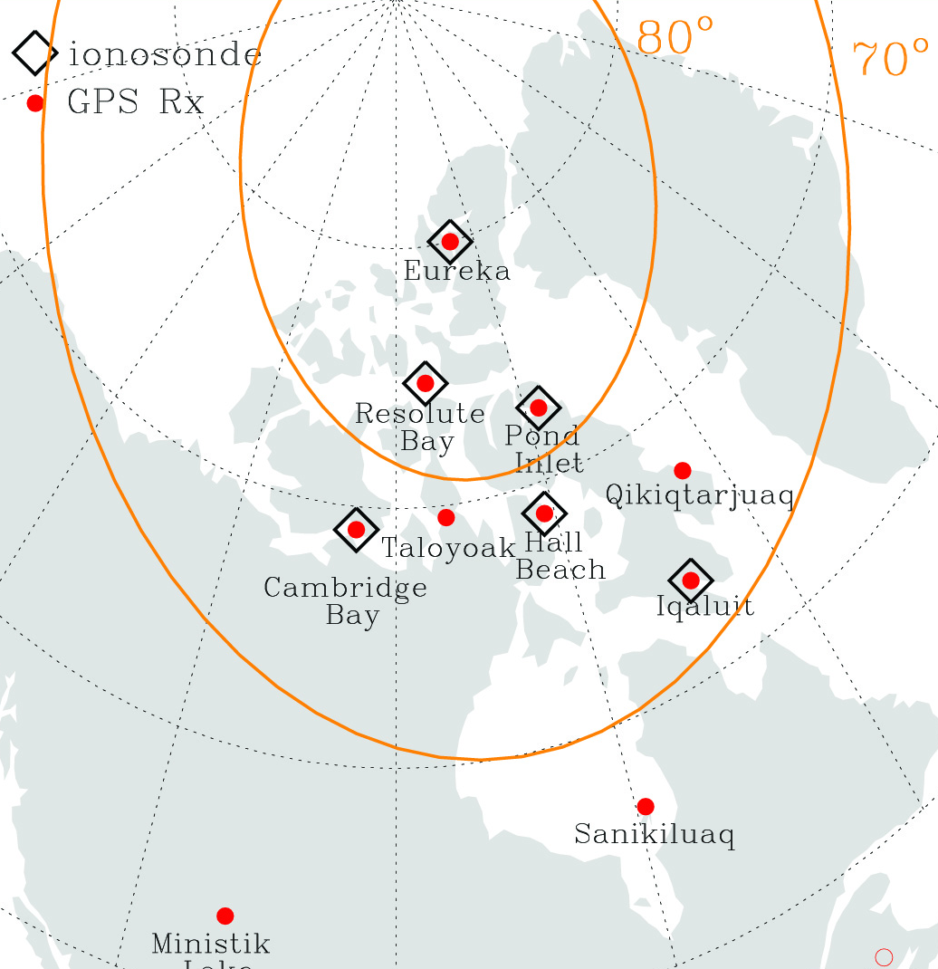
GPS spaceborne-limb and vertical sounding
e-POP/GAP
A GPS satellite occulted by Earth’s atmosphere and refracting the L-band waves
Plasma density distribution in dispersive medium affects wave phase and amplitude
Motion of both GPS and e-POP results
in “tomographic” sweeping of ionosphere
TEC from CHAIN and other ground receivers
yields density variation in horizontal direction
CHAIN
(Illustration adapted from graphic provided by GFZ)

Slide 8
ePOP
Scintillation Measurements for HAARP Operation
CASSIOPE Orbit
Vel ~ 9 km/s; T_{o} ~ 12 - 15 s
Field-aligned
Striations, δn/n
~ 10 km
~ 100 km
250 to 350 km
B_{o}
CERTO Receivers
HF Transmitter
VHF
UHF
L-Band
Amplitude (dB)
Signal Dropouts
-10 dB
-1 dB
-30 dB
Distance (km)

Slide 9
E-POP Radio Receiver Instrument Science
Artificial Waves, 1 kHz - 18 MHz:
Measure the electric fields of waves created by ground transmitters, such as ionosondes, HF radars and ionospheric heaters. These transionospheric propagation experiments will investigate:
a) the dynamics of density structure and the metrology of coherent scatter from it, and
b) the nonlinear plasma physics of the HF-modified ionosphere.
Spontaneous waves, 10 Hz - 3 MHz:
Measure the electric fields of spontaneous waves, for scientific objectives of understanding spontaneous radio emissions of the ionosphere and magnetosphere. These measurements will be made in concert with onboard particle detectors and other space and ground facilities.

Slide 10
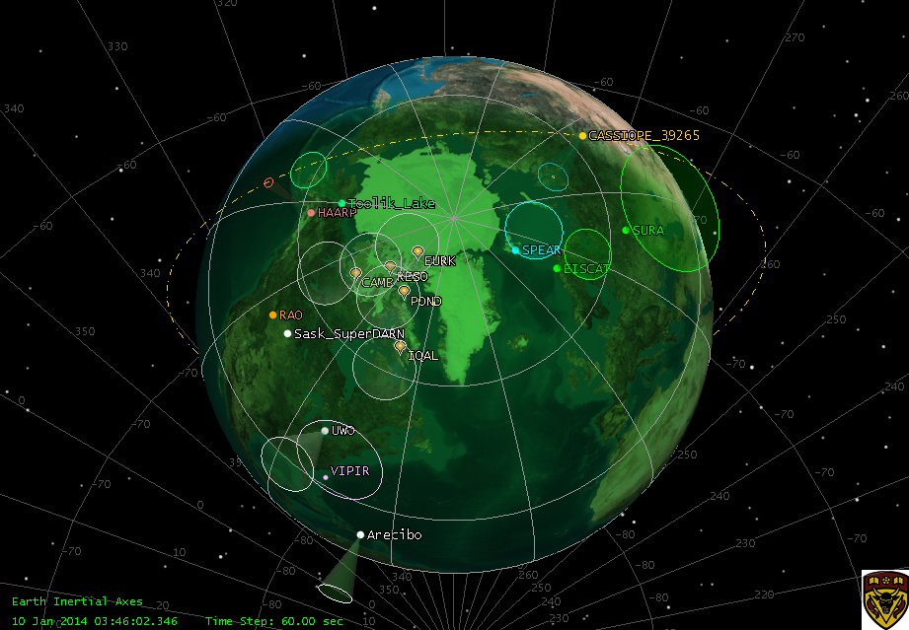
Some radio-science targets
see targets.doc

Slide 11
Artificial Waves in Transionospheric Propagation

Slide 12
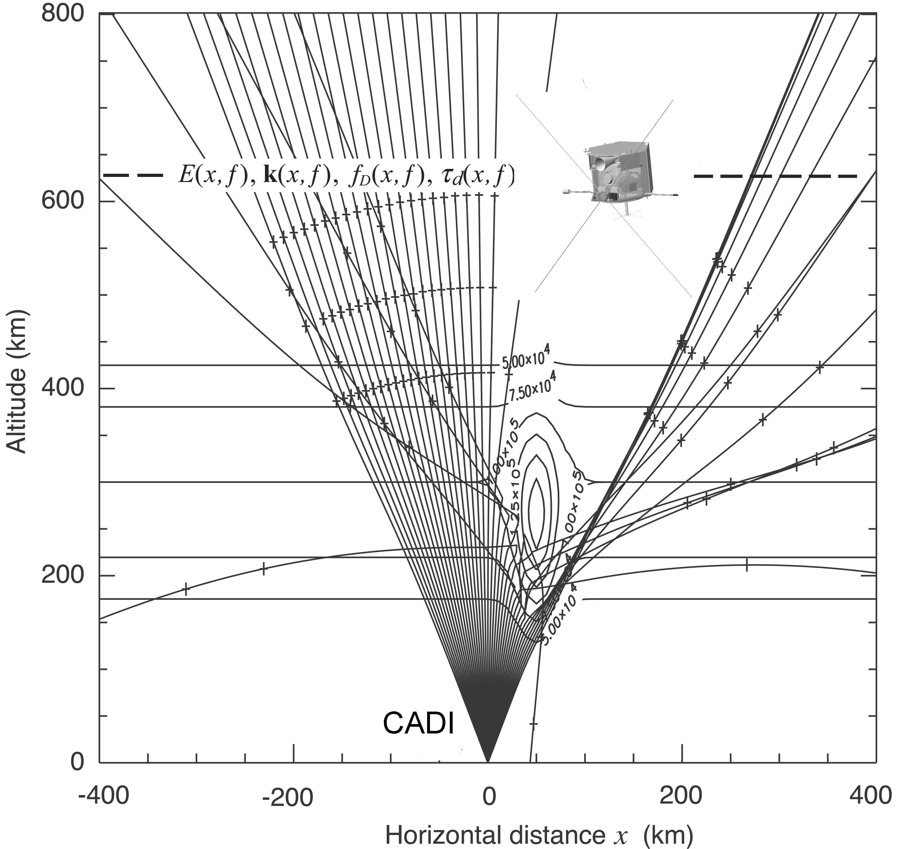

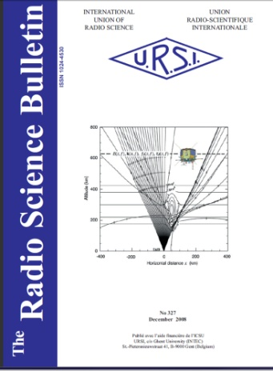
ePOP/RRI imaging using transionospheric HF propagation
History during
pass of wave
parameters shows
variations in:
Amplitude, DOA,
Doppler shift
and time delay

Slide 13
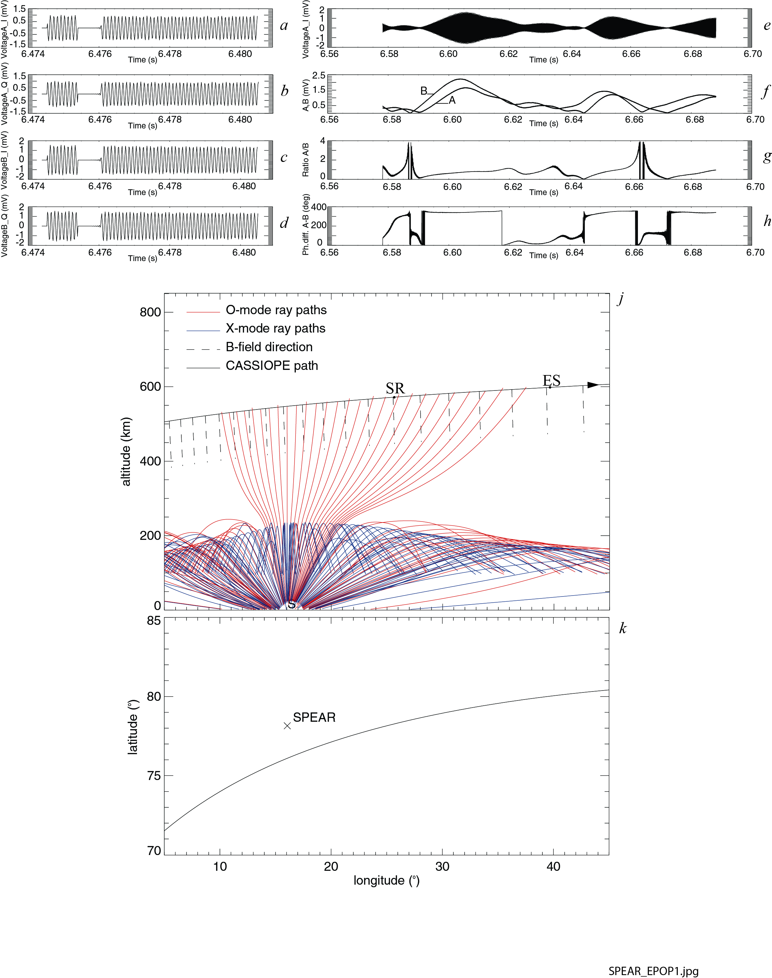
SPEAR transionospheric propagation
Transionospheric propagation on 2013/11/17 from SPEAR, Svalbard
f = 4.45 MHz
foF2 = 3.90 MHz from dynasonde
fxF2 ≈ 4.6 MHz
3D ray tracing shows that only O-mode arrives at satellite. Then cold plasma theoretical polarization allows incident wave normal direction to be determined.
Hope to investigate imaging of density structure using direction, amplitude, delay and Doppler.
3D IDL ray equations (Haselgrove).

Slide 14
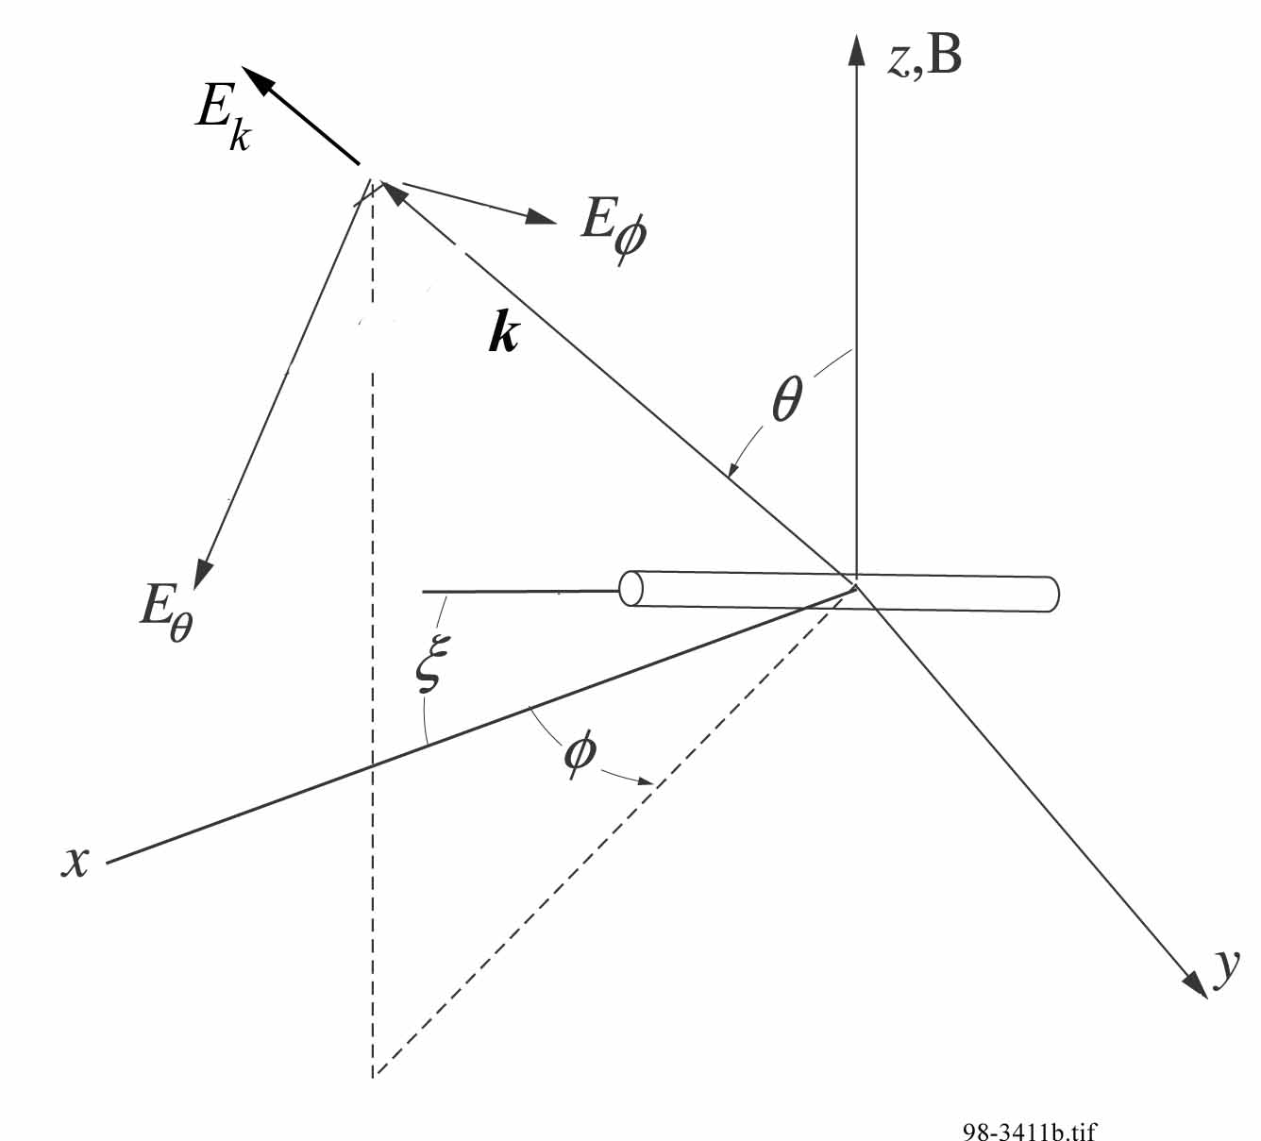
Direction of Arrival (DOA)
For a given propagation direction and cold plasma parameters, the wave electric field amplitudes are in the ratio:
Excluding the time dependence, the total E vector
In B-k space can be written
The open-circuit voltage V_{oc-i} induced on a dipole “i " of effective-length L_{eff-i} by E is
V_{oc-i} = E ∙ L _{eff-i} .
With RRI dipoles 1 and 2 along the y and z axes of CASSIOPE, the induced voltages are
V_{oc-1} = 3E_{y} exp(2πift) and V_{oc-2} = 3E_{z}exp(2πift),

Slide 15
Wave vector direction
E) Apply two metrics: relative amplitude and phase of V_{oc-1} and V_{oc-2}
R ≡ |V_{oc-1}|/ |V_{oc-2}| ; R_{obs} = (I1² + Q1²)^{1/2} / (I3² + Q3²)^{1/2}, and
Φ ≡ Arg(V_{oc-1}) − Arg(V_{oc-2}); Φ_{obs} = arctan(Q1/I1) − arctan(Q3/I3).
F) To determine the direction θ, ϕ of propagation, search the θ, ϕ plane for solutions of F_{d} =[R_{obs} − R( θ, ϕ)] [Φ_{obs} − Φ(θ, ϕ)]= 0.
G) With A), transform θ, ϕ to up, south, east coordinates.

Slide 16
d2
Up
k
d1
South
East
E
k, E - field polarisation ill suited for direction determination

Slide 17
Backscattered Artificial Waves
Paper on SuperDARN to follow: Hussey

Slide 18
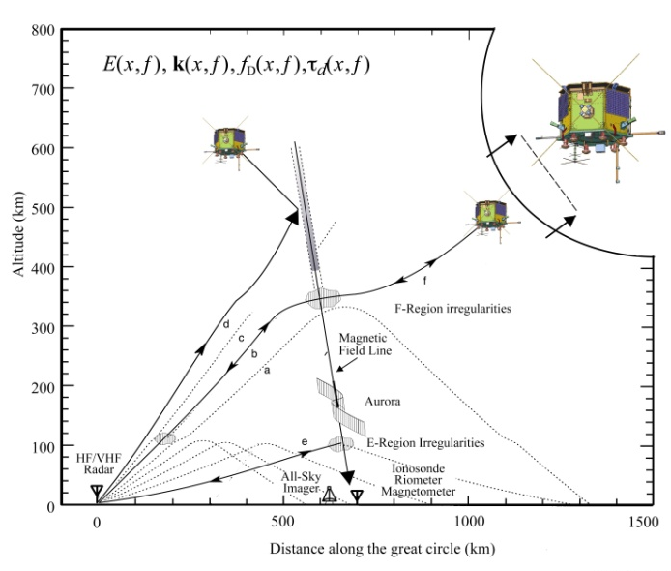
SuperDARN – e-POP Propagation Experiments with Radio Receiver Instrument
e-POP
receiver
Effects of E/F-region density irregularities on trans-ionospheric propagation
Observation of coherent HF backscatter from small-scale structure
Explore angular dependence of scatter mechanism
Ionospheric
Irregularities
HF
Radar
Notes:
The radio wave propagation study on e-POP will enable us to gain new perspectives on E and F-region density irregularities, by comparing SuperDARN and CADI measurements on the ground with simultaneous measurements on e-POP.
The radio receiver instrument onboard will measure the electric field strength, direction of arrival, Doppler shift and signal delay of refracted waves as a function of wave frequency and the e-POP orbital position. The measurements will then be inverted mathematically to infer the two- or three-dimensional shape of the refracting structure.
The RRI will also measure coherent backscatter from small-scale structure, in coordination with SuperDARN.
The RRI measurements will allow us to search for instances of oblique scatter that can be correlated with the ground measurements.
The measured angular spectrum of scatter will allow us to test the concept of coherent backscatter mechanism.

Slide 19
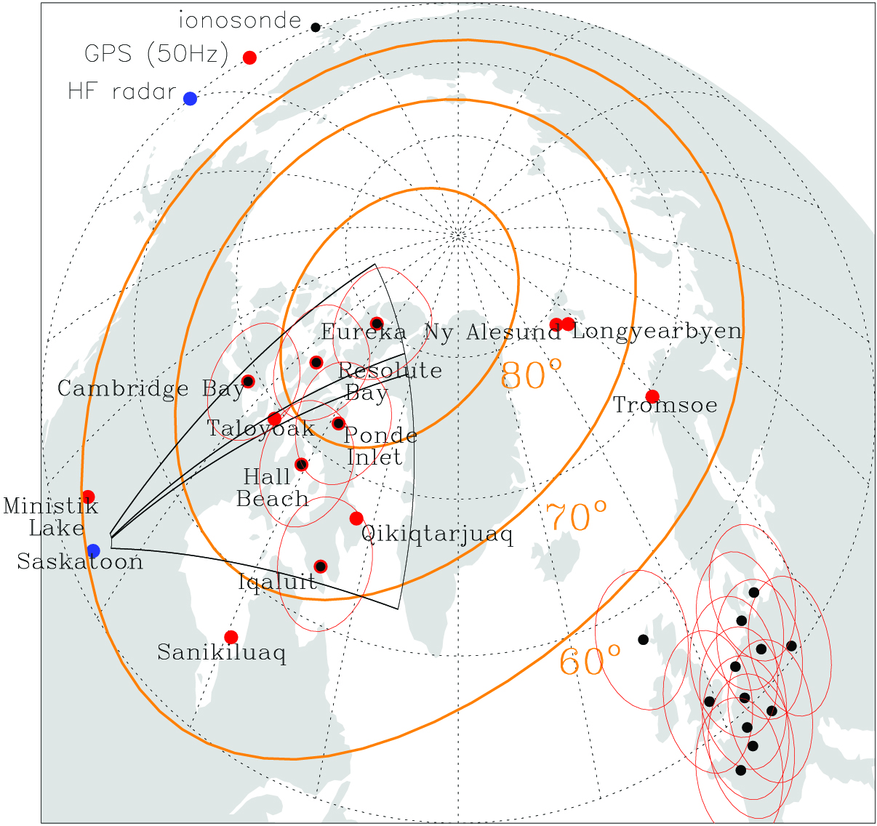
SuperDARN
Azimuthal Resolution

Slide 20
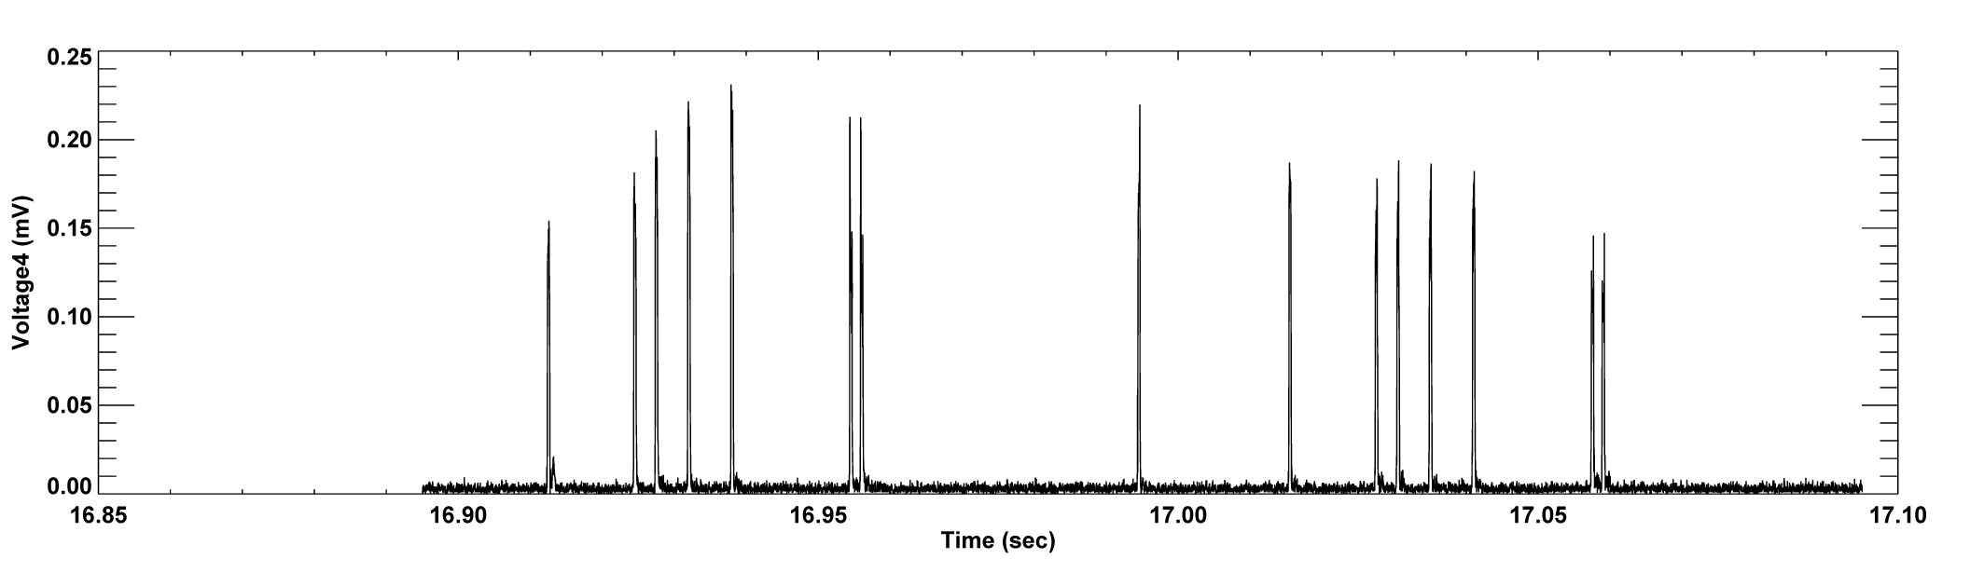
SuperDARN Saskatoon Pulse Train
2013_11_07 23:32:58

Slide 21
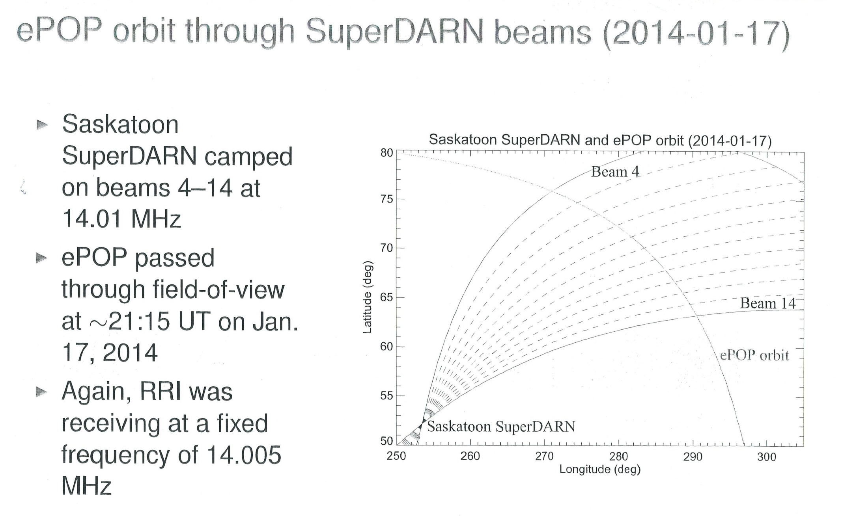

Slide 22
Artificial Waves from Ionospheric Heaters

Slide 23
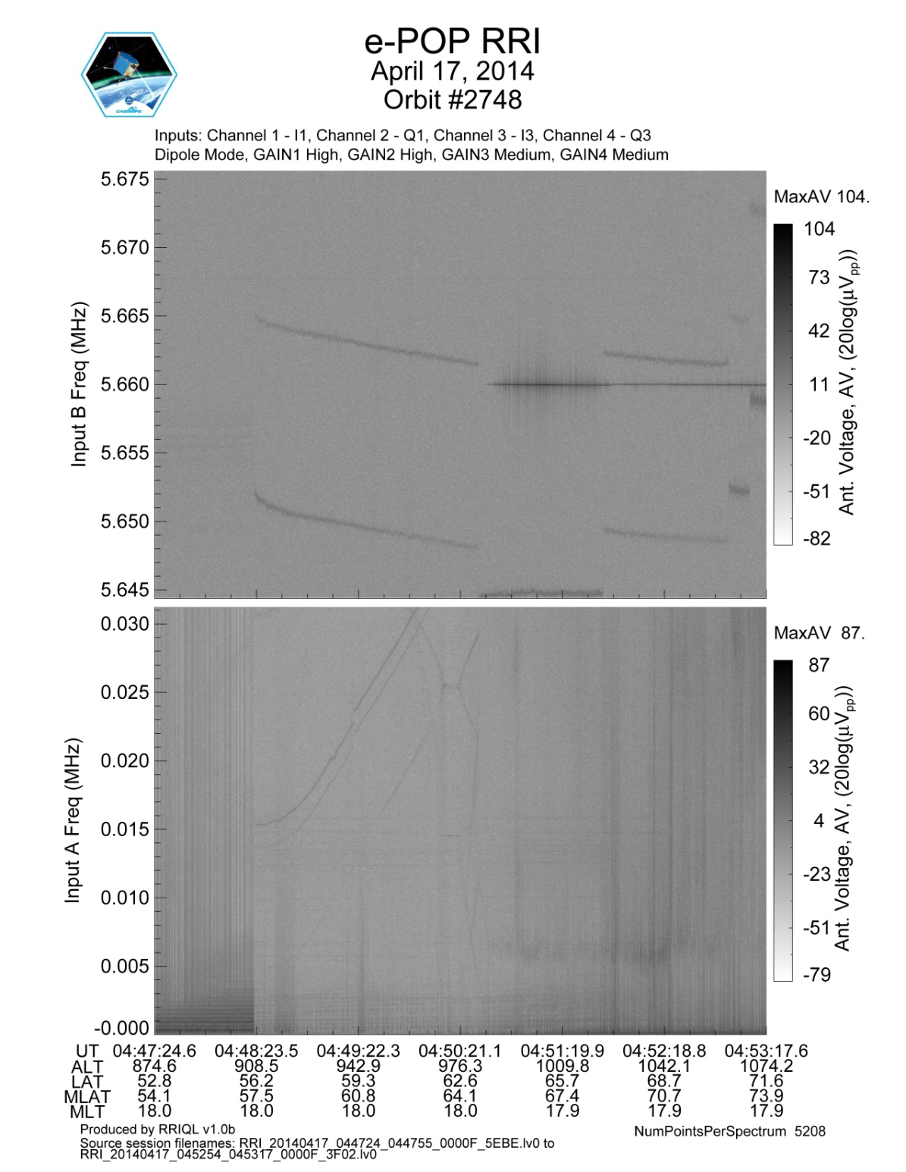
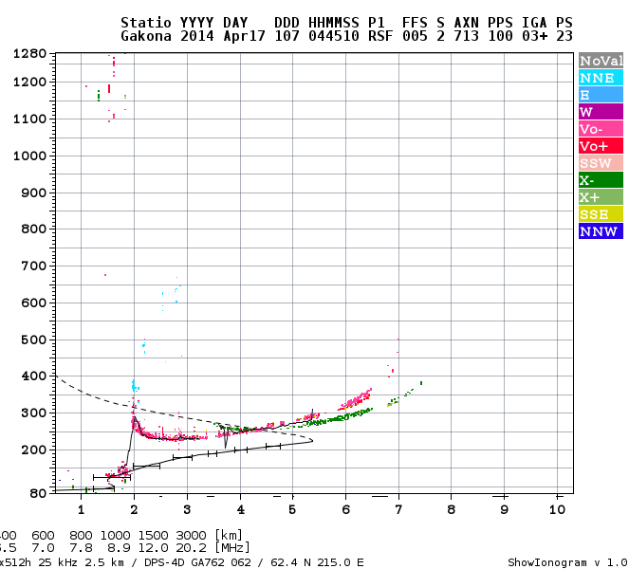
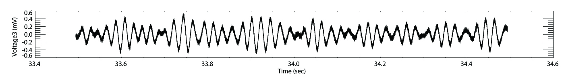
f
HAARP
MHz
5.66 MHz
04:51:33
f_{LHR} = 6 kHz f_{pe} = 270 kHz (H⁺, e⁻)

Slide 24
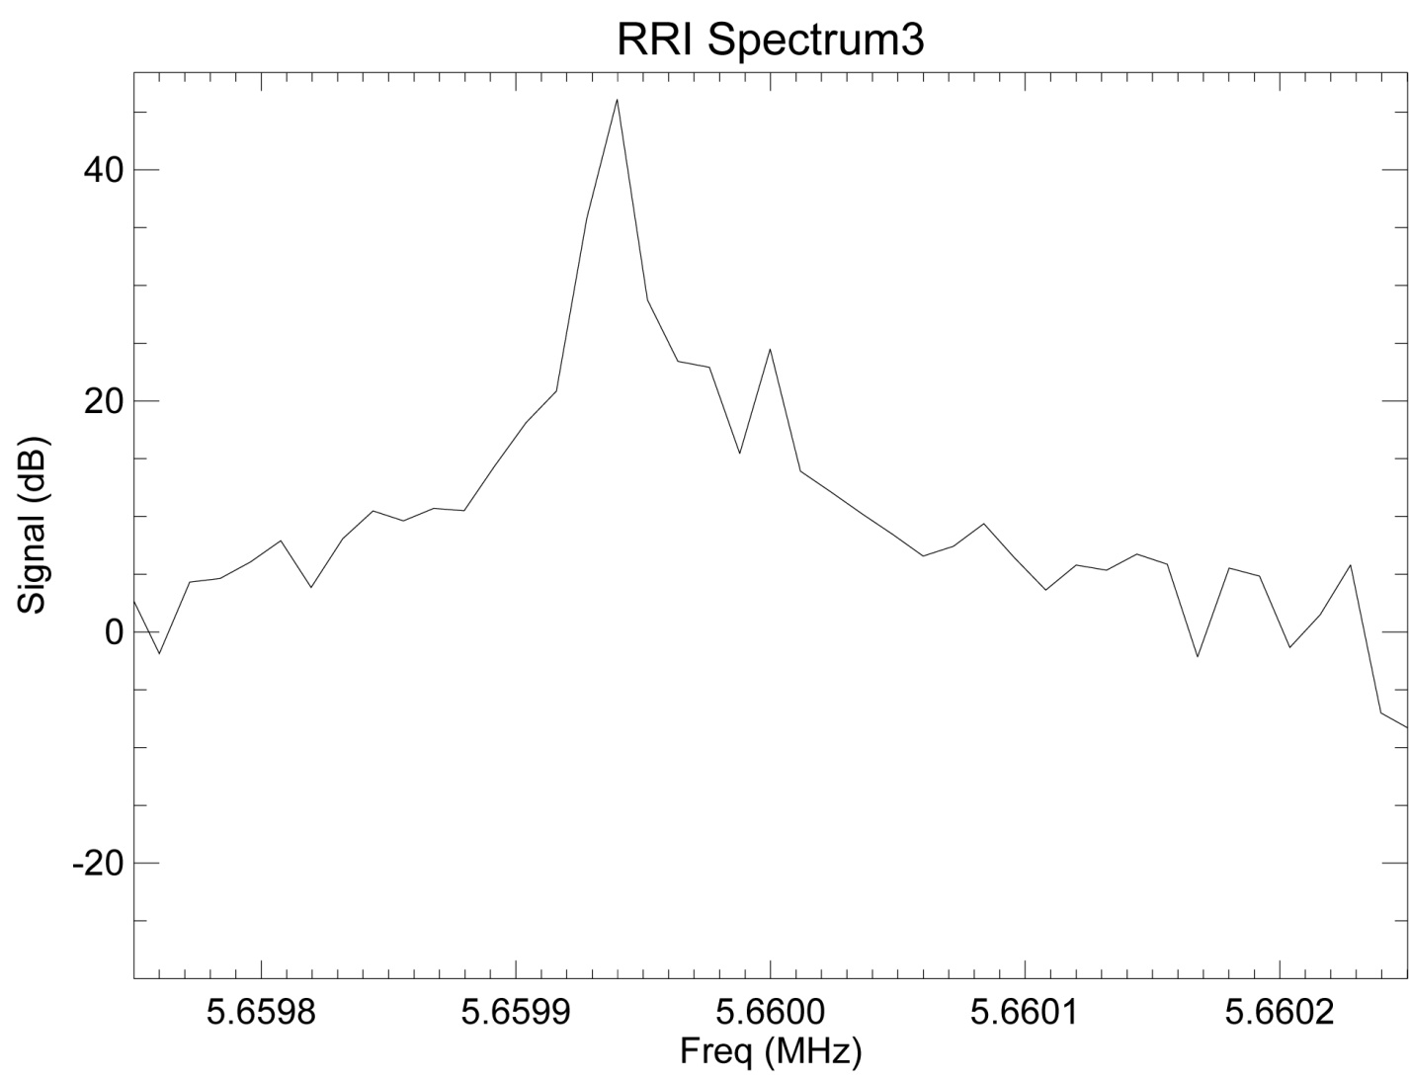
Doppler frequency shift and amplitude, 04:51:33
Volts (dBμV)
v_{s} = 7288 m s⁻¹
f₀ = 5.660 MHz
angkvel = 60.48°
f₀

Slide 25
-B₀
Up
36°
k
South
East

Slide 26
Spontaneous Waves in the Auroral Zone
Results from the ePOP Suprathermal Electron Imager to
follow: Knudsen

Slide 27
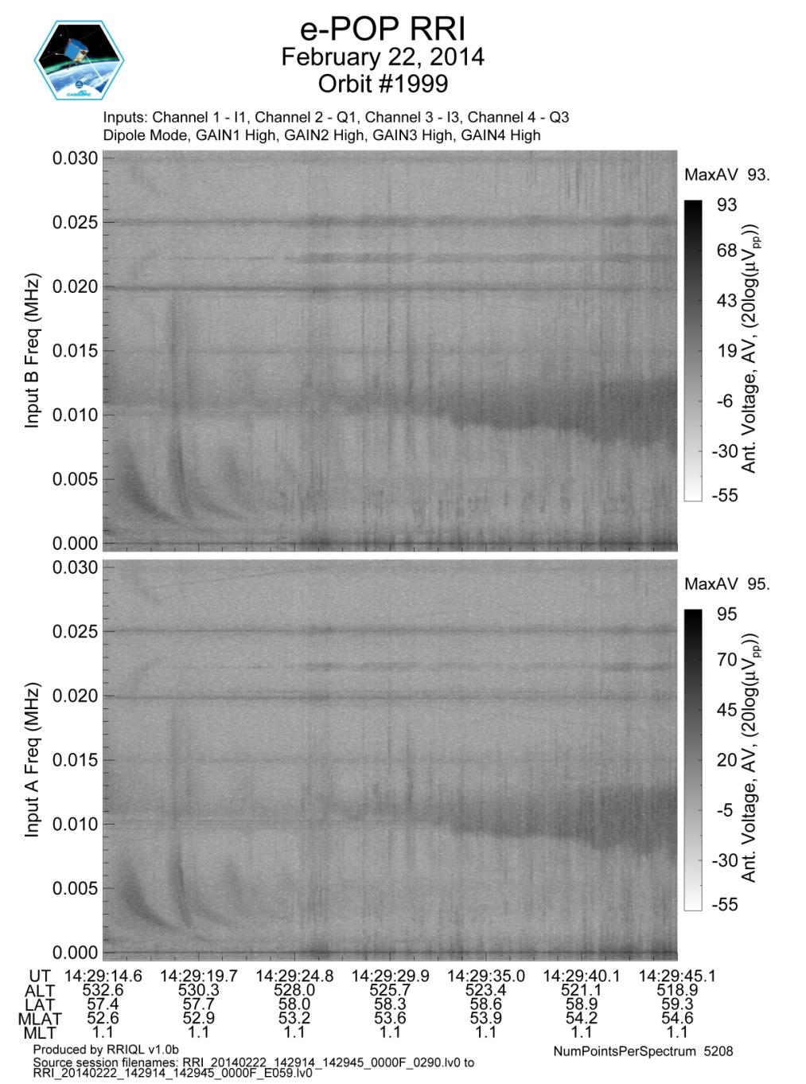
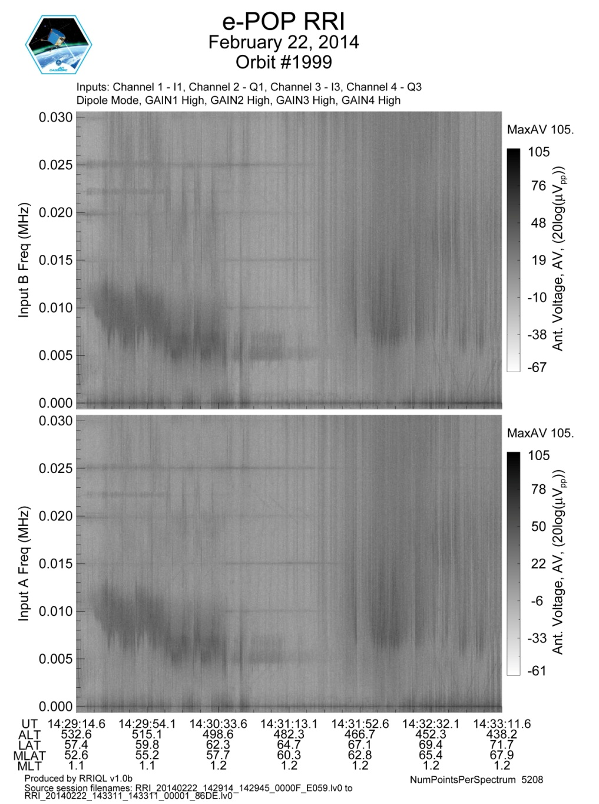
Auroral zone wave emissions

Slide 28
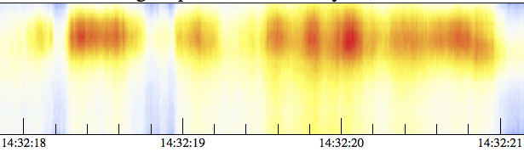
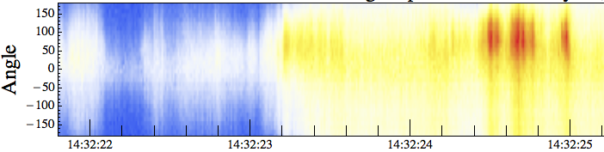
Auroral zone wave emissions
15 kHz
0

Slide 29
Concluding Remarks
e-POP instruments produce interesting, novel data.
Data are being deposited in the Canadian Space Science Data Portal, managed by U. Alberta.
Cascade wide band telemetry not available.
S band limitations require close coordination by eSOC, SIC and Science Team of operations.
CSA funding available until May 2015; negotiations under way for beyond.

