Slide 1
No stone left unturned?
Searches for Physics Beyond the Standard Model at the ATLAS experiment
W. Fedorko
University of British Columbia

Slide 2
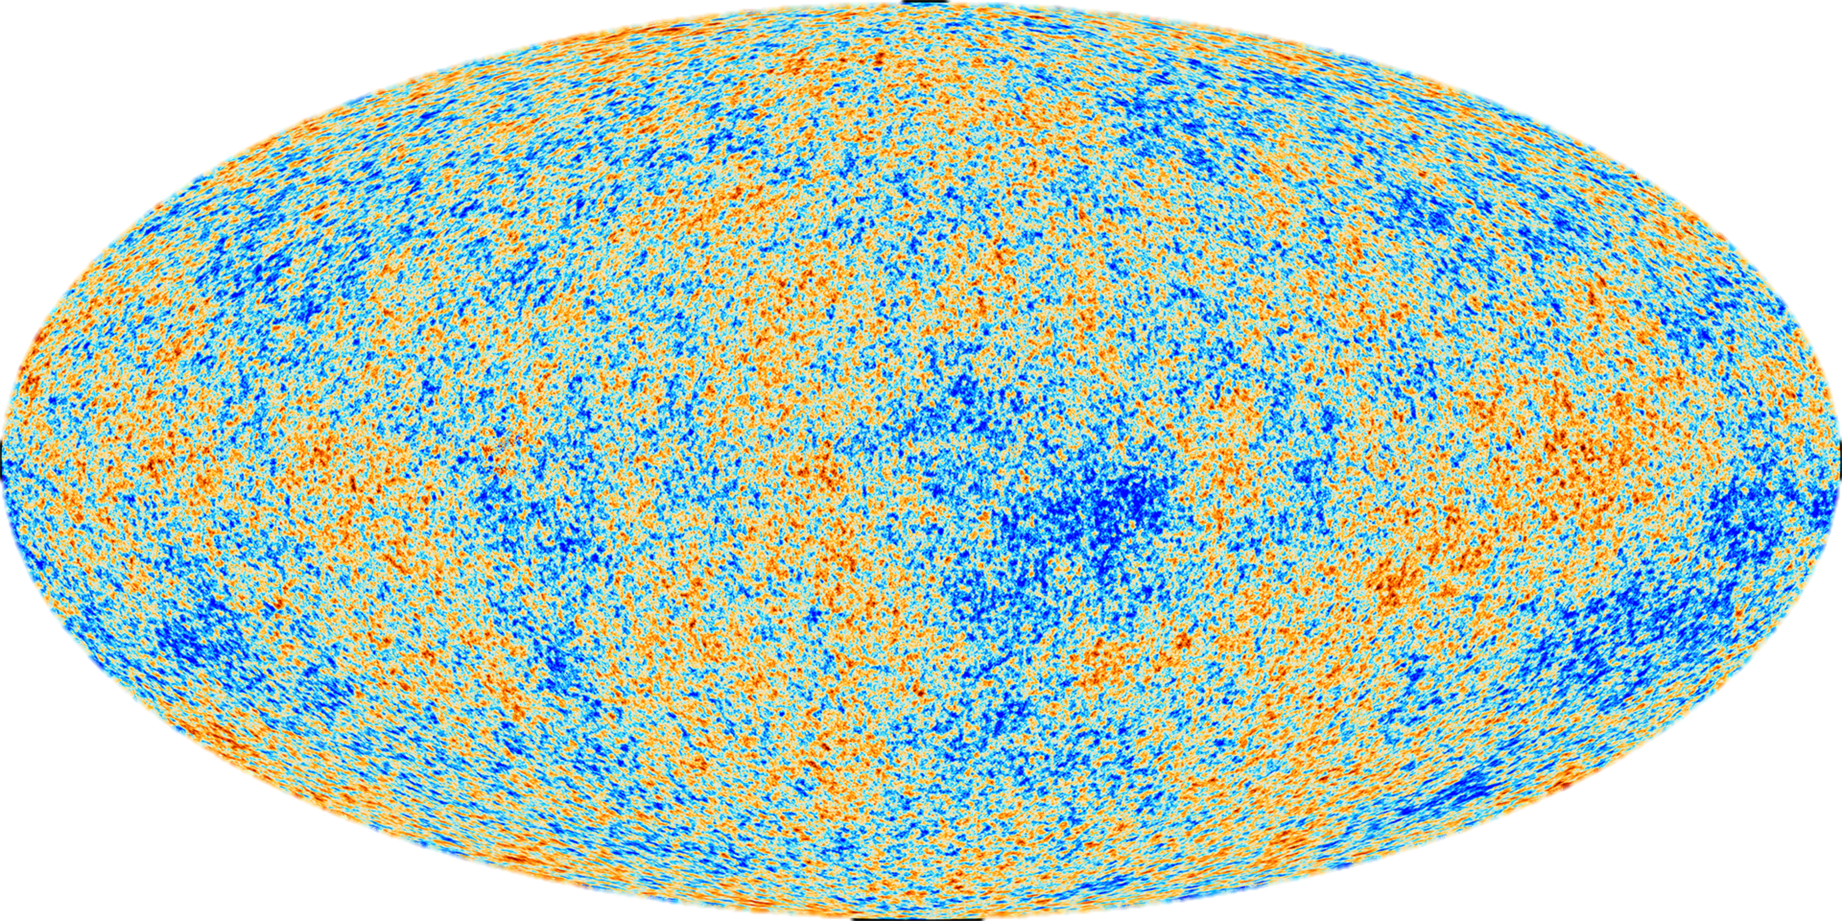

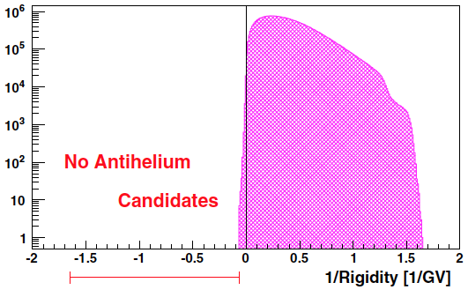
Big open questions
What is Dark Matter?
What is Dark Energy?
(ESA/Planck)
What happened to anti-matter?
Why is gravity so weak?
Why is Higgs so light?
PRL 108, 131301 (2012)
BESS-Polar II
NASA CXC, STScI- Magellan/U.Arizona; ESO WFI.

Slide 3
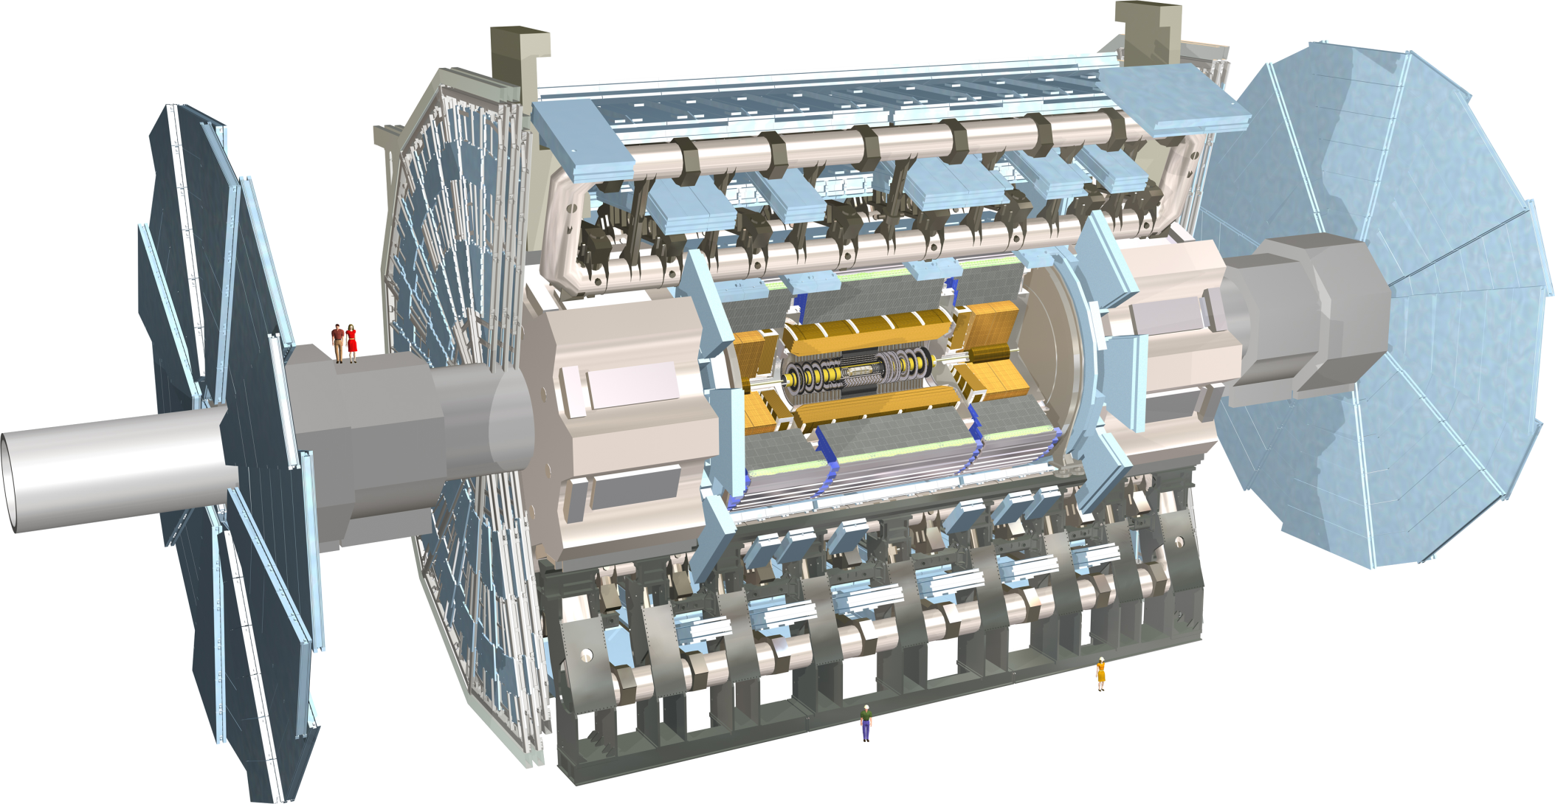
LHC + ATLAS: searching for surprises
In this talk: Searches for (non-SUSY) New Physics
Simple final states to more complex

Slide 4
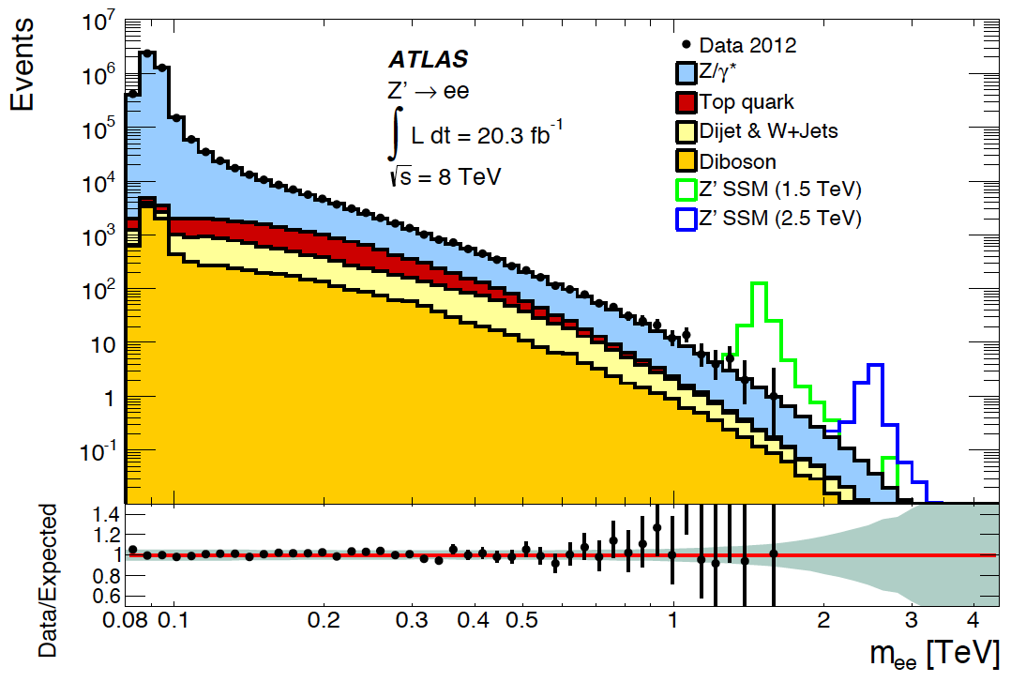
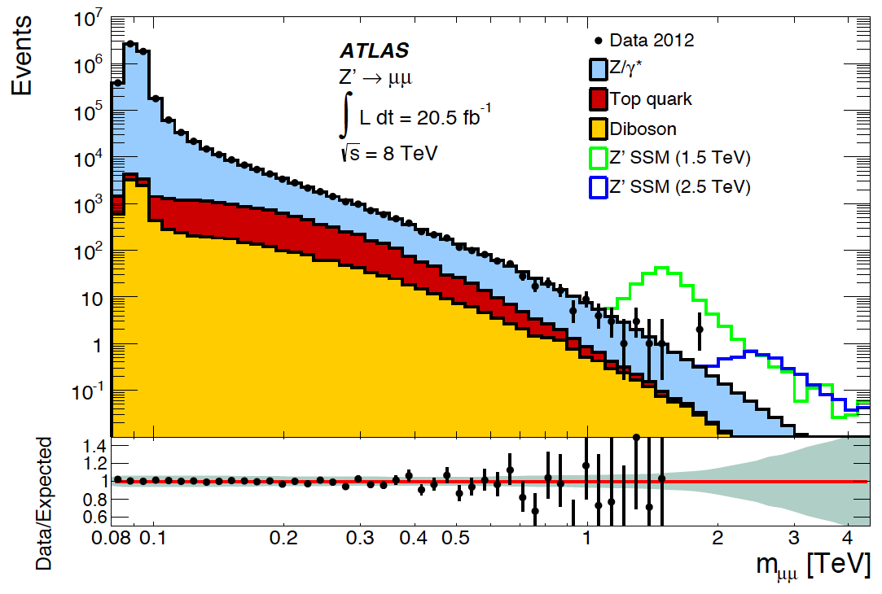
Dilepton Resonance Search
arXiv:1405.4123
q
l⁻
Z’
_
Di-electrons channel
  Leading E_{T} > 40 GeV, Sub-leading E_{T} > 30 GeV, both isolated
Di-muon channel
  p_{T} > 25 GeV, isolated
  High p_{T} quality cuts
  Opposite sign
q
l⁺

Slide 5
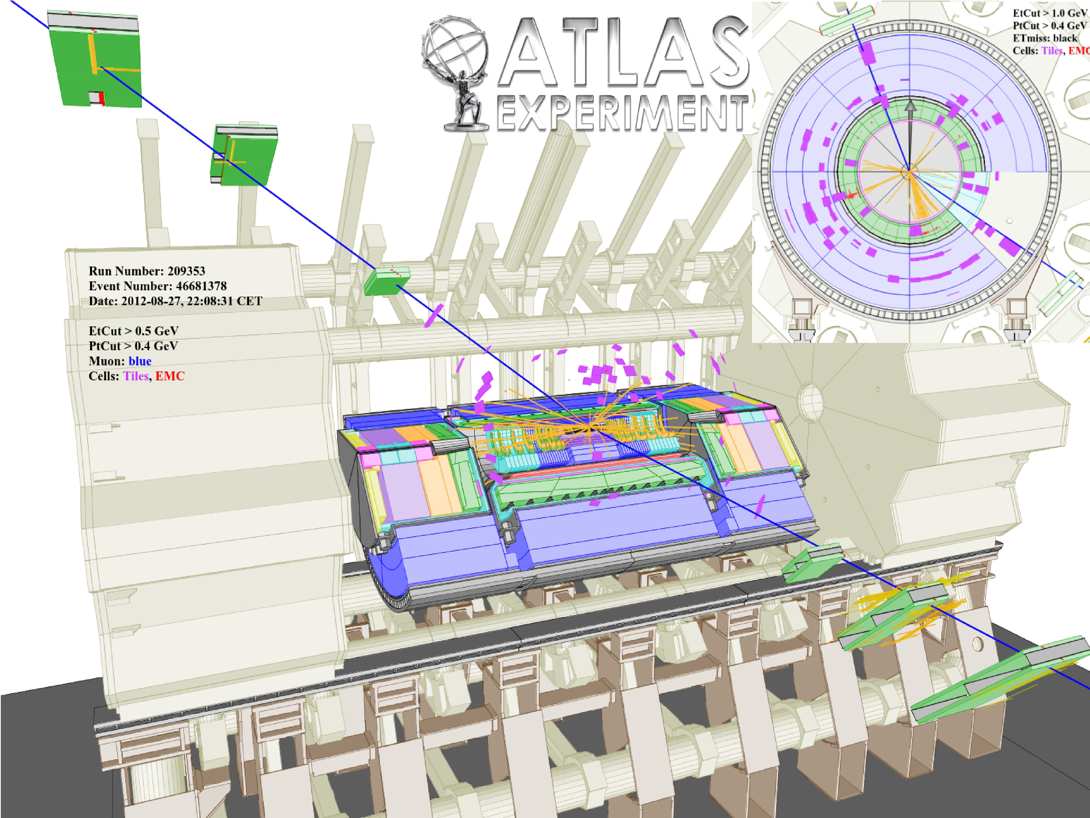

Slide 6
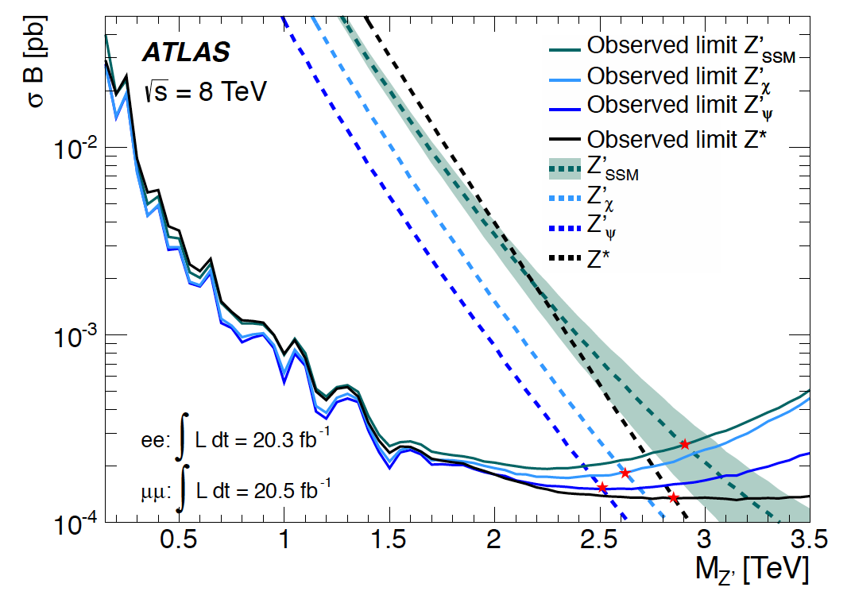
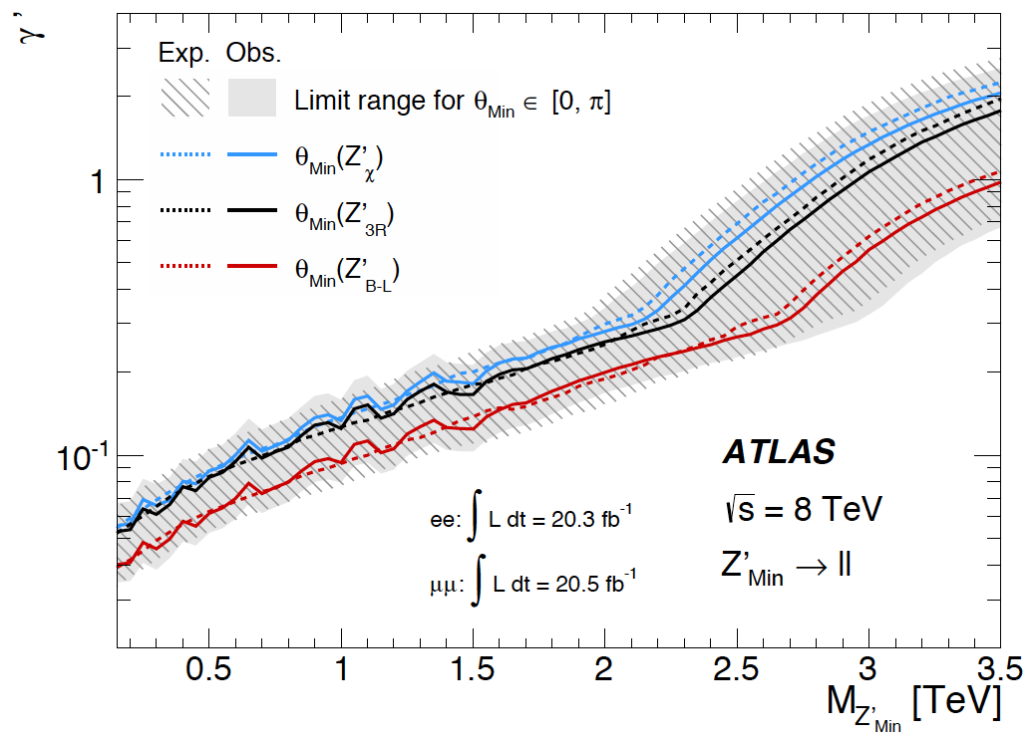
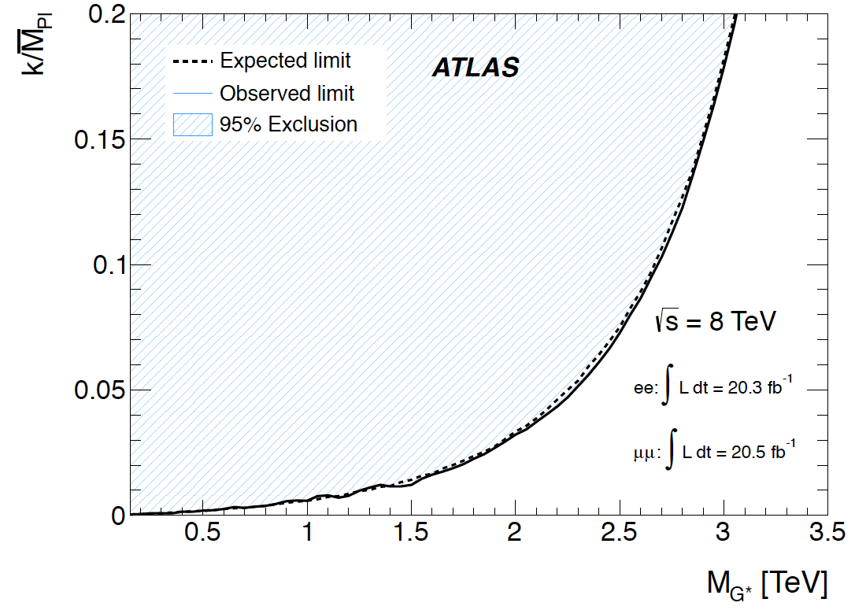
Dilepton Resonance Search: interpretation
Model | Expected Limit [TeV] | Observed Limit [TeV]
Z’_{SSM} | 2.87 | 2.90
Z’_{χ} | 2.60 | 2.62
Z’_{ψ} | 2.46 | 2.51
Z* | 2.82 | 2.85
Also interpretations in QBH, MWT

Slide 7
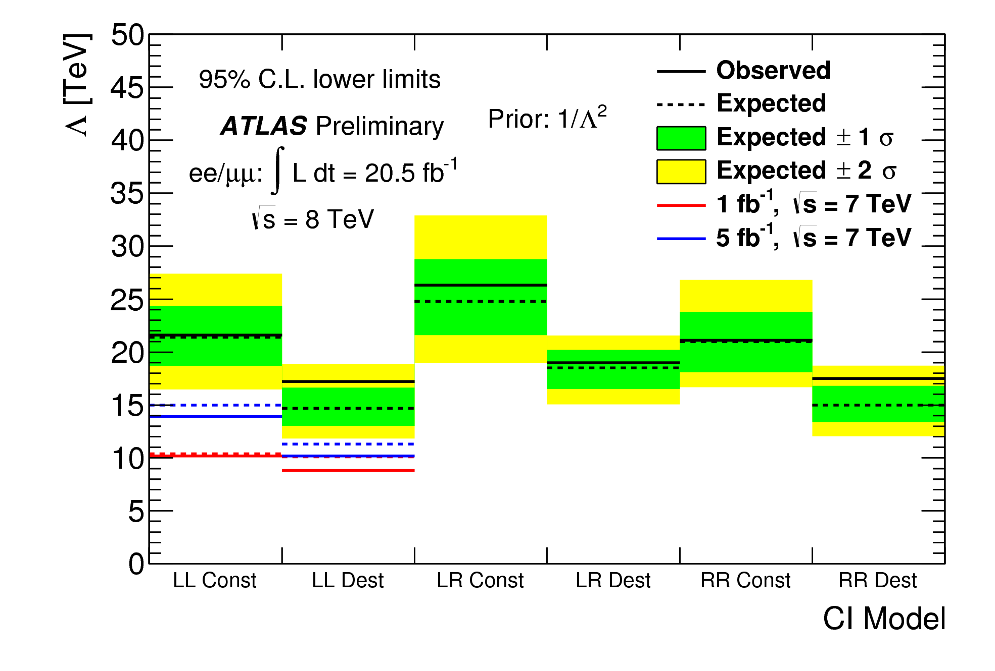
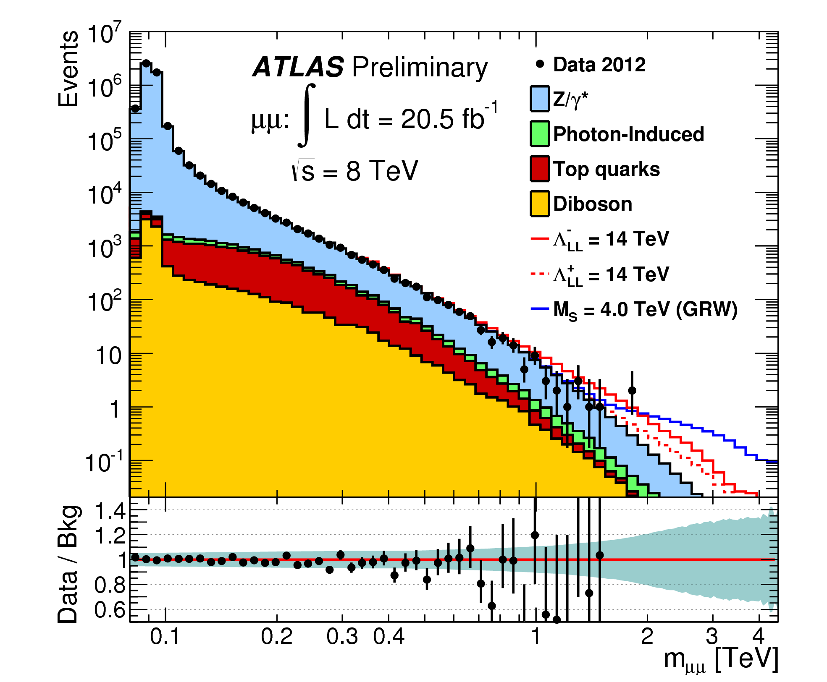
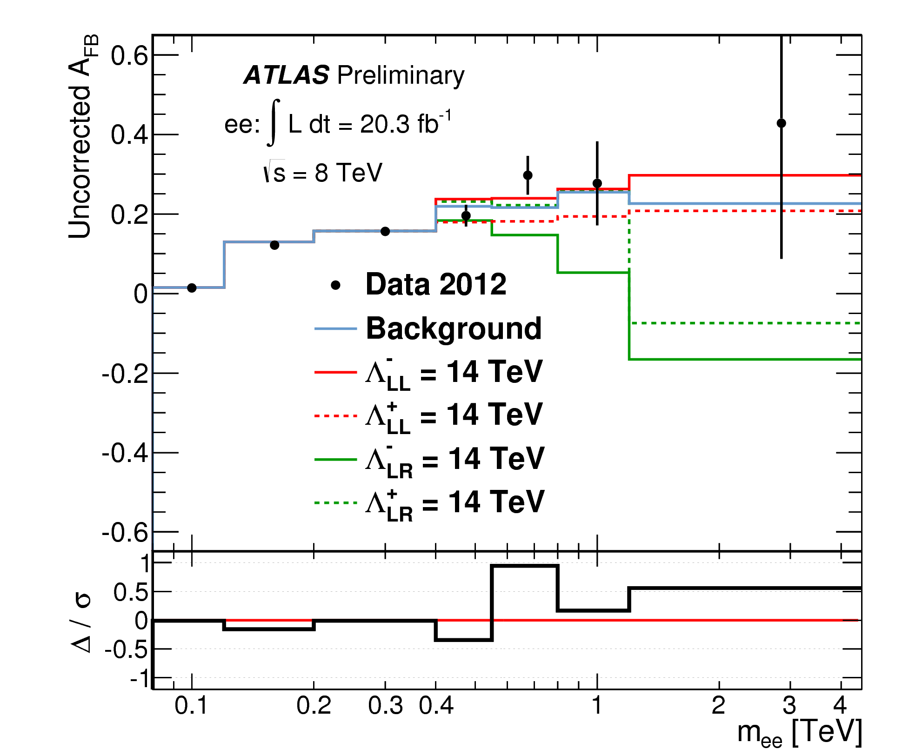
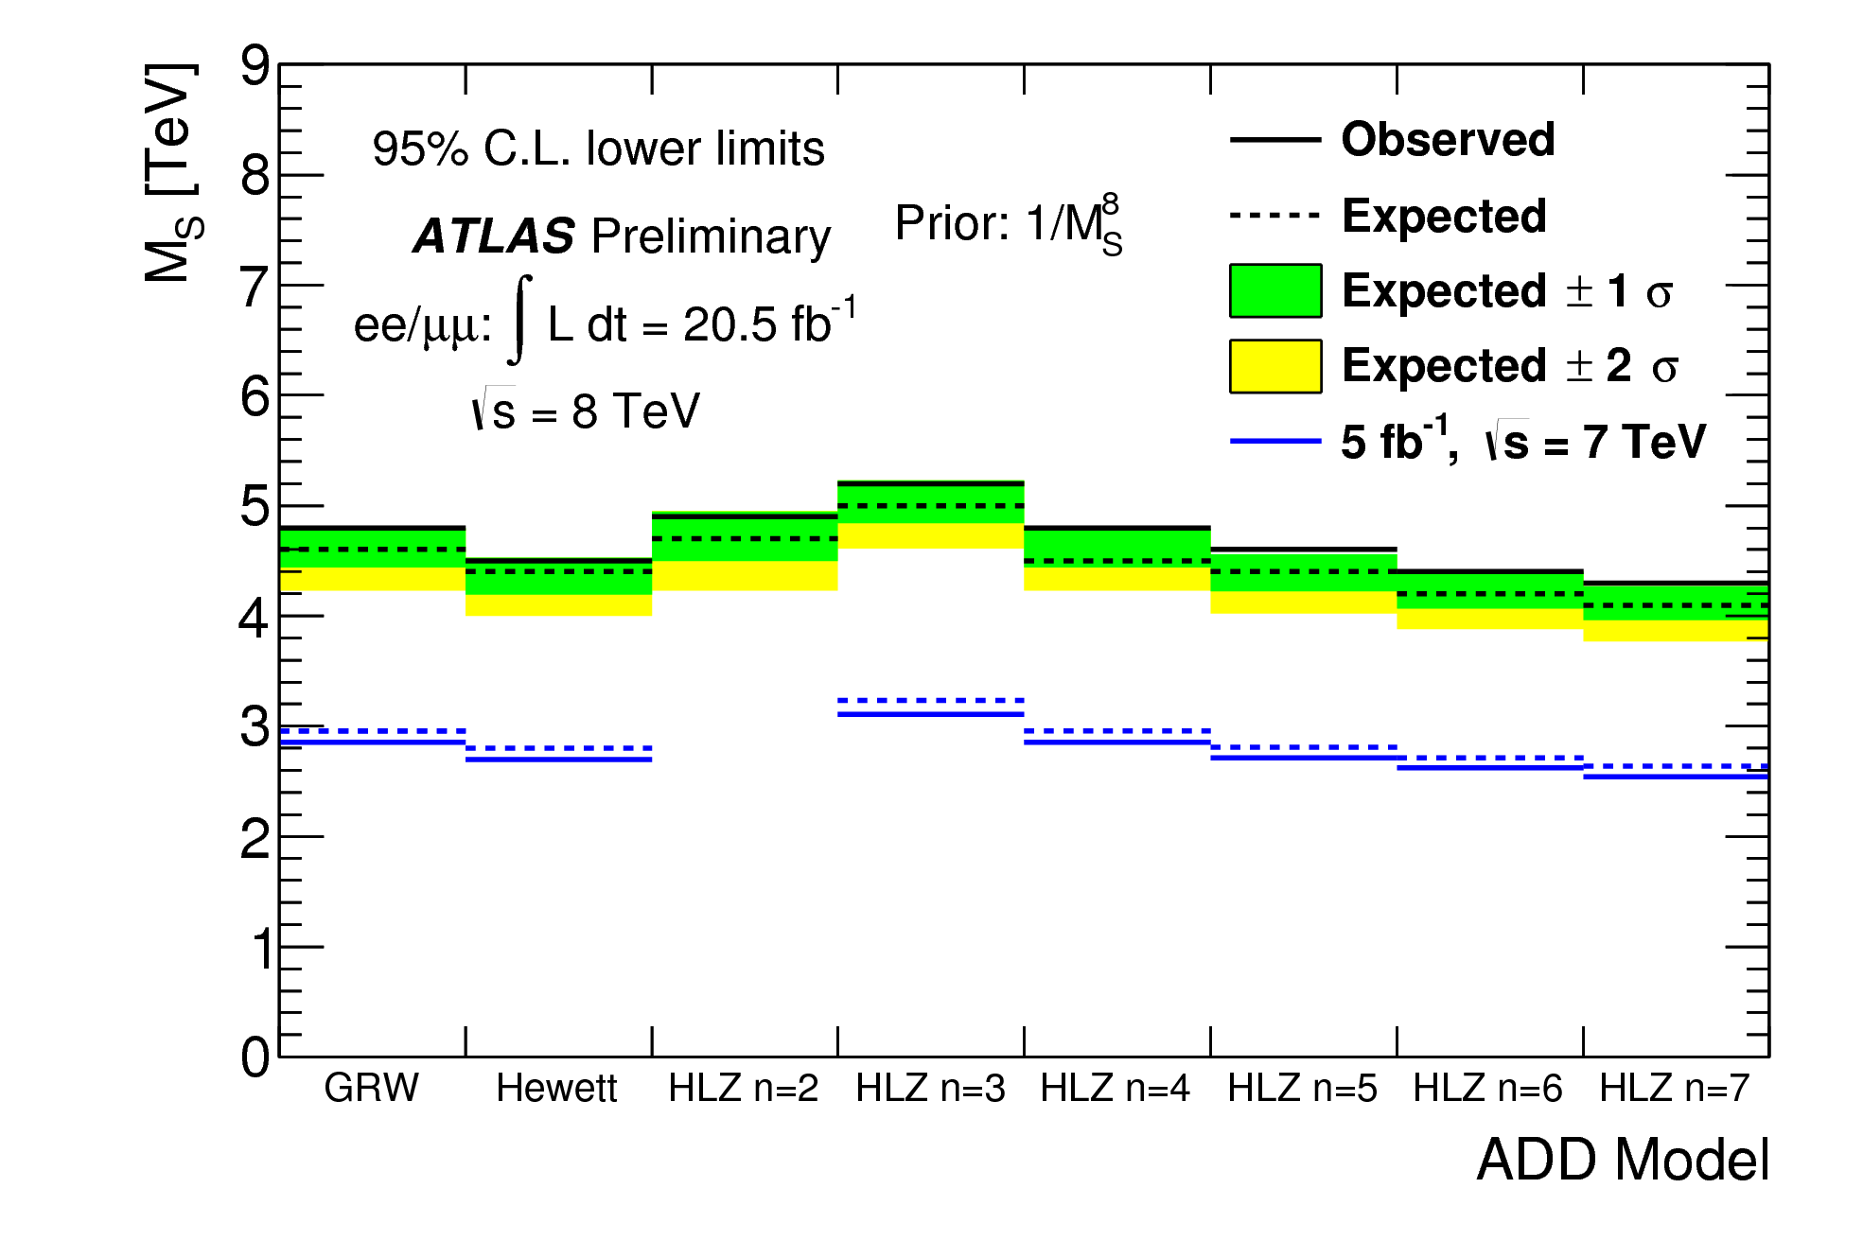
Di-lepton Contact interaction search
ATLAS-CONF-2014-030
q
l⁻
_
~1/λ²
q
l⁺
Re-interpretation in terms of ‘Fermi’ interaction
Opposite sign requirement for e⁺e⁻
cosθ* utilized to improve sensitivity
CI limits set using priors flat in 1/λ² and 1/λ⁴
M_{S} limits set using priors flat in 1/M_{S}⁴ and 1/M_{S}⁸

Slide 8
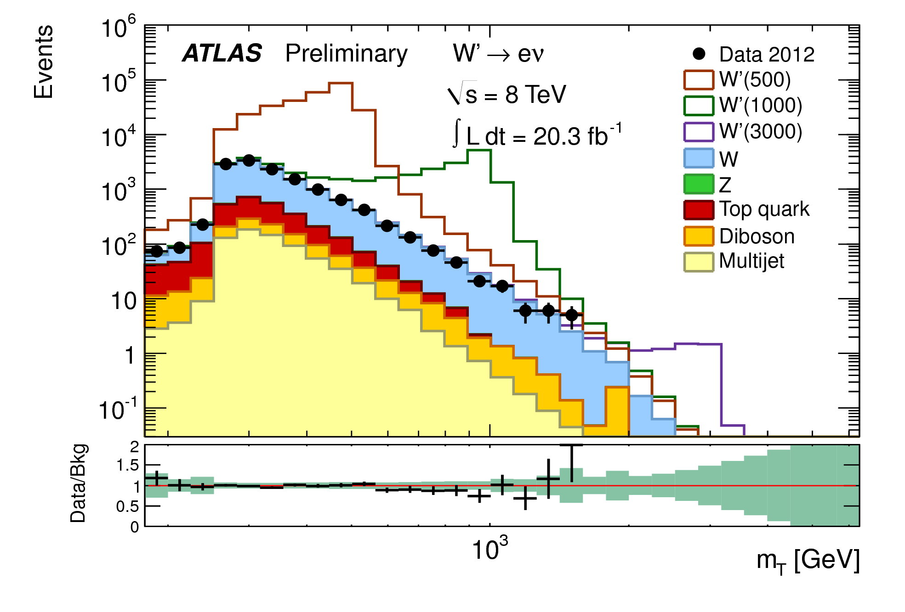
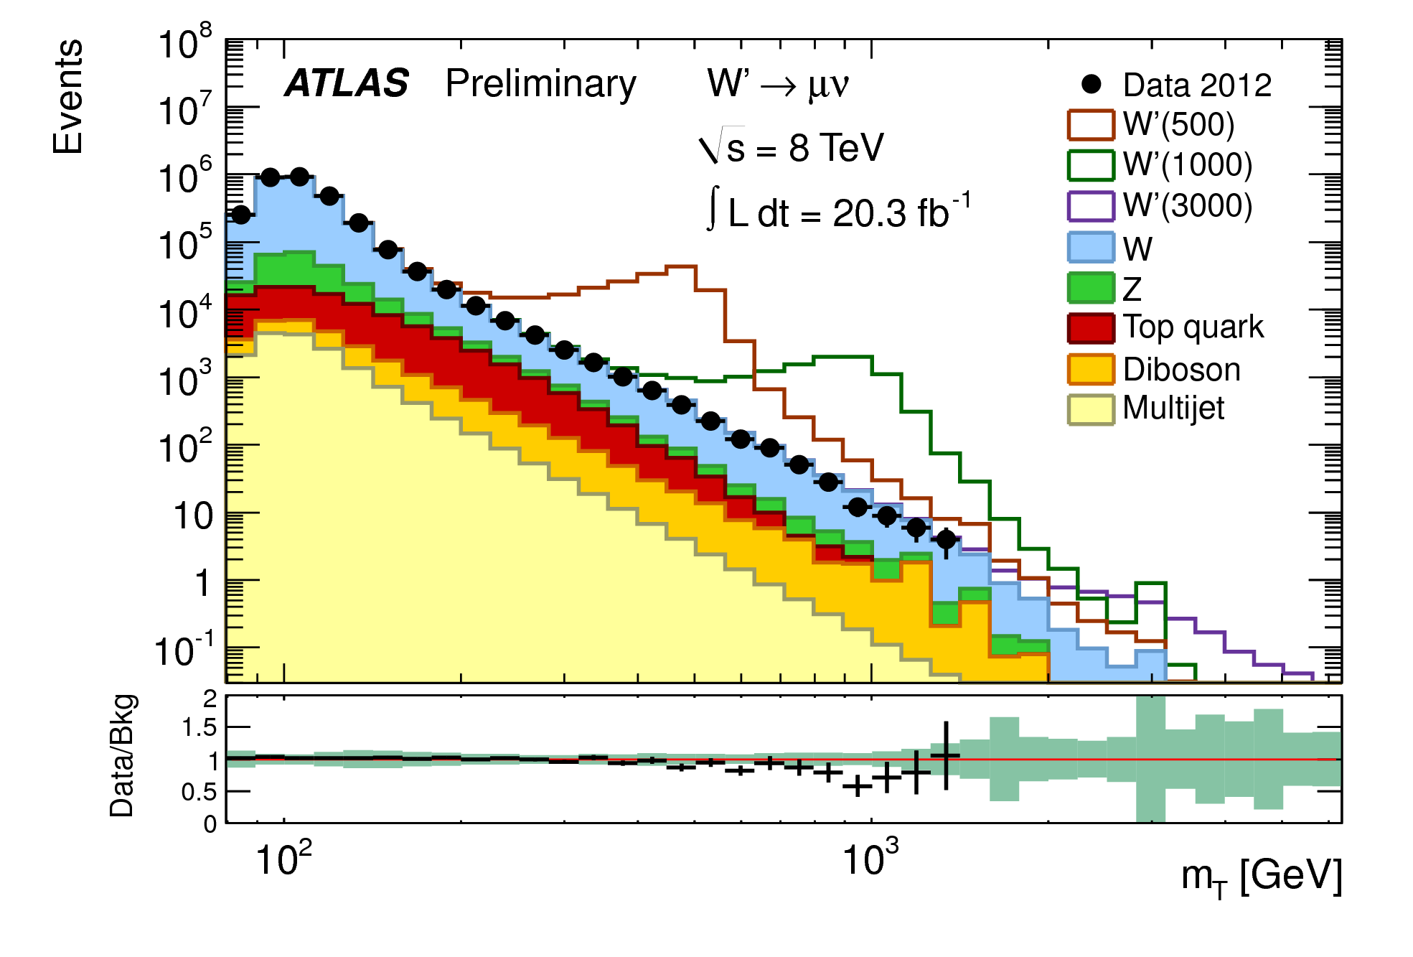
Search in lepton and E_{T}^{miss} final state
ATLAS-CONF-2014-017
q
l
W’
_
_
q'
ν
Electrons:
  E_{T}, E_{T}^{miss}> 125 GeV, isolated
Muons:
  E_{T}, E_{T}^{miss}> 45 GeV, isolated
Optimized m_{T} cut (250-900 GeV)

Slide 9
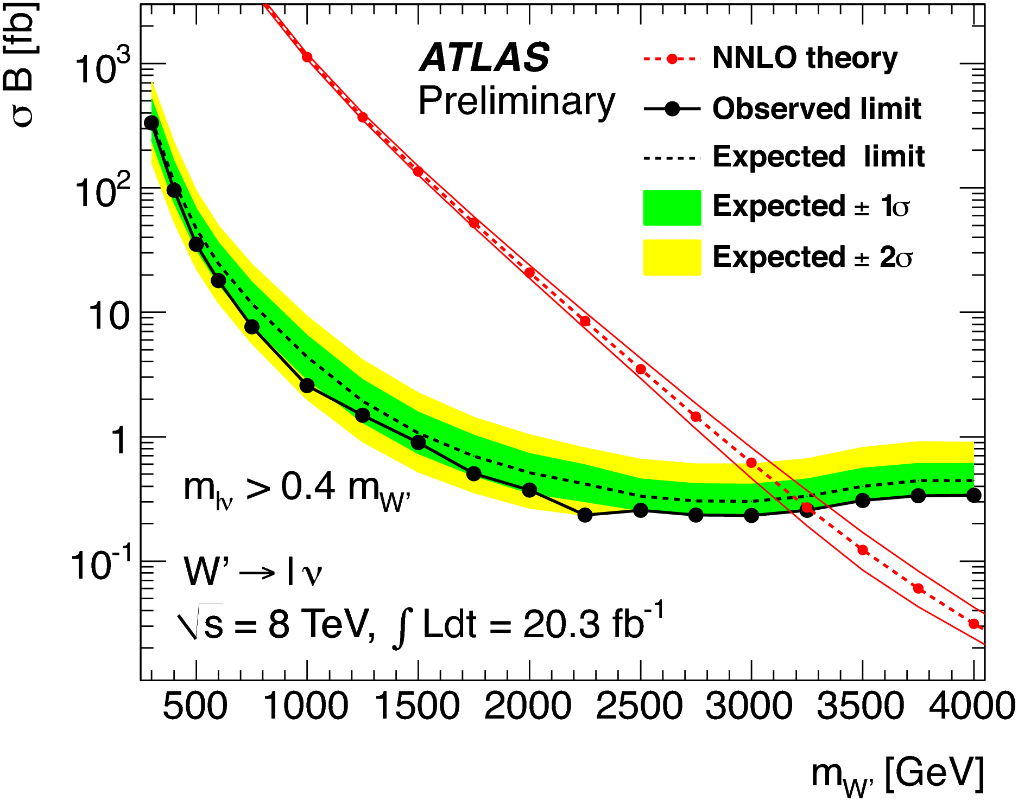
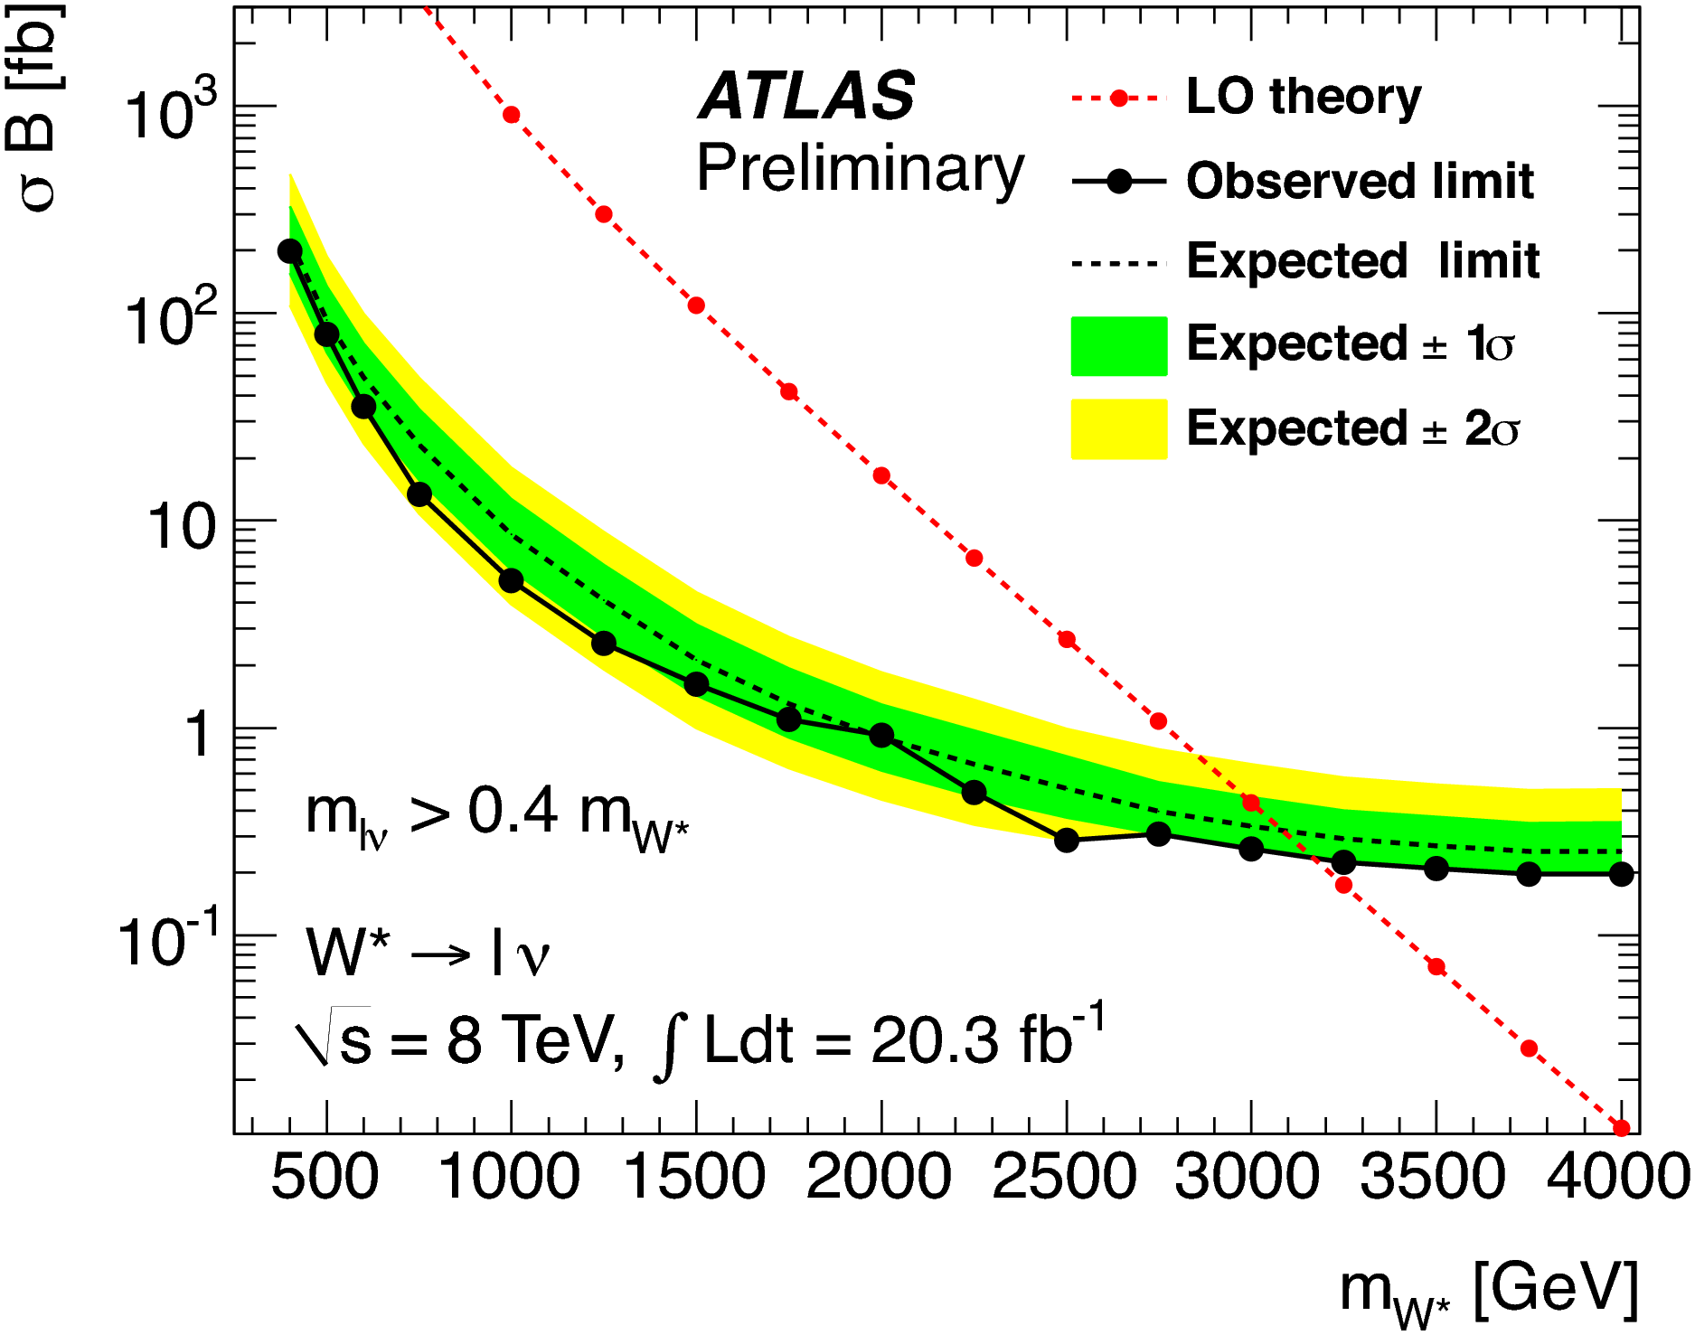
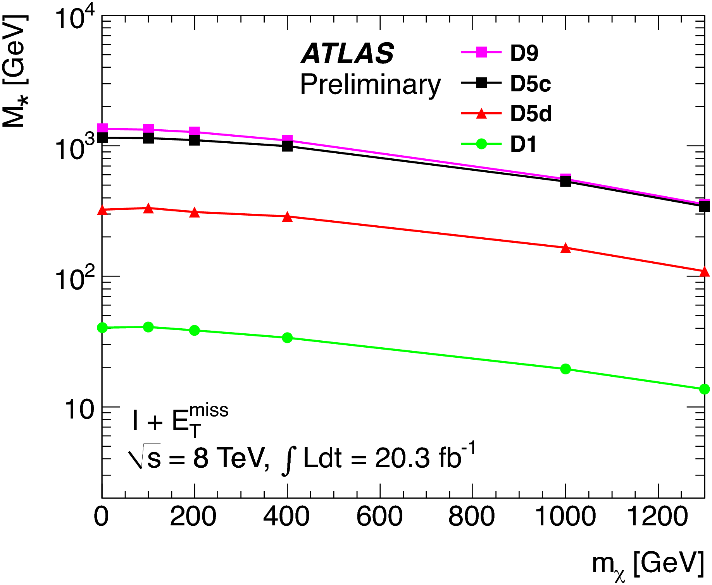
Search in to lepton and E_{t}^{miss} : interpretation
Mono-W interpretation:
χ
u
_
χ
_
W
ν
d
_
l
Observed Mass Limits:
  m_{W’} > 3.19 TeV
  m_{W*} > 3.08 TeV

Slide 10
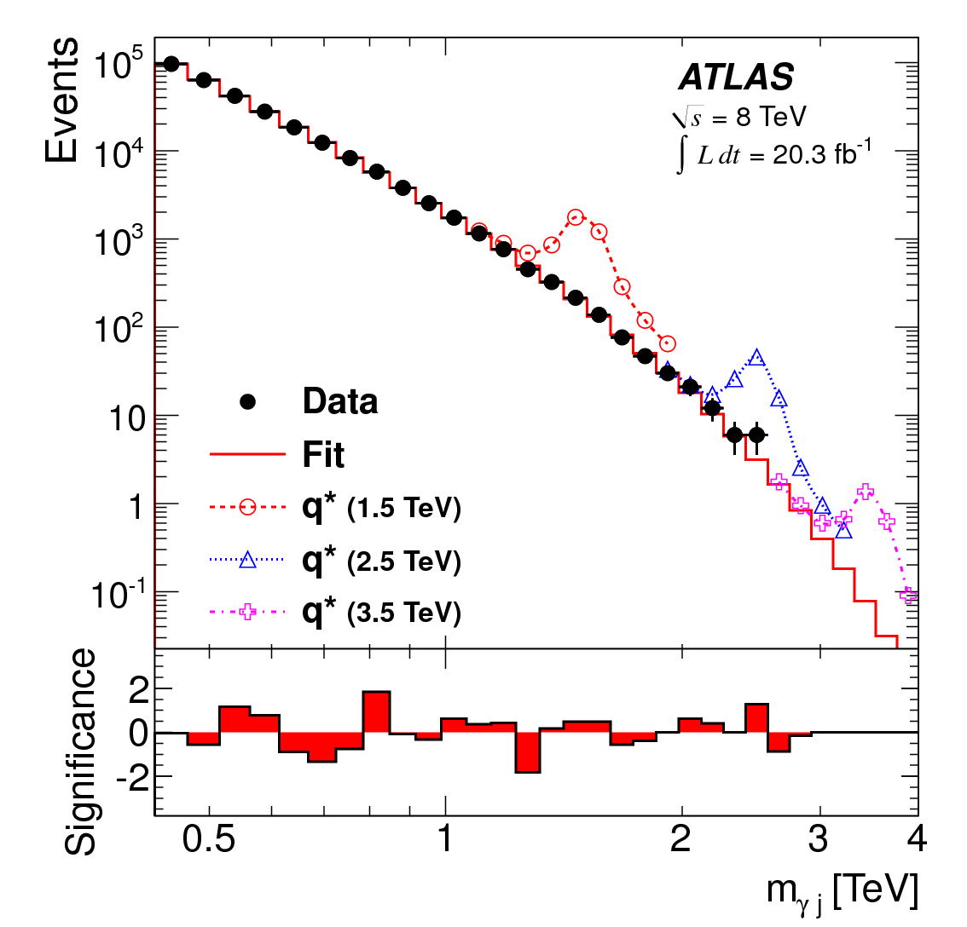
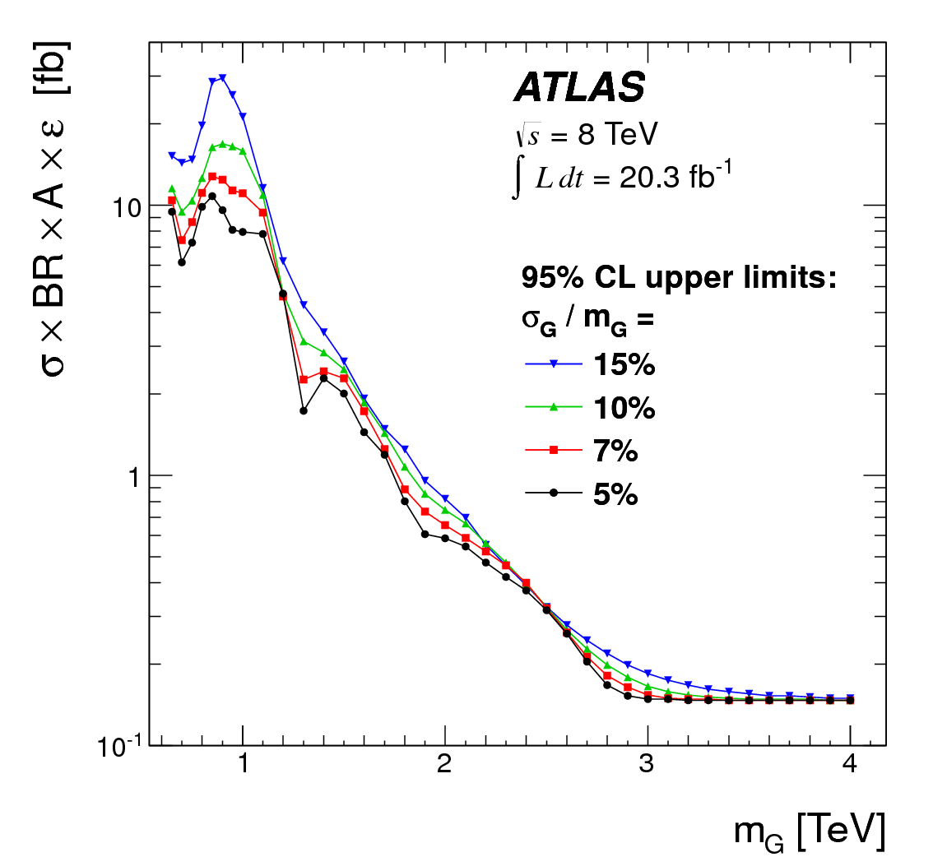
Search for new phenomena in lepton+jet final state
PLB 728, 562 (2013)
q
γ
q*
g
Anti-k_{T} R=0.6 jet E_{T} > 125 GeV
Isolated, central photon, separated from the jet E_{T} > 125 GeV
Pseudorapidity separation < 1.6
q
Generic Gaussian resonance limit:
QBH Limit:
M_{TH} > 4.6 TeV
q* Limit
m_{q*} > 3.5 TeV

Slide 11
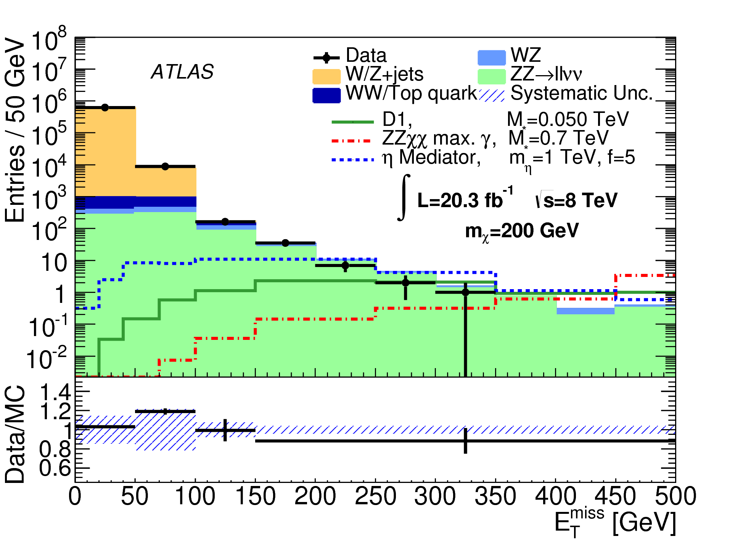
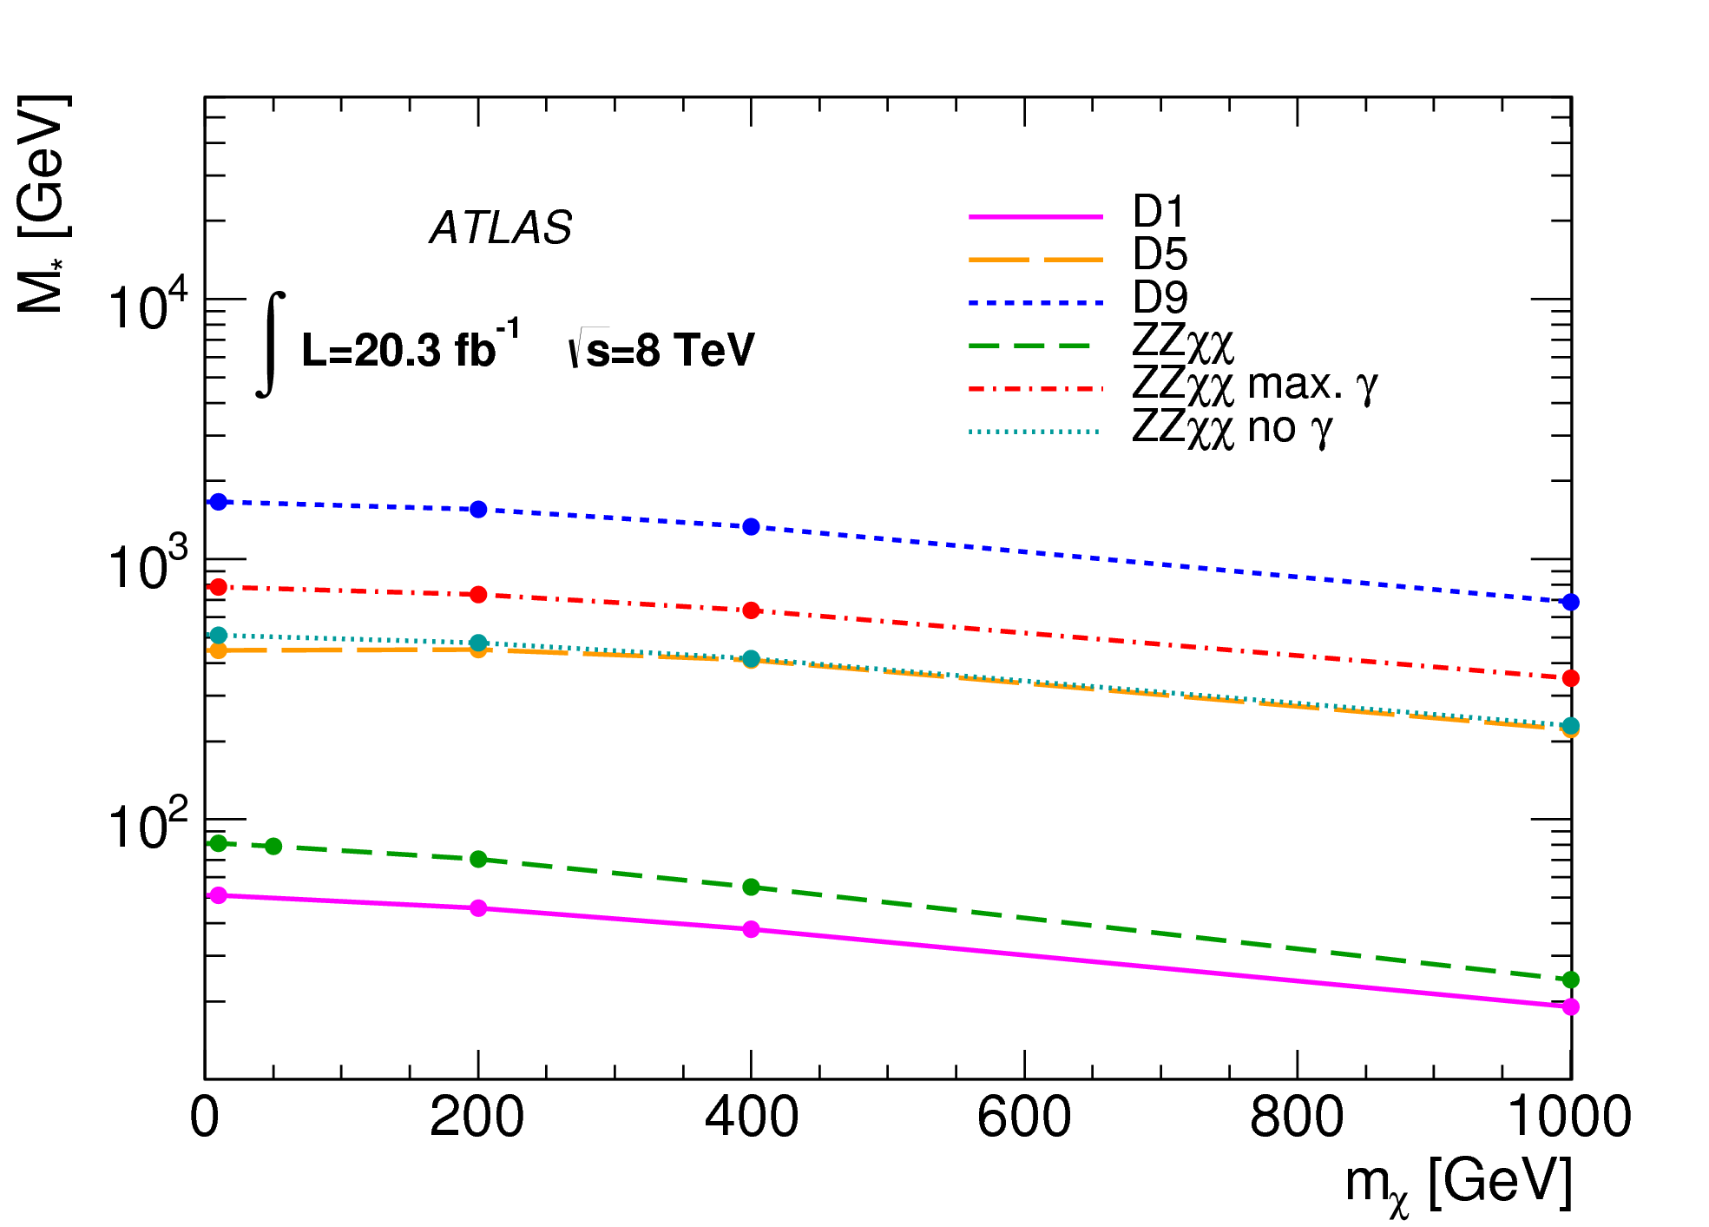
Z( l⁺l⁻)+E_{T}^{miss} search
l⁻
arXiv:1404.0051
Z
l⁺
q
χ
_
e⁺e⁻ or μ⁺μ⁻ pair in Z window, leptons isolated
Topological cuts on E_{T}^{miss} and p_{T}^{ll}
E_{T}^{miss} cut selected depending on the model, fiducial region
q
_
χ
Fiducial cross-section limits [fb]:
Interpretations for DM-nucleon scattering,
scalar particle mediator model and ZZχχ
E_{t}^{miss} threshold [GeV] | 150 | 250 | 350 | 450
Expected limit | 3.0 | 0.73 | 0.36 | 0.27
Observed limit | 2.7 | 0.57 | 0.27 | 0.26

Slide 12
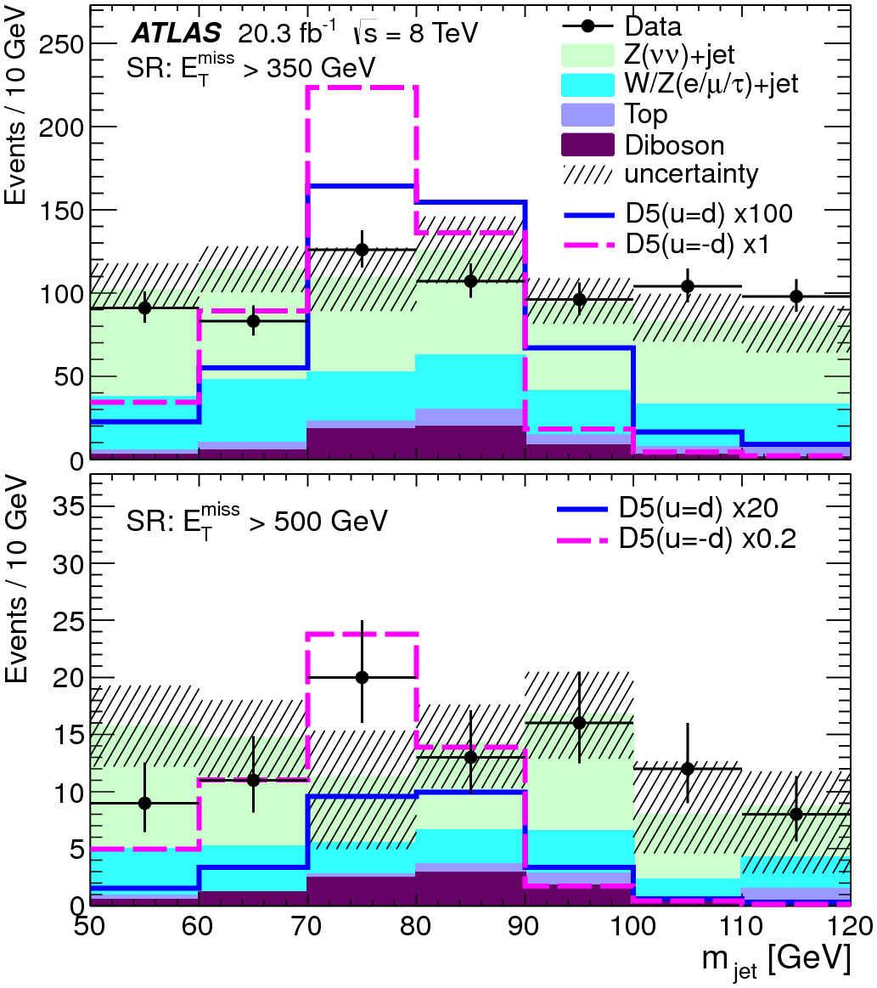
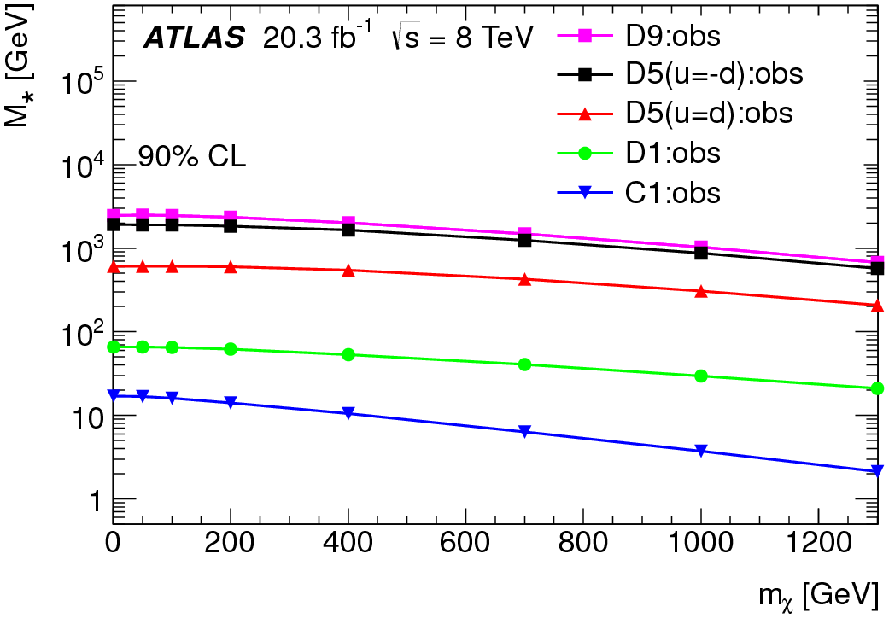
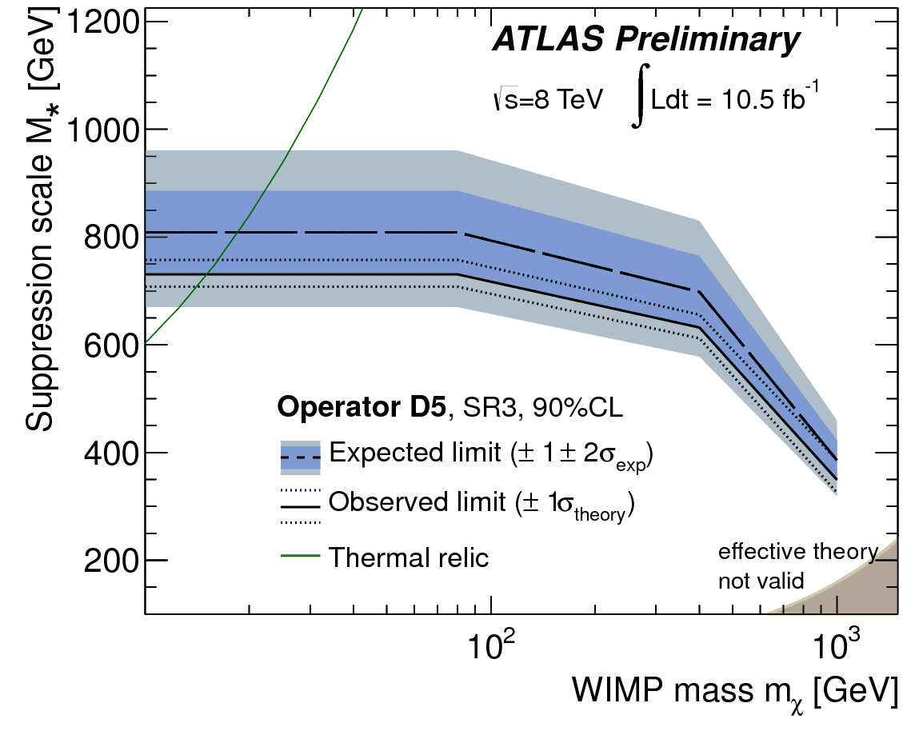
W/Z( qq’)+E_{T}^{miss} search
PRL 112, 041802 (2014)
q
W/Z
_
q'
q
χ
One ‘Cambridge-Aachen’ large radius (1.2) jet
  p_{T} > 120 GeV, m_{j} 50-120 GeV, |η|<1.2, sub-jets balanced
Veto on additional narrow jets and leptons
Signal regions E_{T}^{miss} > 350, 500 GeV
_
_
q'
χ
M* lower limits from monojet search:
ATLAS-CONF-2012-147
Interpretations for DM-nucleon scattering;
Higgs as a mediator limit at m_{H} = 125 GeV: σ < 1.3 pb
Fiducial limits published

Slide 13
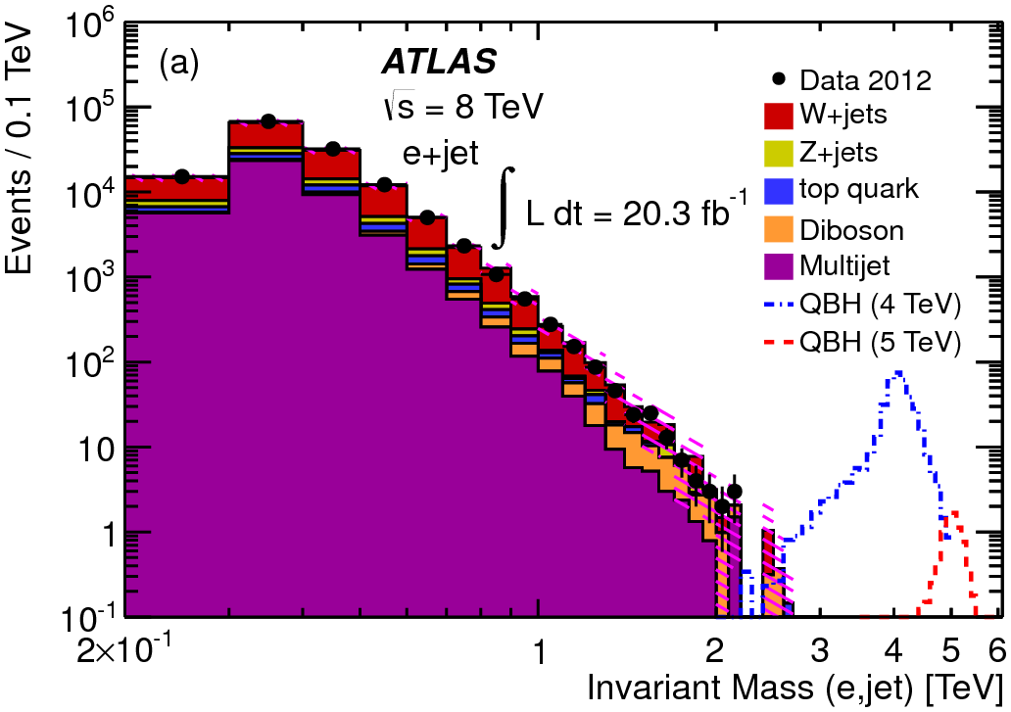
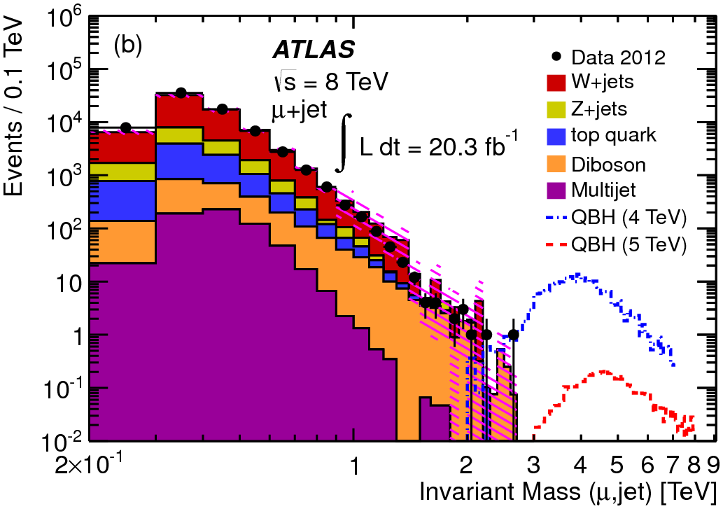
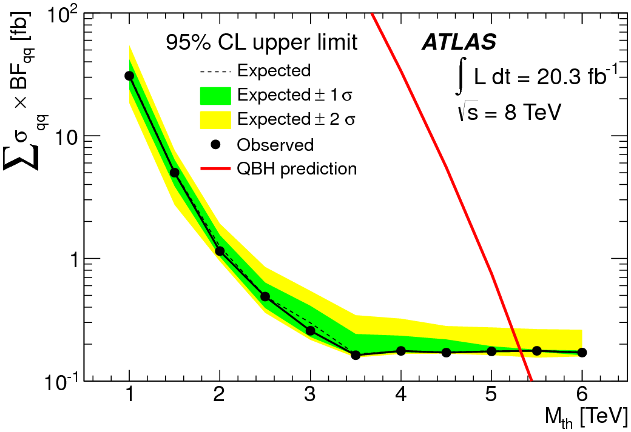
Lepton + jet search for quantum black holes
u
PRL 112, 091804 (2014)
l
QBH
q
u
p_{T lepton} , p_{T jet}> 130, leptons isolated
Topological cuts: |Δφ_{l, j}|>π/2, |<η_{l,j}>|<1.25, |Δη|<1.5
m_{min} cut as a function of M_{TH}
Observed limits:
n=6: M_{TH} > 5.3 TeV
n=2: M_{TH} > 4.7 TeV

Slide 14
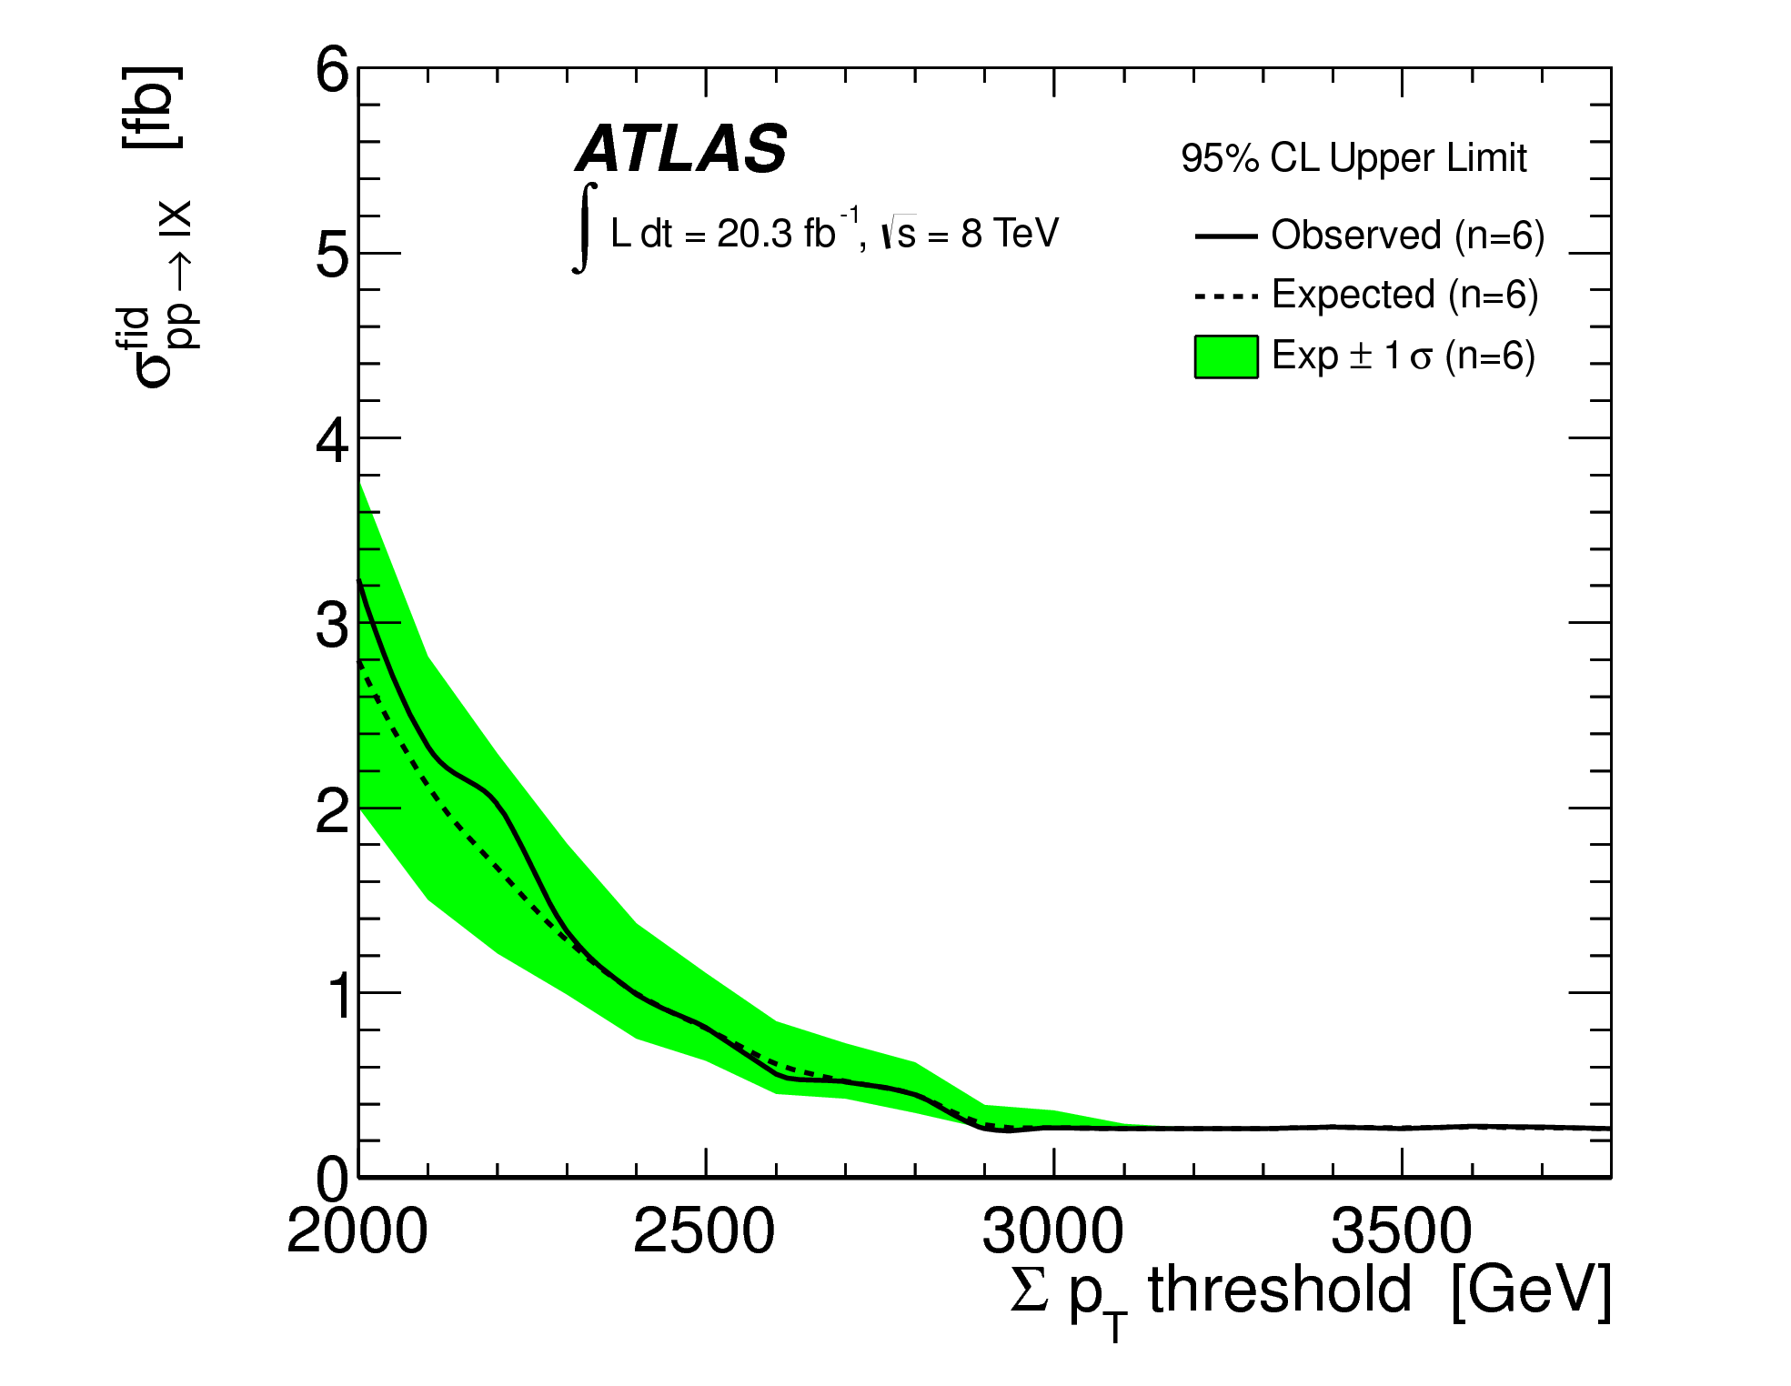
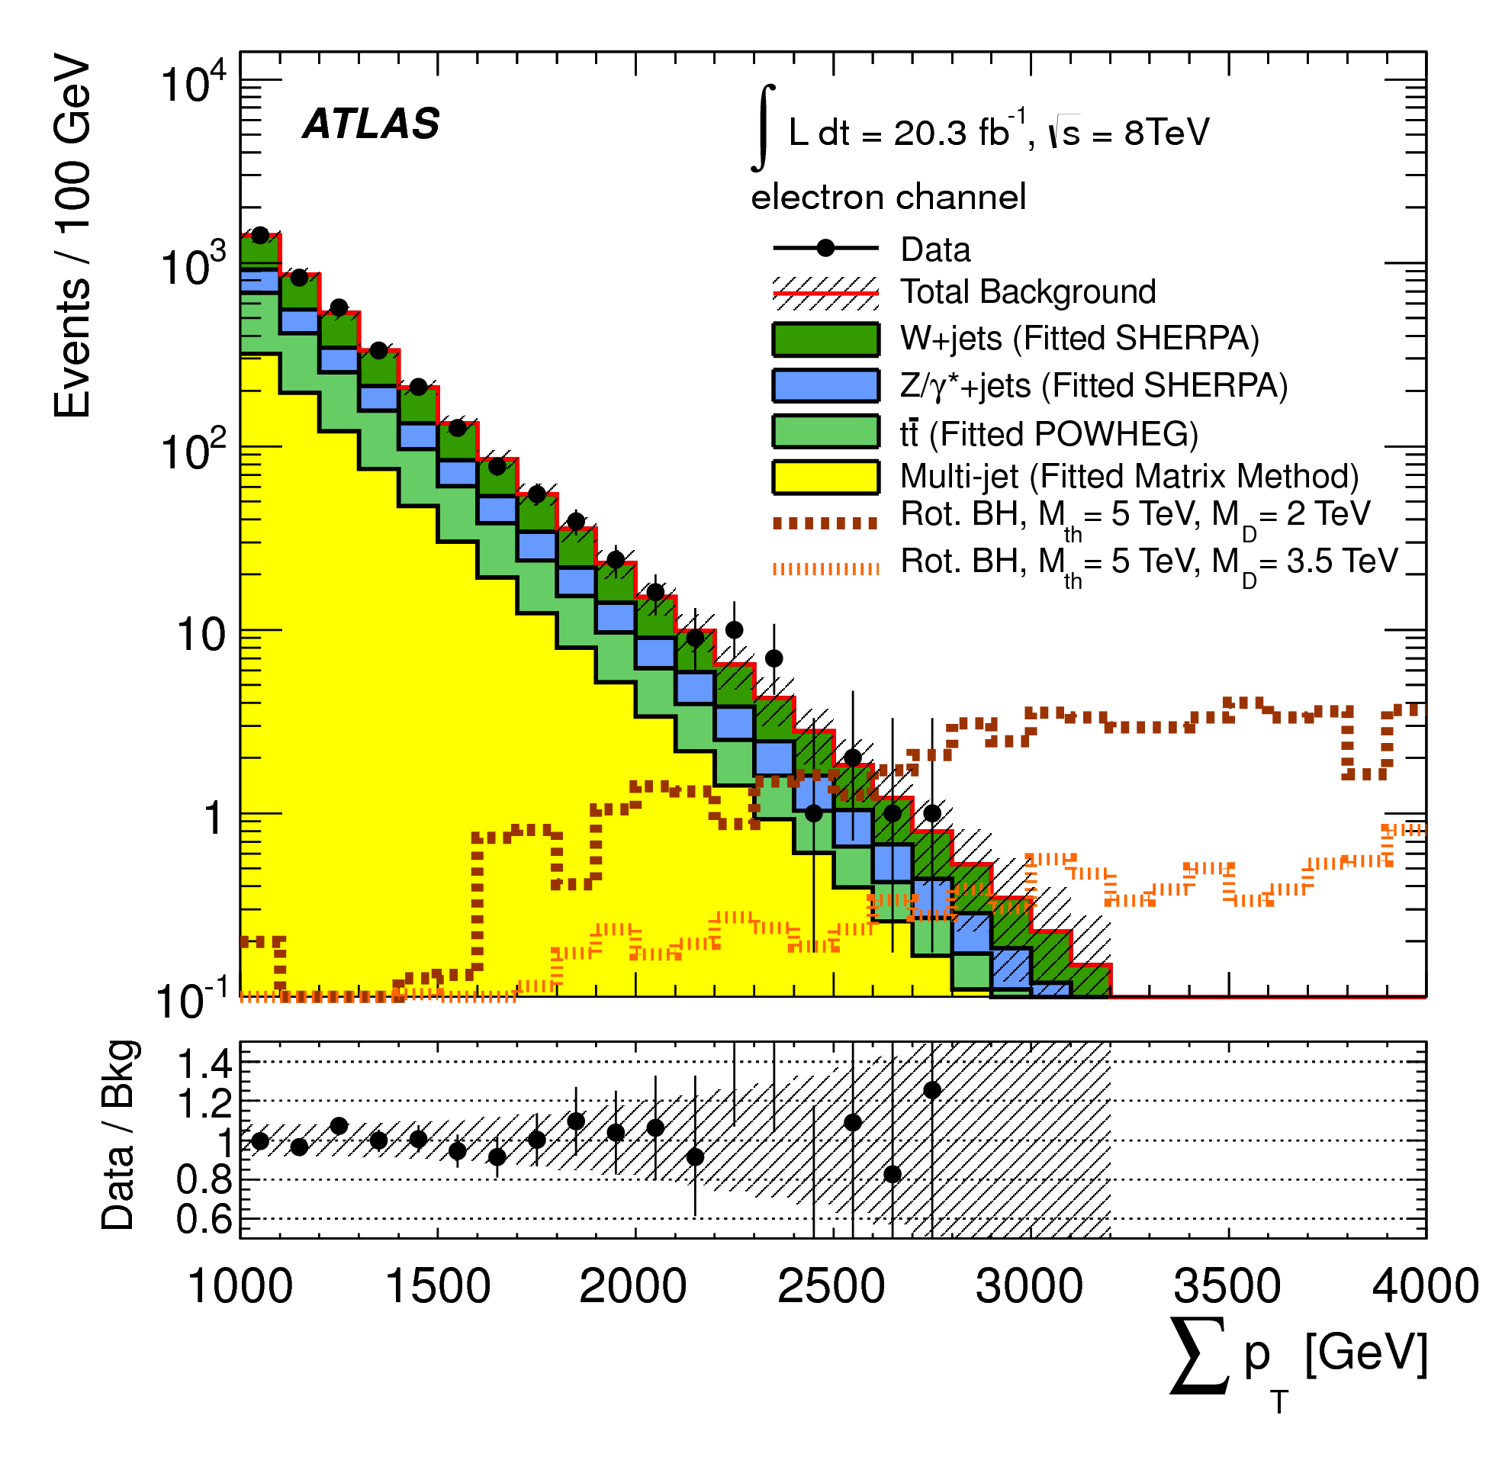
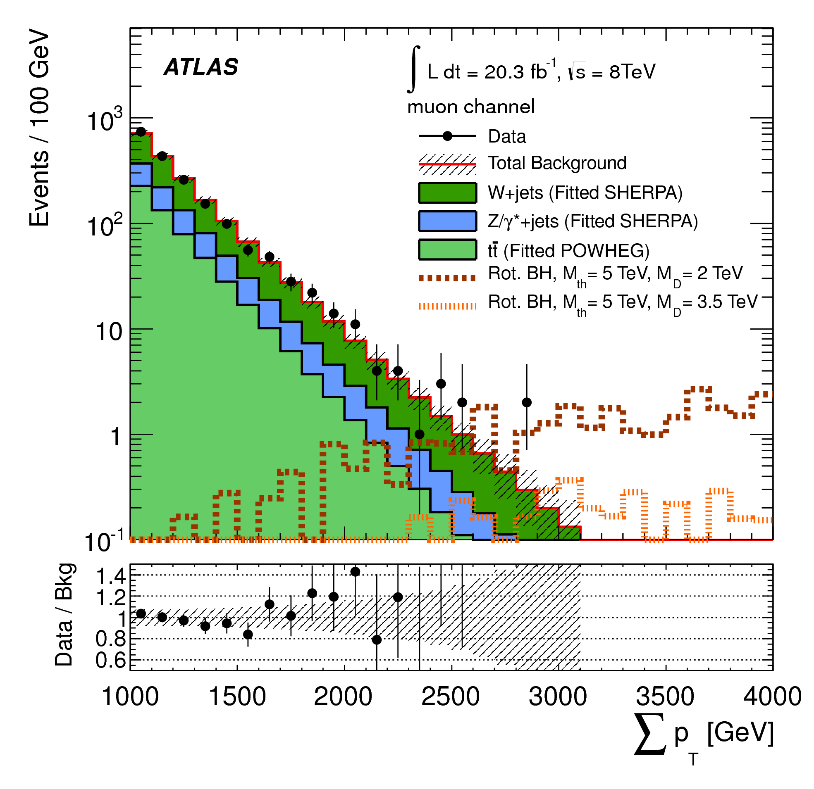
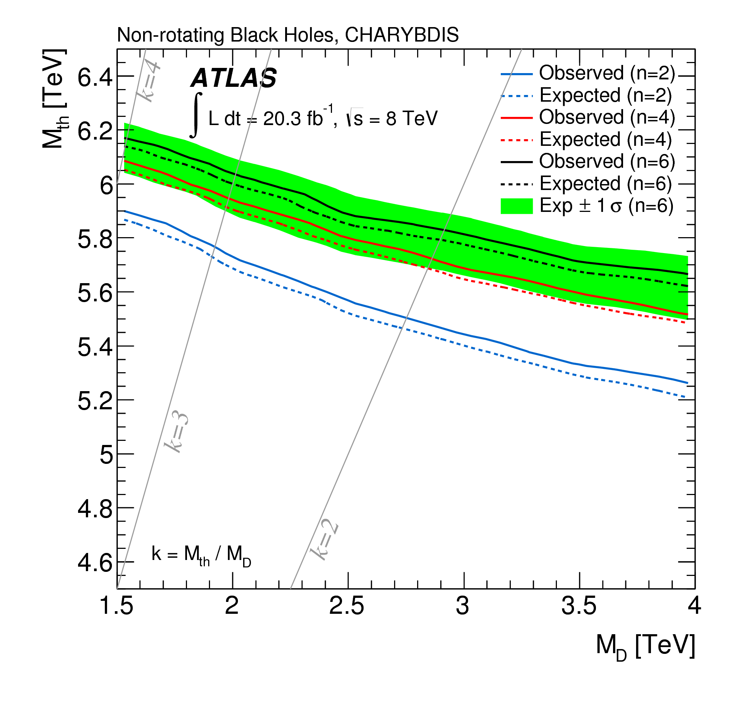
Lepton+jets search for microscopic black holes
l
arXiv:1405.4254
SM
SM
SM
Σp_{T} > 2 TeV
3 objects with p_{T} > 100 GeV, one- an isolated lepton
Observed Limits (non-rotating, M_{D} = 1.5 TeV, n = 6) M_{TH} > 6.2 TeV
Limits published on variety of microscopic black hole scenarios and string balls.

Slide 15
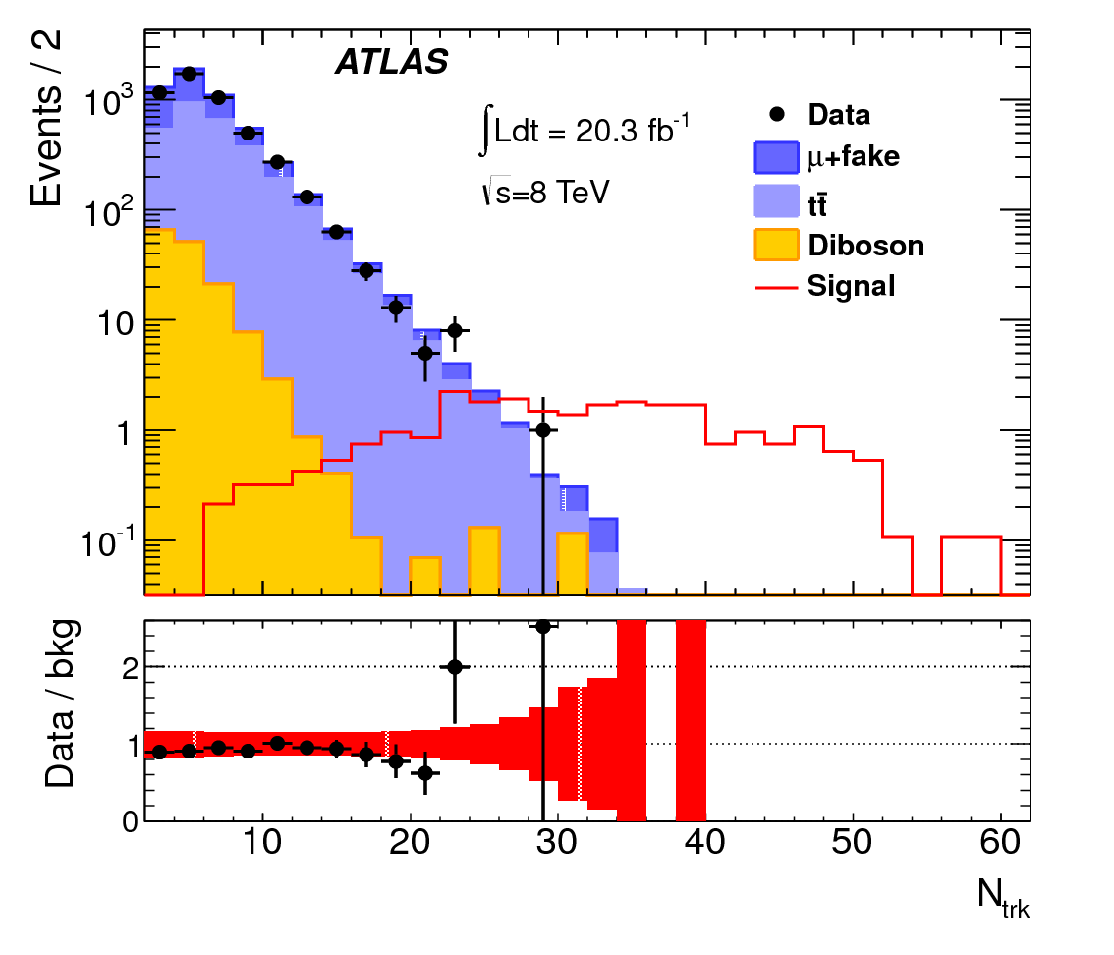
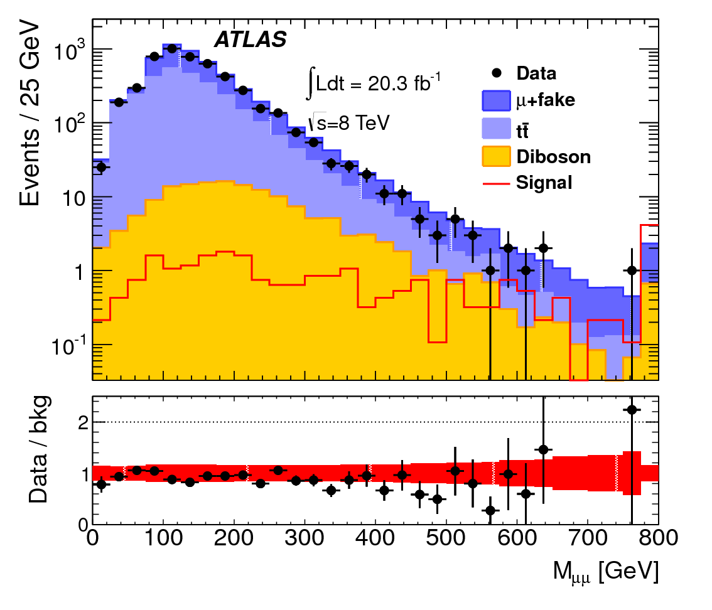
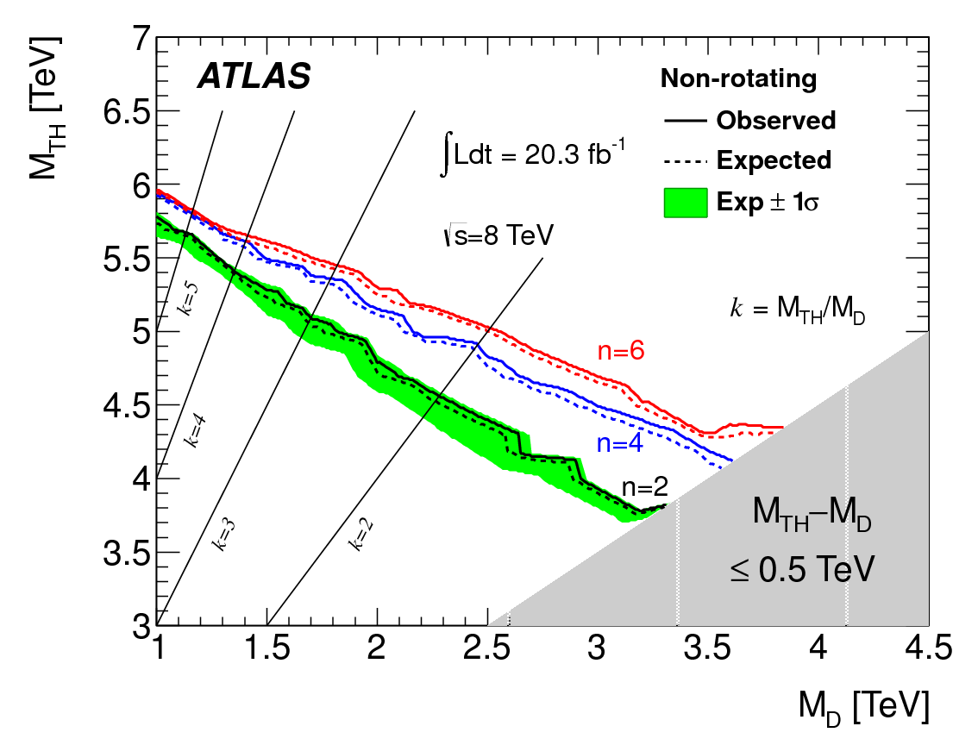
Same-sign dimuon + tracks search for microscopic black holes
PRD 88, 072001 (2013)
Leading muon p_{T} > 100 GeV isolated
Subleading p_{T} > 15 GeV
Leading and sub-leading p_{T} muons same-sign, separated ΔR > 0.2
40 tracks with p_{T} > 10 GeV
Observed limit on σ_{vis}< 0.16 fb
Observed limit on M_{TH} (non-rotating M_{D} = 1.5 TeV, n=6) M_{TH} > 5.7 TeV
Variety of microscopic black hole scenarios and string balls constrained

Slide 16
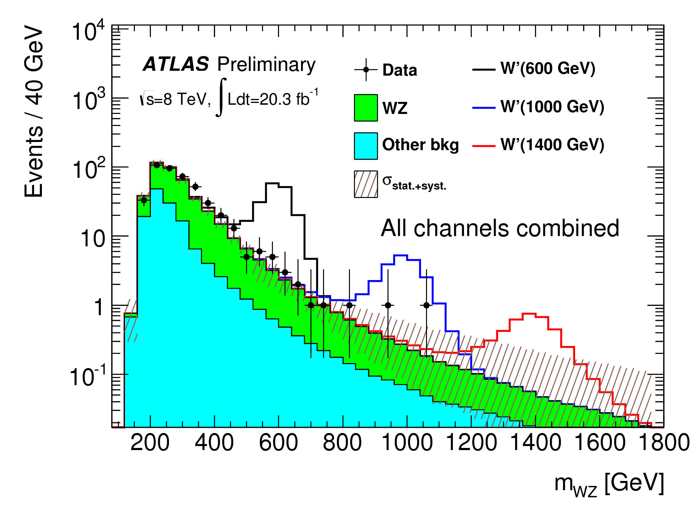
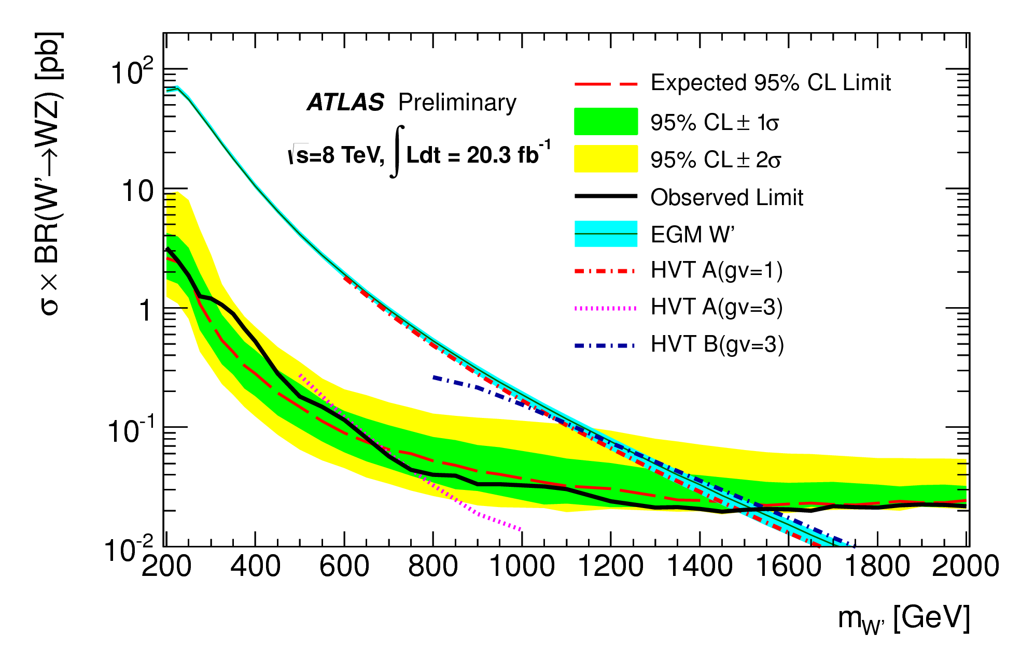
lνl’l’ WZ resonant production search
ATLAS-CONF-2014-015
l'
q
Z
Exactly 3 isolated (calo+track) electrons and muons p_{T} > 25 GeV
  Isolation criteria exclude same flavor lepton
  Two must be same flavor, opposite sign with m_{ll} within 20 GeV of the Z
  e-μ separation ΔR > 0.1
E_{T}^{miss} > 25 GeV
p_{z ν} from m_{W} constraint
Δy(W,Z) < 1.5
For searches for m_{W’} > 250 GeV SR1: ΔΦ(l,E_{T}^{miss}) < 1.5; m_{W’} < 250 GeV SR2: ΔΦ(l,E_{T}^{miss}) > 1.5;
W’
l'
_
q'
W
l
ν
Observed limits:
EGM W’: m_{W’} > 1.52 TeV
HVT W’: m_{W’} > 0.76 – 1.56 TeV
Fiducial cross section limits published

Slide 17
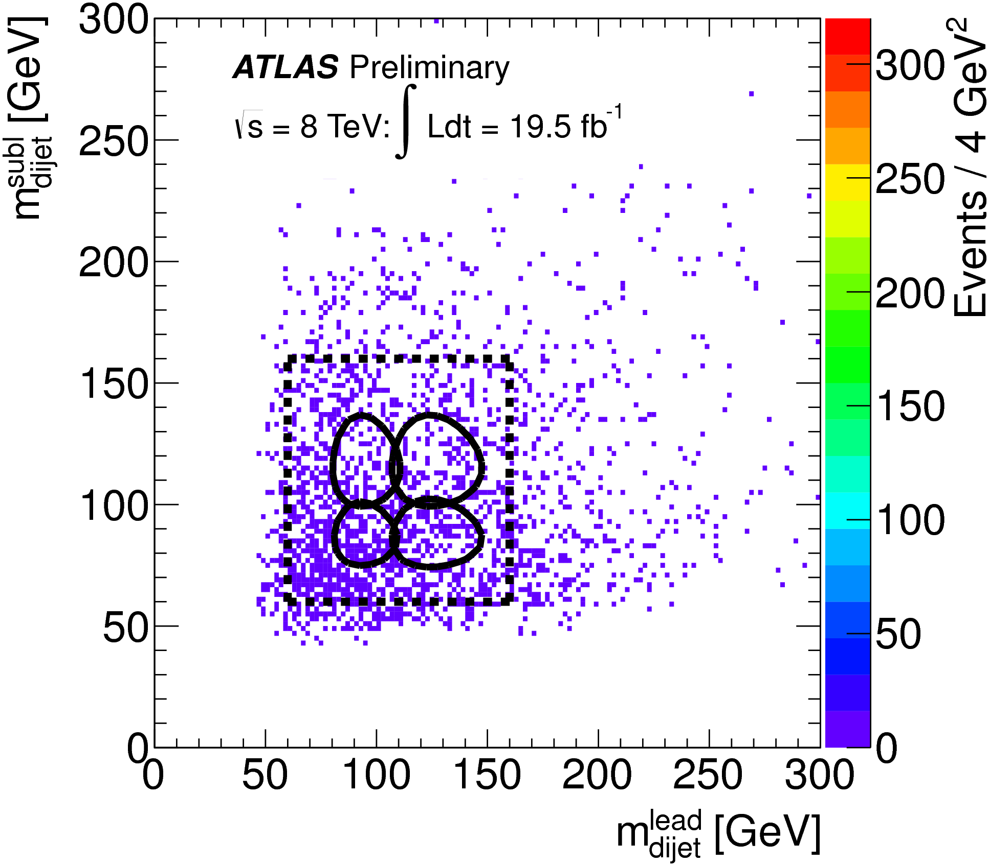
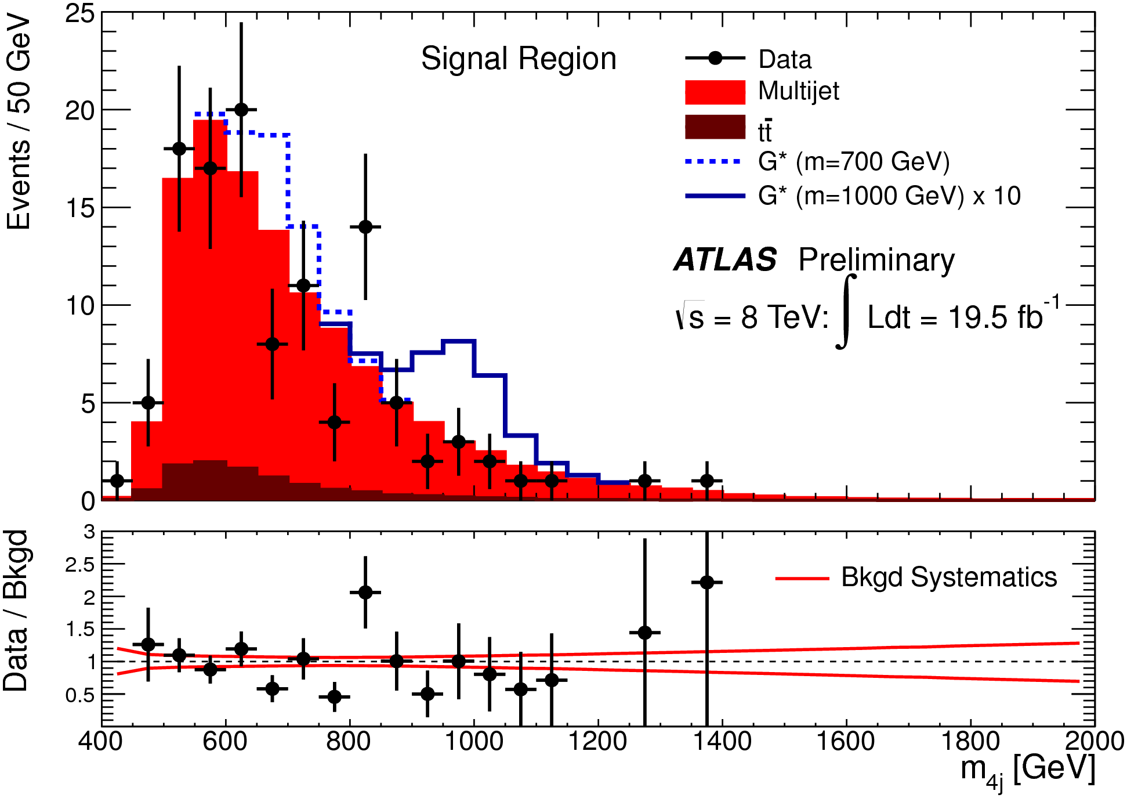
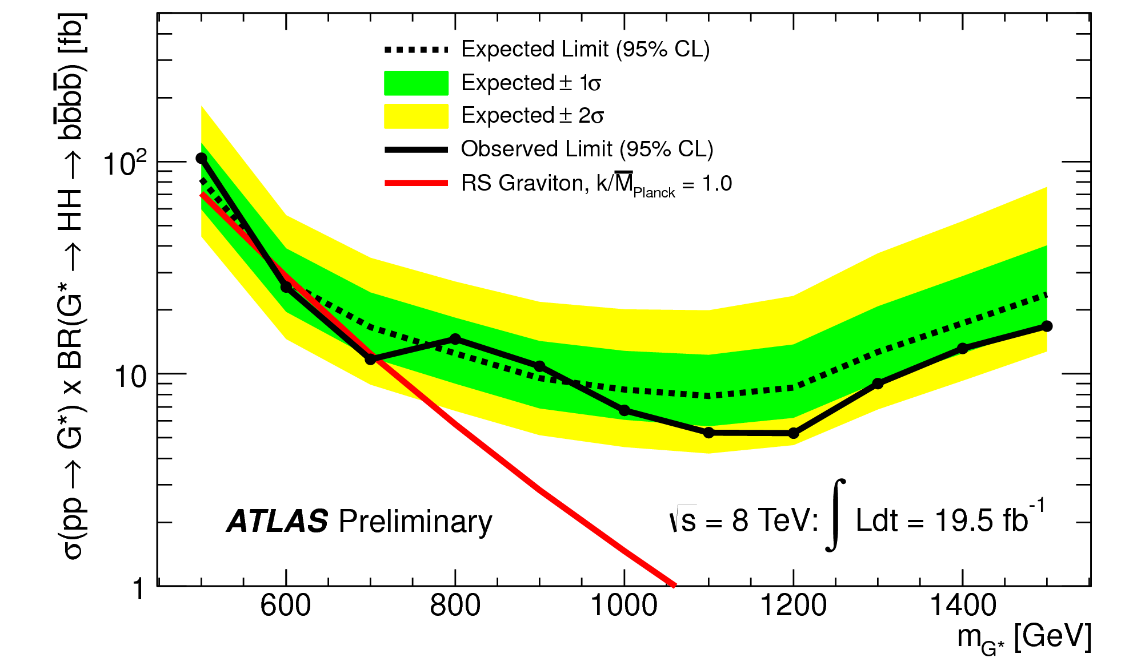
Resonant HH production search decay to 4 b quarks
ATLAS-CONF-2014-005
b
H
_
G*
b
b
4 b-tagged jets p_{T} > 20 GeV
2 ‘dijets’ ΔR_{jj} < 1.5, p_{T, jj} > 200 GeV
tt veto, t hypothesis formed using extra jets
Elliptical cut in m_{jj}^{lead}-m_{jj}^{sublead} plane
H
_
b
_
l

Slide 18
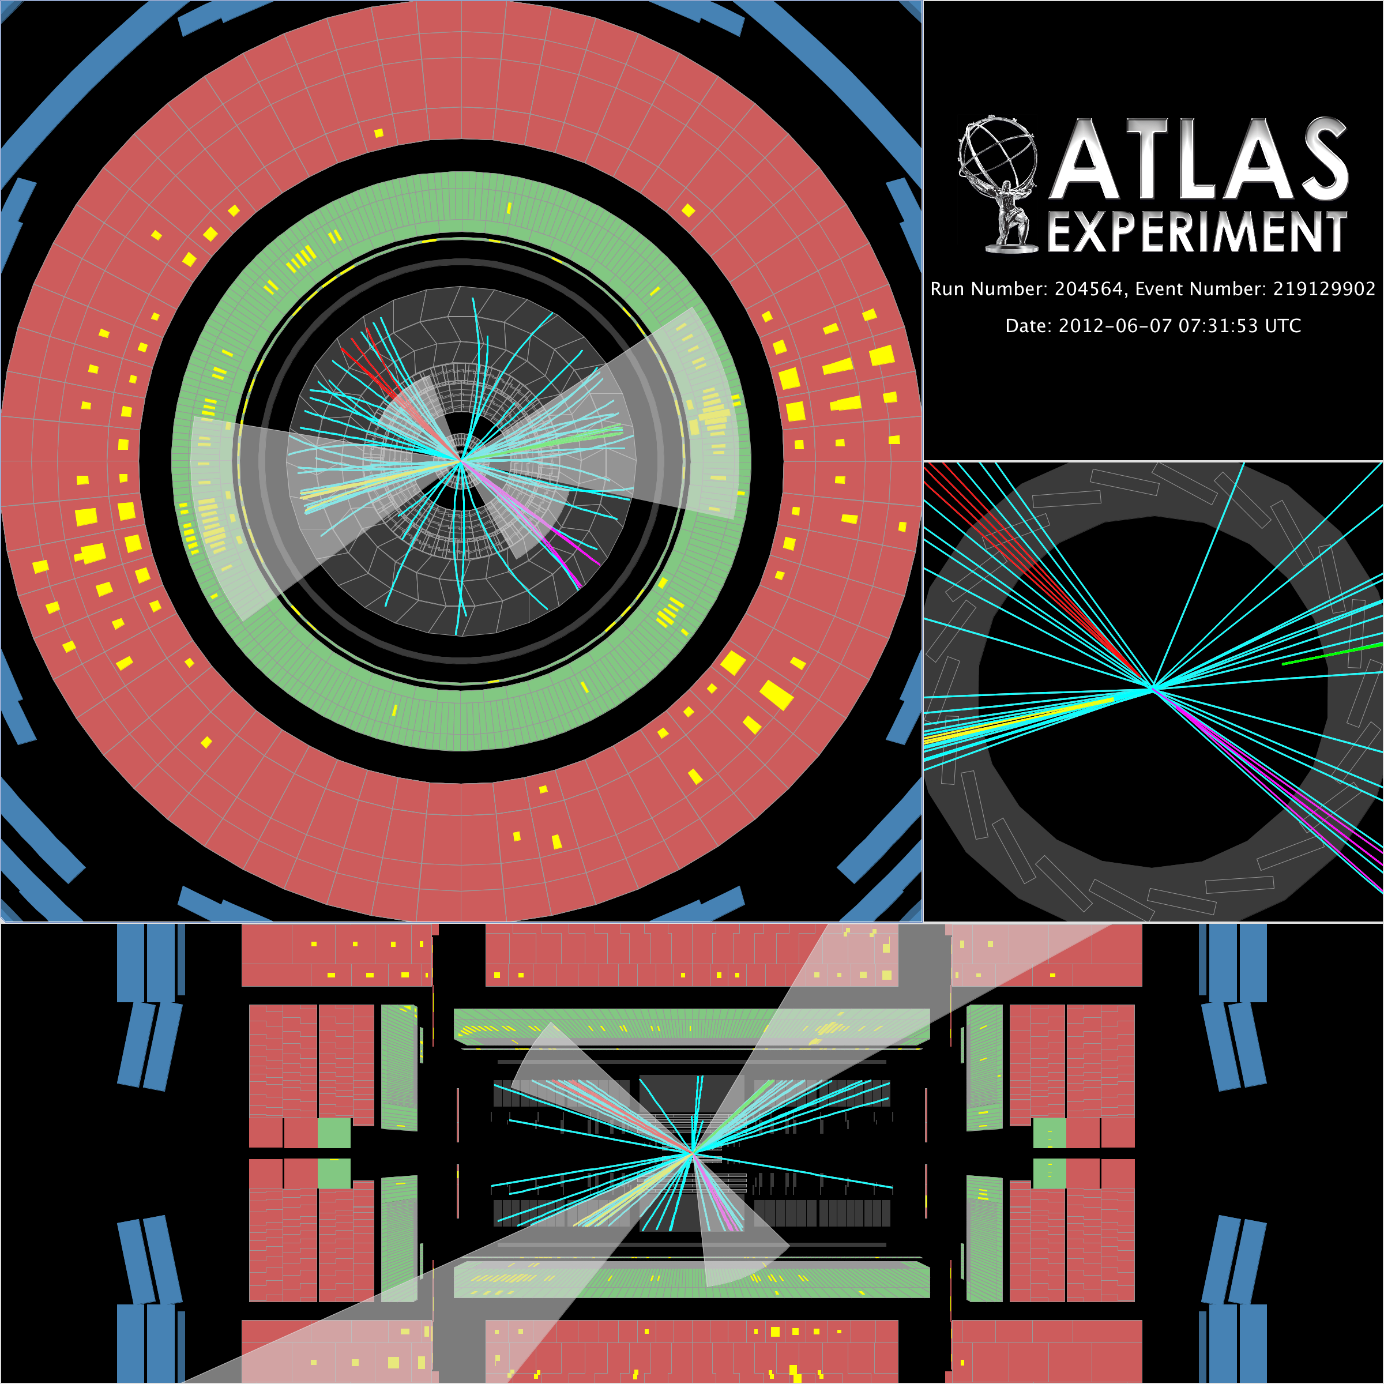
m_{4j}= 834 GeV

Slide 19
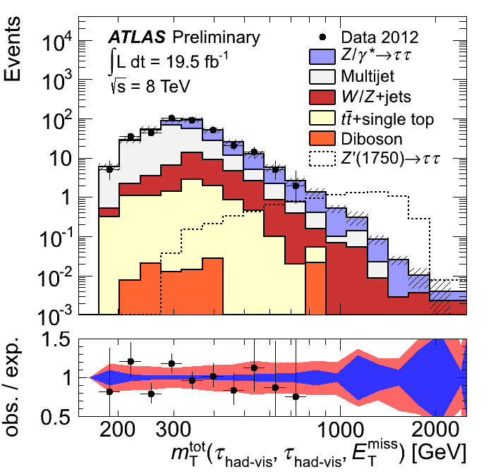
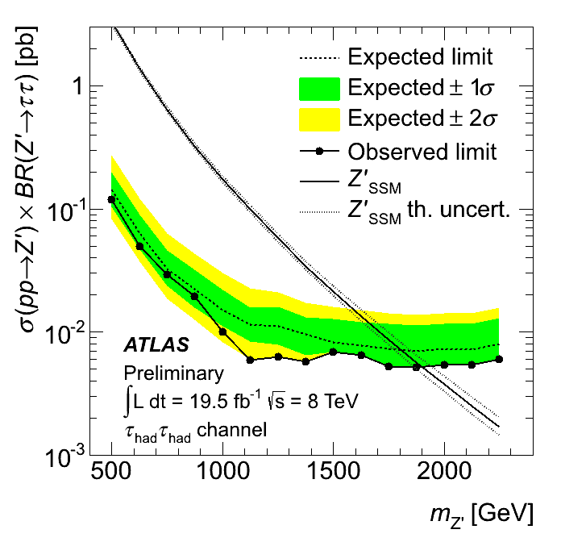
Di-tau resonance search (all hadronic channel)
q
ATLAS-CONF-2013-066
τ⁻
Z’
_
q
τ⁺
τ candidates: jets with 1 or 3 tracks, p_{T} > 50 GeV
2 τ opposite sign, back-to-back candidates, leading p_{T} > 150 GeV
  BDT ID
m_{T,}^{tot} threshold dependent on signal hypothesis ( 400-850 GeV)
SSM Z’ limit m_{Z’} > 1. 90 TeV

Slide 20
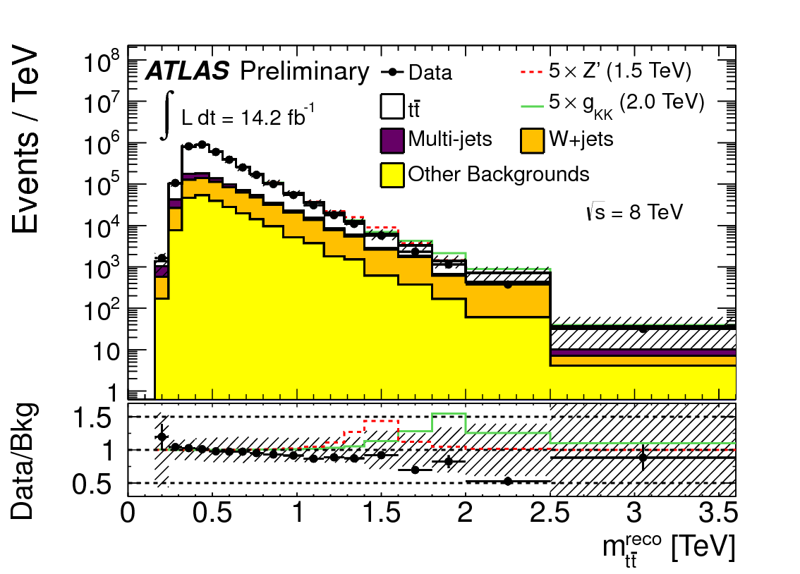
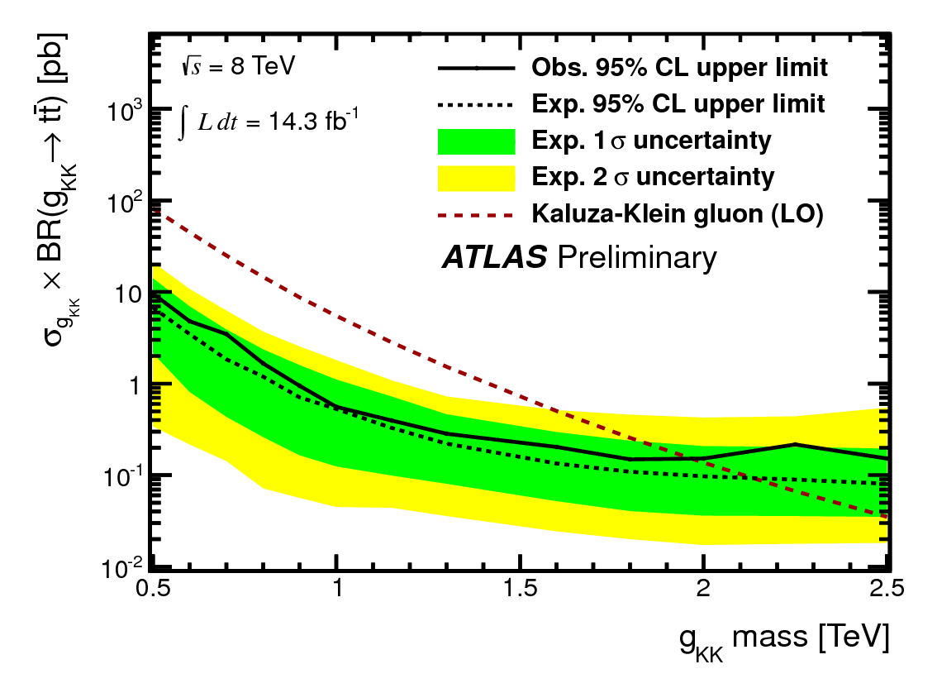
Di-top resonance search (l+jets channel)
q
ATLAS-CONF-2013-052
q'
t
g_{KK}
v
b
_
_
b
t
l
v
Exactly one mini-isolated e or μ, p_{T} > 25 GeV
E_{T}^{miss} > 30 GeV (e-channel); E_{T}^{miss} > 20 E_{T}^{miss} + m_{T,l met} > 60 GeV, p_{z ν} from W constraint
Boosted sample:
  One narrow (R=0.4) p_{T} > 25 GeV, b-tagged
  One large radius (R=1.0) ‘trimmed’ jet p_{T} > 300 GeV, m_{j} > 100 GeV, splitting scale 40 GeV
Resolved sample (fails boosted sample first)
  4 narrow jets or 3 narrow jets with one m_{j} > 60 GeV, one b-taged
  Χ² selects best assignment of jets to partons
ν
Limits:
m_{gKK} > 2.0 TeV
m_{Z’} > 1.8 TeV

Slide 21
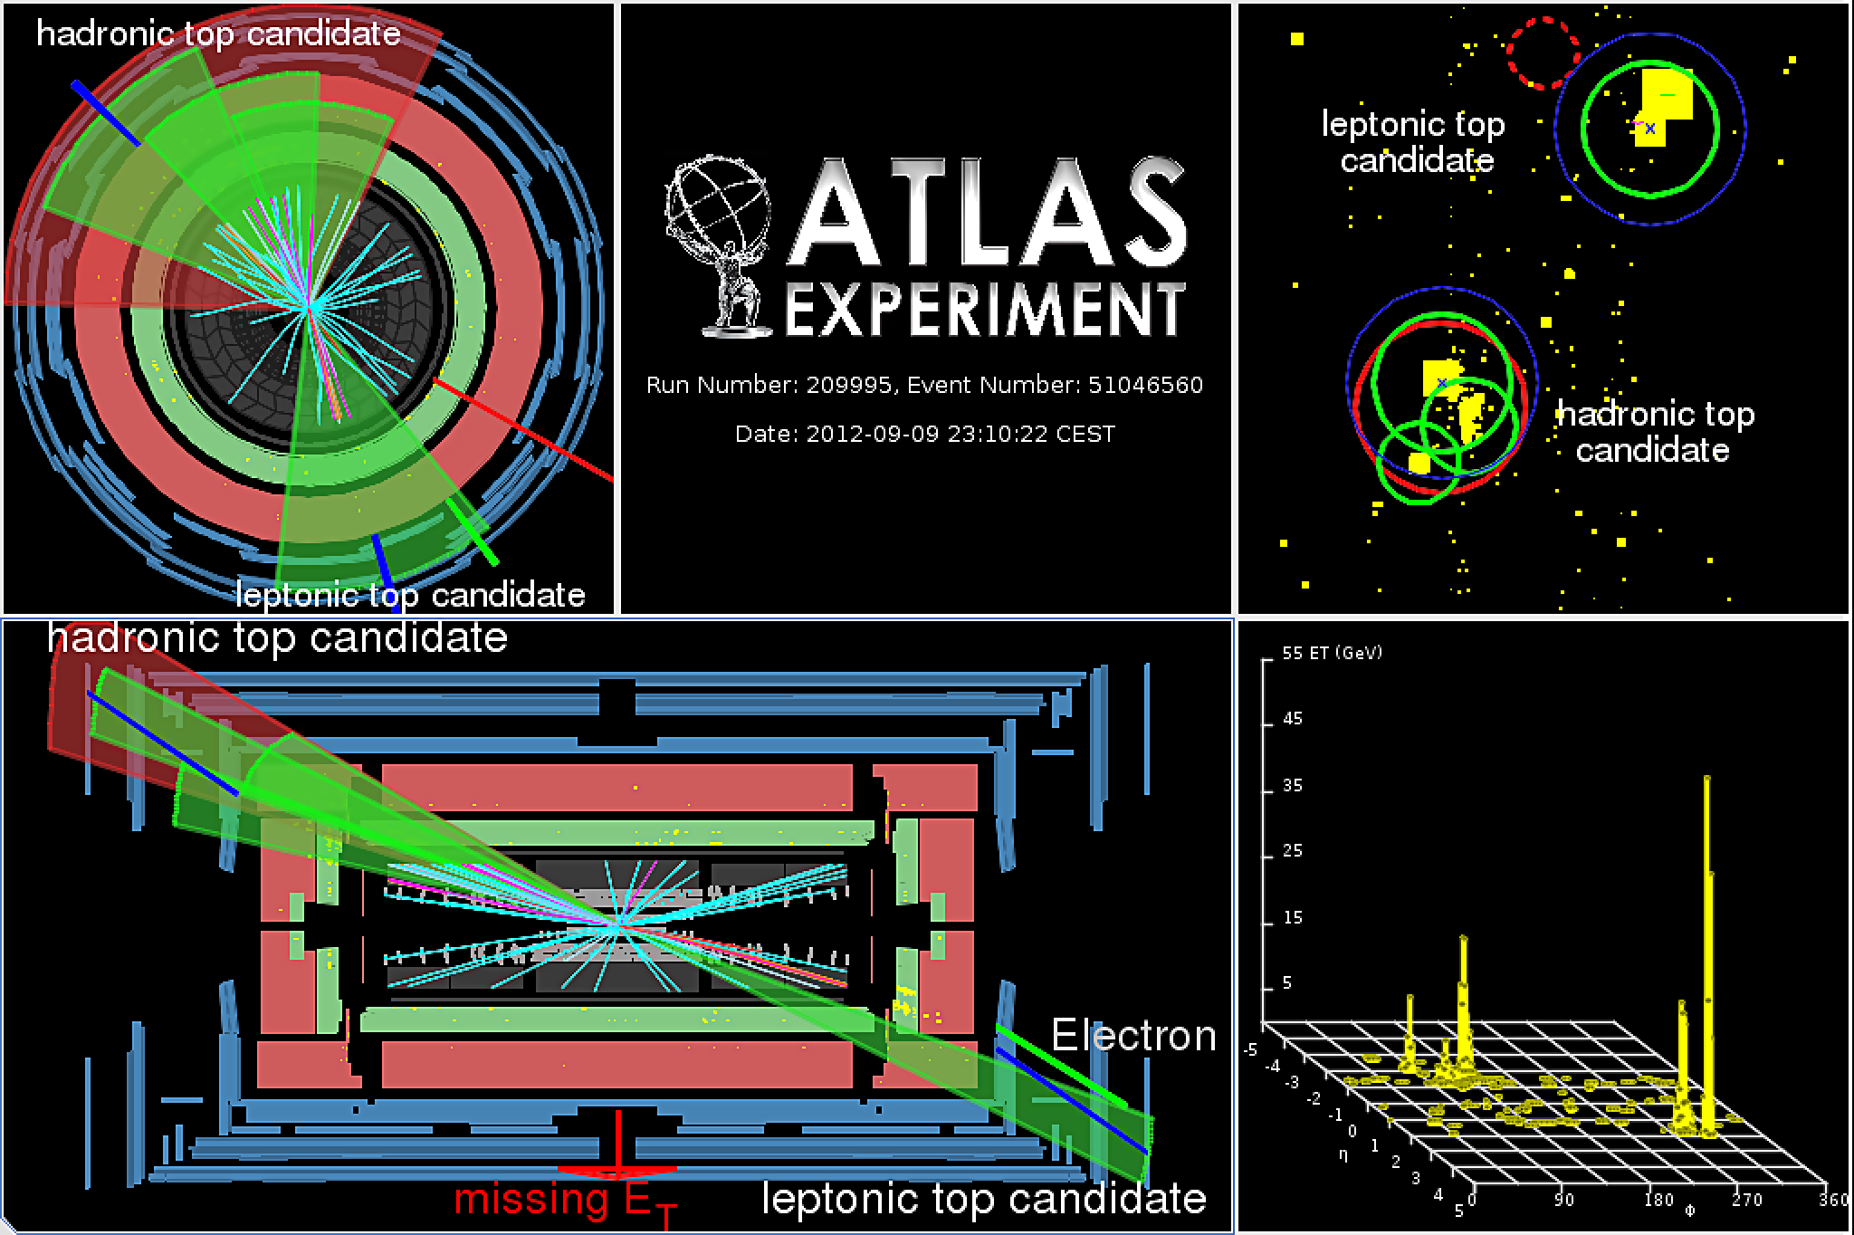
m_{tt}^{reco} = 2.6 TeV

Slide 22
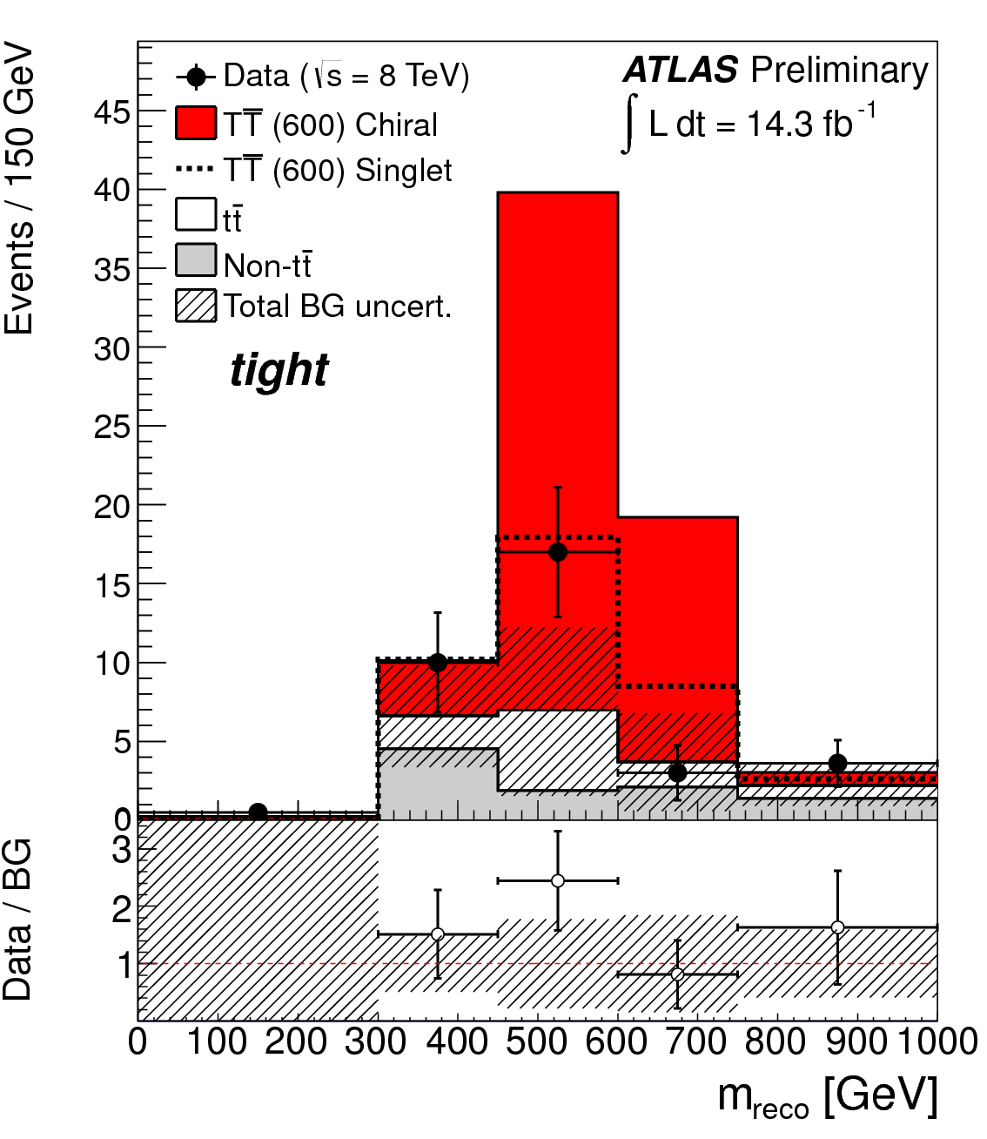
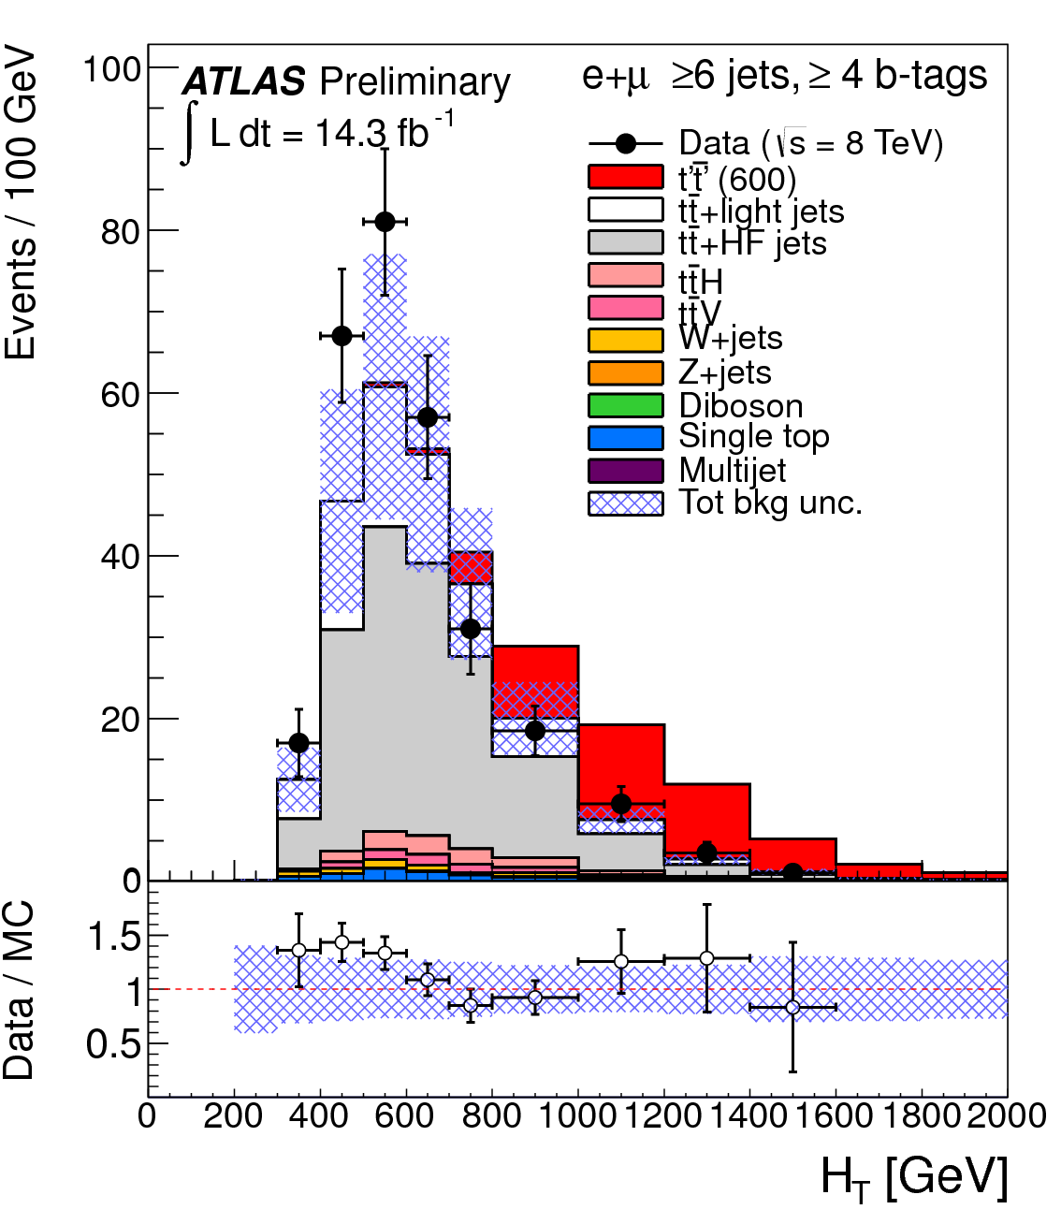
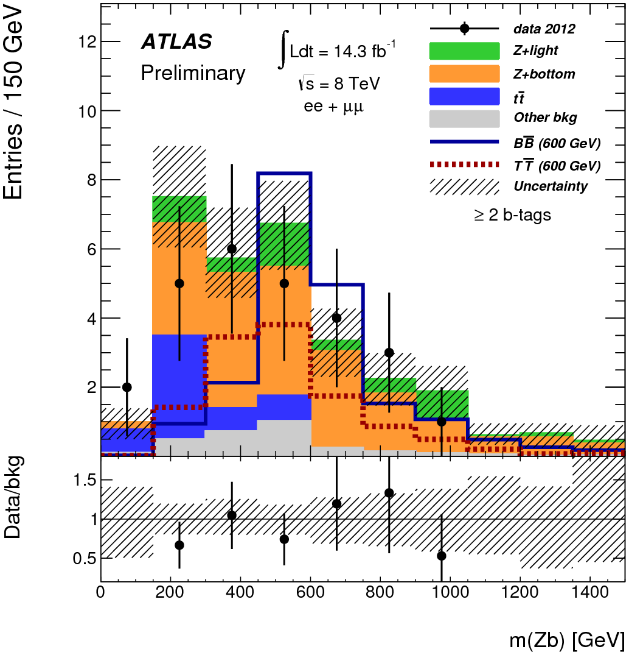
Heavy vector-like quark searches
ATLAS-CONF-2013-060
ATLAS-CONF-2013-056 ATLAS-CONF-2013-018
T->Wb search:
  l+jets channel selection, 1 b-tag
  Discrimination against tt:
    H_{T}, l-ν collimated, W_{had}-b and l-b separation
T->Ht search
  l+jets + H->bb selection
  High jet multiplicity 2,3,4 b-tag SRs
T(B)->Zt(b) search
  Selection of high p_{T} Z->e⁺e⁻, μ⁺μ⁻
  2 b-tagged jets
  High H_{T} of central jets
T(B)
W
T(B)
v
b(t)
g
T(B)
H
_ _
T(B)
t(b)
T(B)
Z
v
t(b)

Slide 23
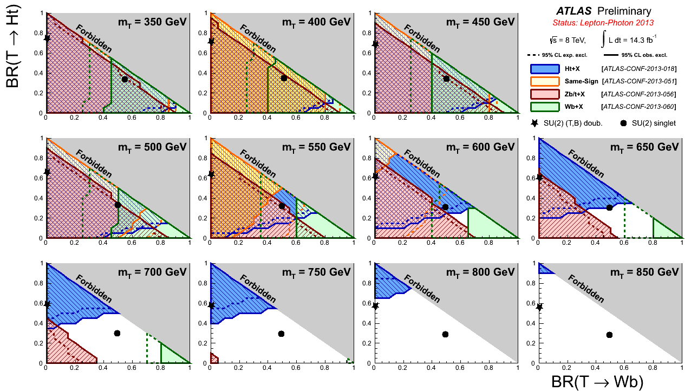
Heavy vector-like quark searches

Slide 24



Search for muonic lepton jets
PLB 721 (2013) 32
μ⁺
γ_{d}
3 μ ‘MS only’ trigger
Muon Jets : clustering of MS tracks
Exclusively two 2 opposite sign μ-MJs required
  Isolated, separated, with no ID activity
f_{d2}
μ⁺
f_{d1}
H
v
f_{d1}
f_{d2}
μ⁺
γ_{d}
v
μ⁺
MC

Slide 25


Monopoles, multi-charged particles
PLB 722, 305 (2013)
PRL 109 (2012) 261803
Discriminate using the TRT dE/dX, high threshold hits

Slide 26



General search
ATLAS-CONF-2014-006
Broad search
Trigger and exclusive final state classification
Regions of highest deviation from prediction identified in m_{inv} and m_{eff} spectra
Trials factor accounted for using pseudo-experiments

Slide 27

No stone left unturned?

Slide 28



outlook
2011
2012
2013
2014
2015
2016
2017
2018
2019
2020
2021
2022
2023
…
~25 fb⁻¹
√s = 7,8 TeV
L=6.8×10³³ cm⁻² s⁻¹
LS1
Muon
Si (IBL)
Trigger/DAQ
√s = 13,14 TeV
L=1×10³⁴ cm⁻² s⁻¹
~75-100 fb⁻¹
LS2
~350 fb⁻¹
√s = 14 TeV
L=2×10³⁴ cm⁻² s⁻¹
ATL-PHYS-PUB-2013-007
Expected Limit prospects (TeV):
LS3
Model \ int Lumi | 300 fb⁻¹ | 1000 fb⁻¹ | 3000 fb⁻¹
g_{KK} -> tt (l+jets) | 4.3 | 5.6 | 6.7
Z’_{SSM}-> e⁺e⁻ | 6.5 | 7.2 | 7.8
√s = 14 TeV
L=5×10³⁴ cm⁻² s⁻¹
Notes:
2012 time to refine the searches, 2014 important to look at the data very quickly then characterize discovery or look in related final states.

Slide 29
Backup

Slide 30



DM limits nucleon scattering interpretation
W/Z-> large jet + E_{T}^{miss}:
Z-> ll + E_{T}^{miss}:
PRL 112, 041802 (2014)
arXiv:1404.0051

Slide 31
DM limits from l+E_{T}^{miss} search

Slide 32

Z’ sensitivity
arXiv:1405.4123

Slide 33


Searches in the Higgs Sector:
FCNC: t->q H
JHEP06(2014)008
tt search with one t decaying to qH and H -> γγ
Two isolated photons
tt selection (hadronic in 7 TeV data, leptonic and hadronic in 8 TeV data)
Limits: B(t->qH)<0.79%, Yukawa coupling to c u < 0.17

Slide 34


New physics interpretations of Higgs properties
ATLAS-CONF-2014-010
Constraints on:
  Additional EW sinler
  2HDM
  Simplified MSSM
  Higgs portal
Use measured properties:
  Production and decay rates: h->γγ, h->ZZ->4, h->WW->lνlν, h->bb, h->ττ
  Mass: h->ZZ->4l, h->γγ
combines Zh->ll+E_{T}^{miss} data:

Slide 35


QBH and MWT limits in dilepton search
arXiv:1405.4123

