Slide 1

Analysis of ²¹⁰Pb by Accelerator Mass Spectrometry
“To live a creative life, we most lose our fear of being wrong.” – Joseph Chilton Pearce
Adam Sookdeo,
Supervisor: Jack Cornett
M.Sc. Candidate
University of Ottawa

Slide 2
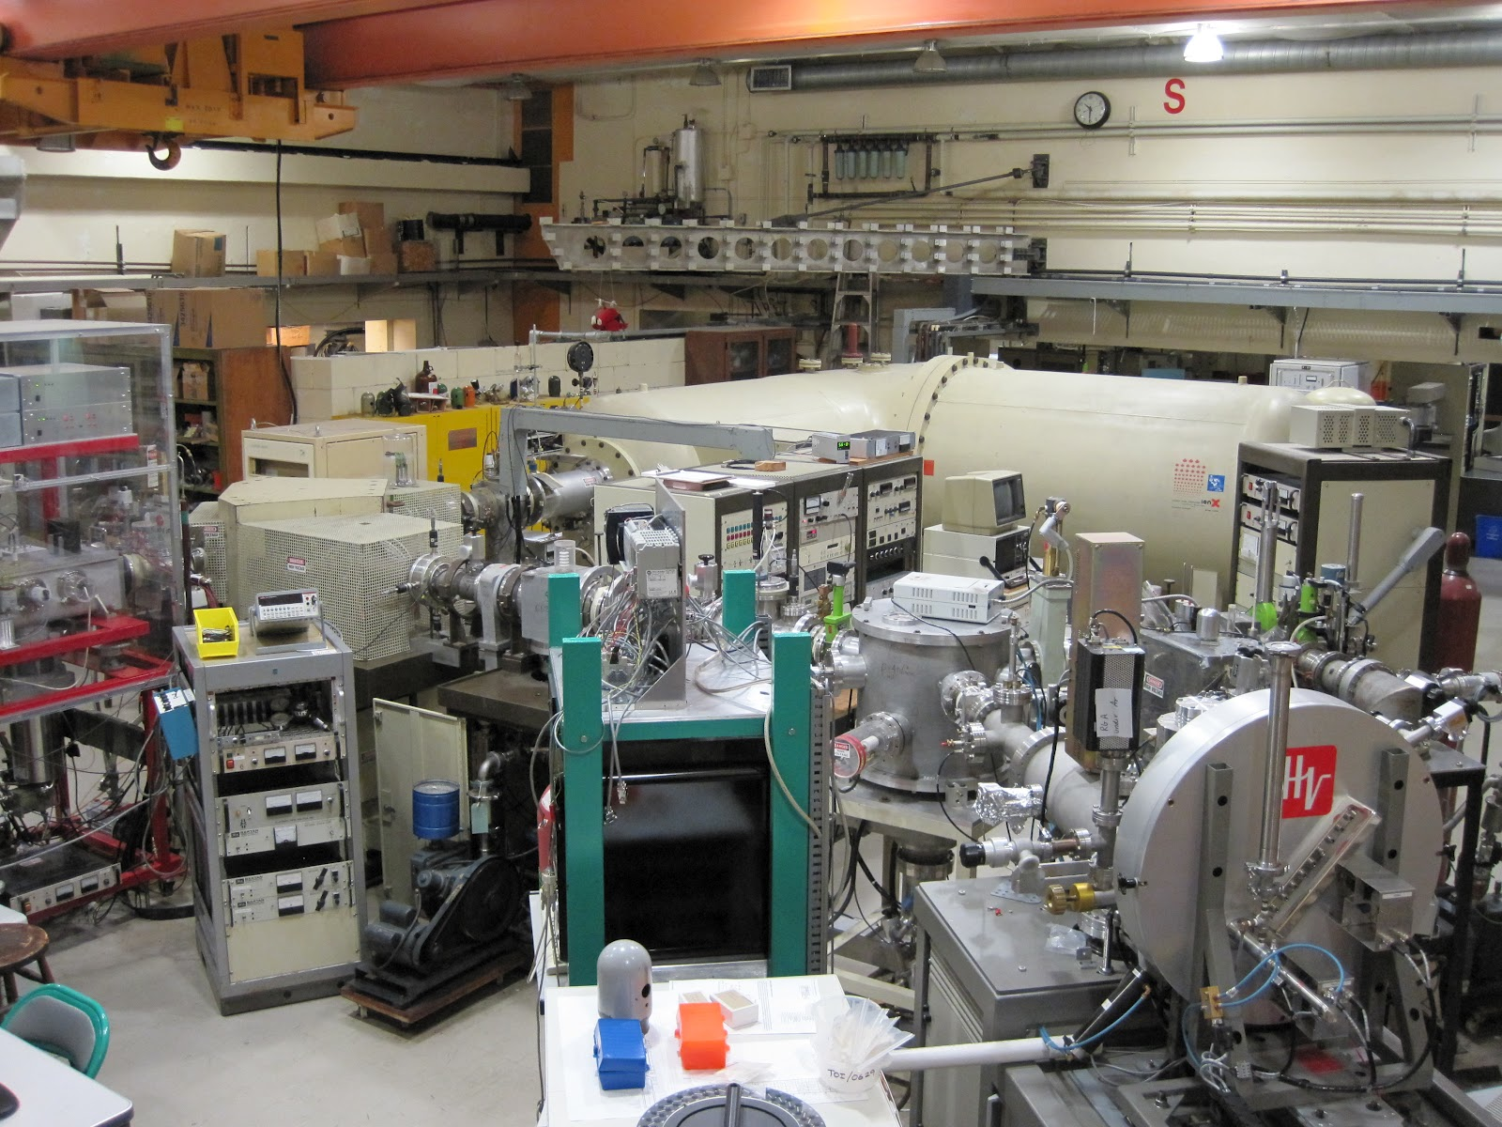
Overview
Radon
Generating a stable beam
Quantification and measurements of ²¹⁰Pb
Removal of Inferences
Standard curve of ²¹⁰Pb
Conclusions

Slide 3
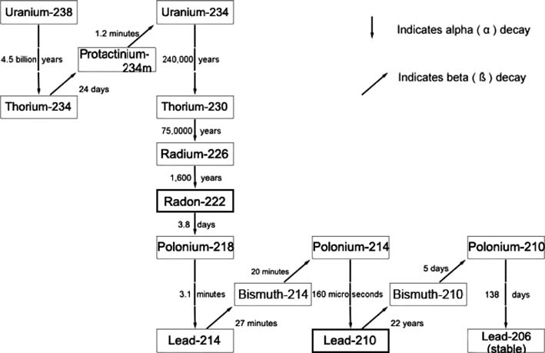
Radon
Image modified from Health Canada http://www.hc-sc.gc.ca/ewh-semt/radiation/radon/decay_scheme-eng.php Accessed March 2013

Slide 4
Measurements of ²¹⁰Pb
Method | Detection limit | Time
ICP-MS | 90mBq/L | Minutes
CC-ICP-MS | 688mBq/L | Minutes
γ-spectrometry | 440mBq | 1000min
LSC | 7 mBq | 8-9days +in-growth period
α-spectrometry | 0.1-1mBq | 3-5days + 3-5month in-growth period
Hou, X., Ross, P. Critical comparison of Radiometric and Mass Spectrometric
methods for the determination of radionuclides in enviromental, biological and nuclear waste samples. Analytica Chimca: 105-139. 2008
Amr, M.A., Al-Saad K.A., Helal, A.I. Ultra-trace Measurements of ²¹⁰Pb in natural occurring radioactive materials by ICP-MS. Nuclear Instruments and Methods in Physics Research A: 237-241, 2010.
Notes:
ICP-MS takes about 30sec to allow the sample to pass through, 20 secs of asparation and 20 or so sec for analysis of analyte
ICP-MS abduance sensitivity 208/210 = 10^9
AMS 208/210= 10^12 potenially 10^13

Slide 5
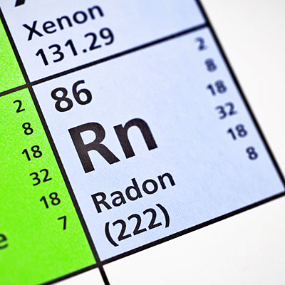
The Project
Can we measure a daughter product of ²²²Rn, ²¹⁰Pb by Accelerator Mass Spectrometry (AMS), quantitatively?
Notes:
Here I will mention that AMS is ultra sensitive can count millions of atoms
Can eliminate isobars
Has low background

Slide 6
To measure ²¹⁰Pb there were four important steps
Generating a stable PbF₃⁻ beam
Quantification and measurements of ²¹⁰Pb
Removal of interferences
Standard curve of ²¹⁰Pb

Slide 7
Generating negative beam: Strongest currents
Compounds | Ion | Average Current of ²⁰⁸PbX⁻ at 10kev (nA)ª | Theoretical current for ²⁰⁸PbX⁻ at 15kev (nA)^{b}
PbO +AgF₂ | (F-²⁰⁸Pb-O)⁻ | 34 | 36.38
PbF₂ * | ²⁰⁸PbF₃⁻ | 120 | 128.4
PbF₂ + AgF₂ +CsF | ²⁰⁸PbF₃⁻ | 175 | 187.3
*The Cs sputter source was optimized for this sample
ª Current was collected in 30min
^{b} Assumed 15% loss in 3hrs

Slide 8
Theoretical calculation of count rate for ²¹⁰Pb
8.2mg of PbF₂ was packed into the targets
Ionization efficiency= ²⁰⁸PbF₃⁻ produced
Initial concentration of ²⁰⁸Pb atoms
Ionization efficiency= 1.20x10⁻³

Slide 9
Theoretical calculation of count rate for ²¹⁰Pb continued
At terminal voltage V_{T} = 1.4500 MV, the following stripping yields were measured:
²⁰⁸PbF₃⁻ → ²⁰⁸Pb⁺¹ 21.2 %
²⁰⁸PbF₃⁻ → ²⁰⁸Pb⁺² 13.6 %
²⁰⁸PbF₃⁻ → ²⁰⁸Pb⁺³ 2.40 %
²⁰⁸PbF₃⁻ → ²⁰⁸Pb⁺⁴ 0.62 %
²⁰⁸PbF₃⁻ → ²⁰⁸Pb⁺⁵ 0.08 %
²⁰⁸PbF₃⁻ → ²⁰⁸Pb⁺⁶ 0.01 %
To bend Pb⁺³ ions the V_{T} has to be 0.9600MV. The stripping yield becomes 0.76%
Work was preformed by Dr. Zhao

Slide 10
Theoretical calculation of count rate for ²¹⁰Pb continued
Overall efficiency = ionization efficiency* transmission efficiency for Pb⁺³
Overall efficiency = 1.23x10⁻³ * 0.76x10⁻³
= 9.35x10⁻⁵
Therefore, 1mBq or 1.01x10⁶ atoms of ²¹⁰Pb would generate:
Atoms measured in 3 hours= Atoms added * Overall efficiency
= 10 counts

Slide 11
To measure ²¹⁰Pb there were four important processes
Generating a stable PbF₃⁻ beam
Quantification and measurements of ²¹⁰Pb
Removal of interferences
Standard curve of ²¹⁰Pb

Slide 12
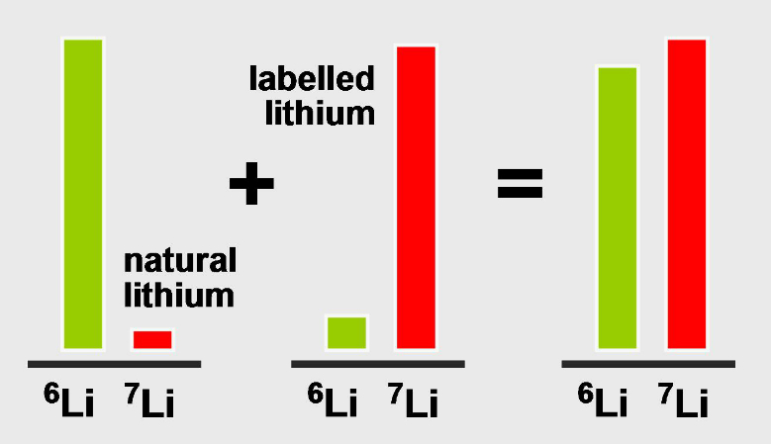
Isotope dilution
Image form http://en.wikipedia.org/wiki/File:Principle_of_isotope_dilution.jpg Accessed April 2014

Slide 13
Quantifying ²¹⁰Pb with isotope dilution
²⁰⁸Pb
Measure in Faraday cup not MCA
Abundant and variable in samples
²⁰⁵Pb
Measure counts in MCA
Not readily available
Thallium-205
Counting efficiency changes

Slide 14
²⁰⁵Pb isotope dilution
²⁰⁵Pb⁺³ + ²⁰⁵Tl⁺³
⁶⁸Zn⁺¹
¹³⁷Ba⁺²

Slide 15
Accounting for Thallium interferences
⁶⁸Zn⁺¹
²⁰³Tl⁺³
¹³⁵Ba⁺²

Slide 16
²⁰⁸Pb isotope dilution
500ug of ²⁰⁸Pb
71pA of ²⁰⁸Pb⁺³
Blank
Zero pA of ²⁰⁸Pb⁺³

Slide 17
²¹⁰Pb Measurements
²¹⁰Pb is measured in a +3 charge state or m/z 210
3
⁷⁰Zn⁺¹
Mass to charge problem: 70 +140 = 210
1 2 3
Accumulated ²¹⁰Pb⁺³ spectrum
¹⁴⁰Ce⁺²

Slide 18
To measure ²¹⁰Pb there were four important processes
Generating a stable PbF₃⁻ beam
Quantification and measurements of ²¹⁰Pb
Removal of interferences
Standard curve of ²¹⁰Pb

Slide 19
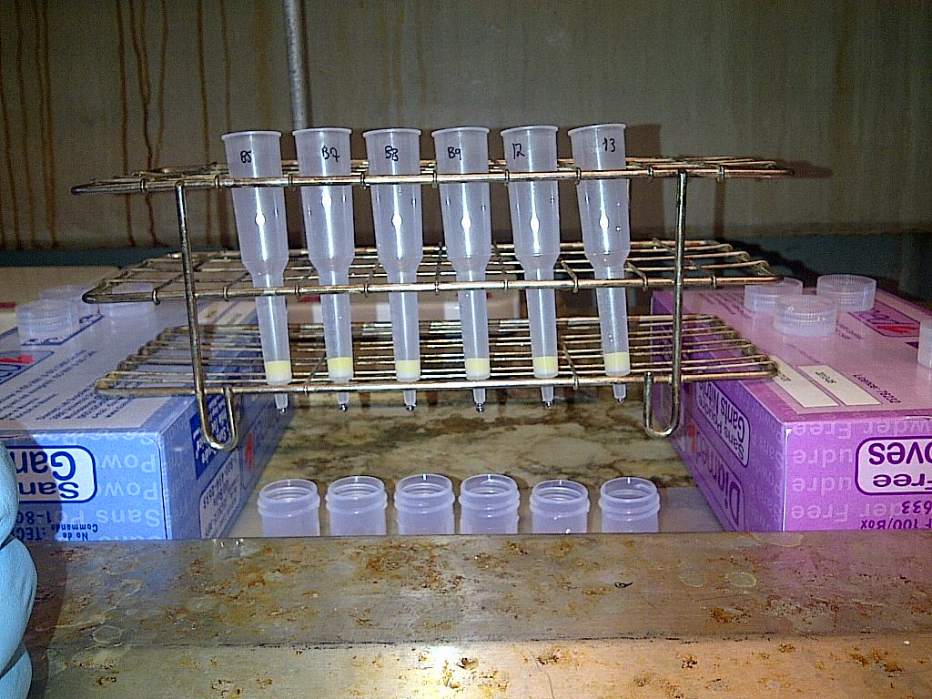
Column Chemistry to remove interferences
Load resin
Convert to Bromide form
Load sample
Wash
Elute with HCl

Slide 20
Removal of interferences
⁷⁰Zn⁺¹
Accumulated ²¹⁰Pb⁺³ spectrum
¹⁴⁰Ce⁺²

Slide 21
To measure ²¹⁰Pb there were four important processes
Generating a stable PbF₃⁻ beam
Quantification and measurements of ²¹⁰Pb
Removal of interferences
Standard curve of ²¹⁰Pb

Slide 22
²⁰⁸Pb isotope dilution
⁷⁰Zn⁺¹
But based on isotope dilution 400mBq of ²¹⁰Pb was measured
¹⁴⁰Ce⁺²
Packing material CsF and AgF₂

Slide 23
Accounting for the efficiency differences between detectors

Slide 24
Measurements of Pb-210
Method | Detection limit | Time
ICP-MS | 90 mBq/L | Minutes
CC-ICP-MS | 688 mBq/L | Minutes
γ-spectrometry | 440 mBq | 1000min
LSC | 7 mBq | 8-9days +in-growth period
α-spectrometry | 0.1-1mBq | 3-5days + 3-5month in-growth period
AMS | 0.04*-1.5 mBq | 3-6 hours
* 0.3mBq detection limit with new AMS
Hou, X., Ross, P. Critical comparison of Radiometric and Mass Spectrometric
methods for the determination of radionuclides in enviromental, biological and nuclear waste samples. Analytica Chimca: 105-139. 2008
Amr, M.A., Al-Saad K.A., Helal, A.I. Ultra-trace Measurements of ²¹⁰Pb in natural occurring radioactive materials by ICP-MS. Nuclear Instruments and Methods in Physics Research A: 237-241, 2010.

Slide 25
Conclusions
PbF₃⁻ produces the strongest beam
²⁰⁸Pb can be used as yield tracer but:
There is a difference in efficiency between atom detector and current detector
Expect limit of detection to be 0.3mBq with newer AMS.

Slide 26

Acknowledgments
Prof. Jack Cornett
Prof. Liam Kieser
Dr. Xiaolei Zhao
Prof. Ted Litherland
PDF. Chris Charles
Dr. Nimal DeSilva
Jack Satterly Geochronology laboratory

Slide 27
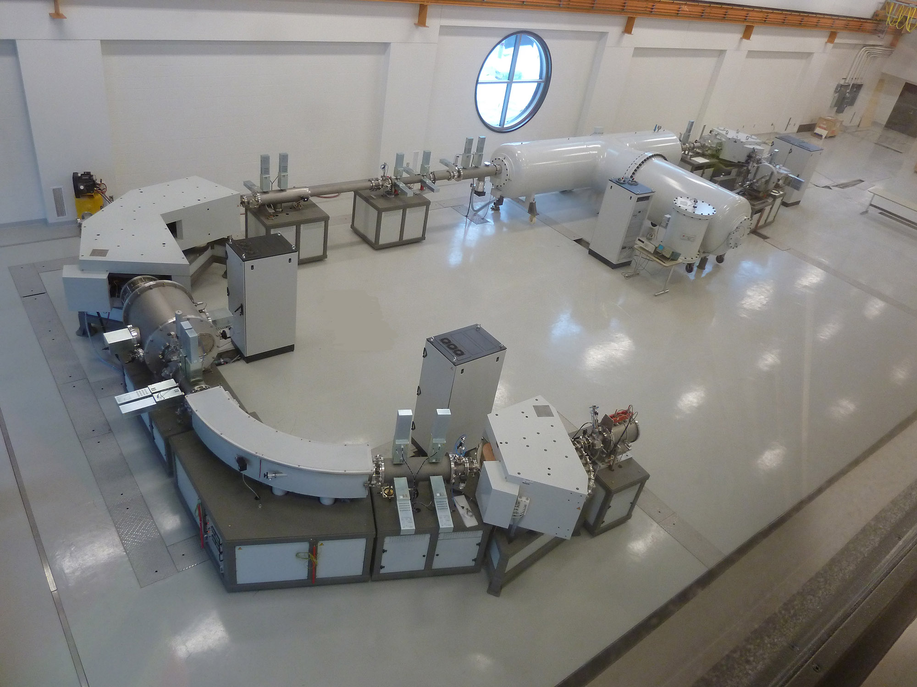
Thank you
Thank you

