Slide 1

High Resolution Depth Profiling of Ti Oxidation
M. Brocklebank, J.J. Noel*, L.V. Goncharova
Department of Physics and Astronomy, University of Western Ontario
*Department of Chemistry, University of Western Ontario
June 12, 2014
Notes:
Motivation:
Ti is widely used in industry and research
Thermal vs. electrochemical
I) Understanding degradation/corrosion specific to Ti
II) Elucidation of general principles of electrochemical oxidation:
Dominant migrating species
Exchange reactions
Transport mechanisms
III) Stopping power for H⁺ in Ti and TiO₂ ultra-thin films

Slide 2
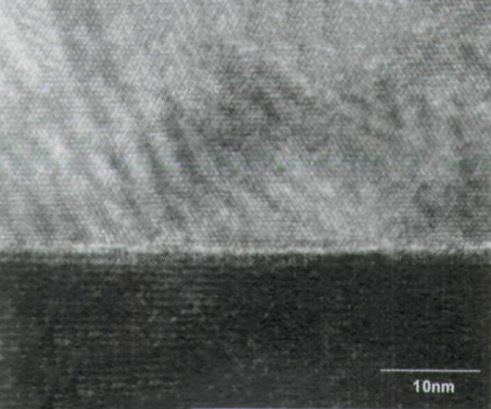
Motivations
Ti is widely used in industry and research
Oxidation processes:
-Thermal: lack of precise control → > 100 nm
-Electrochemical (time vs voltage):
high quality ultra-thin films (≈10 nm)
Corrosion specific to Ti
General principles of electrochemical oxidation:
  -Dominant migrating species
  -Exchange reactions
  -Transport mechanisms
Stopping power for H⁺ in Ti and TiO₂ ultra-thin films
Matsumoto et. al. Science, 2001. Vol. 291, p854-856
Notes:
Motivation:
Ti is widely used in industry and research
Thermal vs. electrochemical
I) Understanding degradation/corrosion specific to Ti
II) Elucidation of general principles of electrochemical oxidation:
Dominant migrating species
Exchange reactions
Transport mechanisms
III) Stopping power for H⁺ in Ti and TiO₂ ultra-thin films
“Atomic resolution TEM image of Co doped TiO2 films no segregation of impurities phase was observed in the film”

Slide 3
Procedure
Ti films deposition on Si(001) by sputtering (with J. Noel, Chemistry, UWO)
Isotopic labeling:
  Ti sample is exposed to isotopic (¹⁸O) water
    Ultra thin TiO₂ Film
  TiO₂/Ti/Si(001) electrochemically oxidized
  in H₂¹⁶O water
Medium Energy Ion Scattering (MEIS):
  Analyze surface layers at sub-nanometer depths
  Simulation of depth profiles of isotopes
Other analytic techniques:
  X-ray Photoelectron Spectroscopy (XPS): Ti oxidation state
  Nuclear Reaction Analysis (NRA): Absolute ¹⁸O conc., potential depth profiling
O-diffusion and
exchange in bulk
of oxide
TiO₂ growth,
O exchange at interface
H₂O decomp.
at surface
Si-substrate
H₂O
TiO₂
O
Notes:
Mention XPS results.
Mention NAR

Slide 4
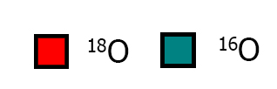

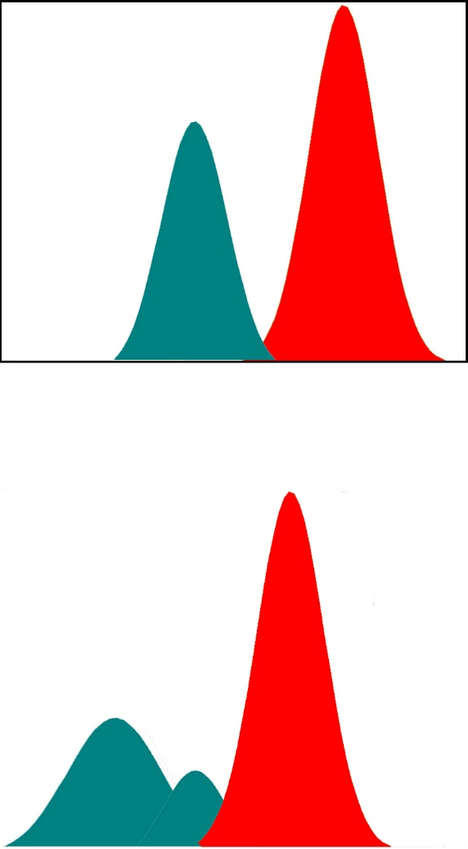
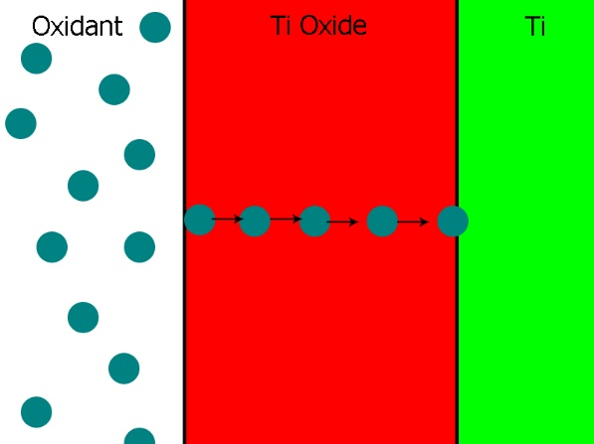
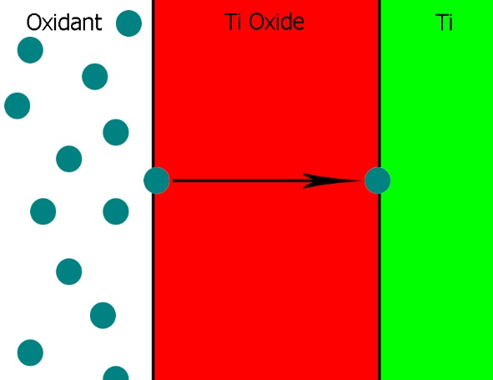
Two Major Oxygen Transport
Mechanisms
Oxygen lattice transport (O or vacancy exchange)
Direct oxygen transport (no O-exchange) to interface
Concentration vs Depth
Ion Scattering Yield vs Energy
Notes:
Supose we oxidized a sample of Ti twice. Once in 18O and again in 16O. Emphasize this is sequential from 18O and then O16
Infer transport mechanism from depth profiles
How can this be done?
How to determine the depth profiles?

Slide 5
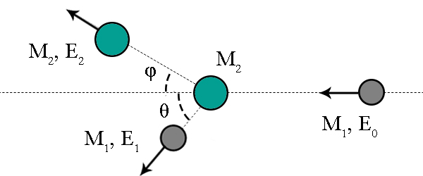
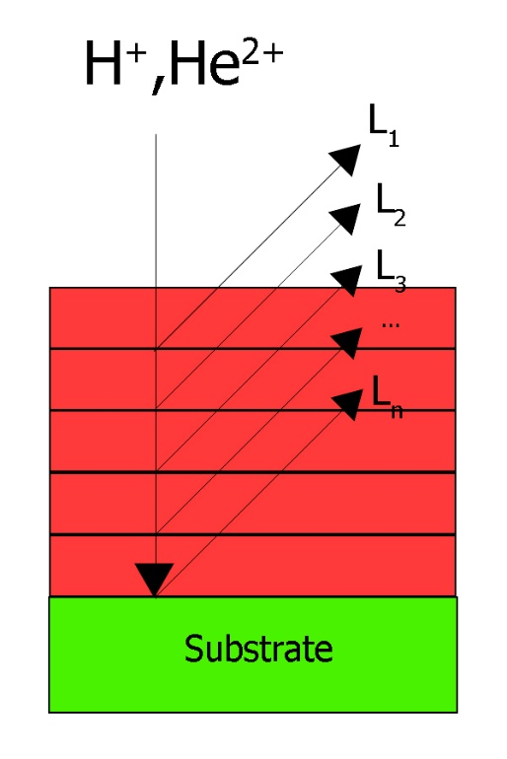
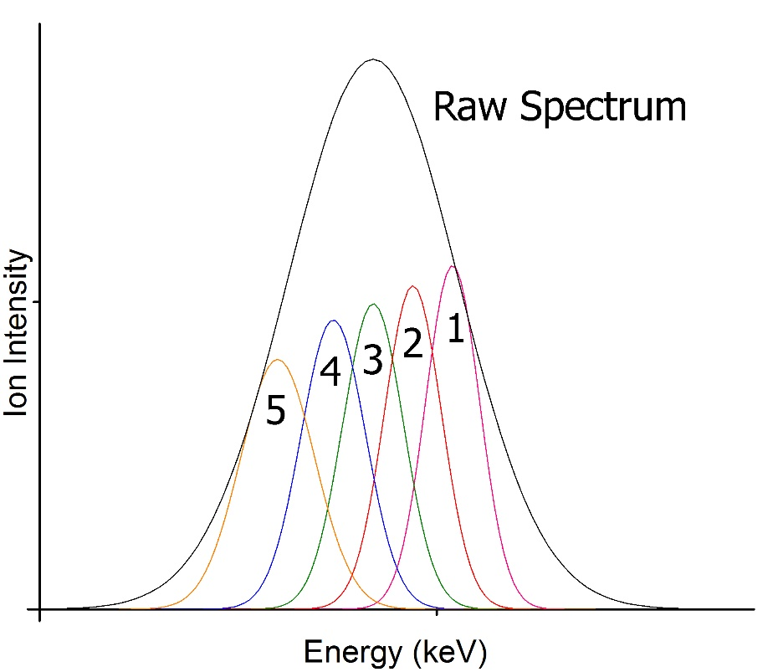
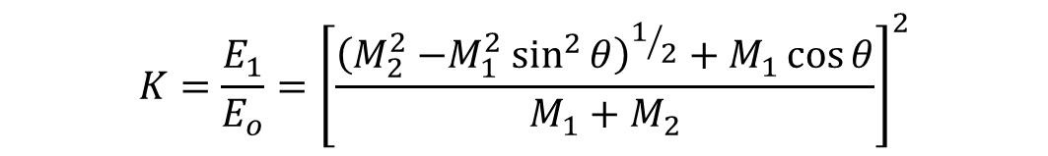
Rutherford Backscattering Spectrometry (RBS) and Depth Profiles
Incident beam of mono-energetic ions
Scattered off target → element/isotope sensitive
Know M_{1 ,}E₀ and θ (detector placement)
Measure E₁ → determine M₂
$$K=\frac{E_{1}}{E_{o}}={\left[\frac{{\left(M_{2}^{2}{−M}_{1}^{2}\sin^{2}{θ}\right)}^{1/2}+M_{1}\cos{θ}}{M_{1}+M_{2}}\right]}^{2}$$
Notes:
Model the film as a series of layers.
Simulation makes use of relevant physics: scattering for energy loss and propabilties of collision: cross sections, stopping powers, etc. to

Slide 6
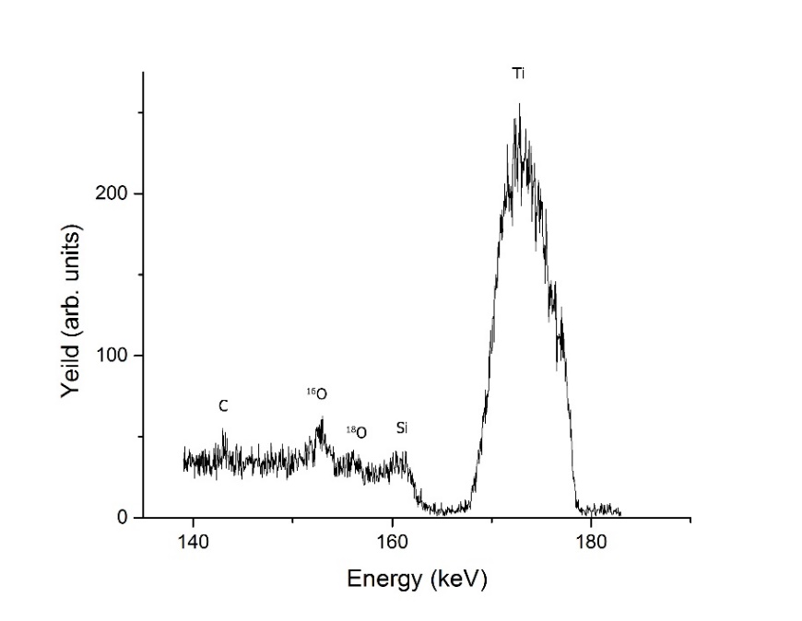
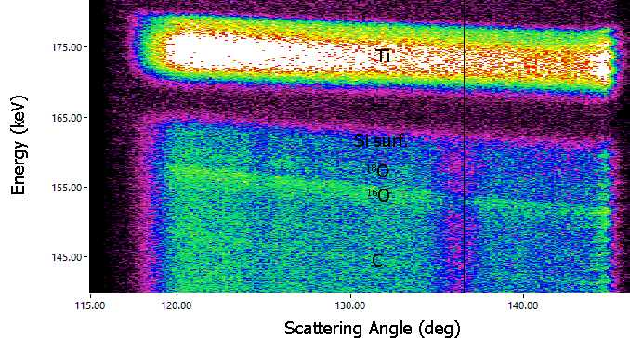
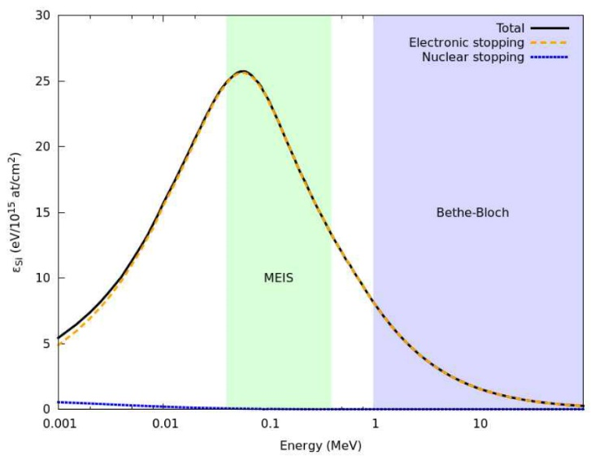
Medium Energy Ion Scattering (MEIS)
Identical to RBS, but:
Torrodial Electrostatic Analyizer (TEA):
-Scattered Ion intensity as a function of scattering
angle, at fixed energy
Channeling incident beam and movable detector positioned
to blocking direction: “Double Alignment”
PSTAR database (NIST): http://www.nist.gov/pml/data/star/index.cfm
Notes:
The relevant Physics is same as RBS
1. Medium Energy: < 200 keV/amu
-Less penetration (higher sur. Sens.), max. Stopping Cross sections for H⁺ and He⁺
2. Toroidal Electrostatic Analyzer(TEA)
-Scattered Ion intensity as a function of scattering angle at a fixed energy with a high energy resolution.
3. Channeling incident beam (by changing orientation of sample) and moving detector to a blocking direction results in double alignment

Slide 7
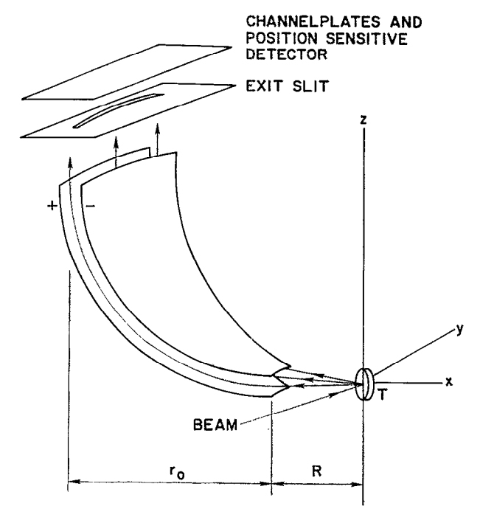
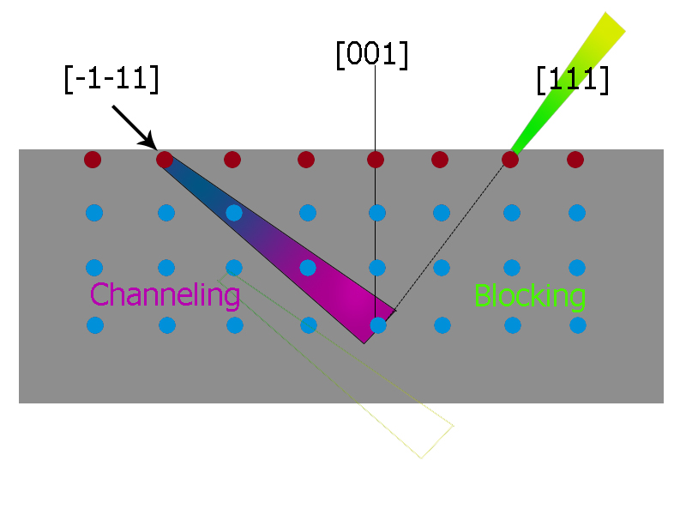
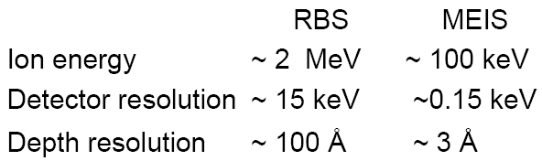
TEA and Double Alignment
Tromp et. al. Review of Scientific Instruments 1991, Vol. 62, p2679
Channeling and blocking in the <111> directions for double alignment.
Notes:
Shadowing plus blocking

Slide 8
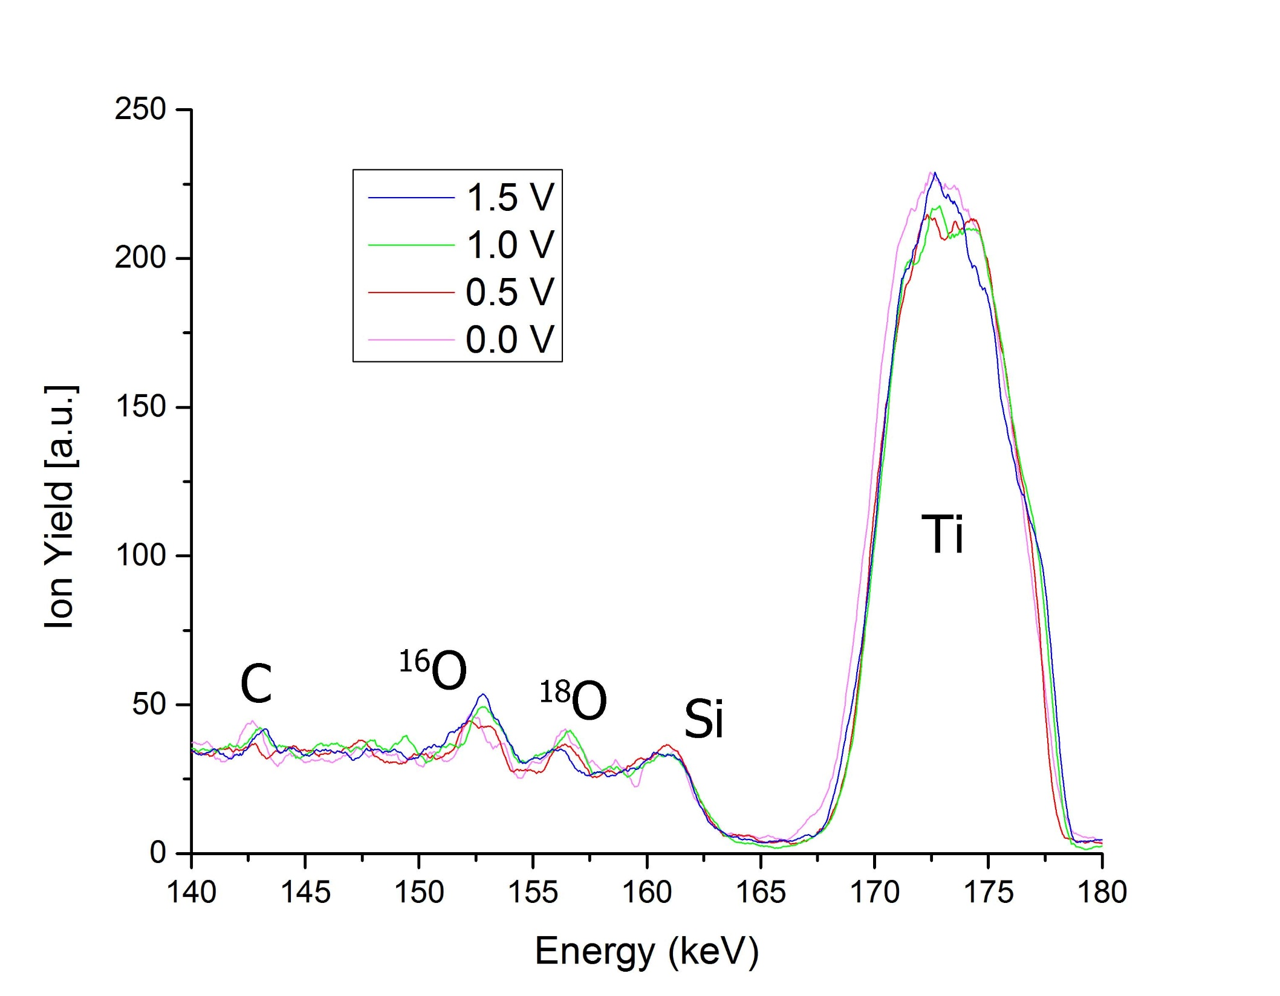
MEIS Full Spectrum

Slide 9
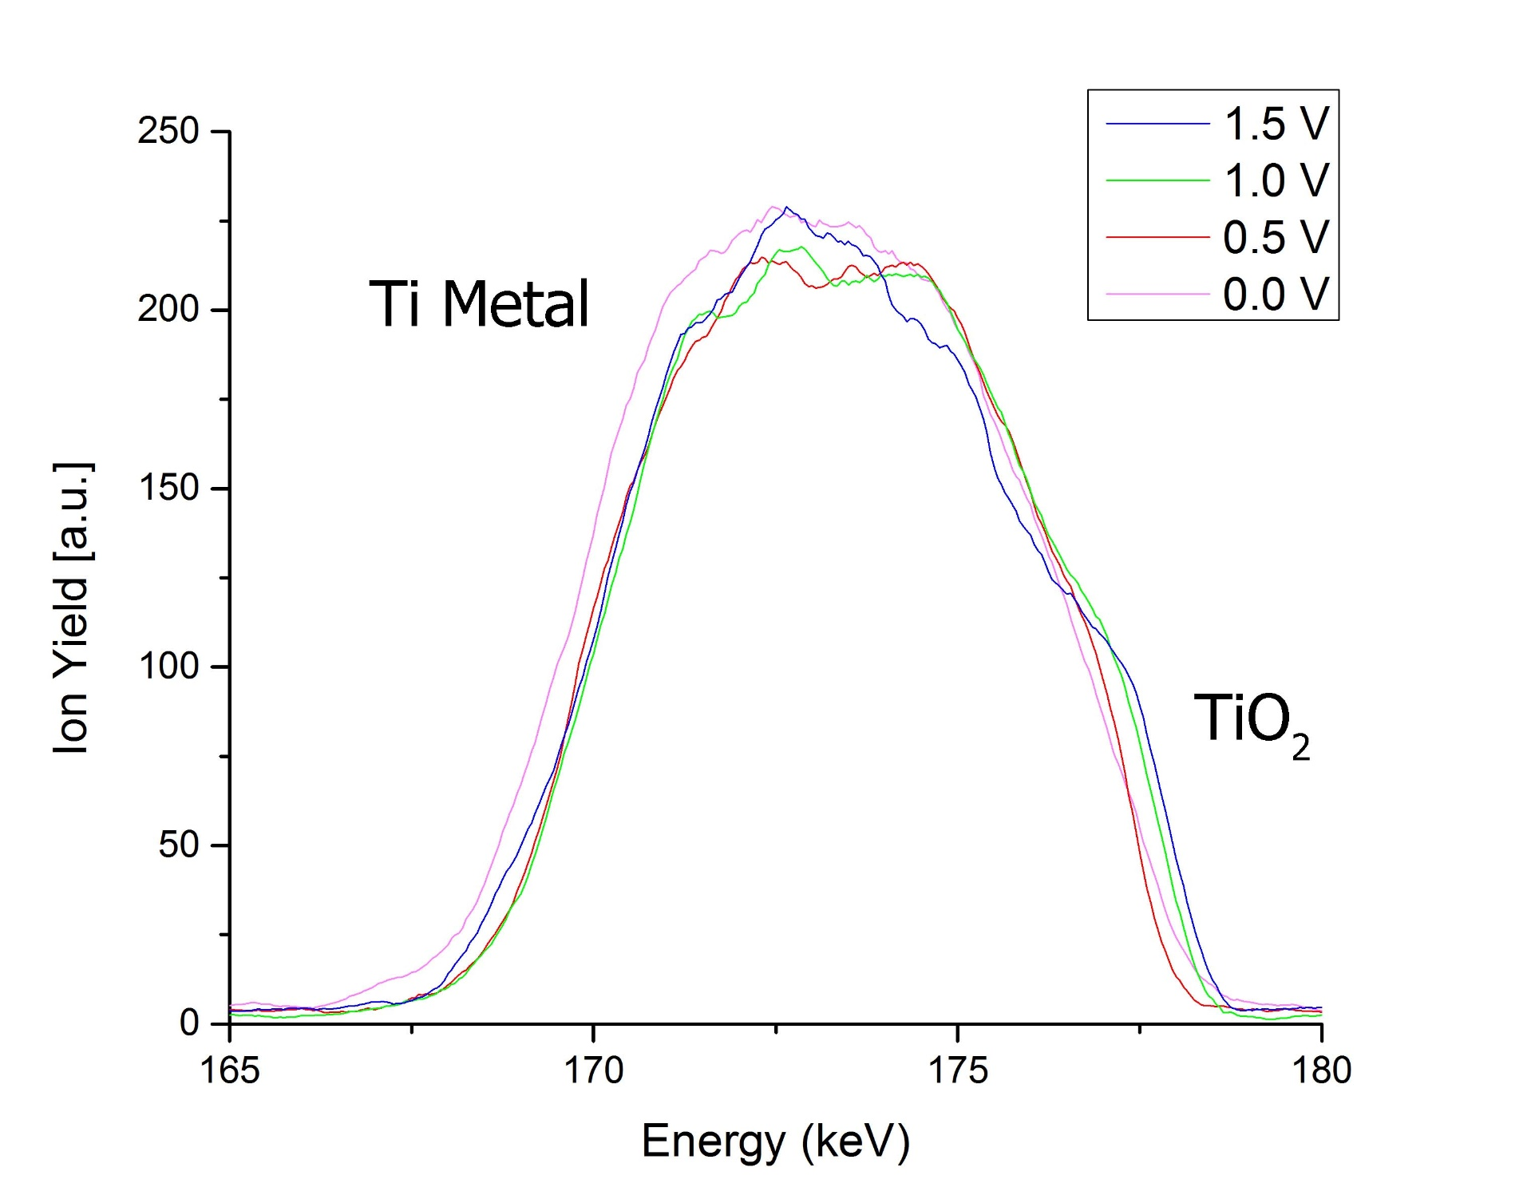
Features of MEIS Spectra: Ti Features
Notes:
Convolution of scattering intensity due to Ti mental and Ti oxide

Slide 10
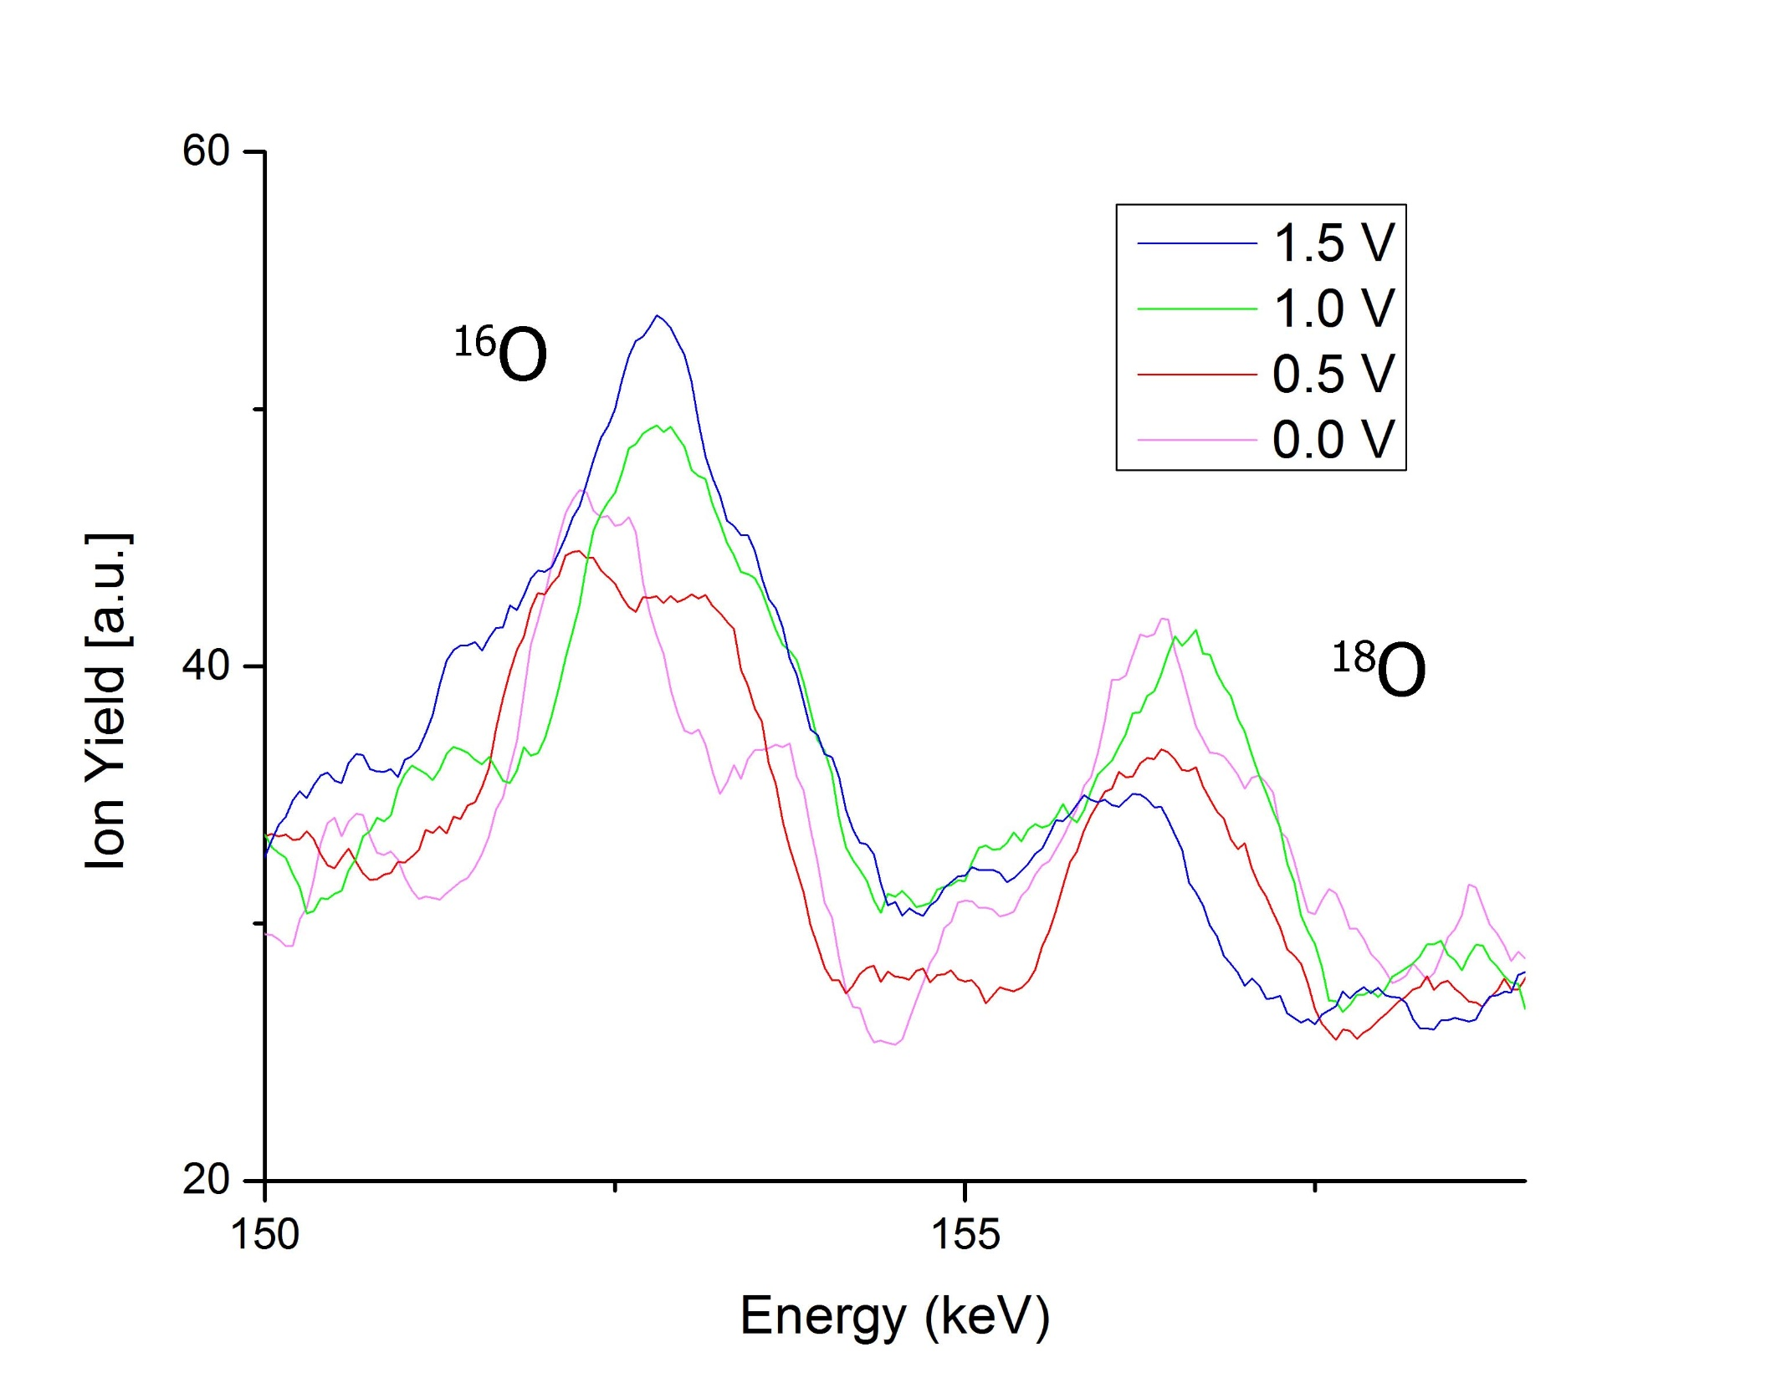
Features of MEIS Spectra: O Features

Slide 11
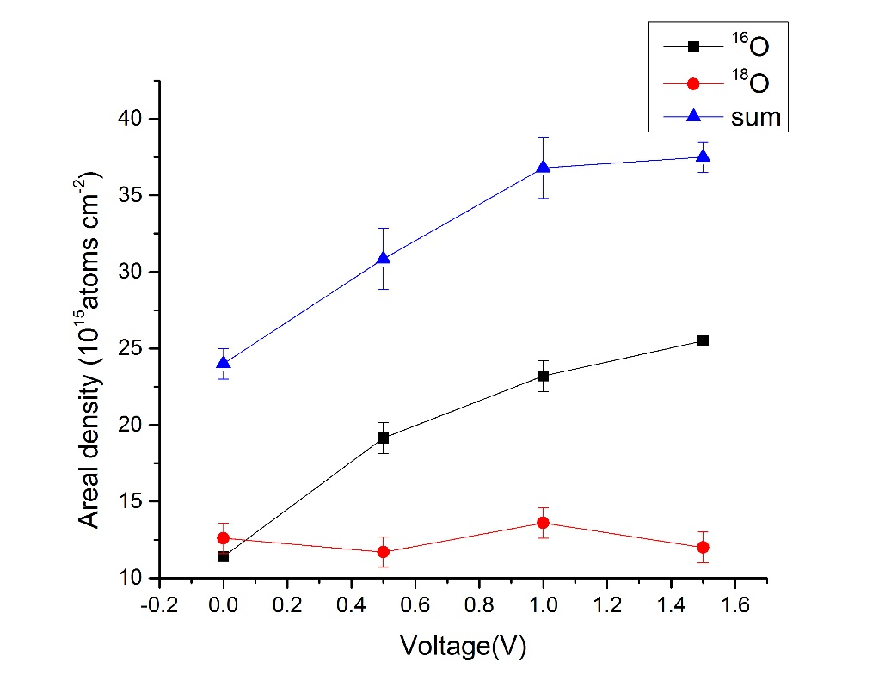
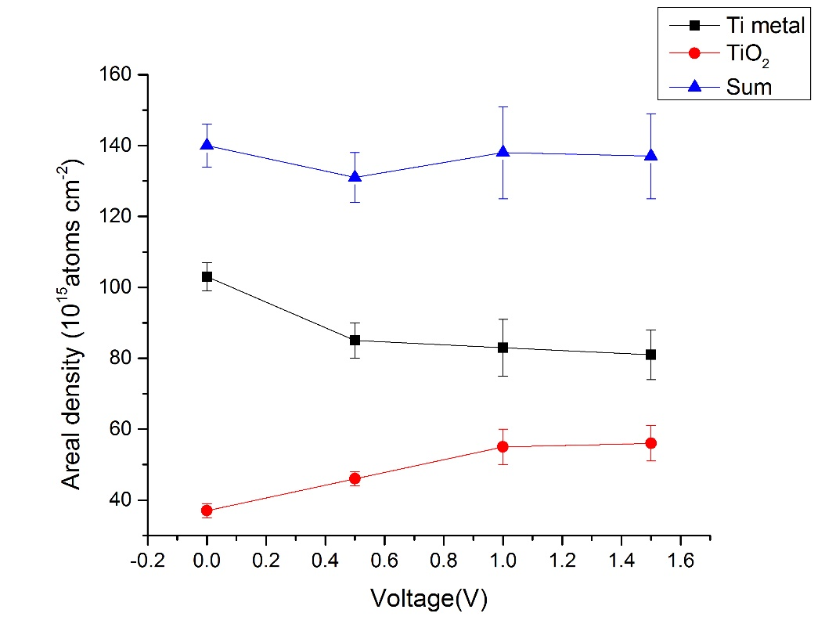
From Simulations:
Areal density (10¹⁵atoms/cm²) | 0 V | 0.5 V | 1.0 V | 1.5 V
Ti | 103 | 85 | 83 | 81
TiO_{x} | 37 | 46 | 55 | 56
¹⁶O | 11.4 | 19 | 23 | 25.5
¹⁸O | 13 | 12 | 14 | 12

Slide 12
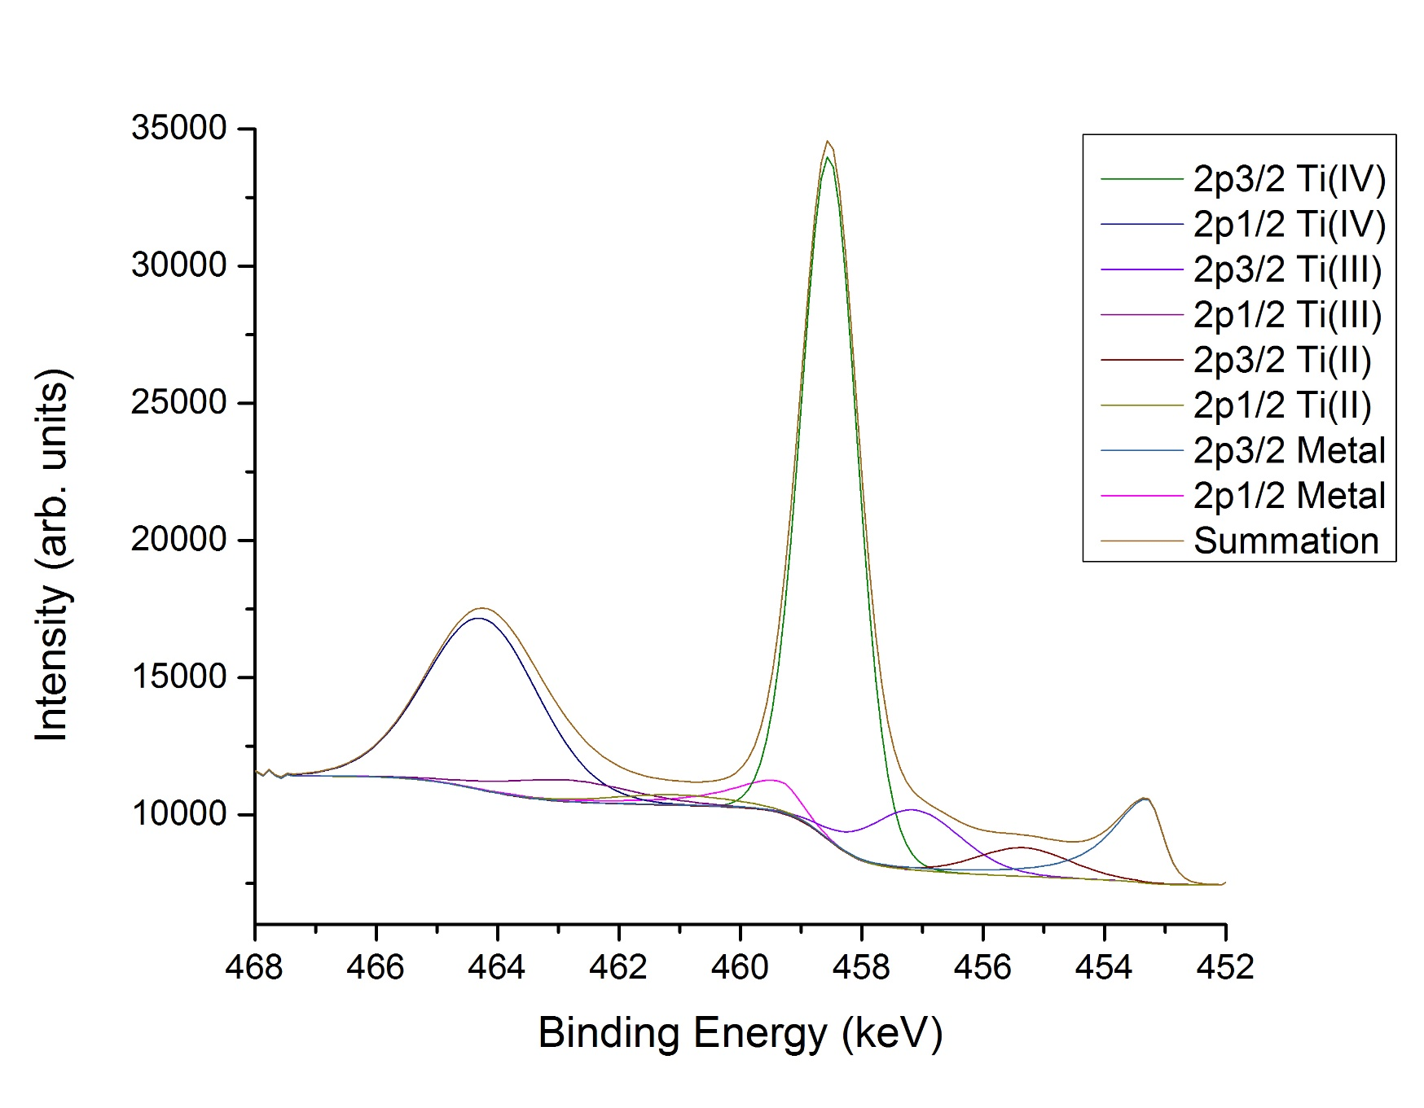
X-Ray Photoelectron Spectroscopy (XPS)
Figure: XPS data of Ti used to justify use of TiO₂ in simulation. More accurate simulations can take into account different oxidation states

Slide 13
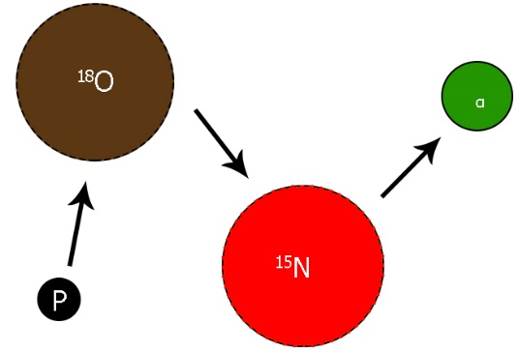
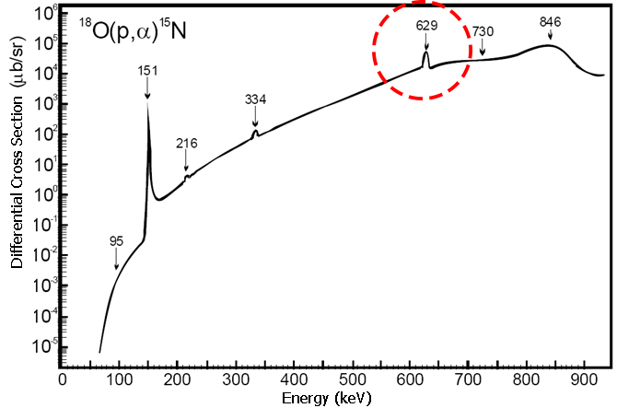
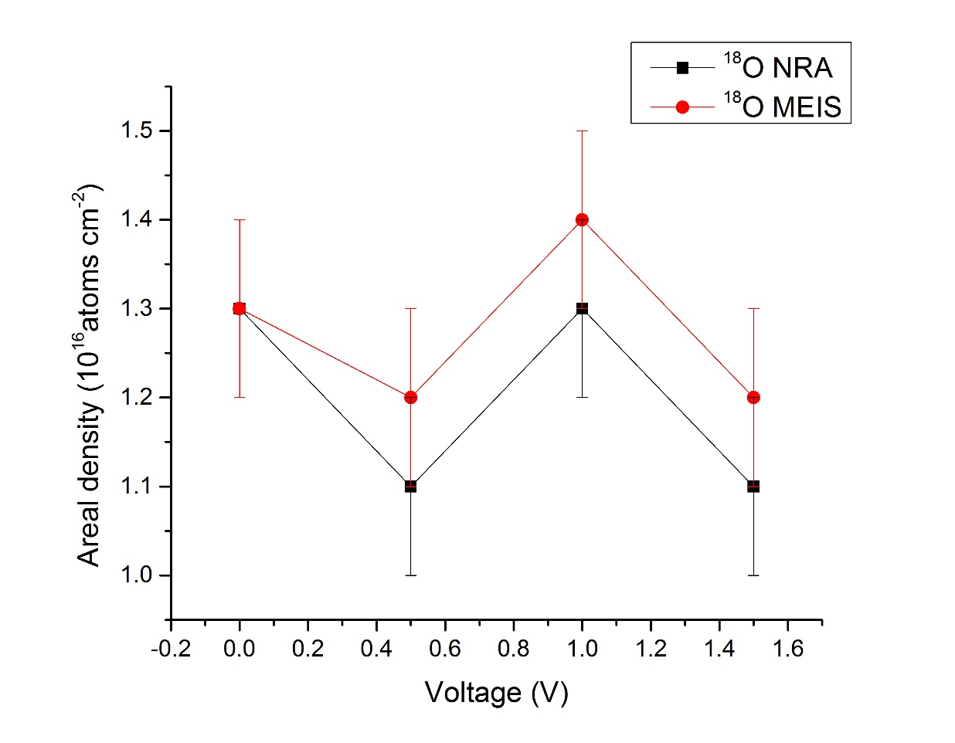
Nuclear Reaction Analysis (NRA): ¹⁸O (p, α) ¹⁵N
Baumvol. Private correspondence.

Slide 14



Conclusions
Direct oxygen transport (no O-exchange) to interface
Oxide growth increases as function of voltage
Increasing incorporation of ¹⁶O towards Ti/Oxide interface:
  -Implies O is the migrating species and not Ti
Exchange between ¹⁶O and ¹⁸O minimal
  -Except possibly at oxide surface
Future work
Oxidation kinetics: with V=const, vary time
Explore alternative ¹⁸O and ¹⁶O methods of depth profiling. Particularly the NRA 151keV resonance. Hopefully this matches
MEIS.
Examine importance of morphology

