Slide 1


Hard Tissue Ablation with Continuous-wave kW Ytterbium Fiber Laser
Chris Galbraith
Alison W. Kinross
Paul J. L. Webster
Logan G. Wright
Cole Van Vlack
Yang Ji
James M. Fraser
Chenman(Cara) Yin
June 19th, 2014
Notes:
Good afternoon everyone.
In case you are wondering why my title slide didn’t match the title printed on the agenda, it is because my talk was regrouped from “Applied Physics” to “Biophotonics” session, so I modified my talk to be more relevant to the audience here. And I would like to show you some of our most recent work on laser bone ablation with a one micron CW laser. Interestingly, The results turned out to be nothing like what we expected. Of course it is a good surprise otherwise I wouldn’t be telling you about it. ;p

Slide 2

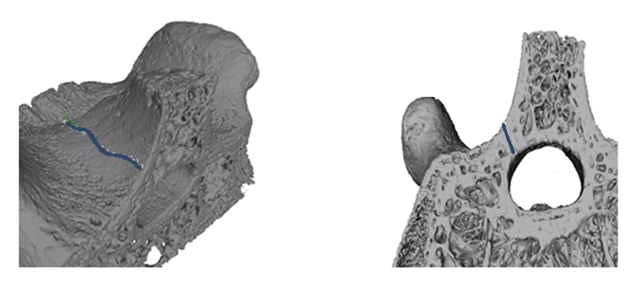
Lasers – New Surgical Tool
Top view
Side view
Surgical path
Traditional method – mechanical saw
vs
Modern method – laser beam
Notes:
The motivation to study laser bone ablation is that lasers are emerging as promising surgical tools. Shown here is a micro-CT scan of a vertebral bone provided by a surgeon we are collaborating with. The blue line is a planned surgical path for treatment of spinal stenosis, a condition where partial bone removal is performed to relive the pressure on the spinal cord. Cutting depth control is extremely important because we have to avoid complete cut-through, otherwise the spinal cord, which runs thought this canal, will be highly subject to damage. Highly invasive….
The traditional method for such surgical procedure is for a trained surgeon to manipulate a mechanical saw to perform bone removal. However, the cut tend to be broad and hand vibrations cause damage to surrounding tissues. So the cut precision is also highly limited by the skills of the surgeon. In comparison for modern method, laser beam can be focused extremely tightly such that the incision can be very narrow. The cutting path can also be automated with a PC so hand vibration is no longer an issue. In addition, the non-contact cutting nature allows real-time monitoring such that depth feedback control is possible.

Slide 3

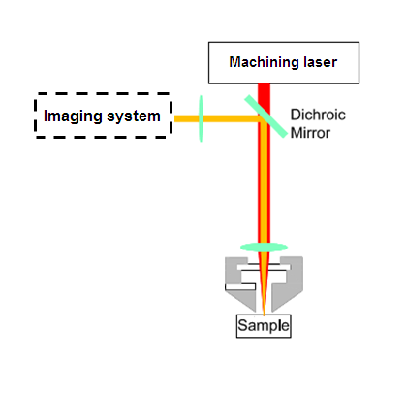

Inline Coherent Imaging (ICI)
Combined machining and imaging laser beam
Depth control
is achieved by monitoring the ablation process in real-time with combined imaging and machining light
Notes:
This is when our technology comes in handy. The system we have developed is called inline coherent imaging, or ICI, which utilized similar imaging principles as spectral domain OCT, which stands for Optical Coherence Tomography. And by combining the imaging and machining light, we are able to monitor and have control over the ablation process in real-time.

Slide 4
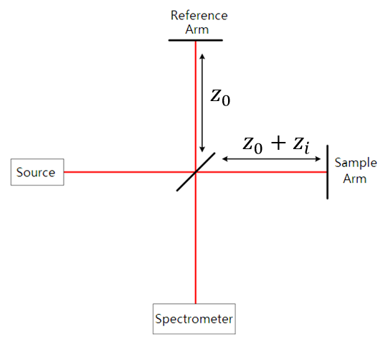
Basics of Inline Coherent Imaging
1
0.8
0.6
0.4
0.2
0
750
800
850
900
Lambda (nm)
1
0.8
0.6
0.4
Imaging system
0.2
0
4
750
800
850
900
Lambda (nm)
Notes:
ICI in the simplest picture is a white light interferometer. The light source, reference arm and spectrometer are the main components of the imaging system.
The light source we use is a broadband SLD. Light propagate through the interferometer setup to form an interference pattern. This equation represents that’s being measured at the spectrometer, and we are interested in finding out Z_i which is the optical path difference between the reference arm and the sample arm.
A software calibration process will allow us to subtract the DC signal so we are only left with this cosine term. It is not hard to realize the trick to go from frequency domain to z-domain.

Slide 5
Basics of Inline Coherent Imaging
1
0
0.5
200
m)
μ
400
0
Depth (
FFT
600
-0.5
800
-1
750
800
850
900
1000
Lambda (nm)
0
0.5
1
Signal (arb)
5
Notes:
The trick is the Fourier transform. In z-domain, the strongest signal represent the sample surface. By plotting the z-domain data on an intensity graph as a function of time, we will have real-time information on the depth of cut by tracking the surface that’s being machined. Currently, our imaging speed can go up to 300kHz.

Slide 6


ICI – Combined Imaging and Machining
Depth Tracking of Percussion Drilling on Bone
Laser on
Laser off
6
Notes:
This is an example of what a typical ICI image looks like. This graph is a record of percussion drilling on bone for 2 seconds. Both machining and imaging starts at time zero, no obvious surface modification occurs until a threshold energy is deposited at about 400ms to cause a sudden onset of ablation. The slope of this line allows us to do direct calculation of the ablation rate which is found to be roughly 120um/J.

Slide 7
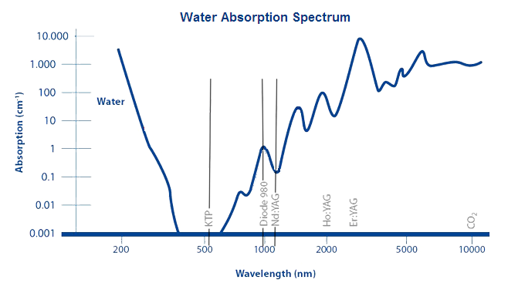
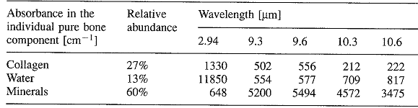
Hard Tissue Ablation
According to water absorption spectrum, Ytterbium fiber lasers at one micron is not ideal for hard tissue ablation.
Metrum, Diode laser
SWING 1470
Ytterbium fiber lasers
Er:YAG
lasers
CO₂
lasers
Forrer M, Appl. Phys. B Photophysics Laser Chem. (1993)
Notes:
Now lets look at how ICI can help us to control bone ablation. Just some background: bone are roughly made of 27% collagen, which are the organics, 13% water, and 60% of minerals, which is mainly hydroxyapatite. Most medical lasers utilize wavelength at water absorption peaks. 3micron Erbium YAG or 10micon CO2 lasers are the most common ones.
However in this study, we explore the laser tissue interaction at 1um with a ytterbium fiber laser. According to water absorption spectrum, Ytterbium fiber lasers at one micron wavelength is not ideal for hard tissue ablation at all.

Slide 8
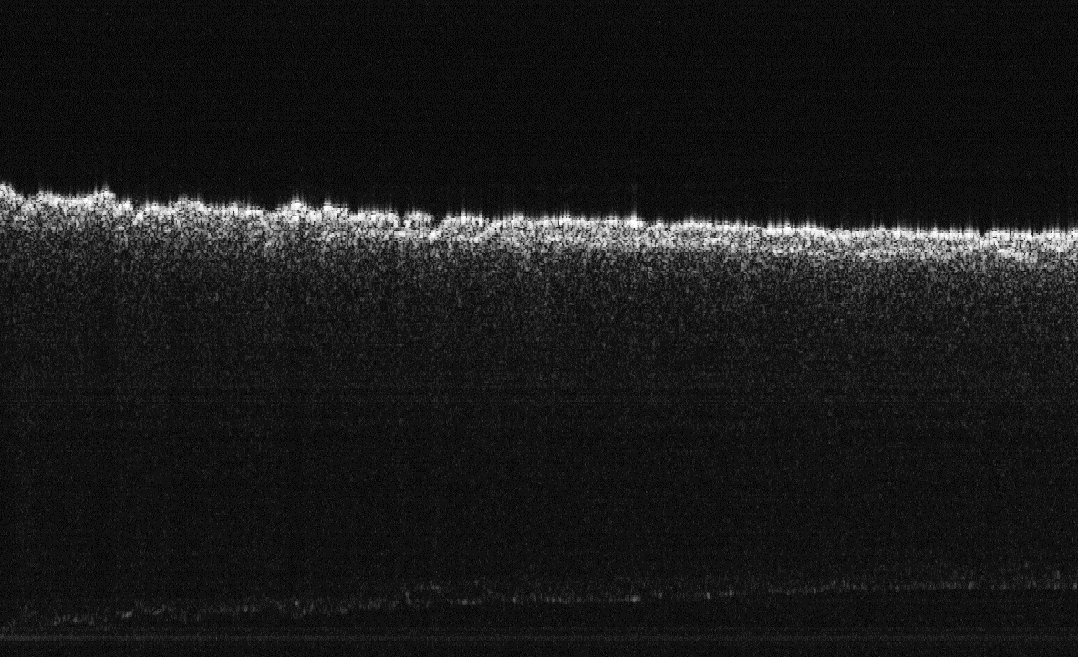
Depth Feedback Control
Original bone surface
Target depth
2mm
Notes:
Anyways we went ahead and we tried some simple tests, for this one here we tried to cut an irregular bone surface to a certain target depth. This is achieved by sweeping while pulsing the laser over a straight line back and forth multiple times until the target depth is reached. The laser peak power was 300W with a rep rate of 100Hz. And the pulse duration is 100us.

Slide 9
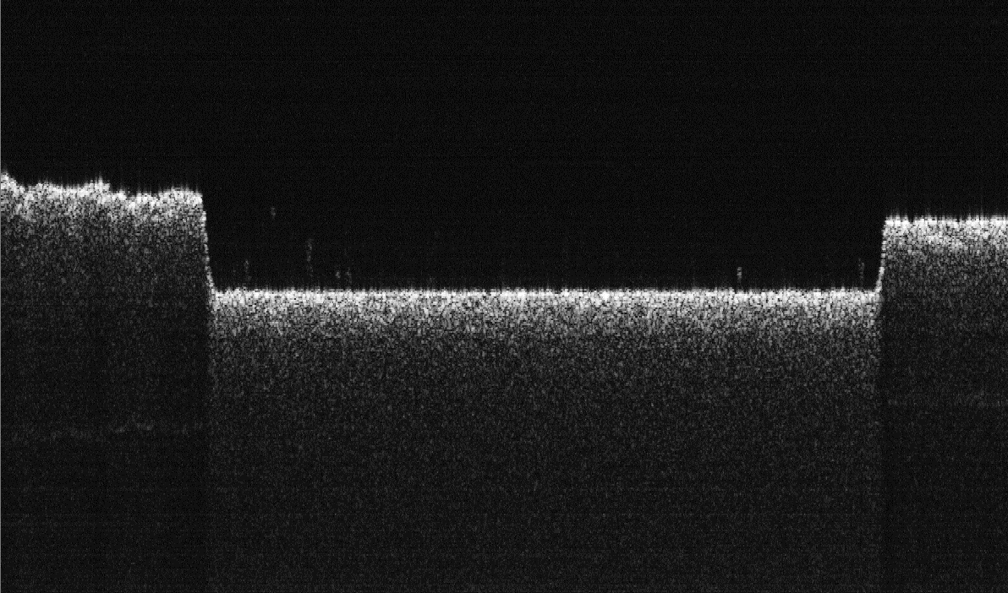
Depth Feedback Control
Original surface
Original surface
Machined surface
Target depth
2mm
Notes:
And this is the end result of a 1cm long cut and roughly 1mm deep incision. As you can see, the bottom of the cut matched with the pre-specified target depth extremely well.
The good line cut quality give us the confidence that with depth feedback control of ICI, we can follow more complicated surgical path and cut to varying target depth if needed.
As a proof of concept, we designed some fairly complicated three-dimensional geometries to be cut out on bone.

Slide 10
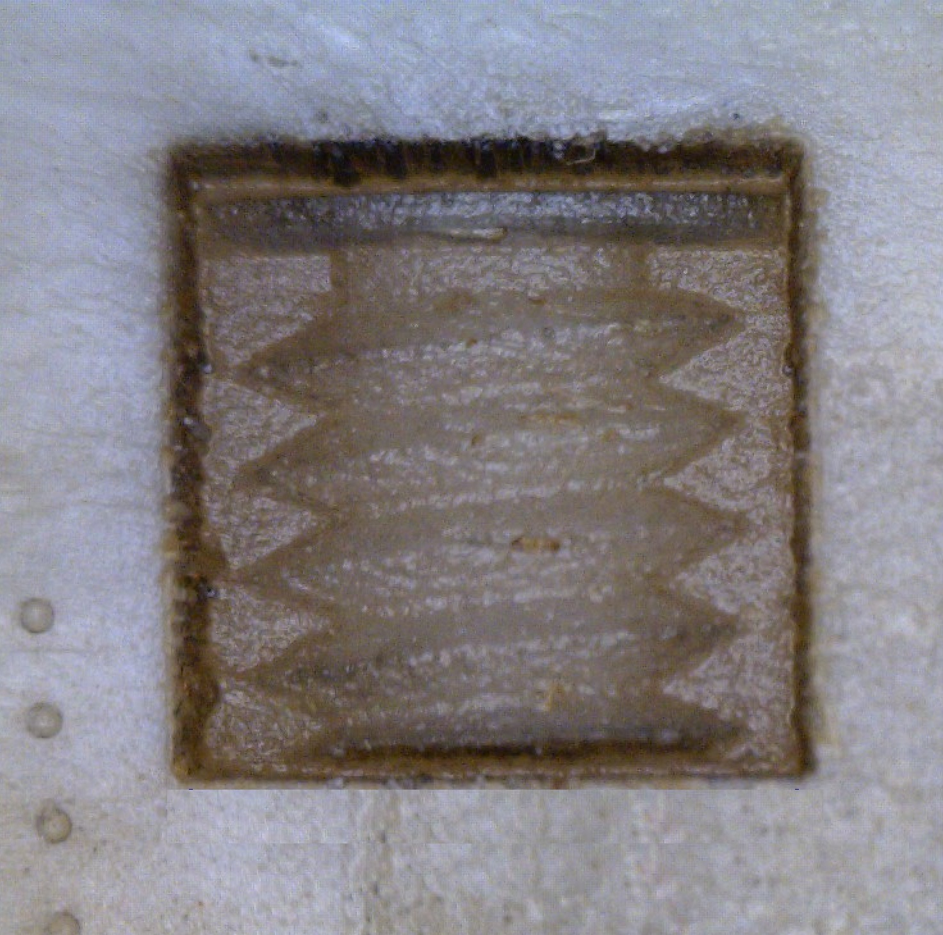
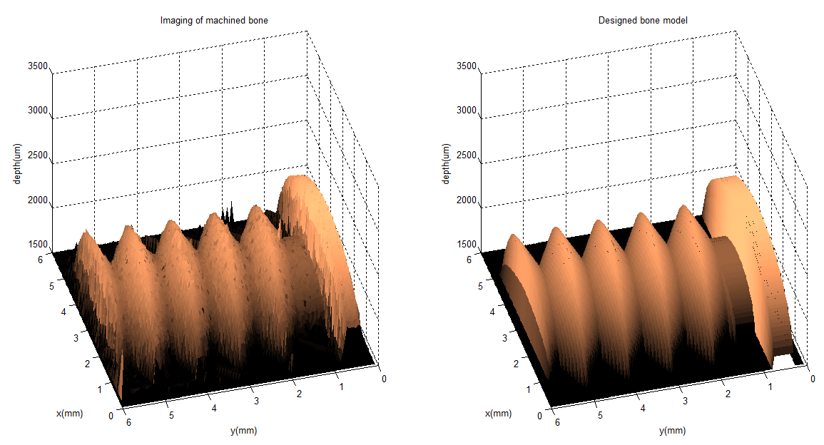
3D “Clean” Bone Machining
Machined Feature vs
Designed Model
6mmx6mm feature
1mm depth range
Notes:
The first shape is a half-screw with a total depth range of 1mm, and a size of 6mm by 6mm. When we tried to machine this pattern out on bone, this is what we got…
The quality looks amazing to the naked eye. We also imaged the feature, plotted it in 3D and compared it to the original model, the agreement is again surprisingly good.

Slide 11
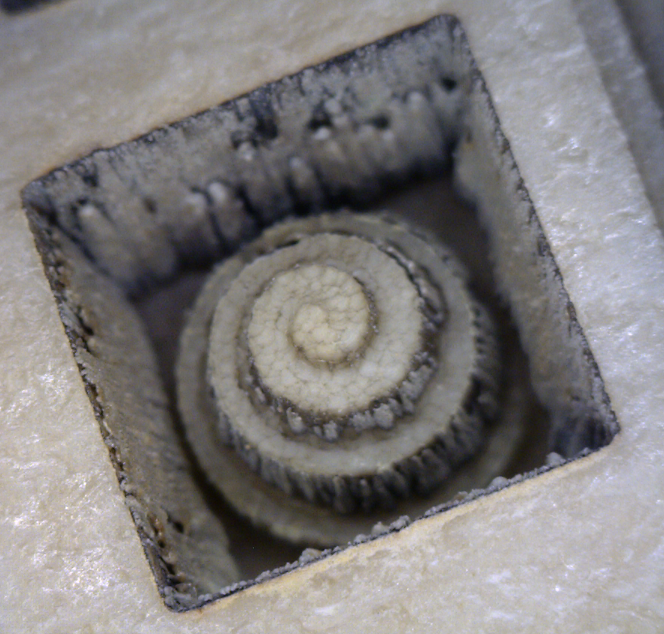
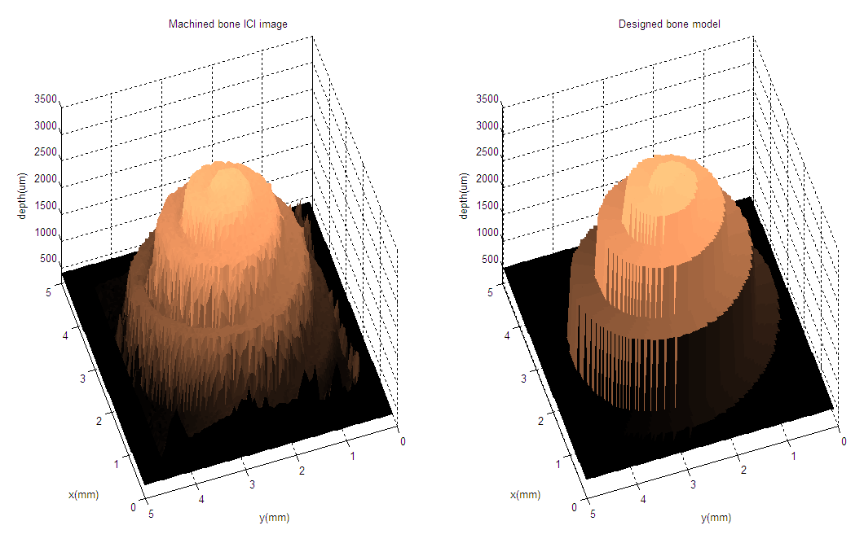
3D “Clean” Bone Machining
Machined Feature vs Designed Model
Designed Model
6mmx6mm feature
3mm depth range
Notes:
Just to show that this process has versatility, this is another spiral shape that we designed. Note that with the same feature size, a max depth of 3mm is achieved on the spiral. So the aspect ratio is a ½ which is three times of the previous feature.
But in fact, the most surprising thing is not how good the pattern matches the model but rather how “clean” the machined surface was. For hole drilling we normally observe a large heat affected zone due to high aspect ratio, but here very little carbonization was present for this 3D machining process. This implies that the heat affected zone is very localized and there is little damage to surrounding tissues.
In my knowledge, this has never been reported before. I mean 3D bone machining with a 1micron industrial laser? No one would expect it to work, so we are really in a regime that has never been explored. So now it comes the question- why did it work after all?

Slide 12
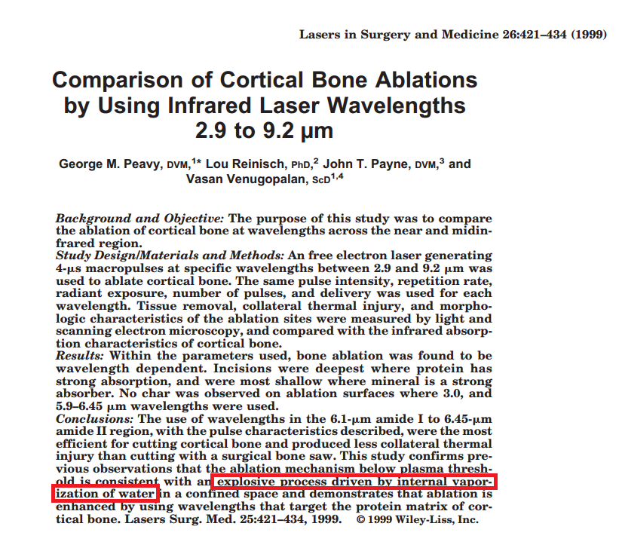
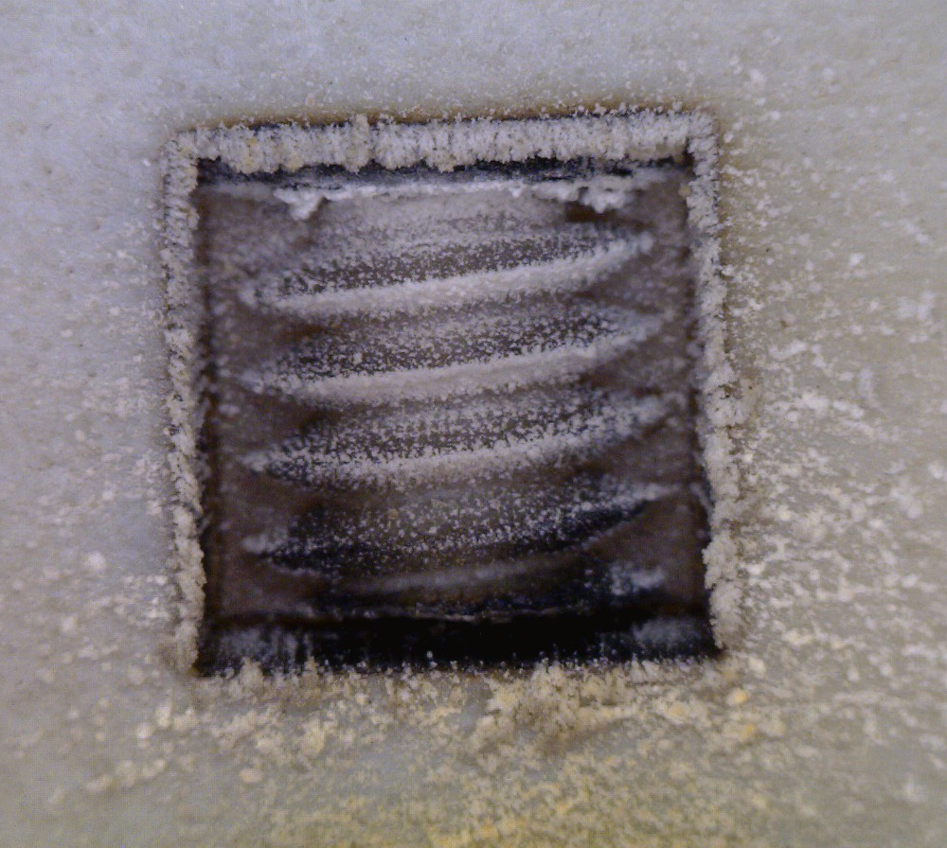
Why Did It Work?
Notes:
I started digging in the literature for an explanation: one of the most documented continuous-wave bone ablation mechanism is water micro-explosion. So basically during machining of bone, heat gets absorbed by water to cause a fast increase of vapor pressure and eventually water undergoes explosive evaporation that ablate material away. However, this mechanism is proposed based on experimental results for lasers with wavelength at water absorption peaks.
But in our case, water absorbs poorly at 1micron. Plus, dry bone samples were used in all of our experiments which has extremely low water component, as shown in this picture. So we really don’t think it’s water that’s driving the micro-explosions.
Although we did observe explosion-like phenomenon where bone power fly out during machining. Therefore, we came up with the following hypothesis.

Slide 13
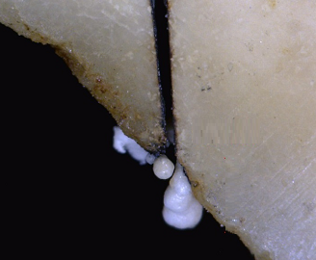
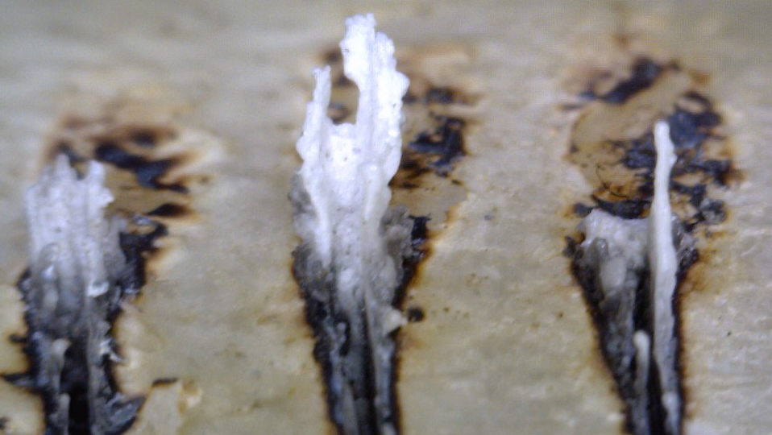
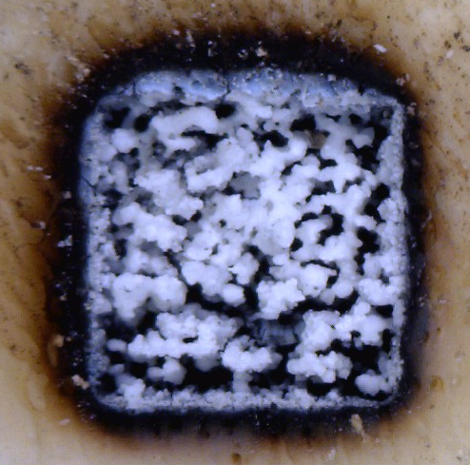
Hypothesis
  Formation of thin carbonization layer
  Higher absorption of carbonized area
  Explosive evaporation of the molten mineral “cleans up” the carbonized layer
Notes:
1)When enough energy is deposited on bone surface, the organic component denatures first to form a thin carbonization layer, and 2) darkened layer absorbs energy more efficiently and bone minerals starts to melt. The molten minerals undergoes explosive evaporation and cleans up the carbonized layer. Therefore in the end, we observe what looks almost like virgin bone surface on the machined 3D features.
Here are some images of solidified bone minerals which exhibited liquid characteristics under high power cutting conditions. And we think this is the evidence of the molten mineral.

Slide 14
Conclusion
Notes:
To sum it up, certain surgical procedures requires high precision cut on hard tissue. And we explored laser bone ablation with a 1 micron laser combined with our inline coherent imaging technology. This allows us to have depth feedback control which is critical in many surgery applications. Preliminary results are surprisingly good – with ICI depth control, we achieved high quality line incision as well as automatic 3D bone machining. Currently, ongoing effort is put into understanding the underlying mechanism of this machining process and potentially verifying our hypothesis.
From an application perspective, we strongly believe that ICI-guided laser ablation has great potential in bone surgery and also in producing complicated autograft bone implants, such as a bone screw.
Thank you for your attention. I have some bone samples here if you wanna take a look.

Slide 15
Extra slides

Slide 16
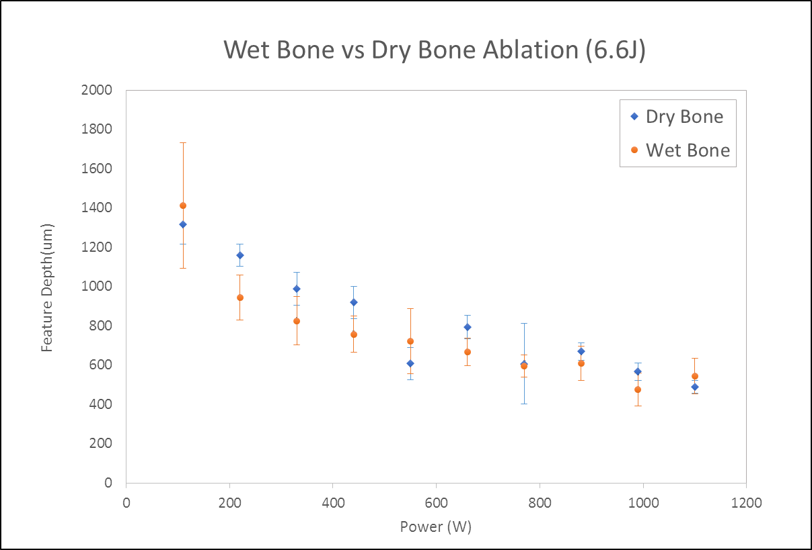

Slide 17

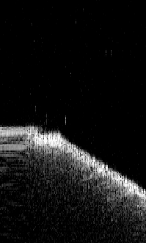
Evidence

Slide 18
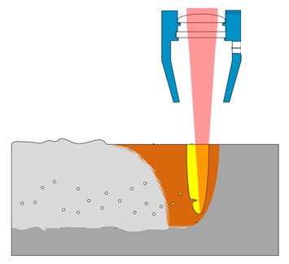
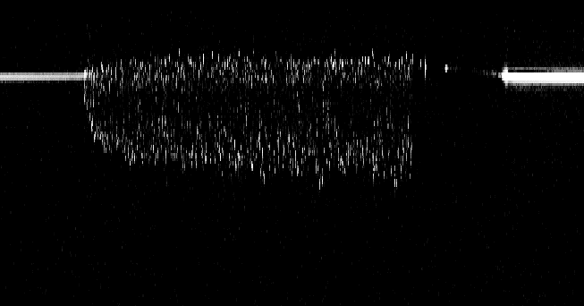
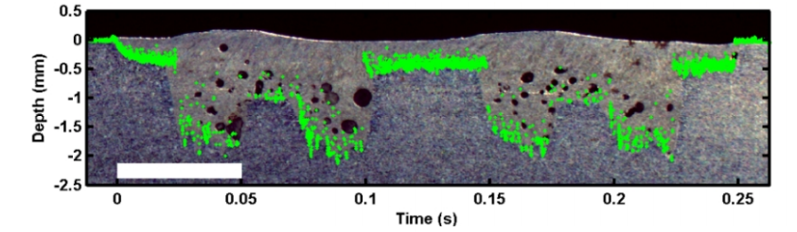
ICI – Combined Imaging and Machining
Example #2
Keyhole
Welding
0
m)
(μ
Depth
100
200
300
0
0.5
1
1.5
2
2.5
3
Time (ms)
ICI-tracked Bottom of a Laser Weld Overlaid on Microscopy Image
2mm
18
Notes:
Laser welding is another application where ICI can give us much insight into this extremely complicated process. This is a typical ICI image for a welding process, and here is the comparison the ICI-tracked weld bottom to the microscope image of weld cross-section. You can see that they show very good agreement.
.

Slide 19
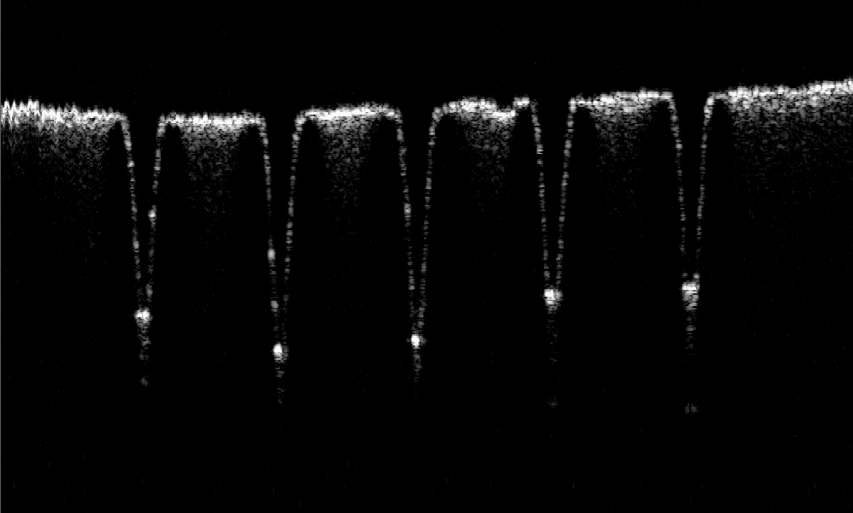
Fixed energy hole drill

Slide 20
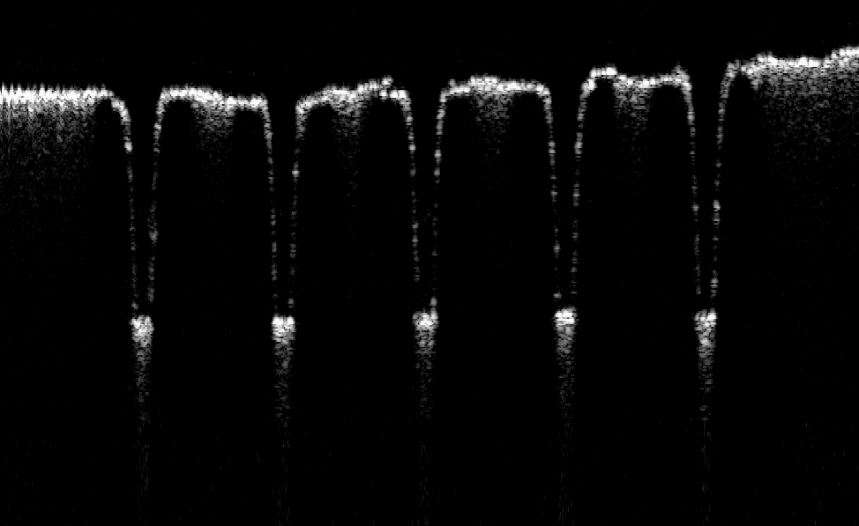
Feedback control hole drill

Slide 21
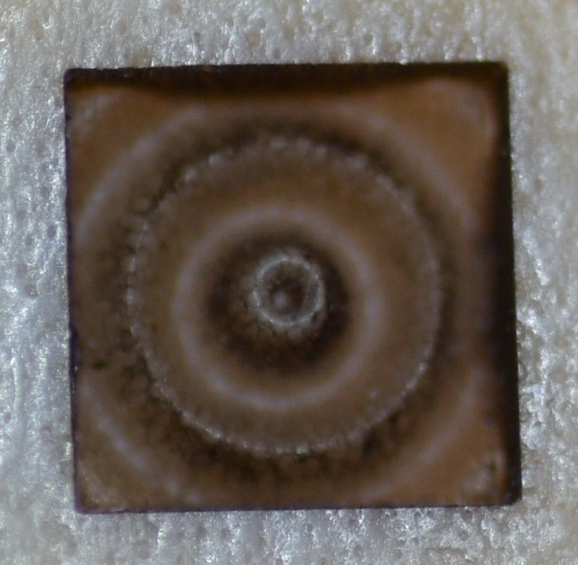
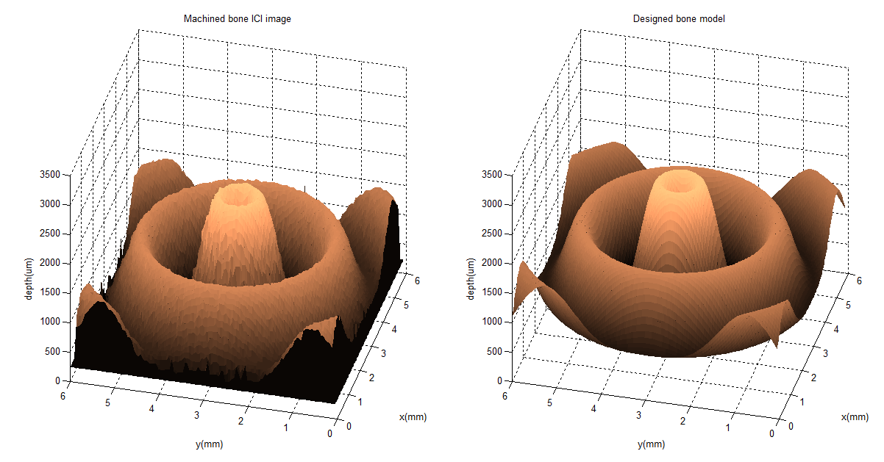
3D “Clean” Bone Machining
6mmx6mm feature
3mm depth range
Three 50us pulses
100Hz rep rate
~1hrs

Slide 22
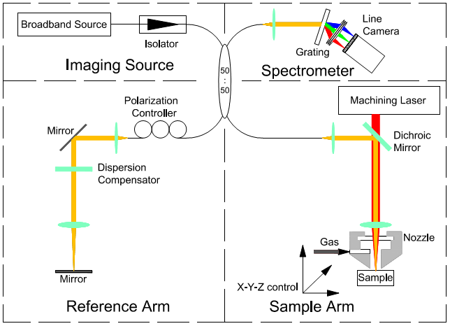
Experimental Set-up

Slide 23
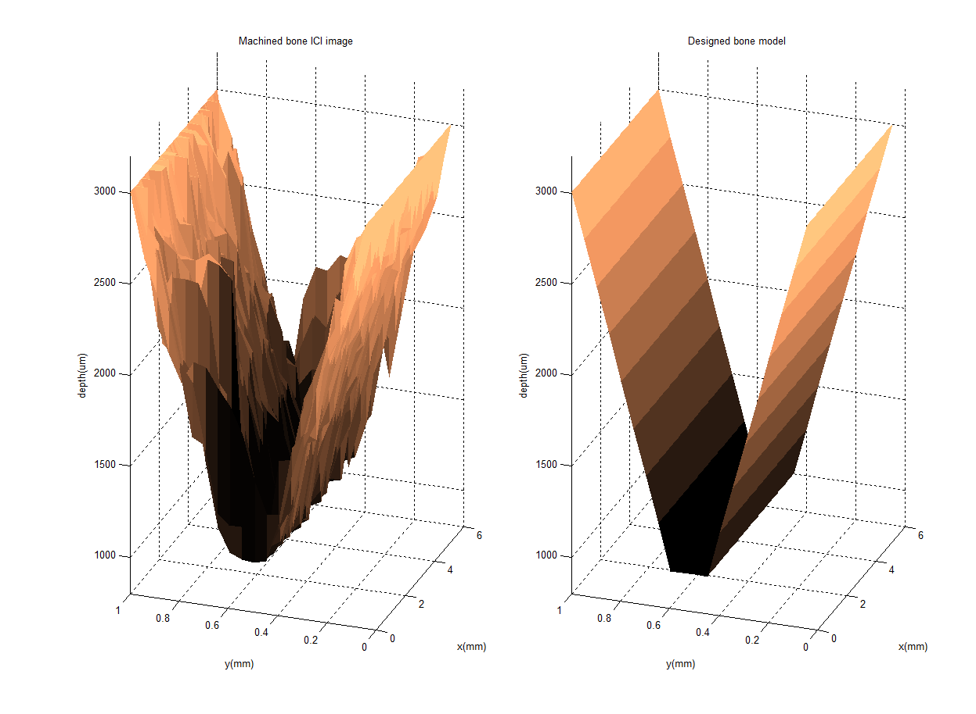

Slide 24
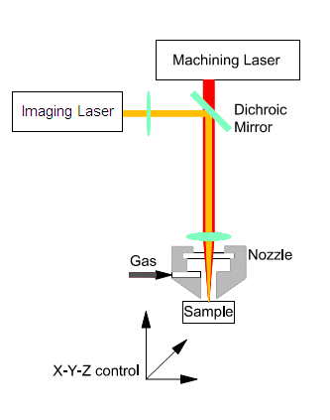
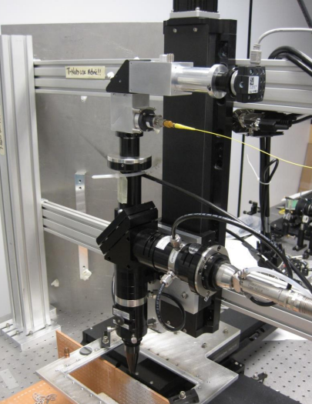
Experimental Set-up
Combined machining and imaging laser beam
Imaging light
Dichroic
Mirror
Machining light
Gas

Slide 25
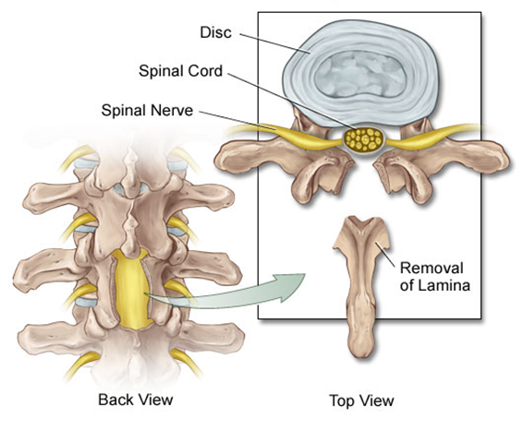
Motivation
Spinal Surgery
(Laminectomy)
Johns Hopkins Medicine Health Library
Notes:
For example, people with spinal stenosis suffer from chronic pain because their spinal cord or nerves are under abnormal pressure. The solution for them is to go through a surgery procedure called laminectomy, which is the removal of partial vertebral bone, or lamina, to relieve the compression.

Slide 26





