Slide 1

A history and development of the LHCb Scintillating Fibre Tracker
by Dr. Blake Leverington

Slide 2
aimed at young scientists regarding the development of a novel tracker for the LHC .
  no fixed process, but I think it is a similar experience among all detectors.
    There’s some fixed LHCC milestones I will describe that a subdetector must pass
  heavily weighted by my own perspective.
  Some technical details, but I’d like to keep the focus on the process

Slide 3
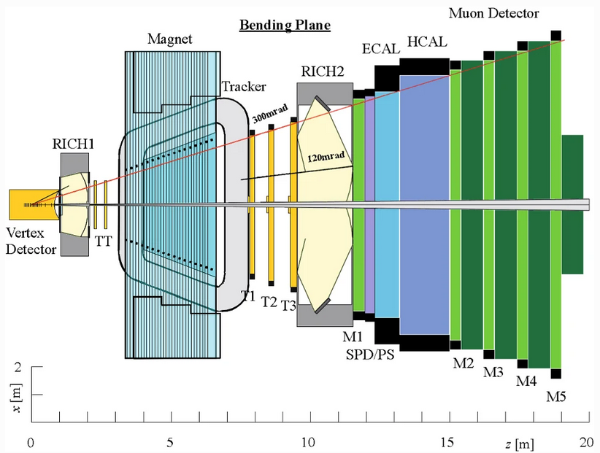
Evolution of Detectors
CERN-LHCC-98-004
CERN-LHCC-2001-024
CERN-LHCC 2003-030
LHCb in the Technical Proposal (1998), very similar to HERA-B
LHCb re-optimized (2003) to be lighter
Notes:
Hera-b 5–10 MHz by moving a target wire into the halo of the circulating proton beam at DESY. The vertex locater was also moved very close to the beam, about 1cm

Slide 4


LHC circulates first beam
19 Sept. 2008
April 2007
LHC Start Planned in April 2007
10 Sept. 2008
Start delayed due to magnet supports
Magnet Quench
Installation of the Outer Tracker bridge
LHCb Assembly is Complete
February 2005
October
2006
June 2006
August 2008
LHCb Dector Installation starts
Installation of the Outer and Inner Tracker begins
Notes:
YouTube: In May 2005, the first video
June 2007, Apple released the iPhone

Slide 5
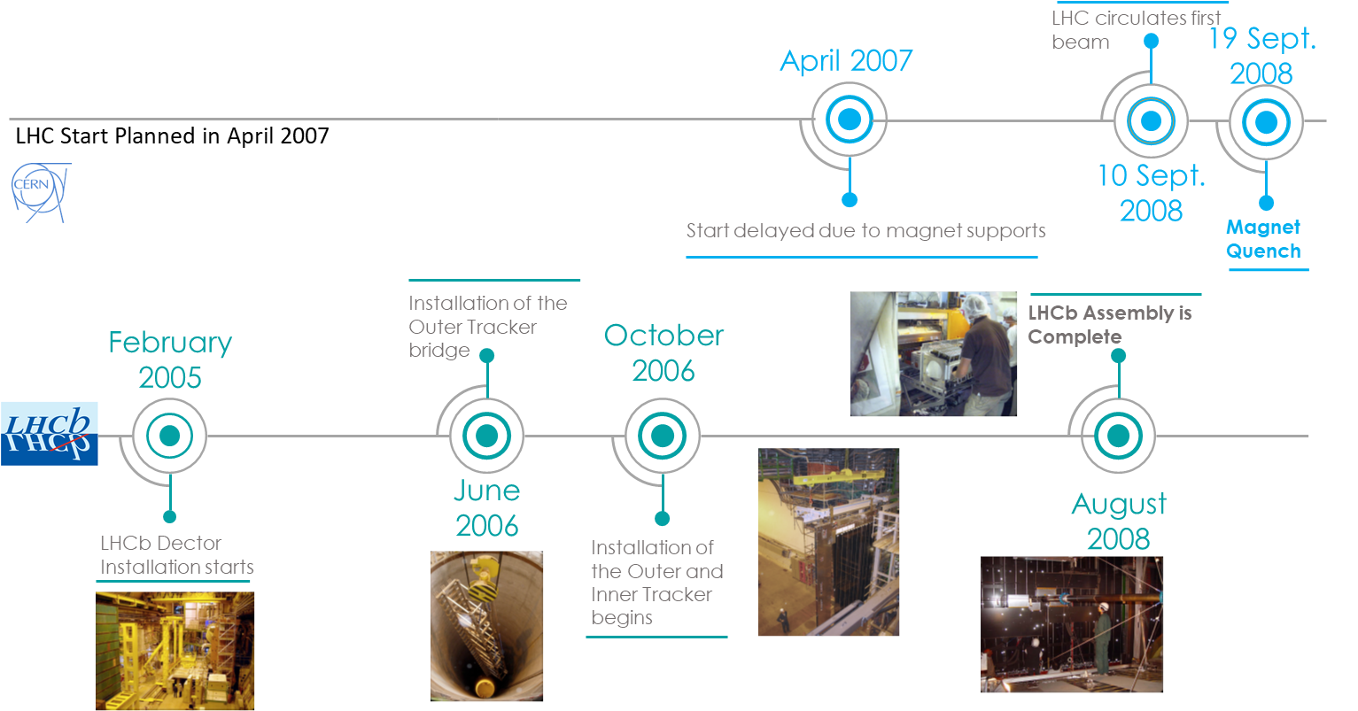

Prediction, by Franz Muheim
January 2007
1st LHCb Collaboration Upgrade Workshop
Expression of Interest (EoI) for a detector upgrade submitted in April 2008

Slide 6
Upgrade of the LHCb Detector
(as planned in 2007-2008)
Motivation
Detector Requirements
No data or published papers yet, but lots of MC
Smaller uncertainties to find SM deviations
  10 fb⁻¹ → 100 fb⁻¹
  Physics case should be robust
  stat.uncertainties of O(few %) → O(1%) in many channels
40 MHz detector readout electronics (25 ns bunch crossing)
Remove the L0 Hardware trigger → flexible software
Instantaneuous luminosity x 10 (above design)
2 → 20 x 10³² cm⁻²s⁻¹
High tracking efficiency (99%)
Reasonable detector occupancy for pattern recognition
Try to reduce material where possible
  Secondaries were a large problem for HERA-B
  Secondaries produce more hits than primaries in T-stations

Slide 7
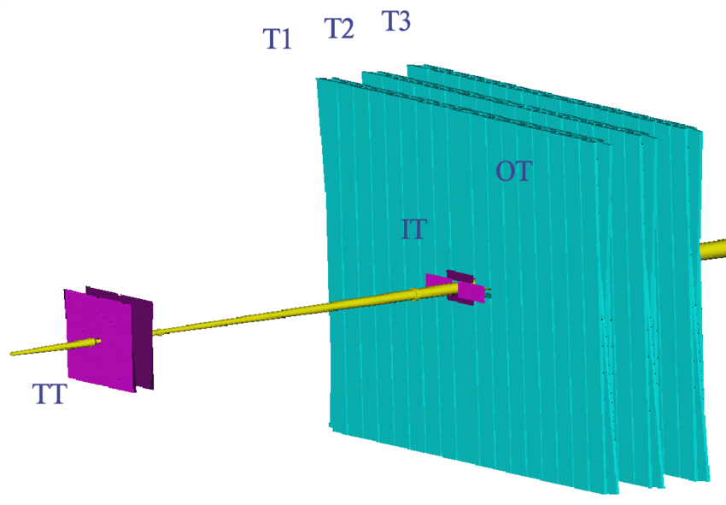
Main tracking System of LHCb
5 m
6 m

Slide 8

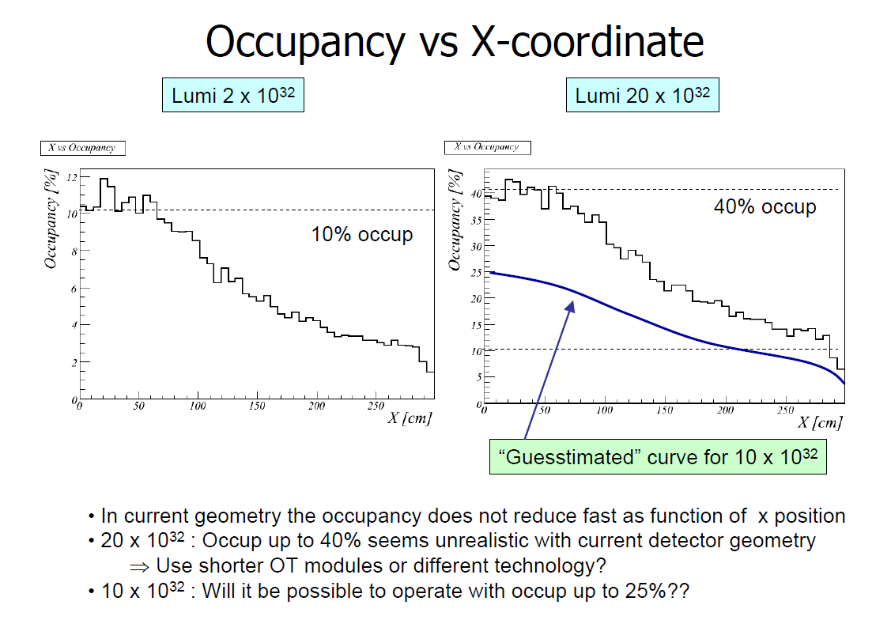
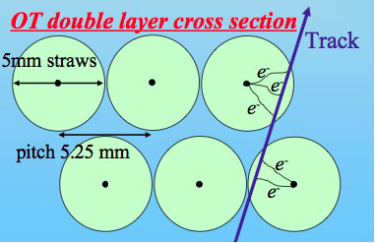
Outer Tracker
Marcel Merk at
, 2007
Notes:
You can’t just change the electronics to a faster readout. There’s some fundamental geometry and signal timing problems.
The detector has a good performance (they think, at this point) though they’re worried about some aging aspects. The material budget of this detector is quite good. Straw tube gas detector. But you just start to have that more than one track crosses a single straw tube in the same bunch crossing, and you can’t count more than one per tube.

Slide 9
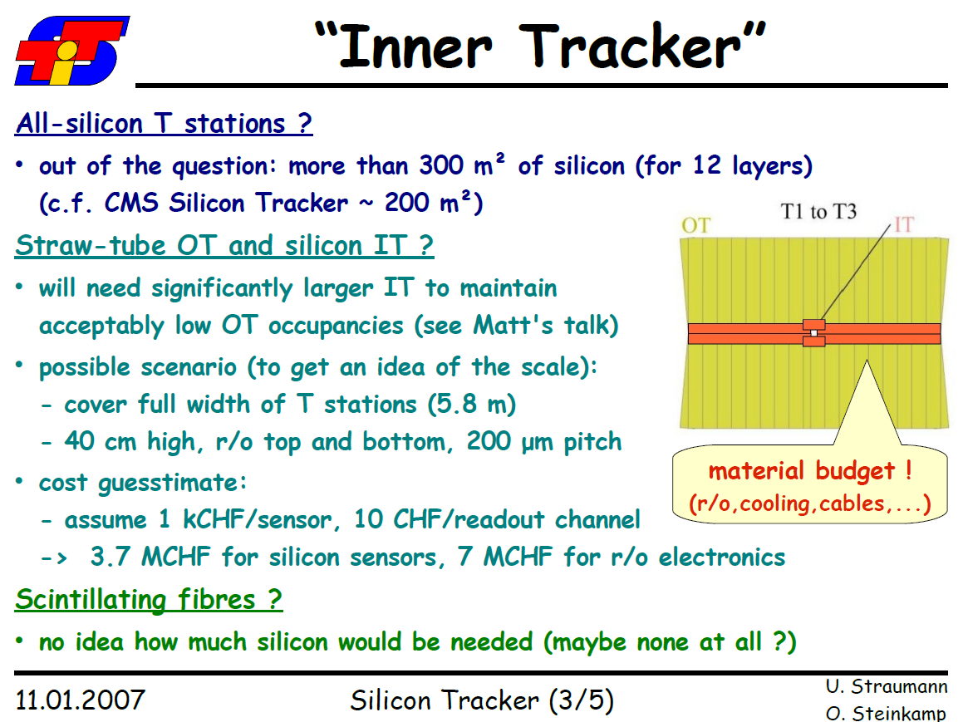
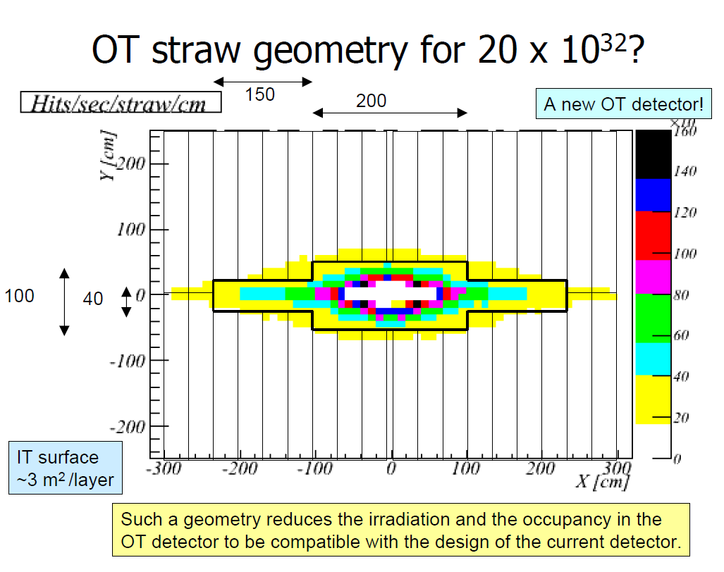

Slide 10
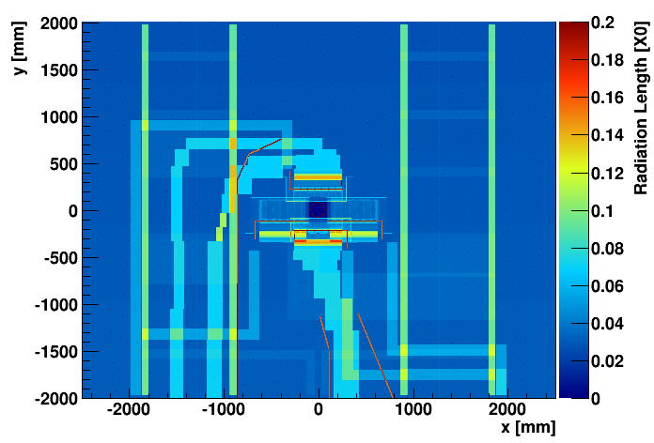
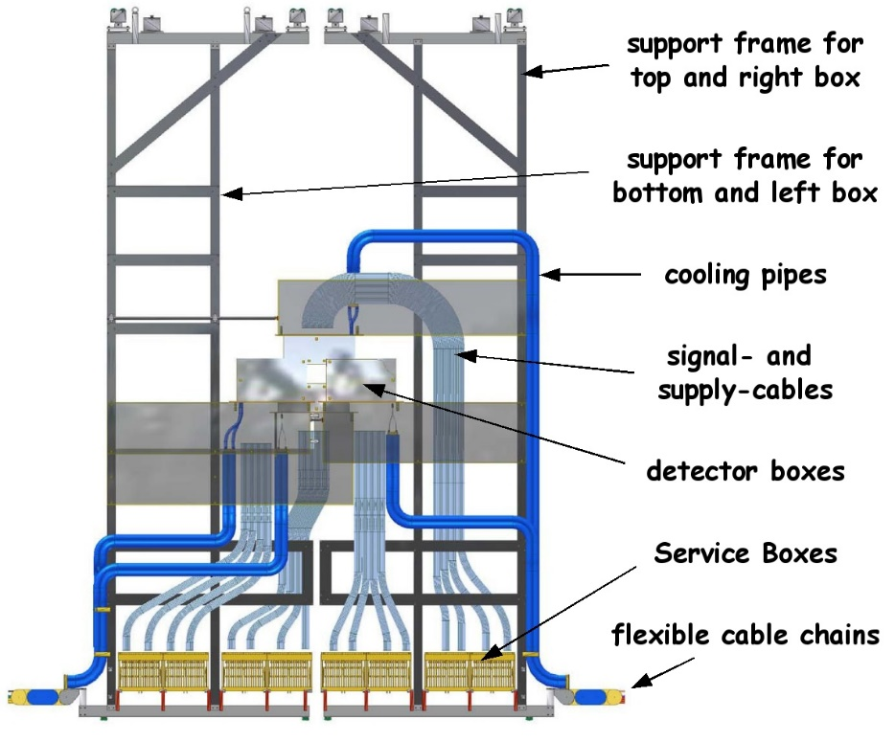
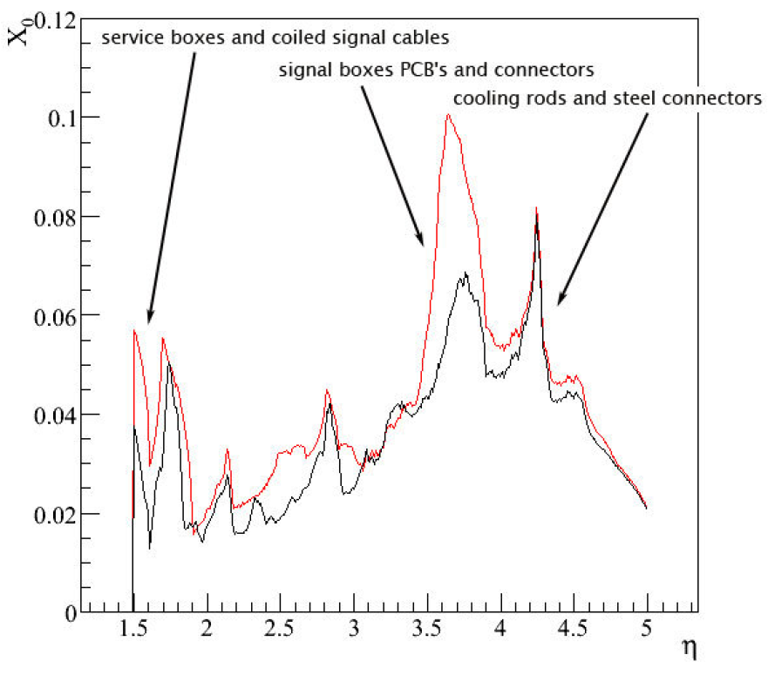
IT+OT Material for 1 T-Station
LHCb-2008-054

Slide 11
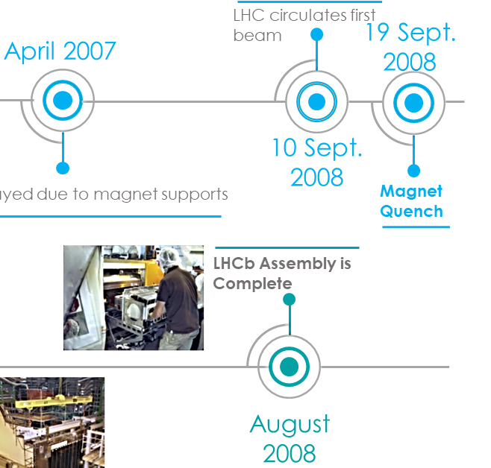
LHC circulates beam again
March 2010
Nov. 20 2009
3.5 TeV Beams
First published paper
commissioning
LHCb starts taking data
August 2010
January 2007
April 2008
CERN-LHCC-2011-001
upgrade in 2013 or in 2017?
Letter of Intent Submitted
Partial staged upgrade?
Shorter straw tubes / more silicon
Radiation damage? (OT/IT aging)
Partial scintillating fibre + Straw + Silicon?
UPGRADE
Keep old OT/IT but new electronics
GEMs?
March 2011
1st LHCb Collaboration Upgrade Workshop
Expression of Interest letter Submitted
CERN-LHCC-2008-007

Slide 12
LoI: Letter of Intent
An initial document submitted to the LHCC of CERN describing interest in performing a new experiment or major upgrade, outlining the physics case and detector required in broad terms. The LHCC reviews the document and determines if the collaboration should proceed to the next stage of approval, typically a Technical Proposal or Framework TDR.
For the original LHCb experiment this is CERN/LHCC-95-5.
For the LHCb Upgrade I there was initially a shorter Expression of Interest document CERN/LHCC-2008-007.
This was followed by a Letter of Intent document CERN/LHCC-2011-001.
Similar documents are often required in the LHCb member countries for their scientific review and funding agencies, focusing for the detector on the elements that will be constructed in that country, as part of their approval process.
From https://lhcb.github.io/glossary/

Slide 13

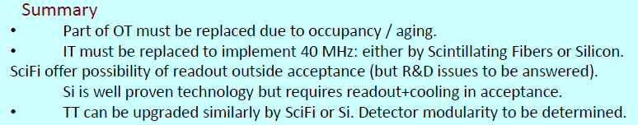
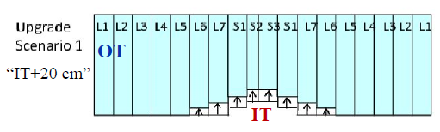
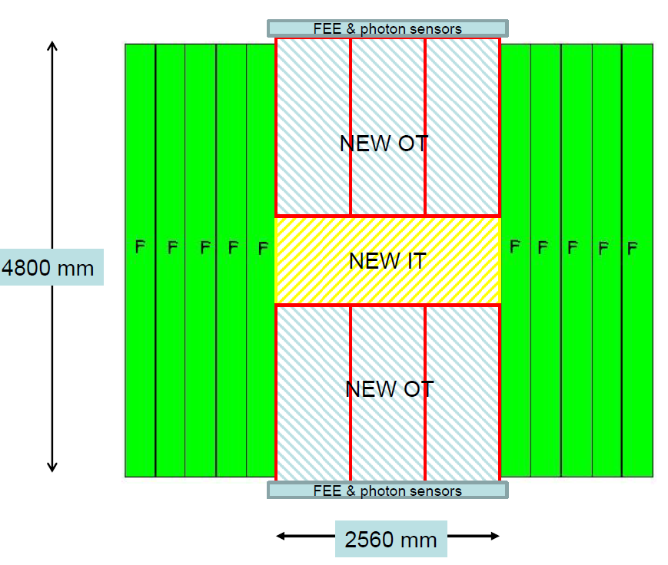
LoI Proposals
2a.
Thin-fibre IT option
1.
2b.
Thick fibre OT option
40 MHz straw-drift tube OT
40 MHz Bigger Silicon IT

Slide 14
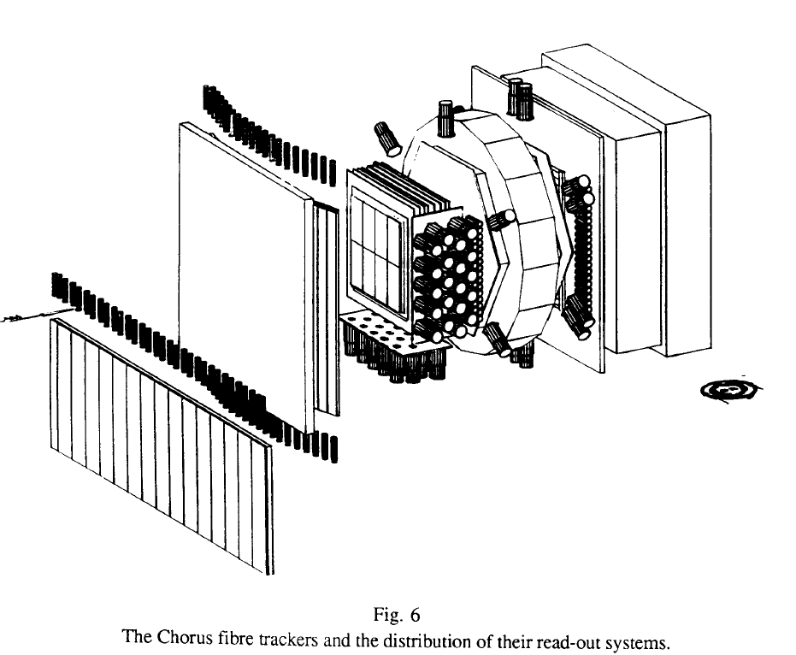
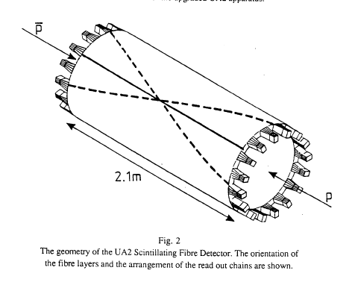
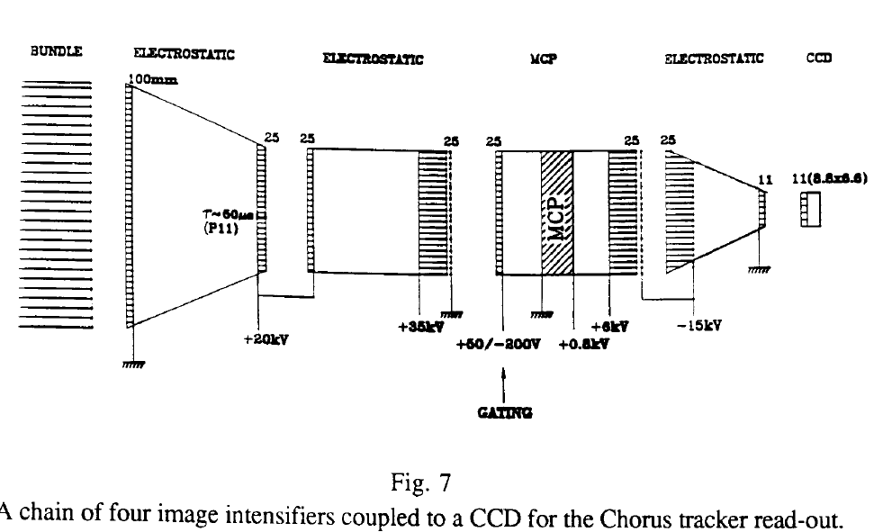
Previous SciFi Trackers
UA2
UA2 & CHORUS (Early ’90s)
image intensifier and CCD
  High voltage (20-35kV)
  doesn’t work in magnetic fields
1mm and 0.5mm diameter fibres
single hit spatial resolution of 0.35mm (for 1mm diam.)
The sensor (fibre) also transports the signal outside of the acceptance!
  No RF noise problems, few metre attenuation
Chorus
microchannel plate (MCP)
Nuclear Instruments and Methods in Physics Research A 387 (1997) 278-281

Slide 15
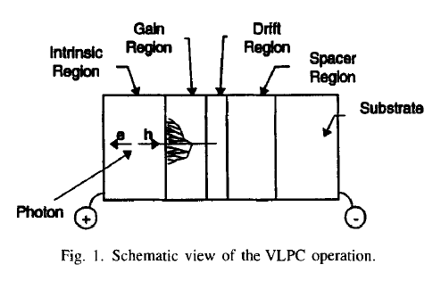
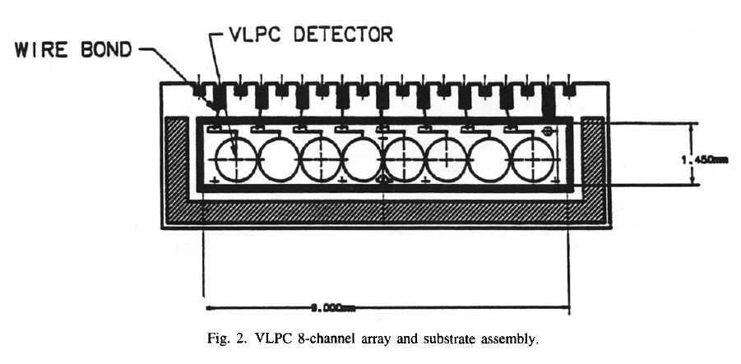
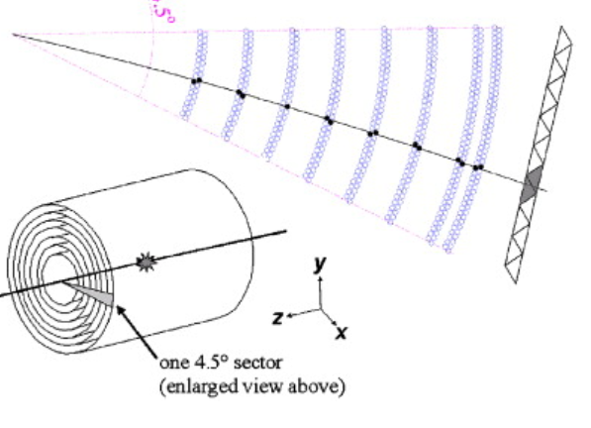
Previous SciFi Trackers
D0 scintillating fibre tracker at Tevatron (early 2000’s)
  DO: 72,000 double clad 3HF 0.8mm diameter fibres 1.7m – 2.7m long
  Each scintillating fibre is mated to a clear fibre waveguide. The length of waveguides ranges from 8.2 to 11.4...
Visible Light Photon Counter (VLPC)
  a solid-state device capable of high-rate single photon counting with excellent quantum efficiency
  Cryogenic cooling (5 - 7 Kelvin)
  Also used at MICE
20,000 to 60,000 electrons per detected photon. QE ~80% .
hit efficiency of 99.5% and a doublet hit resolution of 100 micron.
Nucl.Instrum.Meth.A 387 (1997), 278-281
Notes:
~150 km of fibre

Slide 16
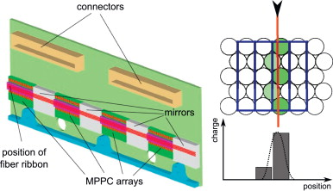
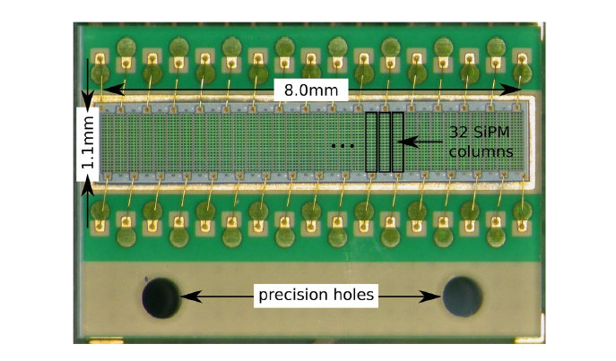
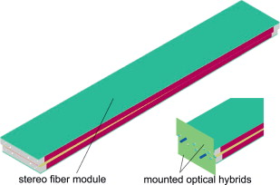
Previous SciFi Trackers
The PEBS balloon experiment(s)
(2006-2012)
Possible with the advent of the SiPM and SiPM array
  Insensitive to magnetic fields.
  (near) Room temperature operation
  Operation at 10s of Volts
  1E6 gain
0.25 mm fibres
  55 micron hit resolution (14 bit ADC)
  SPIROC readout chip (designed for calorimeters)
Hamamatsu MPPC 5883
60-80 cm
SCSF-78MJ scintillating fibres
https://doi.org/10.1016/j.nima.2010.07.011

Slide 17
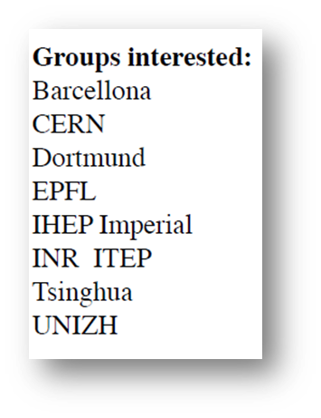
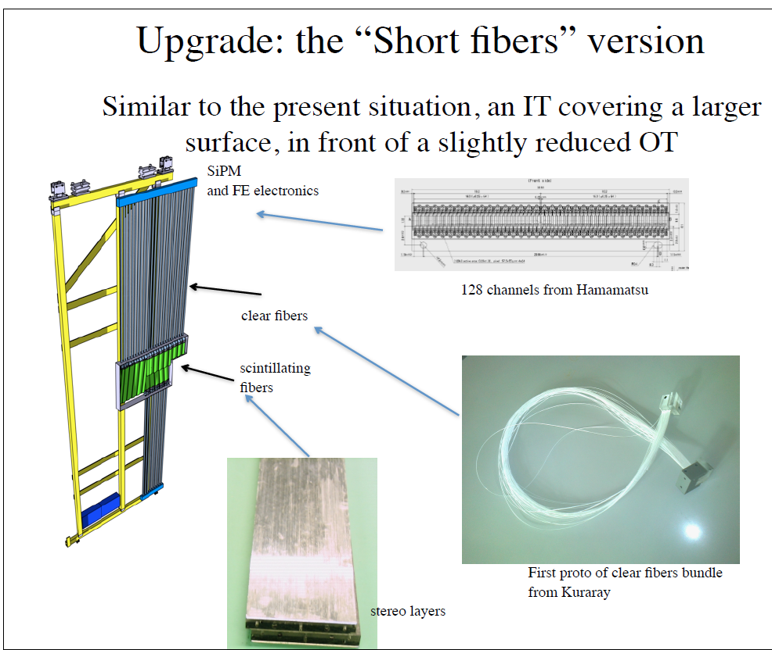
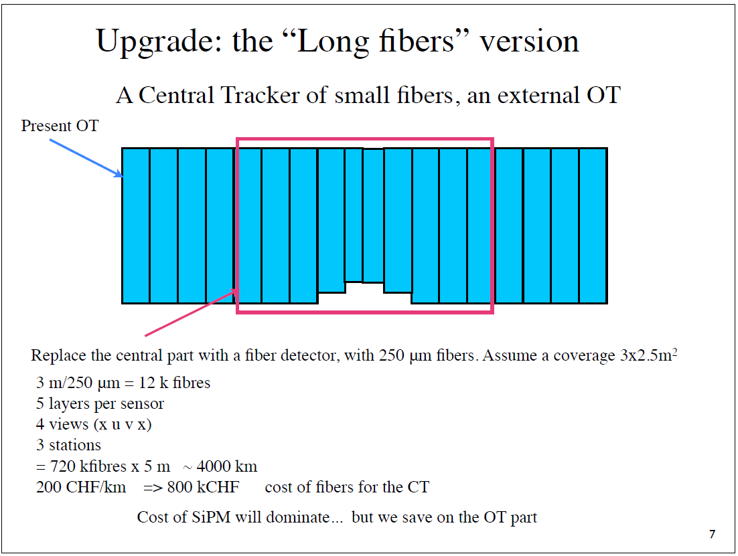
Let the workshops begin!
“A fiber TT could be a shorter version of the “Long fibers” version” – Ueli Straumann
but silicon was the main focus.
Notes:
Still idea proposals with some bits of tech here and there as early proof-of-concept taken from other research.

Slide 18
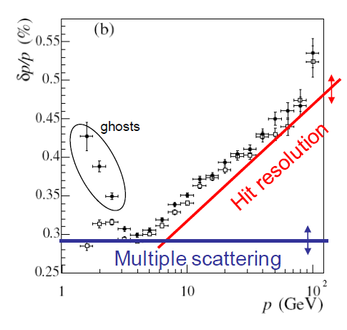
Tracking and the upgrade
High(er) granularity in VELO and Trackers important for pattern recognition.
  Ghosts: Time consumption in trigger and offline
Momentum resolution (dp/p) determined by:
  Multiple scattering term (constant versus p)
  Hit resolution term (rises versus p).
Hit resolution contribution
  determined mainly by OT (IT)resolution.
Current LHCb: We lose 10-15% of our tracks due to material interaction, thus
  little material (not only dead material) is important for high efficiencies
Inner segmentation would be nice (an IT)
Jeroen van Tilburg

Slide 19

Critical R & D Points
Detector signals to have >99% hit efficiency
  Light yield from the scintillating fibres
  Photon detection efficiency (PDE) of the photodetector
  Noise, dead-time, and spillover effects
  Radiation effects on the fibre and photodetector
Electronics for 40 MHz readout
  Digitise the signal from each 25ns bunch crossing, zero dead time
Minimise the material (<1%X₀ per layer for 12 layers)
Fibre mat production (non-commercial)
  Tooling. How could you build a fibre tracker?
Given the incrememental nature of most technology development, it is not clear if everything performs well when put all together.
Prototype all the things!

Slide 20
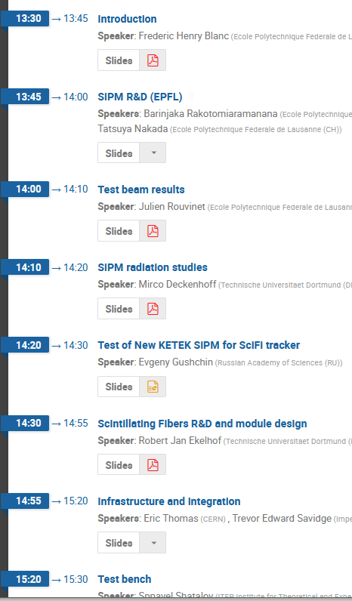
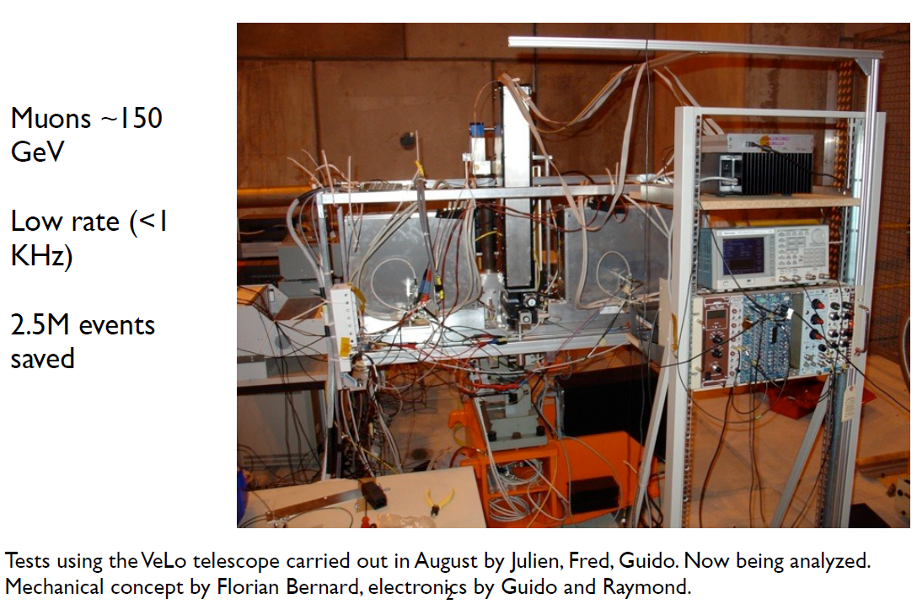
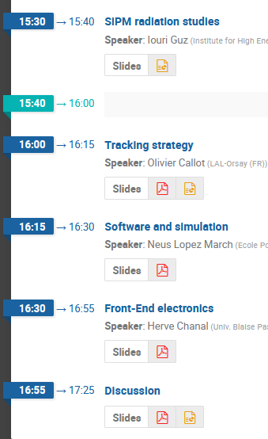
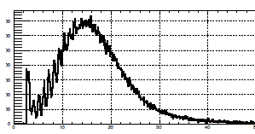
Things are getting serious now
First test beams August 2011
Regular SciFi Tracker Meetings
Photoelectron signal

Slide 21
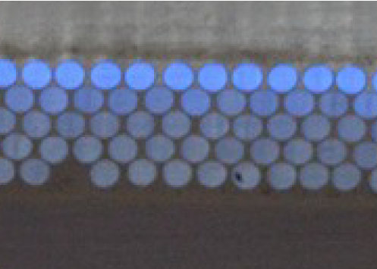
First 2.5 m long fibre mats
Dec 2011
~3cm wide
More difficult than the PEBS 80cm mats. We need semi-automation winding machines. Too big for standard turning machines.
LHCb Upgrade requires hundreds of mats without defects.
Notes:
Idea Similar to winding wire chambers: fixed tension; needs to be glue. (does it?)

Slide 22
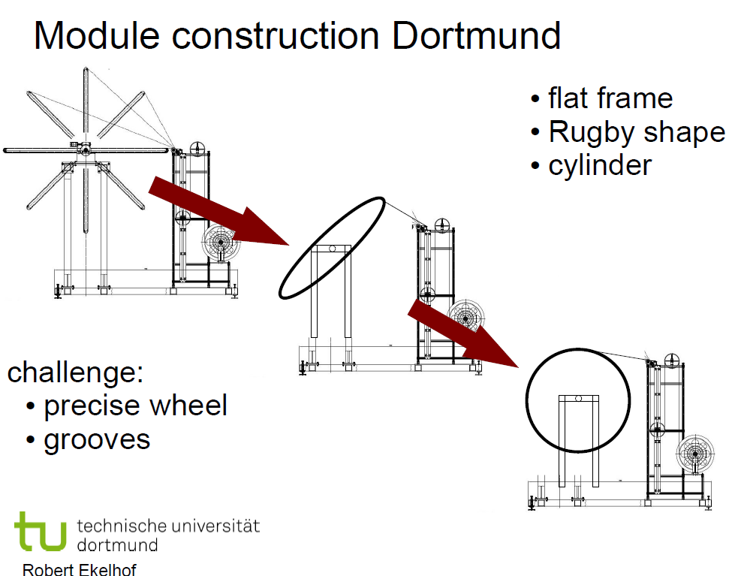
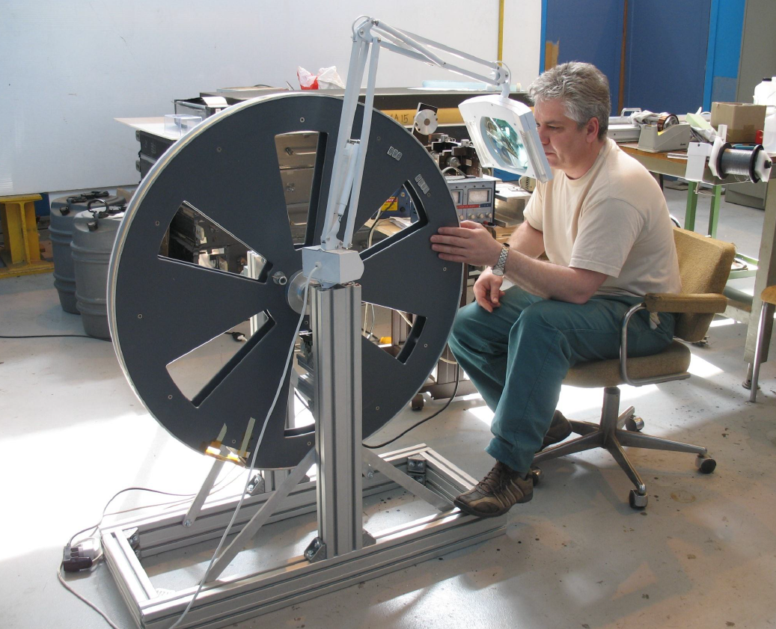
CERN/RUSSIA
vs.

Slide 23
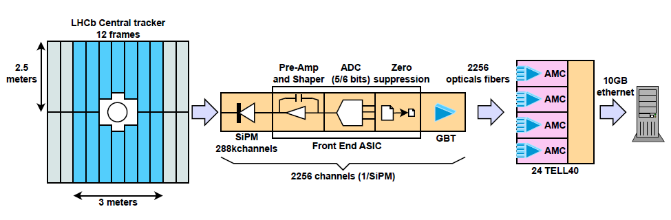
First electronics concepts appear
5 or 6 bits → max 32 photon signals
separate signal and noise (1 - 2 p.e.)
SiPM parameters needed as input
Back-end DAQ
Developing specifications for electronics (April 2012)

Slide 24
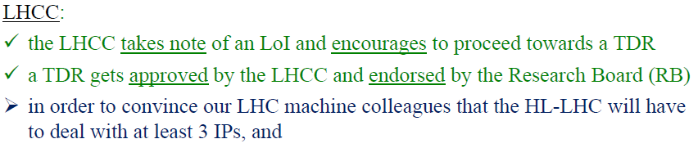
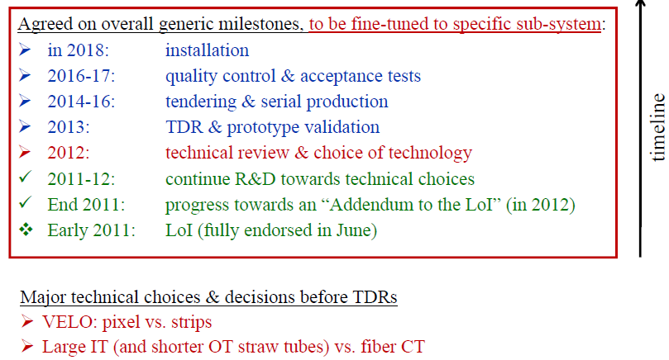
Towards a TDR
.... a framework TDR (May 2012)
(something to go to the funding agencies with, and start to divide tasks among institutes officially)

Slide 25
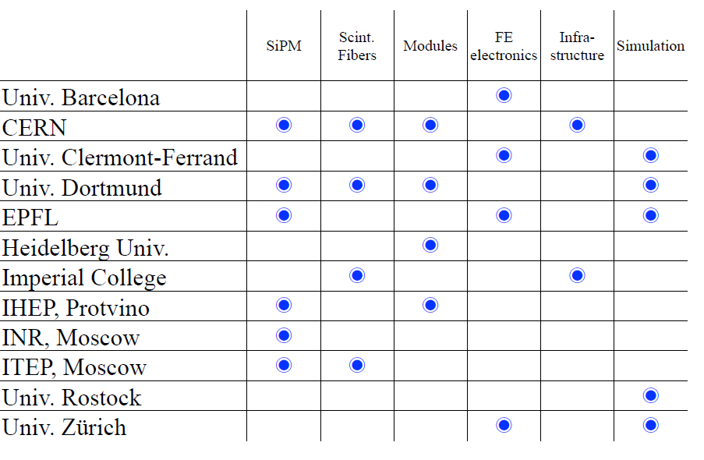
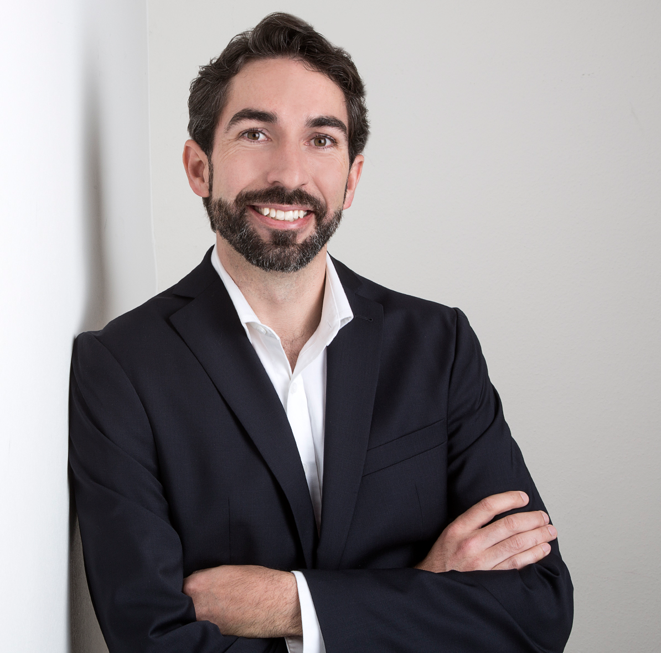
A growing collaboration
Yours truly, since 2012

Slide 26
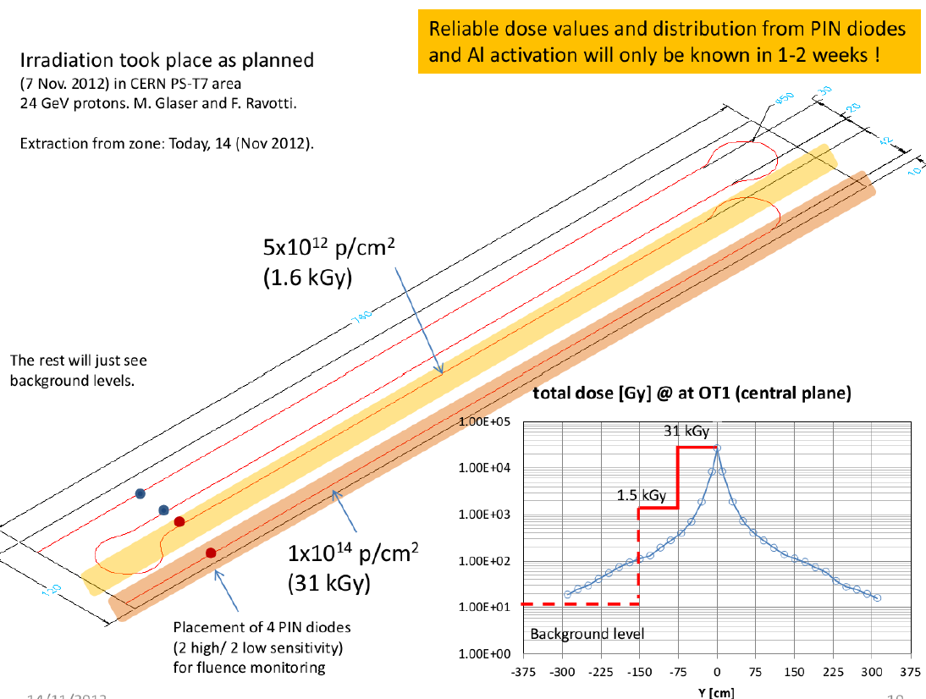
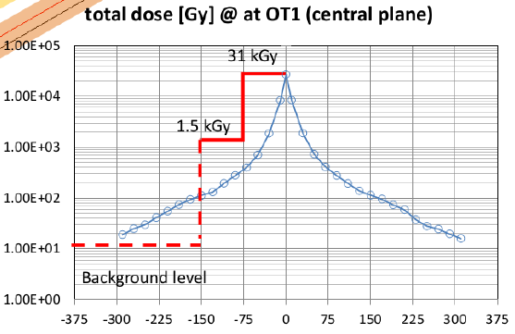
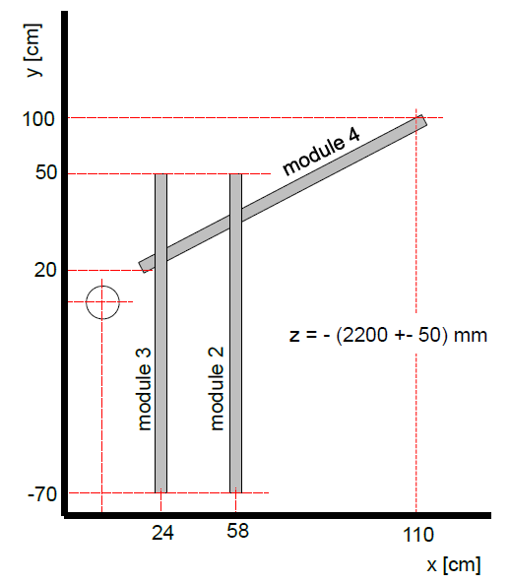
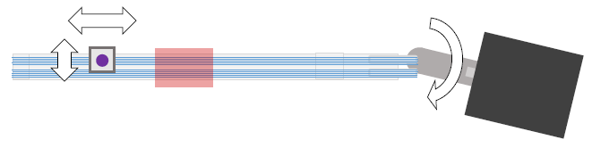
Radiation Damage in Fibres
Fixed Beam at CERN PS
How to simulate 10 years of radiation damage at 5x available intensity on a 2.5m long fibre with varying integrated dose???
  When the magnitude of the effect is rate dependant
  Annealing effects are unknown (at this stage)
  Oxygen effects?? (conflicting literature)
Beam scan at Karlsruhe in 2012
LHCb in-situ (VELO wall)
Garching tandem accelerator

Slide 27
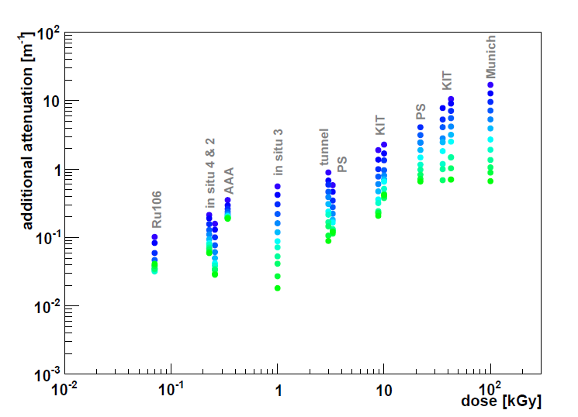
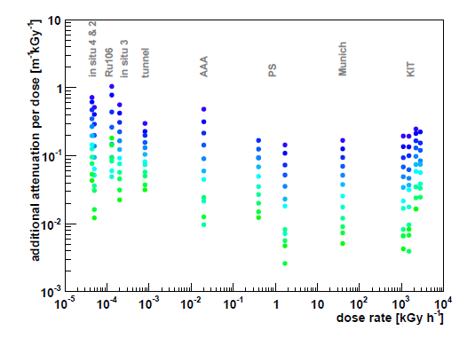
A team effort
Attenuation coefficient from radiation
Attenuation coefficient from radiation per kGy
Natural attentation of the fibre
We base the performance of the Tracker after 50fb⁻¹ on this data.
Studies for the LHCb SciFi Tracker - Development of Modules from Scintillating Fibres and Tests of their Radiation Hardness
Robert Ekelhof (Doctorarbeit, TU Dordmund, 2016)

Slide 28
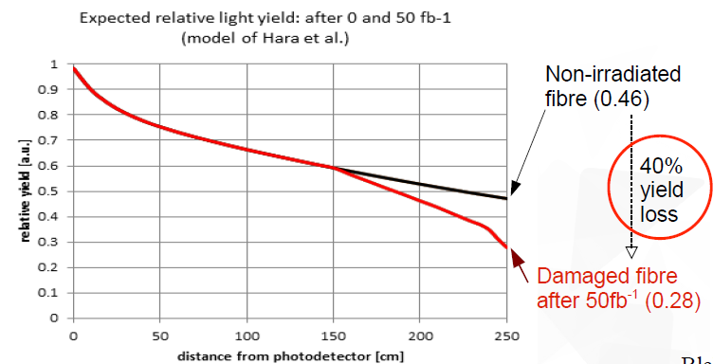
Viability Assessment (Feb 2013)
Fluka
To be honest, it wasn’t clear in the previous years if a SciFi tracker could work at the LHCb Upgrade
Held an LHCb-internal review:
  find that the light yield from current(2013) fibers, and PDE from current(2013) SiPMs are at the limit of the requirements for the LHCb upgrade
  the needed performance will be reached with the expected improvements
  More fibre layers (5->6), better SiPMs with higher PDE in the pipeline

Slide 29
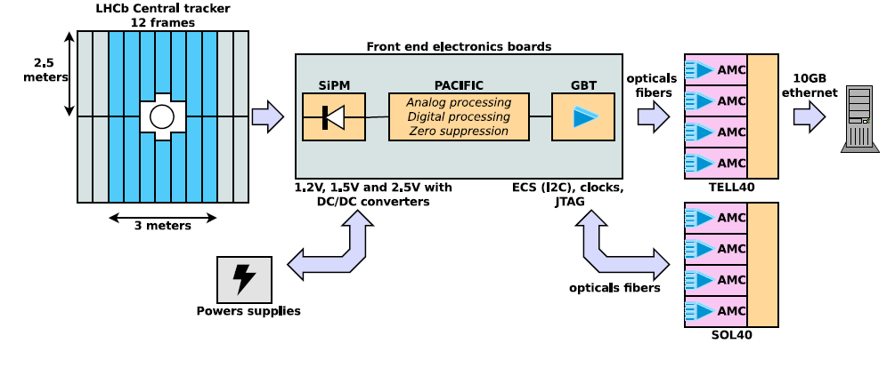
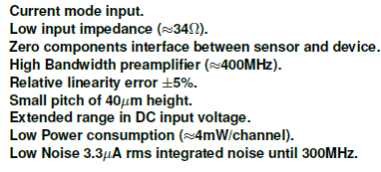
The PACIFIC is born
(low-Power ASIC for the sCIntillating FIbres traCker)
June 2013
288,000 channels
PACIFICr1
PACIFICr1 channels are used to test different blocks implemented; Fast Shaper, Slow Shaper and Dual Interleaved Integrator.
(IBM) 130 micron technology through CERN.
3 analog channels, Submitted in May 2013
Notes:
Details on Voltages appear, control, signal formts, etc

Slide 30
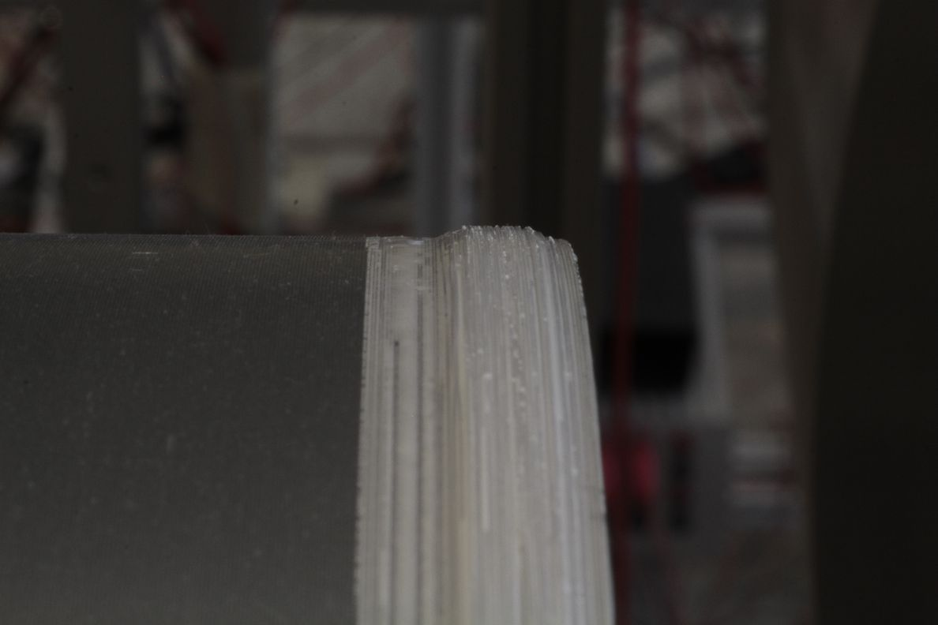
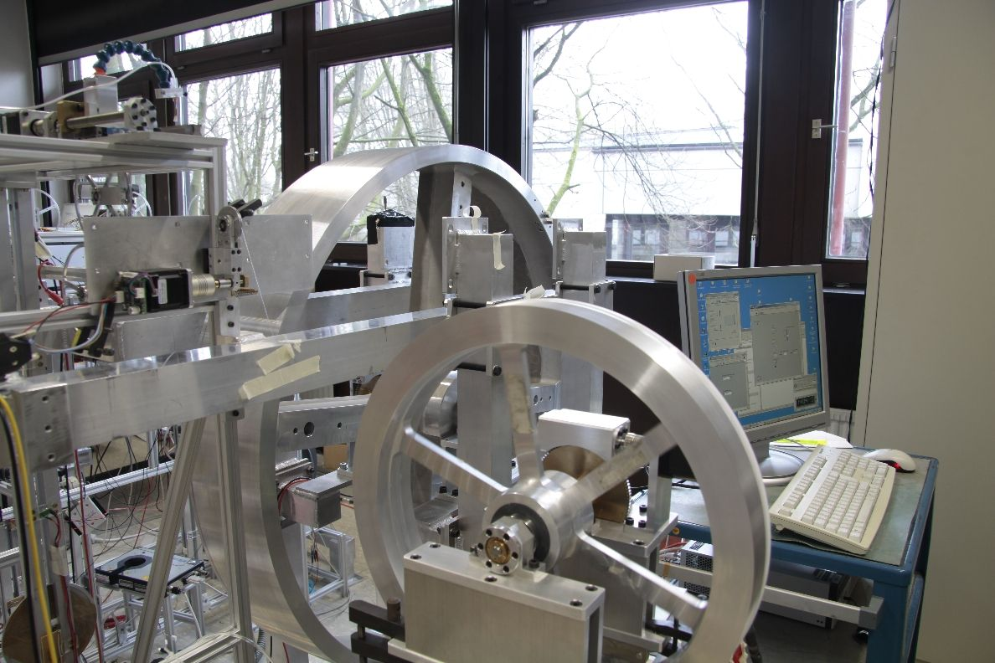
First 3m long fiber mat!
Dortmund: winds first 3m SciFi mat, width approx 1cm!!
Scintillating fibre wound on a threaded wheel. Titanium dioxide loaded glue is used to bond the fibre together.
The prototype Dortmund winding machines.

Slide 31

First Idea Conflict! (But not the last)
Bi-layer assembly of the fibre module panels
-> (80cm construction proven) maybe extends to 250cm??
Mono-layer: strip out all unneccesary materials. Lightest option. Protects the fibres.
Workshops for resolving idea conflicts with internal LHCB reviewers to resolve the issue.
  Need to maintain a friendly collaboration
  Specifications become well defined.
  Competing ideas allowed for them to be tested
  Sometimes you need to pick a single path, and go, and deal with the consequences.
Fibre mat mounted on top of foam and carbon fibre sandwich

Slide 32
The first 2m dummy SciFi Module
July 2013
Testing assembly concepts. Would be ~1% of a radiation length in material thickness.

Slide 33


Decision day...

Slide 34



The light Silicon IT
Silicon strips
  320 micron thick sensor
  200 micron wide strips
  Carbon fibre ladder support
High-flow chilled air(+15C) for cooling
  Reduced material in the acceptance
  Still requires signal and power cables
A viable option for an inner tracker
LHCb-PUB-2014-009

Slide 35



State of the SciFi
7cm mats without defects!!
1% X0/layer
Only 1 detector technology proposed to cover the entire acceptance! 10,000km of fibre (0.5m³ of plastic)

Slide 36


The best laid plans.
Plans should not be confused with schedules.
The estimated time is always wrong by a factor of 2 in R&D (at least).

Slide 37


Project Management
(i.e. things we haven’t be educated for)
Divided into Work Packages:
  Project Leader and Deputy
  Package Coordinators (like a WG convener)
  Lead by institutes (staff, postdocs, phd) with primary interests in topics
  Multiple Interfaces between packages.
From LoI to EDR
From PRR to Installation
I would estimate that the majority of delays and errors were due to poor communication in the team.
Find the (multiple) communication channels that work best for your team.
Email and Twikis are the worst.
In person, Video/Telephone, Mattermost chat are the best.

Slide 38
TDR: Technical Design Report
A document submitted to the LHCC of CERN describing the design of a subdetector or other subsystem (e.g. online, trigger, computing). This document also describes the cost of the detector and which institutes will be responsible for which elements of the construction. The TDRs of LHCb and the upgrades are collected here. The document is reviewed by the LHCC, with involvement from the RRB for financial aspects.
A clear understanding of the requirements, the environment, and the constraints
real “proof-of-concept” prototypes and Monte Carlo simulation to estimate the performance and a good idea how to build this detector
Conceptual Designs and estimated Performances of your sensors, electronics, tooling, etc.

Slide 39

Fibres in the TDR (March 2014)
the “Bump Problem”
  Causes defects in the fibre winding
  Time consuming to fix defects.
Present the radiation damage studies
  40% signal loss expected
  Need a 6th layer of fibre
one scintillating fibre manufacturer, Kuraray
  sole sourcing your central component is risky
  Kuraray willing to improve
  Bicron/Saint Gobain had poorer quality and wasn’t interested in development.

Slide 40



SiPMs in the TDR
SiPM irradiation → -40C cooling will be required
Working with two SiPM manufactureres Hamamatsu (good) and KETEK (packaging issues)
PDE improving regularly
(peak at 28% → 40% now)
  40% improvement in 2 years!
SiPMs needs cooling to
-40 degC due to radiation damage
Signal and hit efficiency is understood
KETEK Sipm Array
Hamamatsu SiPM array

Slide 41





Conceptual Integration (2014)
Mostly detector physicists’ conceptual designs, and not engineering.

Slide 42
CERN-LHCC-2011-001
Tracking TDR
Letter of Intent Submitted
Viability
Assessment
January 2007
April 2008
May 2012
November 2013
UPGRADE
March 2011
February 2013
March 2014
1st LHCb Collaboration Upgrade Workshop
Expression of Interest (EoI) Submitted
Framework
TDR
Tech choice.

Slide 43


Prototypes
Fibre modules for test beam.
The first 5m (mostly) dummy module hung on the wall in Heidelberg.

Slide 44



Test beams (2015-2016)
Spiroc electronics connected to an SiPM arrray
Single fibre mat modules at the SPS H8 beamline

Slide 45
Production numbers
We need to produce 128 scintillating fibre modules
  10,000 km of fibre to process
Mats & Modules:
  1024 mats + mats
  128 modules+ spares
Sipms:
  4096 arrays + spares
Electronics:
  8192 PACIFIC asic + spares , 2048 boards
  2048 FPGA boards
  512 Master boards
Assemble all of this as 12 C-Frames

Slide 46
EDR: Engineering Design Review
A milestone during the construction of a subdetector. The EDR is a meeting with accompanying documentation that describes the detailed design of a component system of the detector (e.g. sensors, an ASIC, high voltage system) based on drawings and prototypes that have been produced. Reviewers with relevant expertise from other subdetectors in LHCb and from other experiments are usually appointed to conduct the review and make recommendations.
The next major milestone is the PRR.

Slide 47


Fibre Mats in the EDR
The fibre mat production reaches an advanced stage
Step by step production process is defined
4 custom winding machines are to be ordered for mat production

Slide 48

8 EDR fibre mats (Summer 2015)
Notes:
8km of fibre per mat. About 1/3rd of D0 in terms of number of KM of scintillating fibre, just for a prototype

Slide 49


Modules
First prototype module is made with the EDR fibre mats
Alignment tooling developed
  Creating the tooling is almost as much work as the objects themselves
Not the final version but the collaboration gives the go ahead to prepare everything for serial production
  Design of beam pipe modules
  Fire safety burn tests
  Light leaks

Slide 50


SiPM EDR in 2016
H2011: First version of 128 channel, 230μm x 1.32mm (WxH), 84 pixels,y,ΔV=1.3V.
  Low PDE (~30% peak)
  High cross-talk (~20%)
  Very temperature sensitive due to low ΔV
H2014: First version with trenches, 230μm x 1.5mm (WxH), 96 pixels , ΔV=3.5V
  Medium PDE (~40% peak)
  Medium cross-talk (~12%)
  Large stable operation range
H2015: new trench LCT5, smaller dead zones, 230μm x 1.625mm (WxH), 104 pixels, typical ΔV=3.5V
  High PDE (~50% peak)
  Low direct cross-talk but medium AP and delayed cross-talk (9% correlated)
Ketek arrays were very nice, with similar or better performance but there were too many production problems with the silicon and packaging at this time
1 year later than TDR plan
KETEK Sipm Array
Hamamatsu SiPM array

Slide 51

The Cold-Box (2016)
Rob Walet, engineer and designer for SciFi

Slide 52

Electronics EDR (Summer 2016)
Prototype Front-end

Slide 53

PACIFIC ASIC Development
TDR
EDR

Slide 54



Electronics EDR
128-channel SiPM
524,288 channels → 4096 data links, 1024 control fibres
Full processing chain is understood.
All components are designed and prototyped.
All the specifications and requirements are met.

Slide 55


More prototypes and testbeam
Scintillating fibre telecope, and two SciFi DUT mats
64-channel PACIFICr5 board at DESY test beam

Slide 56
PRR: Production Readiness Review
A milestone during the construction of a sub-detector. The PRR occurs after the EDR.
The PRR is a meeting with accompanying documentation that describes the detailed design of a component system of the detector (e.g. sensors, an ASIC, high voltage system). Reviewers with relevant expertise from other sub-detectors in LHCb and from other experiments are usually appointed to conduct the review and make recommendations.
The PRR makes recommendations for revisions or approves that the final production of this element of the sub-detector can start.

Slide 57
PRR
Fibre mat Glue-casting
Reviewed by internal LHCb collaboration referees (experts)
Typically a lot of time and expense involved in building a detector
Improvements in processes since EDR
  Step-by step-description of the process, documented
Materials are in hand to start full production
Designs are fully tested. Tooling is ready. QA is ready.
  This was the most time consuming part between EDR and PRR.
Foil-lamination

Slide 58

SciFi Module Production Model

Slide 59



Testbeam with final electronics and production modules (July 2018)
99% hit eff.,
70 micron hit resolution

Slide 60
Production C-Frame model

Slide 61




Be ready on time...
Old TDR schedule
COVID Lockdown
COVID Lockdown
C-Frame Assembly
Production
Cold-box
15 years from conception to the end of installation.
SiPM
electronics
mats and modules
1 – 2 years longer to start and finish production than guessed at in the TDR
  → The end date always matched the end of LS2 (which shifted)

Slide 62


Module storage at Point8 (July 2020)
First module assembly (June 2016)

Slide 63

First SiPMs on a cold-bar

Slide 64




First finished C-Frame (Feb. 2020)
First 7cm fibre mat with SiPM
(August 2014)

Slide 65



First 4 Frames Installed (May 2021)
6 of 12 C-Frames installed (July)

Slide 66



This looks familiar...
What if we had 300 fb⁻¹ of data instead of just 50?....
First workshop in April 2016.
The LHCb Upgrade II EoI was submitted to the LHCC in February 2017.
Expression of Interest is CERN-LHCC-2018-003, Physics Case CERN/LHCC-2018-027.

Slide 67
The End(?)

Slide 68
backup

Slide 69
References
Advances in Tracking Detectors Frank Hartmann and Jochen Kaminski Annual Review of Nuclear and Particle Science 2011 61:1, 197-221 https://doi.org/10.1146/annurev-nucl-102010-130052
THE USE OF SCINTILLATING FIBERS FOR CHARGED-PARTICLE TRACKING R. C. Ruchti Annual Review of Nuclear and Particle Science 1996 46:1, 281-319
https://doi.org/10.1146/annurev.nucl.46.1.281

Slide 70
Thoughts for Upgrade 2
Higher granularity means more channels:
  Lots of power to dissapate
  Lots of optical fibres to clean and inspect
Silicon means cooling when there’s radiation damage
  Cooling and cables in the acceptance are bad for LHCb
Don’t underestimate the infractructure requirements...
  Density of services, cables and fibres

Slide 71


Slide 72


Slide 73


Slide 74
The LHCb Upgrade
Letter of Intent for LHCb
“While LHCb will be able to measure a host of interesting channels in heavy flavour decays in the upcoming few years, a limit of about 1 fb⁻¹ of data per year cannot be overcome without upgrading the detector. The LHC machine does not face such a limitation.
With the upgraded detector, read out at 40MHz, a much more flexible software-based triggering strategy will allow a large increase not only in data rate, as the detector would collect 5 fb⁻¹ per year, but also the ability to increase trigger efficiencies especially in decays to hadronic final states.
In addition, it will be possible to change triggers to explore different physics as LHC discoveries point us to the most interesting channels.”

Slide 75
Technical Proposal
A document submitted to the LHCC of CERN describing the design of a new experiment or major upgrade, outlining the physics case and detector design. This document contains more detail than the LoI, for example reporting on R&D that shows the feasibility of the project and possibly estimating the cost. The LHCC reviews the document and determines if the collaboration should proceed to the next stage of approval, typically TDRs for the individual subdetectors and systems of the experiment. If costs are involved the RRB of CERN is involved in the approval.
For the original LHCb experiment this is CERN-98-004 followed by an LHCb reoptimized detector design and performance TDR that is CERN/LHCC 2003-030. For the LHCb Upgrade I the equivalent document is known as a Framework TDR, and is CERN/LHCC-2012-007. For the LHCb Upgrade II the equivalent document is due to be submitted around late 2020.

