Slide 1
Nb₃Sn Superconducting Accelerator Magnets: state of the art, fabrication and test in the US of the first low-beta quadrupoles for HL-LHC
Maria Baldini
April 16th 2021

Slide 2
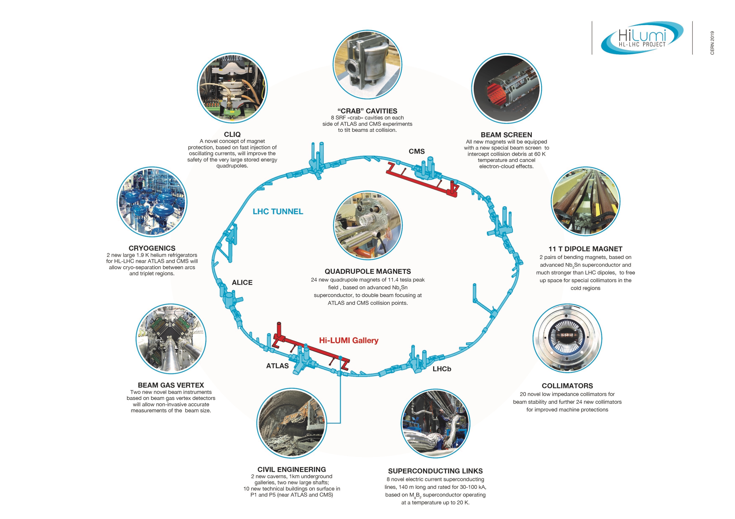
US contribution to the Hi-Lumi-LHC Accelerator Upgrade Project
HL-LHC AUP
HL-LHC: from 300 fb⁻¹ to 3000/4000 fb⁻¹
LARP technology for the HL-LHC Focusing Magnets and Crab Cavities
(DOE supported R&D Program)
The HL-LHC AUP Project, coordinating efforts from US Labs (FNAL, BNL, LBNL with contributions from SLAC, JLAB, ODU & FSU)

Slide 3









The Inner Triplet & Matching Section regions
Connection to LHC (UL)
Service gallery (UR)
Target: 132.6 T/m in 150 mm coil aperture
Q1/Q3
  2 magnets with 4.2 m of magnetic length within 1 cold mass
Q2
  1 magnet of 7.15 m within 1 cold mass, including MCBX (1.2 m)
Different lengths, same design
SC Links
Q2b
Q2a
Q1
TAXS
CP
Q3
DFX
D1
DFM
UA gallery
Service cavern
(BBLR)
Q4
Crab cavities
D2
Collimators
TAXN

Slide 4
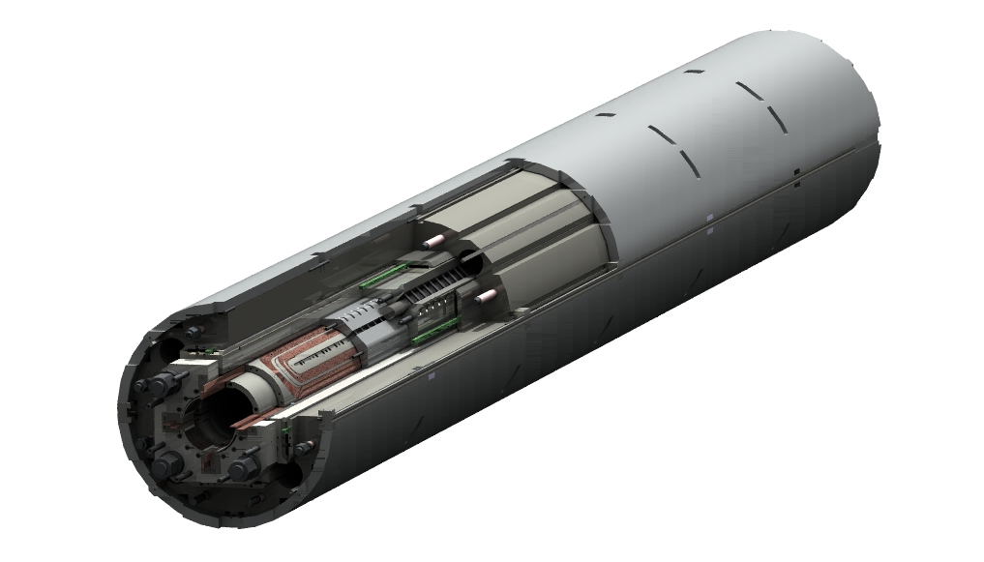
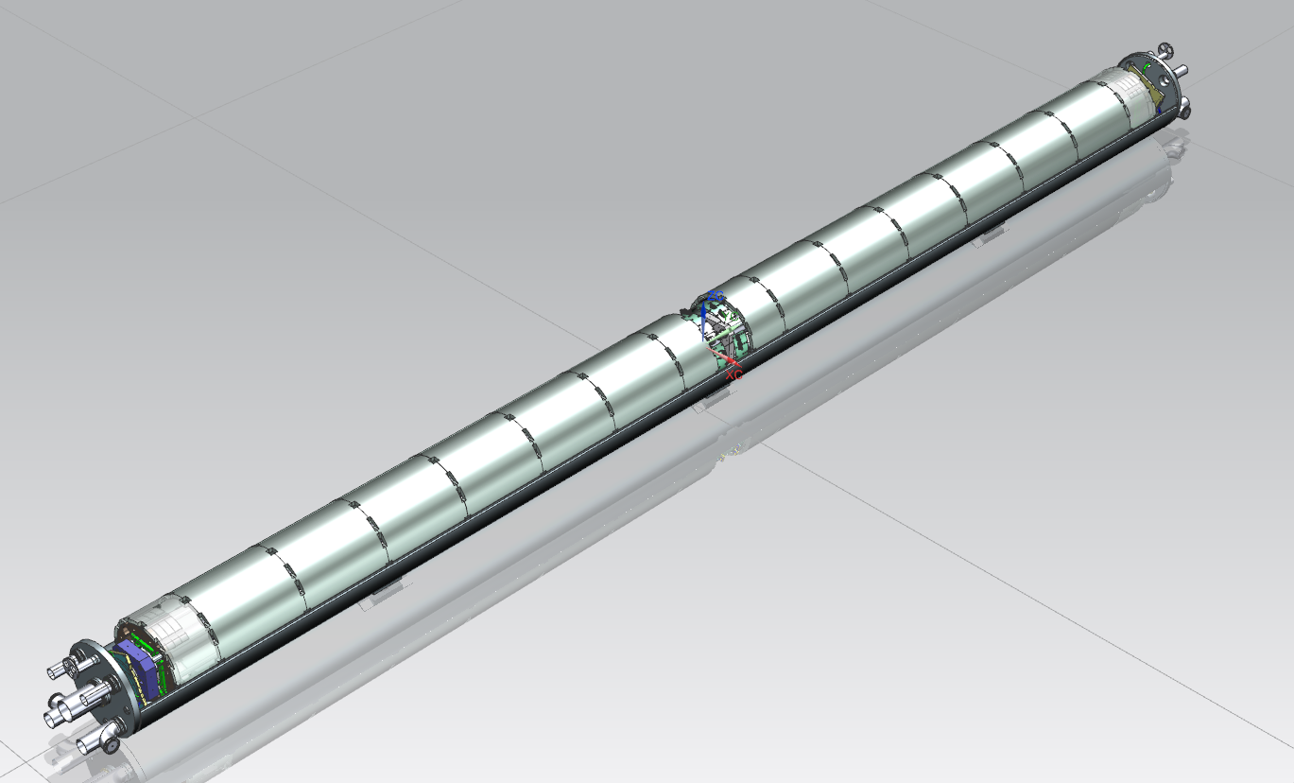
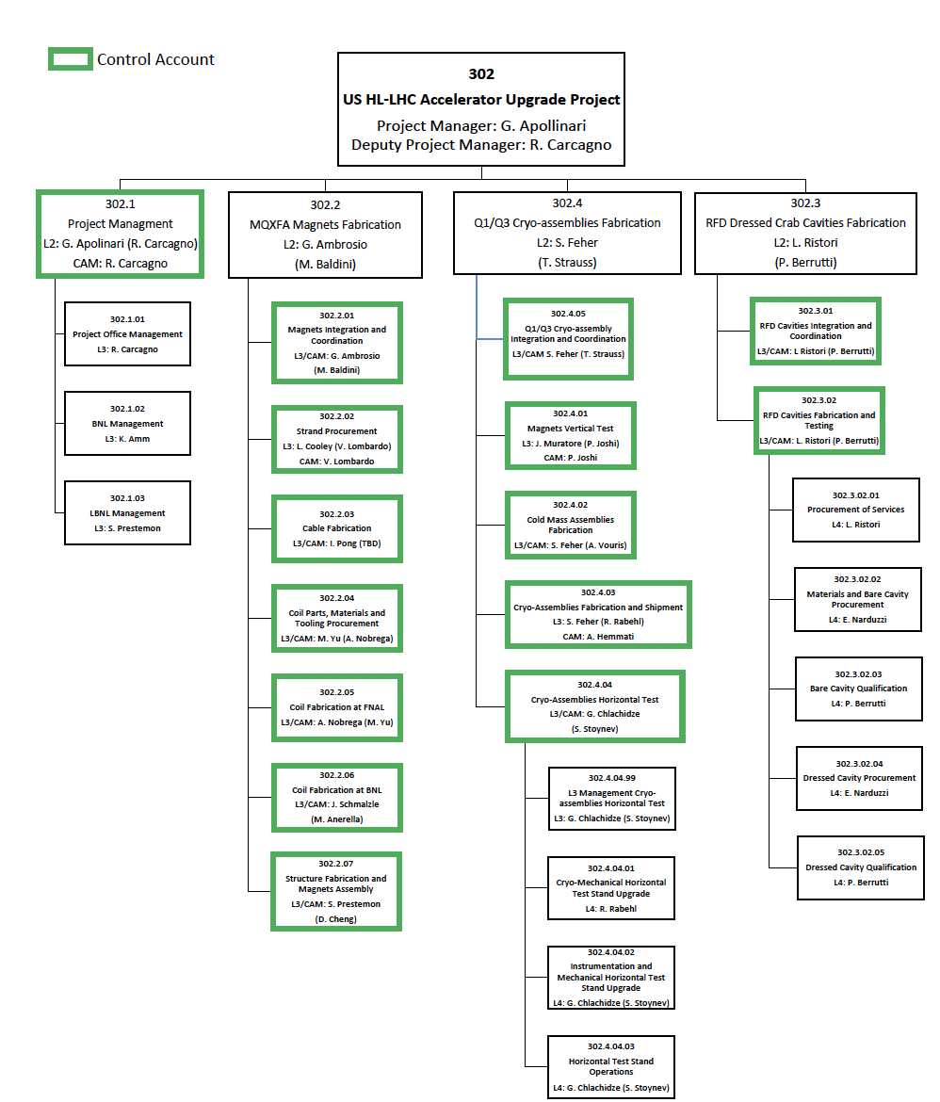
Magnets Deliverables
MQXFA
Magnet
Q1/Q3 Cryoassembly
(10 CryoAssemblies with 20 Magnets)
Cold Mass
Assembly
Delivered to CERN in between February 2023 and October 2025
I am the deputy of the MQXFA magnet manager
Full integration FNAL/BNL/LBNL

Slide 5

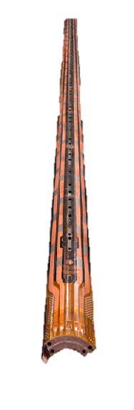
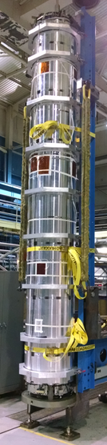
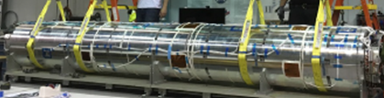
The US-HL-LHC AUP: Cryo-assembly fabrication
Journey across the US fabricating Magnets and learning something about them

Slide 6
Table of contents
Superconducting accelerator magnets
NbTi and Nb3Sn materials: some basics of superconductivity
Superconducting wires and cables
Coil fabrication
Magnet protection and assembly
Training and testing
Bus Bar protection
Quench heaters assessment

Slide 7
Superconducting magnets: challenges overview
The science (or the art …) of superconducting magnets is a exciting, fancy and dirty mixture of physics, engineering, and chemistry
  Chemistry and material science: the quest for superconducting materials with better performances
  Quantum physics: the key mechanisms of superconductivity
  Classical electrodynamics: magnet design
  Mechanical engineering: support structures
  Electrical engineering: powering of the magnets and their protection
  Cryogenics: keep them cool …

Slide 8
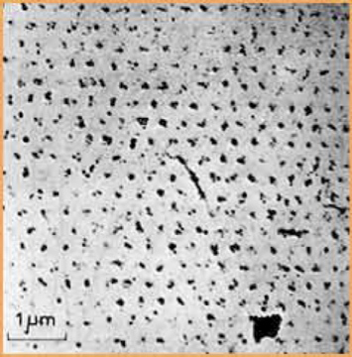
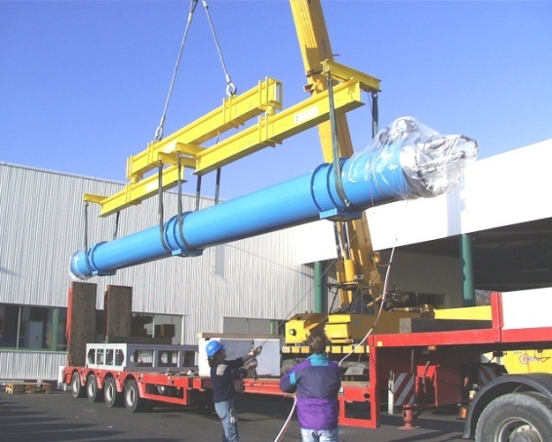
An example
An example of the variety of the issues to be taken into account
  The field of the LHC dipoles (8.3 T) is related to the critical field of Niobium-Titanium (Nb-Ti), which is determined by the microscopic quantum properties of the material
  The length of the LHC dipoles (15 m) has been determined by the maximal dimensions of (regular) trucks allowed on European roads
This makes the subject complex, challenging and complete for any physicist or engineer
Quantized fluxoids penetrating a superconductor used in accelerator magnets
A 15m truck unloading a 27 tons LHC dipole

Slide 9
Superconducting accelerator magnets
Magnetic field steers the particles in a ∼circular orbit
  Driving particles in the same accelerating structure several times
  Particle accelerated → energy increased → magnetic field increased (“synchro”) to keep the particles on the same orbit of curvature r
Limits to the increase in energy
  The maximum field of the dipoles (proton machines)
    This is why high field magnets are important to get high energies!
The arcs: region where the beam is bent
  Dipoles for bending
  Quadrupoles for focusing
Long straight sections (LSS)
  Interaction regions (IR) where the experiments are housed
  Quadrupoles for strong focusing in interaction point to increase luminosity

Slide 10
Table of contents
Superconducting accelerator magnets
NbTi and Nb3Sn materials: some basics of superconductivity
Superconducting wires and cables
Coil fabrication
Magnet protection and assembly
Training and testing
Bus Bar protection
Quench heaters assessment

Slide 11
Superconducting materials for applications
For 40-50 years, superconductivity remained a research activity, until material suitable for practical application were discovered
  type II superconductors.
Nb₃Sn and Nb-Ti, discovered in 1954 and 1961, are the most commonly used type II superconductors (80-90% of all superconducting devices).
Since their critical temperature T_{c} is 9 K (for NbTi) and 18 K (for Nb₃Sn) at 0 T, they are defined as low temperature superconductors.
  High temperature superconductors (HTS) have a T_{c} up to 80-120 K (R&D)
B<B_{c1}
B_{c1}<B<B_{c2}

Slide 12
Some basic of superconductivity
Type II superconductors find it energetically favorable to allow flux to enter via normal zones of fixed flux quanta: “fluxoids” or vortices. The fluxoids or flux lines are vortices of normal material “surrounded” by supercurrents shielding the superconducting material.
Fluxoids in the presence of current flow (e.g. transport current) are subjected to Lorentz force:
⇒ Concept of flux-flow and associated heating
Solution for real conductors: provide mechanism to pin the fluxoids. They have defects to prevent the flow of fluxoid
The ability of real conductors to carry transport current depends on the number, distribution, and strength of such pinning centers

Slide 13
Practical superconductors NbTi
Nb-Ti is the most widely used superconductor.
The Tevatron accelerator, built at Fermilab in the early 80s, was the first project where Nb-Ti was implemented on large scale.
In High Energy Physics, Nb-Ti has been used also for
    HERA at DESY
    RHIC at BNL
    SSC (project canceled in 1993)
    LHC at CERN
The cost is approximately 100-150 US$ per kg of wire.
From 1500 to 2000 tons are produced yearly.

Slide 14
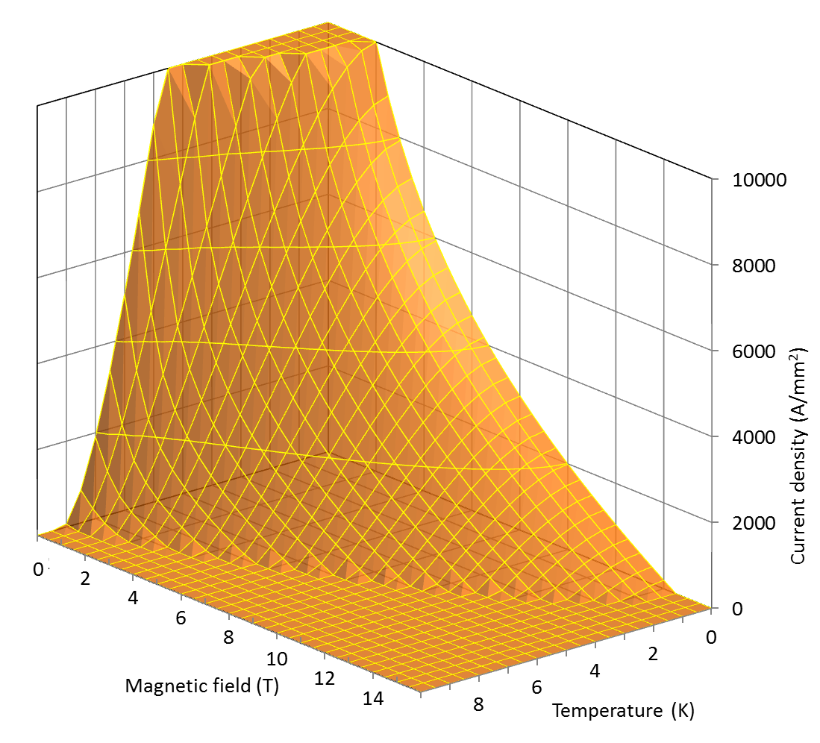
Practical superconductors NbTi
Niobium and titanium are both soluble and at high temperature they combine in a ductile alloy: excellent mechanical propertied
  It is easy to process by extrusion and drawing techniques.
Critical temperature T_{c} and upper critical magnetic field B_{C2} depend on Ti content: the optimal is 46.5-47 in weight %.
  T_{c} is ~9.2 K at 0 T.
  B_{C2} is ~14.5 T at 0 K.
The critical current J_{c} depends on the microstructure.

Slide 15
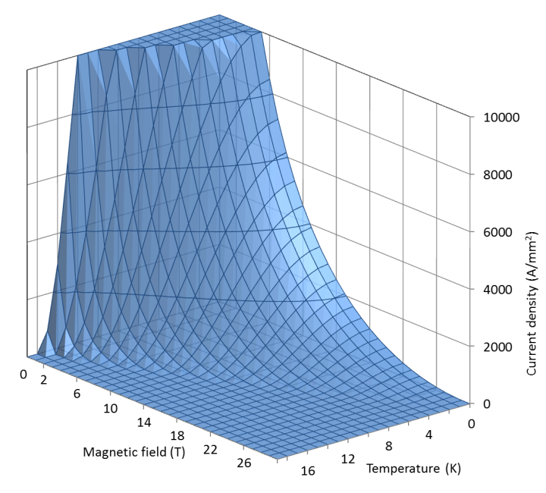
Practical superconductors: Nb₃Sn
Niobium and tin can form an intermetallic compound, with the formula Nb₃Sn
Critical temperature T_{C0m} and upper critical magnetic field B_{C20m} depend on Sn content: the optimal is 20-25 in weight%.
  T_{C0m} is ~18 K at 0 T and zero strain.
  B_{C20m} is ~28 T at 0 K and zero strain.
The critical current J_{c} depends on the microstructure (grain structure).
  High J_{c} obtained with grains from 30 to 300 nm

Slide 16
Practical superconductors: Nb₃Sn
Nb₃Sn is brittle.
  The formation of Nb₃Sn must occur only at the end of the cable and/or coil fabrication process.
In addition, it is strain sensitive: its critical parameters depend on the applied strain (reversible for small strain).
Used in
  NMR, with field of about 20 T
  Model coils for ITER
  High energy physics (HL-LHC)
The cost is approximately 1500 US$ per kg of wire.
About 15 tons are produced yearly.

Slide 17
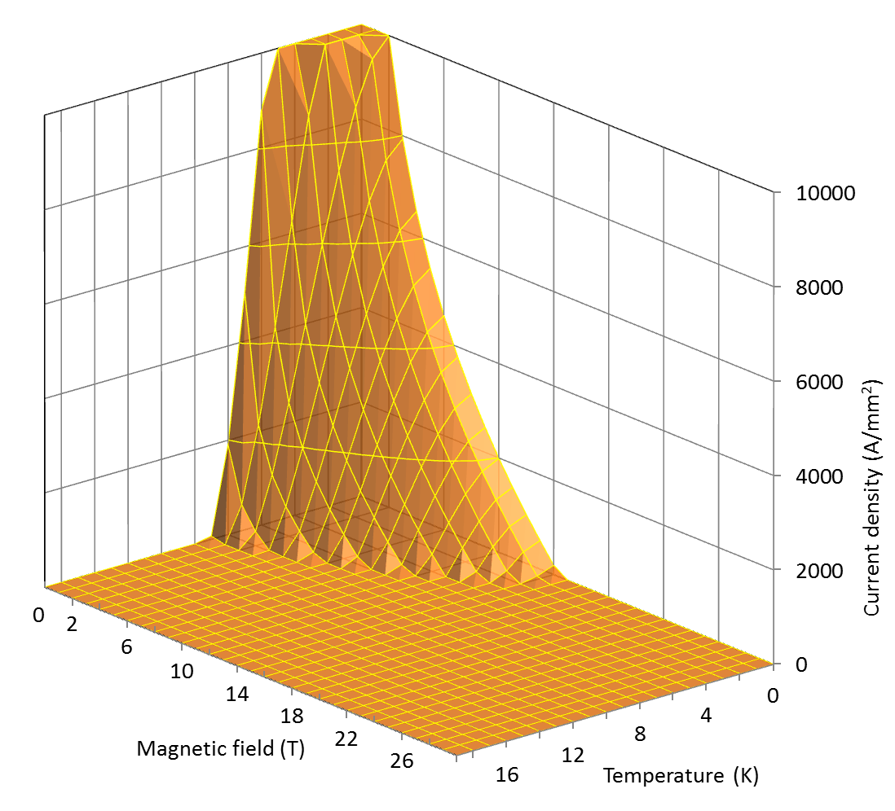

Critical surfaces
The critical surface defines the boundaries between superconducting state and normal conducting state in the space defined by temperature, magnetic field, and current densities.

Slide 18
Practical superconductors

Slide 19
Table of contents
Superconducting accelerator magnets
NbTi and Nb3Sn materials: some basics of superconductivity
Superconducting wires and cables
Coil fabrication
Magnet protection and assembly
Training and testing
Bus Bar protection
Quench heaters assessment

Slide 20
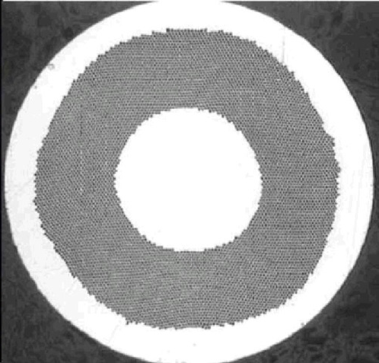
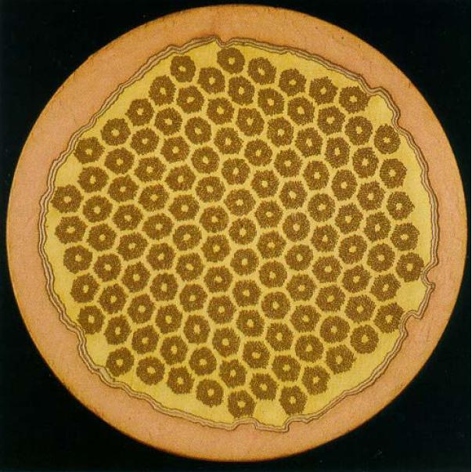
Multifilament wires
For practical applications, superconducting materials are produced in small filaments and surrounded by a stabilizer (typically copper) to form a multifilament wire or strand.
A superconducting cable is composed of several wires into
multistrand cable.
NbTi LHC wire (A. Devred, [1])
Nb₃Sn bronze-process wire (A. Devred, [1])
  filaments of small diameters
    to reduce magnetic instabilities called flux jumps
  twisted together
    to reduce interfilament coupling and AC losses
  embedded in a copper matrix
    to protect the superconductor after a quench
    to reduce magnetic instabilities called flux jumps

Slide 21
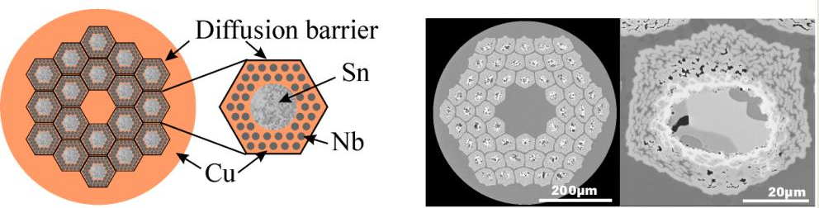
Nb₃Sn wires for MQXFA magnets
Internal tin process
  A tin (Sn) core is surrounded by Nb rods embedded in Cu (Rod Restack Process, RRP)
  Each sub-element has a diffusion barrier.
  Non-Cu J_{C} up to 3000 A/mm² at 4.2 K and 12 T.
For AUP production: 1920 km di RRP 108/127 (9.5 tons of strands).

Slide 22
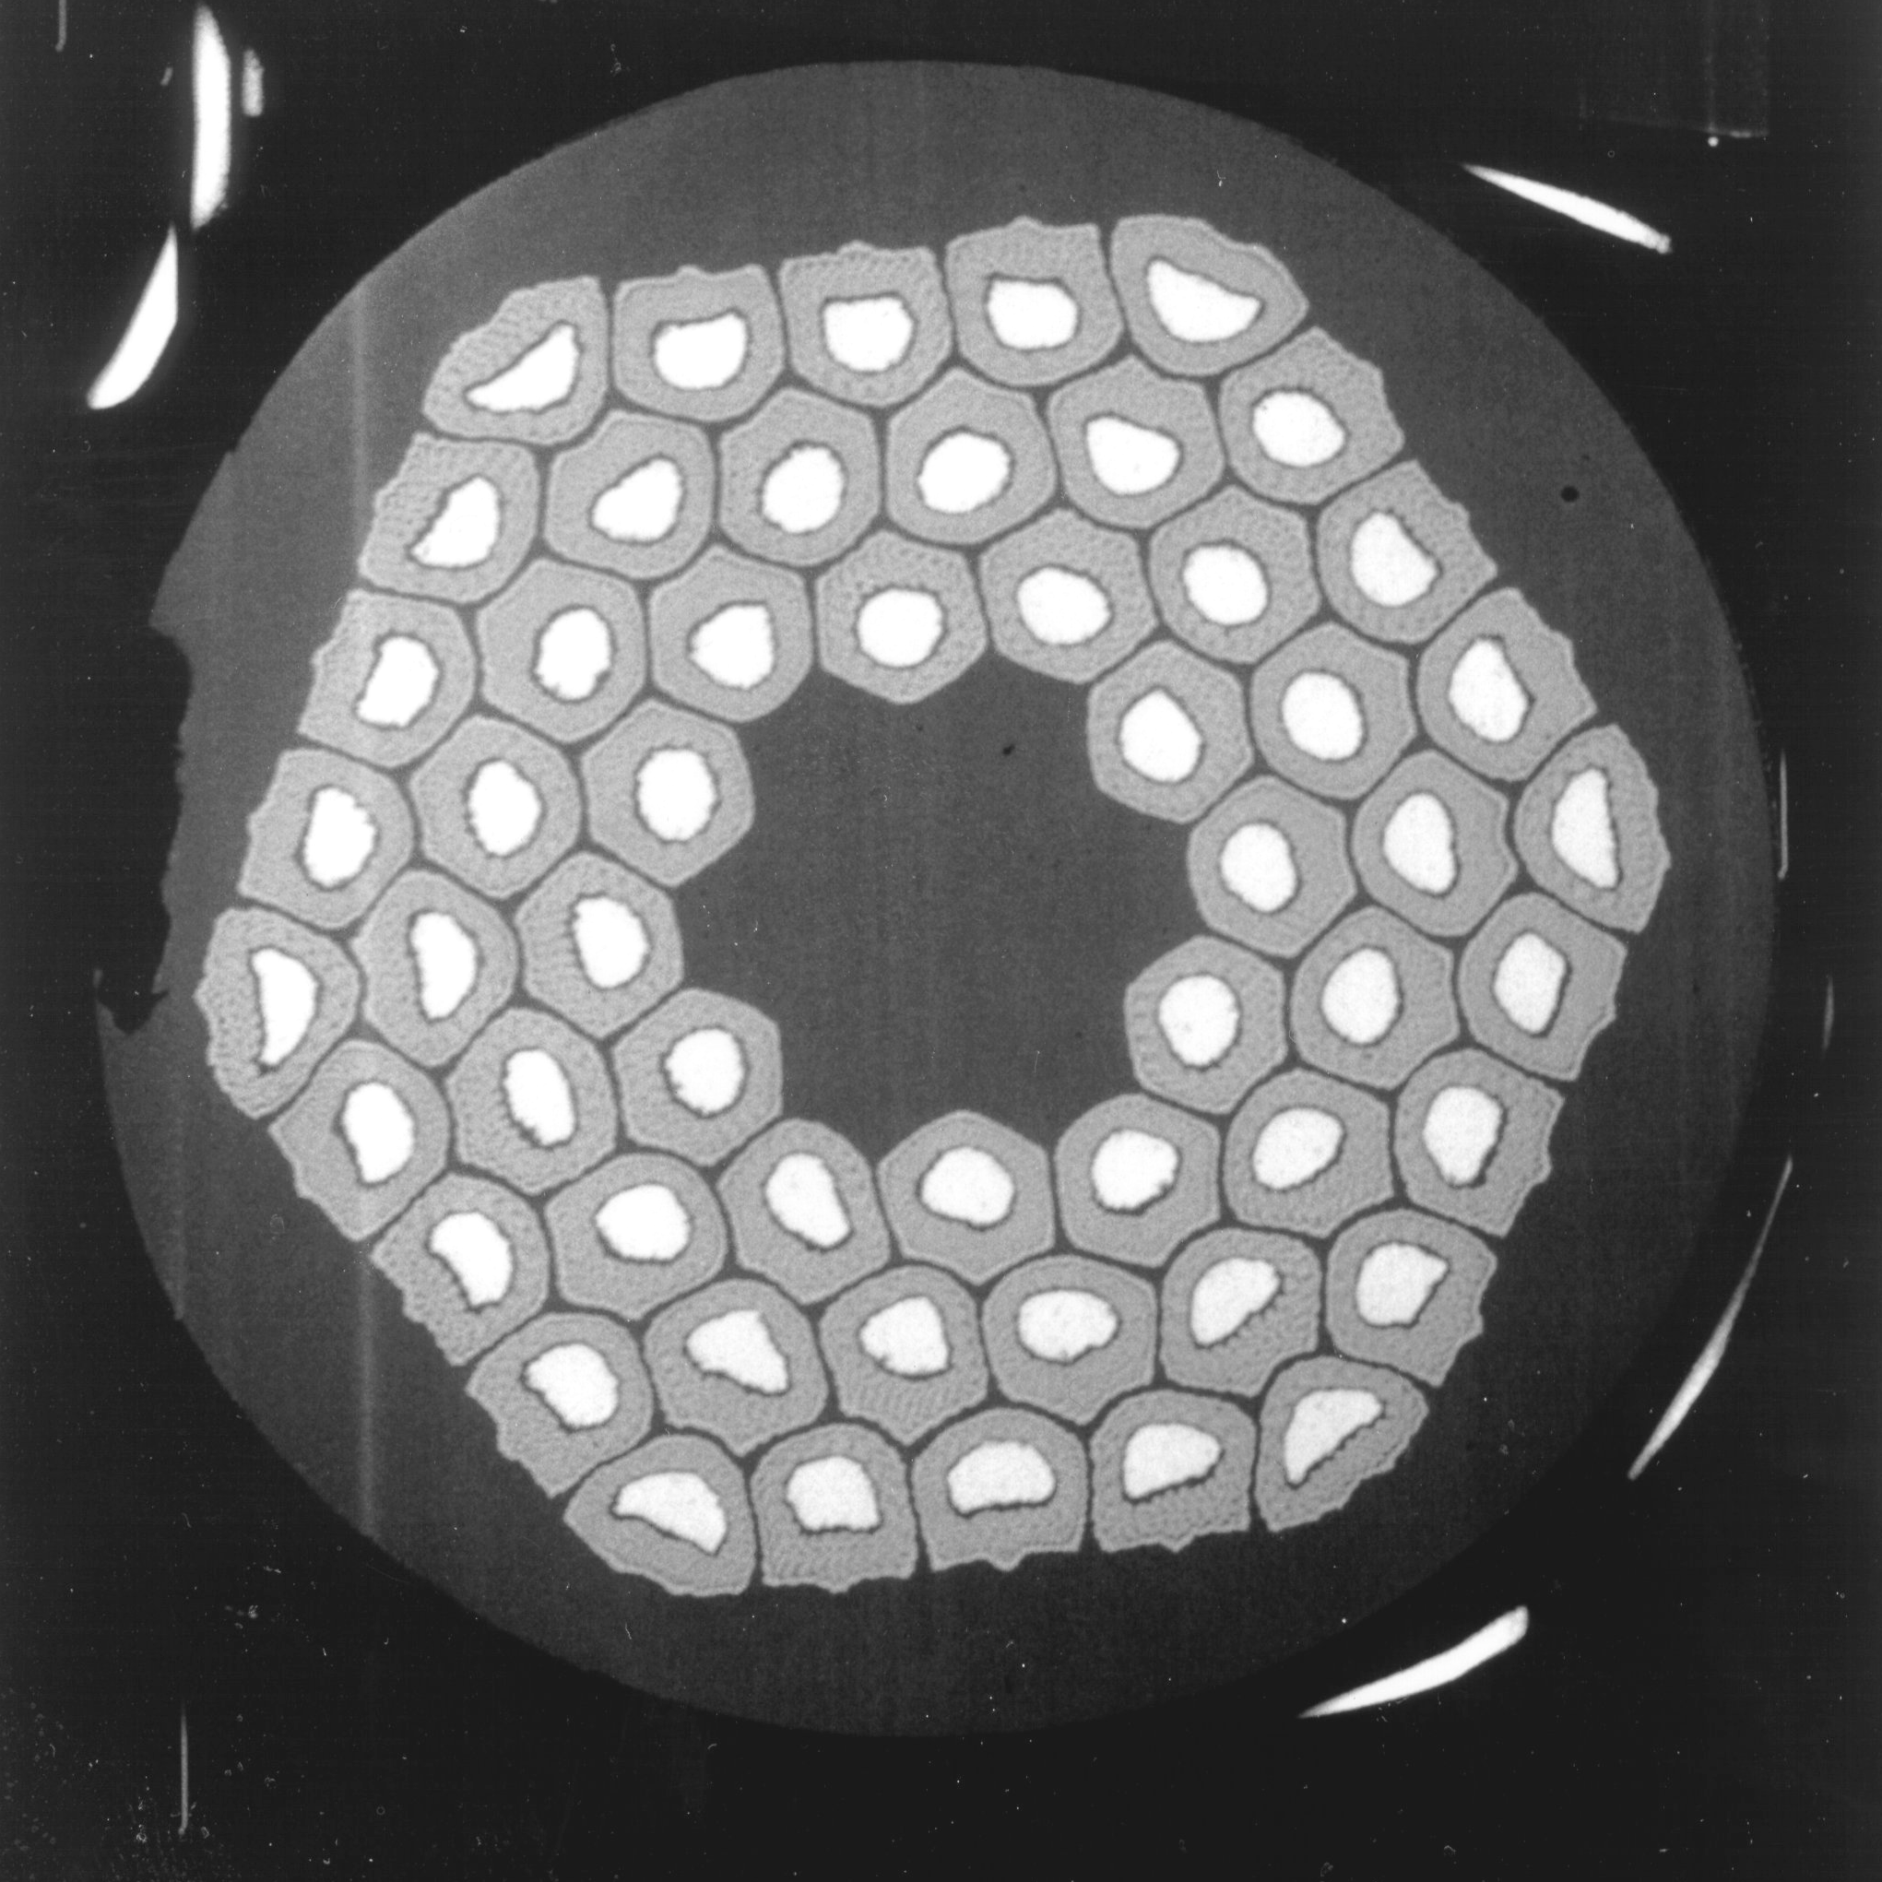
Nb₃Sn wires for MQXFA magnets
Since Nb₃Sn is brittle, it cannot be extruded and drawn like NbTi. It must be formed at the end of the fabrication of the cable (or the coil).
The process requires several steps:
  Assembly multifilament billets from Nb₃Sn precursor (CuSn and Nb).
  Fabrication of the wire through extrusion-drawing technique.
  Fabrication of the cable.
  Fabrication of the coil:
  “Wind & react” First coil winding and then formation of Nb₃Sn

Slide 23
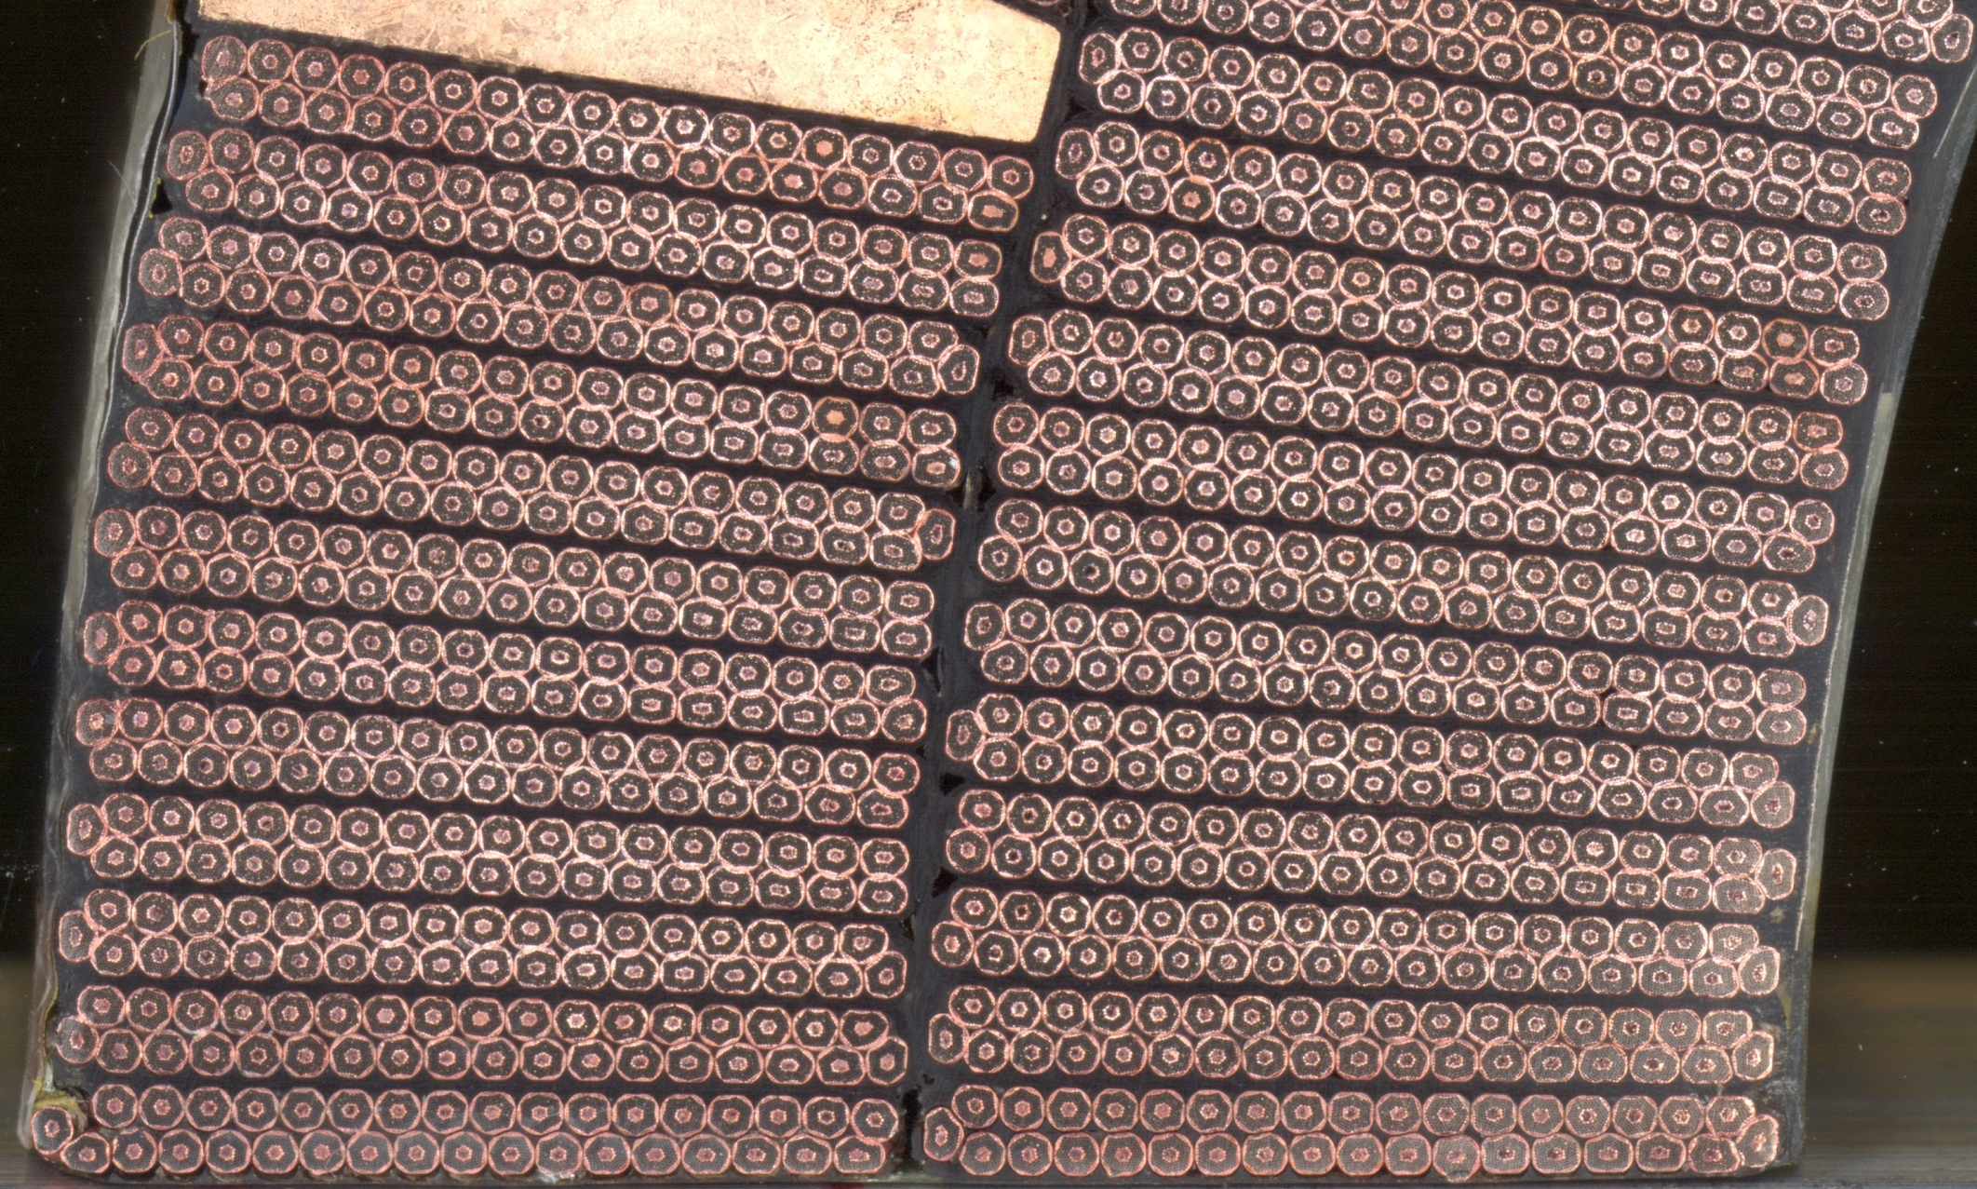
Nb3Sn cables for MQXFA magnets

Slide 24
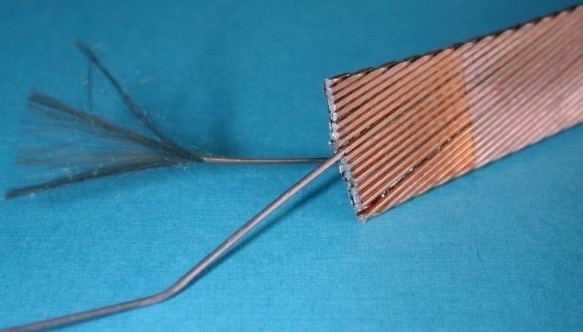
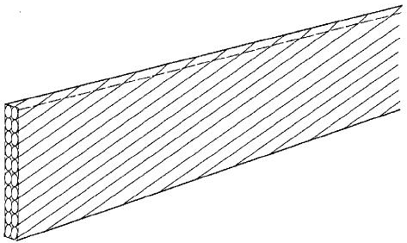
Nb₃Sn cable for MQXFA magnets
Our cables are fabricated at LBNL. The most commonly used multi-strand cables are the Rutherford cable.
The final shape of a Rutherford cable can be rectangular or trapezoidal.
  multi-strand cable so there is current redistribution in case of a defect or a quench in one strand.
  Twisted
  Insulation
  Good electrical properties to withstand high turn-to-turn voltage.
  Porosity to allow penetration of helium (or epoxy)
  Radiation hardness

Slide 25
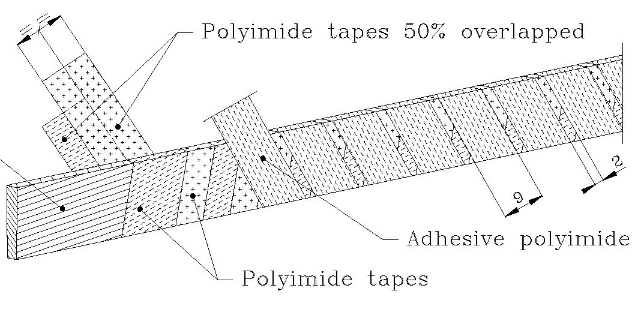
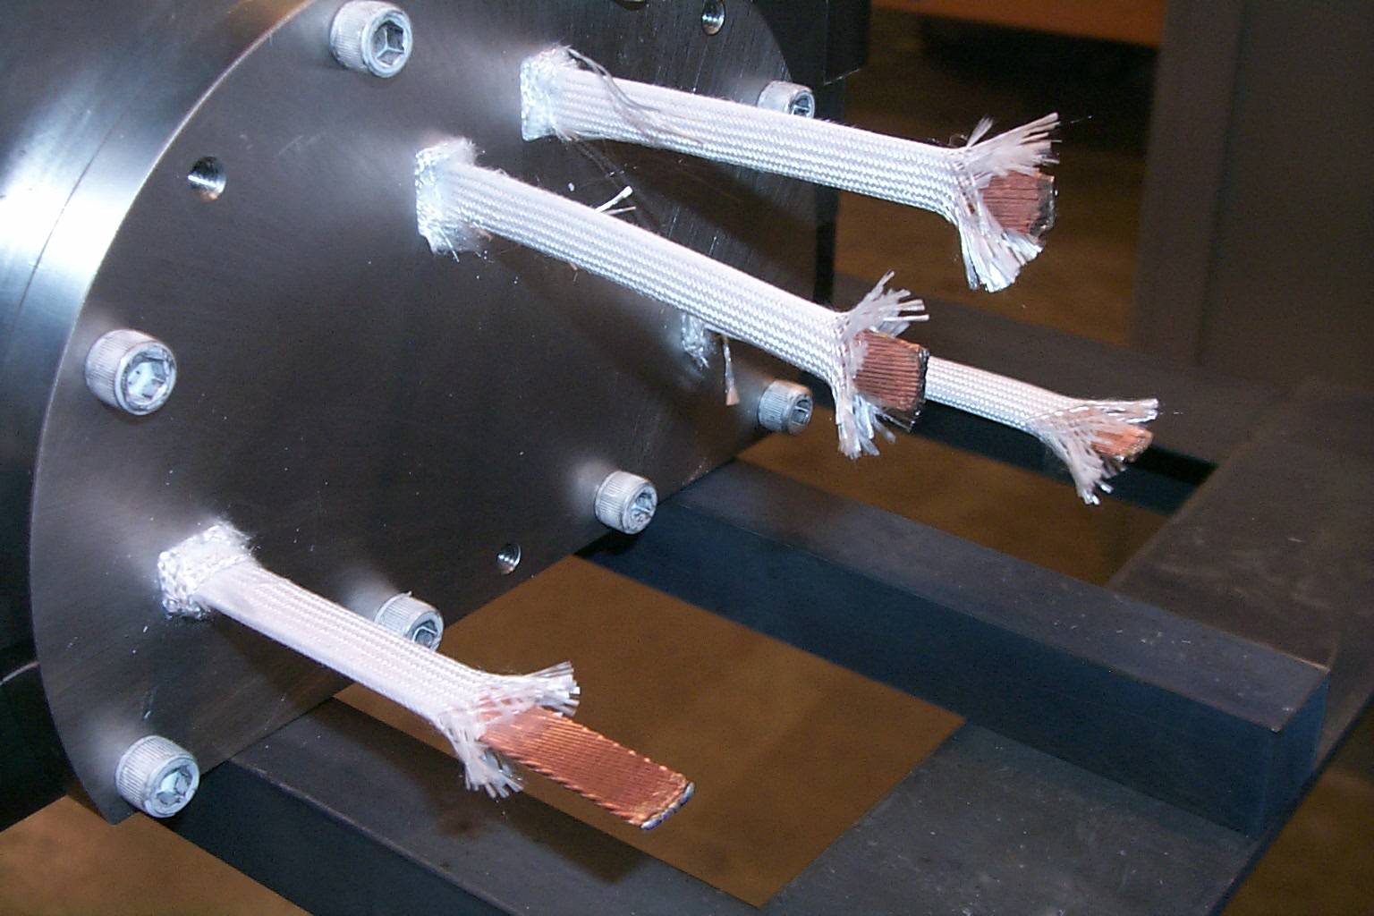
Cable insulation
In Nb-Ti magnets the most common insulation is a series of overlapped layers of polyimide (kapton).
In Nb₃Sn magnets, where cable are reacted at 600-700 °C, the most common insulation is fiberglass: tape or sleeve or braided.
Typically the insulation thickness varies between 100 and 200 µm.

Slide 26
Table of contents
Superconducting accelerator magnets
NbTi and Nb3Sn materials: some basics of superconductivity
Superconducting wires and cables
Coil fabrication
Magnet protection and assembly
Training and testing
Bus Bar protection
Quench heaters assessment

Slide 27
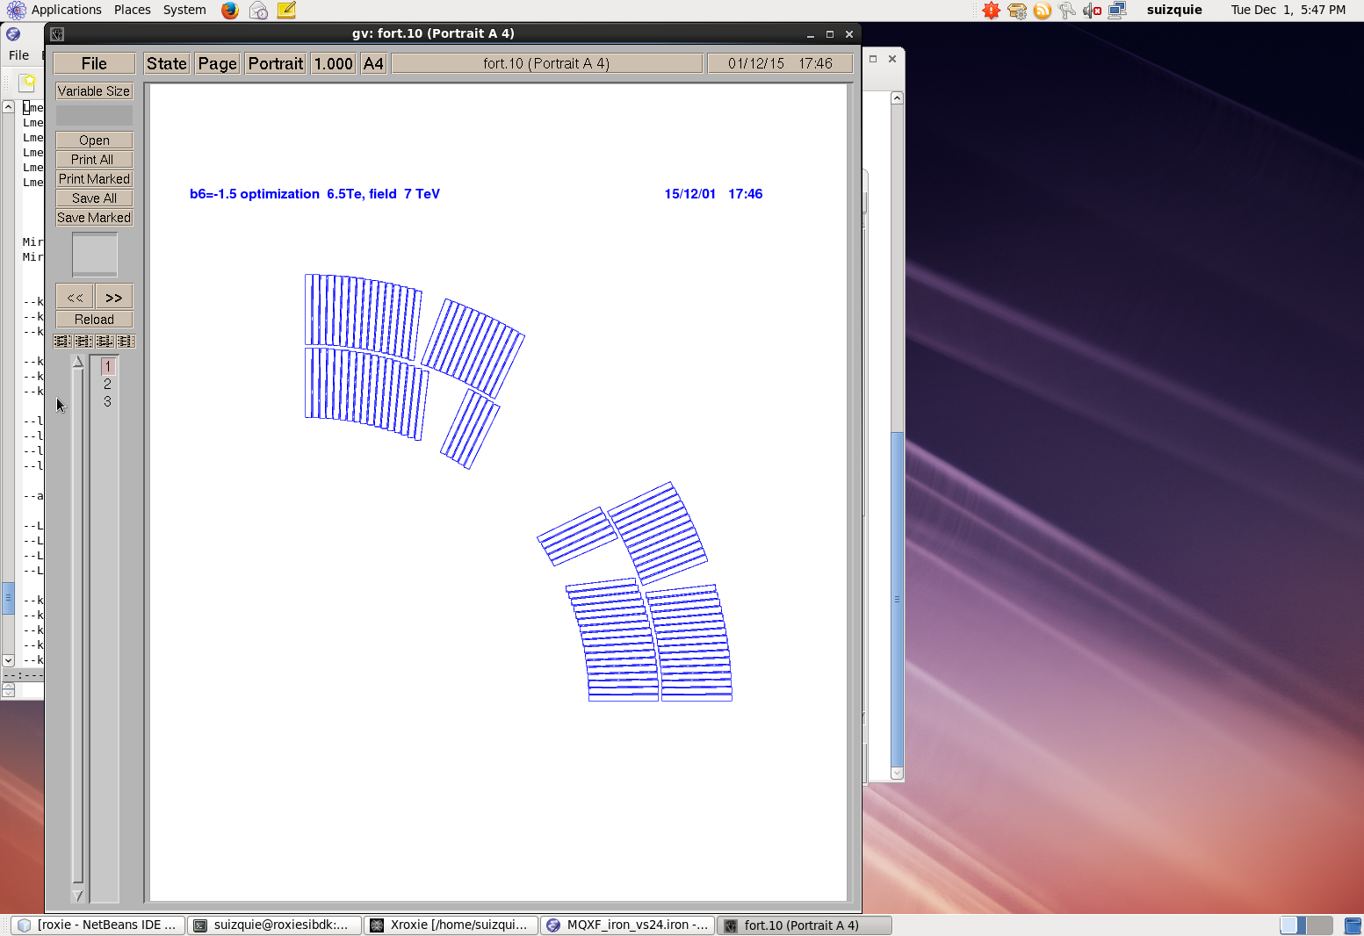
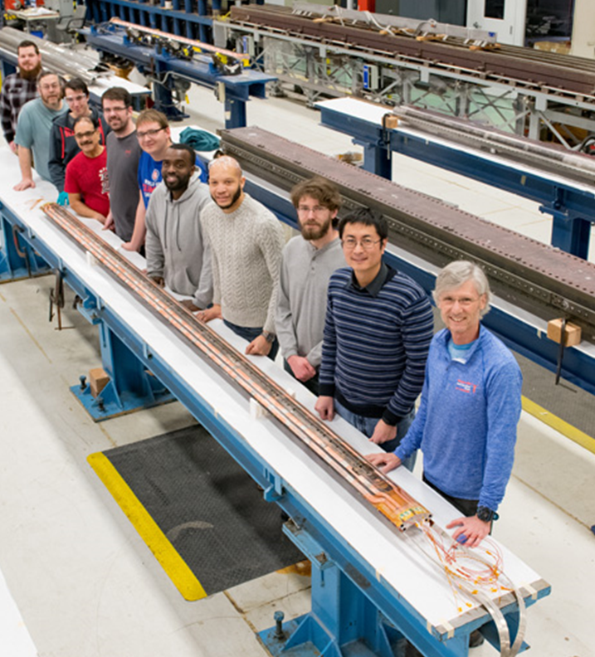
MQXFA coil @ FNAL and BNL
the cos2θ-layout and two layers
2
4
1
3

Slide 28
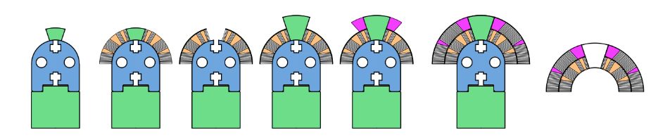
Coil winding
A continuous length of insulated cable sufficient for one coil is wound on a spool.
Then, from the spool, the cable is wound around a pole mounted on a steel mandrel.
Winding starts from the pole turn of the inner layer after preparing the coil ramp for the outer layer.
The cable is maintained in tension (200 N)
A cable of Nb₃Sn is brittle.
In the “Wind & React” approach, the coil is wound un-reacted: then the entire coil undergoes the reaction process.
2
4
1
3

Slide 29
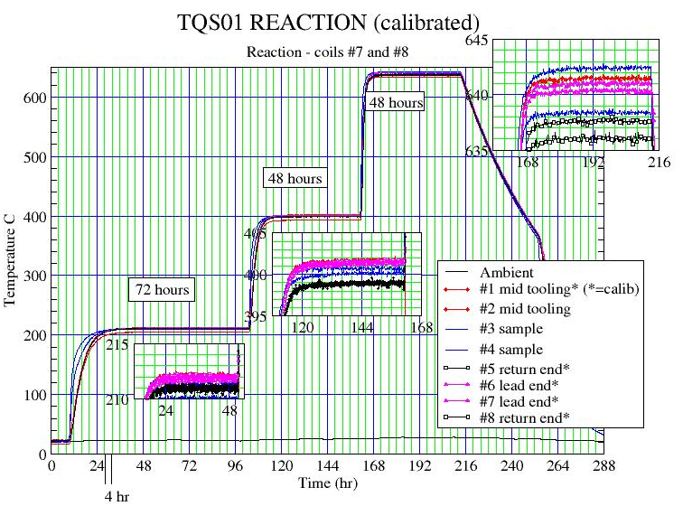
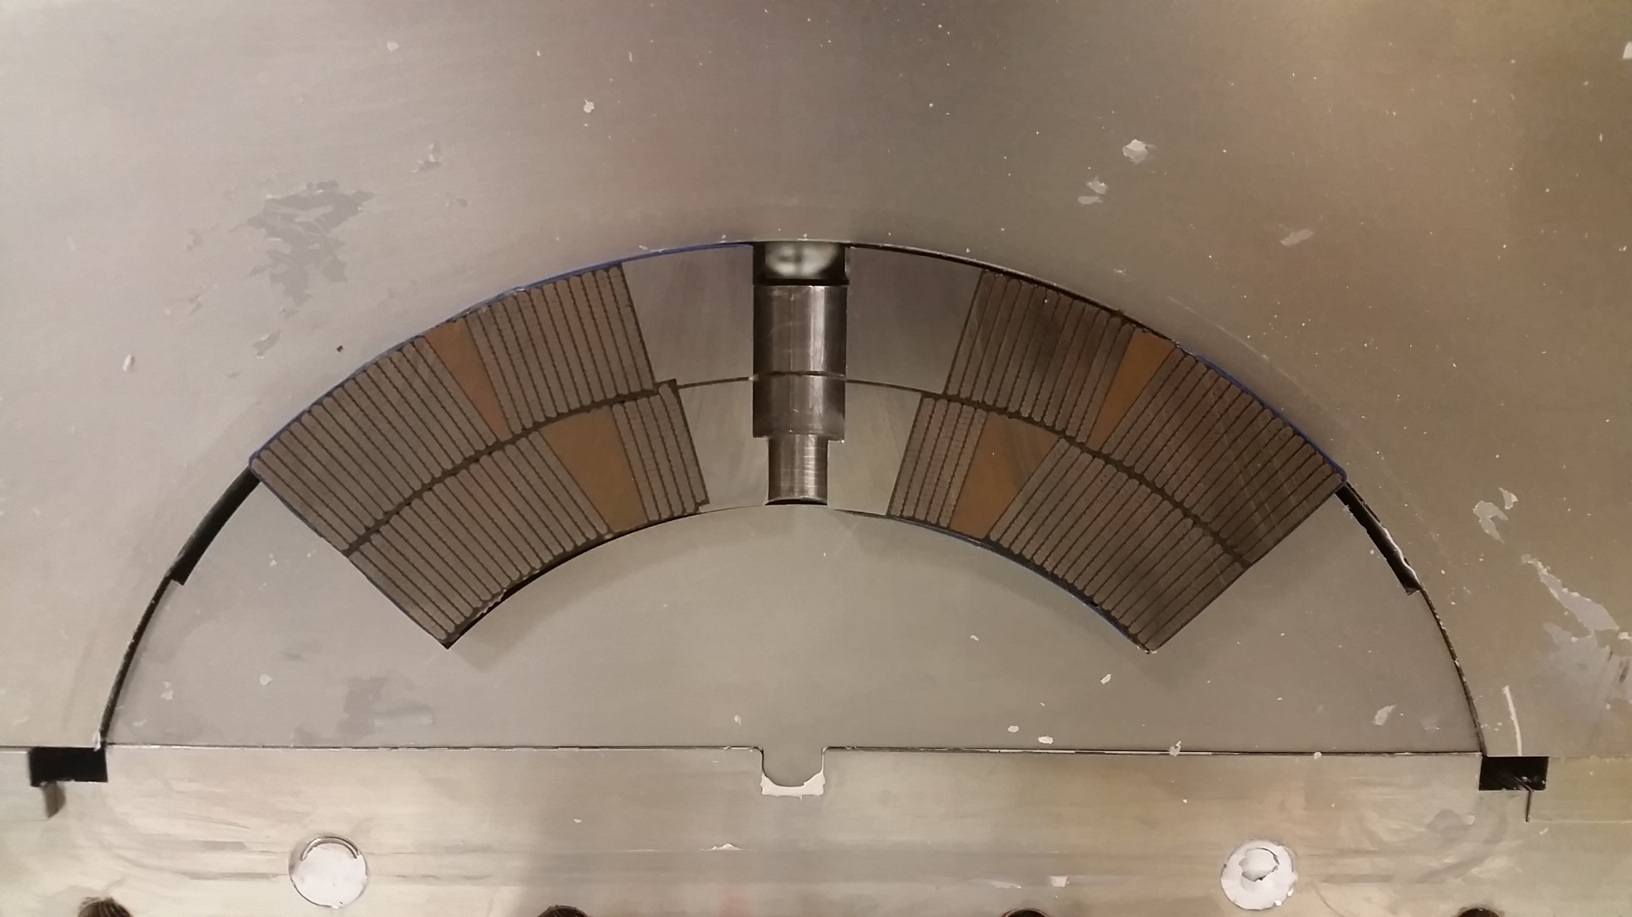
Coil reaction
During the “reaction” process, the CuSn and Nb are heated to about 650-700 C in vacuum or inert gas (argon) atmosphere, and the Sn diffuses in Nb and reacts to form Nb₃Sn.
The reaction is characterized by three temperature steps.
Reaction cycle lasts about 11 days including ramp up and cool down.
Reaction & Impregnation ‘Form’ Blocks
Ti-6Al-4V pole
660 µm insulation
Reaction & Impregnation ‘Mandrel’ Blocks

Slide 30
Coil impregnation
After reaction, Nb₃Sn coil are vacuum impregnated (potted) with epoxy.
  Resin creates a solid block, thus distributing the stress.
Coil is placed in a fixture (potting fixture) and fixture is inserted in a vacuum tank and evacuated.
CTD101K epoxy impregnation at 30-50 mm Hg and 50° C
Epoxy cure is in the vacuum tank at 110° C for 5 hours then 125° C for 16 hours using external heaters mounted on the tooling.

Slide 31
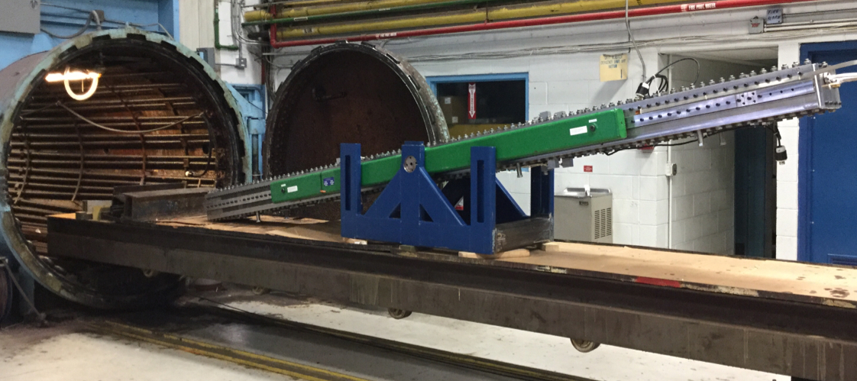
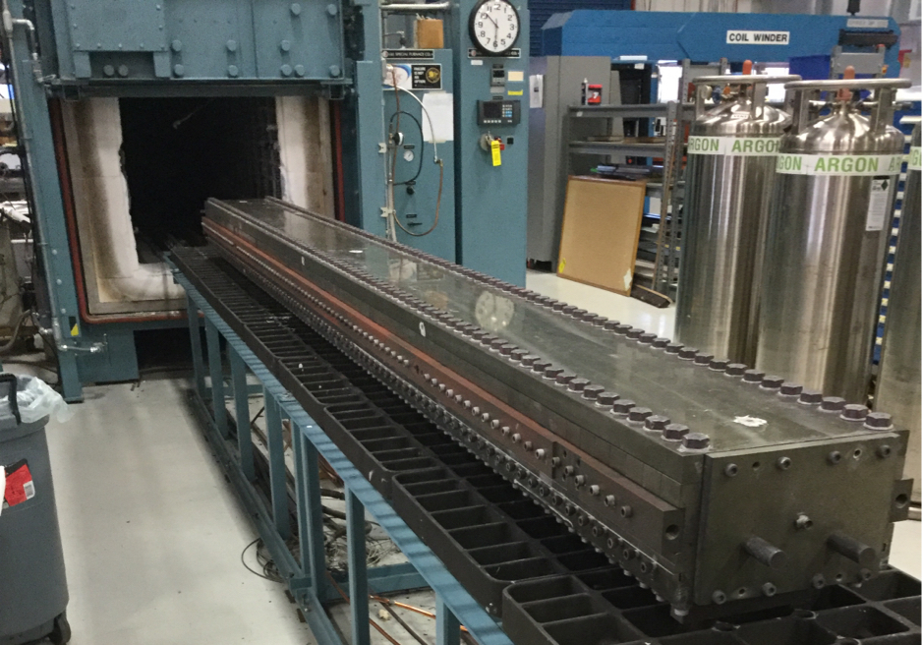
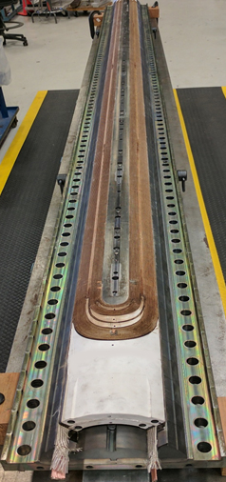
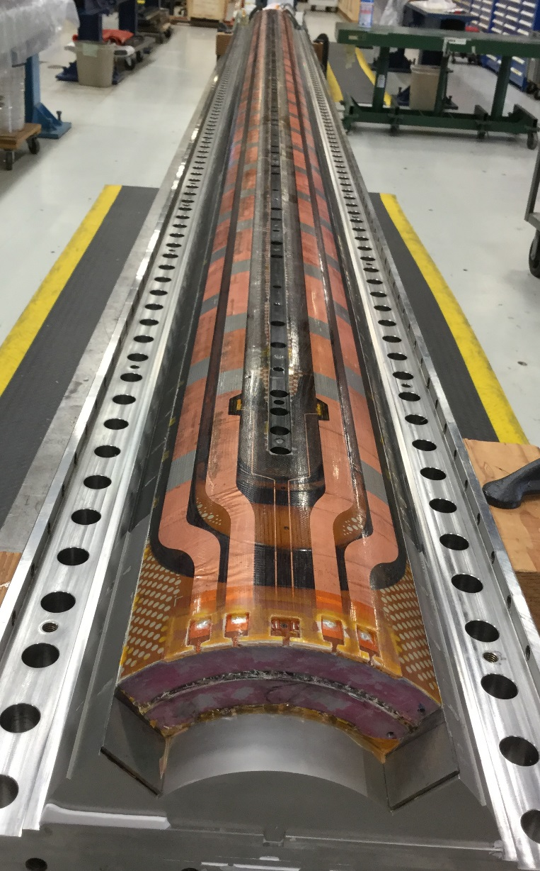
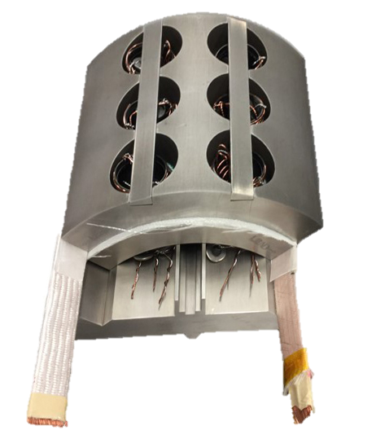
Coil reaction and impregnation

Slide 32
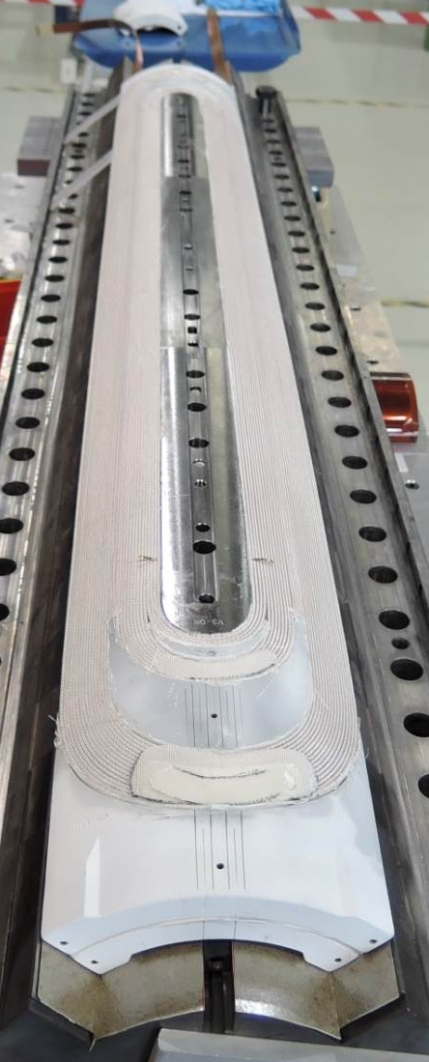
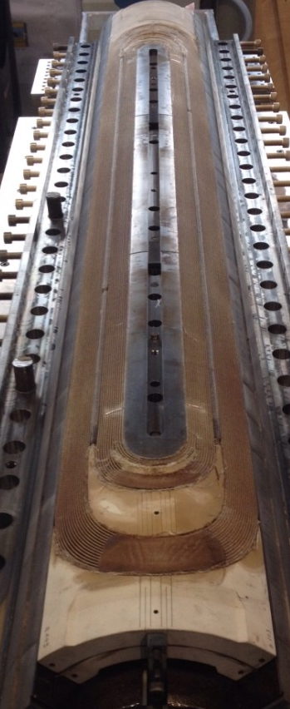
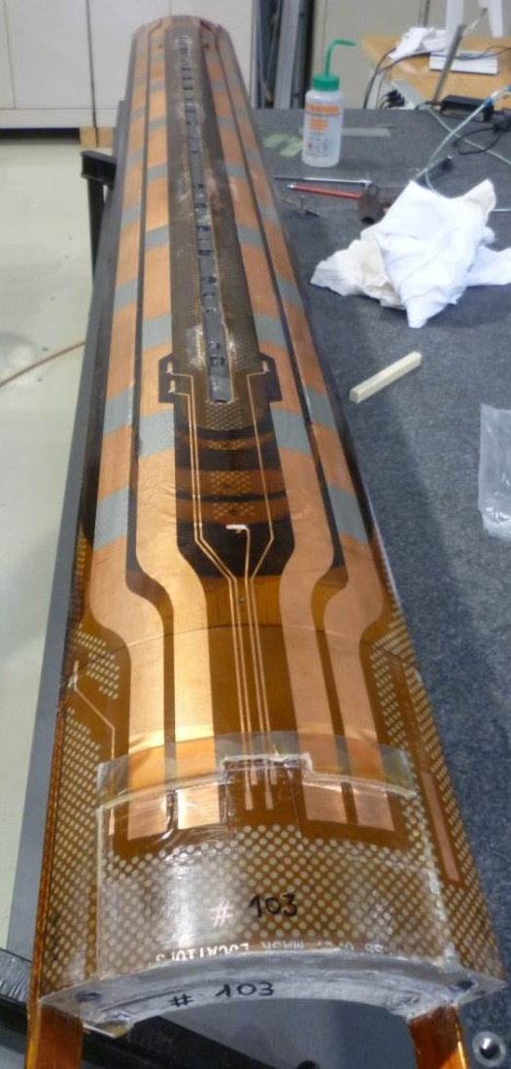
Coil fabrication process
After winding/curing
After reaction
After impregnation

Slide 33
MQXFA coil instrumentation: voltage taps and strain gauges
Voltage taps
  By providing a measurement of the voltage across a conductor segment, they allow monitoring in which turn/location a quench occurred, and how it propagated along the turn and from turn to turn.
Strain gauges
  By measuring strain, they provide information about the stress status of coil and components

Slide 34
Table of contents
Superconducting accelerator magnets
NbTi and Nb3Sn materials: some basics of superconductivity
Superconducting wires and cables
Coil fabrication
Magnet protection and assembly
Training and testing
Bus Bar protection
Quench heaters assessment

Slide 35
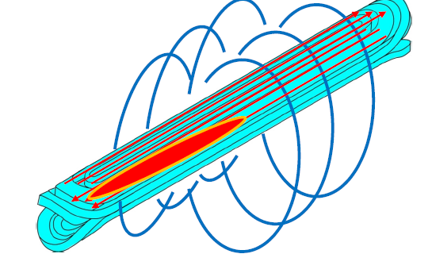
Quench
Quench
If of a point of conductor suddenly
becomes non-superconducting, it
starts heating up
LHC dipole15m and 8.35T stores 8 MJ, which corresponds to melting 1.5L of copper, enough to evaporate 10cm of coil
The energy stored in the magnet
is usually sufficient to melt kilos of
copper and damage the magnet!
Quick propagation of the resistive zone is needed

Slide 36
Why do we need to protect the magnets
A superconducting accelerator magnet has a large magnetic stored
energy
A quench produces a resistive zone
Current is flowing through the magnet
The challenge of the protection is to provide a safe conversion of
the magnetic energy to heat in order to minimize
Peak temperature (“hot spot”) and temperature gradients in the magnet
Peak voltages
The final goal being to avoid any magnet degradation
  High temperature => damage to the insulation or stabilizer
  Large temperature gradient => damage to the conductor due to differential thermal expansion of materials
Joule Heating
Voltages

Slide 37
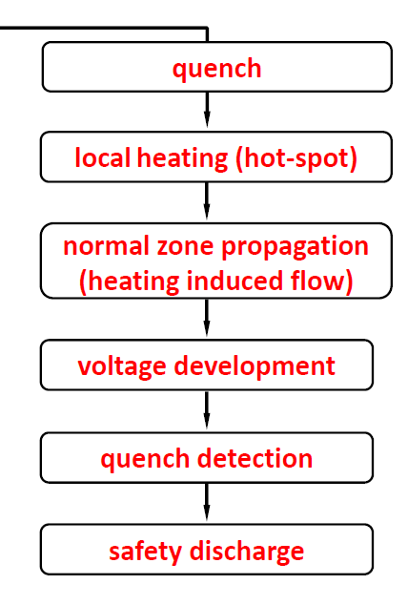
What are critical parameter for quench protection
Typical scenario
The current in the magnet is I₀, a quench occurs
Normal zone propagation and voltage build-up
Detection system based on some voltage threshold
trigger protection options

Slide 38
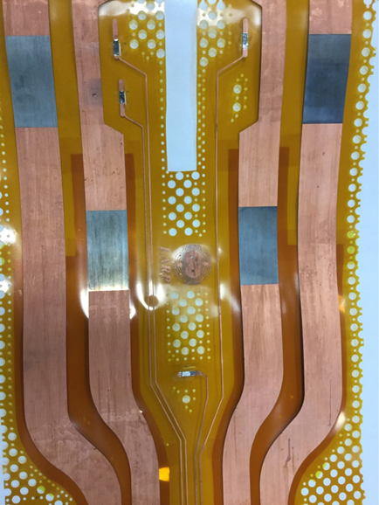
MQXFA protection system: external quench heaters
MQXFA Quench Heaters:
  50 um polyimide + 12 um glue + 25 um steel + 10 um copper (in some areas) ➔ 200 um Heater-Coil distance (including 145 um cable insulation)
  Additional 50 um polyimide in the ends
Quench heaters are μm-thin strips
glued to the coil, which heat the
turns by thermal diffusion

Slide 39
MQXFA protection system: CLIQ system

Slide 40
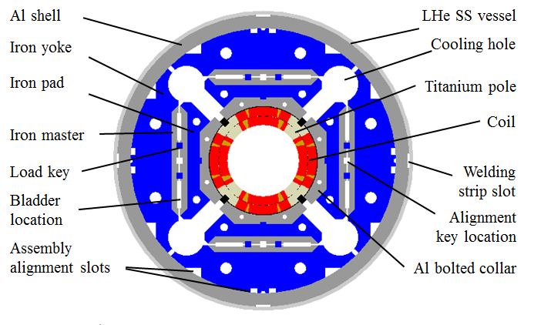
MQXFA structural design
Parameter | Unit | MQXFA
Coil aperture | mm | 150
Magnetic length | m | 4.2
N. of layers |  | 2
N. of turns Inner-Outer layer |  | 22-28
Operation temperature | K | 1.9
Nominal gradient | T/m | 132.6
Nominal current | kA | 16.5
Peak field at nom. current | T | 11.4
Stored energy at nom. curr. | MJ/m | 1.2
Diff. inductance | mH/m | 8.2
After winding and curing (reaction and potting), the coil is placed inside a support structure capable of
  providing the required pre-stress to the coil after cool-down in order to reduce conductor motion;
  withstanding the electro-magnetic forces;
  providing Helium containment.

Slide 41
Table of contents
Superconducting accelerator magnets
NbTi and Nb3Sn materials: some basics of superconductivity
Superconducting wires and cables
Coil fabrication
Magnet protection and assembly
Training and testing
Bus Bar protection
Quench heaters assessment

Slide 42
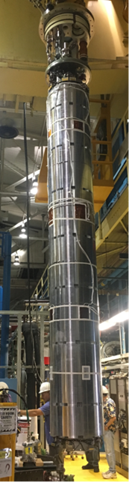
Vertical test facility at BNL: MQXFA magnet training
Magnet test performed at 1. 9 K ramping up current up to nominal current 16230 A (HL-LHC operation)
  The occurrence of premature quenches
  The progressive increase of quench current
    Something not reversible happens, or, in other words, the magnet is somehow “improving” or “getting better” quench after quench.
MAGNET TRAINING
Mechanical induced quenches are considered the main causes of training in a superconducting magnets.
  Frictional motion of a superconductor
    During excitation electromagnetic forces determine conductor motion; any motion of a conductor in a frictional environment produces heat.
  Epoxy failure
    When a crack is initiated and propagates (for example in the resin), part of the original strain energy is dissipated as heat.

Slide 43
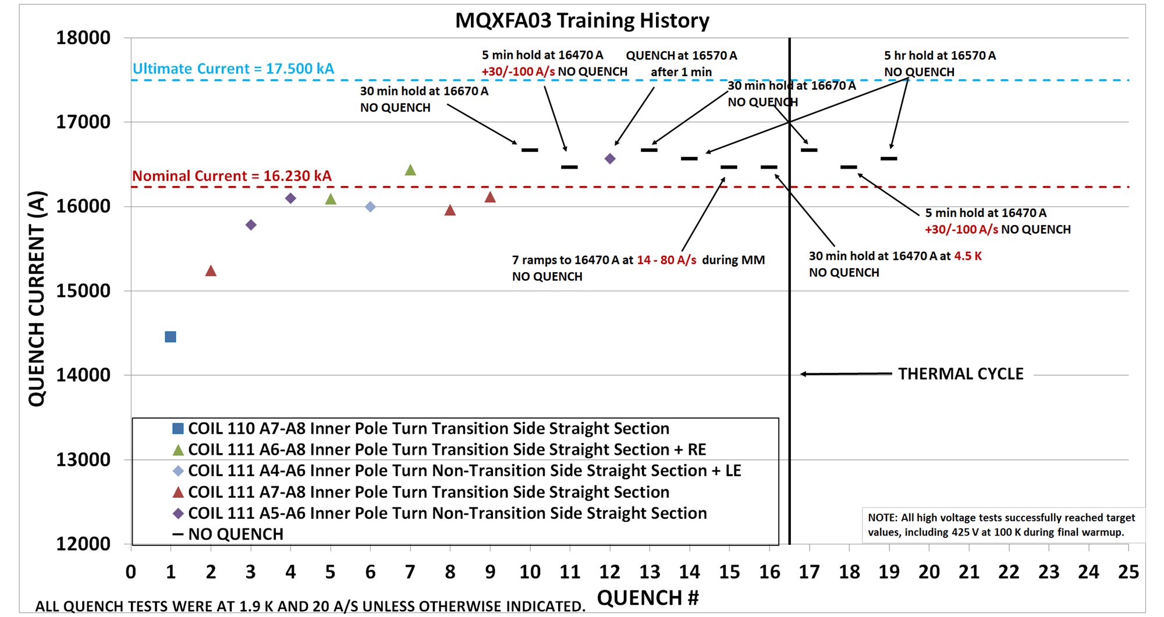
MQXFA03 training
The MQXFA magnet must be capable of operating at steady state at a temperature of 1.9 K. ➔ 16230* A + 300 A (margin) = 16530 A for 300 minutes
After a thermal cycle to room temperature, MQXFA magnets shall attain the nominal operating current with no more than 3 quenches.
MQXFA03 and MQXFA04 successfully tested and ready for cold mass

Slide 44
Table of contents
Intro
NbTi and Nb3Sn materials: some basics of superconductivity
Superconducting wires and cables
Coil fabrication
Magnet protection and assembly
Training
Bus Bar protection
Quench heaters assesment

Slide 45
BUS BAR protection strategy
The 18 kA circuit of the triplet (Q1/Q2a/Q2b/Q3) layout with all magnets in series
Quench protection elements consist of outer layer quench heaters on the coils and Coupling-Loss Induced Quench (CLIQ) units electrically connected to the coils.
The protection strategy: the entire string of magnets is quenched via CLIQ and outer layer quench heaters, if a quench is detected in any of the MQXF magnet or buses.

Slide 46
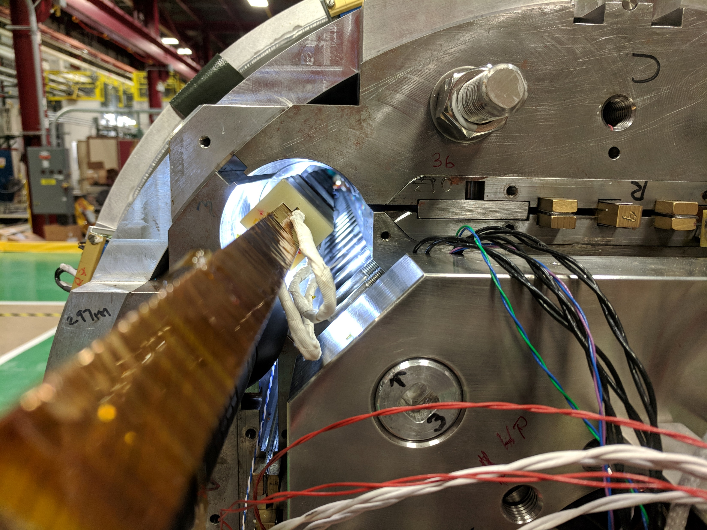
Busbar design validation test
Validate the bus design up to ultimate current (18 kA)
    No spontaneous quench
Assure quench protection of the bus
Investigate quench propagation and compare the results with calculations.
    Determine hot spot temperatures at several voltage thresholds
Bus consist of two pairs of NbTi/Cu Rutherford cables, each pair soldered together and wrapped in polyimide.
19.2 mm
18.2 mm
3.9 mm
975 μm
9.78 mm
Fig. 2 Cross section of the bus assembly.

Slide 47
Busbar testing
SIDE 1
Two spot heaters
Two temperature sensors
28 Voltage taps on the straight section of the bus
Several voltage detection threshold were used during the test
BUS14
BUS13
BUS12
BUS11
BUS10
BUS9
BUS8
BUS7
BUS6
BUS5
BUS4
BUS3
BUS2
BUS1
BUS15
BUS16
BUS17
BUS18
BUS19
BUS20
BUS21
BUS22
BUS23
BUS24
BUS25
BUS26
BUS27
BUS28
SIDE 2
Current [kA] | 5.59 | 8.24 | 9.89 | 11.53 | 13.18 | 14.83 | 16.48 | 17.8
Bus voltage detection thresholds
Current [kA] | 5.59 | 8.24 | 9.89 | 11.53 | 13.18 | 14.83 | 16.48 | 17.8
Voltage threshold (mV) | 50 | 50 | 50 | 50 | 50 | 50 | 50 | 50
 |  | 200 |  |  |  |  | 200
 |  |  |  |  |  |  | 500
 |  |  |  |  |  |  | 800
Quench was induced on the bus at reference currents firing the spot heater

Slide 48
Hot spot temperature
The calculations are in good agreement with the experimental results.
The hot spot temperatures are well below 100 K at each current and detection voltage threshold level.
At nominal current and at 8.2 kA, the bus test was performed at several detection voltage levels, ensuring protection of the bus according to specifications (100 mV, hot spot temperature < 150 K)
M. Baldini et al., "Characterization of NbTi Busbar for HL-LHC Interaction Region Quadrupoles," in IEEE Transactions on Applied Superconductivity, vol. 30, no. 4, pp. 1-5, June 2020

Slide 49
Conclusions
Understand the complexity of magnet science
Journey from conductor to magnet assembly: issues and challenges
MQXFA03 and MQXFA04 met all requirements including steady-state operation demonstrated at nominal current + 300 A.

Slide 50




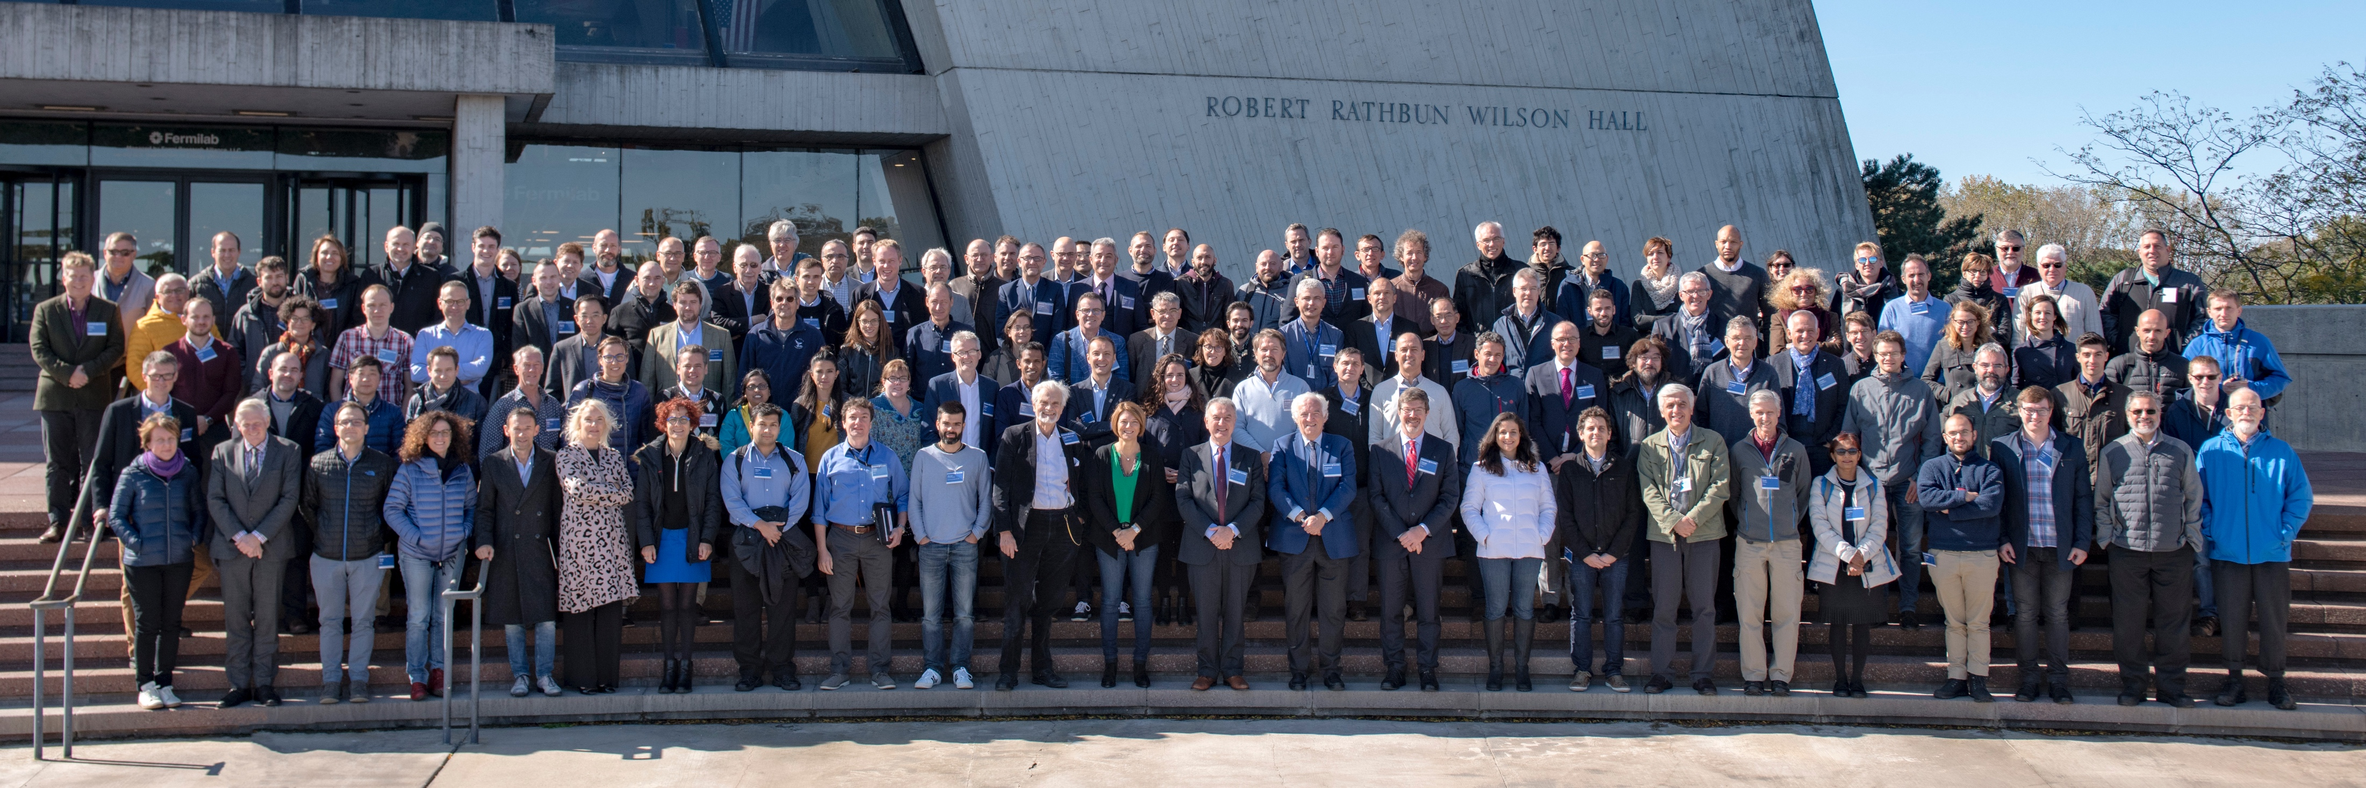
US-HL-LHC AUP collaborations
Many thanks to all my colleague at FNAL, LBNL, BNL and CERN

Slide 51
Table of contents
Intro
NbTi and Nb₃Sn materials: some basics of superconductivity
Superconducting wires and cables
Coil fabrication
Magnet protection and assembly
Training
Bus Bar protection
Quench heaters assessment

Slide 52
ELECTRICAL REQUIREMENTS
High Voltage test component | Voltage @ RT before He | Voltage @ 1.9 K | Voltage in He gas @ 100 K after training & TC | Voltage @ RT after He
Coil-Heater | 3680 V | 2300 V | 850 V (MQXFB) 425 V (MQXFA) | 460 V

Slide 53
COILS ASSEMBLED IN A MAGNET
Magnets | SHORT MIRROR MQXFSM2 US-AUP | MQXFS1 US-AUP | MQXFS3 CERN | MQXFS4 CERN | MQXFS5 CERN | MQXFS6a/b CERN
# of quenches | 21 | 349 | 100 | 160 | 120 | 25/60
# of thermal cycles | 3 | 8 | 5 | 8 | 3 | 4
Magnets | MQXFAP1 US-AUP | MQXFAP2 US-AUP | MQXFAP1b US-AUP | MQXFA03 US-AUP | LONG MIRROR FNAL | MQXFBP1
# of quenches | 18 | 29 | 37 | 9 | 52 | 21
# of thermal cycles | 3 | 1 | 1 | 2 | 1 | 1
157 heaters experienced cooldown and training
  All passed 2.3 kV test in LHe
  All passed 460 V test in air at room temperature after cold test
  Up to 8 thermal cycles and 350 quenches in short models
  Up to 3 thermal cycles and 50 quenches in MQXFA

Slide 54
MARGIN ABOVE REQUIREMENT
Destructive tests were carried out on 109 heaters at 300 K after magnet training and He exposure
  Required: 460 V
  Out of 109 heaters tested, 100% reached 1.4 kV (factor 3 margin)
  74% went up to 3 kV

Slide 55
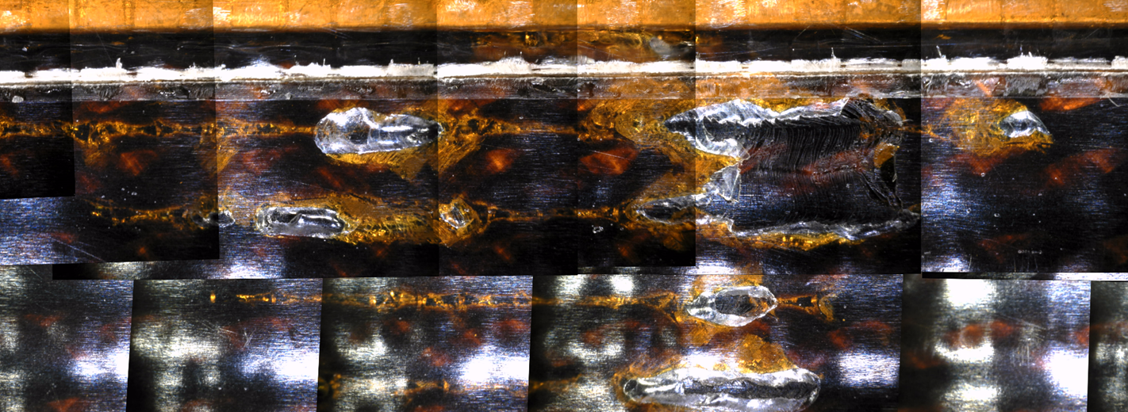
THE BLISTERING MECHANISM
THE BLISTERING MECHANISM
Autopsy of coils after Hipot to failure have shown that failures are located where blistering was present
Blistering: polyimide gets thinner by rapid expansion of GHe trapped in bubbles in the epoxy during quench

Slide 56
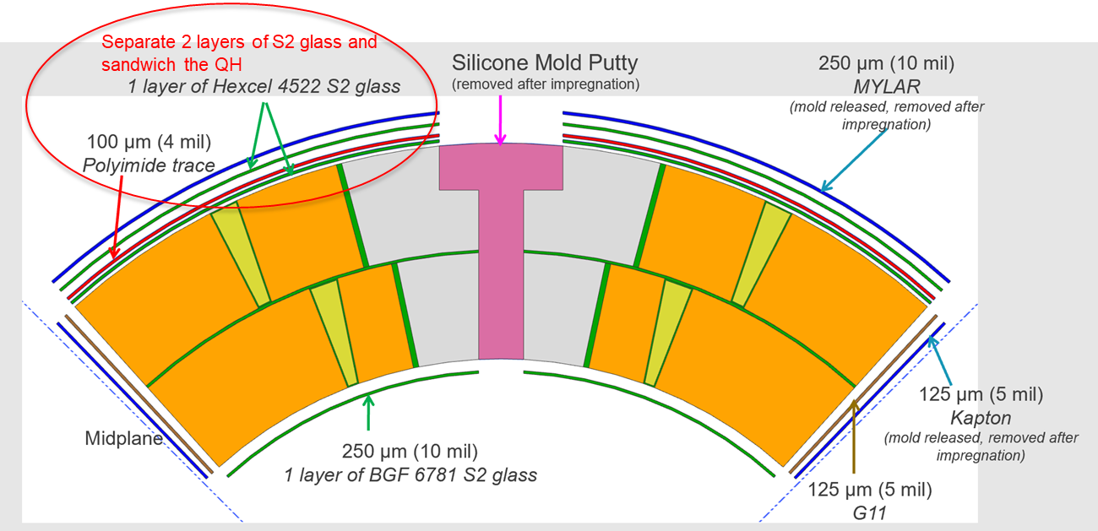
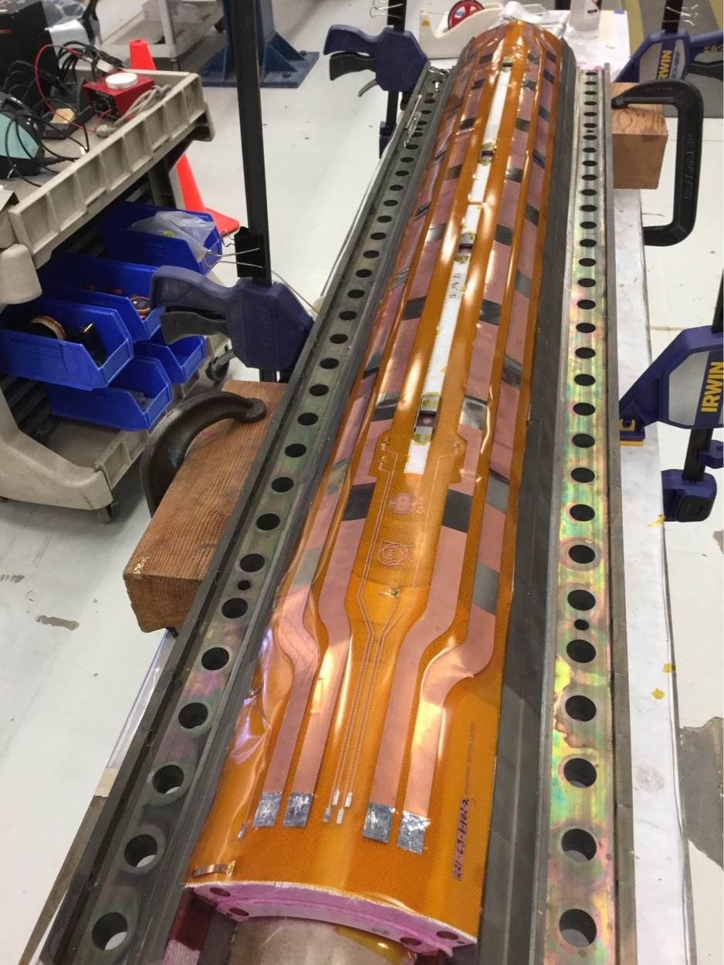
Swap one layer of fresh fiberglass presently set between the heater and the structure, and add it between the heater and the coil
fiber glass (100 um)
polyimide trace (50 um)
fiber glass (100 um)
Cable insulation (140 um)
Add 100 um of insulation:
  It will add a G11 layer separating polyimide from the bubbles (➔ prevent polyimide blistering) btw turns
  It will increase Coil-Heater distance (➔ increased He voltage breakdown)
  Reduce risk that some coils may not pass the HV test in He gas at 100 K

Slide 57
THE SWAP AND BLISTERING
  Visual inspection of QH after magnet cold test displays significant reduction of blistering
  One failure observed at 3.7 kV

Slide 58
Quench heaters assessment
The strength of the heater to coil insulation was assessed for MQXF magnets
  Failure mechanism clarified (blistering)
  Degradation with time/thermal cycles/powering excluded by short models
  Margin explored with destructive test: a factor of 3 at 300 K
  Additional and conservative test defined at 100 K in He gas : no failures
  Margin explored with destructive test: 2.5 at 100 K
  Additional margin is provided by He pressure increase during quench
Baseline quench heater design meets the specification, including the additional test at 100 K
Swap option was explored in a mirror magnet, tested in US
  The additional gain in margin (proved with limited statistics) does not appear to be worth the loss in hotspot temperature (70 K)

Slide 59
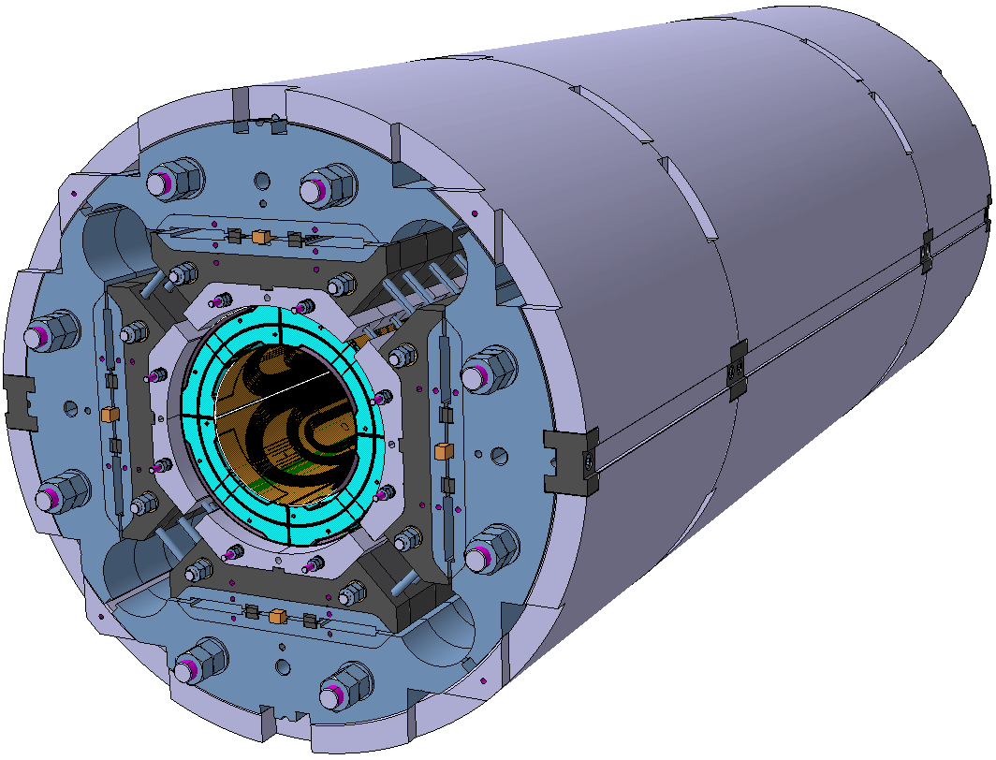

Slide 60
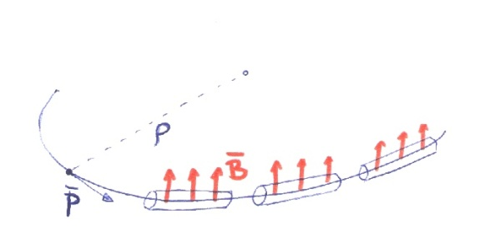
Field vs orbits
Relation momentum-magnetic field-orbit radius

