Slide 1
Synchrotron applications at PSI
Anna Bergamaschi :: Photon Science Detector Group :: Paul Scherrer Institut
Fast timing & low gain silicon pixel detectors: Synchrotron and electron microscopy applications :: Diamond Light Source :: 25.11.2019

Slide 2
Outline
Soft X-ray applications
  Imaging
  Spectrometry
  Time resolved
LGADs with X-rays
Perspectives
A. Bergamaschi, Diamond 25.11.2019

Slide 3
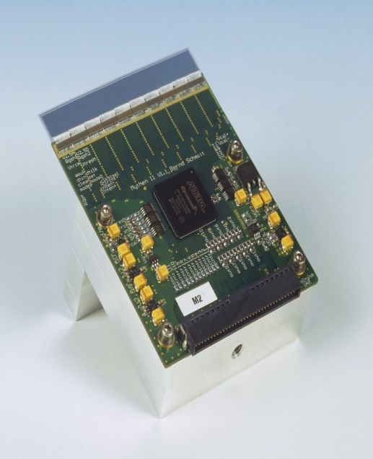
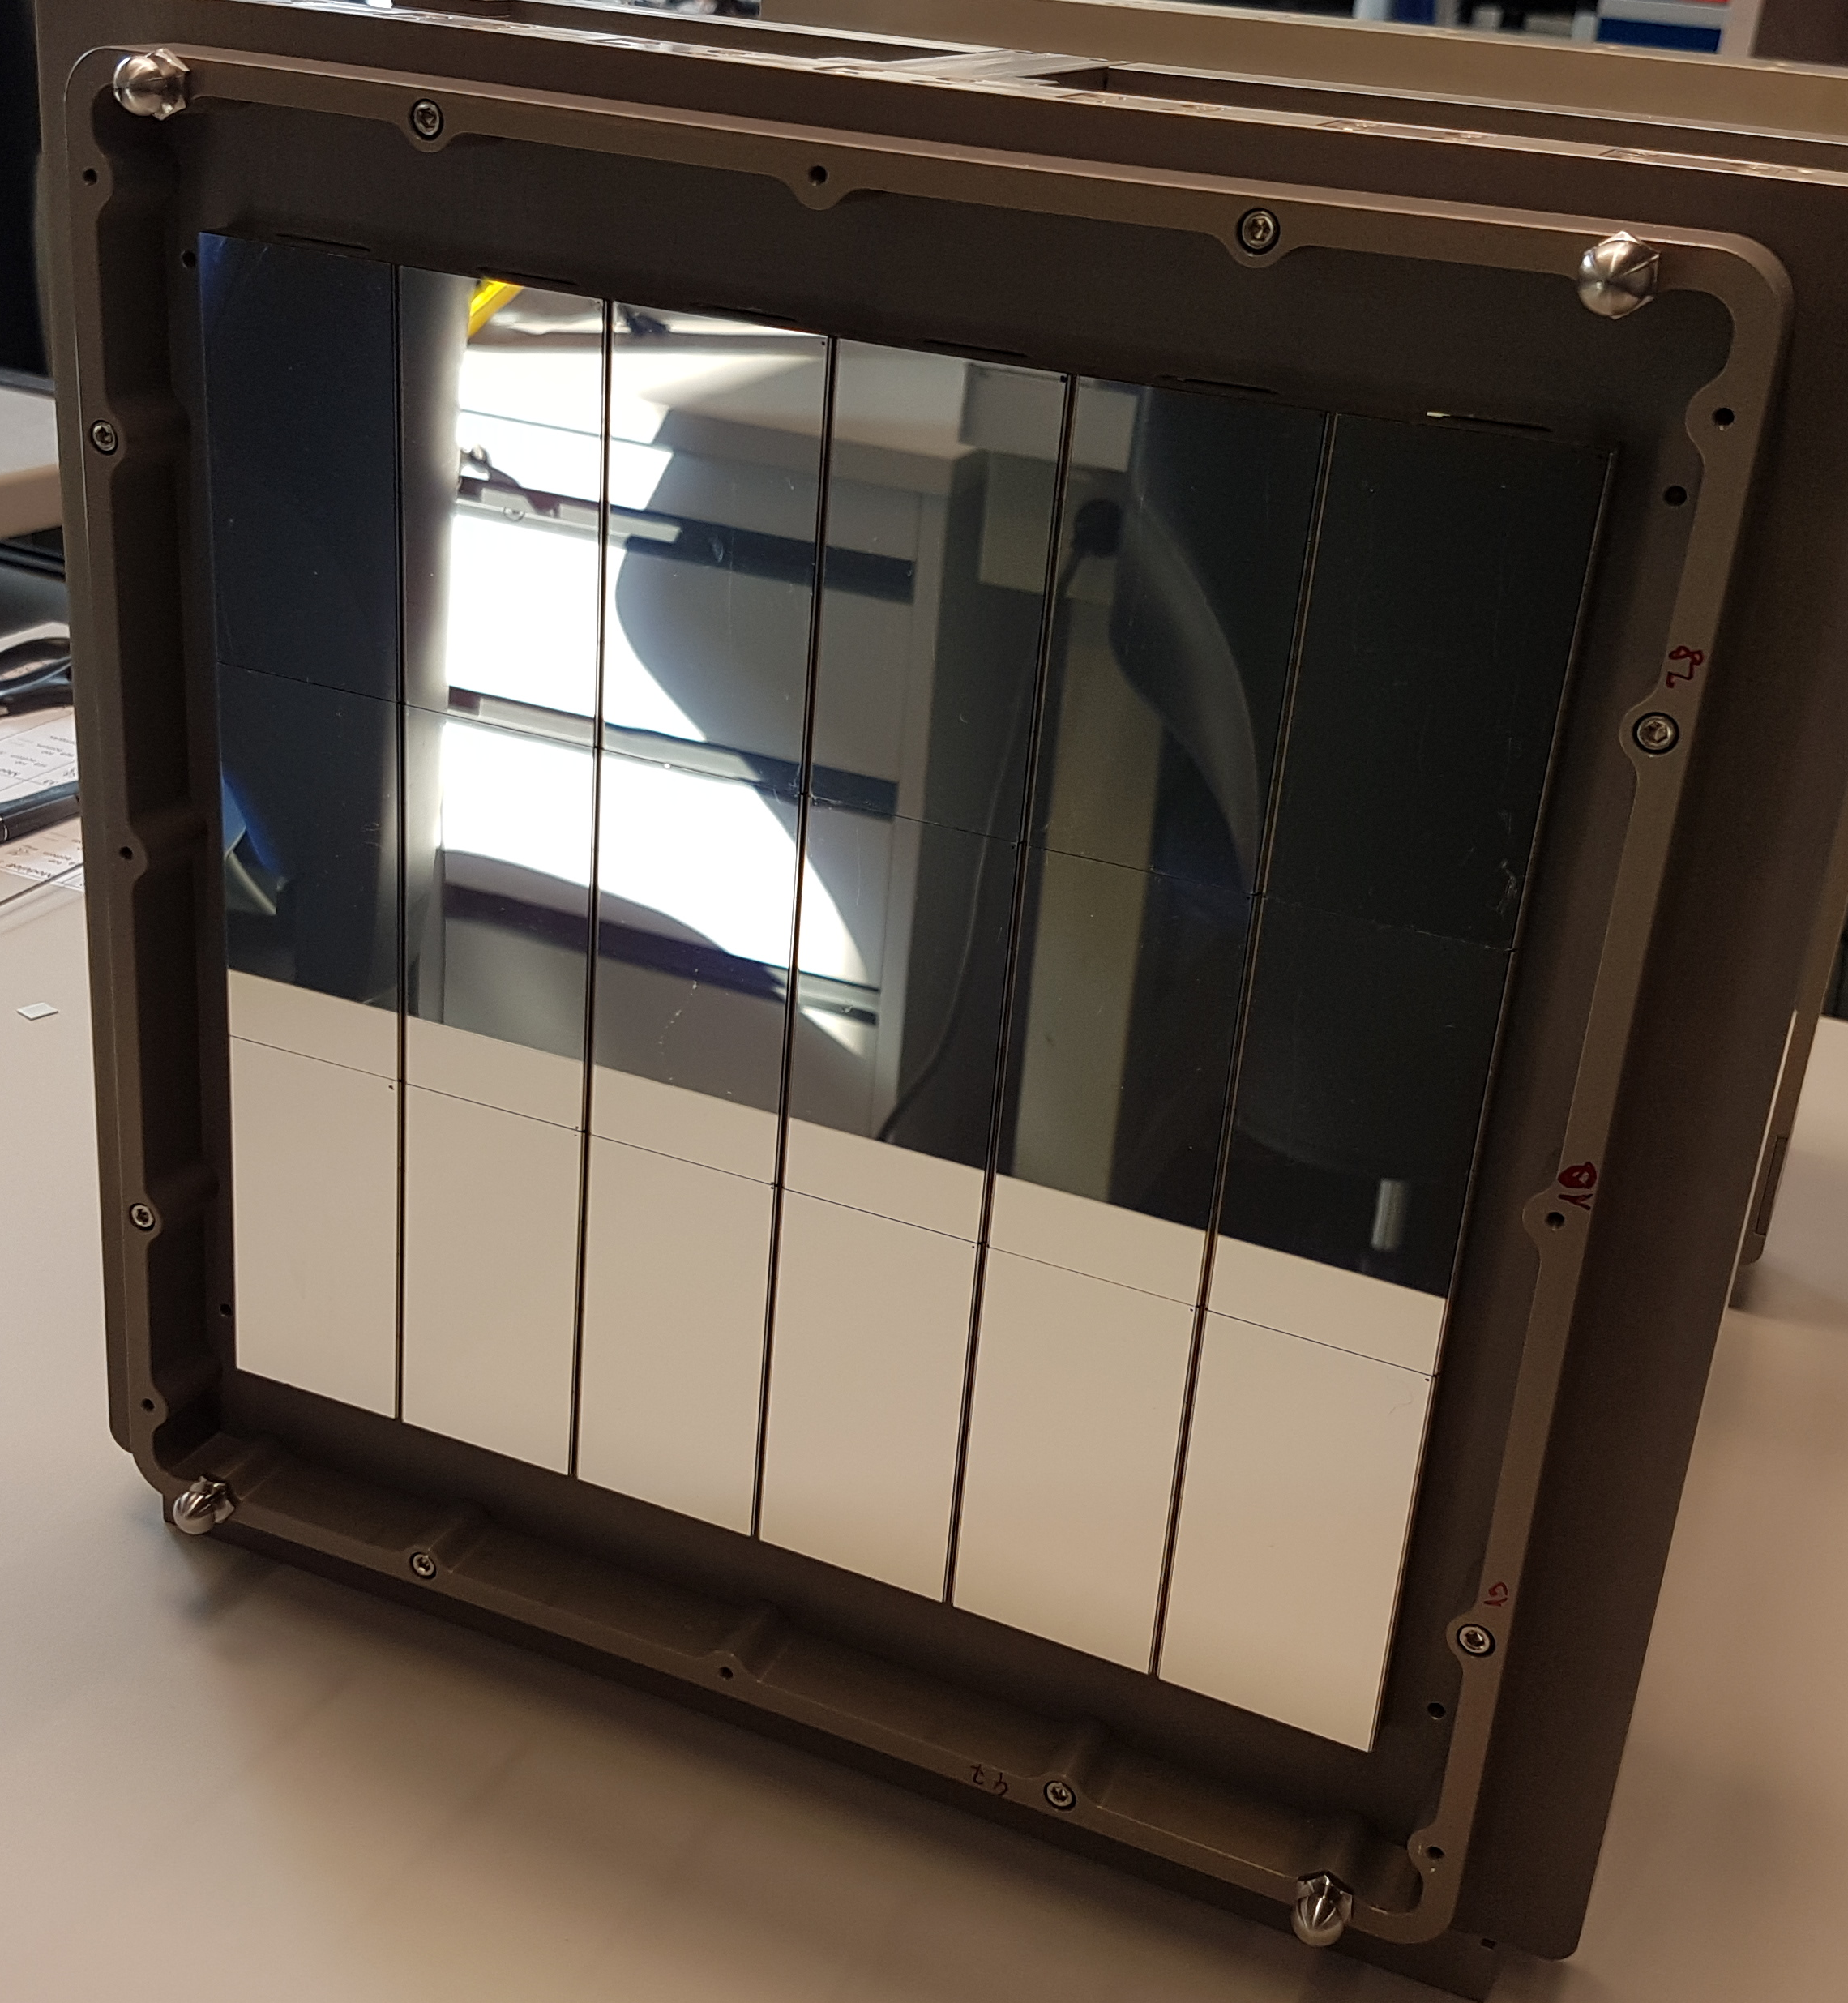
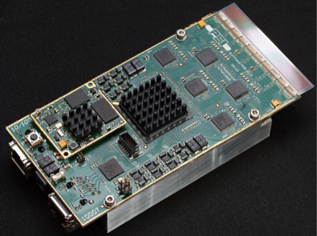
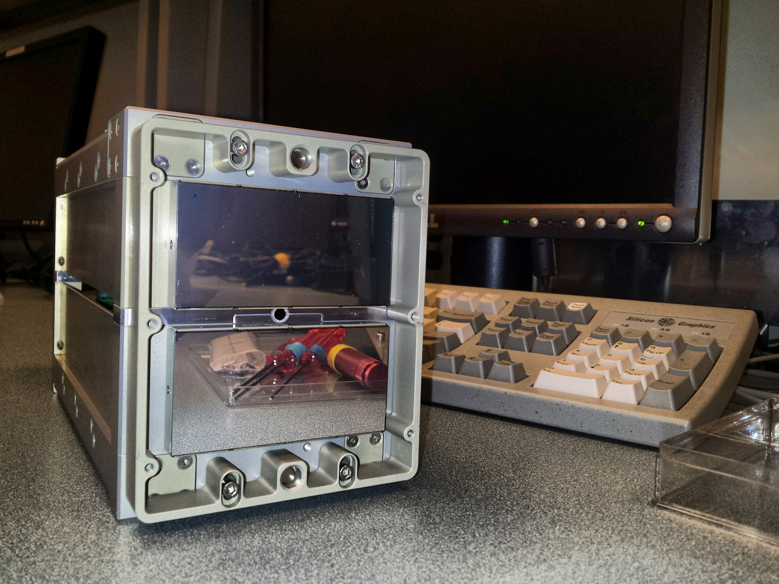
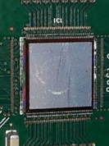



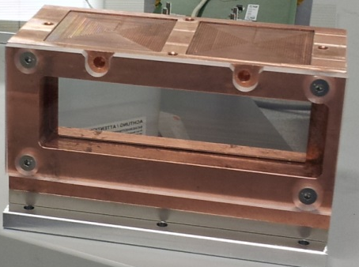
Hybrid SLS Detectors
Microstrips
Pixels
✗
✗
50 um
75 um
25 um
200 um
Single
Photon
Counting
MYTHEN
EIGER
Charge
Integrating
GOTTHARD
JUNGFRAU
MÖNCH
AGIPD
A. Bergamaschi, Diamond 25.11.2019

Slide 4
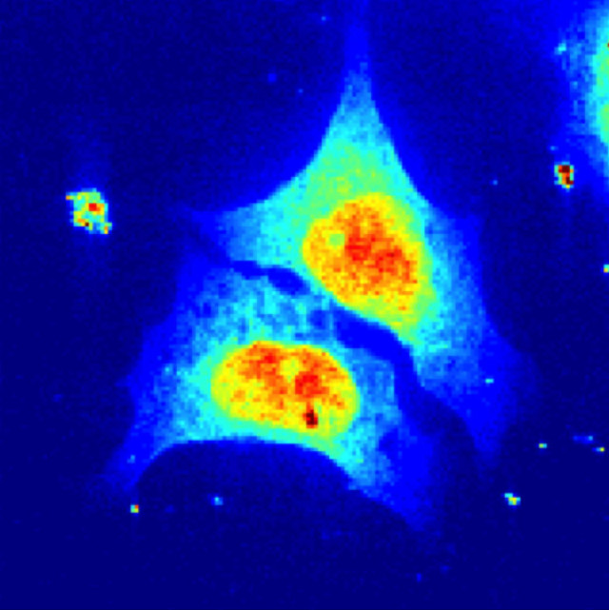
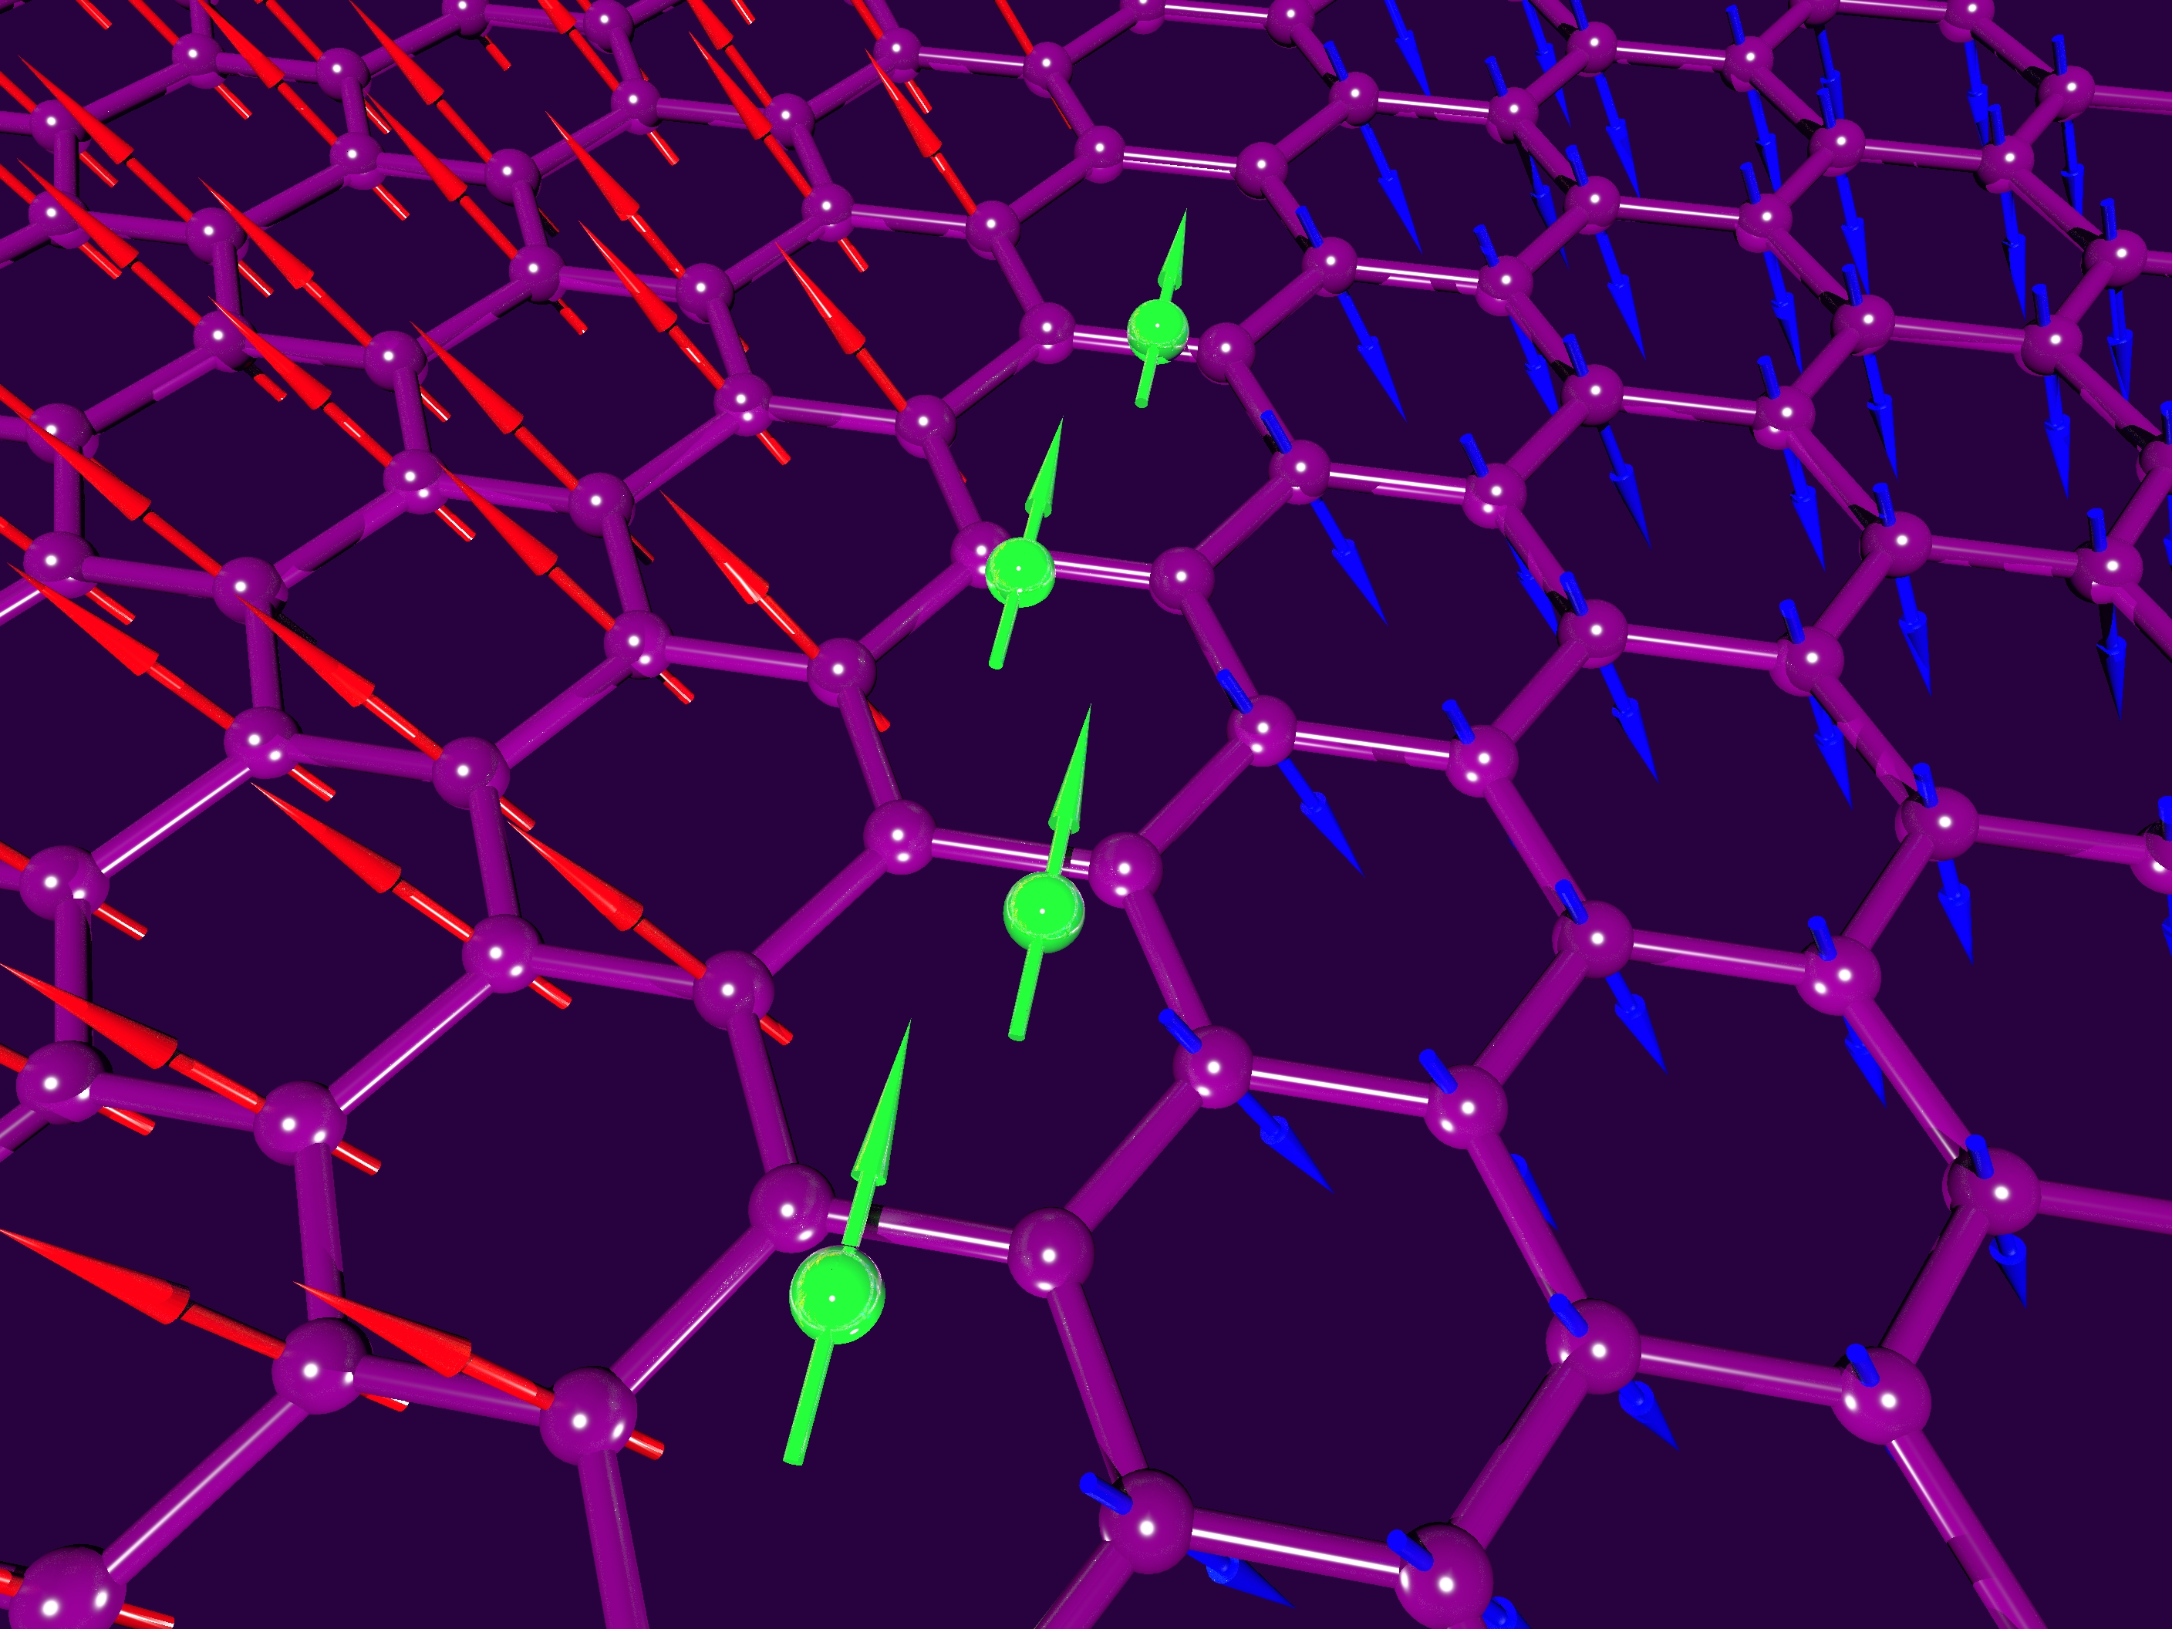
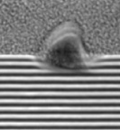
Soft X-rays (250-2 keV)
High absorption coefficient
  Thin samples
  Light elements
K-edges of bio-elements (e.g. C, O, N, S, P)
  pharmaceuticals, cell imaging
L-edges of 3d-transition metals
  magnets, superconductors, batteries, quantum materials, catalysts…
EUV: lithography and mask inspection
(Avalanche) Photodiodes
  Unsegmented
(EM-)CCDs
Slow frame rate
    Radiation damage
    No electronic shutter
Same as hard X-ray applications
15 years ago
A. Bergamaschi, Diamond 25.11.2019

Slide 5
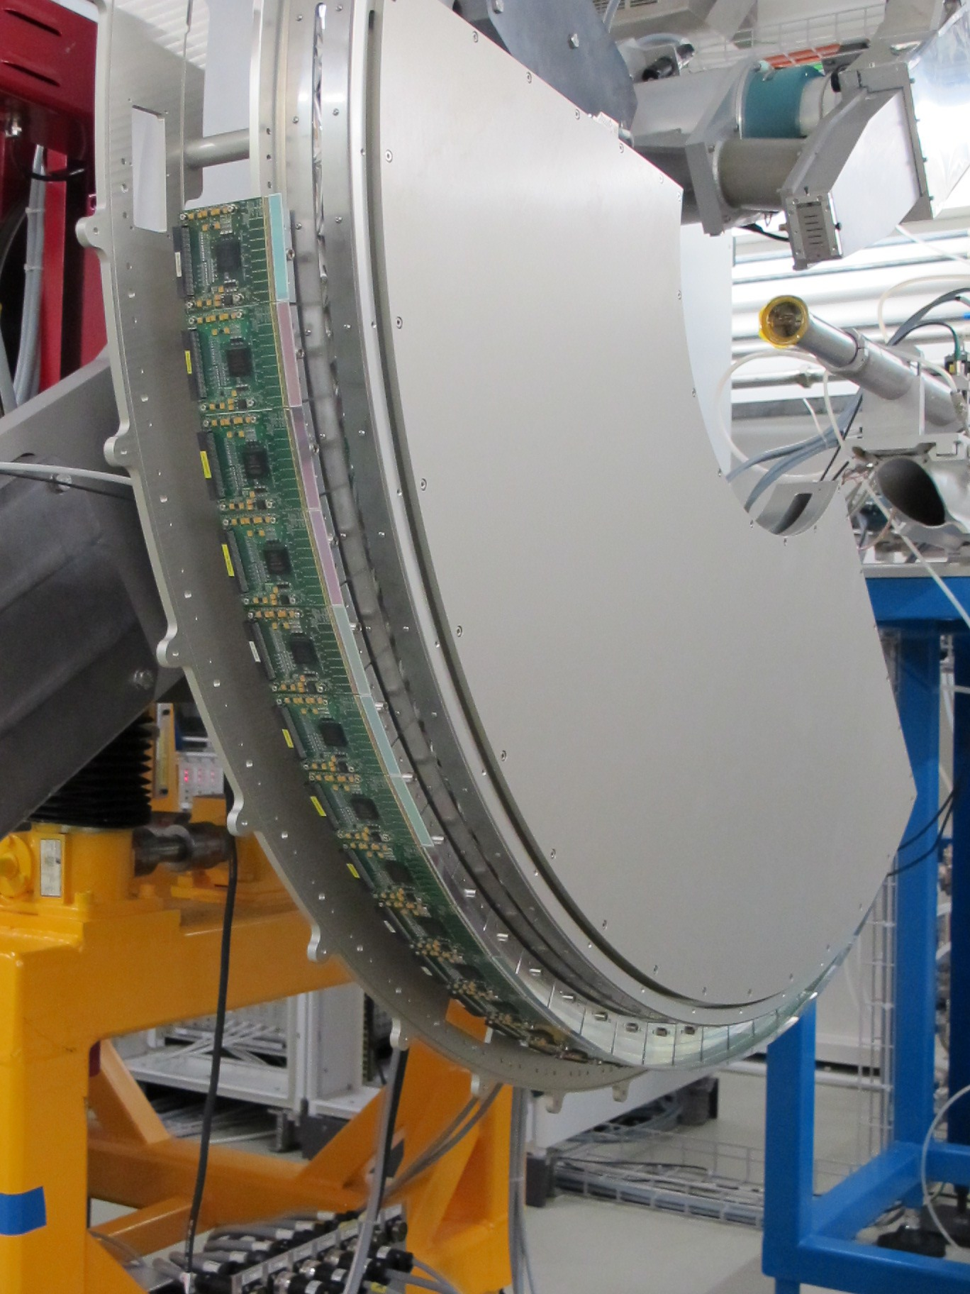
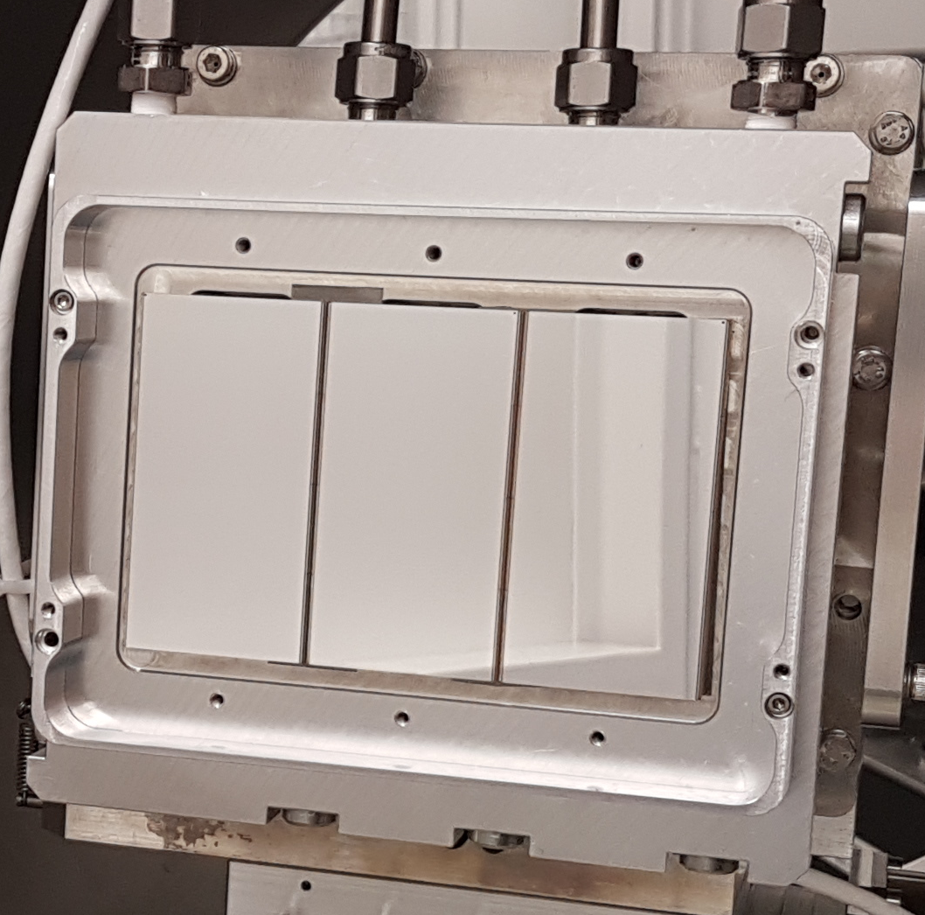
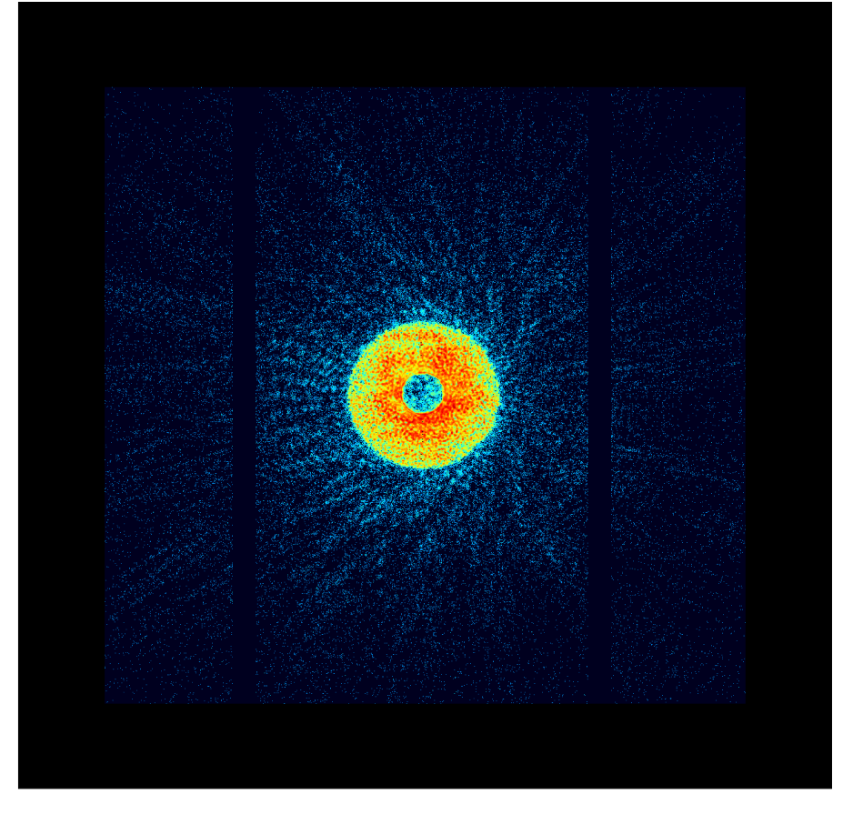
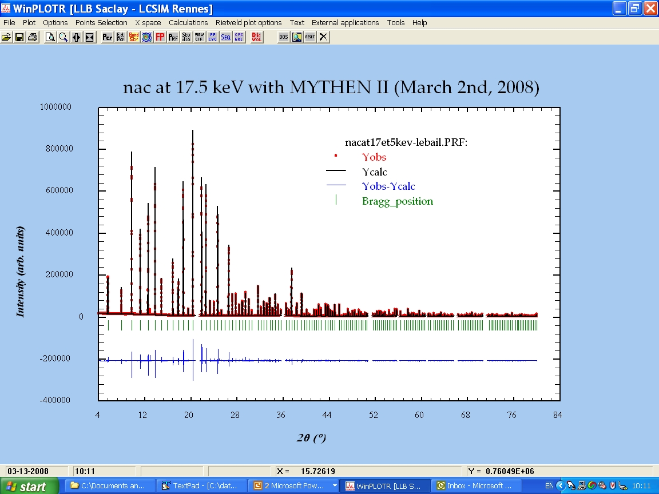
Photon Counting detectors for photon science
Pixel and strip single photon counters have been a game changer for hard X-rays synchrotron applications 5-20 keV
Poisson-limited statistics
Noise free, Large dynamic range
Fast readout
Almost insensitive to sensor leakage current
Large area obtained by tiling
Stable and user friendly
A. Bergamaschi, Diamond 25.11.2019

Slide 6
Soft X-ray photon counting detectors?
No single photon counting detectors exist below 2 keV
  The electronic noise limits the minimum detectable energy
  Signal-to-Noise-Ratio >10 to set threshold at 50% of the energy
  E=2.5 keV ⇨ ENC < 70 e-
  E=1 keV ⇨ ENC < 27 e- E=500 eV ⇨ ENC < 12 e-
  E=250 eV ⇨ ENC < 6 e-
We currently use low noise charge integrating pixel detectors ENC ≈ 40 e-
  Single photon resolution can be compromised at 5 σ
  Multiple photons of low energy can still be detected
  Fast frame rate compared to CCDs
  Large dynamic range thanks to dynamic gain switching
  No radiation damage even in case of saturation
/10
+1
A. Bergamaschi, Diamond 25.11.2019

Slide 7
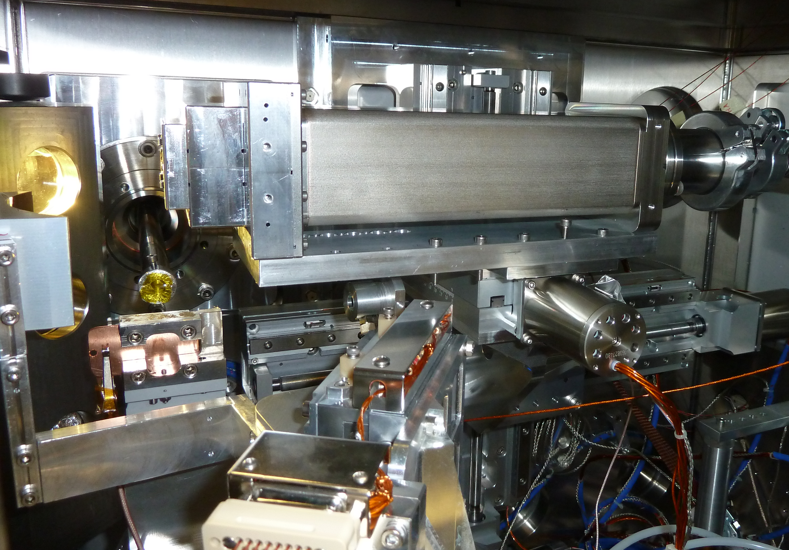
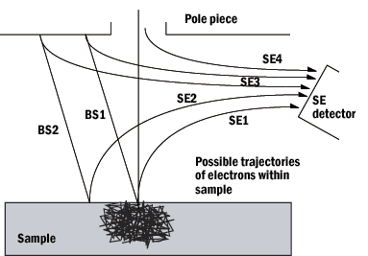
Soft X-rays challenges
Single photon resolution
Vacuum operation and cooling
  Vacuum barrier between the detector and the readout board
Quantum efficiency
  Shallow implant required to avoid absorption in the entrance window
  Useful also for electron detection
  Aluminum can be etched away
Soft
X-ray
Hard
X-ray
electron
A. Bergamaschi, Diamond 25.11.2019

Slide 8
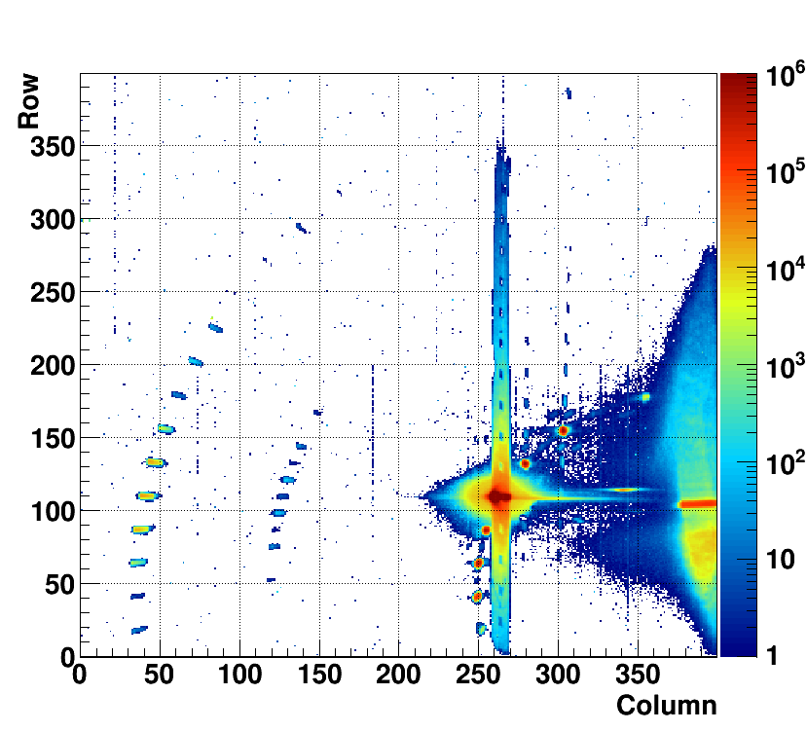
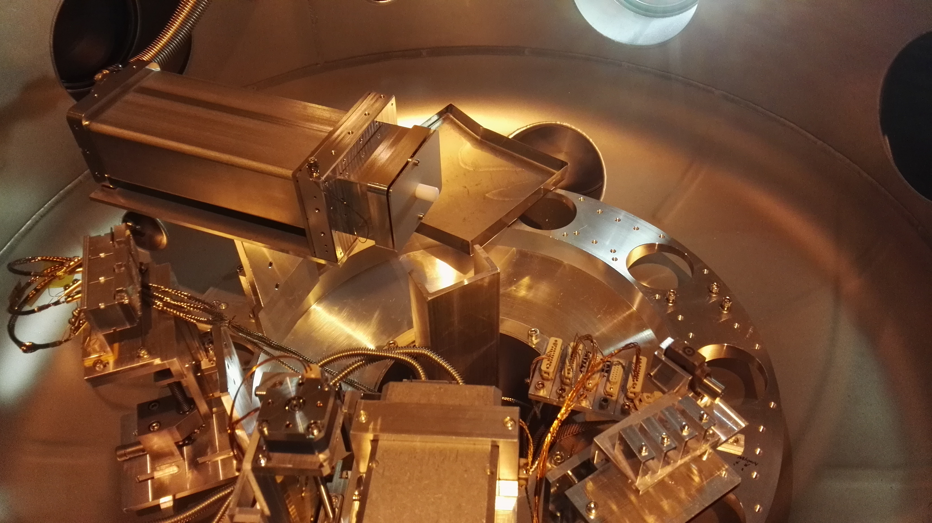
Resonant diffraction
V. Scagnoli, U. Staub, RESOXS endstation, SIM beamline SLS
Energy range 500-1500 eV
Large dynamic range and single photon resolution
  At XFELs up to 1E5 1keV photons could arrive simultaneously
Number of pixels more important than pixel size
  Compact setup to operate in vacuum (pitch <75 um)
Bragg
peaks
Direct
beam
Reflectivity
Magnetic
peaks
Artificial spin ice, 708 eV
A. Bergamaschi, Diamond 25.11.2019
Notes:
Erbium manganite on Neodyum Gallium oxide

Slide 9
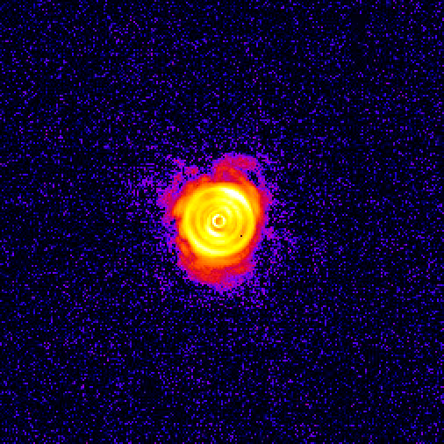
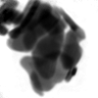
Ptychography
M. Langer, J. Raabe, A. Kleibert et al., SIM beamline SLS
Energy range 500-1500 eV
Fast frame rate necessary for scanning experiment
Large dynamic range and single photon resolution
  Noise-free signal at pixels far from the center determines final resolution
Number of pixels more important than pixel size
  Compact setup to operate in vacuum (pitch <75 um)
10 nm
resolution
©M. Langer
200 nm
Sample BiFeO₃ nanoplatelets, energy 709 eV
A. Bergamaschi, Diamond 25.11.2019

Slide 10
Tender X-rays Von Hamos spectrometer
Th. Huthwelker, C. Borca et al., PHOENIX beamline SLS
Cl Kα1-Kα2
doublet
ΔE
MÖNCH
Bent crystal
Fluorescence
Sample
Primary beam
Energy range 2-5 keV
Extremely low flux
Spatial resolution defines energy resolution
  Pitch smaller than 25 um (also to interpolate)
A. Bergamaschi, Diamond 25.11.2019

Slide 11
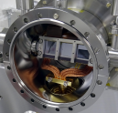
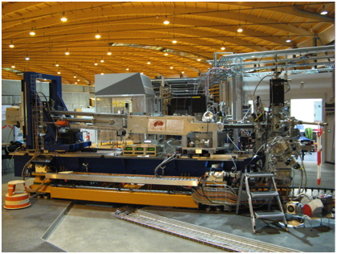
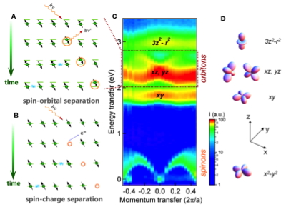
Resonant Inelastic X-ray Scattering
Energy range 250-1500 eV
Spatial resolution defines energy resolution
  Requires interpolation to achieve <5um in one direction
  Second direction only to increase solid angle and correct for misalignment
Extremely low flux
  Few electrons noise for single photon resolution
  1 Hz frame rate of EM-CCD already gives pile-up
Schlappa et al., Nature 485, 82 (2012)
RIXSCAM @SLS
XCAM, OO, PSI
A. Bergamaschi, Diamond 25.11.2019

Slide 12
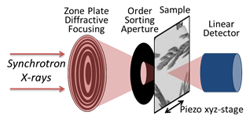
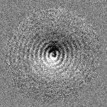
Time Resolved Scanning Transmission Microscopy
Synchrotron radiation has a pulsed structure
  Bunch separation ≈2 ns
    BW>1GHz
  Bunch width ≈ 40 ps
  Bunch jitter ≈ 300 ps
Time resolution < 30 ps can improve experimental results compared to beam bunch structure
Spatial information not required
Occupancy up to 10⁸ ph/s
Energy range 250 – 2000 eV
Spin-wave generation (7.4 GHz)
G. Dieterle et al., PRL 122, 117202
1 µm
A. Bergamaschi, Diamond 25.11.2019

Slide 13



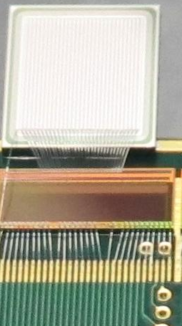
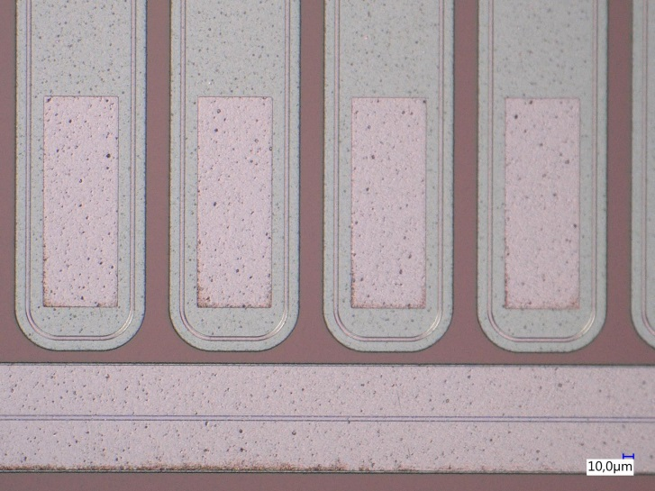
LGAD microstrip tests
Microstrip sensors 150 µm pitch, 50 µm thick, 5 mm long
  Junction Termination Extension around the strips
  Input capacitance 2.57 pF:
    Higher noise than 1.52 pF standard MYTHEN sensors
  Electron collection
  Fabricated on a substrate
      Must be irradiated from the strip side
MYTHEN II readout
  Single photon counting
  Old “noisy” chip
    Minimum detectable
    energy ca. 8 keV
    Optimized for hole
    collection
A. Bergamaschi, Diamond 25.11.2019

Slide 14
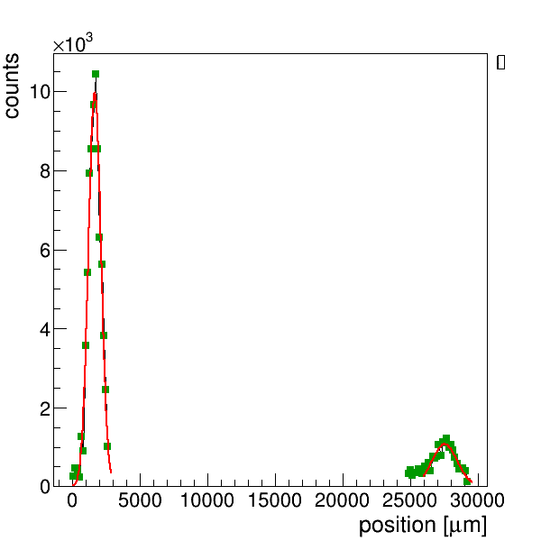
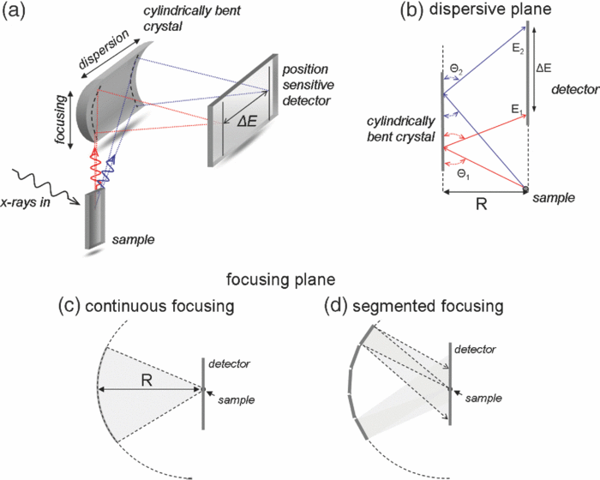
LGADs in fluorescence emission spectrometer
Still only proof of principle
Fill factor ≈50% due to junction termination extensions
Handling substrate prevents irradiation from backside (no pixel possible)
Quantum efficiency in multiplication region should be understood
Sulphite
K_{α}=2.31 keV
K_{β}=2.46 keV
Unfocused 3 keV beam
*
Minimum detectable energy of MYTHEN II reduced by a factor 5
Single 15 s exposure instead of
15000 x 1 ms frames with MÖNCH
No multiplication
No multiplication
Handling substrate
M. Andrae, J. Zhang et al. (2019) J. Synchrotron Rad. 26, 1226.
https://doi.org/10.1107/S1600577519005393
A. Bergamaschi, Diamond 25.11.2019

Slide 15
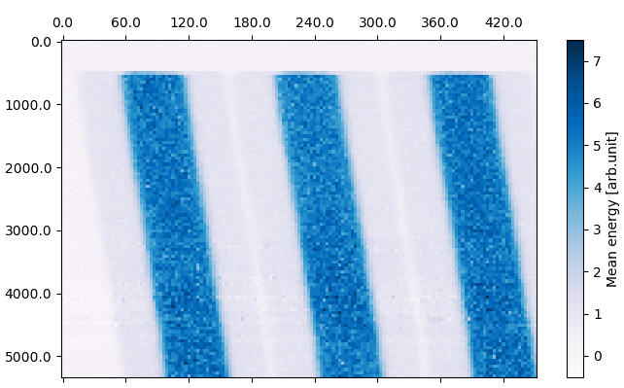
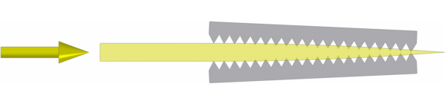
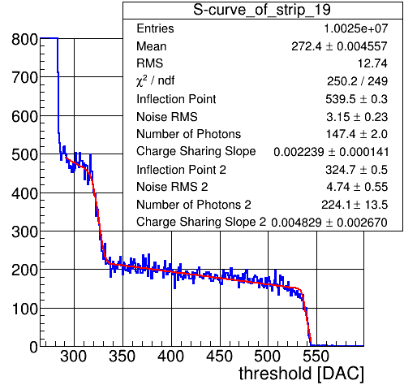
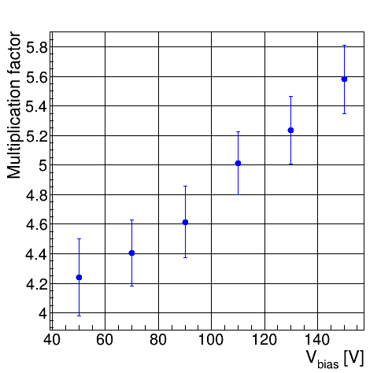
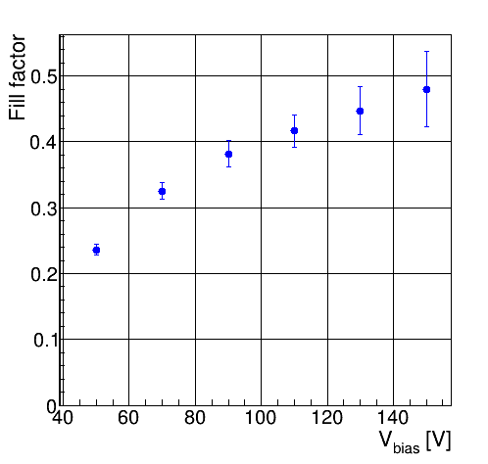
Characterization using X-rays
X-rays are a powerful tool for sensor characterization
©J. Zhang
©M. Andrae
multiplied
unmultiplied
72µm
M =
67µm
62µm
57µm
49µm
35µm
multiplied γ
total γ
FF =
M. Andrae, J. Zhang et al. (2019) J. Synchrotron Rad. 26, 1226.
https://doi.org/10.1107/S1600577519005393
A. Bergamaschi, Diamond 25.11.2019
Notes:
15

Slide 16
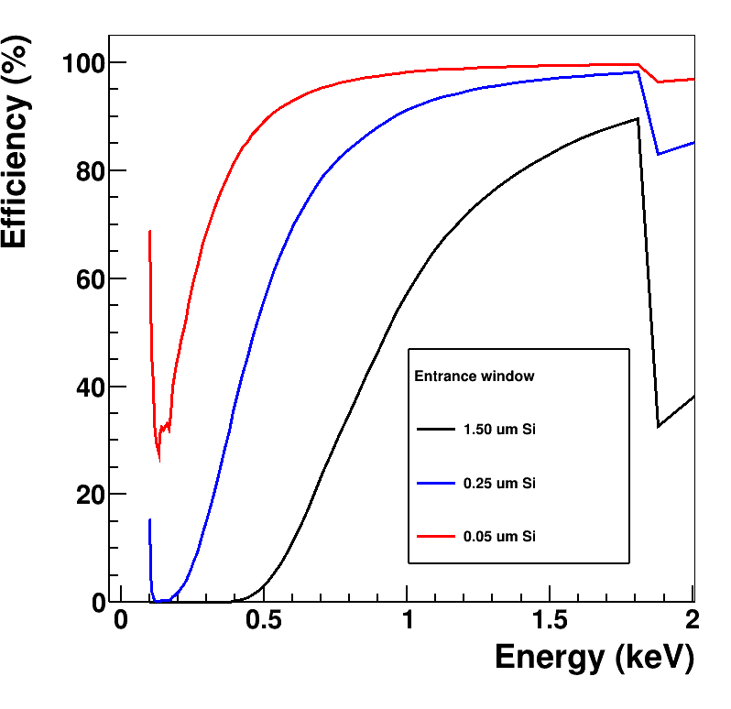
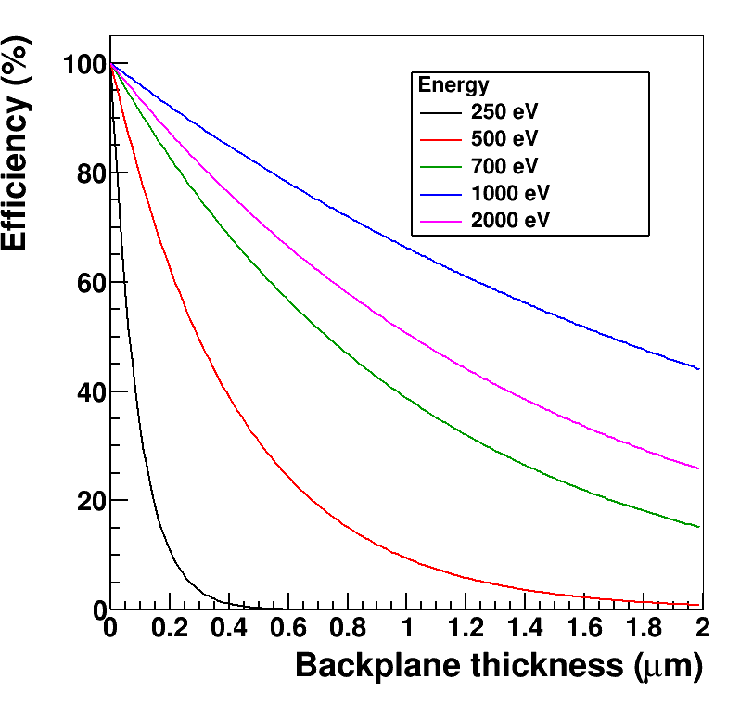
Main challenge for soft X-ray detection
Standard sensors have QE >50% down to 1 keV
We aim at QE >50% down to 250 eV
Gain uniformity in the amplification region for i-LGADs?
A. Bergamaschi, Diamond 25.11.2019

Slide 17
 | Diffraction Ptychography | XES RIXS | Time-resolved STXM | Time-resolved Ptychography
Pixel size | < 75 um | < 20 um | As large as BW allows | < 75 um
Number of pixels | 1k x 1k | >1k in the energy dispersive direction | As few as multiplicity allows | 1k x 1k
Area (mm²) | 40 x 40 | 40 x as large as possible in the non energy dispersive direction | 1 x 1 | 40 x 40
Energy range (eV) | 250-2000 | 250-5000 | 250-2000 | 250-2000
Photons/pixel/s | Up to 10⁸ Up to 10⁵ | <1 | 10⁸ (total) | 0-10⁵
Time resolution | Not an issue |  | < 30 ps | < 30 ps
Radiation damage | Not an issue

Slide 18
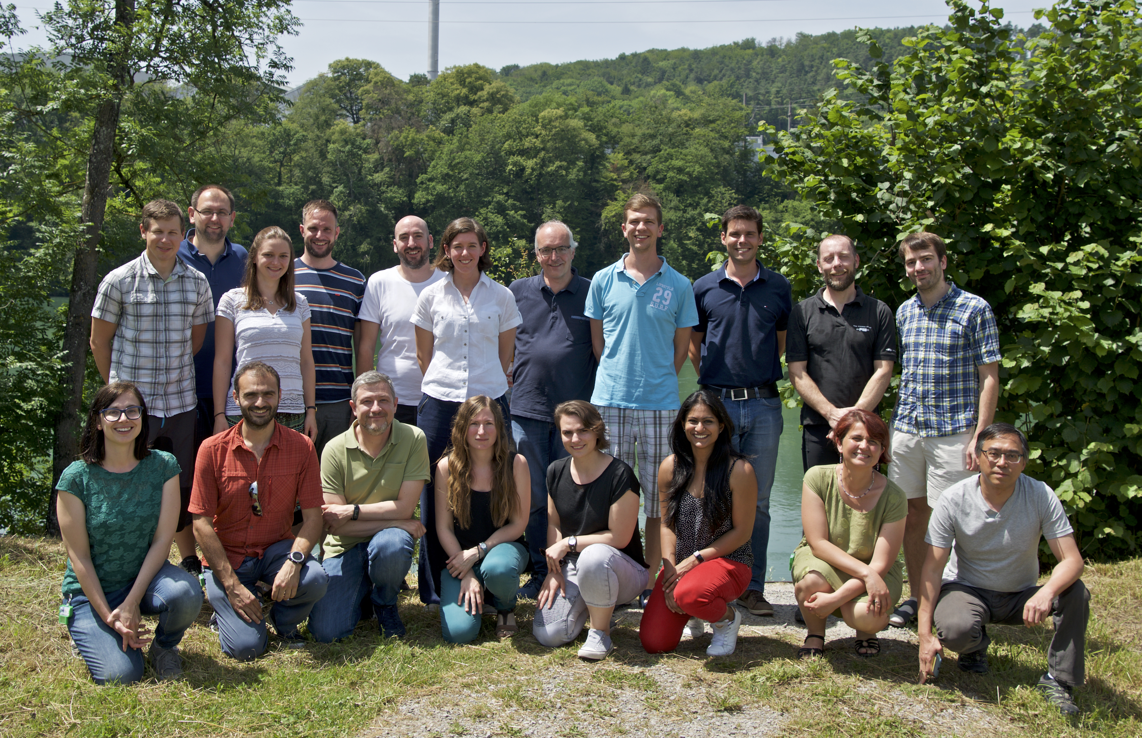
Acknowledgements
Paul Scherrer Institut
V. Scagnoli, U. Staub
S. Finizio, A. Kleibert, M. Langer, J. Raabe, C. Vaz,
C. Borca, T. Huthwelker
Fondazione Bruno Kessler
M. Boscardin, G. Borghi, F. Ficorella, G. Paternoster
INFN Torino
N. Cartiglia, M. Ferrero,
V. Sola
University of Trento
G-F. Dalla Betta, L. Panchieri
ESRF
P. Busca, P. Fajardo, M. Ruat
E. Fröjdh, M. Brückner, M. Andrä, D. Greiffenberg, C. Ruder,
S. Redford, B. Schmitt, S. Vetter, C. Lopez-Cuenca,
A. Mozzanica, M. Meyer, G. Tinti, D. Mezza, R. Dinapoli,
S. Chiriotti, R. Barten, D. Thattil, A. Bergamaschi,
J. Zhang (not in picture).

